Slide 1

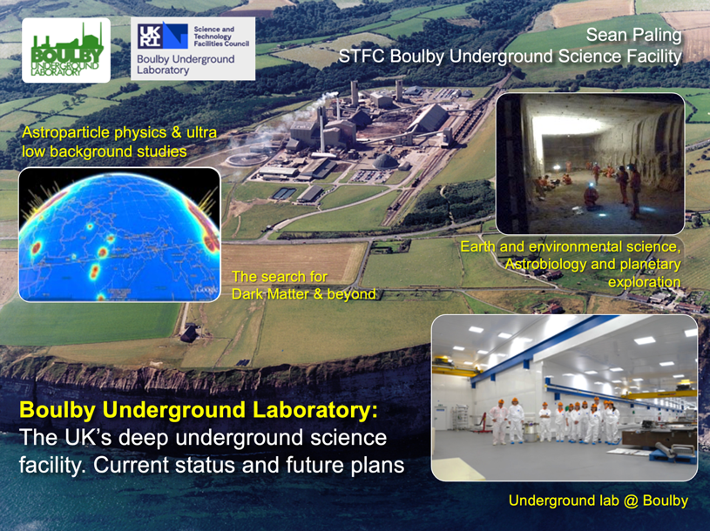
Boulby Underground
Laboratory:
Status, plans and strategy for the UK’s deep underground science facility.
Sean Paling
Boulby Underground Laboratory, UK
Sean Paling. Boulby Underground Lab. 2024

Slide 2

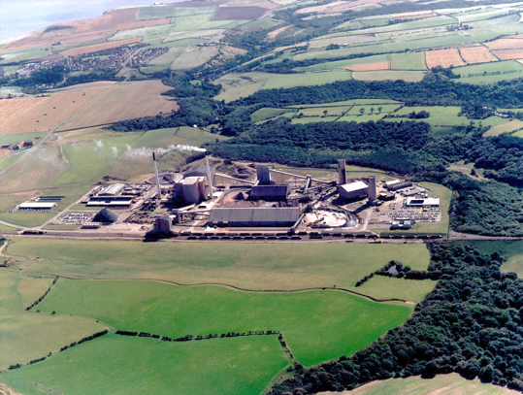



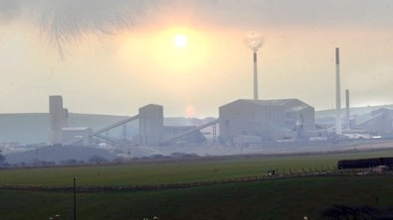
Boulby Mine
A working polyhalite and rock-salt mine on the North East coast of England.
Owned by Israel Chemicals Ltd. (ICL-UK). Locally operated as Cleveland Potash Ltd.
Major local employer: ~500 direct staff and 2000 indirect employment.
Polyhalite: K₂Ca₂Mg(SO₄)
Middlesborough
Ships worldwide for agricultural fertiliser
Staithes
Whitby
York
Deepest mine in Britain: 1300km
The world’s first polyhalite mine
12 miles North of Whitby, N. Yorks
View from Staithes

Slide 3
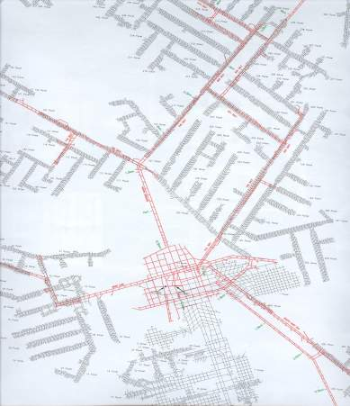
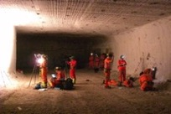
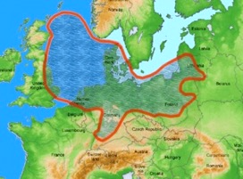
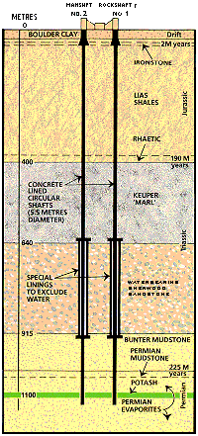



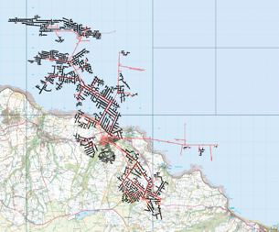


Boulby Geology & Mining
Excavations are in Salt (NaCl), Potash (KCl) and Polyhalite (K₂Ca₂Mg(SO₄)). Permian evaporite layers left over from the Zechstein Sea (250m.yrs past).
Over 40 kms of tunnel mined each year (now >1,000kms in total), the long-lived roadways being cut in the lower NaCl layer.
Typical Boulby Salt Roadway
Polyhalite
Potash
Zechstein Sea
Rock-Salt
Low activity salt
U ~67 ppb,
Th ~125 ppb
Mine Shafts
>1000kms of tunnel mined in 50 years
Current Lab
(2017)
Boulby Geology

Slide 4

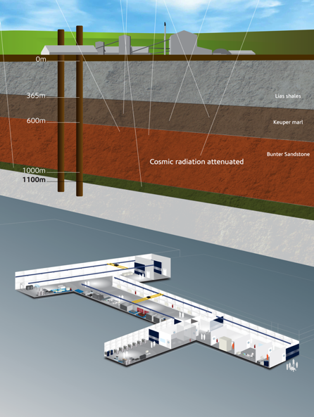
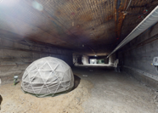
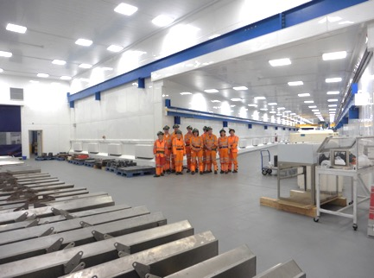
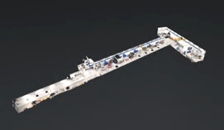
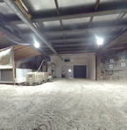


Boulby Underground Laboratory
The UK’s deep underground science facility operating in a working potash and salt mine.
1.1km depth (2805 mwe). With low background surrounding rock-salt
Operated by the UK’s Science & Technology Facilities Council (STFC) in partnership with the mine operators ICL-UK
Outside Experimentation Area (OEA)
4000m³ class 10k and 1k clean lab space
Permian Evaporites
Factor ~10⁶ reduction in cosmic ray flux
vs. surface
A QUIET place in the Universe
Lab entrance

Slide 5
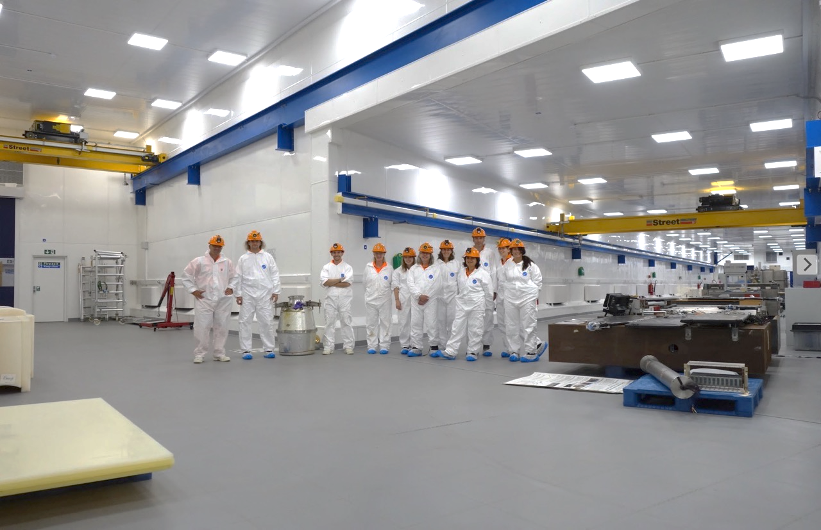
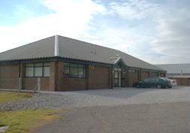
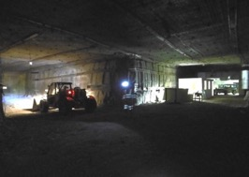


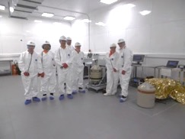
Office space, chemistry & clean prep lab, storage and staging space, IT room, conference room,
Supported access to surrounding geology & UG environs. Power, wifi/internet.
Surface support and staging building
3000m³ Outside Experimentation Area
Boulby Underground Lab Facilities 2023: >4000m³ class 1k & 10k (ISO 6 & 7) clean room lab space. 10Gb Internet. AC, air filtration, 5T & 10T lifting, LN generation, fume hood & clean prep space. 3000m³ Outside Experimentation Area (OEA) with power & internet. Supported access to wider mine environs.
BUGS Material screening

Slide 6

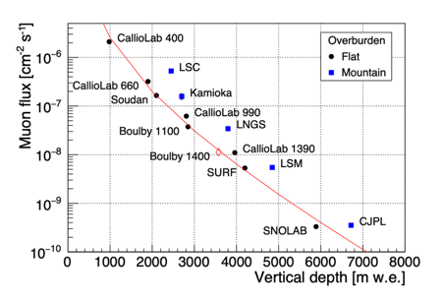
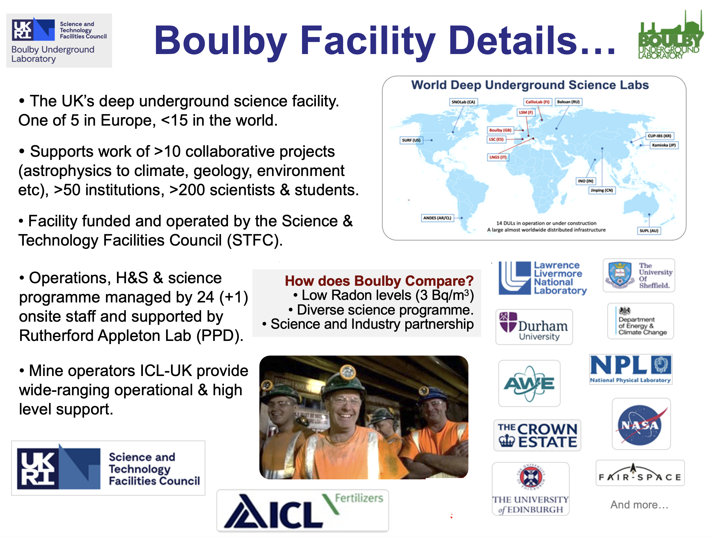


Boulby Underground Laboratory (UK)

Slide 7
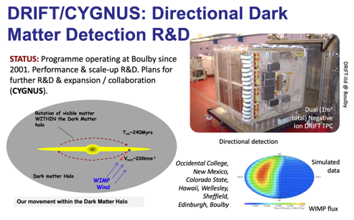
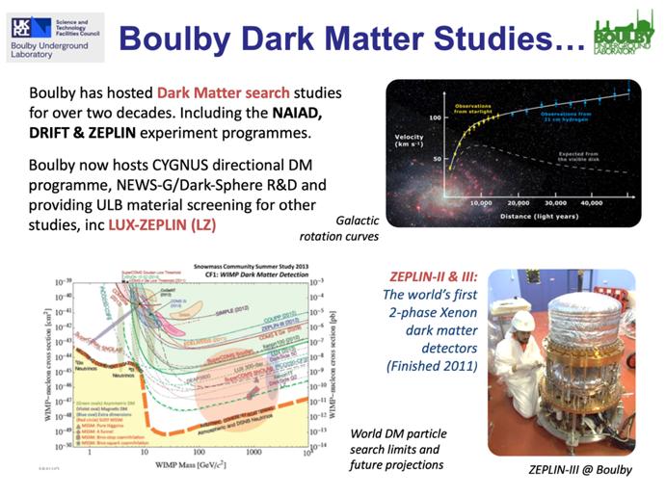
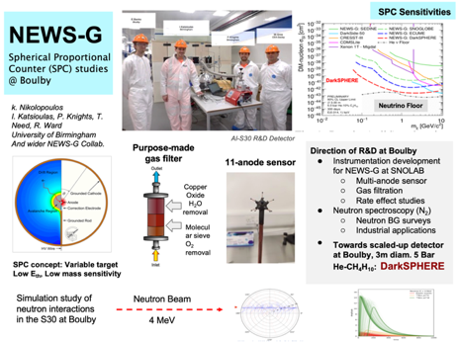
Boulby Science Now & Future
Particle physics and ultra-low background studies

Slide 8
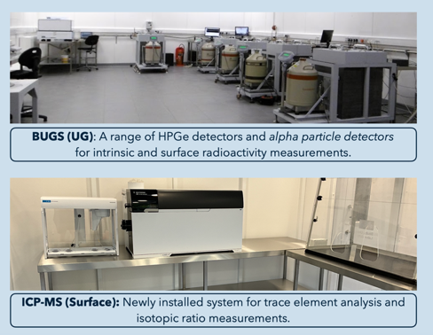
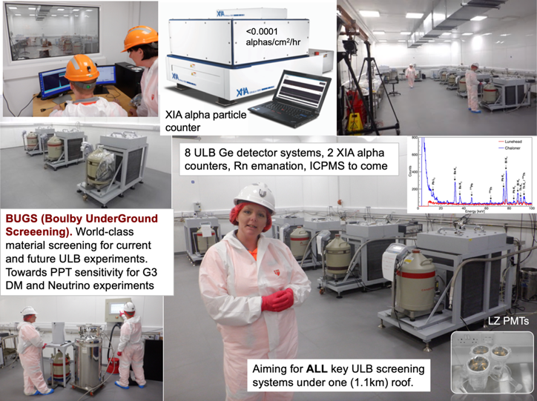
Boulby Science Now & Future
Particle physics and ultra-low background studies
BUGS Facility: (Boulby Under-Ground Screening)
  ULB Germanium (8)
  XIA: Surface alphas (2)
  Radon Emanation *
  ICPMS * * Commissioning

Slide 9
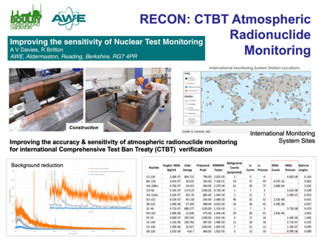
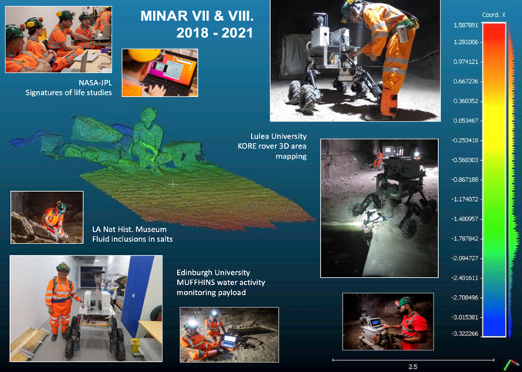
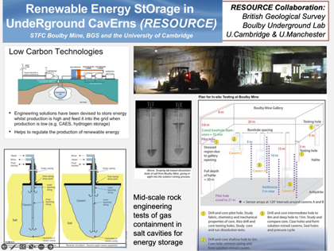
Multidisciplinary Science
RECON:
Atmospheric monitoring for nuclear
security
Applied low background particle physics, Earth and Environmental science, Astrobiology & Planetary Exploration Technology Development.
MINAR:
Astrobiology and planetary exploration technology development
RESOURCE:
Compressed gas energy storage R&D

Slide 10

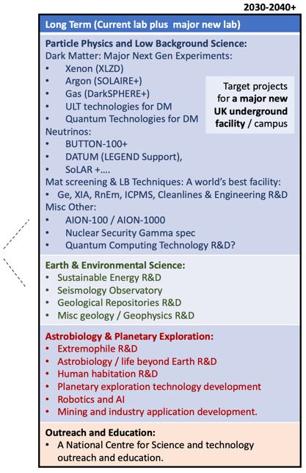
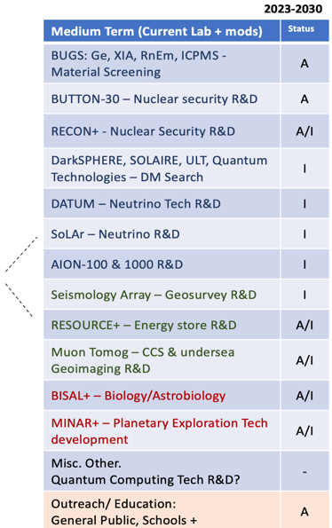
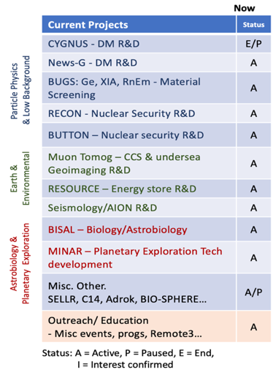
Future facilities & science @ Boulby?
Boulby Activities Now and in the Future

Slide 11
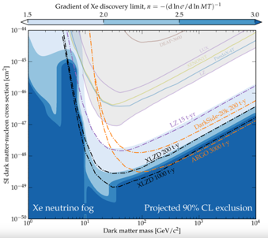
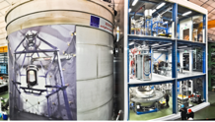
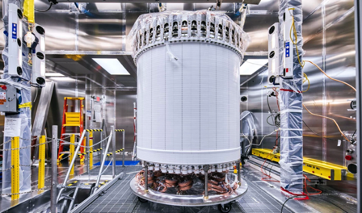

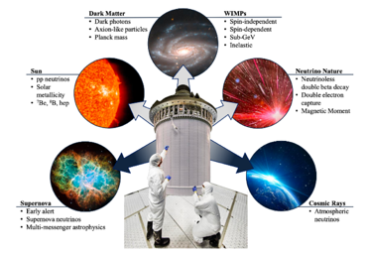
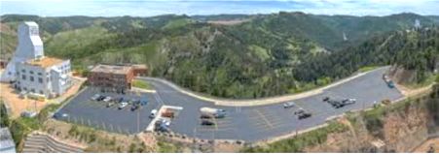
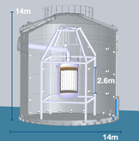
Next Generation Xe-based Dark Matter Detector (XLZD)
Projected sensitivity
(Akerib P5 town hall mtg 2023)
Lux-ZEPLIN (LZ). SURF, S. Dakota, USA
XLZD
2021 merging of LZ, Xenon and DARWIN teams
LZ:
10 T Liquid Xenon
Xenon-nT
LNGS, Italy
Next generation world’s best Dark Matter (+) detector. Expected 2030+
XLZD
50-100T LXe
Operation 2032+
Site evaluation underway 2023-5
DARWIN
(Proposed)
LZ: SURF, USA
Could XLZD be constructed and operated at Boulby 2030+?
LZ: 10T 2-phase Drk Matter detector operating in SURF lab, USA. Early 2-phase Xe technology developed in the UK. STFC/UK investment continues.

Slide 12
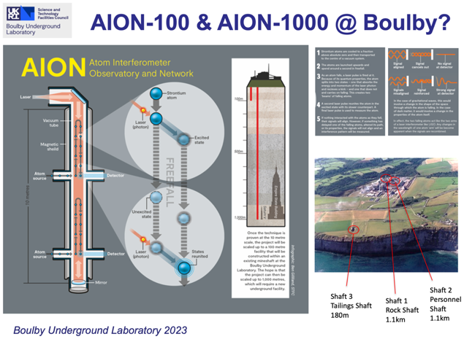

Future facilities & science @ Boulby?
Quantum Sensors and Quantum Computing
AION-100 & 100: Atomic interformetry for GW and light DM studies
Quantum Computing in Ultralow background environment

Slide 13

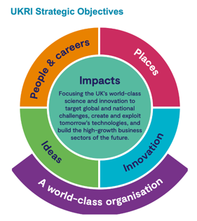
UK Underground Science Facilities. Now and the Future…
What Boulby Is:
An internationally-important centre for pure & applied multi-disciplinary science.
A local (North East) and national asset for science, technology and outreach/education.
A successful and proud example of science and industry partnership
A UKRI/UK facility with potential, opportunity and support for wide-ranging growth.
STFC/Boulby now looking to: continue to develop the UK underground science facilities to further enable truly internationally-important astro-particle physics and pure and applied multi-disciplinary science.
Short term: Maximally exploit the current Boulby facility to host world class Underground Science:
Medium-to long term: Prepare to build a major new deep underground science facility in the UK to host next-generation world-leading science projects coming 2030+
Medium-Scale Dark Matter Experiments Fund - 2024
Boulby Development Project:
Plans & preparations for a major new multi-disciplinary Deep Underground Science Facility in the UK

Slide 14


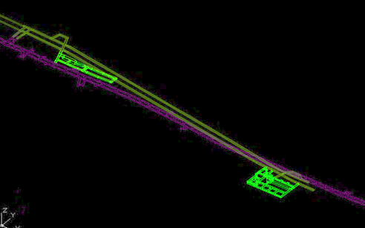
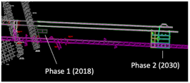

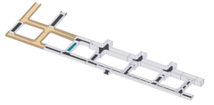
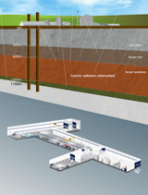
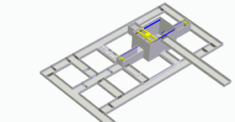
Boulby Development Project
Task 1: Site and design Development.
Stage 1: Clean manufacturing and multi-science lab in salt (1.1km) - 2028
Stage 1 (2028)
Stage 2 (2030)
Stage 2: Full depth science lab in Polyhalite (1.3km) ~2030+
A new lab @ Boulby
Stage 1 (Salt)
DRAFT: 2-stage Designs
~(30m)³ main cavity
Total volume
(Stage 1 + stage 2) ~120,000m³
Stage 2
(Polyhalite)
Stage 2 Polyhalite)
Excavations for stage 1 of expansion currently expected to begin mid-2024.
Phase 1 lab (salt 1.1km)

Slide 15
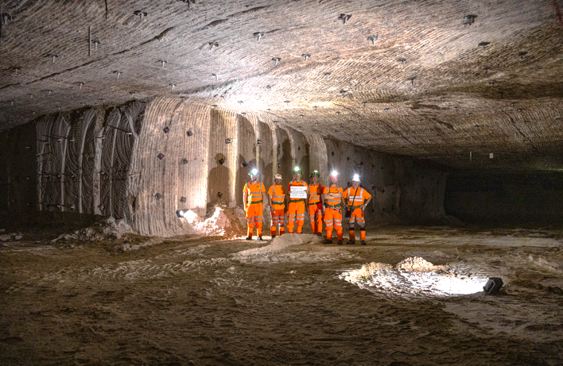
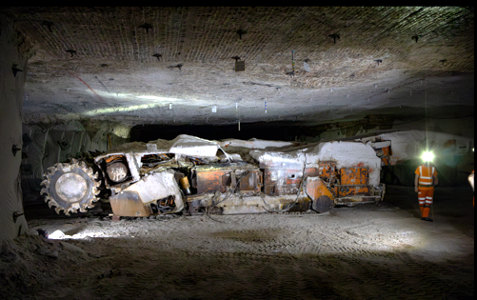
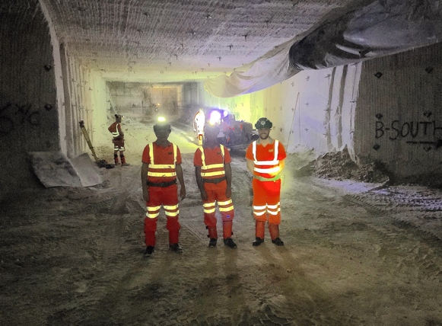
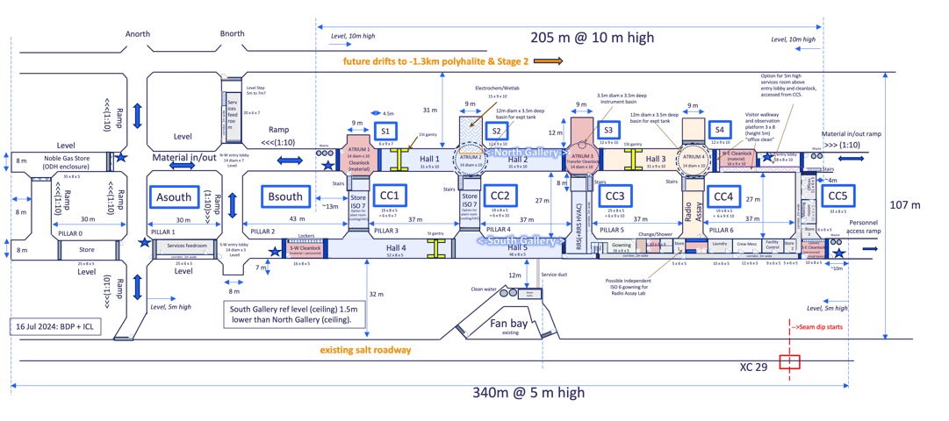
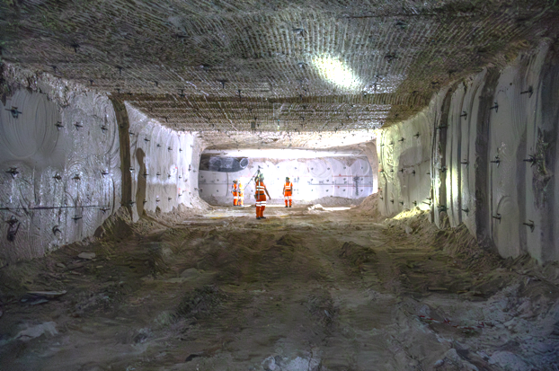
Boulby Development Project:
Stage 1 Excavation
Progress August 2024
Stage 1 Functional Design
Excavation well underway. Completion mid 2025 (Outfitting ~2028)

Slide 16

Our Plan & Strategy: 2025+…
Continue doing our laboratory Core Business well…
  Running Facility
  Supporting Science
  Stakeholders
  Public Engagement & Outreach
Develop our Organisational Systems
  Facility Governance
  Project lifecycle management
  Science / task prioritisation (BSAG)
Manage Coordinated Science Prog Development
  Astro-particle Physics
  Earth & Environmental Science
  Astrobiology & Planetary exploration
  Quantum Sensors & Computing
Continue to work toward growth – the Boulby Development Project (BDP)…
  Design and build new lab(s)
  Develop Science Case(s)
  Engage Stakeholders
  Develop & submit business case(s).
Consider Team and STFC Connectivity
  Support individuals & team in growth
  How to best connect with STFC?
  How to best connect with wider PPD?

Slide 17
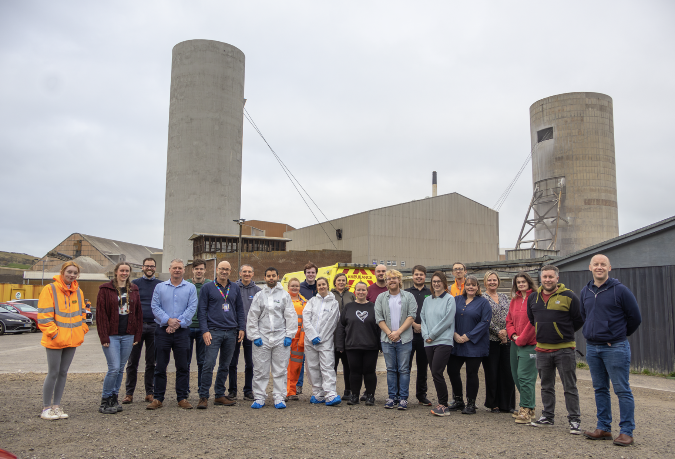
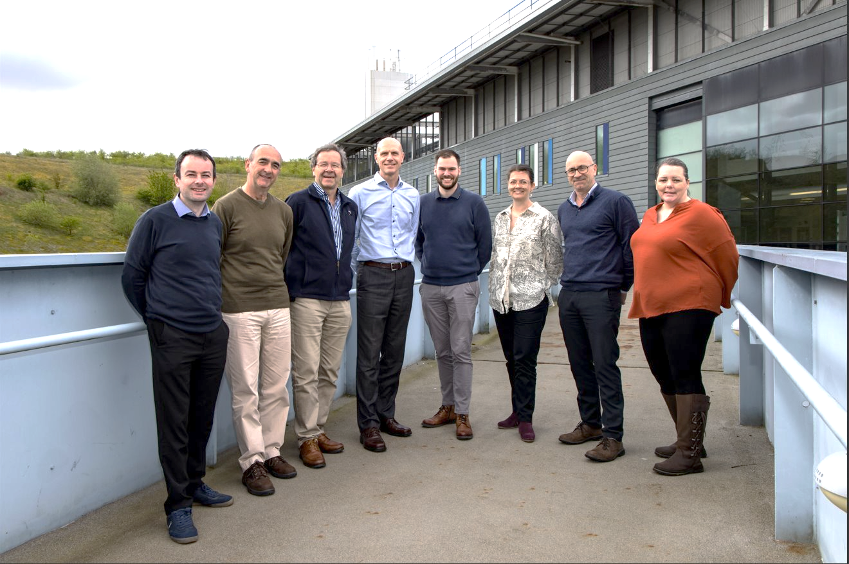
Best Wishes! For 2025 and beyond
From Boulby Lab and Boulby Development
Project Teams

Slide 18


Next (Current) Steps: Boulby Development Project (BDP)
Next level planning and preparing for a…
“… greatly expanded underground science facility in the North East, with potential to host a major international science infrastructure, such as a next generation dark matter experiment.” (STFC strategic delivery plan (2022-2025)
BDP Project Goal:
UKRI Preliminary Infrastructure Funding
£2.84M, 3 year project (2022/3-2024/5).
Tasks / Deliverables:
Facility design development (for sites at various depths and locations)
Science programme development
Business case(s), economic impact studies, risks → Submission to Gov.
Stakeholder engagement: Local, National & International:
  Public & Partners
  Government
  Science communities & funders
Boulby Development Project Organisation
Boulby Development Timeline
stage 1
stage 2
DRAFT

Slide 19


Governance, Strategy & Management
S. Paling, P. Scovell, E. Meehan, Kevin Lester, Sue Armstrong
Facility and Science Strategy, Governance, Organisation Oversight, External Representation. Funding, Team & HR
ICL – Boulby Mine
Strategy, Governance, Management, Comms & Ops Support
Boulby Development Project (BDP)
Boulby Future
J Burns, A Ball, G Mottershead,
H Newton, J Elmer, J Hill, P. Edey
PPD/STFC/UKRI
Strategy, Governance, Management, Comms, HR, Finance & Ops Support
Facility and Operations
E. Meehan
L. Yeoman, T Cunniffe,
M. Wood, G Pinkney, R Meehan, C Keeler, G Currie, B. Metcalfe
Environment Health and Safety
K Lester
P. Scovell, S. Armstrong,
L. Yeoman, ALL
Science Operations Support
P. Scovell
E Shoemark Banks,
J. Puputti, A. Hamer,
Sophie Carroll, Beth Green, K. Johnson
Research and Technical
P. Scovell
E. Shoemark Banks, J. Puputti, A. Hamer, Jon Elmer. Sid Ahmed Maouloud, L. Gibbs
Public Engagement and Comms
E. Meehan
S. Paling,
J. Gutteridge, A. Butcher, ALL
Facility Operations:
(L. Yeoman)
Finance/Purchasing
Deliveries & Materials
Stock monitoring
Misc. Maintenance
Training
Visitor Handling
Mine Ops Liaison
Facility Infrastructure:
(Toby Cunniffe, George Pinkney)
Construction planning & management
Facility Maintenance
Facility Snagging
Deliveries & Materials
Facility Core Services & Ops.
(M. Wood, R Meehan, C ?)
Surface Building Cleaning, maintenance and stock control
UG Lab Cleaning, Maintenance, Stock Control, Ops support
EH&S Management
IMS development and management
Systems and organisation
Monitoring & reporting
Internal communication
External communication
Facility EH&S
Infrastructure
Operations
Future planning
Science Project EH&S
Equipment
Operations
Future planning
Science Project Support
Science and technical support and studies for hosted science projects.
BUGS Scientific Lead and Science Support
BUGS Science support (analysis and Technical)
BUGS external representation
Future Science Support
Boulby big future design studies.
Science support for ad-hoc future science projects
Facility Technical Projects
IT / Networking
Cleanliness
Facility Monitoring
Ad-hoc facility technical support
Outreach / Public Engagement
Public talks
Live links
Schools Liaison
Outreach/PE projects
Public Events
Social Media
Communications
Websites
Comms materials
Briefing notes
Stakeholder Liaison
ICL
STFC/UKRI
General Public
Science User Community
Boulby Development Project support
Science Projects Support:
Onsite project management
Science team liaison
Visit planning and support
Operations support
ES&H management
Communications and record keeping
BUGS Operations
Management
Instrument install, set-up, operation and maintenance.
Sample processing.
Collaborator communication
Boulby Underground Lab
Functional Org Chart 2024

