Slide 1
Particle Physics Department
Sinead Farrington
2nd December 2024
Notes:
The abstract pattern can be removed or repositioned if required. Be careful to ‘Send to Back’ so that it does not obscure any important information.

Slide 2
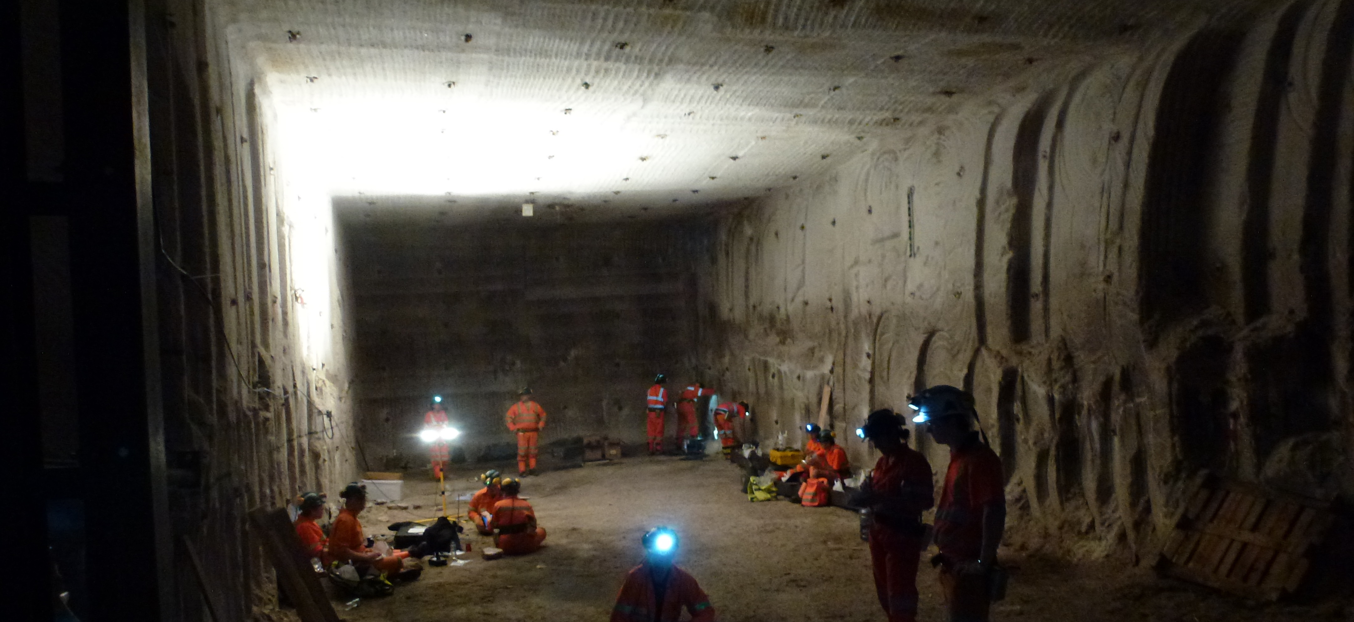
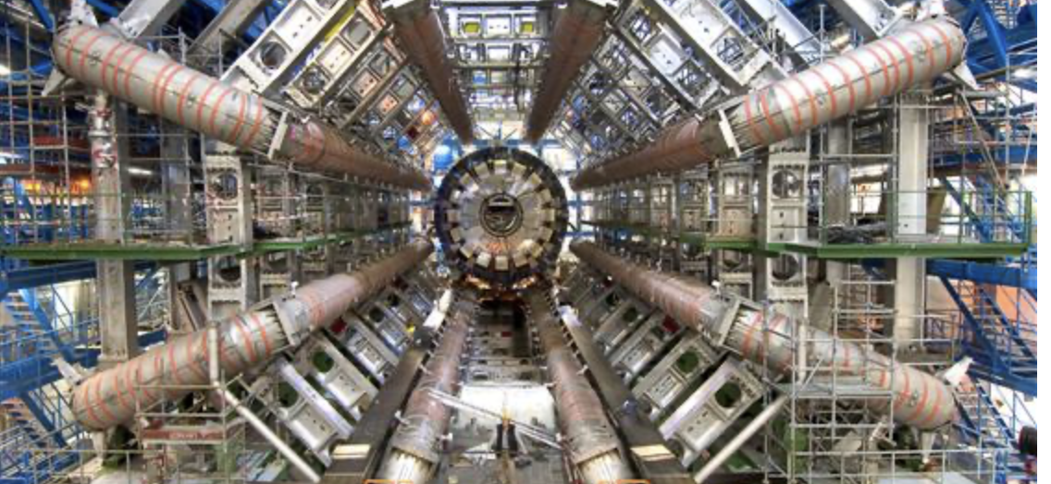
What is PPD
~100 staff, many permanent
~56 senior scientific staff
~5 senior joint with universities ~19 postdoctoral staff
~20 PhD students
~7 project manager experts
~6 program support staff
Underpin UK Particle and Astroparticle physics
Construction of experiments and upgrades
Computing infrastructure and software
Exploitation and operation
Project management
UK community role (technical and admin)
Operating the only deep underground research facility in the UK through staff based in Yorkshire
Staff based at CERN, Japan, USA to construct,
operate and exploit experiments
Notes:
To replace photo with one of your own. 1) Send the geometric shape overlay to the back – Right-Click > Send to Back > Send to Back. 2) Replace image – use the guides provided to correctly position it. 3) Send your image to the back so that the geometric overlay re-appears over the image. Remember to delete the image credit if using your own image.

Slide 3
What is PPD
A happy and fulfilling place to work
A very openly collaborative place to work
… a place where people would like to engage more with what their colleagues do
… a place where people would like to socialise more
… where people are excited to figure out more of the next steps in the department, to match the next steps in the field of particle physics
A place with doors open to the other national labs
And international labs of course
A place of ideas
And of immense expertise
Notes:
To replace photo with one of your own. 1) Send the geometric shape overlay to the back – Right-Click > Send to Back > Send to Back. 2) Replace image – use the guides provided to correctly position it. 3) Send your image to the back so that the geometric overlay re-appears over the image. Remember to delete the image credit if using your own image.

Slide 4
Vision – a work in progress
Caveat: I want to set a strategy that engages
The expertise in the department in its own future “Director’s Discussions”
The community in PPD’s future: University group discussions
That said, my vision for PPD:
Hub of expertise in particle physics technology (hardware, software, operation, exploitation, project management)
Maintains and builds unique capability, distinct from universities – plan staffing needs wrt future projects
In partnership with universities – strategic secondments, CASE studentships, Industrial liaison
PPD puts its expertise to use in novel areas (quantum, AI)
And in doing so, opens unique intellectual opportunities in quantum science onsite
PPD: STFC’s in-house experts in particle physics exploitation, technology and project management
To be a strong and clear voice on the UK vision for international PP, influencing future collider choices, and to positioning the UK for leadership in future PP experiments.
To be host to a fully integrated, funded and operational international facility, housing an international dark matter experiment and quantum experiments at Boulby.
To be a strong partner in a network of national labs hosting science on their own sites in addition to collaborating in international facilities overseas
Notes:
Much of our operation is linked into the UK PPAN program and thus defined by Programs directorate spending with advice from Science Board

Slide 5
UK Particle Physics Program Delivery
Involved with three LHC experiments in the UK program (ATLAS, CMS, LHCb) - major High Luminosity LHC upgrades under construction (R&D phase in LHCb), large-scale silicon detector, software, readout, calorimeter
Neutrino program (both DUNE and Hyper-K)
Dark matter detectors and underground lab
Computing, in particular WLCG contribution, through project funding
Supporting future work in particle physics through small R&D
Maintains our skills base and in some cases delivers science in R&D
Exploitation of the data; maintenance and operations
Engineers all reside in the Technical Department
Some computing staff in Scientific Computing Department
Notes:
Much of our operation is linked into the UK PPAN program and thus defined by Programs directorate spending with advice from Science Board

Slide 6
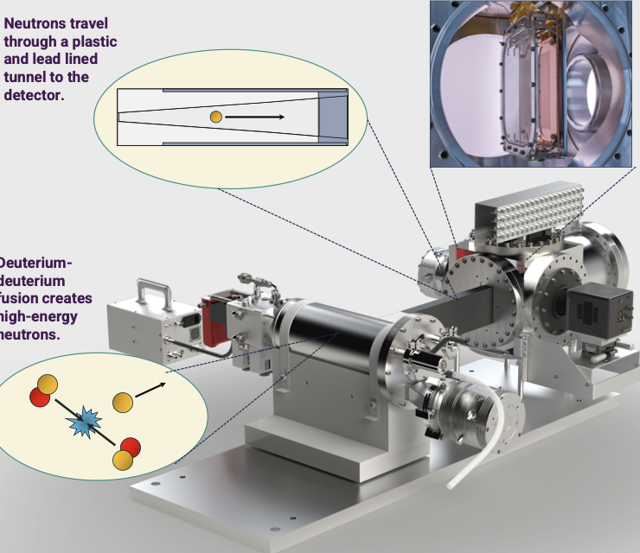
Delivery includes ideas (just two examples…)
Migdal
AI ML on FPGAs
Notes:
Much of our operation is linked into the UK PPAN program and thus defined by Programs directorate spending with advice from Science Board

Slide 7
Opportunities
Deliver commitments ~on time and ~on budget – and then exploit them!
European Strategy Particle Physics Update 2025
Future collider: majority of PPD expertise: DAQ, silicon, calorimeter, software and more: workforce question for 10-15 years from now
UK community has the lead in quantum experiments – time for a quantum experiment strategy, fully internationalised? UK has the opportunity to lead it, PPD part of this
Boulby: UK proposes to host largest scale “rare observatory” international experiment XLZD – rule in or out large class of one of most likely type of DM candidates among other science
With many opportunities beyond (quantum, geology…)
On-campus science: ISIS (neutrinos, kaons), e-pac, CLARA… Migdal… other table-top experiments? (quantum?) – international network of national labs
PPD – working with other national lab departments – has capabilities to deliver on STFC and national strategies on AI, Quantum…
A new director is a new opportunity to look at our interaction with universities – on-campus presence; large and small scale project formation
Notes:
Much of our operation is linked into the UK PPAN program and thus defined by Programs directorate spending with advice from Science Board

Slide 8
Strategy Discussions
First of all thank you – a few still to go
How to foster interaction across the department
Common technologies to take forward in the context of Detector Research and Development, and computing/software
What infrastructure could bolster our future capabilities?
How to position ourselves for future collider?
Data exploitation - right balance in PPD?
Theory involvement?
How to attract more fellows?
What’s unique about the lab compared with university groups?
On-campus science? (A la Migdal, neutrino physics with ISIS beam? etc)
Accelerator science within PPD
Our application to the quantum world - both fundamental quantum experiments and in quantum computing?
AI
Notes:
Much of our operation is linked into the UK PPAN program and thus defined by Programs directorate spending with advice from Science Board

Slide 9
Strategy Discussions
How to foster interaction across the department
Notes:
Much of our operation is linked into the UK PPAN program and thus defined by Programs directorate spending with advice from Science Board

Slide 10
Strategy Discussions
Common technologies to take forward in the context of Detector Research and Development, and computing/software
Notes:
Much of our operation is linked into the UK PPAN program and thus defined by Programs directorate spending with advice from Science Board

Slide 11
Strategy Discussions
What infrastructure could bolster our future capabilities?
Notes:
Much of our operation is linked into the UK PPAN program and thus defined by Programs directorate spending with advice from Science Board

Slide 12
Strategy Discussions
How to position ourselves for future collider?
Notes:
Much of our operation is linked into the UK PPAN program and thus defined by Programs directorate spending with advice from Science Board

Slide 13
Strategy Discussions
Data exploitation - right balance in PPD?
Notes:
Much of our operation is linked into the UK PPAN program and thus defined by Programs directorate spending with advice from Science Board

Slide 14
Strategy Discussions
Theory involvement?
Notes:
Much of our operation is linked into the UK PPAN program and thus defined by Programs directorate spending with advice from Science Board

Slide 15
Strategy Discussions
What’s unique about the lab compared with university groups?
Notes:
Much of our operation is linked into the UK PPAN program and thus defined by Programs directorate spending with advice from Science Board

Slide 16
Strategy Discussions
How to attract more fellows?
Notes:
Much of our operation is linked into the UK PPAN program and thus defined by Programs directorate spending with advice from Science Board

Slide 17
Strategy Discussions
On-campus science? (A la Migdal, neutrino physics with ISIS beam? etc)
Notes:
Much of our operation is linked into the UK PPAN program and thus defined by Programs directorate spending with advice from Science Board

Slide 18
Strategy Discussions
Accelerator science within PPD
Notes:
Much of our operation is linked into the UK PPAN program and thus defined by Programs directorate spending with advice from Science Board

Slide 19
Strategy Discussions
Our application to the quantum world - both fundamental quantum experiments and in quantum computing?
AI
Notes:
Much of our operation is linked into the UK PPAN program and thus defined by Programs directorate spending with advice from Science Board

Slide 20
Next steps
Working groups
Opt-in – choose your topics
We will stagger them, so it won’t feel too heavy a load if you want to follow >1
Which topics
- subject of this afternoon’s structured discussion
Must end this process with an idea of PPD’s DRD groups alignment
And with firm ideas on all the questions posed
Can take as long as a 15-20 year arc for “workforce planning” (e.g. future collider, e.g. DUNE) but mostly focus on strategy what we actually do in the next 5 years to get there
I will propose the final topics by Christmas break and appoint area “leads” and invite (self-)nominations
The working groups will report by ~ mid-March with ideas from their area
Strategy document should not be long
Converge strategy by mid-April and reconstitute international advisory board to advise

Slide 21
Science and Technology Facilities Council
@STFC_matters
Science and Technology Facilities Council
Notes:
The abstract pattern can be removed or repositioned if required. Be careful to ‘Send to Back’ so that it does not obscure any important information.

Slide 22
Common technologies to take forward in the context of Detector Research and Development, and computing/software
FPGA
LGADs
CMOS
28nm silicon
non-silicon semiconductors
crates, power supplies
Cryogenics
GPUs, silicon module, chips, wire bonding, flip-chip bonding
AI on FPGAs
L1Calo - have FPGA stuff,
“high-level synthesis” instead of “FPGA”?
chip design - increase options - not alot elsewhere
AI/FPGA/IPBus/DAQ
Calorimetry, LiquidO
…

Slide 23
Infrastructures
— racks of mix of processors
— hosting capability for code repository
— testbeam
— having facility for building FPGA firmware asap - weekly call on FPGA programming
— digital infrastructure - jupyter notebook server - platform to share files and software tools
…

