Slide 1
Channel Finder Metrics
PRESENTED BY SKY BREWER

Slide 2
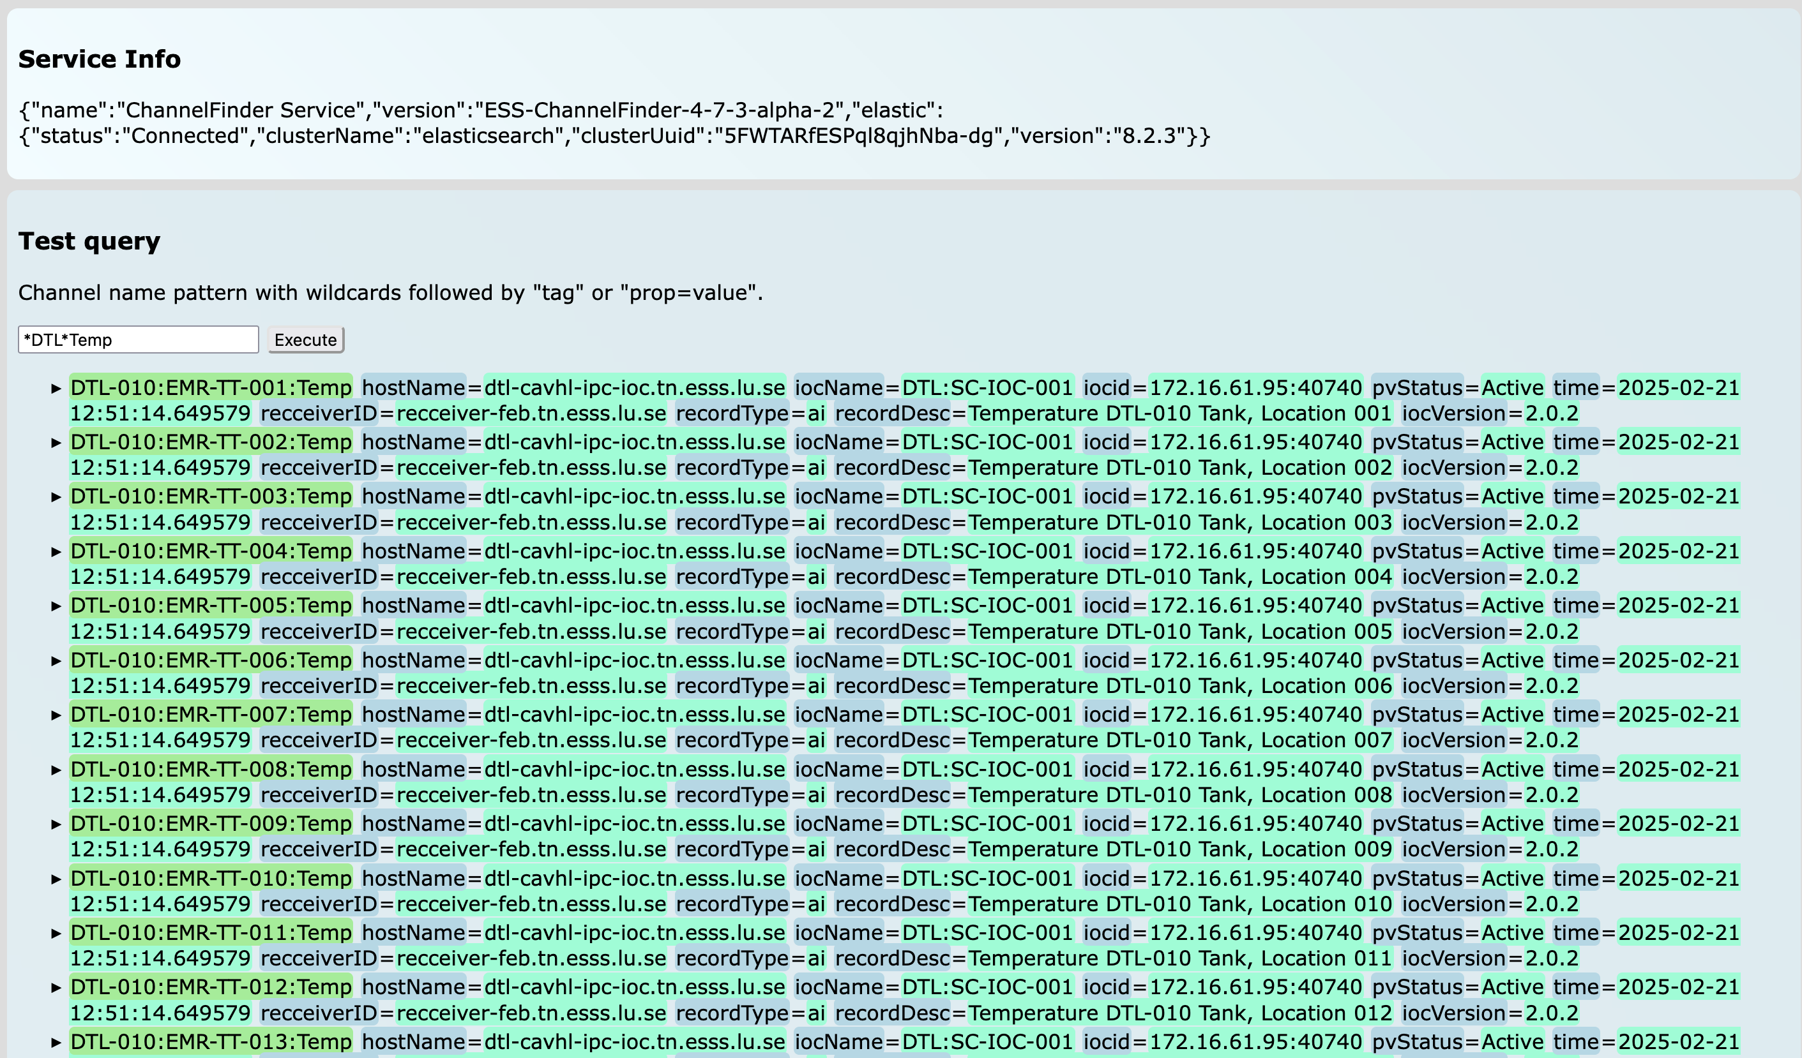
What is Channel Finder?
Directory Service of available channels

Slide 3
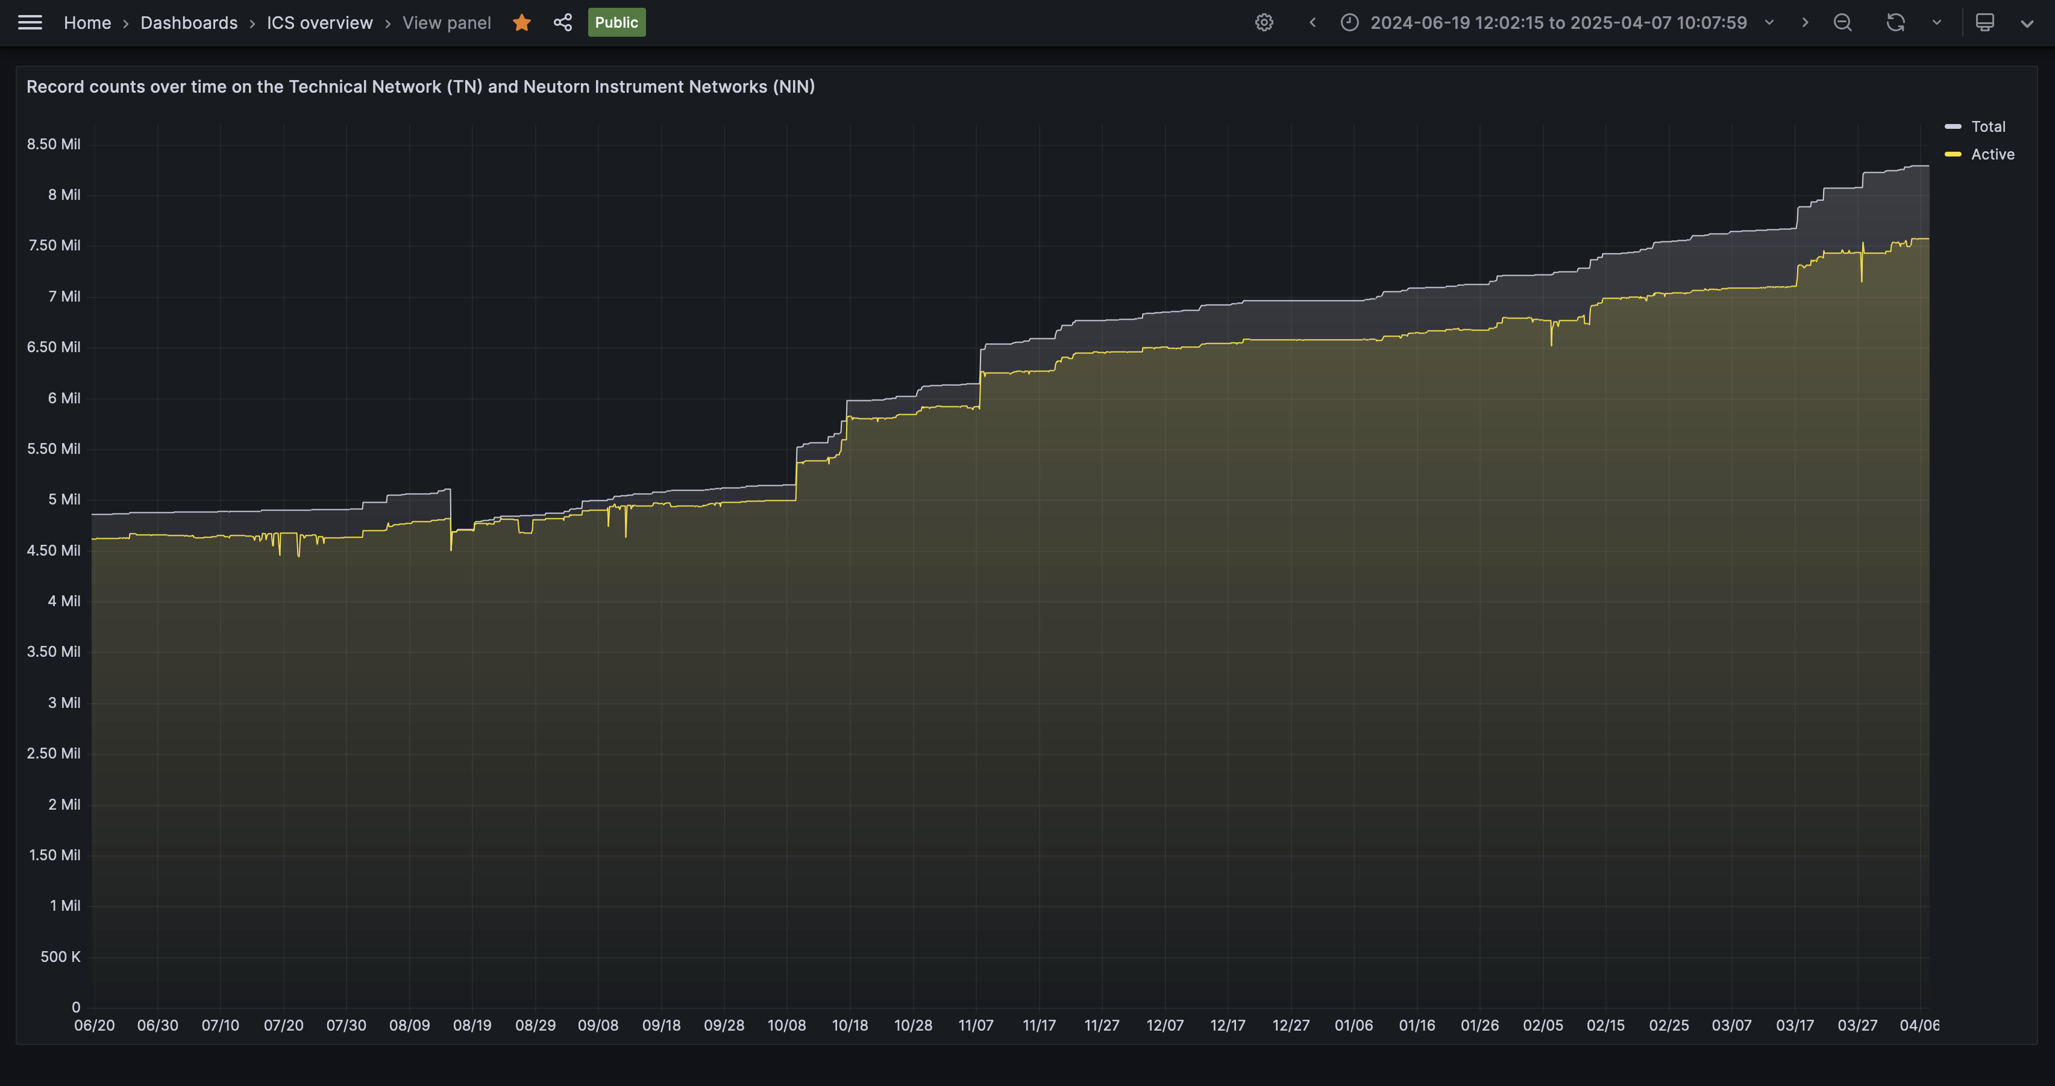
pvStatus Active vs Inactive

Slide 4
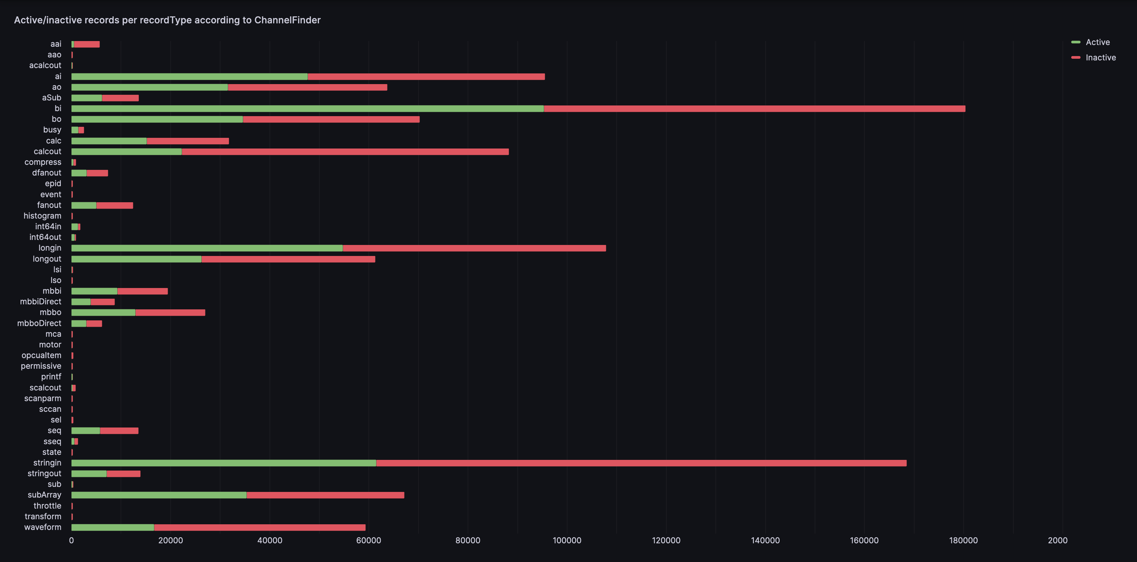
Active vs Inactive by recordType

Slide 5
Configuration
Modify application.properties or set env variables
Tags
  metrics.tags=Tag1, tag2, …
Properties
  metrics.properties= testProp0: value0, value1; testProp1: value0, !*
  “,” to separate property Values
  “;” to separate property names
  “!” for “!=”
  “!*” for not set at all

Slide 6
Finish presentation

