Slide 1
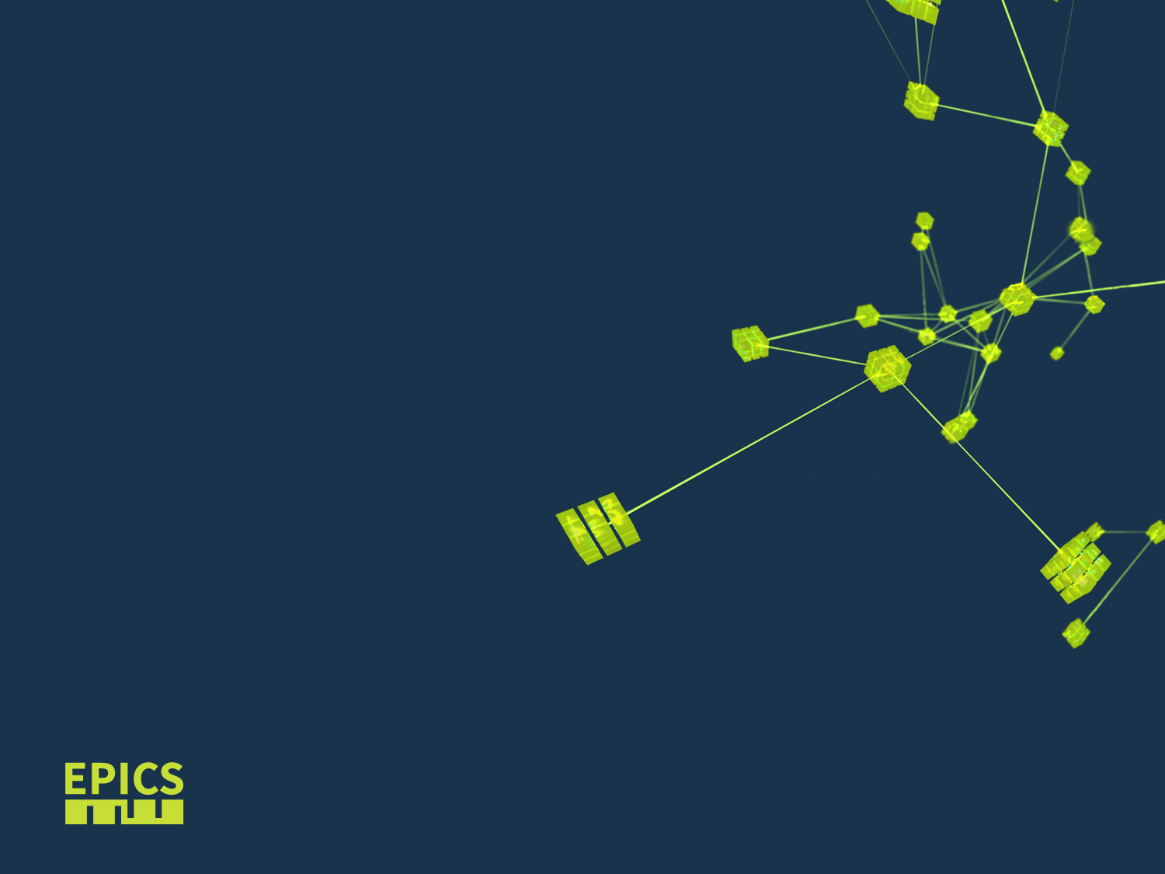
EPICS after 30+ years
Presenting a story of a fantastic community

Slide 2
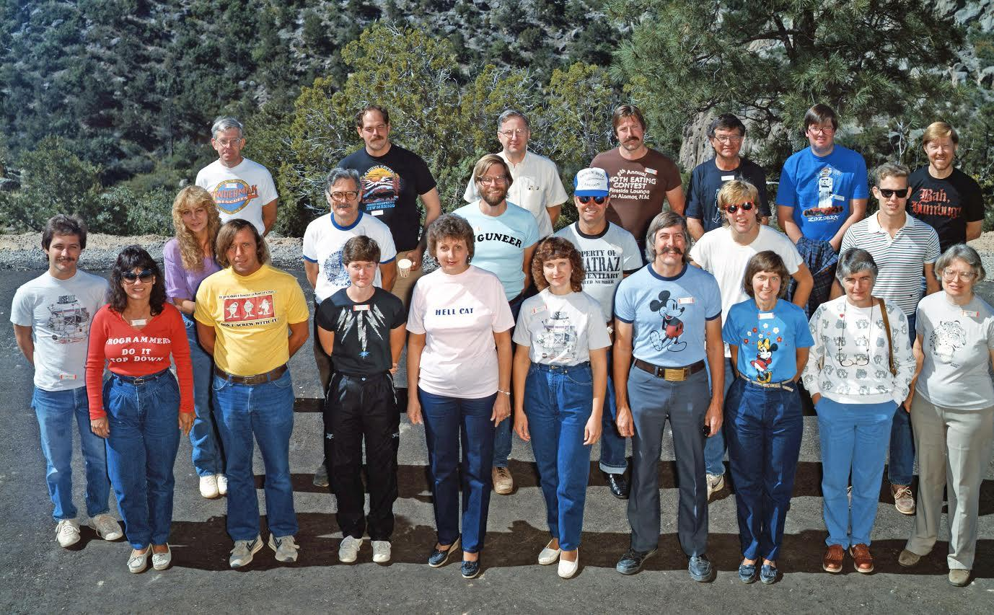
1985 LANL - GTACS
AT-8
  Antares Controls – SNL
  EMC Controls - Emcon D-3 – SCADA
  toolkit and Process Database
AT-2
  APS-Telescope – TCP/IP ‘C’ types
GTACS
  SNL, Process Database w links
  TCP/IP with DBR_Types (metadata)
  Operating system: Unix/vxWorks
  Network: TCP/IP/UDP
  Backplanes: PLC & VME
  Shared Software: License
Notes:
In experimental facilities it is common to have requirements and specifications develop late into the project cycle.
Configuration of a control system in place of programming supports rapd modification with limited risk of software errors.
All common code was carefully optimized to get the maximum performance possible as the demands of the experimental facilities have typically exceeded the available electronics.
Clean interfaces were developed to develop new hardware interfaces and expand the set of tools. The proliferation of drivers and clients suggests that this was done successfully.

Slide 3
1985 LANL, 1987 CERN, 1988 LANL toolkit workshops – the technology wars
Language wars: C, Fortran, Assembly language, Matlab etc…..
Operating systems: VMS, Unix, DOS
Network: Token ring, TCP/IP
Backplanes: PLC, CAMAC, VME/VMI
Shared Software
  using a library from CERN (NODAL)
  Purchasing software (Vsystem – from AT2 or VxWorks-LBL)
  1988 workshop – first community-wide discussion of a network based toolkit approach
Notes:
In experimental facilities it is common to have requirements and specifications develop late into the project cycle.
Configuration of a control system in place of programming supports rapd modification with limited risk of software errors.
All common code was carefully optimized to get the maximum performance possible as the demands of the experimental facilities have typically exceeded the available electronics.
Clean interfaces were developed to develop new hardware interfaces and expand the set of tools. The proliferation of drivers and clients suggests that this was done successfully.

Slide 4
Motivation Behind a Toolkit Architeture
Distributed and Scalable Control System – SCADA for Science
Reduce programming by 85%
High Performance / Scalable to 100k PVs
Expandable / Flexible – Well defined APIs so each lab could expand it
Robust - fail safely
Notes:
In experimental facilities it is common to have requirements and specifications develop late into the project cycle.
Configuration of a control system in place of programming supports rapd modification with limited risk of software errors.
All common code was carefully optimized to get the maximum performance possible as the demands of the experimental facilities have typically exceeded the available electronics.
Clean interfaces were developed to develop new hardware interfaces and expand the set of tools. The proliferation of drivers and clients suggests that this was done successfully.

Slide 5
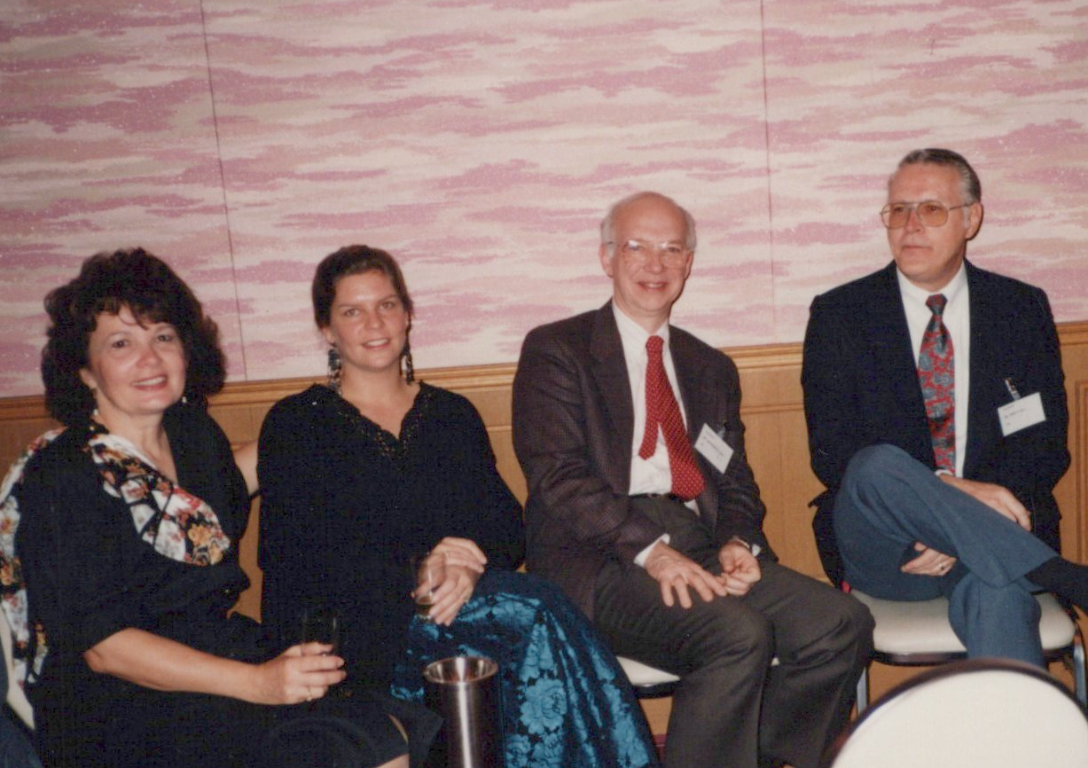
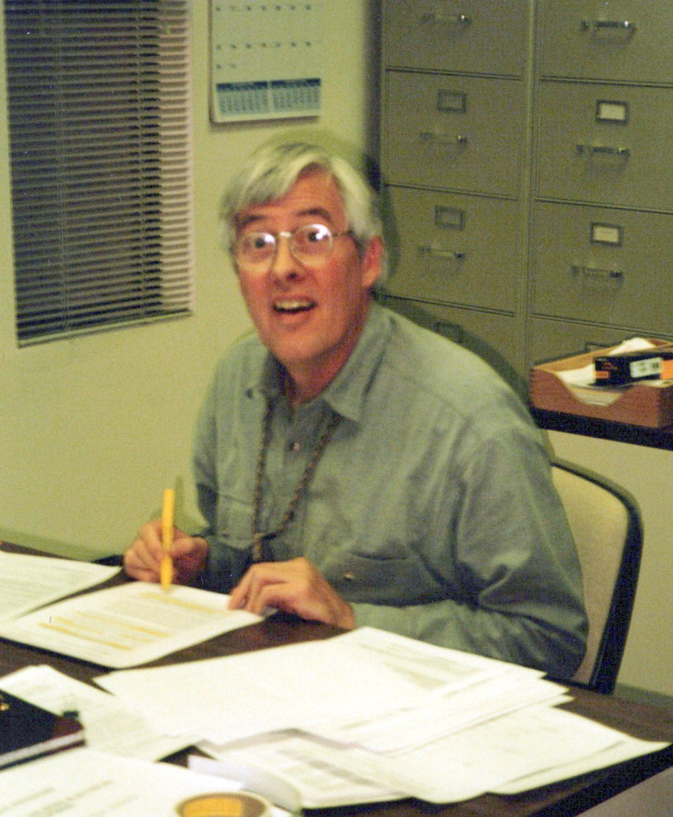
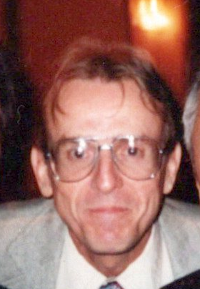
Genesis: 1989 ICLAPECS at TRIUMF
Many toolkit papers from GTA/LANL (star wars)
Mike Thuot (LANL), Marty Knott, Bill McDowell (ANL) discuss leveraging off of the GTA work
1990 Marty Kraimer spends 6 months at LANL – evaluating code.
1990 A collaboration is formed – a new name is given:
Experimental Physics and Industrial Control System (EPICS)
Notes:
In experimental facilities it is common to have requirements and specifications develop late into the project cycle.
Configuration of a control system in place of programming supports rapd modification with limited risk of software errors.
All common code was carefully optimized to get the maximum performance possible as the demands of the experimental facilities have typically exceeded the available electronics.
Clean interfaces were developed to develop new hardware interfaces and expand the set of tools. The proliferation of drivers and clients suggests that this was done successfully.

Slide 6
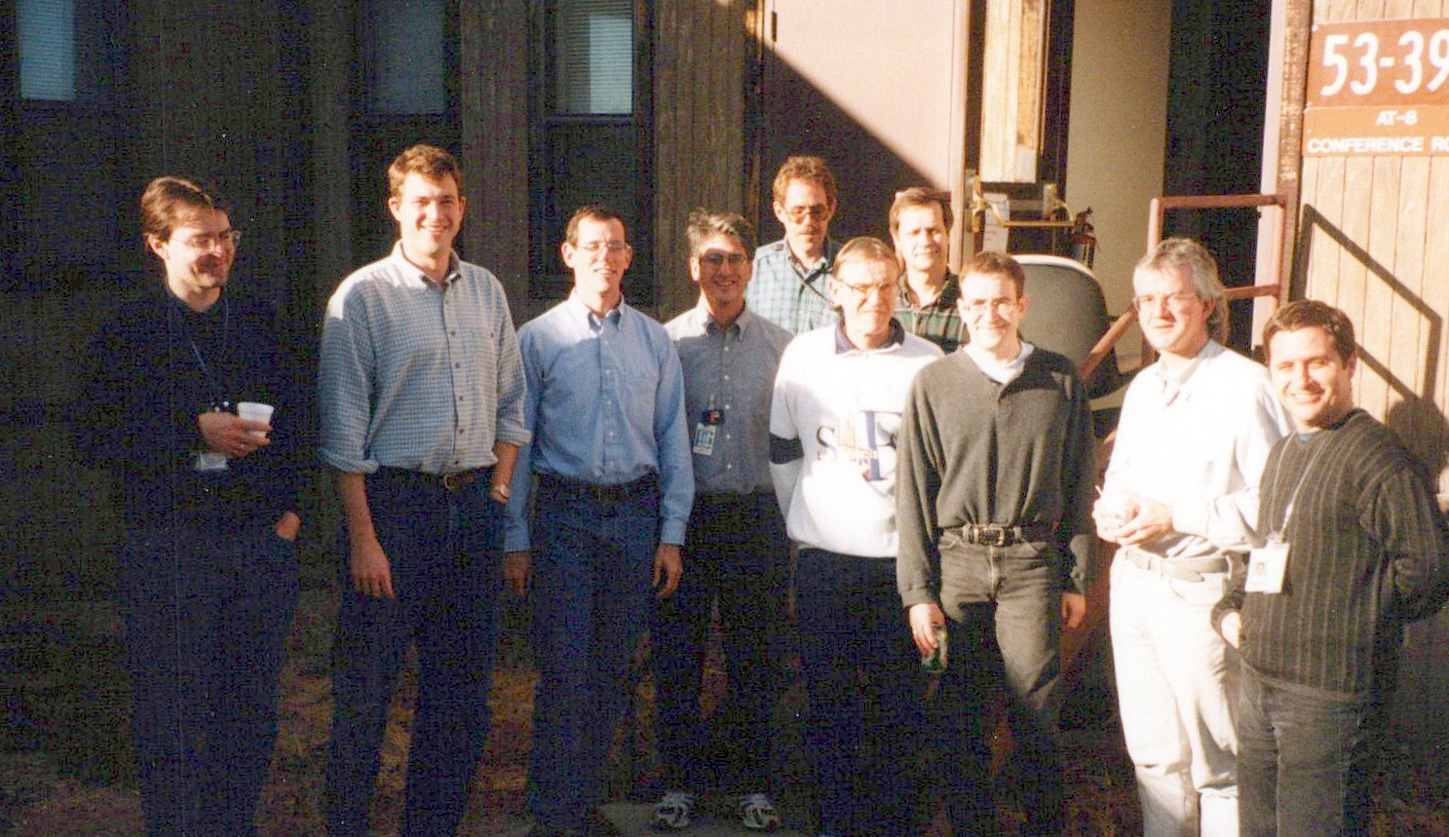
Distribution of EPICS
Initially required signed license agreement – 5-ish in 1993
1991 – 3 commercial licensees: Tate, Kinetic Systems, Hathaway
Up to 2004 there were 100+ sites
Since 2004 free, open source
⇒ We have given up trying to track who is using EPICS.
Its success is based on loose collaboration of volunteers
Please enter your facility on https://epics-controls.org/epics-users/projects/
Notes:
This year is noted as the 30th anniversary of EPICS as the collaboration between LANL and ANL that was formed by Mike Thuot (LANL) and Marty Knott (ANL) after discussion at the 1989 ICALEPCS.
The initial work that was done for the Ground Test Accelerator started in 1985 The team consisted of two different groups at Los Alamos with ideas flushed out aa a meeting that was a predecessor of the ICALEPCS series. It was held in Los Alamos and include a number of other international laboratories. A second meeting was held at Luzeren in 1987 and in 1989 turned into the ICALPECS series.: The ICALEPCS series cited these organizers: Peter Clout, Axel DANEELS, Shin-Ichi KUROKAWA, Dave GURD, Daniele BULFONE, Ryotaro TANAKAs, with a lifetime achievement award.
The toolkit deployed there was called the Ground Test Accleroator Control System.
Clearly it was an in appropriate name for a multi-lab collaboration and the team agreed to call it Experimental Physics and Industrial Control System.

Slide 7
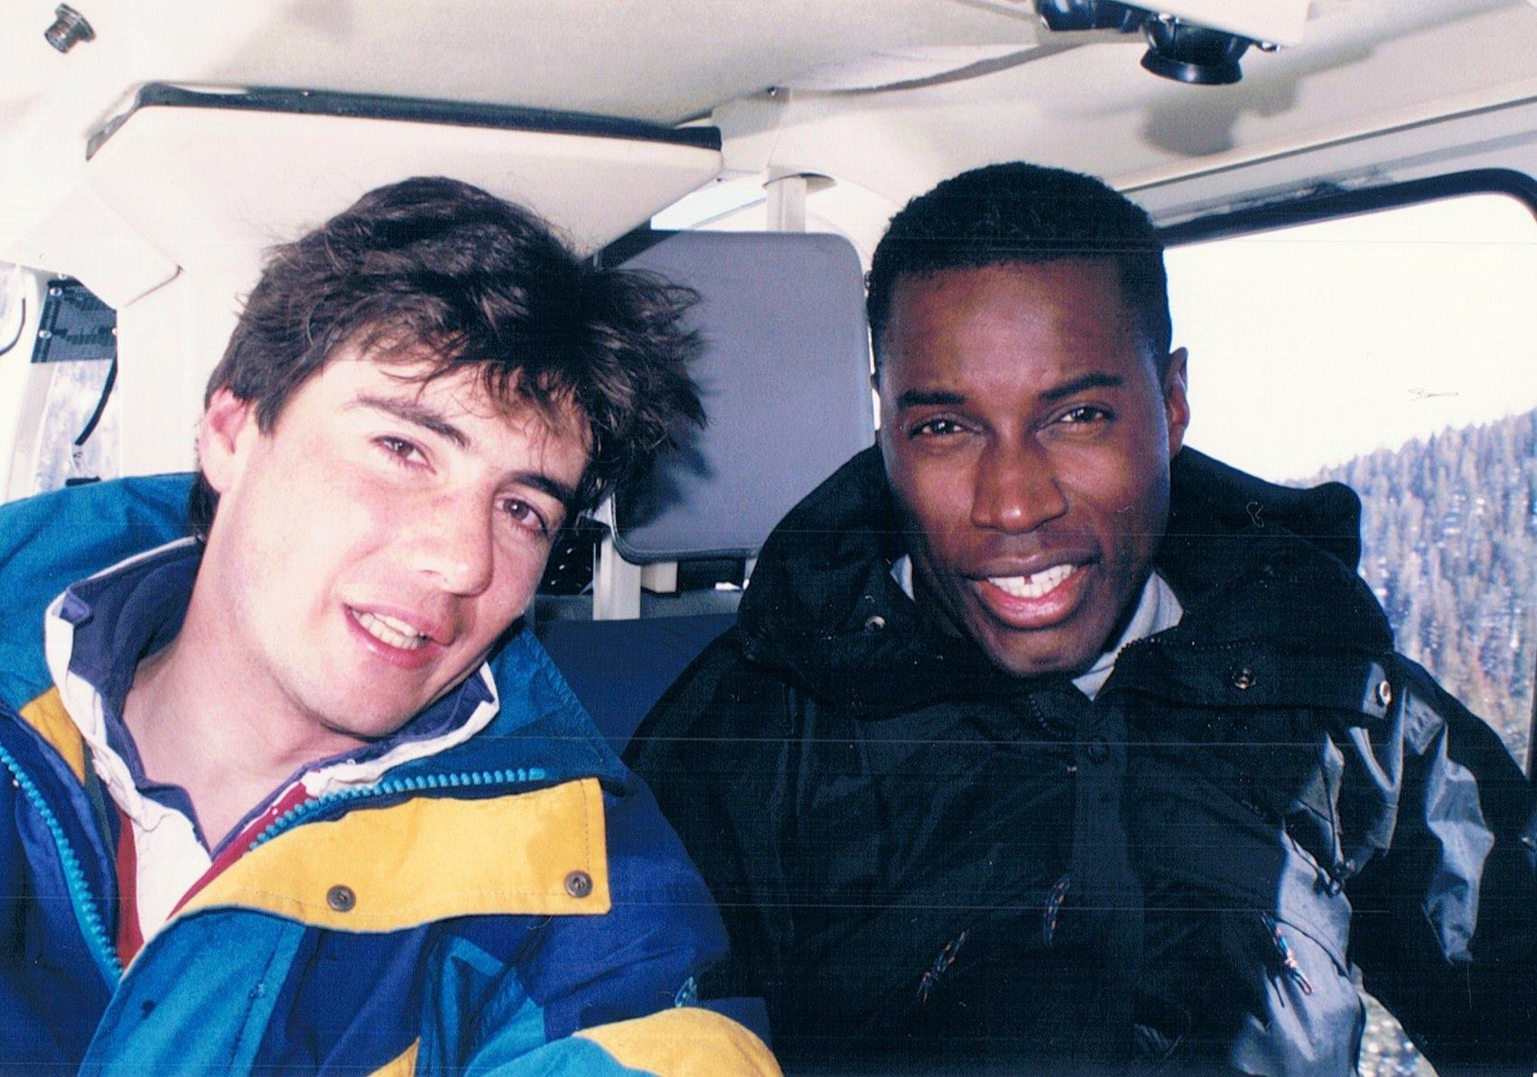
Distribution of EPICS
Initially required signed license agreement – 5-ish in 1993
1991 – 3 commercial licensees: Tate, Kinetic Systems, Hathaway
Up to 2004 there were 100+ sites
Since 2004 free, open source
⇒ We have given up trying to track who is using EPICS.
Its success is based on loose collaboration of volunteers
Please enter your facility on https://epics-controls.org/epics-users/projects/
Notes:
This year is noted as the 30th anniversary of EPICS as the collaboration between LANL and ANL that was formed by Mike Thuot (LANL) and Marty Knott (ANL) after discussion at the 1989 ICALEPCS.
The initial work that was done for the Ground Test Accelerator started in 1985 The team consisted of two different groups at Los Alamos with ideas flushed out aa a meeting that was a predecessor of the ICALEPCS series. It was held in Los Alamos and include a number of other international laboratories. A second meeting was held at Luzeren in 1987 and in 1989 turned into the ICALPECS series.: The ICALEPCS series cited these organizers: Peter Clout, Axel DANEELS, Shin-Ichi KUROKAWA, Dave GURD, Daniele BULFONE, Ryotaro TANAKAs, with a lifetime achievement award.
The toolkit deployed there was called the Ground Test Accleroator Control System.
Clearly it was an in appropriate name for a multi-lab collaboration and the team agreed to call it Experimental Physics and Industrial Control System.

Slide 8
Three Major Aspects of EPICS
Architecture
Tool Kit
Collaboration – the major difference between GTACS and EPICS
Notes:
The architecture supports incremental integration of facilities with new nodes containing their connection information. Once a new IO Controller is plugged into the network, it is visible by all clients.
The toolkit supports configuration of many SCADA and specialized clients.
Most importantly, a community grew that could provide control systems to a wide variety of applications. More importantly, the community provided a host of benefits: support for existing code, extensions to that code,and new tools, The community also came together to support a common base and support on many related issues such as hardware and relational database applications.

Slide 9
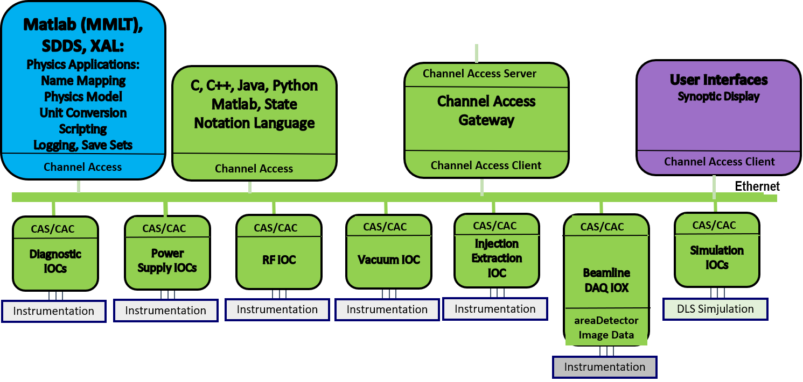
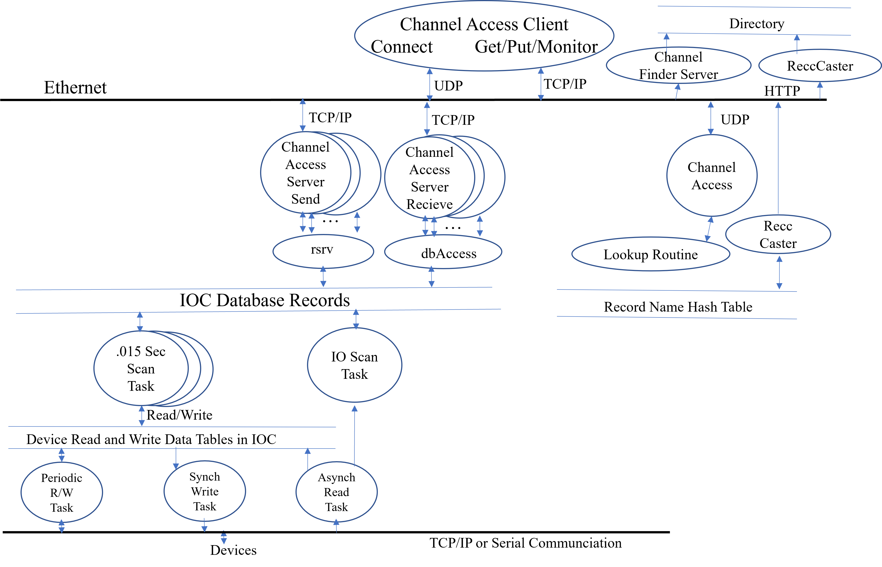
Modular Architecture Enables Collaboration
Collaboration defeats technology wars
Notes:
EPICS Version 3 had a2-tier, flat architecture with well defined interfaces to:
Integrate new hardware
Develop new client applications
Adding new I/O Controllers.

Slide 10
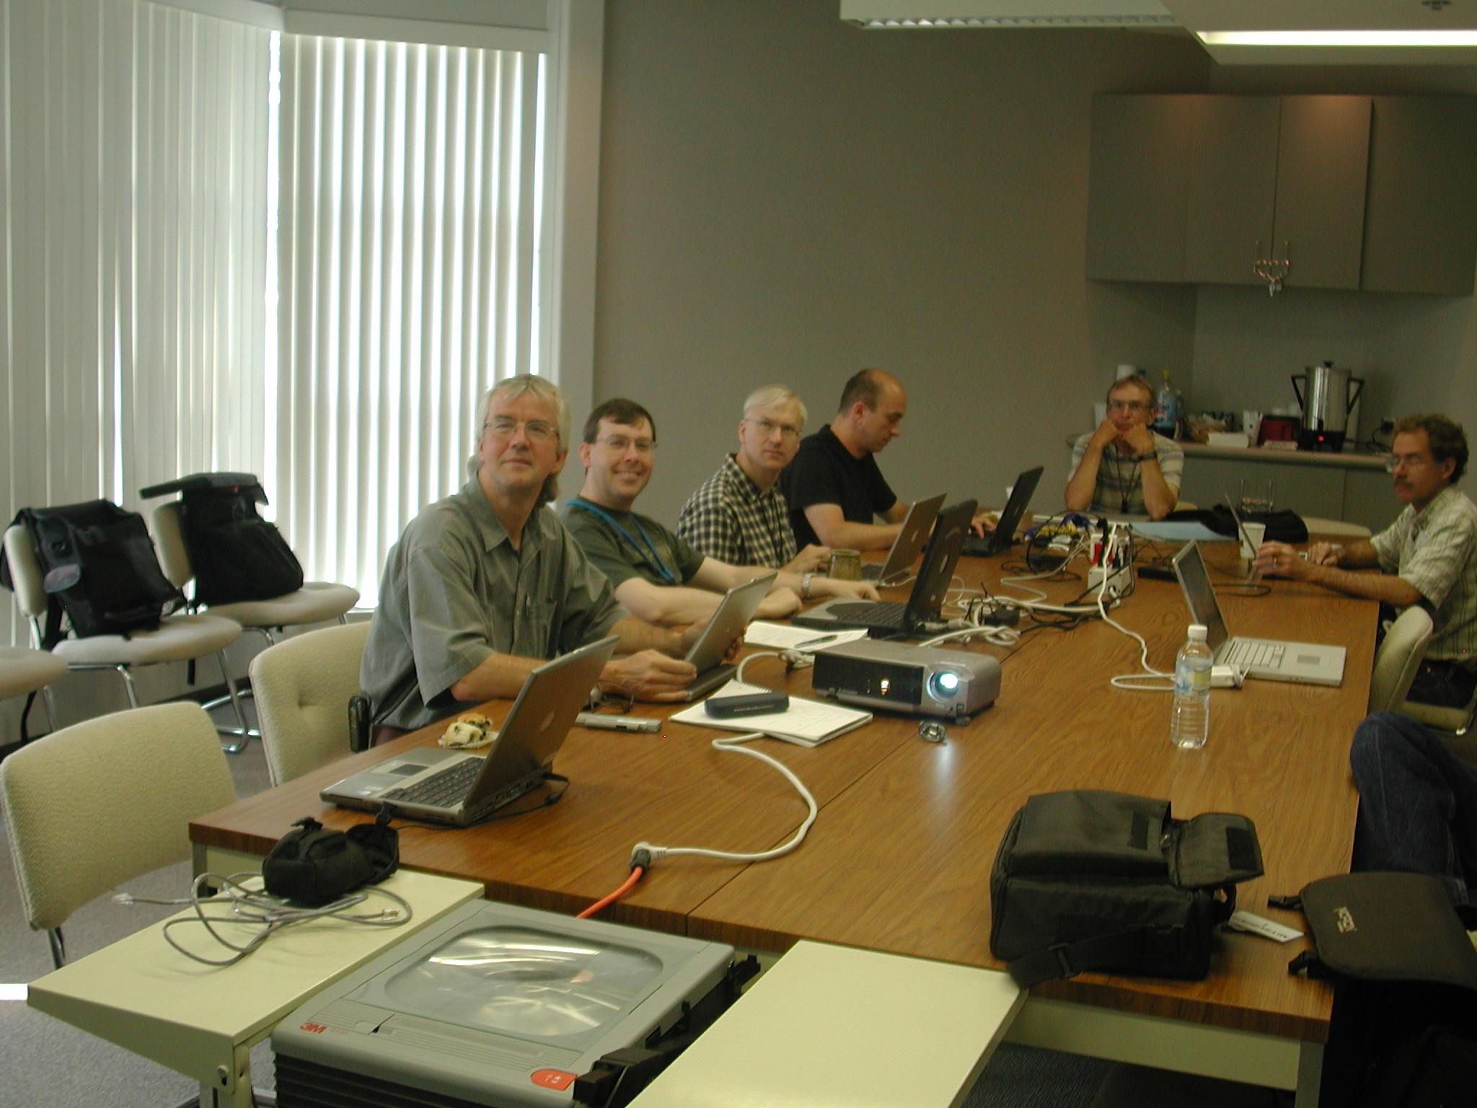
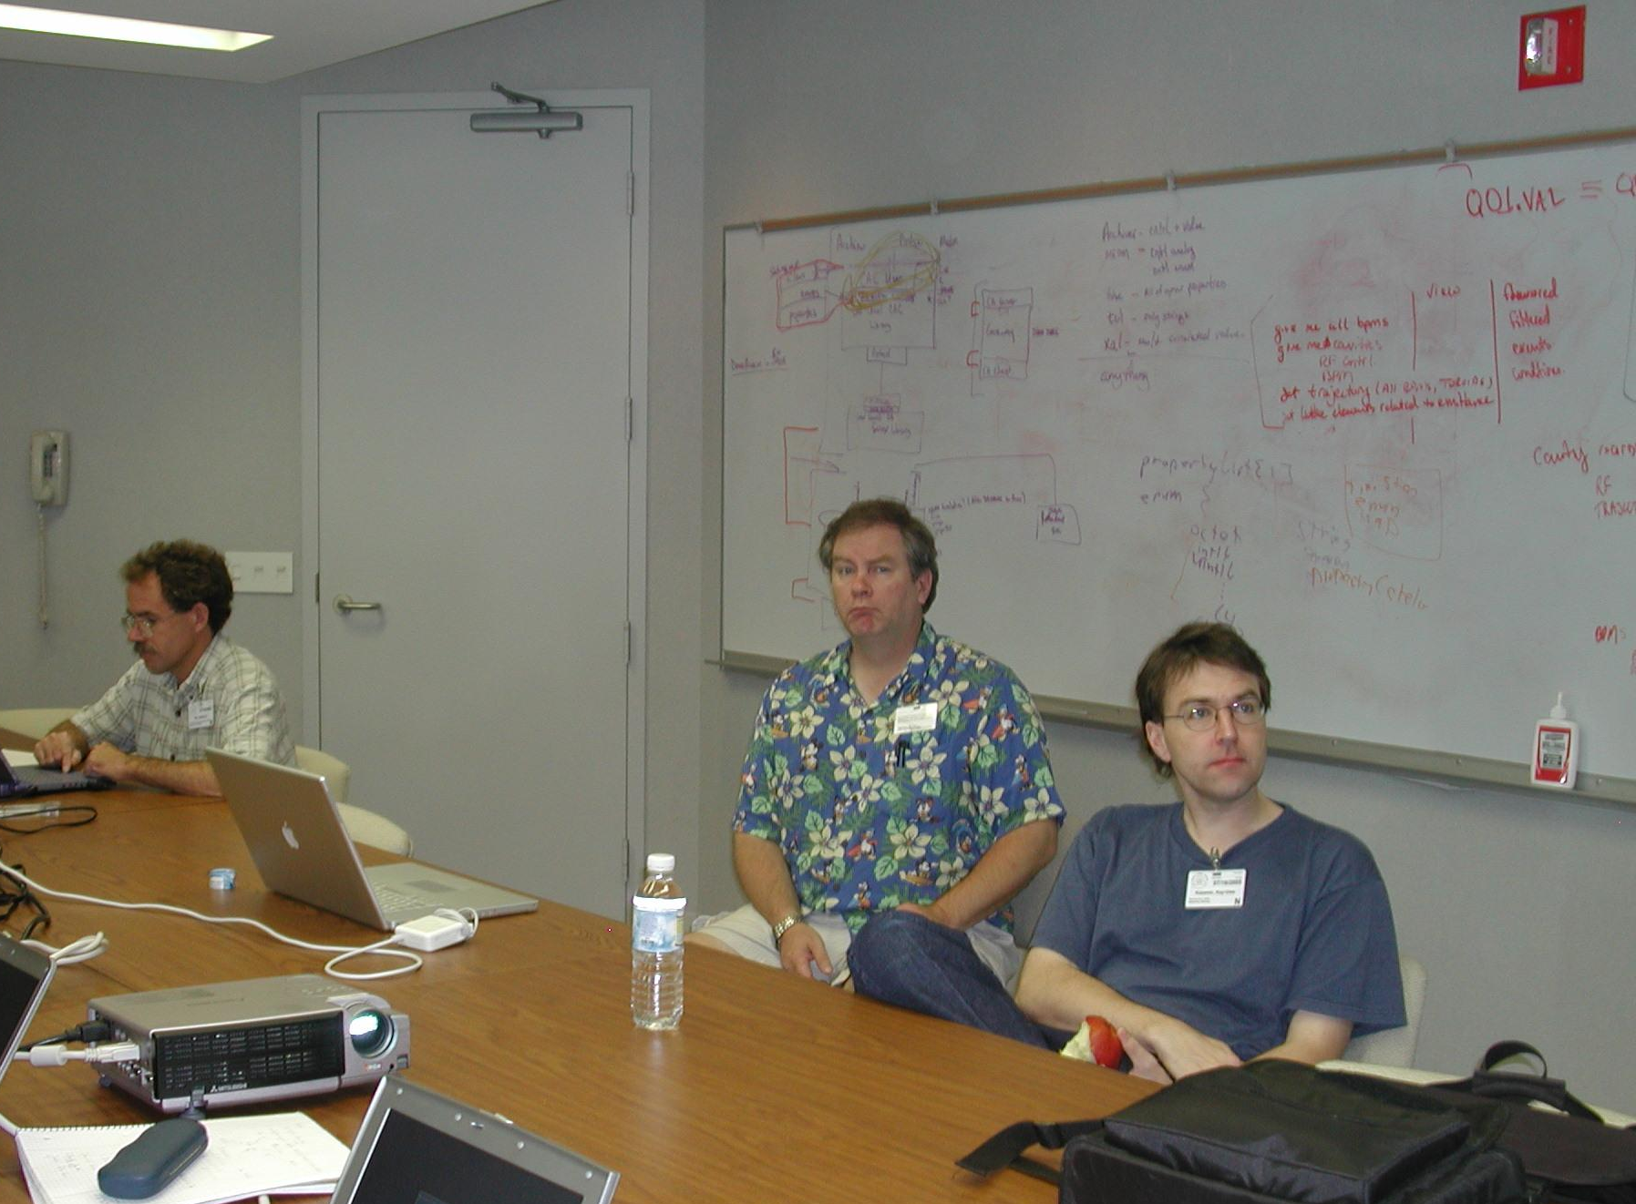
Developer’s Meetings
Notes:
Developers’ meeting were held every 3 months for the first several years when there were many issues to resolve and porting to new platforms and applications
As version 3.14 was around for a long time, these meetings were reduced the primary users meetings 2x a year with side meetings for developers.

Slide 11
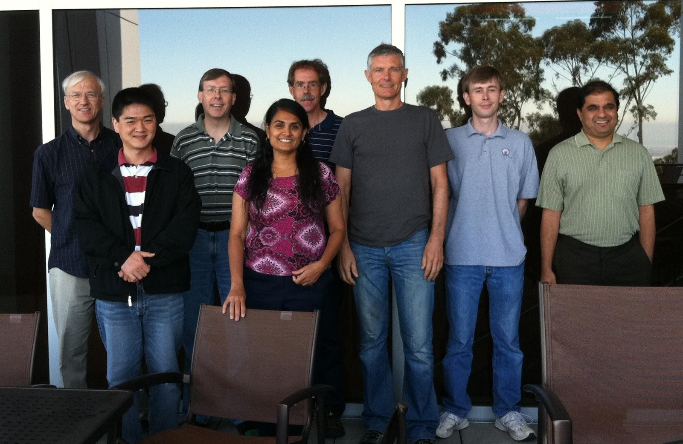
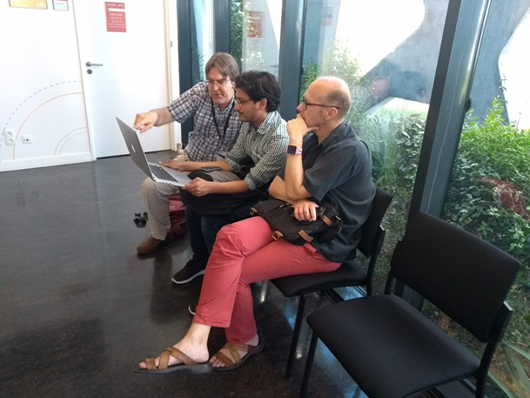
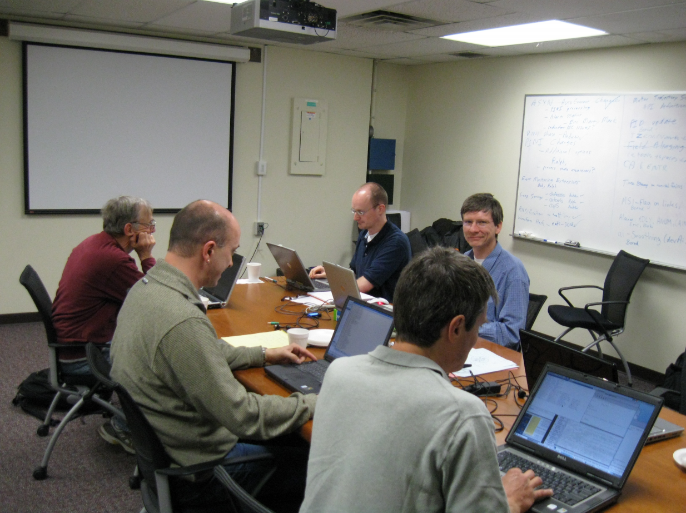
Developer Meetings and Codeathons
Developer Meetings
PVA Services
AreaDetector Developers
CS-Studio Developers
EPICS Core Developers
BlueSky Workshop
Open Hardware
Motion Control
Notes:
Most importantly, there are development teams that continue to push all areas of control system software ahead for the community – all through volunteer contributions to the expanding pool of open-source software.

Slide 12
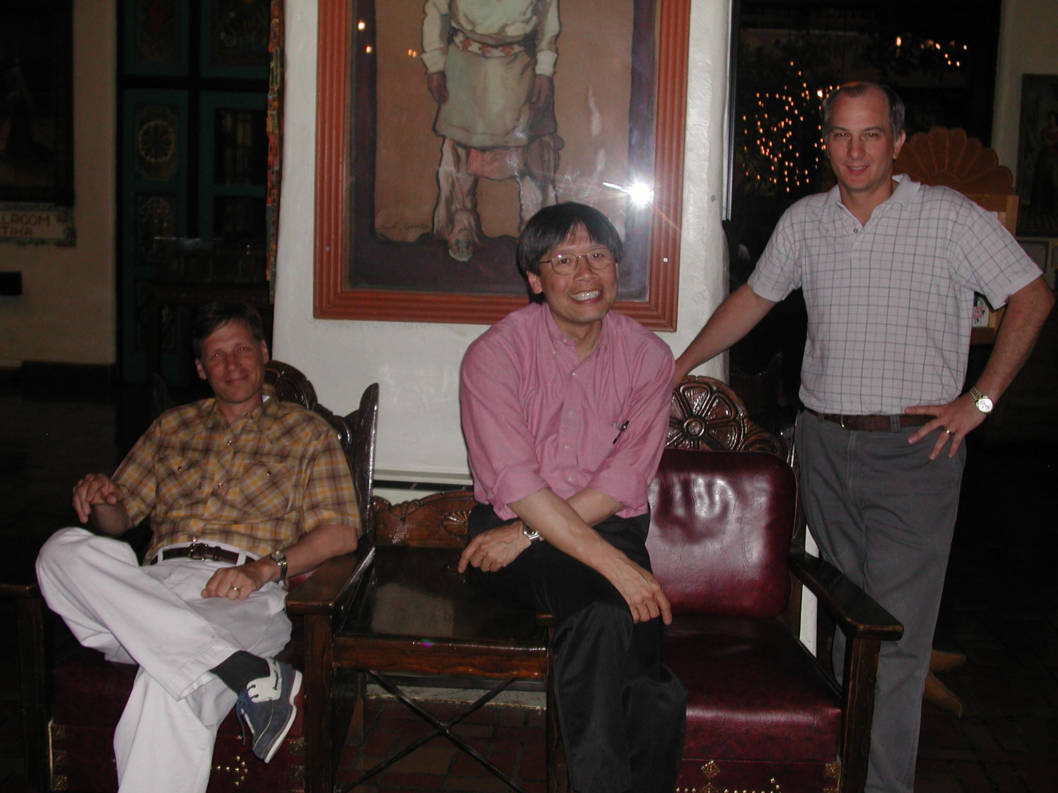
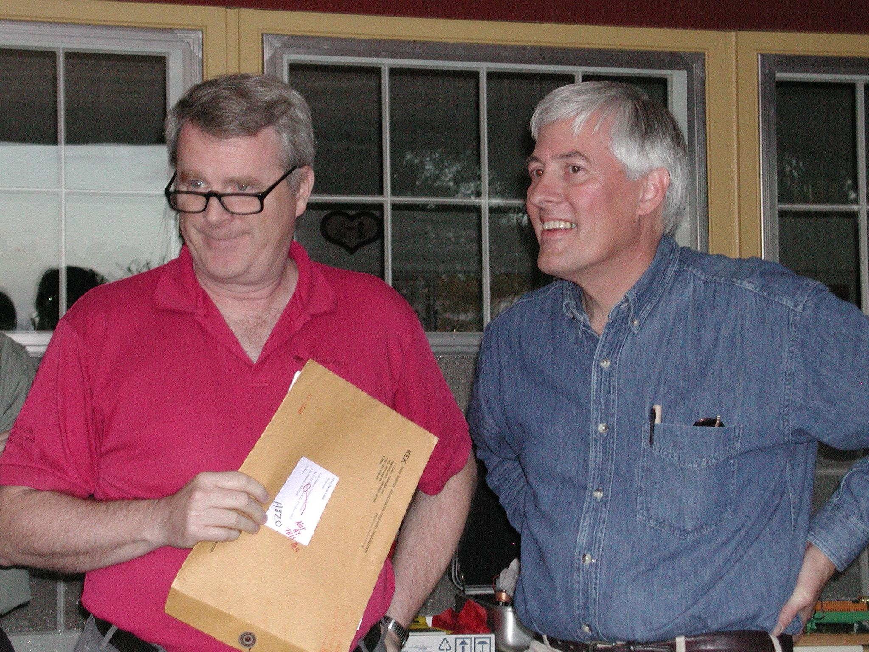
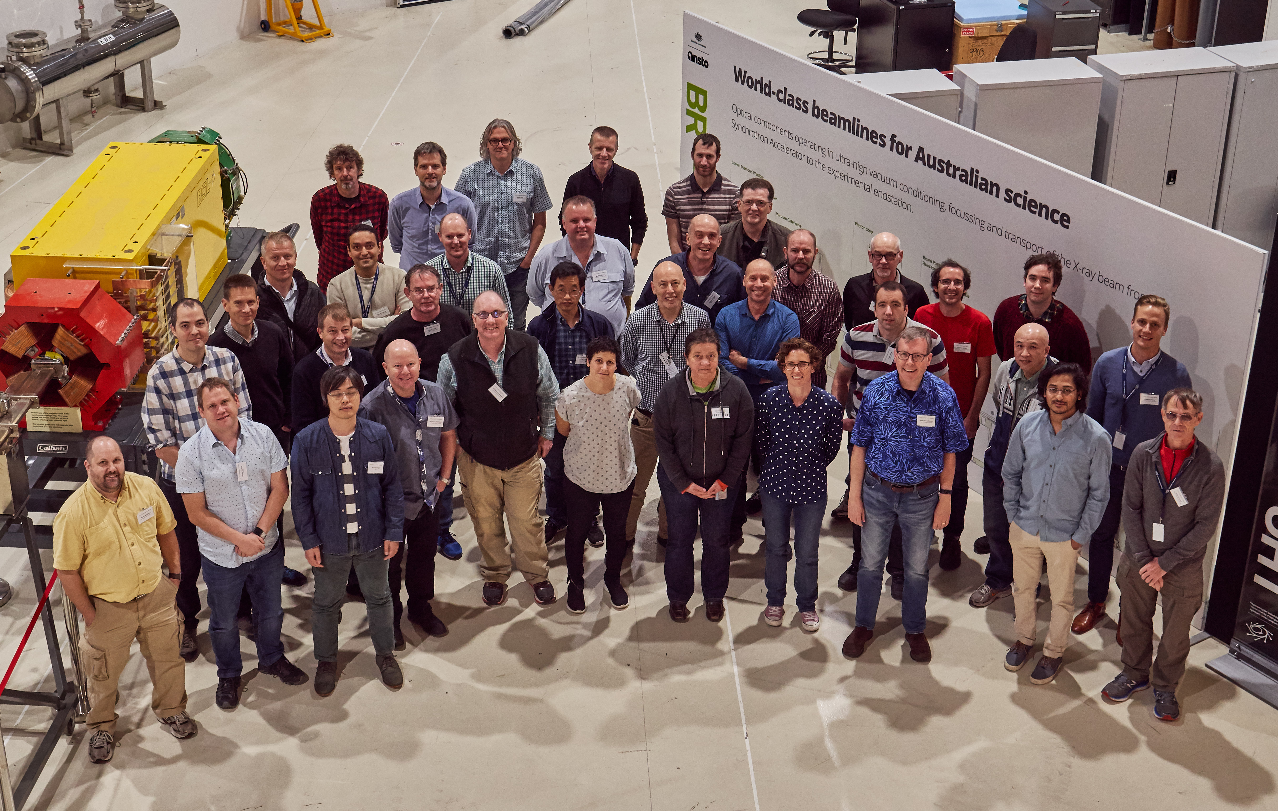
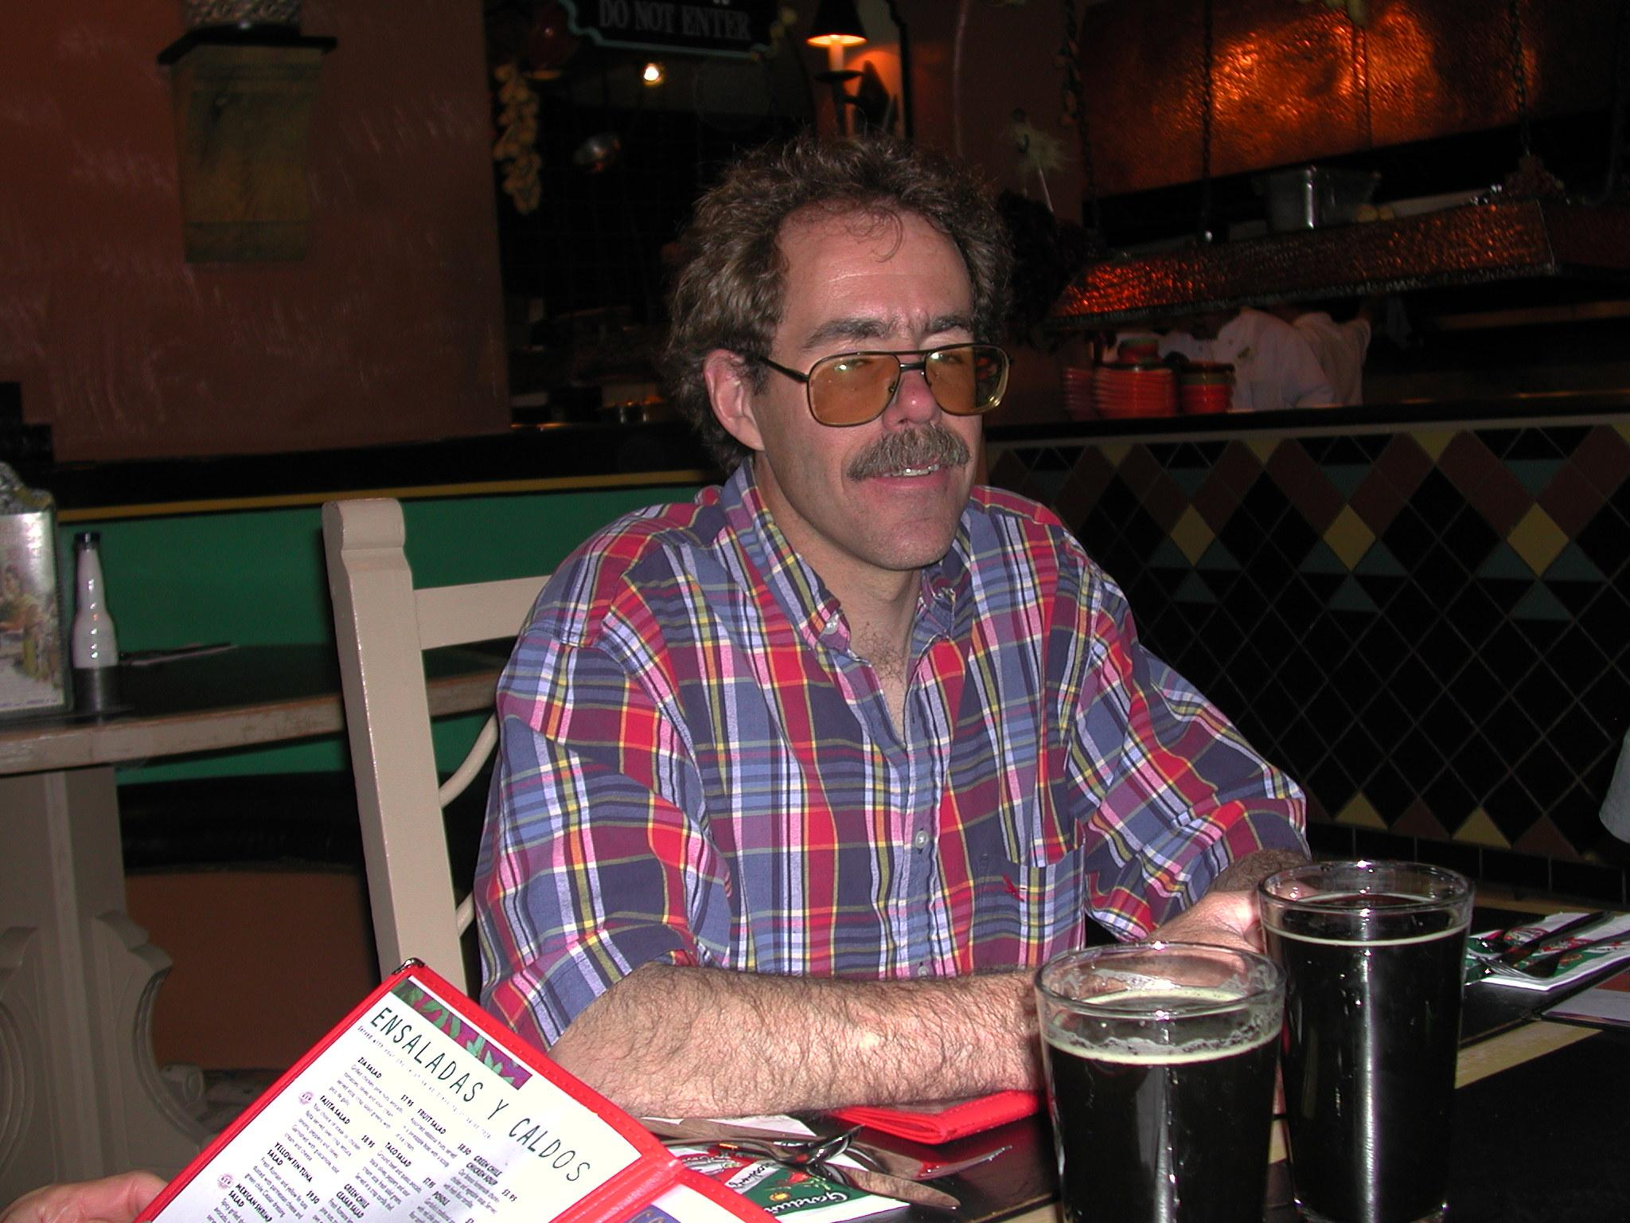
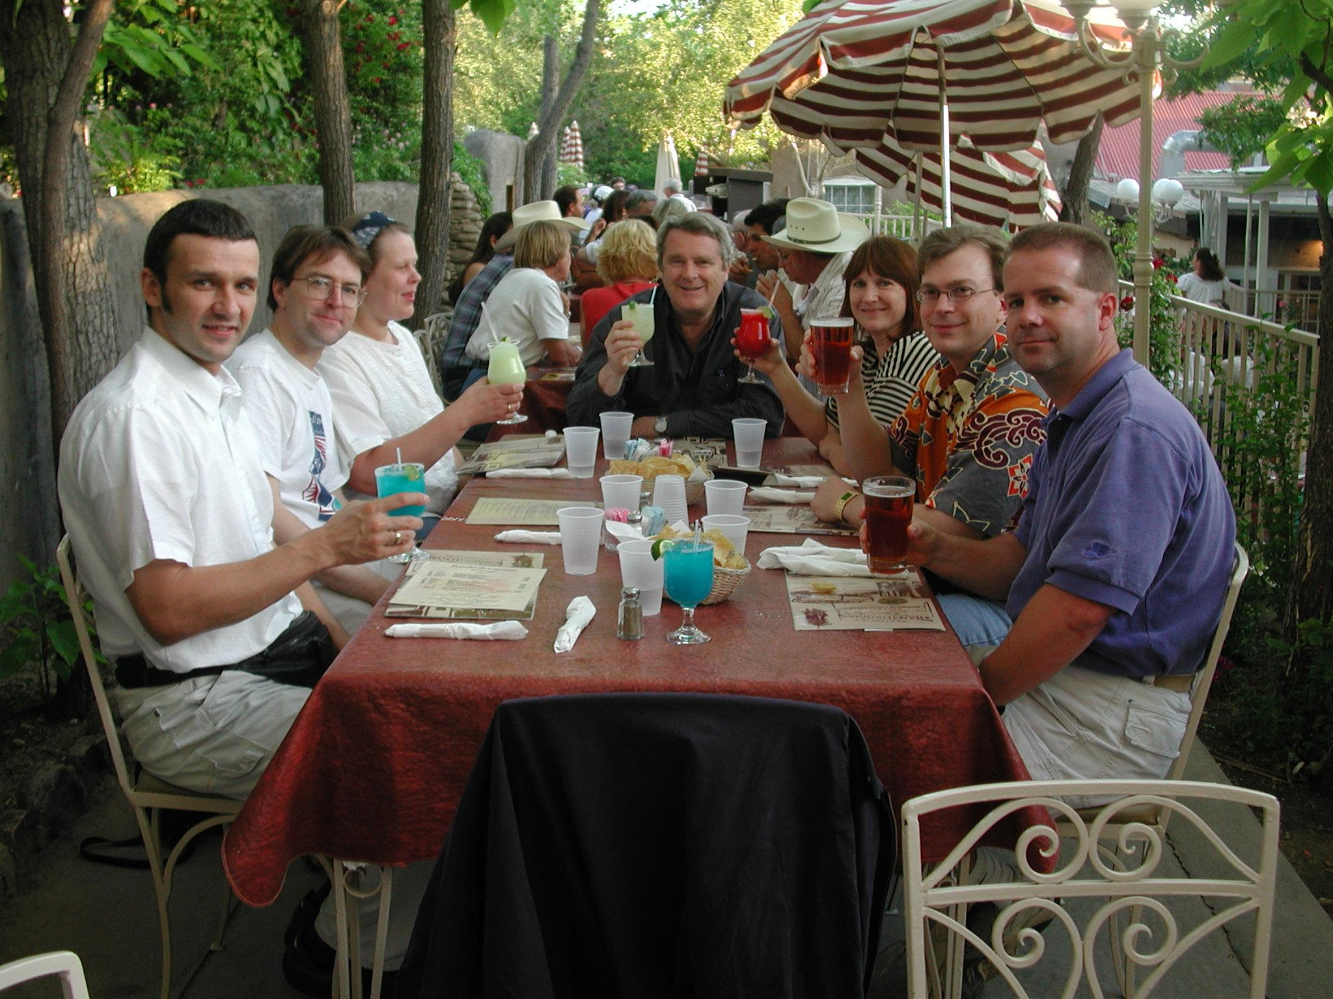
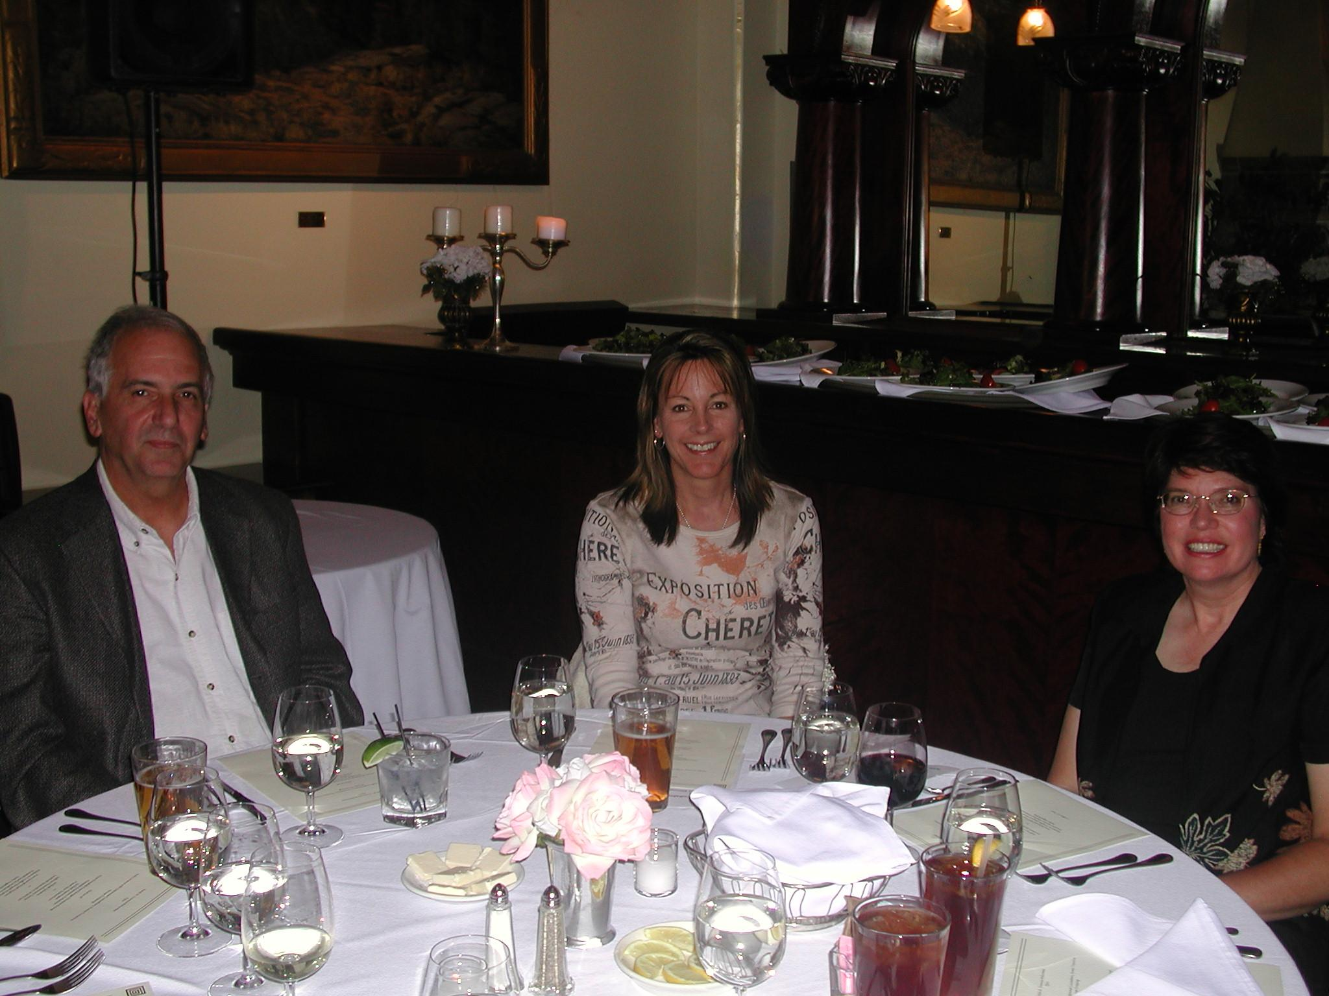
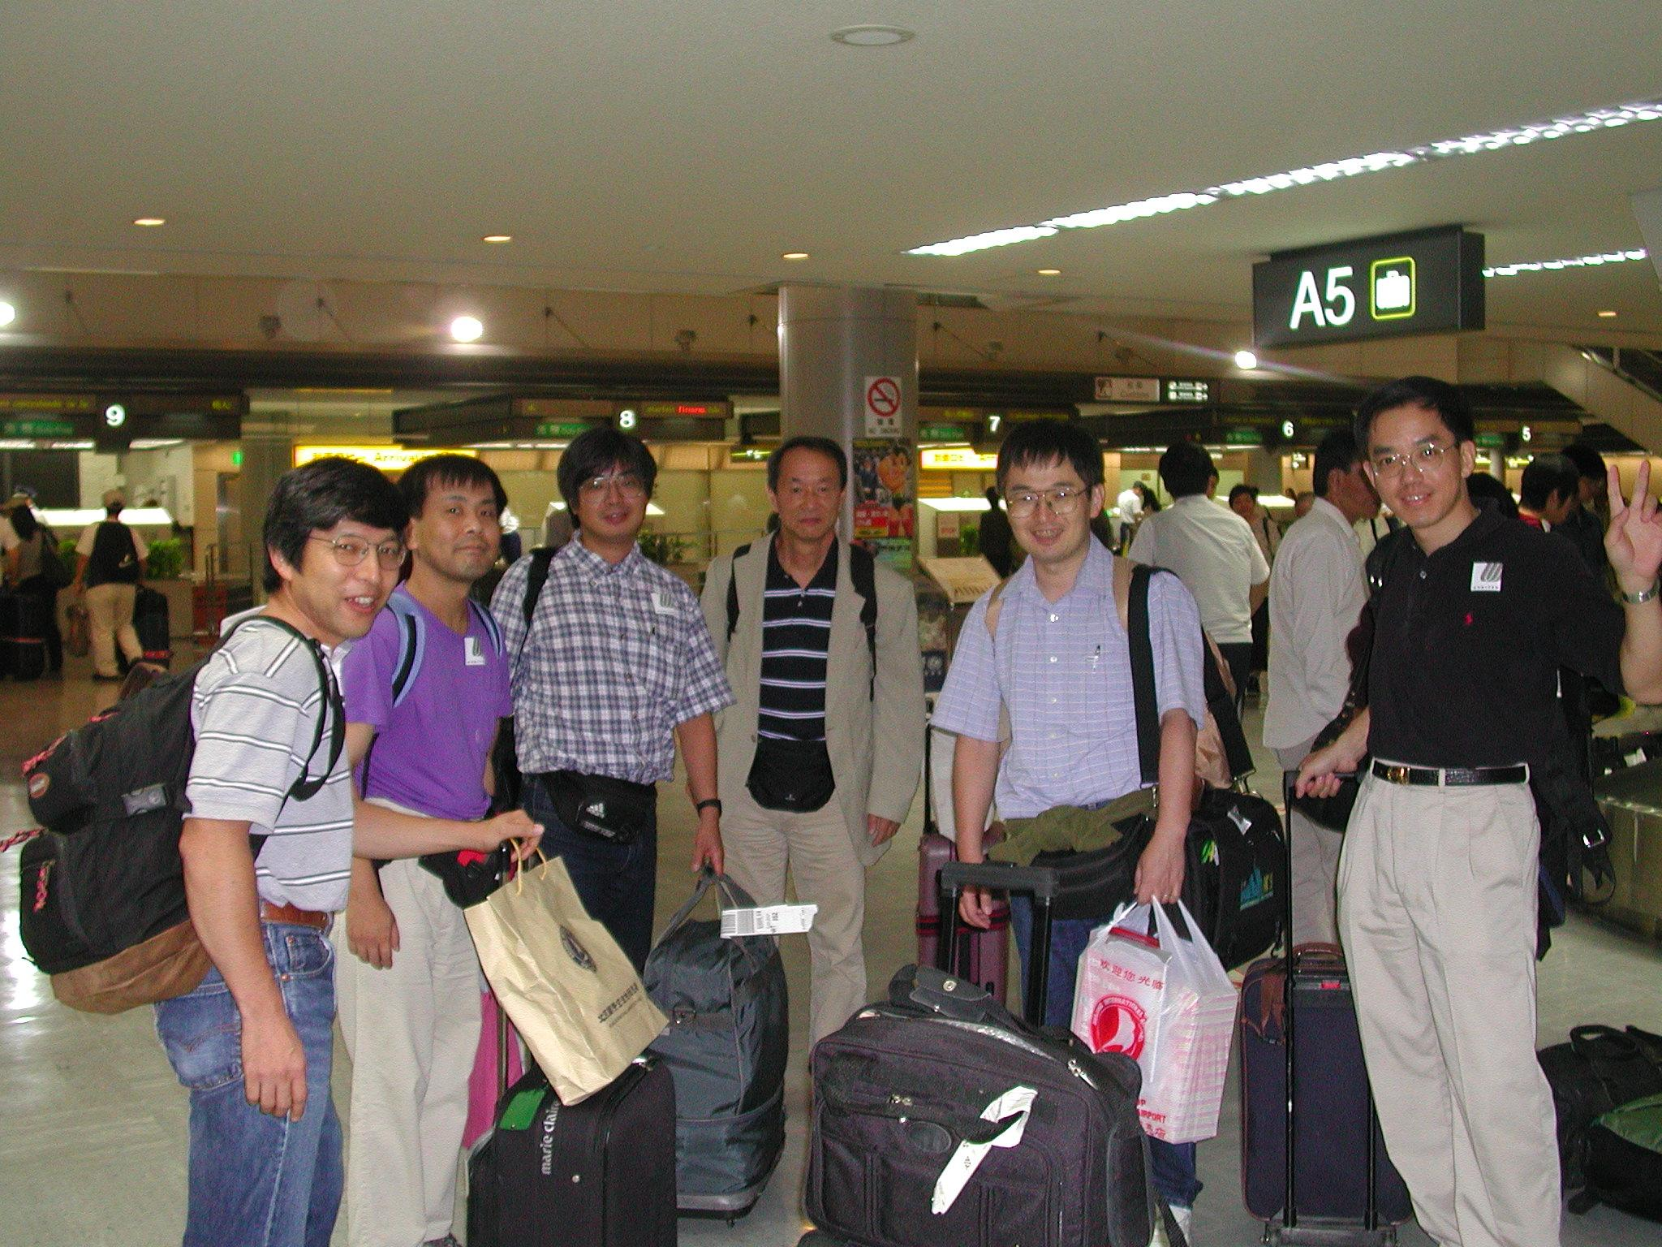
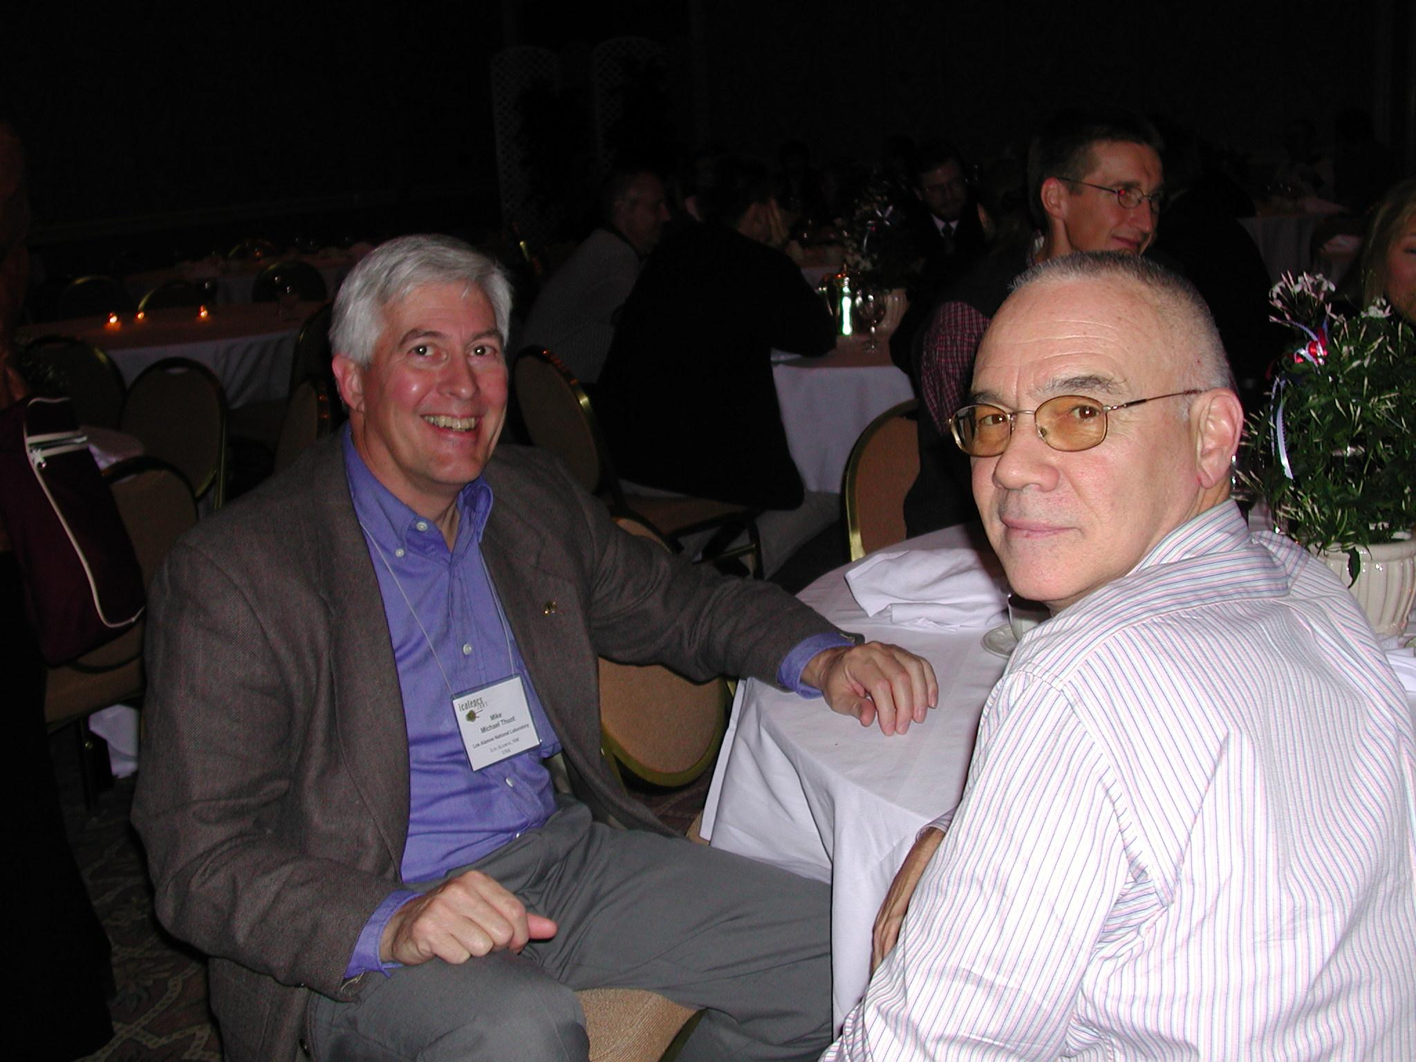
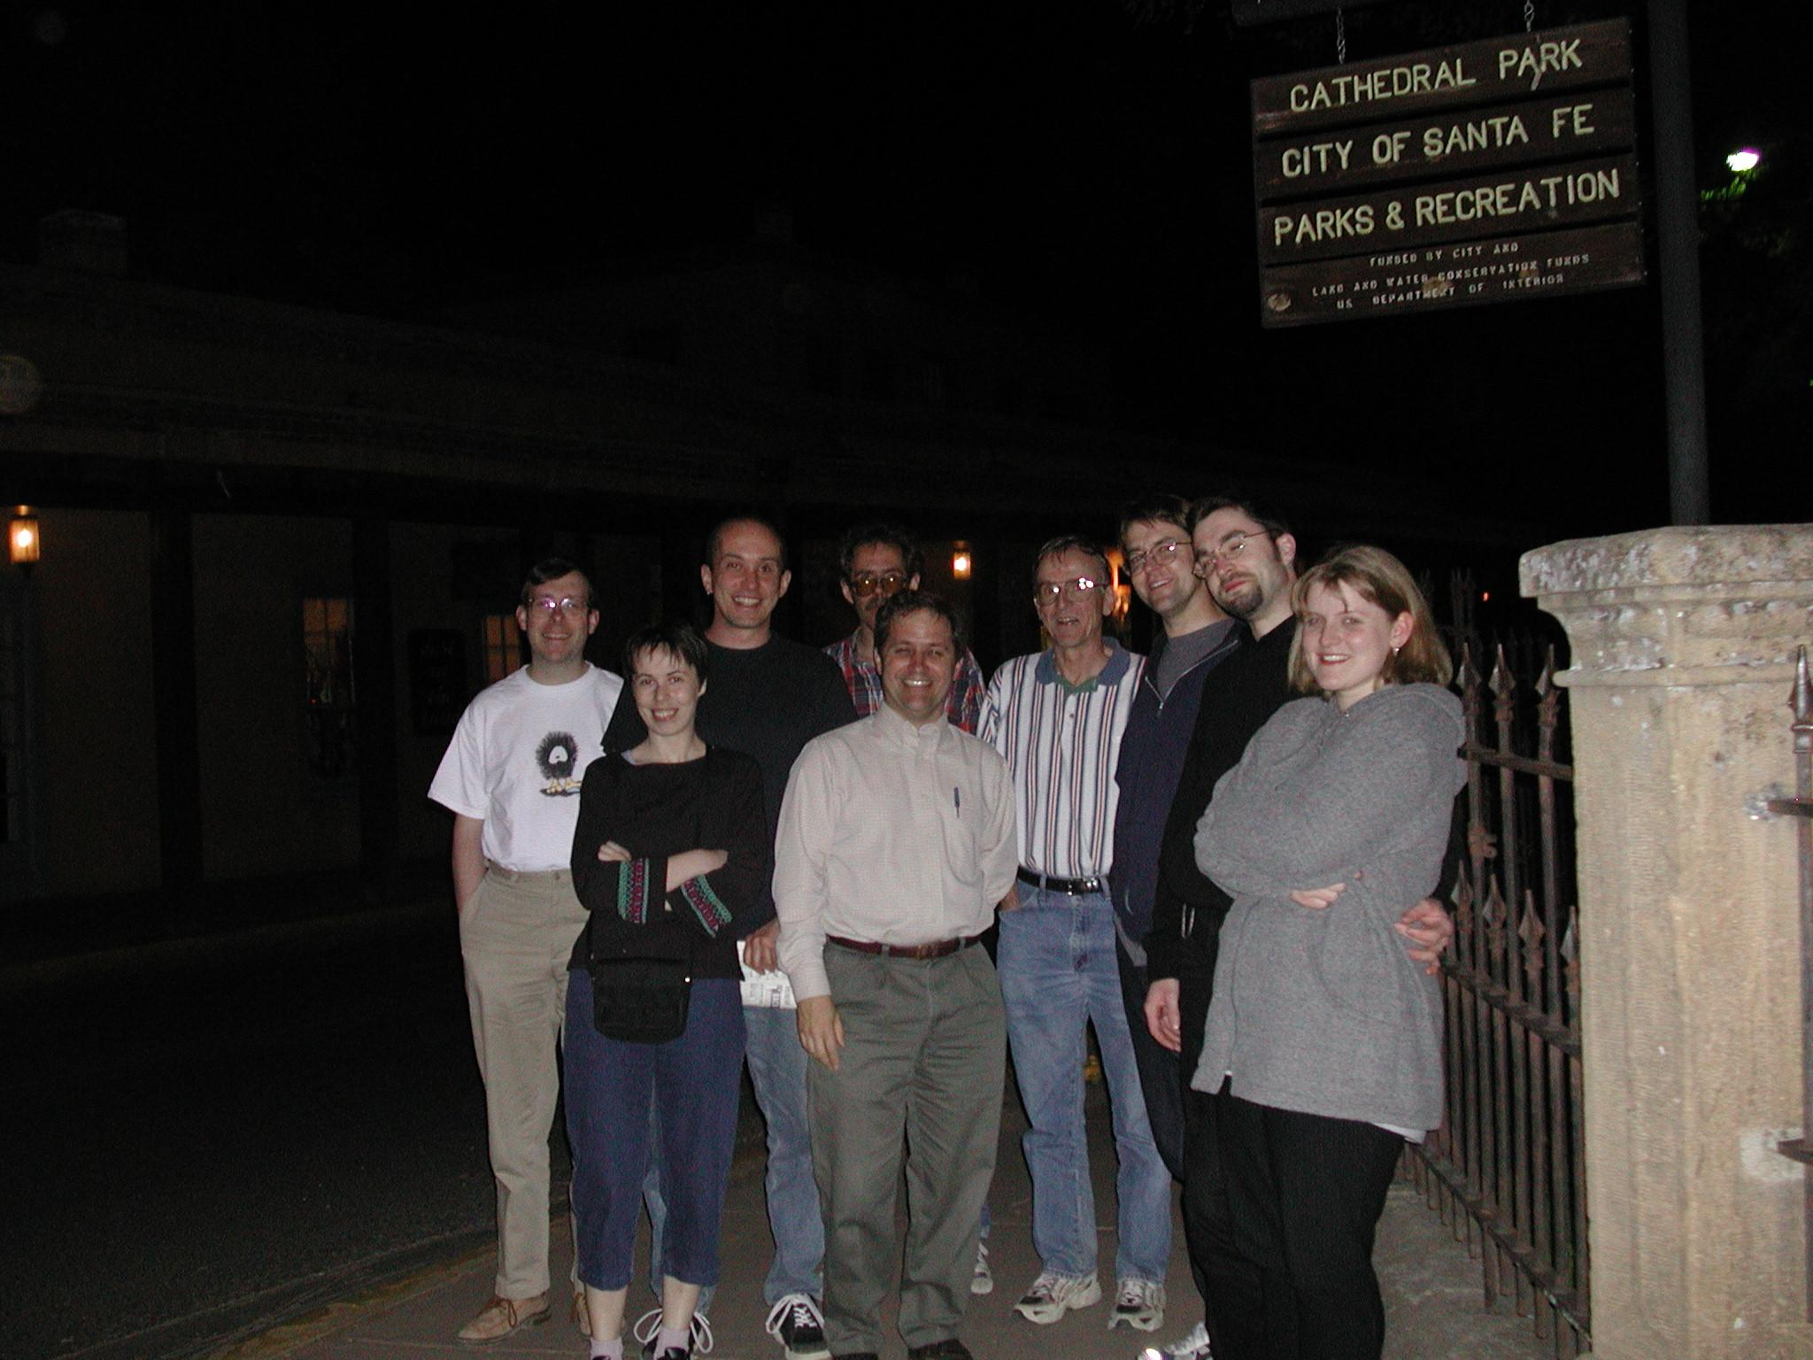
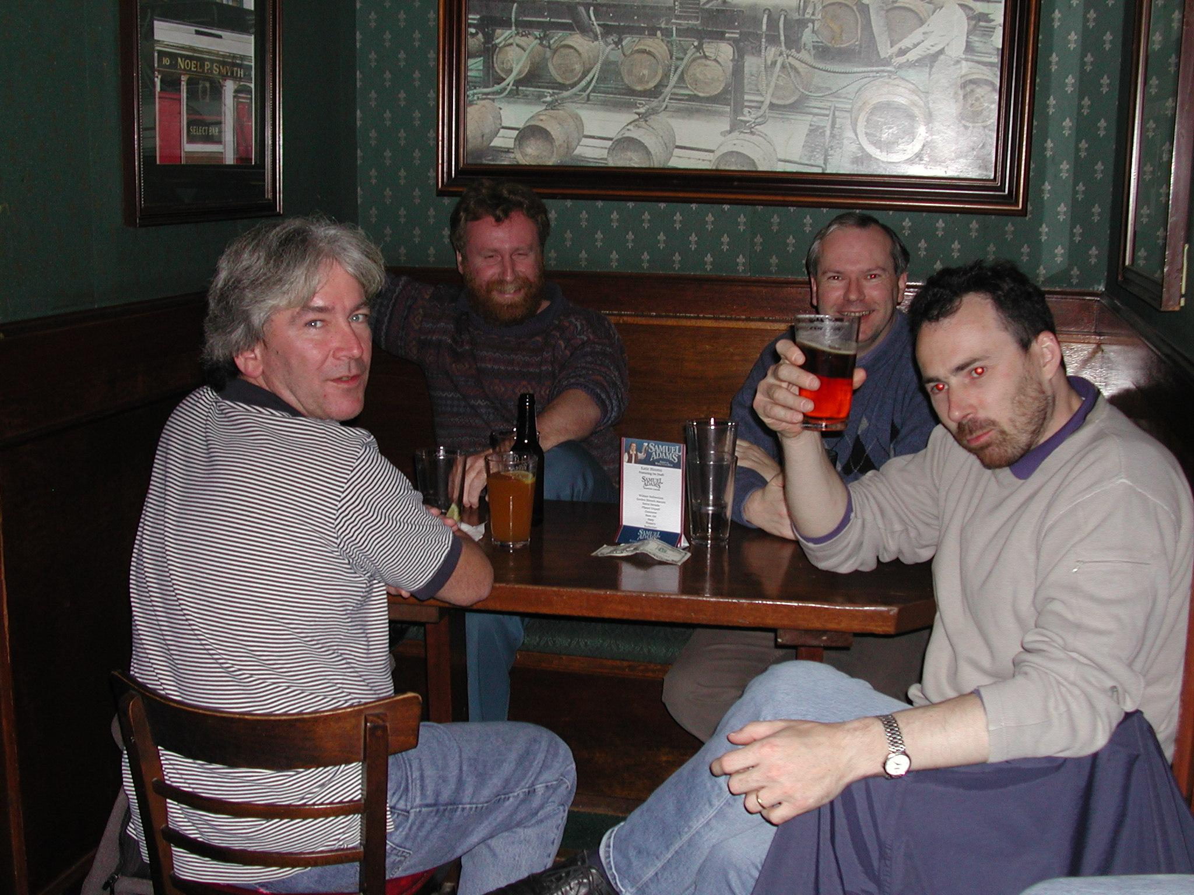
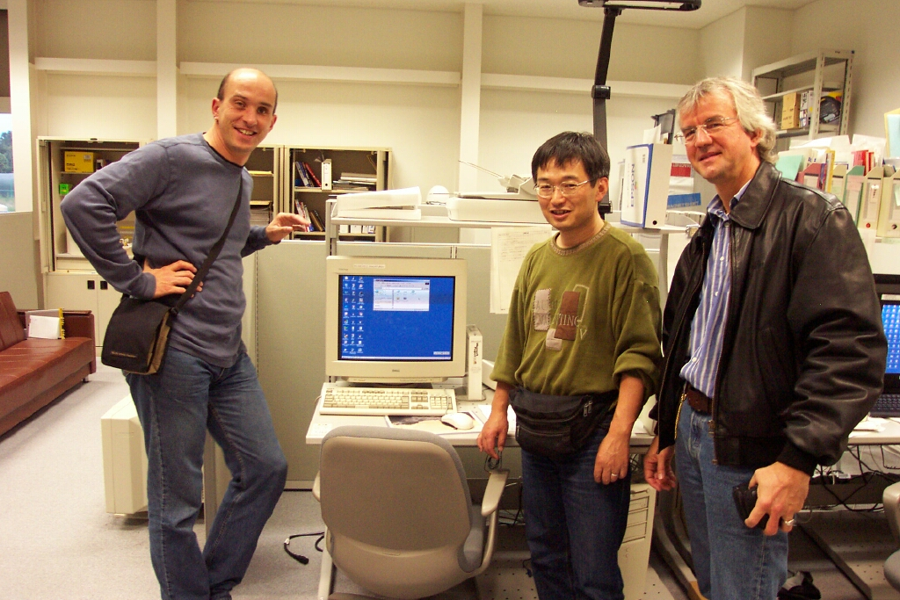
Collaboration - then
Notes:
From a small group of core developer’s a very large user community developed around EPICS version 3.
Many users interfaces were developed and many drivers.
Some major contributions after the release of EPICS 3.13 included:
Making EPICS OpenSource
Support of training throughout the community (mostly free)
EDM – synoptic Display Editor
Porting the EPICS IOC off of VxWorks
areaDetector for experimental data acquisition
Physics environments: Matlab Middle Layer Toolkit, SDDS and XAL
BEAST – Alarm Server
Archive Appliance
Control System Studio

Slide 13
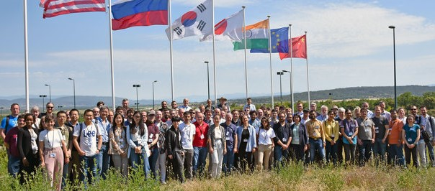
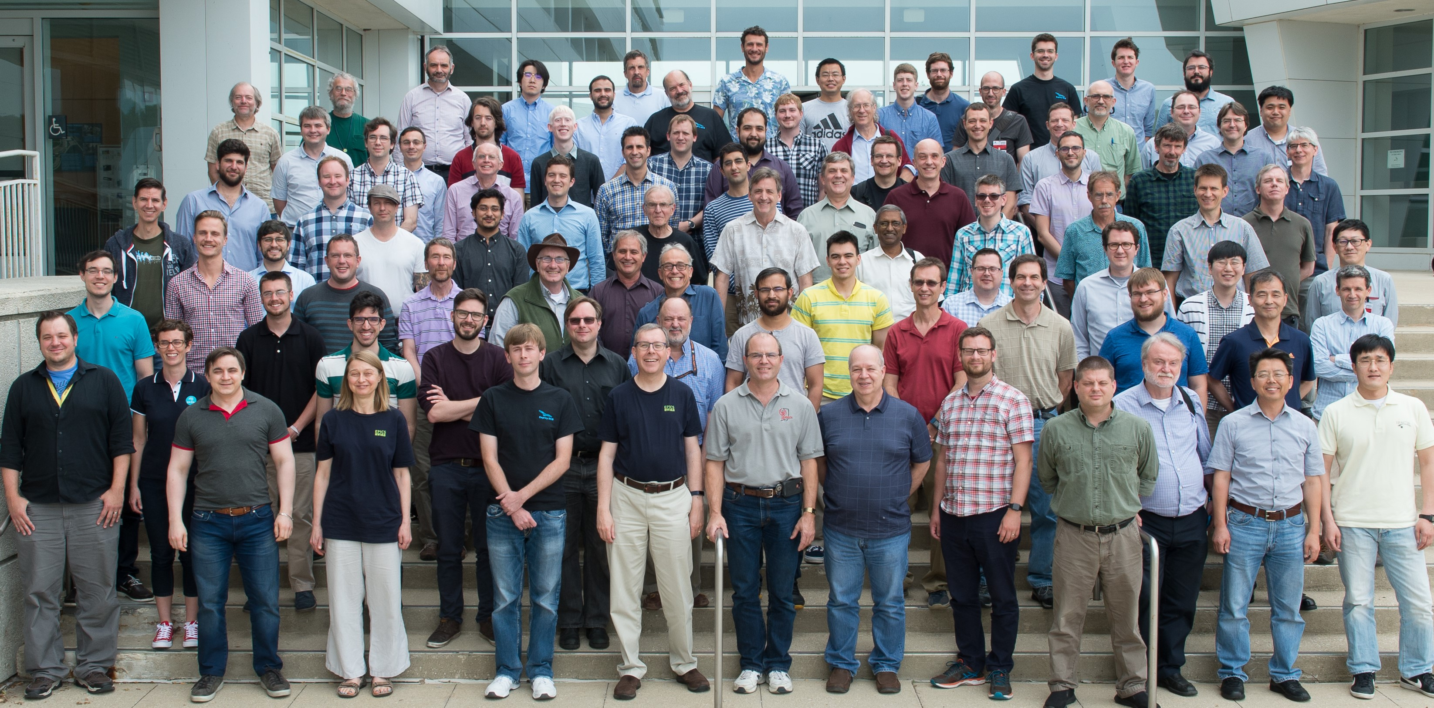
Collaboration and more recently
Notes:
The most recent three semiannual EPICS meetings continue to have robust attendance.

Slide 14
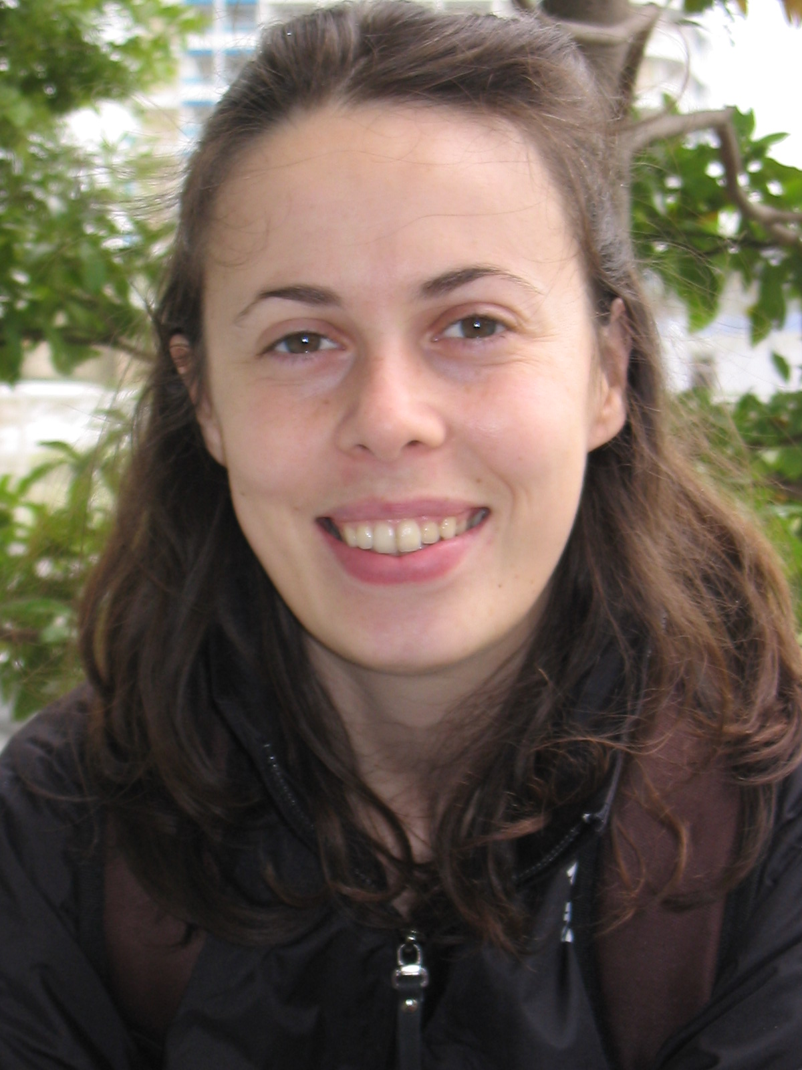
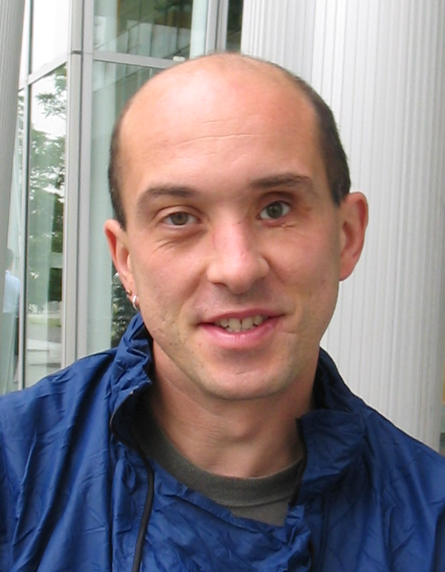
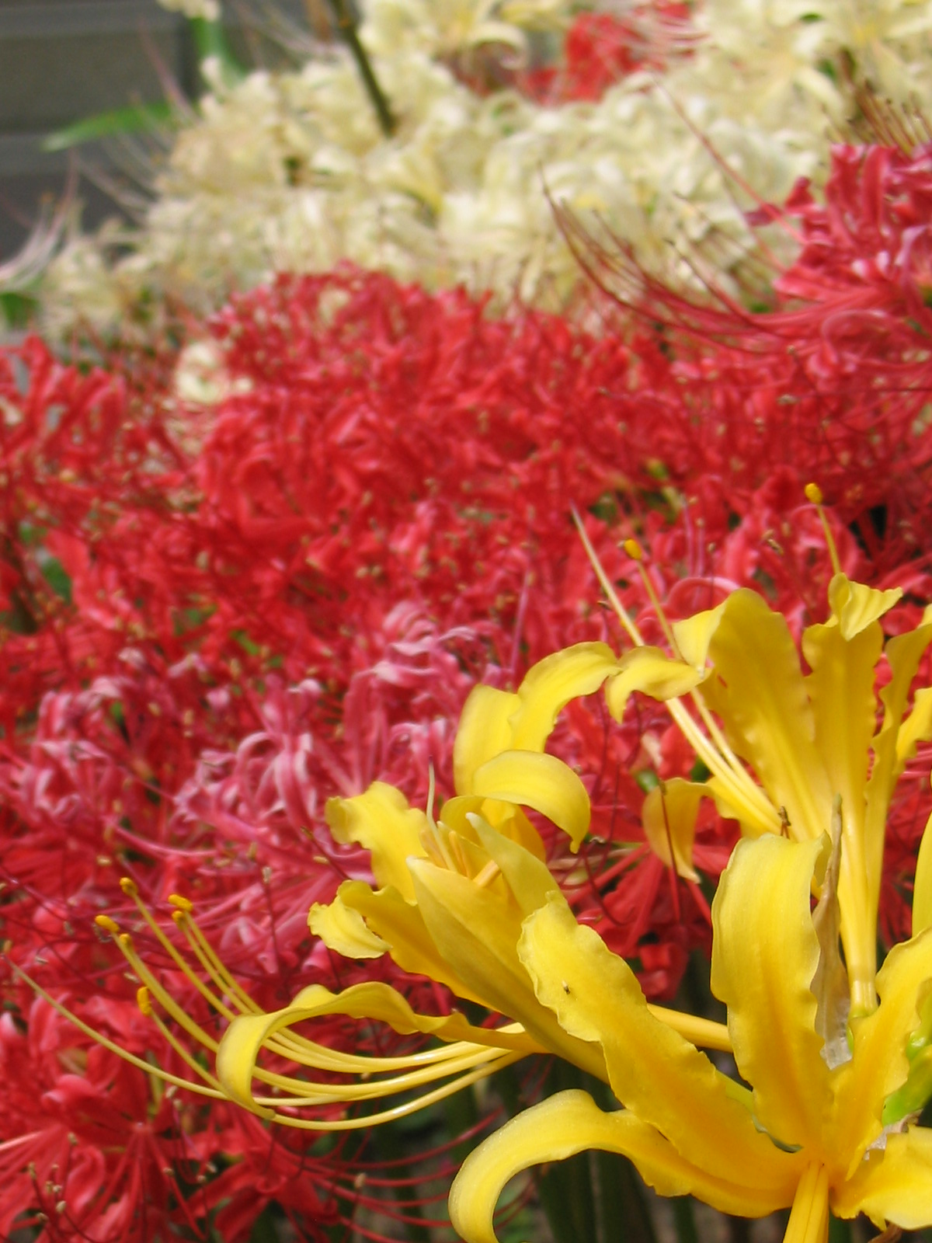
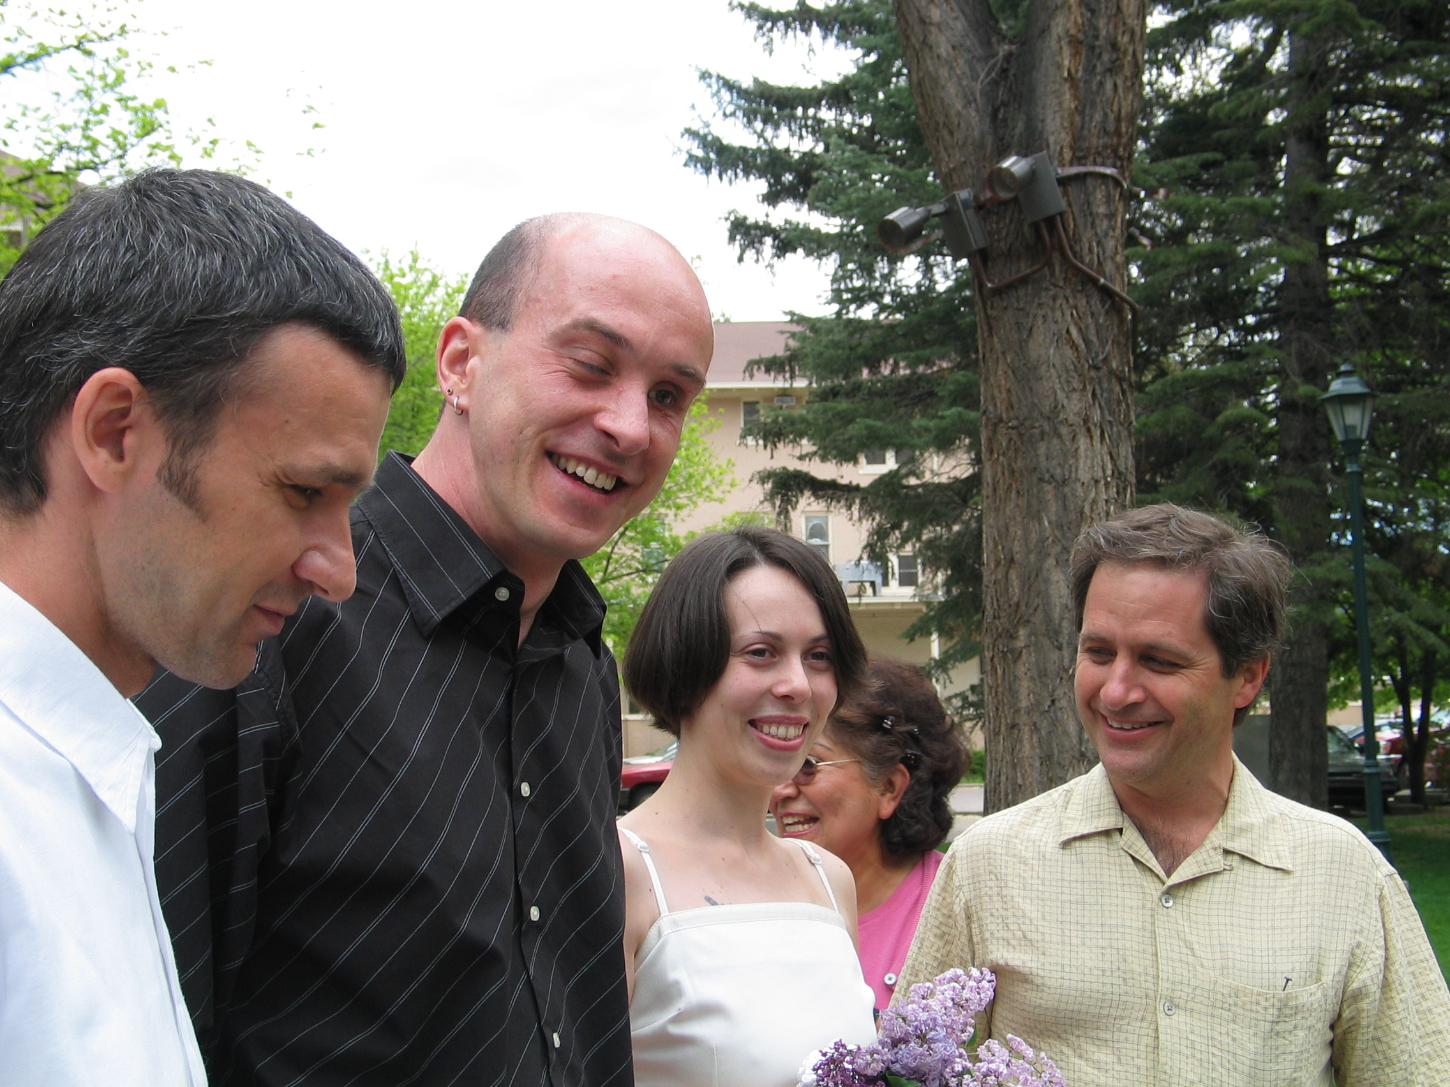
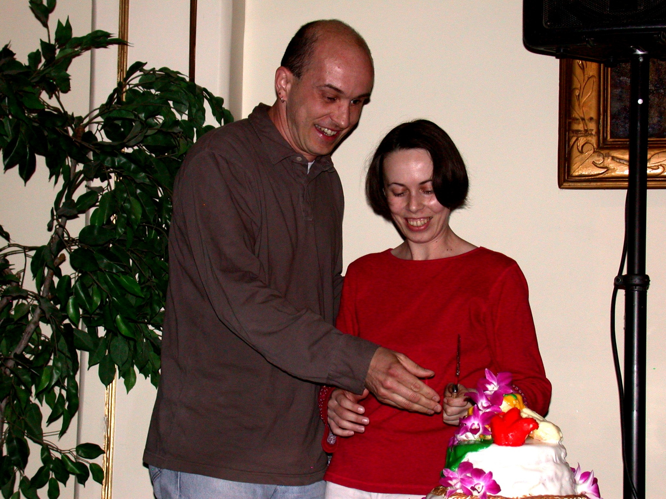
One Wedding!
May 2000 Japan
May 2004 Santa Fe

Slide 15

Collaboration Surviving Without A “Model”
Individuals, working diligently support the community. The primary reward is the comradery of their peers and awareness of the science that benefits from their efforts.
Developing, co-developing, sequentially developing, distributed testing, open online support, online training, meetings to discuss and learn.
.
Notes:
I don’ know Kay? Andrew? Where does this belong? Does it belong?

Slide 16
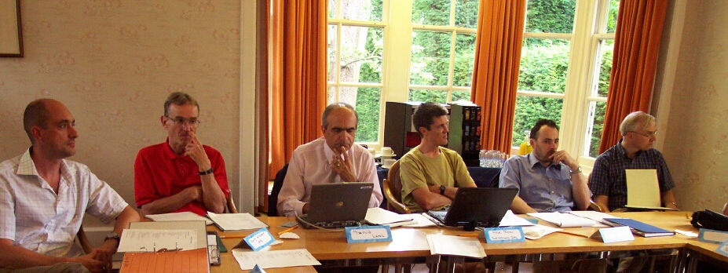
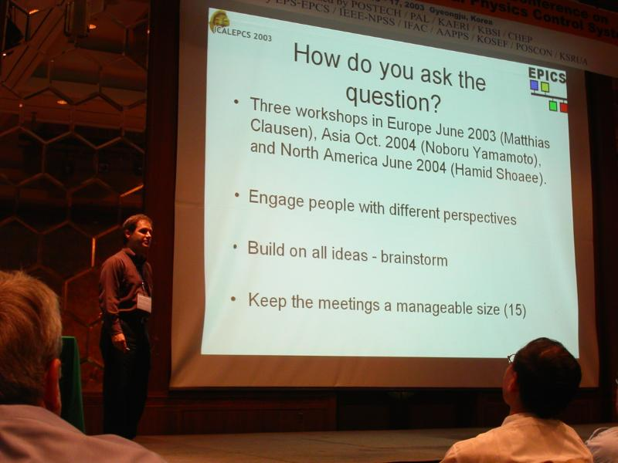
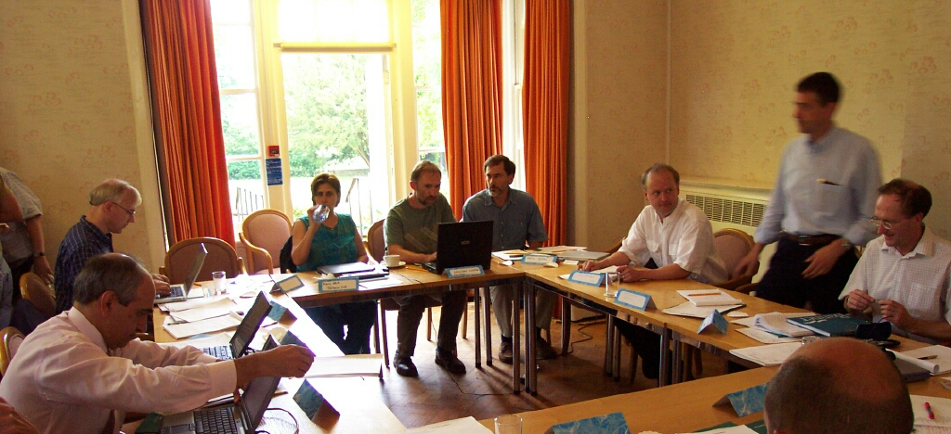
EPICS 2010 – Support fast instrumentation
EPICS V3 was frozen
What will EPICS look like in 2010?
It was clear that the requirements of the community were expanding
We did not want to throw away the things that worked.
Meetings were organized to brainstorm
Notes:
In 2003-2004 a series of meetings were organized to gather ideas for the next generation of EPICS.
System architects from the ICALEPCS community joined these meetings and freely shared their opinions and ideas. It included telescope and accelerator control system developers. Everyone was very generous with their time and open with their contributions.

Slide 17
There were lots of ideas –
Technology and Architecture
(1) Application Services
  Name-Service
  Logging-Service
  Archiving-Service
  Alarm-Service
  .....
  Application Framework
(2) EPICS-OO and Networking
  How much OO does EPICS need?
  Do we need a second network protocol?
    CORBA?
    DDS?
  If only one – which one?
(3) Managing and Creation of Databases
(4) EQS (EPICS Quick Startup)
(5) News on the use of Ethernet and intelligent I/O (collection wiki only)
Interest groups run dedicated wiki‘s
(Public Web pages)
Most Interest Groups have members outside the EPICS collaboration.
Notes:
I don’ know Kay? Andrew? Where does this belong? Does it belong?

Slide 18
Motivation Behind the Development of EPICS7
Upwardly Compatible with V3
Improve Ease to Expand Data Types
Send Meta-Data Efficiently
Support Middle Layer Services: Directory, SnapShot etc..
Expand MetaData to Support High Rate Data:
  N Dim Arrays
  Tables
  Statistical Samples
Improve Time Stamp and Alarm MetaData

Slide 19
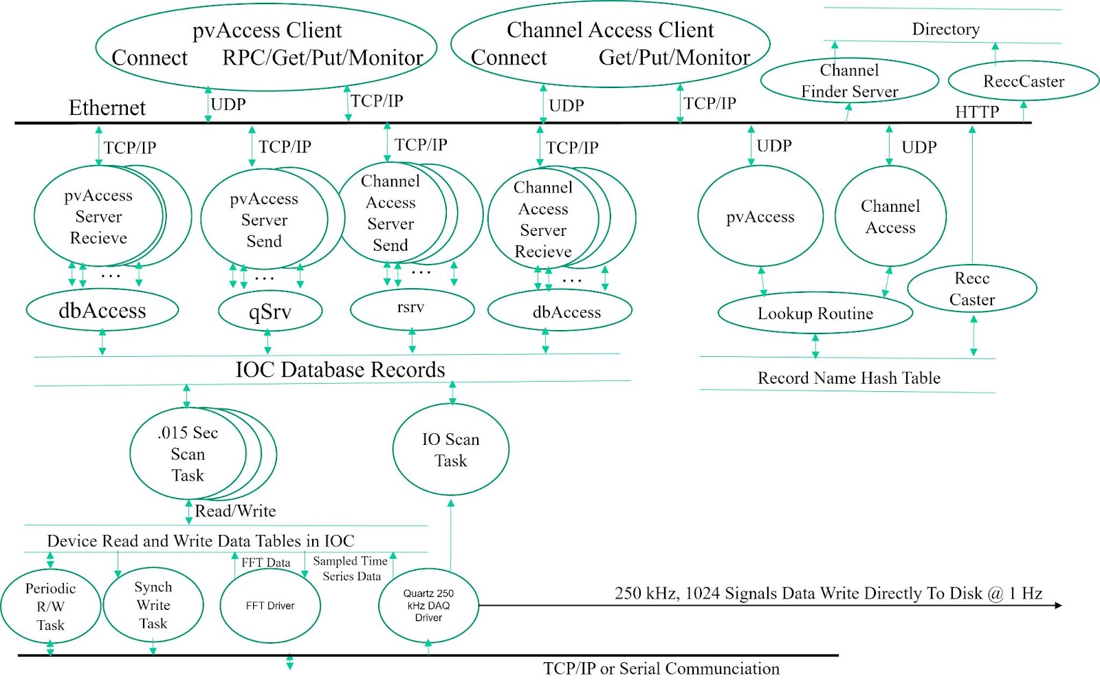
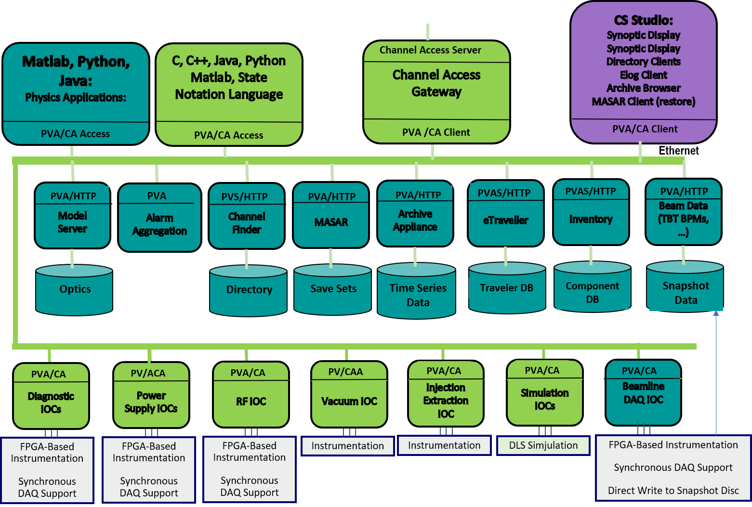
Architecture Now Supports Detectors, FPGA and Middle Layer Services
Show areaDetector
Notes:
Throughout the years applications built in areaDetector to support data acquisition of 2D detectors as well as some bam diagnostics and environments for physics applications exposed areas where the next version of EPICS did not provide adequate support.
pvAccess and pvData support communication mechanisms to support database queries and tables that allow us to develop Middle Layer Services. These are used to provide modular data sources for different aspects of physics applications.
pvAccess also has NDArrays and statistical sampleds that support DAQ. Modifications planned to the EPICS database will support thes as standard record types

Slide 20
Conclusions – after 40 years in scientific systems……
Technologies change every 10 years or so….
Architecture is more important than technologies (which come and goes like fashion – but a bit slower). Good architecture encourages collaboration.
People are more important than architecture.
A community of engineers produces better results than a single team with a single funding source or “One person can go faster – a community of people can go further” restating … Katy Saintin’s statement

Slide 21
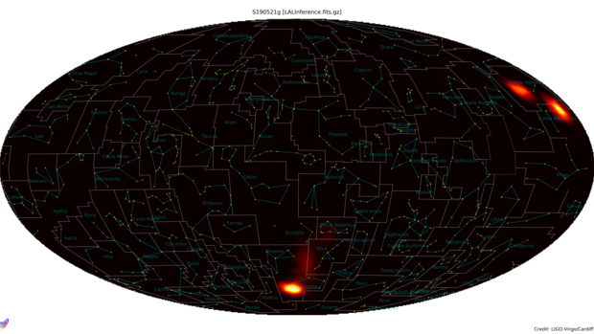
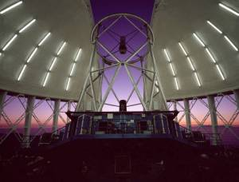
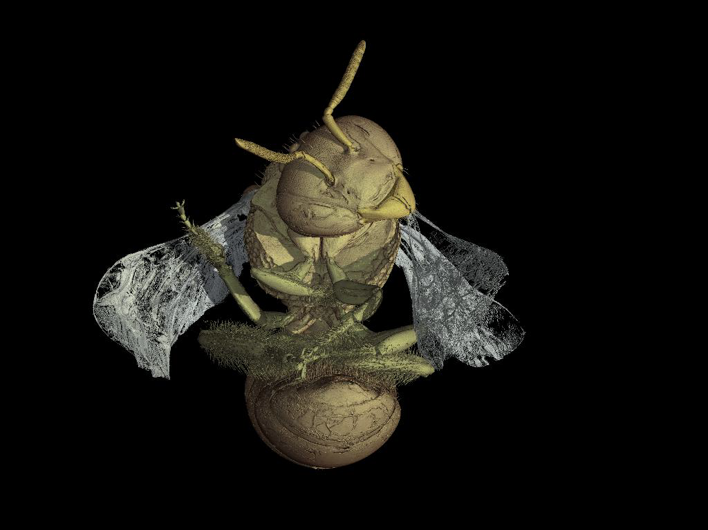
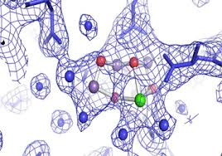
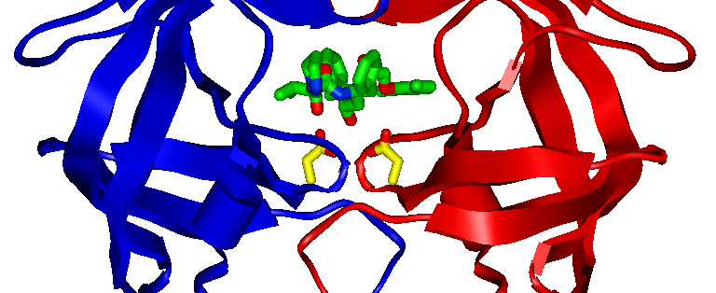
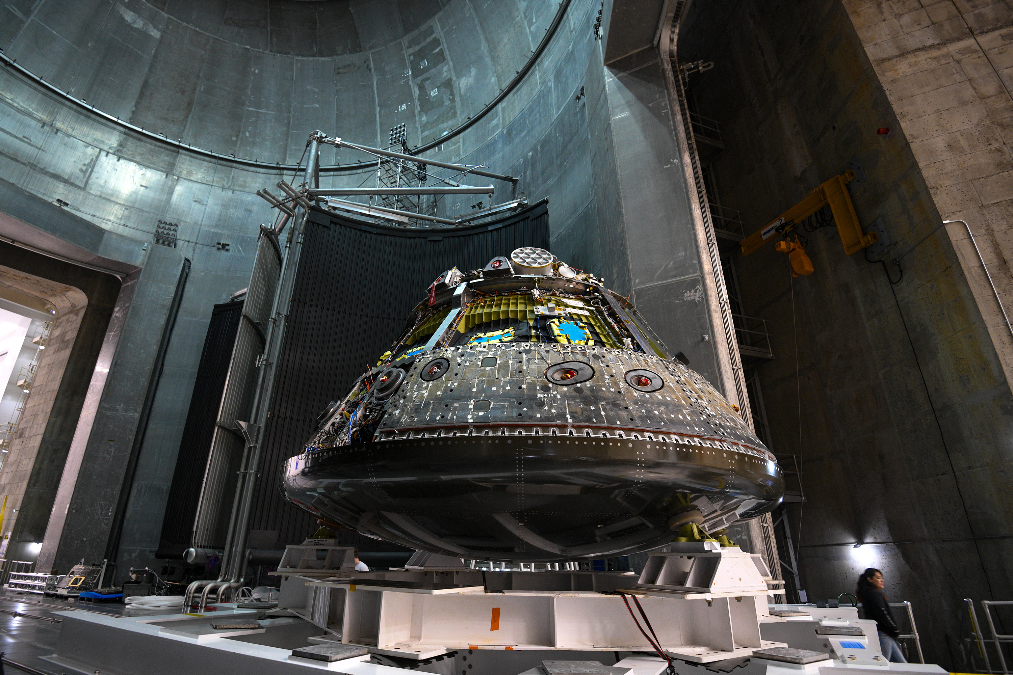
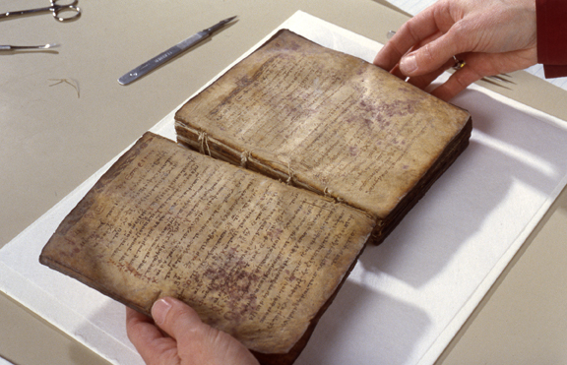
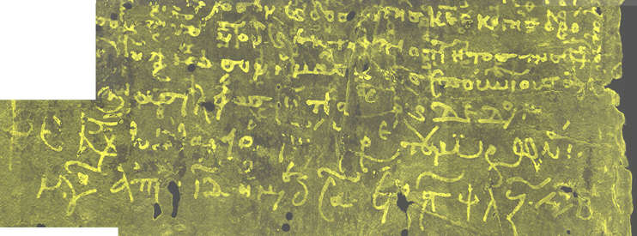
Our work enables discovery!
Gravitational Wave Astro-physics predicted by Einstein
Relativity
Notes:
The purpose of out work is to provide technology that support scientific discovery. New electronics and devices enable us to sample data at 100s of MHz and close control loops at 10 kHz greatly improving the quality of information that is available to the state of the art facilities and experiments that are on the Fortier of scientific exploration.

