Slide 1
Update from Science Board
Science Board has been split into two:
PPAN Particle Physics, Astronomy and Nuclear Physics: will provide STFC with strategic scientific advice on, and assessment of, the STFC (Particle Physics, Astronomy and Nuclear Physics) PPAN programme, which includes particle astrophysics, space science and the accelerator and computational requirements of the science programmes.
Dave Ireland has just completed his 6 year term and Dave Jenkins has joined the board.
I started on the board in Jan 2024.
(Dave I will attend the prioritisation meeting as an ‘observer’)
Facilities and Laboratories: provides advice and guidance to STFC on:
STFC-supported national and international multidisciplinary facilities
the STFC National Laboratories
related technologies, including accelerators and computing
There is a natural overlap and the boards do have regular joint meetings.

Slide 2
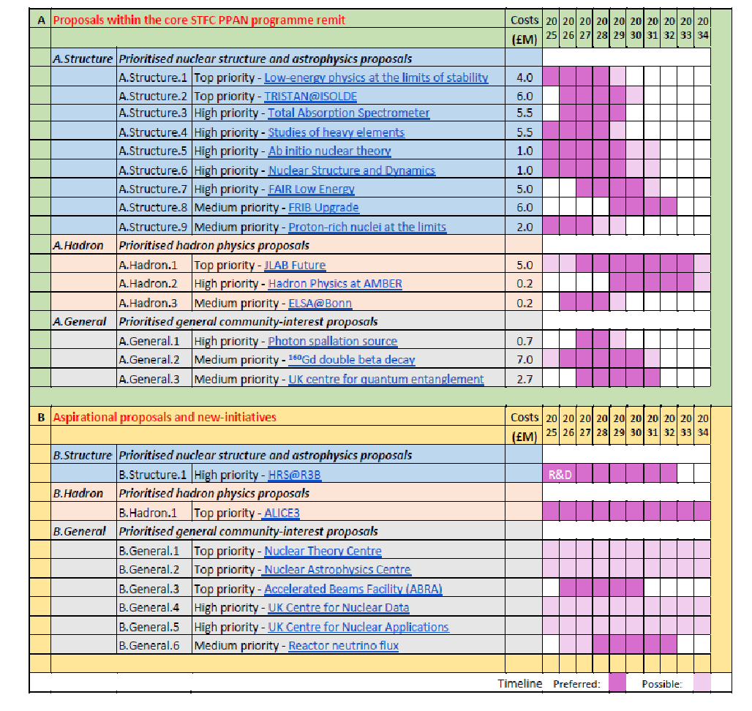
Development of the roadmap:
Detailed submission received from NPAP
which has fed into the process.
Next step is to discuss prioritisation across PPAN.
This will be the main work of the March meeting.
Note however that this will be a live document which will be reviewed/revised/updated at regular intervals.

Slide 3
Nuclear theory centre:
Following discussion at science board, an initiativ was received to consider including nuclear theory in the
Institute for Particle Physics Phenomenology (IPPP) at Durham …this would be additional positions and not
intended to replace theory provision in the current CG.
Dave Ireland gave an overview of the NP programme at the December annual IPPP meeting..well received and generated some discussion.
Next step..gauge interest in having a workshop to explore possibilities and overlaps ..open to both theorists and experimantalists (and all encouraged to attend).
Presentation from IPPP at the IoP in Manchester.

