Slide 1
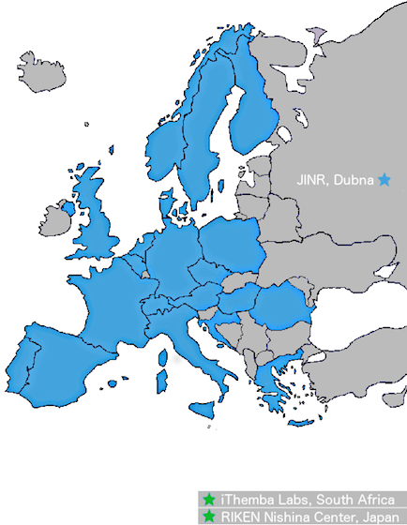
Update from NuPECC
Rodi Herzberg
Community Meeting, IoP, 9th January 2025

Slide 2
NuPECC Objectives
The objective of NuPECC is to strengthen European Collaboration in nuclear science through the promotion of nuclear physics, and its transdisciplinary use and application in collaborative ventures between research groups within Europe.
In pursuing this objective, the Committee shall:
define a network of complementary facilities within Europe and encourage the optimisation of their usage;
provide a forum for the discussion of the provision of future facilities and instrumentation;
provide advice, and make recommendations on the development, organisation, and support of European nuclear research and of particular projects.
Notes:
New diagram representing interlocking scientific areas, permeated by theory.

Slide 3
Terms of Reference
Adapted to changing realities in 2018:
More Observers
ESF - EPS-DNP - ECFA - APPEC - NSAC - ANPhA - CINP - ALAFNA - IAEA - EPS-HEPP
More Associated Members
iThemba - RIKEN - Israel - CERN
More Institutional Members
ECT* - FAIR - SPIRAL2 - JINR (temporarily suspended) - MYRRHA - ELI-NP
See www.nupecc.org
Notes:
New Terms are on the NuPECC website. Most changes necessary because of changes in relationship with ESF and much expanded Observers and Associated Members.

Slide 4
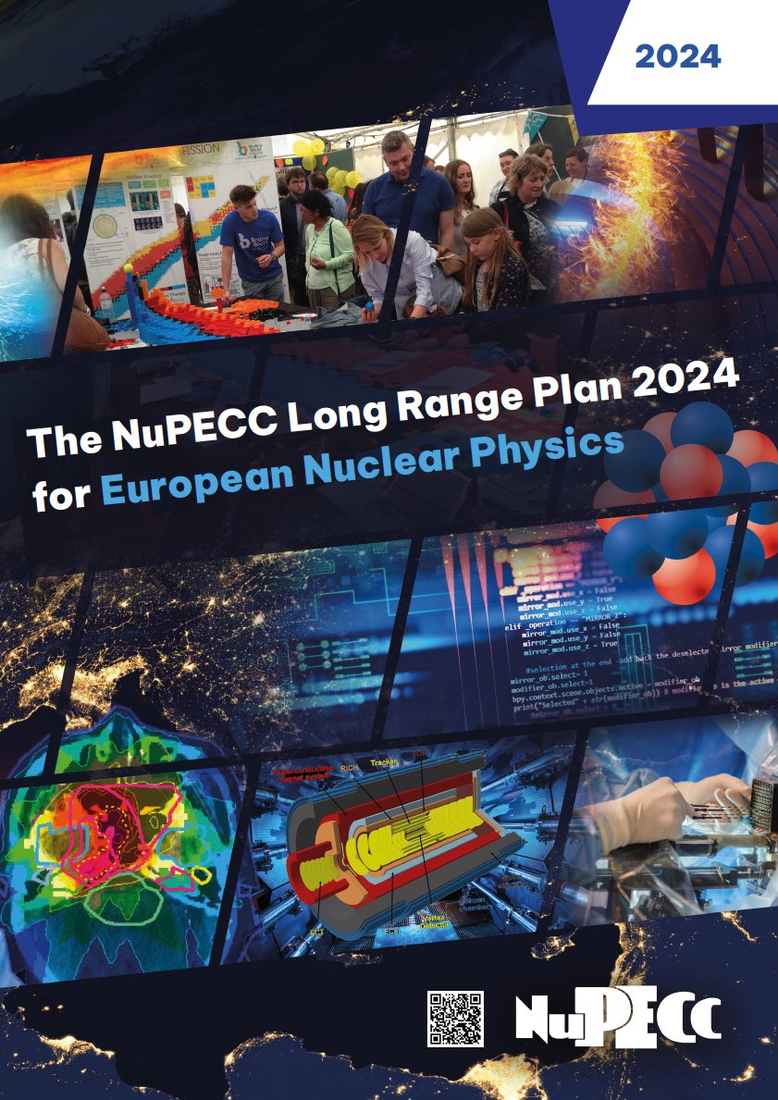
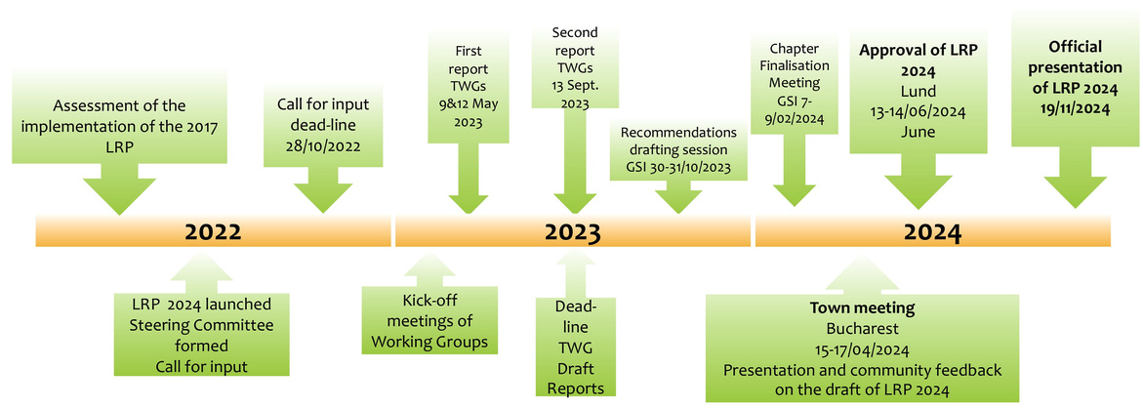
Long Range Plan 2024
Presented in Brussels 19th Nov 2024
Available at nupecc.org
Assessment of Outcomes from last time
Glossy Brochure available
Several new chapters

Slide 5
New Chapters
Discover NuPECC’s Long Range Plan 2024 at
https://www.nupecc.org/lrp2024/Documents/nupecc_lrp2024.pdf
Nuclear Physics Tools
Detectors and Experimental Techniques Computing, Artificial Intelligence, Machine Learning and Quantum Computing
Open Science and Data
Nuclear Science – People and Society
Outreach – Training – Education – Diversity – Careers

Slide 6
NuPECC Forum For Early career Researchers: NuFFER
nuffer.web.cern.ch
Mission
NuFFER operates guided by three principles - to:
Support early-career researchers in nuclear physics across Europe
Represent their needs and interests in the NuPECC decision making
Inform them about opportunities for development
Plan
NuFFER's action plan includes:
Online and in-person events to bring together ECRs across Europe and build a community.
Workshops dedicated to the personal and professional development of ECRs, including their career opportunities within and outside academia.
Questionnaires designed to gather the opinions of ECRs on topics of importance in the European nuclear physics community
Chair
Annika Thiel (Bonn)
UK Reps
Rachel Montgomery (Glasgow)
Jacob Heery (Surrey)

Slide 7
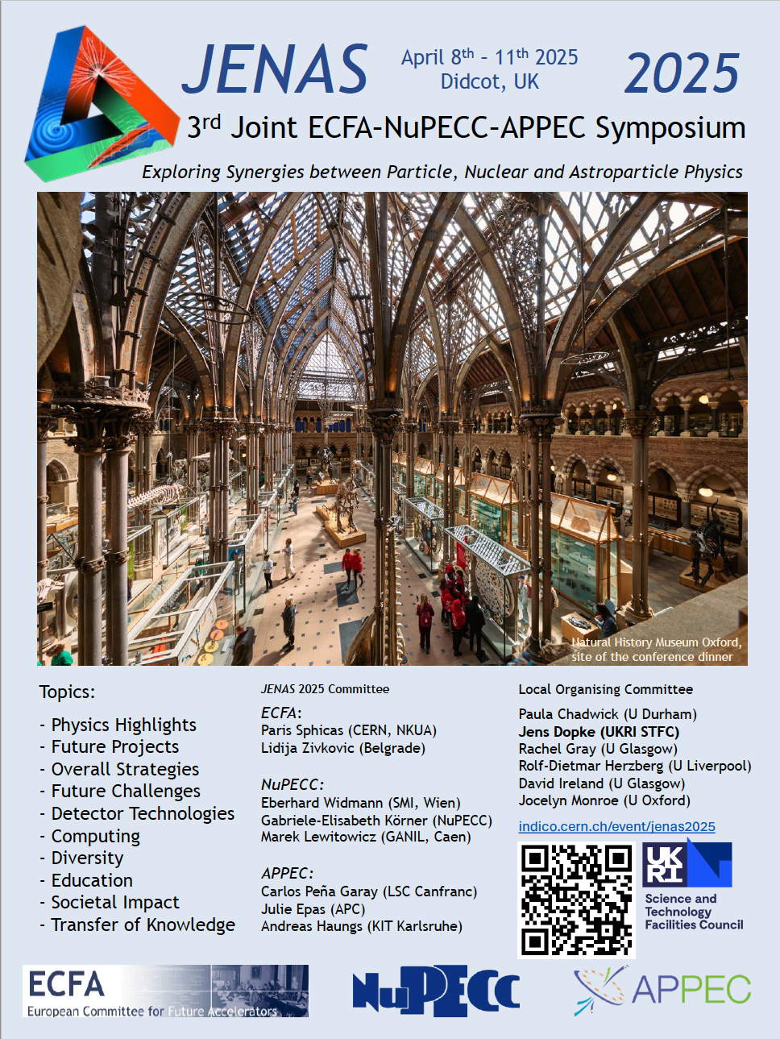
JENAS 2025
Previous meetings in 2019 in Orsay and 2022 in Madrid
Following the joint IoP in Liverpool David Ireland and I applied
for the JENAS 2025 meeting and got it, to be held at RAL.
8-11 April 2025

Slide 8
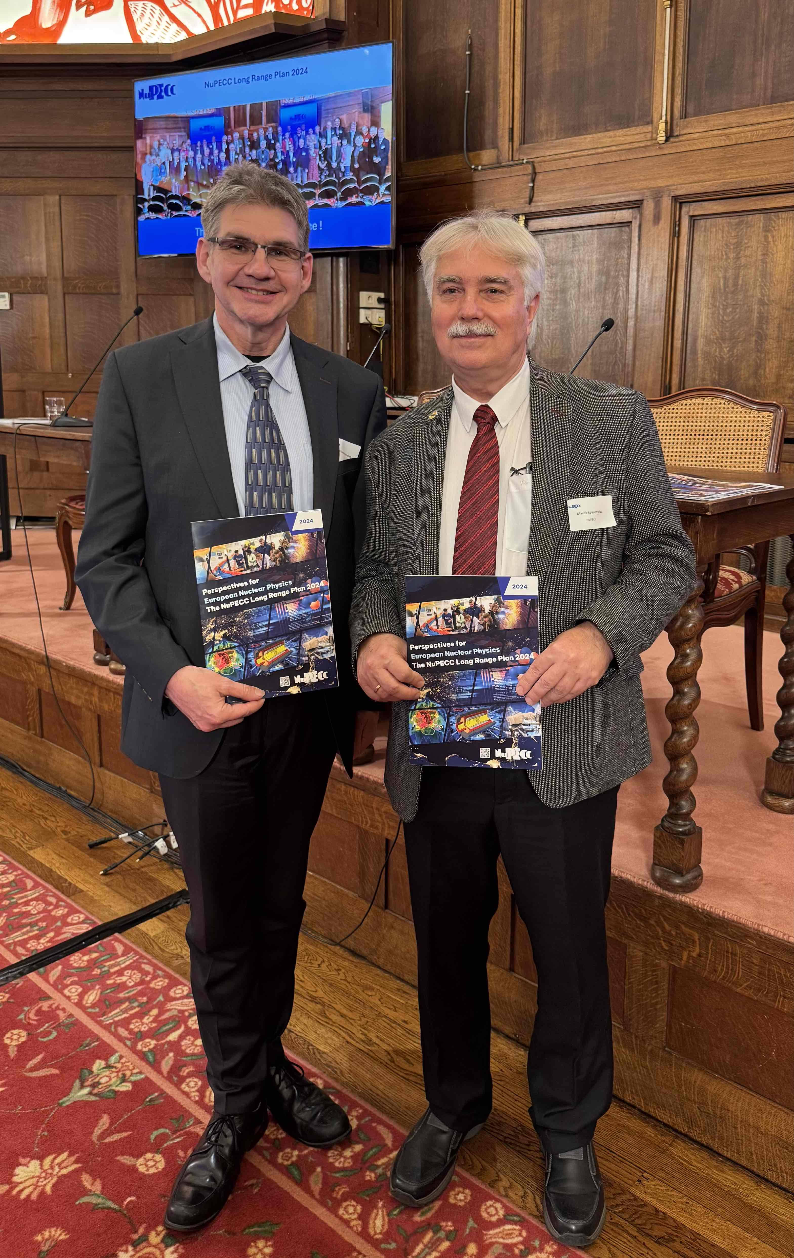
Membership
Eberhard Widman (SMI Vienna) is the new chair from Dec 5th
My term ended on Dec 31st after seeing two Long Range Plans to fruition.
Thank you for your confidence and support!
I will be replaced by Paul Stevenson (Surrey). Congratulations!
David Ireland will remain in post for another year.

