Slide 1
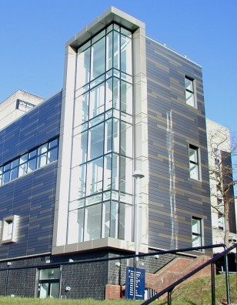
Beamline optimisation updates

Slide 2
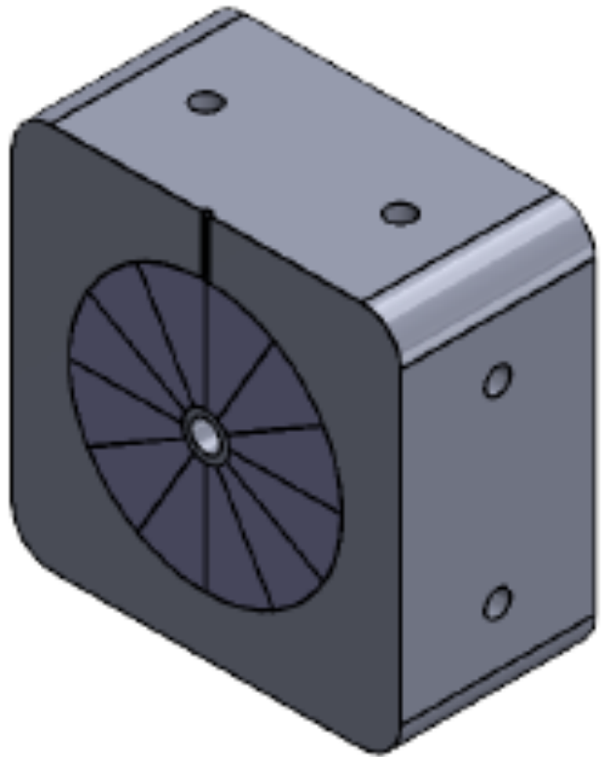
PoPLaR Components
Collimator
Halbach Quadrupoles
10cm
Quadrupoles
10cm
Beam from
laser source
Radiobiological set-up
2cm
1cm
Quad
Pair

Slide 3
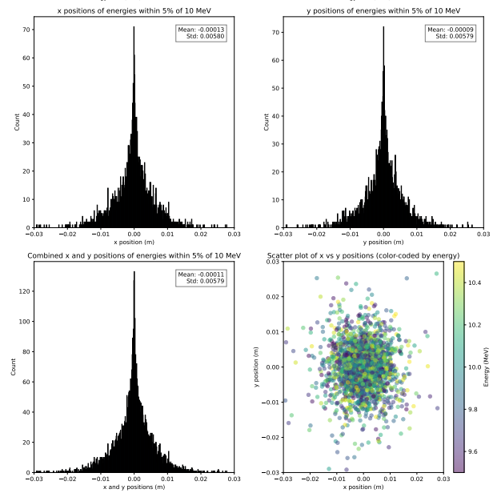
Optimisation Step 1- Collimator 1
PoPLaR: Source
Mapping the positions of the particles with 10MeV (+/- 5%) at 3cm:
Mean & std similar in x and y- use circular collimator
1cm radius circular aperture decided on

Slide 4
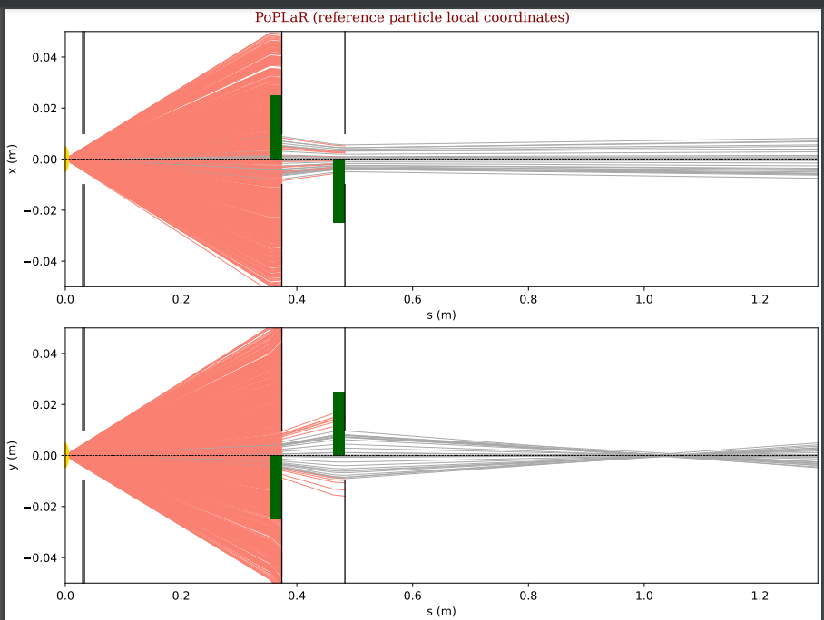
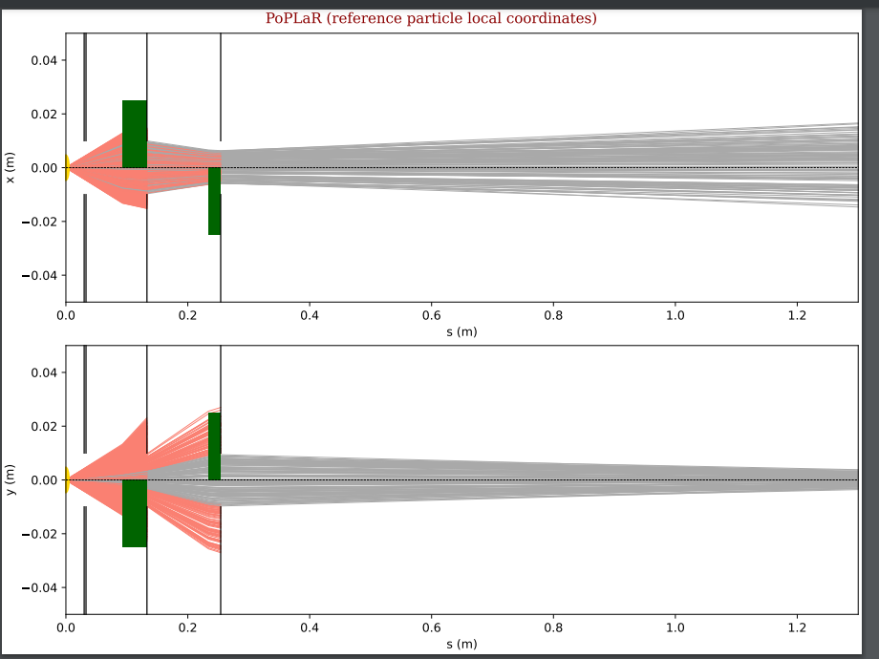
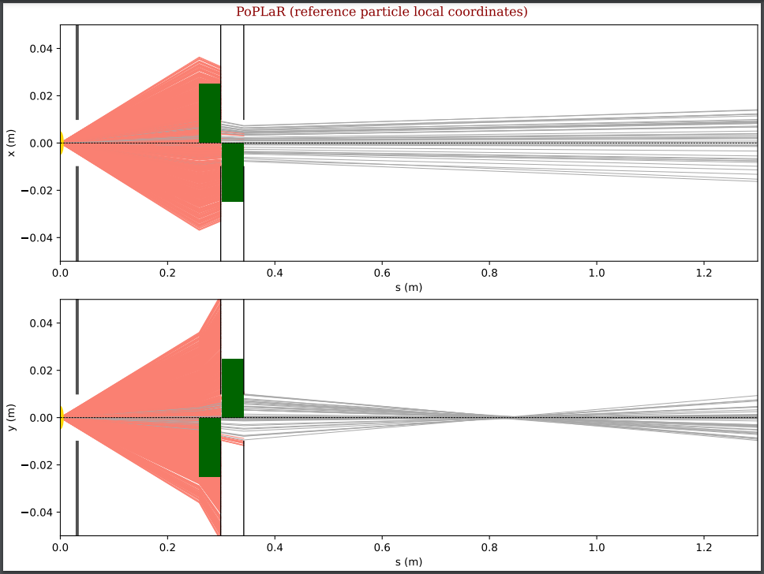
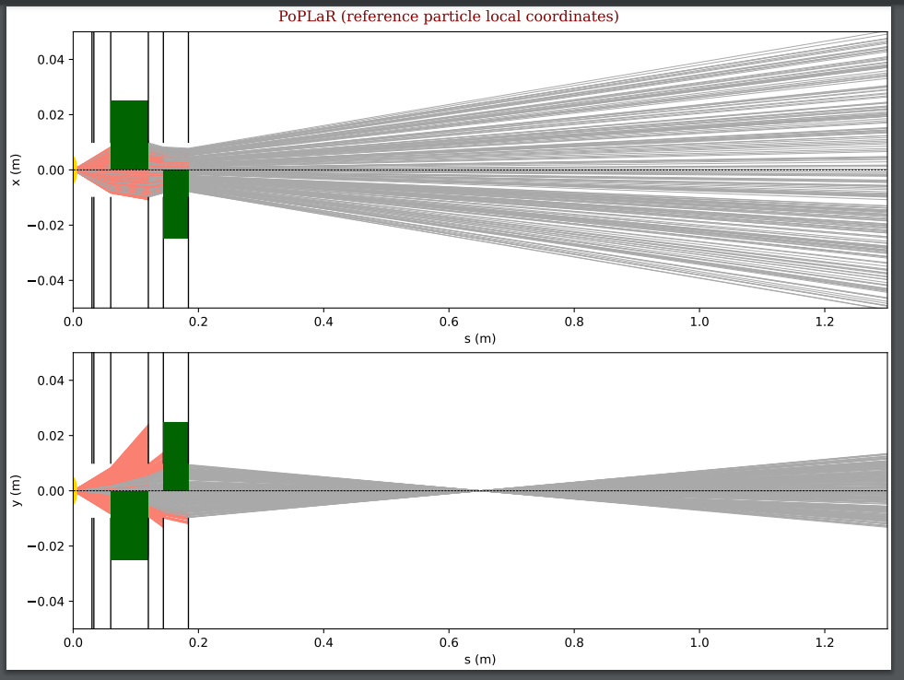
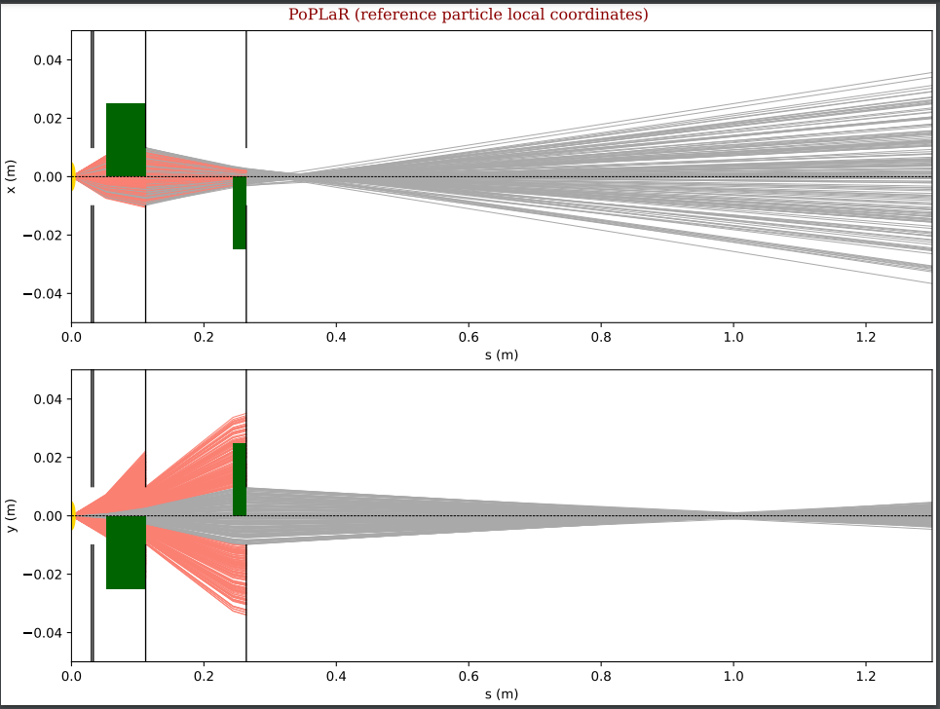
Optimisation Step 2- Quad doublet
2cm 2cm
4cm 2cm
4cm 4cm
6cm 4cm
6cm 2cm

Slide 5
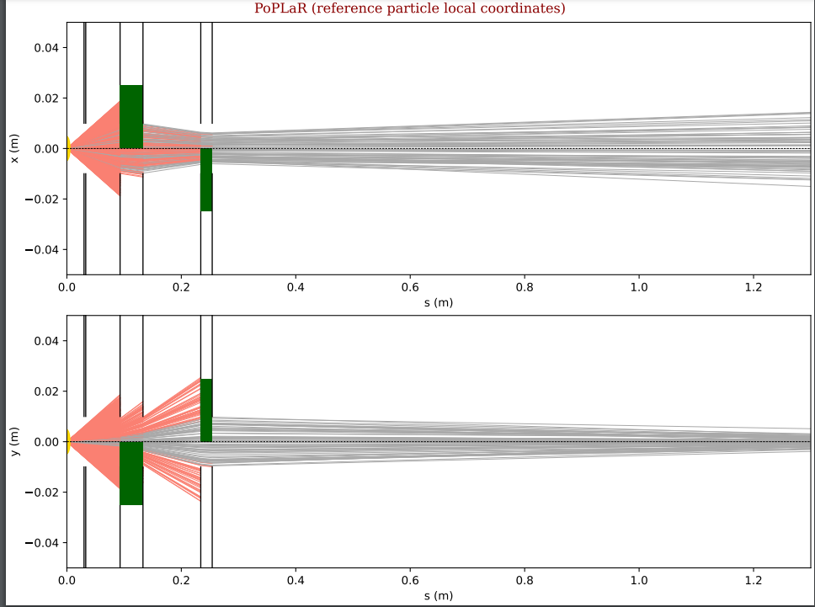
Optimisation Step 2- Quad doublet
Cost function for Bayesian to create circular aperture to create spot size between 1 and 3cm.
Bayesian Optimisation showed optimal positions of:
Focus quad: 9.3cm from laser source
Defocus quad: 23.4cm from laser source
4cm 2cm

Slide 6
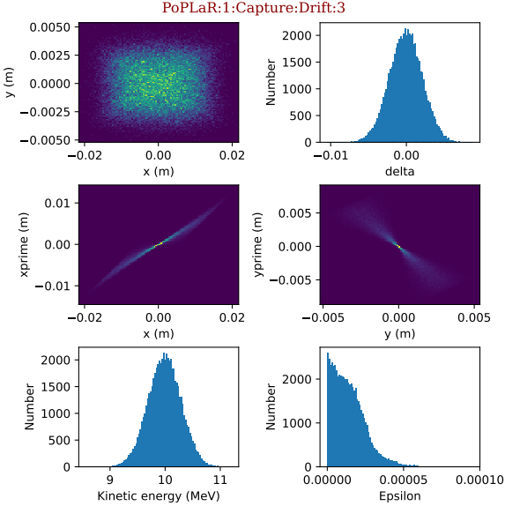
Sensitivity testing step 1- xy shifting
Reference: 4cm 2cm quad combination

Slide 7
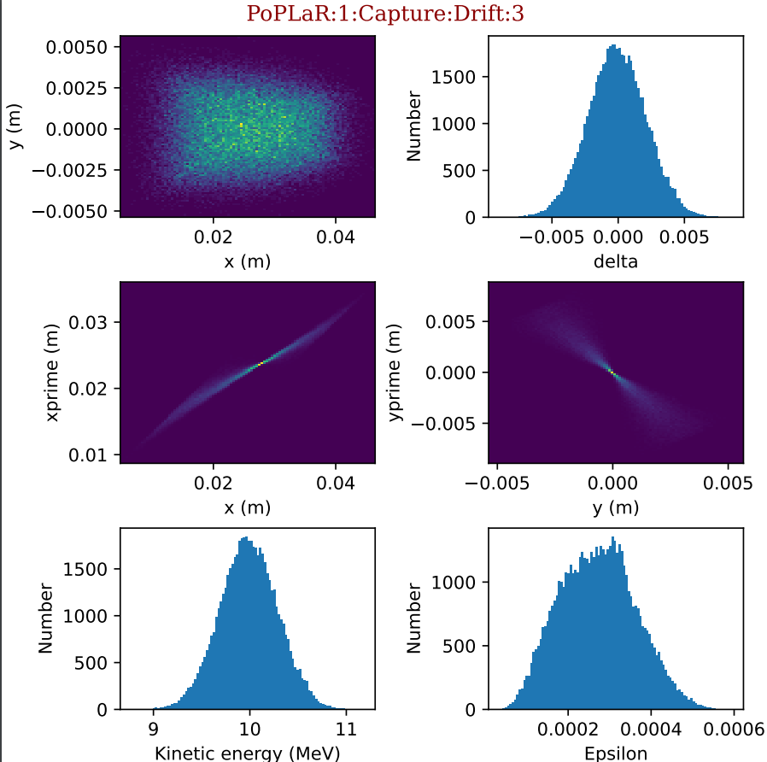
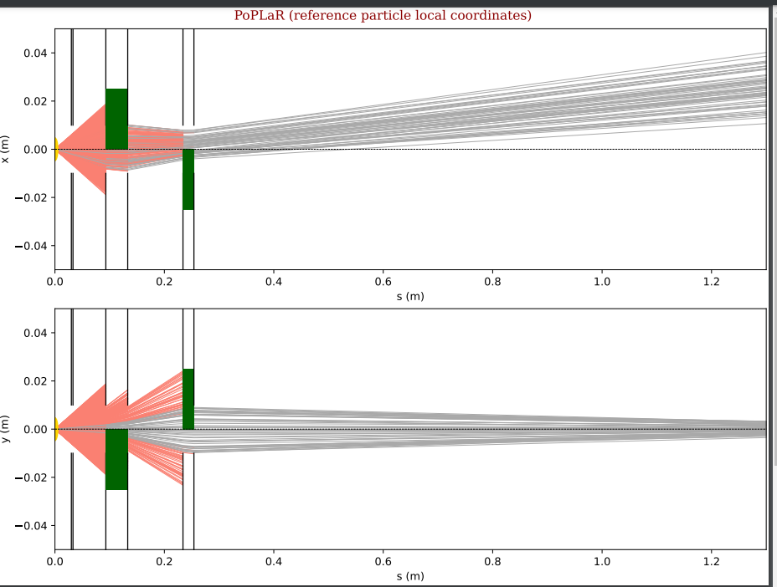
Sensitivity testing step 1- xy shifting
Quadrupole 1 shifted in x axis 1mm

Slide 8
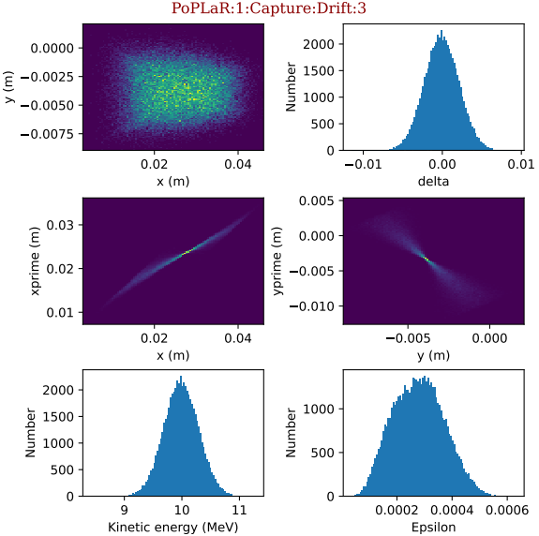
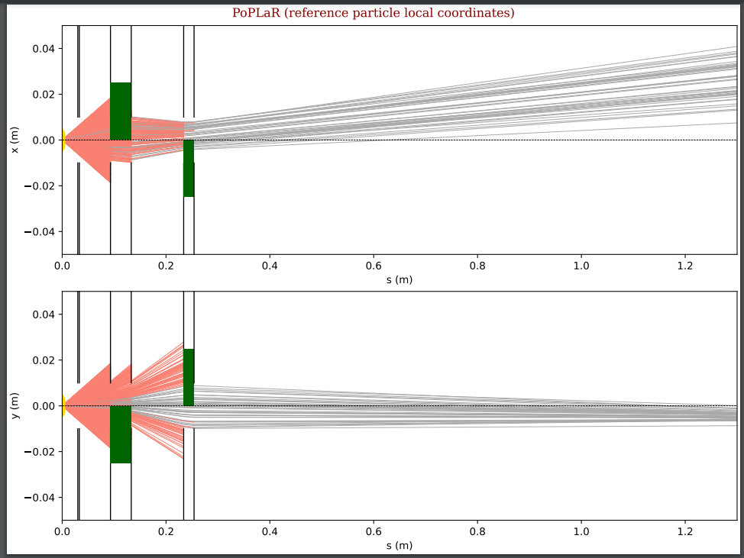
Sensitivity testing step 1- xy shifting
Quadrupole 1 shifted in x and y axis 1mm

Slide 9
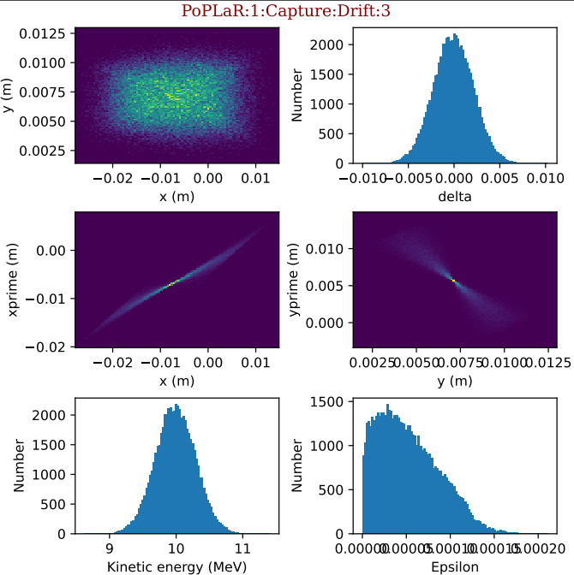
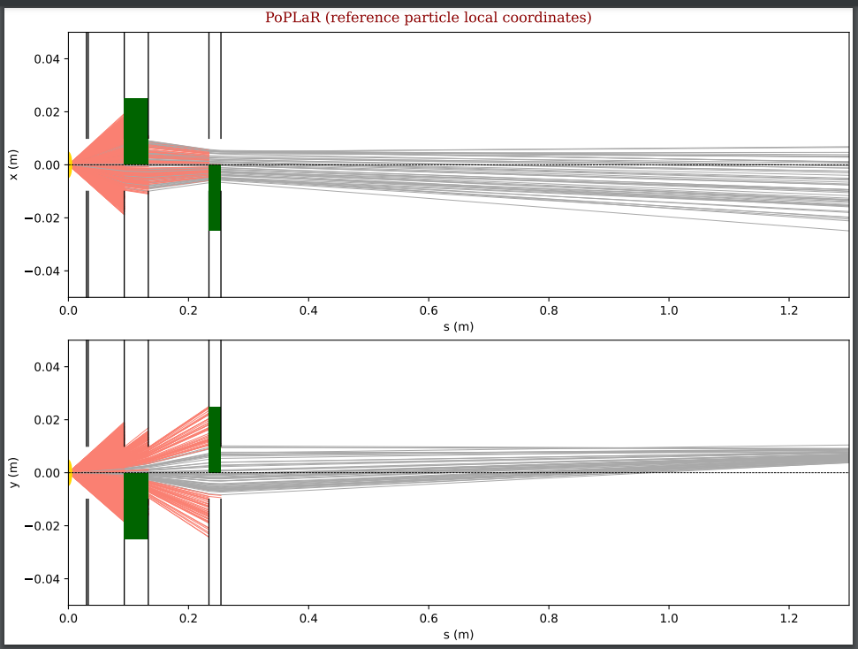
Sensitivity testing step 1- xy shifting
Quadrupole 2 shifted in x and y axis 1mm

Slide 10
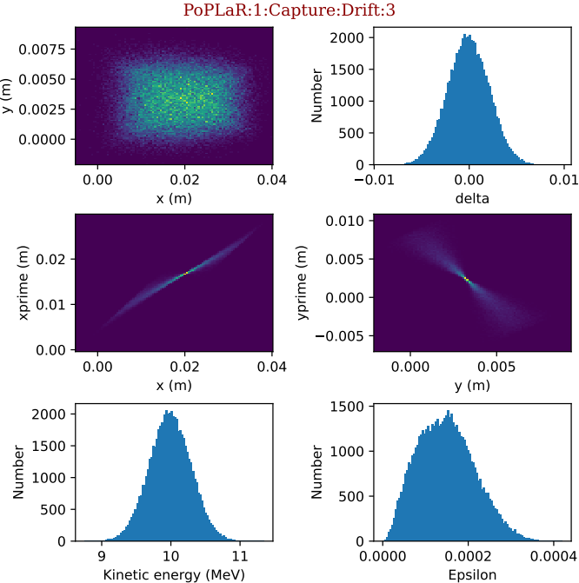
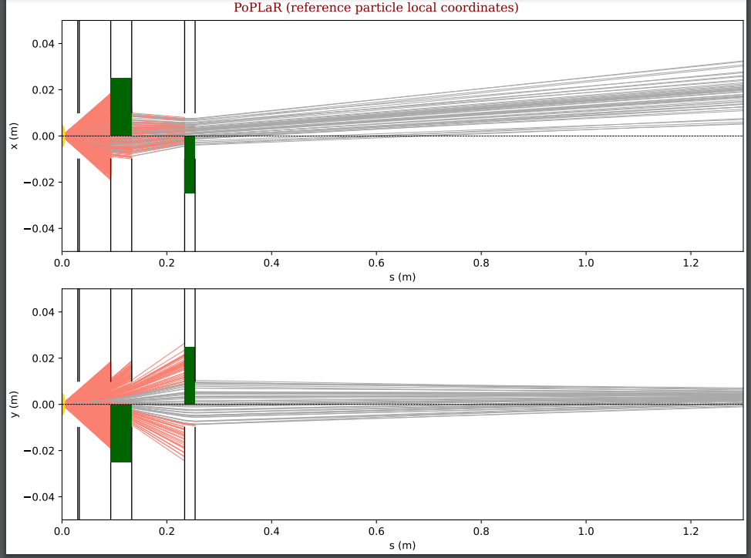
Sensitivity testing step 1- xy shifting
Quadrupole pair shifted in x and y axis 1mm

Slide 11
Sensitivity testing step 2- quad tilt
Reference: 4cm 2cm quad combination

Slide 12
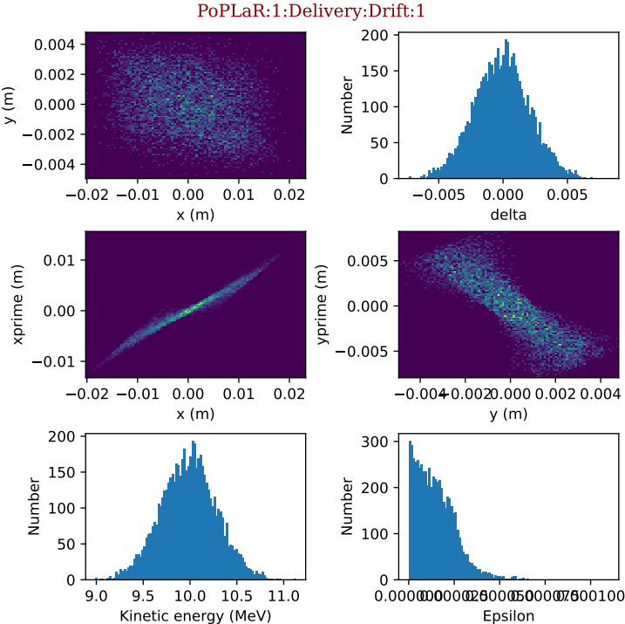
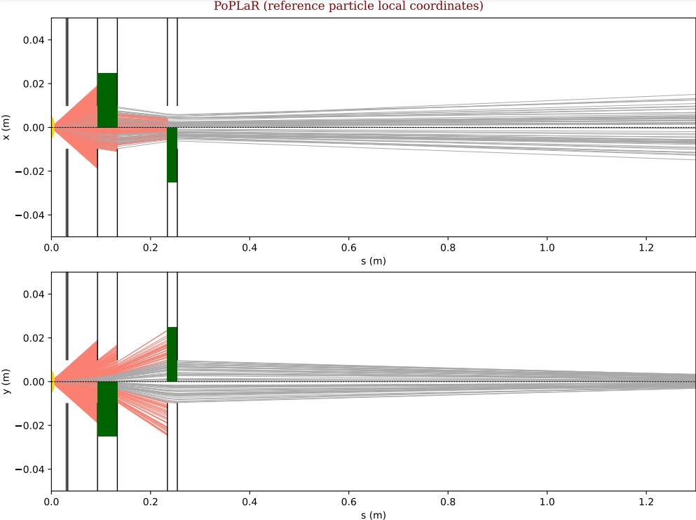
Sensitivity testing step 2- quad tilt
Quadrupole 1 tilted- alphaE rotation 0.01rad

Slide 13
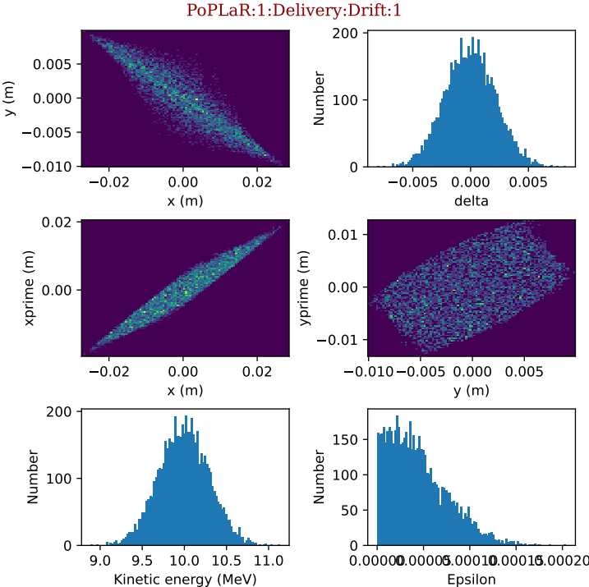
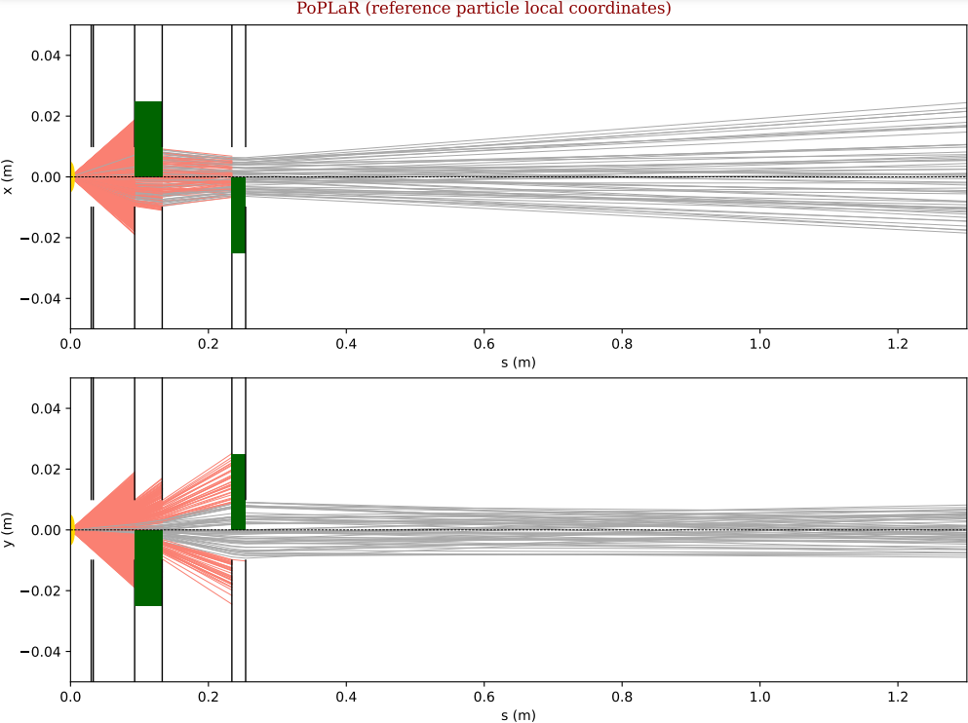
Sensitivity testing step 2- quad tilt
Quadrupole 1 tilted- alphaE rotation 0.1rad

Slide 14
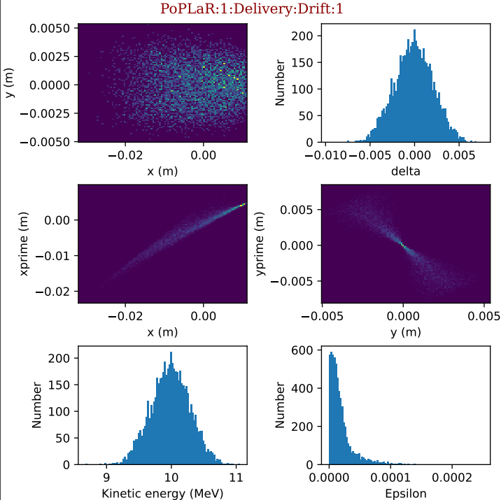
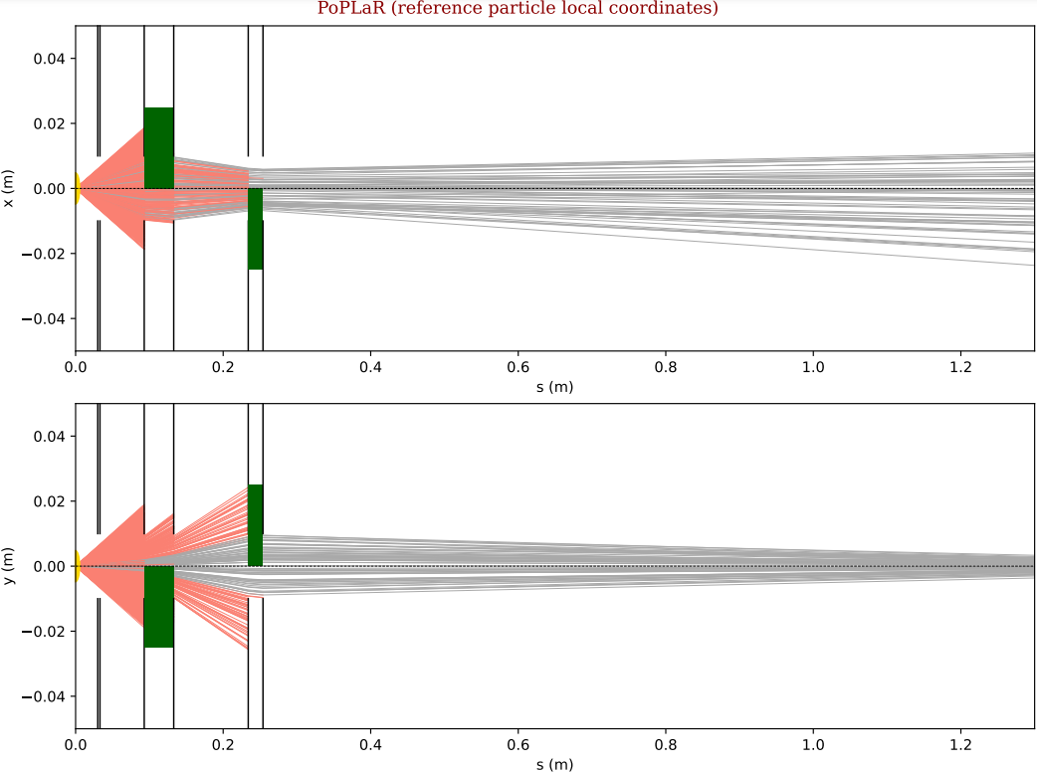
Sensitivity testing step 2- quad tilt
Quadrupole 1 tilted- betaE rotation 0.01rad

Slide 15
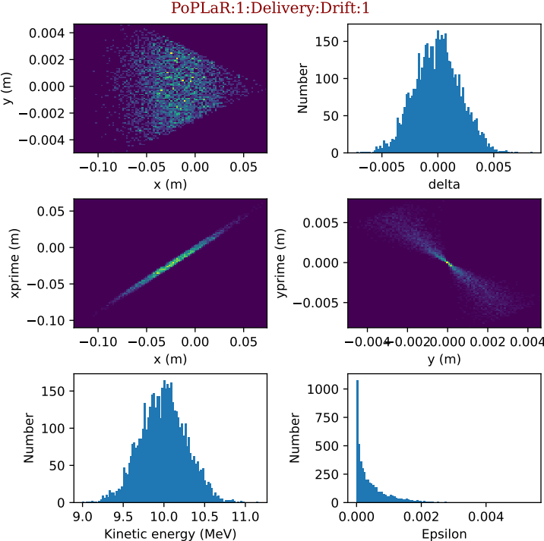
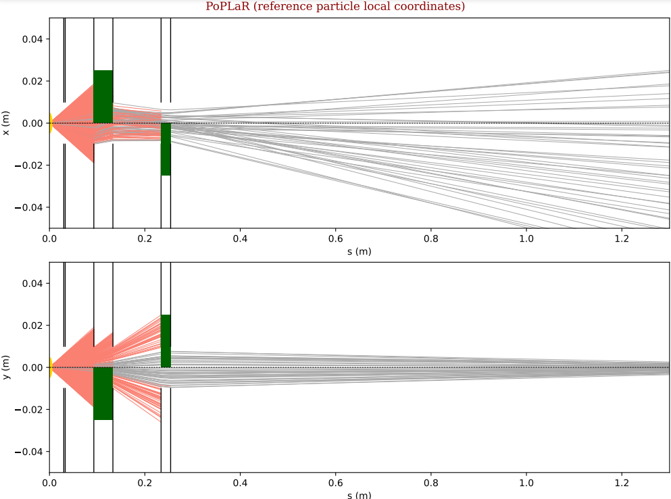
Sensitivity testing step 2- quad tilt
Quadrupole 1 tilted- betaE rotation 0.1rad

Slide 16
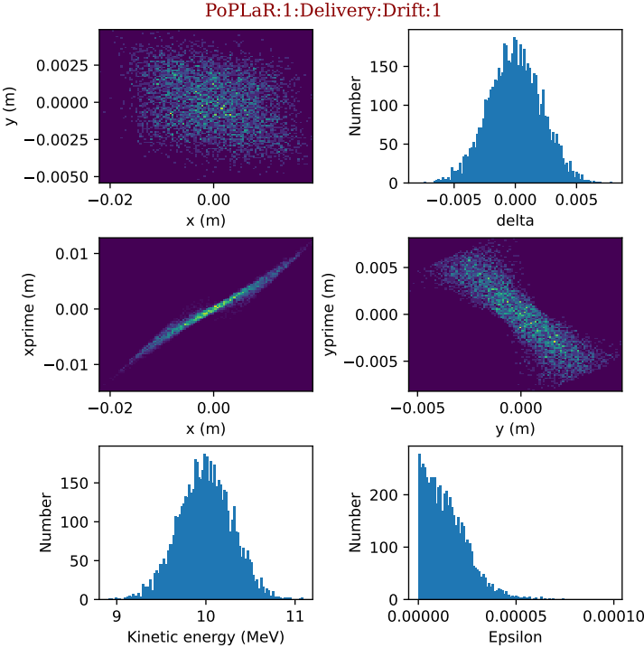
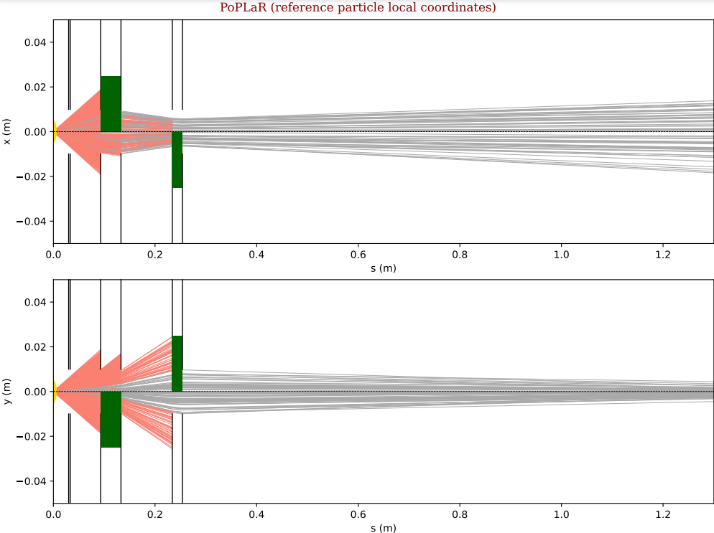
Sensitivity testing step 2- quad tilt
Quadrupole 1 tilted- gammaE rotation 0.01rad

Slide 17
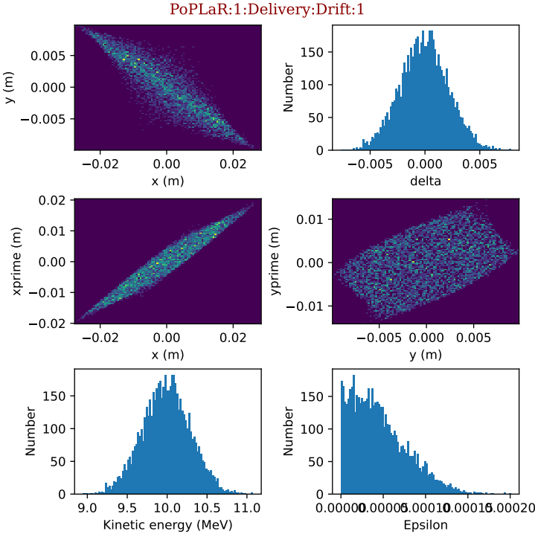
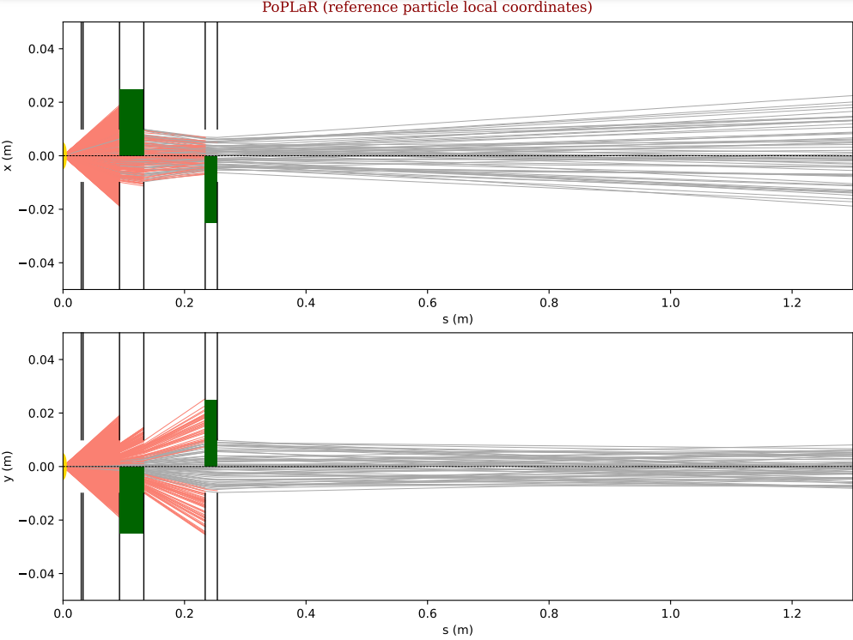
Sensitivity testing step 2- quad tilt
Quadrupole 1 tilted- gammaE rotation 0.1rad

Slide 18
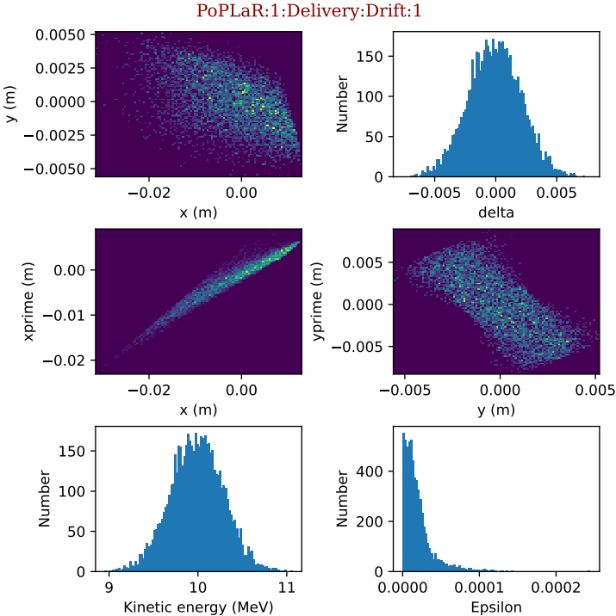
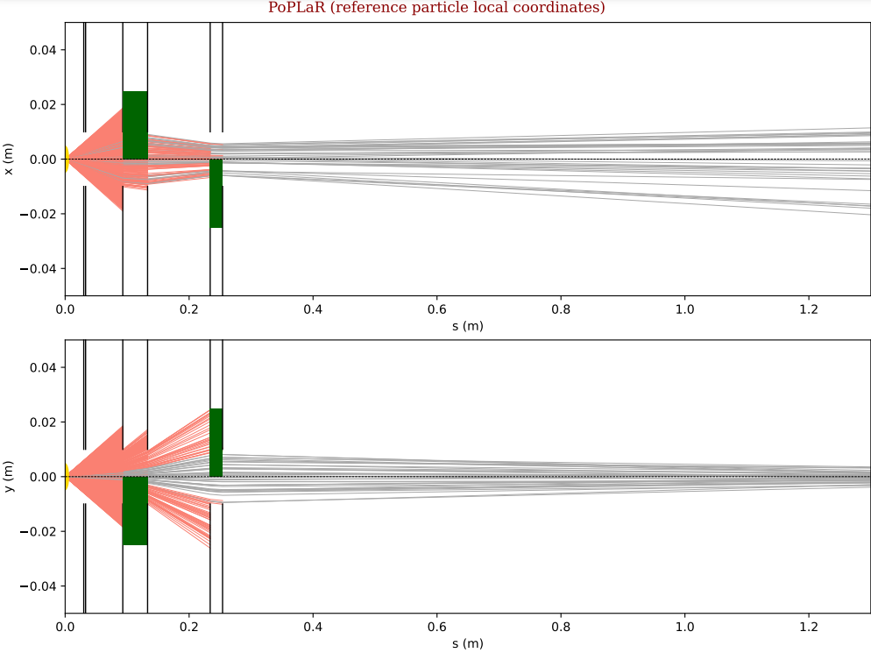
Sensitivity testing step 2- quad tilt
Quadrupole 1 tilted- alphaE, betaE, gammaE rotation 0.01rad

Slide 19
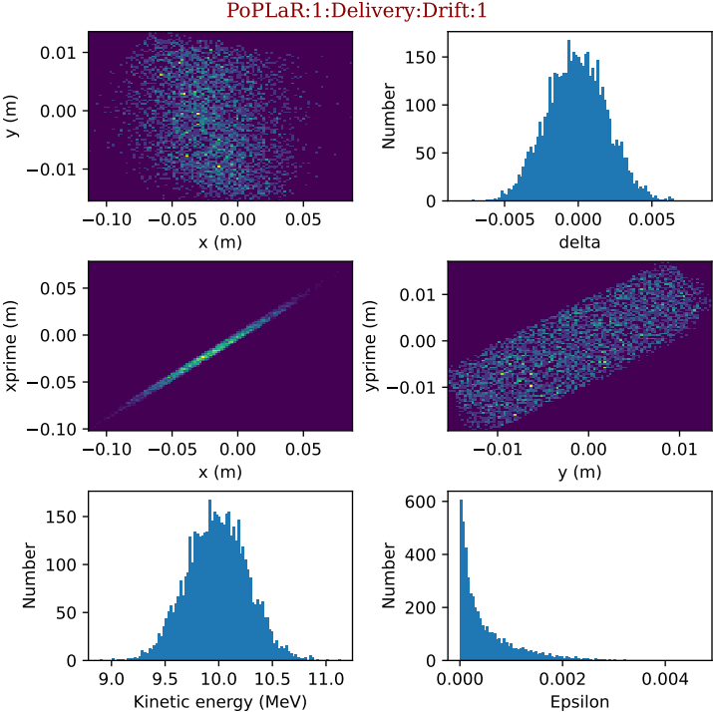
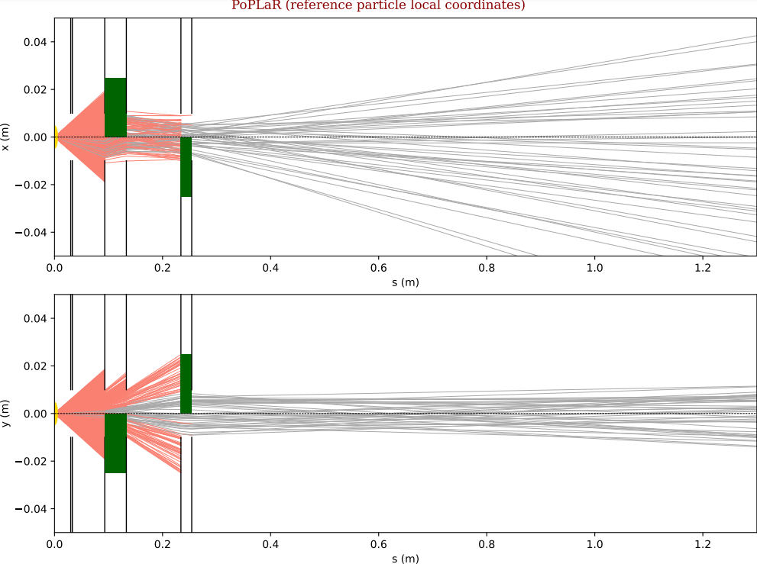
Sensitivity testing step 2- quad tilt
Quadrupole 1 tilted- alphaE, betaE, gammaE rotation 0.1rad

Slide 20
Next steps
Sensitivity testing on the source
Decide on if 2nd collimator
Design & make collimator/s
Obtain or design clamp for 4cm quads
Order xyz motorised stage
Magnet testing
Alignment
Experiment

Slide 21
Timeline
November
Order xyz stage, decide on collimator 2, design collimator/s, quads should arrive, sensitivity testing on the source
December
Make collimators, potentially alignment- more likely testing without components, obtain or design clamp for 4cm quads
January
Hopefully alignment, expect xyz stage to arrive by then & all equipment to be secured
February
Any additional simulations/extra planning to be done to correct any inconsistencies found in alignment testing
Experiment!
March

