Slide 1
Radiobiology research at SCAPA - PoPLaR
Emma Melia
Professor Jason Parsons
22.11.2024

Slide 2
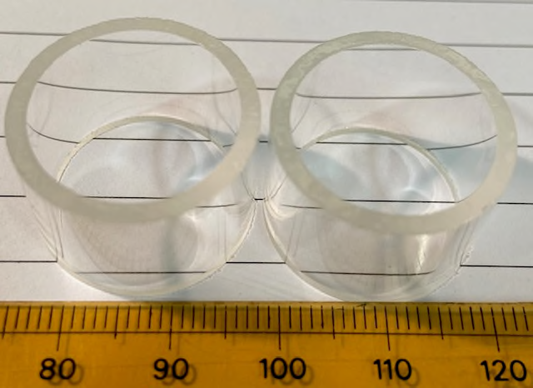
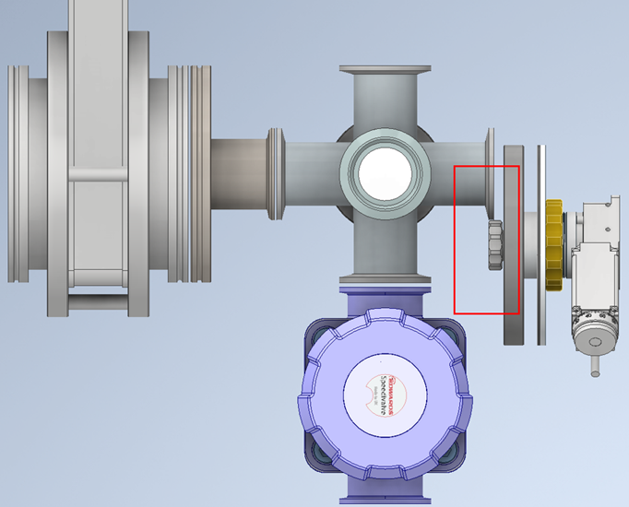
Radiobiology Set up at SCAPA
~10 MeV – grow cells on 2.5 µM Mylar in glass rings
Glass ring holder
Internal diameter – 18.5 mm
Outer diameter – 22.5 mm
Leave a slot free for dosimetry?
Sealable lids
CONV - 0.1Gy per pulse separated by 1 sec = 6Gy/min
ULTRA-HIGH - 1-3Gy/pulse (2ns) = 0.5-1.5 GGy/sec (~10⁹ Gy/s)

Slide 3
Initial radiobiology experiments at SCAPA
HeLa and FaDu cell lines
Clonogenic assays
Control
4Gy
ULTRA-HIGH – 1, 2, 3Gy – in triplicate
CONV – 1, 2, 3, 4, 6, 8Gy – in triplicate
54 dishes to irradiate per experiment
Need at least 3 independent biological repeats
Timeline:
Thaw and culture cells at least one week before
Seed cells the day before (PM) irradiation (AM)
Stain colonies 7-10days later (SCAPA) and analyse (Birmingham) – Results in ~2 weeks
Initial session – can do two consecutive days (two independent repeats) but won’t know if any alterations needs to be made until staining
Would need to do 2-3 more repeats in the next session – based on initial results

Slide 4
Initial radiobiology experiments at SCAPA
DNA repair foci analysis
γH2AX
RAD51
CONV 3Gy (?) – 1, 4, 8, 24 hr – in duplicate
ULTRA-HIGH 3Gy (?) – 1, 4, 8, 24 hr – in duplicate
32 dishes to irradiate per experiment
Need at least 3 independent biological repeats
Cells need to be fixed at certain timepoints (SCAPA) but can be processed later (Birmingham) – Results in ~1 week
DNA repair Comet analysis
4Gy
CONV – 3Gy (?) – in duplicate
ULTRA-HIGH – 3Gy (?) – in duplicate
8 dishes to irradiate per experiment
Need at least 3 independent biological repeats
Requires immediate sample processing (SCAPA):
Embed cells on microscope slides, lyse (across different timepoints - 0, 0.5, 1, 2, 4 hr) and run electrophoresis
Staining and analysis can be done later (Birmingham) – Results in ~1 week

