Slide 1
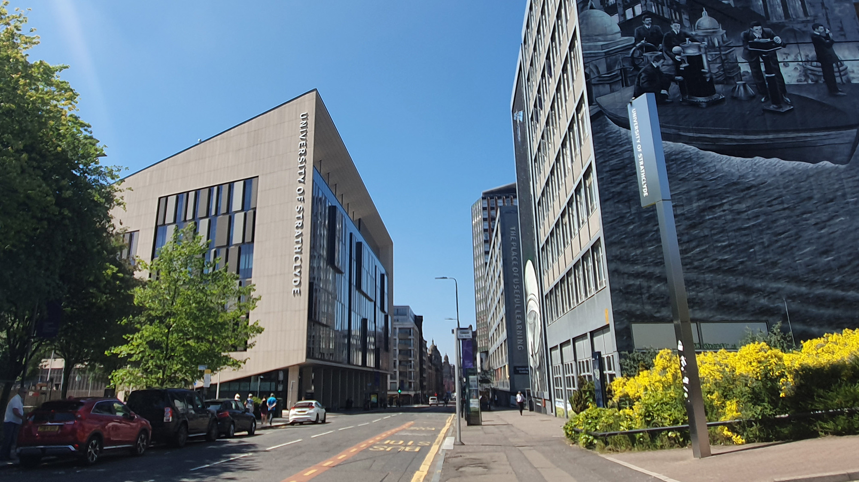

PoPLaR Meeting @ Strathclyde
X THE PLACE OF USEFUL LEARNING
Update on proton source capabilities and beamline design in SCAPA Bunker B
22nd November 2024
Dr. Ross Gray
ross.gray@strath.ac.uk

Slide 2
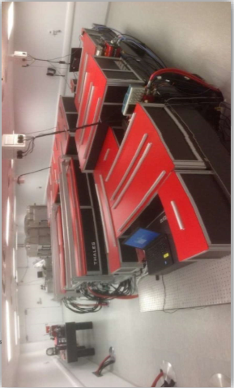
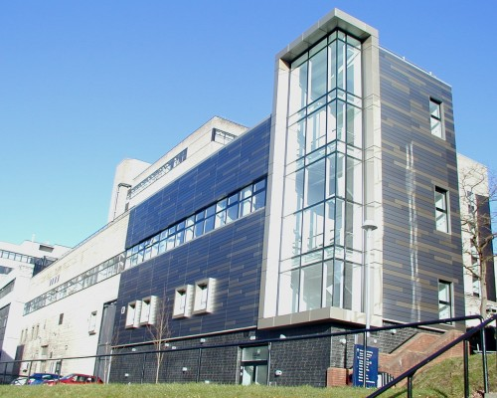
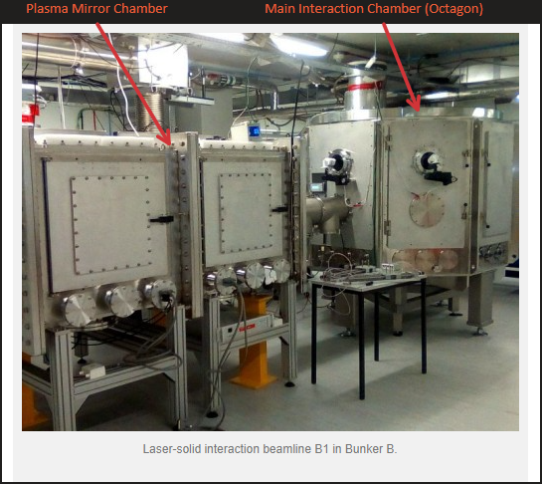
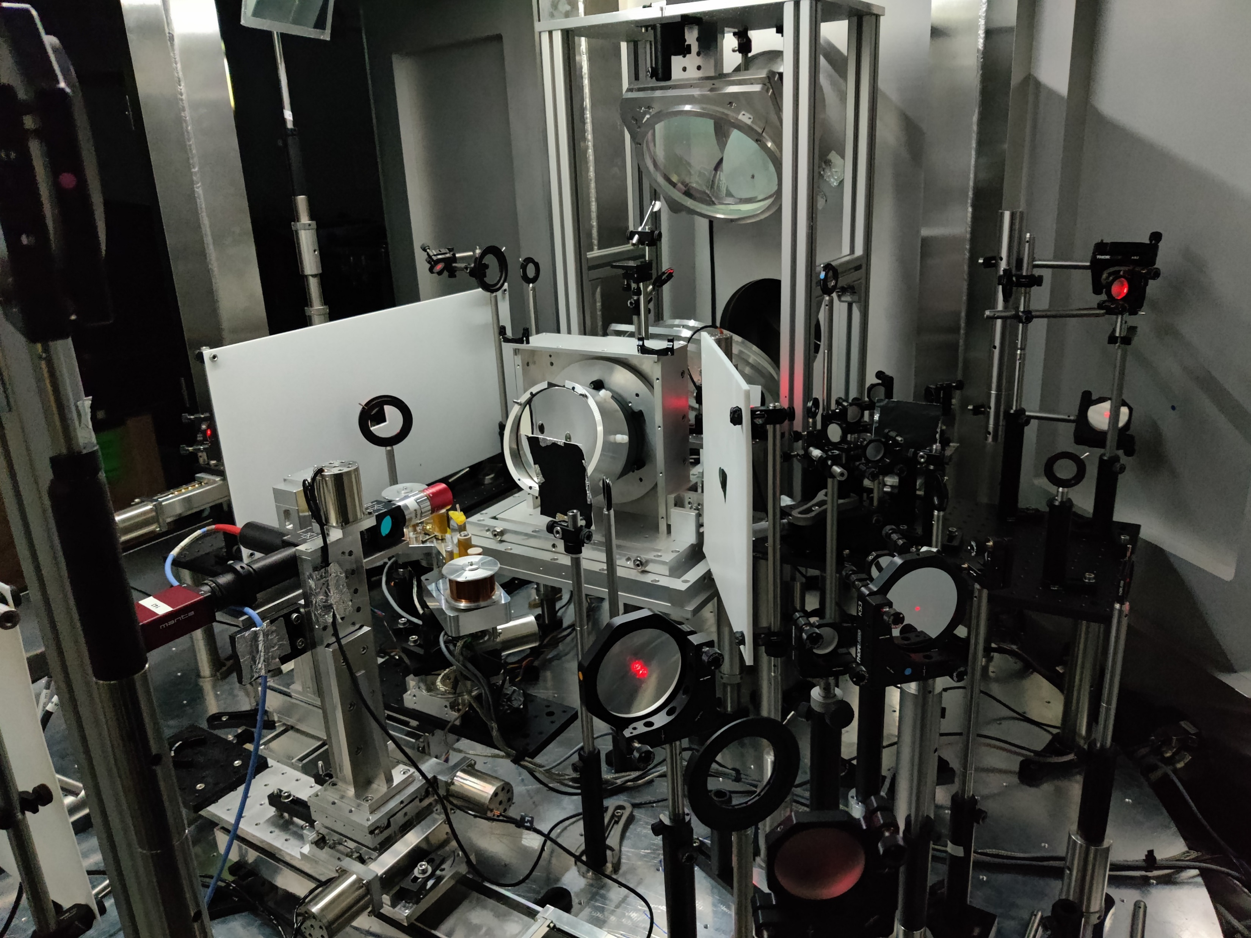
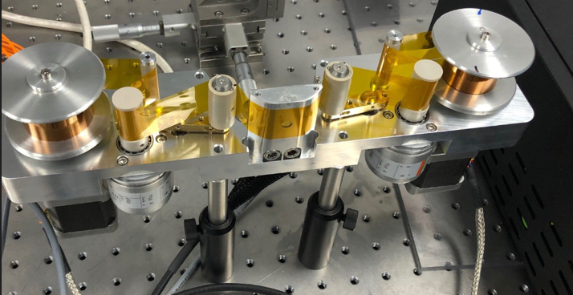
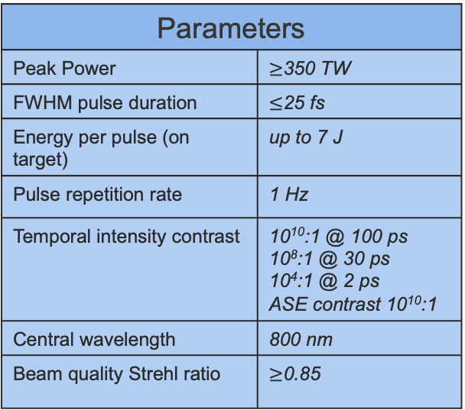
SCAPA: Scottish Centre for the Application of Plasma-based Accelerators
Research is focused on the development and application of laser-driven particle acceleration.
Parameters
Peak Power | $≥$350 TW
FWHM pulse duration | $≤$25 fs
Energy per pulse (on target) | up to 7 J
Pulse repetition rate | 1 Hz
Temporal intensity contrast | 10¹⁰:1 @ 100 ps 10⁸:1 @ 30 ps 10⁴:1 @ 2 ps ASE contrast 10¹⁰:1
Central wavelength | 800 nm
Beam quality Strehl ratio | $≥$0.85
Can deliver high proton numbers, within the MeV energy range, at Hz level reception rate.

Slide 3
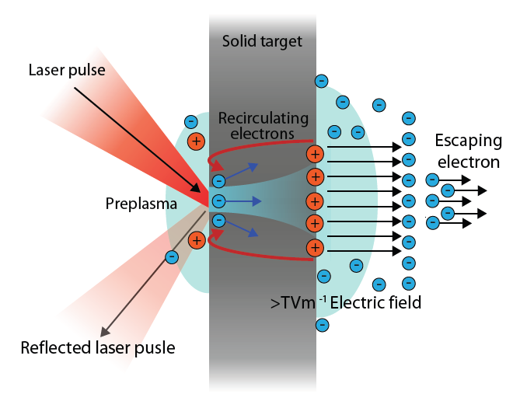
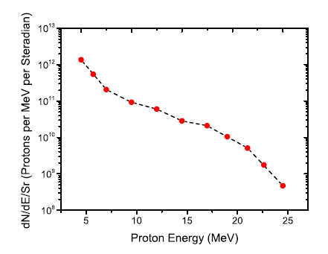
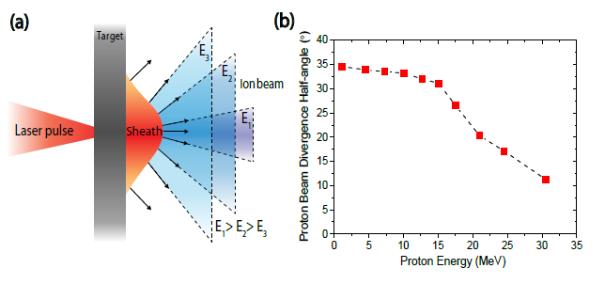
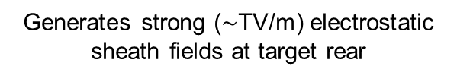
Mechanism for laser-driven ion acceleration
Target Normal Sheath Acceleration (TNSA)
Laser energy absorbed producing large population of hot electrons
Hot electrons injected and propagate through the target
Generates strong ($\sim$TV/m) electrostatic sheath fields at target rear
Drives acceleration of high energy protons
Proton beam characteristics
i)
ii)
0
0.5
1
0
0.5
1
Ep/Ep Max
Ep/Ep Max
Broad energy spectrum, up to a maximum cut off energy.
Proton energy dependent beam divergence.

Slide 4
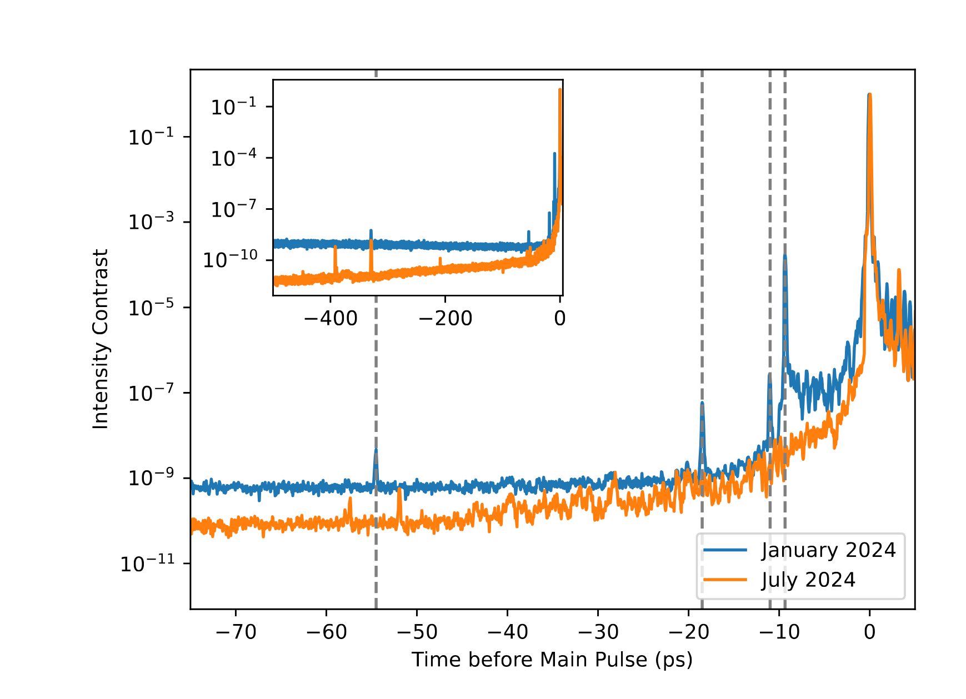
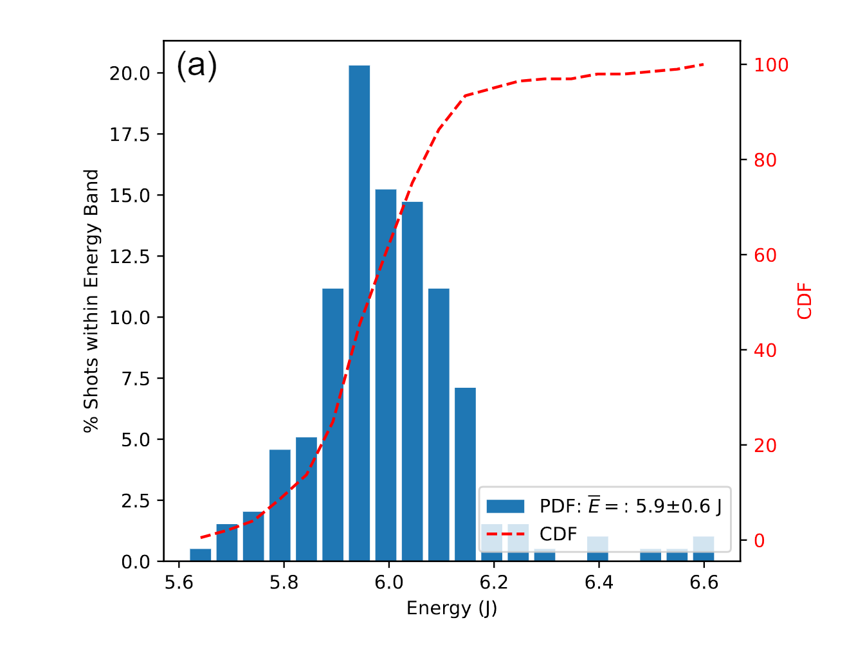
Update on Proton Source Parameters/Characterisation
  As reported during the last milestone meeting there were significant prepulses measured in the system which were limiting our proton energy and flux
  Offending prepulses have been removed, the contrast is significantly improved and there has been detailed characterisation of laser stability
4

Slide 5
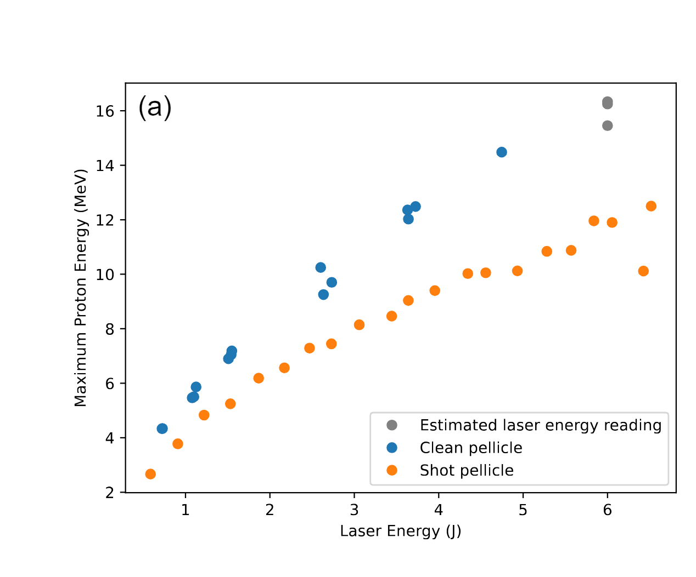
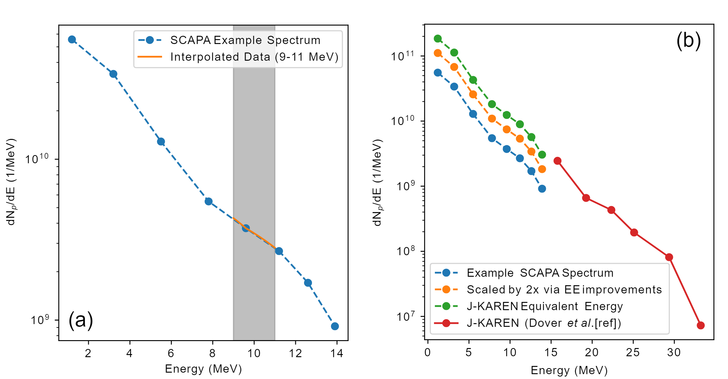
Beamtime Updates
  Performed a 3-week experiment in June/July after laser contrast work in SCAPA and another run in September
  We have now measured protons > 15 MeV on SCAPA at up to 1 Hz repetition rate (typically 0.3 Hz)
  This has been cross calibrated with RCF dosimetry and we find with >10⁹ protons at 10 MeV.
5

Slide 6
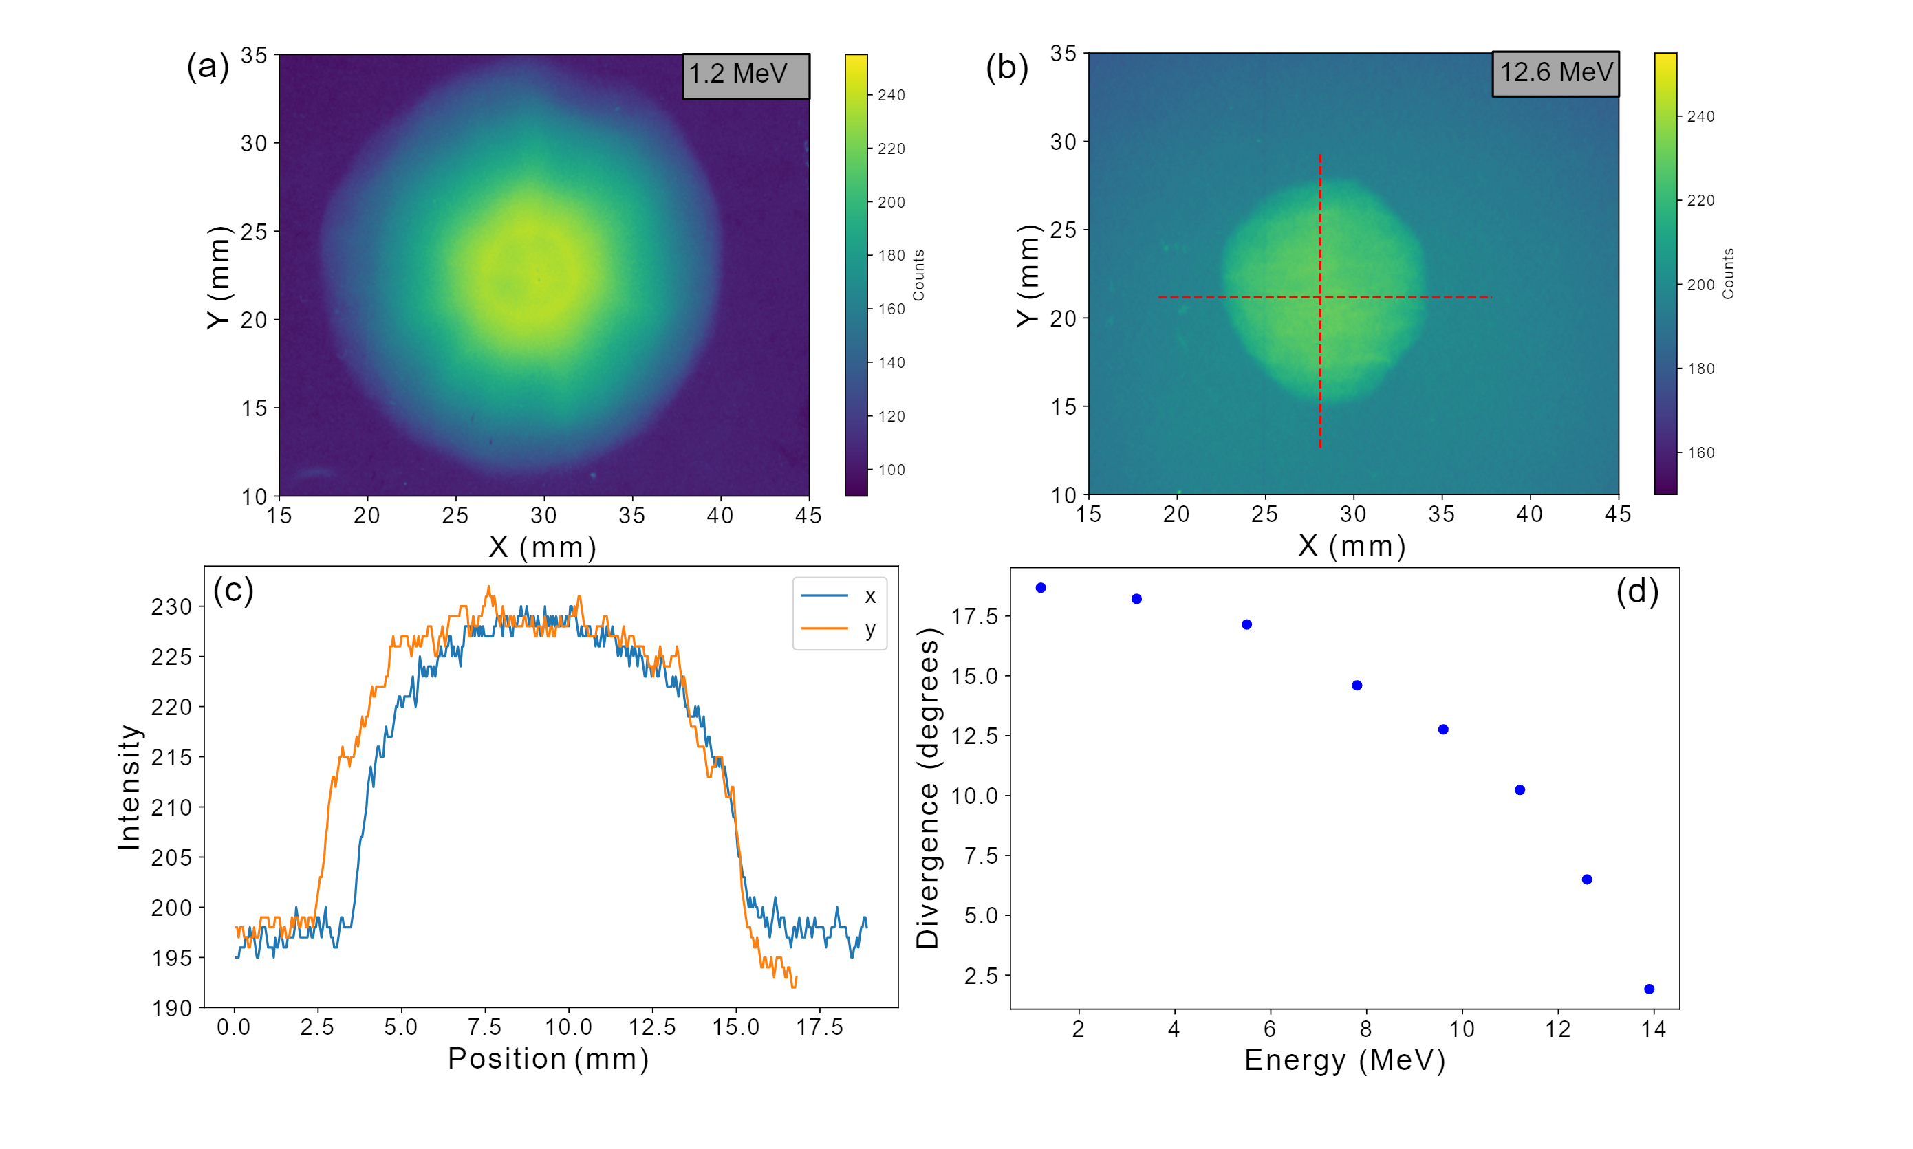
Update on Proton Source Parameters/Characterisation
Irradiation Setup
Focusing laser pulse
TNSA Ion beam
Dosimetry Film Stack
Target
35 mm
To Thompson Parabola Ion Spectrometer
  More detailed measurements made of beam divergence and uniformity
  Uniformity is good at the relevant energies and divergence is as expected
6

Slide 7
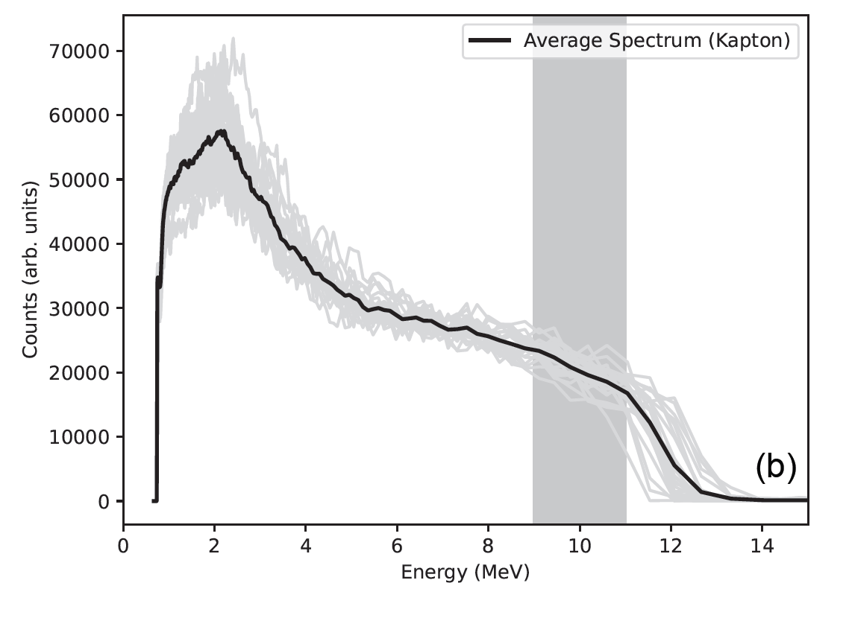
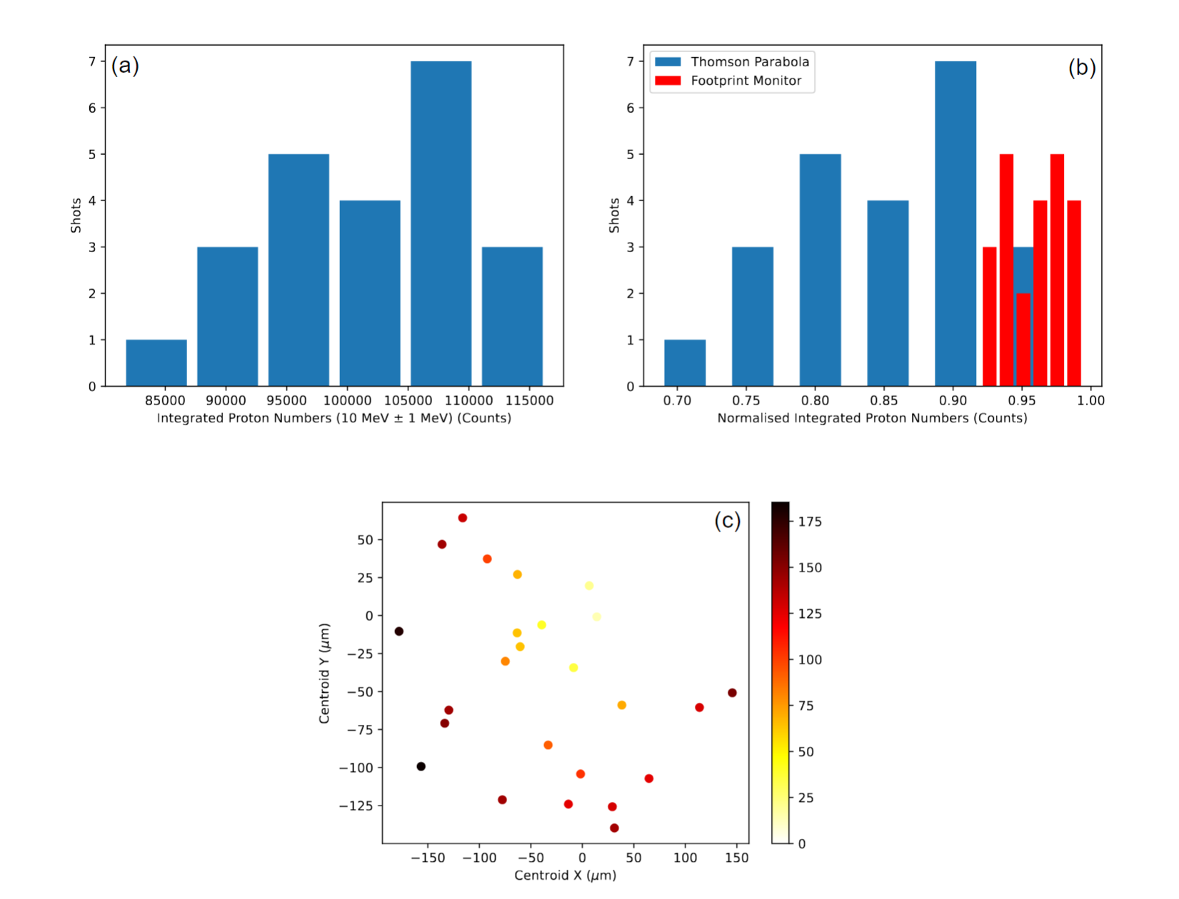
Update on Proton Source Parameters/Characterisation
  Part of the experiment focused on measuring shot-to-shot stability of the proton spectrum
  On the TP this is around 8-10% but in reality it is around 2% as TP biases for beam structure and jitter
  We will be able to measure the spectrum on shot and so variation will be accounted for
7

Slide 8
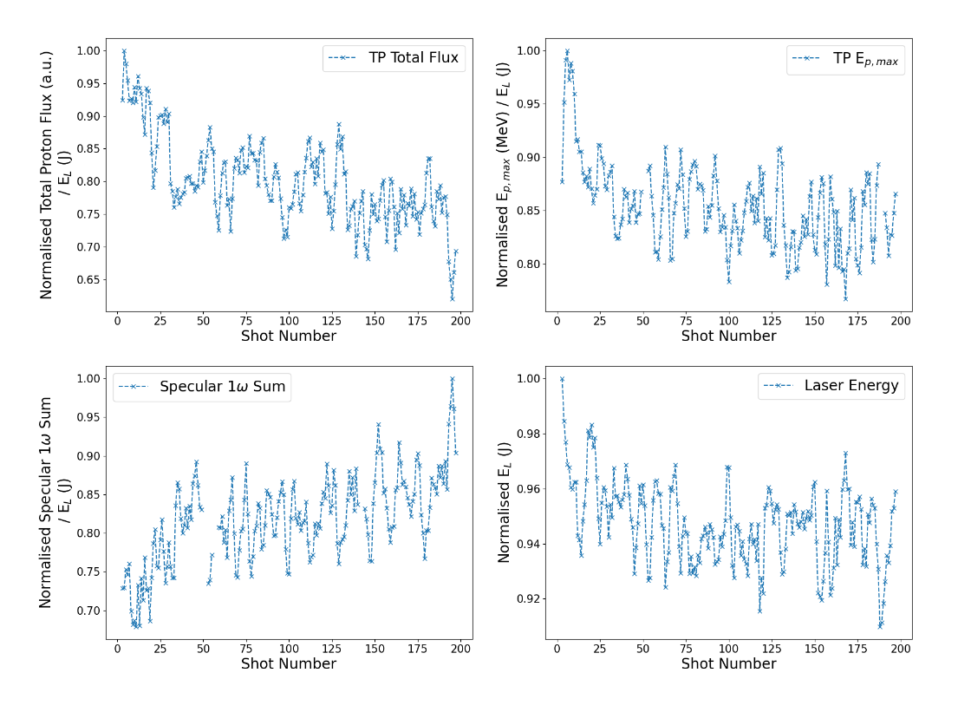
September beam performance
  We performed an experiment in September 2024 which was not related to LhARA….but provided relevant measurements
  During the experiment the same shot was taken >100s of times to investigate the stability of the source
  While the laser parameters are stable the proton flux, max energy are seen to decrease while the specular (the fraction of reflected light increases).
  This was confirmed to be the burning of the pellicle at a rate faster than previously seen….this is concerning and needs to be resolved for continuous operations
8

Slide 9
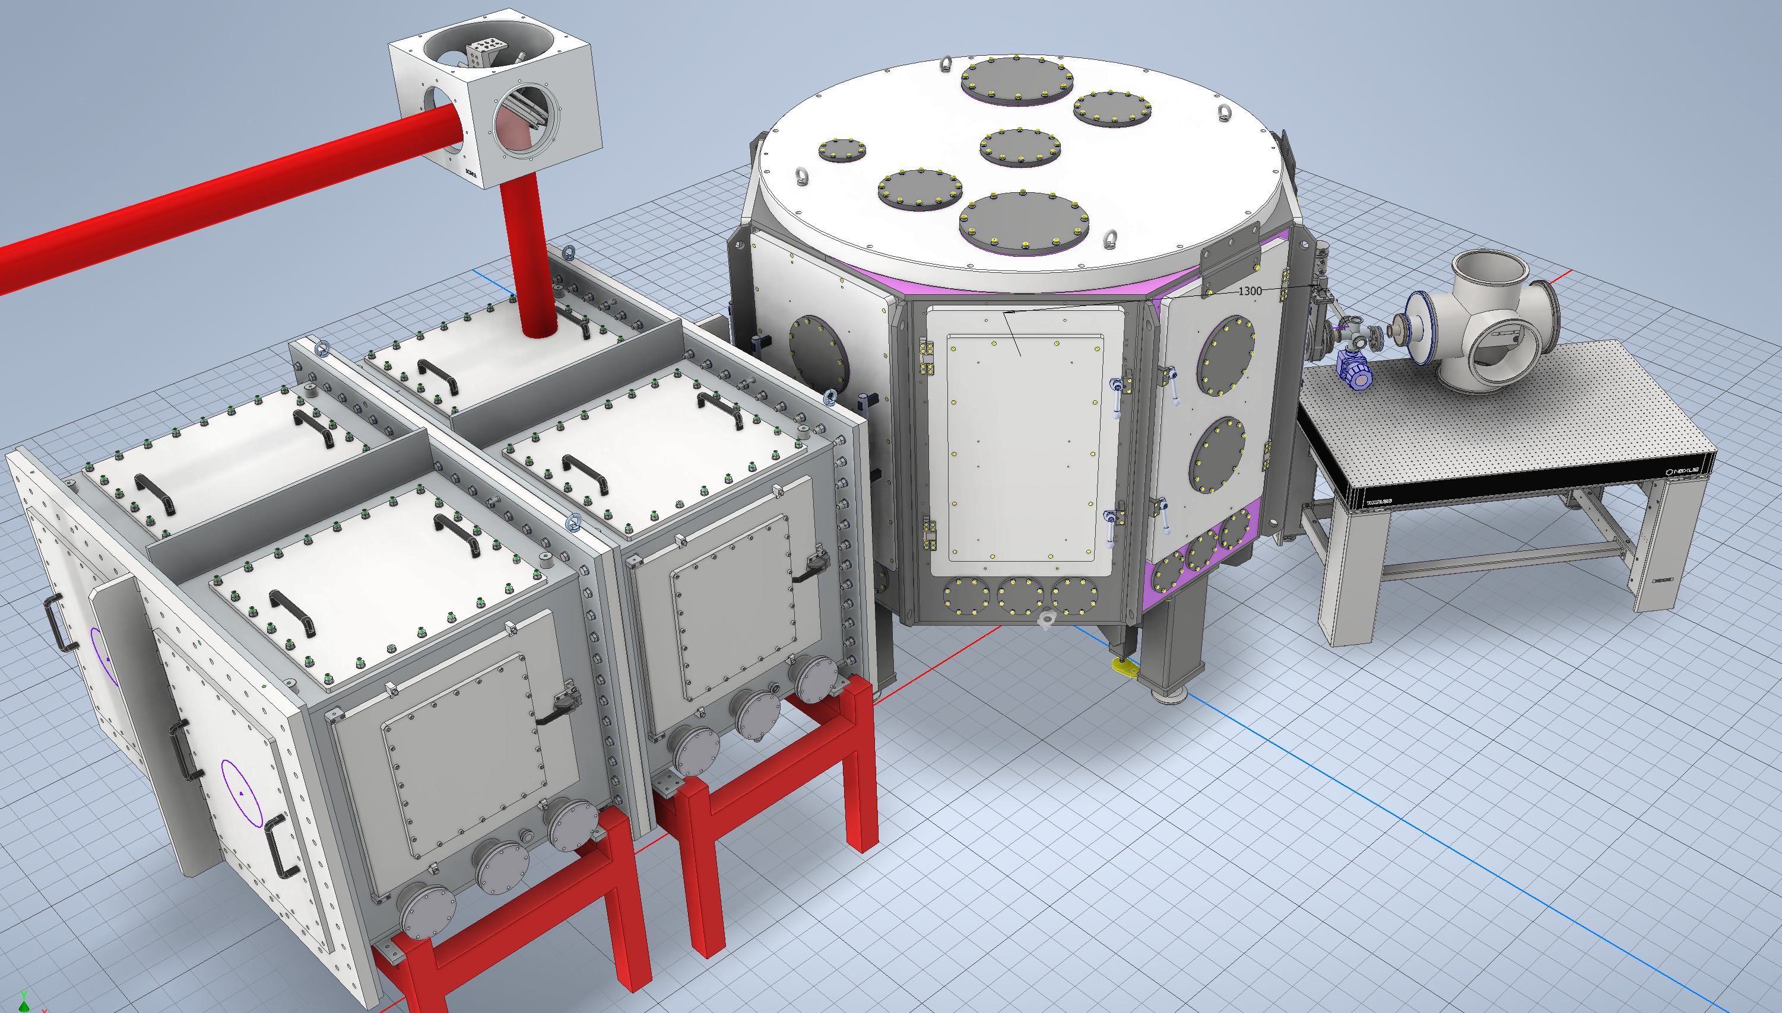
Update on beamline design
9

Slide 10
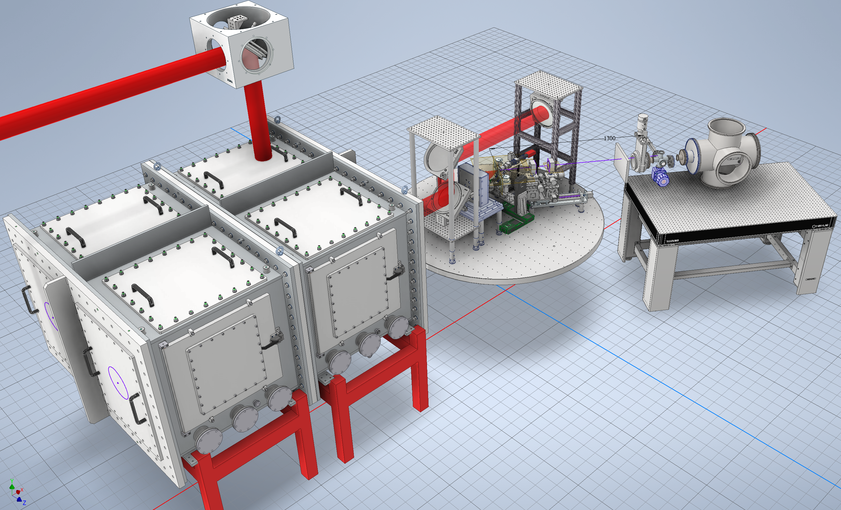
Update on beamline design
10

Slide 11
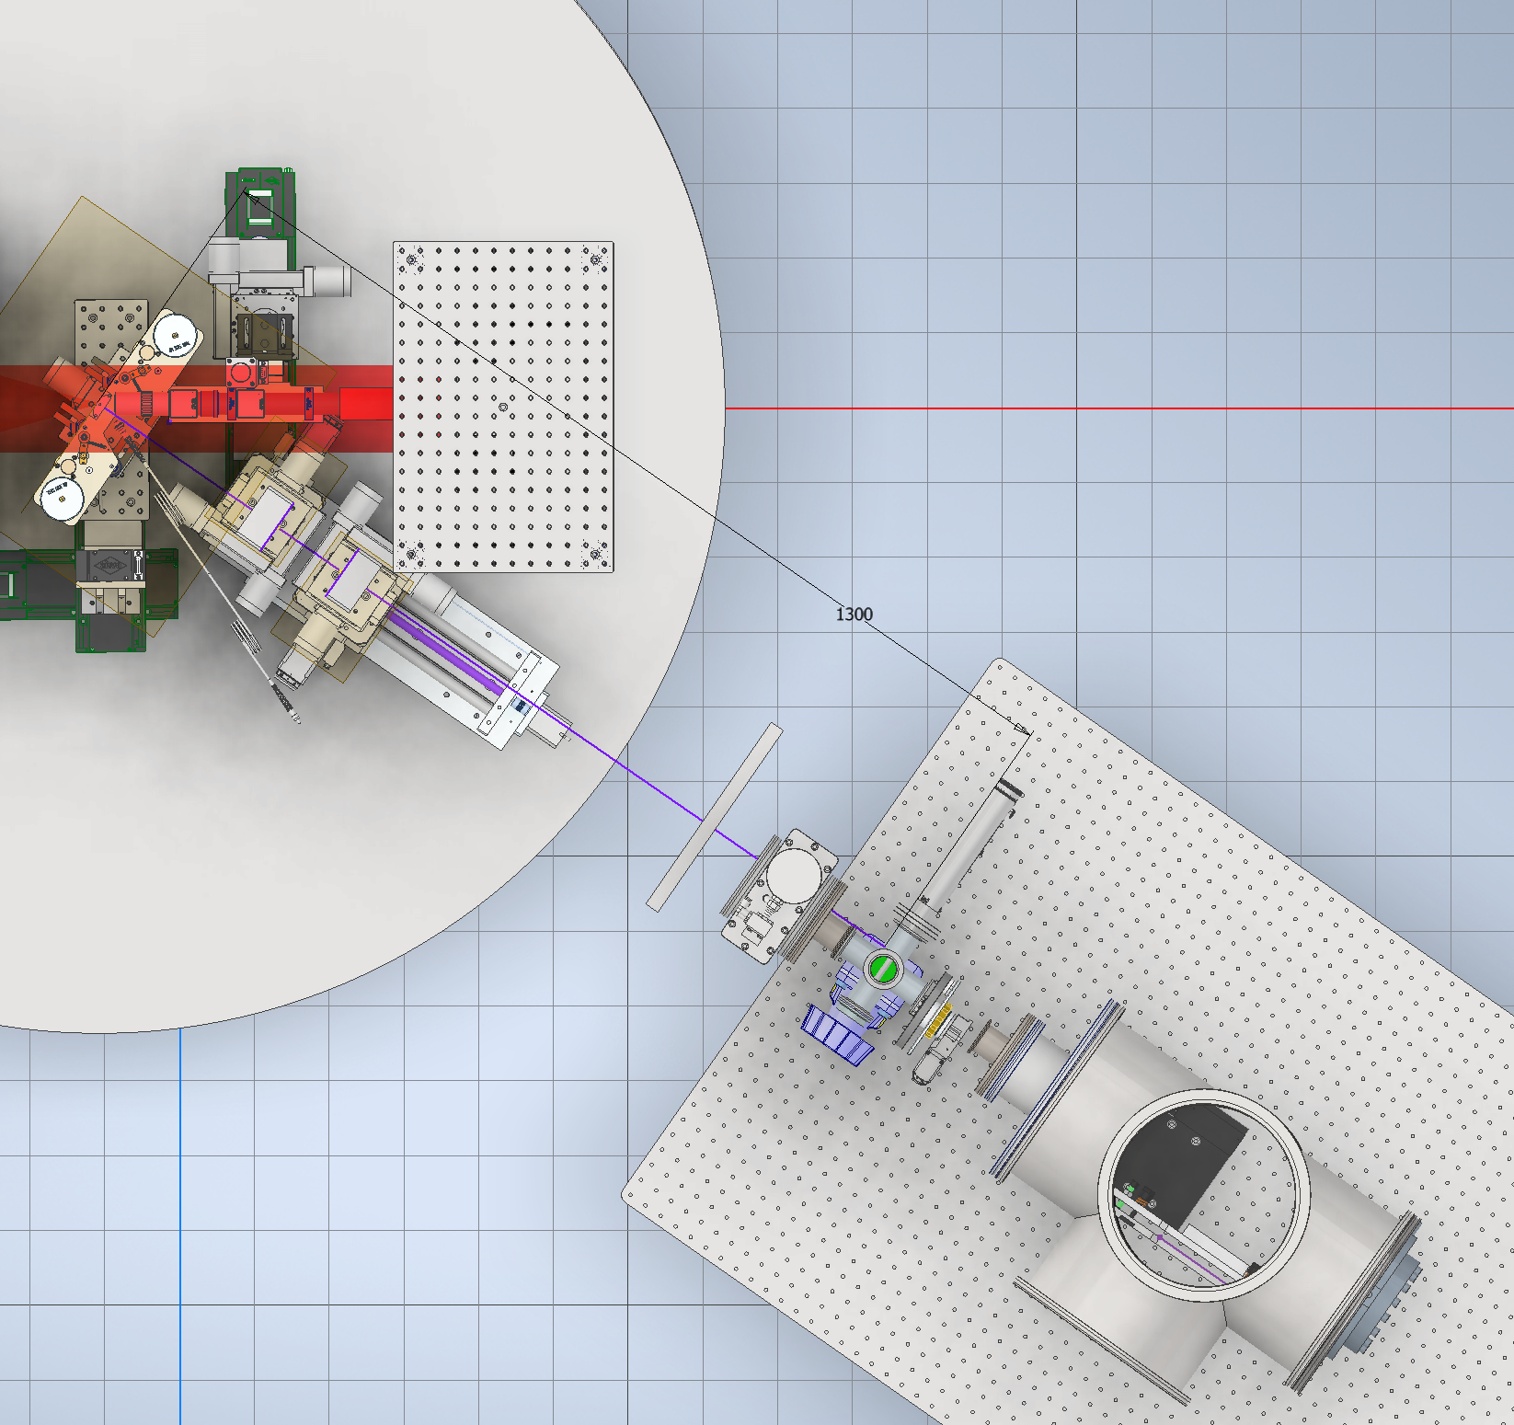
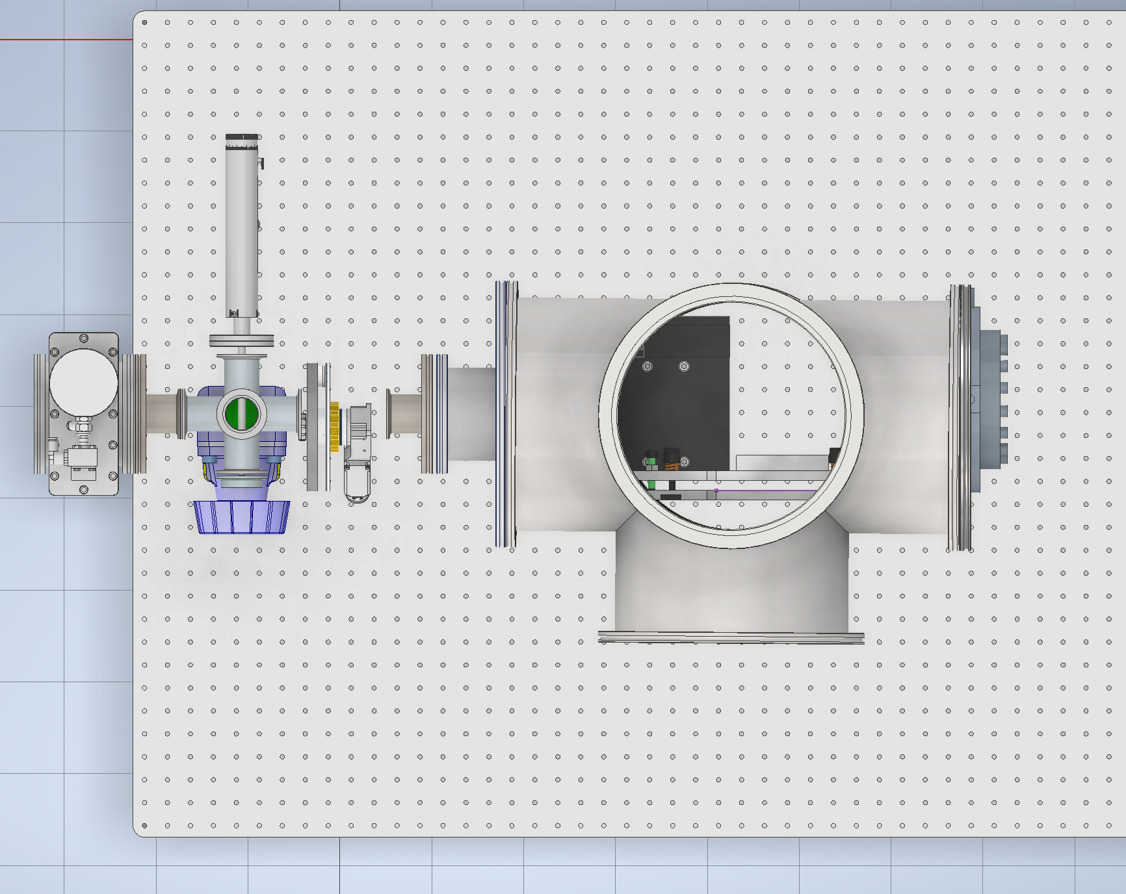
Update on beamline design
  Progress has been made towards designing the PMQ beamline and cell station setup in SCAPA
  We would be looking to order parts in early January
11

Slide 12
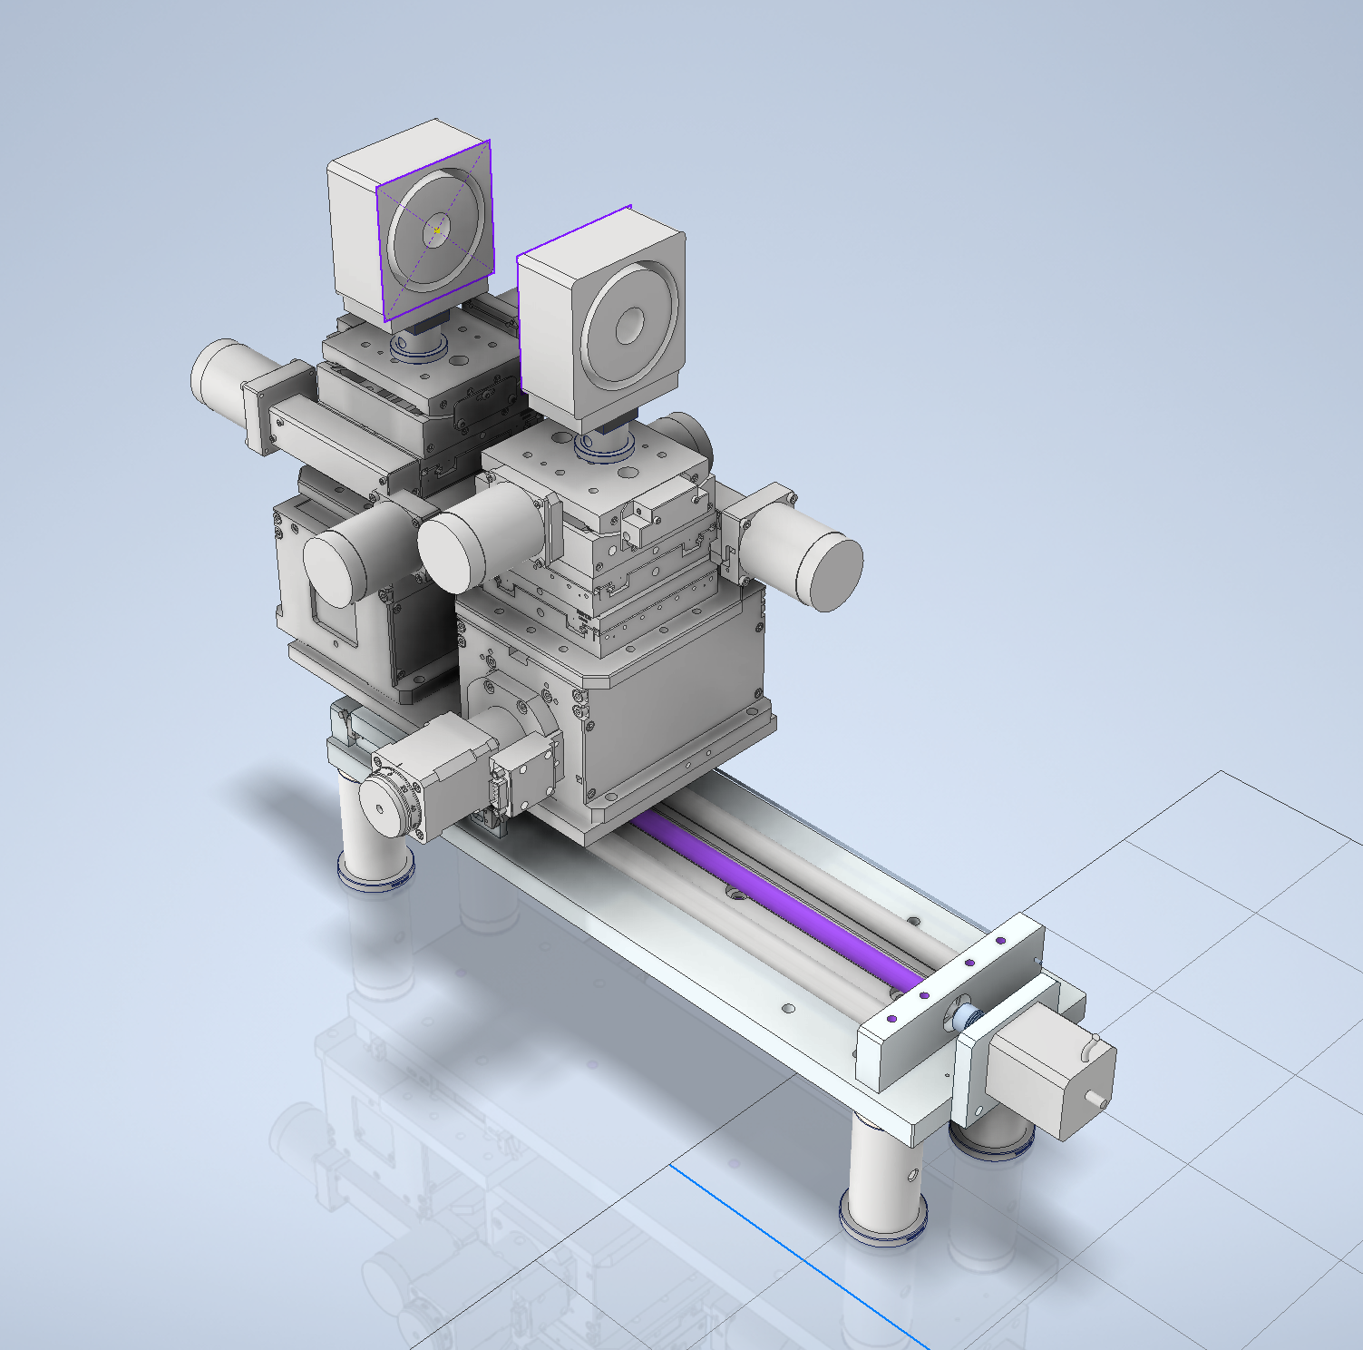
Update on beamline design
  We are progressing with a simplified PMQ design
  2 PMQs will be used with one being fixed in place and the other having XYZ and rotation about the central axis as degrees of freedom
  PMQ setup is designed so the magnets are detachable and moveable on a large stage
  This enables normal beam characterisation activity before PMQ use
  The cost of this design is still very high but delivers the flexibility in vacuum we need
12

Slide 13
Update on beamline model
Developed a simple model to help us identify the optimum set of parameters to go for to reach the biological end goals
Model uses Pstar CSDA ranges in water to work out the proton dose deposited at the end of the beamline
Proton numbers derived from experimental data then we are free to vary:
    Beam radius
    Beamline transmission
    Repetition rate
    Energy-range of protons being considered
There are a couple of potential solutions for >40 Gy/s (everything is a compromise!)
13

Slide 14
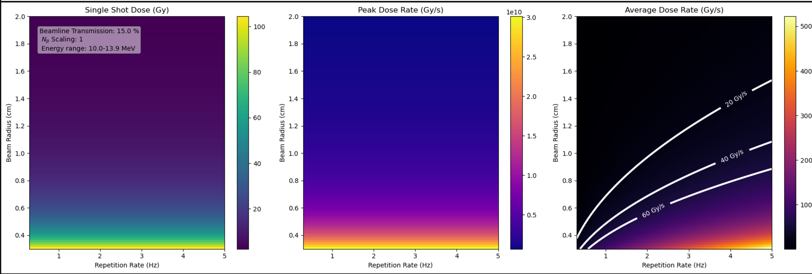

Update on beamline model
This simple model suggests operating above 2 Hz with around 600 micron spot we could reach 40 Gy/s
The model is quite simplistic at the moment. Doesn’t take into account losses in the windows or the actual beam profile at the end of beamline
SCAPA and the systems in Bunker B are not yet operating > 1Hz so this is very much a stretching target. The route to bring this closer is improving the proton flux in SCAPA (December source experiment)
14

Slide 15
Current system risks/status
We have seen some growing damage on the parabola, gratings, final turning mirror and the pellicle
The gratings are not replaceable in the short term, the final turning mirror is (we might switch to a dielectric mirror to improve longevity)
We have a new parabola on order with delivery in the next couple months
The pellicle performance is concerning and more work is needed to resolve
All of these effects act to reduce energy on target and the quality of the focal spot reducing the performance of the source
15

Slide 16
Proposed Experiment Stages & Gateways
I. Design & Procurement
II. Assembly & Alignment
III. Source Characterisation
IV. Radiobiology
Start of BP1 funding
Order of PMQ XYZ stage (5-7 week delivery)
Order of cell station vacuum parts (4 weeks delivery)
Manufacture of thin window
Manufacture of Oxford cell station
Construction of the cell station and updated TP beamline
Definition of an offline alignment line
Construction and offline alignment of PMQ setup
Install of PMQ system in vacuum chamber
1 week of SCAPA beamtime
Laser Beamline alignment (0.5 days)
Source optimisation w/o PMQ (0.5 days)
PMQ transmission, activation and debris test (0.5 days)
Lanex/beam profiler measurement at end of beamline (1 day)
PMQ position optimisation (0.5 days)
RCF measurements through beamline (0.5 days)
Full cell assembly RCF measurement (0.5 days)
2 weeks of SCAPA beamtime (with a gap between the alignment week)
Laser Beamline alignment (0.5 days)
Source optimisation with PMQs (1 day)
Dosimetry and source stability measurements (2 days)
Cell irradiation (6.5 days) + regular dosimetry
16

Slide 17
Summary
We are in a generally good position for the beam time. The proton source has been developed and optimised during experiments in July 2024 and September 2024…more to come in December 2024
We have completed model calculations using this data and have identified a way to potentially achieve the required absorbed dose in good time
The experiment will ramp up from beam and diagnostic optimisation, to dose calibration and then finally the irradiation.
Potential issues are purchase of the PMQ parts, alignment of the beamline and the long term performance of the system due to pellicle damage
17

Slide 18
X THE PLACE OF USEFUL LEARNING

