Slide 1
SUMMARY OF Transverse BEAM dynamics

Slide 2
er
Recall - Hill’s Equation and Solutions
Piecewise Solution
Courant-Snyder Solution

Slide 3

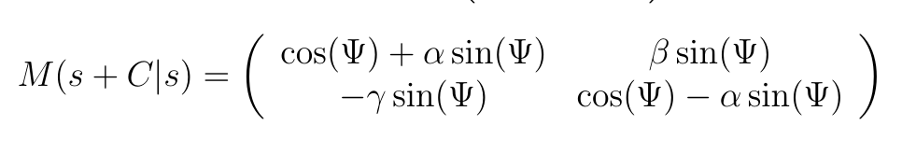
er
Recall – One-turn map, lattice functions
One-turn
map
Propagating lattice functions

Slide 4
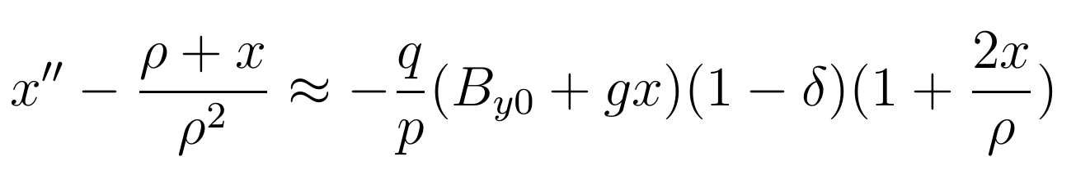
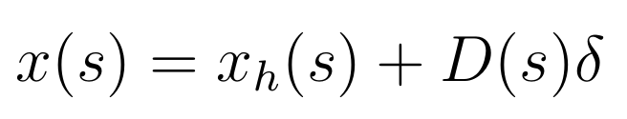
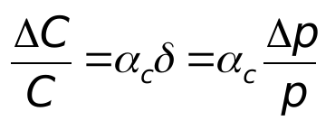
er
Recall – Dispersion, Momentum Compaction
Dispersion
E.g. Dipoles
Linear momentum compaction

Slide 5
er
Recall – Dispersion, Momentum Compaction
Dispersion
E.g. Dipoles
Linear momentum compaction

Slide 6
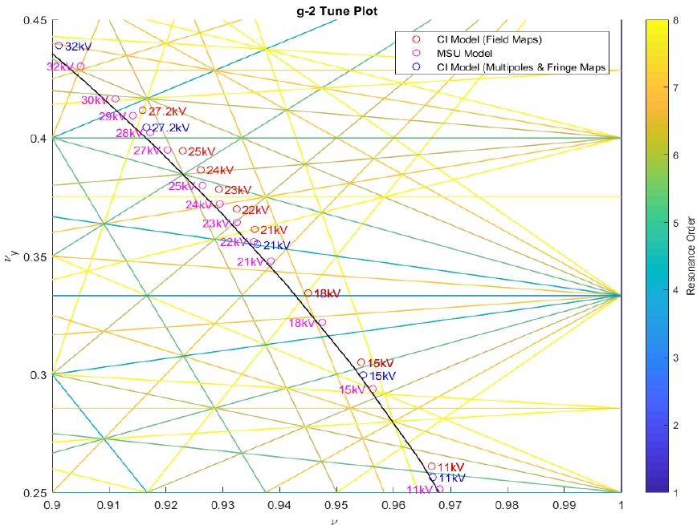
er
Recall – Tune, Resonances, Chromaticity
Tune and resonances
Natural chromaticity
Reducing chromaticity using sextupoles

Slide 7
er
Recall – Tune, Resonances, Chromaticity
Tune and resonances
Natural chromaticity
Reducing chromaticity using sextupoles

Slide 8
er
Recall – Tune, Resonances, Chromaticity
Tune and resonances
Natural chromaticity
Reducing chromaticity using sextupoles

Slide 9
longitudinal BEAM dynamics

Slide 10
Longitudinal dynamics
So far we have studied transverse motion (x,x’) (y,y’). Now we need to study the remaining motion involving the coordinates in the longitudinal direction. This is called synchrotron motion.
One way of proceeding would be to define longitudinal lattice functions, by analogy to our studies of transverse beam dynamics, but a different approach is usually taken.
The synchrotron tune is typically much less than the transverse tunes:
As the motion is slow, we can ignore the s-dependent effects around the ring, and avoid a longitudinal Courant-Snyder formalism.
In addition, we might expect to use z and z’ as the longitudinal coordinates. Instead of z’, we typically use the momentum deviation δ or the energy deviation.

Slide 11
Longitudinal dynamics
So far we have studied transverse motion (x,x’) (y,y’). Now we need to study the remaining motion involving the coordinates in the longitudinal direction. This is called synchrotron motion.
One way of proceeding would be to define longitudinal lattice functions, by analogy to our studies of transverse beam dynamics, but a different approach is usually taken.
The synchrotron tune is typically much less than the transverse tunes:
As the motion is slow, we can ignore the s-dependent effects around the ring, and avoid a longitudinal Courant-Snyder formalism.
In addition, we might expect to use z and z’ as the longitudinal coordinates. Instead of z’, we typically use the momentum deviation δ or the energy deviation.

Slide 12
An RF cavity in a ring
Let’s add an RF cavity to our storage ring.
This cavity is designed to generate a time-dependent longitudinal electric field to transfer energy to the particle.
RF cavity

Slide 13
An RF cavity in a ring
Let’s add an RF cavity to our storage ring.
This cavity is designed to generate a time-dependent longitudinal electric field to transfer energy to the particle.
RF cavity

Slide 14
RF waveform and bunches arriving in a RF cavity
Accelerating voltage
Synchronous bunch
Time
Bunch arriving late
The RF voltage applied to the particle is sinusoidal in time
Choose the RF frequency to be an integer multiple of the revolution frequency. This is called synchronism.

Slide 15
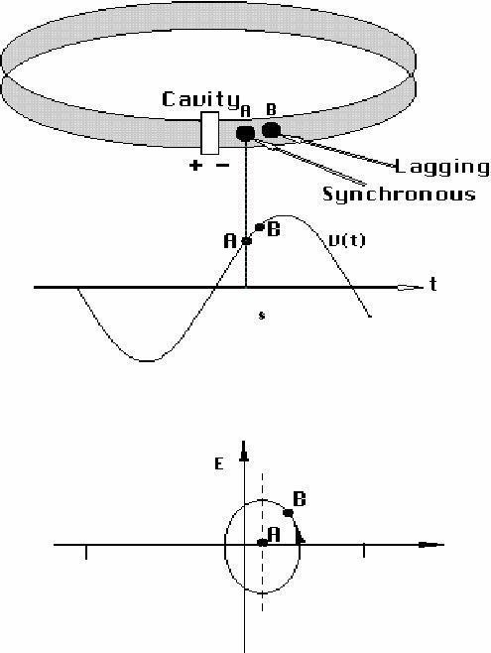
Cavity synchronism
The particle at the centre of the bunch, called the synchronous particle, acquires the right amount of energy such that it experiences the same voltage difference on each turn.
Particles experience a voltage difference across the cavity of
In the case of no acceleration, a synchronous particle has 𝜙_{s}= 0, and so it ‘see’s the zero of the sine function.
Particles arriving early see φ<φ_{s}
Particles arriving late see φ>φ_{s}
For this discussion, we’ll assume that if 0 <𝜙<π the synchronous particle gains energy on each turn of the machine.
V
t

Slide 16
The principle of phase stability
For synchronism to work, the RF frequency must be an integer multiple of the revolution frequency
so the beam always sees the correct accelerating field.
h is the ‘harmonic number’.
But what if h is slightly non-integer, e.g. h=200.0000000001
or what if a particle has a slightly different revolution frequency?
After many turns the beam will be out of phase with the RF system and will no longer be accelerated.
We need the motion to be stable even if there are small errors in the frequencies / spread in energies.
This is ‘phase stability’.
The concept of phase stability was developed by McMillan and Veksler in 1945.
i) Choose your RF frequency. This determines the energy of a synchronous particle.
ii) Particles with slight deviation in longitudinal coordinates will now oscillate (slowly) around this (ideal) synchronous particle.

Slide 17
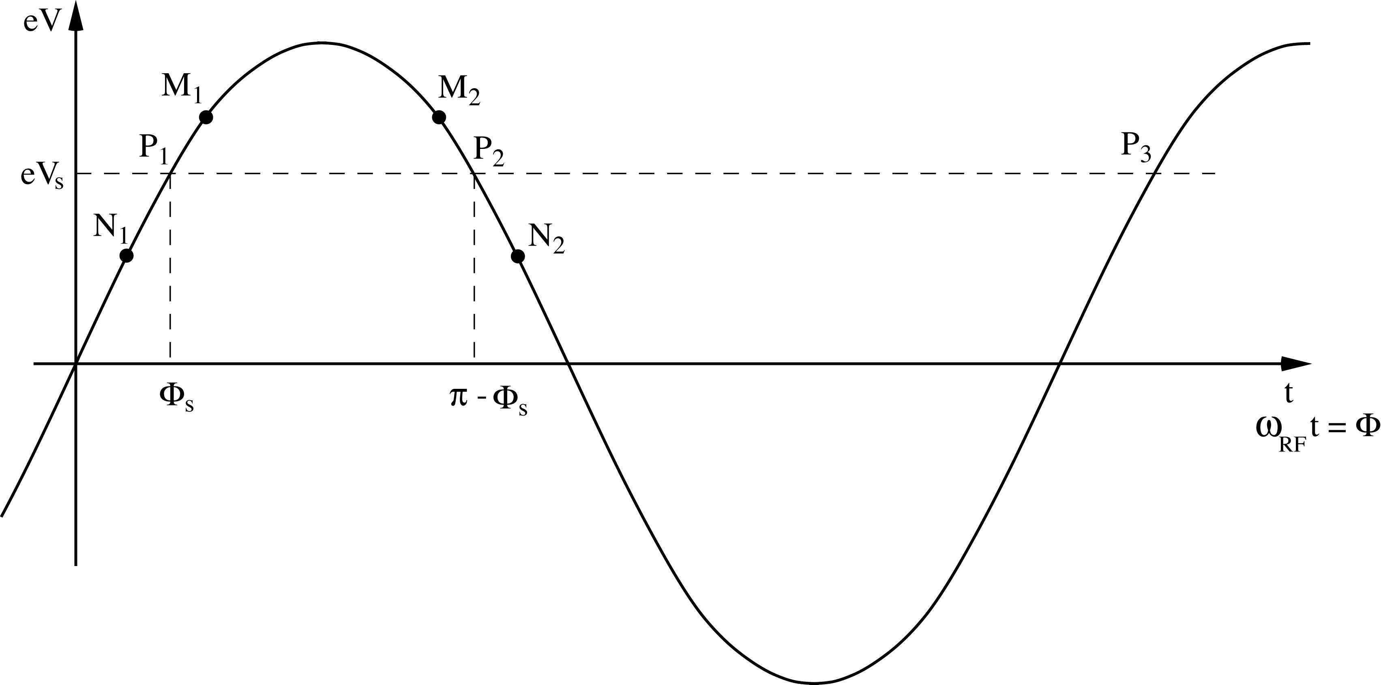
The principle of phase stability (stable phase)
Let’s consider a spread of energy (momenta) in the beam.
Let’s consider a ring for which the synchronism condition is fulfilled by a phase 𝜙s.
eV_{s} is the energy gain in one accelerating region required for the particle to reach the next accelerating region with the same RF phase. This fixes the phases P₁ ,P₂, etc
First consider P₁. Imagine a particle arrives a little later than the synchronous particle. So it sees a slightly later phase of the RF, so sees M₁. This means it gets a larger momentum kick, so has a higher speed and gets around the ring faster. It arrives slightly earlier than it did, and hence moves towards P₁.
Similarly, an early particle will see N₁, get a smaller kick and move towards P₁

Slide 18
The principle of phase stability (stable phase)
Let’s consider a spread of energy (momenta) in the beam.
Let’s consider a ring for which the synchronism condition is fulfilled by a phase 𝜙s.
eV_{s} is the energy gain in one accelerating region required for the particle to reach the next accelerating region with the same RF phase. This fixes the phases P₁ ,P₂, etc
First consider P₁. Imagine a particle arrives a little later than the synchronous particle. So it sees a slightly later phase of the RF, so sees M₁. This means it gets a larger momentum kick, so has a higher speed and gets around the ring faster. It arrives slightly earlier than it did, and hence moves towards P₁.
Similarly, an early particle will see N₁, get a smaller kick and move towards P₁

Slide 19
The principle of phase stability (stable phase)
Let’s consider a spread of energy (momenta) in the beam.
Let’s consider a ring for which the synchronism condition is fulfilled by a phase 𝜙s.
eV_{s} is the energy gain in one accelerating region required for the particle to reach the next accelerating region with the same RF phase. This fixes the phases P₁ ,P₂, etc
First consider P₁. Imagine a particle arrives a little later than the synchronous particle. So it sees a slightly later phase of the RF, so sees M₁. This means it gets a larger momentum kick, so has a higher speed and gets around the ring faster. It arrives slightly earlier than it did, and hence moves towards P₁.
Similarly, an early particle will see N₁, get a smaller kick and move towards P₁

Slide 20
The principle of phase stability (unstable phase)
Let’s consider a spread of energy (momenta) in the beam.
Let’s consider a ring for which the synchronism condition is fulfilled by a phase 𝜙s.
eV_{s} is the energy gain in one accelerating region required for the particle to reach the next accelerating region with the same RF phase. This fixes the phases P₁ ,P₂, etc
Next consider P₂. Imagine a particle arrives a little later than the synchronous particle. So it sees a slightly later phase of the RF, so sees N₂. This means it gets a smaller momentum kick, so has a lower speed and gets around the ring slower. It arrives even later than it did, and hence moves away from P₂.
Similarly, an early particle will see M₂, get a larger kick and move away from P₂.

Slide 21
The principle of phase stability (unstable phase)
Let’s consider a spread of energy (momenta) in the beam.
Let’s consider a ring for which the synchronism condition is fulfilled by a phase 𝜙s.
eV_{s} is the energy gain in one accelerating region required for the particle to reach the next accelerating region with the same RF phase. This fixes the phases P₁ ,P₂, etc
Next consider P₂. Imagine a particle arrives a little later than the synchronous particle. So it sees a slightly later phase of the RF, so sees N₂. This means it gets a smaller momentum kick, so has a lower speed and gets around the ring slower. It arrives even later than it did, and hence moves away from P₂.
Similarly, an early particle will see M₂, get a larger kick and move away from P₂.

Slide 22
The principle of phase stability (unstable phase)
Let’s consider a spread of energy (momenta) in the beam.
Let’s consider a ring for which the synchronism condition is fulfilled by a phase 𝜙s.
eV_{s} is the energy gain in one accelerating region required for the particle to reach the next accelerating region with the same RF phase. This fixes the phases P₁ ,P₂, etc
Next consider P₂. Imagine a particle arrives a little later than the synchronous particle. So it sees a slightly later phase of the RF, so sees N₂. This means it gets a smaller momentum kick, so has a lower speed and gets around the ring slower. It arrives even later than it did, and hence moves away from P₂.
Similarly, an early particle will see M₂, get a larger kick and move away from P₂.

Slide 23
The principle of phase stability
So if an increase in energy is transferred into an increase in speed, M₁ & N₁ will move towards P₁(stable), while M₂ & N₂ will move away from P₂ (unstable).
This is the principle of phase stability.
This suggests that with the right choice of phase, particles will oscillate around the synchronous phase, even though they have a natural spread of momenta.

Slide 24
Relativistic considerations
i) For a highly-relativisitic particle an increase in energy translates to an increase in Lorentz factor but only a small increase in speed.
ii) Particles with lower/higher momenta move on an inner/outer dispersive orbit, with a shorter/longer revolution time.
For highly-relativistic particles, higher energy means a longer revolution time, this means P₂ becomes a stable point and P₁ becomes an unstable fixed point. Now M₁ & N₁ will move away from P₁(unstable), while M₂ & N₂ will go towards P₂ (stable).

Slide 25
Relativistic considerations
The change of ring behaviour when P₁ and P₂ swap between stable and unstable is called transition.
For highly-relativistic particles, higher energy means a longer revolution time, this means P₂ becomes a stable point and P₁ becomes an unstable fixed point. Now M₁ & N₁ will move away from P₁(unstable), while M₂ & N₂ will go towards P₂ (stable).

Slide 26



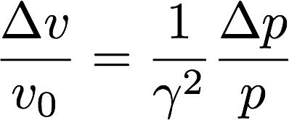
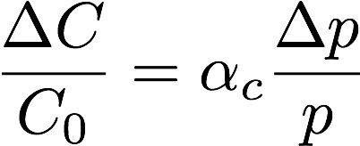
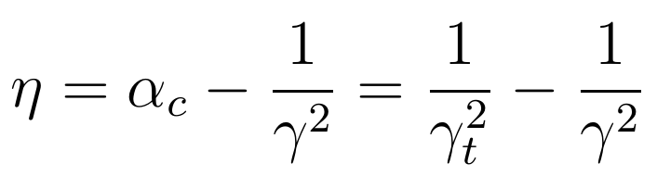
Phase slip and transition energy
Particles with different momenta travel on different paths. The revolution period depends on the circumference taken by a particle and its speed
The fractional revolution frequency for a slightly different circumference and velocity is therefore given by
The particle arrival time is affected both by a longer path around the machine and also by the particle moving faster. We can relate both these contributions to the fractional momentum deviation,
And define the phase slippage factor by

Slide 27
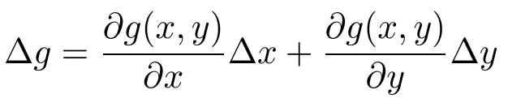
Phase slip and transition energy
Particles with different momenta travel on different paths. The revolution period depends on the circumference taken by a particle and its speed
The fractional revolution frequency for a slightly different circumference and velocity is therefore given by
The particle arrival time is affected both by a longer path around the machine and also by the particle moving faster. We can relate both these contributions to the fractional momentum deviation,
And define the phase slippage factor by

Slide 28
Phase slip and transition energy
Particles with different momenta travel on different paths. The revolution period depends on the circumference taken by a particle and its speed
The fractional revolution frequency for a slightly different circumference and velocity is therefore given by
The particle arrival time is affected both by a longer path around the machine and also by the particle moving faster. We can relate both these contributions to the fractional momentum deviation,
And define the phase slippage factor by

Slide 29
Phase slip and transition energy
Particles with different momenta travel on different paths. The revolution period depends on the circumference taken by a particle and its speed
The fractional revolution frequency for a slightly different circumference and velocity is therefore given by
The particle arrival time is affected both by a longer path around the machine and also by the particle moving faster. We can relate both these contributions to the fractional momentum deviation,
And define the phase slippage factor by

Slide 30

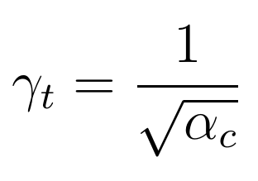



Transition energy
The quantity is called the transition gamma and is related to the momentum compaction factor of the lattice:
Below the transition energy we have
and a higher momentum particle has a revolution period shorter than that of the synchronous particle and so makes a single turn back to the cavity in a shorter time. This means our fixed point P₁ is stable and P₂ is unstable.
Above the transition energy we have
And the opposite is true. Now higher momentum particles have a revolution period greater than that of the synchronous particle. This means our fixed point P₁ is unstable and P₂ is stable.
At the transition energy the machine is isochronous for all momenta and all particle circulate with the same period. I.e.
(Some authors define the phase slippage eta the other way around!)

Slide 31
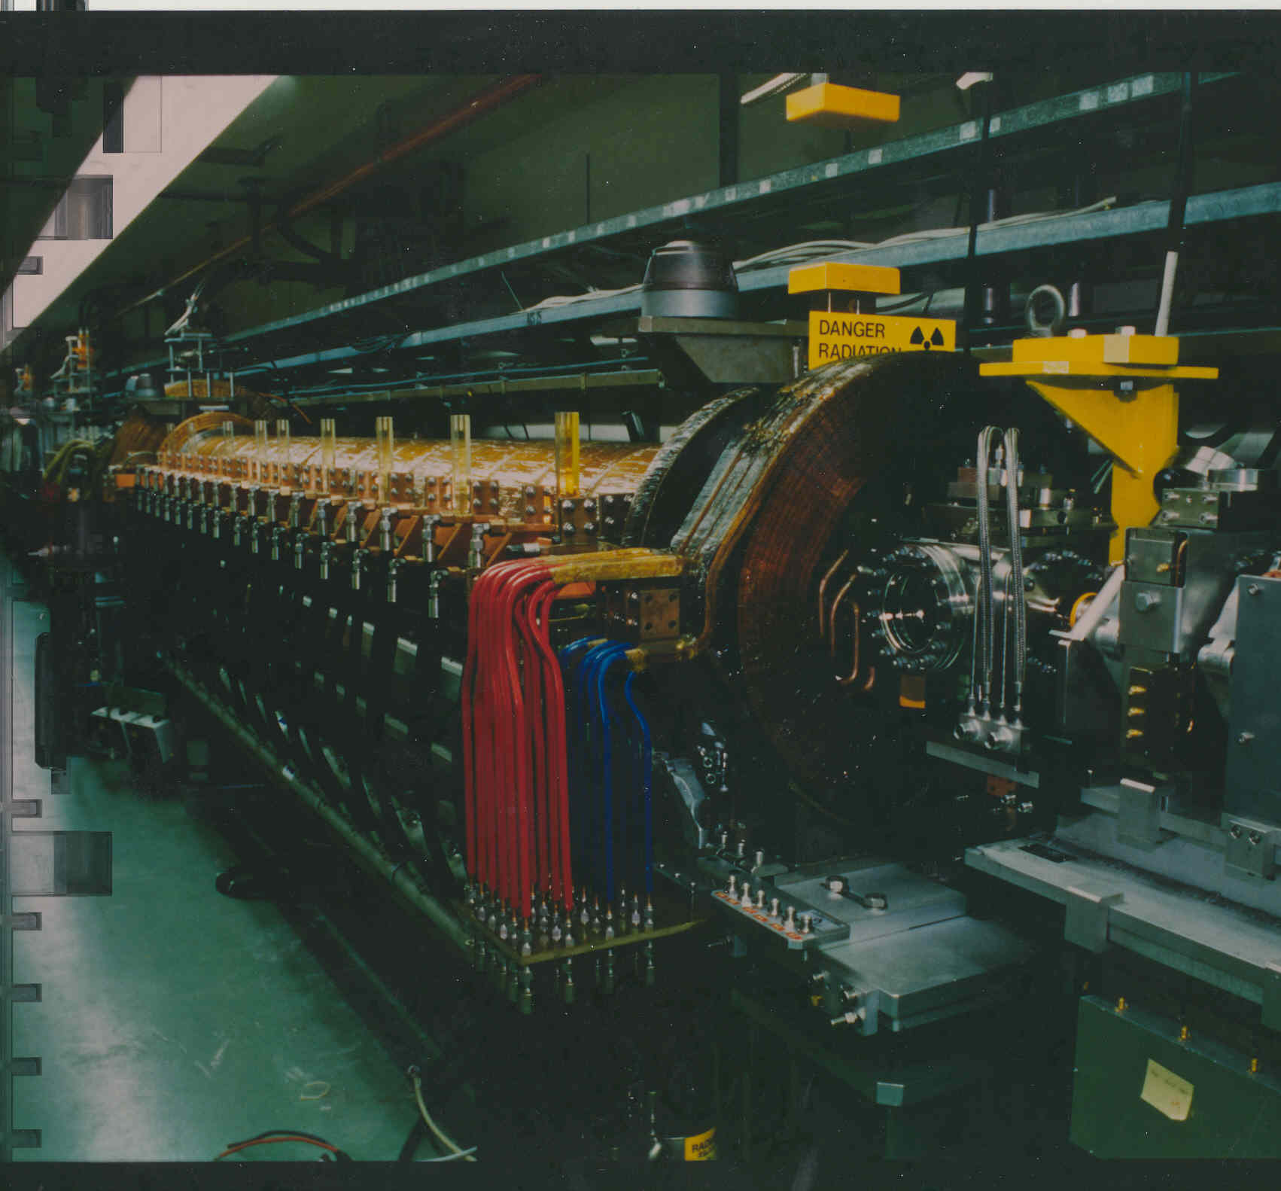
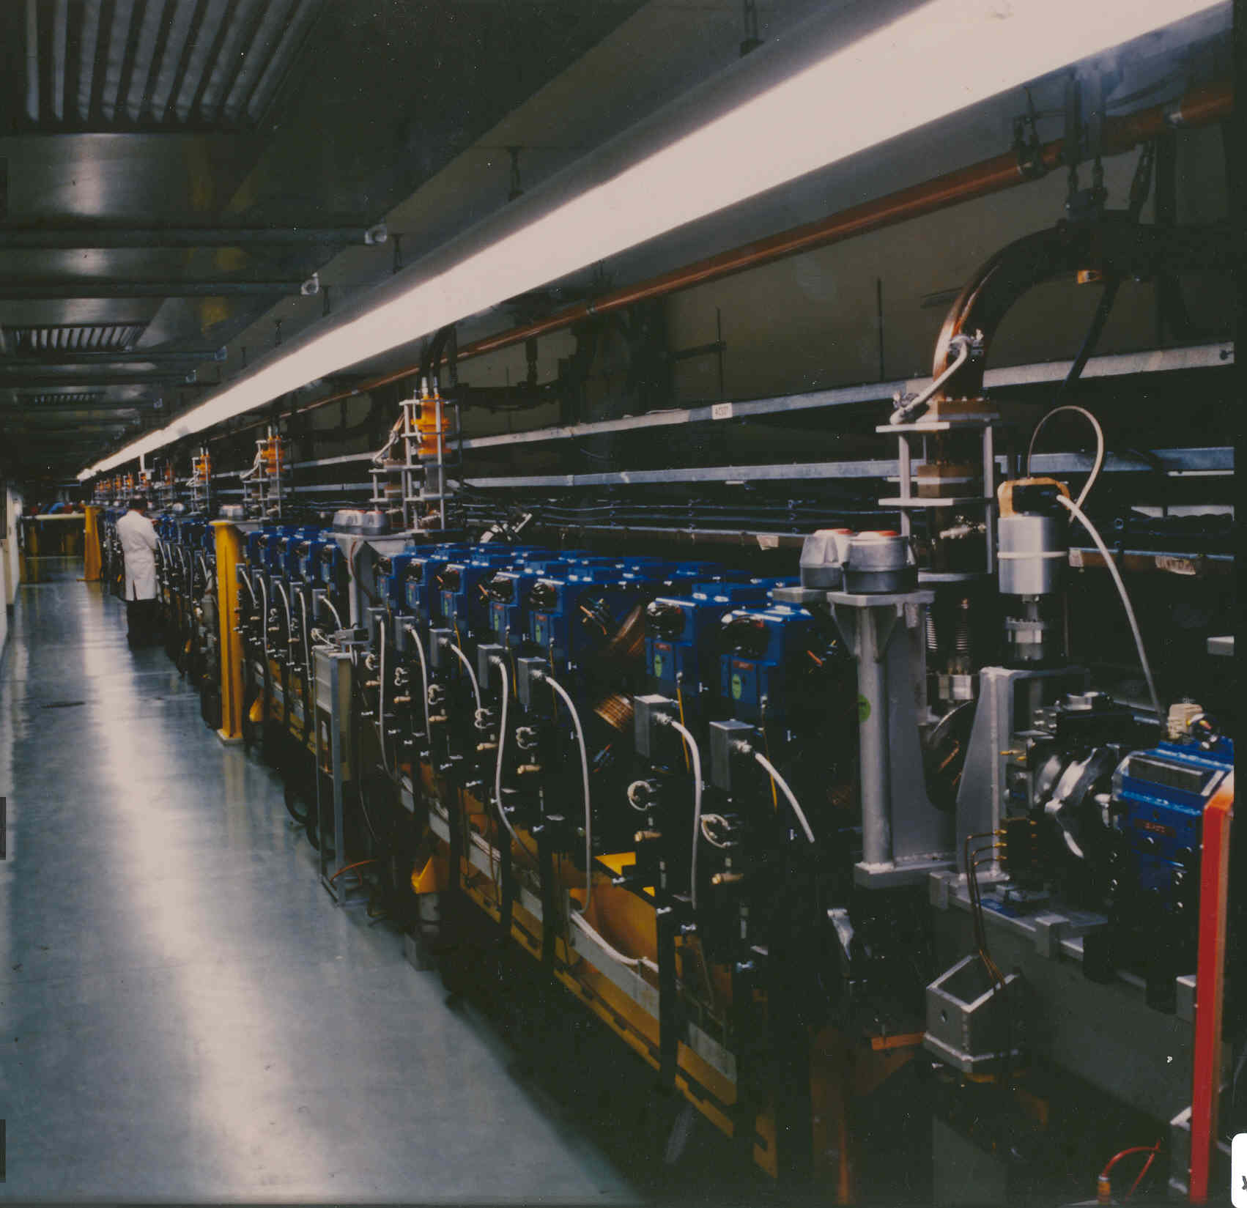
Linacs
Accelerating section, of an electron linac, equipped with quadrupoles
Accelerating section, of an electron linac, equipped with solenoids
(In a linac, only speed changes matter for longitudinal stability as there are no dipoles and hence no momentum compaction)

Slide 32
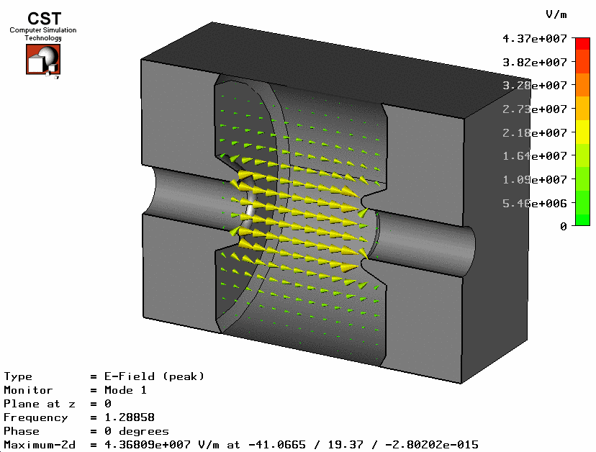
A ‘real’ cavity on-axis field
Courtesy of Graeme Burt

Slide 33
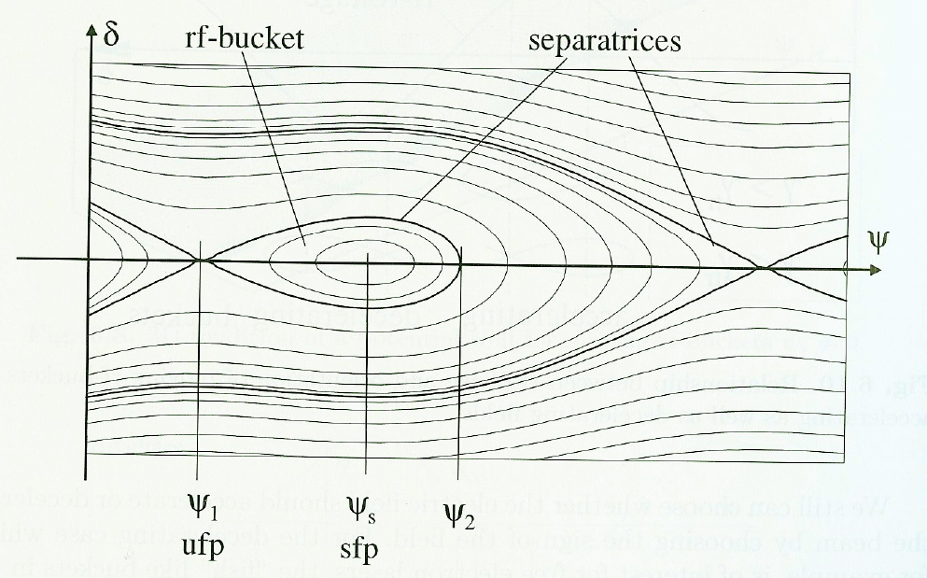
The phase space portrait
Given the parameters of the cavity, we can compute the motion in the longitudinal phase space.
Wiedemann p212
The separatrix starts from a point very close to (but not exactly at) the unstable fixed point, moves away and forms an ‘alpha’ or ‘fish shape’ around the stable fixed point. The area enclosed is the bucket and corresponds to stable motion.

Slide 34


Stable and unstable fixed points (SFP, UFP)
Our “fixed points” are
If the synchronous phase P₂ in the diagram below is stable, P₂ is a SFP. Hence P₁ is an UFP. This is above transition.
If the synchronous phase P₁ in the diagram below is stable, P₁ is a SFP. Hence P₂ is an UFP. This is below transition.

Slide 35
The phase space portrait – above and below transition
Each fish-shaped curve corresponds to a different value of the synchronous phase (RF settings).
(Ignore the odd units of the energy axis….
It’s expressed in terms of a normalised momenta deviation).

Slide 36
Buckets and bunches – LHC example
The particles oscillate back and forth in phase/energy
RF Voltage
LHC bunch spacing = 25 ns = 10 buckets ⇔ 7.5 m
RF bucket
time
2.5 ns
LHC harmonic number is 35,640
RF frequency is 400 MHz
Every 10th bucket is filled
Bunch spacing is 7.5m

Slide 37
Longitudinal dynamics (variables)
The RF acceleration process relates the energy gained by a particle to the RF phase experienced by the same particle. Since there is a well-defined synchronous particle which always experiences the same rf phase ψ₀, and gains the nominal energy E₀, it is sufficient to follow other particles with respect to that particle. Possible choice of “reduced variables” are
revolution frequency : Δf_{r} = f_{r} – f_{rs}
particle RF phase : Δψ = ψ – ψ_{s}
azimuth angle : Δθ = θ - θ_{s}
particle momentum : Δp = p - p_{s}
particle energy : ΔE = E – E_{s}

Slide 38
Longitudinal dynamics (variables)
The RF acceleration process relates the energy gained by a particle to the RF phase experienced by the same particle. Since there is a well-defined synchronous particle which always experiences the same rf phase ψ₀, and gains the nominal energy E₀, it is sufficient to follow other particles with respect to that particle. Possible choice of “reduced variables” are
revolution frequency : Δf_{r} = f_{r} – f_{rs}
particle RF phase : Δψ = ψ – ψ_{s}
azimuth angle : Δθ = θ - θ_{s}
particle momentum : Δp = p - p_{s}
particle energy : ΔE = E – E_{s}

Slide 39
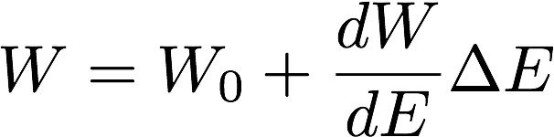
Longitudinal motion
The periodic longitudinal motion around the nominal phase is known as synchrotron motion.
Let’s study this motion in a more quantitative way by looking at energy balance for one complete turn of the machine.
The nominal quantities are denoted by ‘0’ subscripts, U is the peak voltage and W denotes the energy loss per revolution of the particle.
The nominal particle energy balance is
An arbitrary particle which has a slight momentum deviation and a slight phase deviation from the nominal particle has energy balance
We write the energy loss per turn for the arbitrary particle as a linear function in the energy deviation

Slide 40
Longitudinal motion (smooth approximation)
If we take the difference between the one-turn energy balance of the nominal and arbitrary particle, we get an expression for the energy difference between the two
One synchrotron oscillation lasts many turns of the machine. So to get the rate of change of the energy deviation we can simply divide by the revolution time T₀
This gives a differential equation for the energy deviation in the smooth approximation.
Now we want a differential equation for the phase difference.

Slide 41
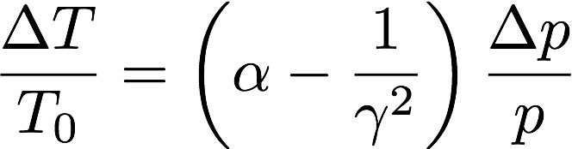
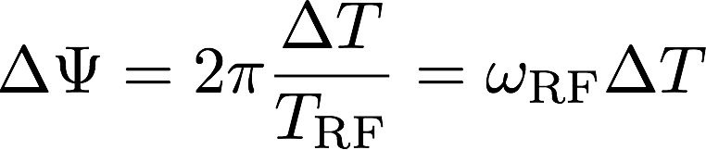
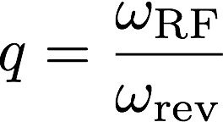
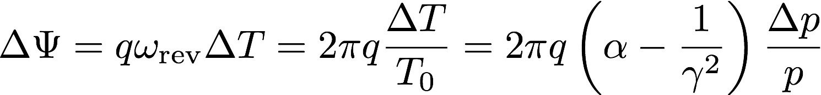

Getting an equation for the phase difference
We already have a useful starting expression a few slides ago, when we derived
c
in our discussion of the transition ‘gamma’.
As the accelerating RF frequency has period T_{RF}
Recall the RF frequency should be an integer multiple of the revolution frequency. The harmonic number q (or h) is
Therefore the more general expression for the phase deviation is given by
c

Slide 42
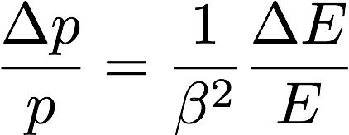
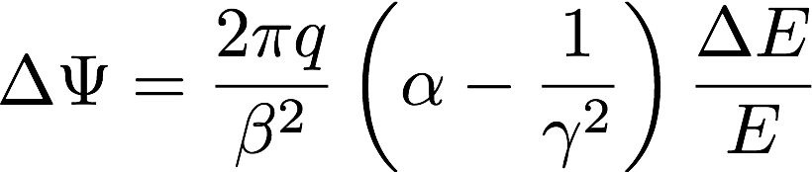
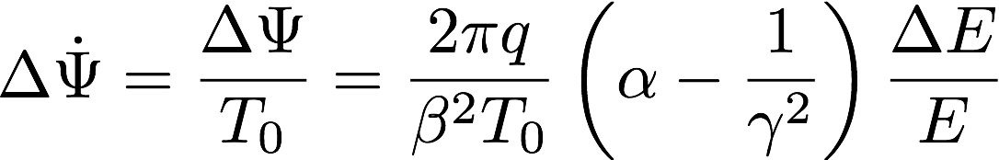
Phase differential equation
Let’s swap momentum deviation for energy deviation (convention) using
giving an expression for the phase deviation
‘Differentiating’ this with respect to time using the smooth approximation as before gives us
Together with the first order equation for the energy deviation
We can either solve the equations numerically, or combine them to make a second order ODE.

Slide 43
Phase differential equation
Let’s swap momentum deviation for energy deviation (convention) using
giving an expression for the phase deviation
‘Differentiating’ this with respect to time using the smooth approximation as before gives us
Together with the first order equation for the energy deviation
We can either solve the equations numerically, or combine them to make a second order ODE.

Slide 44

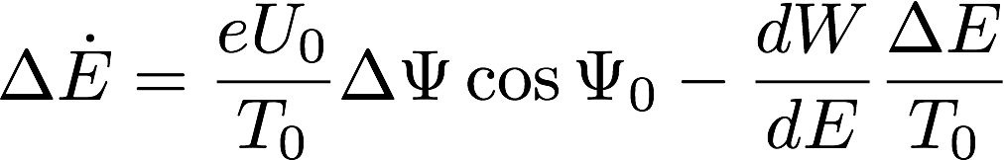
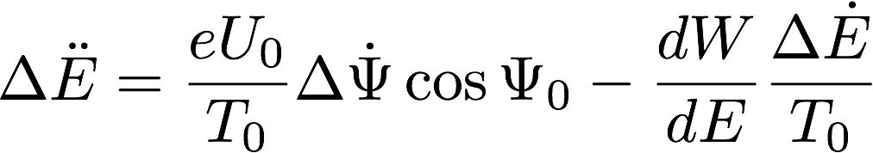
Longitudinal motion
Let’s make a second order ODE for small momentum deviations i.e.
Expanding the sine function using standard identities we get
Which is approximately
and so our energy equation becomes
which we can differentiate to get

Slide 45
Longitudinal motion
Let’s make a second order ODE for small momentum deviations i.e.
Expanding the sine function using standard identities we get
Which is approximately
and so our energy equation becomes
which we can differentiate to get

Slide 46
Longitudinal motion
We can eliminate the phase differential to obtain

Slide 47
Longitudinal motion
We can eliminate the phase differential to obtain

Slide 48
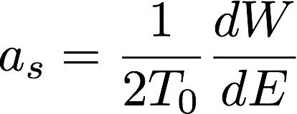
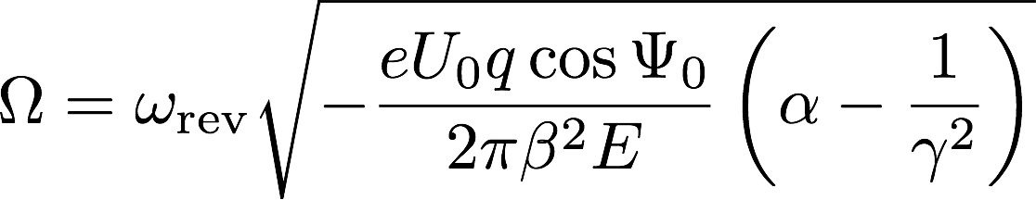
Longitudinal motion
We can eliminate the phase difference from the ODE to obtain
Here we have defined a damping term as
and the ‘frequency’ of the motion as
c
This differential equation is the same form as the one for a damped harmonic oscillator, and means our motion in longitudinal phase space is (at least for small values of the energy deviation) oscillatory around the nominal energy provided the damping term is not too large.
We can use our knowledge of differential equations to find the solutions to this equation…

Slide 49






Longitudinal motion
We adopt a trial solution for the energy deviation, where the constant may in general be complex
This gives the characteristic equation for ω,
Which can be solved to get
If we assume light damping, then the second term is purely imaginary and we obtain an oscillatory solution for the energy deviation
Frequency
Damping constant

Slide 50
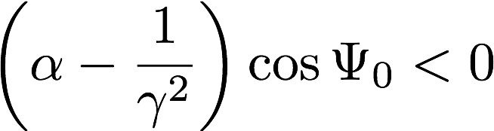
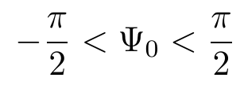
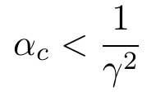
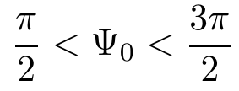
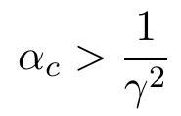
Above and below transition
Recalling the expression for the frequency,
c
Stable solutions require this to be a real number, and so we require that
c
There are two solutions for this stable phase, namely the ones we derived previously when we talked about the transition energy. This solution below transition is
and
And above transition is
and

Slide 51
longitudinal phase analysis - summary
Choose the required energy gain per turn. Knowing the RF voltage we obtain the synchronous phase. There are two possible phase solutions between 0 and 2π.
Here we assume we want acceleration, so U₀ > 0
We now check the phase slippage factor. I.e. how does the frequency of revolution change for a small change dp/p? Positive means above transition, meaning the synchronous phase lies between π/2 and π. Negative means below transition, meaning the synchronous phase lies between 0 and π/2.
The curve in phase space which divides the stable and unstable regions of flow is called the separatrix. The stable region surrounds the stable fixed point. The separatrix can be found by a Hamiltonian analysis of the system (beyond this course).
The region inside the separatrix, where stable motion exists, is called the bucket. Expressions exist (beyond this course) for the width (in phase), height (in energy) and the area (maximum longitudinal emittance) of this bucket.
Motion is stable near the stable fixed point and unstable near the unstable fixed point. So particles cluster around the SFP and stay away from the UFP. Hence we observe the fact that beams in a synchrotron when RF is applied are necessarily bunched.

Slide 52
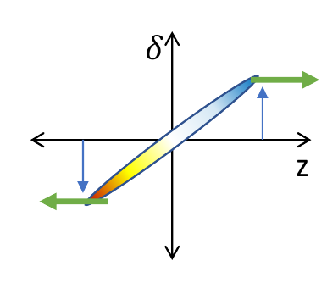
longitudinal phase analysis – the need for compression
Bunches of particles accelerated in this way have a spread of momenta imprinted on the bunch by the change of rf phase with time.
This can lead to a spread in the bunch length.
Some (many) applications require very short bunches.
Figure courtesy of G. Perez Segurana
Therefore in some machines a “bunch compressor” is necessary.
This often takes the form of a chicane or an arc.

Slide 53
Synchrotron radiation and damping

Slide 54
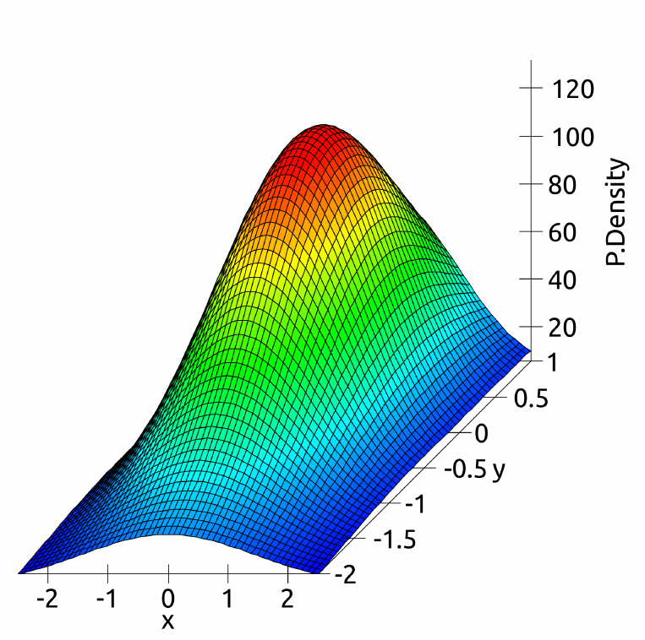
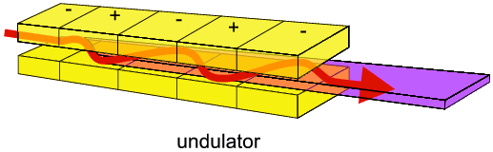
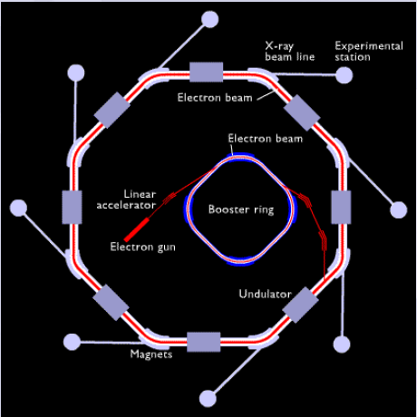
Emission of synchrotron radiation
All accelerating charges radiate electromagnetic radiation.

Slide 55
It can be intense...

Slide 56
And can interact with material...

Slide 57
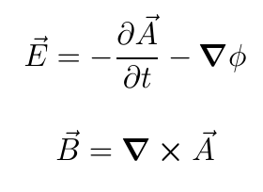
Retarded potentials
The radiation field is given in terms of the potentials by
Where the potentials are the retarded potentials (see EM course).
The calculations of E and B lead to a doughnut-shaped pattern of radiation power in the instantaneous rest frame of an accelerating, charged particle.
This means the pattern is also doughnut-shaped in the non-relativistic case in the lab, but in the relativistic case becomes two back-to-back cones in the lab after the appropriate Lorentz transformation.

Slide 58
Emission of synchrotron radiation from a dipole bend
The radiation is emitted into a cone with an opening angle of ~1/γ, where γ is the relativistic Lorentz factor.
(We shall assume the radiation is emitted in the direction of motion i.e. v is close to c)

Slide 59
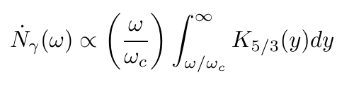

The spectrum of bending radiation
A fixed observer sees a very short EM pulse of photons as the circulating electron bunch passes them turn after turn.
This gives a broad photon frequency spectrum characterised by the “critical energy”, which divides the spectrum into two regions of equal power.
We won’t be deriving the expression here, but for reference, the number of photons emitted per unit time as a function of frequency / energy is given by
where K is a modified Bessel function and the critical frequency is given by

Slide 60
The spectrum of bending radiation
A fixed observer sees a very short EM pulse of photons as the circulating electron bunch passes them turn after turn.
This gives a broad photon frequency spectrum characterised by the “critical energy”, which divides the spectrum into two regions of equal power.
The plot shows the spectrum for an electron beam of energy 5 GeV passing through a dipole of bend radius 12.2 m but the shape is universal.
The Physics of Accelerator Physics, K. Wille

Slide 61
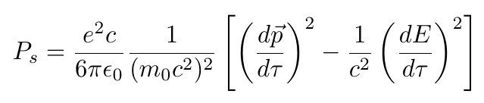

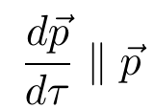
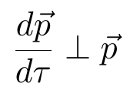
Larmor’s formula
To calculate the SR power in colliders, we’ll jump from the retarded potentials to the relativistic version of Larmor’s formula, giving the power emitted by a charged particle
This tells us that power is emitted in the form of SR if the momentum of the charged particle changes or its total energy changes.
We’ll deal with two limiting cases:
Linear
acceleration
Circular acceleration

Slide 62
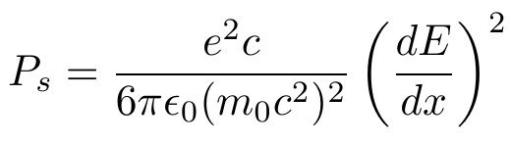
The linear case
For the case in linear acceleration (linacs), the spatial energy gradient is often known, and a short calculation gives a formula for the power radiated from linearly-accelerating particles:
Even a high field gradient such as dE/dx=35 MeV / m gives P_{s} around 10⁻¹⁶ W (for electrons).
For ultra-relativistic particles we can generally neglect this effect.

Slide 63




The circular case
Assume the motion is circular and the total energy stays the same. Larmor’s formula becomes
This can be written in terms of the energy of the particle E (for a relativistic particle) and the bending radius of the motion R
This formula was found by Lienard. Note it depends on the fourth power of the particle energy and the second power of the radius.
Comparing electrons to protons
i.e. SR much more important in electron machines

Slide 64
The circular case
Assume the motion is circular and the total energy stays the same. Larmor’s formula becomes
This can be written in terms of the energy of the particle E (for a relativistic particle) and the bending radius of the motion R
This formula was found by Lienard. Note it depends on the fourth power of the particle energy and the second power of the radius.
Comparing electrons to protons
i.e. SR much more important in electron machines

Slide 65
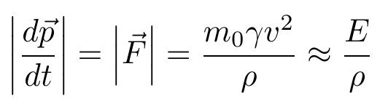
The circular case
Assume the motion is circular and the total energy stays the same. Larmor’s formula becomes
This can be written in terms of the energy of the particle E (for a relativistic particle) and the bending radius of the motion R
This formula was found by Lienard. Note it depends on the fourth power of the particle energy and the second power of the radius.
Comparing electrons to protons
i.e. SR much more important in electron machines

Slide 66
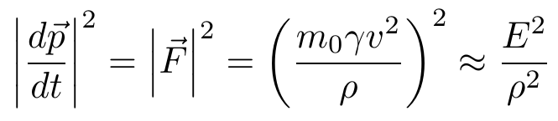
The circular case
Assume the motion is circular and the total energy stays the same. Larmor’s formula becomes
This can be written in terms of the energy of the particle E (for a relativistic particle) and the bending radius of the motion R
This formula was found by Lienard. Note it depends on the fourth power of the particle energy and the second power of the radius.
Comparing electrons to protons
i.e. SR much more important in electron machines

Slide 67
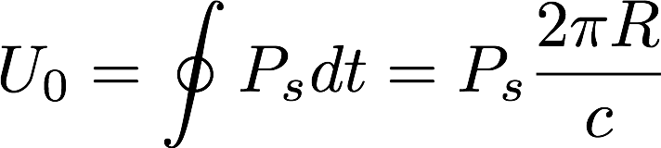
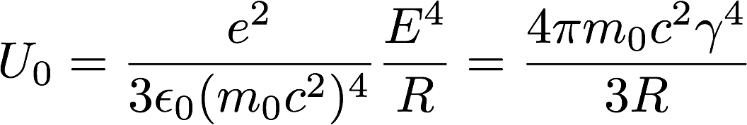
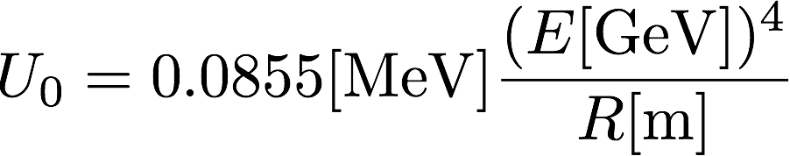
The circular case
We’d like to know the energy loss per turn i.e. for one complete revolution. We assume constant R (i.e. a circular machine) and P_{s}
We obtain a useful expression for the energy loss per turn of a circular machine
Choosing values for an electron (or positron) we arrive at

Slide 68
The circular case
We’d like to know the energy loss per turn i.e. for one complete revolution. We assume constant R (i.e. a circular machine) and P_{s}
Orbit period.
We obtain a useful expression for the energy loss per turn of a circular machine
Choosing values for an electron (or positron) we arrive at

Slide 69
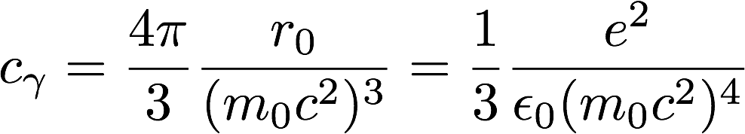
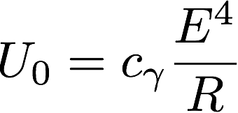




The circular case
We define the useful constant
giving the compact formula for the energy radiated per revolution
Rewriting the radius R using the beam rigidity
we end up with our final expressions for the energy lost per turn,
and the power radiated:
r₀=classical electron radius

Slide 70

The circular case
We define the useful constant
giving the compact formula for the energy radiated per revolution
Rewriting the radius R using the beam rigidity
we end up with our final expressions for the energy lost per turn,
and the power radiated:
r₀=classical electron radius

Slide 71
Energy losses
Wille
At around 100 GeV beam energy the SR losses get so large that it becomes too expensive to replace them with the RF systems (e.g. LEP).
We need to use either heavier particles (protons, muons, ...) or a larger bending radius.

Slide 72

Energy losses – e.g. the proposed FCC-ee at CERN
Eur. Phys. J. Special Topics 228, 261–623 (2019)

Slide 73
Energy losses – e.g. the proposed FCC-ee at CERN
Eur. Phys. J. Special Topics 228, 261–623 (2019)

Slide 74
Away from the design orbit
Note that we’ve implicitly assumed that we’re considering a particle on a circular reference orbit moving in an isomagnetic ring.
What if a particle is not on the reference orbit?
If the particle is not on the reference orbit but does have the reference energy, E, then the effect of the betratron oscillations on the synchrotron radiation emission will average out, as long as the fields vary linearly with displacement from the design orbit.
What if a particle does not have the reference energy / momentum?
That will affect the amount of synchrotron radiation emitted, and that’s what we’ll consider next.

Slide 75
Effect of radiation on beam
So far all our analysis of beams has assumed motion in dipoles, quadrupoles and sextupoles without any effects of radiation.
We now know a charged particle moving in an electromagnetic field (e.g. a dipole magnet or an rf cavity), will radiate.
What does this mean for the particle motion?
The radiation can produce damping effects in all planes, and lead to concepts such as equilibrium emittance, growing energy spread and beam polarization.

Slide 76






Radiation damping for longitudinal motion (rough calculation)
Synchrotron radiation gives a natural mechanism to damp the synchrotron oscillations of a particle:
Let E_{s} be the synchronous particle energy.
Imagine some particle has more energy by .
Then this particle will radiate more, moving its energy close to E_{s}.
The radiation power is
Hence we can show that for a period of orbit T0
Showing that the rate of energy loss varies linearly with and hence exponential damping will occur.
the change in ΔE is given by

Slide 77
it
Transverse damping
So the synchrotron radiation provides a natural damping mechanism scaling as U₀/E_{s}.
There is also a natural damping in the transverse plane too. The radiation takes energy from all three spatial directions, so p_{x} and p_{y} reduce.
Momentum is regained longitudinally in the RF cavity.
This means the ratios p_{x}/p_{z} and p_{y}/p_{z} drop, and so the slopes x’ and y’ reduce.
Hence radiation damps the beam motion in all three planes.
The full calculation of how fast the emittance drops is too long for this course, but let’s look at the general procedure and some of the results.

Slide 78


Result of a more detailed calculation vertically
To get the correct answer for how the emittance reduces with time due to damping, we need to be a little more careful in our calculation. Let’s look at the answer for all three planes separately.
Vertically, it turns out the rough estimate we derived for longitudinal damping is quite accurate, and the vertical emittance damps according to
With the damping time given by
This is valid for v≈c, such that E=pc.

Slide 79


Result of a more detailed calculation longitudinally
We have to do a bit more work to get the correct effects for longitudinal damping but the results are given here.
We introduce the longitudinal beam emittance:
Then
where we define the longitudinal damping time
and introduce j_{z} which is an example of a ‘damping partition number’.

Slide 80


Damping partition numbers and radiation integrals
The full analysis to calculate jz starts by considering the radiated energy per turn
Recall this?
We’ve identified our energy loss W as due to radiation emission Urad. So to find the damping time we need to calculate

Slide 81




Damping partition numbers and radiation integrals
The full analysis to calculate jz starts by considering the radiated energy per turn
Now we need to calculate
We won’t carry out all of the steps here, but using
we can calculate
which helps us see where some of the terms come from in the answer (on the next slide).
evaluated at E=E₀

Slide 82
Damping partition numbers and radiation integrals
The full analysis to calculate jz starts by considering the radiated energy per turn
Now we need to calculate
We won’t carry out all of the steps here, but using
we can calculate
which helps us see where some of the terms come from in the answer (on the next slide).
evaluated at E=E₀

Slide 83




Damping partition numbers and radiation integrals
For the longitudinal case the full analysis finds
The discussion of damping partition numbers is beyond this course, but there is one for each plane. It is a function of the lattice (not the beam).
This result is phrased in terms of “radiation integrals”, where we need numbers 2 and 4
Each is an integral over the lattice.

Slide 84
Damping partition numbers and radiation integrals
For the longitudinal case the full analysis finds
The discussion of damping partition numbers is beyond this course, but there is one for each plane. It is a function of the lattice (not the beam).
This result is phrased in terms of “radiation integrals”, where we need numbers 2 and 4
Each is an integral over the lattice.

Slide 85
Damping partition numbers and radiation integrals
For the longitudinal case the full analysis finds
The discussion of damping partition numbers is beyond this course, but there is one for each plane. It is a function of the lattice (not the beam).
This result is phrased in terms of “radiation integrals”, where we need numbers 2 and 4
Each is an integral over the lattice.
K_{x}

Slide 86



Radiation damping for transverse
The horizontal emittance is a very involved calculation due to dispersion, coupling and other factors.
The complete calculation shows the horizontal emittance also decays exponentially,
Where we define the damping constant,
With the damping partition number

Slide 87



Parition numbers summary
The damping times for the synchrotron/betatron oscillations are given by
Note that the sum of the three damping partition numbers is 4. This result comes from “Robinson’s damping criterion” which you can read about if you would like to understand this topic in more depth. See e.g. Wiedemann, Particle Accelerator Physics.

Slide 88
Quantum excitation
So, we have damping times in all three planes of order E_{S}/U₀.
According to this picture, a beam of electrons in a storage ring would damp down to zero size in a few thousand turns. Which cannot be true!

Slide 89
Quantum excitation
So, we have damping times in all three planes of order E_{S}/U₀.
According to this picture, a beam of electrons in a storage ring would damp down to zero size in a few thousand turns. Which cannot be true!
Lots of things happen to stop this (e,g intra-beam scattering, beam-beam effects) but often the first physics to limit the shrinking beam is the synchrotron radiation itself.
The discrete quantum nature of photon emission acts as a noise source on the beam through little kicks causing the energy oscillation to grow, providing a growth on the emittance.
The result is that some kind of equilibrium, where beam sizes (length, height, energy spread, etc) all tend to some non-zero values.
See later courses for more details!

