Slide 1












21ST INTERNATIONAL CONFERENCE ON ION SOURCES
SEPT
8-12
ORGANISERS
OUR SPONSORS

Slide 2

ICIS 2025 by numbers:
16 invited orals
36 contributed orals
117 posters
169 total possible papers
190 delegates
13 accompanying persons
9 exhibitors
SEPT
8-12
21ST INTERNATIONAL CONFERENCE ON ION SOURCES

Slide 3
International Advisory Committee:
Edward Beebe – BNL, USA
Jeong-Jeung Dang- KENTECH, Korea Dan Faircloth – RAL, UK Ursel Fantz – IPP, Univ. Augsburg, Germany Santo Gammino – INFN-LNS, Italy Ralph Hollinger – GSI, Germany Oliver Kester – TRIUMF, Canada Hyung Jin Kim – IBS, South Korea Atsushi Kitagawa – QST, Japan Daniela Leitner – LBNL, USA Renan Leroy – GANIL, France Takahide Nakagawa – RIKEN, Japan Harushisa Nakano – NIFS, Japan Shixiang Peng – PKU, China Mahendrajit Singh – ITER, India Panagiotis Svarnas – Univ. of Patras, Greece Pierluigi Veltri – Consorzio RFX, Italy Rick Vondrasek – ANL, USA Robert Welton – ORNL-SNS, USA Fredrik Wenander – CERN, Switzerland Hongwei Zhao – IMP, China
Many thanks to:
Local Organizing Committee:
Dan Faircloth (Chair) Olli Tarvainen (SPC Chair) Damian King (SPC Co-Chair Fusion) Erin Flannigan (Conference Proceedings Manager) Amanda Hoyland
Alex Garcia Sosa (Industrial Exhibit Manager) Claire Talbott (Social Programme Manager) Rob Abel
Chrstopher Cahil Maria Nicassio Roy McAdams Darren Mitchard Dean Morris
Scientific Program Committee:
Friedhelm Ames – TRIUMF, Canada Mainak Bandyopadhyay – ITER, India Janilee Benitez – LBNL, USA Luigi Celona – INFN-LNS, Italy Yong-Sub Cho – Kaeri, South Korea Clayton Dickerson – ANL, USA Baoxi Han – ORNL-SAS, USA Damian King – CCFE, UK Hannu Koivisto – JYFL, Finland Detlef Küchler – CERN, Switzerland Alain Lapierre – NSCL-FRIB, USA Guillaume Machicoane – NSCL-FRIB, USA Fabio Maimone – GSI, Germany Laurent Maunoury – Ion Beam Application, France Kenji Miyamoto – Naruto University, Japan Masahiro Okamura – BNL, USA Muneer Sakildien – iThemba LABS, South Africa Liangting Sun – IMP, China Thomas Thuillier – LPSC, France Olli Tarvainen – RAL, UK Christian Wimmer – IPP-MPI, Germany Yahong Xie – ASIPP, China
St Catherine’s College:
Belinda Gardener
All the staff at St Catz
Our sponsors:
SEPT
8-12
21ST INTERNATIONAL CONFERENCE ON ION SOURCES

Slide 4
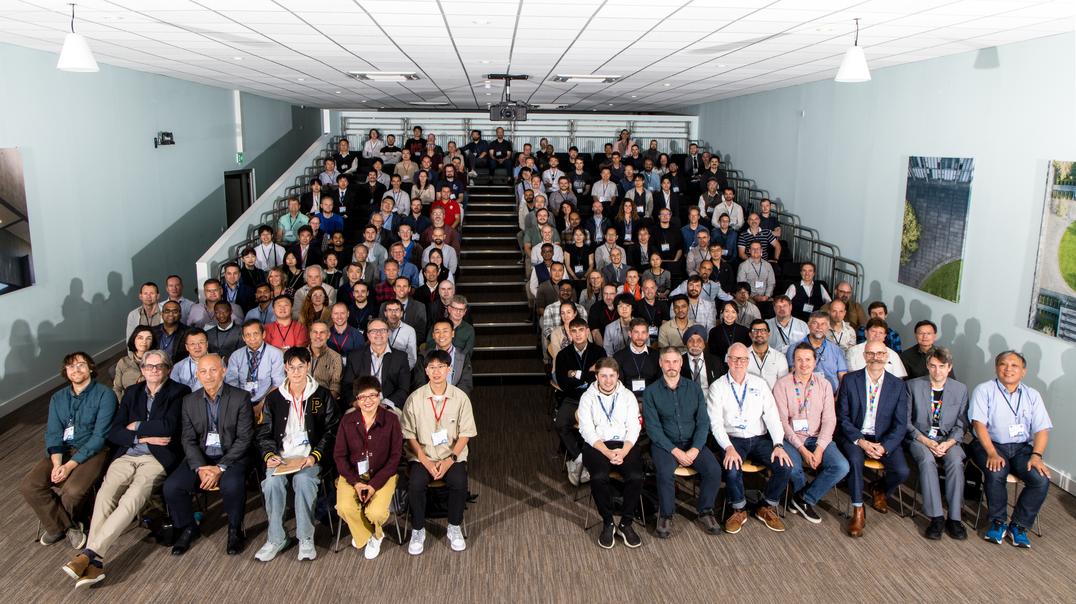

Slide 5
