Slide 1

ICIS’25 Opening Remarks
John Thomason
ISIS Associate Director for Accelerators
8 September 2025

Slide 2
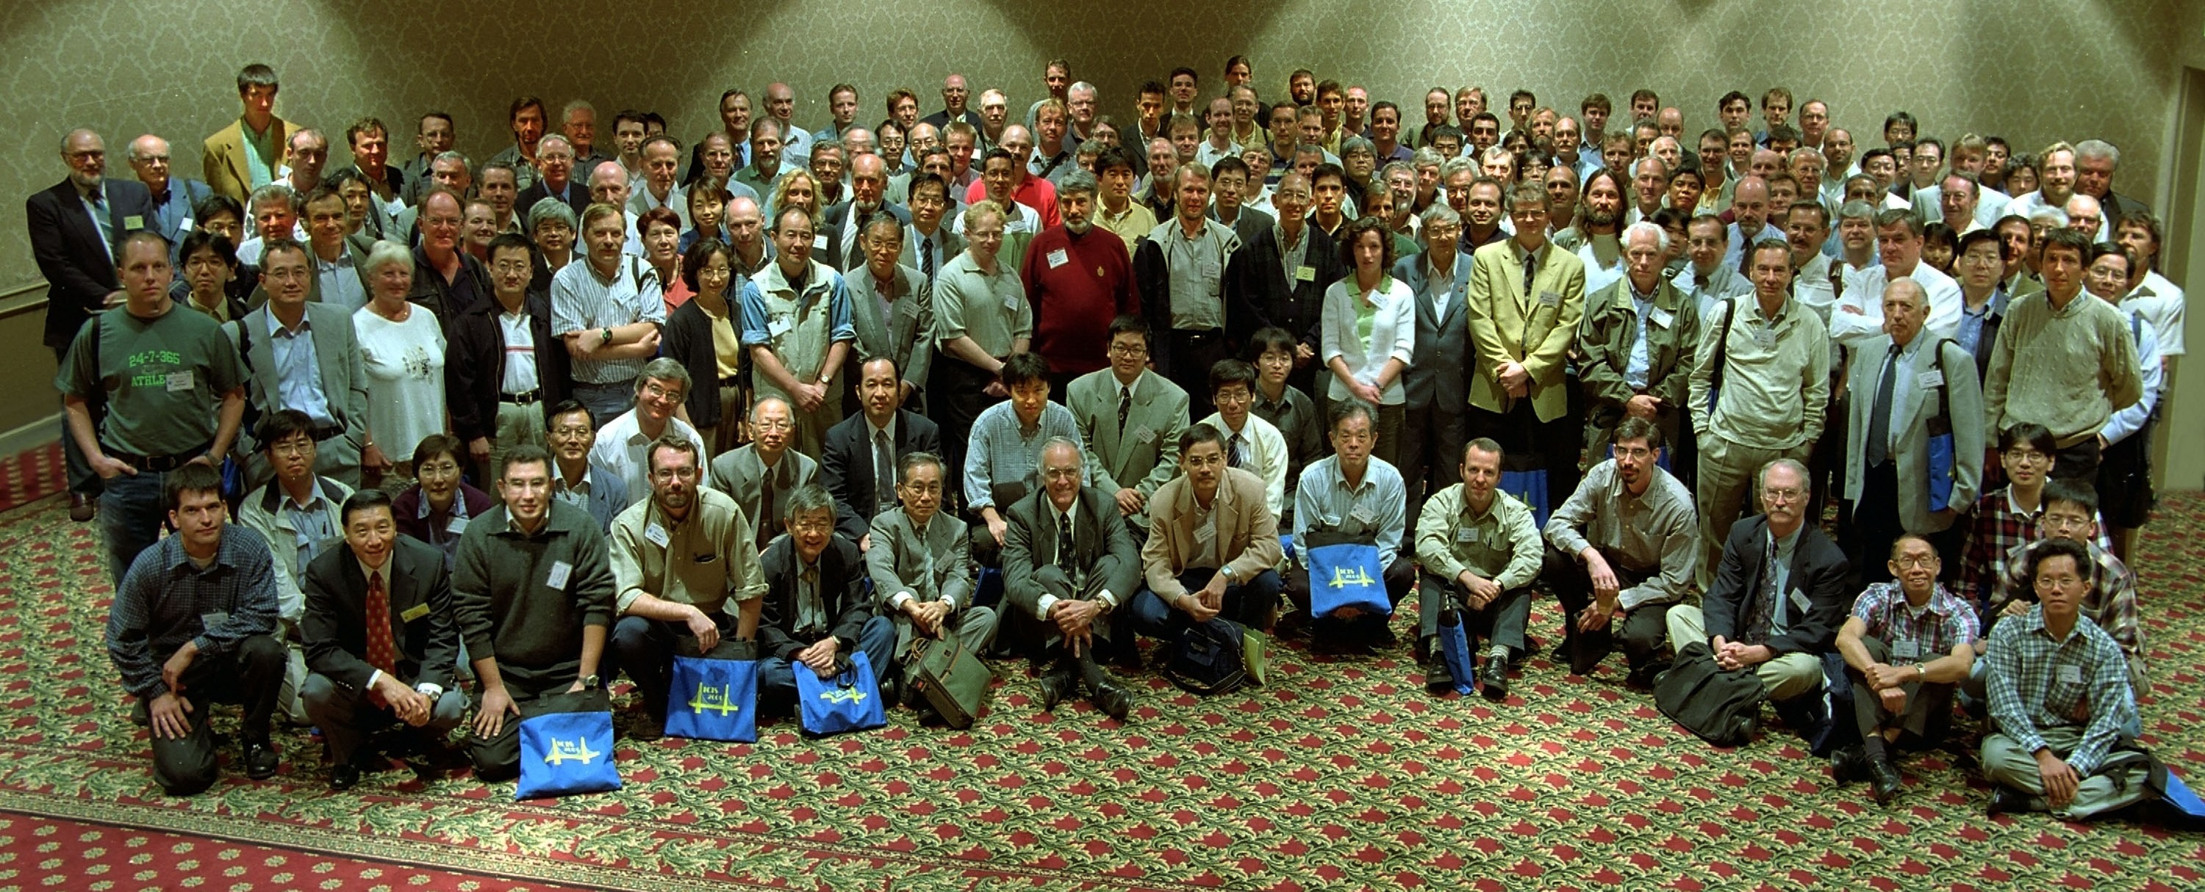
ICIS’01 Oakland

Slide 3
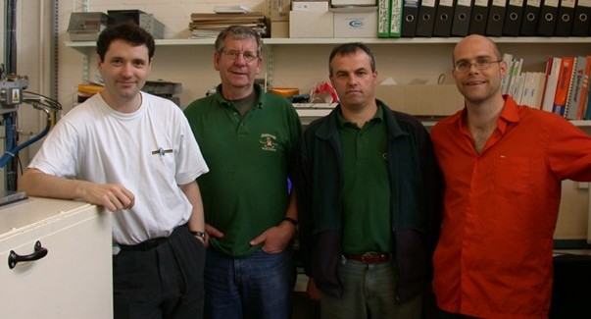
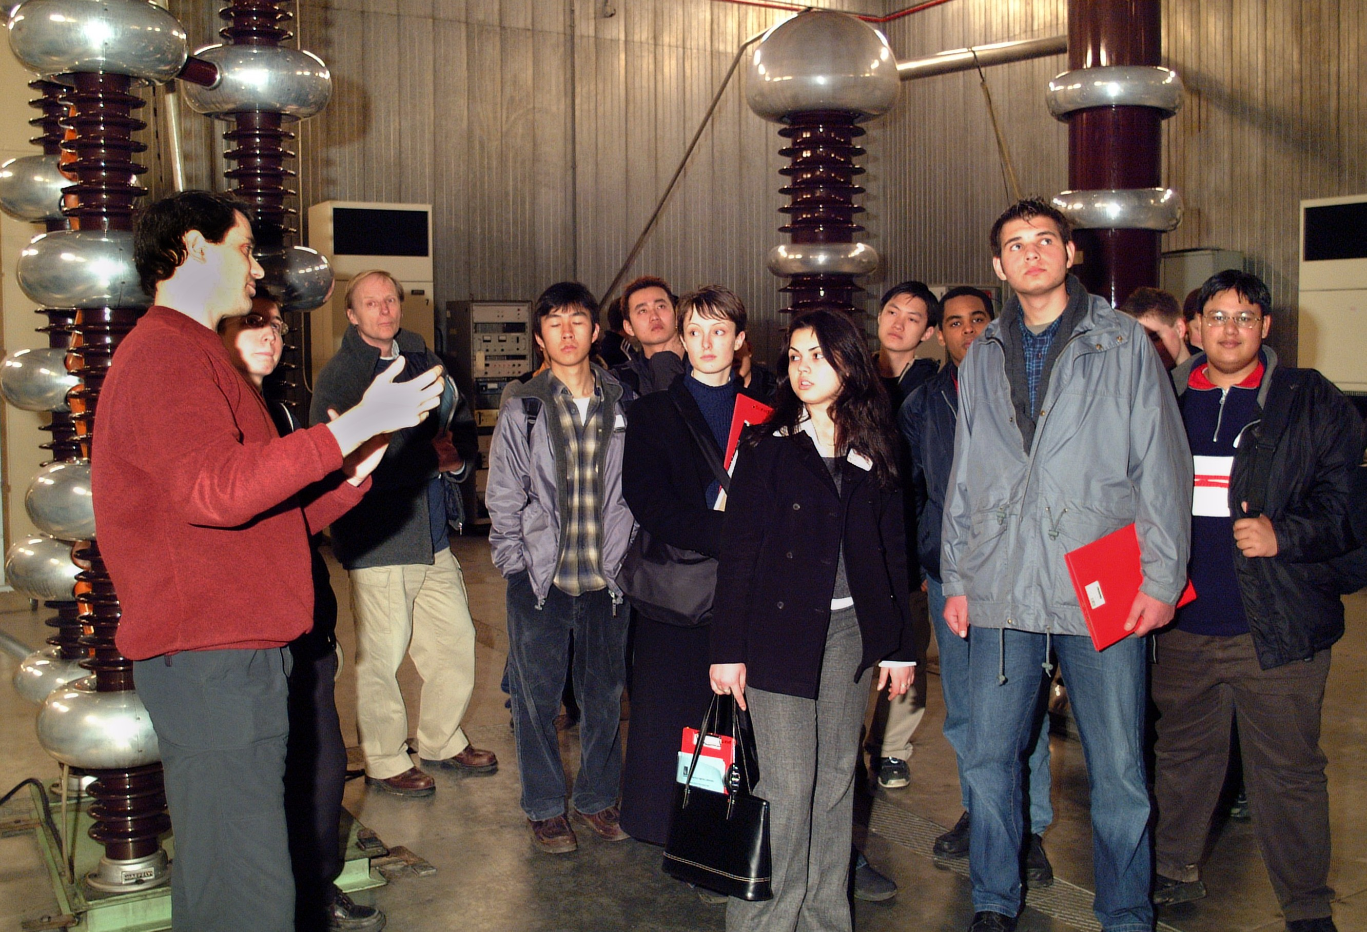

Slide 4
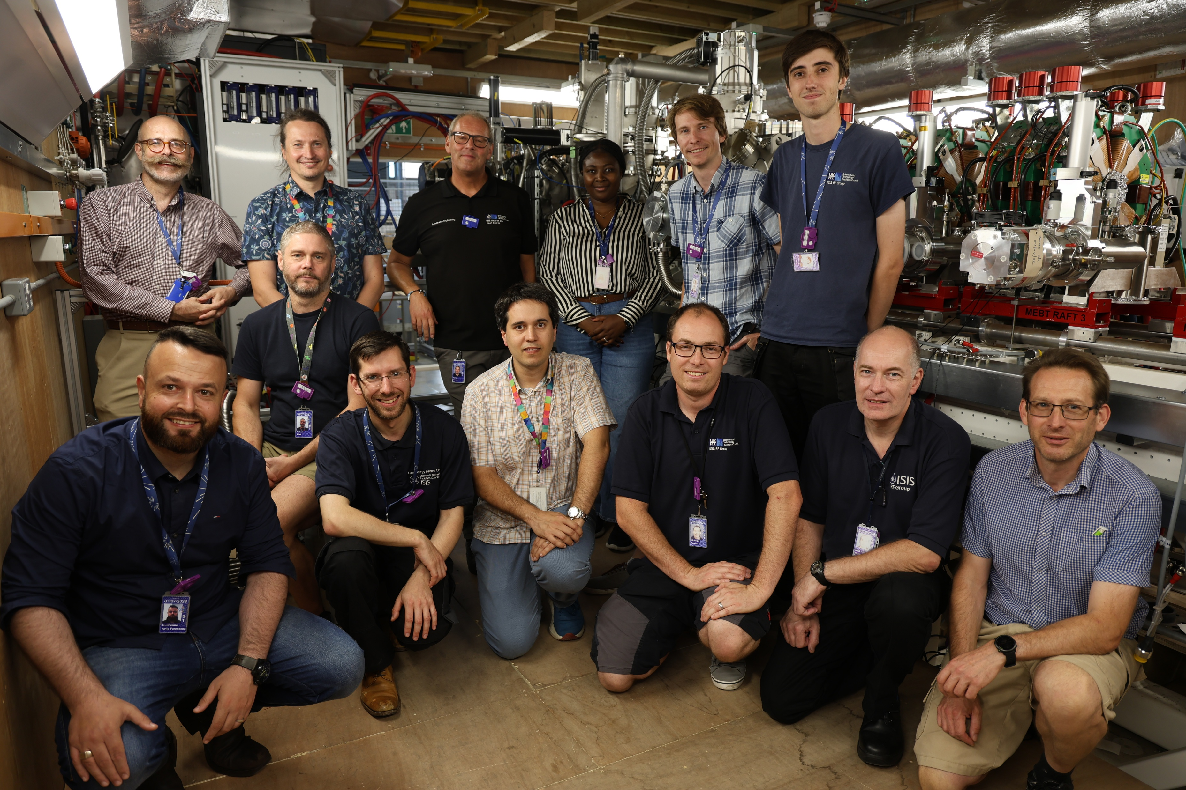
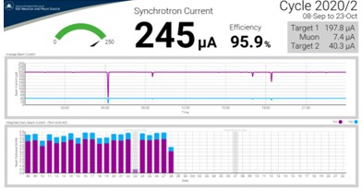
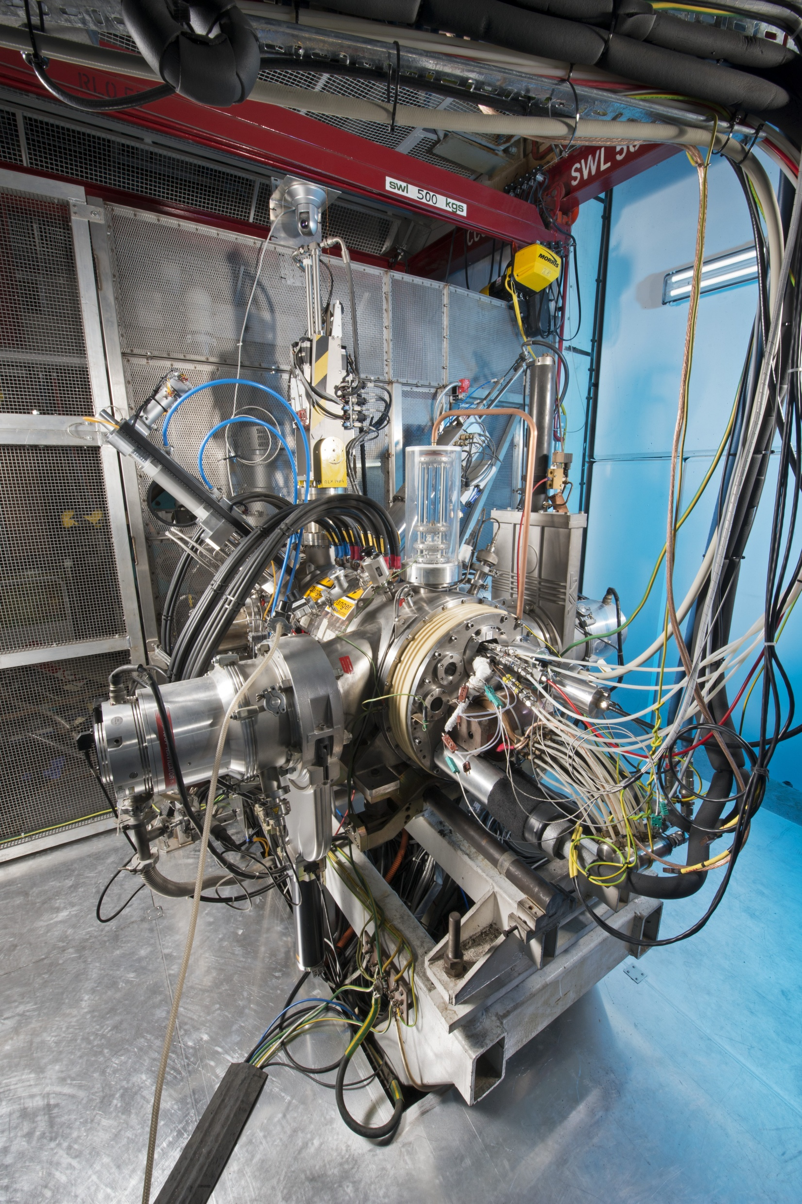
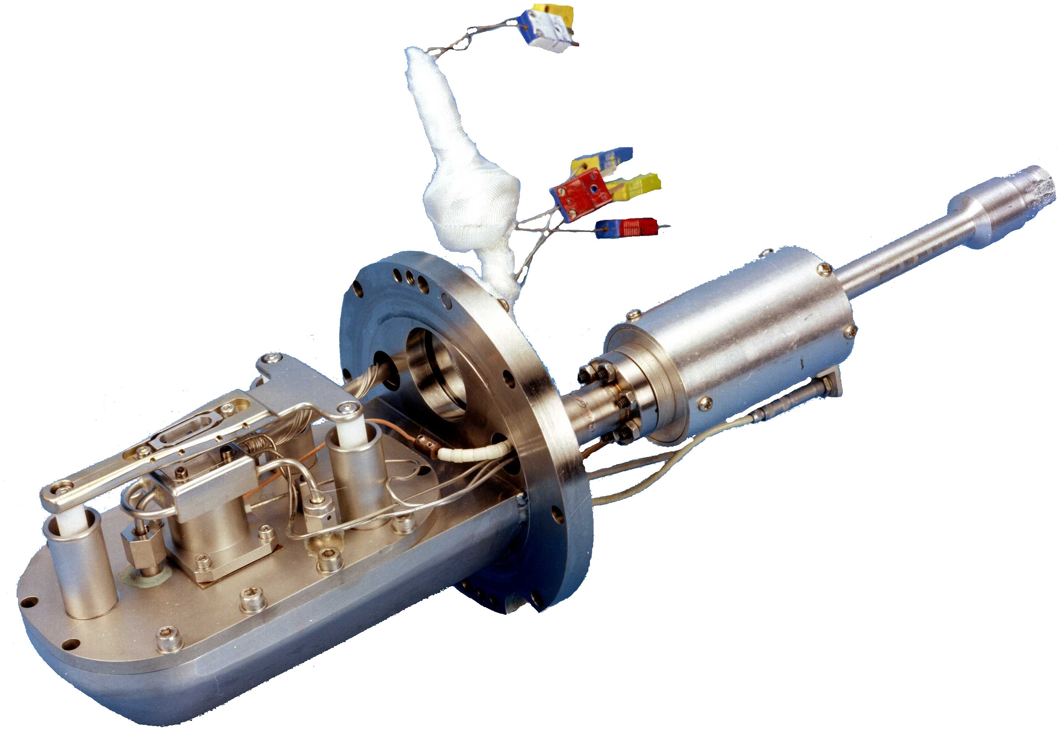
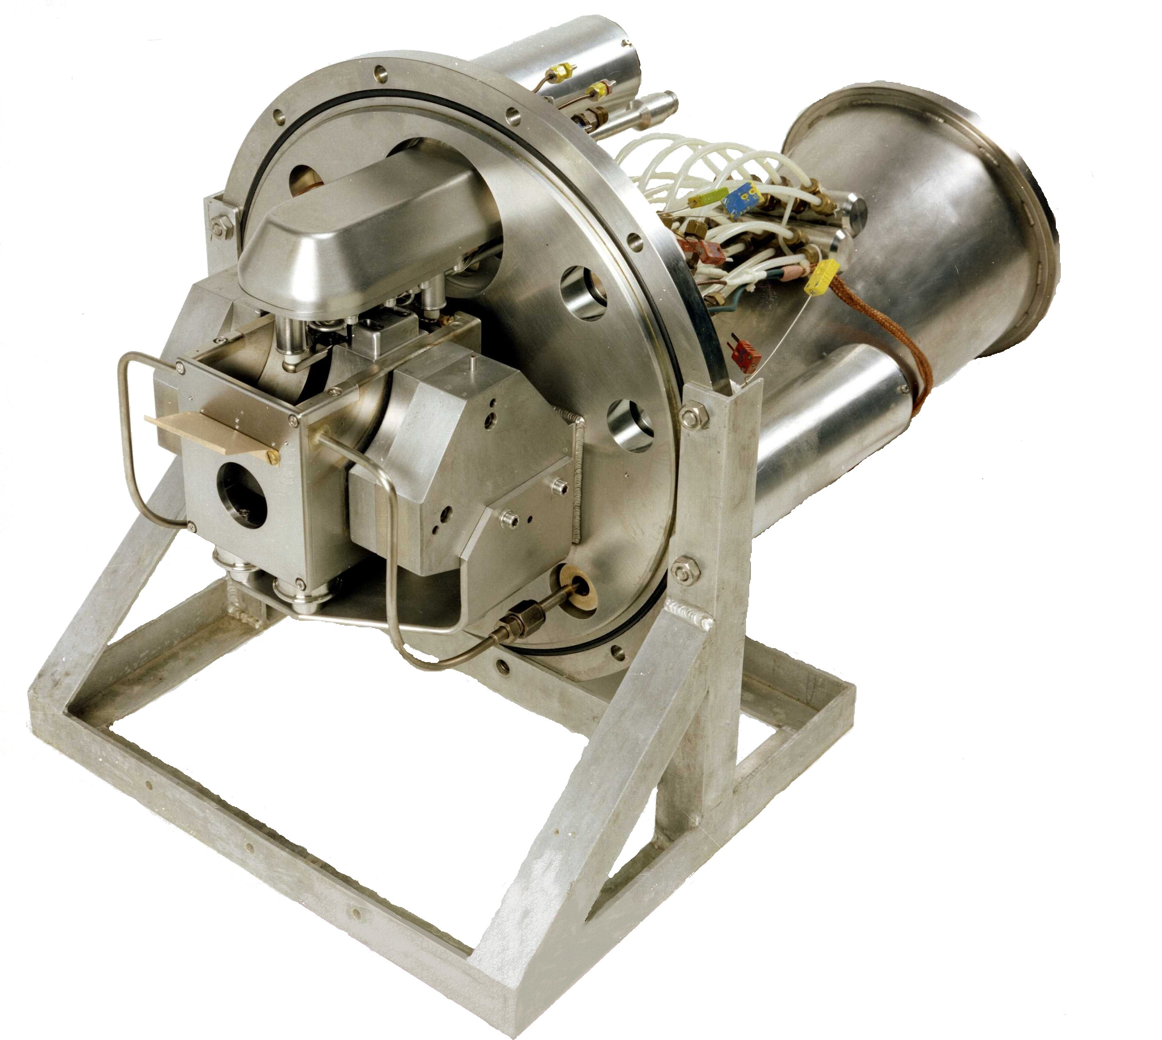
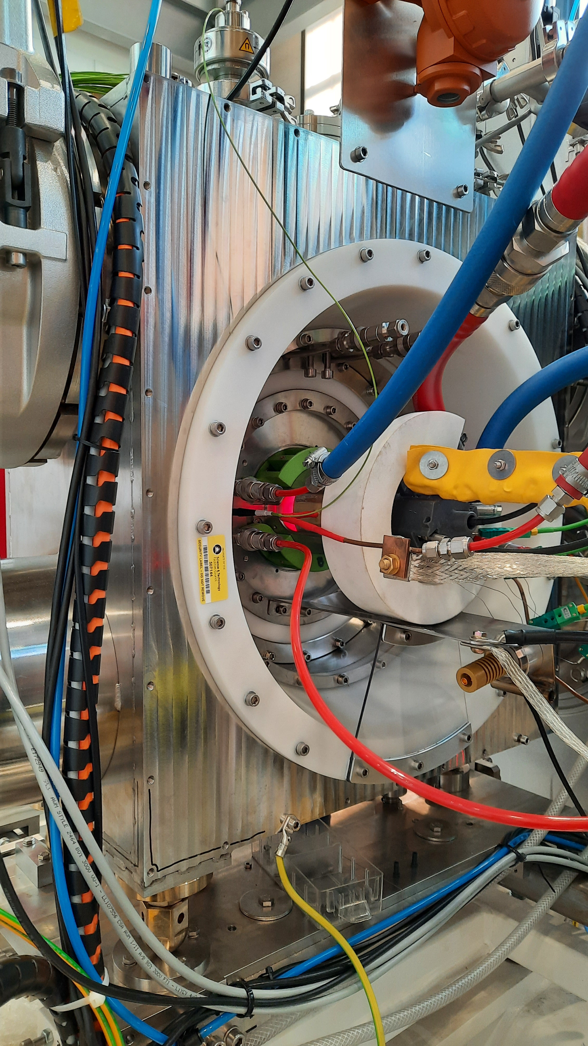
Operational Sources

Slide 5
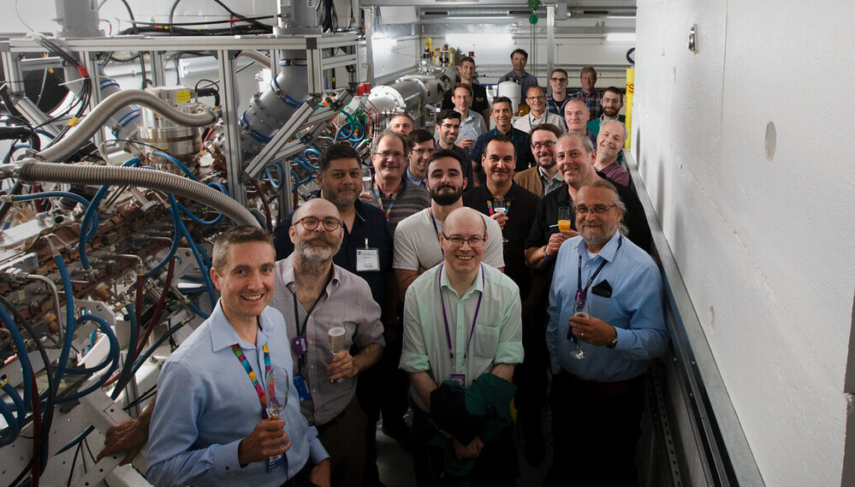

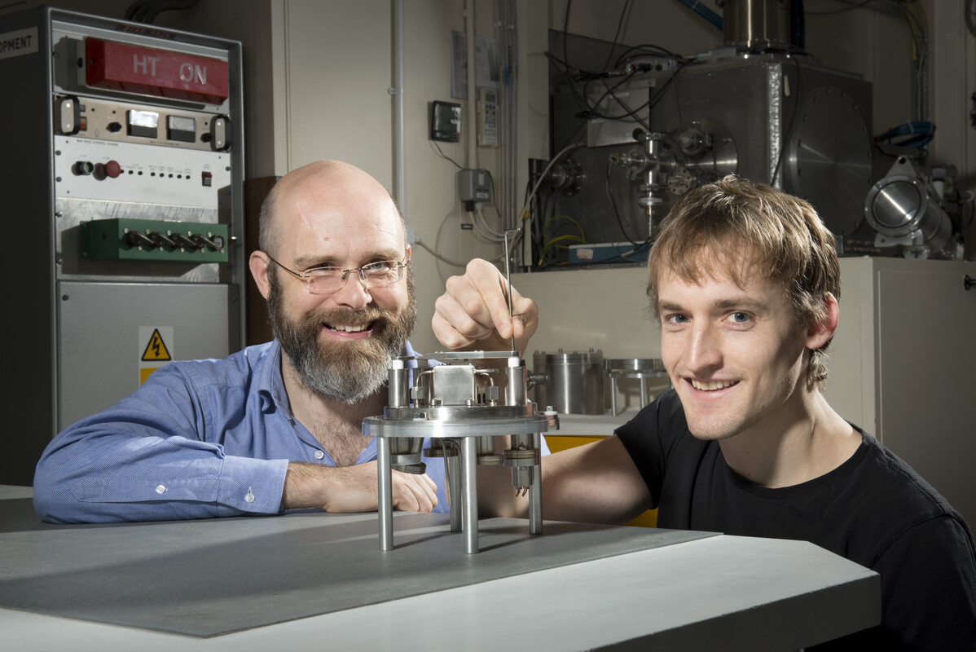
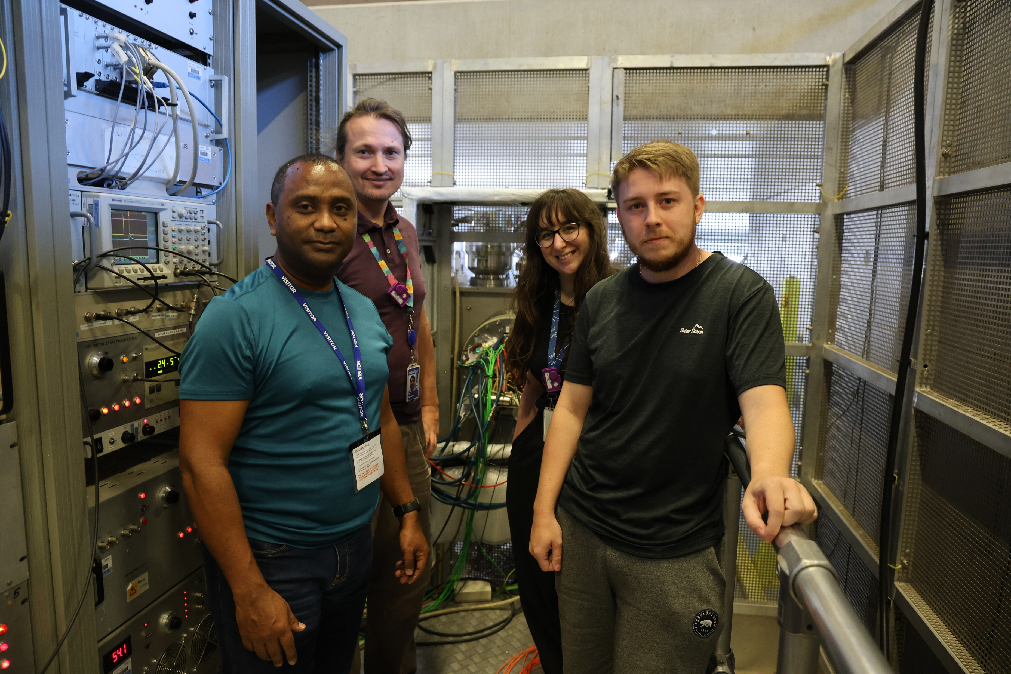
Development Sources

Slide 6
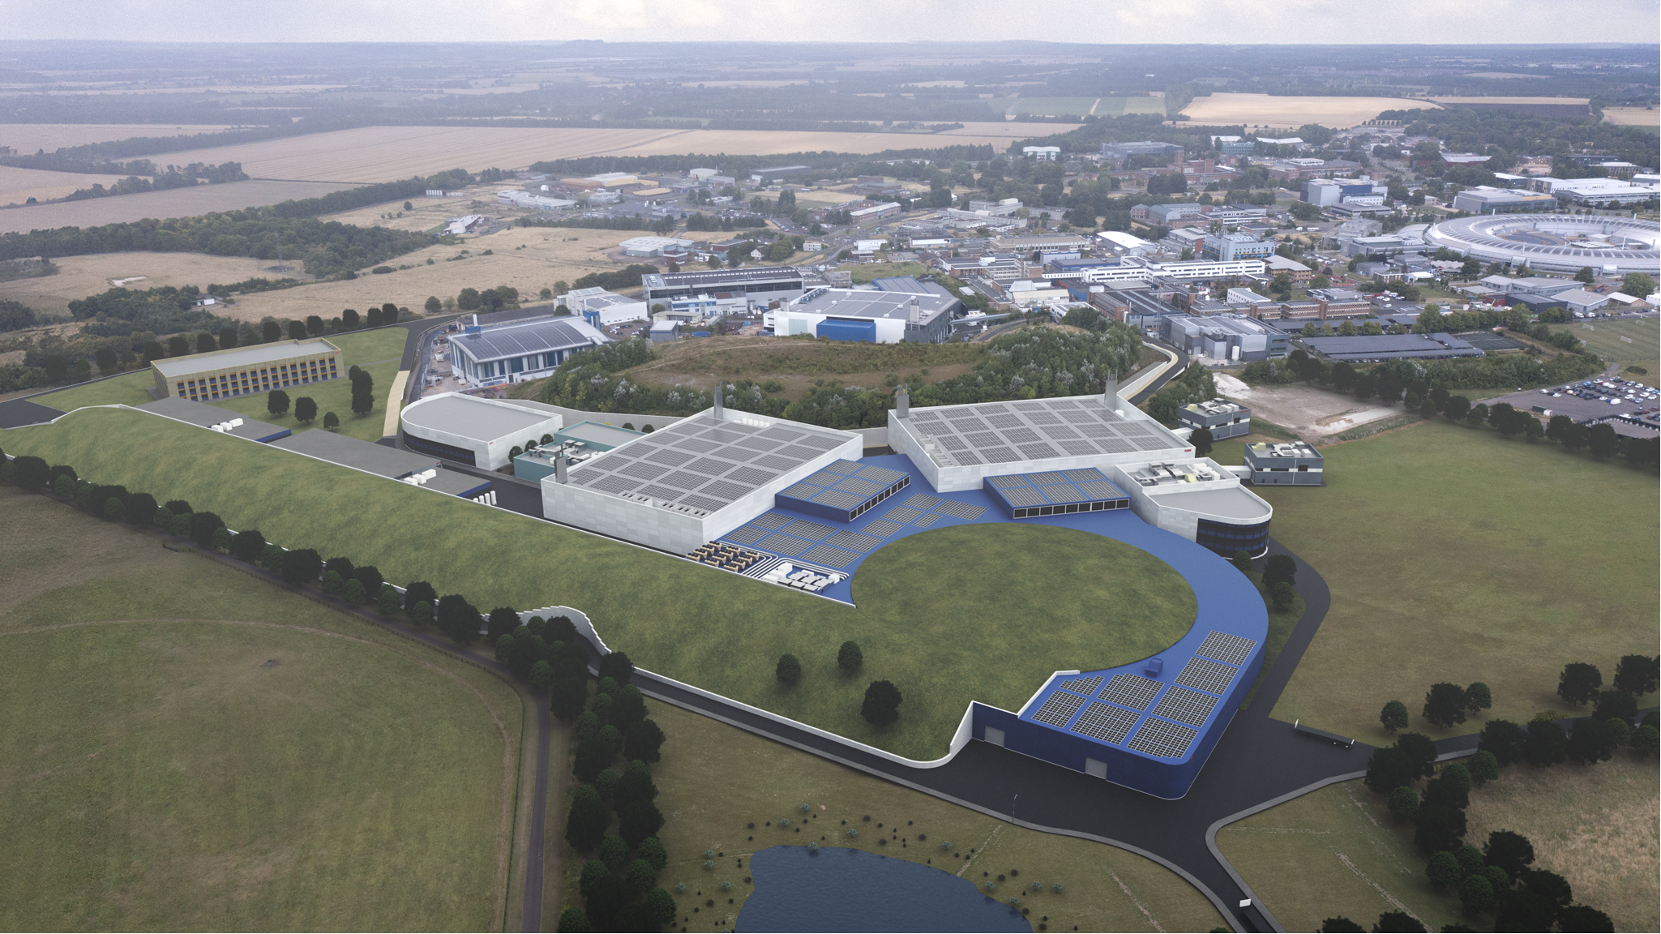
ISIS-II

Slide 7

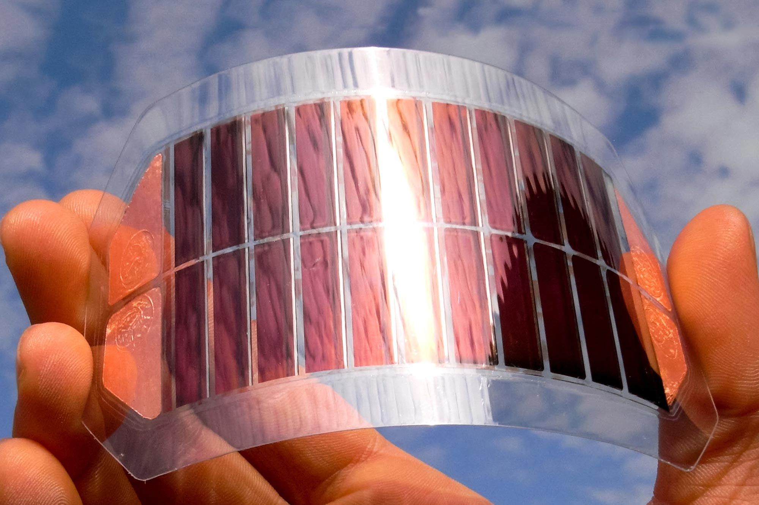

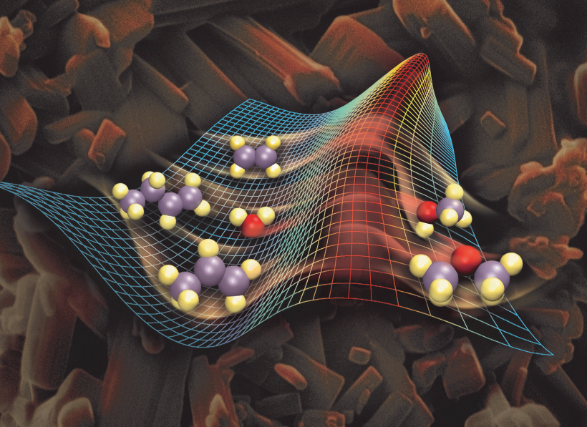
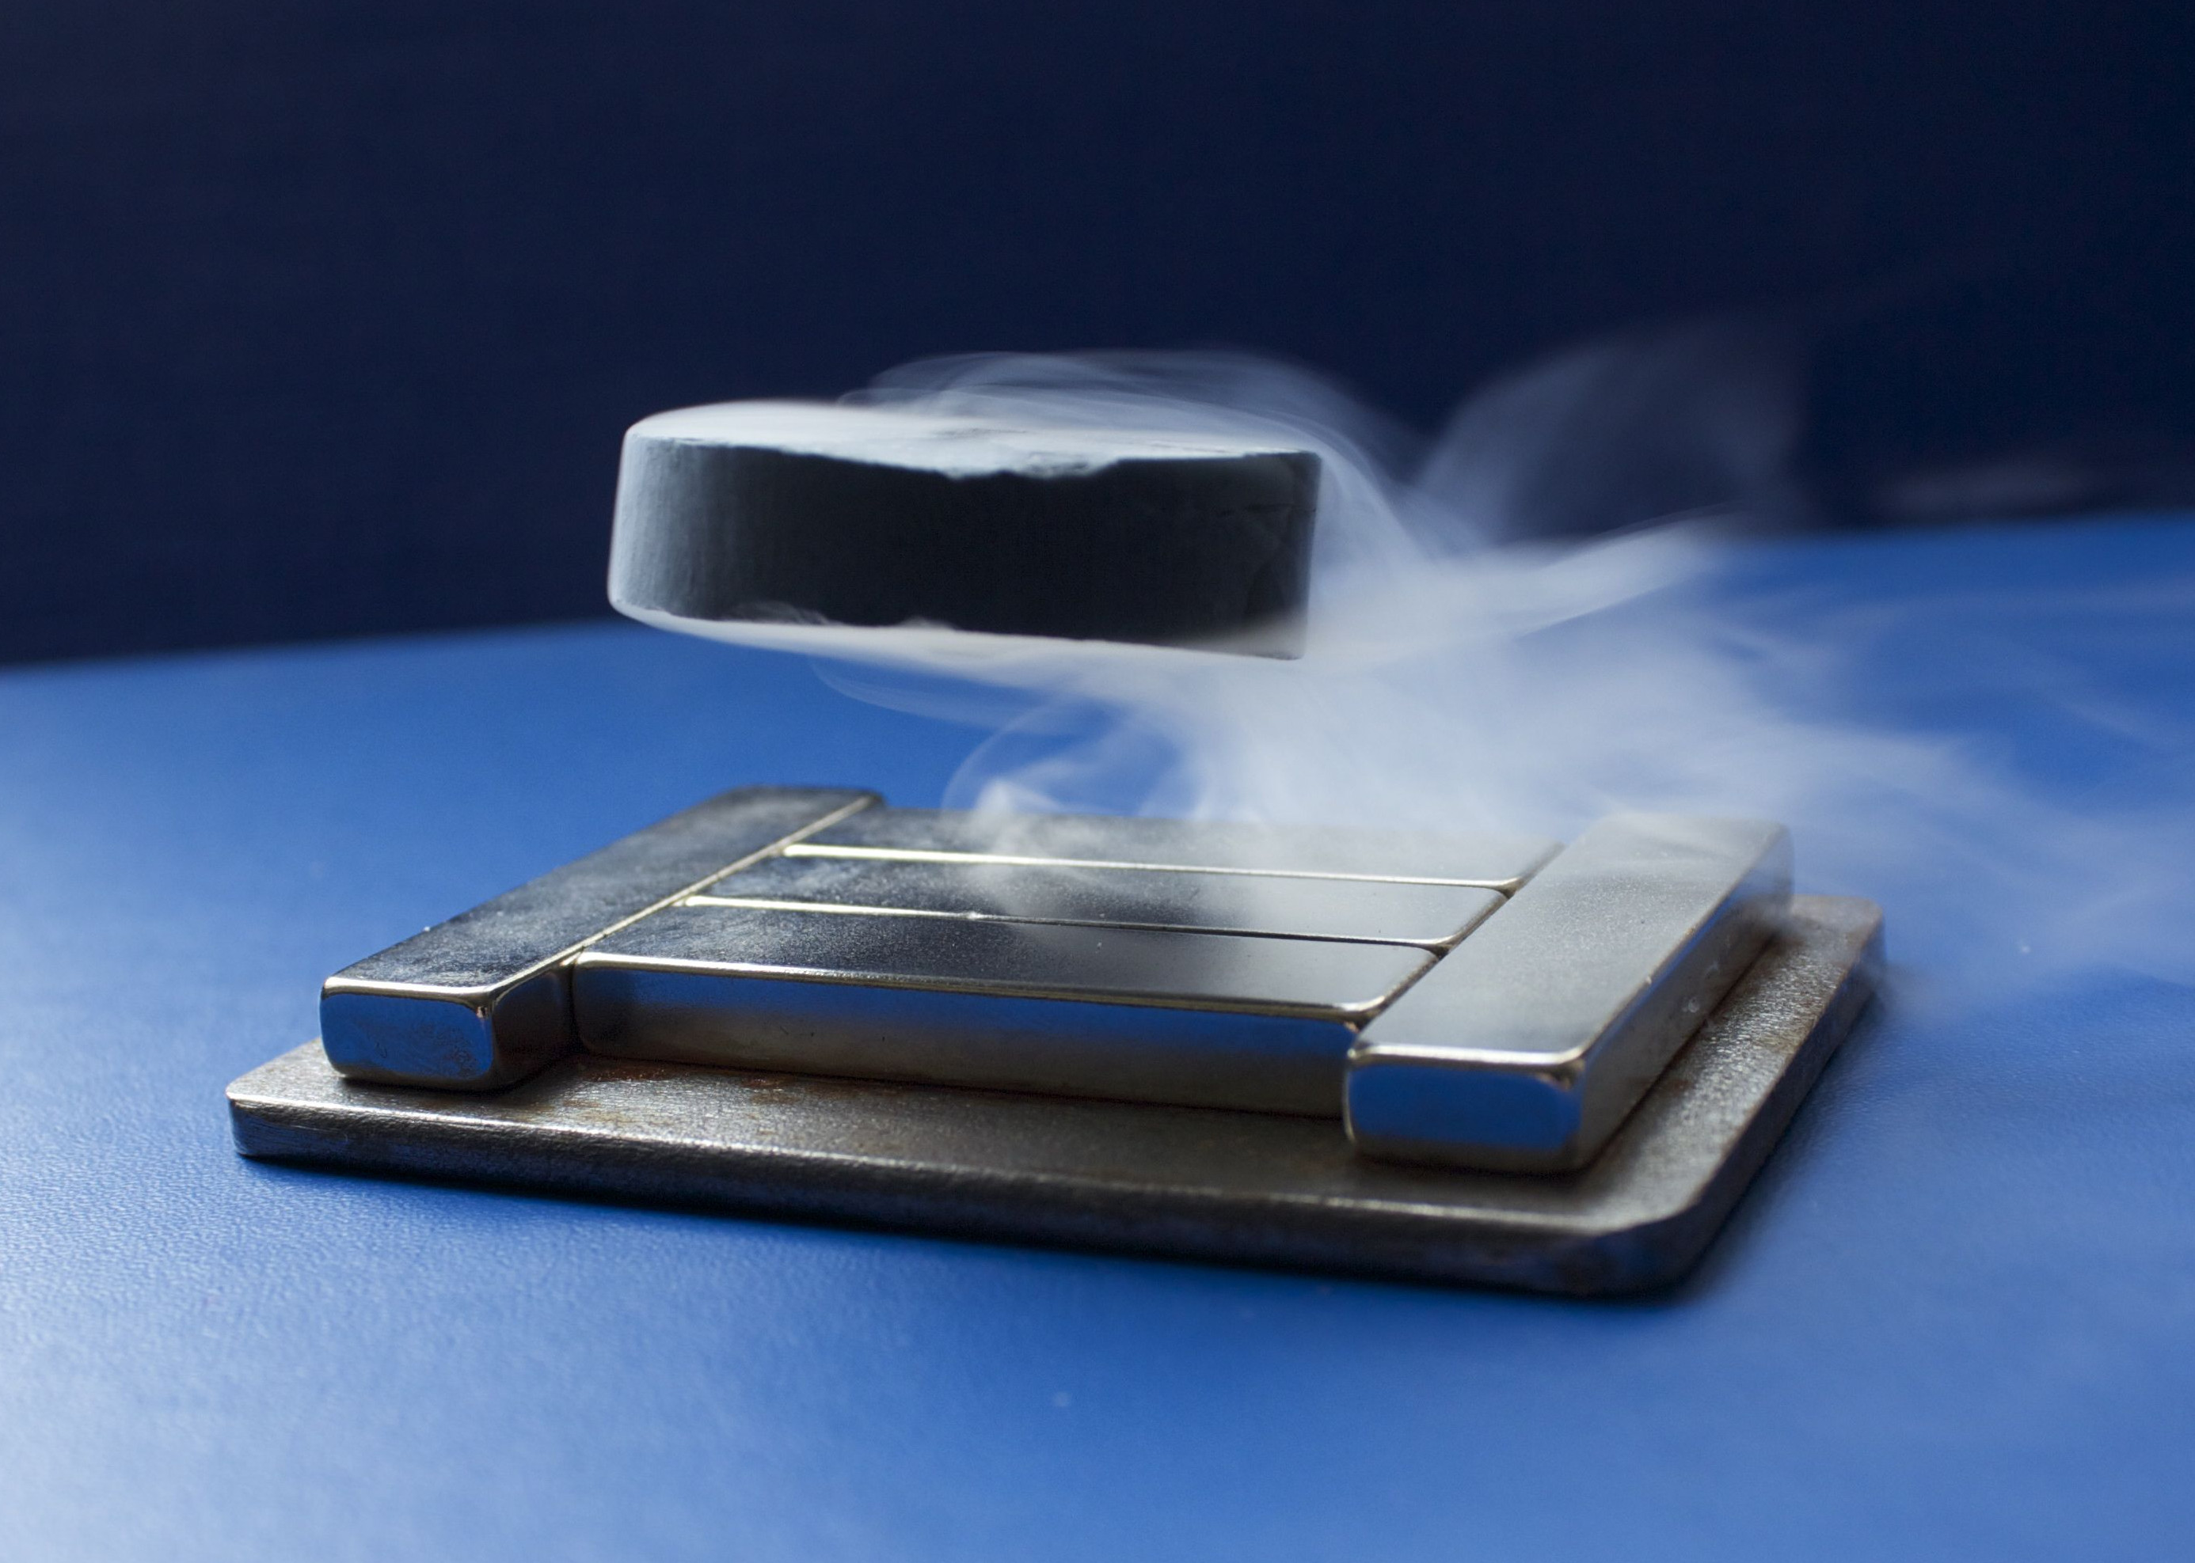
ISIS-II Science Case
Diverse key areas identified
  Materials discovery
  Discovery science
  Healthcare
  Energy
  Manufacturing
  Electronics testing
Future Grand Challenges
  Smart/personalised healthcare
  Drive to net zero
  Next generation quantum technology
  Sustainable materials and manufacturing

Slide 8
