Slide 1
Microwave Power Source Products Introduction
Website: www.prodigyEI.com
Mailbox: Shawn.wang@prodigyEI.com
Date: 10 September 2025

Slide 2

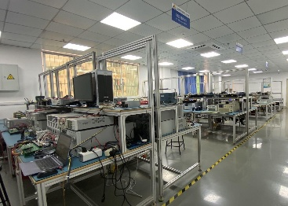
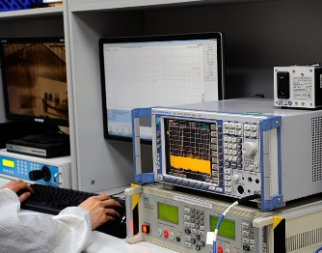
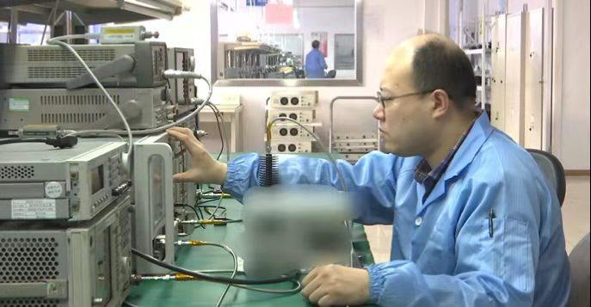
Prodigy Company Profile
CORPORATE INFORMATION:
Headquarters(China): Beijing Feifan Langtian Tech. Co., Ltd.
U.S. Branch: Prodigy Enterprises Inc
Year of Establishment: 2004
Business: R&D and Manufacturing of Microwave RF Components;
R&D and Manufacturing of RF Power Amplifiers;
R&D and Manufacturing of other Satellite Communication Products;
Development of Intelligent Operation and Maintenance software, M&C
Software etc. for Communication System;
Satellite Communication System Integration Services.
Established the CPI-Prodigy Service Center in China in 2007, Provides after-sales services for CPI power amplifiers of Chinese customers.
Has provided technical services for high-power RF equipment to users in the ion accelerator field for nearly 20 years.

Slide 3
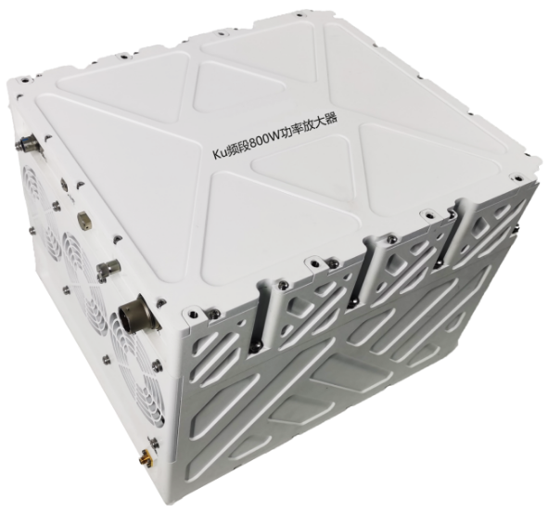
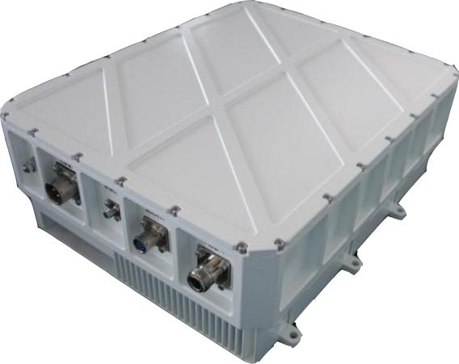

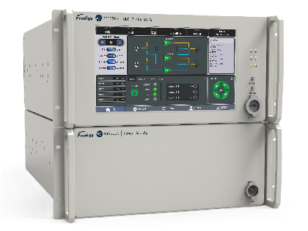
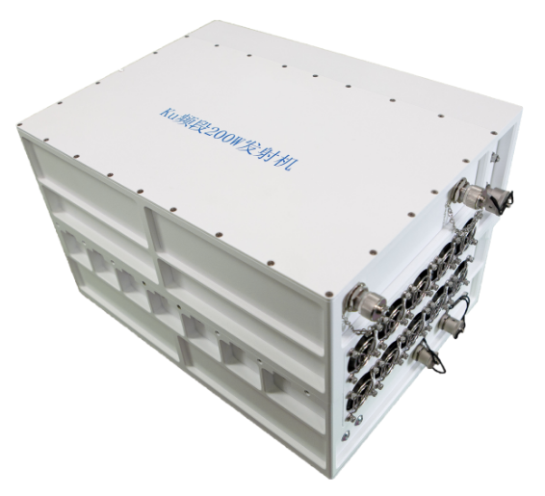
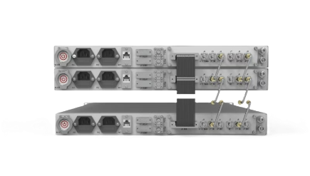
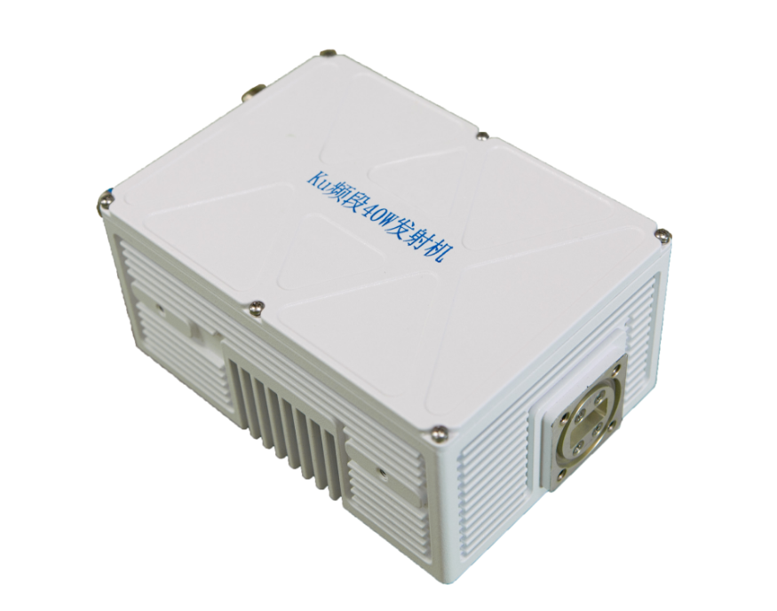
Prodigy Company Profile
Products
C/Ku-Band GaN SSPA up to 2.5KW;
Ka-Band GaN SSPA up to 500W
C/Ku/DBS-Band
Up Converter
Microwave Power Sources 14GHz/18GHz Up to 2.4KW

Slide 4

18GHz 2.4KW Microwave Power Source Product Introduction
Special Features for the Operating Environment of Accelerator Systems
Advantages of Core Technology
Specifications
Application Case

Slide 5
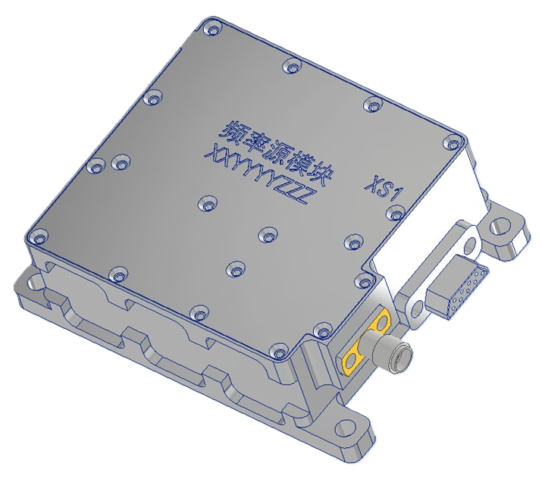
Special Features for the Operating Environment of Accelerator Systems
Function Integration:
The microwave power source is developed by integrating an RF signal generator module into the power amplifier product, thus meeting the application requirements of accelerator systems. This module can generate continuous wave (CW) signals in the 17.3~18.1GHz frequency band and can receive external control to produce pulse signals.

Slide 6
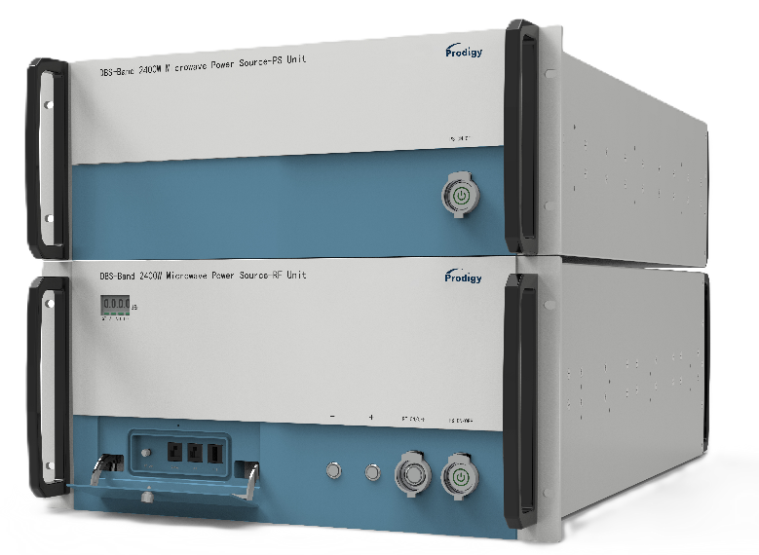
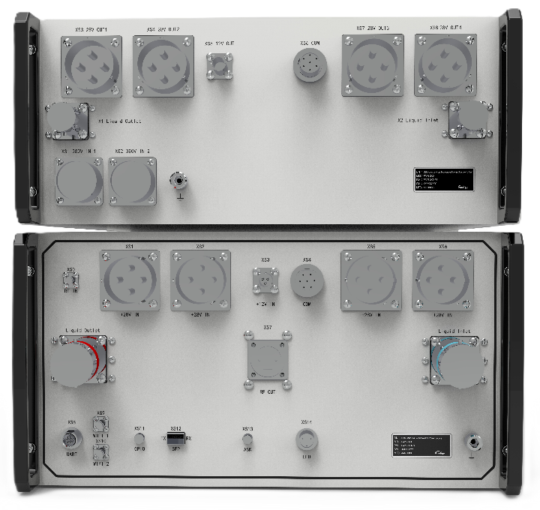
Special Features for the Operating Environment of Accelerator Systems
Full-shielded chassis
The 18GHz 2.4kW microwave power source equipment consists of one 5U (698×482.6×221.5mm) RF chassis and one 4U (668×482.6×177mm) power supply chassis. It adopts a fully shielded chassis design, which can effectively protect internal components from damage in high-intensity electromagnetic field environments.
Chassis Front Panel
To ensure the overall shielding performance of the chassis, we have omitted the large-size LCD control screen
A switchable shielded door for hiding essential interfaces is designed on the front panel. Inside the shielded door, there are an RF output sampling port, an ethernet port, a USB port, and a dedicated data interface for the manufacturer to debug the equipment.
Chassis Rear Panel
All power and control interfaces employ aviation connectors, ensuring exceptional anti-interference capability and unwavering operational stability.

Slide 7
Special Features for the Operating Environment of Accelerator Systems
Optically Isolated Control Port
The optically isolated control ports are adopted to prevent ground loops and electromagnetic interference (EMI) from propagating into the main control circuit, thereby avoiding damage to the equipment's control motherboard.
The control interfaces of the microwave source (including Ethernet port, GPIO linkage control port, and ASK pulse modulation signal port) are all converted to optical ports via optical modules. The power source can be isolated with the control system via Optical Fiber.

Slide 8
Special Features for the Operating Environment of Accelerator Systems
Flexible Monitoring and Control:
Built-in WEB Server & Integrated Wi-Fi
To ensure the chassis' shielding performance, no LED control panel is installed on the equipment's chassis panel. As an alternative, a high-performance web server is embedded in the microwave power source, with an additional Wi-Fi module integrated. Users can establish a wireless connection to the microwave power source via web browser using smartphones, tablets, or laptops to achieve full-function control of the equipment. Additionally, users can also connect to the equipment via a wired ethernet.
Supports industry-standard TCP/MODBUS protocols
Supporting MODBUS protocol enables customized development of monitoring platform software for various devices, software, or systems. It allows seamless connectivity between devices from different manufacturers, enhancing flexibility and scalability in industrial automation systems.

Slide 9
Special Features for the Operating Environment of Accelerator Systems
Abundant GPIO Interconnection and Interlocking Functions
In accordance with the characteristics of users' requirements for the interlocking control function of power source equipment in accelerator systems, the 18G/2.4KW power source equipment is equipped with a comprehensive set of GPIO interconnection and interlocking functions. These functions encompass 4 types of TLC(trip lock control) signals, specifically: equipment fault interlock signal, power on/off linkage interlock signal, power source operating status interlock signal (indicating whether it is in the transmission state), and power source alarm interlock signal.
By leveraging these diverse interlock signals, users can implement the most fundamental and direct remote monitoring of the power source equipment. This not only expands the user's equipment management capabilities but also further safeguards the safe operation of the accelerator system.

Slide 10
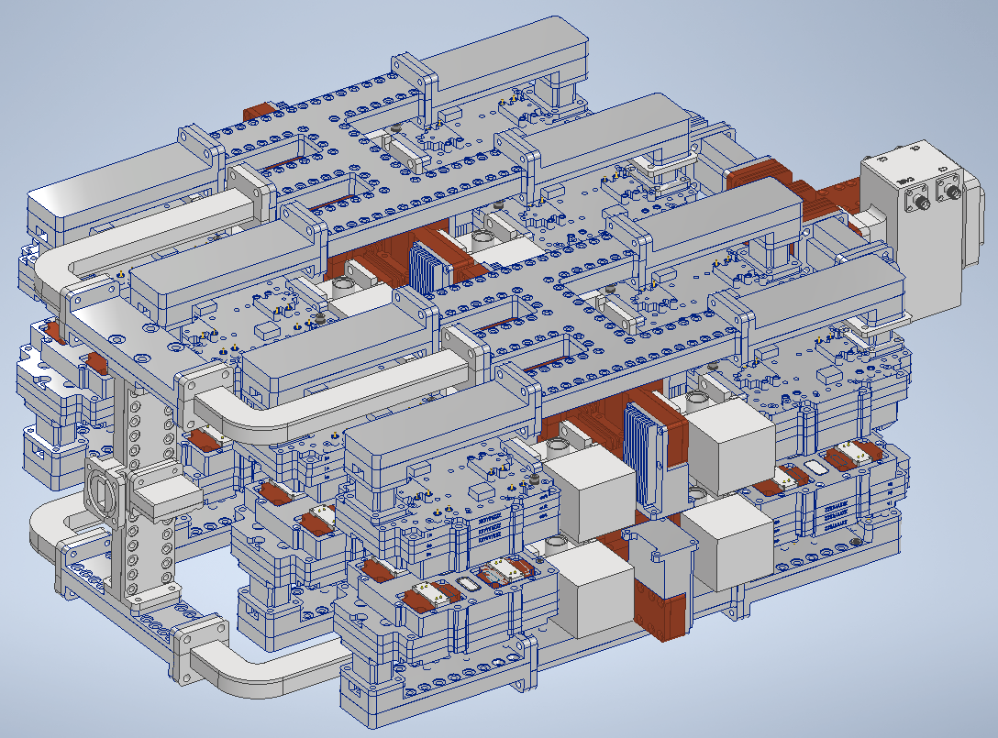
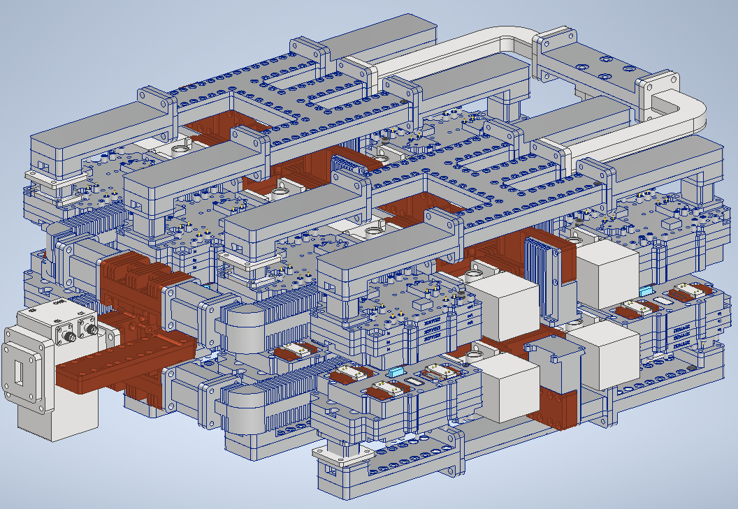
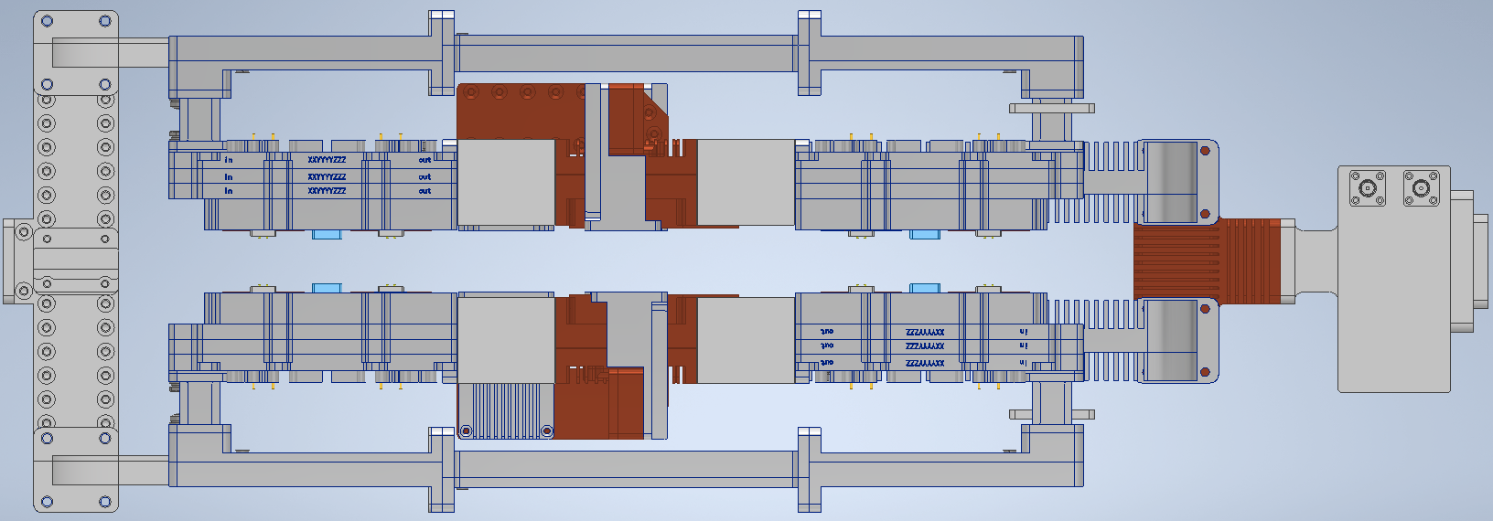
Advantages of Core Technology
Spatial waveguide combining techonology
Waveguide spatial power combining technology exhibits key technical advantages, including high power capacity, low insertion loss (with high combined efficiency), and strong anti-interference capability.
The 18GHz 2.4KW microwave power source enables power combining and output by integrating 16 200W power modules via a multi-stage waveguide spatial power combining network.
By leveraging advanced microwave transmission simulation technology, the structural design of the waveguide combining cavity has been optimized appropriately. Consequently, its comprehensive actual insertion loss is controlled within 0.8dB, and the power amplifier’s output power exceeds 2400W.

Slide 11
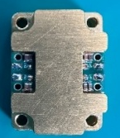
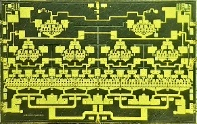
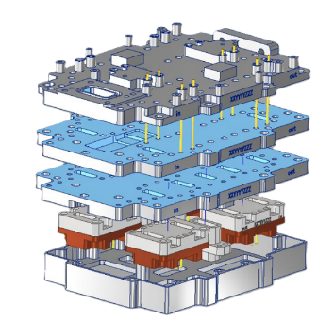
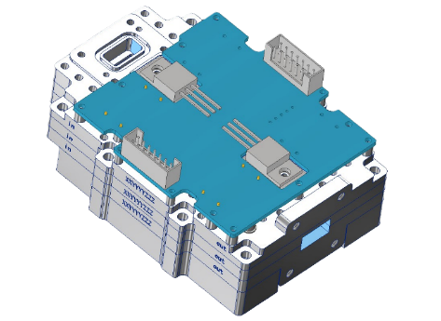
Advantages of Core Technology
GaN MMIC chips in 200W GaN Power Module
The 18GHz 200W power amplifier module employs four basic power amplifier sub-modules packaged with 50W GaN MMIC chips, and achieves 200W power output through the waveguide spatial power combining technology.
The operating efficiency of the power module is ≥37.2%.
18GHz 50W GaN MMIC
18GHz 50W
GaN Power Unit
18GHz 200W GaN Power Module

Slide 12
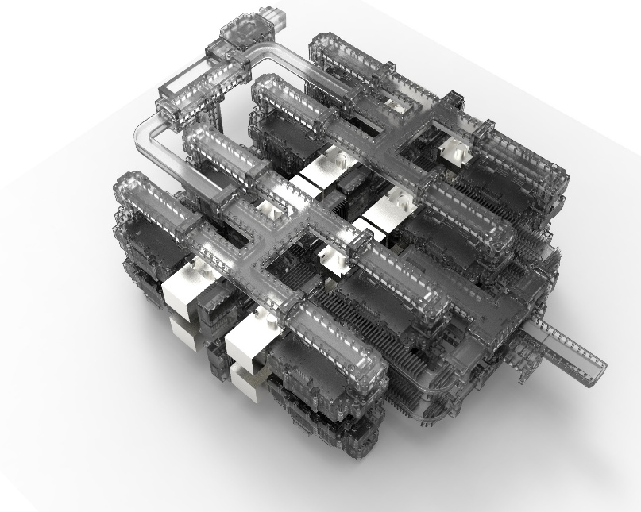
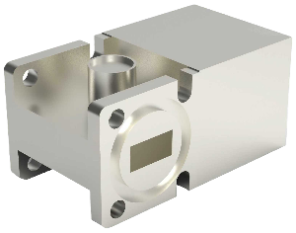
Advantages of Core Technology
Distributed Waveguide isolators
The waveguide isolators are functional modules specifically added to protect core power components, which addresses the issue of high reflected power caused by load mismatch when power sources are applied in heavy ion accelerator systems.
Adopting a distributed isolator design offers distinct advantages of low heat generation, low loss, and high isolation. the reflected power tolerance for CW is more than 300W, and that for pulsed wave more than 2400W.
Waveguide isolator

Slide 13
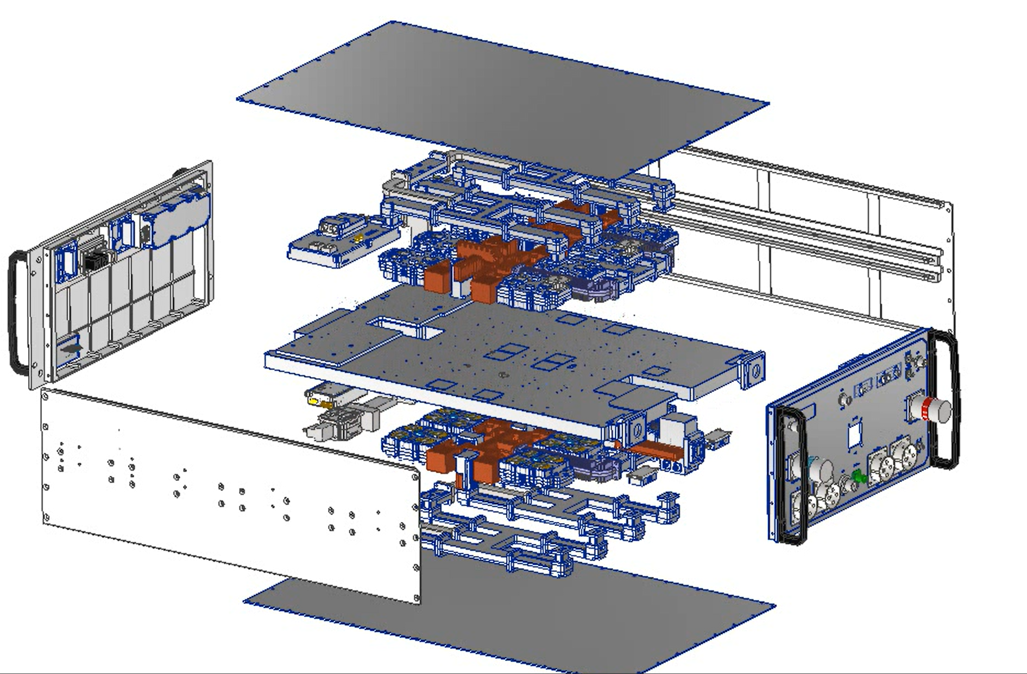
Advantages of Core Technology
Liquid-cooled plate heat conduction and dissipation method
The microwave power source adopts a liquid cooling method and can make full use of the existing deionized cooling water resources of the accelerator.
The RF unit adopts the liquid-cooled plate heat conduction and dissipation method. Through thermal analysis of each component in the RF unit and design simulation, the structure of the liquid-cooled plate and its internal flow channels are reasonably optimized and designed, thereby achieving the effect of rapid heat extraction and ensuring the stable and reliable operation of the entire power source.
liquid-cooled plate
Liquid Supply Requirements
Power Supply Chassis
Medium: | Deionized Water
Water Temperature: | 25±2℃
Water Pressure: | 0.4–0.6 MPa
Flow Rate: | ≥5 L/min
RF Unit Chassis
Medium: | Deionized Water
Water Temperature: | 25±2℃
Water Pressure: | 0.4–0.6 MPa
Flow Rate: | ≥30 L/min

Slide 14
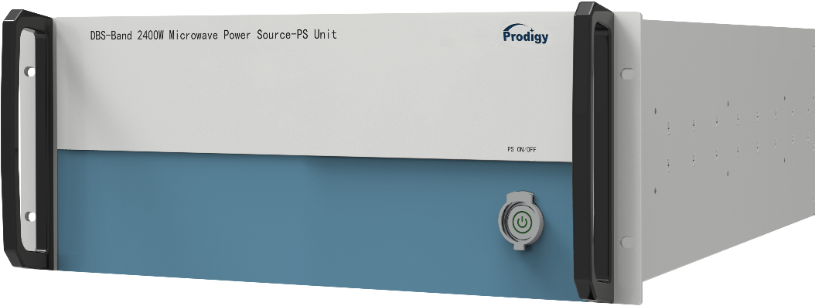
Advantages of Core Technology
Power Supply Unit Design
The power supply adopts an independent 4U power cabinet design, which can convert two channels of 380V AC (three-phase four-wire system) into three channels of low-voltage DC power, with a maximum output power of up to 20KW.
Modular Design
The power cabinet integrates 4 AC/DC power modules.
Input: 380VAC；Output: Single module delivers a maximum current of 155A at 28VDC; 4 modules operate in parallel to achieve 620A output.
Heat Dissipation
The liquid-cooled plate heat conduction and dissipation method is adopted.
Dust-free interior design for maintenance-free operation.
Performance Parameters
Input Voltage Type | : Three-phase AC
Input Voltage Range (VAC) | : 266-456
Frequency Range (Hz) | : 50/60±7%
Output Rated Voltage (V) | : 28.0
Output Maximum Current (A) | : 620.0
Voltage Regulation (Su) | : 0.1%
Load Regulation (Su) | : 0.3%
Output Voltage Ripple (Peak-to-Peak) | : ≤200mV
Efficiency | : 94%
Power Factor | : 0.95
Output Control | : Available

Slide 15
Specifications
Technical Specifications of 18GHz 2.4kW Microwave Power Source

Slide 16




The Application of Microwave Power Sources in China
Fundamental Scientific Research Field:
18GHz 2.4kW Microwave Power Source: 3 sets
14GHz 200W Microwave Power Source: 2 sets
Heavy Ion Therapy Application:
14GHz 500W Microwave Power Source: 10 sets
5 sets of Microwave Power Sources are in the process of production and awaiting delivery

Slide 17
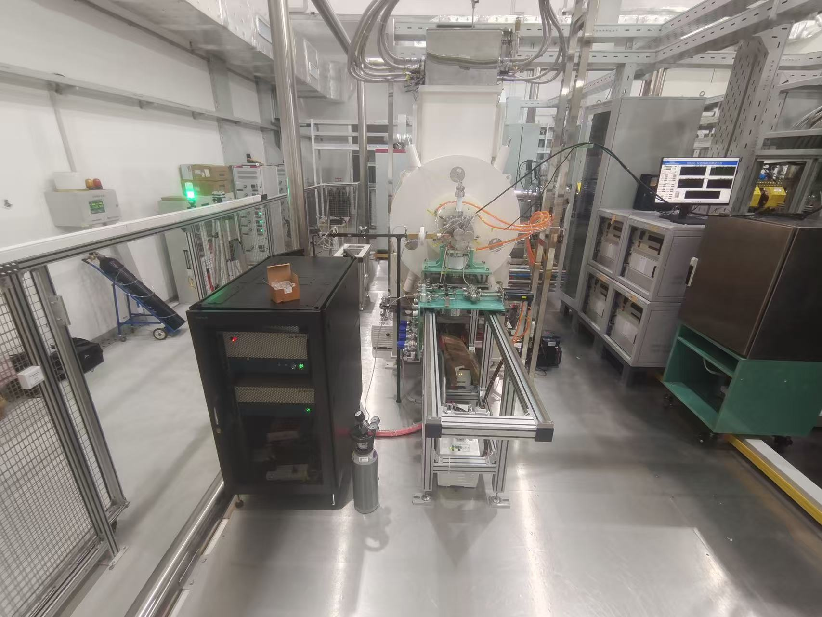
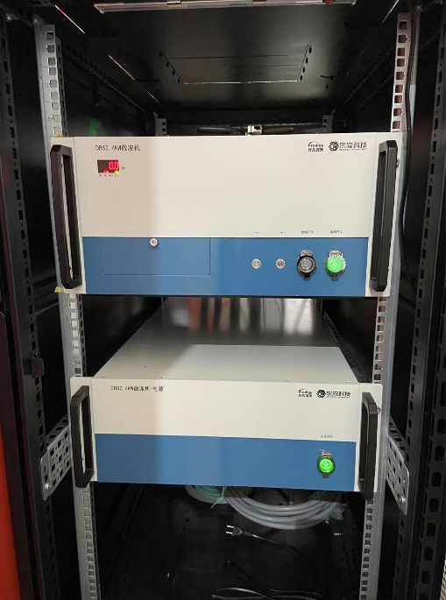
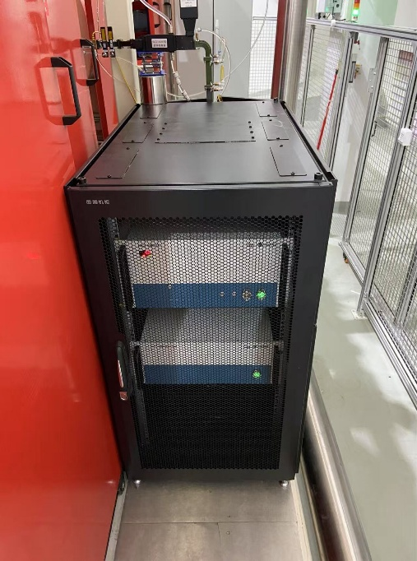
The Application of Microwave Power Sources in China
On-Site Application Photos of 18GHz 2.4kW Microwave Power Sources （ Courtesy of IMP ）

Slide 18
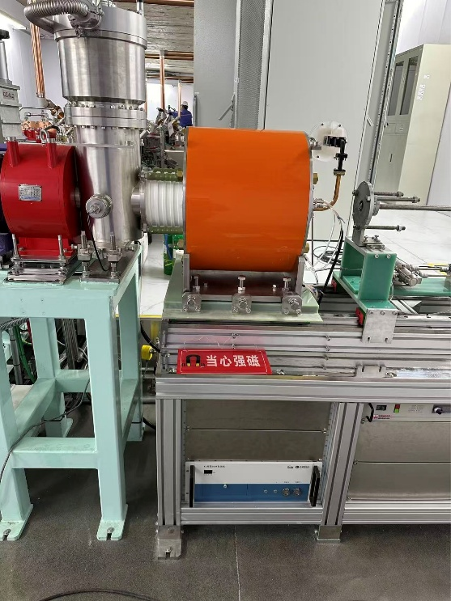
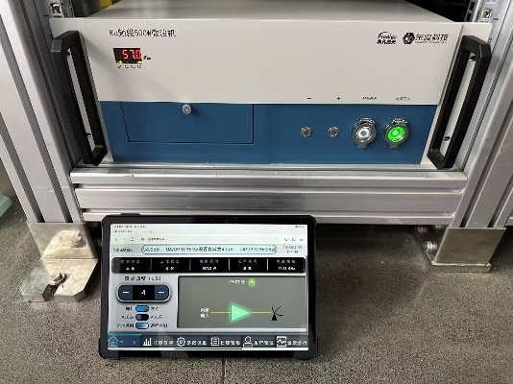
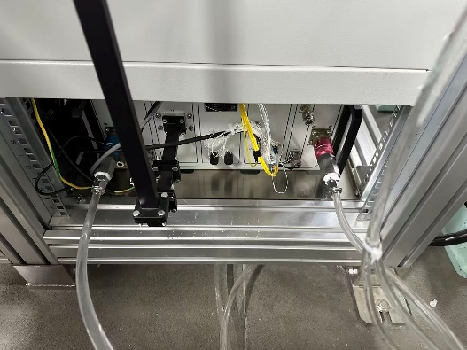
The Application of Microwave Power Sources in China
On-Site Application Photos of 14GHz 500W Microwave Power Sources for Heavy Ion Cancer Therapy System （ Courtesy of LITC ）

Slide 19
Thanks

