Slide 1
ICIS Exhibitor Presentation
Ion Source Modeling with VSimPlasma
David Green, PhD
Principal Field Applications Engineer
david.green@silvaco.com
September 2025

Slide 2





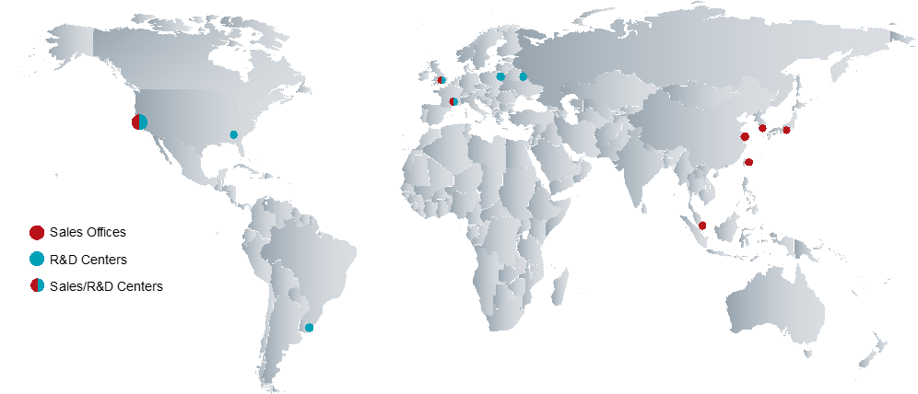






Silvaco At A Glance
Enabling semiconductor innovation from atoms to systems
Silvaco Leadership
Design, Simulate, Analyze, and Verify
from Concept to Complete Product Yield
8 of 10⁽¹⁾
Largest Display Companies Use
Silvaco’s TCAD
4 of 10⁽⁴⁾
Largest SiC, GaN Power Device Providers Use Silvaco’s TCAD
6 of 10⁽³⁾
Largest Semiconductor Companies Use
Silvaco’s EDA
ATOMS
TRANSISTORS
ATOMS
SYSTEMS
800+ ⁽²⁾
Customers
200+
University Customers
400+⁽⁵⁾
Employees
TCAD
TCAD
EDA
Global Presence
SYSTEMS
TRANSITORS
SIP
EDA
Headquarters & Development Center
Silicon Valley, USA
SIP
Automotive
IoT
5G / 6G
Display
Memory
HPC
Power
Largest in terms of revenue from Q4’2023 to Q3,2024 according to Counterpoint Research
Data as of September 30, 2024
Largest in terms of revenue according to companiesmarketcap.com
2024 Future Market Insight SiC and GaN Semiconductor Market Report
Data as of August 2025

Slide 3
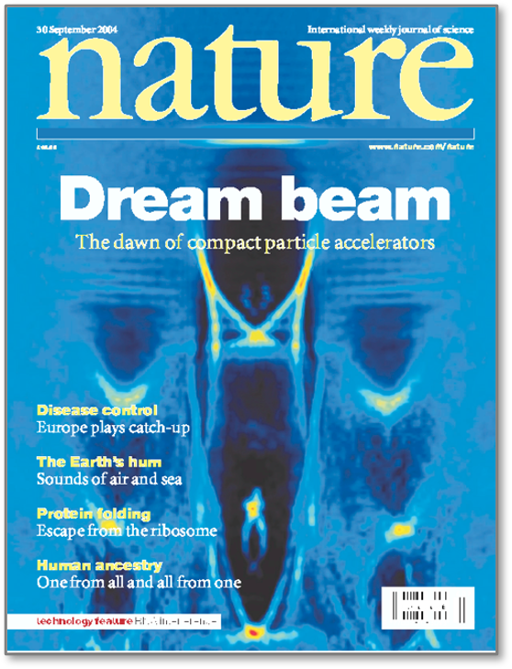
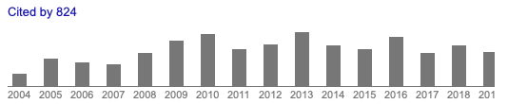
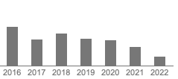
Tech-X - Acquired by Silvaco April 2025
31 years of high performance, highly technical software development
Founded in 1994 by computational physicist Drs. John R. Cary, physics professor at University of Colorado, and Sveta Shasharina
Company vision was to use the latest advances in physics and computational research to solve complex, real-world problems
Company focus is plasma (fusion, laser plasma acceleration) and EM simulation.
Brief History:
1994 – 2006: Mostly Dept. of Energy SBIR​
2006 – 2012: VSim (nee Vorpal) released and commercialization increases​
2012 – 2025: Commercialization significant portion of efforts
2025: Silvaco acquisition
Citations of the journal publication that introduced VSim

Slide 4
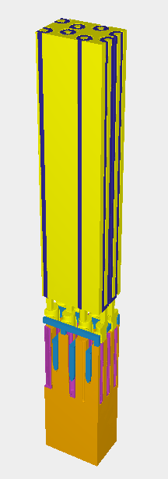
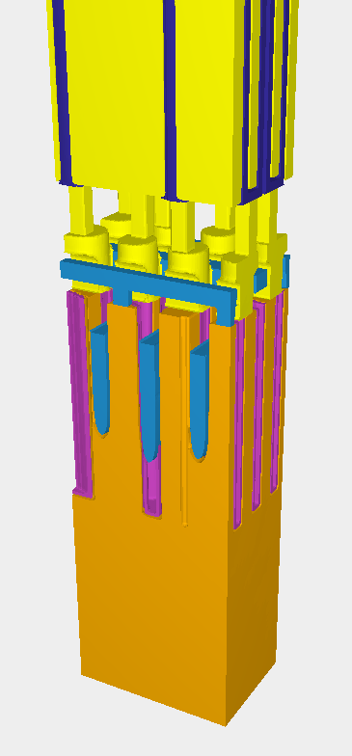
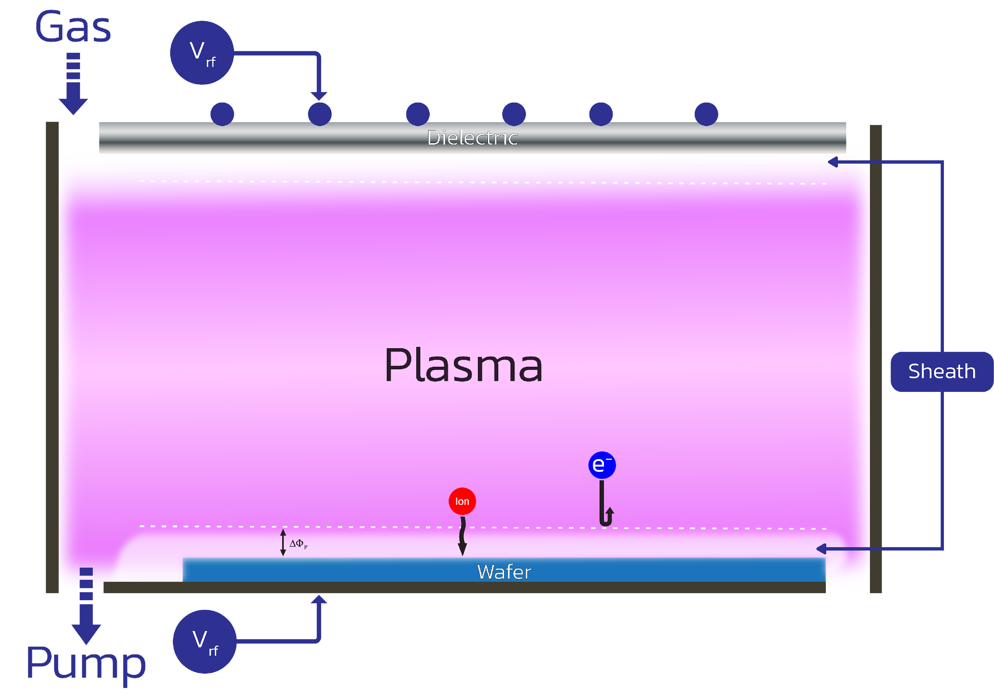
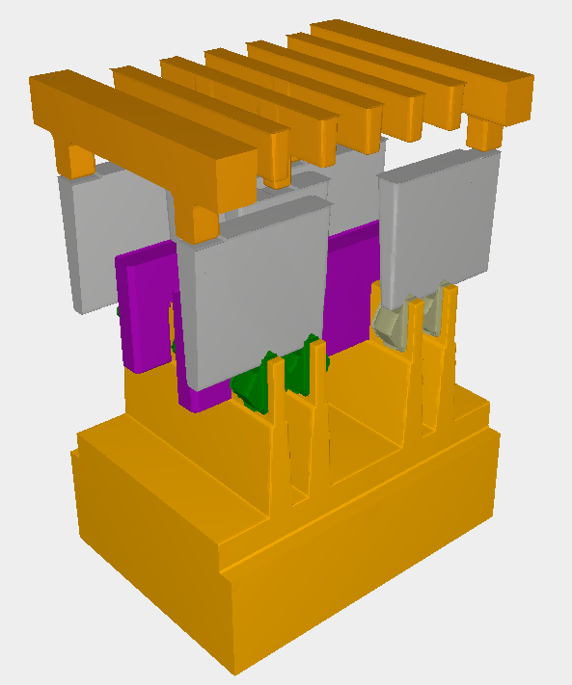
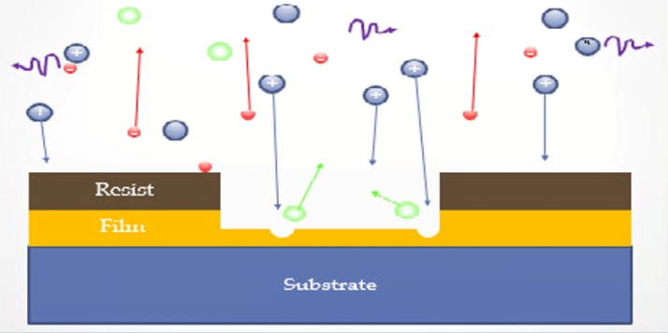
Expanding Silvaco’s Capabilities
Reactor and Feature Scale Physics Modeling
Reactor Scale Level (Tech-X VSIM)
Encloses the whole reactor space
Feature Scale Level (Silvaco Victory Process (TCAD))
Represents a microscopic portion of the reactor space, specifically at the wafer
DRAM Process
FinFET Process

Slide 5
VSim By Tech-X
Multiphysics Simulation Solver
  Plasma Physics
  Vacuum Electronics
  Electromagnetics
  Electrostatics
Targeted to Academic / Research since 1994
GUI Based front end / code access
Multithreaded HPC compatible enables efficient analysis on methods such as:
  Finite-Difference Time-Domain
  Particle-in-cell
  Charged fluid (finite volume)
Domain Decomposition

Slide 6
VSim By Tech-X
VSimEM - Electromagnetics simulation to design phased-array antenna systems, radar equipment and photonics devices.
VSimVE- Vacuum electronics and microwave devices. Child-Langmuir current density studies and Fowler-Nordheim electron tunneling issues are the big applications for VSimVE, with diagnostics available for current, power and electron currents.
VSimPlasma - Plasma simulation of kinetic particles in background gases. Typical applications such as reactor scale etch/deposition. A particle-in-cell solver that uses Monte Carlo simulations to study “the effects of elastic, excitation, and ionization collisions between electrons, ions and neutral particles.”

Slide 7
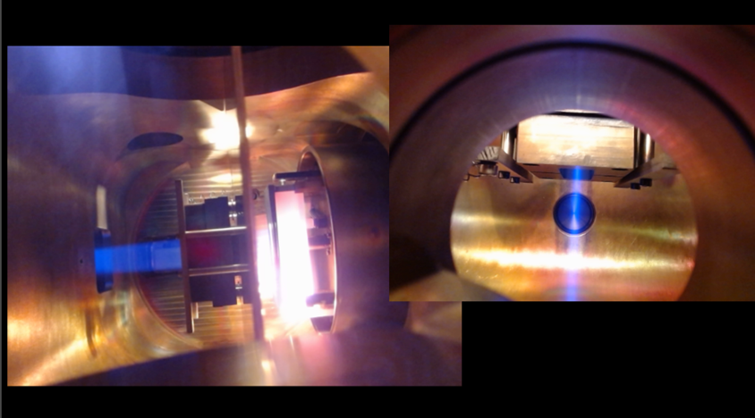
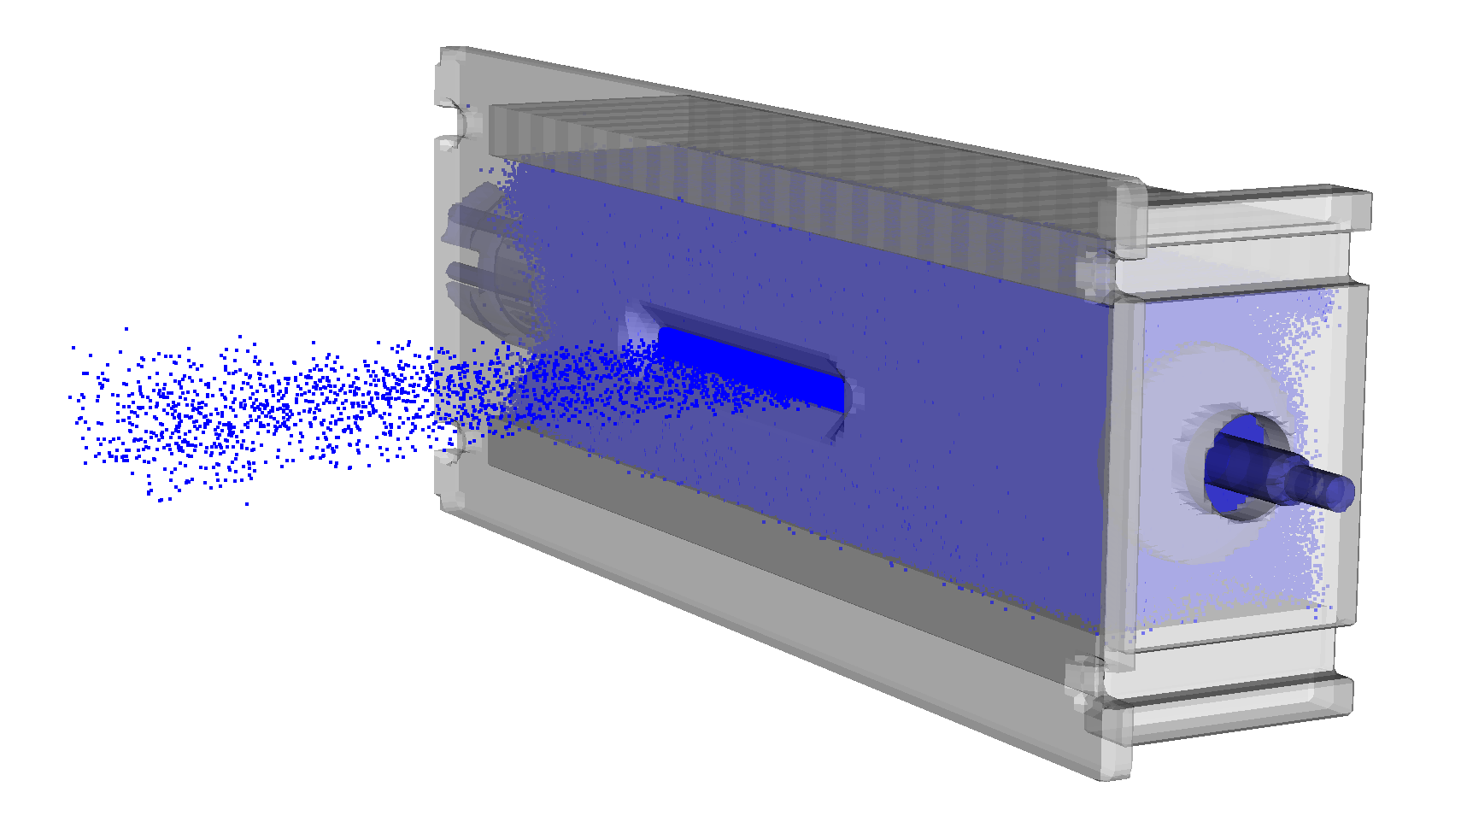
Ion Source Modeling With VSimPlasma
Why we are here today
VSimPlasma features for Ion Source modeling:
  Kinetic particle-in-cell modeling of EM fields and particles
  Complex plasma chemistry and Monte Carlo collision models
  Self-consistent particle/surface interactions such as secondary electron emission
  High-powered post-processing/visualization and data analysis
Plasma-based Bernas ion source showing beam formation and propagation in the laboratory (courtesy D-Pace Inc.)
VSim kinetic model of Bernas ion source. Detailed simulation reduces cost, optimizes performance and design, and reduces time-to-market for ion sources.
https://doi.org/10.1557/s43580-025-01230-x

Slide 8
Summary
Digital Twin and AI
TRANSISTORS
We enable next generation products
We leverage AI to deliver Digital Twin technology models for Fabs to improve productivity, time-to-market, and lower operational costs
Our expertise spans from atomistic to system-level IP
Our solutions have been used in production flows for the past four decades
Our agile R&D teams respond to unique customers’ needs
Customer success is our highest priority
ATOMS
SYSTEMS
TCAD
EDA
Services
SIP

