Slide 1

Optimization for RF-driven H- source and Low
Energy Beam Transport for CSNS-II
Weidong Chen
Institute of High Energy Physics, CAS.
Spallation Neutron Source Science Center.
Sep. 12th, ICIS2025
Oxford, UK

Slide 2
Outline
Introduction to CSNS Front-End
H- Ion source development.
Beam test on New LEBT
Summary

Slide 3
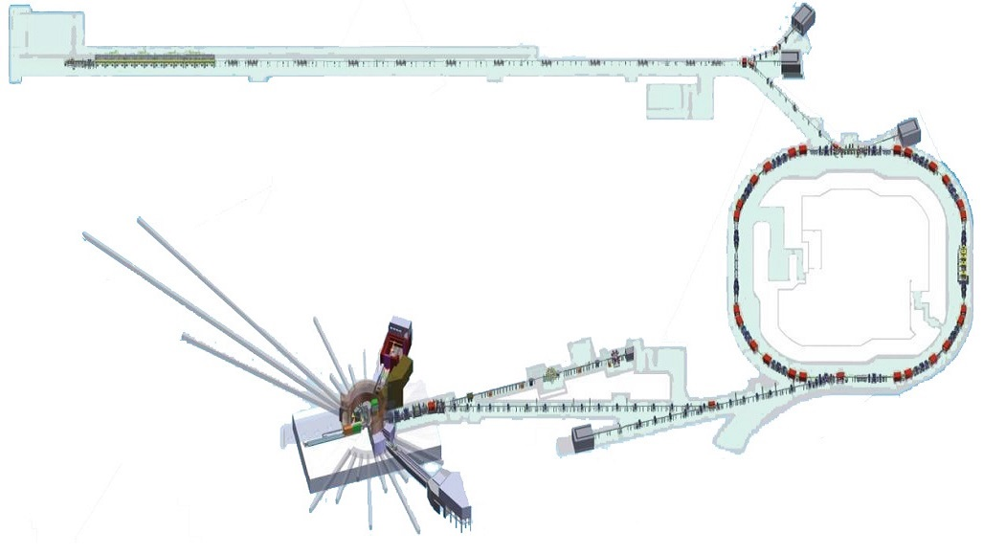

Introduction to CSNS accelerator
RFQ
LINAC
Parameters | CSNS 2018 | CSNS-II 2029
I.S. Current (mA) | 30~40 | 50~55
Repetition Rate (Hz) | 25 | 50
Pulse-width (us) | 415 | 500-700
Chopping Factor | 42% | 50-65%
Linac Components | R.T. | R.T.+SC
Linac-energy (MeV) | 80 | 300
RCS-energy (GeV) | 1.6 | 1.6
Beam Power (kW) | 100 | 500
Spoke+elliptical
CSNS-II
H- Ion
Source
DTL
Rapid Cycling Synchrotron
Target
Front-End
System
Spectrometer
Important front-end parameters：
Beam-power=Current × Energy × Pulse-width × Repetition × Chopping factor
500 kW
40~55 mA
1.6 GeV
500~700 us
25 Hz
50~75%

Slide 4
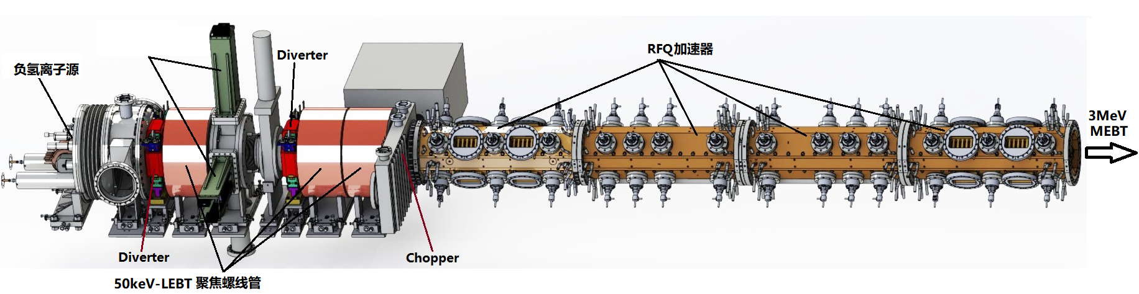
Introduction to the front end system
The front end of the CSNS accelerator in service
Double-slit
scanner
RFQ accelerator
H⁻ ion source
Focusing solenoid
The LEBT has 3 solenoids, initially designed for the penning ion source.
The penning source has been replaced by RF-driven H⁻ ion source in Sep. of 2021.
The ion source produces 37~42 mA, and throttled to 10~13 mA by a collimator before RFQ.
A new LEBT is constructed and tested in the lab.

Slide 5
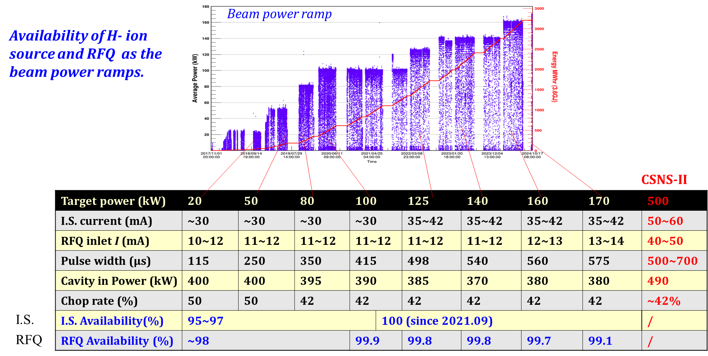
Operation status

Slide 6
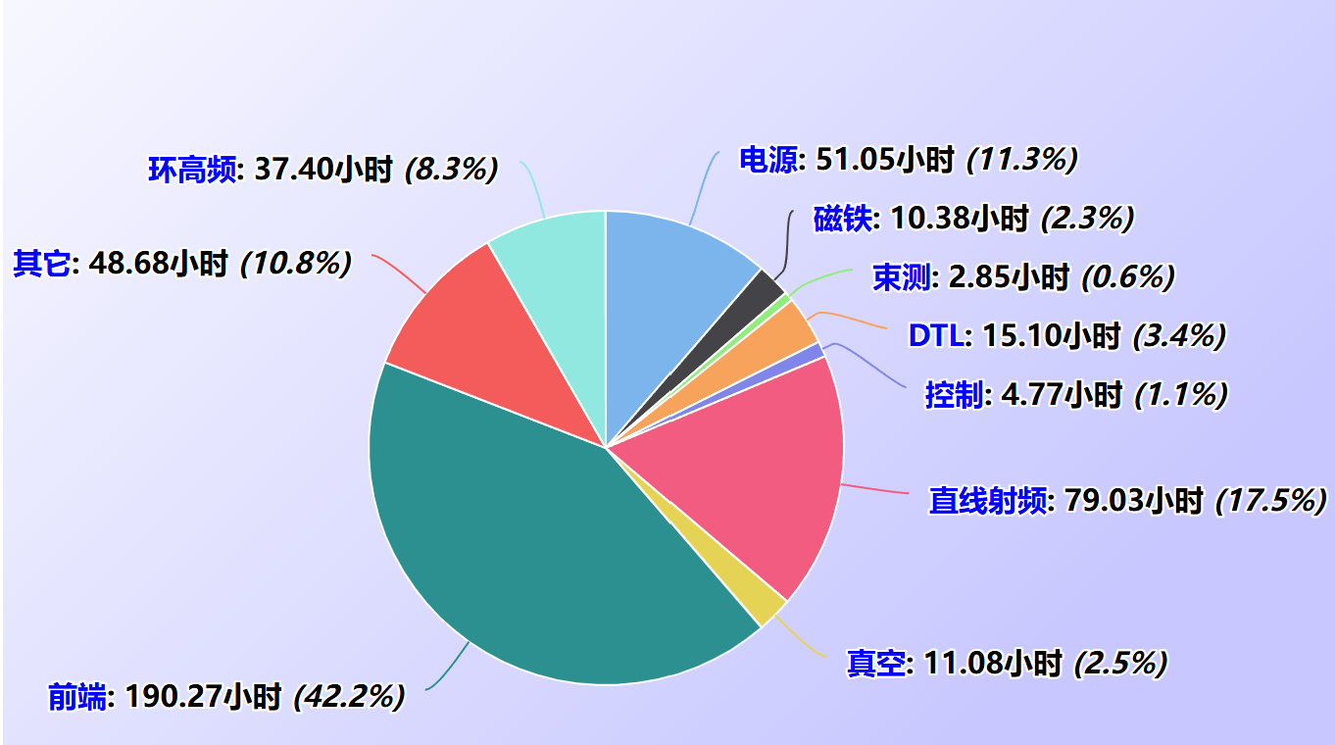
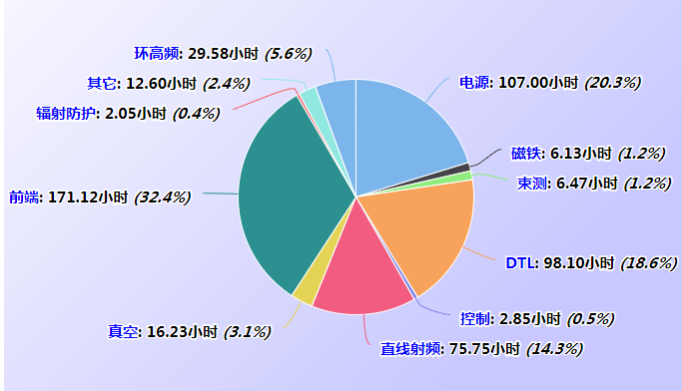
Issues of penning ion sources
Issues of penning ion source up to Sep. 2021
Principle of the penning ion source
Down-time of the penning ion source
Emittance@50mA, 0.8∙π∙mm∙mrad
2019-2020 I.S.-113.4 hours, RFQ-76.9 hours
2020-2021 I.S.-64.9 hours, RFQ-98.2 hours
Penning source cloned from ISIS, Oxford
Peak Current: 50 mA，typical 30~40 mA
Typical lifetime: 1 Month
Main problems: Extinguish， fluctuation、discharge
Survey for new design of IS started in 2015, visited PKU (Prof. S. Peng) and SNS (M. Stockli, R. Welton and B. Han) .

Slide 7
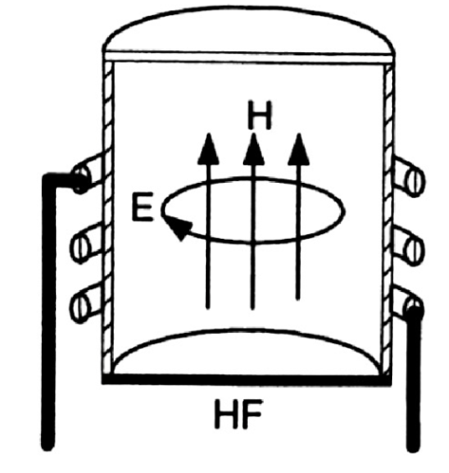
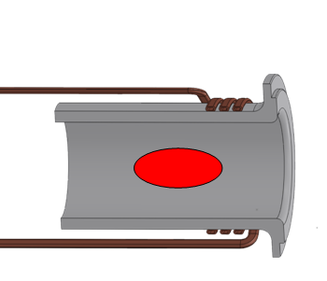
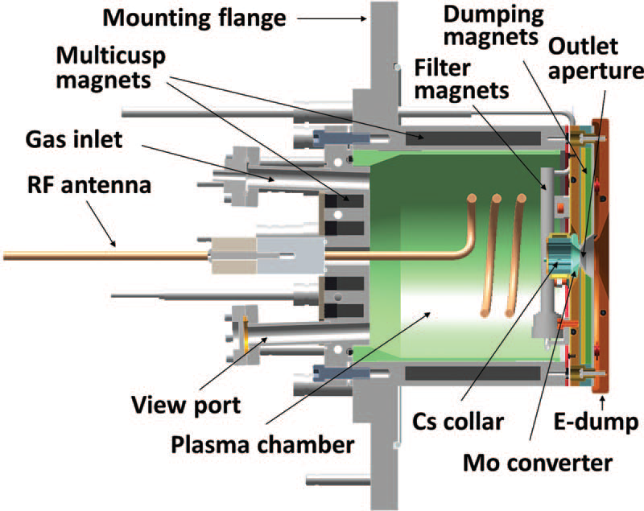
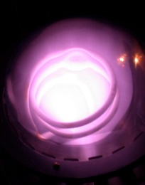
Inspiration of RF-driven ion source with ext-antenna
Inner ant. in SNS/J-PARC
External ant. in HERA
External ant. in
CSNS/SNS/CERN
H2
Antenna failure problems in the initial stage of the commissioning. Solved by improvements of antenna.
Stable operation with high current up to now.
Jens Peters from HERA suggested an external-antenna structure.
Development in CSNS,
2016.01-- R&D Fund from CAS received.
2018.12 -- First H- beam produced in lab.
2021.09 -- Put into operation on CSNS.
2025.06 -- 1200 operation days for single source accumulated.

Slide 8
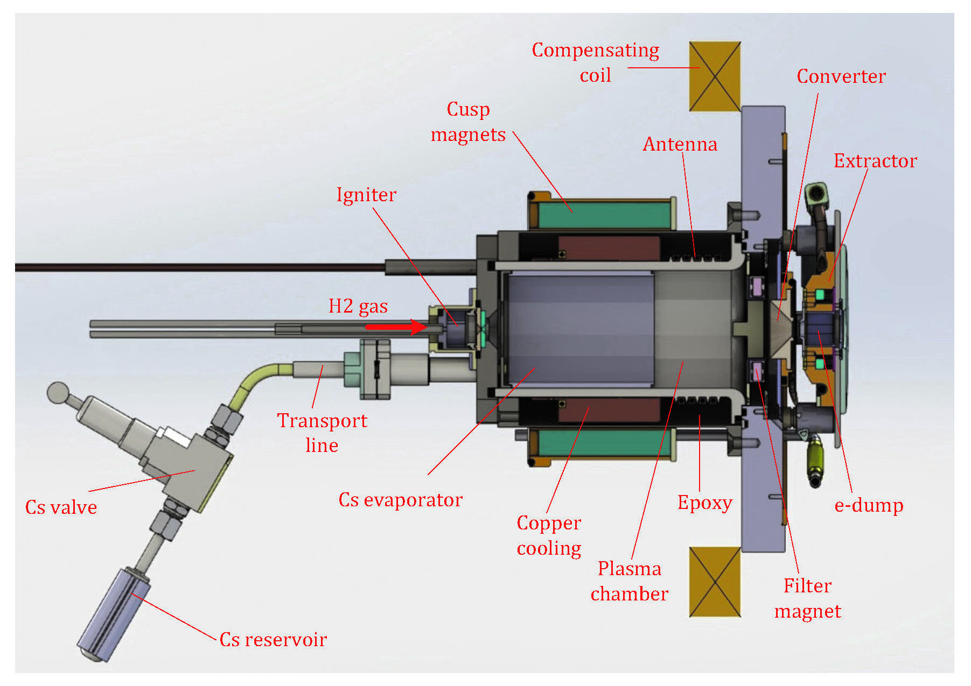
The new RF-driven H- source
Silicon-Nitride plasma chamber is used.
Indirect cooling scheme.
Elementary cesium.
Compensation B-Field is used.
Glow dis charge igniter.

Slide 9
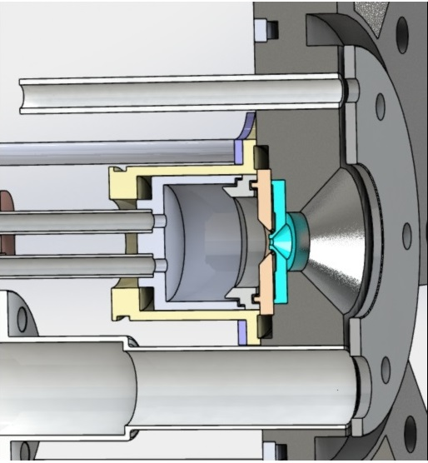
The new RF-driven H- source
The glow discharge igniter
Simple structure
Pulsed 560 V DC voltage
Average power less than 0.5 W
Since the pressure in the igniter is 200~400 Pa, the seed electrons are blew to the plasma chamber and guided by the weak axial magnetic field produced by the magnetic coil.
Ceramic insulator
Timing sequence
Plasma chamber~3 Pa
electrons
B-field produced by the
axial compensation coil.
<400Pa
Cathode
Anode

Slide 10
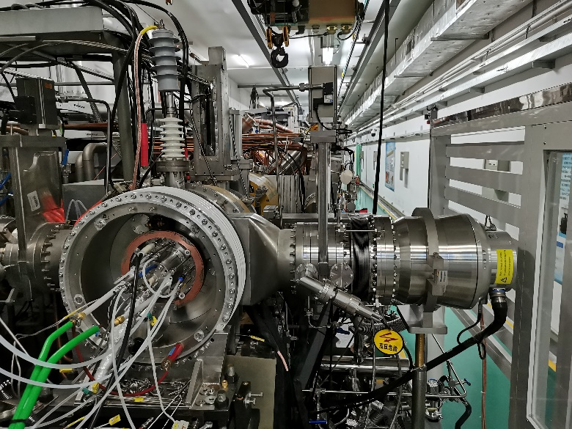
Operation parameters
Typical operation parameter for user service and experimental study
The RF-driven ion source installed in the accelerator tunnel
 | CSNS service | Test bench study
Peak RF-power | 31 kW | 25~40kW
H2 flow rate | 21 SCCM | 18~24 SCCM
Repetition rate | 25 Hz | 25/50 Hz
Plasma pulse width | 680 μs | 500~800μs
Beam pulse width | 498 μs | 100~750 μs
H- peak current | 37 mA | 50~60mA
Cs reservoir temp | 80~90 ℃ | 77~120℃
Service cycle | >330days
Beam energy | 50 keV | 55 keV
Norm. 95% beam RMS emitt. | Not measured | ~0.21 π.mm.mrad (New LEBT)

Slide 11
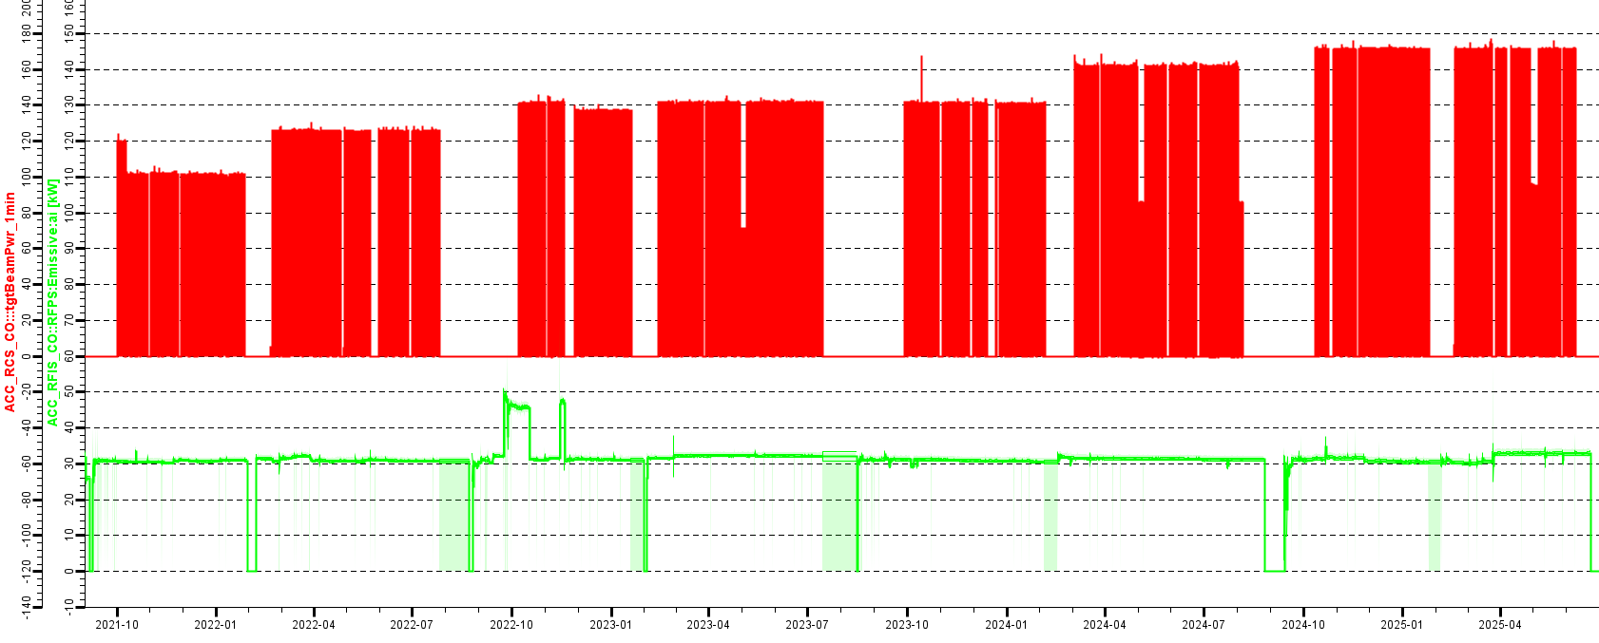
Operation status from 2021.9 to 2025.6
Operation in last 4 run cycles, always be ready for neutron production or machine study.
Summer maintenance: disassemble → clean/fill cesium→ reassemble.
Chinese new year: power off, kept in vacuum.
Summer
Maintenance
Summer
Maintenance
Summer
Maintenance
Target power
1 sample/min
CN New year
CN New year
CN New year
CN New year
I.S. RF power
1 sample/s
2021.9-2022.7,
310 days accumulated
2022.8-2023.7,
323 days accumulated
2023-2024,
~330 days accumulated
2024-2025,
~300 days accumulated

Slide 12
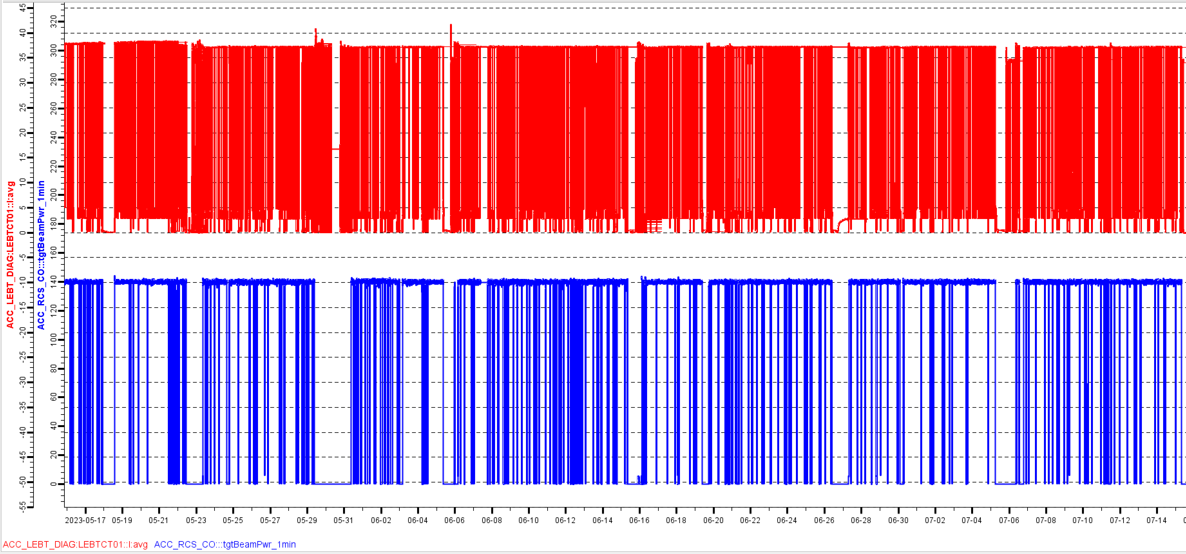
Operation status from 2021.09 to 2024.08
The ion source runs unattended. The routine maintenance includes H2 gas bottle replacement, 50 kV insulation cleaning, gas/water line inspection, and plasma emission spectra check.
LEBT CT01
25 samples/s
Beam power
1 sample/min
Ion source beam current and target beam power from May 16th to July 15th 2023.
When parameters reaches equilibrium in 30 minutes, the beam current output fluctuation is less than 1%.

Slide 13
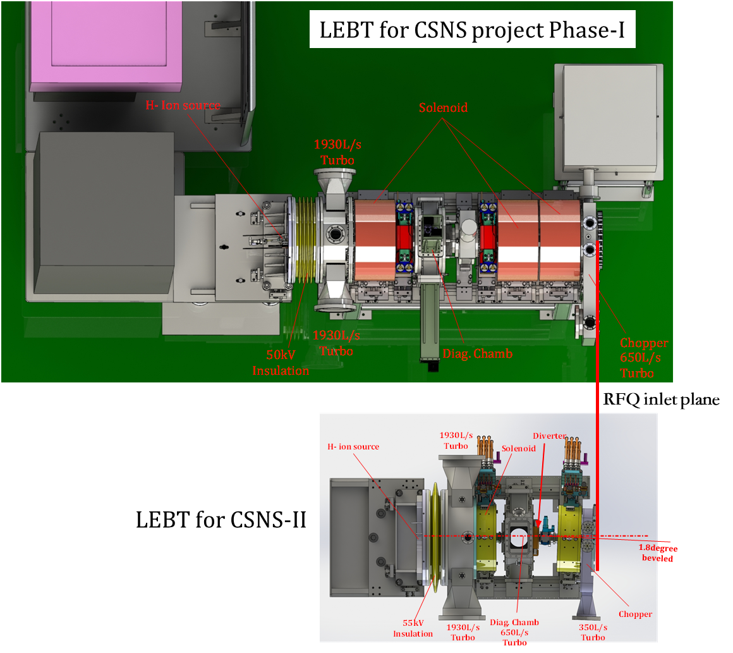
The new LEBT
LEBT parameters comparison
Parameters | CSNS LEBT | CSNS-II LEBT
Length | 1668mm | 738mm
Inner diameter | 138mm | 64mm
RFQ inlet current | ~40mA | 60mA
RMS Emitt. @RFQ inlet | 0.307@37mA | 0.24@52mA
Num. of solenoids | 3 | 2
Length of solenoids | 240mm | 127mm
Mean vacuum | 3E-3Pa | 2E-3Pa
Stripped proton removal | No deflection | 1.8 degree（3.6 to H-）
Chopper length | 50mm | 27mm
Chopper voltage | 3.8~5kV | 6~8kV
Suppression of emittance growth
Shorter LEBT, higher beam transmission.
Beam enters the solenoid as early as possible.
Shorter Solenoids, lower fringe effect of B-field.

Slide 14
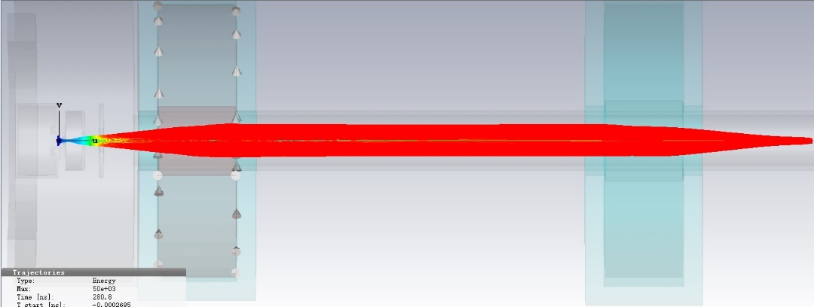
Emittance optimization for CSNS-II on new LEBT
Emittance optimization new LEBT
85mm
95mm
I.S.
RFQ
Many sets of parameters of LEBT is studied with the help of CST Particle-studio.
Parameter of solenoids
Acceleration gap
Meniscus simulation.
Space charge compensation via CST and IBSimu.

Slide 15
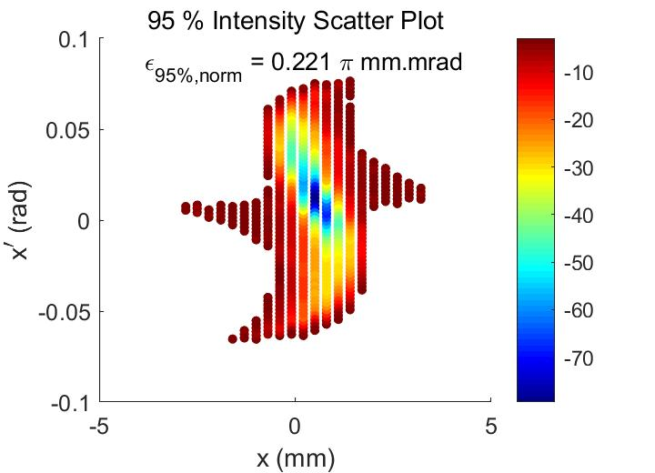
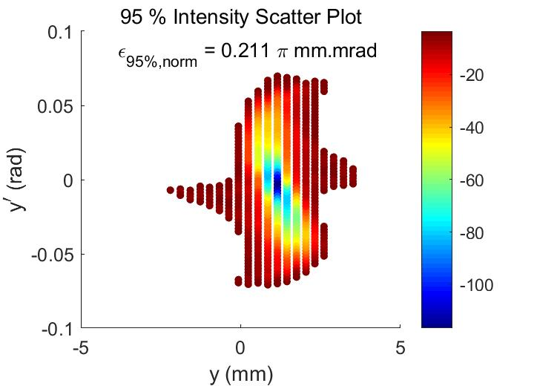
Emittance optimization on new LEBT
Emittance measurement on new LEBT for 60mA beam
RF frequency-2.048MHz，RF power-44kW，Solenoid-316A，gas-24sccm
95% beam emittance x=0.221 π.mm.mrad
95% beam emittance y=0.211 π.mm.mrad

Slide 16
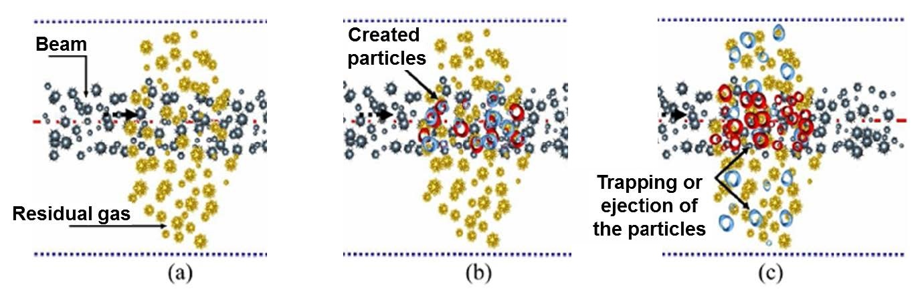
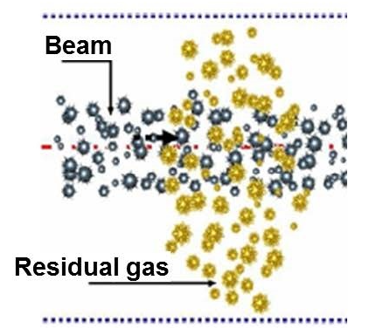


Effect of chopper field to emittance growth
Build up/destroy of space charge compensation (SCC)
+
—
Destroy of SCC in external E-field
$H^{−}+H_{2}\overset{→}{}H_{2}^{+}$+3e+p
$H^{−}+H_{2}\overset{→}{}H_{2}^{+}$+2e+H

Slide 17
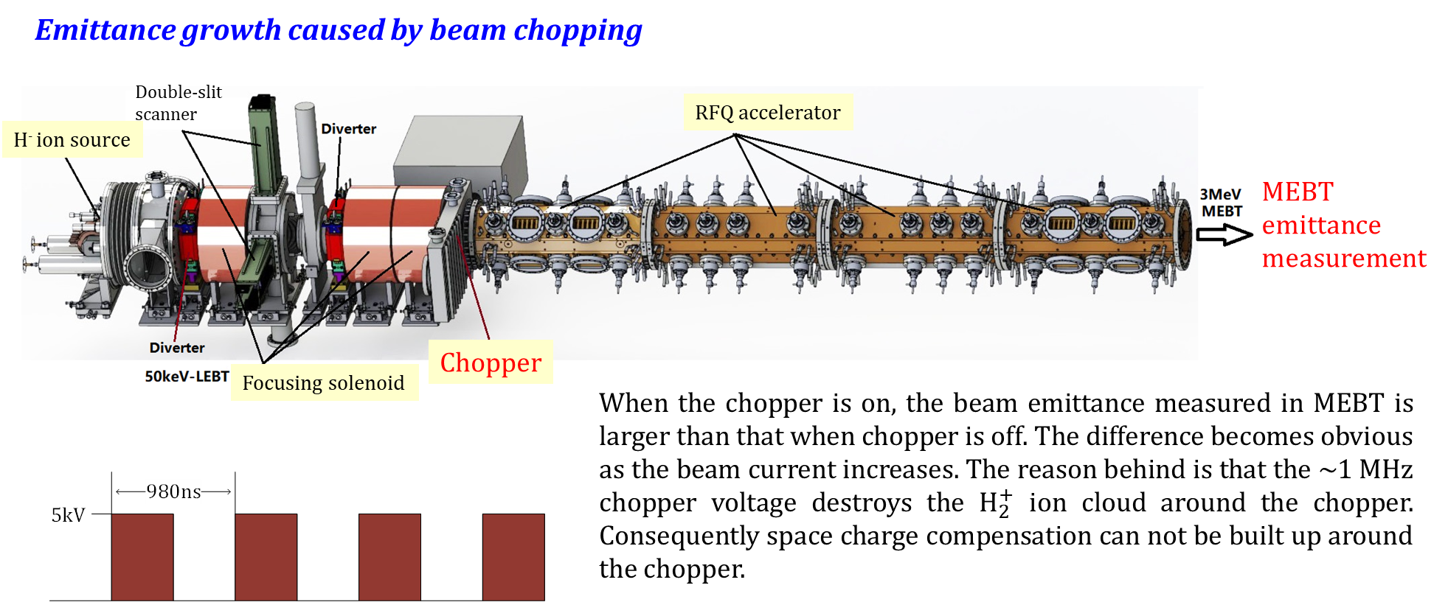
Effect of chopper field to emittance growth

Slide 18
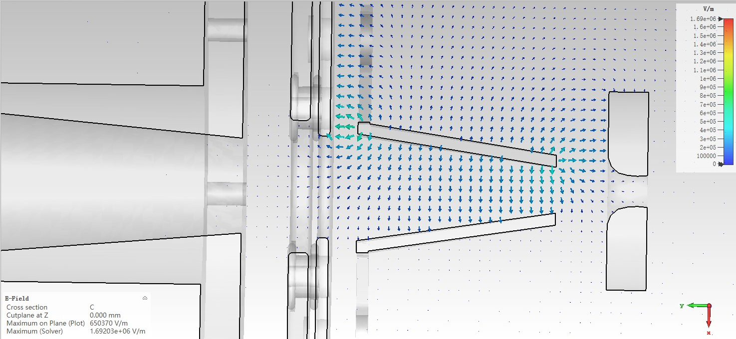
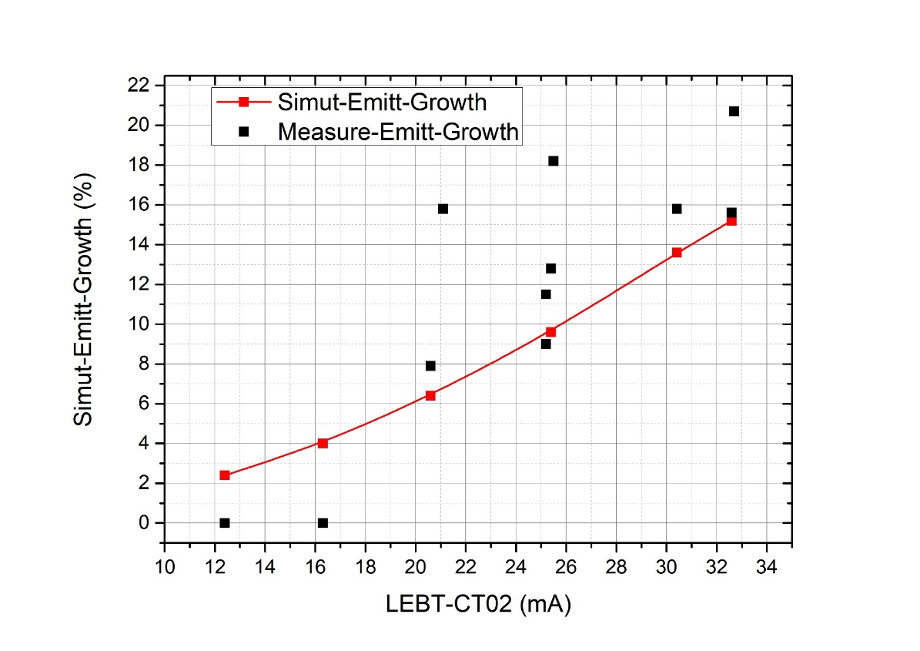
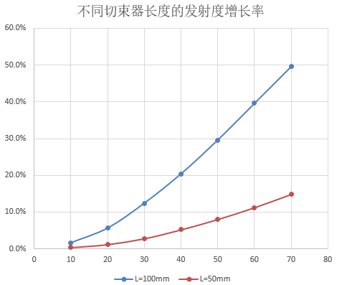
Effect of chopper field to emittance growth
Emittance growth v.s. current
Influence range of chopper’s E-Field
Shorter chopper length is favorable to the emittance control.
30mm chopper length for CSNS-II.
Beam energy increased to 55keV.
Fast power supply limits the further shortening.
100mm
Emittance growth (%)
E.M. measurement after RFQ.
Simulated by Tracewin, beam envelope is focused from 21.5 mm to 6.8mm within 100 mm drift length.
50mm
Current (mA)

Slide 19
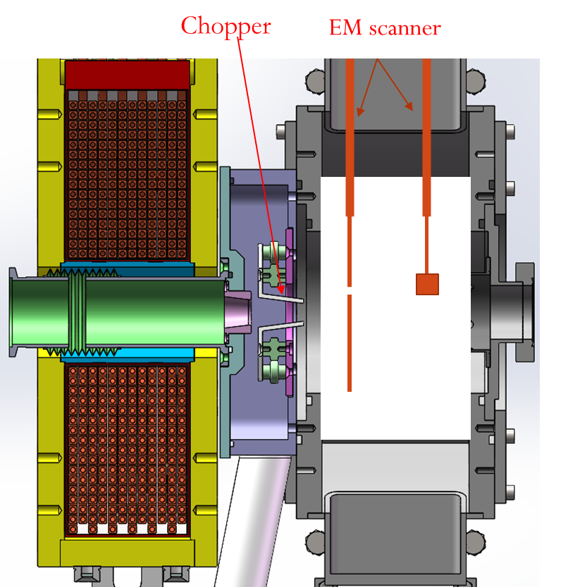
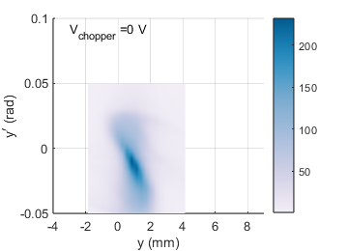
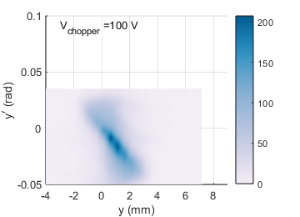
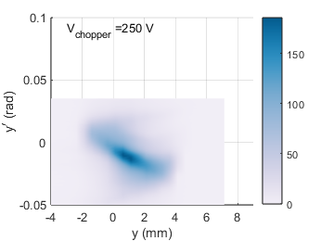
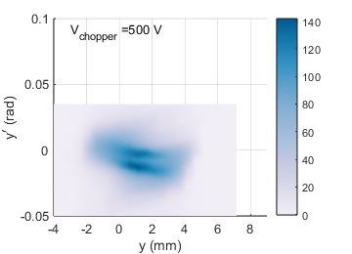
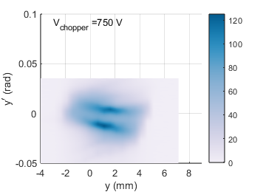
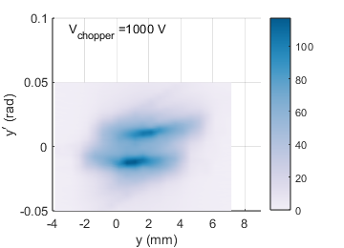
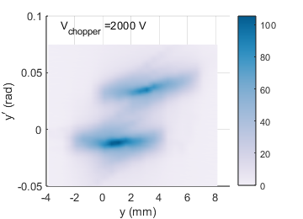
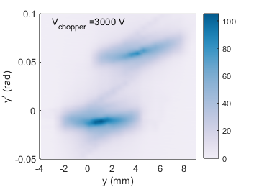
Effect of chopper field to emittance growth
Direct measurement of phase-space change on new LEBT
The primary and chopped beam are separated in phase space with the increase of the chopper voltage.
Emittance growth caused by SCC destroy starts to saturate when chopper voltage is larger than 1kV.
0V
100V
250V
500V
750V
1000V
2000V
3000V
For a beam current of 33 mA, RMS emittances of 95% beam are measured.
Before chopped: 0.175 pi.mm.mrad, after chopped:0.206 pi.mm.mrad

Slide 20
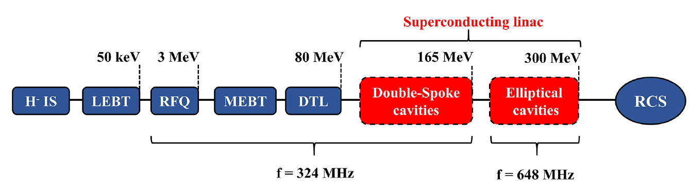
Stripped protons removal on new LEBT
Risk of stripped protons to SCC with doubted frequency
Vac. 2E-3Pa
Stripped protons
produced
Vac. 1E-6Pa
Stripped protons lost
Low beam energy, high residual gas density in LEBT corresponds to high stripping rate.
Protons are accelerated by RFQ, DTL, and Spoke-SCC together with H- beam with phase shift of π.
Stripped proton loss in 648MHz Elliptical cavities contributes to the heat load and radioactivity.

Slide 21
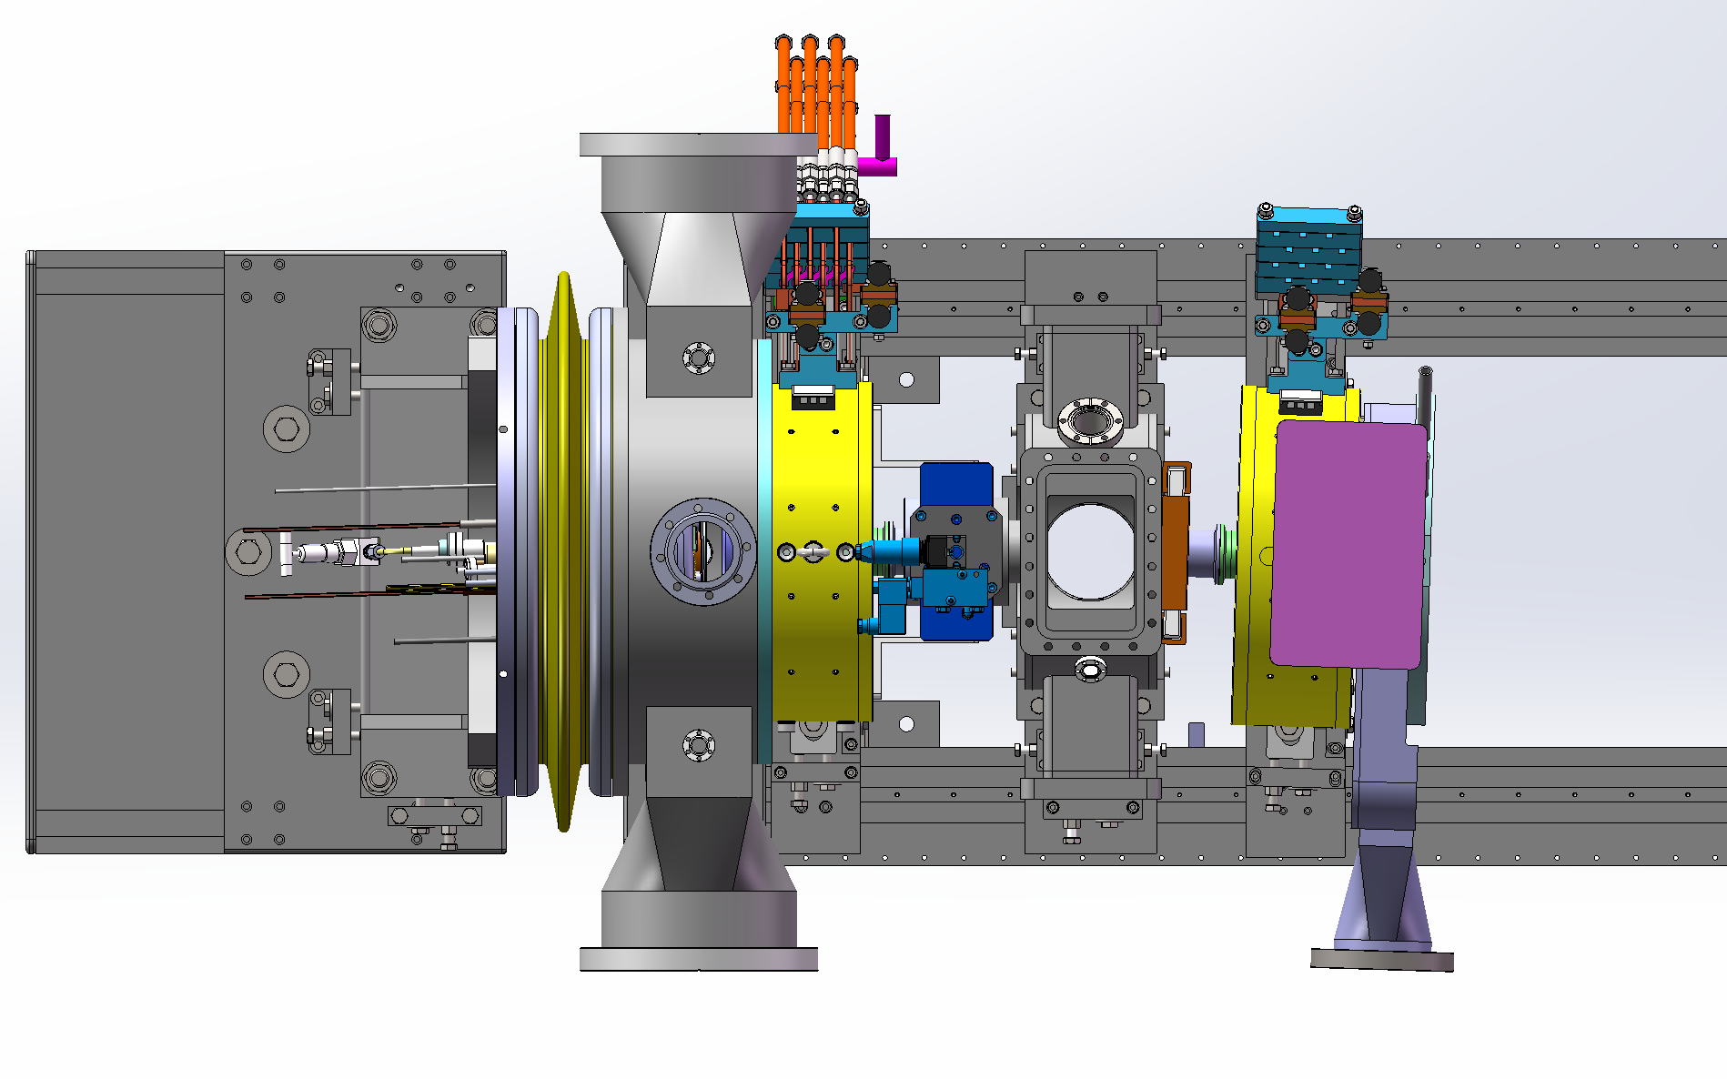
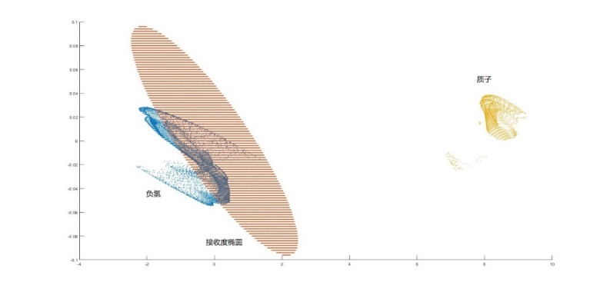
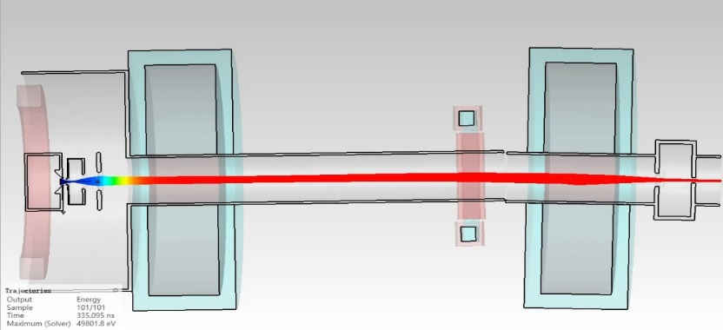


Stripped protons removal on new LEBT
Bending magnet
Stripped protons production
$H^{−}+H_{2}\overset{→}{}H_{2}^{}$+2e+p
The associated proton beam can be accelerated by RF cavities with 180 degrees phase shift. It may heat up and quench the super-conducting cavity. So it should be suppressed before it enters the super-conducting cavities.
1.8degree
RFQ acceptance
p
$$H^{−}$$
Residual gas distribution.

Slide 22
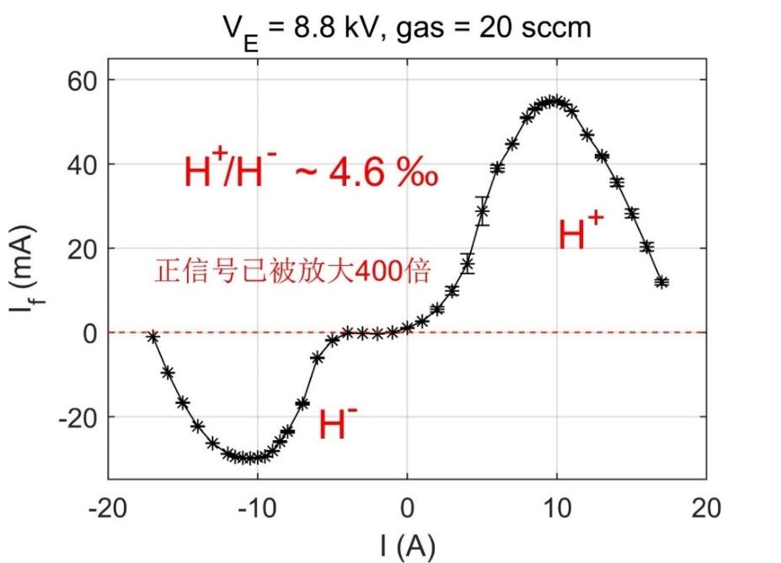
Stripped protons removal on new LEBT
Stripped protons measurement
Small Angle
Bending Magnet
Faraday Cup
Proton signal
enlarged by 400
At a gas flow rate of 20 SCCM, the protons produced before the bending magnet is less than 0.5% of the H- beam. These protons can not enter the RFQ after bent by the magnet.

Slide 23
Stripped protons removal on new LEBT
Without the bending magnet, 37% of proton beam is captured by RFQ, p/H- in RFQ~0.15%
5X RFQ accept.
eclipse
With the bending magnet, 3% of proton beam is captured by RFQ, p/H- in RFQ~0.01%
5X RFQ accept. eclipse
Simulated with IBSimu Code, tend to overestimate the captured protons.

Slide 24
Proton-loss power in the SCL
The total power lost of protons in the linac after RFQ is approximately 0.67 W.
About 20% of the protons are lost in room temperature linacs.
In the SCL section, proton beam loss primarily occurs after the first cryomodule for spoke cavities and also near the end of the elliptical (648 MHz) cavities.
The maximum proton loss at a single mesh grid is approximately 0.25 W, located in the room temperature matching section between the first and second cryomodules.

Slide 25
A backup scheme
Crossed beam transport rather than a parallel beam transport.
An Iris aperture 16~38 mm will be installed in chamber 2 close to the beam waist.
Additional 1000 l/s TMP in chamber 2.
In this scheme, the IBSimu simulation shows that the number of protons captured by the RFQ can be further reduced by an order of magnitude.
Drawback: Longer time to build up space charge compensation, more beam should be chopped.

Slide 26
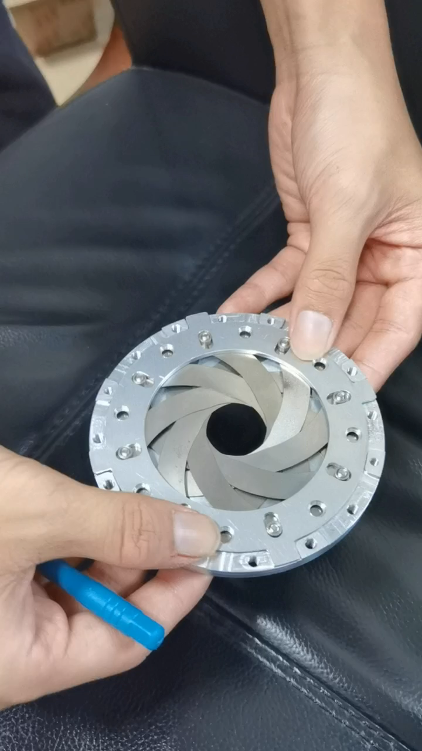
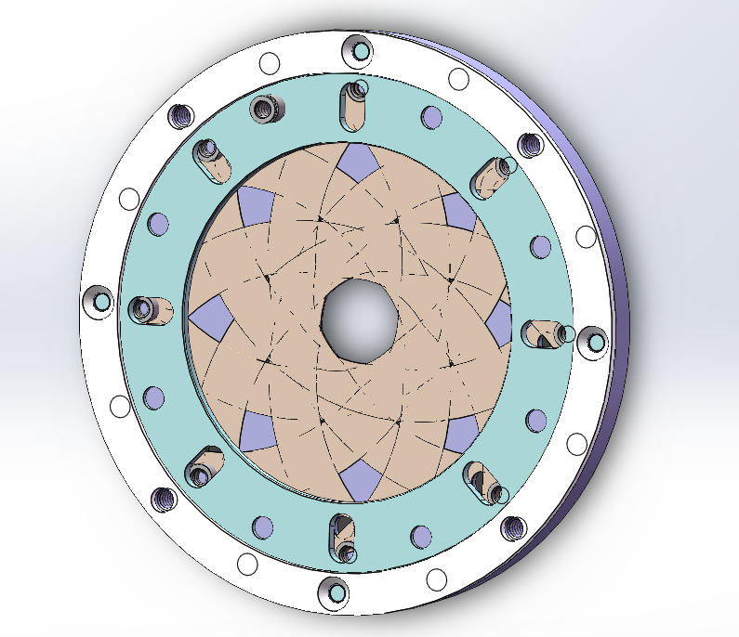
A backup scheme
Aperture diameter adjustable from 16~38mm, covering crossed and parallel beam transport.
Blades are made from molybdenum, working up to 800 degree.
Also as a beam scrapper for 25 W average power dump per blade (15mA×55kV, 3% d.f.)
Beam intensity regulation in LEBT without changing focusing optics.

Slide 27
Summary
The RF-driven H⁻ ion source with external antenna demonstrate a life-time of above 1000 days.
Emittance of the H- beam is optimized on new LEBT
1.8 degree bending in LEBT successfully suppresses the stripped protons produced in LEBT.

Slide 28
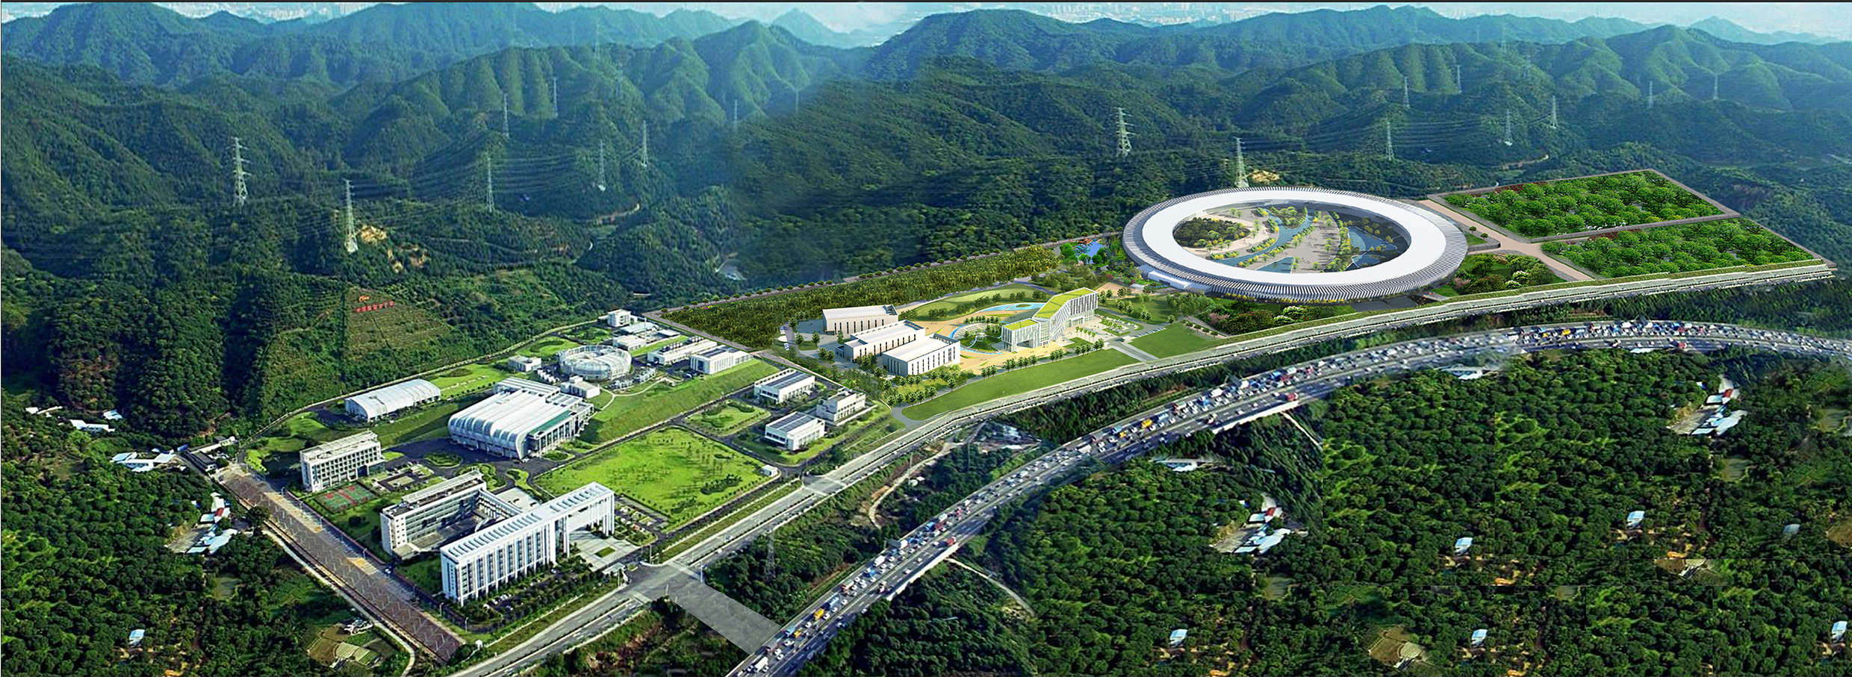
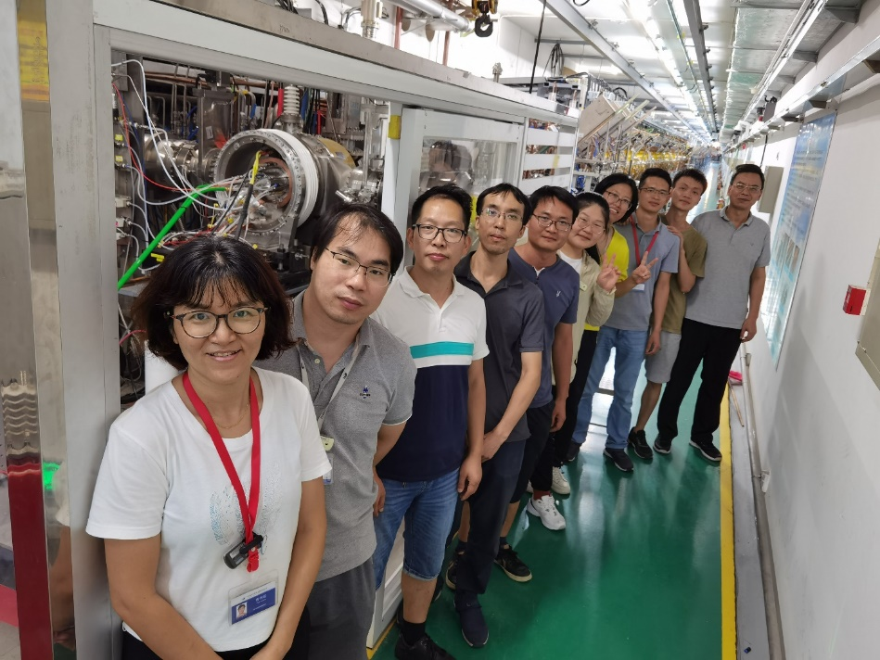
SPS in plan
Thanks for your attention!

