Slide 1
The High Intensity Polarized Proton Source
G. Atoian`, A. Cannavo, T. Lehn, D. Raparia, J. Ritter, B. Snyder, A. Zelenski
21st International Conference on Ion Sources, Oxford, UK
September 8-12, 2025

Slide 2
Introduction
Almost 25 years, the polarized proton source based on OPPIS (Optically Pumped Polarized H-Ion Source) reliably delivered the high-intensity polarized proton beam for the RHIC spin physics program at BNL.
The OPPIS polarized source for RHIC was developed in collaboration BNL – KEK – TRIUMF – INR at 1998-2002.
The source has been upgraded several times and continuously improves polarization, intensity and emittance.
Prior to Run-12, the ECR-type source was used to generate the primary proton beam. The ECR-source was originally developed to operate on a DC current and placed inside a super conductive solenoid (SCS).
In 2012, the ECR-source was replaced by a high-brightness source “Fast Atomic Beam Source”. FABS placed outside of SCS and operating in a pulsed mode. The new source improved the beam current density, angular divergence and stability.

Slide 3
EIC Accelerator Performance
Requirements for an Electron-Ion Collider are defined in the White Paper:
“In order to address the crucial scientific questions discussed in the previous sections, the EIC must provide:
• A Highly polarized electron (∼70%) and proton (∼70%) beams;
• Ion beams from deuterons to heavy nuclei such as gold, lead, or uranium;
• Variable e+p center-of-mass energies from 29−140 GeV;
• High collision electron-nucleon luminosity 10³³−10³⁴ cm⁻² s⁻¹;
• The possibility to have more than one interaction region.”
By the request of this White Paper we are looking to improve the polarization and the intensity of the polarized proton beam.
“White Paper on the Electron-Ion Collider in Preparation for the NSAC Long Range Plan EIC”, p.5 User Group, January 2, 2023

Slide 4
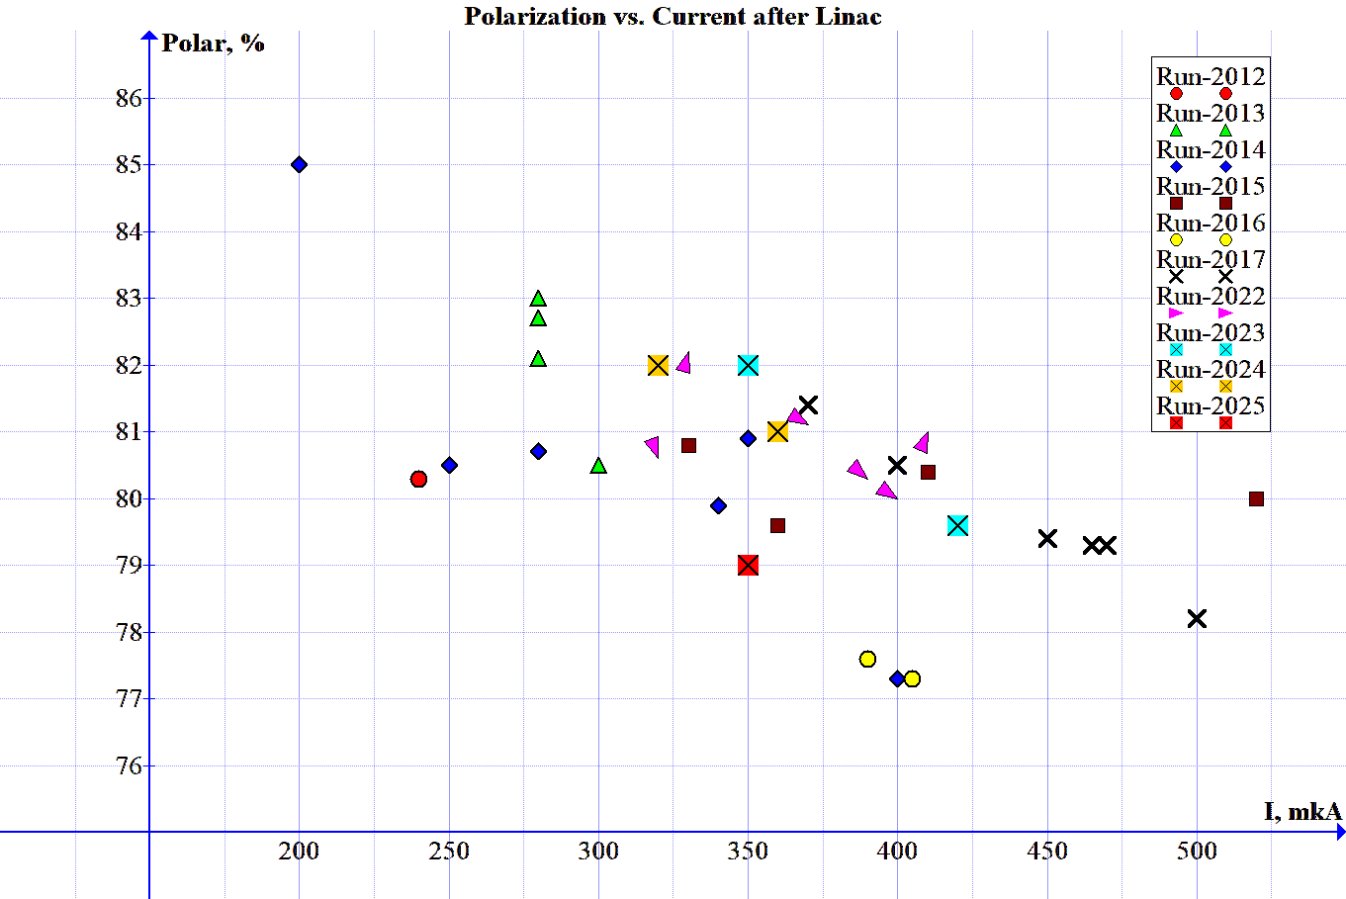
Performance of the beam injected into the booster

Slide 5
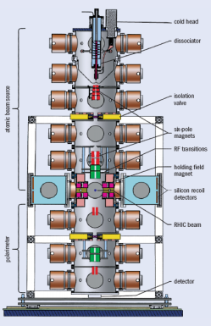
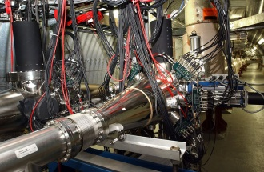
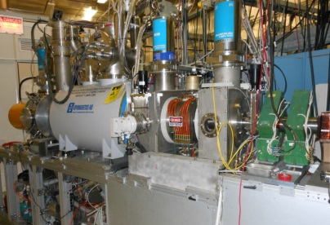
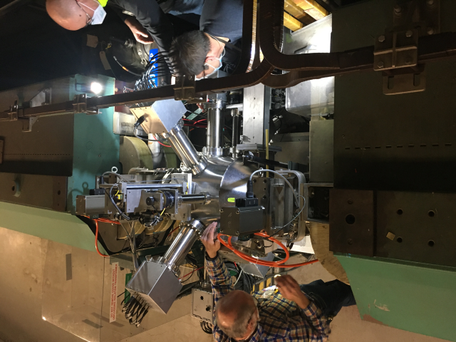
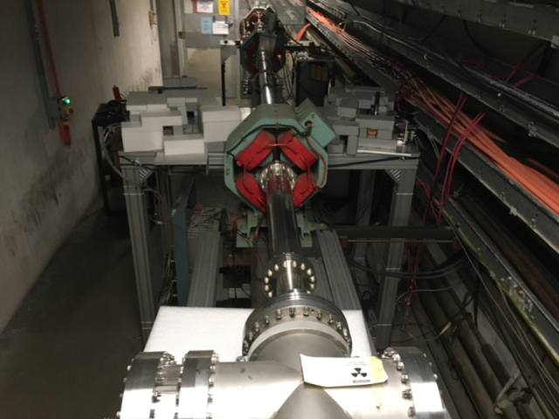
Polarization facilities at RHIC
The world’s only polarized proton collider: 60% proton polarization , L _{max}=1.6×10³² s⁻¹cm⁻²; 50<√s <510 GeV
Absolute H-jet
polarimeter
RHIC pC “CNI” polarimeters
Siberian Snakes
RHIC
Siberian Snakes
PHENIX
STAR
H- polarize source OPPIS
Spin Rotators
AGS pC “CNI” polarimeter
BOOSTER 2.5 GeV
LINAC
AGS 24 GeV
200 MeV polarimeter
Strong and Partial
Siberian Snakes

Slide 6
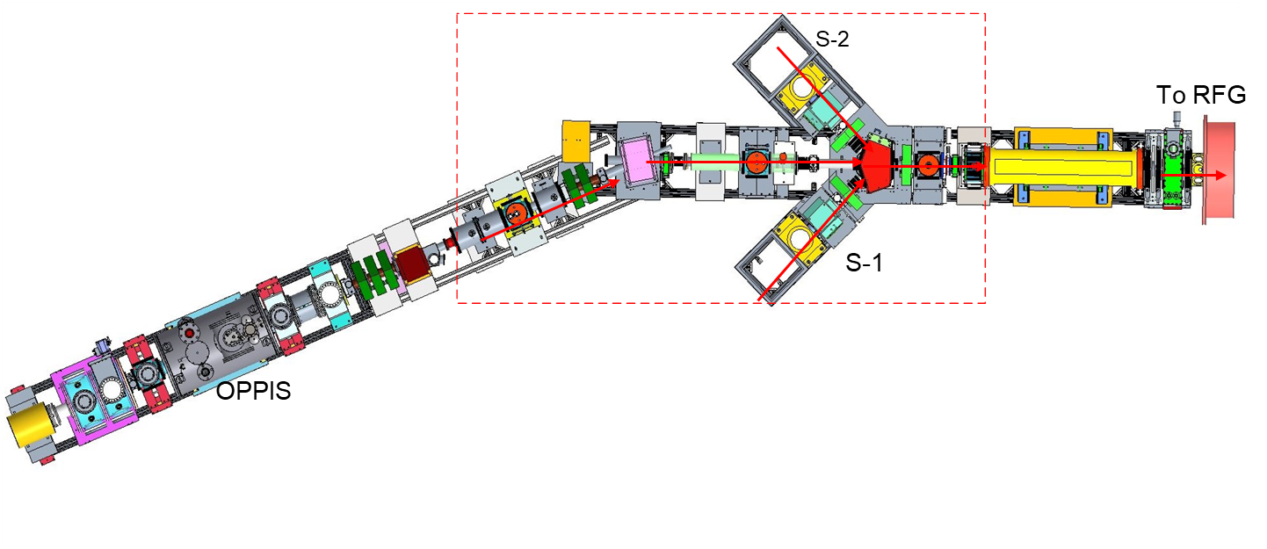
Optically Polarized proton source (OPPIS)
Extractor 35kV
SCS Magnet 23.7⁰ Spin rotator
Spin transfer: longitudinal→ transverse(horizontal)→ vertical
Ionization Na-cell
Solenoid
Switching Magnet (50 ms)
Sona transition
Magnet
23.7⁰
Spin rotator
Correction coil system
Neutralization Ru-cell
RFQ
To LINAC
Neutralization H-cell
Deceleration 3-grids ~3-4keV
Acceleration
4-grids
(5-7) keV
Ionization He-cell
MEBT
LEBT
Plasmatron
SCS
Laser room
Prob laser
Pumping laser

Slide 7
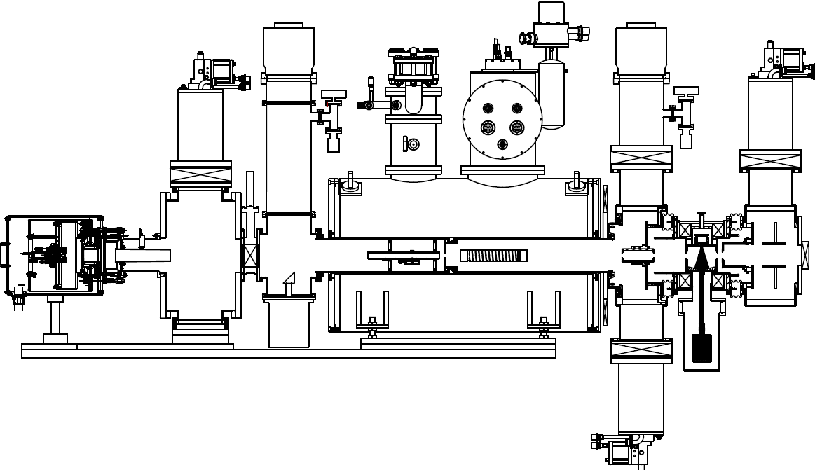
2013 OPPIS upgrade with FABS source
~1mA H-
Plasmatron
H-injector
Neutralizing
H-cell
Ionizing He-cell
Neutralizing Rb-cell
Na-cell coil
~35kV extractor system
Accelerating
4-grids system
Decelerating
3-grids system
Sona
transition
Ionizing Na-jet cell
H₂
He
Rb
Na
H⁺
H⁰
H⁺
H⁰
H⁻

Slide 8
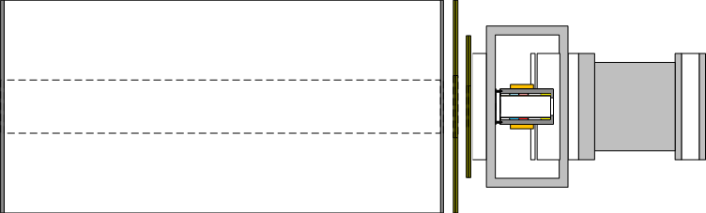
Polarization transfer technique (OPPIS)
Polarized light
Polarized electron
Polarized proton
Production of circular polarized tunable wavelength (~795nm) laser beam
Polarization of the Rb-atom (Rb-cell)
Ionization of hydrogen atom by He (He-cell).
Production of electron spins polarized hydrogen atoms by capturing an electron from Rb
Polarization transfer from the electron to proton by “Sona-transition” technique
The ionization of hydrogen atoms by capturing a second electron in Na-jet for acceleration (Na-cell)
H^{0*}
H⁰
H⁺
H^{0*}
H⁻
Na-jet
&
Solenoid
Laser beam
He-cell
Rb-cell
SC-solenoid
Sona-transition with 3 corr. coils in it

Slide 9
Energy separation a residual un-polarized H⁰ component
Only a portion of the beam is ionized in the He-cell (~60%) and can be further polarized.
H⁰ + He → H⁺ + He + e⁻
Ionization
in He-cell
Deceleration
by 3-grids system
Neutralization
in Rb-cell
He-cell
Rb -cell
H⁰(7keV)
H⁺(60%)
H⁺(3keV)
H⁰(3keV)
H⁰(40%)
H⁰(7keV)
H⁰(7keV)
-3.9.0 kV
-3.8 kV
-4.0 kV
-2.4 kV
+0.1 kV
The polarized part of the beam separates from the un-polarized by the bending magnet, LEBT (quadrupoles and steering magnets) and collimators. Energy separation ratio H⁻(4keV)/H⁻(7keV)is better by 25-30 times.

Slide 10

Ion Source Development
Since 2012, when FABS was implemented, we have made many adjustments to improve the beam parameters. We achieved the best polarization volume of over 86%, intensity over 1000uA, and a beam pulse duration of over 400us compared to the average volume of polarization of ~78-80% and an intensity of ~350uA.
Now, our goal is to have OPPIS maintain the best parameters for several months by improving monitoring and simplifying control, as well as making it fast and easy to repair and completely safe. Our goal for the future is stability and safety with the best performance.
DEVELOPMENT
PERFORMANCE
STABILITY
SAFETY
As a first approximation, the main parameters of the quality of the formed beam is intensity, polarization and emittance.
Notes:
We performed a set of upgrades in the OPPIS source to meet the requirements and goals for this Run. The idea was to base the development of the source on three main pillars: performance, stability and safety.

Slide 11
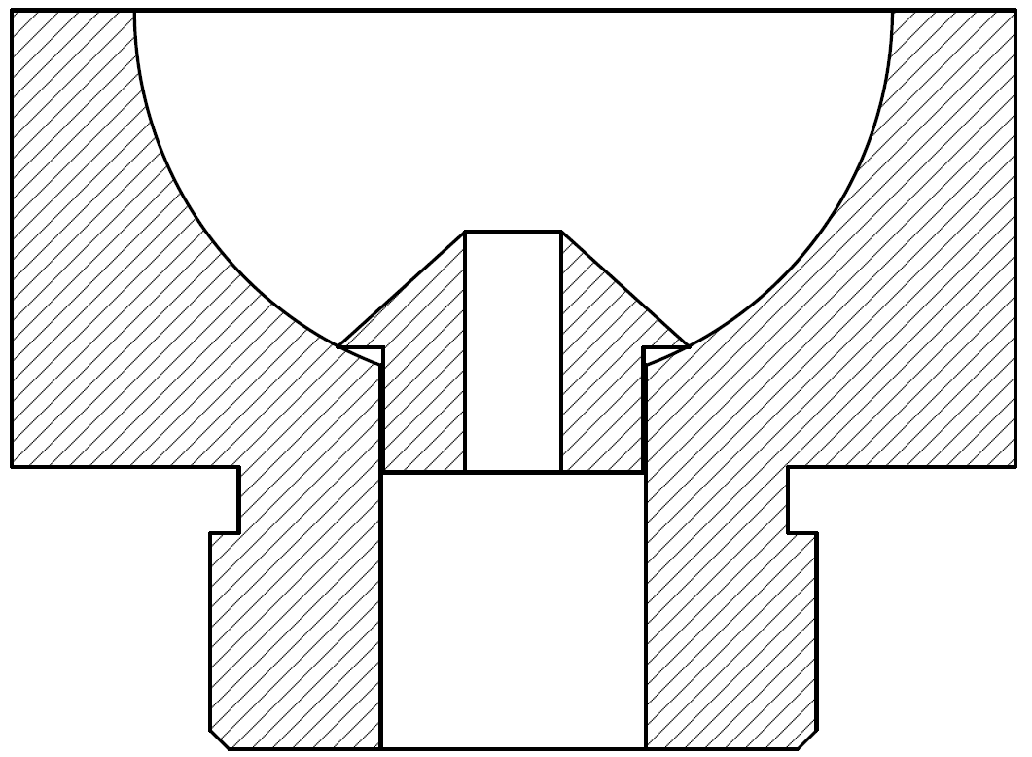
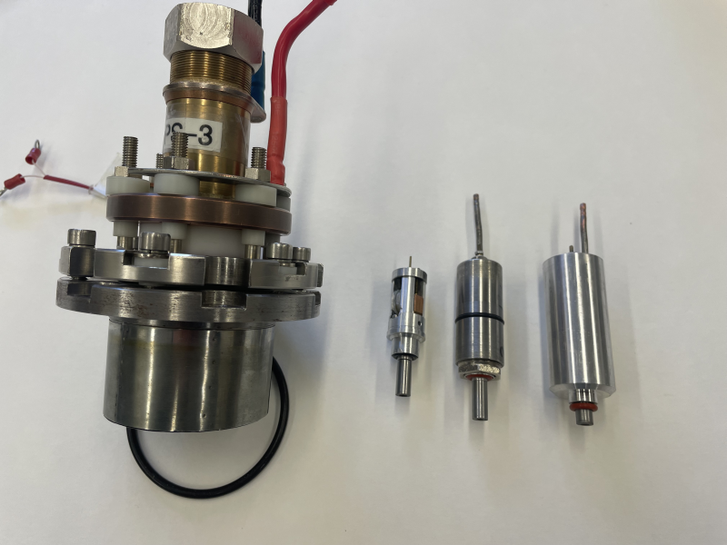
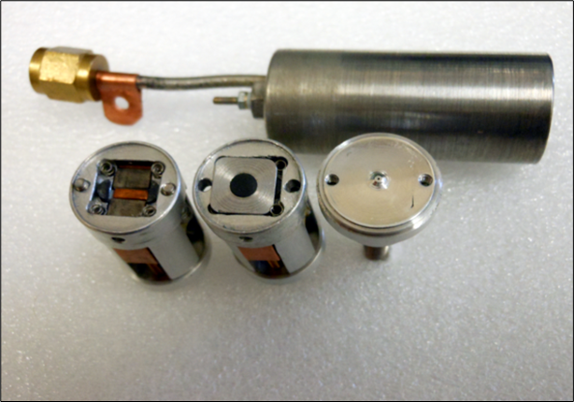
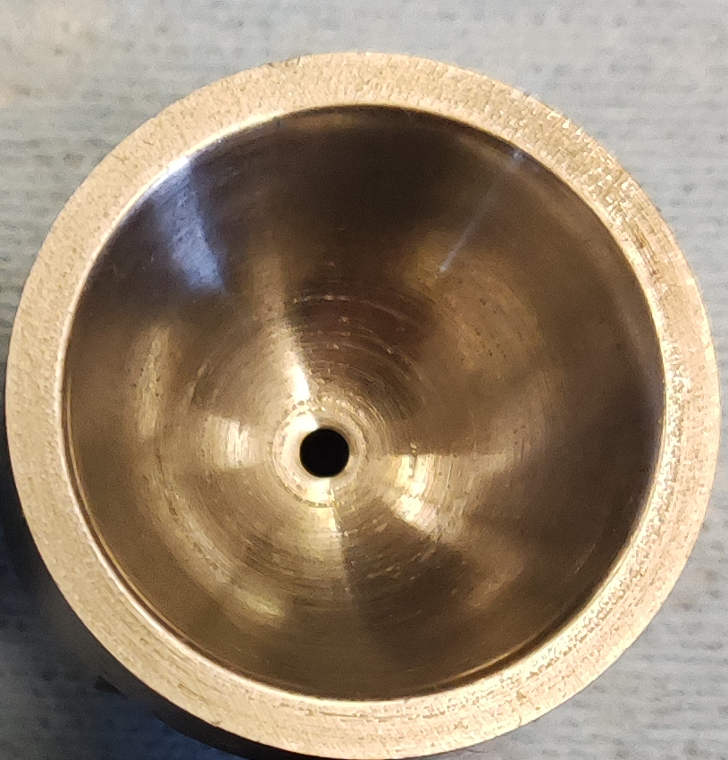
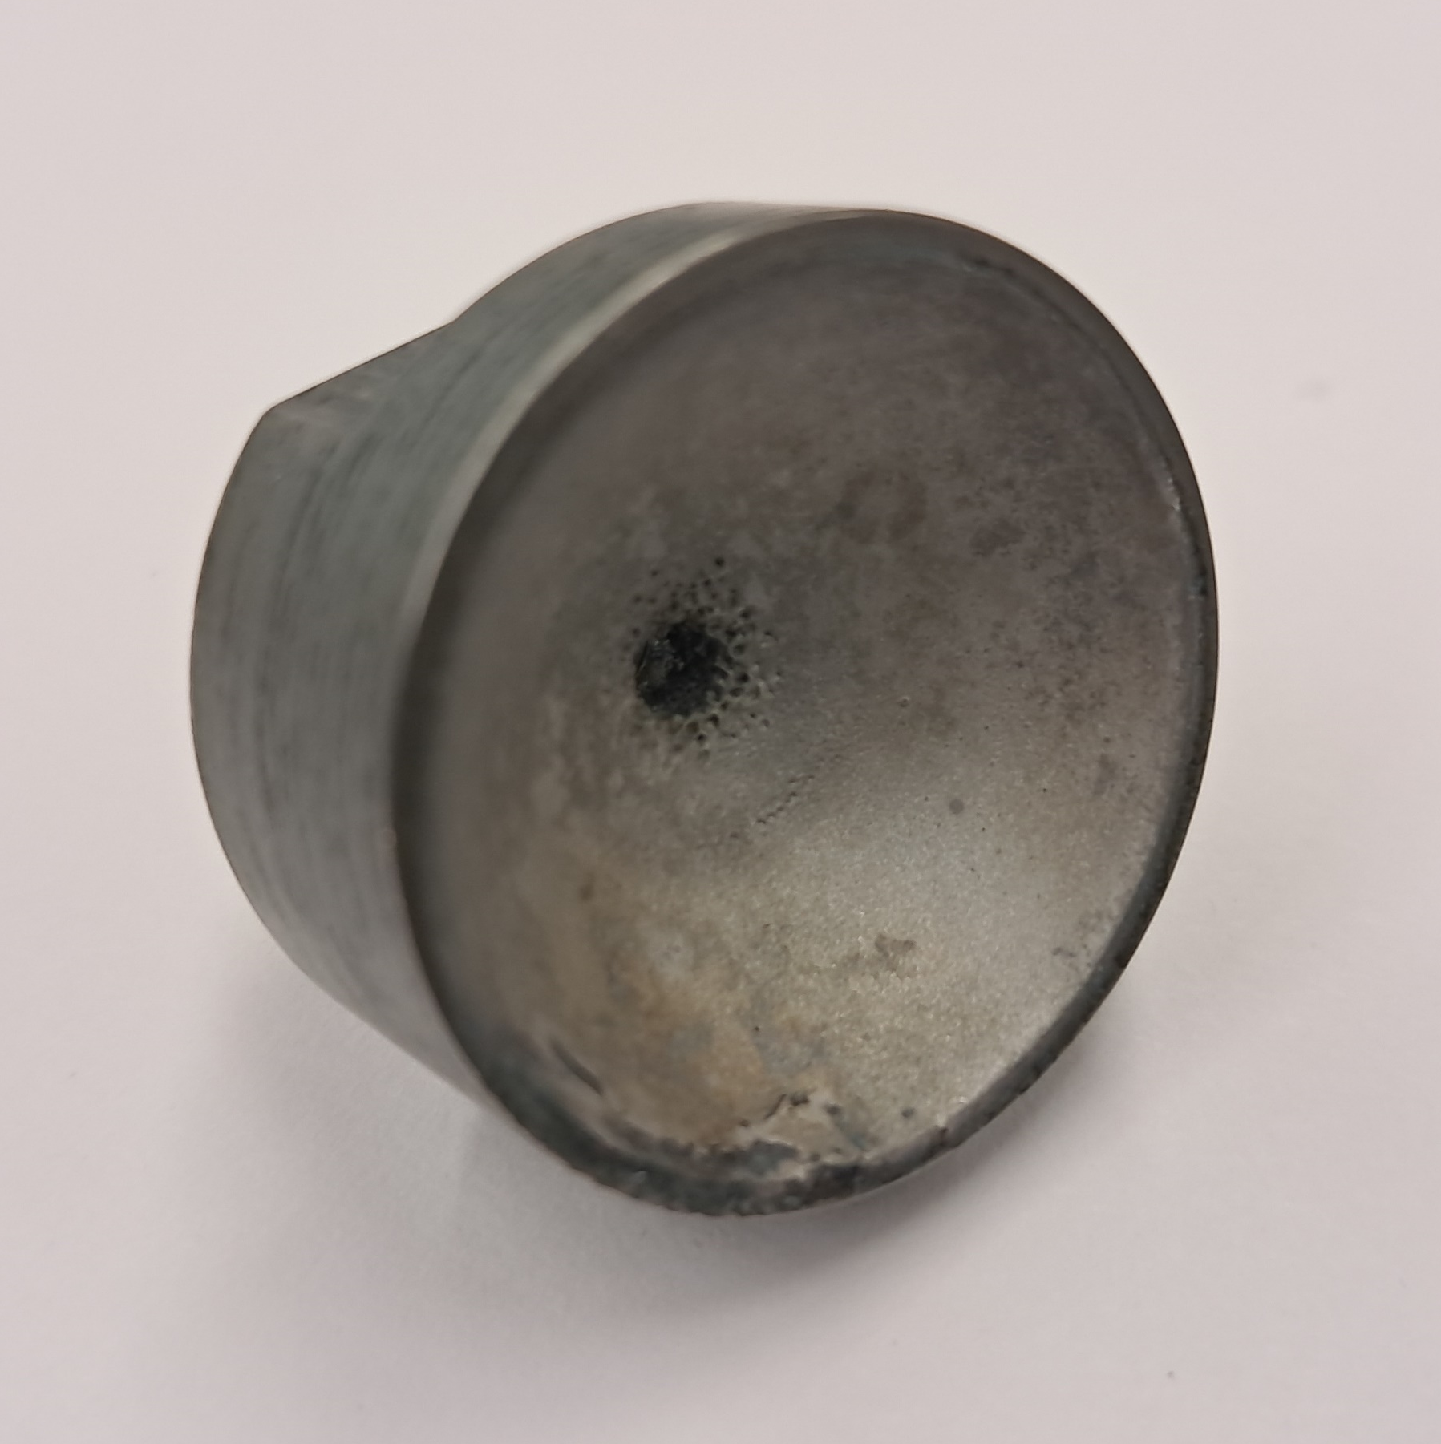
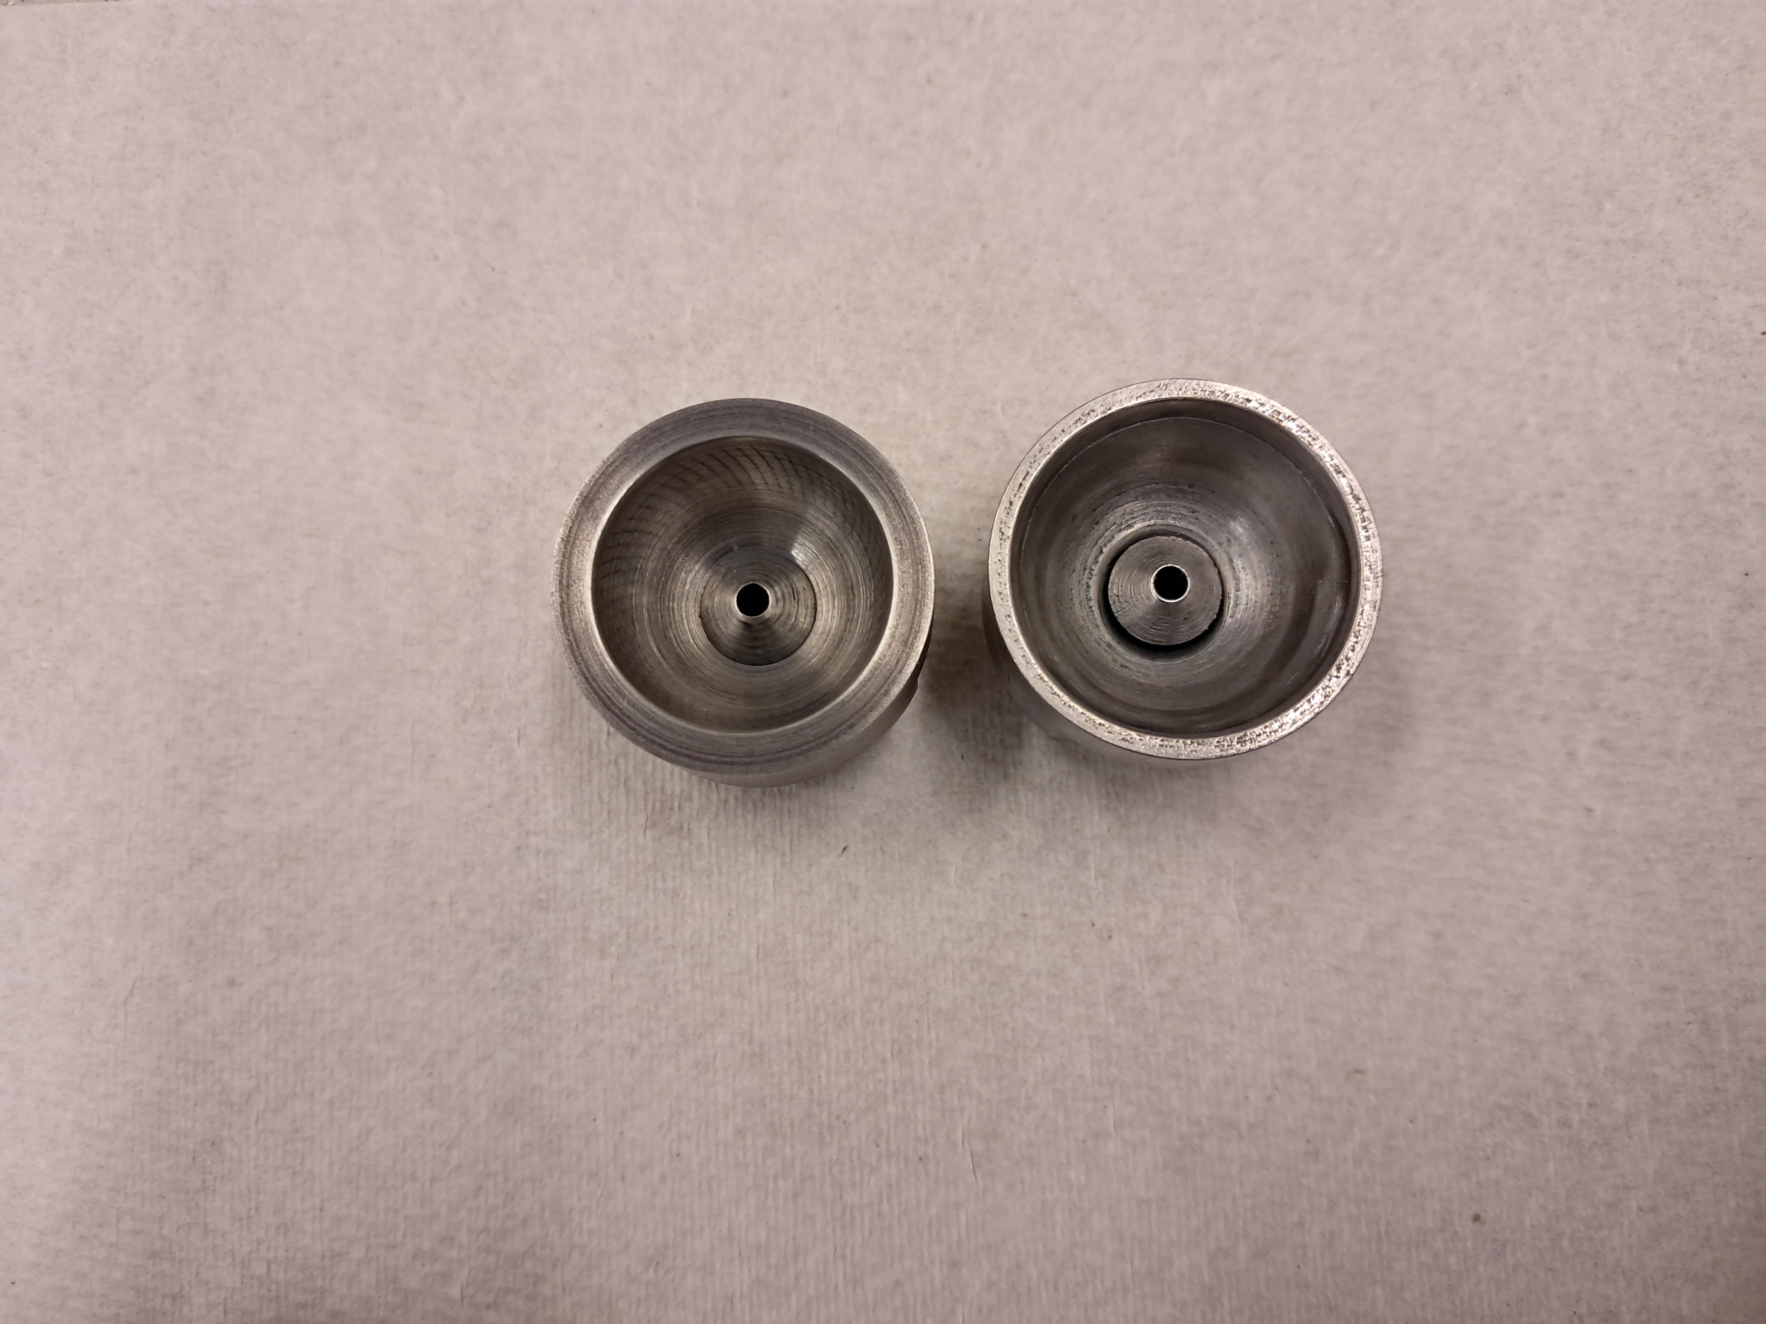
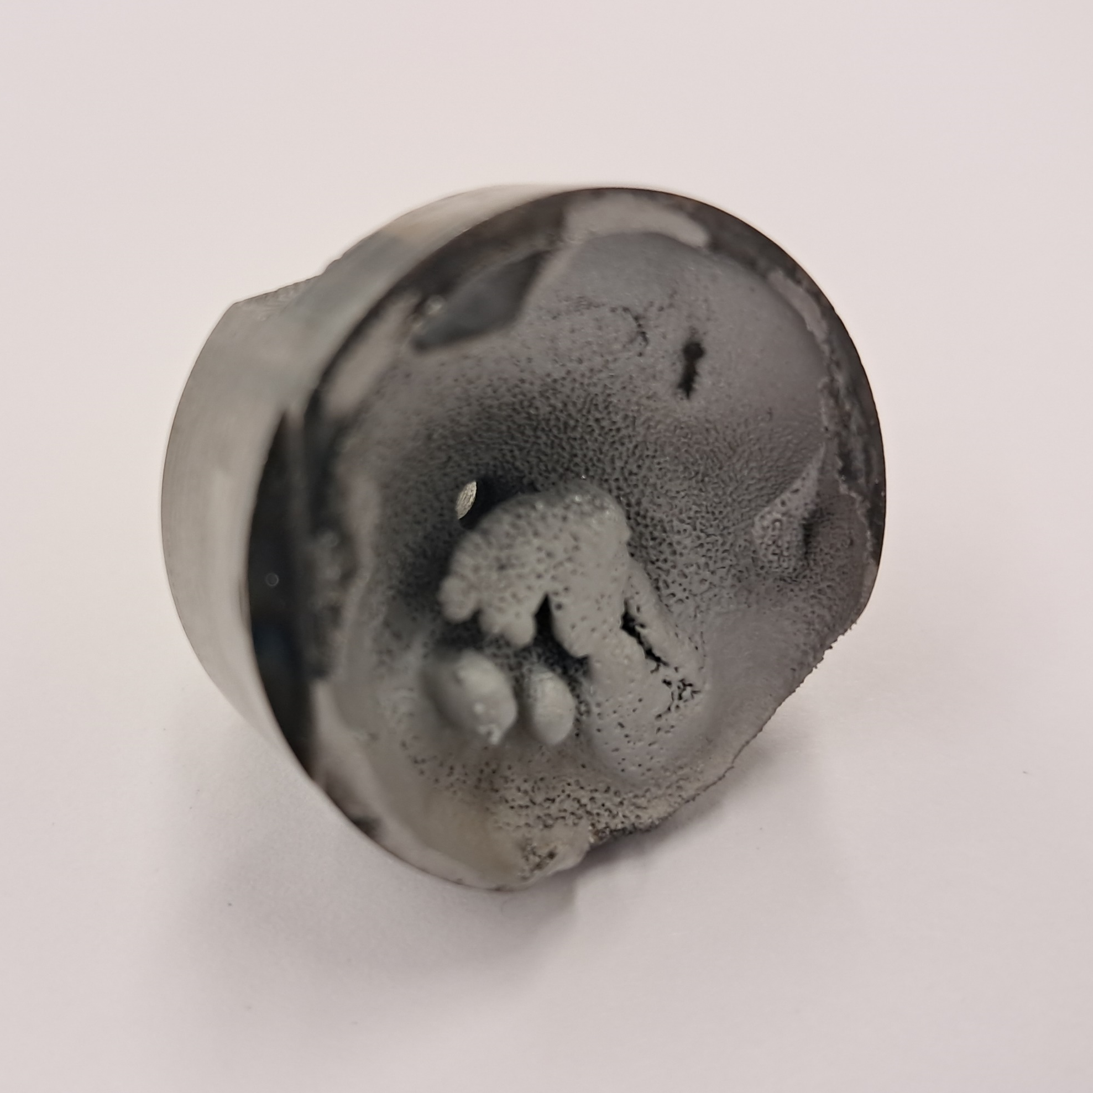
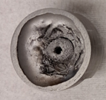
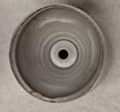
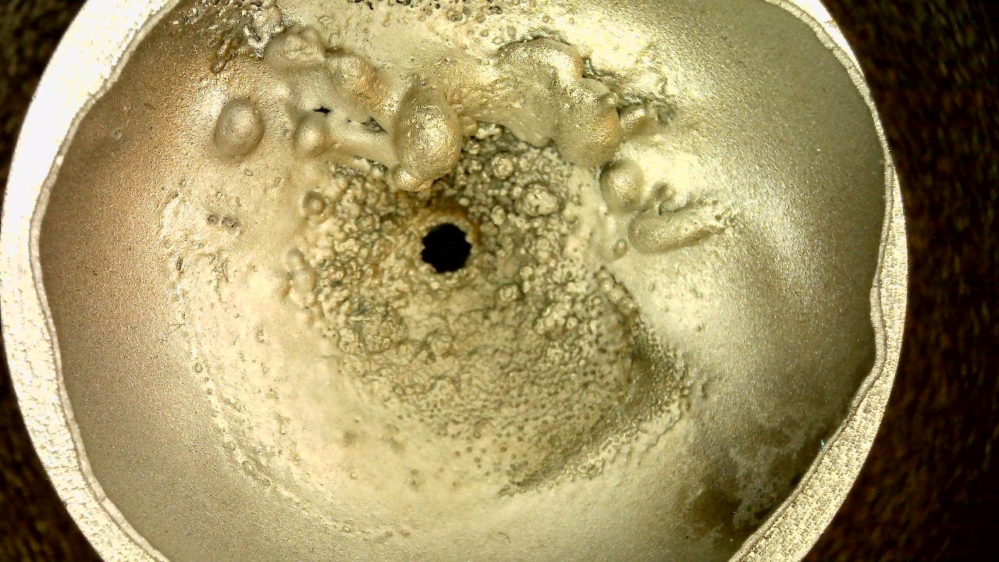
Plasmatron (cathode and pulse-valve)
One of the most important elements of plasma formation for a stable operation of the source is the pulse valve for injection of the hydrogen-containing gas and the cathode (arc current ~500A).
Cathode
Pulse valve
The original copper cathode (~1085*C) in this high current cold cathode only lasted a few days (~5·10⁵ arc pulses). Using molybdenum cathode (~2600*C) significantly improved the service life to ~5·10⁶ arc pulses (~1-2 months).
Improving the geometric shape of the cathode by inserting a small nozzle and enlarging the outer rim, as well as improving the vacuum sealing of the plasmatron, limited the plasma dispersion, and increased the service life by more than 10⁷ arc pulses (RUN-24).
The pulse valve has been upgraded several times to provide precise control and long-term stable hydrogen supply to the plasmatron to form a stable plasma.
The same type of valve is used in the helium neutralization cell.
Cupper
Molybdenum
Moly with nozzle
Corr. shape
Before use
~1 day
~1 month
~1.5-2 months
~1.5-2 months
After used

Slide 12
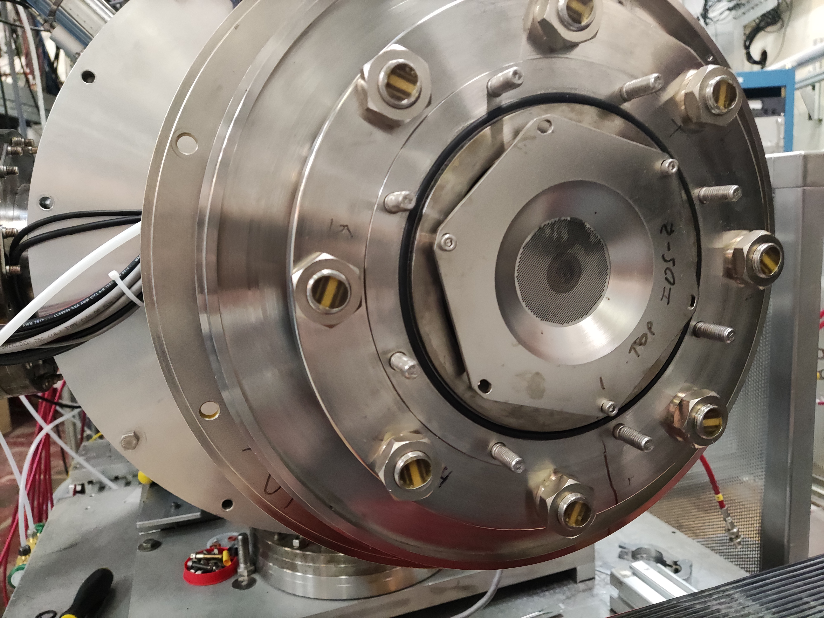
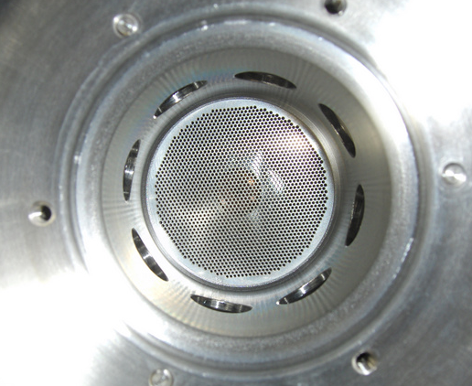
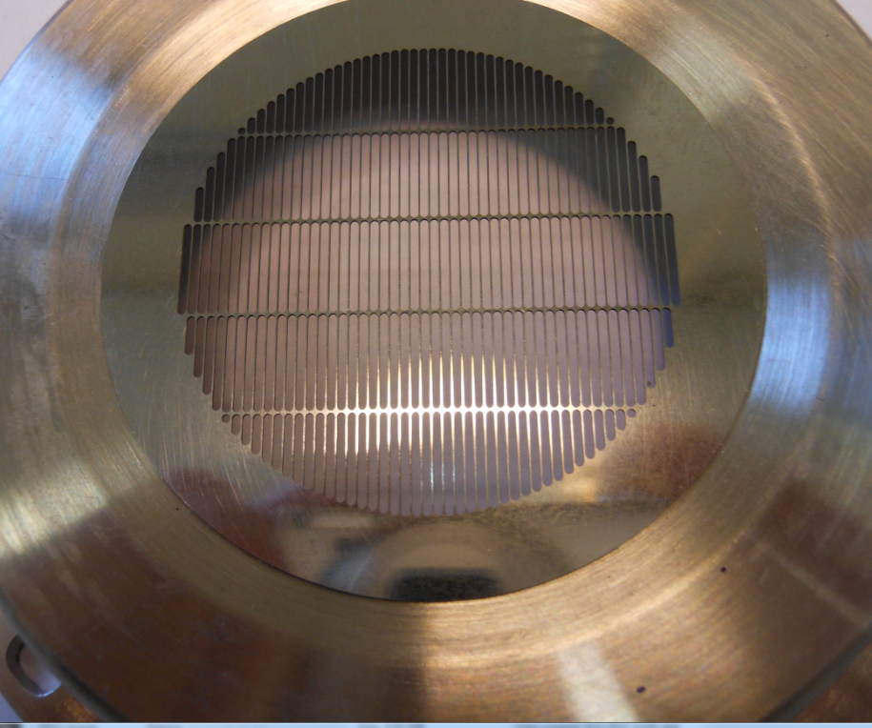
FABS 4-grid (spherical) Ion Optical System with “geometrical focusing”
Grids system made by 0.4 mm thick molybdenum plates.
IOS# | I⁰,A | F, m | a, mrad | H⁰, mA | H⁻, mA
1 | 3.5 | 170 | 12 | 270 | 9
2 | 3.2 | 300 | 7 | 730 | 22
3 | 3 | 280 | 8 | 650 | 20
N grids = 4
Diameter of grids ~ 50 mm
N holes = 1820
Diameter of holes = 0.8 mm
Step of holes = 1.1 mm
Transparency ~ 53 %
New slit-type IOS grid for higher brightness beam formation
Radii of the spherical grids:
R1~ grid1 ~ 180 cm
R2~ grid2 ~ 150 cm
R3~ grid3 ~ 120 cm
R4~ grid4 ~ 120 cm
Gap of grids:
1→2 ~ 0.4-0.5 mm
2→3 ~ 1.0-1.4 mm
3→4 ~ 0.4-0.5 mm
Proton energy ~ 5-10 keV
Intensity ~ 2.5-5.0 A

Slide 13
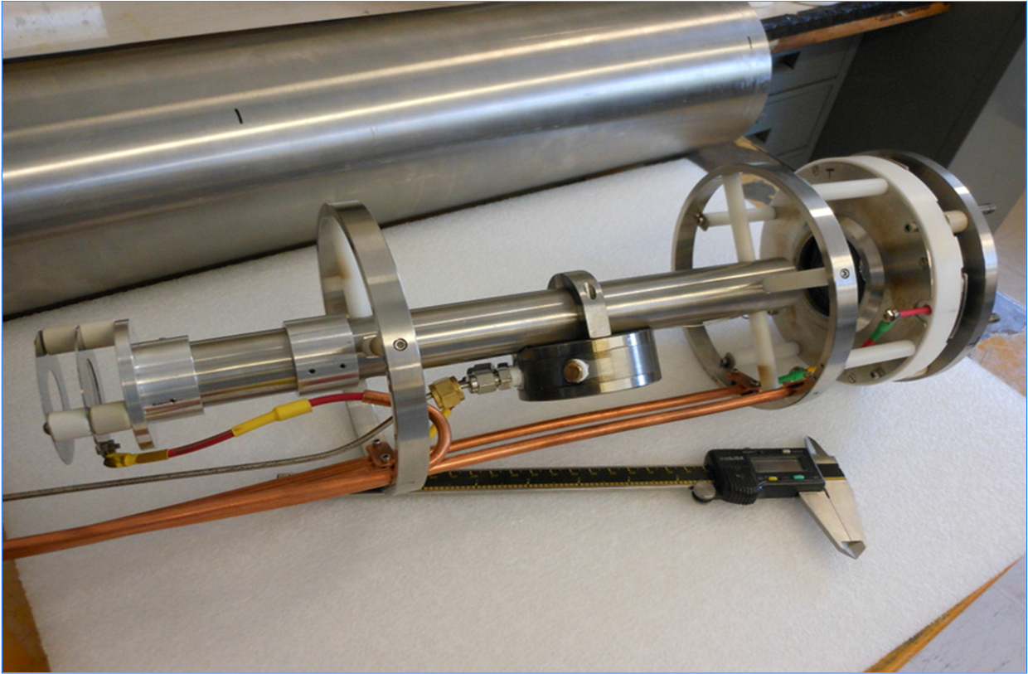
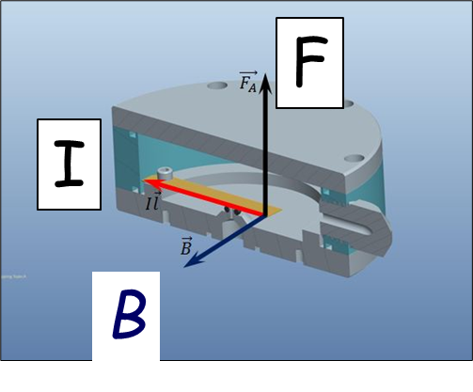
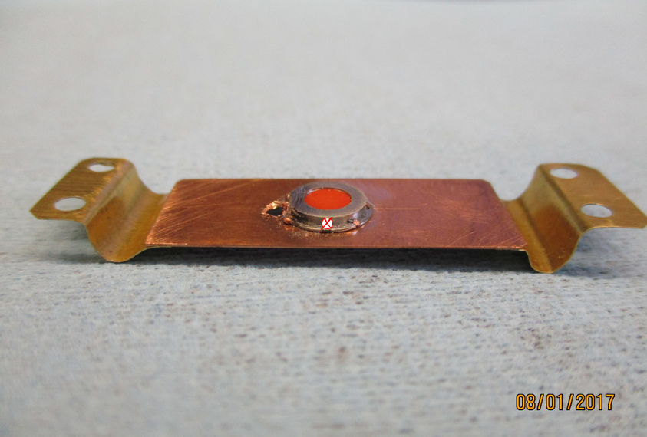
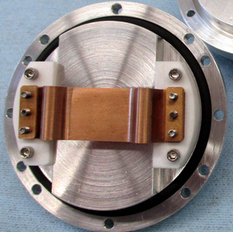
He-ionizer cell and 3-grid deceleration system
Two functions of the new He-cell with pulsed valve:
Ionization of the injected neutral beam in the He-cell
Deceleration of the ionized part of the beam by 3-grids system to separate from the not ionized part
“Electro-magnetic” pulse valve
Lorentz (Laplace) force moves the flexible conducting plate in the high (~ 2-5 T) magnetic field. For I=10 A, L=5 cm, F=2.5 N. Current pulse duration ~100-300 us
He-cell
He-pulsed
valve
3-grid beam
Deceleration system
I
B

Slide 14
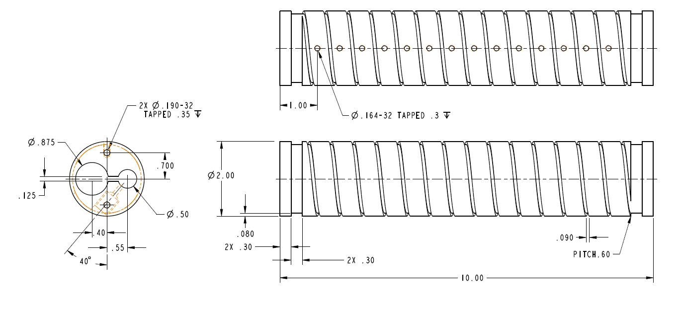
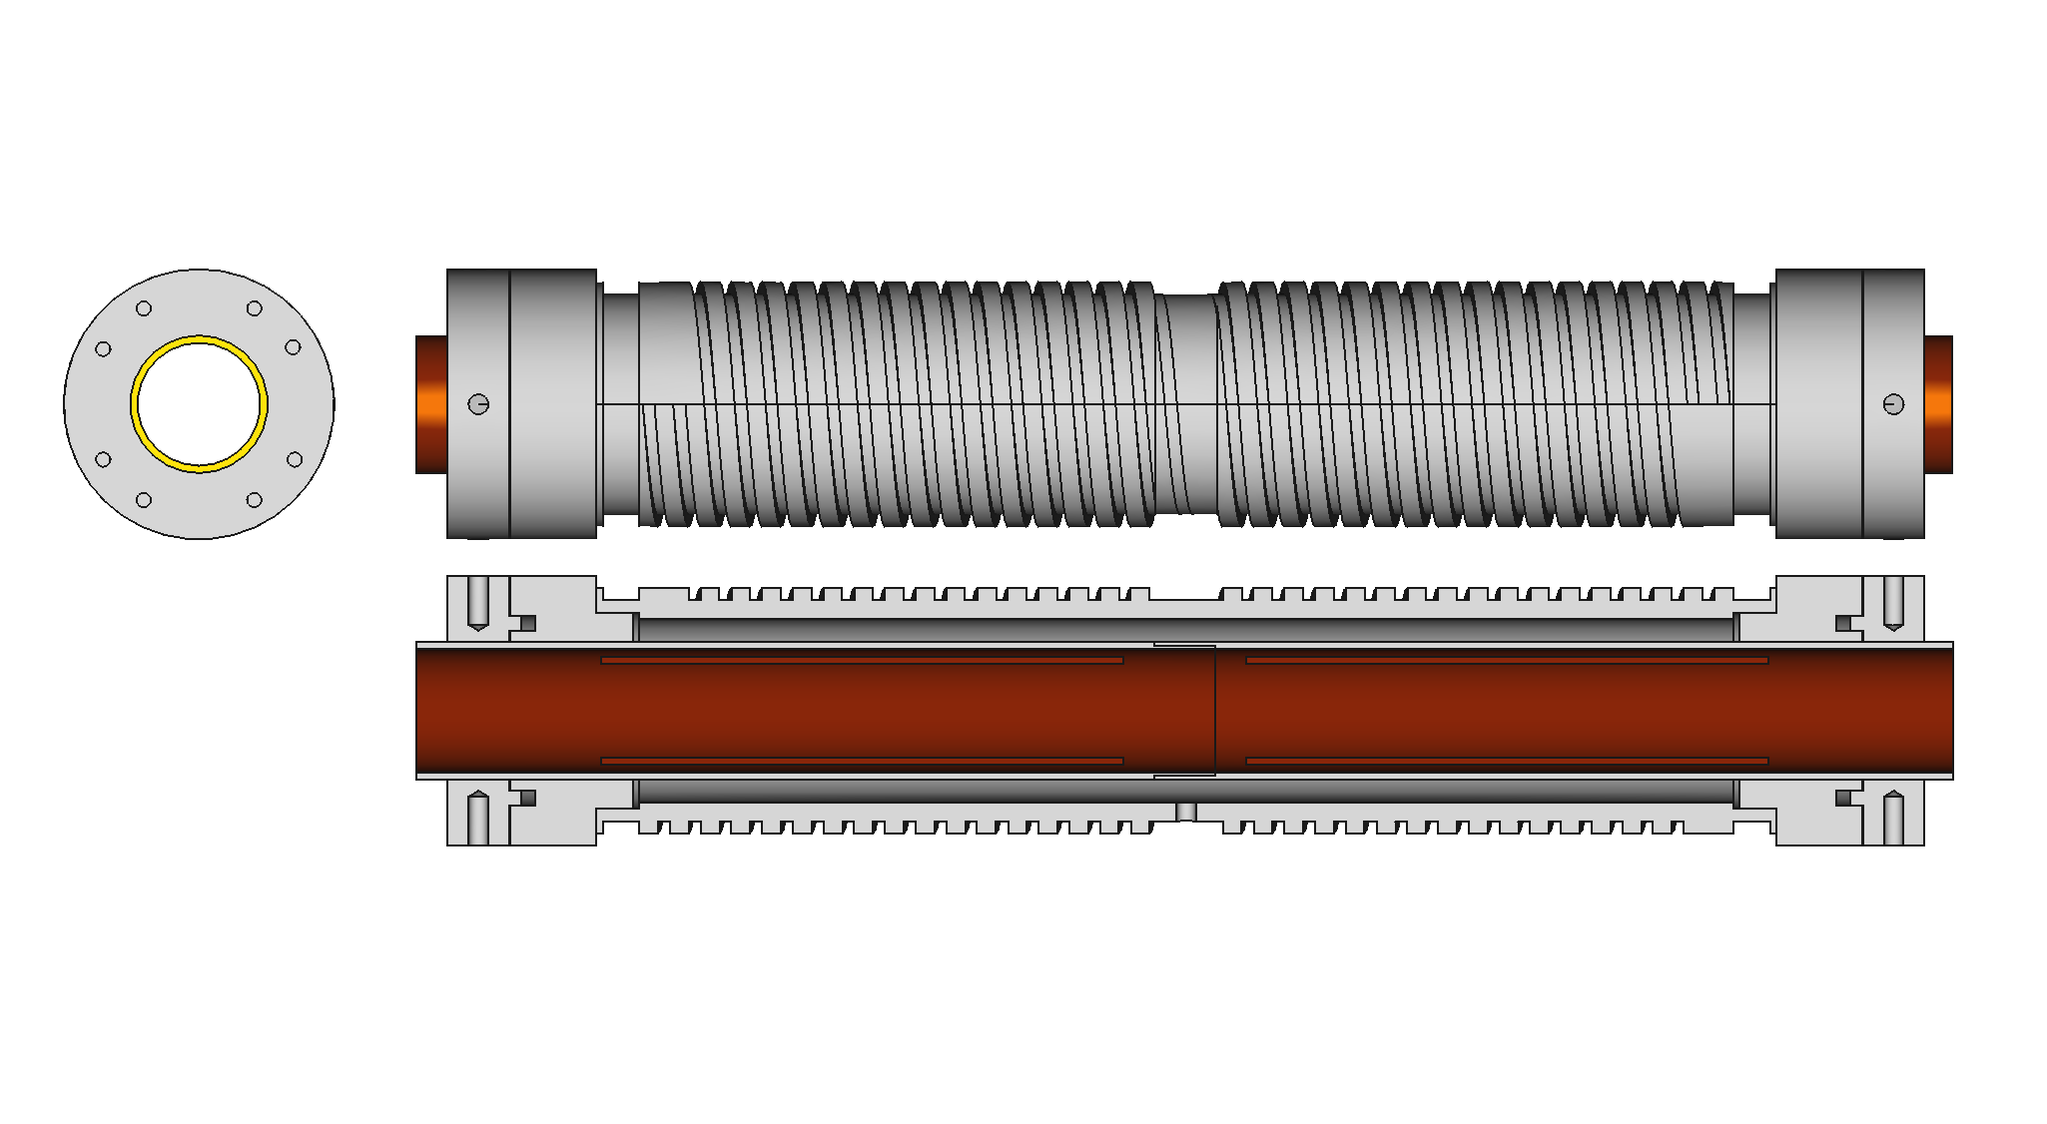
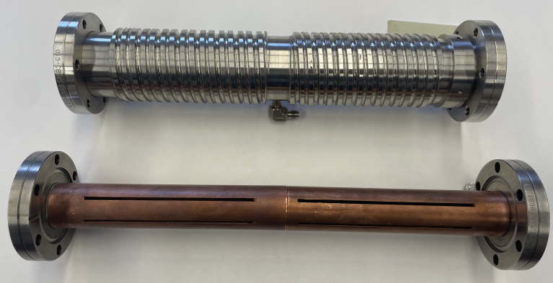
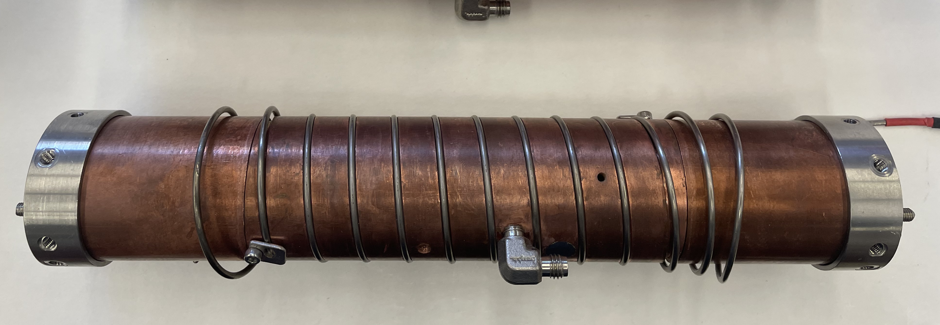
Rb-cell and laser spot
SS Cell (Run24)
Cupper Rb-cell
SS vessel
Heating/cooling groove
Inner Cu cylinder
Slits
Rb inlet
5 cm

Slide 15
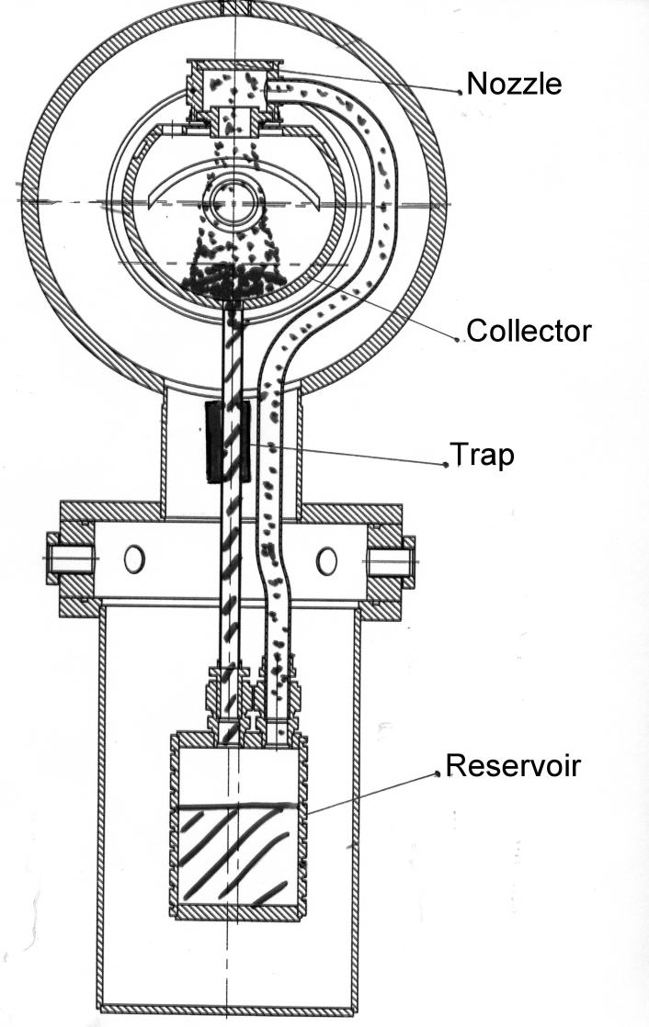
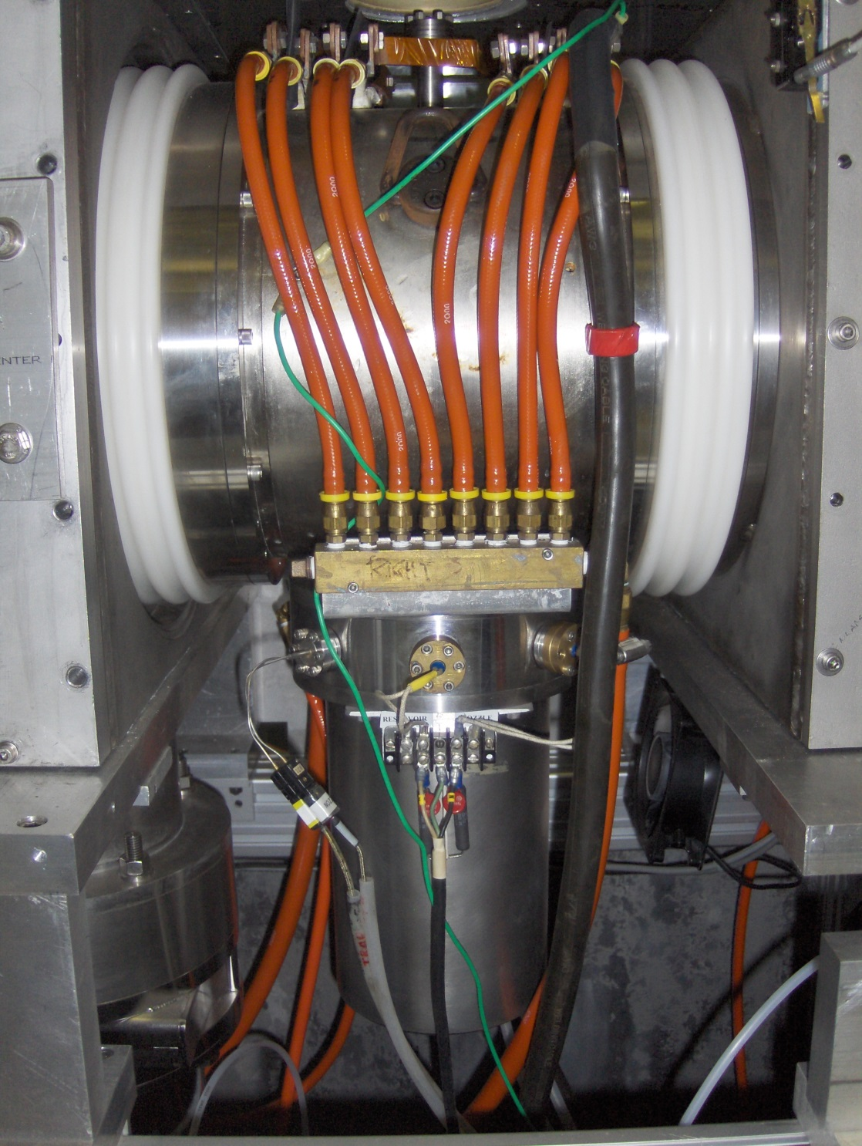
Sodium-jet ionizer cell
Transversal vapor flow in the Na-jet cell. Reduces sodium vapor losses for 3-4 orders of magnitude, which allow the cell aperture
increase up to 3.0 cm .
Nozzle
500deg.C
NL ~2·10¹⁵ at/cm²
L ~ 2-3 cm
Collector
~150 deg.C
Return
line
Boiler
~500 deg.C

Slide 16
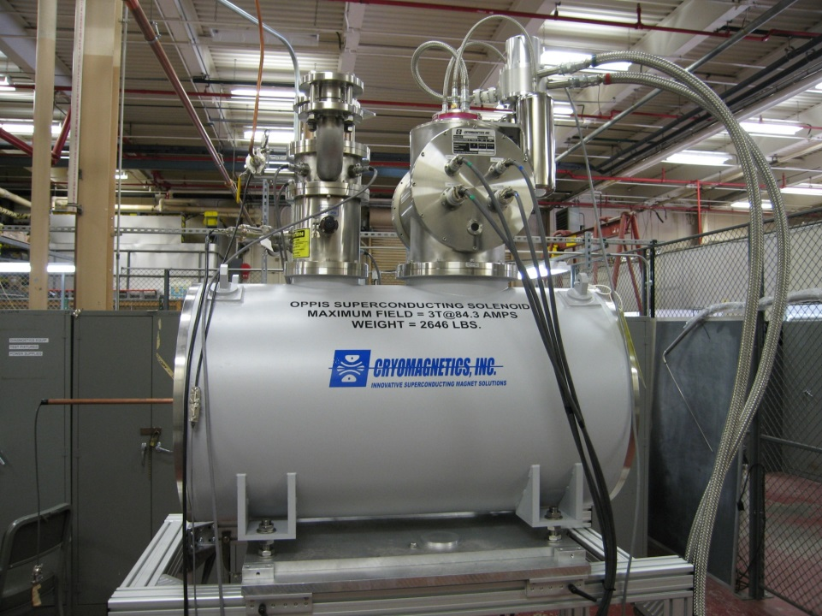
Superconducting Solenoid
The Solenoid is fully re-condensing with no measurable helium losses. 152 mm in diam. warm aperture, total length-115 cm. Flattop magnetic field (+/- 0.5%) is ~65cm.
Spin Up: 377 THz +
Spin Dn: 377 THz +

Slide 17
Depolarization factors
Depol. factor |  | Process | Estimate
1 | E_{H}⁰ | Dilution due H⁰ part of the beam (LEBT) | 0.99 - 0.99
2 | P_{Rb} | Rb-optical pumping (Laser system) | 0.99 - 0.99
3 | S | Rb polarization spatial distribution (Collimators) | 0.97 - 0.98
4 | B_{RG} | Proton neutralization in residual gas (Vacuum) | 0.98 - 0.99
5 | E_{LS} | Depolarization due to spin-orbital interaction | 0.98 - 0.98
6 | E_{ES} | Dilution due to incomplete energy separation not polarized component of the beam (LEBT) | 0.98 - 0.99
7 | E_{Sona} | Sona-transition efficiency (Adjustment) | 0.96 - 0.98
8 | E_{ion} | Incomplete hyperfine interaction breaking in the ionizer magnetic field | 0.98 - 0.99
Total: 0.85 - 0.90
P = E_{H}⁰ ∙ P_{Rb}∙ S ∙ B_{RG}∙ E_{LS}∙ E_{ES} ∙ E_{Sona}∙ E_{ion} ~ 85-90%

Slide 18
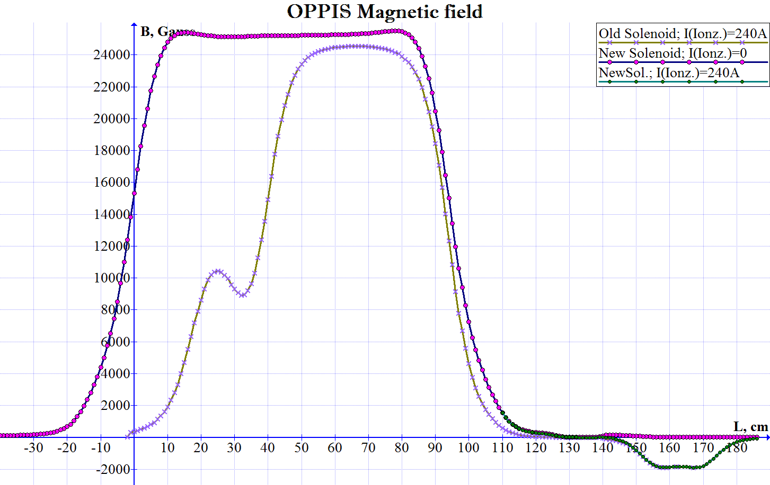
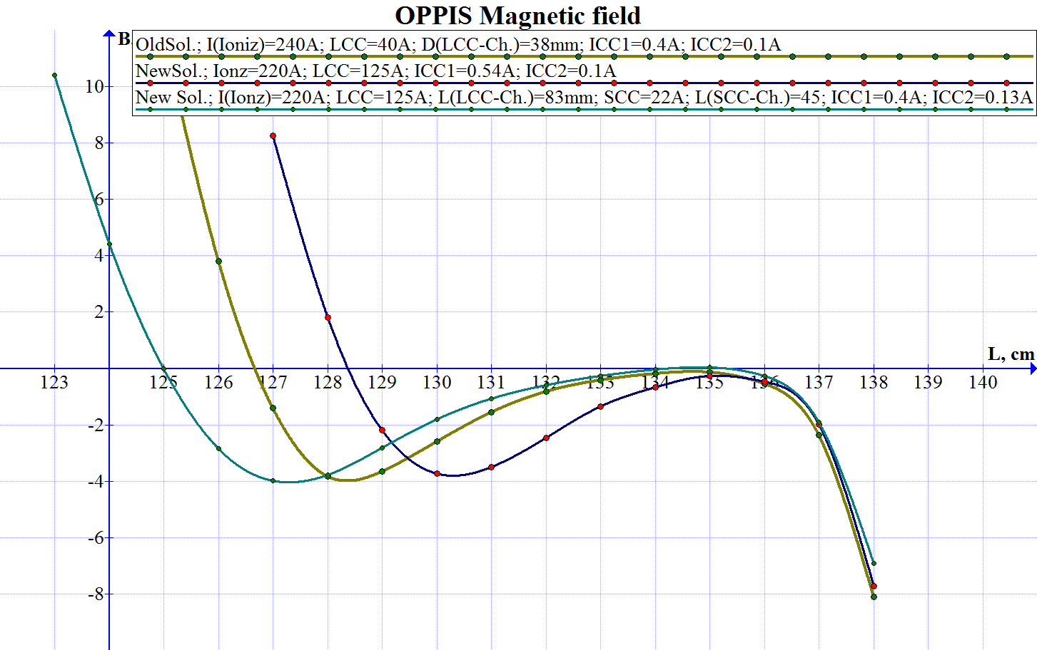
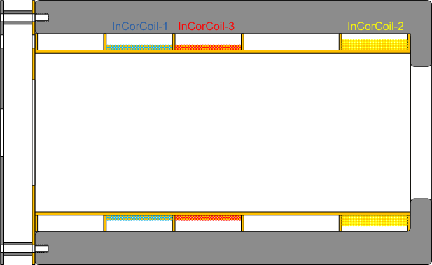
Sona-transition efficiency
The shape of the magnetic field in the "Sona Transition" area depends on the following factors and can be adjusted by:
The optimization of the solenoid position;
2 correction coils (LCC and SCC) with the field in the opposite direction to the SCS;
3 correction coils (ICC1-3) for fine field tuning inside the “Sona Transition”;
“Sona-shield” (soft steel cylinder- of 100 mm diameter and 120 mm length).
Na-cell coil (Na-C) - solenoid around sodium ionizer.
dBz/dZ< 0.2G/cm
He-cell
Rb-cell
Na-C
ICC1 ICC2 ICC3
SCS
Sona-shield
ICC1-3
LCC SCC

Slide 19
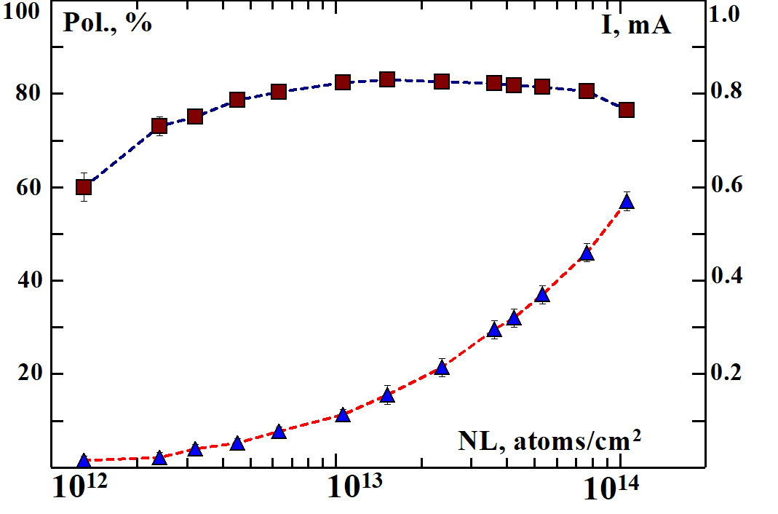
H⁻ beam current and polarization at 200 MeV
H⁻ beam current and polarization vs. Rb vapor thickness
Polarization in 200 MeV polarimeter
H⁻ ion beam current (mA)
Rb-vapor thickness

Slide 20
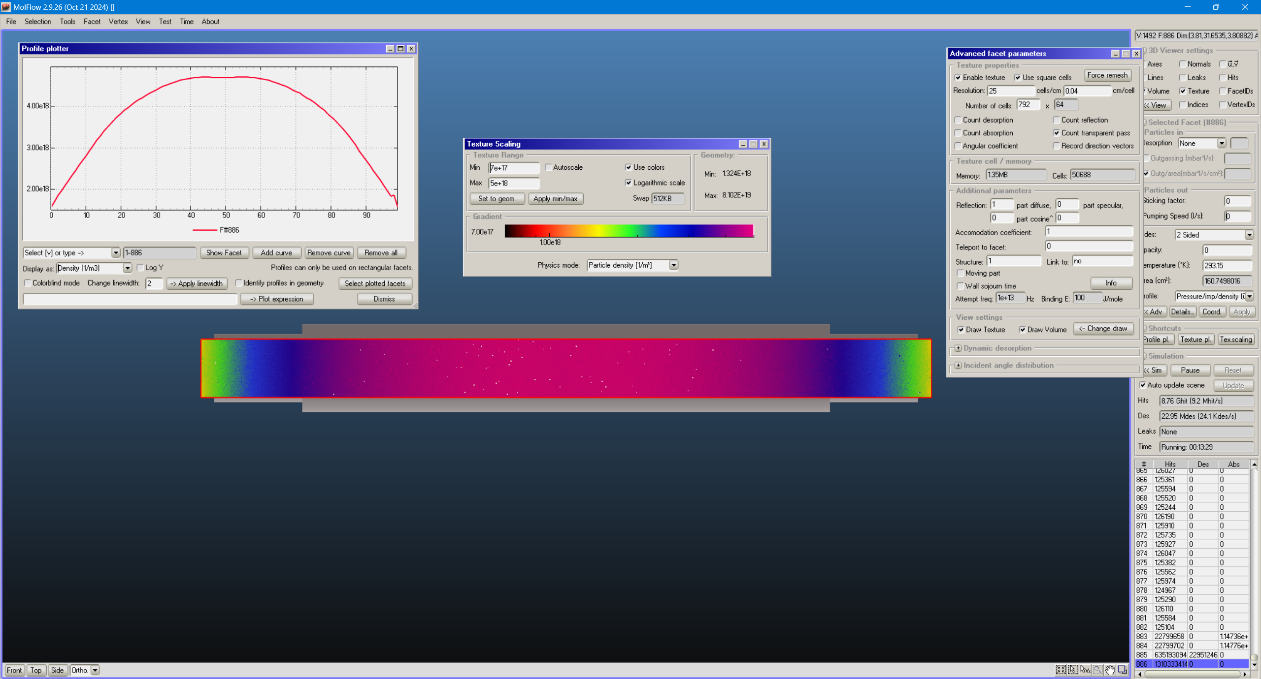
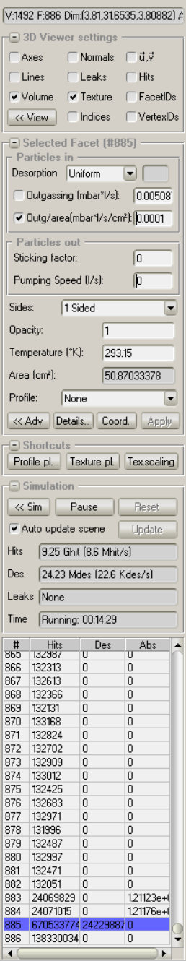
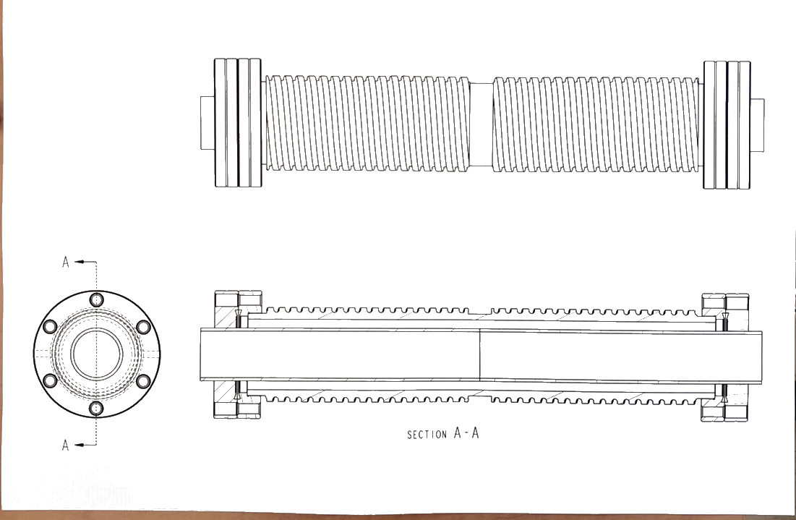
Simulation tools

Slide 21
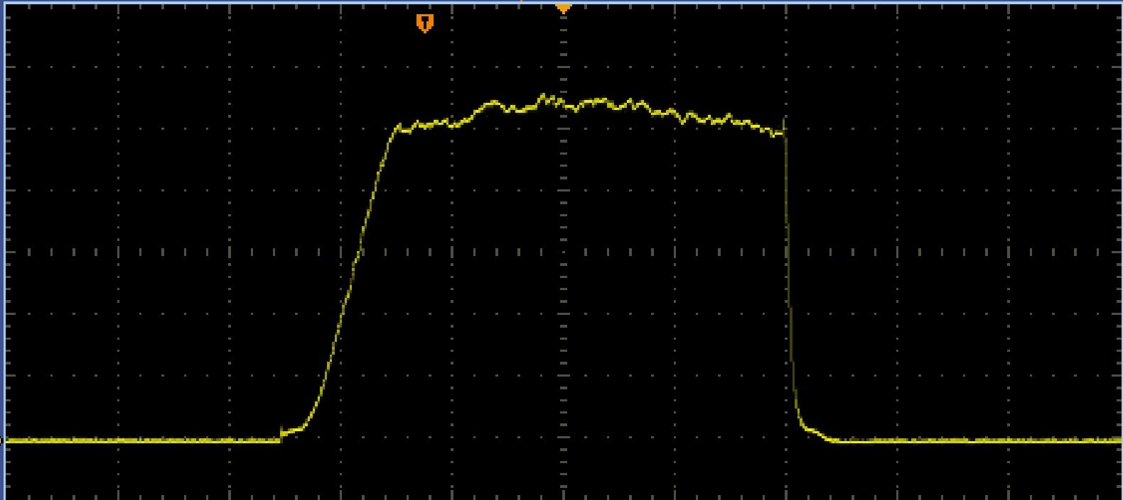
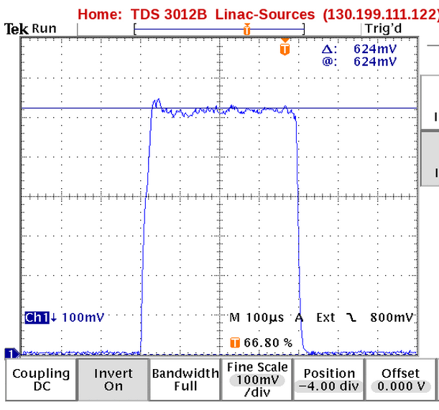
200 MeV polarized proton after Linac
Polarized H⁻ current-1.05 mA, after RFQ 750 keV
~620 µA×400µs ~1.5∙10¹² p/pulse after LINAC
200 uA/div
100 us/div

Slide 22
Polarization dilution due H⁺ in the new source
In FABS-source
Inside of the SCS
Ionizer & Extractor
H⁺
7keV
~90% of plasma
0.72%
H₂-cell
40%
H⁰
7keV
2%
H⁻
7keV
Neutralize
H⁰
7keV
H⁻39keV
Na-jet
Extr.
60%
Ionize
Accelerate
32keV
Ionize
He-cell
H⁺
7keV
He-cell
H⁺
3keV
Decelerate, ΔE=4.0keV
70%
Rb-cell
H⁰
3keV
Neutralized
8%
Na-jet
H⁻
3keV
Ionize
0.72/3 =0.24 - polarization dilution and 4.0keV energy separation (~25-30 times) allows dilution reduction to 0.24/25~ 0.01
3%
Extr.
H⁻
35keV

Slide 23
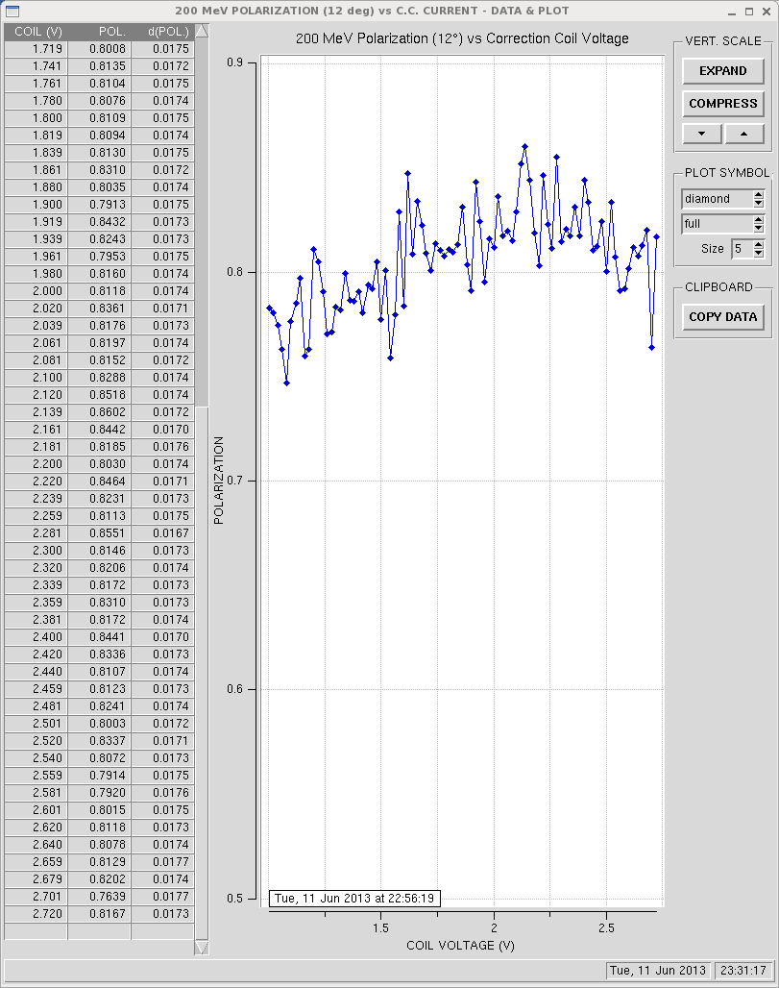
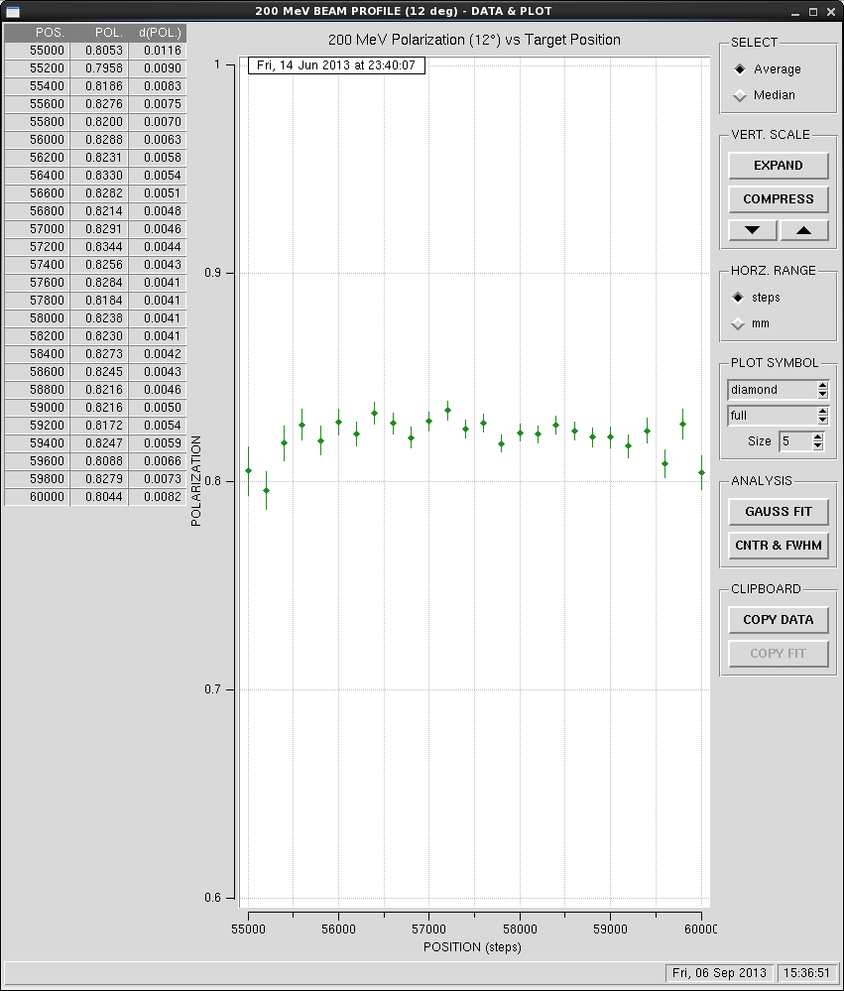
Depolarization factors by the shape of magnetic field
For maximum polarization there must be an accurate selection of settings for all correction coils. Any change in the magnetic field of coils, SCS or ionizer as well as their position requires a new setting.
Polarization vs. LCC current
Polarization vs. target position

Slide 24
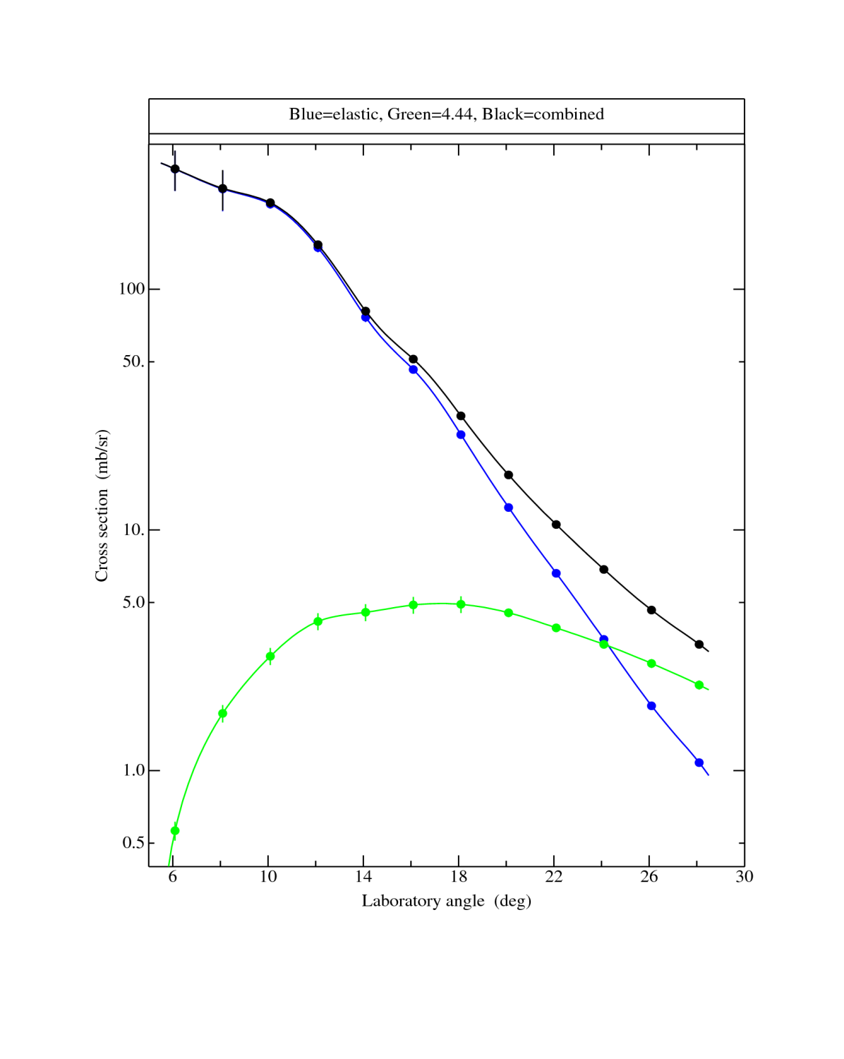
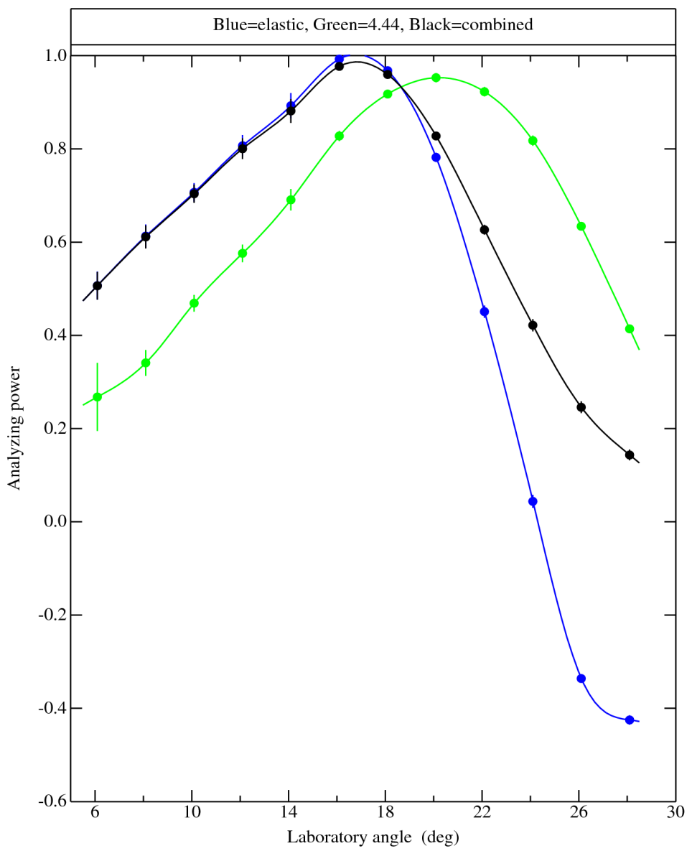
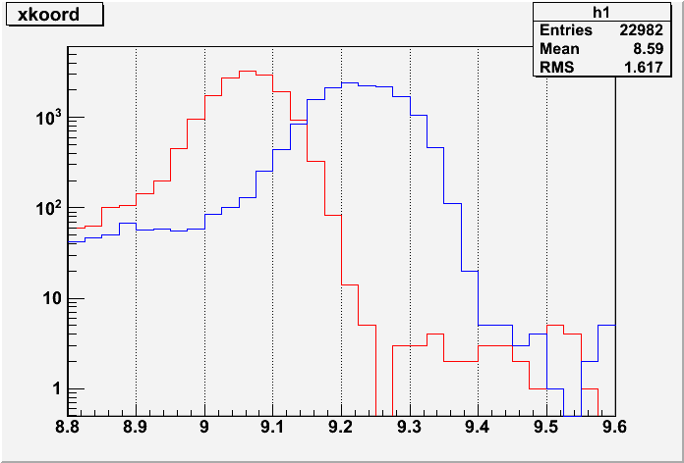
Precision, Absolute Proton Beam Polarimeter at 200MeV
Cross section and analyzing power for elastic pC scattering at 200 MeV
GEANT calculation of pC polarimeter for 200MeV proton beam
N, particles stopped in the slice of Cu-absorber
~99.35%
~82%
inelastic
~50mb/sr
elastic
~5mb/sr
3.7 3.8 3.9 4.0 4.1 4.2 4.4 4.3
~12
~16.2_{o}
L, cm
Measurements of the cross section and analyzing power for proton scattering from ¹²C at 200 MeV. The blue curves correspond to the ground state protons of carbon. The green curve corresponds the protons from the first excited state (-4.44MeV). The black curve represents the sum of the two data sets.
Scattered proton
proton 200MeV
Recoil Atom
Target

Slide 25
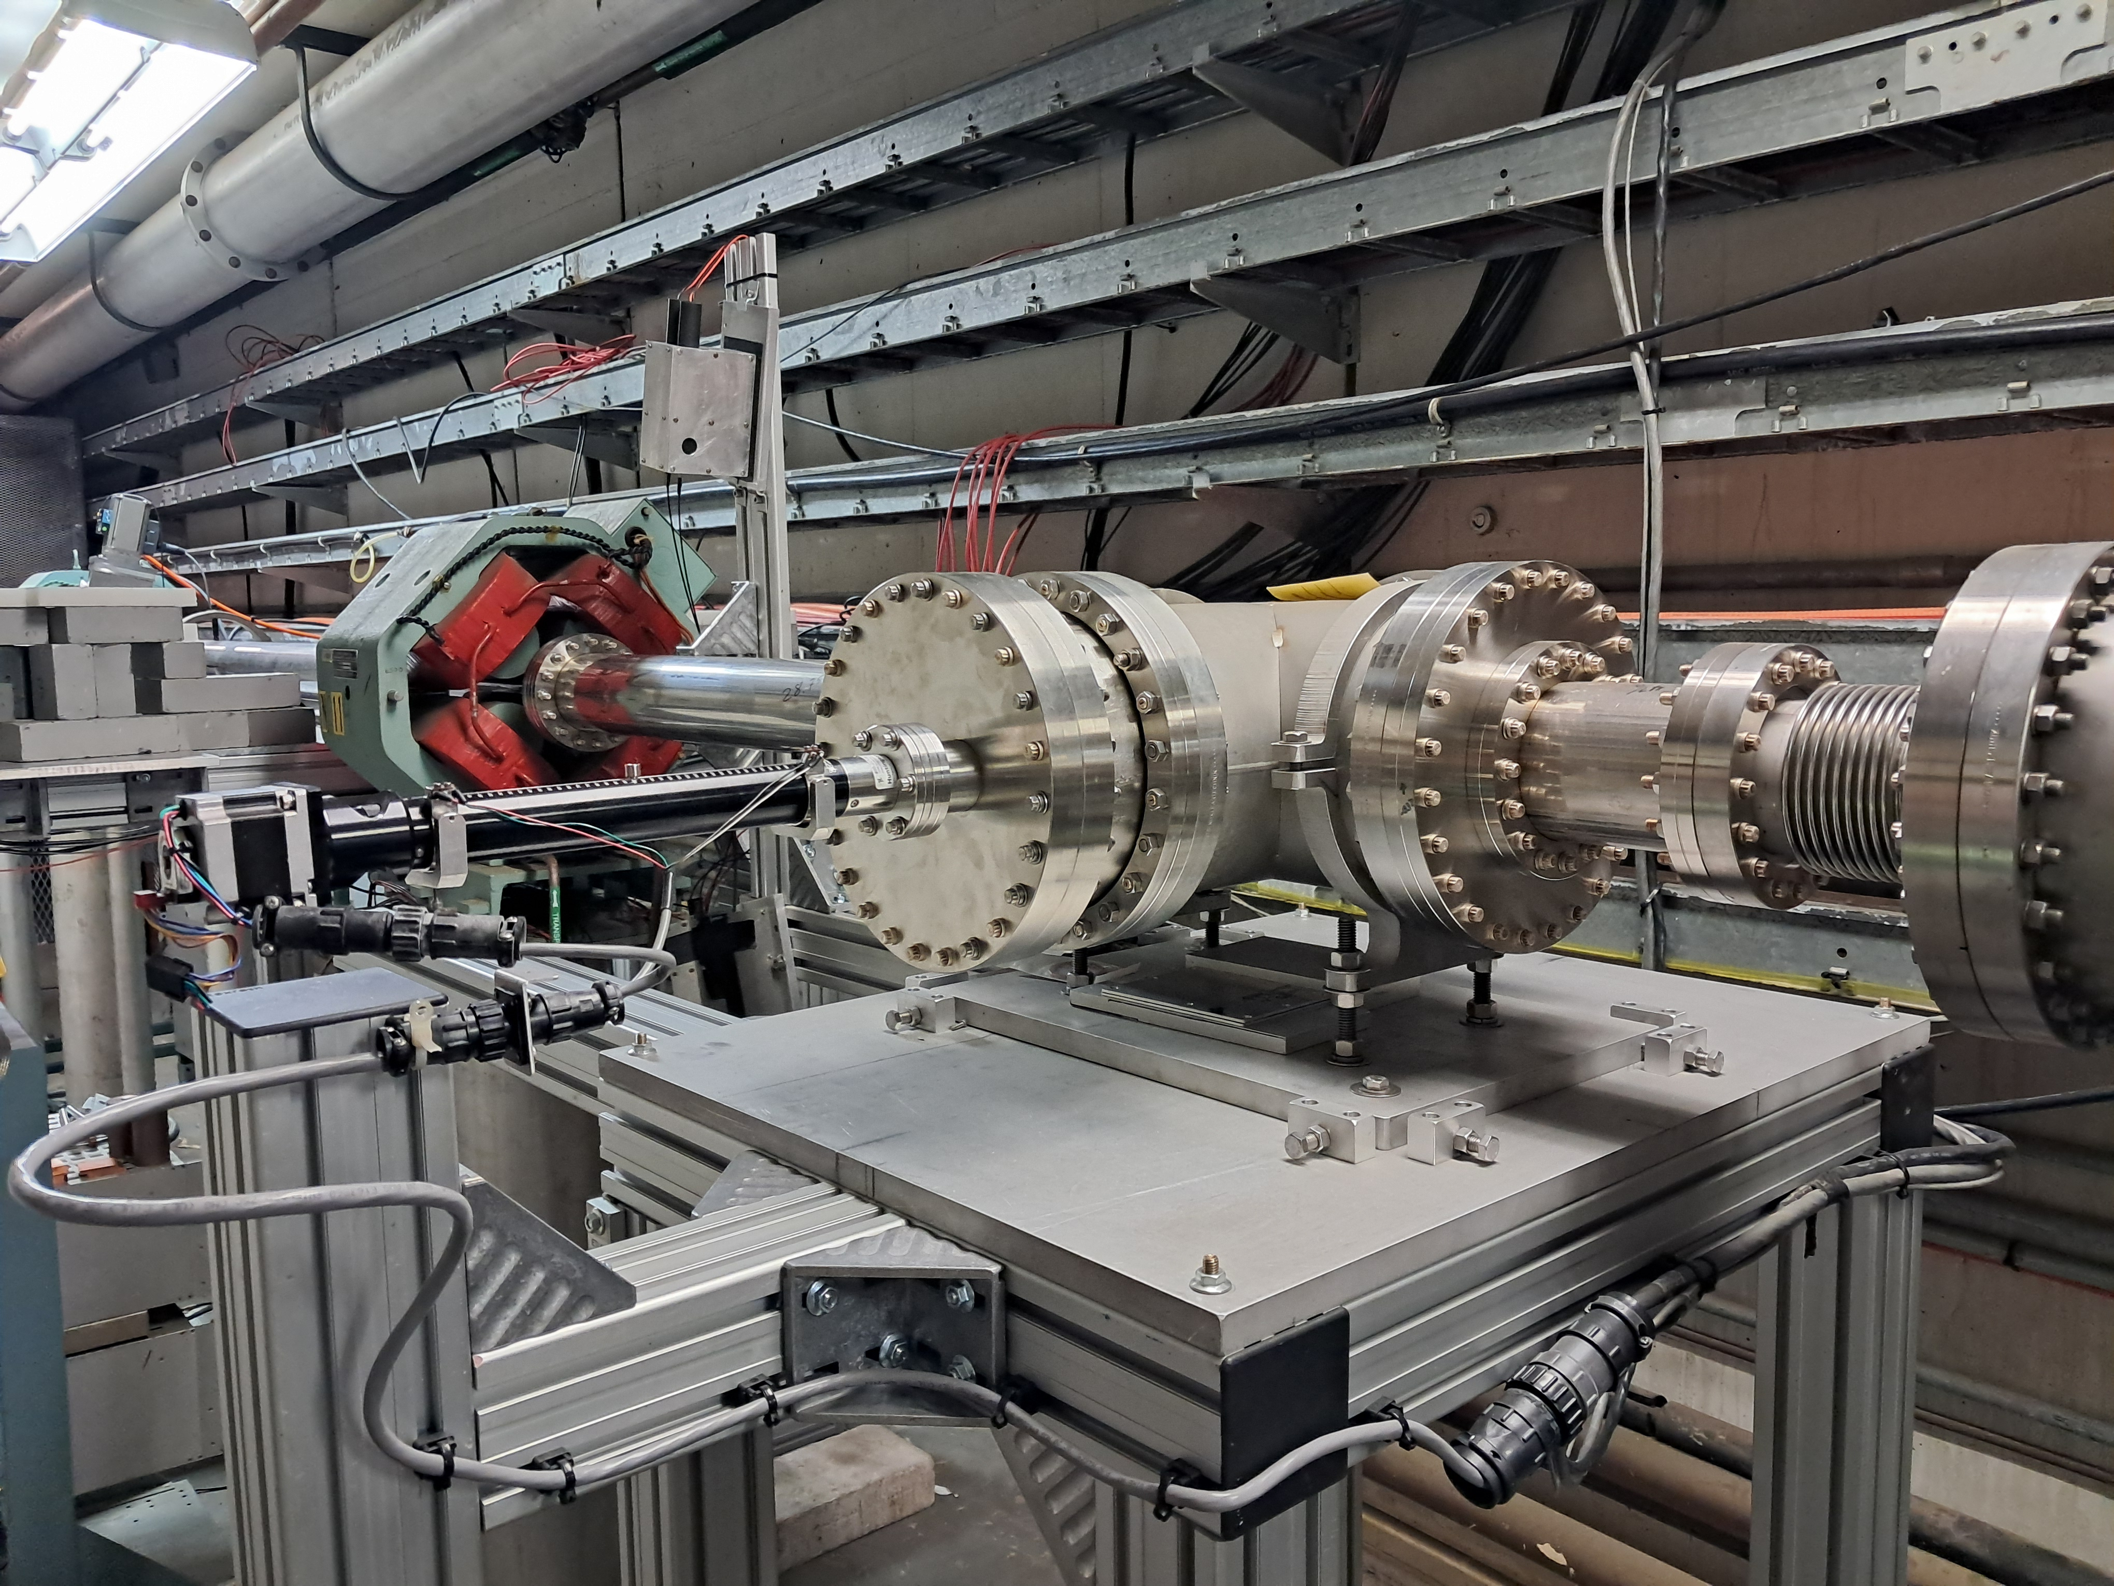
Precision, Absolute Proton Beam Polarimeter at 200MeV

Slide 26
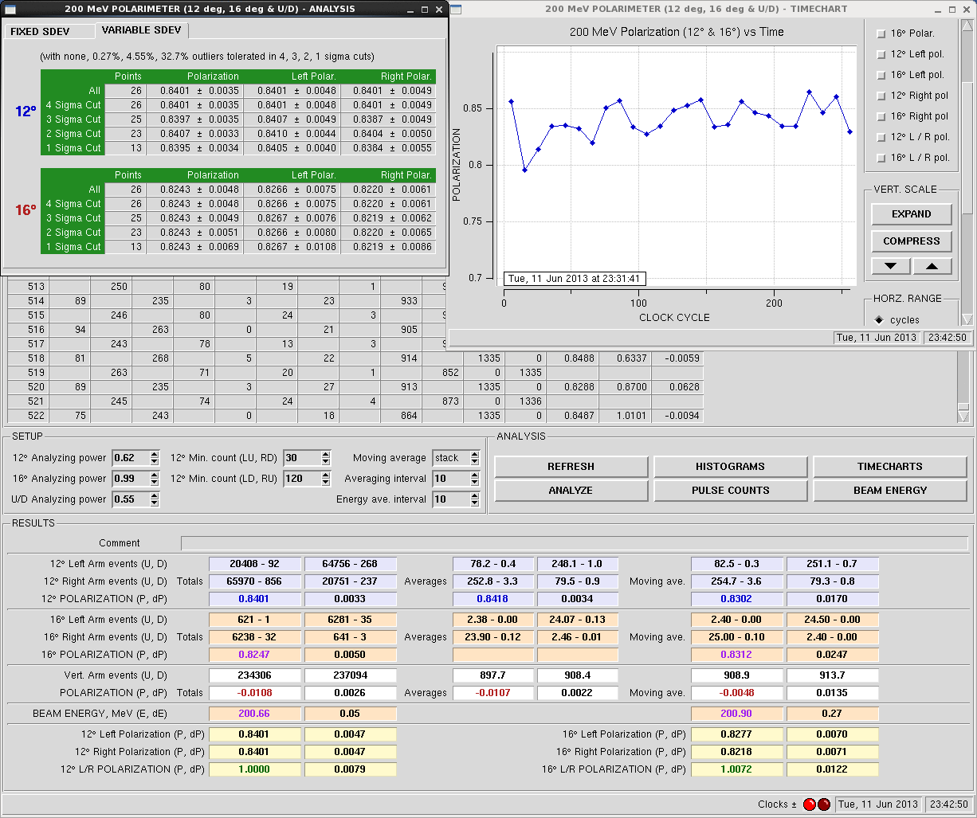
Precision, Absolute Proton Beam Polarimeter at 200MeV

Slide 27
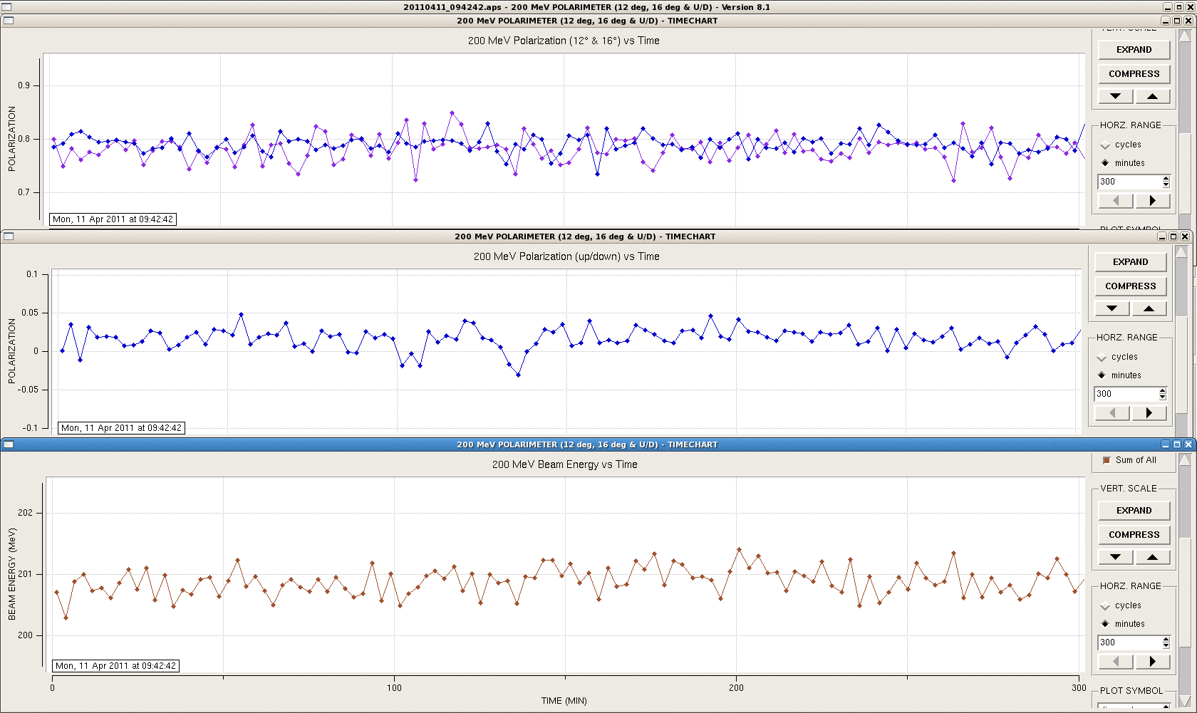
The 200MeV polarimeter
The 200MeV polarimeter simultaneous measured vertical and horizontal polarization and an energy of a beam.
Vertical and Horizontal polarization and Energy of a beam time chart
12 deg and 16 deg polarimeter
Vertical polarimeter
16 deg polarimeter

Slide 28
Summary
We believe that after:
optimization of the geometry and position of the source elements: He-cell, Rb-cell, collimators, vacuum system … based on the results of the modulation of the distribution of helium gas and Rb evaporation cloud;
improvement of laser alignment control and monitoring;
stabilization of the source parameters by implementing software with feedback control;
…
we will obtain a polarized proton source for the EIC with the required parameters.

