Slide 1
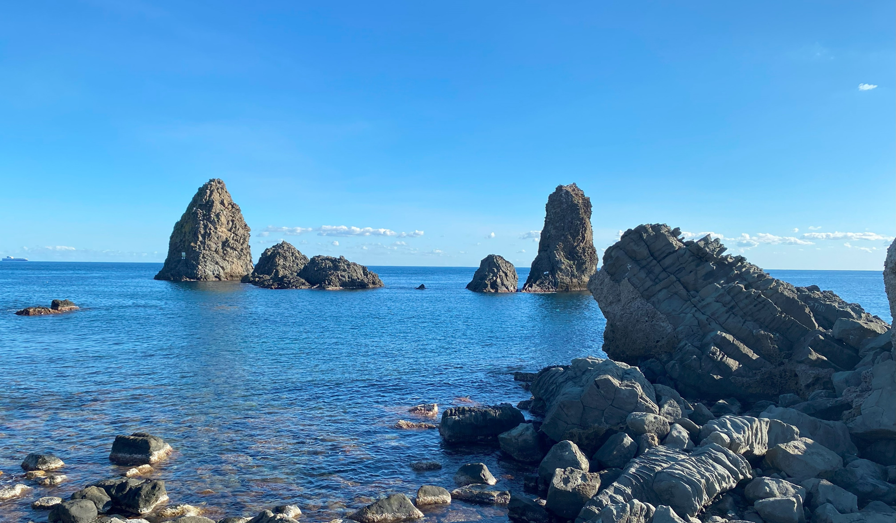



PIBHI 2025: open mind discussions on status and perspectives of ECR ion sources
L. Celona, A. Andreev, J. Benitez, P. Ferracin, B. Gall, S. Gammino, R. Hollinger, S. Kondrashev, G. Machicoane, T. Nagatomo, V. Skalyga, L. Sun, O. Tarvainen, T. Thuillier, O. Tuske, D. Todd, R. Vondrasek, X. Wang, H. Zhao
International Conference on Ion Sources
St. Catherine’s College, Oxford, 11th September 2025
Notes:
Give the highlights of the workshop called PIBHI we had in April close to Catania

Slide 2

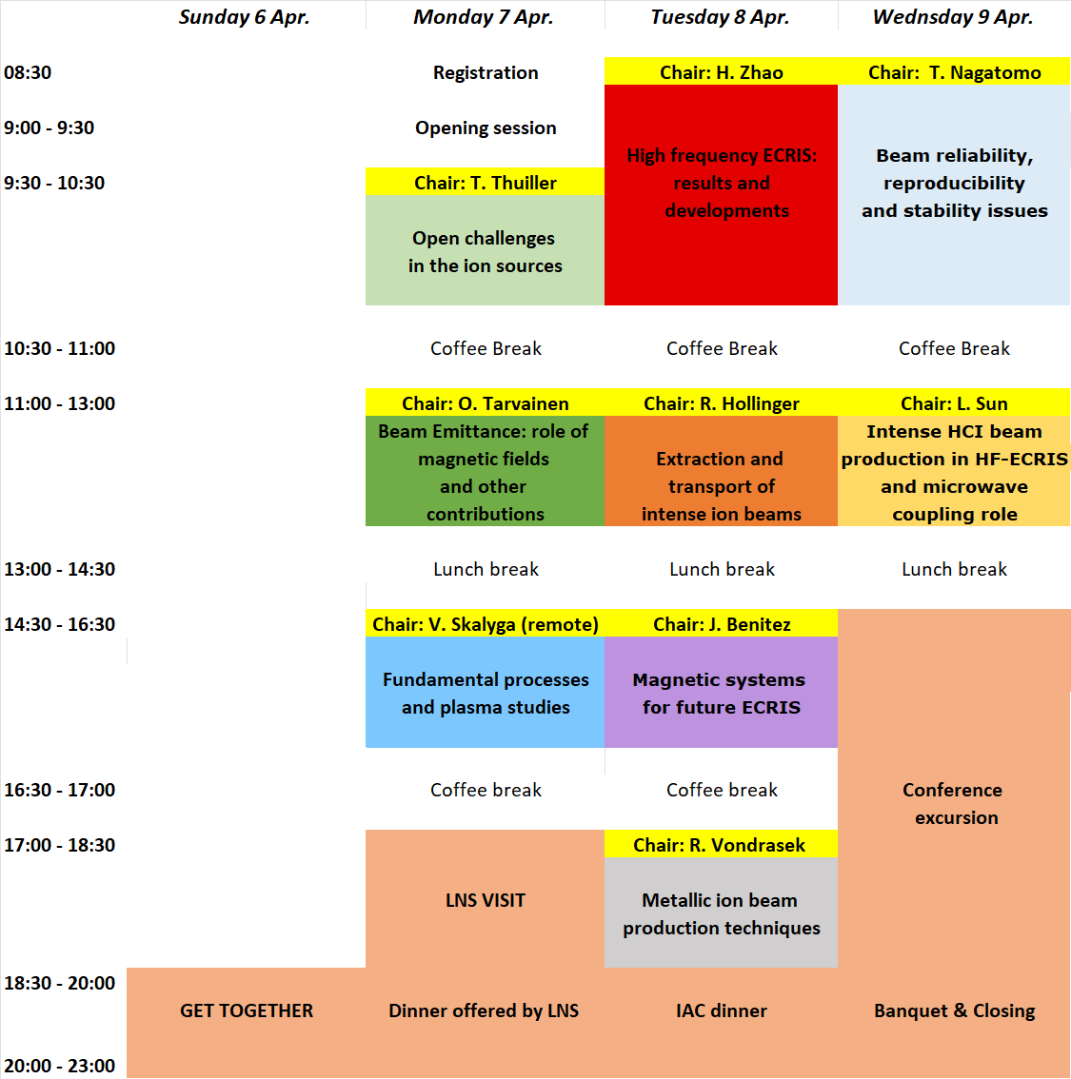

Workshop agenda (1/2)
R01- Chair: T. Thuillier (LPSC) (45’+15’)
Review opening talk: Open challenges in the ion source field
R02- Chair: O. Tarvainen (STFC-UKRI) (75’+45’)
Beam emittance: role of magnetic fields and other contributions
O. Tarvainen (STFC-UKRI)- What contributes to the emittance of an ion beam?
S. Kondrashev (BNL)- Application of pepper pot emittance probe for ECRIS beam studies
L. Sun (IMP-CAS)- Emittances with ECRISs: one major challenge to realize high intensity
heavy ion beam acceleration with SRF linac
R03- Chair: V. Skalyga (IAP-RAS) Remote (50’+70’)
Fundamental processes and plasma studies
V. Skalyga (IAP-RAS)– Fundamental processes and plasma studies
O. Tarvainen (STFC-UKRI)- Ion confinement in minimum-B ECRIS plasmas
V. Mironov (JINR)- Recent results from NAM-ECRIS simulations of TFH and afterglow
R04- Chair: H. Zhao (IMP-CAS) (60’+60’)
High frequency ECRIS: results and developments
H. Zhao (IMP-CAS)- 28-45 GHz ECRIS results and development at IMP
D. Todd (LBNL)- 28 GHz ECRIS results and development at LBNL
T. Nagatomo (RIKEN)- 28 GHz ECRIS results and development at RIKEN
R05- Chair: R. Hollinger (GSI) (60’+60’)
Extracton and transport of intense beams
R. Hollinger (GSI)- Extraction and transport of intense beams at GSI
E. Flannigan (STFC-UKRI)- Space charge compensation of pulsed hydrogen ion beams
D. Todd (LBNL)- Extraction and transport of intense beams at LBNL
O. Tuske (CEA-IRFU)- Extraction and transport of intense light ion beams
L. Celona et al. International Conference on Ion Sources, St. Catherine’s College, Oxford, 11th September 2025
Notes:
The main scope of the workshop was to stimulate the discussions among the attendees on a several topics of interest by the community, in dedicated round tables which usually are not part of the programme of classical ion source conferences. An opening review talk and 8 round tables with the policy to have almost 50% of time given to the presentations and the remaining 50% for opern discussion. I need to start apologizing with some contributors because it will be not possible to condensate in 15 minutes more than 8 hours of discussions and at the same time I would like to thank all the workshop Chairs which have been the engine of each single RT helping me in finding contributions triggering discussions among us.

Slide 3
Workshop agenda (2/2)
R06- Chair: J. Benitez (LBNL) (60’+60’)
Magnetic systems for future ECRIS
J. Benitez (LBNL)- Introduction & 45 GHz MARS - Update
L. Sun (IMP-CAS)– FECR - Update
P. Ferracin (LBNL) Remote - Beyond 45 GHz (VENUS with Nb3Sn sextupole for FRIB, ECR
designs such as Uni-layer concept, option HTS for future ECR)
R07- Chair: R. Vondrasek (ANL) (60’+60’)
Metallic ion beam production
R. Vondrasek (ANL)– Metal ion beam production techniques
B. Gall (CNRS) Remote - MIVOC preparation and beams, Inductive oven development,
Isotopic metal preparation for HT oven (Ti, Cr)
L. Sun (IMP-CAS)- High temperature oven development issues at IMP
Aleksandr Andreev (GSI) - Metallic ion beam production techniques at GSI
R08- Chair: T. Nagatomo (RIKEN) (60’+60’)
Availability, reproducibility and stability issues
T. Nagatomo (RIKEN)- HCI Beam Production and Challenges at RIKEN
L. Sun (IMP-CAS)- Production of intense HCI metallic ion beams for routine operation
D. Todd (LBNL)- VENUS operation and HCI beam production for SHE in LBNL
R09- Chair: L. Sun (IMP-CAS) (60’+60’)
Perspectives of HCI production in HF-ECRIS and microwave coupling role
L. Sun (IMP-CAS)- Perspectives in high charge-state ECR ion source development and scope
G. Machicoane (FRIB) Remote- Current operational experience with ECR ion sources at
FRIB and path forward for high power operation
X. Wang (IMP-CAS) - Microwave launching studies with the 3rd generation ECR ion sources
L. Celona et al. International Conference on Ion Sources, St. Catherine’s College, Oxford, 11th September 2025

Slide 4
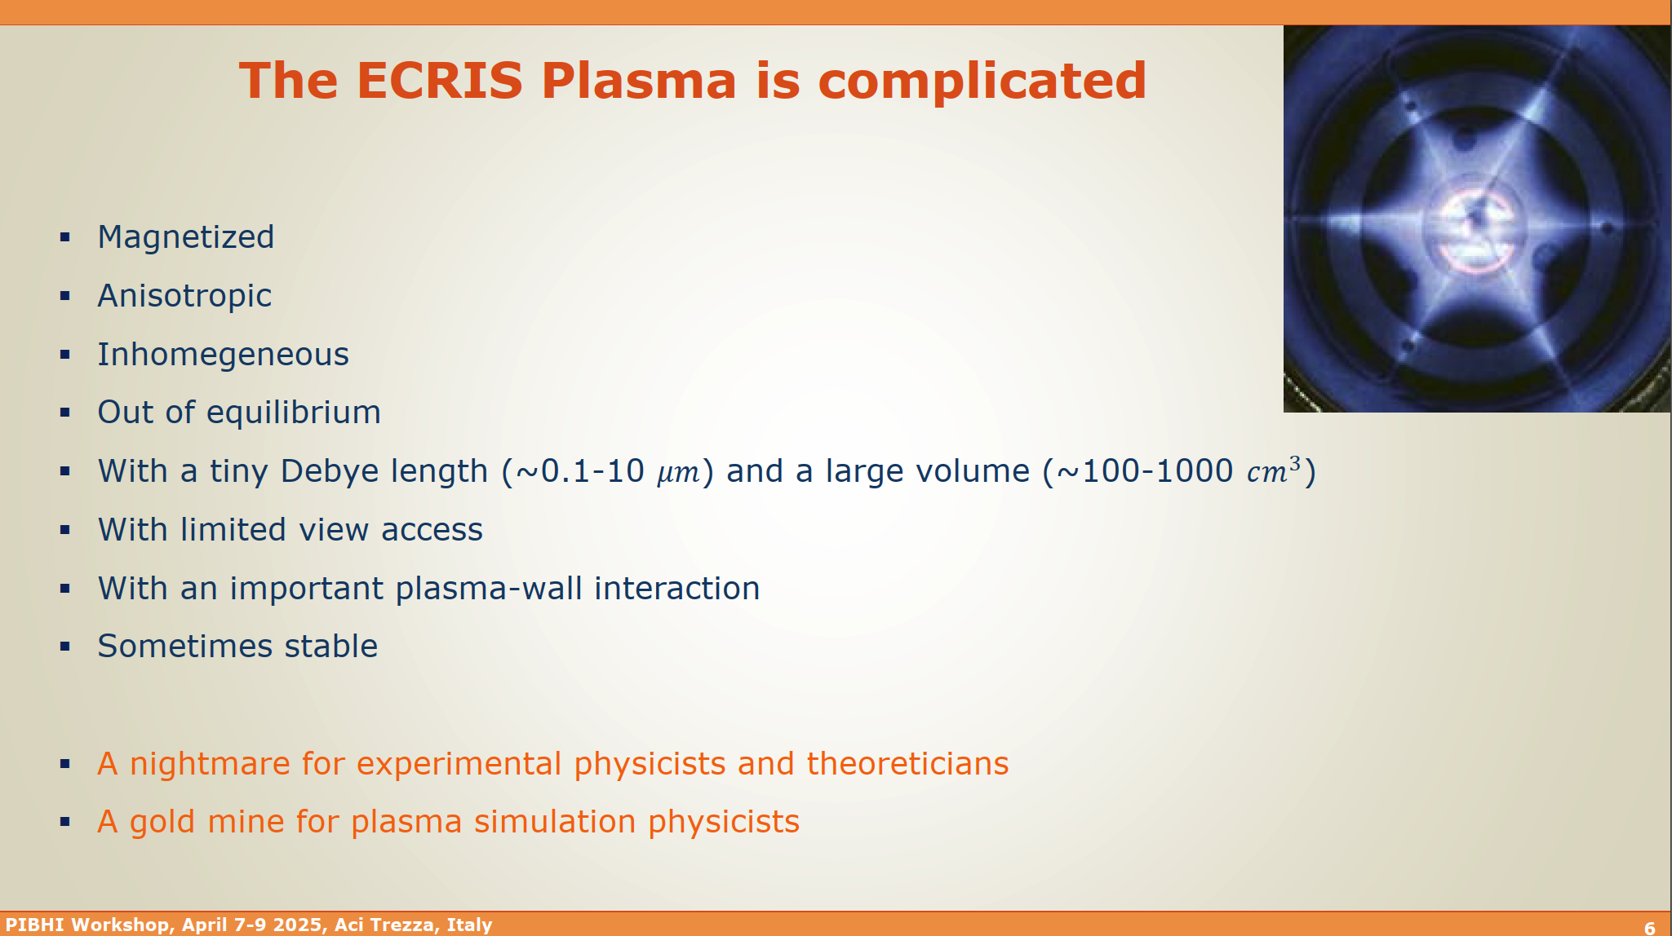
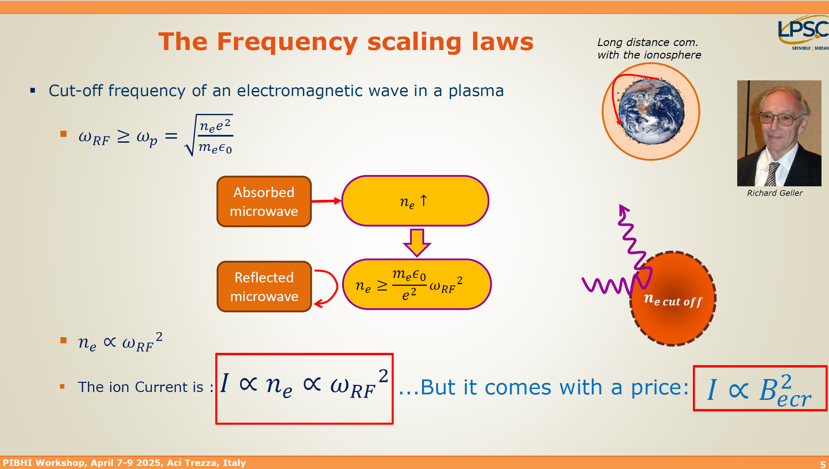
ECRIS plasma
Courtesy of T. Thuillier (LPSC)
L. Celona et al. International Conference on Ion Sources, St. Catherine’s College, Oxford, 11th September 2025
Notes:
Behind this achievement and the future ones there is the production of a plasma…
Increase of current …. increase of frequency

Slide 5
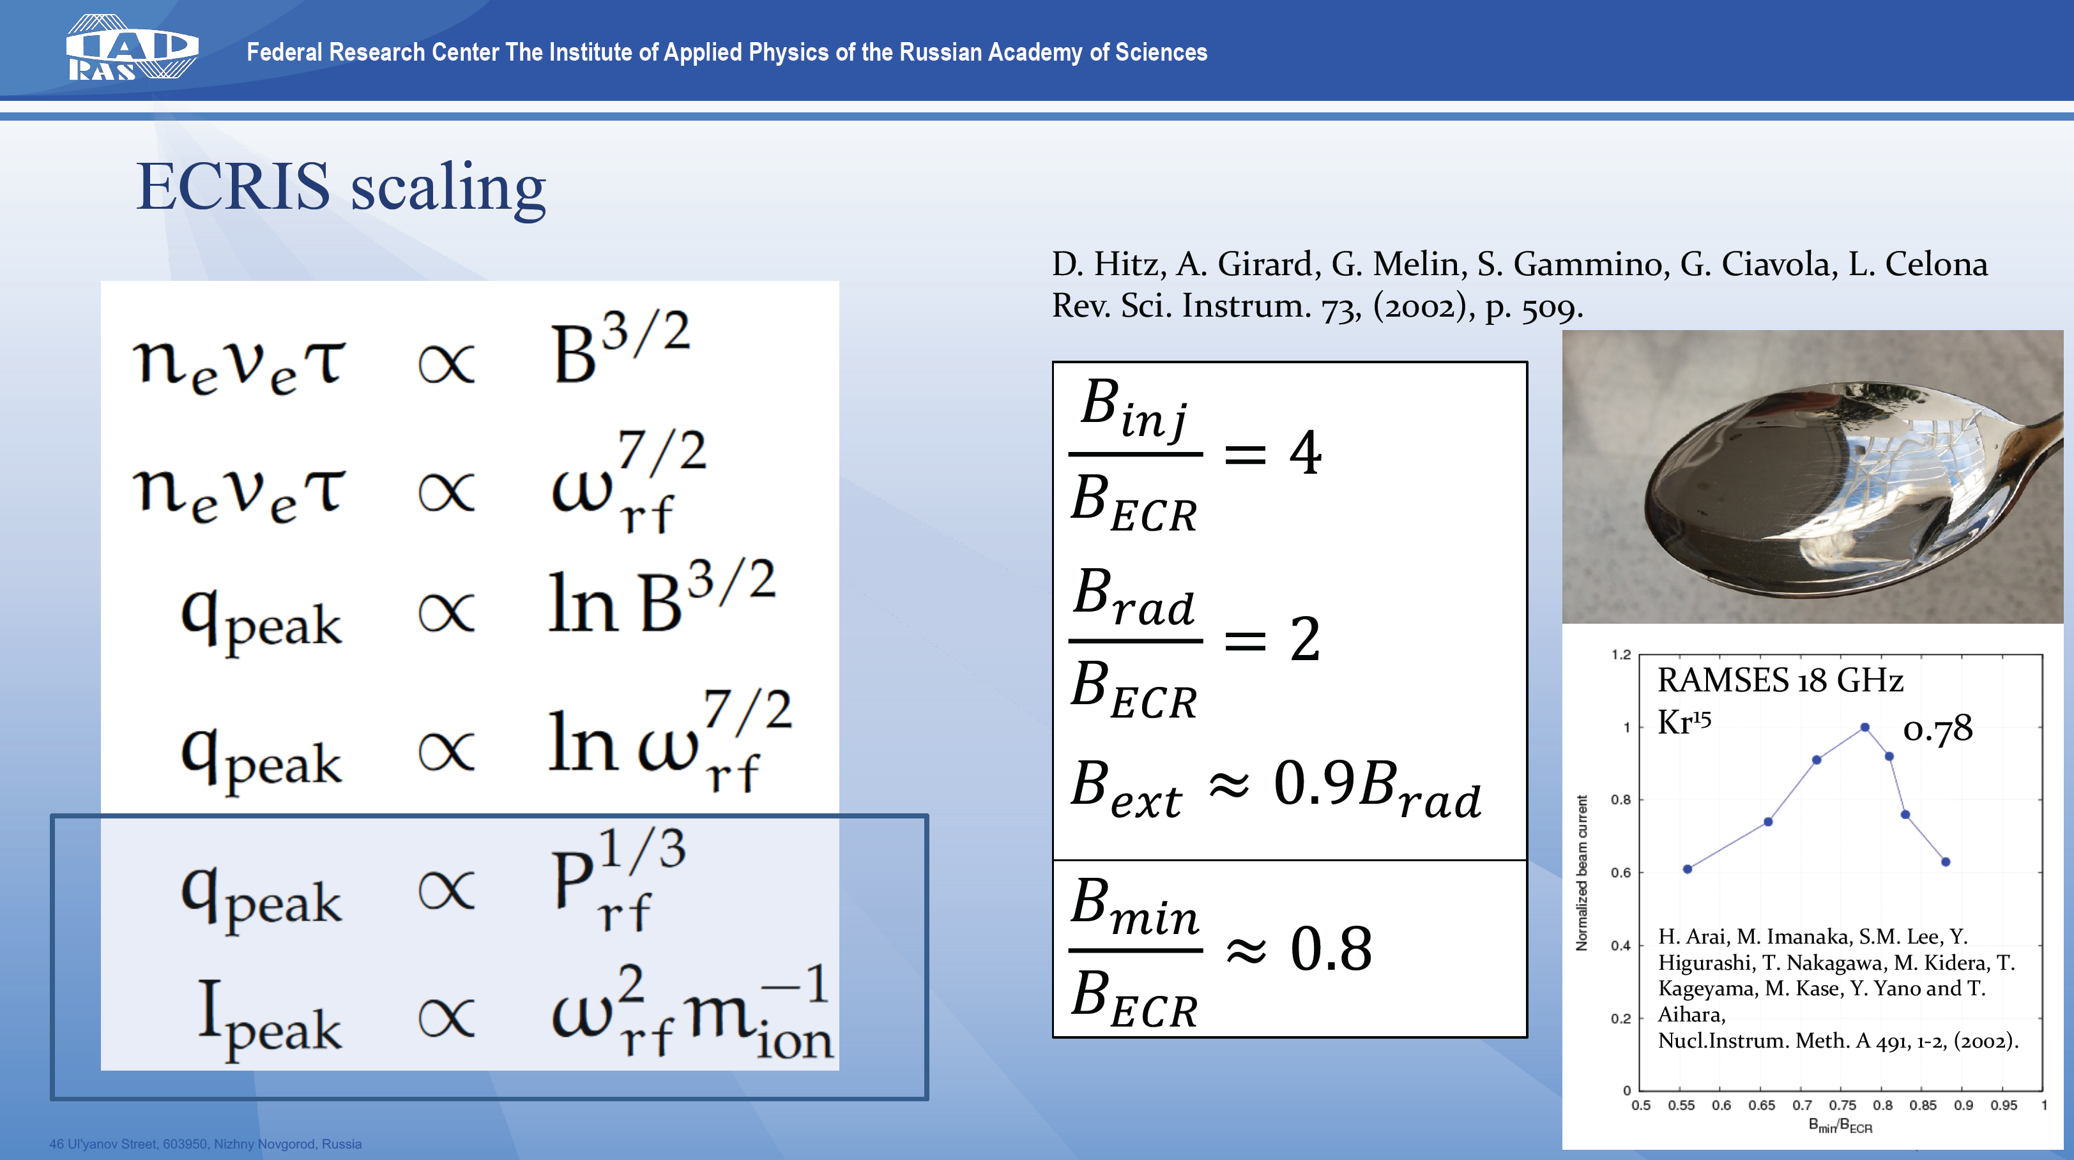
ECRIS plasma
Courtesy of V. Skalyga (IAP-RAS)
L. Celona et al. International Conference on Ion Sources, St. Catherine’s College, Oxford, 11th September 2025
Notes:
BRUTE FORCE!

Slide 6
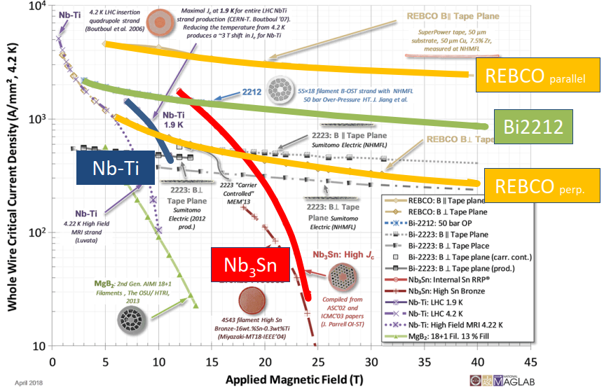
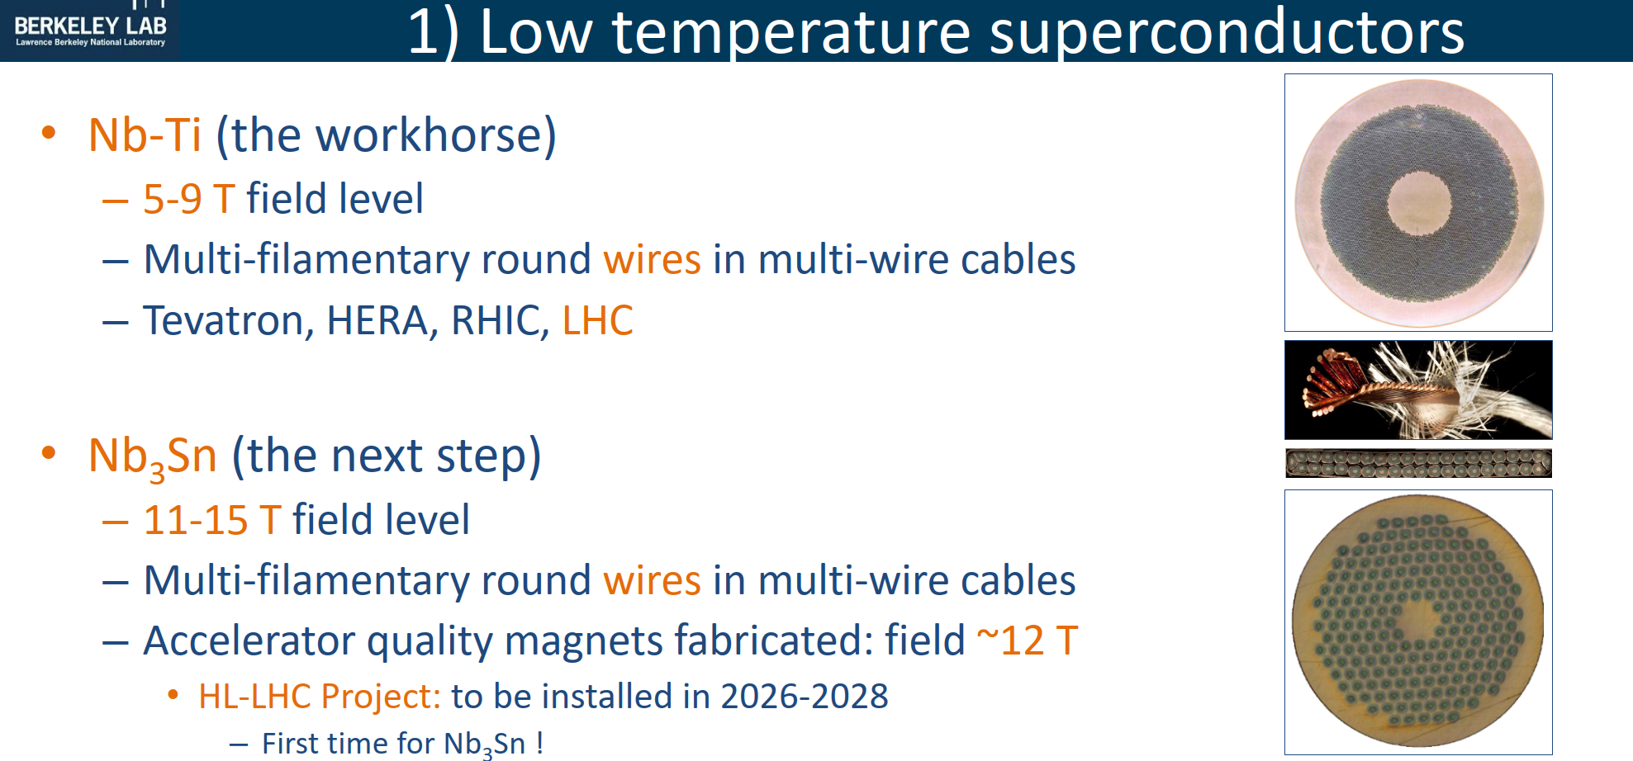
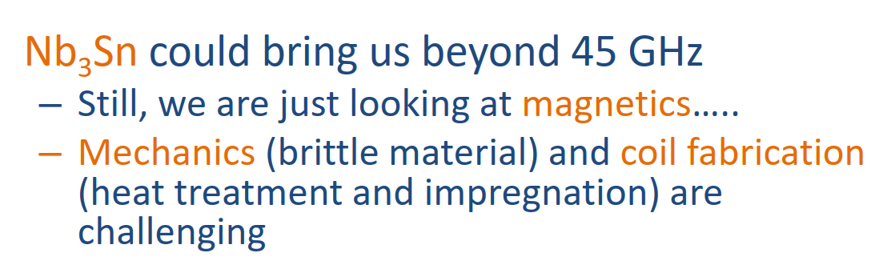
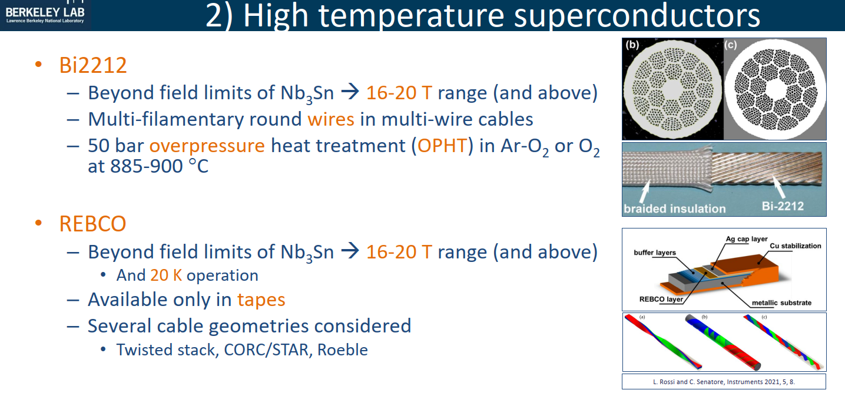
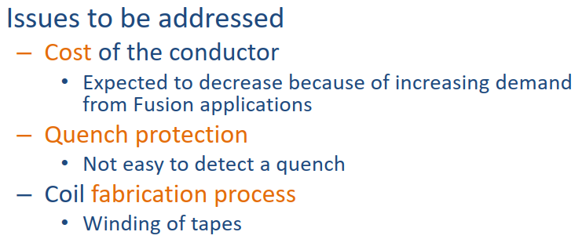


SC materials status&perspects
Courtesy of P. Ferracin (LBNL)
L. Celona et al. International Conference on Ion Sources, St. Catherine’s College, Oxford, 11th September 2025
Notes:
Nb-Ti cable limitis reached.
Nb3Sn brittle, risky, expensive Labtech mainly. 1 quench and magnet to garbage…
HTS very expensive
High energy stored in the magnet coils> 1 MJ, active quench protection system required

Slide 7
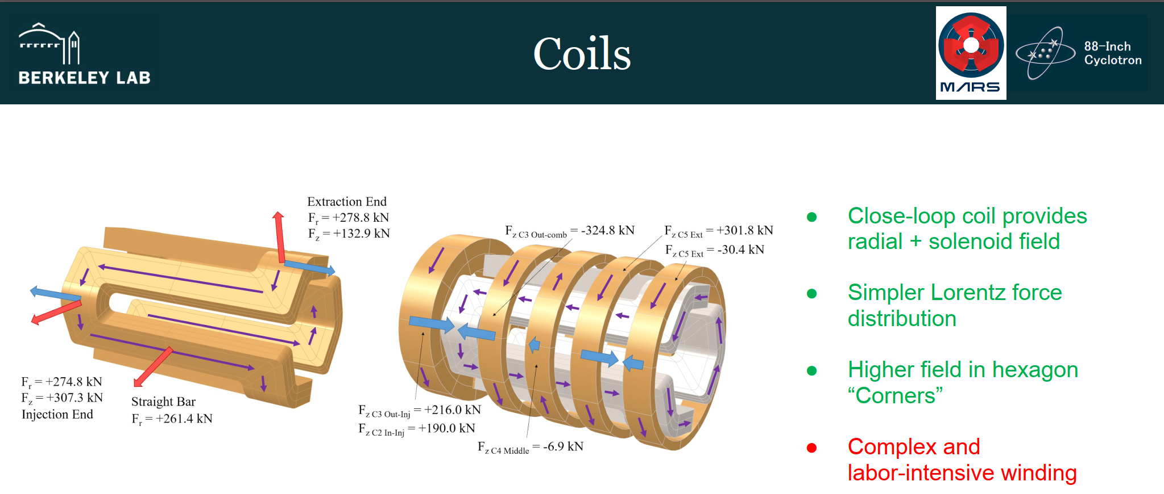
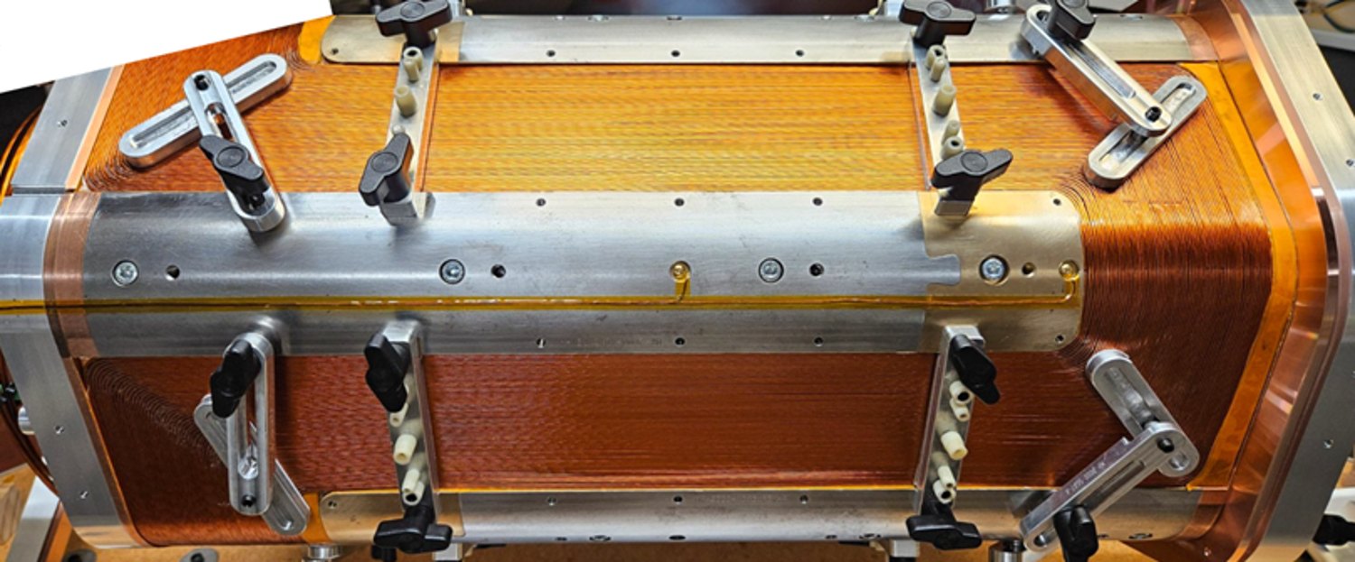
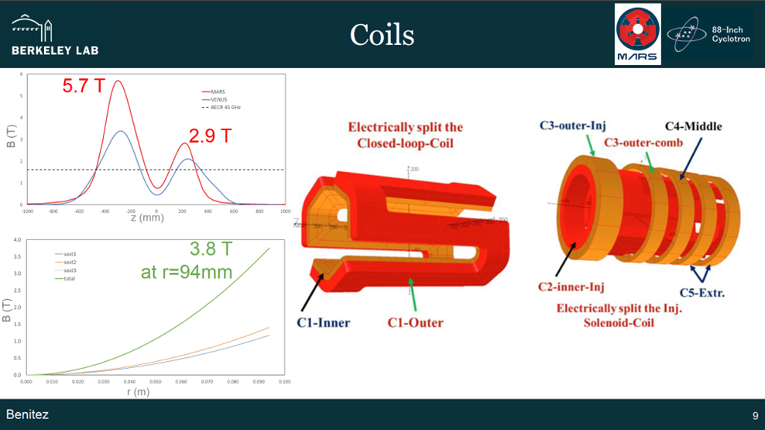
MARS
3rd generation VENUS uses NbTi in conventional structure
4th generation Nb3Sn in conventional structure difficult to clamp
4th generation MARS-D allows continued use of NbTi by means of an optimized geometry providing 50% greater fields
Courtesy of J. Benitez (LBNL)
L. Celona et al. International Conference on Ion Sources, St. Catherine’s College, Oxford, 11th September 2025

Slide 8
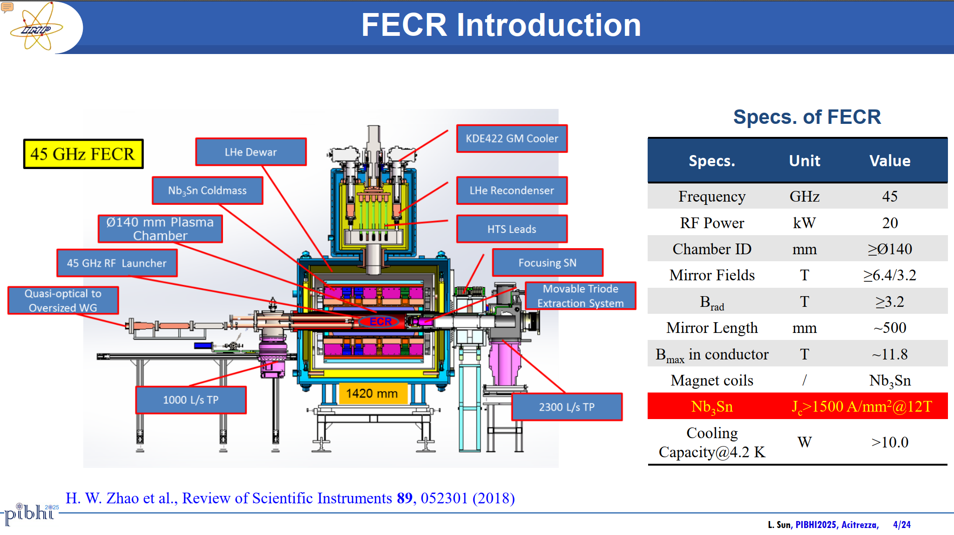
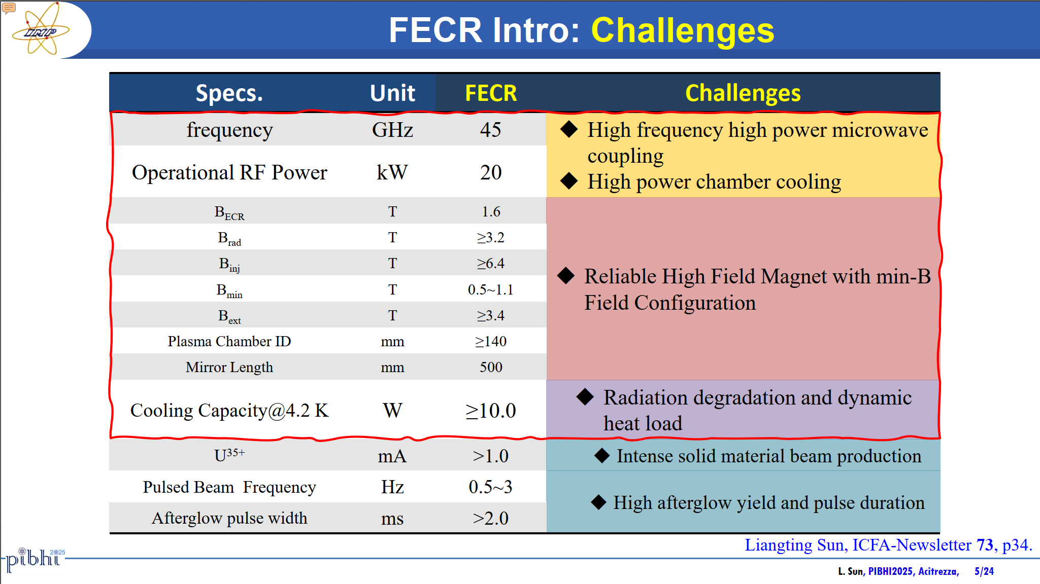


FECR
Courtesy of H. Zhao and L. Sun (IMP-CAS)
L. Celona et al. International Conference on Ion Sources, St. Catherine’s College, Oxford, 11th September 2025

Slide 9
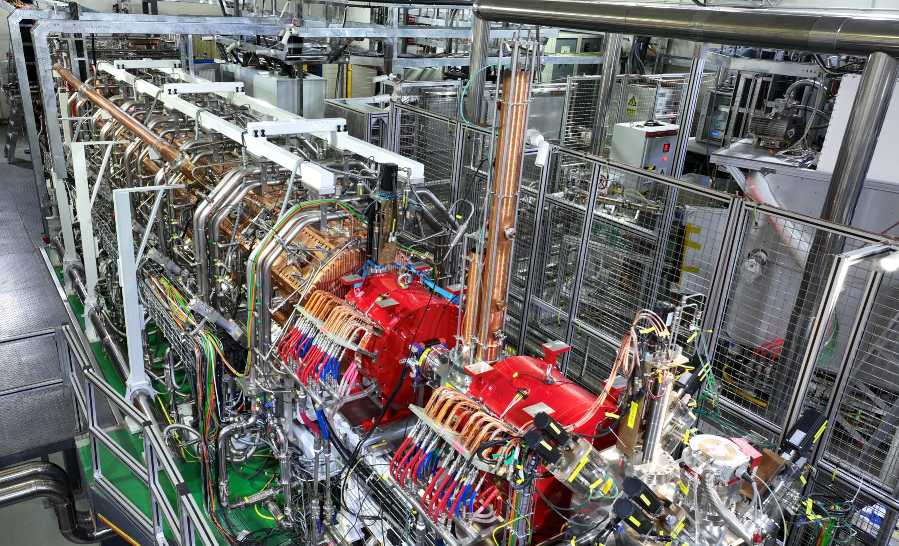
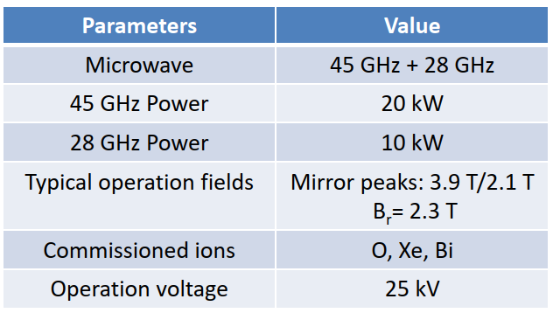
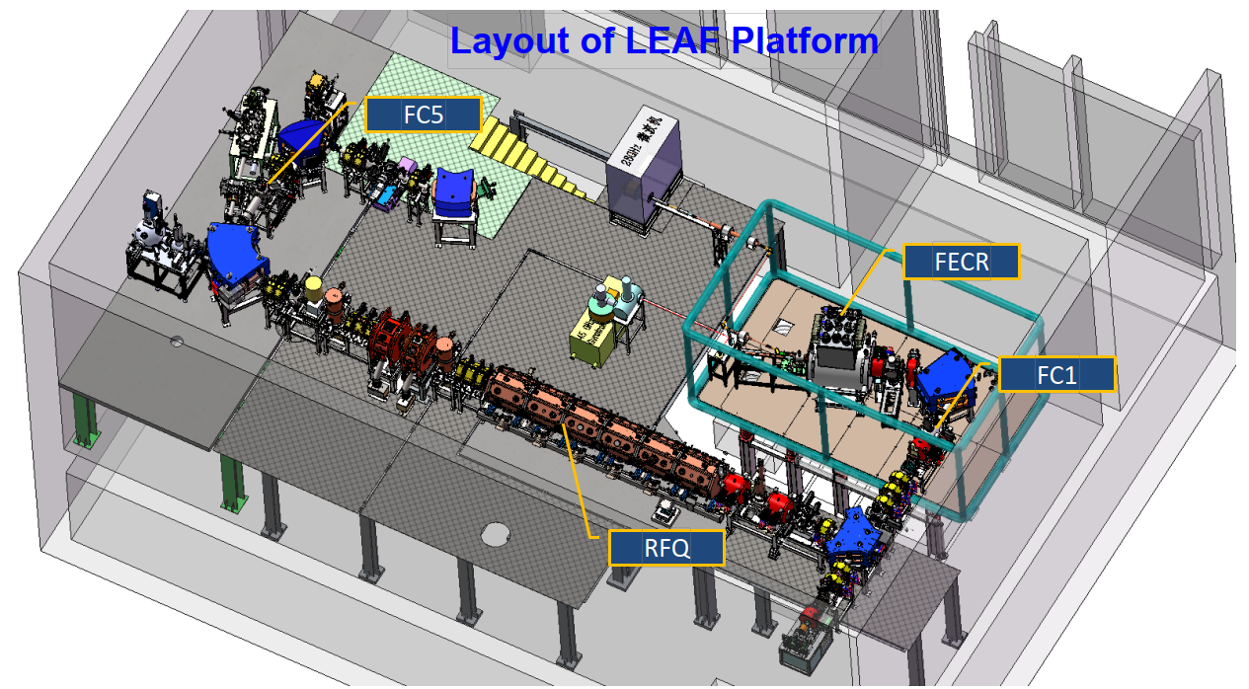
FECR commissioning
Courtesy of H. Zhao and L. Sun (IMP-CAS)
L. Celona et al. International Conference on Ion Sources, St. Catherine’s College, Oxford, 11th September 2025

Slide 10
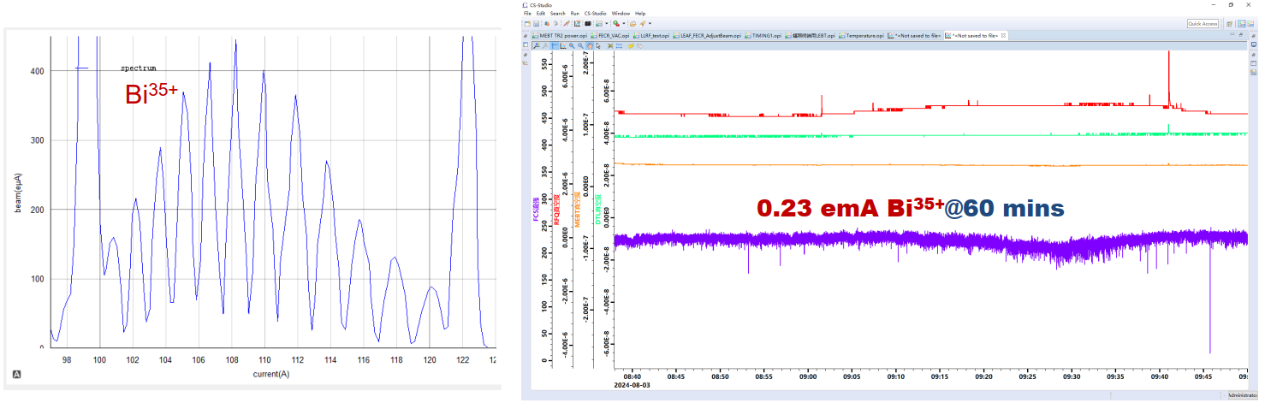
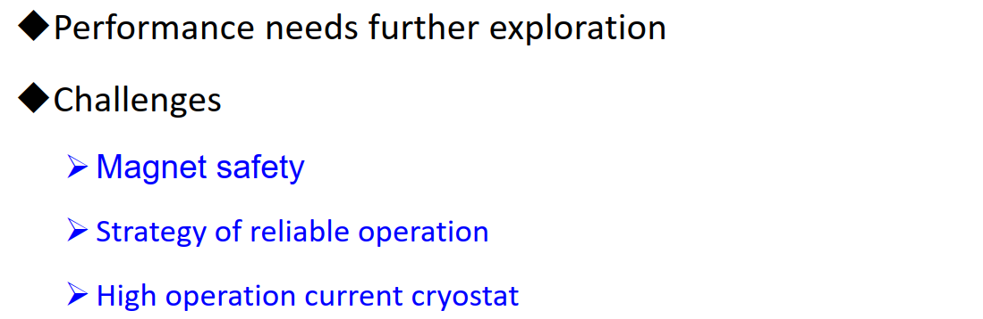
FECR commissioning
Courtesy of H. Zhao and L. Sun (IMP-CAS)
L. Celona et al. International Conference on Ion Sources, St. Catherine’s College, Oxford, 11th September 2025
Notes:
So, it’s all ok? No, it isn’t.
And Thomas resumed in the following slide some open questions looking also to the results of new gen. ECRIS

Slide 11
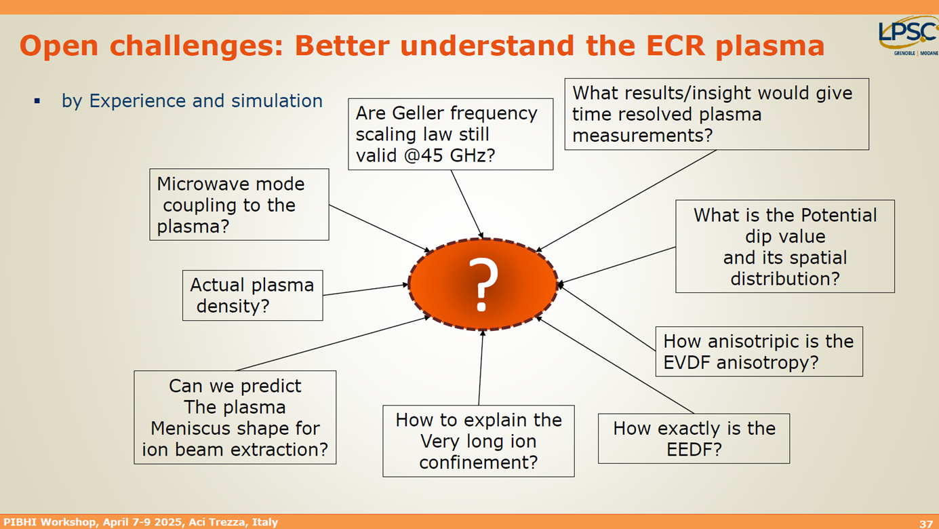
ECRIS plasma
Courtesy of T. Thuillier (LPSC)
L. Celona et al. International Conference on Ion Sources, St. Catherine’s College, Oxford, 11th September 2025

Slide 12
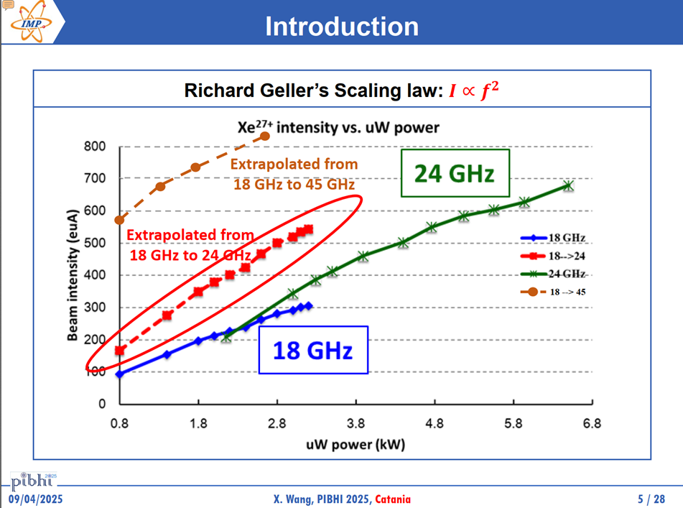
Geller’s scaling law
What is going on?
Courtesy of L. Sun (IMP-CAS)
L. Celona et al. International Conference on Ion Sources, St. Catherine’s College, Oxford, 11th September 2025
Notes:
Based on the Scaling law, the beam current is proportional to the square of the frequency. Many experiments have confirmed this law over the last thirty years. However, with the third-generation ECR ion source appeared controversial results. For example, here are the results from SECRAL at 18 GHz and 24 GHz. Lower beam current than expected at 24 GHz. WHY?
At the beginning of ECRIS history the design of microwave injection has been not considered relevant to enhance performance of the ion sources. It has has been mainly driven from other consideration. Plasma was simply considered like a sponge.
Since ‘94 (Xie, Lyneis) the role of frequency has been evident in ECRIS, but the fine structure has been accepted from the community after ECRIS06 (i.e.: Lyneis et al., Proc. ECRIS 2012).

Slide 13
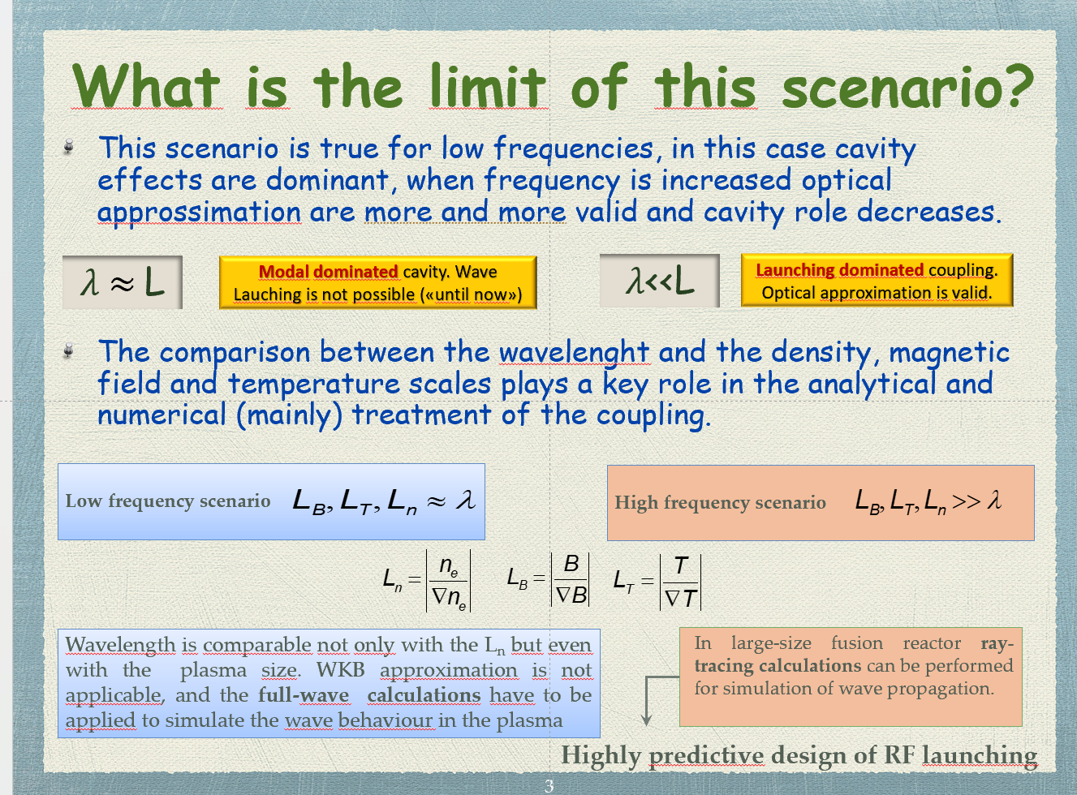
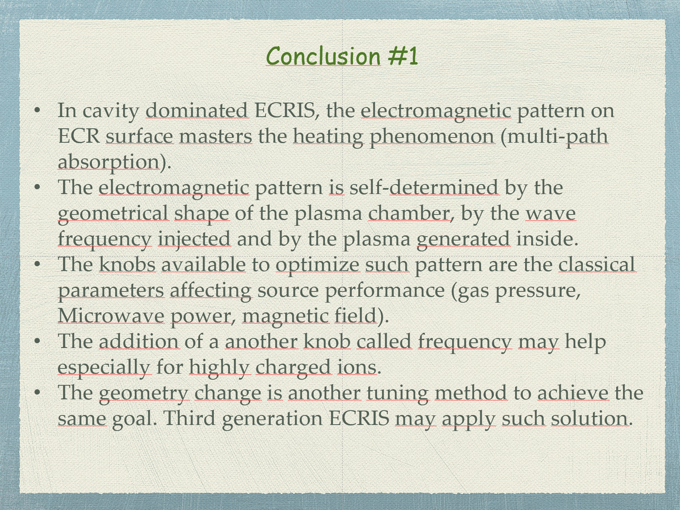

Microwave heating in ECRIS
L. Celona et al. International Conference on Ion Sources, St. Catherine’s College, Oxford, 11th September 2025
Notes:
In this scenario cavity effects are dominating and we are dealing with conditions that imply full-wave solution a cavity-dominated regime (Gen. I-II).
By increasing the frequency optical approximation is more and more valid, cavity role decreases and we enter in launching-dominated regime (as may be the case for Gen. III and above), the approach may make use of ray-tracing modelling. In this way, the design of the RF component becomes HIGHLY PREDICTIVE, since there is no need to rely on the self-consistency of the wave-plasma-wave interaction. In this latter case the plasma can be more easily described as a "target" and the first-pass absorption efficiency maximized.

Slide 14
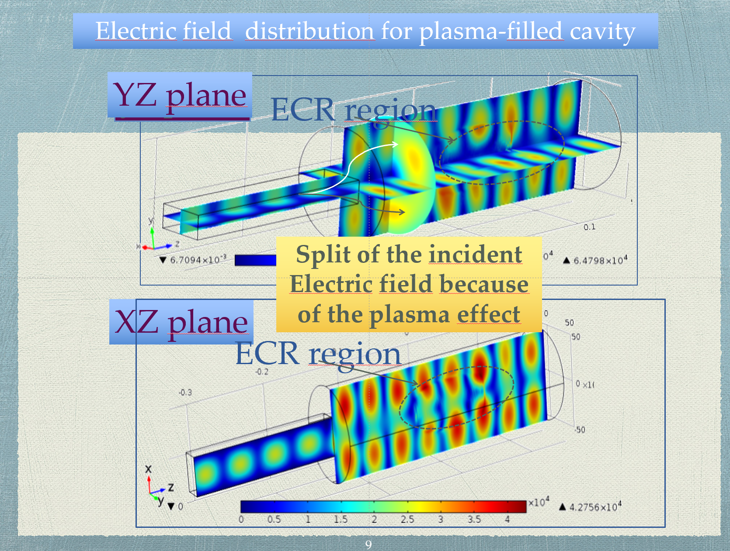
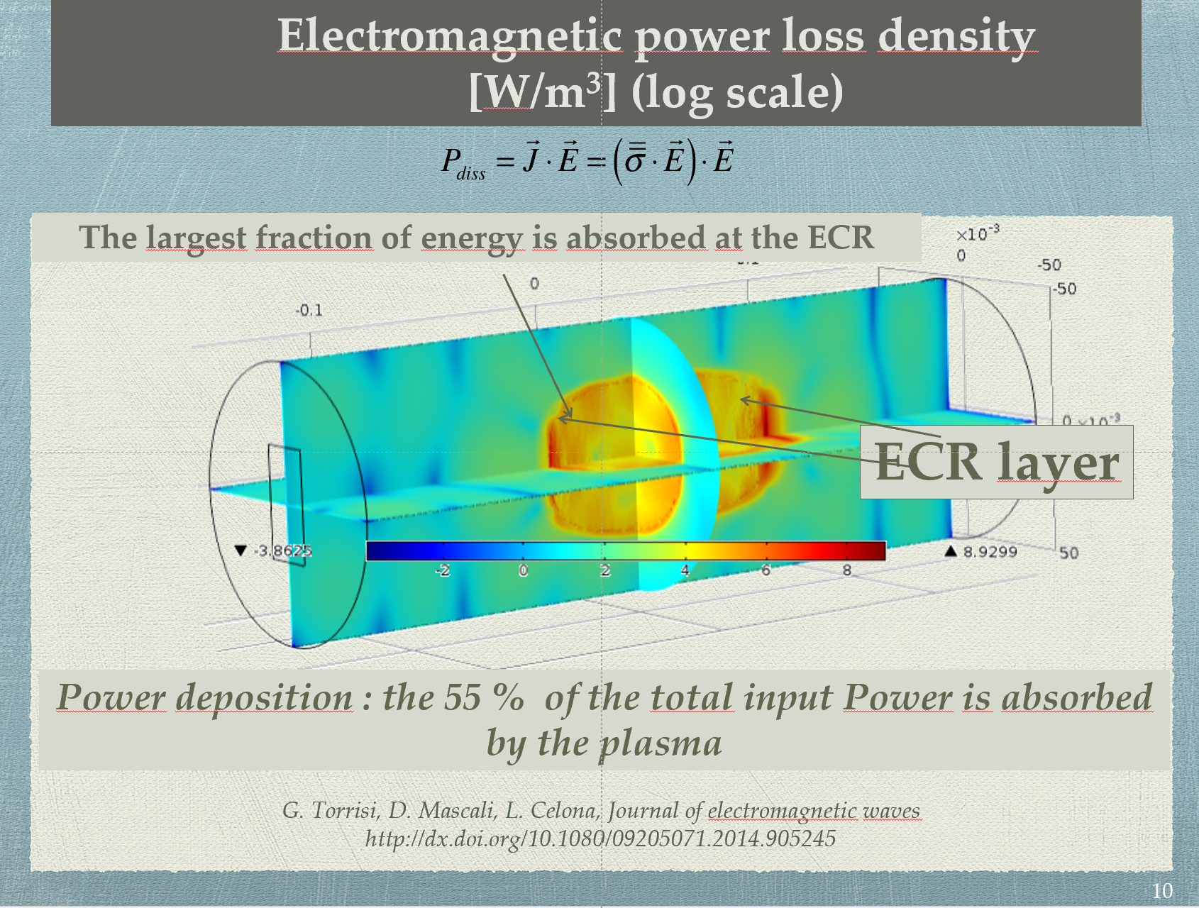
ECR heating on modal dominated cavities
L. Celona et al. International Conference on Ion Sources, St. Catherine’s College, Oxford, 11th September 2025

Slide 15
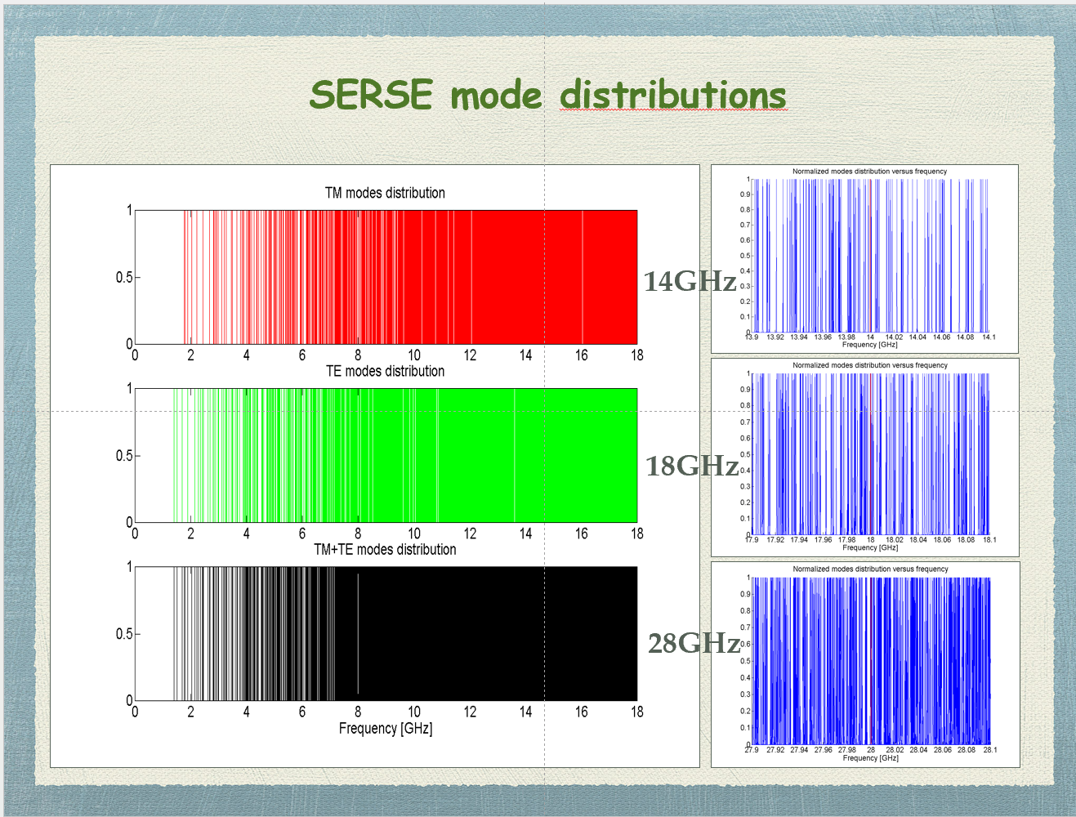
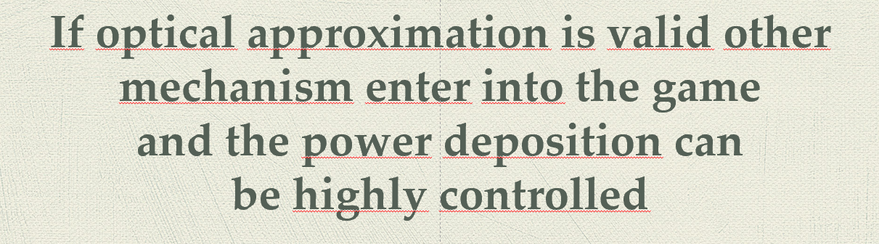
HF ECRIS: microwave heating
Microwave absorption oriented design is needed for future ECRIS. It may give a highly controlled electromagnetic radiation from a flexible RF launcher system with the possibility of reduction, increase, redistribution, power level, polarization, power deposition location of the radiated signal.
This could be of primary importance for maximizing the power efficiency, improving plasma parameters.
Simulations can be a useful tool to verify the effectiveness of the proposed scheme
COULD YOU IMAGINE THE DISTRIBUTION AT 45 GHz???
L. Celona et al. International Conference on Ion Sources, St. Catherine’s College, Oxford, 11th September 2025
Notes:
As frequency increases we can say that the energy absorption mechanism from the plasma electrons remains the same.
The mode distribution will reach a «continuum».

Slide 16
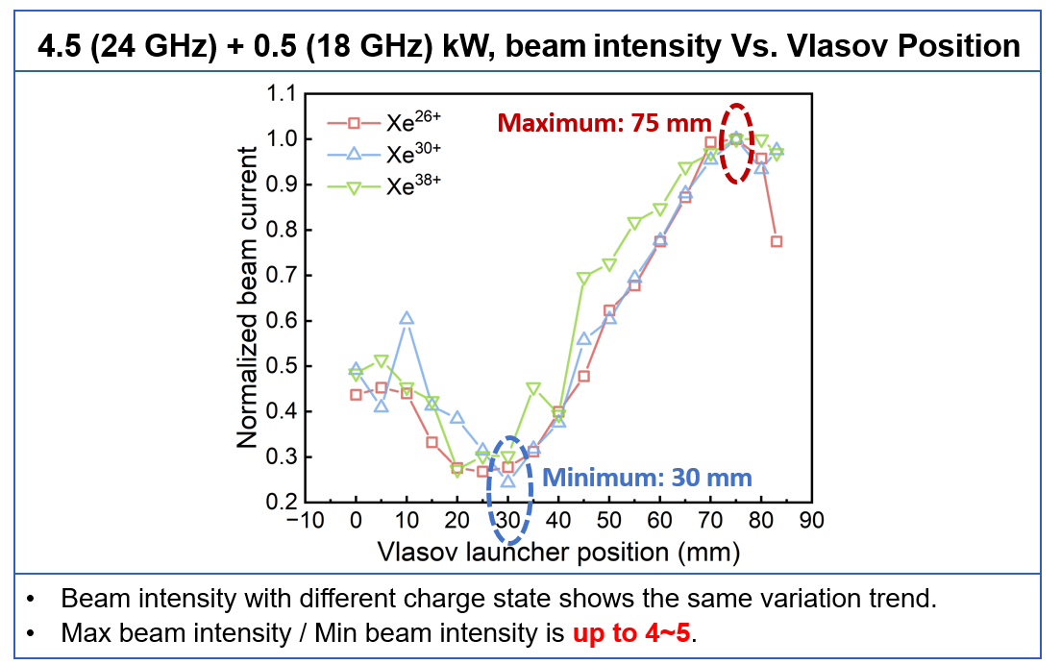
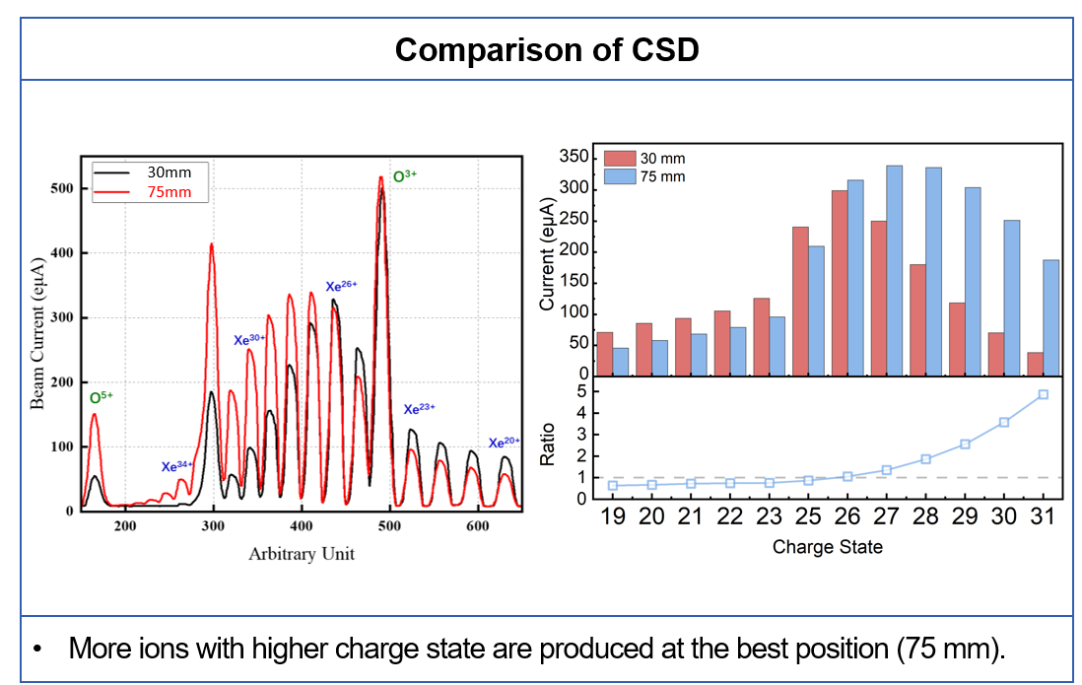
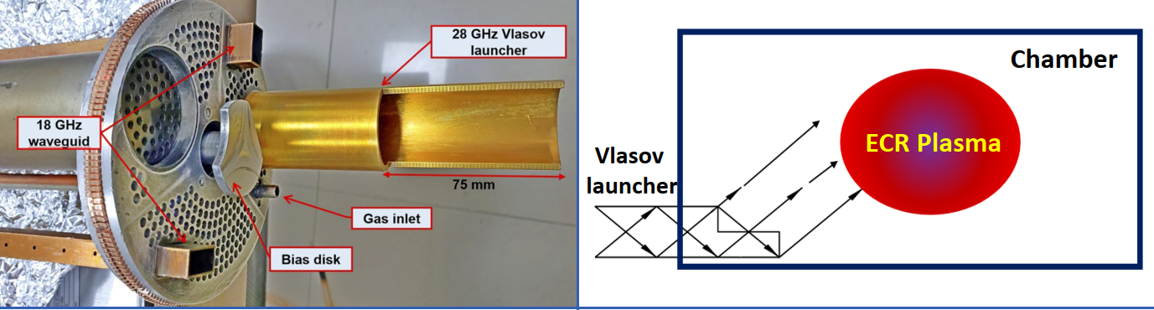
IMP movable Vlasov launcher
Courtesy of X. Wang (IMP-CAS)
L. Celona et al. International Conference on Ion Sources, St. Catherine’s College, Oxford, 11th September 2025

Slide 17
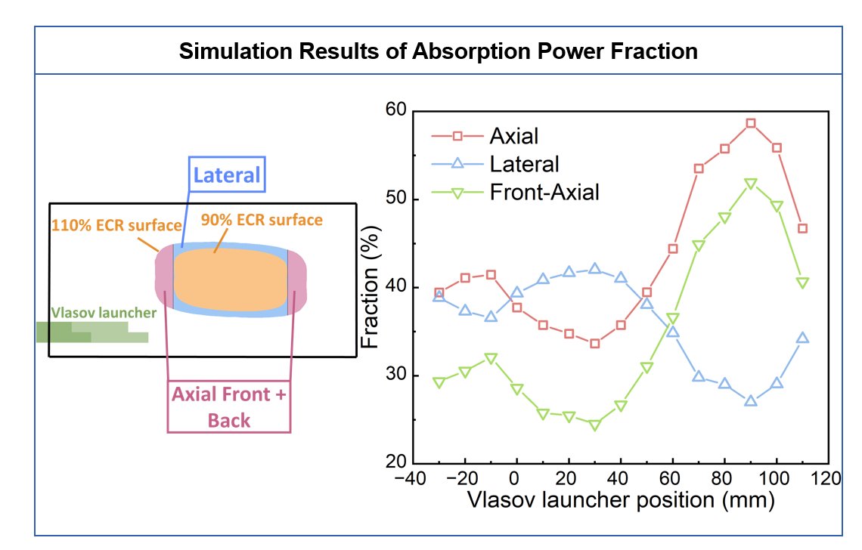
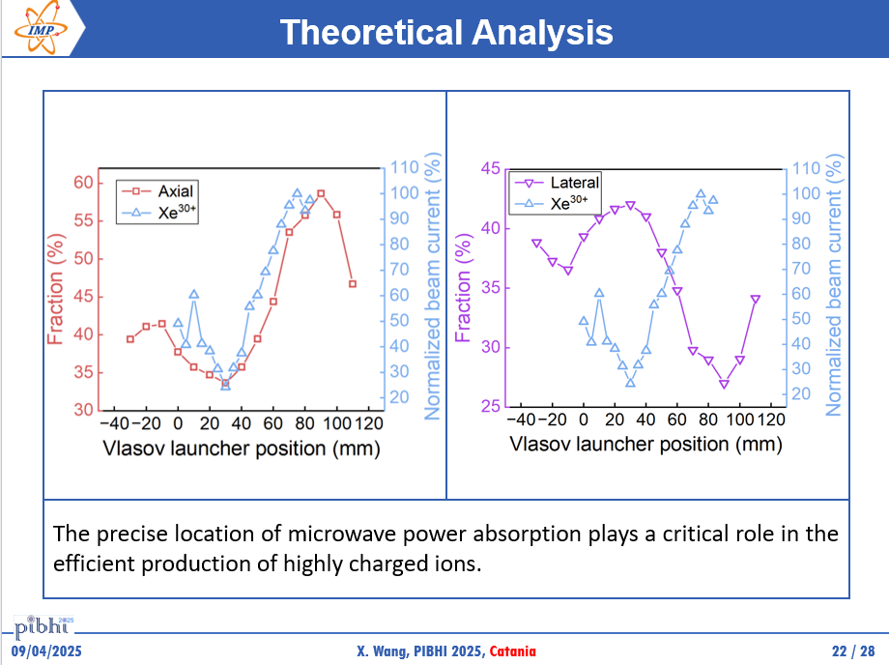
IMP movable Vlasov launcher
Courtesy of X. Wang (IMP-CAS)
L. Celona et al. International Conference on Ion Sources, St. Catherine’s College, Oxford, 11th September 2025

Slide 18
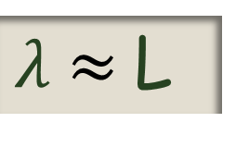
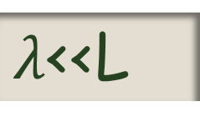
HF ECRIS: microwave heating some conclusions and other questions
Change of paradigma needed in the design of microwave heating
for future generation ECRIS
$λ$ $≈$L
$λ$<<L
Modal dominated cavity.
Wave Lauching is not possible
Launching dominated coupling. Optical approximation is valid.
Contribution of each mechanism?
Where is the switch over?
Clue: 18 GHz FTE on AISHa is still present, but… the other mechanism? Phased waveguide array!
What will happen at 21 GHz?
L. Celona et al. International Conference on Ion Sources, St. Catherine’s College, Oxford, 11th September 2025

Slide 19
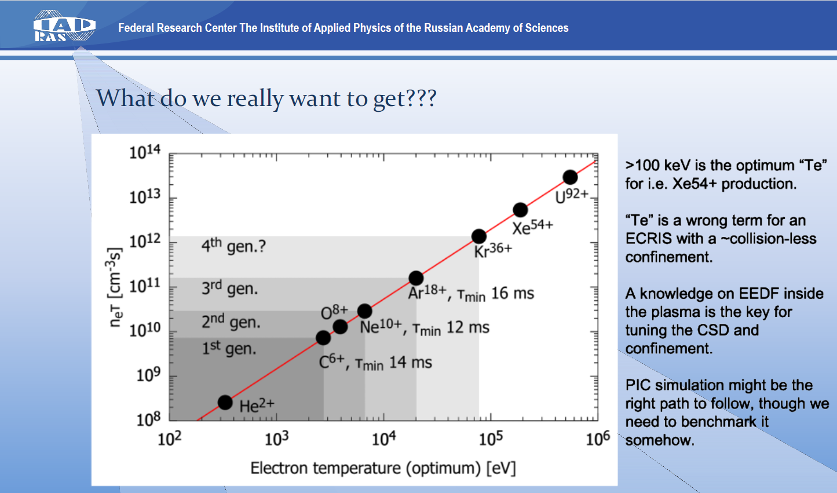
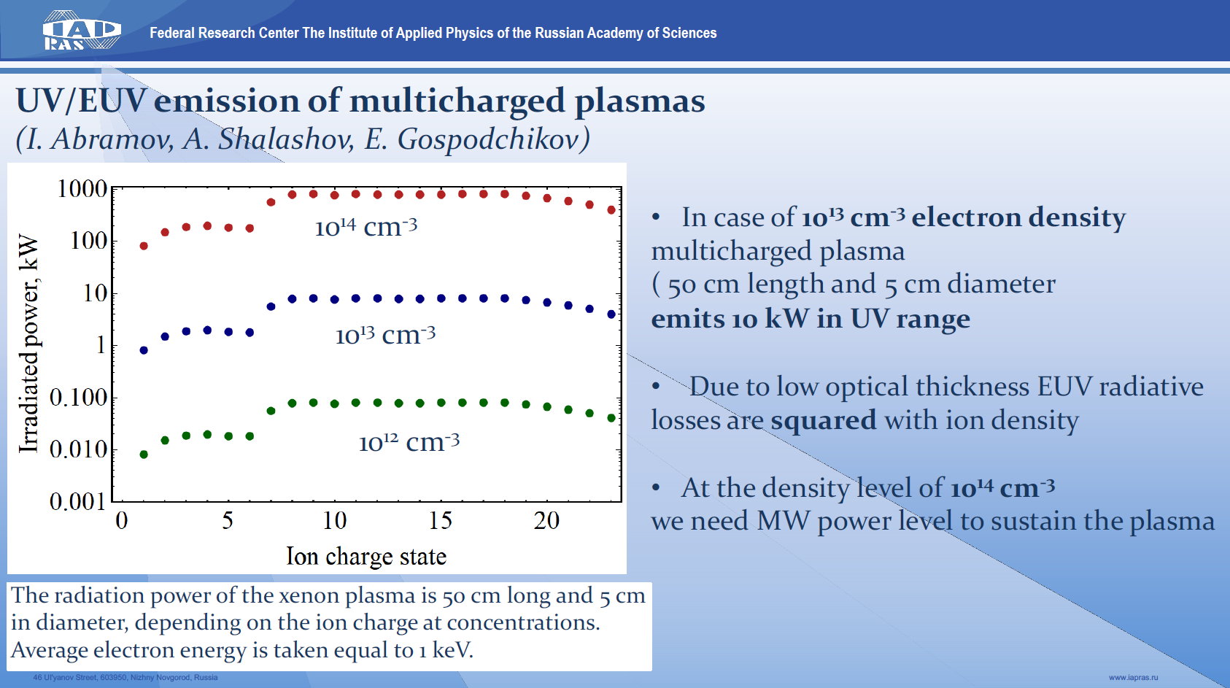
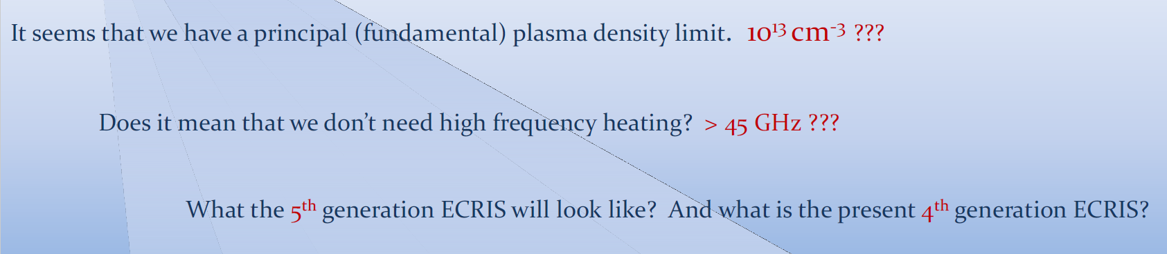
WARNING!!!
Courtesy of V. Skalyga (IAP-RAS)
L. Celona et al. International Conference on Ion Sources, St. Catherine’s College, Oxford, 11th September 2025
Notes:
The characteristics of beams generated by a high charge state ion source critically depend on plasma parameters.
An adequate understanding of the electron and ion distribution functionsCan provide crucial information for performance optimization.
This discussion should also focus on plasma diagnostics,
Determining which diagnostic tools are most appropriate
In specific experimental contexts and identifying
Which ones might warrant further progress.

Slide 20
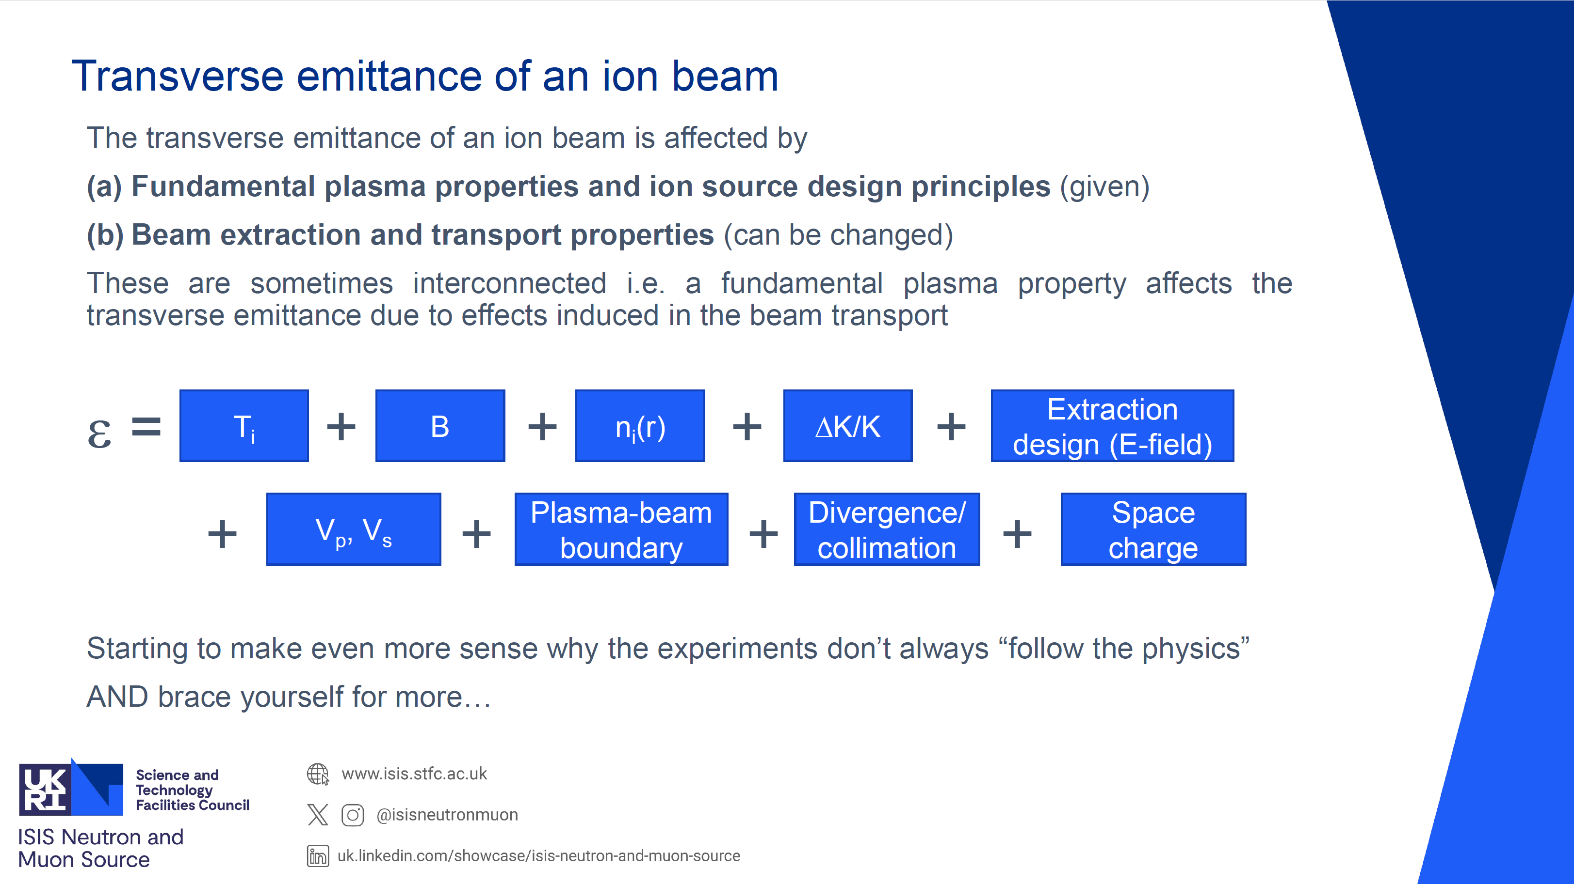
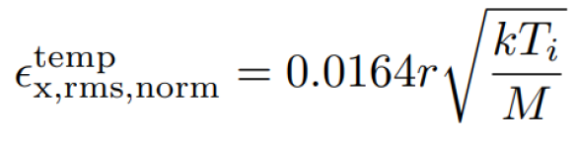
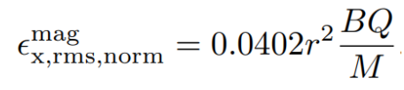
ECRIS beam emittance
kTi higher than expected. Magnetic emittance dominates at high frequencies and charge states
Non-uniform distribution of ions across the extraction aperture→ smaller than predicted emittance for high Q/M
Plasma meniscus, space charge and extraction system design affect the longitudinal energy spread
Courtesy of O. Tarvainen (STFC-UKRI)
L. Celona et al. International Conference on Ion Sources, St. Catherine’s College, Oxford, 11th September 2025
Notes:
2.45 contribution almost 1:1. Plasma meniscus and space charge in the extraction affect the longitudinal energy spread.
Monoenergetic, uniform beam at extraction has longitudinal energy spread at zero B-field. In “real extraction systems” the effect is pronounced i.e. longitudinal energy spread is larger

Slide 21
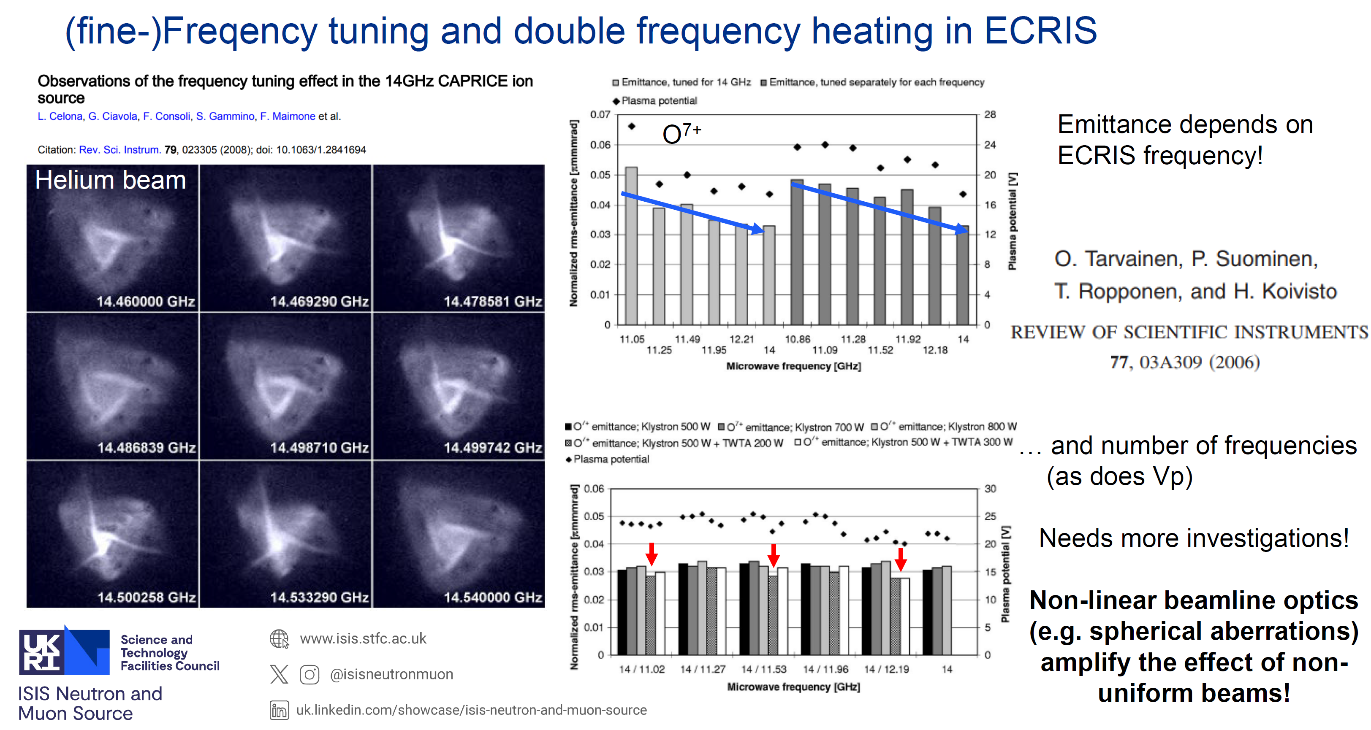
Frequency dependence
Courtesy of O. Tarvainen (STFC-UKRI)
L. Celona et al. International Conference on Ion Sources, St. Catherine’s College, Oxford, 11th September 2025

Slide 22
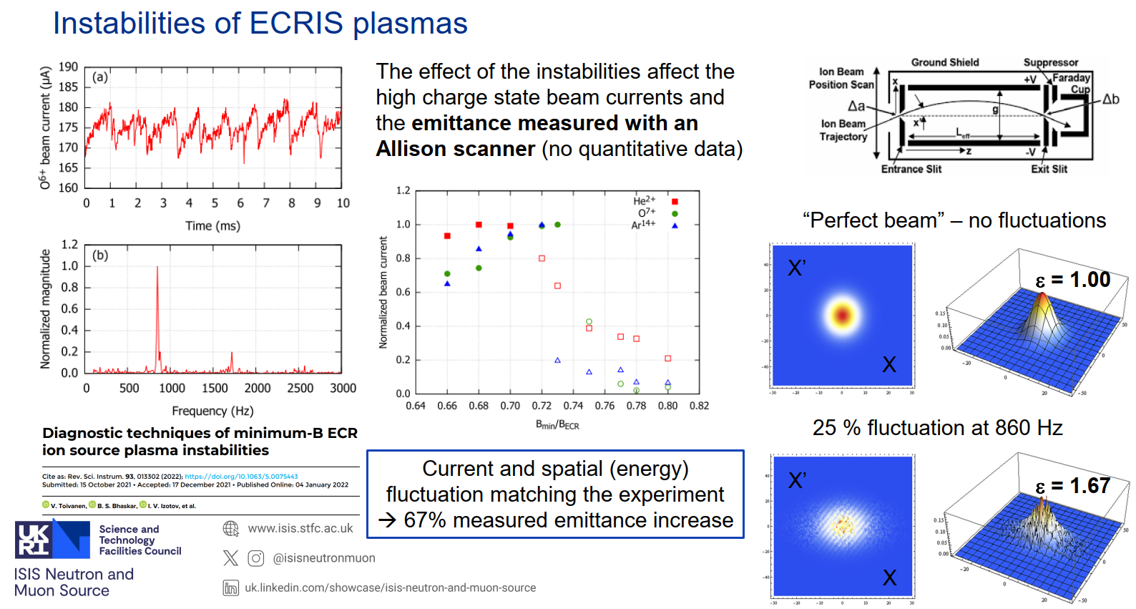
ECRIS plasma instabilities
Courtesy of O. Tarvainen (STFC-UKRI)
L. Celona et al. International Conference on Ion Sources, St. Catherine’s College, Oxford, 11th September 2025

Slide 23
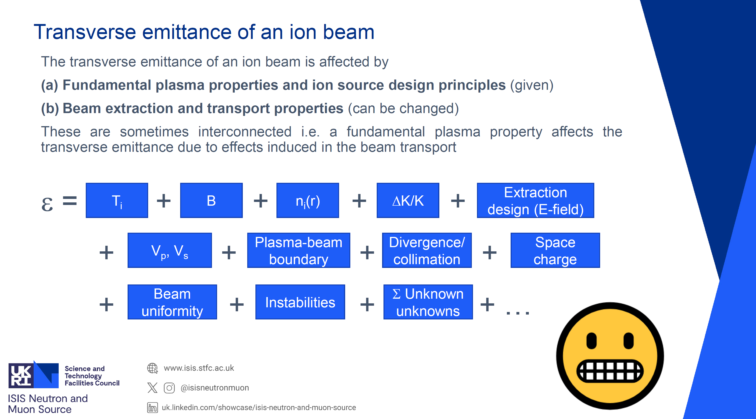
Final scenario
Beam extraction effects contribute significantly.
How to make sure a factors affecting the transverse (normalised) emittance are not masked by divergence-limited extraction and collimation further down the beamline?
Does the measurement technique affect the transverse emittance values?
Is there a preferred technique?
Courtesy of O. Tarvainen (STFC-UKRI)
L. Celona et al. International Conference on Ion Sources, St. Catherine’s College, Oxford, 11th September 2025

Slide 24
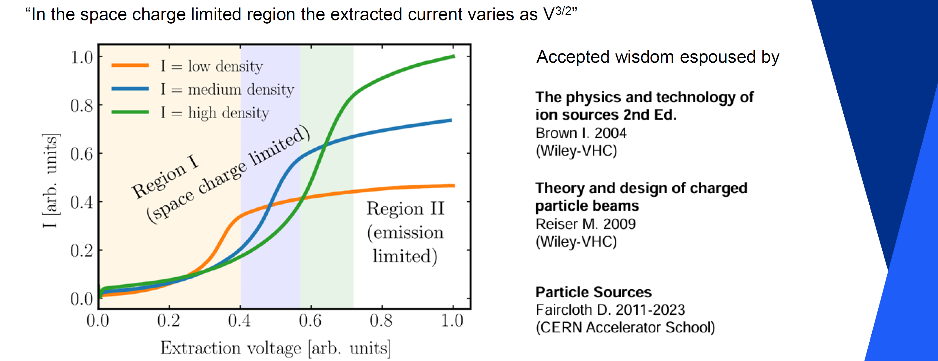
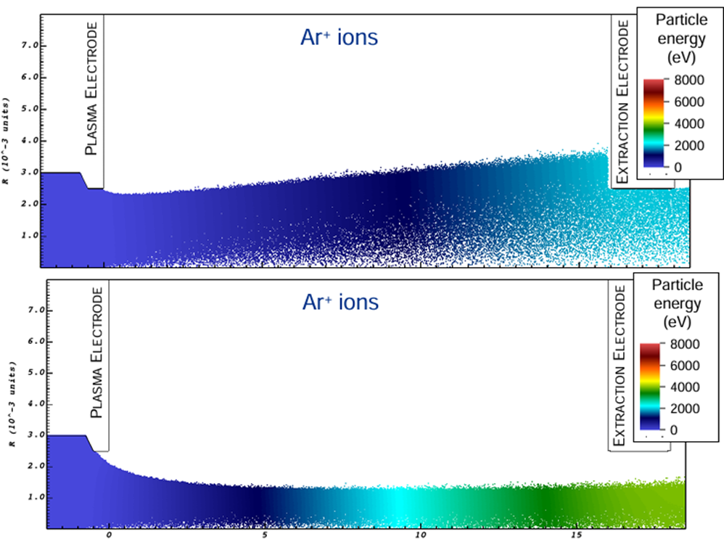
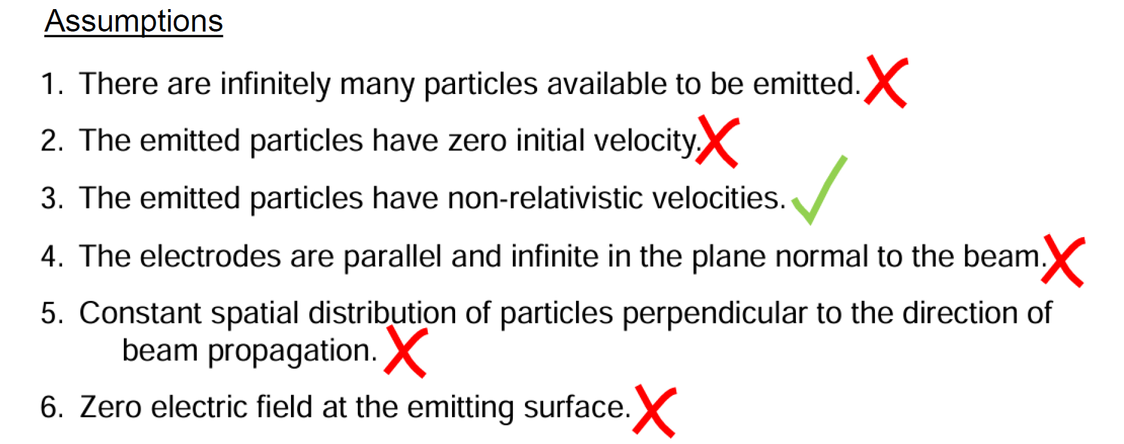
Space Charge- Child Langmuir law
Too low focusing
Overfocusing
Matched case always sought in simulations
Second illusion?
The true cause for the observed power law is “meniscus focusing” and collimation on the extraction electrode
Courtesy of O. Tarvainen (STFC-UKRI)
L. Celona et al. International Conference on Ion Sources, St. Catherine’s College, Oxford, 11th September 2025

Slide 25
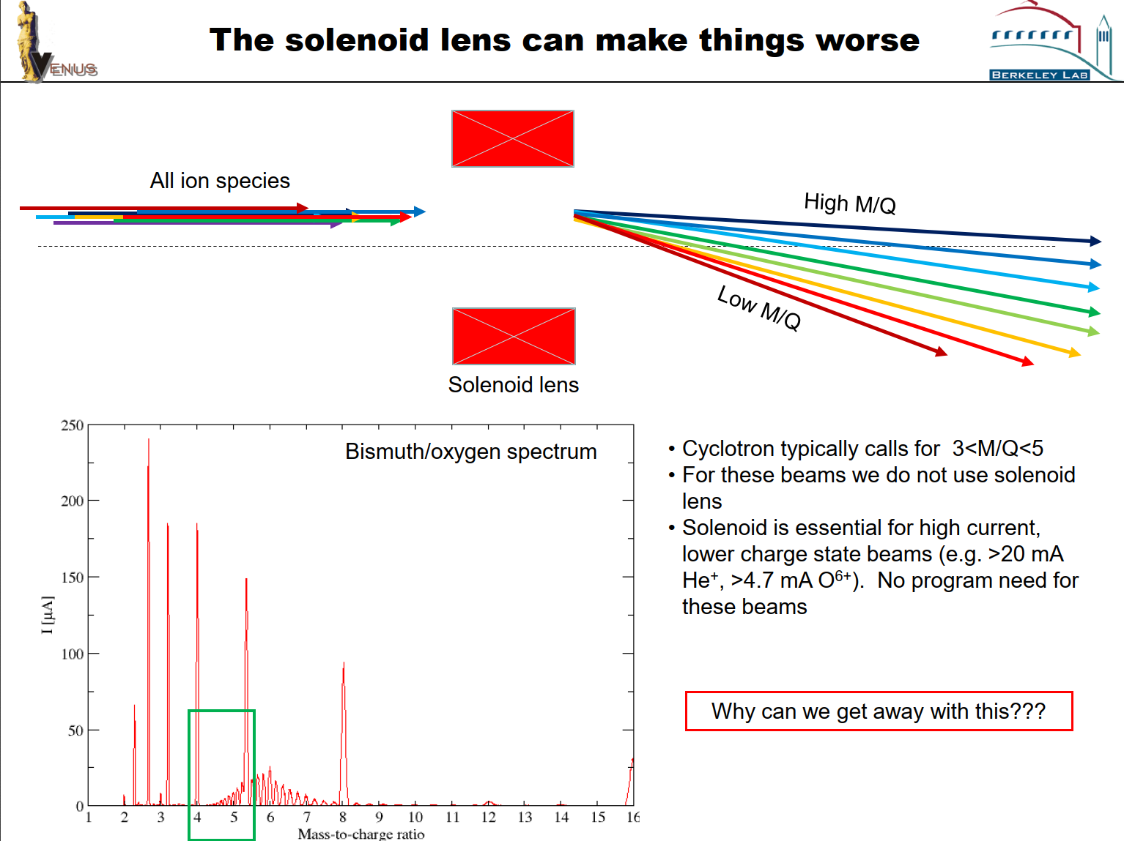
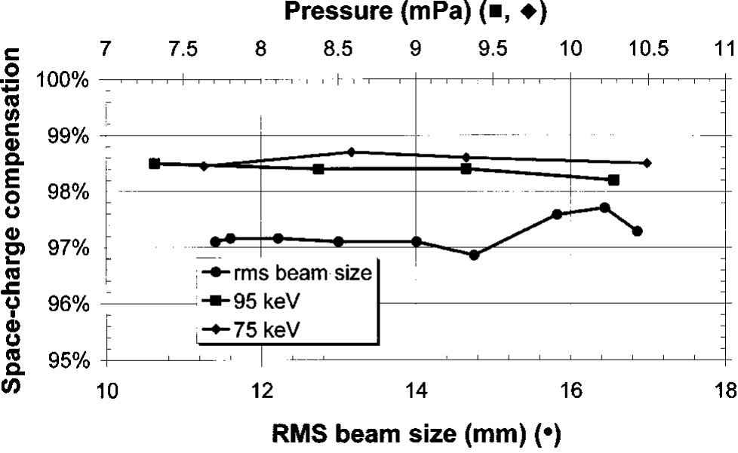
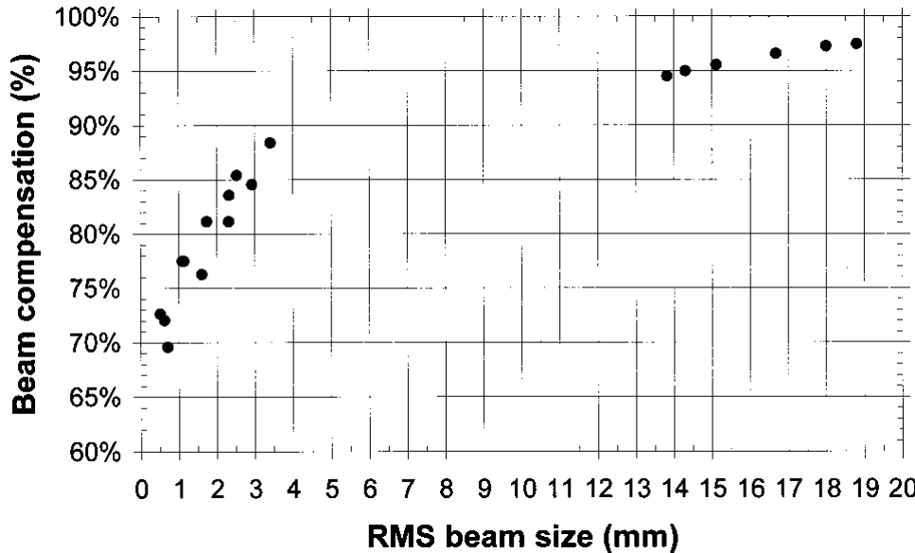


Multi M/Q extraction
Courtesy of D. Todd (LBNL)
L. Celona et al. International Conference on Ion Sources, St. Catherine’s College, Oxford, 11th September 2025

Slide 26



VENUS beamline simulation
Simulation of extraction section:
IGUN-like particle-in-cell simulation:
Ion macroparticles are tracked, depositing charge density on a 2D or 3D mesh
Solve Laplace on mesh
Apply Boltzmann-distributed electrons using potential from step 2
Repeat until relaxed
Simulation of transport section
2D slice mode (x,y) simulation:
Read particle distribution from extraction simulation
Solve Laplace for x-y potential
Move particles using solved field and any applied fields
Repeat from 2 to end of beam line
“Cheat”
Simulate extraction using 2D (3D expensive)
Track triangular initial distribution through relaxed extraction solution
Complete transport section
Courtesy of D. Todd (LBNL)
L. Celona et al. International Conference on Ion Sources, St. Catherine’s College, Oxford, 11th September 2025

Slide 27













































VENUS simulation of O beam extraction and transport
Experiment
Experimentally Measured Spectrum
Simulation
Experiment
Simulation
8 cm
Courtesy of D. Todd and J. Benitez (LBNL)
L. Celona et al. International Conference on Ion Sources, St. Catherine’s College, Oxford, 11th September 2025

Slide 28


C⁴⁺ Hollow beams
«Error» is generated inside the source as previously seen in other measurement with 2nd gen. ECRIS
Space charge effects
Courtesy of D. Todd (LBNL)
L. Celona et al. International Conference on Ion Sources, St. Catherine’s College, Oxford, 11th September 2025

Slide 29

Kobra 3D simulation of beam extraction and transport
Courtesy of R. Hollinger (GSI)
L. Celona et al. International Conference on Ion Sources, St. Catherine’s College, Oxford, 11th September 2025

Slide 30




Impact on HCI acceleration
Courtesy of L. Sun (IMP-CAS)
L. Celona et al. International Conference on Ion Sources, St. Catherine’s College, Oxford, 11th September 2025
Notes:
Long term high current HCI acceleration is challenging!

Slide 31


Long term stability operation
Courtesy of H. Zhao (IMP-CAS)
L. Celona et al. International Conference on Ion Sources, St. Catherine’s College, Oxford, 11th September 2025

Slide 32



Long term stability operation
Courtesy of L. Sun (IMP-CAS)
L. Celona et al. International Conference on Ion Sources, St. Catherine’s College, Oxford, 11th September 2025

Slide 33






U performances@RIKEN
3 kW
3 kW
3 kW
U35+ consumption @110μA →2.4mg/h
U35+ consumption @ 250μA →10.5 mg/h
High consumption causes unstable beam intensity
Anti-deposition shield
Emittance growth expected due to the higher drain currents
Courtesy of T. Nagatomo (RIKEN)
L. Celona et al. International Conference on Ion Sources, St. Catherine’s College, Oxford, 11th September 2025

Slide 34







V¹³⁺ performances@RIKEN
Emittance Growth as a function of drain current
RF=1.25 kW, 9x10⁻⁵ Pa
RF power =3.5 kW, 15x10⁻⁵ Pa
consumption rate 26 mg/h
3.6 mg/h
Courtesy of T. Nagatomo (RIKEN)
L. Celona et al. International Conference on Ion Sources, St. Catherine’s College, Oxford, 11th September 2025

Slide 35


Beam stability issues
・Beam reduction was caused by sudden evaporation of flake-shaped metal deposits inside the chamber wall when the plasma touch them.
・AD shield has the potential to suppress such changes avoiding deposition
High-power GMJT (RJT-100) was developed by SHI Cryo. Group and installed in RG28-S with cooling power of > 8 W @ 4 K
Courtesy of T. Nagatomo (RIKEN)
L. Celona et al. International Conference on Ion Sources, St. Catherine’s College, Oxford, 11th September 2025

Slide 36





Metallic ion beam production
Courtesy of R. Vondrasek (ANL)
L. Celona et al. International Conference on Ion Sources, St. Catherine’s College, Oxford, 11th September 2025

Slide 37



Metal ion beams
28 GHz ECRIS may have not yet reached its peak performance?
What new ideas and technologies may further enhance performance of 28 GHz ECRIS?
Courtesy of L. Sun and H. Zhao (IMP-CAS)
L. Celona et al. International Conference on Ion Sources, St. Catherine’s College, Oxford, 11th September 2025

Slide 38



SHE synthesis
L. Celona et al. International Conference on Ion Sources, St. Catherine’s College, Oxford, 11th September 2025

Slide 39



OES for metal ion beams
Courtesy of A. Andreev (GSI)
L. Celona et al. International Conference on Ion Sources, St. Catherine’s College, Oxford, 11th September 2025

Slide 40



Machine Learning
Courtesy of J. Benitez and D. Todd (LBNL)
L. Celona et al. International Conference on Ion Sources, St. Catherine’s College, Oxford, 11th September 2025

Slide 41

AI for ECRIS?
Courtesy of L. Sun (IMP-CAS)
L. Celona et al. International Conference on Ion Sources, St. Catherine’s College, Oxford, 11th September 2025
Notes:
Personally, I feel much better with human deficience. This would be the dead of human creativity. High efficiency kills creativity because creativity requires space for exploration, ambiguity, and even failure. ECR story began with a beautiful failure and our success is still based on a lot of beatiful failures!

Slide 42


Thanks for your attention!!!

Slide 43

SPARE SLIDES
L. Celona et al. International Conference on Ion Sources, St. Catherine’s College, Oxford, 11th September 2025
43

Slide 44


VENUS attempt: static launcher
L. Celona et al. International Conference on Ion Sources, St. Catherine’s College, Oxford, 11th September 2025
Notes:
Free plasma electrons are the real target. «it is not just as cooking a hot dog» (C. Lyneis cit.)

Slide 45



FTE - Hollow beams
f=14.5GHz±40 MHz
Viewer in BaF located 20 cm far from extraction electrode without any optical element in between.
Acquistion time=250 sec
Video 15x
INTERPLAY between plasma structure and beam parameters (current, shape, brightness, emittance)
[L. Celona, G. Ciavola, S. Gammino, F. Maimone, et al., Review of Scientific Instrument 79, 023305 (2008)]
L. Celona et al. International Conference on Ion Sources, St. Catherine’s College, Oxford, 11th September 2025

Slide 46





Ion confinement
Only a small fraction of the ions can escape
The charge state distribution of the
extracted beam is different from that of the
core plasma
Courtesy of O. Tarvainen (STFC-UKRI)
L. Celona et al. International Conference on Ion Sources, St. Catherine’s College, Oxford, 11th September 2025

Slide 47




Plasma studies: instabilities
Courtesy of V. Skalyga (IAP-RAS)
L. Celona et al. International Conference on Ion Sources, St. Catherine’s College, Oxford, 11th September 2025

Slide 48





SCC Diagnostics
Courtesy of E. Flannigan (STFC-UKRI)
L. Celona et al. International Conference on Ion Sources, St. Catherine’s College, Oxford, 11th September 2025

