Slide 2
01
Introduction
02
Design
03
Experiment
04
Conclusion

Slide 3
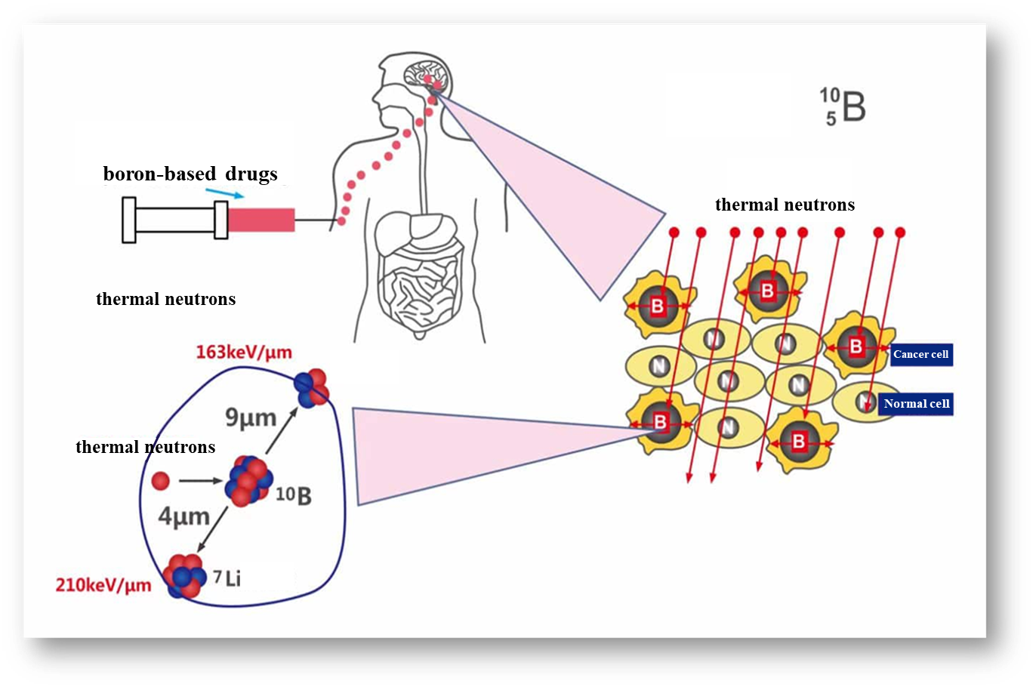
The Principle of BNCT
The basic principle of BNCT is to utilize the capture reaction of boron-10 isotopes under neutron irradiation, selectively killing tumor cells by producing high-energy secondary particles of lithium and helium with high linear energy transfer (LET).
BNCT Process
Boron Injection: ¹⁰B drug selectively accumulates in tumor cells.
Neutron Beam: The tumor site is irradiated with a beam of epithermal neutrons generated by a neutron source.
Nuclear Reaction: ¹⁰B captures neutrons, causing ¹⁰B(n,α)⁷Li reaction.
Boron Neutron Capture Therapy(BNCT)
¹⁰B+n➡⁷Li+⁴He

Slide 4
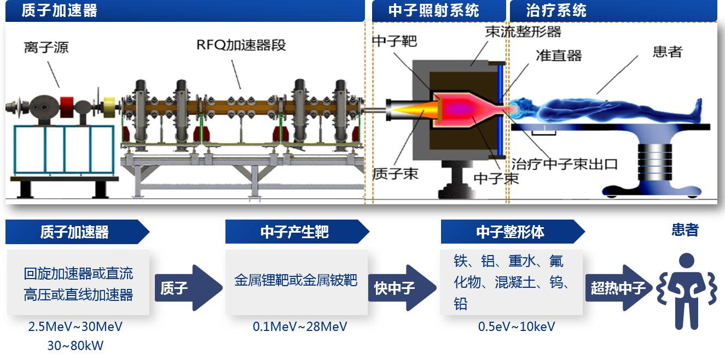
Accelerator-based BNCT
with the advancements in accelerator technology over the past decade, BNCT now increasingly relies on accelerators to generate neutrons, which are more cost-effective, safer, and easier to operate, install, and maintain.
Accelerator
Neutron Irradiation System
Therapeutic System
BSA
Ions Source
RFQ
Target
Patient
Collimator
Proton Beam
Neutron Beam
Thermal Neutron
Accelerator
Target
BSA
Patient
Cyclotron/DC High-Voltage/Linac Accelerator
Li/Be Target
Iron、Aluminum、Heavy Water、Fluoride、Cement、W、Pd
proton
Fast Neutron
Thermal Neutron

Slide 5
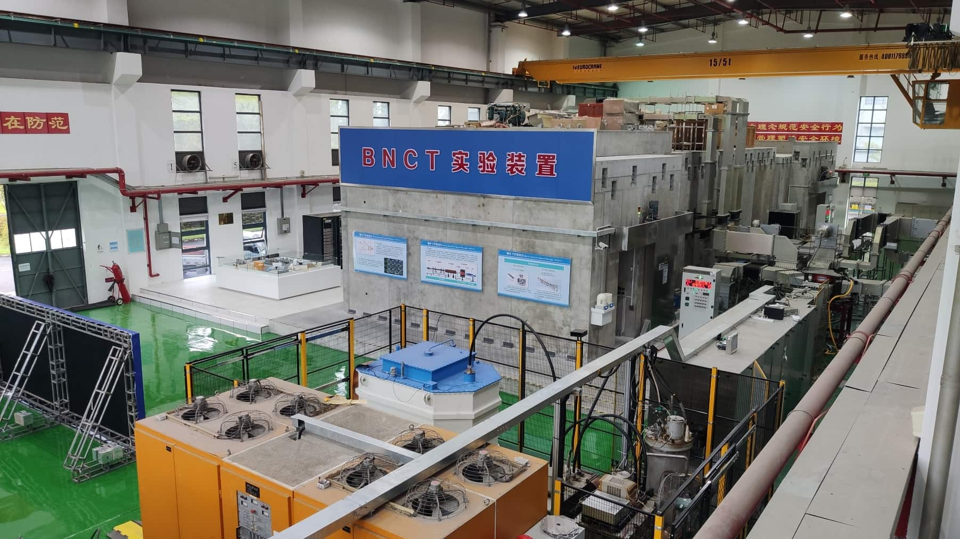
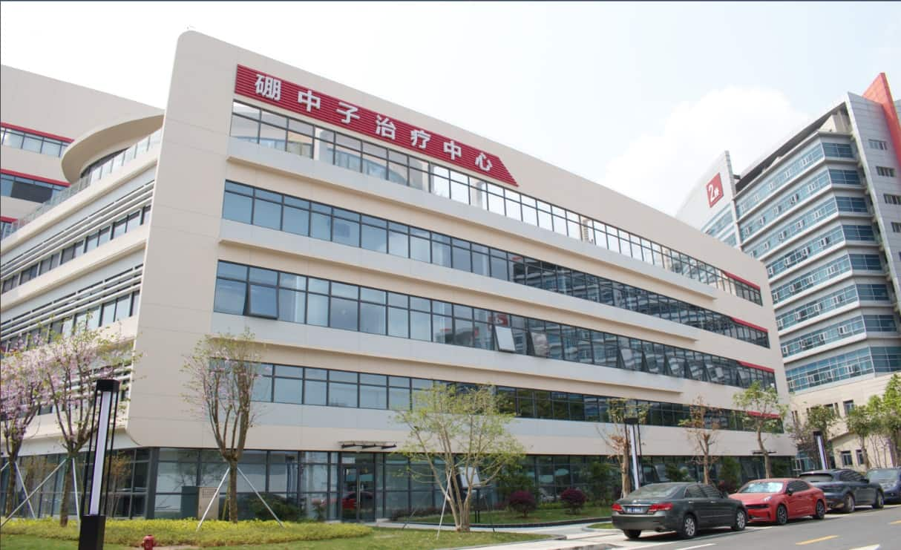
BNCT Experimental Facility
Located in China Spallation Neutron Source (CSNS). It is the first accelerator-based BNCT experimental facility in China. Cover an area of 1,000 square meters.
BNCT Center
The BNCT Center building, with a total floor area of 18,421.61 square meters, is constructed at Dongguan People's Hospital.

Slide 6
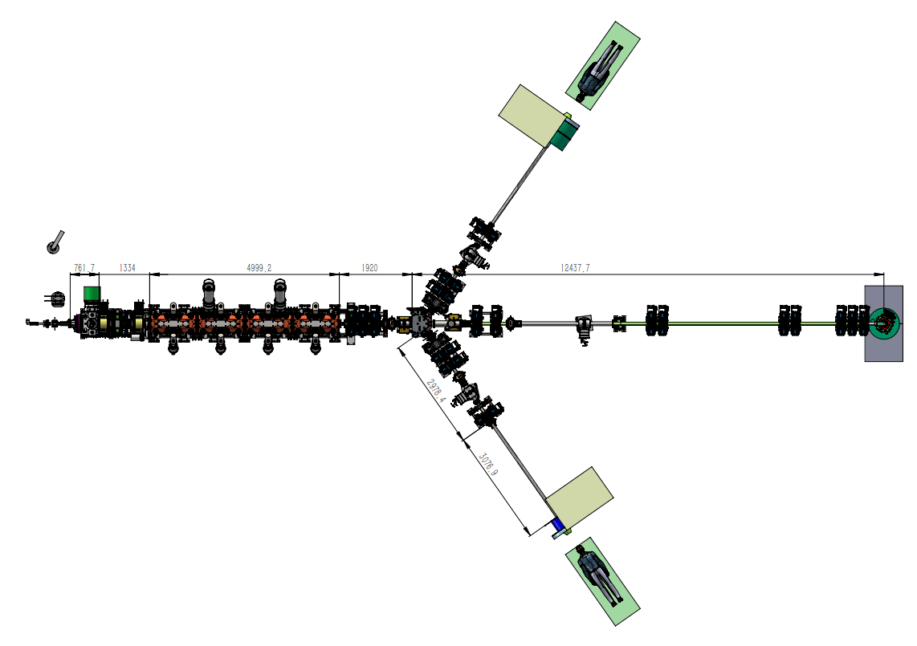
BNCT Accelerator
ECR (Ion Source) +RFQ (Radio Frequency Quadrupole) + Solid-State Power Supply :
Advantages: Low proton energy, high beam power, excellent stability, and long lifespan, making it particularly suitable for medical applications.
Low Proton Energy: Conducive to radiation protection, neutron moderation, reducing the size of the Beam Shaping Assembly (BSA) and shortens treatment interval time.
High Beam Power: Increases neutron yield, reducing treatment time.
TR1
35 keV IS
LEBT
2.787MeV RFQ
HEBT
TR5
TR2

Slide 7
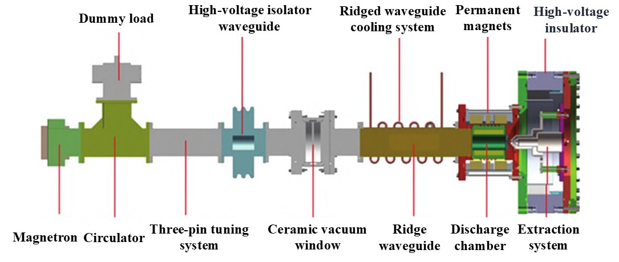
The main design parameters for the ion source
Design parameters | Value
Output energy | 35 keV
Pulse intensity | 25 mA
Average beam current | ＞20 mA
RMS emittance at the exit | ＜0.2 π·mm·mrad
Duty cycle | 80%
Routine Frequency | 200Hz
Why we choose ECR ion source?
High-purity, high-charge-state ion beams. High-purity, high-charge-state ion beams offer significant advantages in generating high-quality neutron beams, reducing interference from impurity ions, ensuring a purer neutron energy spectrum, and improving the precision and therapeutic efficiency of the neutron beam.
Lower energy loss during acceleration and transmission. It is stable and reliable for the neutron source.

Slide 8
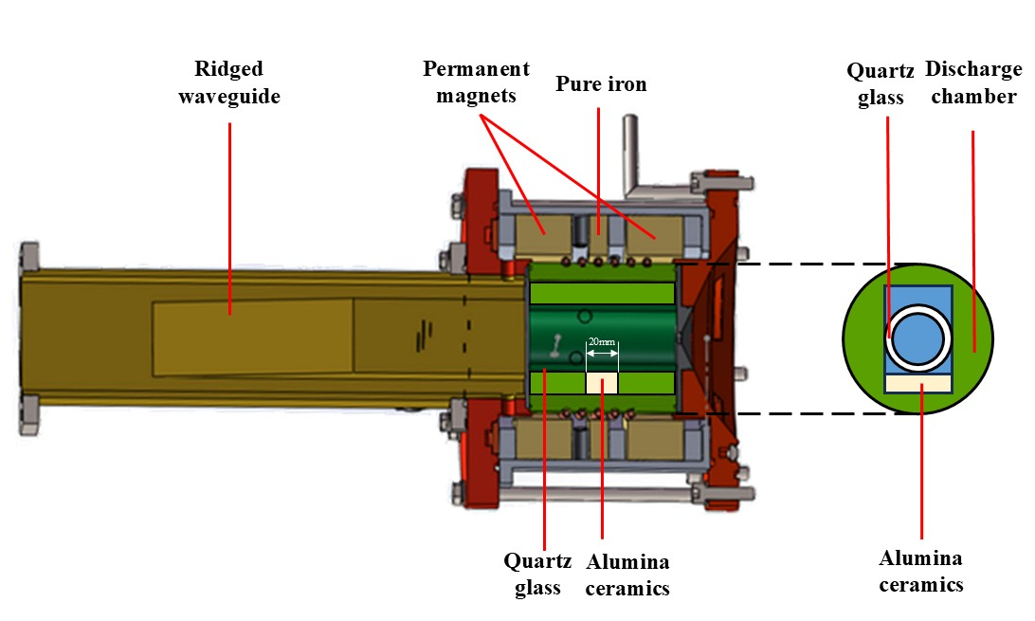
Measured frequency of three 2.45GHz magnetrons
Number of magnetrons | Frequency (GHz)
1# | 2.4711
2# | 2.4743
3# | 2.4758
Challenges Encountered
Discharge: ECR ion source cannot enable 100% reliable discharging.
Bandwidth: the frequency dispersion of commercially available 2.45 GHz magnetrons is relatively large, with a nominal dispersion value of 50 MHz .
Alumina ceramics: the discharge chamber experienced instability due to the influence of the ceramic pieces, significantly affecting the plasma generation within the discharge chamber.

Slide 9
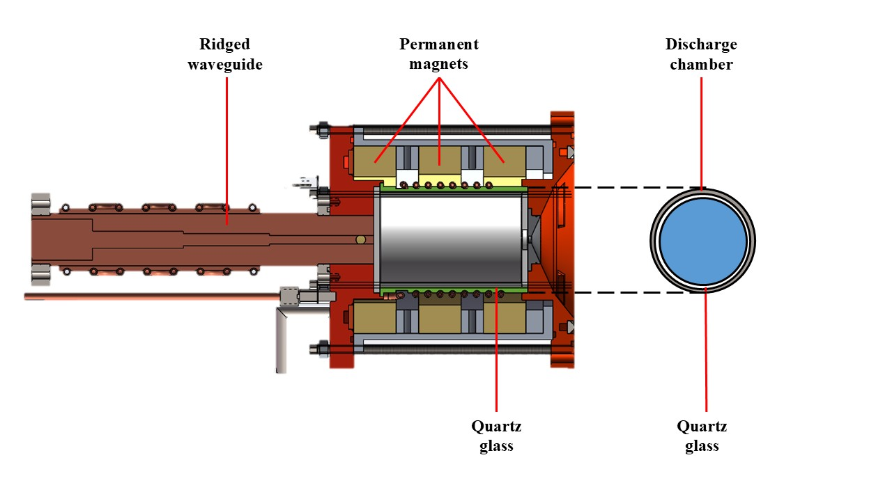
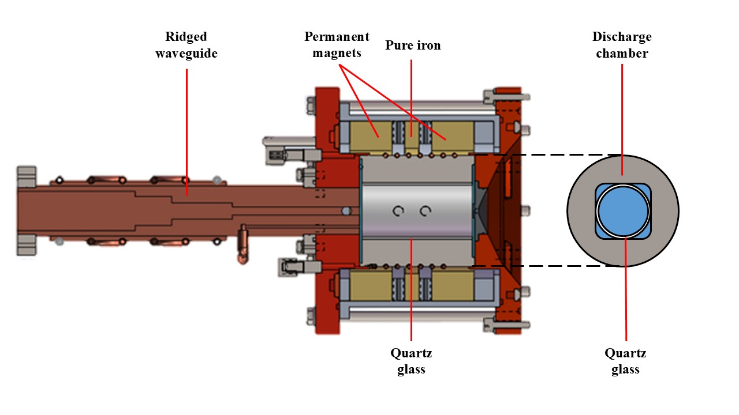
Design Highlights
Low Energy: Reduce the difficulty of high-voltage insulation and enhance the high-voltage stability of the ion source, reducing or avoiding high-voltage discharging of the ion source.
Low SWR: Ensure easier discharging, guaranteeing the availability of the BNCT ECR ion source.
Axial Magnetic Field : Permanent magnets and adjustable pure iron for precision and flexibility.
One-Click Operation Mode: Enable rapid startup of the ECR ion source.

Slide 10
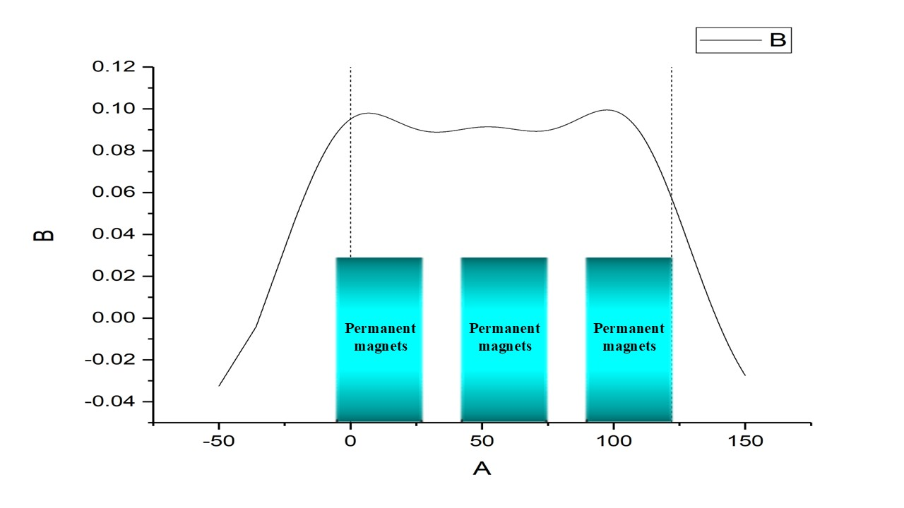
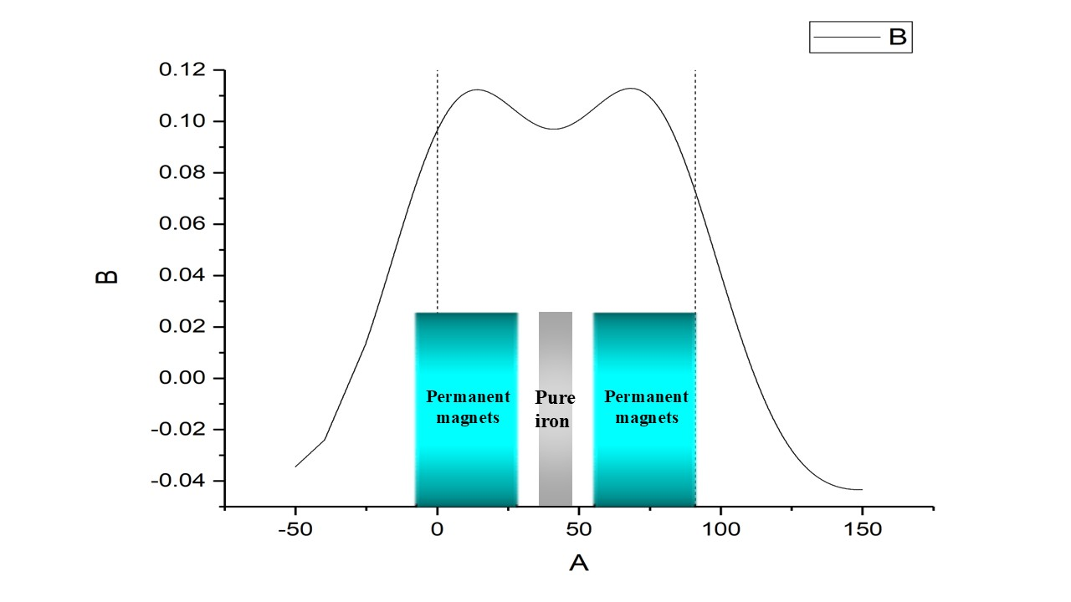
Magnetic field Configuration
The magnetic field configuration provides a stable saddle-shaped magnetic field distribution within the discharge chamber, ensuring smooth and controllable electron motion, and enhancing plasma generation efficiency. The magnetic field is now provided by permanent magnets with a residual magnetization of 1.26 T.
The magnetic field configuration obtained with the three permanent magnets
The magnetic field configuration obtained with the two permanent magnets and a pure iron

Slide 11
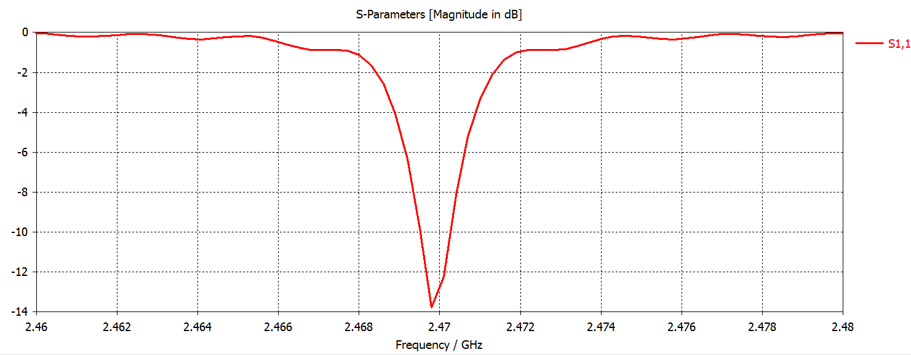
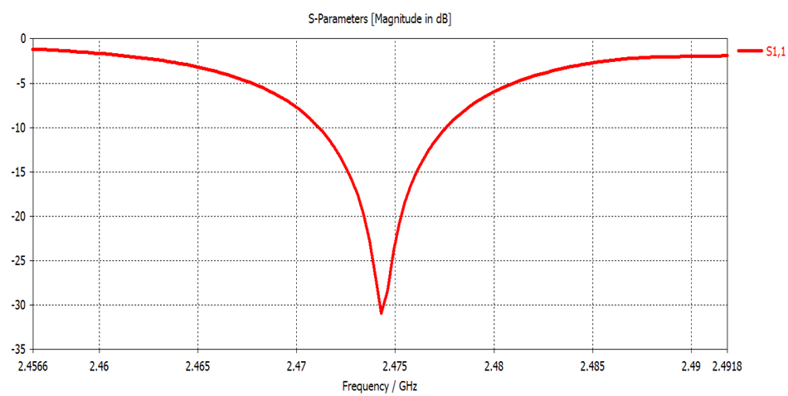
Low SWR Design
the S11 curve with cylindrical discharge chamber at the entrance of the ridged waveguide obtained through CST simulation
the S11 curve with square discharge chamber at the entrance of the ridged waveguide obtained through CST simulation
It is evident that the square discharge chamber exhibits lower reflection compared to the cylindrical discharge chamber, with a SWR of only 1.06. Furthermore, the square discharge chamber has a wider bandwidth. The square discharge chamber's bandwidth measures 19.674 MHz, approximately 8.6 times that of the cylindrical discharge chamber's bandwidth of 2.288 MHz.
 | cylindrical discharge chamber | square discharge chamber
SWR | 1.6 | 1.06
bandwidth(MHz)* | 2.228 | 19.687
*Taking the frequency at which the S11 curve decreases to -3 dB as the start and end points for bandwidth

Slide 12
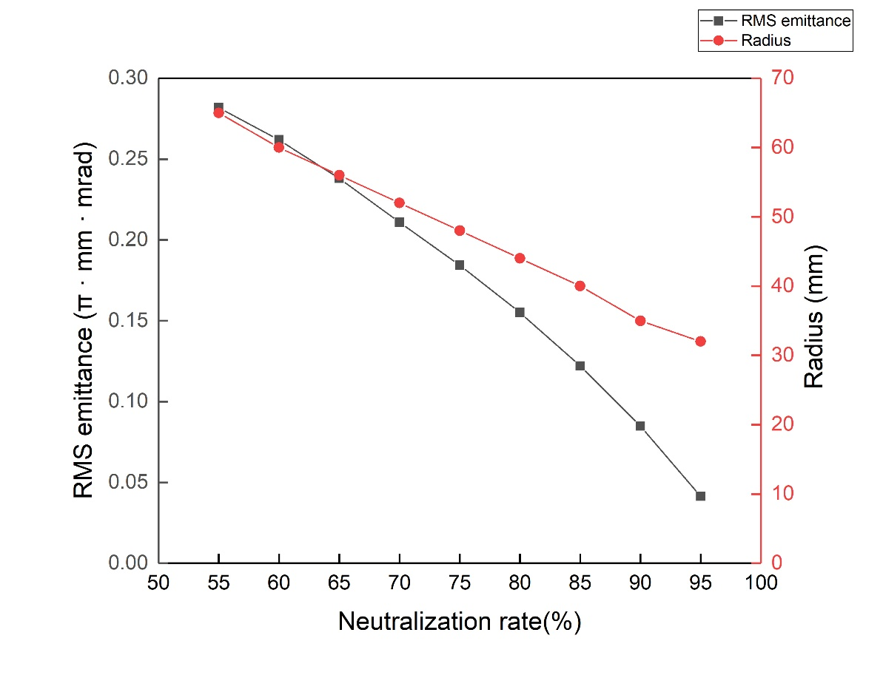
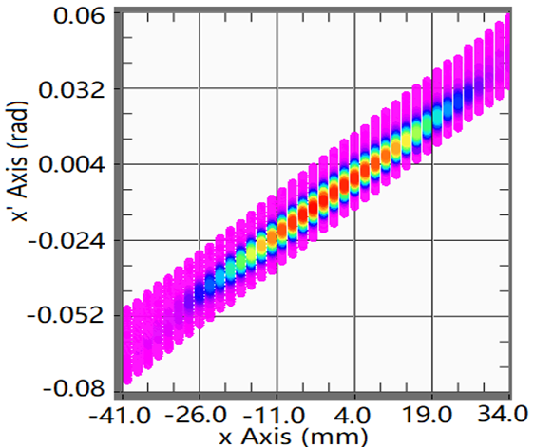
Extraction system
The plasma electrode is set at a potential of 35 kV, the suppressor electrode at -2.2 kV, and the ground electrode at 0 V.
The RMS emittance was measured at a low duty cycle because the double-slit emittance measurement device is an interceptive instrument, where the first slit intercepts nearly the entire beam.
The normalized root-mean-square (RMS) emittance of the beam at the exit of first solenoid was 0.197 π·mm·mrad.
Emittance and envelope at the entrance of first solenoid vs fraction of space–charge neutralization
Emissivity phase diagram at the exit of first solenoid

Slide 13
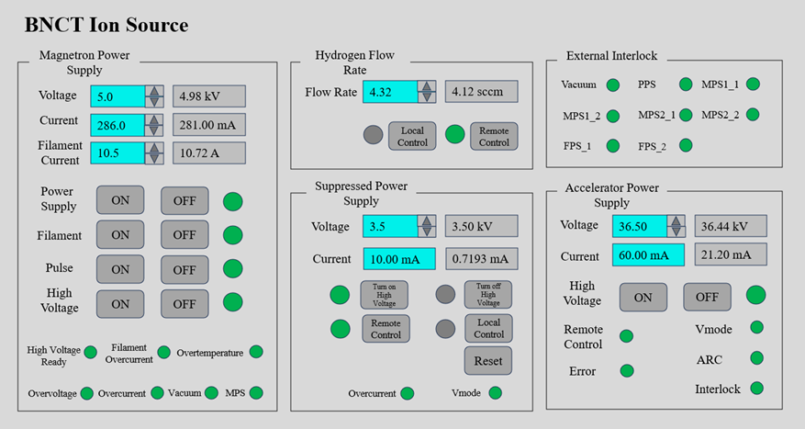
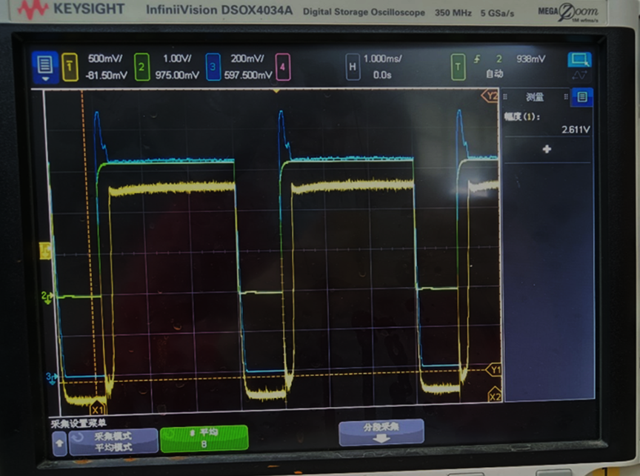
Tuning and conditioning
Operating parameters of the BNCT02 ion source
The maximum pulsed current measured at 26.11 mA with a duty cycle of 75% for cylindrical discharge chamber

Slide 14
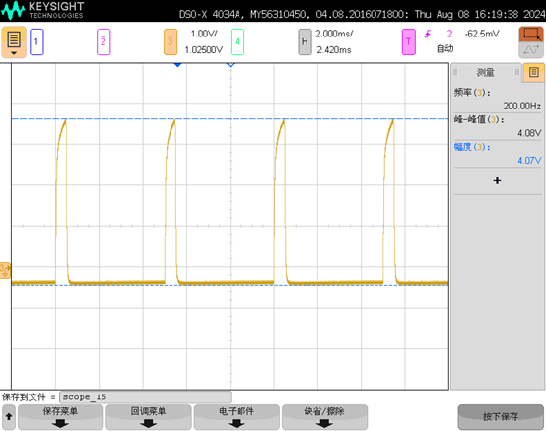
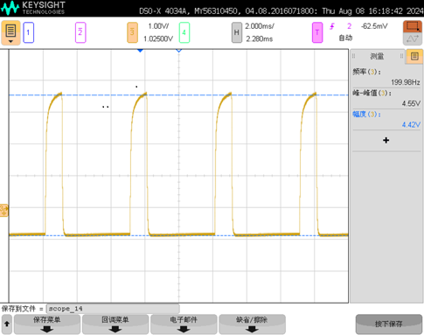
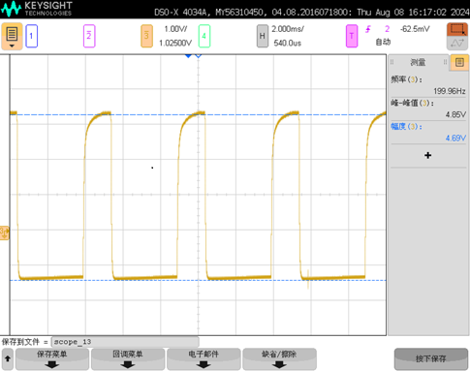
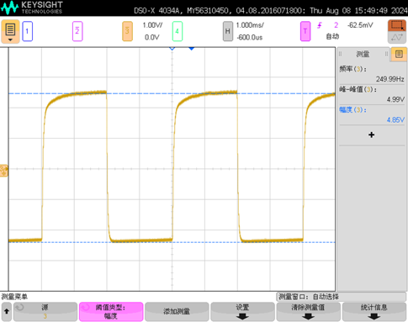
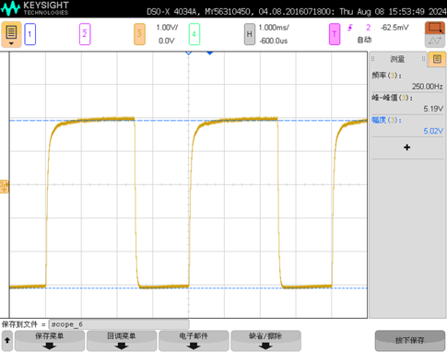
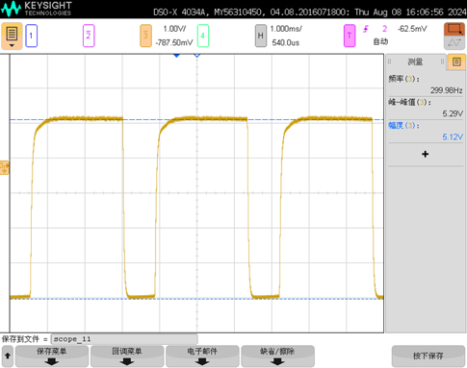
Conditioning with Square Discharge Chamber
Duty Cycle: 10% (32.56mA)
Duty Cycle: 20% (36.4mA)
Duty Cycle: 30% (38.8mA)
Duty Cycle: 50% (39.92mA)
Duty Cycle: 62.5% (41.52mA)
Duty Cycle: 75% (42.32mA)

Slide 15
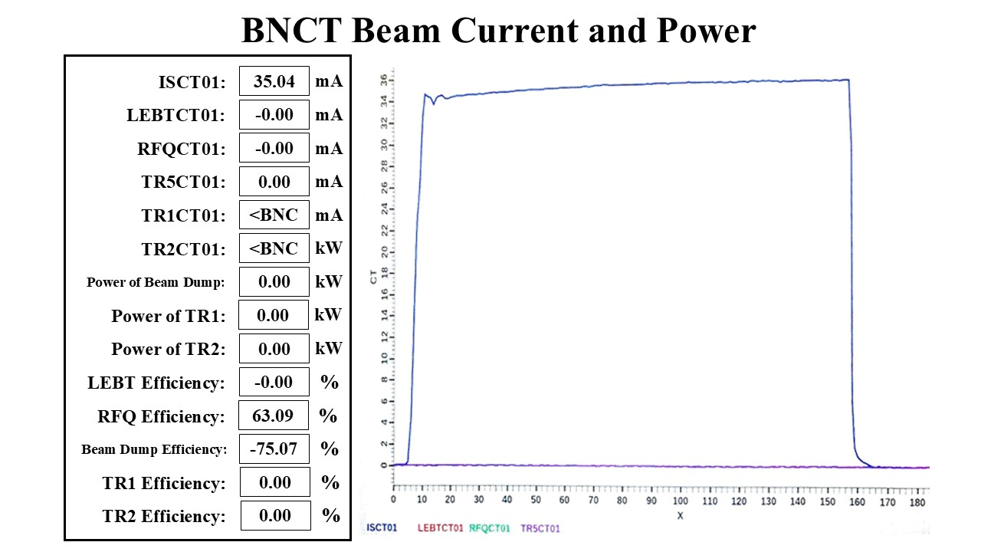
Operation
The cylindrical discharge chamber was installed on the BNCT02 ECR ion source at Dongguan People's Hospital in September 2023.
The BNCT device achieved a pulsed beam current of 35.04 mA with a repetition frequency of 200 Hz, a pulse width of 3 ms, and a duty cycle of 60%.
However, after a breakdown in April 2024, the ion source's output current gradually dropped from 32.2 mA to 18.8 mA due to damaged BN ceramic pieces at the discharge chamber ends, causing debris contamination, a frequency shift from 2.47 GHz to 2.4676 GHz, and an SWR increase from 1.75 to 10.85.
The major drawback of the cylindrical discharge chamber is its narrow bandwidth.
Beam current of the ECR ion source with cylindrical discharge chamber at duty cycle of 60%

Slide 16
Conclusion
Provide two different design of discharge chamber: cylindrical and square
It should be emphasized that the square discharge chamber exhibits higher stability and availability of the ion source for following reasons:
Lower SWR: Low SWR design ensures easier discharging, guaranteeing the availability of the BNCT ECR ion source.
Broader operational bandwidth: Discharge chamber with wider bandwidth can help ion source adapt to frequency fluctuations, which fully improves the stability of the ion source.
In the initial design, an ignition device was installed at the discharge chamber flange. But it has never been used, indicating that the low SWR design of our ECR ion source enables 100% reliable discharging.
Currently, the clinical BNCT equipment installed at Dongguan People's Hospital has maintained stable and efficient operation over the past year, with a targeted beam power of approximately 28 kW and an uptime rate of over 95%.
The neutron flux density of BNCT02 has reached the standards set by the IAEA for clinical BNCT treatments.

