Slide 2
01
Introduction
02
Design
03
Experiment
04
Conclusion

Slide 3
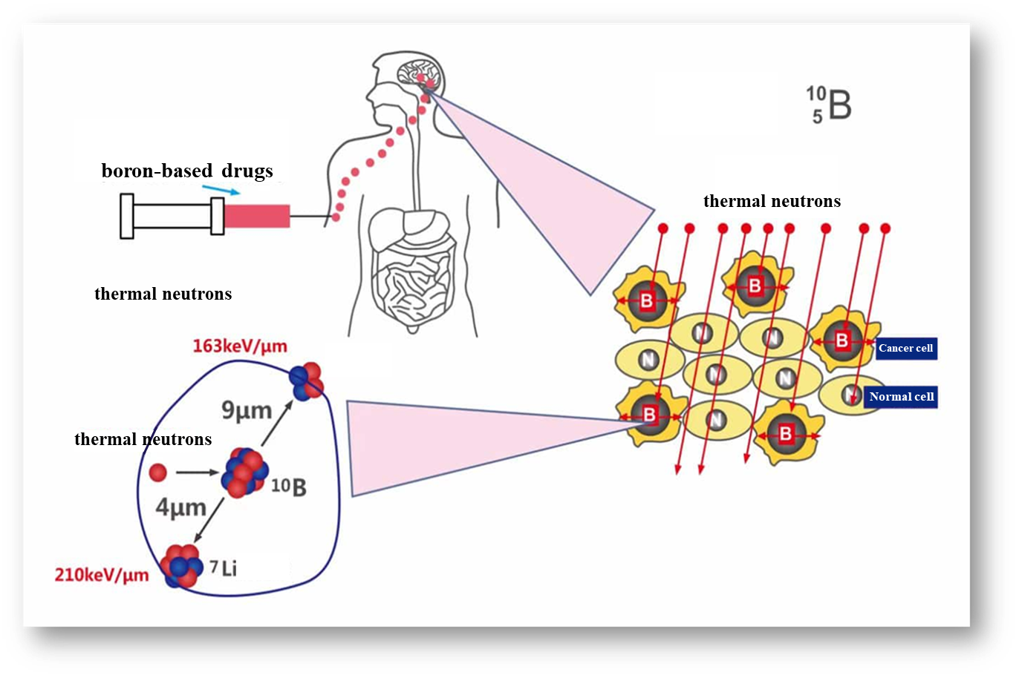
The Principle of BNCT
The basic principle of BNCT is to utilize the capture reaction of boron-10 isotopes under neutron irradiation, selectively killing tumor cells by producing high-energy secondary particles of lithium and helium with high linear energy transfer (LET).
BNCT Process
Boron Injection: ¹⁰B drug selectively accumulates in tumor cells.
Neutron Beam: The tumor site is irradiated with a beam of epithermal neutrons generated by a neutron source..
Nuclear Reaction: ¹⁰B captures neutrons, causing ¹⁰B(n,α)⁷Li reaction.
Boron Neutron Capture Therapy(BNCT)
¹⁰B+n➡⁷Li+⁴He

Slide 4
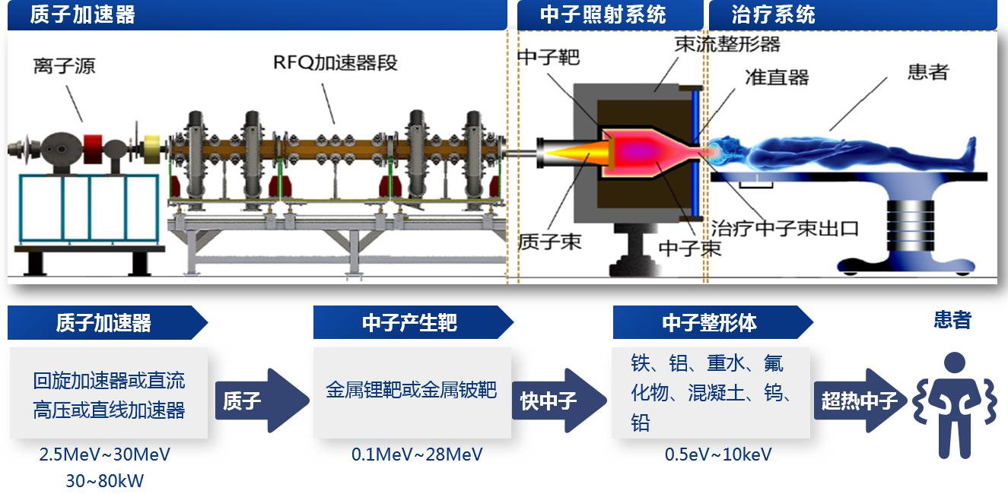
Accelerator-based BNCT
Breakthrough in high-current proton accelerator technology has shifted BNCT focus to accelerator-based systems, enabling medical commercialization.
Accelerator
Neutron Irradiation System
Therapeutic System
BSA
Ions Source
RFQ
Target
Patient
Collimator
Proton Beam
Neutron Beam
Thermal Neutron
Accelerator
Target
BSA
Patient
Cyclotron/DC High-Voltage/Linac Accelerator
Li/Be Target
Iron、Aluminum、Heavy Water、Fluoride、Cement、W、Pd
proton
Fast Neutron
Thermal Neutron

Slide 5
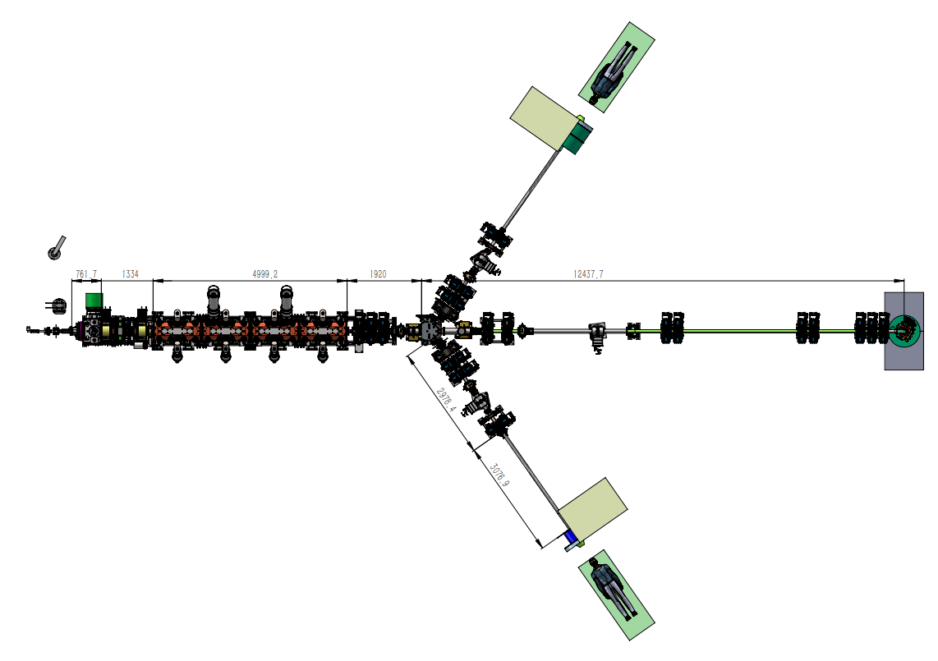
Layout and Structure
ECR (Ion Source + RFQ (Radio Frequency Quadrupole) Accelerating Cavity + Solid-State Power Source:
Advantages: Low proton energy, high beam power, excellent stability, and long lifespan, making it particularly suitable for medical applications.
Low Proton Energy: Facilitates radiation protection, neutron moderation, reduces the size of the Beam Shaping Assembly (BSA), and shortens treatment intervals.
High Beam Power: Increases neutron yield, reducing treatment time.
TR1
The main design parameters for the ion source
Design parameters | Value
Output energy | 35 keV
Pulse intensity | 25 mA
Average beam current | ＞20 mA
RMS emittance at the exit | ＜0.2 π·mm·mrad
Duty cycle | 80%
Routine Frequency | 200Hz
35 keV IS
LEBT
2.787MeV RFQ
HEBT
TR5
TR2

Slide 6
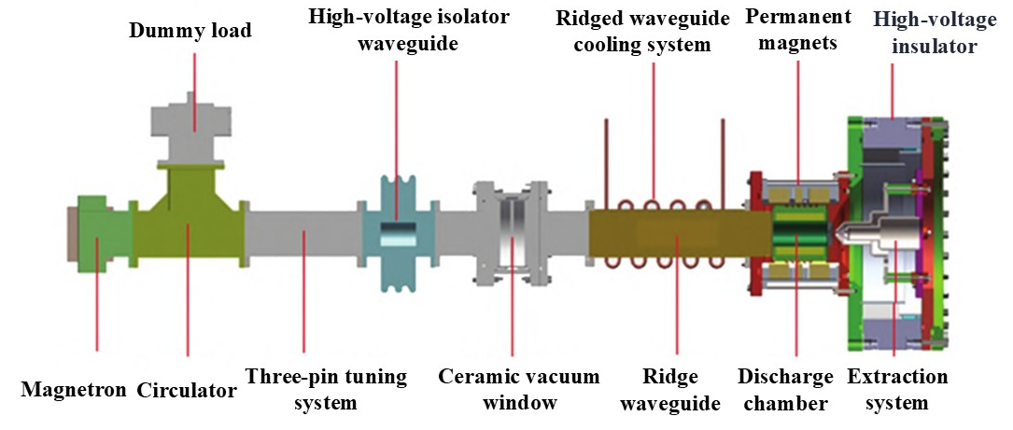
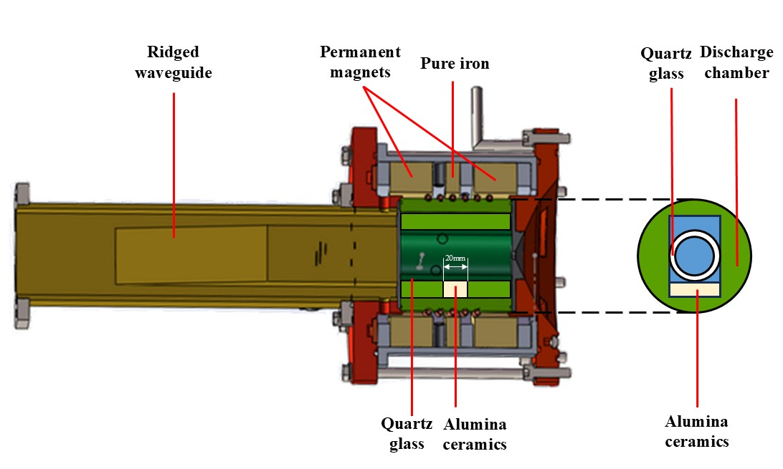
Challenges Encountered
Discharge: ECR ion source cannot enable 100% reliable discharging.
Alumina ceramics: the discharge chamber experienced instability due to the influence of the ceramic pieces, significantly affecting the plasma generation within the discharge chamber.
Bandwidth: the frequency dispersion of commercially available 2.45 GHz magnetrons is relatively large, with a nominal dispersion value of 50 MHz .

Slide 7
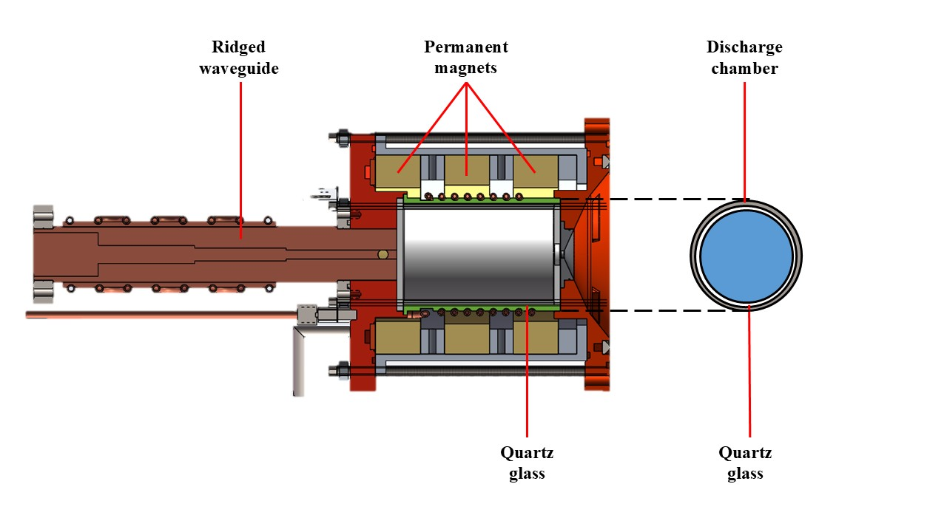
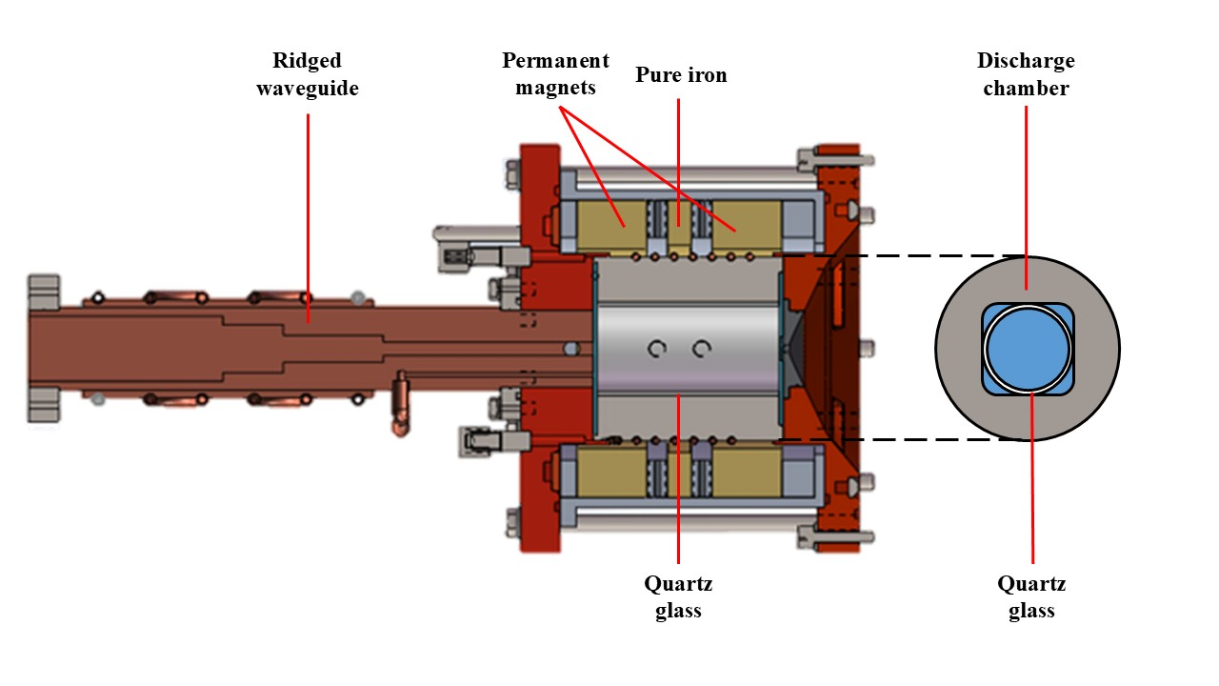
Design Highlights
Low Energy: Reduce the difficulty of high-voltage insulation and enhance the high-voltage stability of the ion source, reducing or avoiding high-voltage discharging of the ion source.
Low SWR: Ensure easier discharging, guaranteeing the availability of the BNCT ECR ion source.
Axial Magnetic Field : Permanent magnets and adjustable pure iron for precision and flexibility.
One-click operation mode: Enable rapid startup of the ECR ion source.

Slide 8
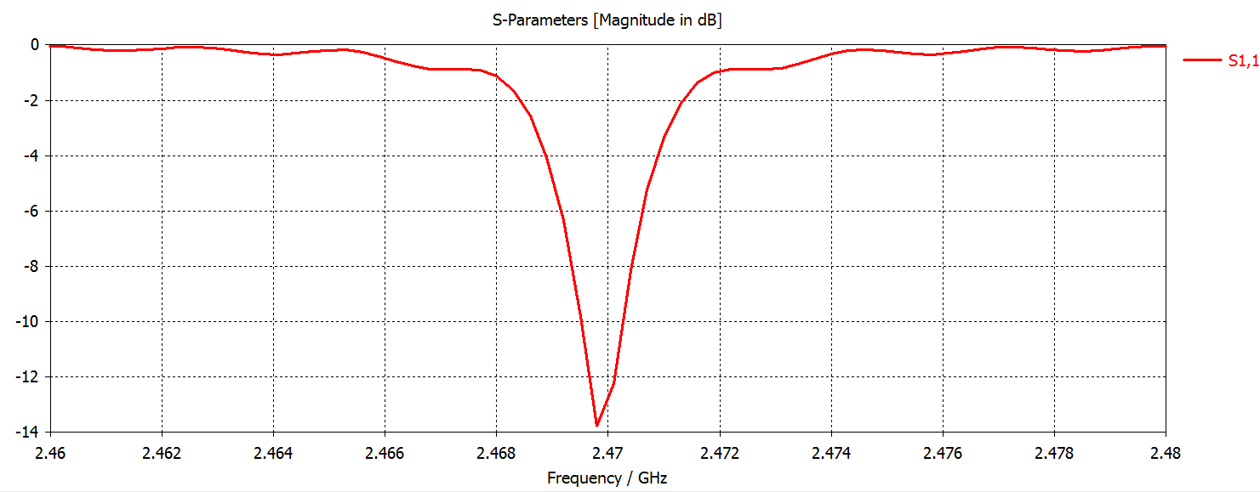
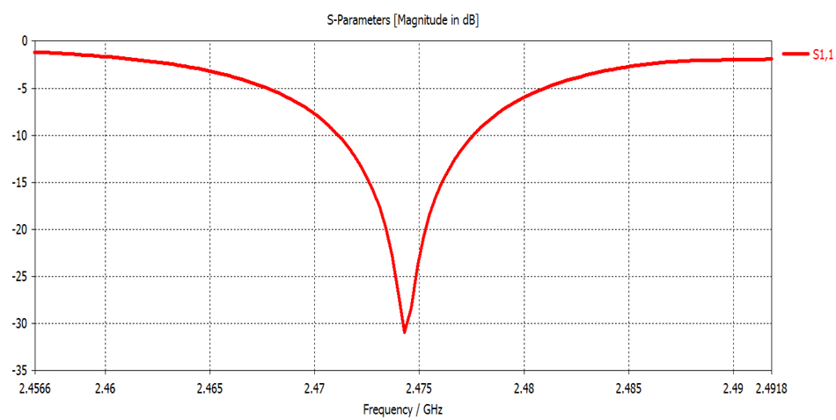
Low SWR Design
the S11 curve with cylindrical discharge chamber at the entrance of the ridged waveguide obtained through CST simulation
the S11 curve with square discharge chamber at the entrance of the ridged waveguide obtained through CST simulation
Advantages of Low SWR
 | cylindrical discharge chamber | square discharge chamber
SWR | 1.6 | 1.06
bandwidth(MHz)* | 2.228 | 19.687
In the initial design, an ignition device was installed at the discharge chamber flange.
But it has never been used, indicating that the low SWR design of our ECR ion source enables 100% reliable discharging.
*Taking the frequency at which the S11 curve decreases to -3 dB as the start and end points for bandwidth

Slide 9
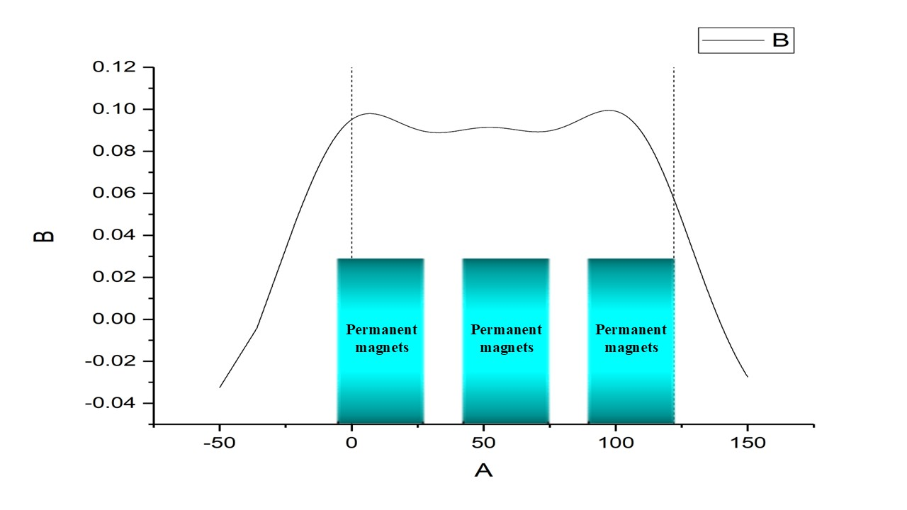
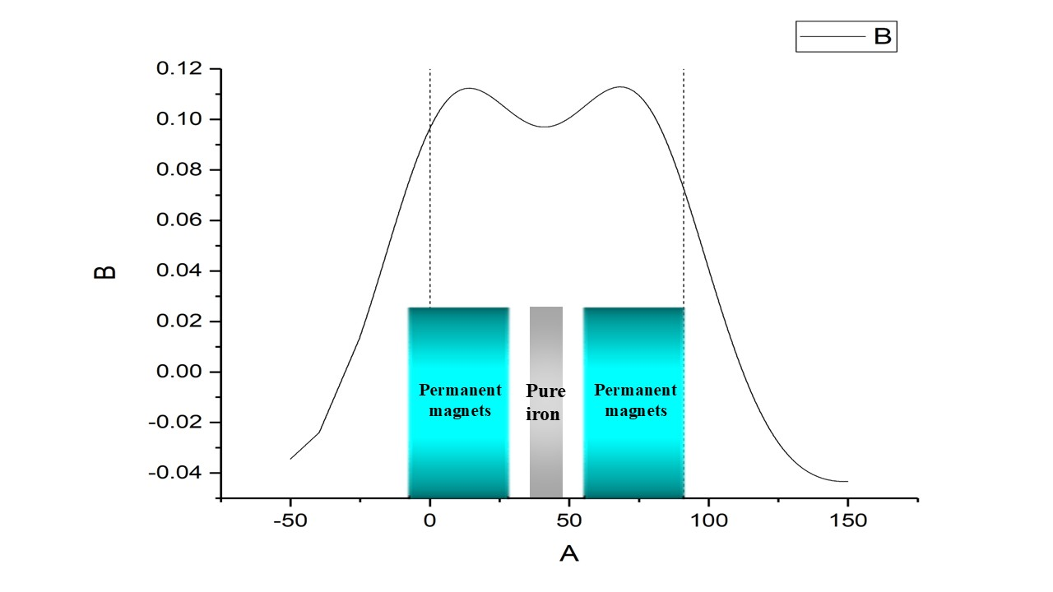
Magnetic field Configuration
The magnetic field configuration provides a stable saddle-shaped magnetic field distribution within the discharge chamber, ensuring smooth and controllable electron motion, and enhancing plasma generation efficiency. The magnetic field is now provided by permanent magnets with a residual magnetization of 1.26 T.
The magnetic field configuration obtained with the three permanent magnets
The magnetic field configuration obtained with the two permanent magnets and a pure iron

Slide 10
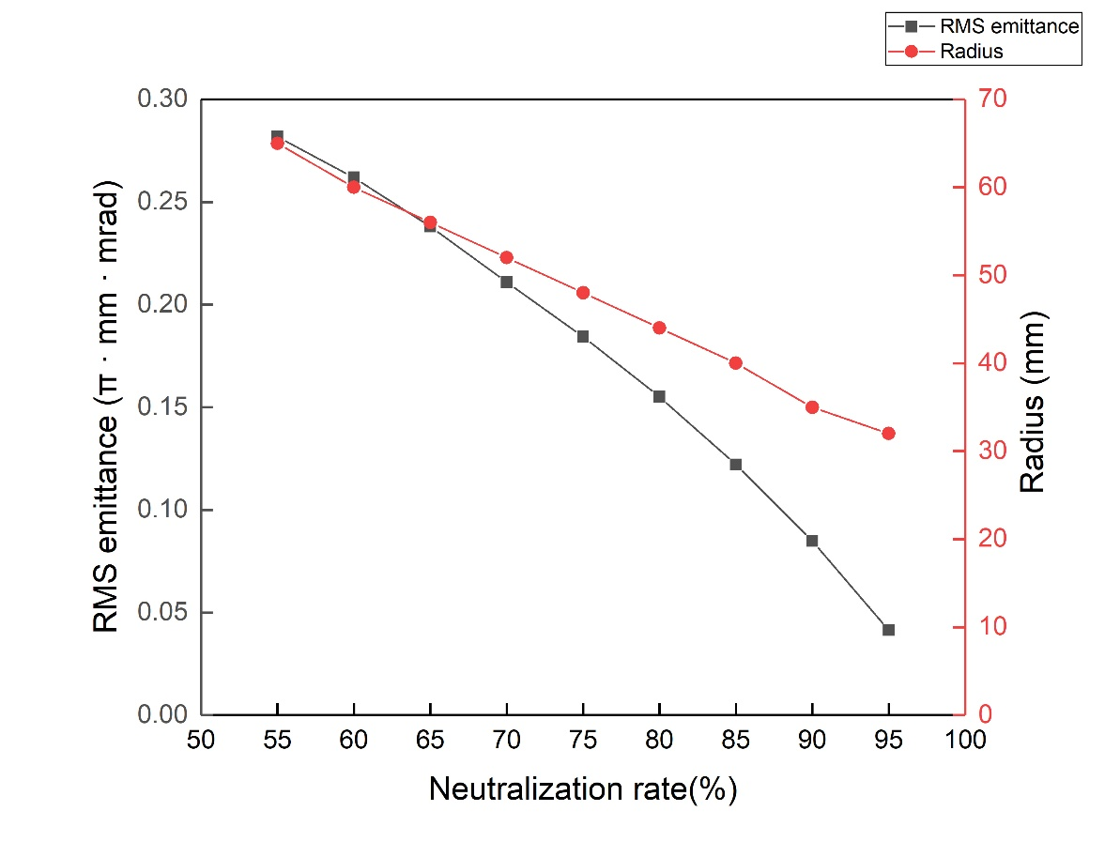
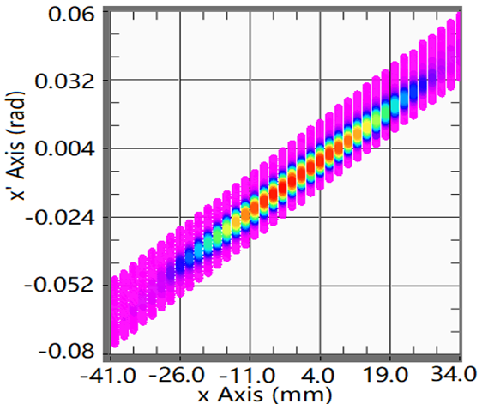
Extraction system
The plasma electrode is set at a potential of 35 kV, the suppressor electrode at -2.2 kV, and the ground electrode at 0 V.
The RMS emittance was measured at a low duty cycle because the double-slit emittance measurement device is an interceptive instrument, where the first slit intercepts nearly the entire beam.
The normalized root-mean-square (RMS) emittance of the beam at the exit of first solenoid was 0.197 π·mm·mrad
Emittance and envelope at the entrance of first solenoid vs fraction of space–charge neutralization
Emissivity phase diagram at the exit of first solenoid

Slide 11
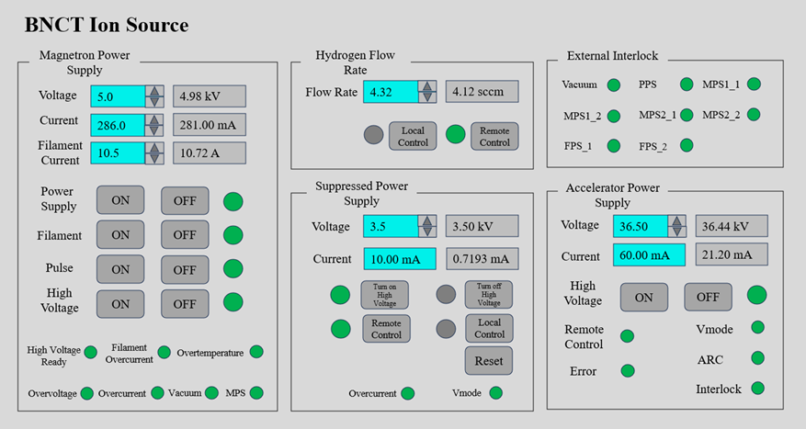
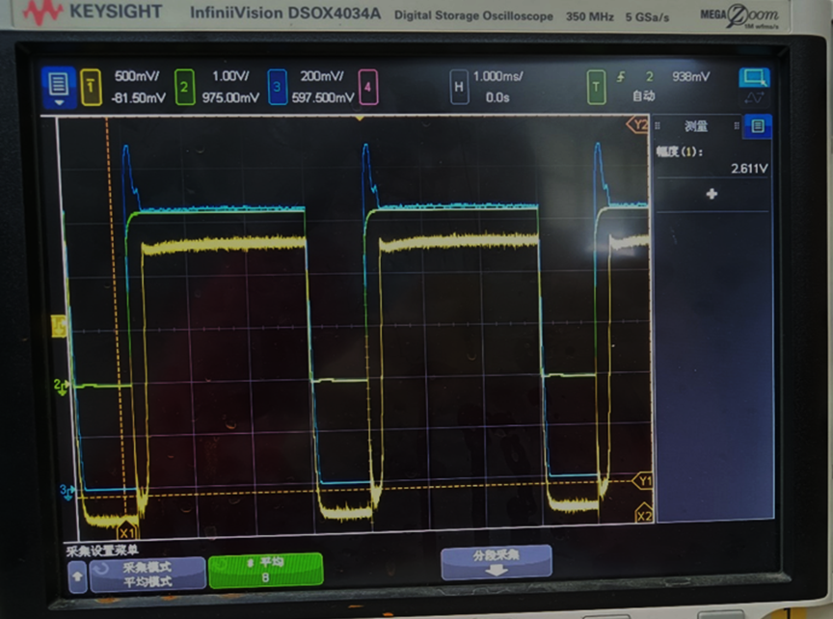
Tuning and conditioning
Operating parameters of the BNCT02 ion source
The maximum pulsed current measured at 26.11 mA with a duty cycle of 75% for cylindrical discharge chamber

Slide 12
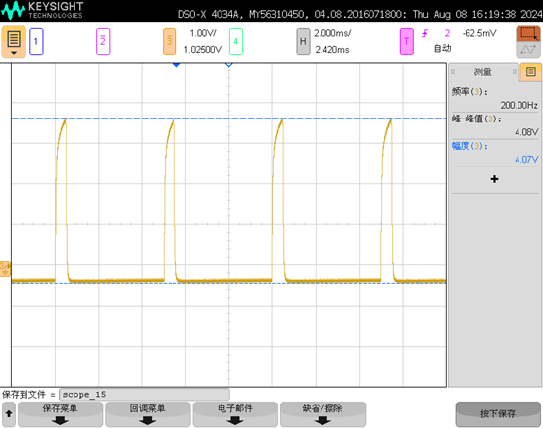
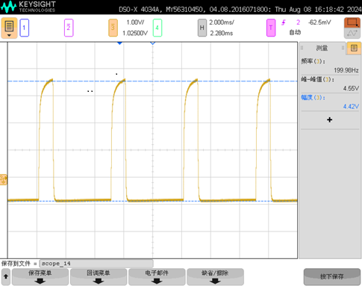
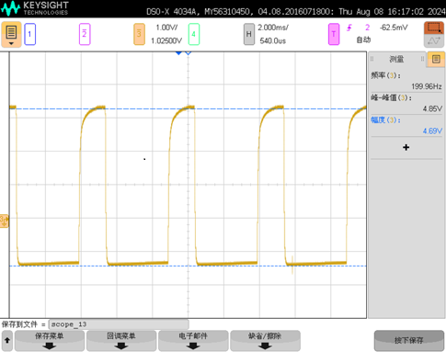
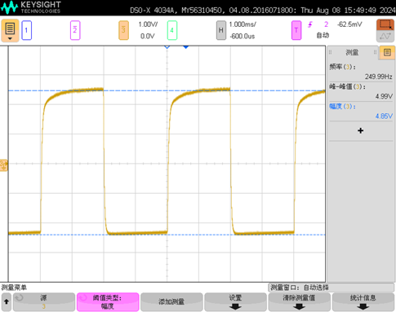
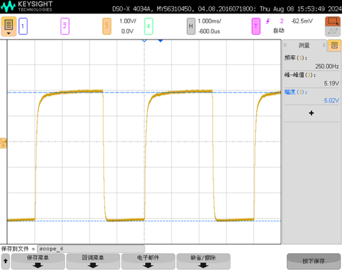
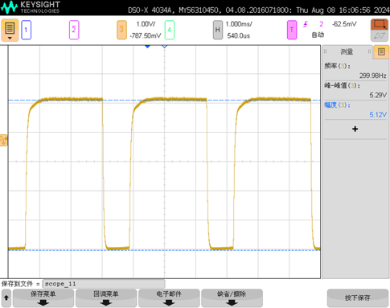
Conditioning with Square Discharge Chamber
Duty Cycle: 10% (32.56mA)
Duty Cycle: 20% (36.4mA)
Duty Cycle: 30% (38.8mA)
Duty Cycle: 50% (39.92mA)
Duty Cycle: 62.5% (41.52mA)
Duty Cycle: 75% (42.32mA)

Slide 13
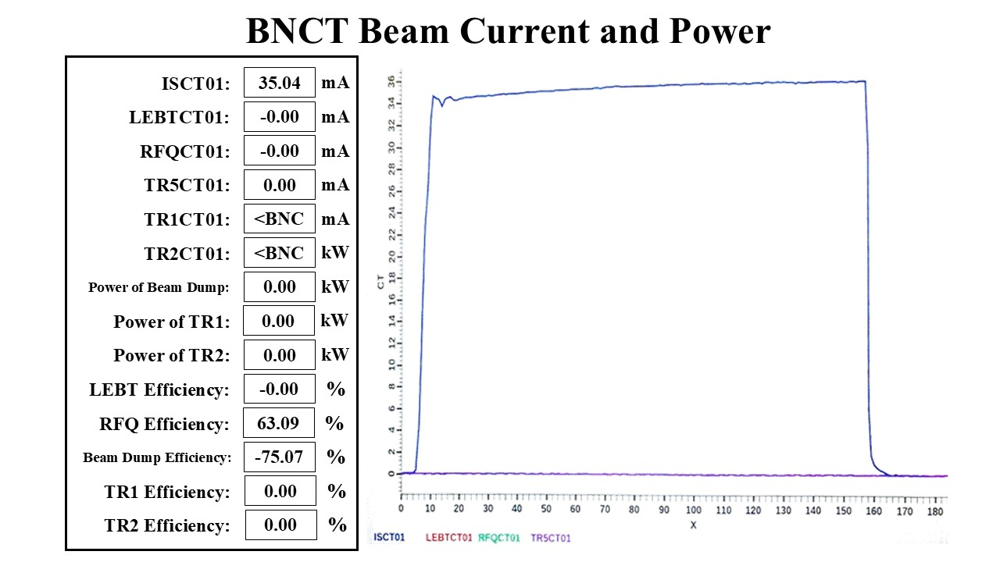
Operation
The clinical BNCT equipment has maintained with a targeted beam power of approximately 28 kW and an uptime rate of over 95%.
The ion source can provide beam current continuously for 24 hours, accumulating a total operating duration of 6,694 hours.
The power source has also been capable of continuous operation for 24 hours, with a total operating duration of 7,073 hours.
The neutron target has accumulated a total beam time of 5,160 milliampere-hours, with a single day’s longest beam time exceeding 110 milliampere-hours.
The neutron flux density of BNCT02 has reached the standards set by the IAEA for clinical BNCT treatments.
Beam current of the ECR ion source with cylindrical discharge chamber at duty cycle of 60%

Slide 14
Conclusion
Provide two different design of discharge chamber: cylindrical and square
It should be emphasized that the square discharge chamber exhibits higher stability and availability of the ion source for following reasons:
Lower SWR: Low SWR design ensures easier discharging, guaranteeing the availability of the BNCT ECR ion source.
Broader operational bandwidth: Discharge chamber with wider bandwidth can help ion source adapt to frequency fluctuations, which fully improves the stability of the ion source.
Currently, the clinical BNCT equipment installed at Dongguan People's Hospital has maintained stable and efficient operation over the past year, with a targeted beam power of approximately 28 kW and an uptime rate of over 95%.
The neutron flux density of BNCT02 has reached the standards set by the IAEA for clinical BNCT treatments.

