Slide 1



Numerical design and experimental characterization of an innovative, 3D-printed, ‘plasma-shaped’ cavity for ECR Ion Sources
D. Mascali¹, G. S. Mauro¹, D. Bianconi¹, G. Torrisi¹, O. Leonardi¹, A. Galatà², C. S. Gallo²,
A. Pidatella¹, B. Mishra¹, E. Naselli¹, F. Russo¹, E. Chyhyrynets², C. Pira²,
A. Gallo³, D. Cester³, L. Salvò³, P. Rebesan³, A. Pepato³, R. Dima³
¹Istituto Nazionale di Fisica Nucleare – Laboratori Nazionali del Sud – Catania (Italy)
²Istituto Nazionale di Fisica Nucleare – Laboratori Nazionali di Legnaro – Legnaro (Italy)
³Istituto Nazionale di Fisica Nucleare – Padova Division – Padova (Italy)
G. S. Mauro – 21st International Conference on Ion Sources – 8-12 September 2025, Oxford

Slide 2
Outline
Introduction and motivation
IRIS electromagnetic design
Additive Manufacturing prototype realization
Experimental validation
Preliminary PIC simulations
Conclusion and perspectives
G. S. Mauro – 21st International Conference on Ion Sources – 8-12 September 2025, Oxford
1 / 28

Slide 3
Outline
Introduction and motivation
IRIS electromagnetic design
Additive Manufacturing prototype realization
Experimental validation
Preliminary PIC simulations
Conclusion and perspectives
G. S. Mauro – 21st International Conference on Ion Sources – 8-12 September 2025, Oxford
2 / 28

Slide 4
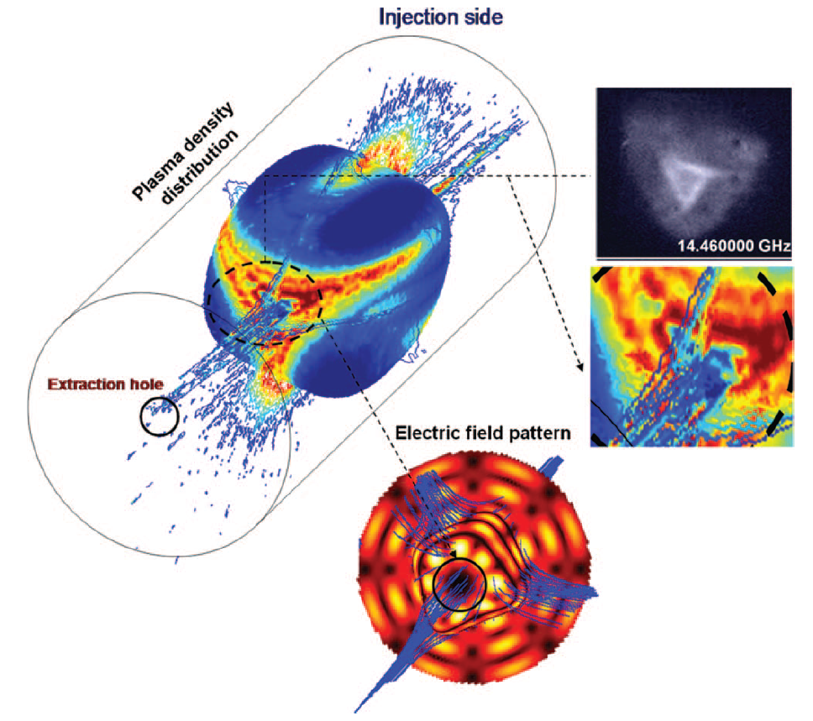
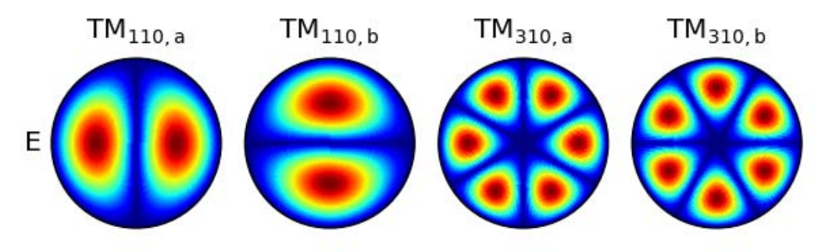


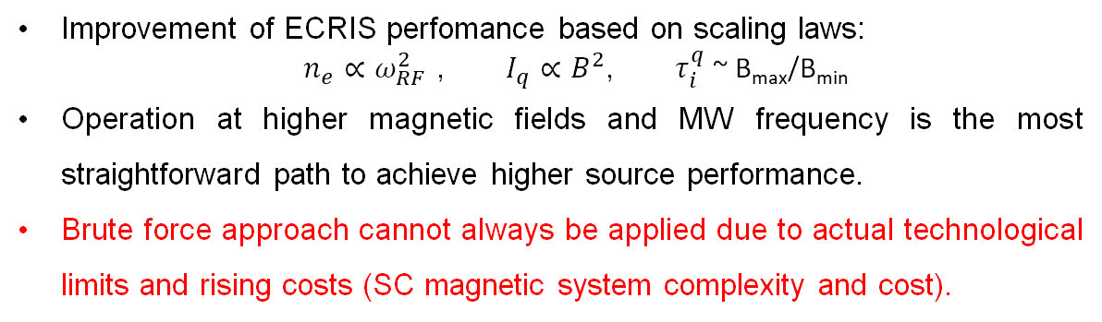
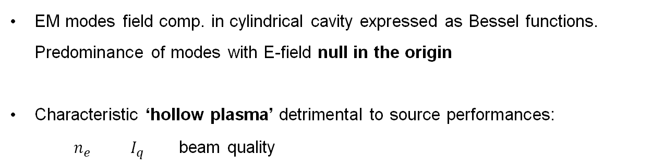
Introduction and motivation
Improvement of ECRIS perfomance based on scaling laws:
$n_{e}∝ω_{RF}^{2}$ , $I_{q}∝B^{2}$, $τ_{i}^{q}$ ~ B_{max}/B_{min}
Operation at higher magnetic fields and MW frequency is the most straightforward path to achieve higher source performance.
Brute force approach cannot always be applied due to actual technological limits and rising costs (SC magnetic system complexity and cost).
Hollow ion beam
EM modes field comp. in cylindrical cavity expressed as Bessel functions. Predominance of modes with E-field null in the origin
Characteristic ‘hollow plasma’ detrimental to source performances:
$n_{e}$ $I_{q}$ beam quality
Hollow electron density
Hollow E field
RF power deposited off-axis causes plasma ‘hollowness’
D. Mascali et al., Rev. Sci. Instrum. 83, 02A336 (2012)
L. Celona et al., Rev. Sci. Instrum. 79, 023305 (2008)
Improve source performances through plasma chamber re-design and microwave launch system optimization
G. S. Mauro – 21st International Conference on Ion Sources – 8-12 September 2025, Oxford
3 / 28

Slide 5
Introduction and motivation
Some reference about this topic
SERSE: demonstration of gyrotron mw transmission line + coupling system and description of the magnetic field requirements in order to obtain larger intensities and charges with ≥ 28 GHz frequency operation (D. Hitz, A. Girard, G. Melin, S. Gammino, G. Ciavola, and L. Celona, Review of Scientific Instruments 73, 509 (2002)).
SECRAL: production of beams of highly charged ions, in 18 + 24 GHz TFH operation, through the use of an optimized waveguide (∅ 20 mm) operating in the TE01 mode (gyrotron oscillator), with total power of 7.5 W (Zhao, H. W. et. al., “Intense highly charged ion beam production and operation with a superconducting electron cyclotron resonance ion source”, Physical Review Accelerators and Beams, vol. 20, no. 9. 2017. doi: 10.1103/PhysRevAccelBeams.20.094801).
TE01 wave mode is used since losses along the waveguide are very low, due to almost zero electric fields at the inner surface and axis of the waveguide (reduced probability of electric breakdown due to the employed high power).
VENUS: the microwave coupling scheme with the ∅ 20 mm waveguide has been adopted and validated with the 28 GHz VENUS ion source at LBNL (D. Z. Xie, W. Lu, J. Y. Benitez, C. M. Lyneis, and D. S. Todd, in Proceedings of the 22th International Workshop on ECR Ion Sources, Busan, S. Korea, 2016).
SECRAL II: implementation of a new mw coupling scheme based on the ‘Vlasov launcher’, a cylindrical waveguide with a shaped end able to radiate mw directly to the first ECR surface from cylindrically symmetric modes in circular waveguides (TE01) (J. W. Guo et. Al., Rev. Sci. Instrum. 91, 013322 (2020)).
HIISI: implementation of a new plasma chamber geometry that possesses reduced thickness at the hexapole magnetic poles, in order to enhance the radial magnetic field in the plasma loss area (H. Koivisto et. Al., Rev. Sci. Instrum. 91, 023303 (2020)).
G. S. Mauro – 21st International Conference on Ion Sources – 8-12 September 2025, Oxford
4 / 28

Slide 6
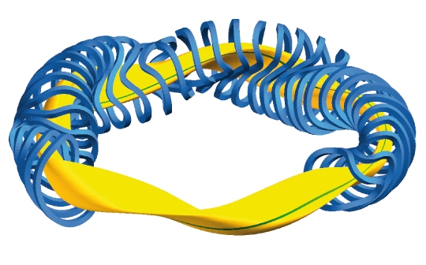
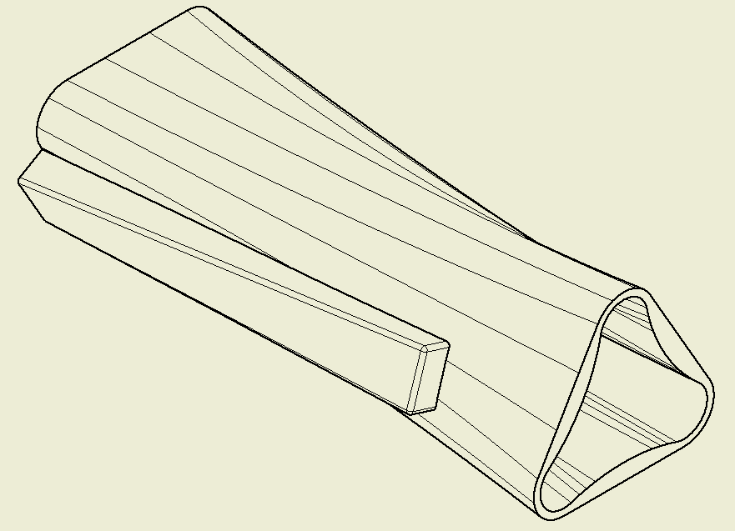
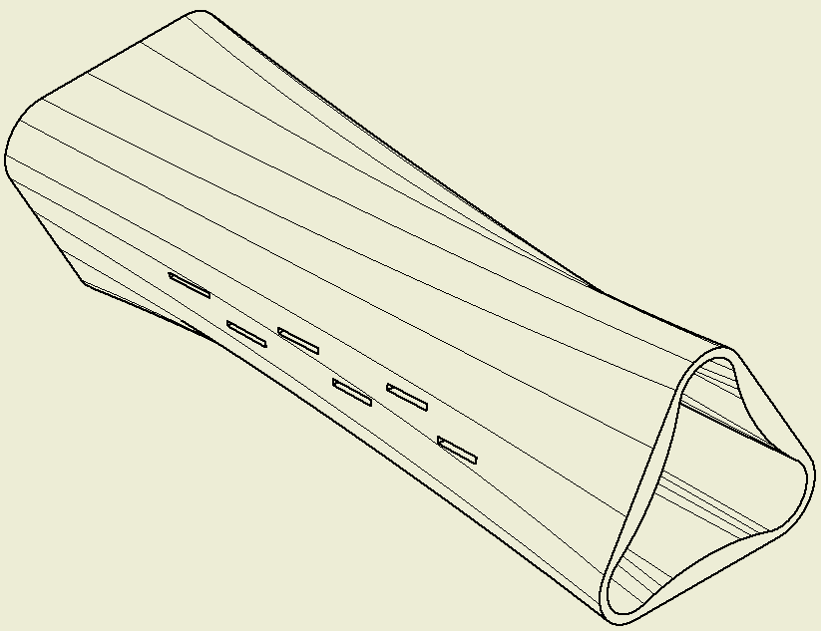
Introduction and motivation
What we propose …
Inspired by “Stellarators” Thermonuclear Reactors
A complex asymmetric magnetic field ensures every plasma particle feels the same force, so the particle confinement is optimized and the plasma can be maintained.
Innovative Resonator Ion Source – IRIS
(patent n° IT202000001756A1)
Plasma chamber
Shape-matching
waveguide
Diffractive apertures (slots)
G. S. Mauro – 21st International Conference on Ion Sources – 8-12 September 2025, Oxford
6 / 28

Slide 7
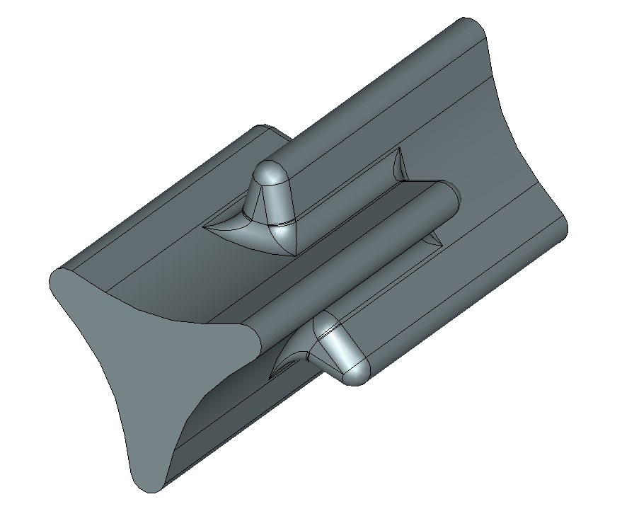
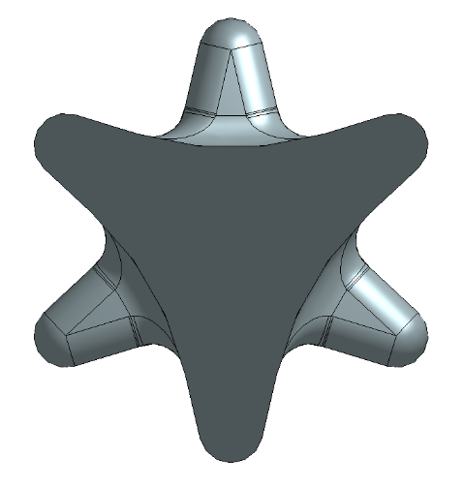
Introduction and motivation
‘plasma-shaped’ cavity first concept:
3D occupancy map: plot of the surface enclosing all the points where an electron has passed through at least one time
D. Mascali et al 2022 J. Phys.: Conf. Ser. 2244 012003
Cavity geometry: take into account the electrons trajectories as they move under the influence of the magnetic field.
RESULT: plasma cavity with minimized volume → determined by the maximum space occupied by electrons inside ECR plasma.
In order to employ the new cavity with the INFN-LNS CAESAR ion source setup, further mechanical and e.m. tuning operations have been performed.
G. S. Mauro – 21st International Conference on Ion Sources – 8-12 September 2025, Oxford
5 / 28

Slide 8
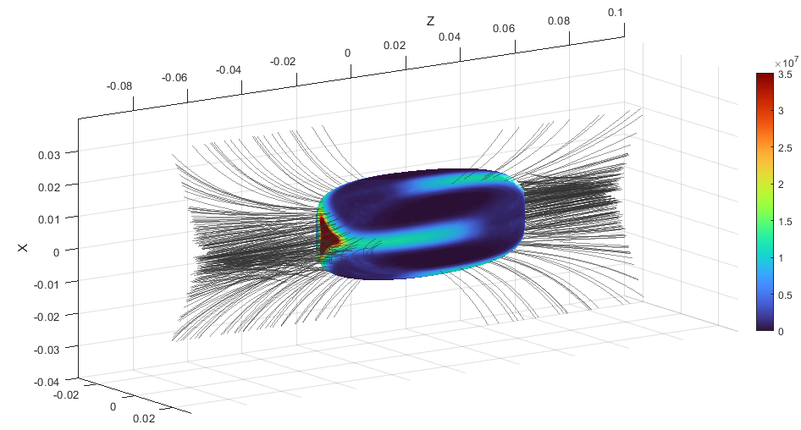
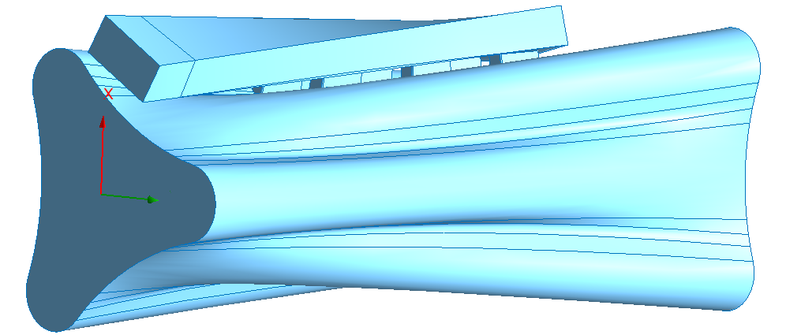
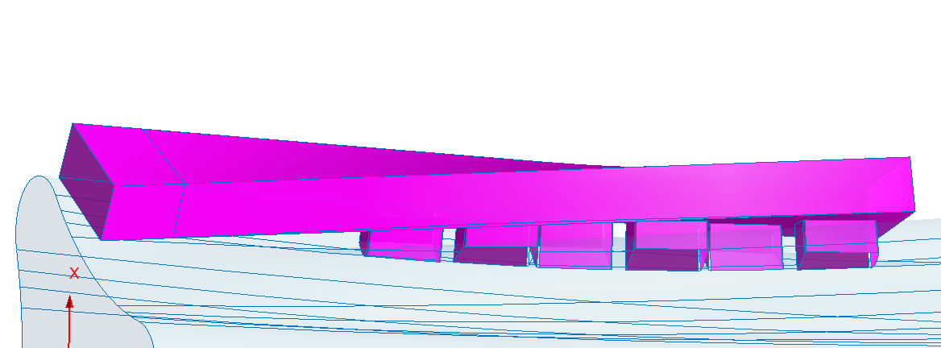
Introduction and motivation
Innovative Resonator Ion Source – IRIS
(patent n° IT202000001756A1)
Two main modifications to increase source performances:
Plasma chamber
waveguide
Diffractive apertures (slots)
Shape of the last e⁻ iso-density surface set by B field
Shape obtained from self-consistent PIC simulations
Shape optimized to occupy only plasma volume
Symmetry breaking to excite on-axis EM modes
Cavity re-design
Structure vacuum volumes
G. S. Mauro – 21st International Conference on Ion Sources – 8-12 September 2025, Oxford
7 / 28

Slide 9
Introduction and motivation
Innovative Resonator Ion Source – IRIS
(patent n° IT202000001756A1)
Two main modifications to increase source performances:
Plasma chamber
waveguide
Diffractive apertures (slots)
Axial rectangular waveguide replaced by a smoothly matched slotted waveguide
Better wave to plasma power coupling
Homogeneous and symmetric power distribution into plasma
Injection closer to the power deposition layer
Better overall structure compactness (more space in input f.)
Novel RF injection system
Structure vacuum volumes
G. S. Mauro – 21st International Conference on Ion Sources – 8-12 September 2025, Oxford
8 / 28

Slide 10
Outline
Introduction and motivation
IRIS electromagnetic design
Additive Manufacturing prototype realization
Experimental validation
Preliminary PIC simulations
Conclusion and perspectives
G. S. Mauro – 21st International Conference on Ion Sources – 8-12 September 2025, Oxford
9 / 28

Slide 11
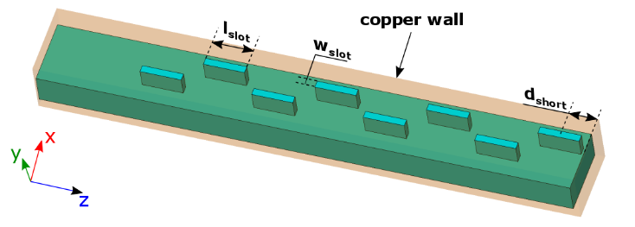
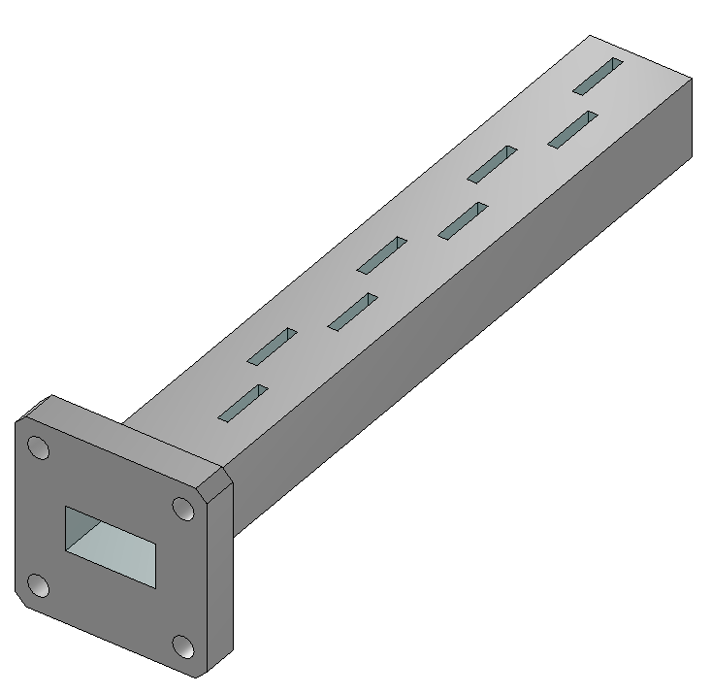
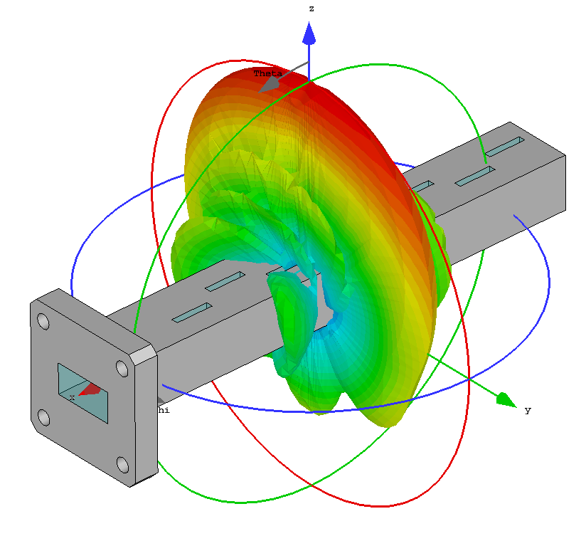
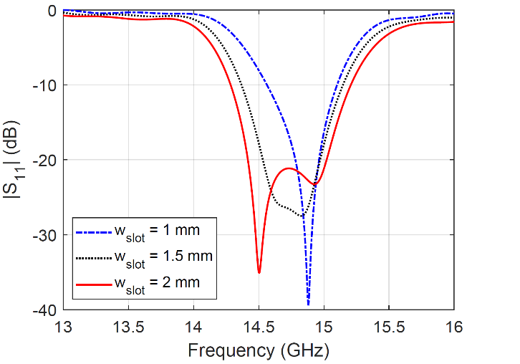
IRIS electromagnetic design
The MW injection system is based on a slotted waveguide (WR62).
It has been firstly studied as a stand-alone antenna to study the performances vs. the main parameters.
The antenna works in the band [14.2; 15.25] GHz with central frequency 14.7 GHz.
G. S. Mauro et al., Telecom 2021, 2(1), 42-51;
Number of slots limited by the impedance bandwidth of the slotted waveguide antenna.
Antenna efficiency is directly proportional to the number of slots and increases with these.
OBJECTIVE: maximize |S₁₁| impedance bandwidth and obtain uniform radiation pattern.
G. S. Mauro – 21st International Conference on Ion Sources – 8-12 September 2025, Oxford
10 / 28

Slide 12
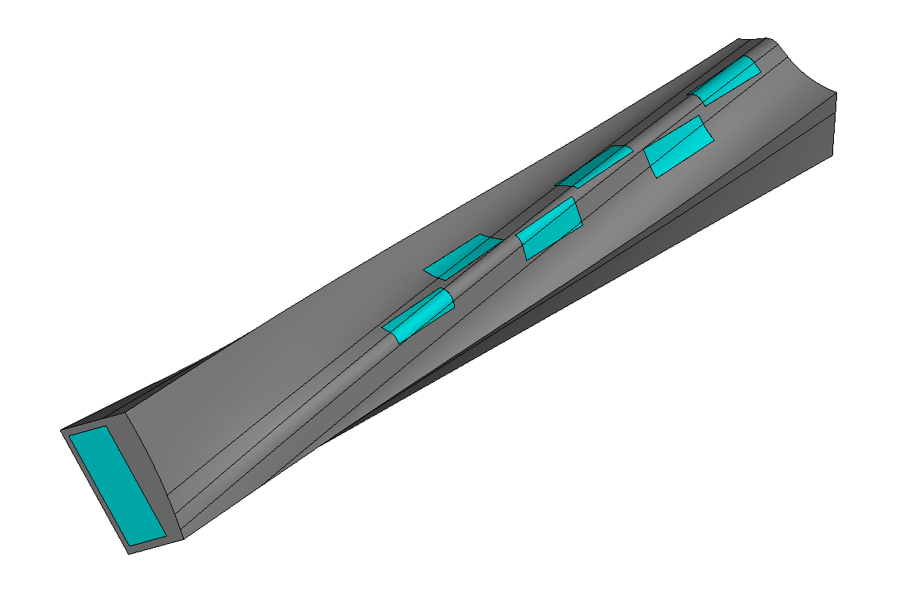
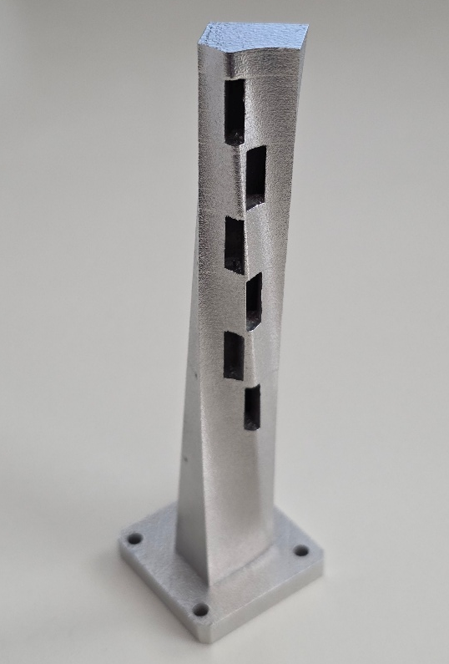
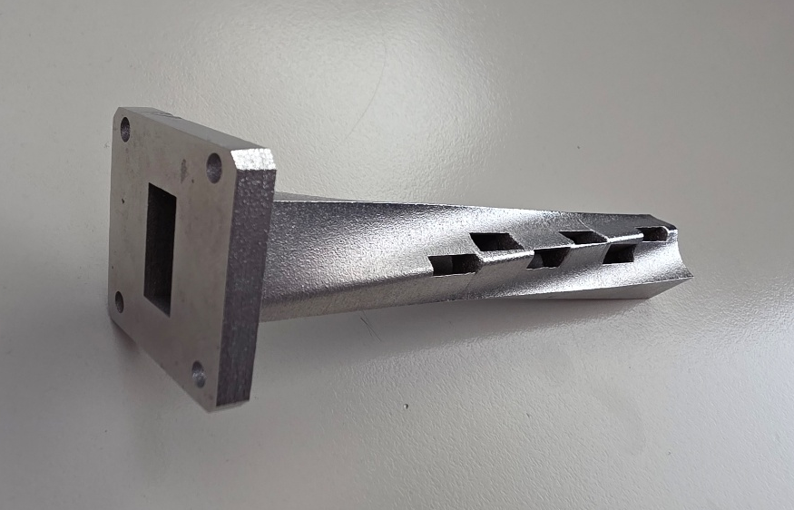
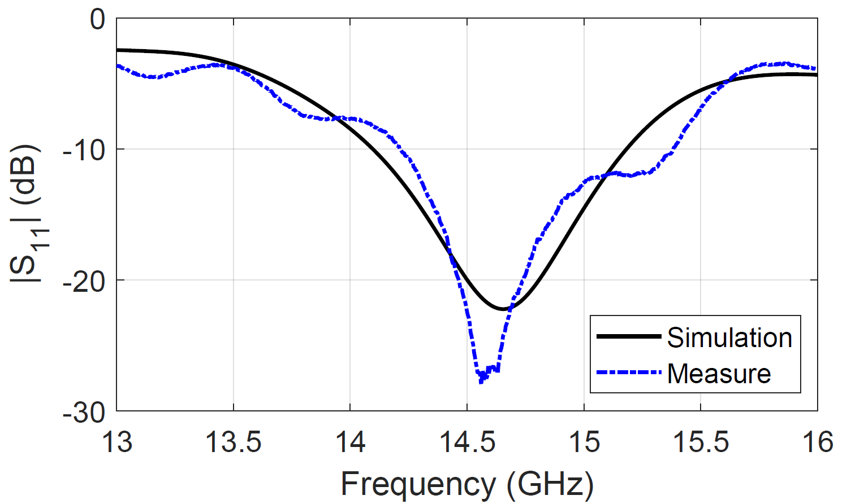
IRIS electromagnetic design
Final ‘twisted’ version of the slotted antenna.
A prototype has been realized through AM technique.
Results obtained after measurements are comparable with the ones obtained with the simulation.
Aluminum
Air
G. S. Mauro – 21st International Conference on Ion Sources – 8-12 September 2025, Oxford
11 / 28

Slide 13
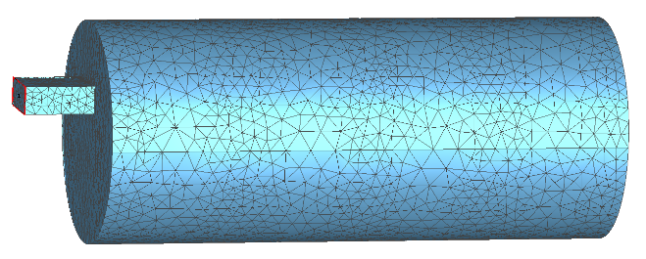
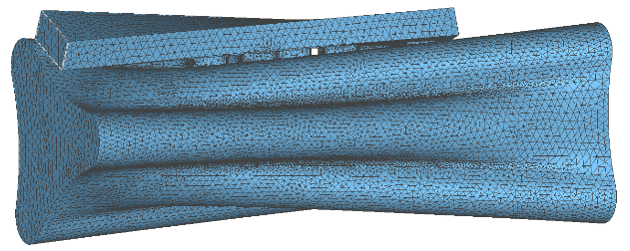
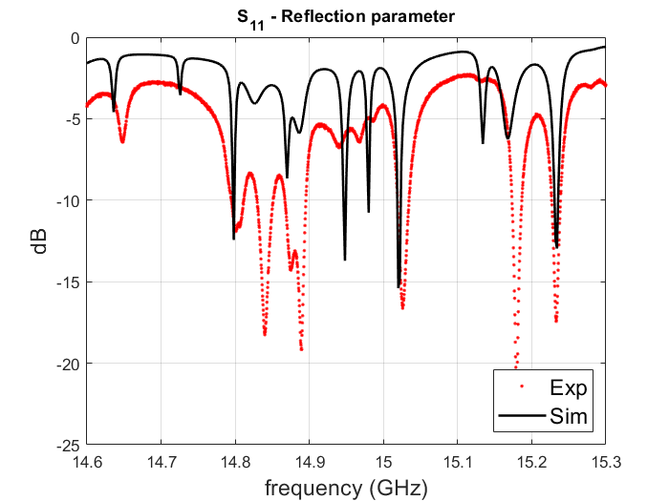
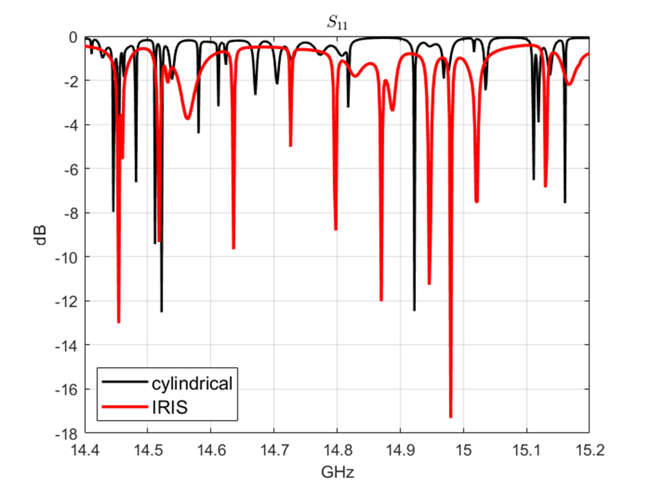
IRIS electromagnetic design
IRIS has been designed and optimized by employing commercial electromagnetic simulators (Ansys HFSS, CST Studio Suite).
CAESAR ion source (INFN-LNS) has been taken as starting point (dimensions and performances) and as comparison case.
Complex vacuum geometry: no analytical modes.
Compared to a standard cylindrical cavity with axial MW injection system, IRIS cavity presents:
More excited electromagnetic modes
Better wave-to-cavity coupling
G. S. Mauro – 21st International Conference on Ion Sources – 8-12 September 2025, Oxford
12 / 28
Notes:
Partiamo da CAESAR

Slide 14
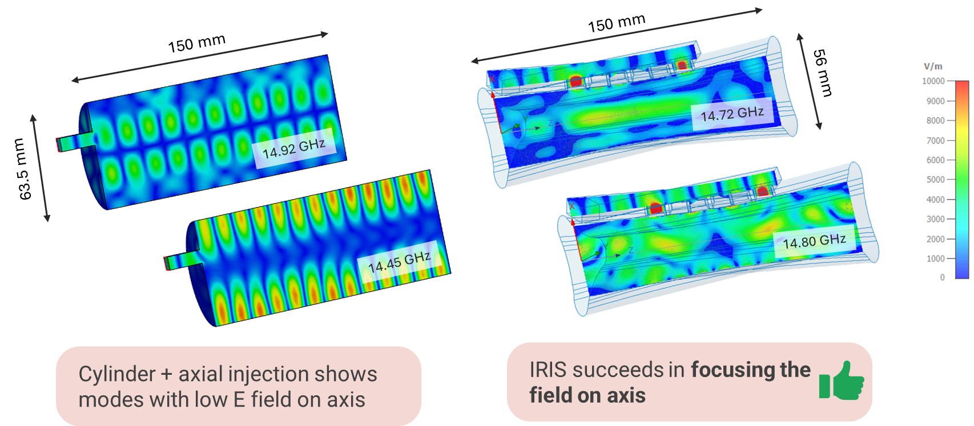
IRIS electromagnetic design
G. S. Mauro – 21st International Conference on Ion Sources – 8-12 September 2025, Oxford
13 / 28

Slide 15
Outline
Introduction and motivation
IRIS electromagnetic design
Additive Manufacturing prototype realization
Experimental validation
Preliminary PIC simulations
Conclusion and perspectives
G. S. Mauro – 21st International Conference on Ion Sources – 8-12 September 2025, Oxford
14 / 28

Slide 16
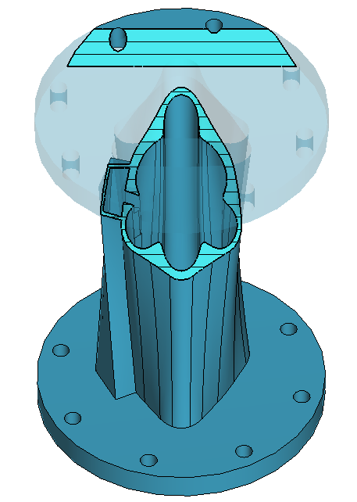
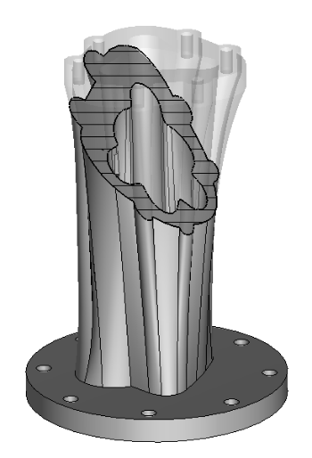


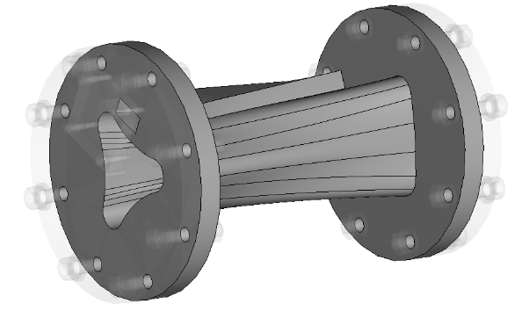

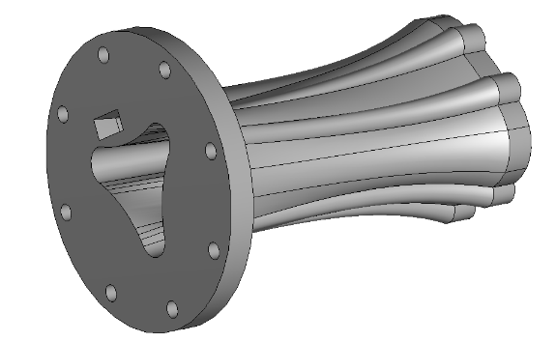

Additive Manufacturing prototype realization
Printing
surface
IRIS geometry too complex to build with traditional tools: Additive Manufacuring
Laser Powder Bed Fusion ( L-PBF )
3D model optimized to be printed at 45° to ensure slices with a connected area and to avoid defects while cooling
3D printer: EOS M280
Material: 316L stainless steel
G. S. Mauro – 21st International Conference on Ion Sources – 8-12 September 2025, Oxford
15 / 28
Notes:
Em innovation – realization innovation

Slide 17
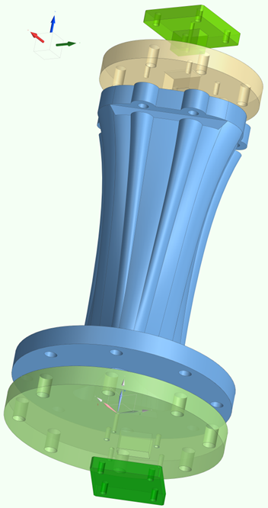
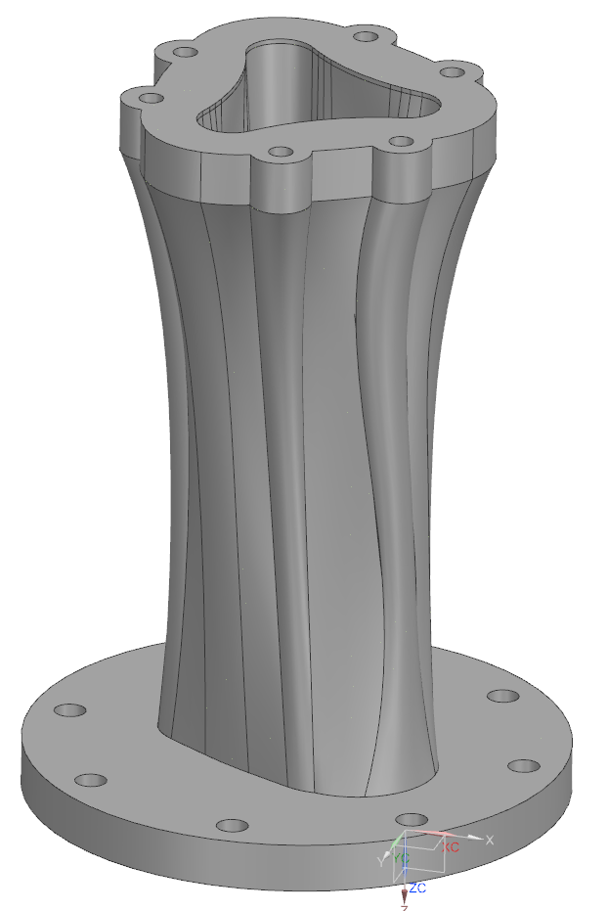
Additive Manufacturing prototype realization
Final prototype design
Axial wg plug
Central body
Input flange
Slotted wg plug
Output flange
G. S. Mauro – 21st International Conference on Ion Sources – 8-12 September 2025, Oxford
16 / 28

Slide 18
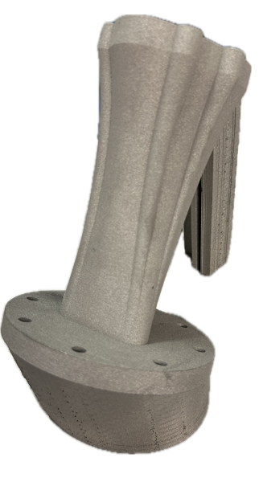
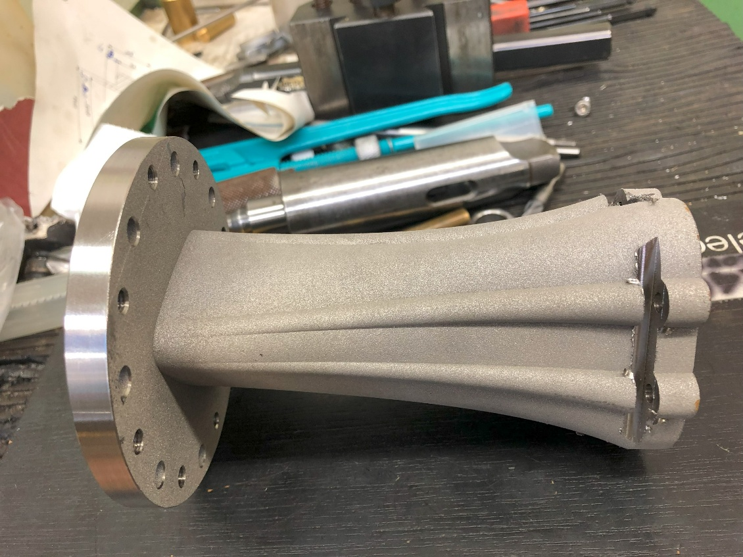
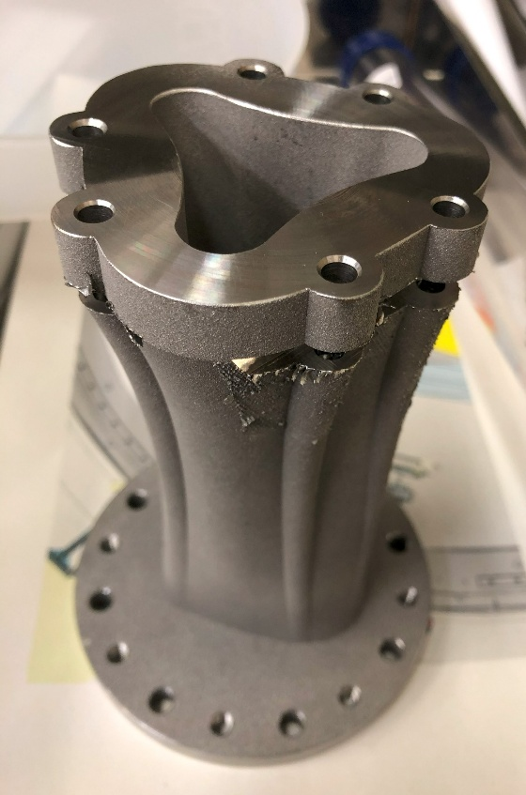
Additive Manufacturing prototype realization
Engraving
Polished flange
Printing supports
As built with printing supports
After first post-processing to remove supports, flange polishing and engravings for closure
IRIS has been designed to be mounted on a ECRIS without the need to modify I/O flanges:
the swap between IRIS and a cylindrical chamber will be automatic.
G. S. Mauro – 21st International Conference on Ion Sources – 8-12 September 2025, Oxford
17 / 28

Slide 19
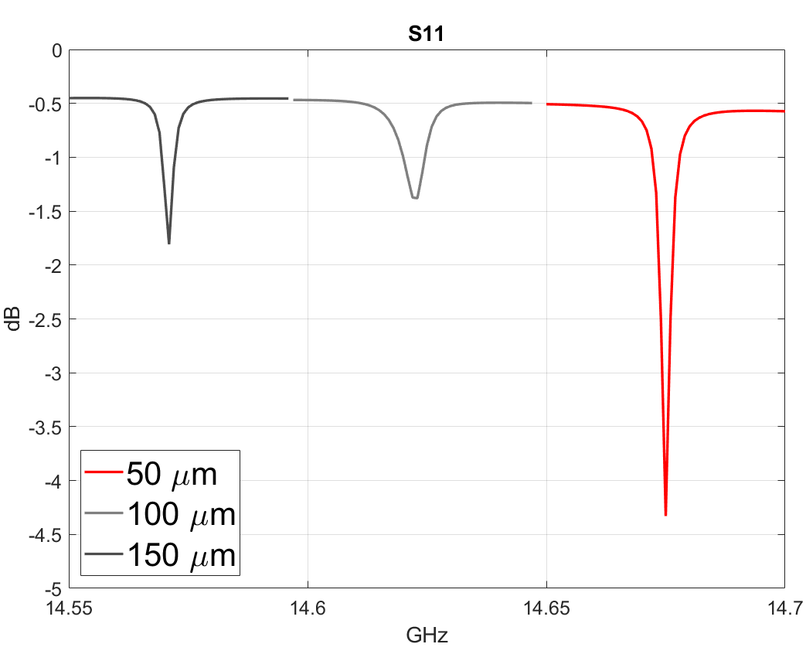

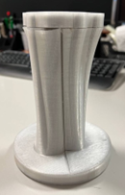
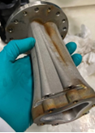
Additive Manufacturing prototype realization
Additional post-processing steps, performed at INFN-LNL, have been necessary to control surface finishing and avoid:
RF power loss
local field hotspots (could lead to RF breakdown)
gas trapping
Technique: Plasma Electrolytic Polishing (PEP)
Risk to remove too much material and lose the desired modes (frequency shift of mode de-coupling).
EM simulation performed to remove 50, 100, 150 µm from cavity inner walls.
Etching <50 µm allows to measure the modes
G. S. Mauro – 21st International Conference on Ion Sources – 8-12 September 2025, Oxford
18 / 28

Slide 20
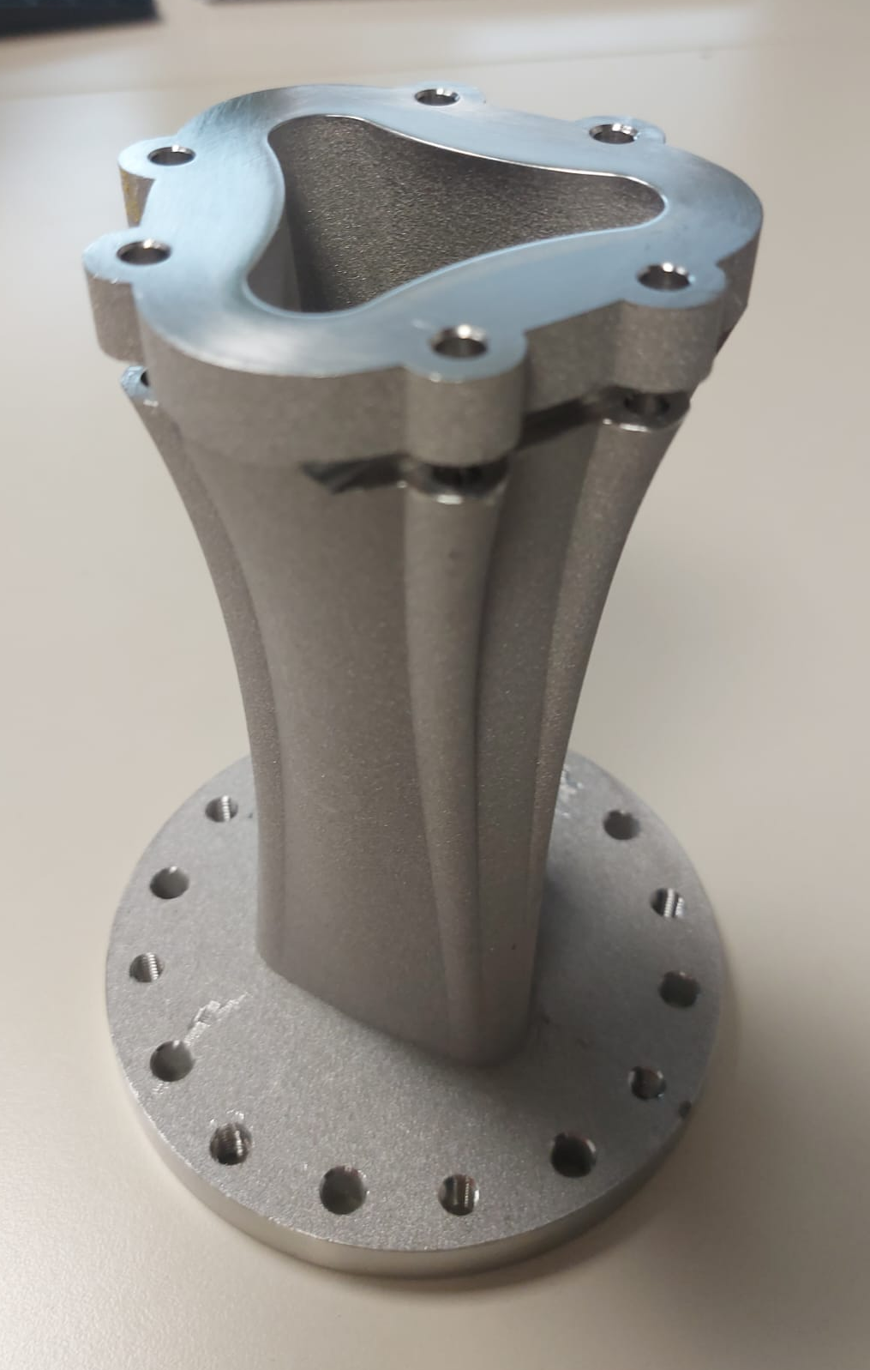
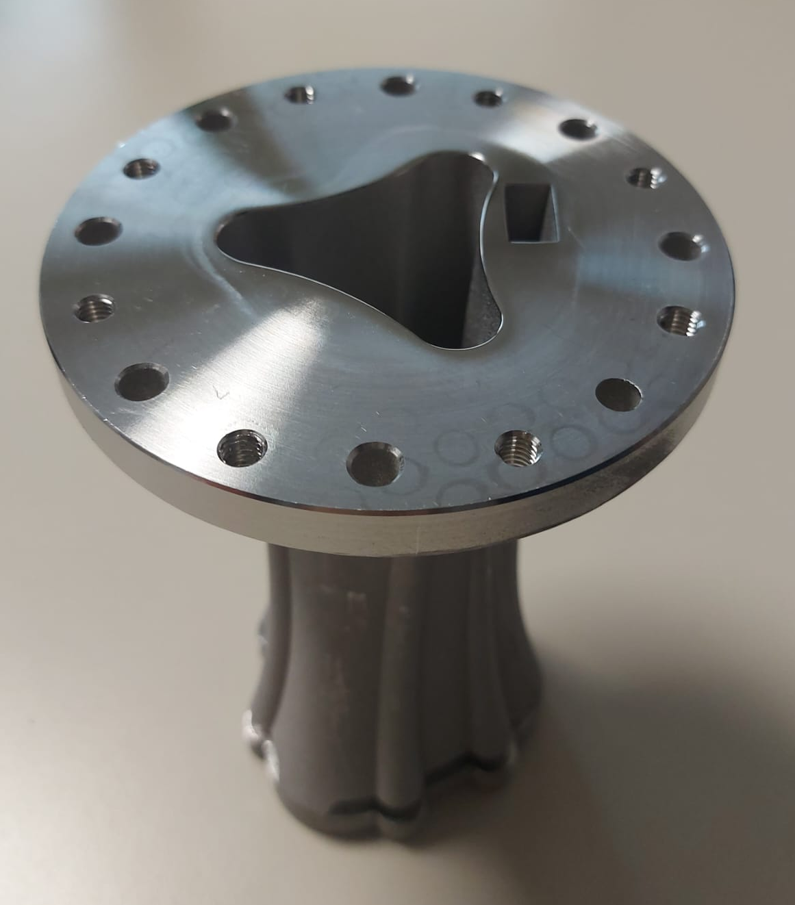
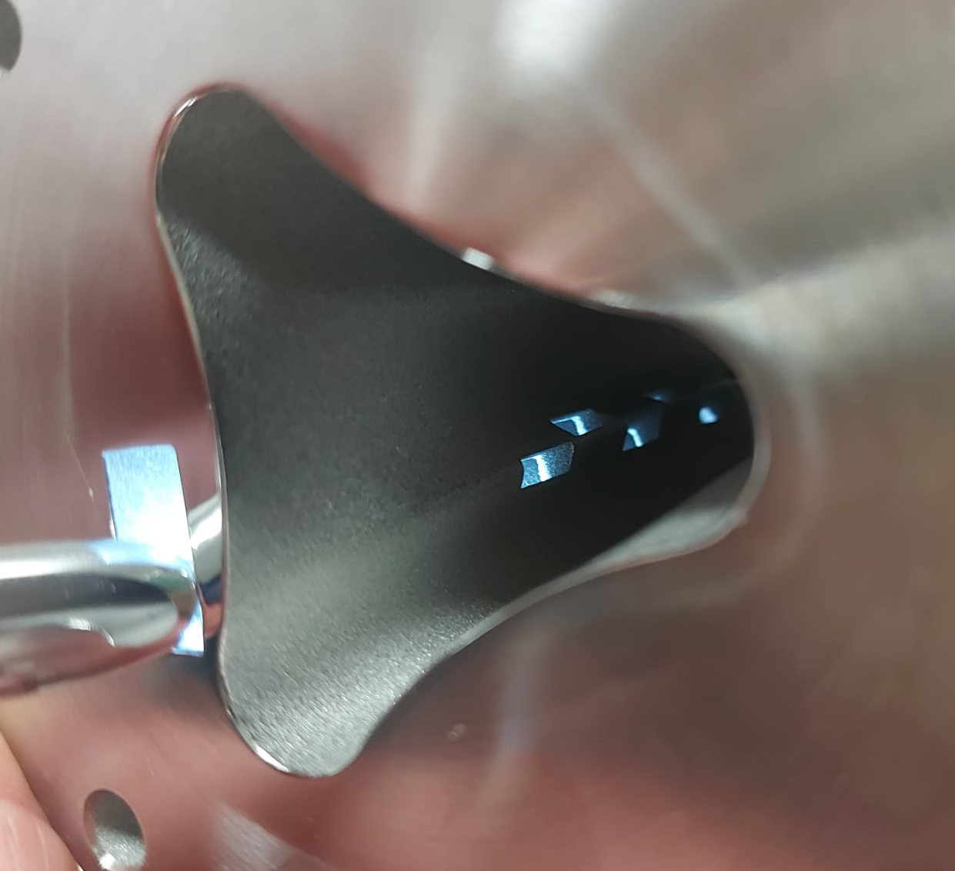
Additive Manufacturing prototype realization
Final prototype
Radiating slots
G. S. Mauro – 21st International Conference on Ion Sources – 8-12 September 2025, Oxford
19 / 28

Slide 21
Outline
Introduction and motivation
IRIS electromagnetic design
Additive Manufacturing prototype realization
Experimental validation
Preliminary PIC simulations
Conclusion and perspectives
G. S. Mauro – 21st International Conference on Ion Sources – 8-12 September 2025, Oxford
20 / 28

Slide 22
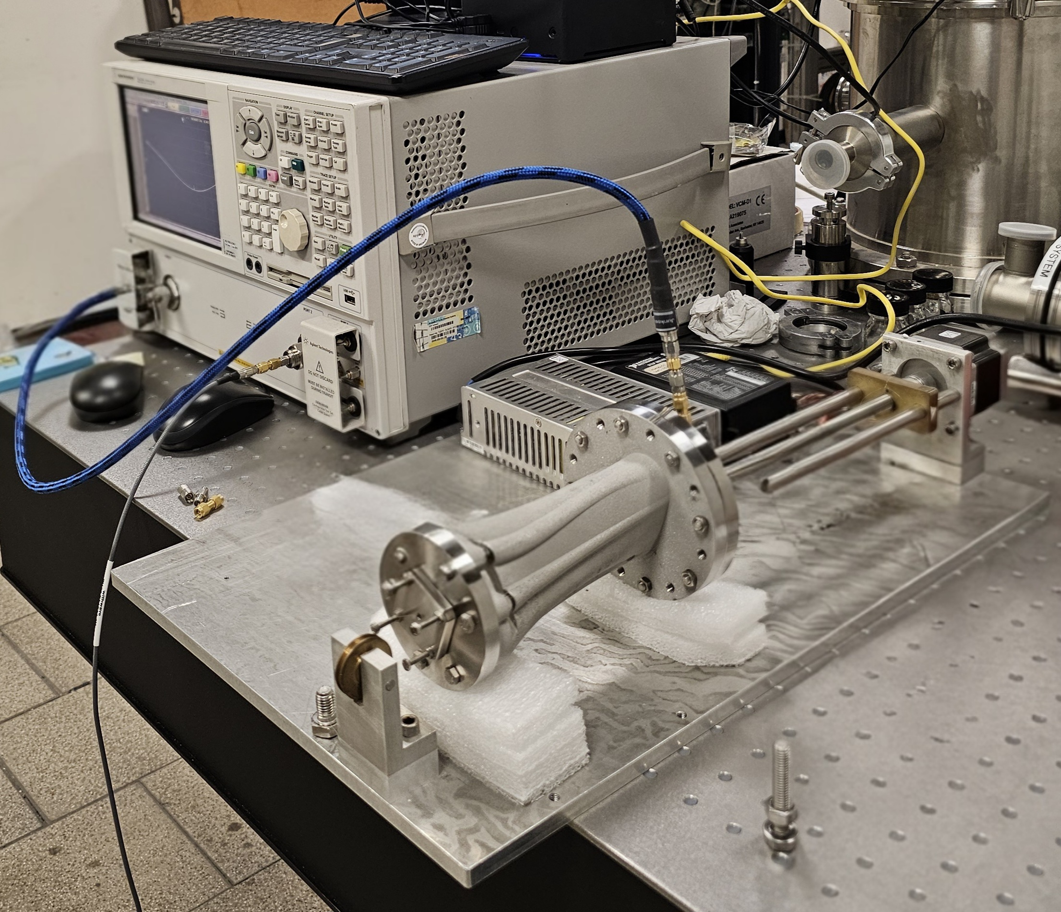
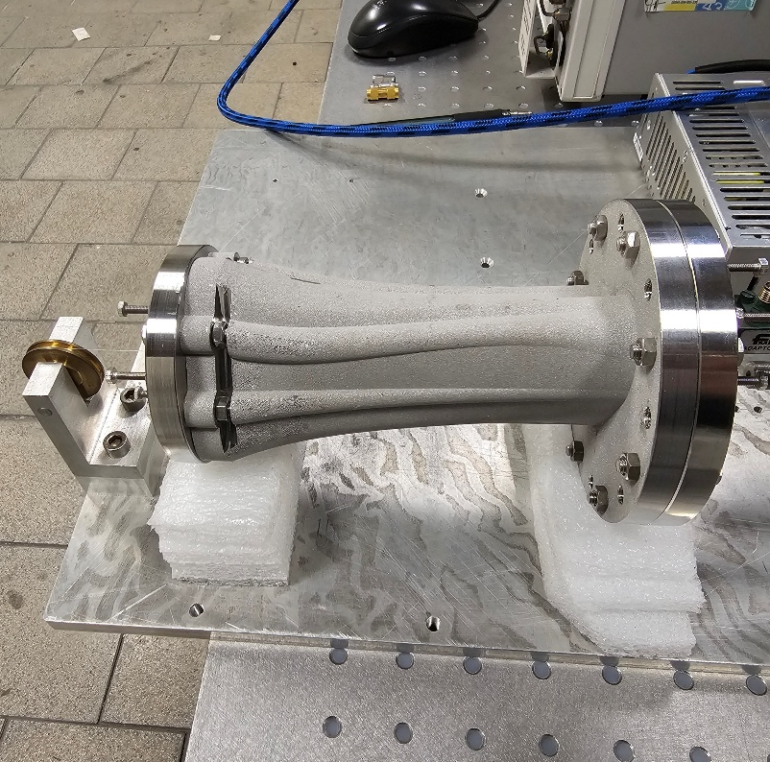
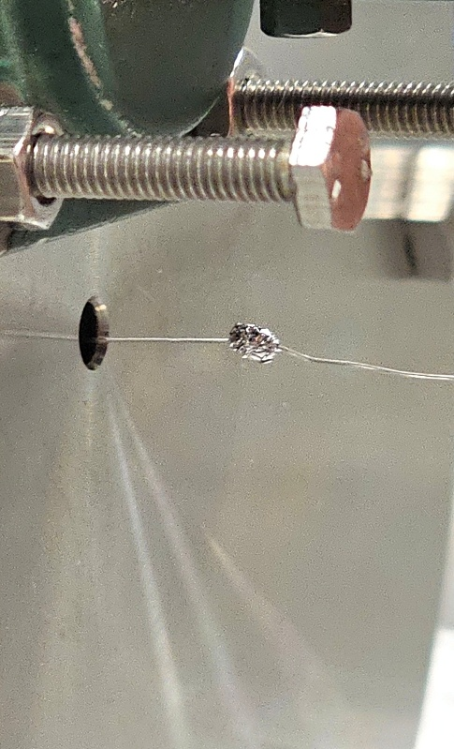
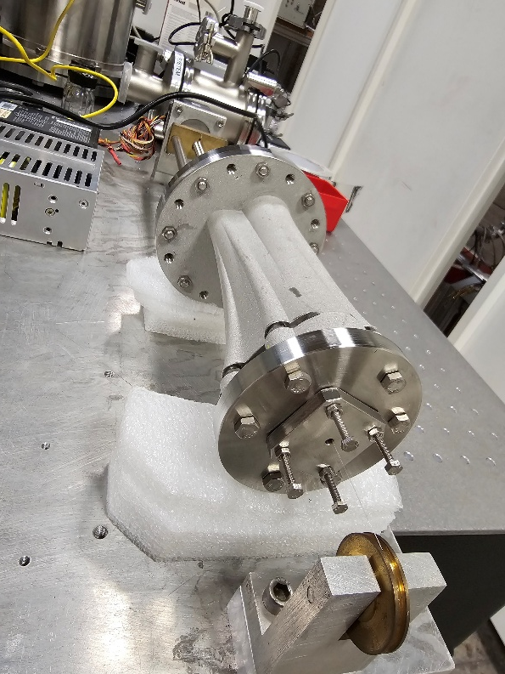
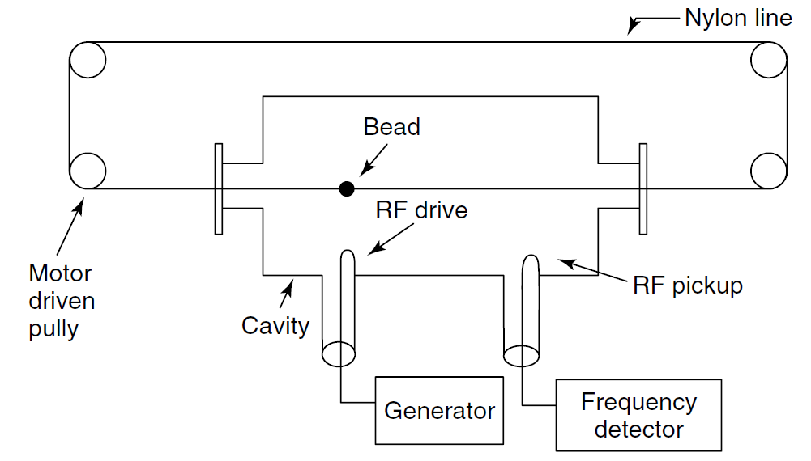
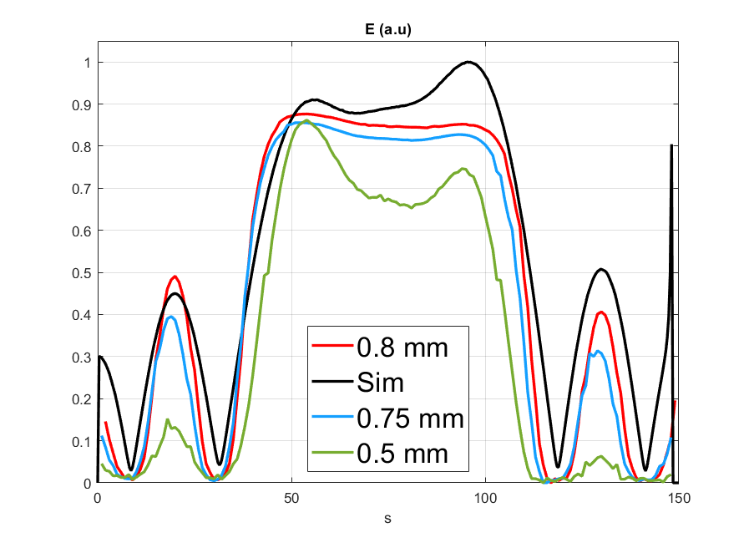
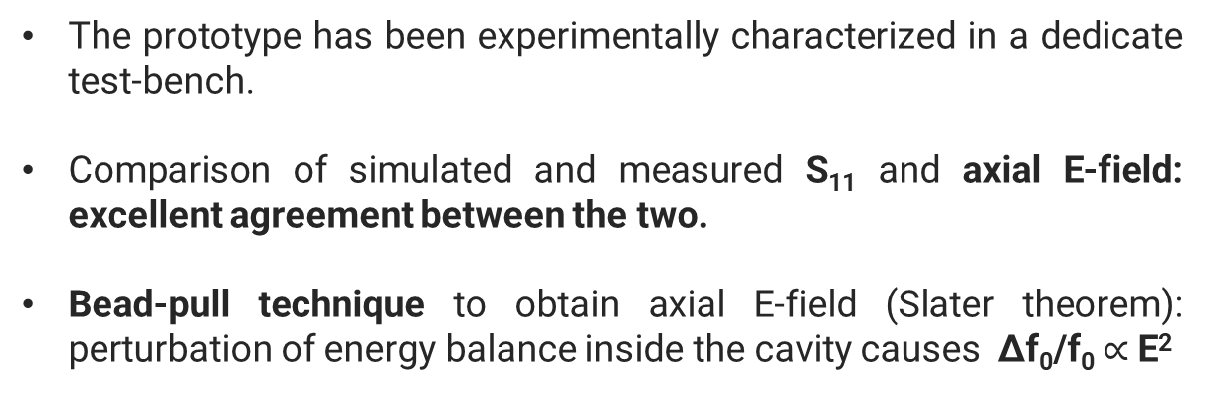
Experimental validation
The prototype has been experimentally characterized in a dedicate test-bench.
Comparison of simulated and measured S₁₁ and axial E-field: excellent agreement between the two.
Bead-pull technique to obtain axial E-field (Slater theorem): perturbation of energy balance inside the cavity causes Δf₀/f₀ $∝$ E²
stepper motor
IRIS
r_{bead} = 0.8 mm
21 / 28

Slide 23
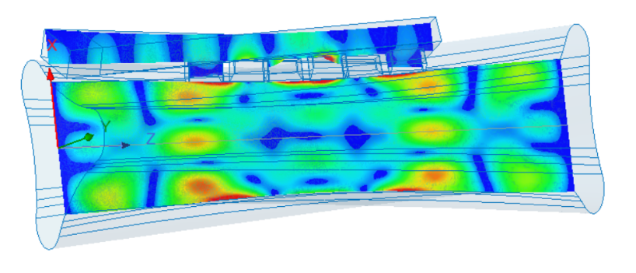
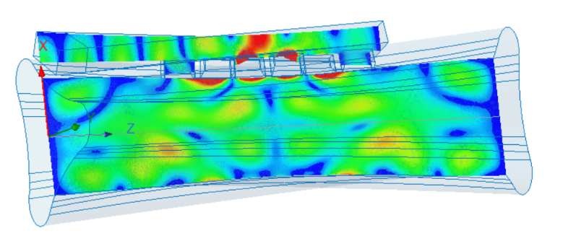
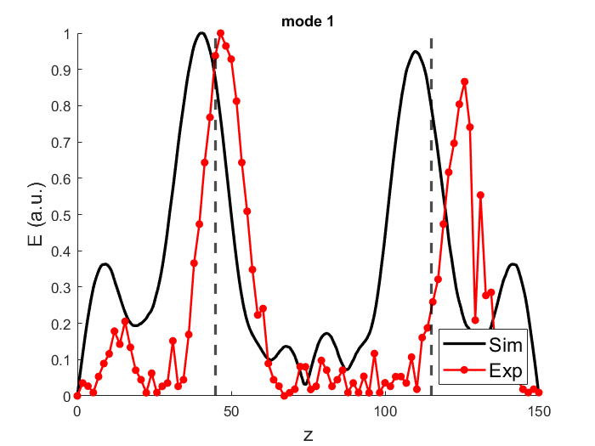


Experimental validation
Good agreement vs. simulation, considering realization issues
Good field profile agreement
ECR surface (dashed) at high field region
G. S. Mauro – 21st International Conference on Ion Sources – 8-12 September 2025, Oxford
22 / 28

Slide 24
Outline
Introduction and motivation
IRIS electromagnetic design
Additive Manufacturing prototype realization
Experimental validation
Preliminary PIC simulations
Conclusion and perspectives
G. S. Mauro – 21st International Conference on Ion Sources – 8-12 September 2025, Oxford
23 / 28

Slide 25




Preliminary PIC simulations
Particle tracking
Step 0
EM field in empty cavity
Density map
3D dielectric tensor
Step 1
Step N
EM field in plasma filled cavity
Density map
Particle tracking
A. Galatà et al., Rev. Sci. Instrum. 91, 013506 (2020)
G. S. Mauro – 21st International Conference on Ion Sources – 8-12 September 2025, Oxford
24 / 28
Notes:
Milione di elettroni inizializzati all’interno della superficie ECR allo step 0 (non collisionale).
In seguito, il campo EM in vuoto esportato da comsol viene usato per muovere le particelle allo step 0.
Lo step 0 è compreso di due sottostep: uno collisionale ed uno non-collisionale. Quello non collesionale viene usato per calcolare la prima densità dalla quale ricavare dei parametri per implementre le collisioni, tipo la frequenza collisionale (che ha bisogno di una mappa di densità).
Alla fine dello step 0 noi otteniamo una mappa di densità e di energia.
Dopo avere la densità, calcoliamo il tensore del plasma e lo importiamo in comsol per rifare una simulaizone RF.
Quindi si va avanti fino alla convergenza (ad esempio del campo elettrico).

Slide 26









Preliminary PIC simulations
f₀ = 14.5 GHz
P_{in} = 400 W
Particle density distribution
Energy density distribution
IRIS
IRIS
CAESAR
CAESAR
G. S. Mauro – 21st International Conference on Ion Sources – 8-12 September 2025, Oxford
25 / 28
Notes:
Caesar: 14.5 GHz, 400 W, Bmax_ax=1.1T, Bmax_rad=1.1, this numerically validates IRIS

Slide 27
Outline
Introduction and motivation
IRIS electromagnetic design
Additive Manufacturing prototype realization
Experimental validation
Preliminary PIC simulations
Conclusion and perspectives
G. S. Mauro – 21st International Conference on Ion Sources – 8-12 September 2025, Oxford
26 / 28

Slide 28



Conclusion and perspectives
The design of a new ‘plasma-shaped’ cavity, able to increase ECRISs performances through a radical re-design approach, has been presented.
Structure designed with commercial simulators and build by the AM technique.
Prototype has been experimentally validated: experimental results are in excellent agreement with the numerical results.
Next steps:
‘hot’ prototype (with cooling channels) design and characterization.
Advance self-consistent plasma simulations.
G. S. Mauro – 21st International Conference on Ion Sources – 8-12 September 2025, Oxford
27 / 28
Notes:
Aggiungere immagini

Slide 29
Numerical design and experimental characterization of an innovative, 3D-printed, ‘plasma-shaped’ cavity for ECR Ion Sources
D. Mascali¹, G. S. Mauro¹, D. Bianconi¹, G. Torrisi¹, O. Leonardi¹, A. Galatà², C. S. Gallo²,
A. Pidatella¹, B. Mishra¹, E. Naselli¹, F. Russo¹, E. Chyhyrynets², C. Pira²,
D. Cester³, L. Salvò³, P. Rebesan³, A. Pepato³, R. Dima³
¹Istituto Nazionale di Fisica Nucleare – Laboratori Nazionali del Sud – Catania (Italy)
²Istituto Nazionale di Fisica Nucleare – Laboratori Nazionali di Legnaro – Legnaro (Italy)
³Istituto Nazionale di Fisica Nucleare – Padova Division – Padova (Italy)
Thank you!
G. S. Mauro – 21st International Conference on Ion Sources – 8-12 September 2025, Oxford
28 / 28

Slide 30




Cylindrical cavity modes
[G. S. Mauro et al., Telecom 2021, 2(1), 42-51;]
D. Bianconi – 51st EPS Conference on Plasma Physics – Vilnius, 7-11 July 2025

Slide 31




Slater perturbation theorem
[G. S. Mauro et al., Telecom 2021, 2(1), 42-51;]
The Slater perturbation theorem describes the shift of the resonant frequency, when a small volume ΔV is removed from the cavity of volume V.
D. Bianconi – 51st EPS Conference on Plasma Physics – Vilnius, 7-11 July 2025

Slide 32






Axial waveguide injection: cylindrical vs. ‘plasma-shaped’ cavity
The performances of both structures have been observed in terms of S-parameters in the band of [14; 14.5] GHz.
Number of modes and mode adaptation have been chosen as the main quality parameters.
Better coupling plus mode with intense electric field at the cavity center.
How can we improve axial symmetry?
Bad mode coupling to the cavity.
Notes:
For the IRIS case, the observed mode with an axial electric field predominance is located around 14.303 GHz.

Slide 33




Side-coupled waveguide injection: cylindrical vs. ‘plasma-shaped’ cavity
More modes coupled inside the cavity and better wave-to-cavity match
BUT predominance of modes with off-axis electric field maximum.
More modes coupled inside the cavity and better wave-to-cavity match PLUS possibility to obtain modes with predominant axial field maximum.
Notes:
IRIS good mode at 14.466 GHz.

