Slide 2

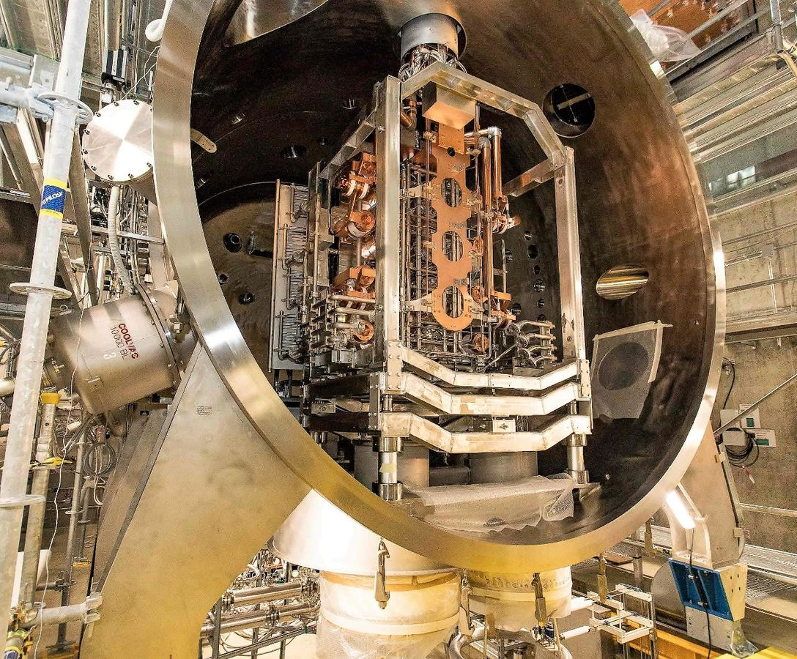
ITER Neutral Beam Test Facility
SPIDER experiment
(Source for Production of Ion of Deuterium Extracted from RF Plasma)
Contributed talk
by A. Shepherd on Tuesday!
Full-size prototype of ITER Negative Ion Source [1]
2

Slide 3
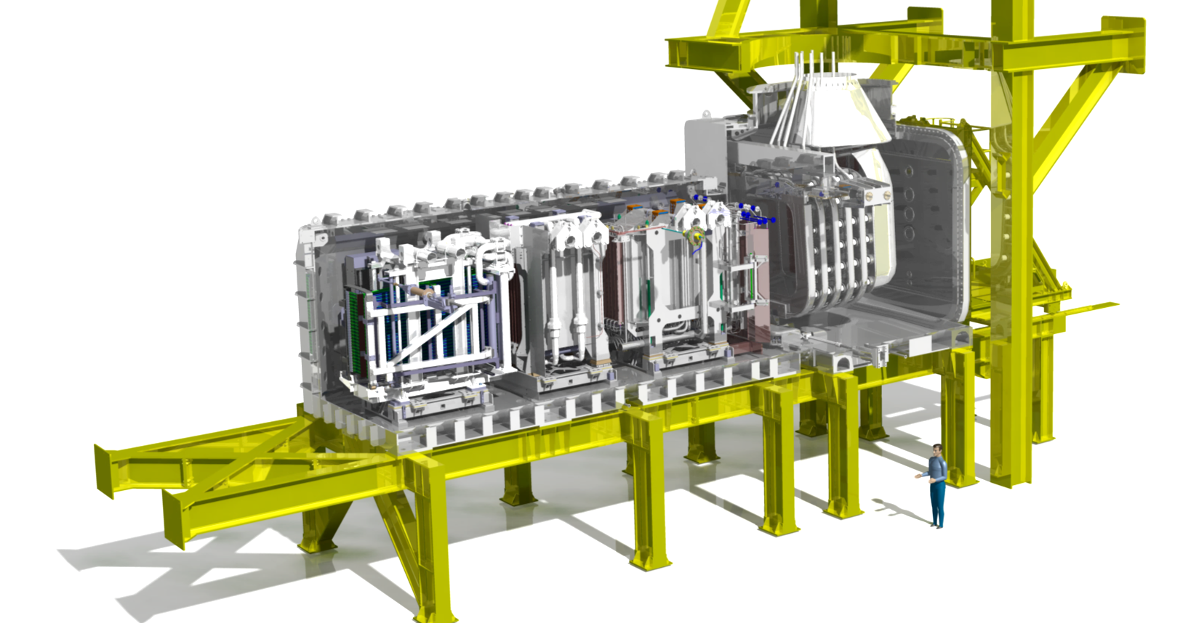
ITER Neutral Beam Test Facility
Full-size prototype of ITER Neutral Beam Injector [1]
SPIDER experiment
(Source for Production of Ion of Deuterium Extracted from RF Plasma)
Contributed talk
by A. Shepherd on Tuesday!
MITICA experiment
(Megavolt ITER Injector and Concept Advancement)
Full-size prototype of ITER Negative Ion Source [1]
2

Slide 4
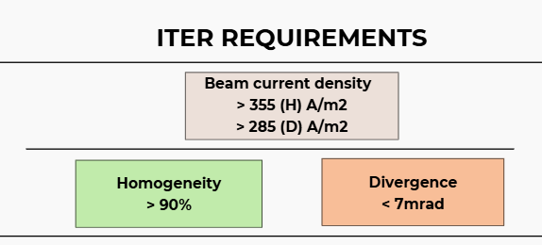
ITER Neutral Beam Test Facility
Full-size prototype of ITER Neutral Beam Injector [1]
SPIDER experiment
(Source for Production of Ion of Deuterium Extracted from RF Plasma)
Contributed talk
by A. Shepherd on Tuesday!
MITICA experiment
(Megavolt ITER Injector and Concept Advancement)
Full-size prototype of ITER Negative Ion Source [1]
2

Slide 5
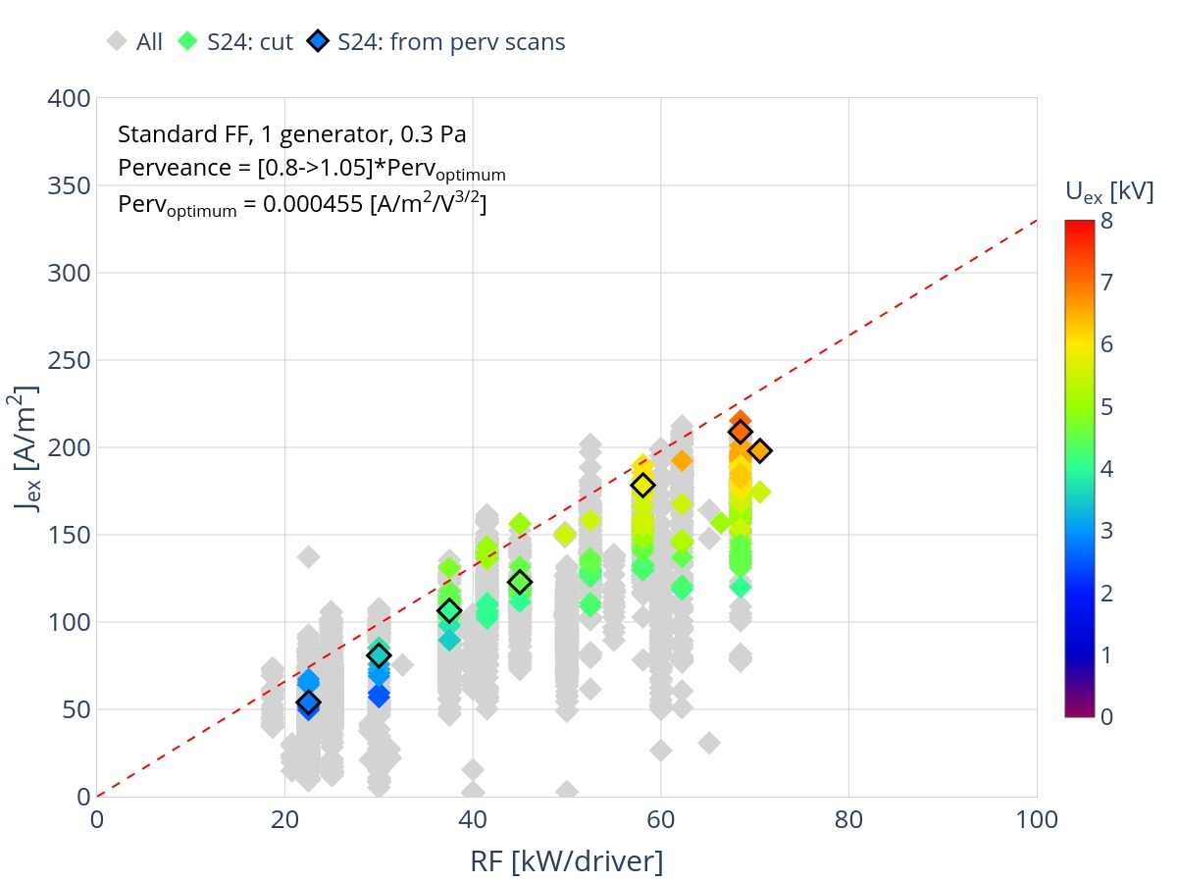
SPIDER Experimental Campaign
Operation with up to 312 beamlets open!
Beam current density
3

Slide 6
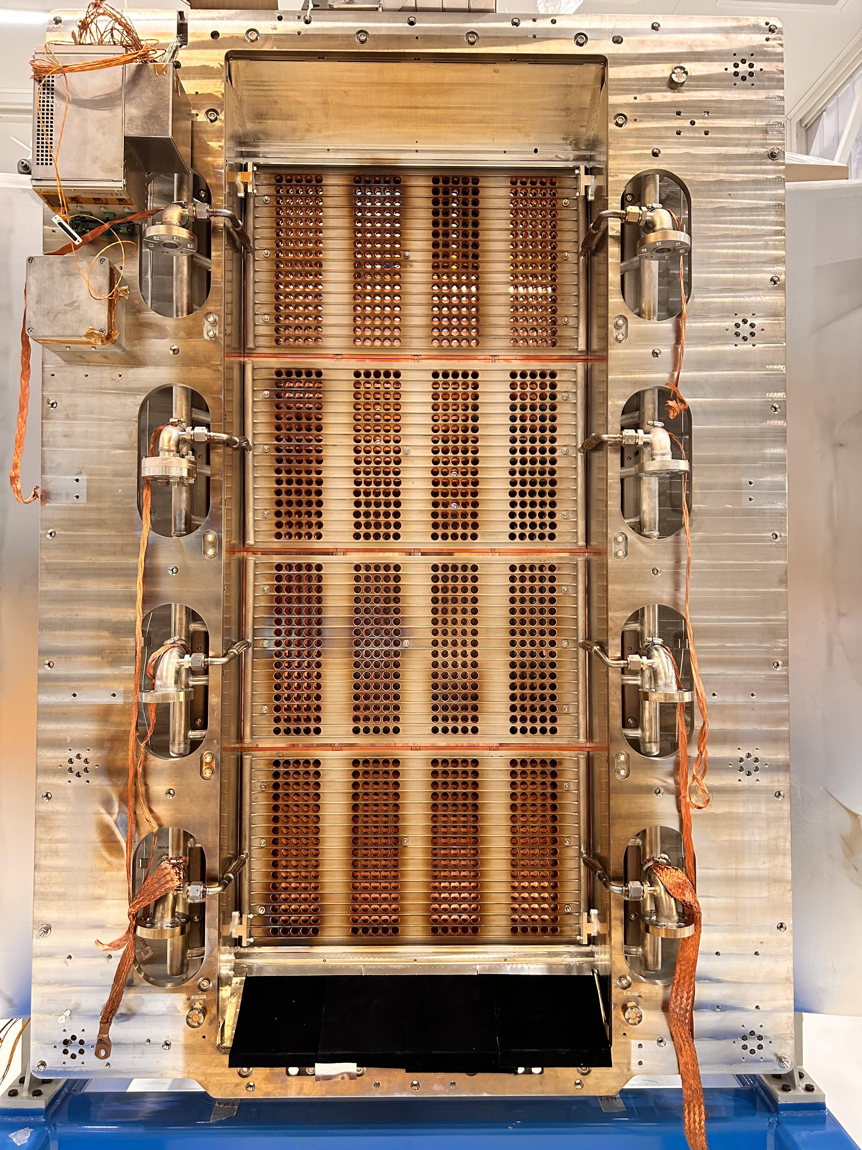
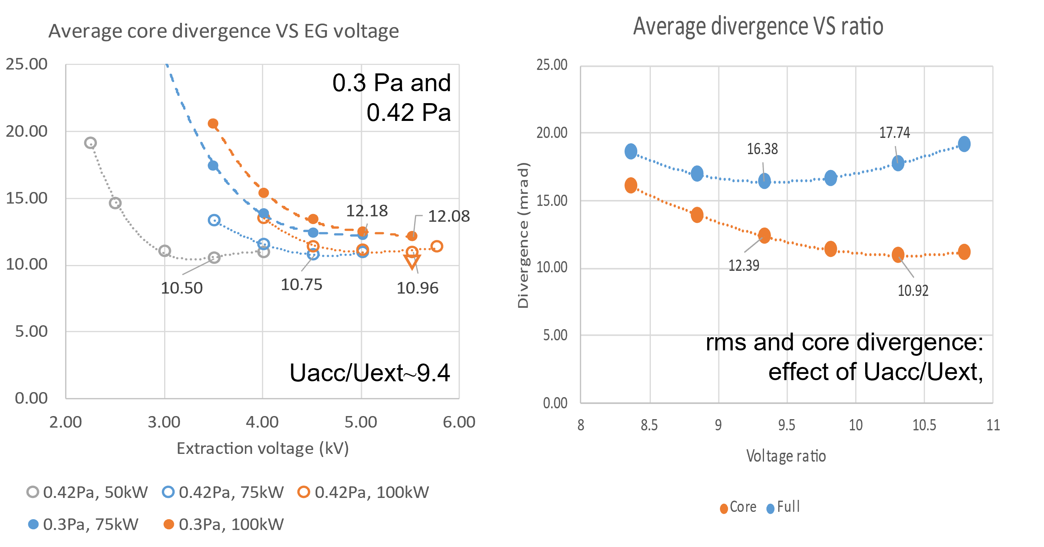
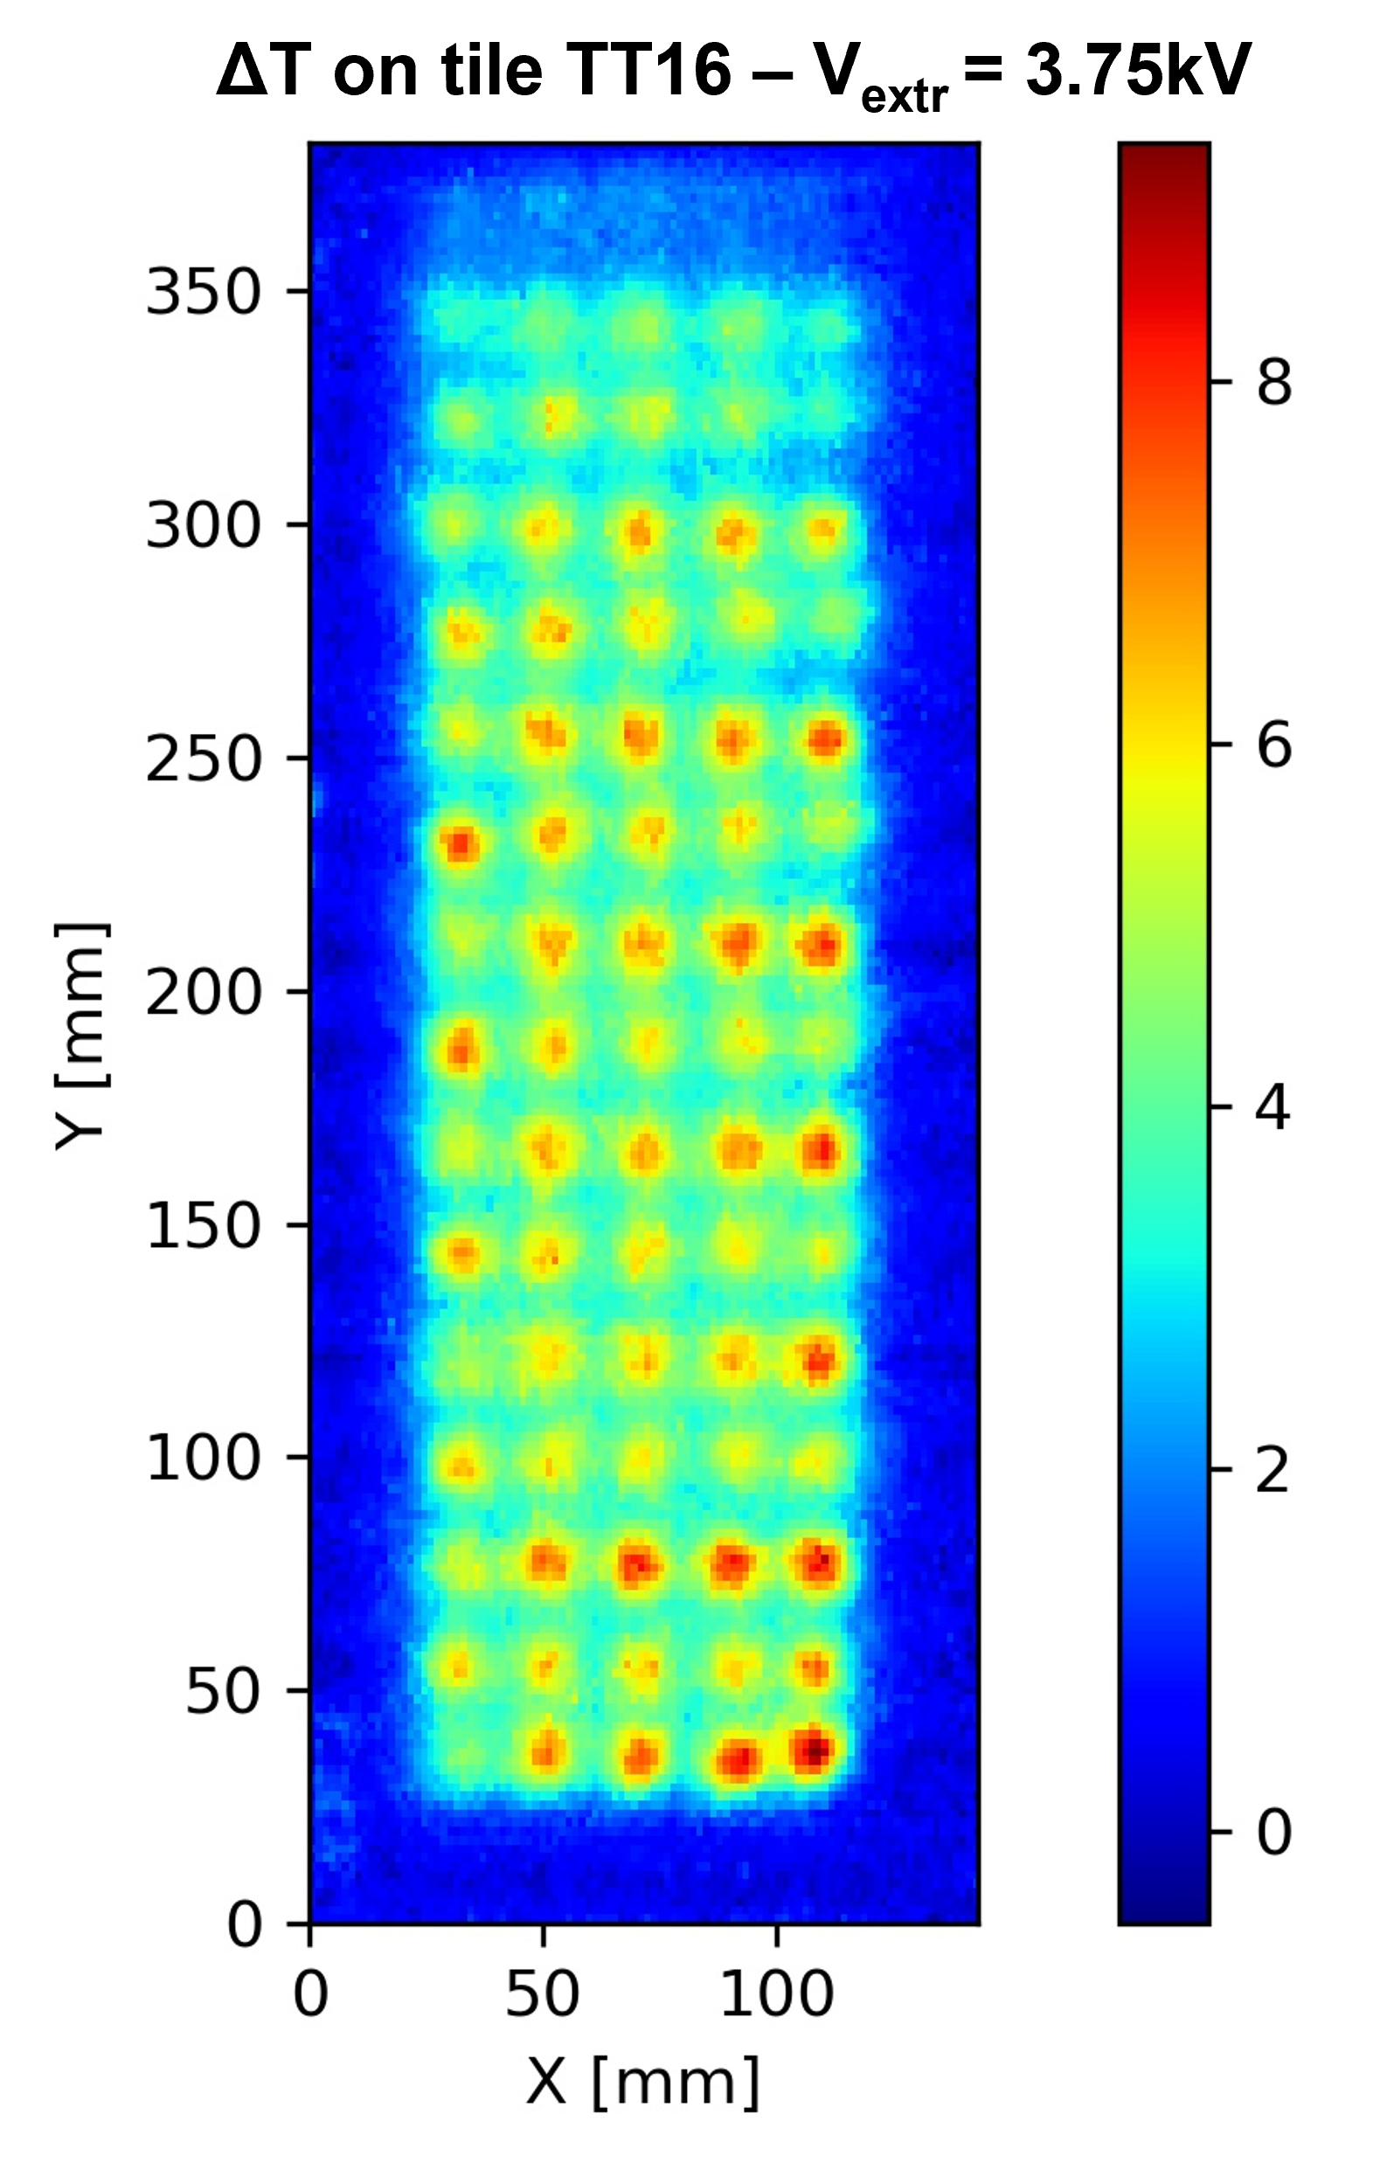
SPIDER Experimental Campaign
Operation with up to 312 beamlets open!
Divergence investigation
1/e divergence [mrad]
Beam current density
Uniformity investigation
3

Slide 7
SPIDER Experimental Campaign
Operation with up to 312 beamlets open!
Divergence investigation
1/e divergence [mrad]
Beam current density
Investigate beam optics under different experimental conditions through visible cameras
Uniformity investigation
3

Slide 8
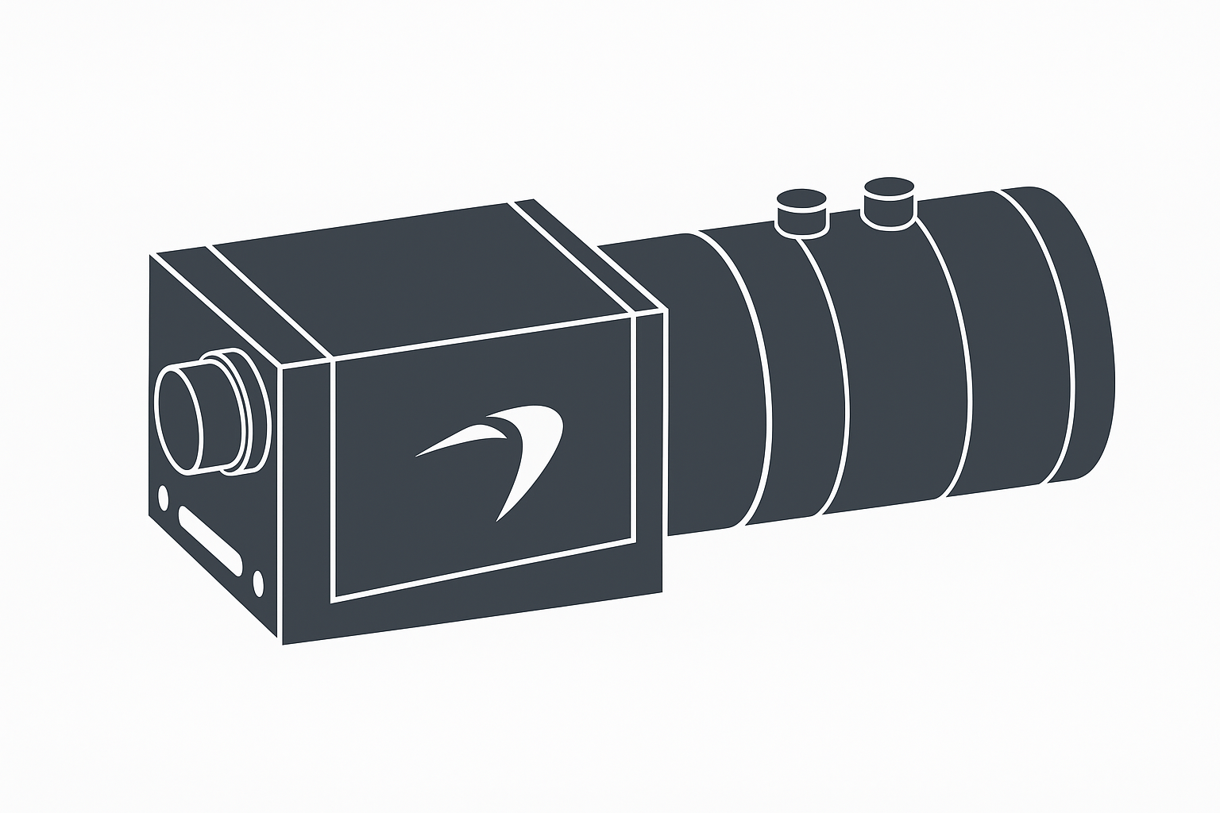
Table of Contents
Visible cameras
Description of the experimental setup
4

Slide 9

Table of Contents
Visible cameras
Method of Analysis
Description of the experimental setup
Description of the analysis method
4

Slide 10

Table of Contents
Visible cameras
Method of Analysis
Beam Optics investigation
Description of the experimental setup
Description of the analysis method
Analysis of the SPIDER experimental results
4

Slide 11

Table of Contents
Visible cameras
Method of Analysis
Beam Optics investigation
Conclusions
Description of the experimental setup
Description of the analysis method
Analysis of the SPIDER experimental results
Summary and final considerations
4

Slide 12
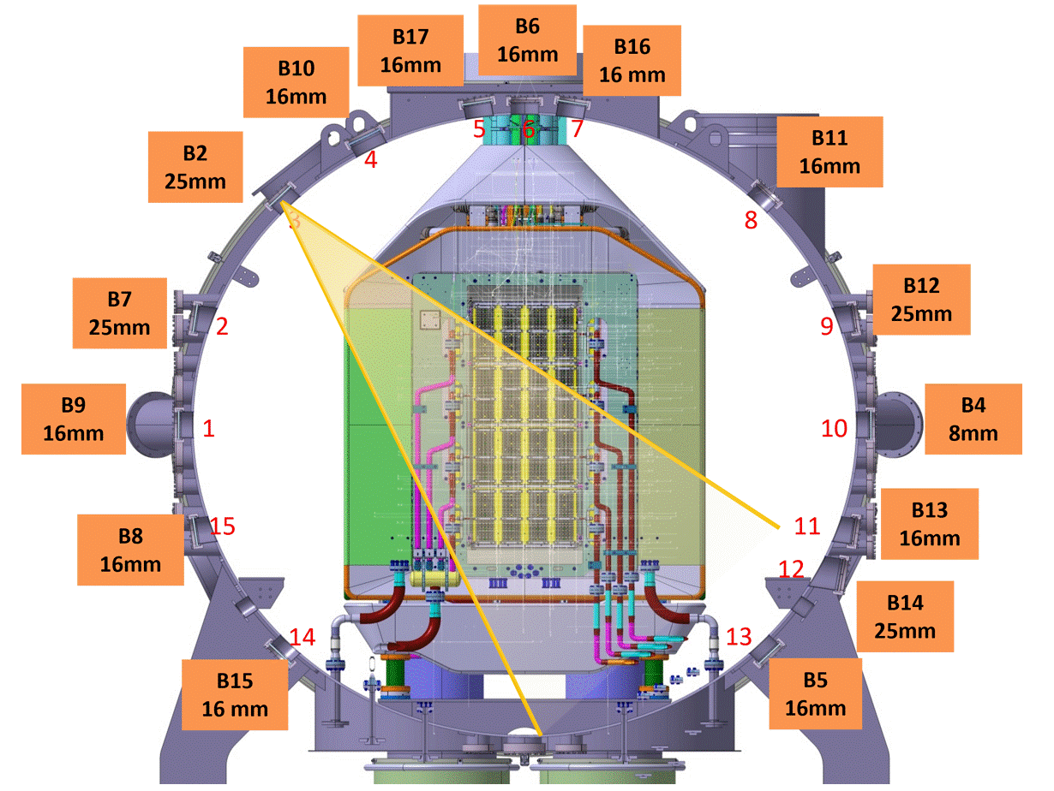
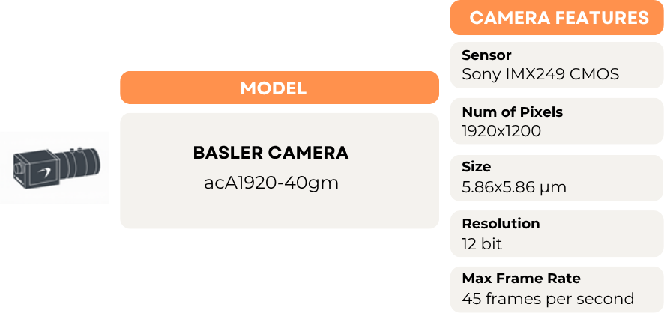
Visible cameras as diagnostic tool
15 2D visible cameras
Installed on the vessel, calibrated (absolutely and spatially) and aligned to look at the beam from different points of view
Measurement of the emitted light produced by the interaction of the negative ions with the background gas
5

Slide 13
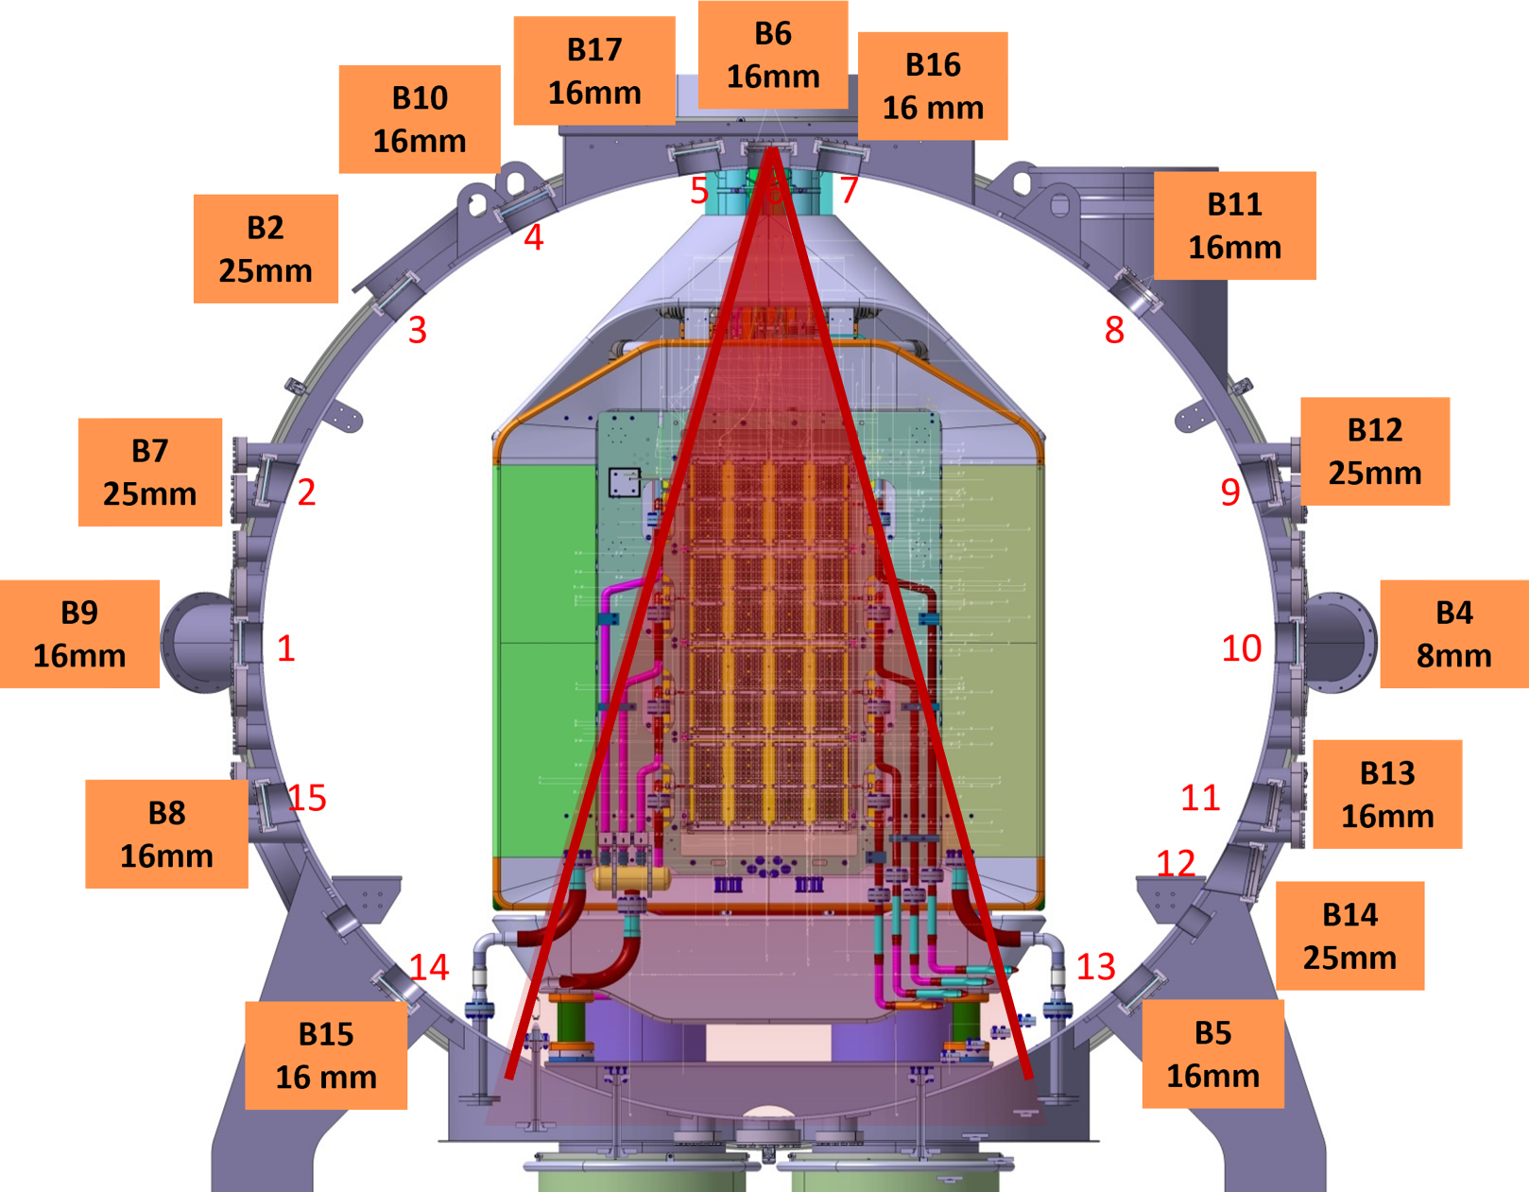
Visible cameras as diagnostic tool
6

Slide 14
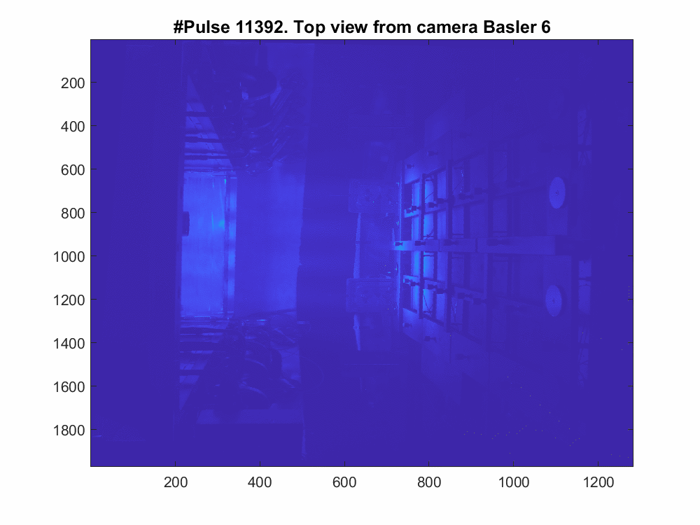
Visible cameras as diagnostic tool
2D beam image!
Beam Direction
Beam source
STRIKE
6

Slide 15
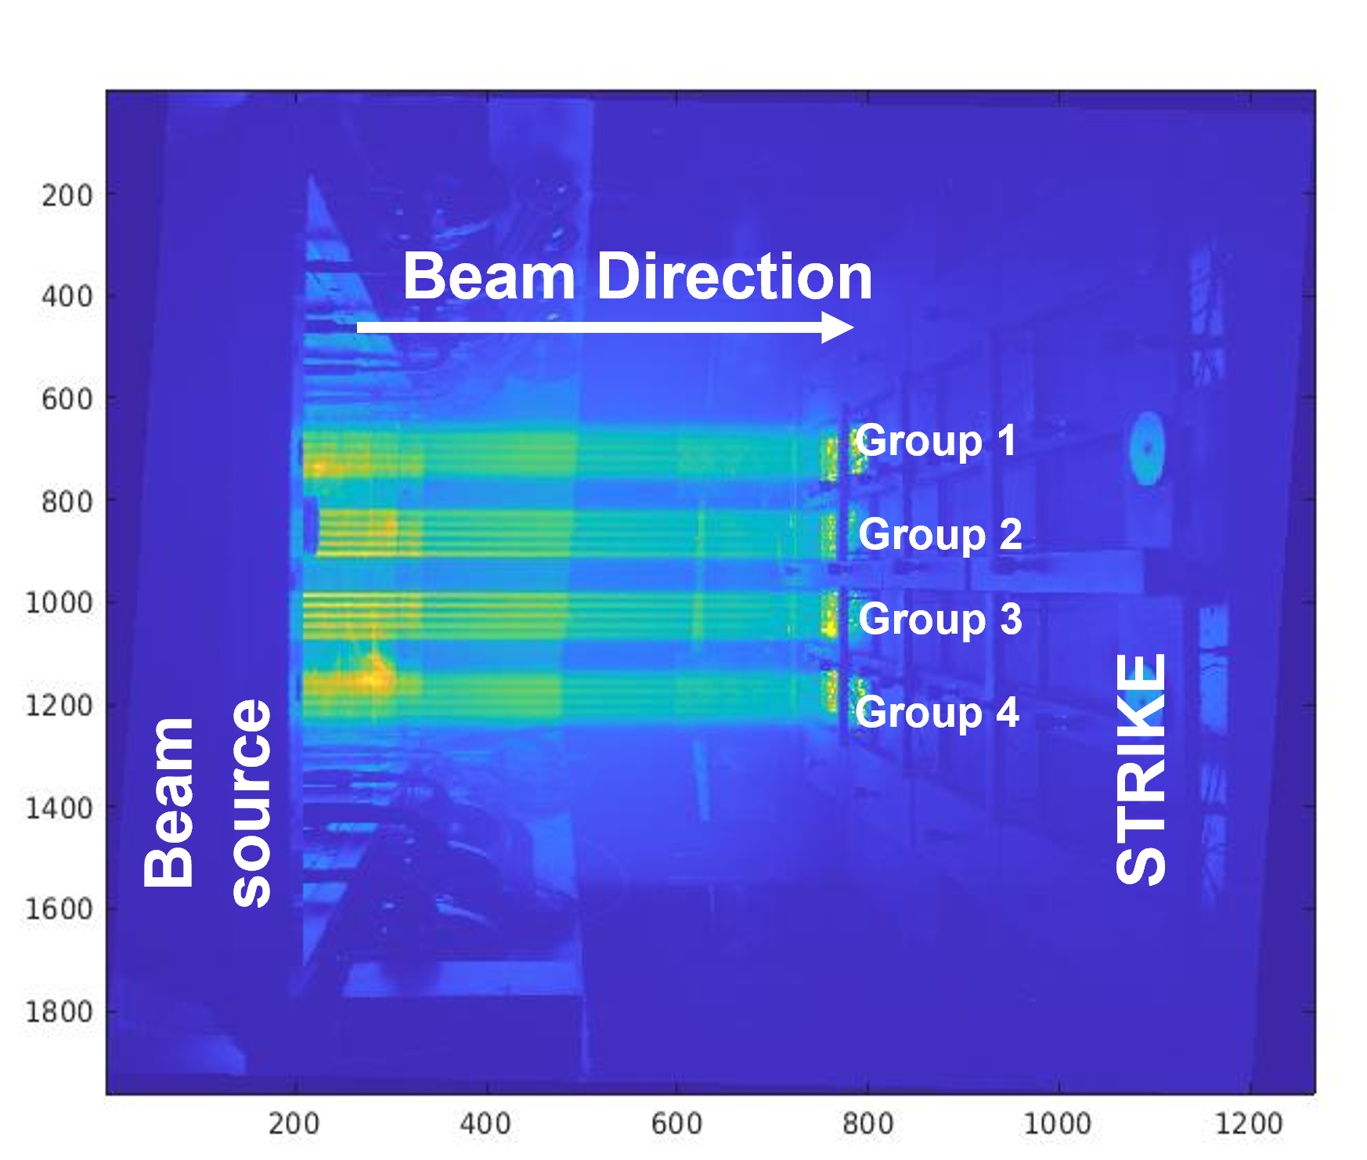
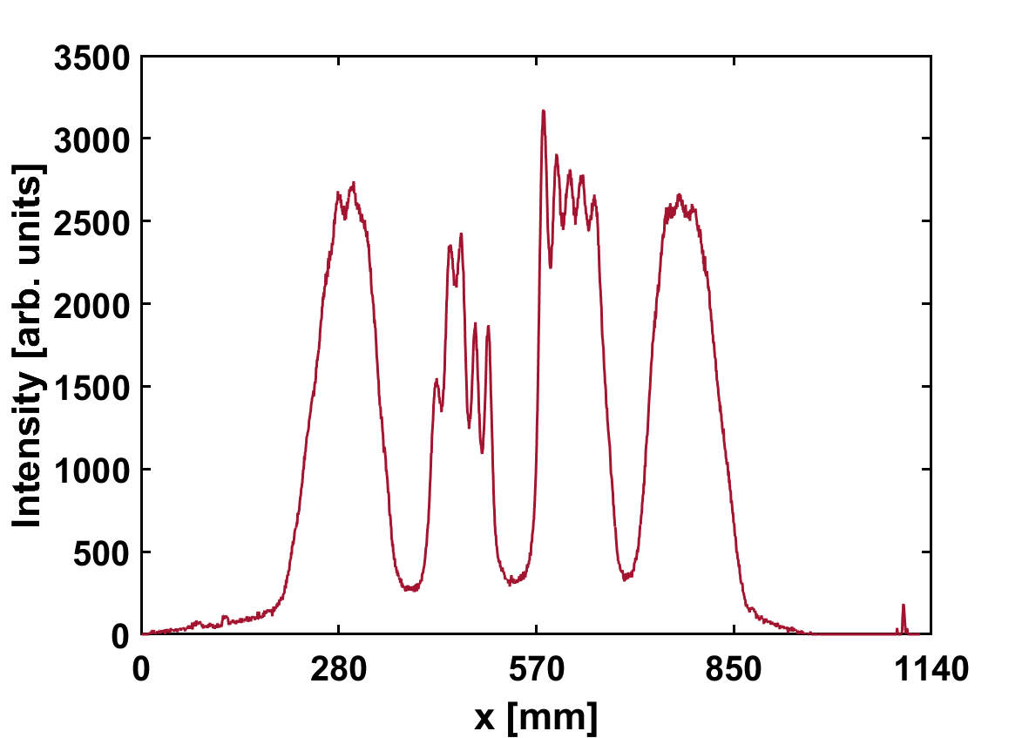
Visible cameras as diagnostic tool
2D beam image!
x
Reconstructed beam profile
Group 3
Group 1
Group 4
Group 2
Able to distinguish columns of superimposed beamlets within the same group
7

Slide 16

Visible cameras as diagnostic tool
2D beam image!
x
Reconstructed beam profile
Group 3
Group 1
Group 4
Strengths of the diagnostics
Group 2
Non-invasive diagnostics
No limits due to high power beams
Time evolution in long pulses
Analysis for beam optics investigation
Monitoring of the in-vessel environment
Able to distinguish columns of superimposed beamlets within the same group
7

Slide 17
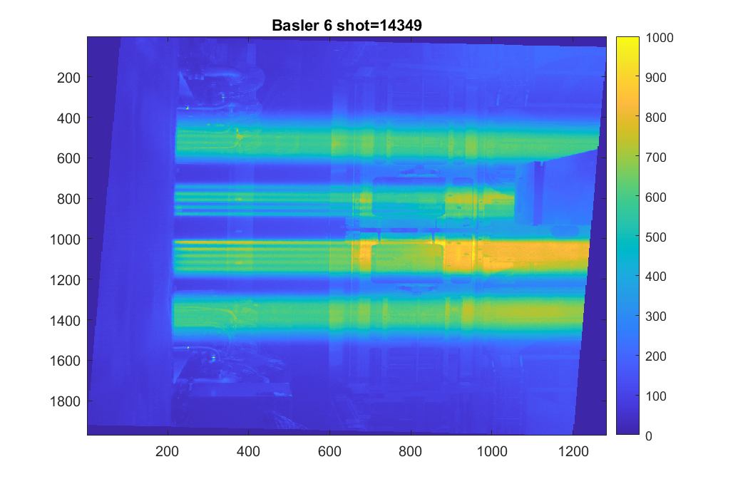
Method of Analysis
From top view camera (B6):
Beam direction
Group 1
Group 2
Beam source
Group 3
Group 4
STRIKE support
STRIKE support
z (beam direction)
8

Slide 18
Method of Analysis
From top view camera (B6):
Select different distances z along the beam direction
z1
z18
Group 1
Group 2
Beam source
Group 3
Beam source
Group 4
STRIKE support
STRIKE support
~ 23 cm from GG
~32 cm from GG
z (beam direction)
z (beam direction)
8

Slide 19
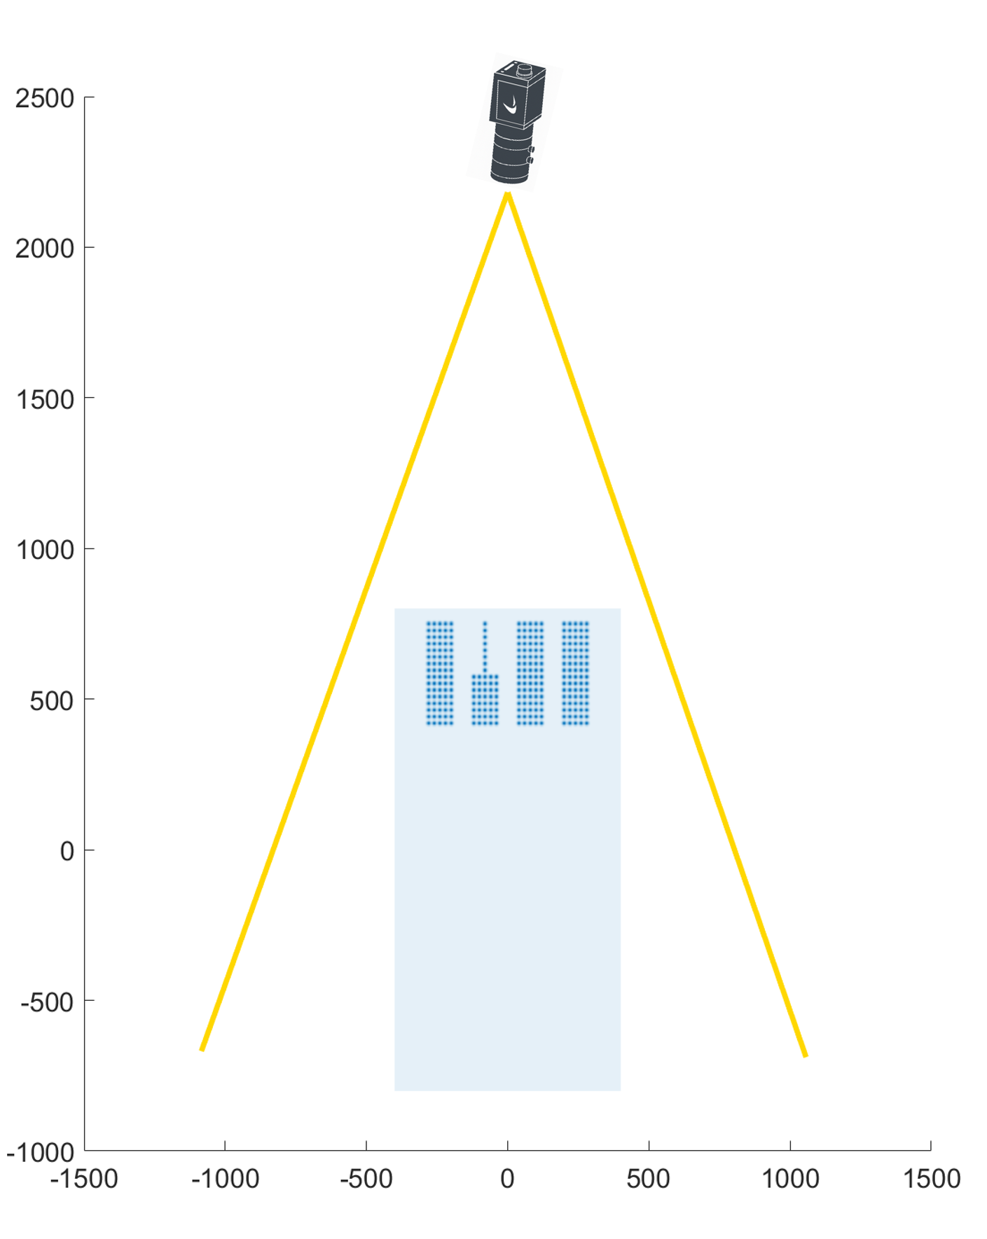
Method of Analysis
From top view camera (B6):
Select different distances z along the beam direction
Select the beam group (i.e. group 3) to be analyzed
z1
z18
Group 1
Group 2
Beam source
Group 3
Beam source
Group 4
STRIKE support
STRIKE support
~ 23 cm from GG
~32 cm from GG
z (beam direction)
z (beam direction)
8

Slide 20
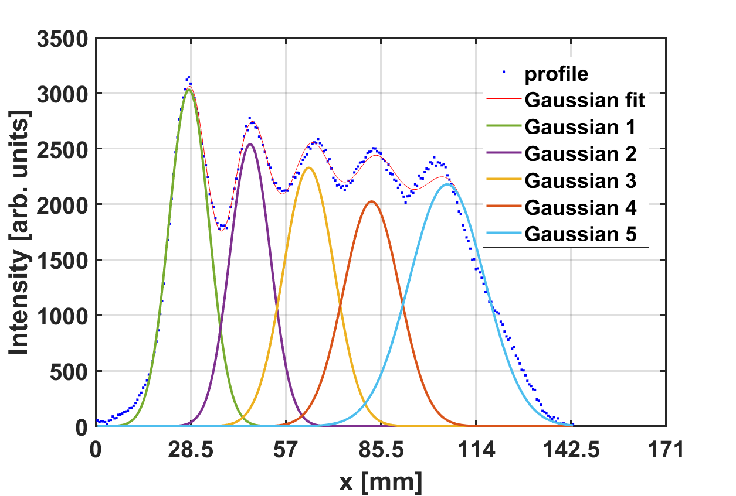
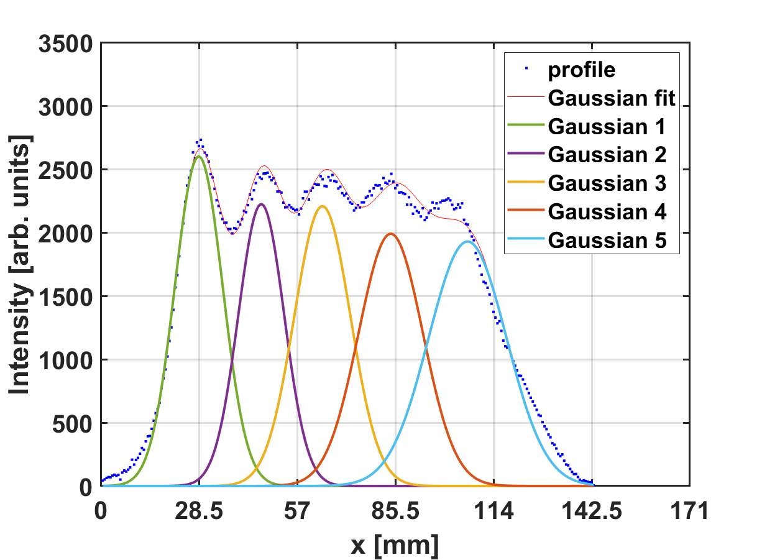
Method of Analysis
From top view camera (B6):
Select different distances z along the beam direction
Select the beam group (i.e. group 3) to be analyzed
Extrapolate the beamlet width w
z1
z18
Group 1
Group 2
Beam source
Group 3
Beam source
Group 4
STRIKE support
STRIKE support
~ 23 cm from GG
~32 cm from GG
z (beam direction)
z (beam direction)
Multi-gaussian fit!
w1
w3
w5
w2
w4
w1
w3
w5
w2
w4
8

Slide 21
Method of Analysis
From top view camera (B6):
Select different distances z along the beam direction
Select the beam group (i.e. group 3) to be analyzed
Extrapolate the beamlet width w
z1
z18
Group 1
Group 2
Beam source
Group 3
Beam source
Group 4
STRIKE support
STRIKE support
~ 23 cm from GG
~32 cm from GG
z (beam direction)
z (beam direction)
Multi-gaussian fit!
w1
w3
w5
w2
w4
w1
w3
w5
w2
w4
8

Slide 22
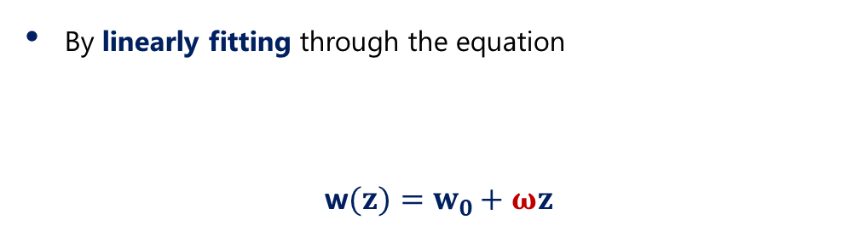
Method of Analysis
By linearly fitting through the equation
w$(z)=w_{0}+ωz$
z=30cm
Beamlet width at the exit of the last SPIDER grid
Beamlet width at z
Beam source
STRIKE support
Beamlet divergence
Robust method → no need of assumptions on w₀
w0
9

Slide 23
Beam optics investigation
Different source parameters to study the beam optics:
Source
Driver
Expansion region
Driver
Beam direction
10

Slide 24
Beam optics investigation
ISBI
Different source parameters to study the beam optics:
RF power
Source pressure
Bias plate polarization (ISBP)
Plasma grid polarization (ISBI)
Magnetic filter field (FF)
- +
- +
ISBP
Source
Driver
Expansion region
Driver
IPG
Bias Plate (BP)
Plasma Grid (PG)
Beam direction
10

Slide 25
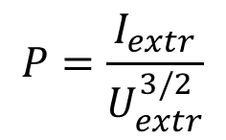
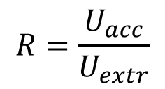
Beam optics investigation
ISBI
Different source parameters to study the beam optics:
RF power
Source pressure
Bias plate polarization (ISBP)
Plasma grid polarization (ISBI)
Magnetic filter field (FF)
- +
- +
ISBP
Extraction Grid (EG)
Source
Grounded Grid (GG)
Driver
Beam optics is related to the beam transport over large distances and depends on:
Beam perveance P
Voltage ratio R
Expansion region
Driver
$$P=\frac{I_{extr}}{U_{extr}^{3/2}}$$
$$R=\frac{U_{acc}}{U_{extr}}$$
IPG
Bias Plate (BP)
Plasma Grid (PG)
Beam direction
10

Slide 26
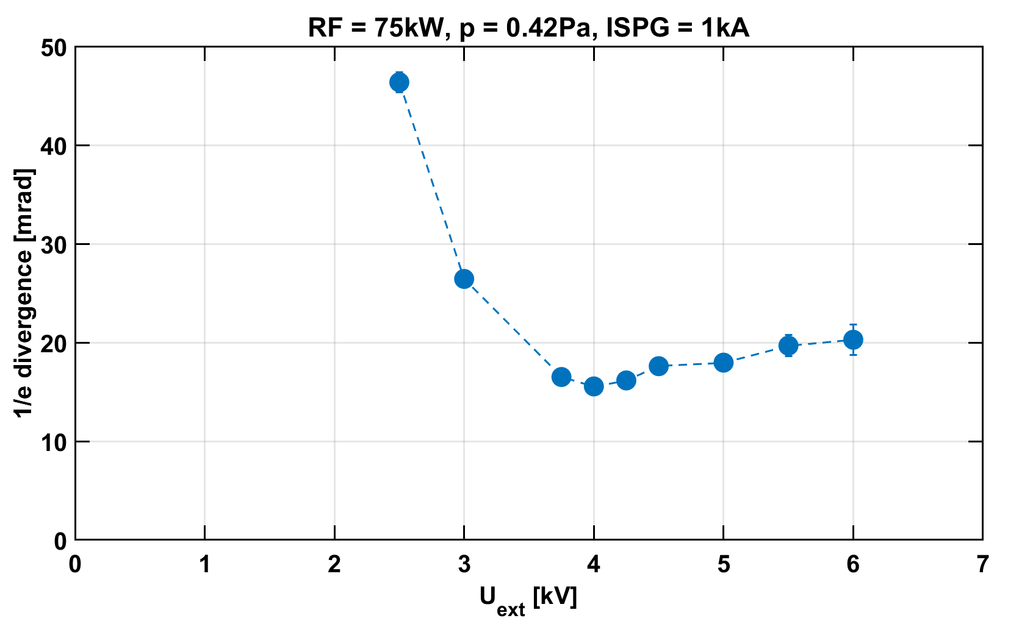
Beam optics investigation
11

Slide 27
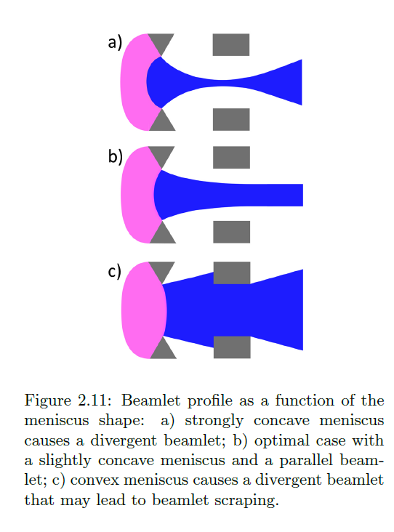
Beam optics investigation
Study the beamlet divergence as a function of the meniscus shape:
EG
PG
EG
PG
Plasma
Concave meniscus
Concave meniscus
perveance match
Beam
Meniscus
under-perveance
Optimal case
over-perveance
Convex meniscus
Meniscus: interface between the neutral plasma and the negative ion beamlets. It plays a fundamental role in the definition of the beamlet divergence
11

Slide 28

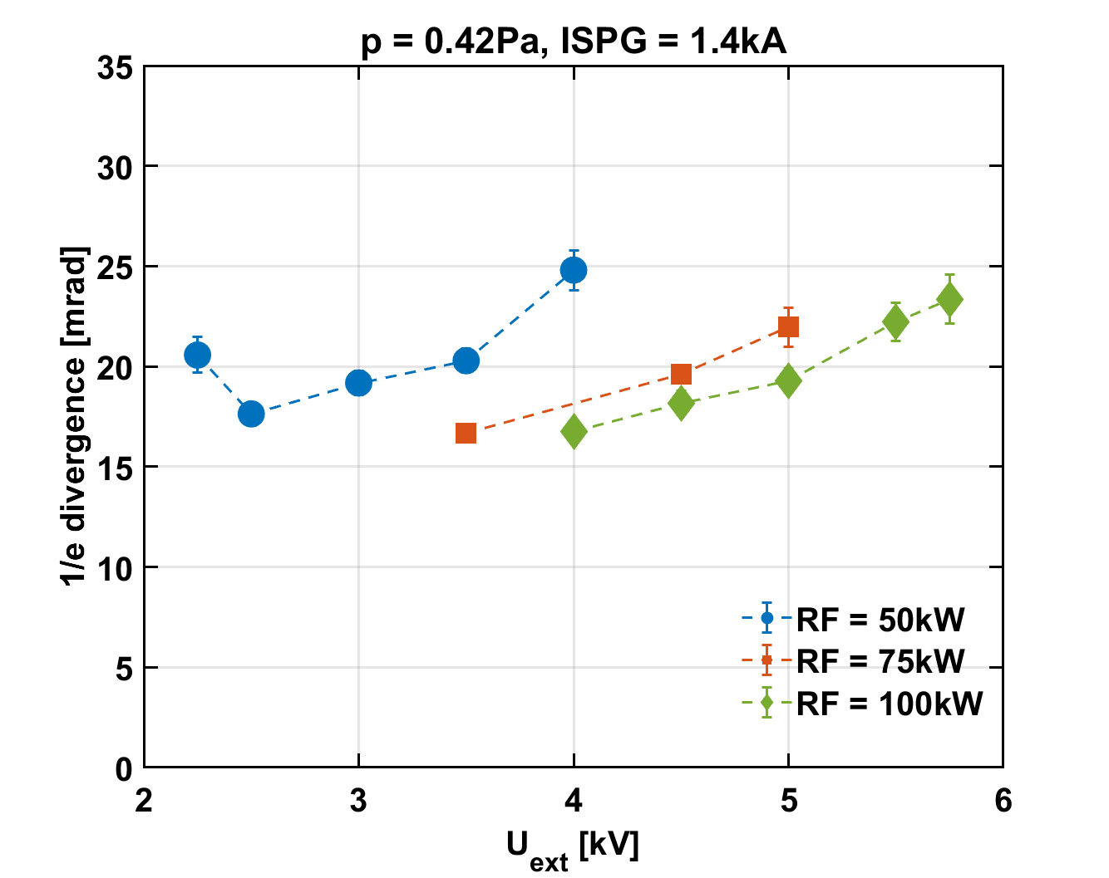
LET’S SEE SOME SCANS

Slide 29
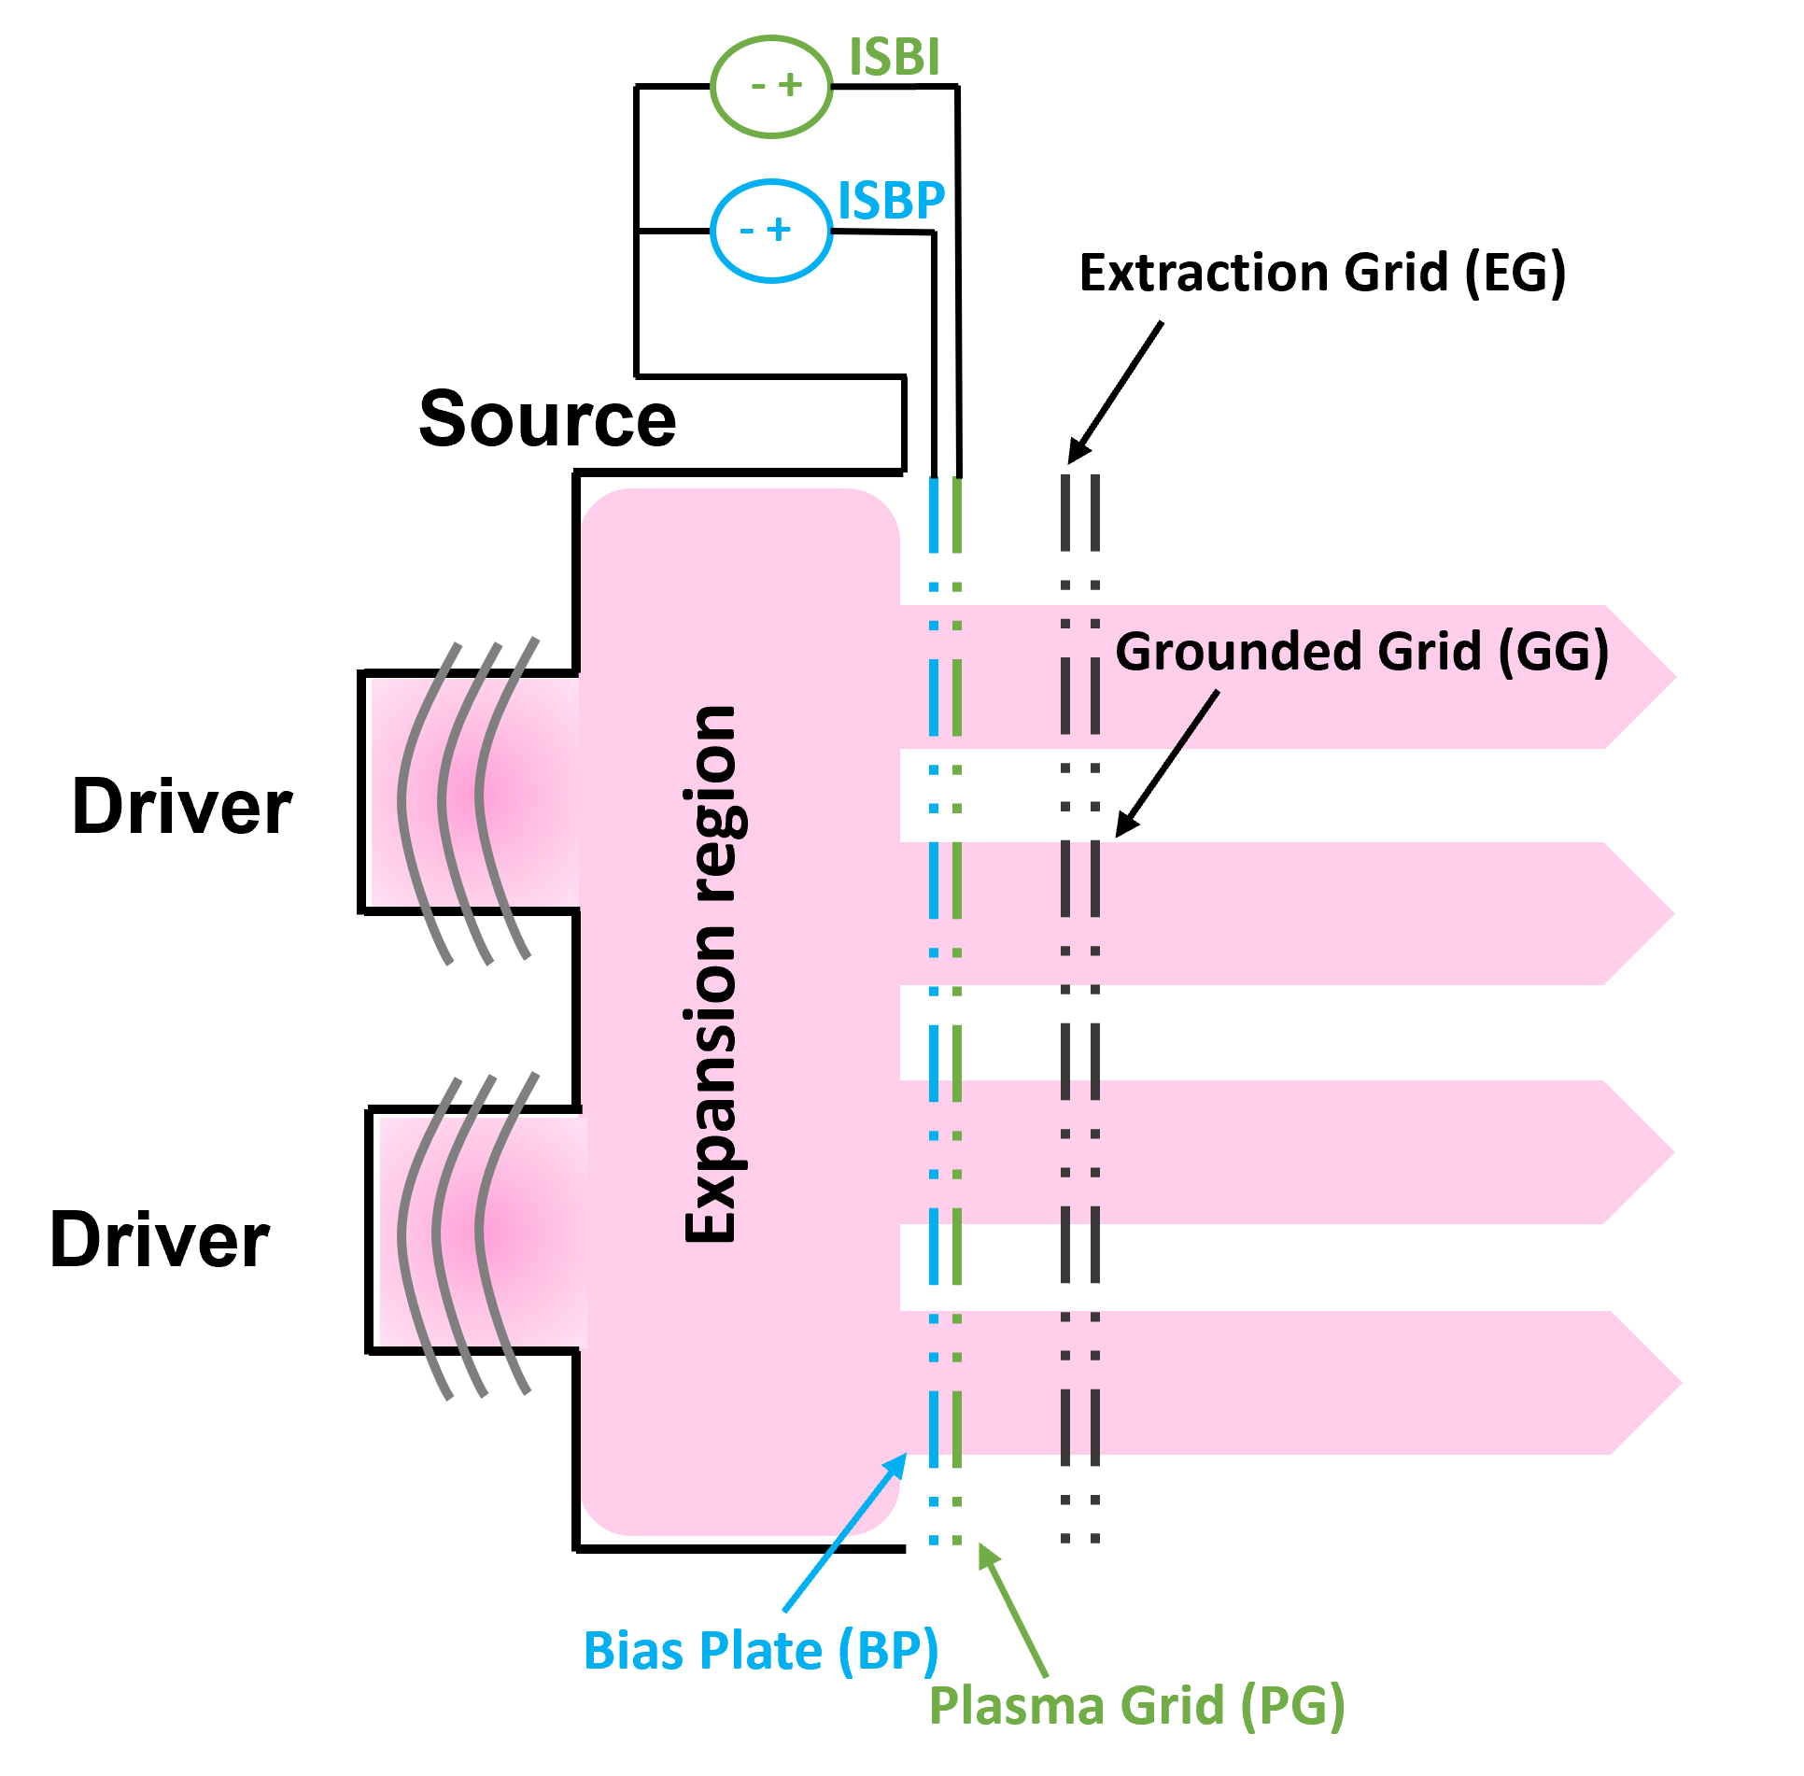
RF power dependence
Three perveance scans at different RF power
Effect on the divergence as the minimum moves to higher EG voltages
[kW/generator]
12

Slide 30
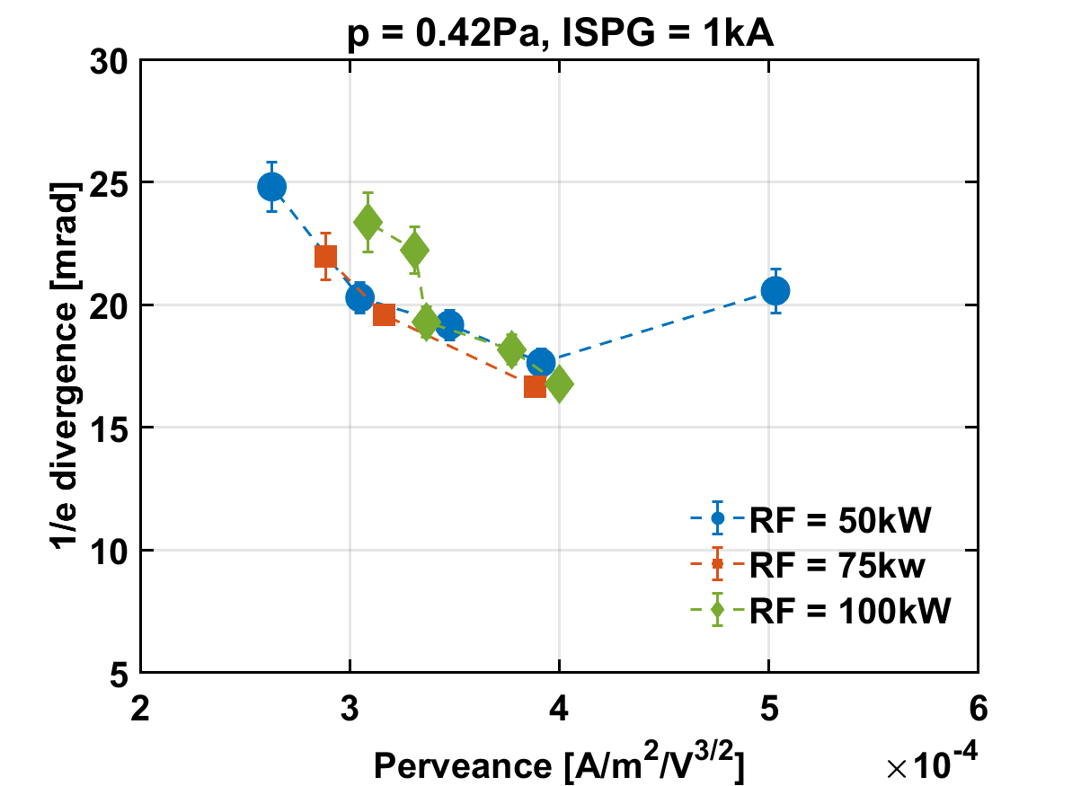
RF power dependence
Three perveance scans at different RF power
[kW/generator]
12

Slide 31
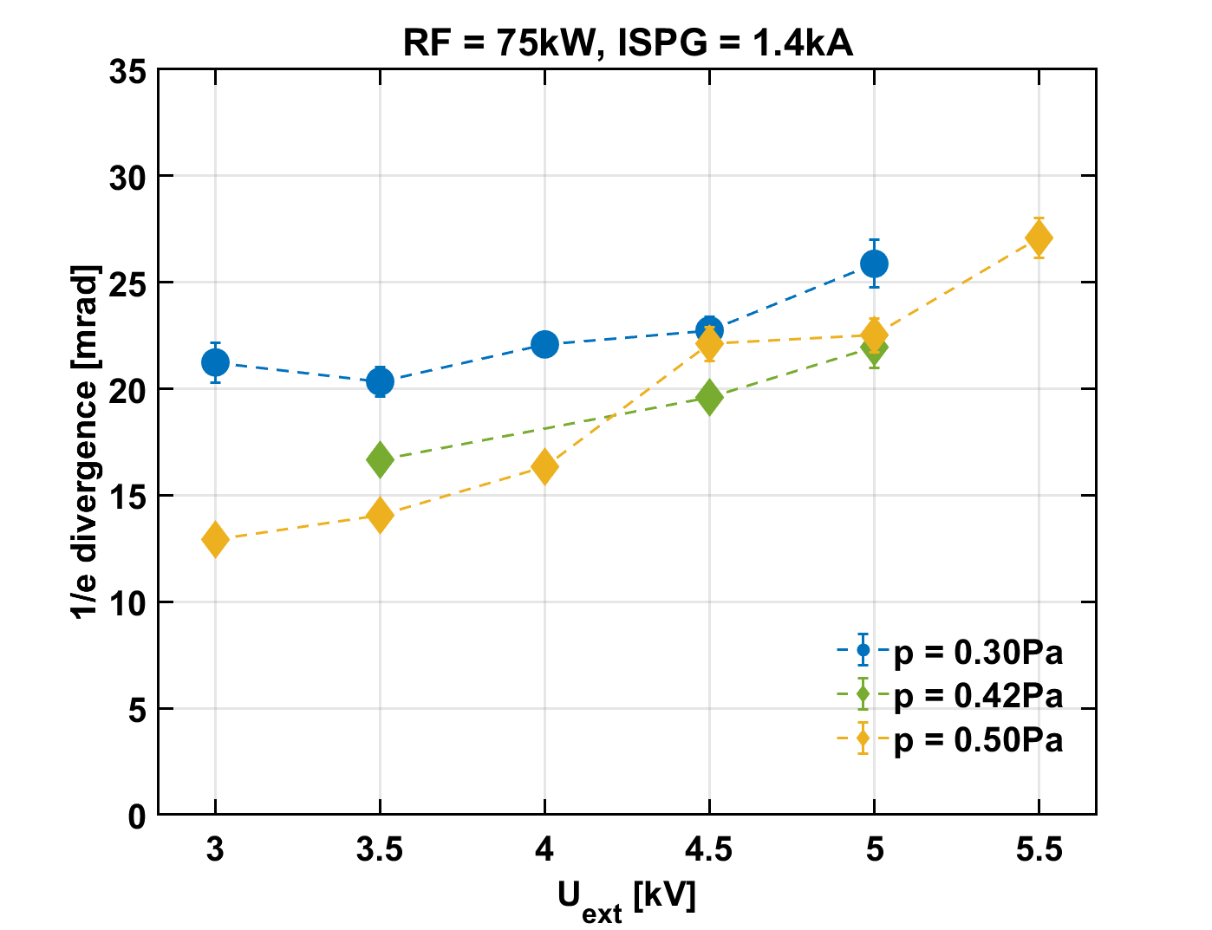
Pressure dependence
Three perveance scans at different source pressure
Higher the pressure, less the minimum of divergence
20.3
12.9
13

Slide 32
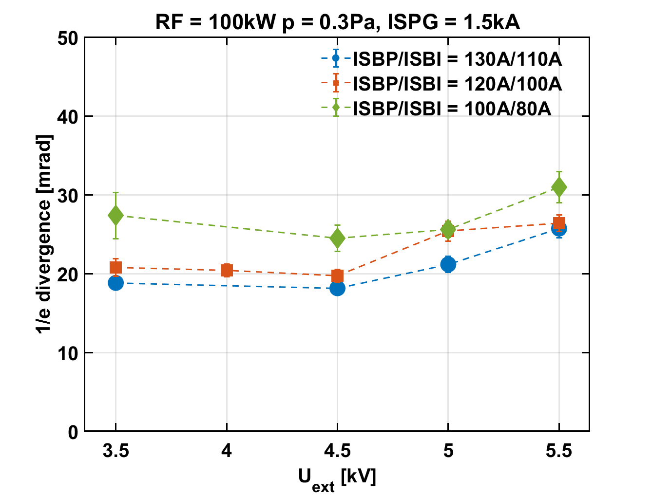
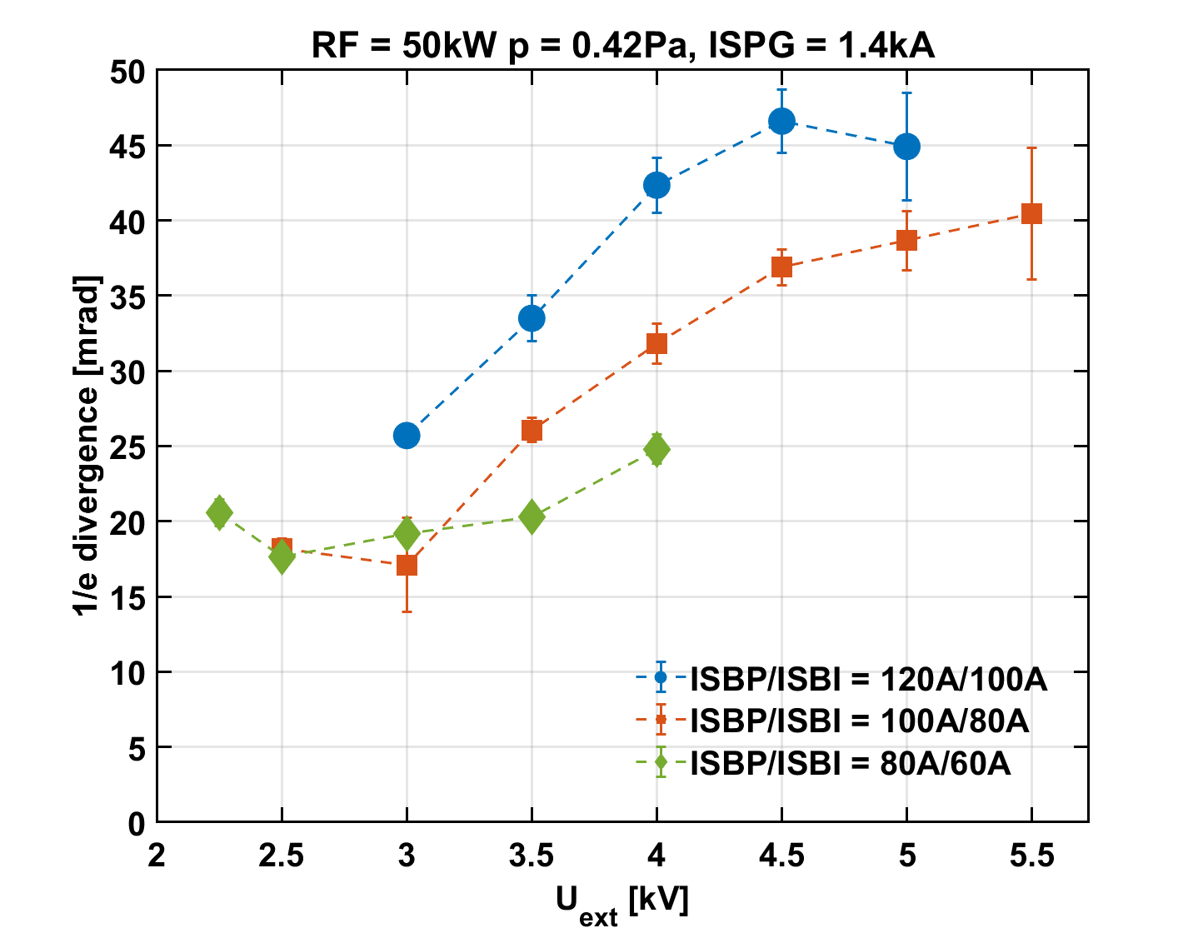
Bias dependence
14

Slide 33
Bias dependence
At this power of 100kW, increasing bias seems to have a good effect on the optics
Minimum of divergence for the configuration with higher bias
14

Slide 34
Bias dependence
At this power of 100kW, increasing bias seems to have a good effect on the optics
Minimum of divergence for the configuration with higher bias
At this power of 50kW, increasing bias seems to have bad effect on the optics
Minimum of divergence for the configuration with lowest bias
14

Slide 35
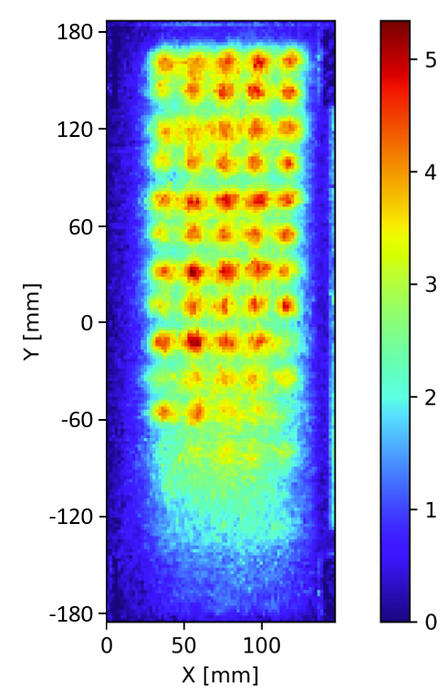
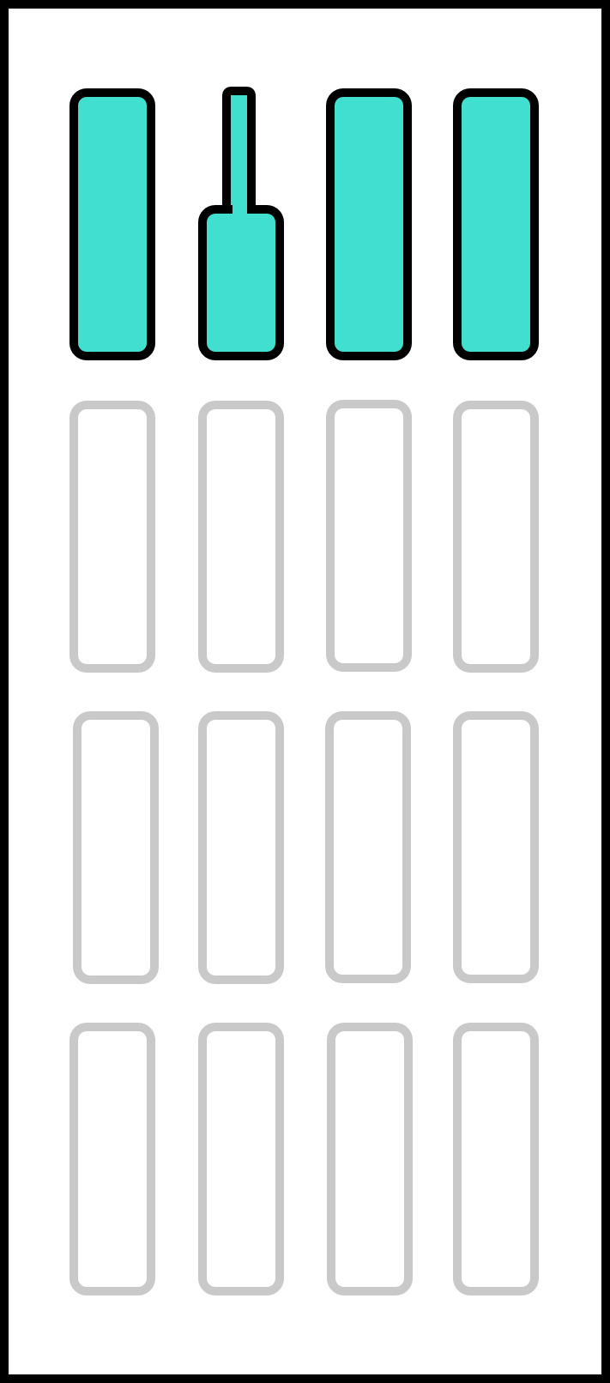
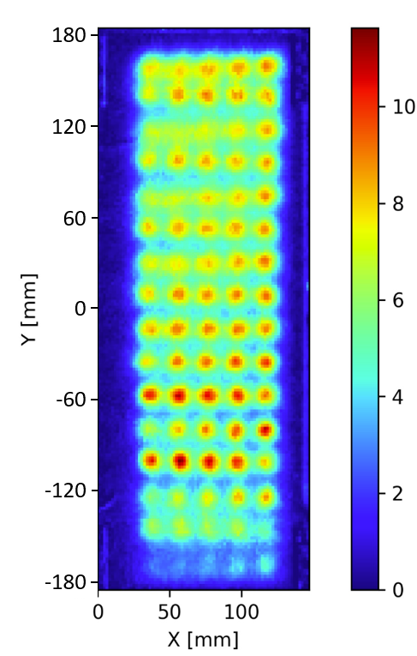
Role of Beam Uniformity
Cases with 1 and 2 generators are compared with same source parameters:
Same RF power & pressure
Fixed bias and FF
One generator case
Two generators case
15

Slide 36
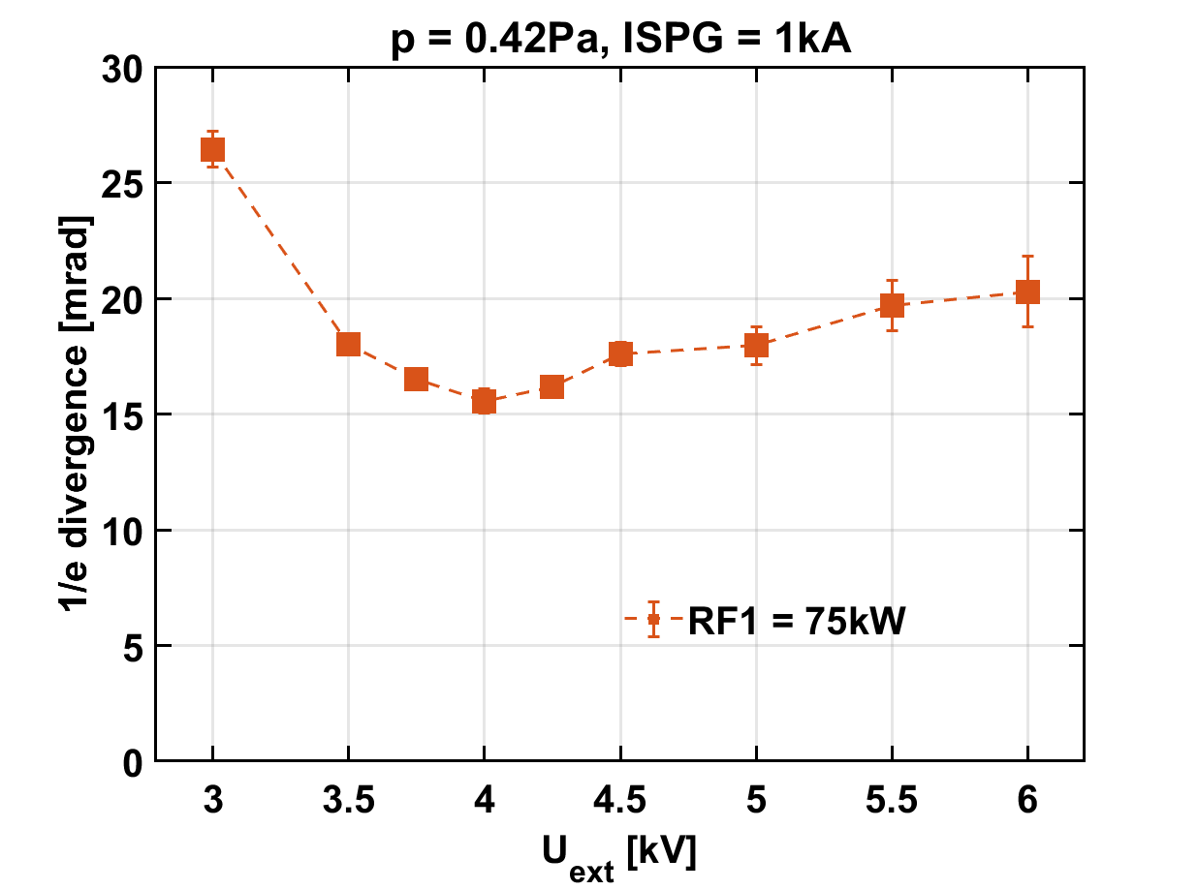
Role of Beam Uniformity
Cases with 1 and 2 generators are compared with same source parameters:
Same RF power & pressure
Fixed bias and FF
One generator case
Two generators case
15

Slide 37
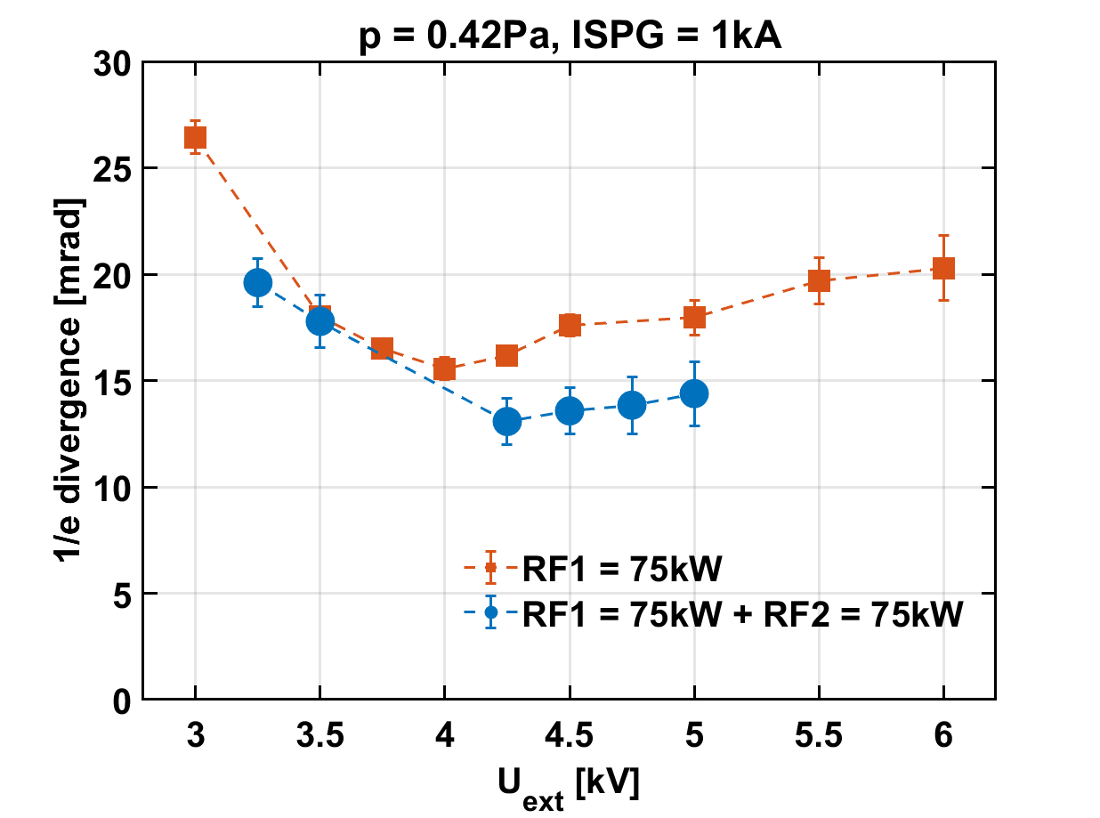

Role of Beam Uniformity
Cases with 1 and 2 generators are compared with same source parameters:
Same RF power & pressure
Fixed bias and FF
One generator case
Two generators case
15

Slide 38
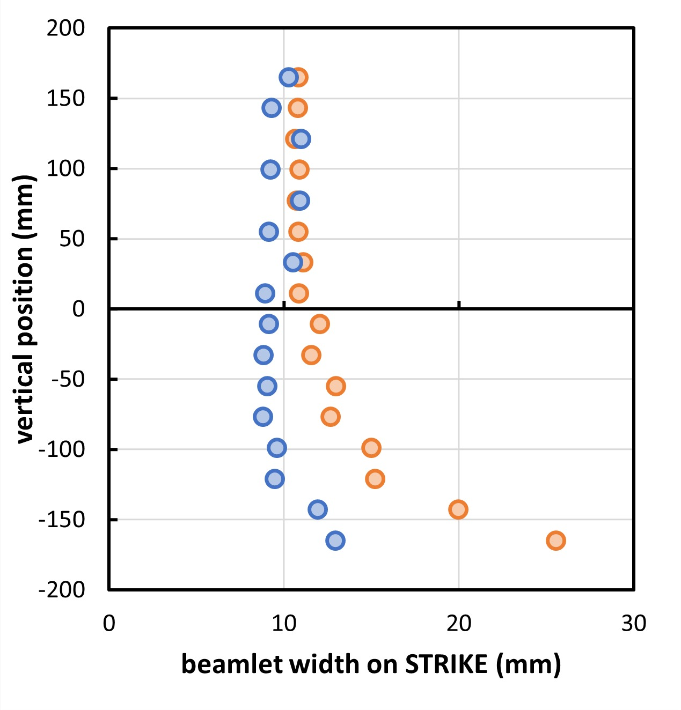



Role of Beam Uniformity
Cases with 1 and 2 generators are compared with same source parameters:
Same RF power & pressure
Fixed bias and FF
One generator case
$$\overline{w}=9.93 mm$$
$$\overline{w}=\frac{\sum{w⋅I}}{\sum{I}}$$
$$\overline{w}′=12.04 mm, +20\%$$
Two generators case
15

Slide 39
Conclusions
Pros of the diagnostics system:
Investigation on the beam optics in multi-beamlet configuration
Beamlet divergence estimation → robust method
Correct response to optics variation → expected trends
Real-time estimation during operation
Non-invasive diagnostics → future MITICA operation
Expected behavior with the RF power
Evident effect of the pressure
Bias optimization required
16

Slide 40
Conclusions
Pros of the diagnostics system:
Investigation on the beam optics in multi-beamlet configuration
Beamlet divergence estimation → robust method
Correct response to optics variation → expected trends
Real-time estimation during operation
Non-invasive diagnostics → future MITICA operation
Expected behavior with the RF power
Evident effect of the pressure
Bias optimization required
Cons of the diagnostics system:
X Average on the beamlet column
Sensitive to beam uniformity
16

Slide 41
Conclusions
Pros of the diagnostics system:
Investigation on the beam optics in multi-beamlet configuration
Beamlet divergence estimation → robust method
Correct response to optics variation → expected trends
Real-time estimation during operation
Non-invasive diagnostics → future MITICA operation
Expected behavior with the RF power
Evident effect of the pressure
Bias optimization required
Cons of the diagnostics system:
X Average on the beamlet column
Sensitive to beam uniformity
Future perspective: tomography to evaluate the beam current density → stay tuned at ICIS 2027 ☺
16

Slide 42
Thank You
For Your Attention!

Slide 43
List of References
[1] V. Toigo et al., New J. Phys., vol. 19, 085004 (2017), doi: 10.1088/1367-2630/aa78e8
[2] U. Fantz et al., Negative Hydrogen Ion Sources for Fusion: From Plasma Generation to Beam Properties, Front. Phys., 29 September 2021, Sec. Low-Temperature Plasma Physics, Volume 9-2021, https://doi.org/10.3389/fphy.2021.709651
[3] E. Sartori et al., Nuclear Fusion, vol. 62 (8), 086022 (2022), doi: 10.1088/1741-4326/ac715e
[4] M. Ugoletti, “Beam physics via tomography diagnostics”. PhD Thesis, Università degli studi di Padova, 2022
[5] M. Ugoletti et al., “First results of SPIDER beam characterization through the visible tomography”, Fusion Engineering and Design, Volume 169, 2021, 112667, ISSN 0920-3796, https://doi.org/10.1016/j.fusengdes.2021.112667
[6] M. Agostini et al., “Characterization of SPIDER beam optics in volume operations with visible cameras”, Phys. Plasmas 29, 103102 (2022), https://doi.org/10.1063/5.0089843

Slide 44
EXTRA SLIDES

Slide 45
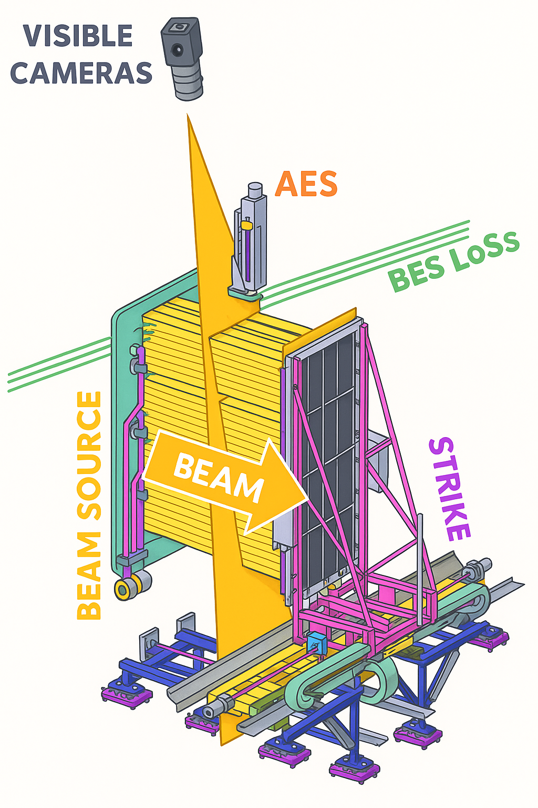
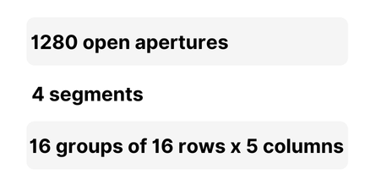
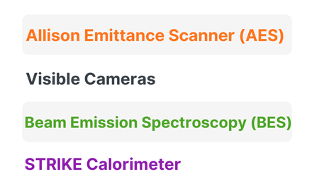
SPIDER Experiment
SPIDER BEAM
BEAM DIAGNOSTICS
4

Slide 46
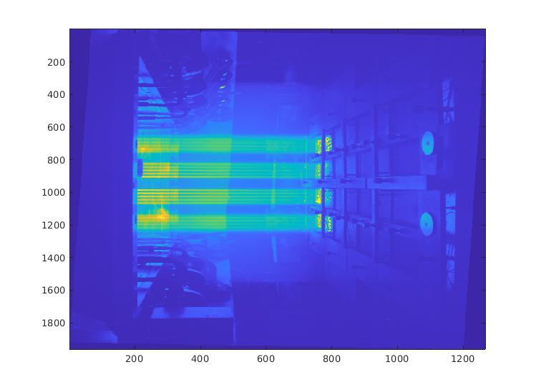
STRIKE
Beam Direction
Strip of aluminum black foil

Slide 47
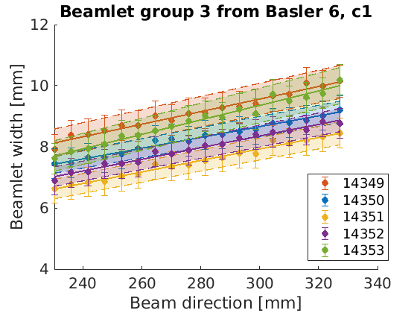
w0

