Slide 1

Conversion of a positive ion into a negative ion and a neutral atom: formation processes from a few keV to MeV energies
Sargis Ter-Avetisyan
Extreme Light Infrastructure-Nuclear Physics (ELI-NP) Bucharest-Magurele, Romania
sargis.ter-avetisyan@eli-np.ro
Matthias Schnürer
Max Born Institute, Berlin, Germany
Vladimir Tikhonchuk
CELIA, Université de Bordeaux-CNRS-CEA, France
ELI Beamlines, Dolní Břežany, Czech Republic
St Catherine's College, Oxford, UK,
8 - 12 September, 2025

Slide 2


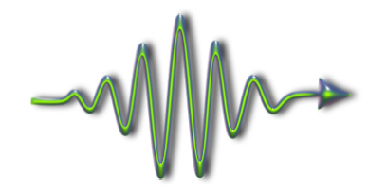
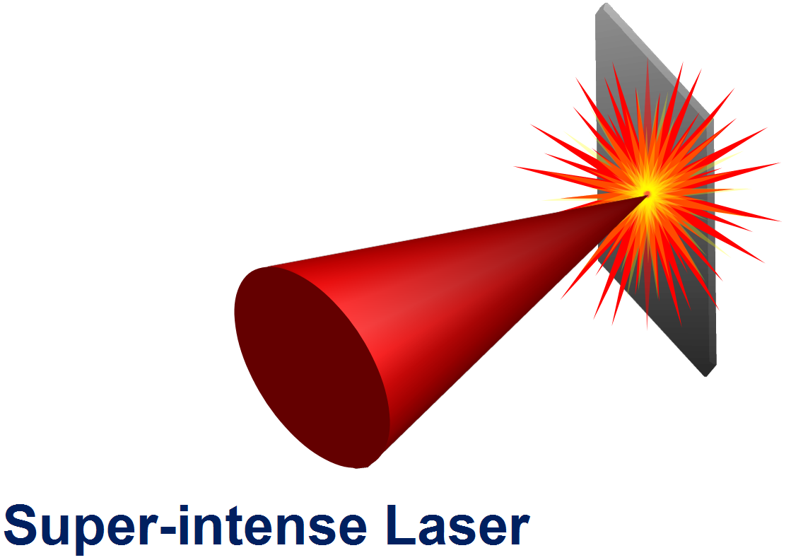




with advances in laser technology the frontier of maximum intensity is pushed now above 10²² W/cm²
(e.g. 10 PW laser at ELI-NP)
exploration of Relativistic Laser-Matter Interactions
Atto/Zeptosecond
Science
Relativistic Laser-Plasma
Lab. Astrophysics
High Energy Protons
Relativistic Electrons
Laser Nuclear Physics
x-rays, γ-rays
Novel Applications

Slide 3
This work highlights another important aspect of ion acceleration research:
namely the ability to generate high-energy beams of
Negative ions and Neutral atoms

Slide 4
Why the negative ions are interesting?
there is a strong fundamental interest in negative ions
in screening of nucleus the inter–electronic interactions become relatively more important than the electron–nuclear interactions
electron correlation plays an important role.
The interplay of these attractive and repulsive interactions allows better understand the atomic physics.
there is a strong practical interest in negative ions

Slide 5
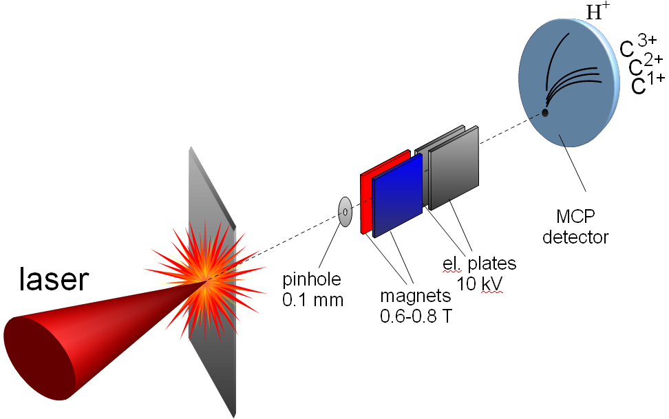
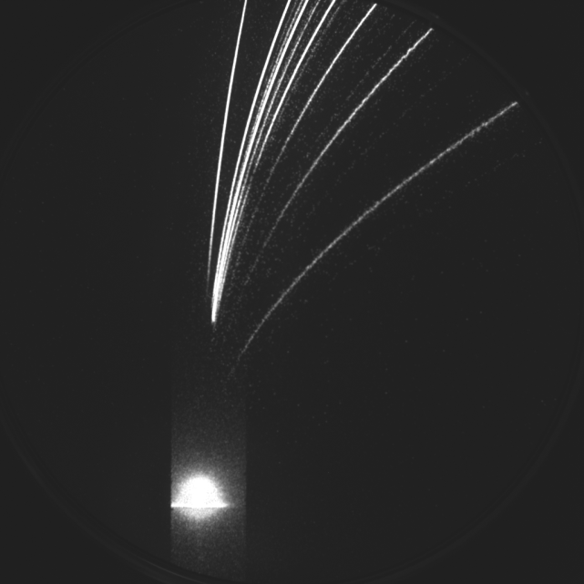
measurement of laser accelerated ion spectra
(Thomson spectrometer)
Absolute calibrated MCP detector
10 nm C, 10 J
I ∼ 5×10²⁰ W/cm²
C6+
P
C2+
7
3
10
5
C1+
magnetic deflection
20
10
30
15
50
I > 10¹⁸ W/cm²
C6+(MeV)
Ion spectra (Thomson spectrometer)
Protons (MeV)
electric deflection
“Zero” point

Slide 6
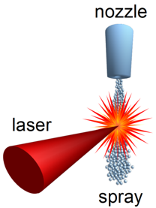
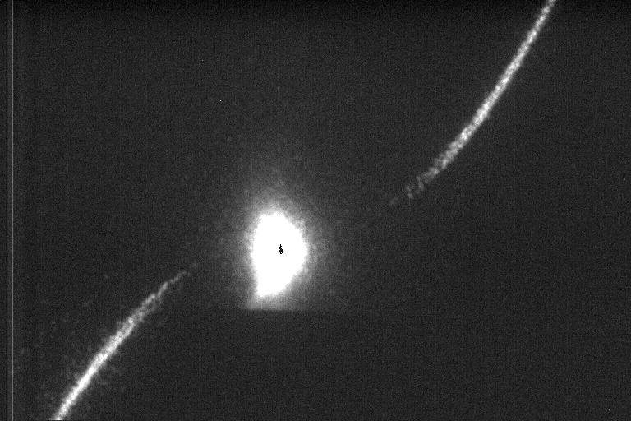
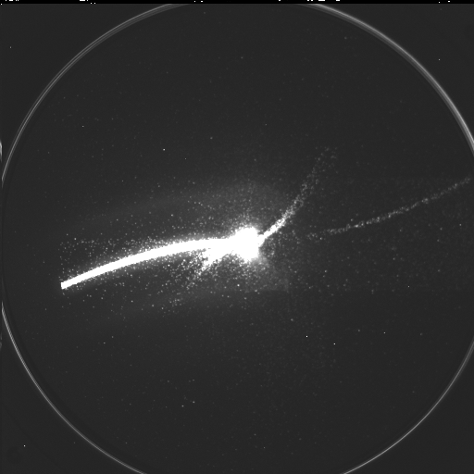
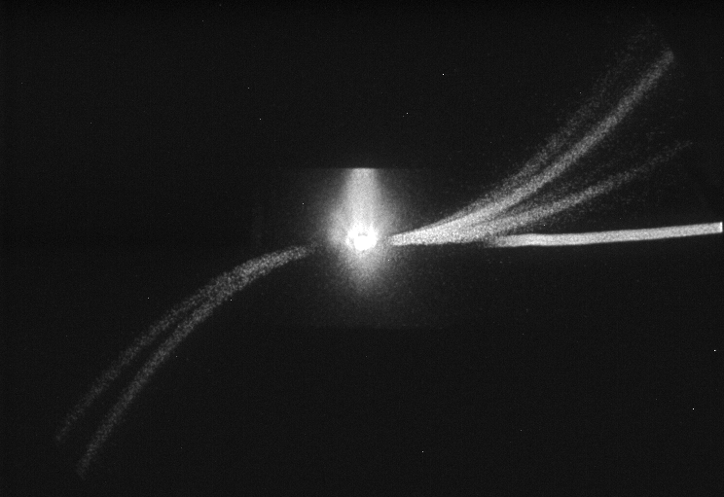

first observation of negative ions accelerated from liquid spray
water spray
O⁻
$I \sim$5×10¹⁹ W/cm²
τ = 40 fs
electric deflection
H ⁻ ∼ 150 keV
O⁺
magnetic deflection
ethanol spray
H⁺
H⁻
O¹⁺
C¹⁺
O²⁺
d_{droplet} ~150 -180 nm
C²⁺
density 10¹⁸ - 10¹⁹ cm⁻³
electric deflection
p
C¹⁻
O¹⁻
magnetic deflection

Slide 7
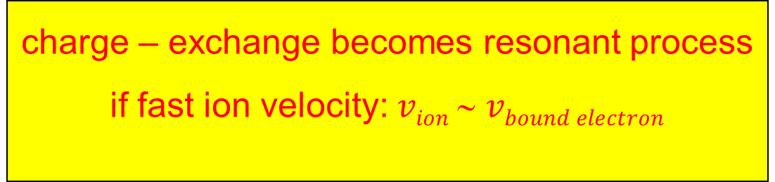
water spray and negative ion formation in charge-exchange
interaction geometry
possible scenario
2 mm
positive ions are accelerated in Coulomb explosion
ion propagation through the spray is collisional
laser
spray
charge-exchange can explain negative ion formation:
high-intensity region
4 μm
O^{n+} ↔ O^{(n-1)+}
electron capture and loss by fast projectile
single droplet
-
-
-
-
-
-
charge – exchange becomes resonant process
if fast ion velocity: $vion$ ∼ $vbound electron$
+
+
+
-
+
+
-
-
+
-
-
-
+
-
+
-
+
+
-
-
-

Slide 8
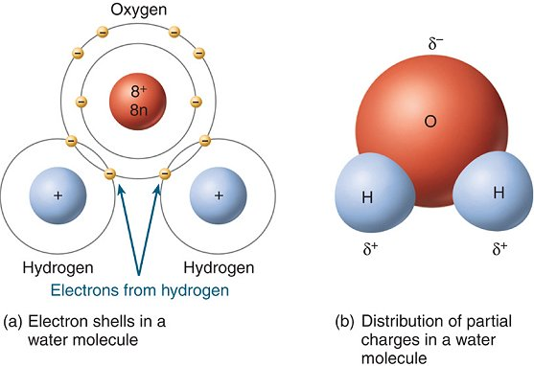
Artist's conception of electron capture by proton
H
oxygen
H
-
→
A⁻
A⁺ → A⁰
→
A⁺
- the angular spread is very narrow, of the order of 1°
- the interaction proceeds almost elastically, without energy exchange
The ion that captures or loses an electron propagates essentially in the same direction and with the same energy as before the collision.

Slide 9
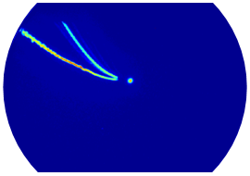
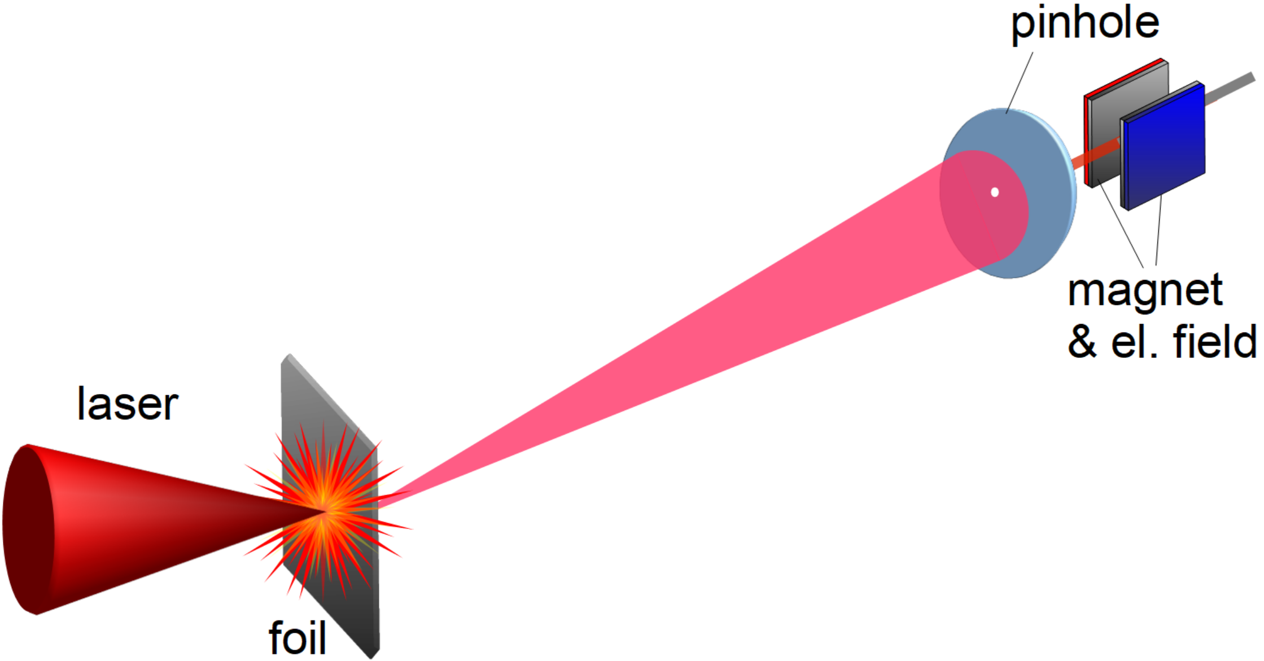
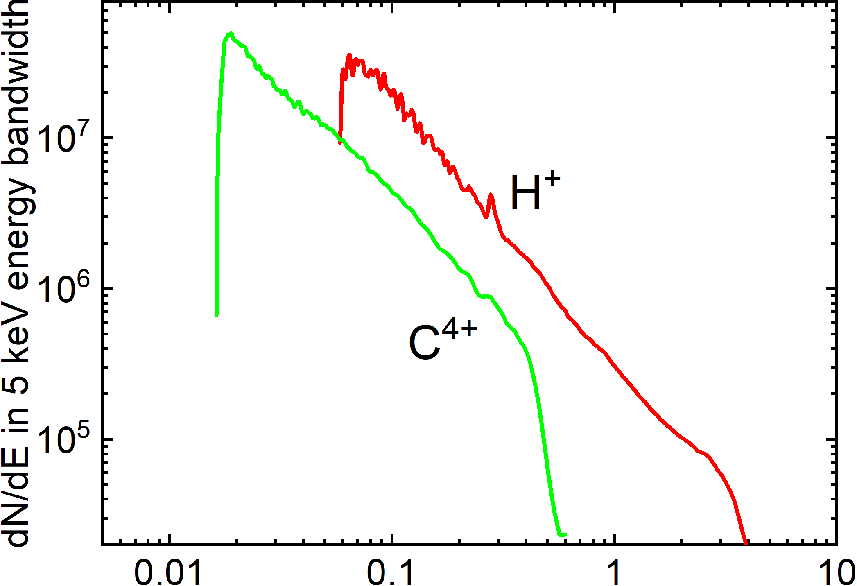




in acceleration from Ti foil target
ion spectra on MCP phosphor screen
$$H^{+}$$
$$C^{4+}$$
electric deflection
Thomson spectrometer
$I \sim$5×10¹⁹ W/cm²
τ = 40 fs
5 µm $Ti$foil
$$H^{+}$$
magnetic deflection
Ion spectra

Slide 10
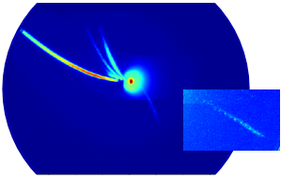
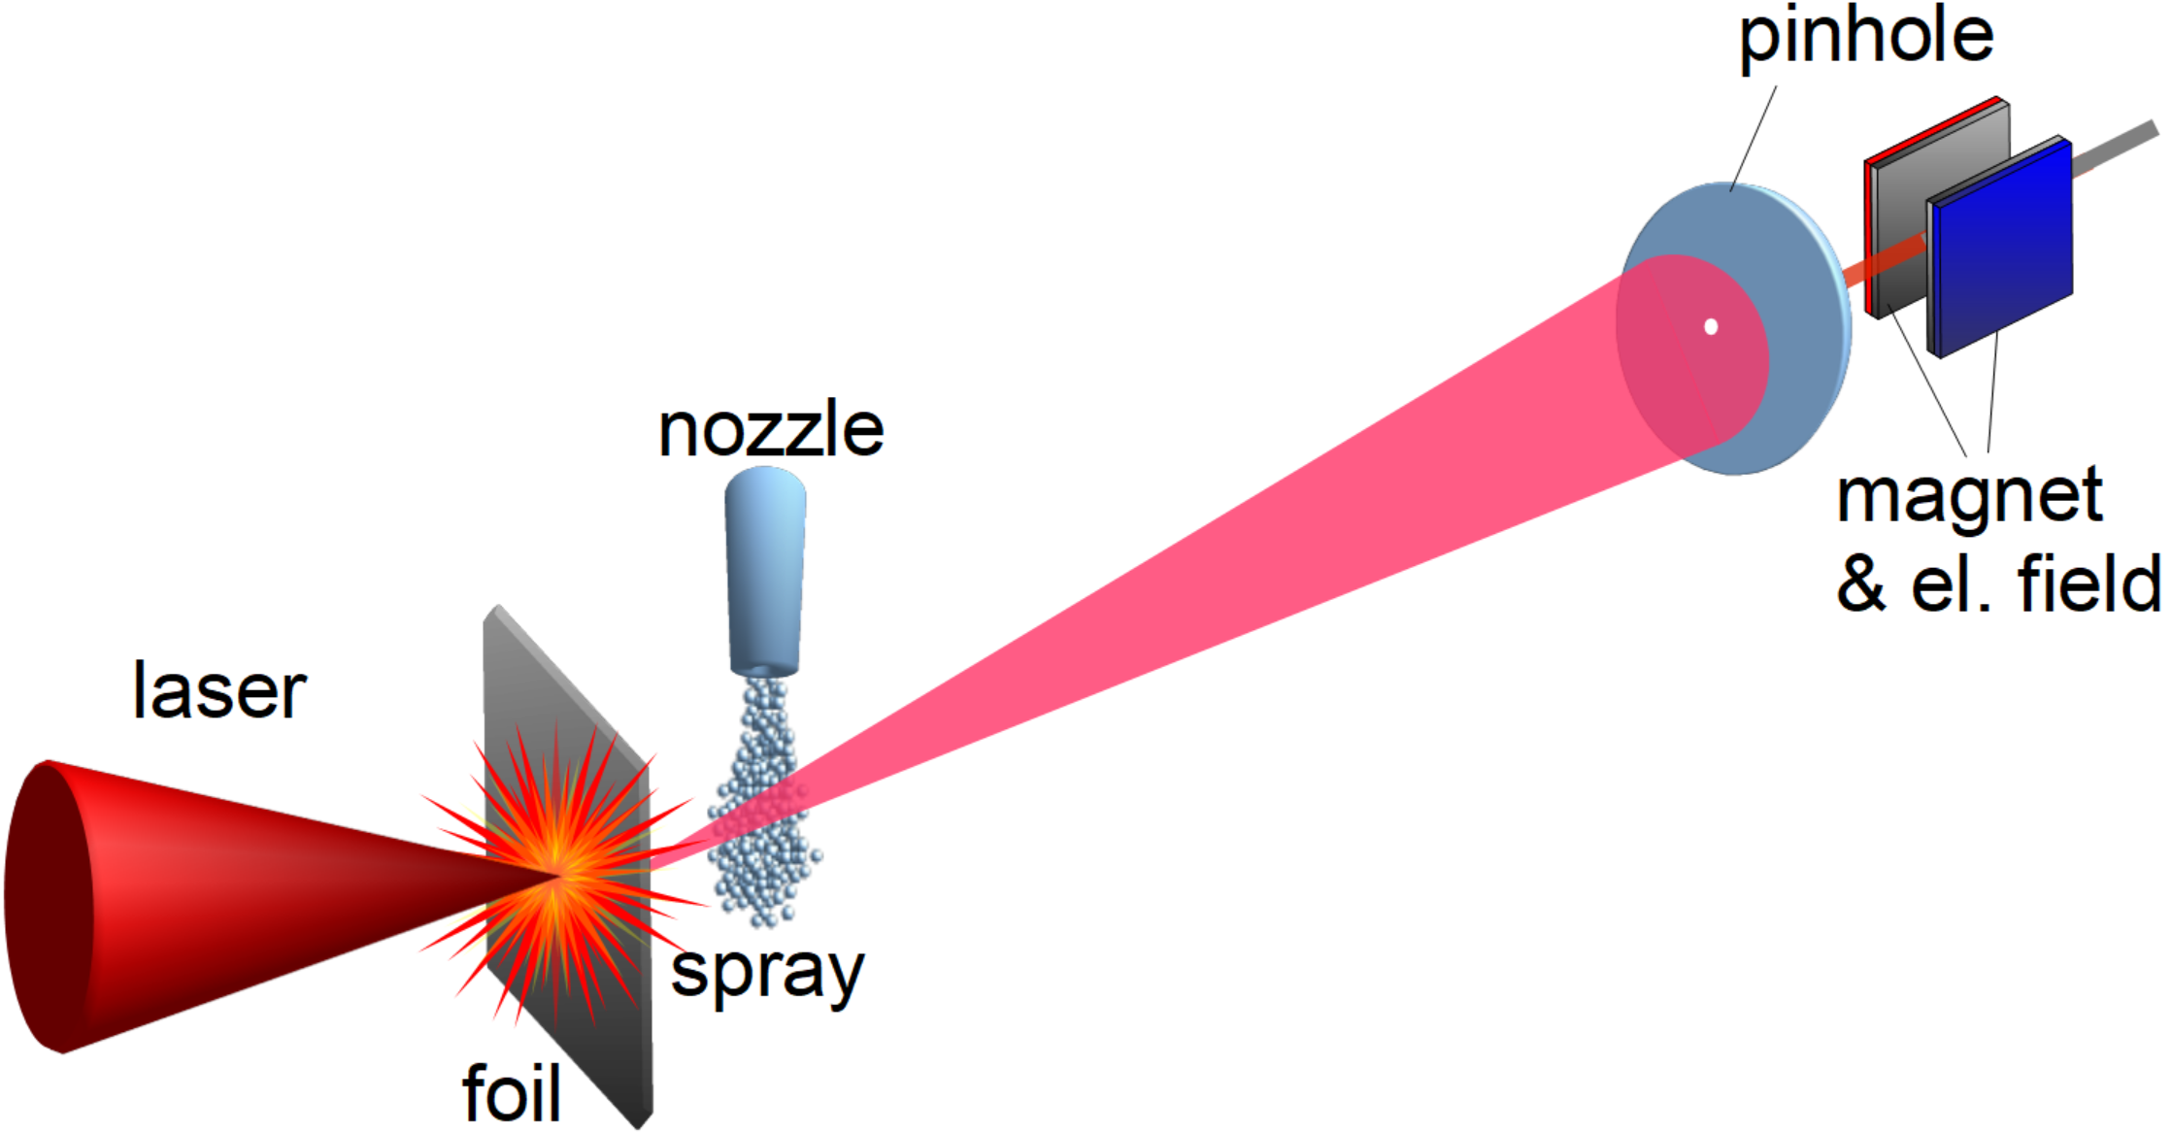
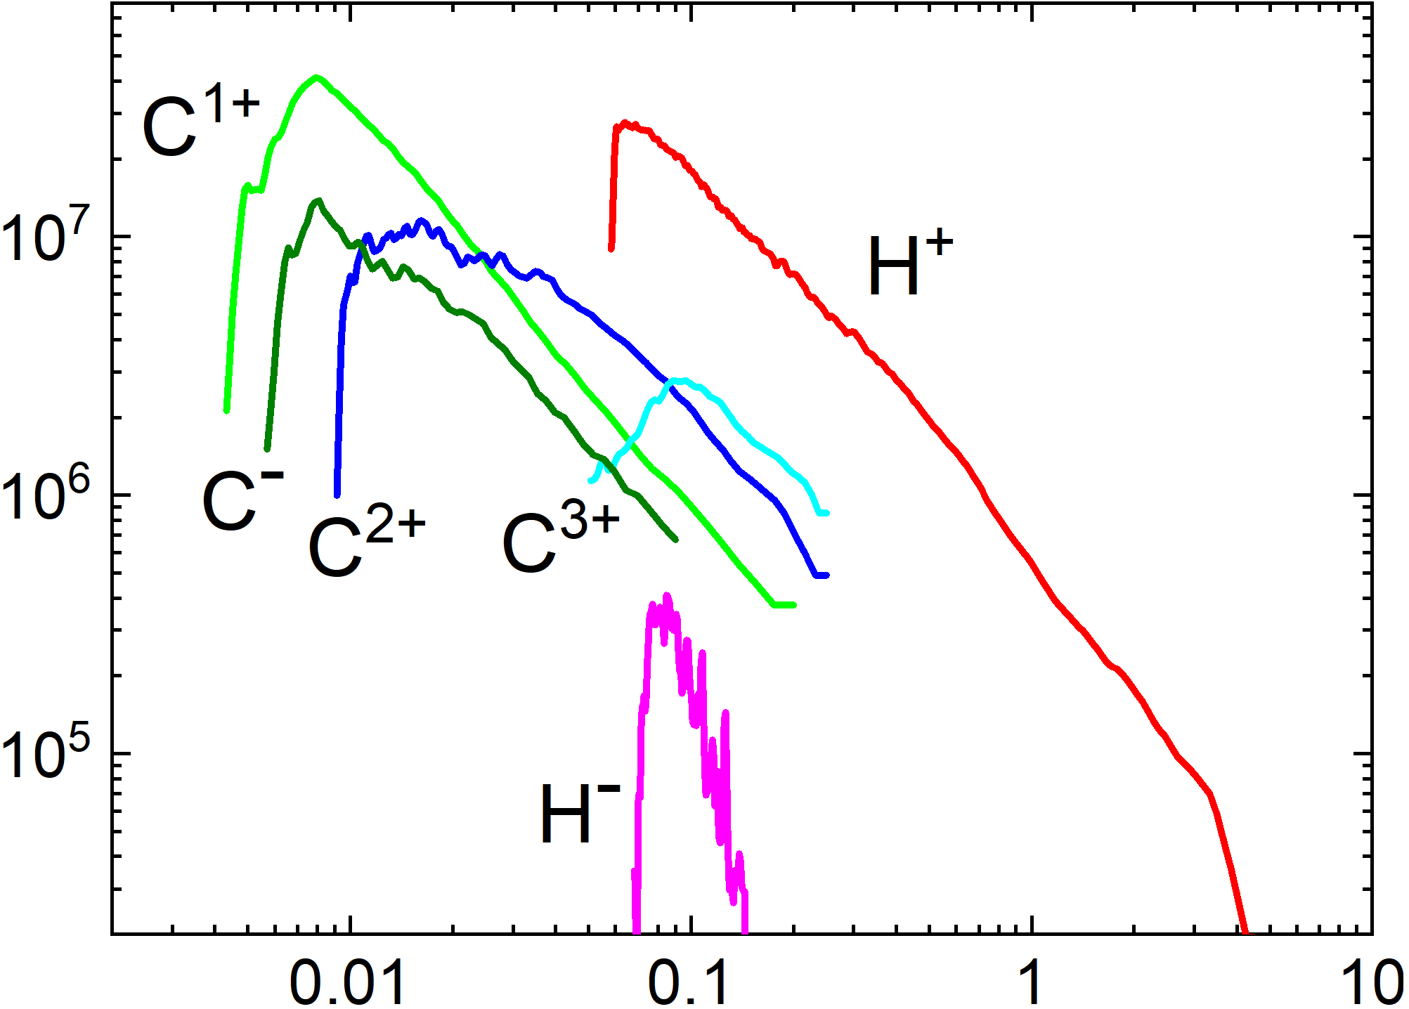





water spray was introduced in the path of positive ion beam
ion spectra on MCP phosphor screen
spray as secondary target
$$C^{2+}$$
$$C^{+}$$
inserted spray
$$H^{+}$$
$$H^{−}$$
$$C^{−}$$
positive and negative
ion spectra
A⁻
→
A⁺ → A⁰
→
A^{+n}
spray at4 cm from the foil target
it suppose existence of neutrals

Slide 11
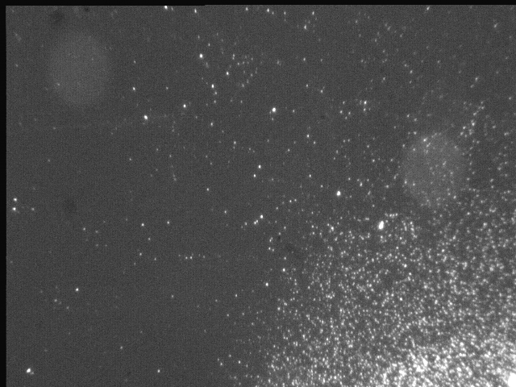
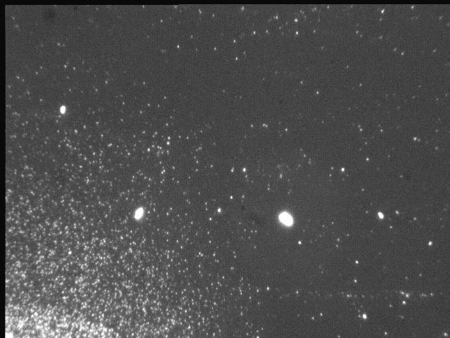
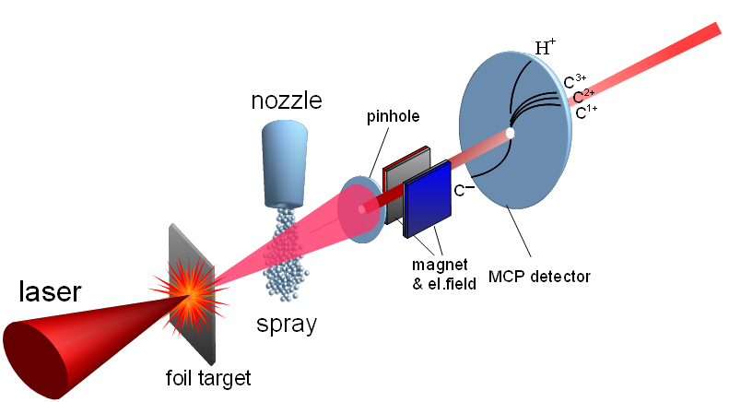
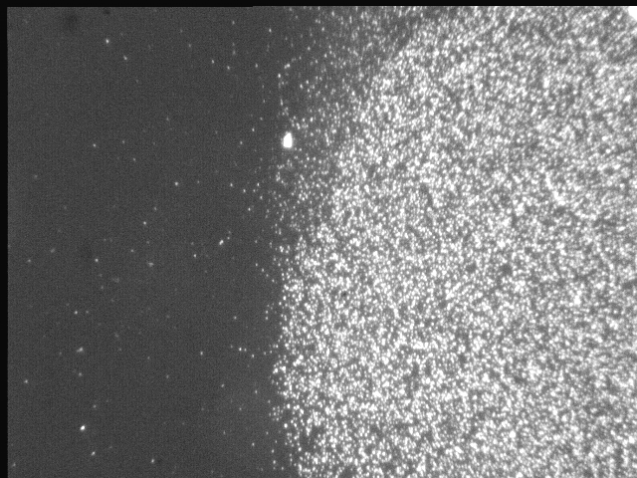
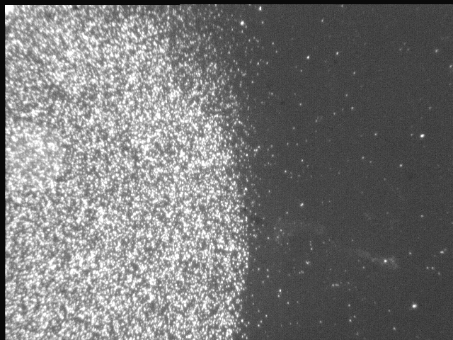
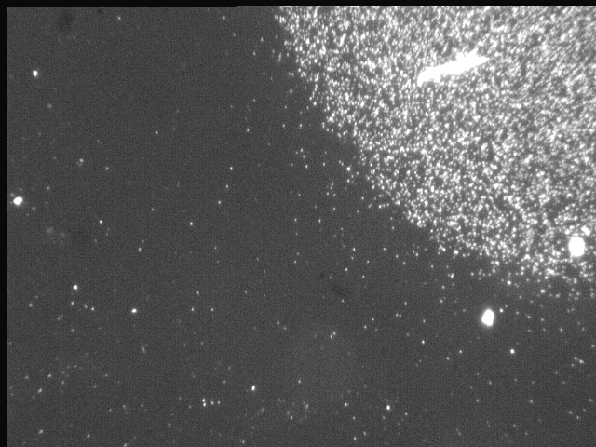
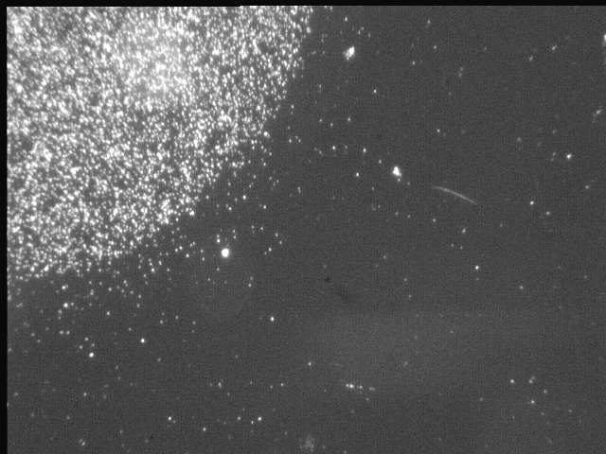
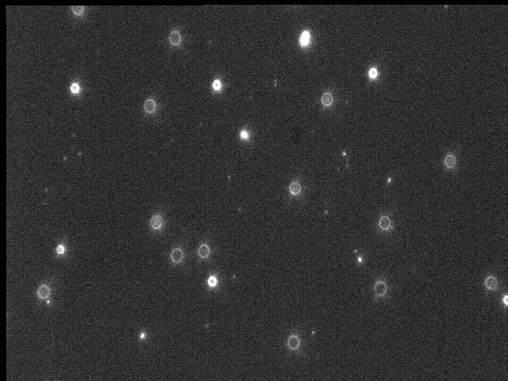
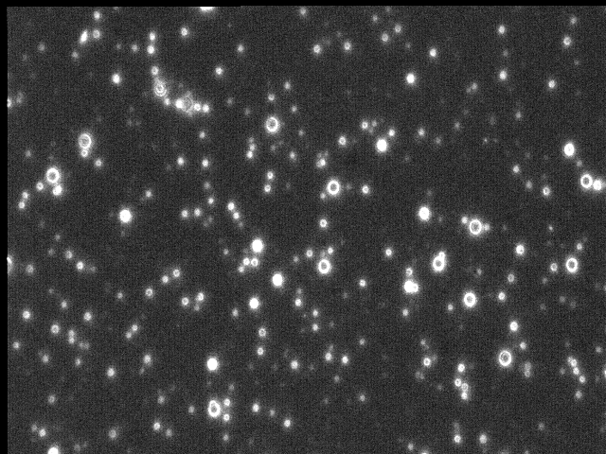
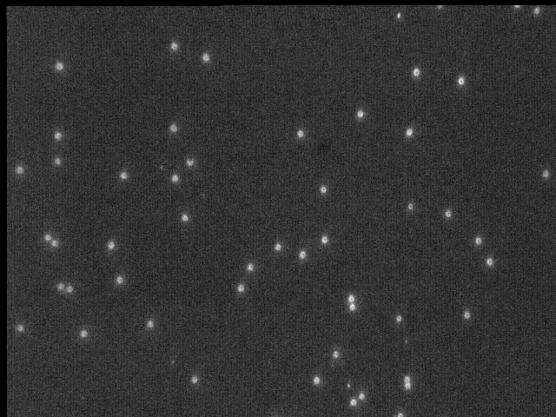
chase for neutrals
“zero” point on CR39 (1mm pinhole)
neutral particles
beam cleaning from charged particles
by magnet
oxygen pits
pinhole
O
H
TOF of neutrals: H and O
hydrogen pits

Slide 12
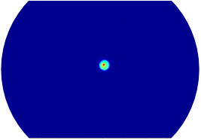
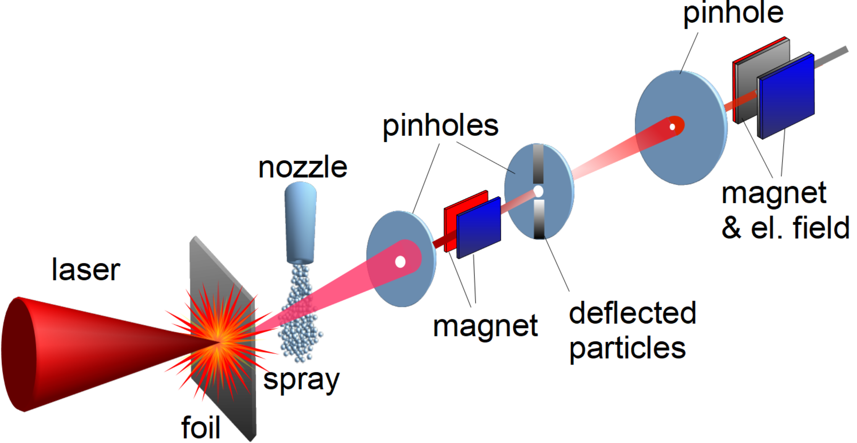
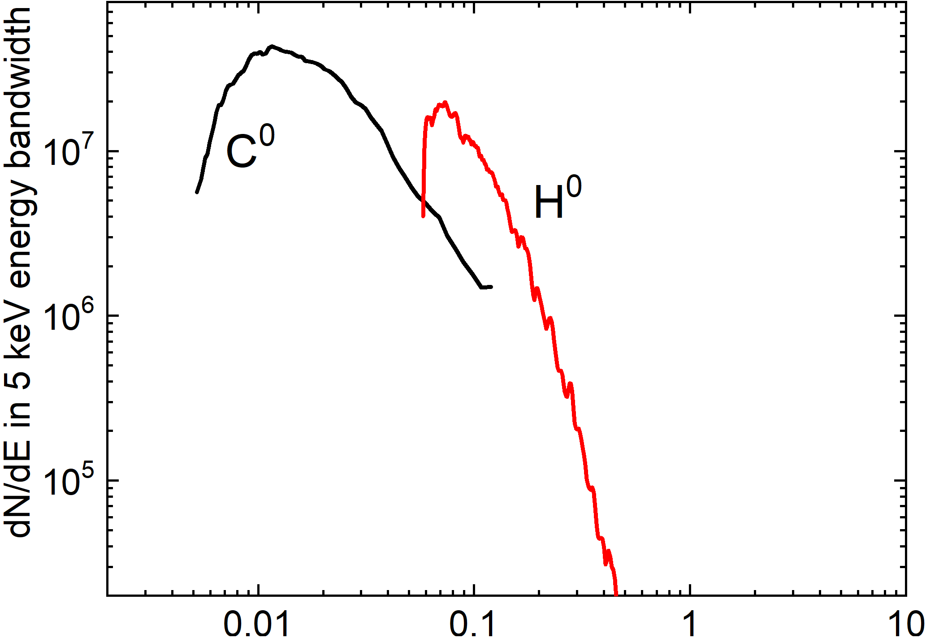


cleaning of the beam from charged particles
neutral atoms on MCP phosphor screen
beam cleaning from charged particles
inserted magnet
$$C^{0}$$
$$H^{0}$$
c")
neutral atoms spectra
using a time-and-space (TaS) mass analyser, the spectrum of C⁰ and H⁰ atoms was reconstructed
Rev. Sci. Instrum. 88, 083303 (2017).
first observation of neutral atom beams with such high energies

Slide 13
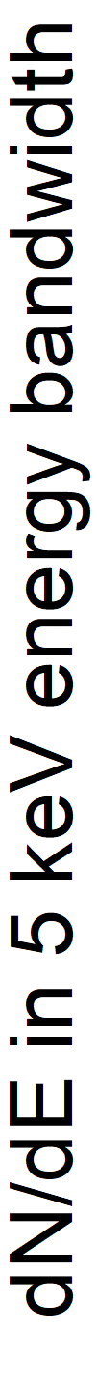
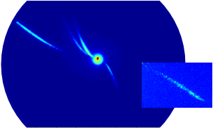

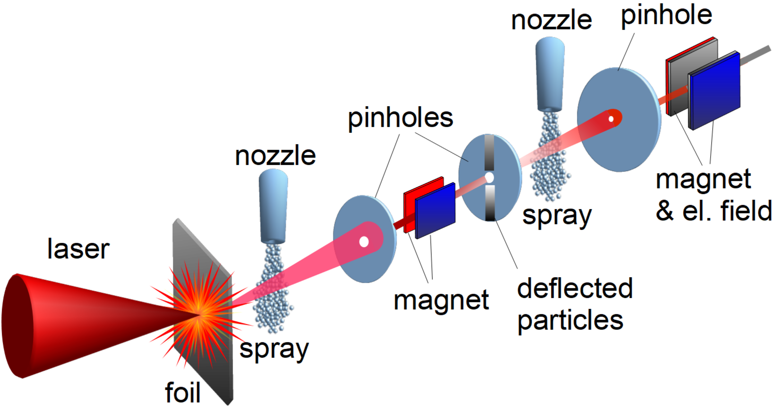
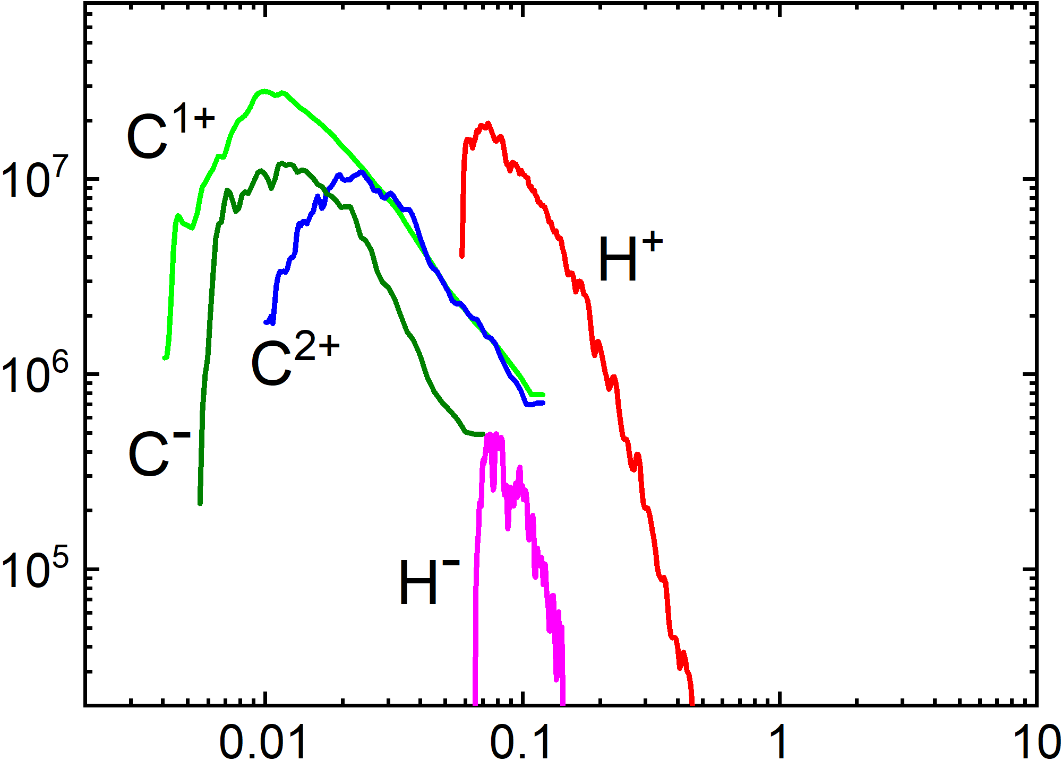







water spray was introduced in the path of neutral atoms
ion spectra on MCP phosphor screen
spray as secondary target on the way of neutral atoms
C⁻_{max} ∼ 1 MeV
$$C^{2+}$$
$$C^{+}$$
H⁻_{max} ∼ 150 keV
inserted spray
$$H^{+}$$
$$C^{0}$$
$$H^{−}$$
$$H^{0}$$
$$C^{−}$$
positive and negative
ion spectra
A⁻
→
A⁺ → A⁰
→
A⁺
regardless of the input beam: $H^{+}$ and $C^{4+}$ ions, or $H^{0}$ and $C^{0}$ atoms, charge conversion proceeds similarly
charge state distribution is in equilibrium

Slide 14
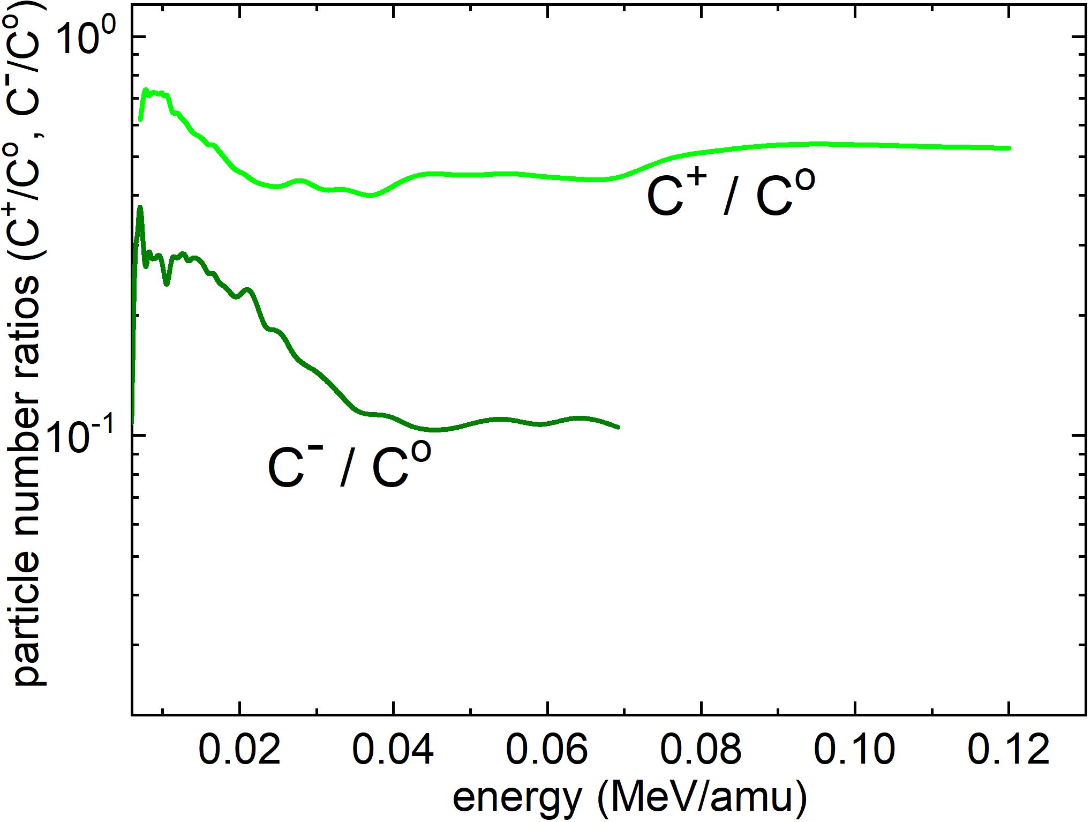
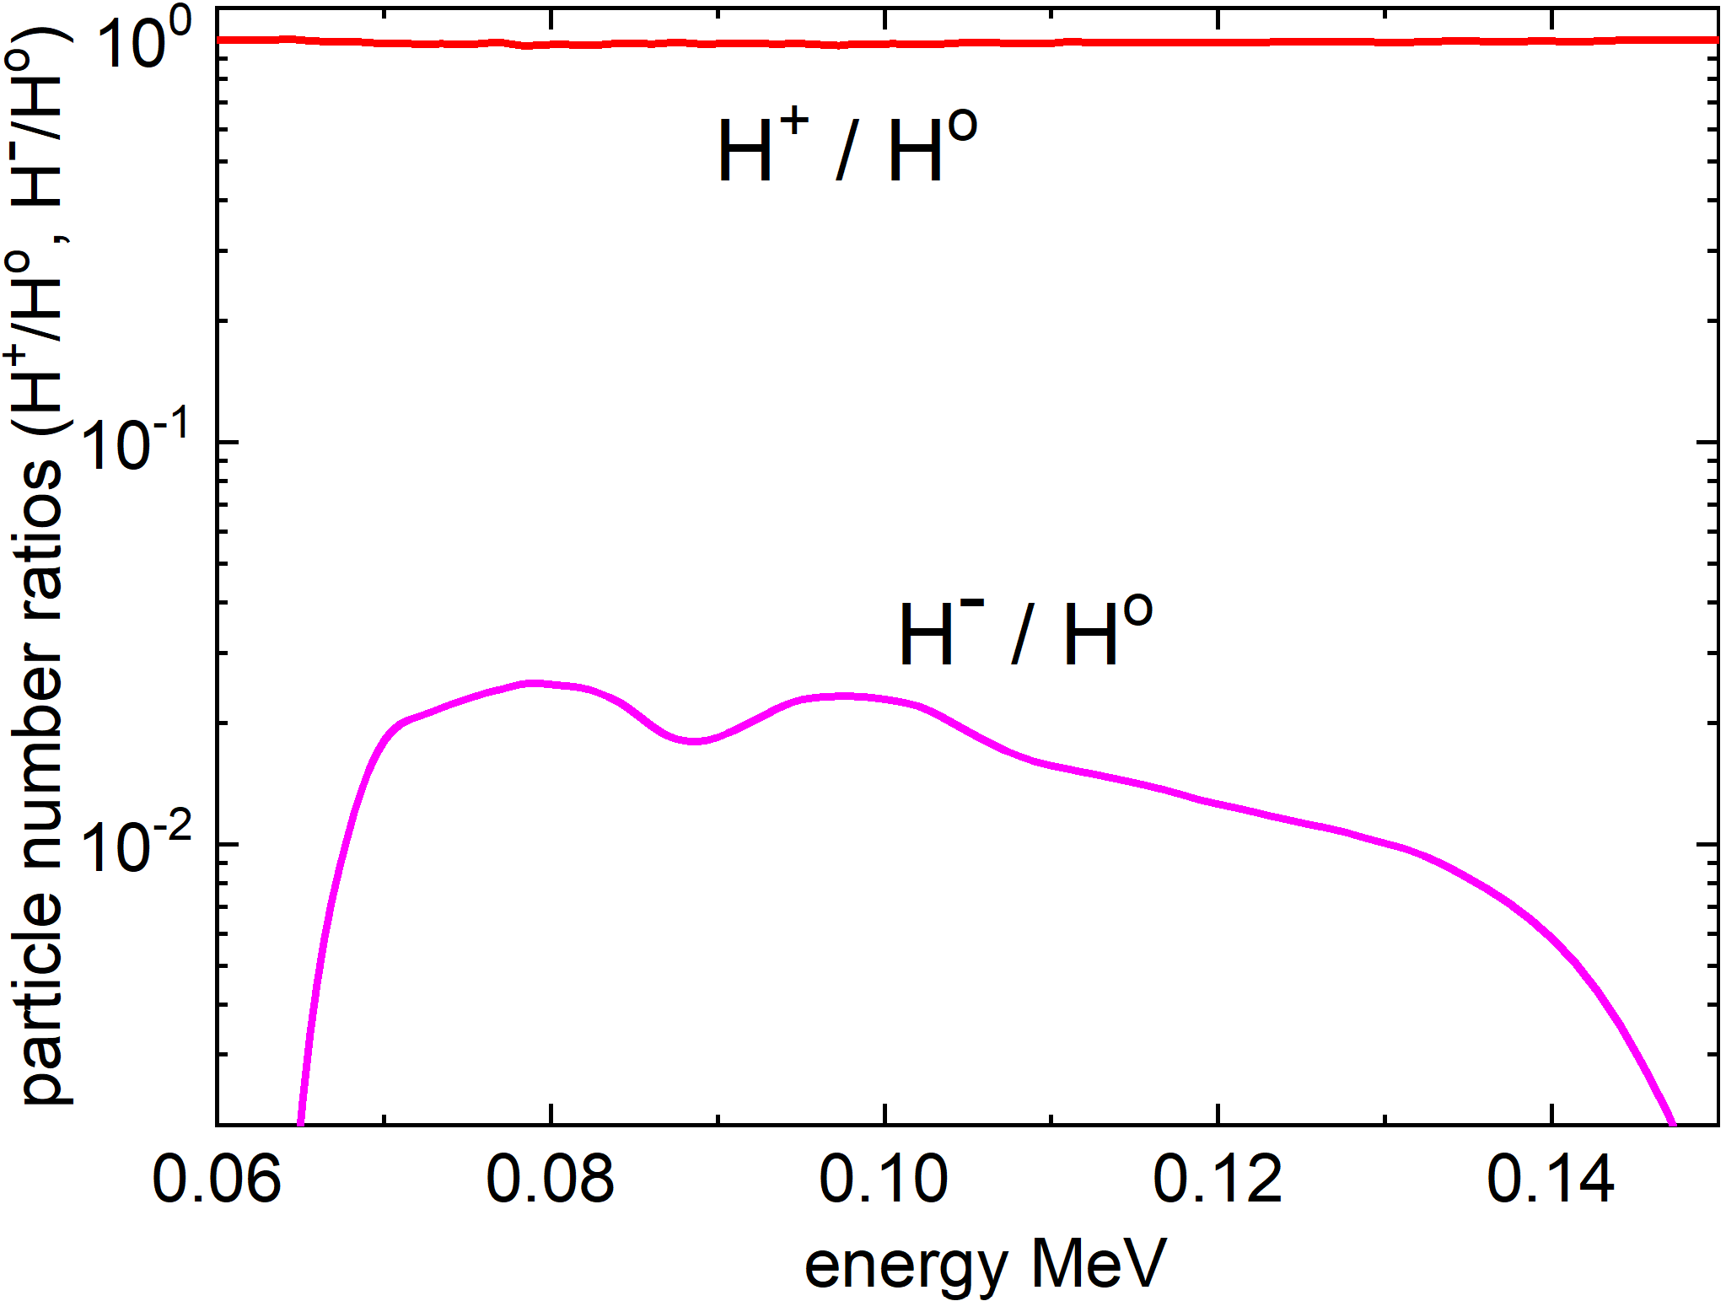




open problems
fractions of the equilibrium charge state can provide values for the ratios of the cross sections
almost equal presence of ions and neutral atoms was measured
$H^{+}/H^{0} 1$
$C^{+}/C^{0} 0.5$
$H^{−}$/$H^{0}≈{10}^{−2}$
$$C^{−}/C^{0}≈{10}^{−1}$$
In contrast: the known cross sections for gaseous targets suggest an order of magnitude decrease in $C^{+}/C^{0}$ and $H^{+}/H^{0}$
H ⁻ ∼ 150 keV
above 30 keV the electron attachment cross section becomes prohibitively low

Slide 15
proposed hypothesis
“spray electrification”
The spray consists of 150 nm water droplets
formed when the vapor expands through a supersonic nozzle
This process could be compared with droplets formation in thunderstorms where droplets electrically charged:
spray electrification, or a waterfall effect
The degree of electrification depends on droplet temperature and speed, and a contact with foreign surface
The droplet potential can be several volts, or the electric field at surface ∼ (1 − 10) MV/cm.
Two processes can account for an enhancement production of negative ions:
the electron capture takes place at the charged droplet surface, or
it interacts with the vapor in a strong field.
R. Prasad, et al., Rev. Sci. Instrum. 84, 053302 (2013).

Slide 16
apart from the fundamental interest,
there is also a practical interest in liquid spray

Slide 17
To quantify the energy content in the beams at a measured 3.6 x 10⁻⁷ sr solid angle
beams energy : after 1st spray
beam energy from the spray
conversion efficiency
H⁻ (70 – 150) keV – 0.24 µJ
H⁺ → H⁻ 0.857 %
C⁻ (75 – 1000) keV – 10.8 µJ
C⁴⁺ → C⁻ 4.57 %
H⁰(50 – 500) keV – 23 µJ
H⁺ → H⁰ 45%
C⁰(60 – 1440) keV ∼ 47.4 µJ
C⁴⁺ → C⁰ 17%
P(H⁰) ∼ 6 kW
Beam powers
(in 3.6 x 10⁻⁷ sr)
P(C⁰ ) ∼ 0.8 kW
Possible application?

Slide 18
It might be interesting for Neutral Beam Injection (NBI) system
for plasma heating and current drive for magnetic confinement fusion devices
The used spray area : ∼3.8×10⁻⁷ cm², whereas the whole spray area: ∼3×10⁻² cm².
Hence, the spray producing ∼10⁵ times more neutral particles
Spray size can be changed applying the concept of “corresponding jets”:
yield will be the same, because the charge state distribution is in equilibrium
The spray operation in a long pulse mode, more than 5 ms, has not yet been demonstrated, but this is also subject to the scaling laws and similarity relations.
The range of energies can be extended (Massey criterion corresponds to resonant process), e.g.:
by adding an appropriate contaminant to the water,
choosing a different liquid
using a spray in which the atoms or molecules are excited to the Rydberg state
negative ions and neutral atoms have the same emittance and the same energy as the positive ions,
the above reasonings can only be qualitative unless confirmed experimentally

Slide 19








summary
we observed:
$$O^{−}$$
$$C^{−}$$
$$H^{−}$$
$$D^{−}$$
and
$$O^{0}$$
$$C^{0}$$
$$H^{0}$$
$$D^{0}$$
CE : 45% measured for $H^{+}→H^{0}$ up to 500 keV and 17% for $C^{4+}→C^{0}$up to 1.5 MeV energies
These estimates are conservative, and the beam-target interaction conditions not optimized
the method is general:
different species of neutral atoms and negative ions can be created
beams inherit the characteristics of positive ions
open questions
the measured trends are quite different from the data available in the literature
there is no clear explanation for the difference between the known data and our measurements.
the physics of charge exchange at high ion energies was not well understood

