Slide 1
ICIS 2025
Beam current performance in the ITER negative ion source prototype SPIDER
Alastair Shepherd, E Sartori, V Candeloro, R Casagrande, G Emma, I Mario, A Pimazzoni, B Pouradier Duteil, G Serianni and the NBTF team
alastair.shepherd@ukaea.uk, alastair.shepherd@igi.cnr.it

Slide 2
OUTLINE
ITER NBTF and SPIDER
SPIDER campaign overview 2024/25
Extracted current estimation
Beam current performance
Conclusions and future perspectives

Slide 3
OUTLINE
ITER NBTF and SPIDER
SPIDER campaign overview 2024/25
Extracted current estimation
Beam current performance
Conclusions and future perspectives

Slide 4
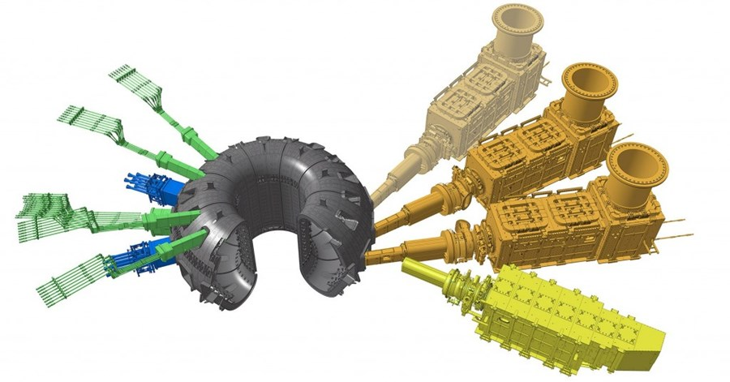
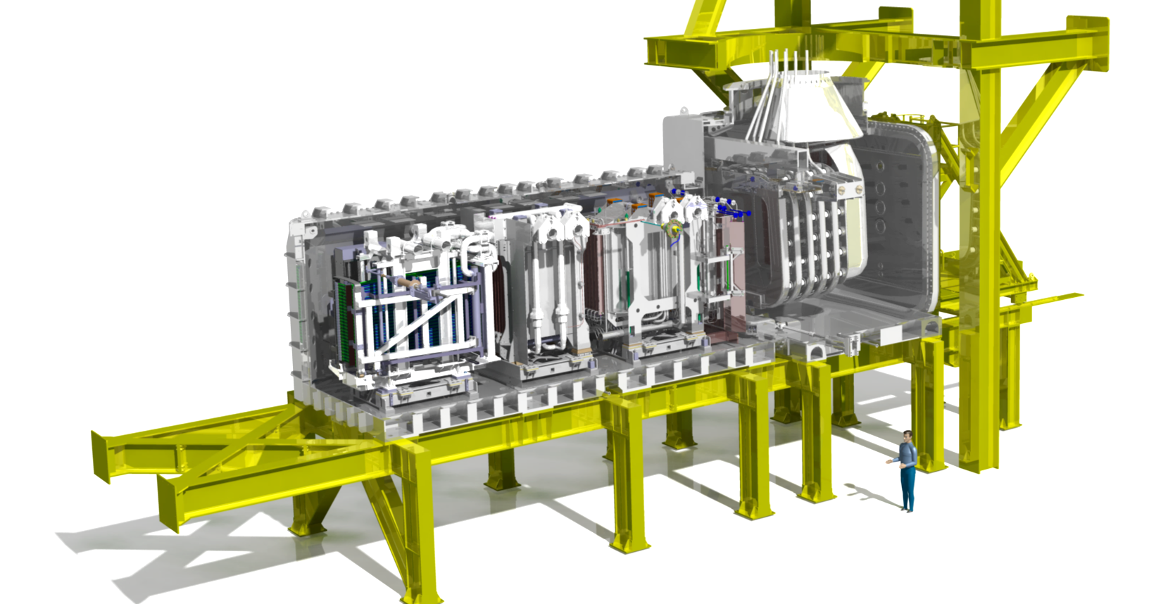
ITER Neutral Beam Test Facility
ITER Neutral Beam Injection (NBI)
2(+1) Heating Neutral Beam (HNB) [1]
33-50 MW
1 Diagnostic Neutral Beam (DNB) [2]
Neutral Beam Test Facility (NBTF) [3]
Hosted by Consorzio RFX (Padova, Italy)
MITICA: full scale HNB prototype
SPIDER: full scale ion source prototype

Slide 5
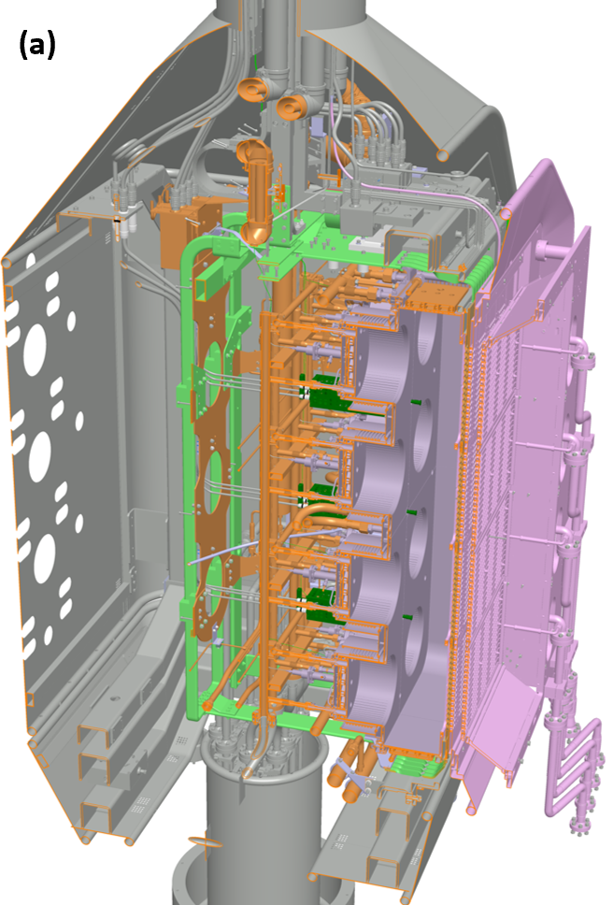
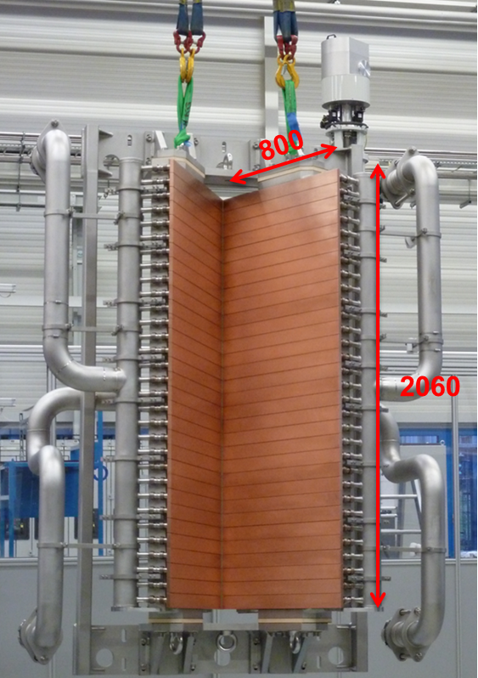
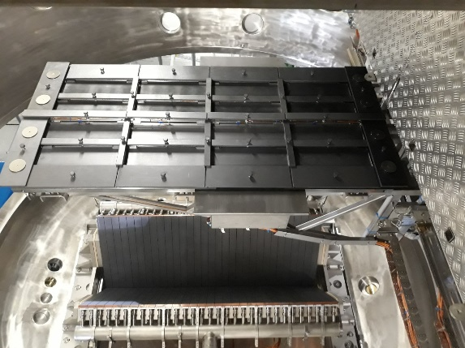
SPIDER
Beam dump
CFC calorimeter STRIKE
Ion source and accelerator

Slide 6
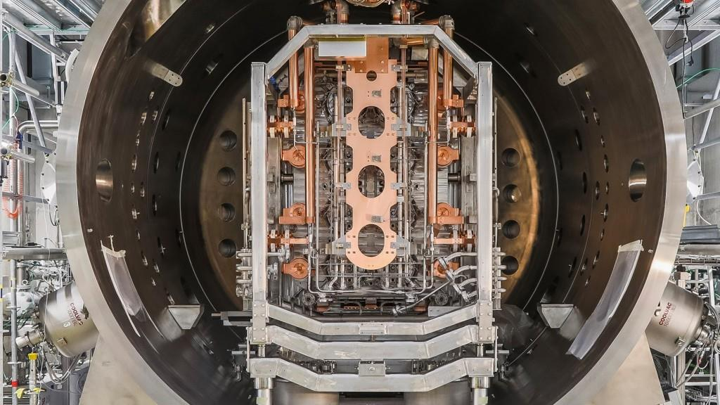
SPIDER requirements
Parameter | Value
Source Area | 2.0 x 0.87 m²
Extraction Area | 0.197 m²
Total Voltage | 108 kV
Extraction Voltage | 12 kV
Isotopes | H, D
Acc. Ion Current | 60 A (H), 40 A (D)
RF Power | 4 x 200 kW
Pulse Length - Plasma - Extraction | 3600 s 1000 s (H), 3600 s (D)

Slide 7
OUTLINE
ITER NBTF and SPIDER
SPIDER campaign overview 2024/25
Extracted current estimation
Beam current performance
Conclusions and future perspectives

Slide 8
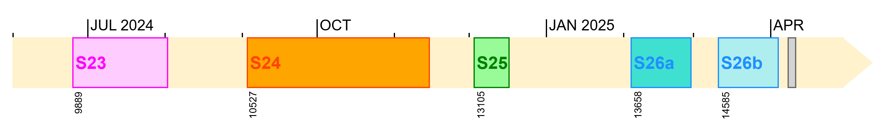
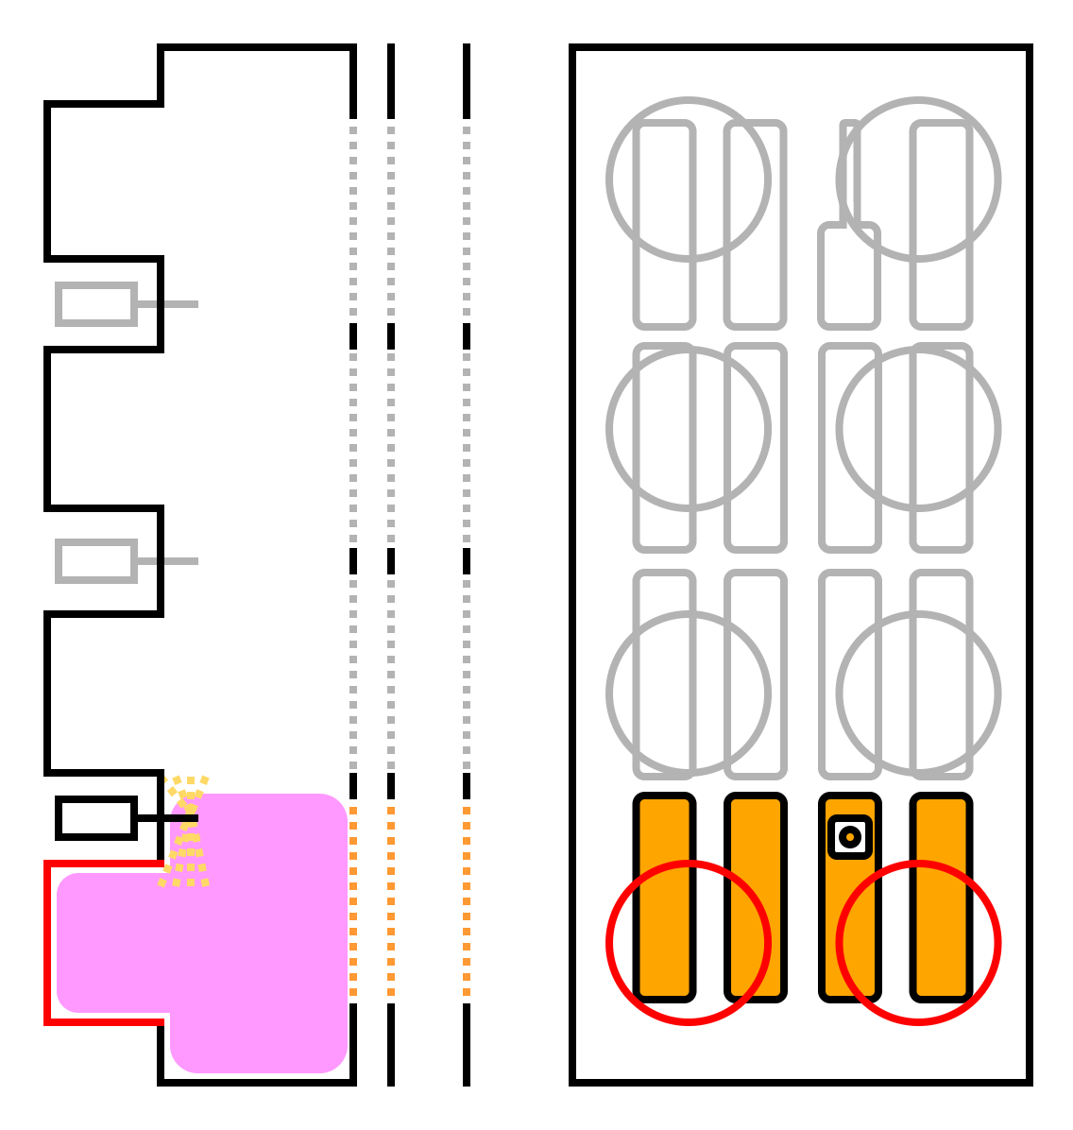
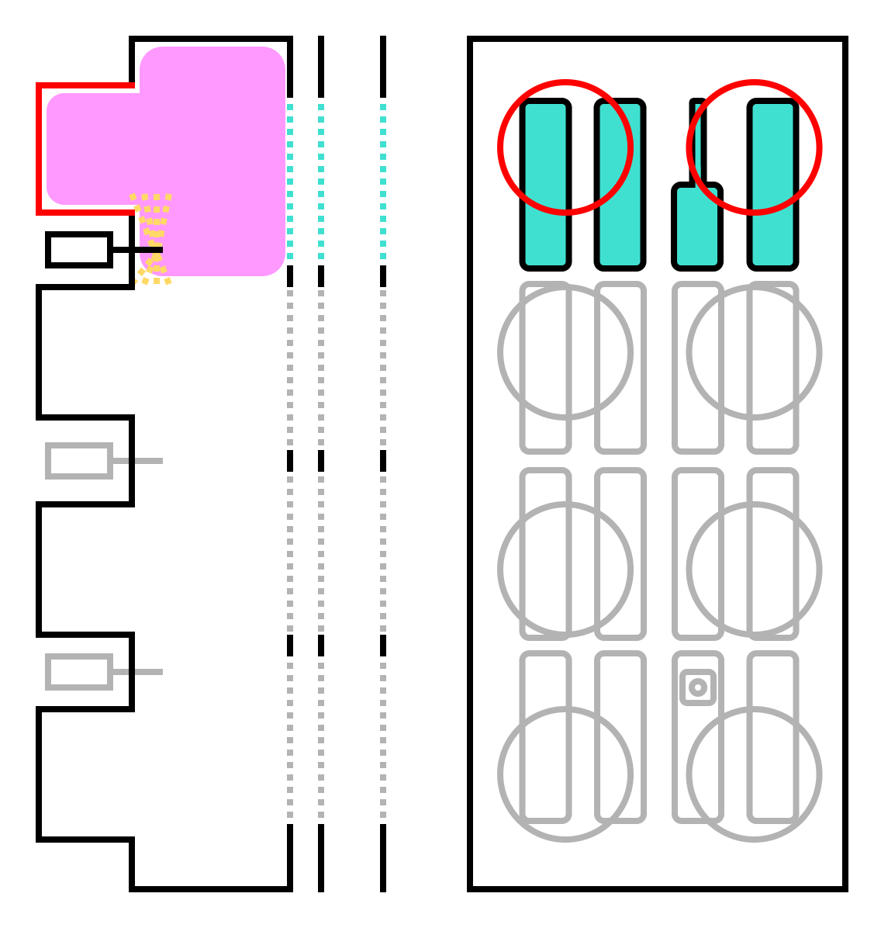
SPIDER operational timeline
0.3 Pa,
68 kW/driver
215 A/m² at perveance match
Divergence studies:
Core divergence; effect of pressure and bias
SO-2:
validate the design with high beam power
develop procedures in multi-beamlet configuration
obtain large negative ion current and power
measure divergence and uniformity
Decoupling FF:
ferromagnetic screen around drivers
0.43 Pa,
63 kW/driver
190 A/m² at perveance match
Plasma volume: operation w/ segm. 1 and 2

Slide 9
SPIDER contributions
Poster
Overview of Cs evaporation control and monitoring,
Basile Pouradier-Dutiel, 08/09, 16:30
Oral
Beamlet optics analysis by visible cameras,
Giulia Emma, 11/09, 11:20
Related IPP contributions
Oral
Pressure dependence on beam divergence, Christian Wimmer, 09/09, 15:20
Oral
Overlap of plasma and beam properties, Dirk Wünderlich, 09/09, 15:40

Slide 10
OUTLINE
ITER NBTF and SPIDER
SPIDER campaign overview 2024/25
Extracted current estimation
Beam current performance
Conclusions and future perspectives

Slide 11
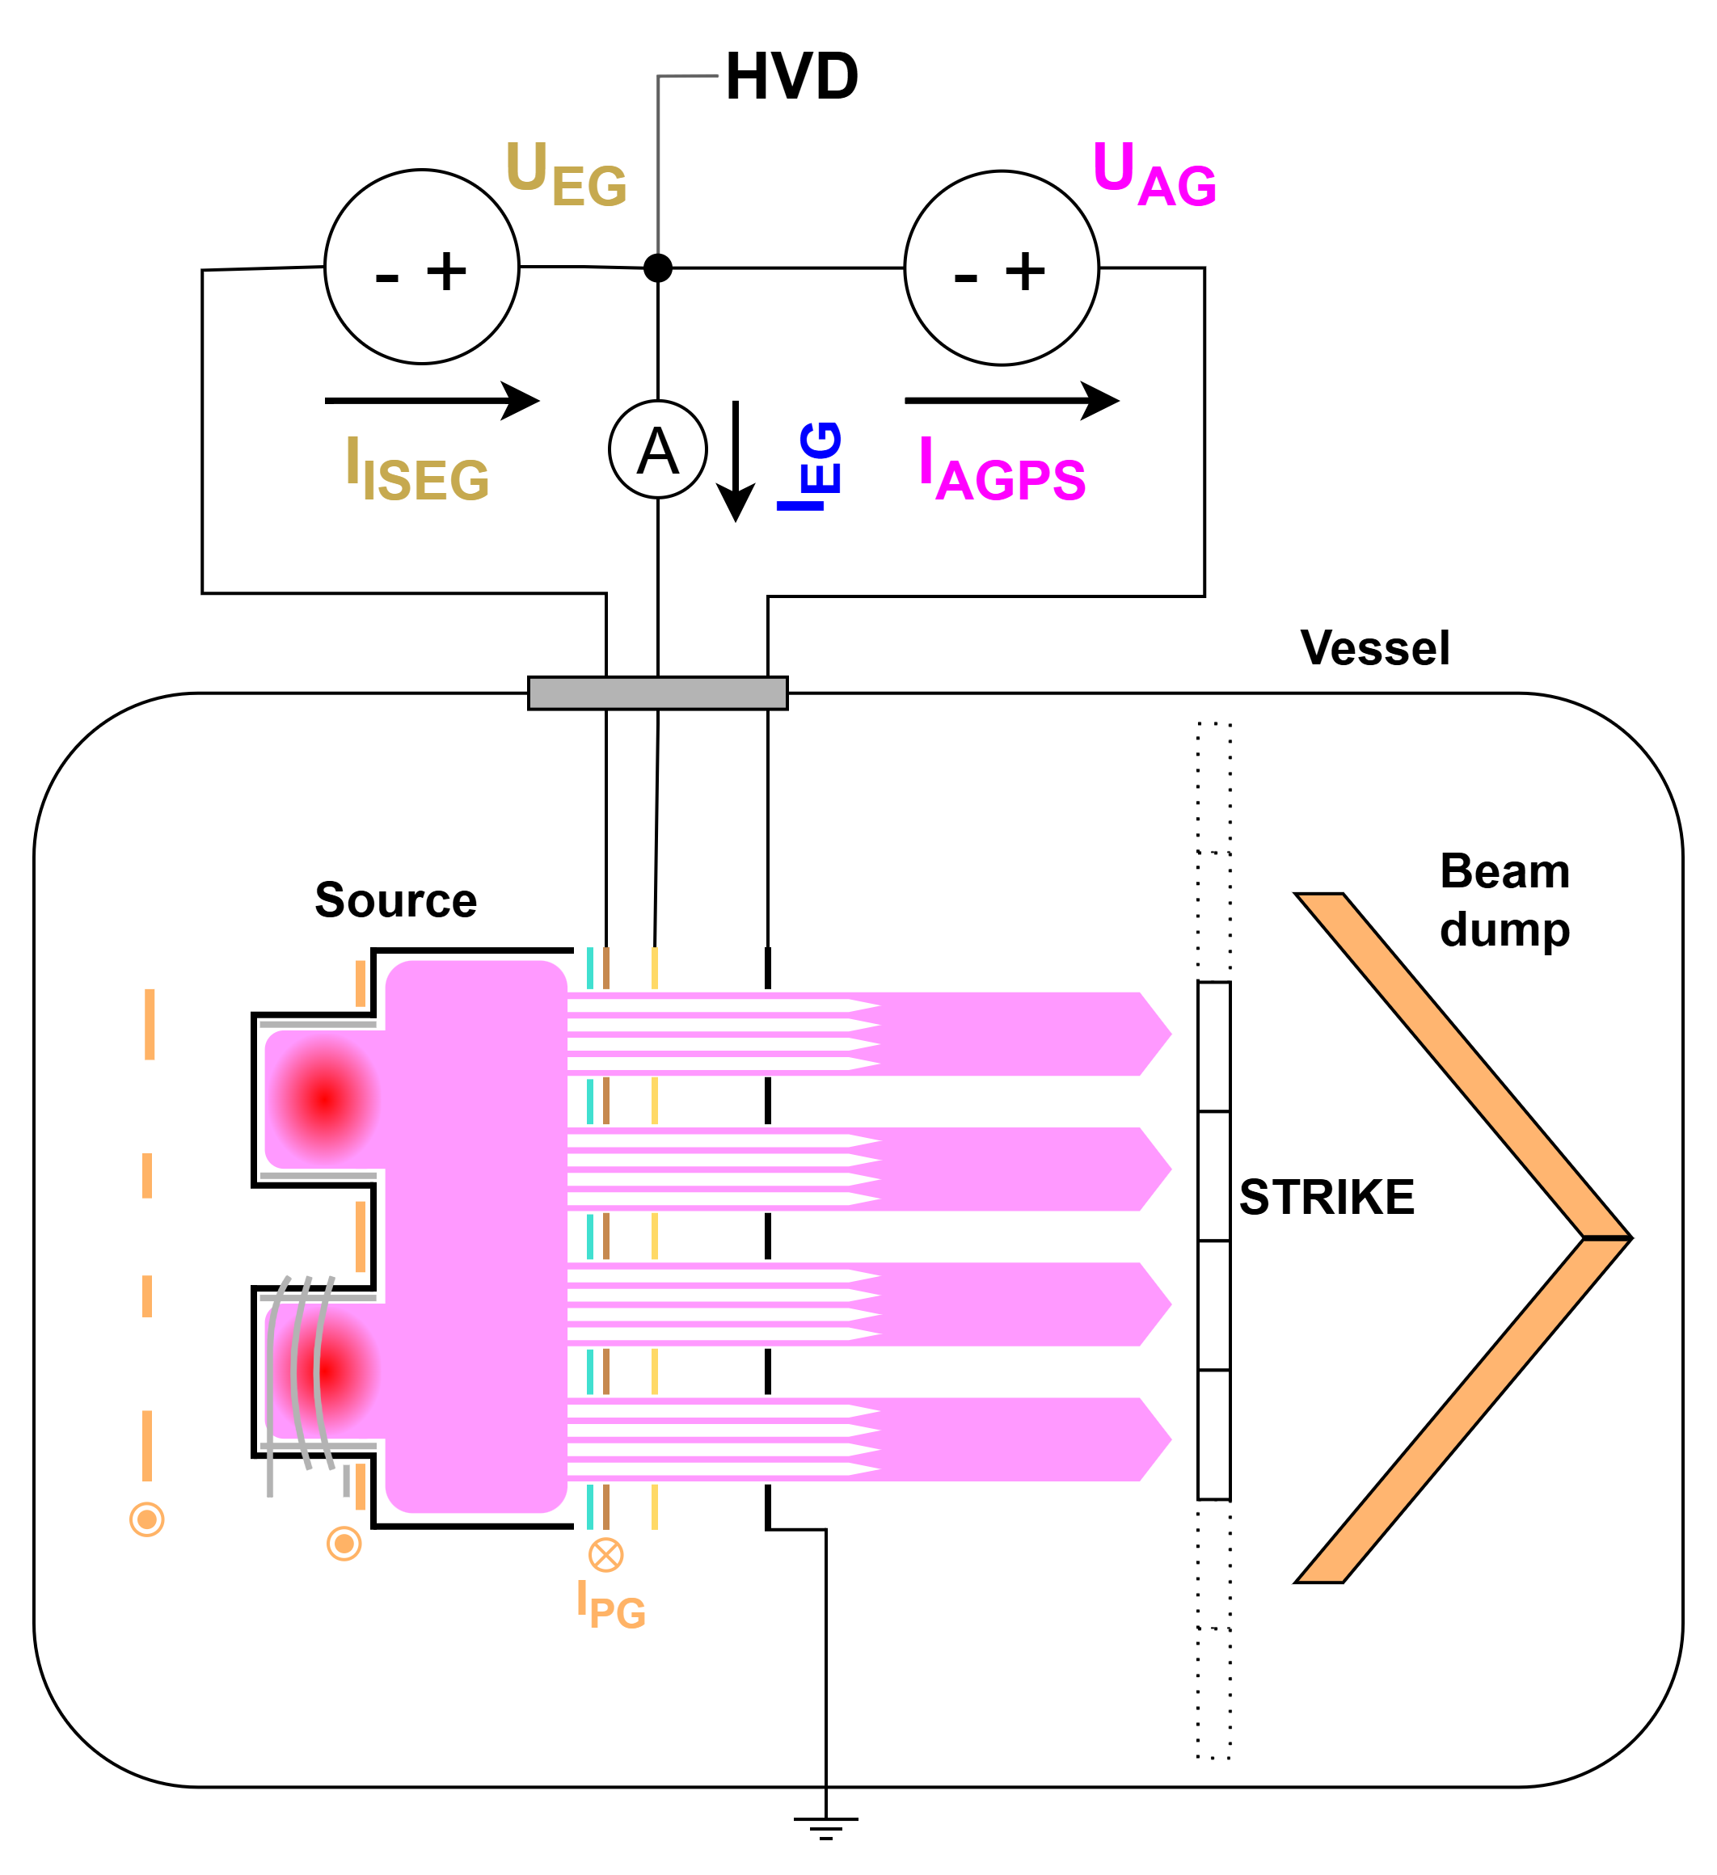
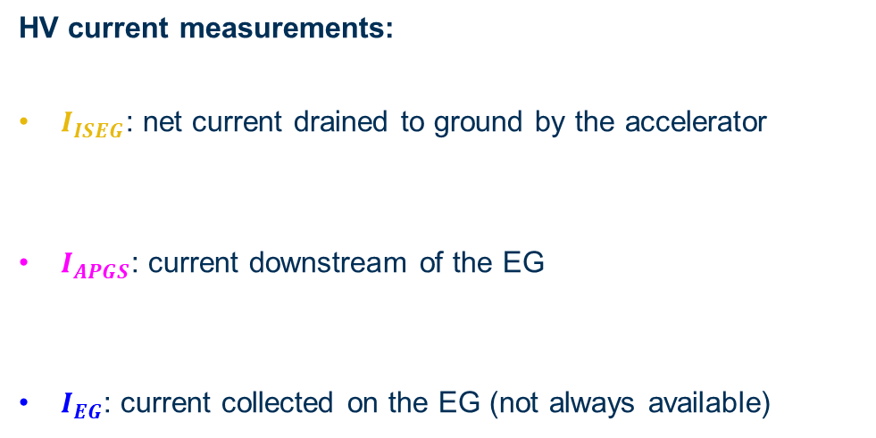
SPIDER HVPS
HV current measurements:
$I_{ISEG}$: net current drained to ground by the accelerator
$I_{APGS}$: current downstream of the EG
$I_{EG}$: current collected on the EG (not always available)

Slide 12
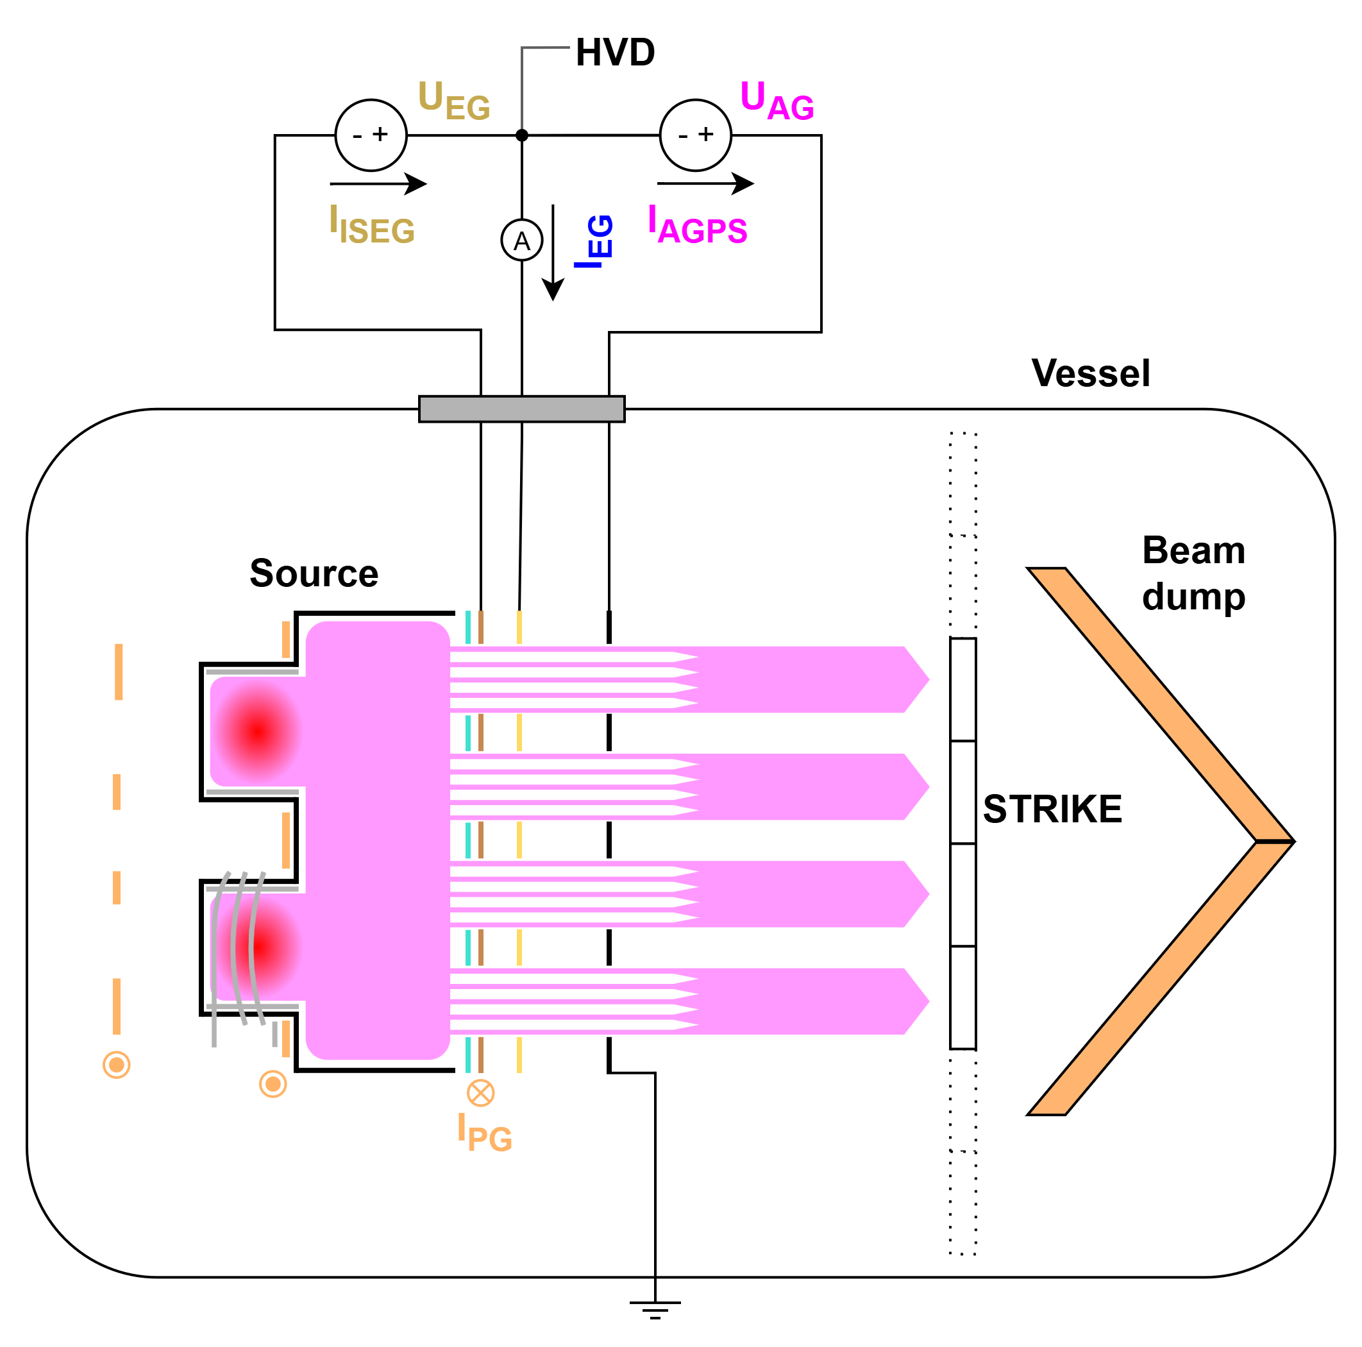
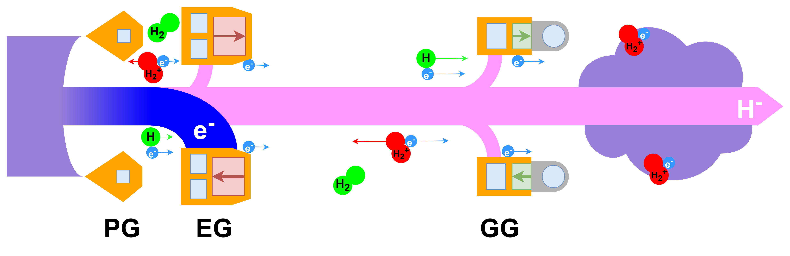
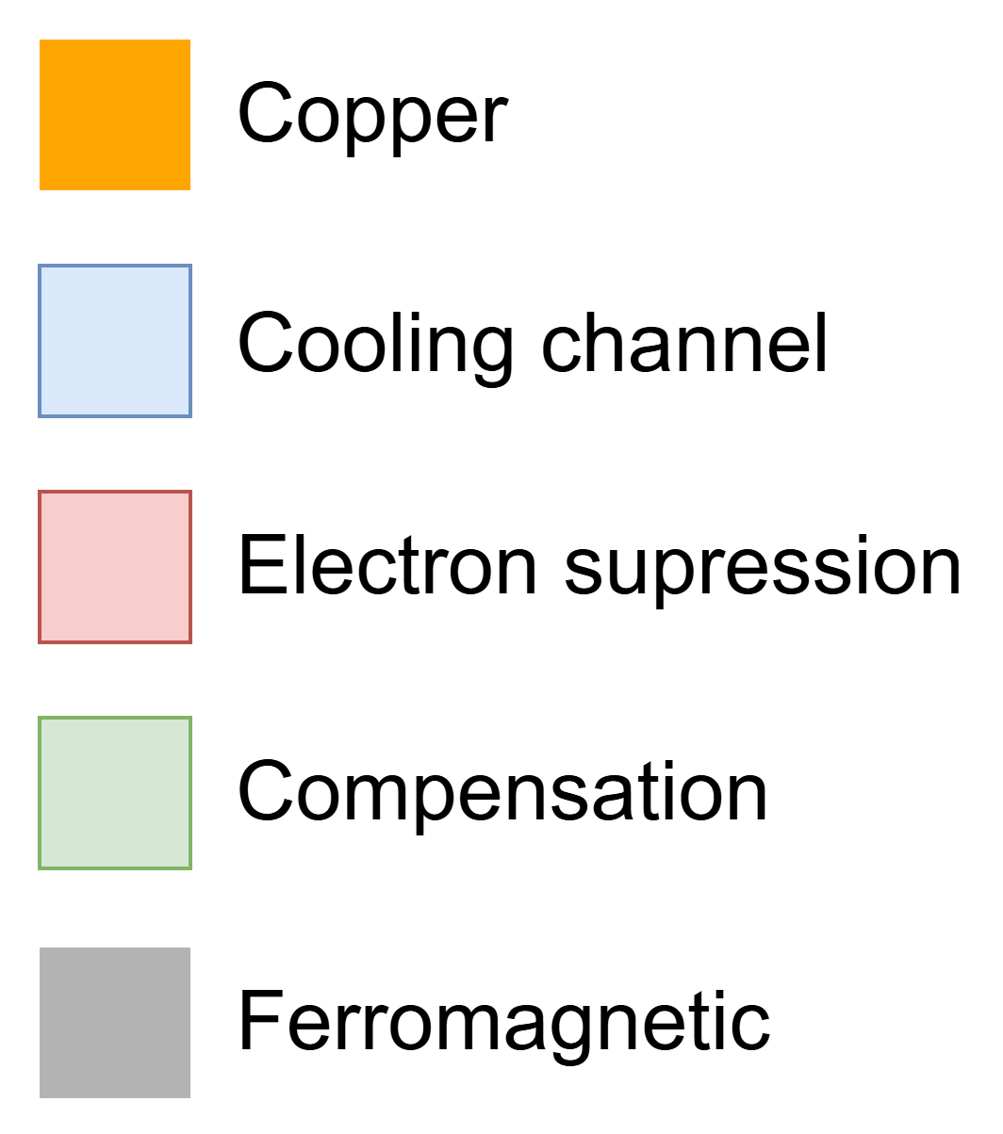
Accelerator processes
Within the accelerator charges can be generated/converted by:
Dependent on:
stripping, ionisation, interception, beam plasma
pressure, beam energy, optics, geometry

Slide 13
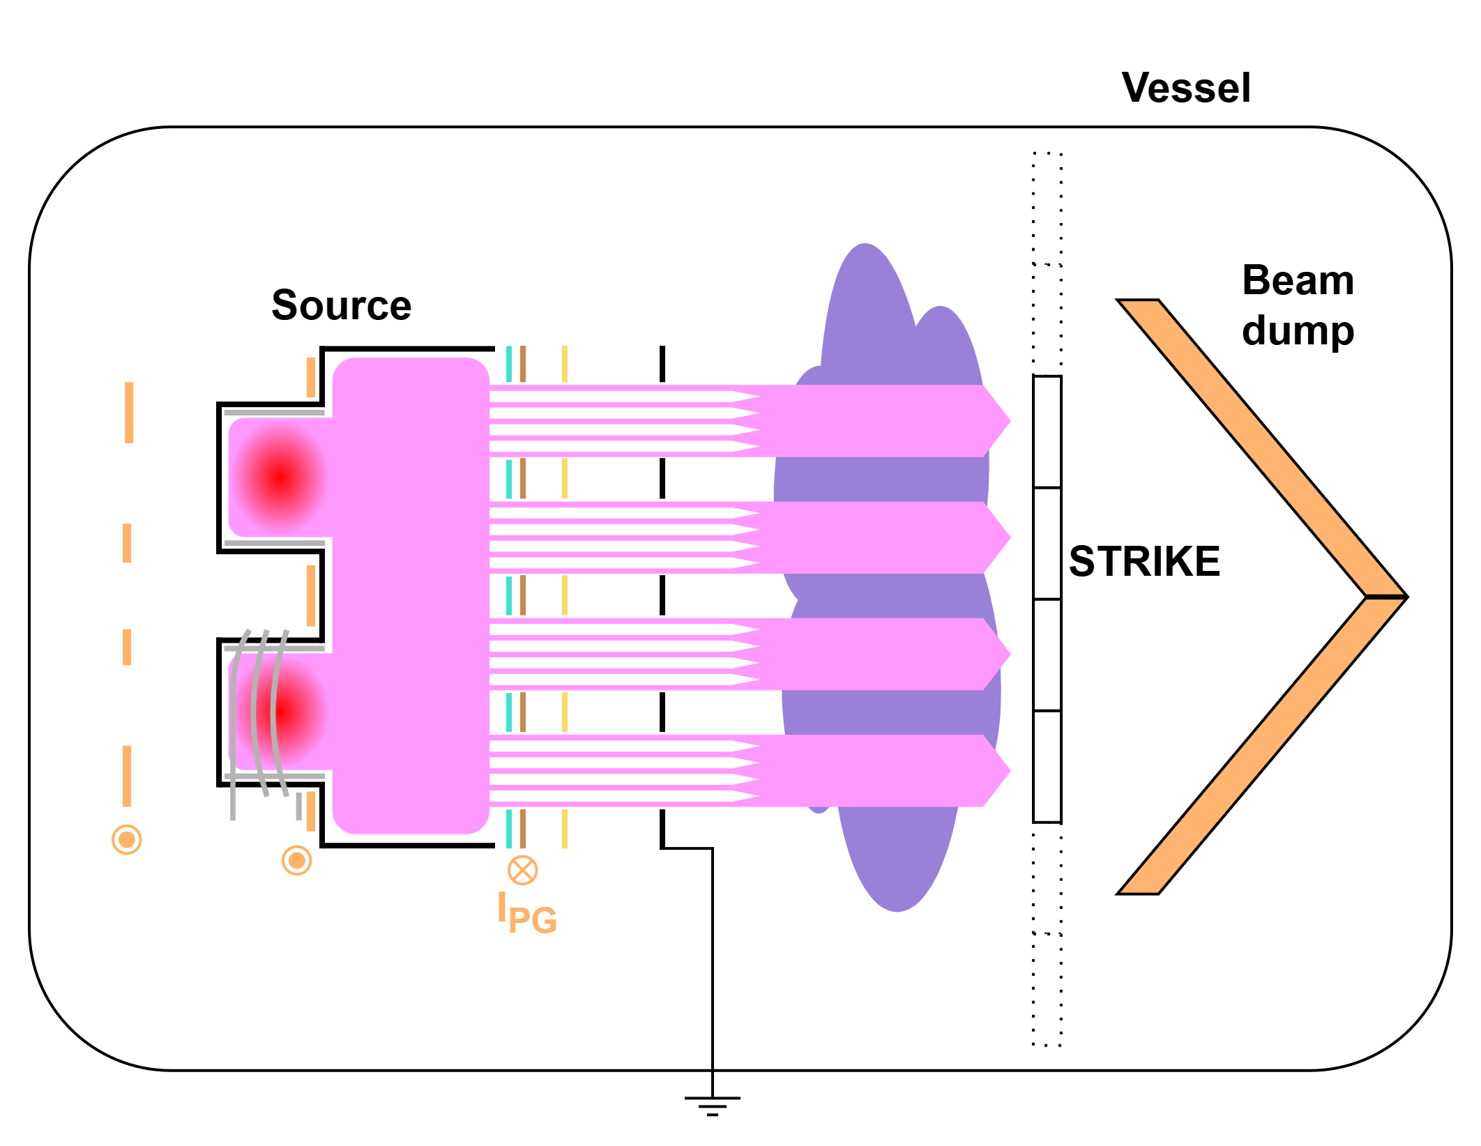
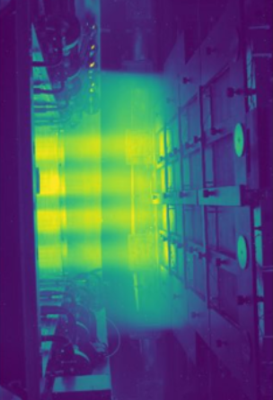
Beam generated plasma
Beam generated plasma downstream of the GG
Large background signal seen by cameras when acceleration is applied
With the open vacuum structure can the beam plasma influence the electrical measurements?

Slide 14
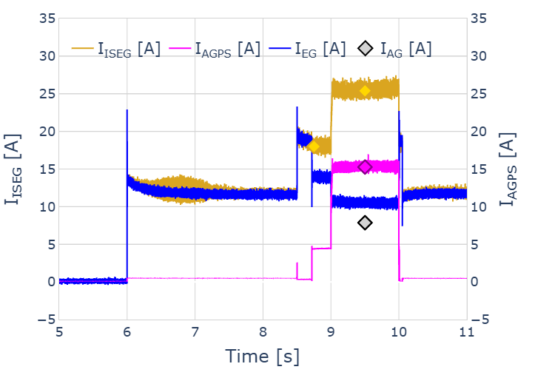
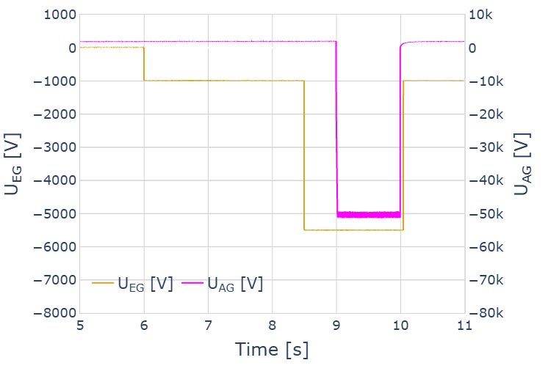
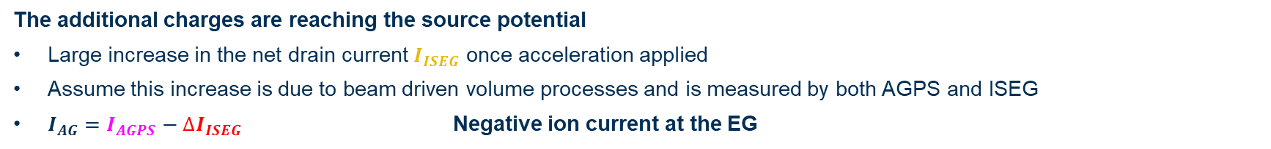


Increasing drain current
$${∆I}_{ISEG}$$
$${∆I}_{ISEG}$$
The additional charges are reaching the source potential
Large increase in the net drain current $I_{ISEG}$ once acceleration applied
Assume this increase is due to beam driven volume processes and is measured by both AGPS and ISEG
$I_{AG}=I_{AGPS}−{∆I}_{ISEG}$ Negative ion current at the EG

Slide 15
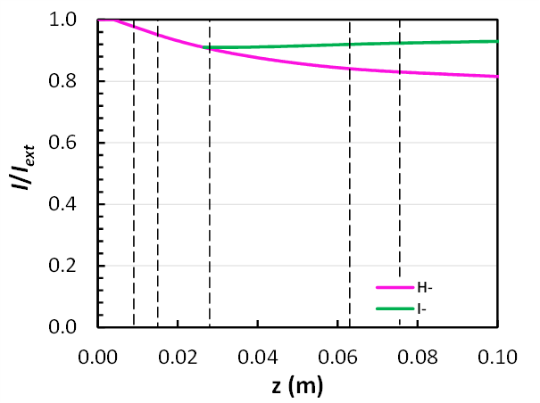

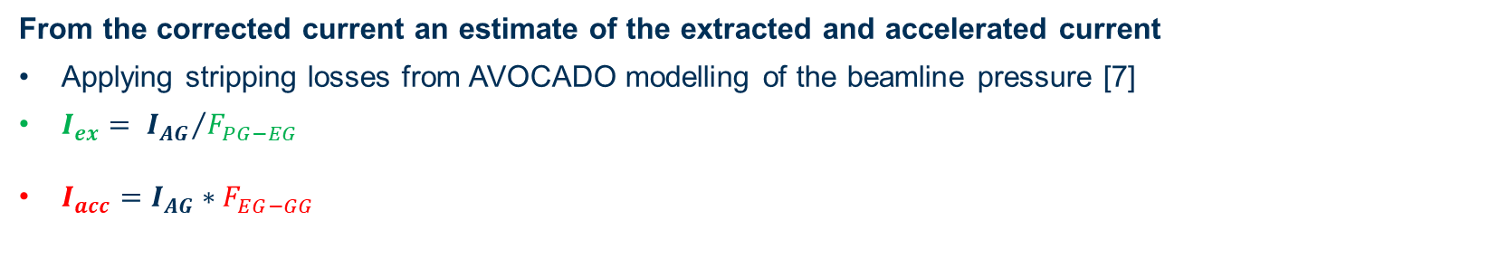


Extracted current estimation
From the corrected current an estimate of the extracted and accelerated current
Applying stripping losses from AVOCADO modelling of the beamline pressure [7]
$I_{ex}= {I_{AG}}/{F_{PG−EG}}$
$I_{acc}=I_{AG}∗F_{EG−GG}$
$$I_{ex}$$
$$I_{AG}$$
$$I_{acc}$$

Slide 16
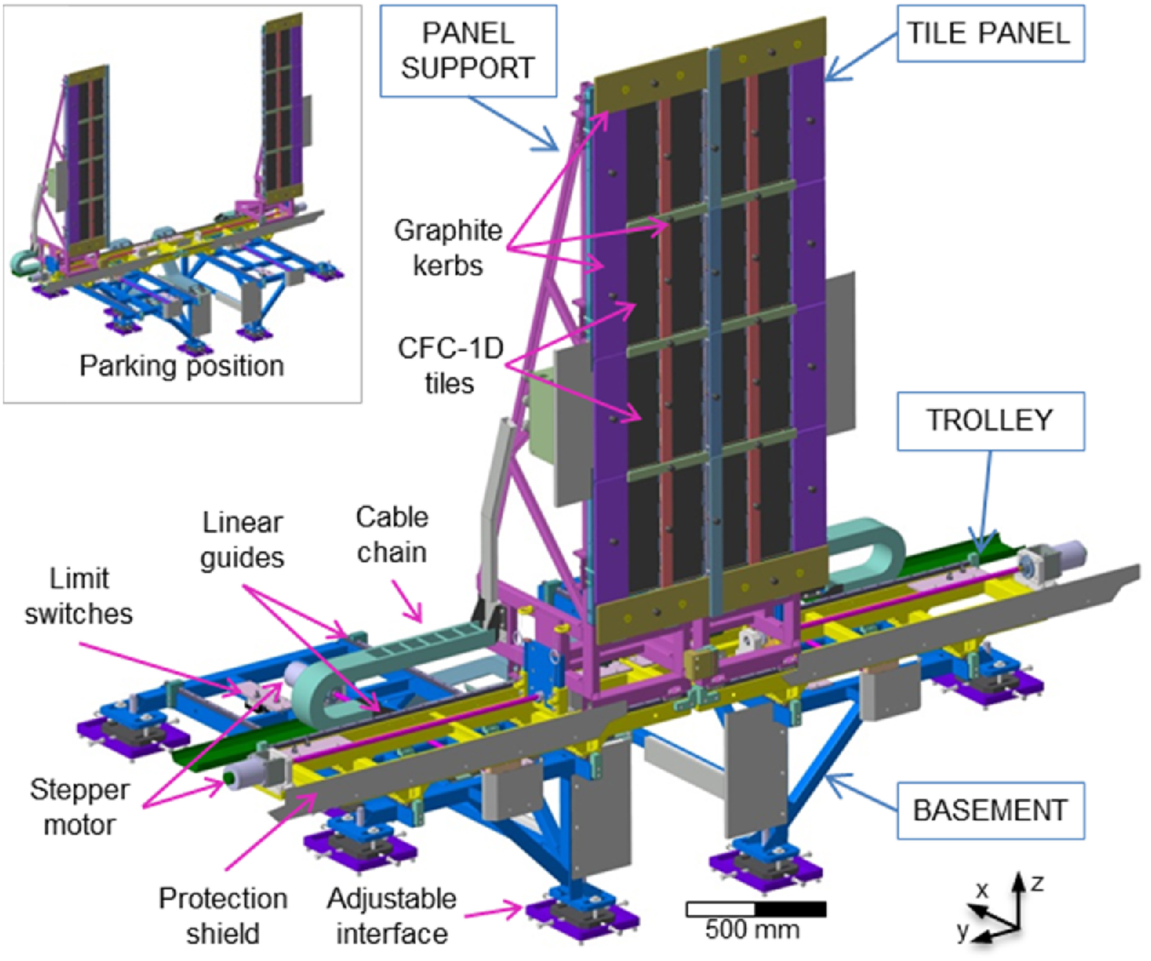
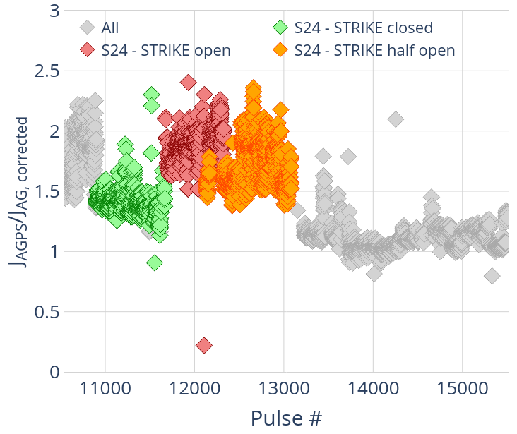
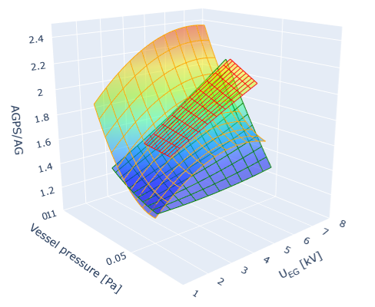

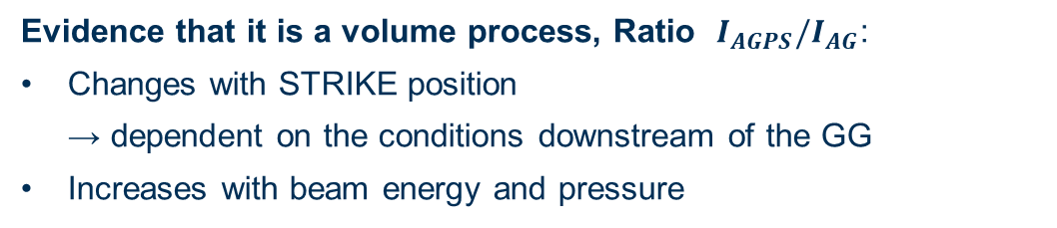




AG current correction
Evidence that it is a volume process, Ratio $I_{AGPS}/I_{AG}$:
Changes with STRIKE position
→ dependent on the conditions downstream of the GG
Increases with beam energy and pressure
$$I_{AGPS}/I_{AG}$$
$$I_{AGPS}/I_{AG}$$
$$P_{vessel} [Pa]$$
$U_{EG}$ [kV]
$$Pulse \#$$

Slide 17
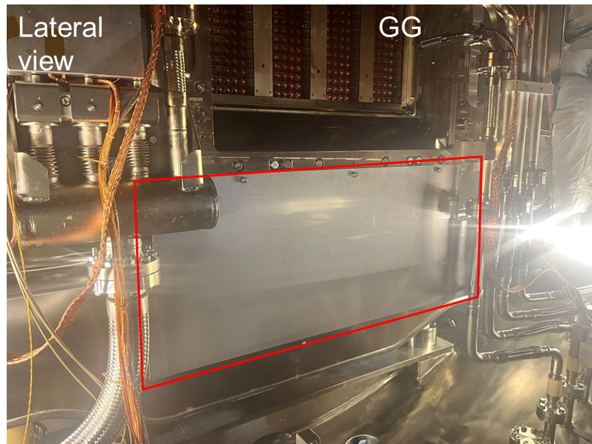
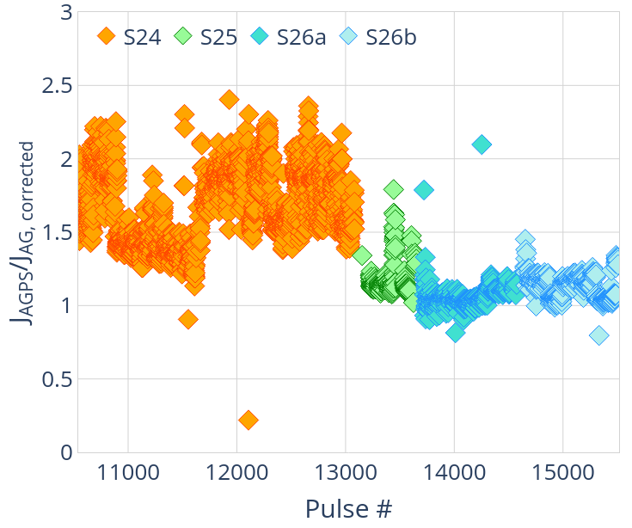
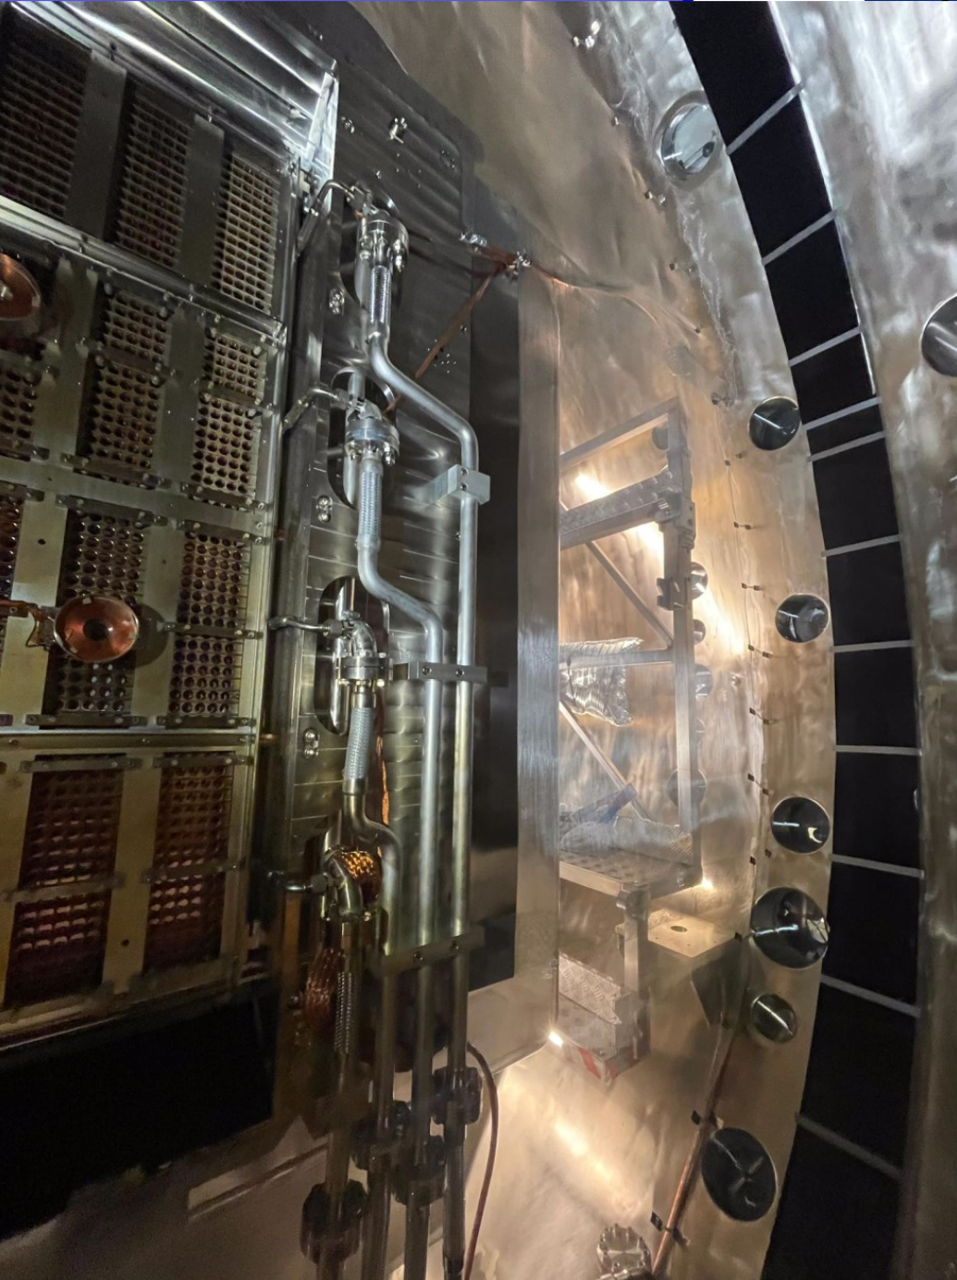

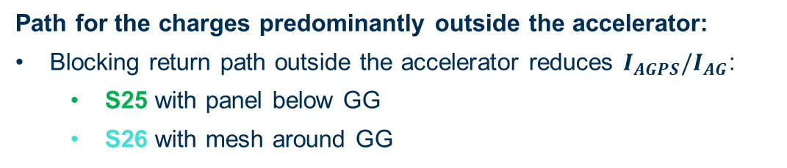
AG current correction
Path for the charges predominantly outside the accelerator:
Blocking return path outside the accelerator reduces $I_{AGPS}/I_{AG}$:
S25 with panel below GG
S26 with mesh around GG
$$I_{AGPS}/I_{AG}$$
Factor greater than previous estimates of the volume processes/losses [6]
$$Pulse \#$$

Slide 18
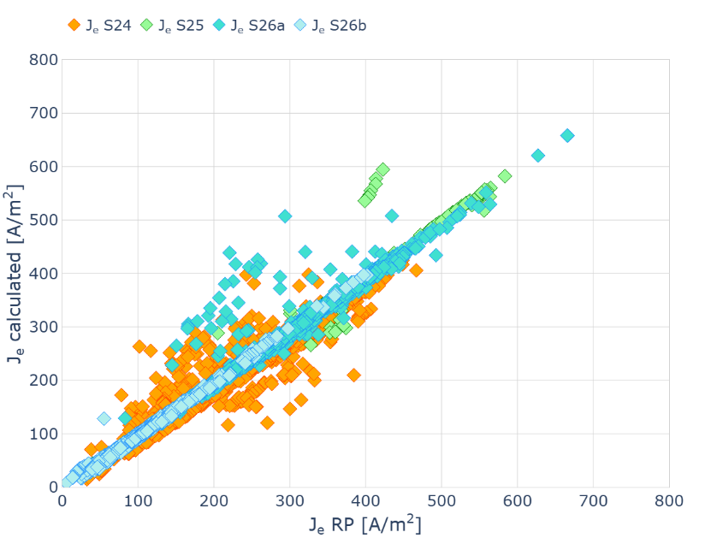
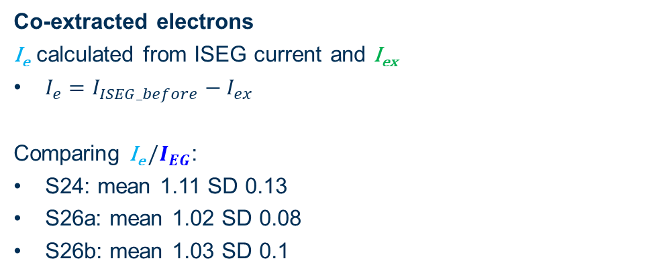

Validation against EG current
Co-extracted electrons
I_{e} calculated from ISEG current and I_{ex}
$I_{e}=I_{ISEG_before}−I_{ex}$
Comparing I_{e} $/I_{EG}$:
S24: mean 1.11 SD 0.13
S26a: mean 1.02 SD 0.08
S26b: mean 1.03 SD 0.1
J_{e} [ A/m²]
$$I_{e}$$
J_{EG} [A/m²]

Slide 19
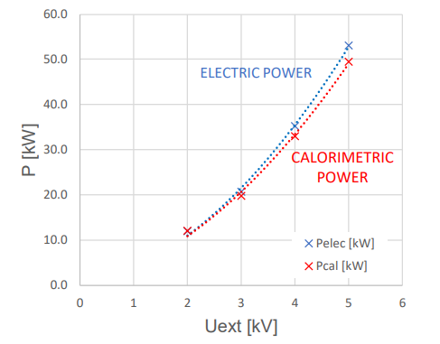
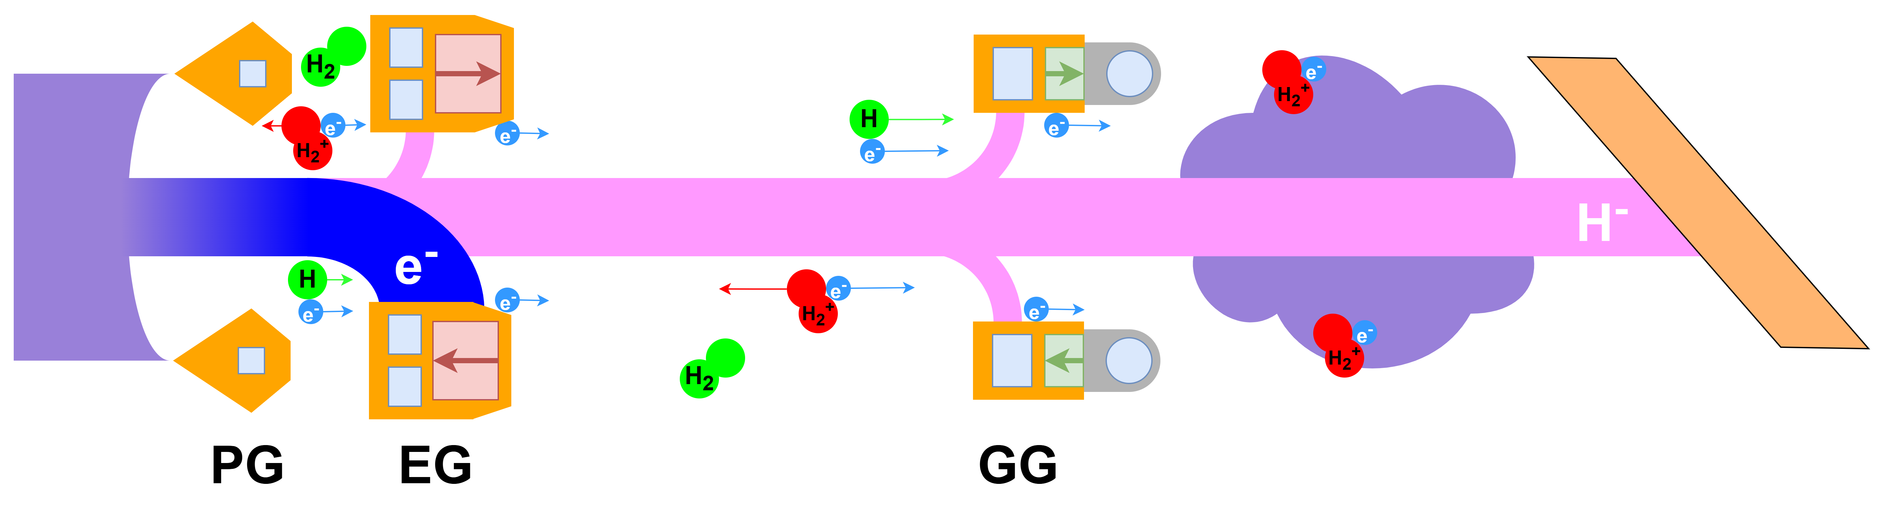
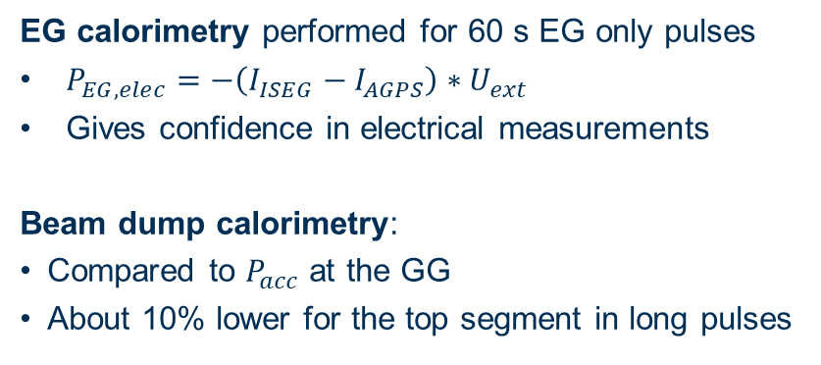
Validation against calorimetry
EG calorimetry performed for 60 s EG only pulses
$P_{EG,elec}=−\left(I_{ISEG}−I_{AGPS}\right)∗U_{ext}$
Gives confidence in electrical measurements
Beam dump calorimetry:
Compared to $P_{acc}$ at the GG
About 10% lower for the top segment in long pulses
EG calorimetry
BD calorimetry

Slide 20
OUTLINE
ITER NBTF and SPIDER
SPIDER campaign overview 2024/25
Extracted current estimation
Beam current performance
Conclusions and future perspectives

Slide 21
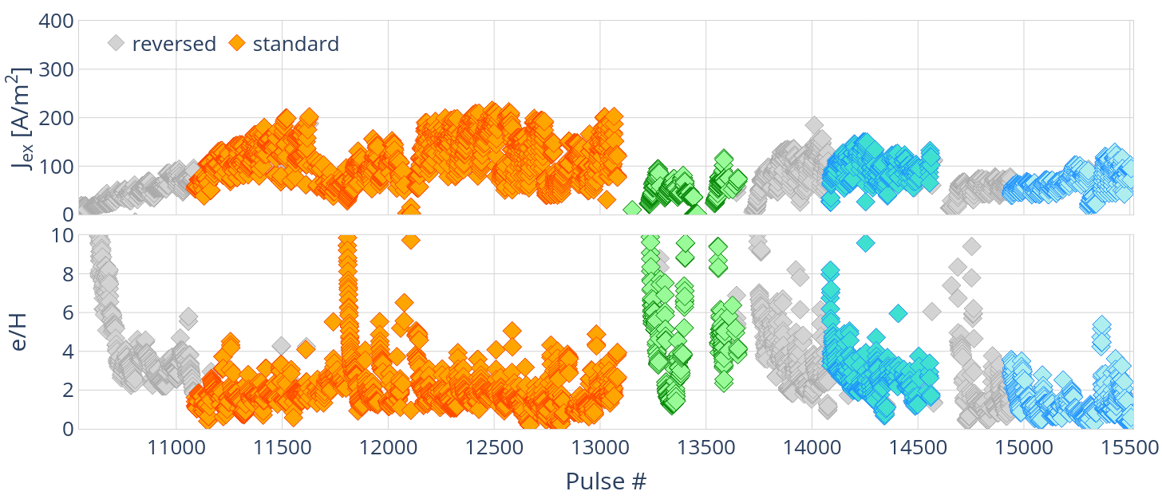
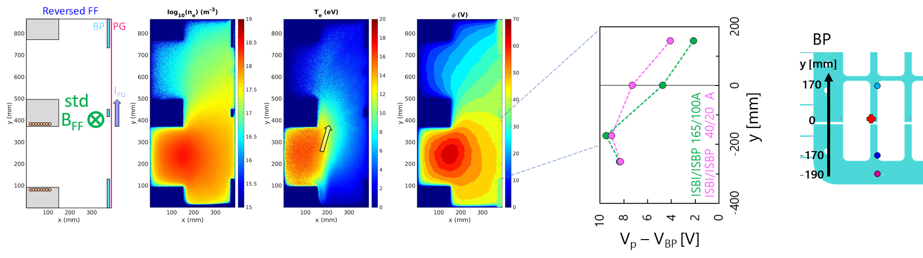
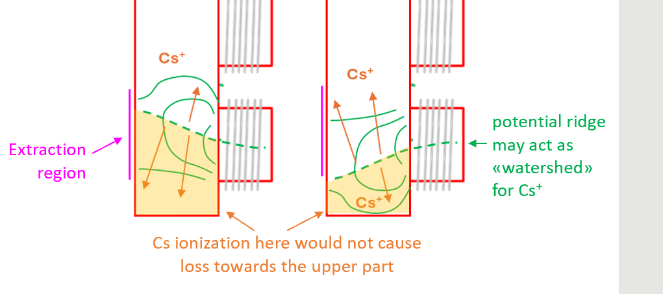



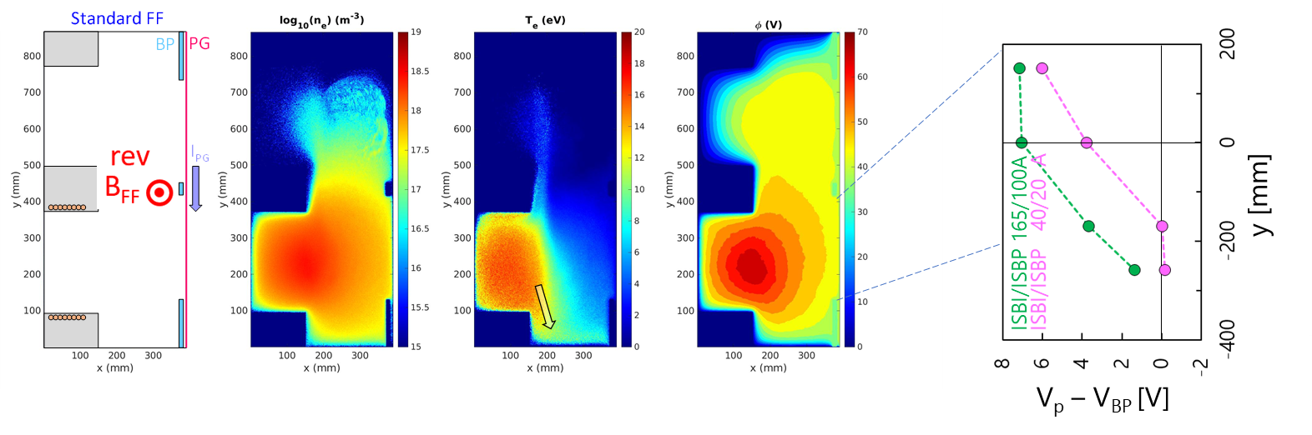

Operating conditions
Operation with single segment (present limitations of pumping system)
Higher Cs evaporation rates (20 mg/h at high RF) [8]
→ plasma free surfaces act as a sink
Combinations of FF direction (std. and rev. ) and biases were tested
Plasma drifts influence plasma and beam uniformity
At the bottom of the source e/H < 1 only possible in std.
Cs distribution influenced by plasma uniformity

Slide 22
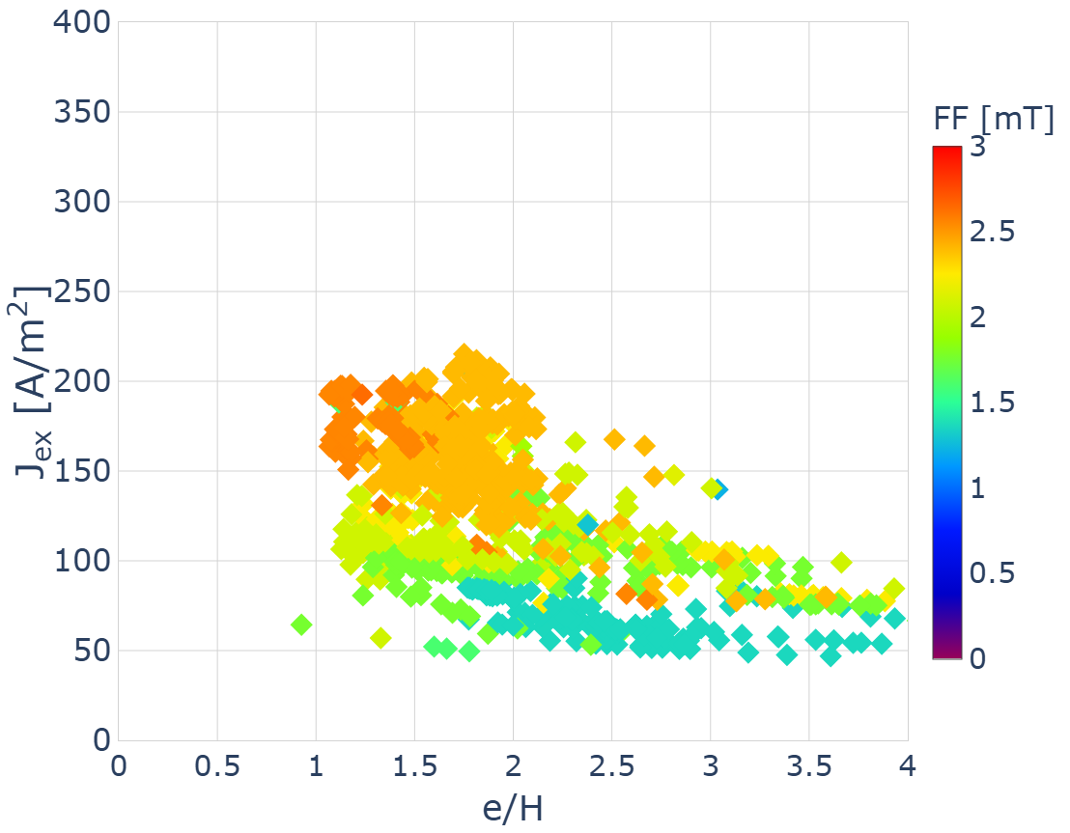
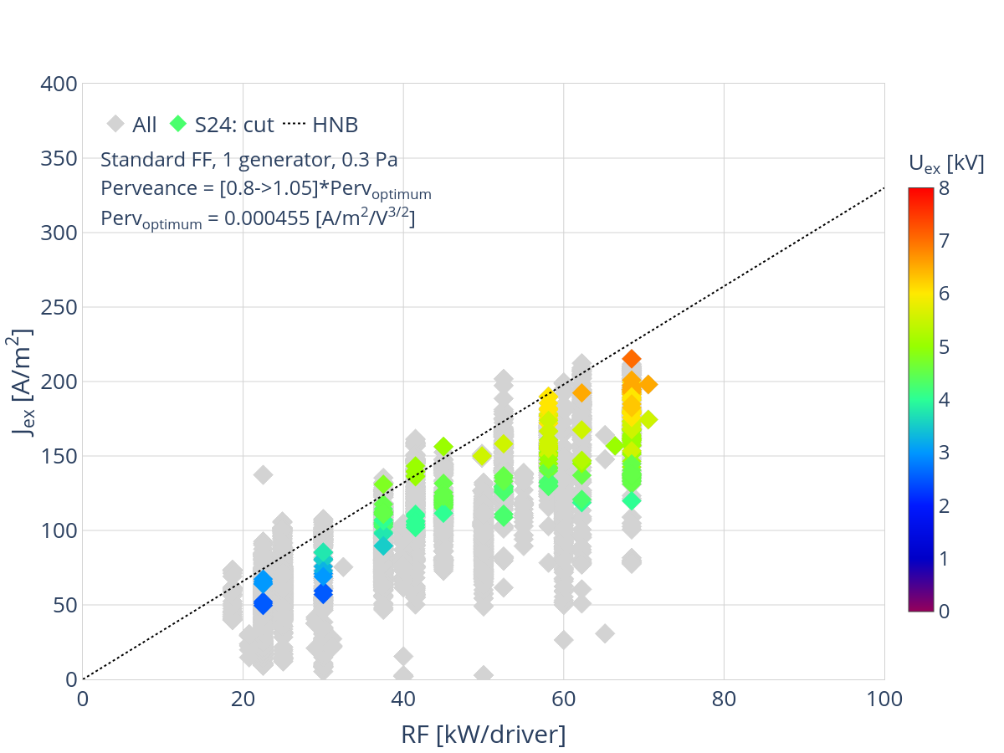
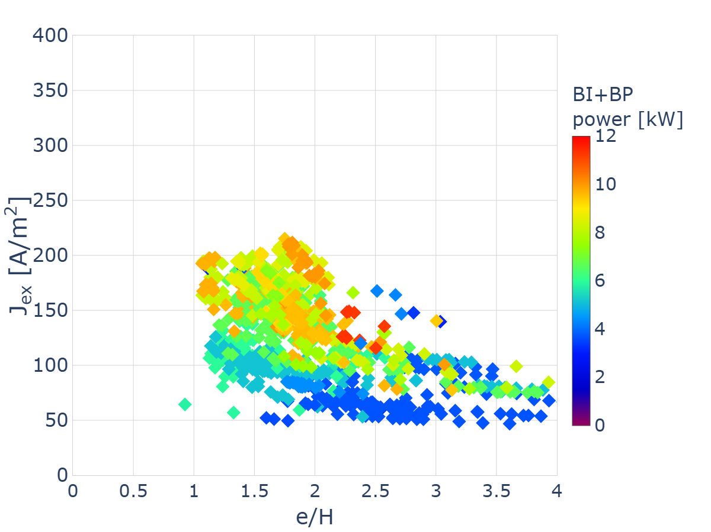
Scaling with RF
Filter
Solid State generators needed
Bias
Extracted current scaling with RF power at ITER relevant parameters:
0.3 Pa, perveance match, 215 A/m² at 68 kW/driver
Filter field in the range ⁓2.5 mT
High bias voltages and currents (⁓50 V, ⁓250 A)

Slide 23
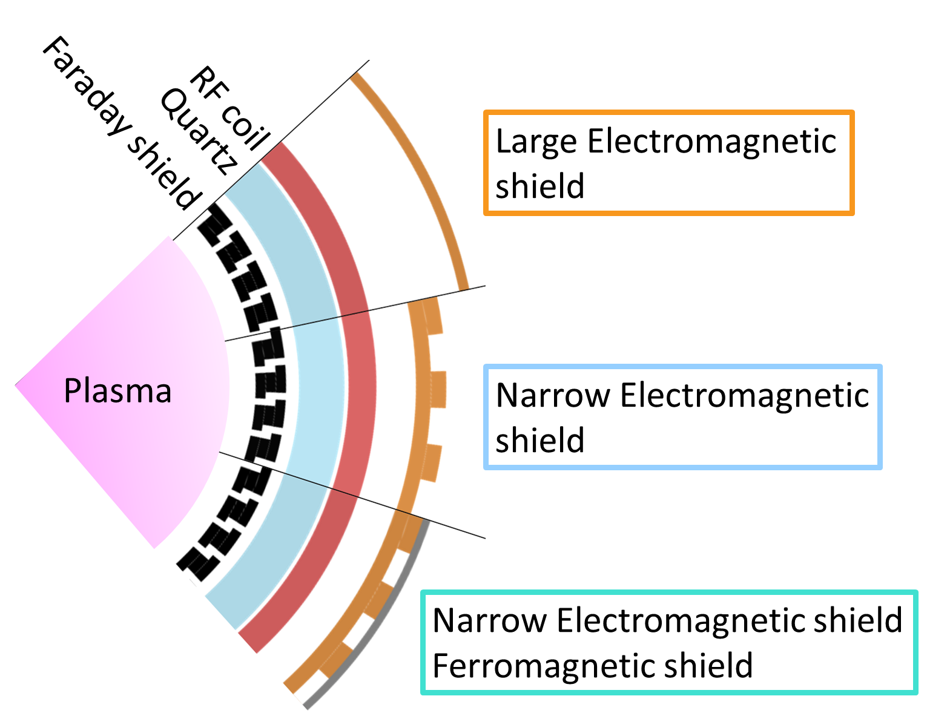
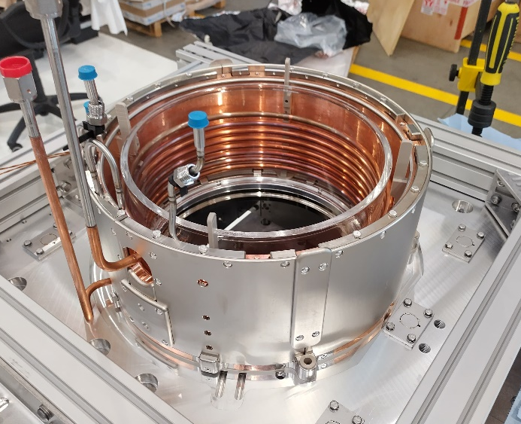
Decoupling driver and expansion region
driver
Fe shield around driver:
Decreases field integral in the driver
RF driver is partially decoupled from the expansion region
Left/right asymmetry is greatly reduced

Slide 24
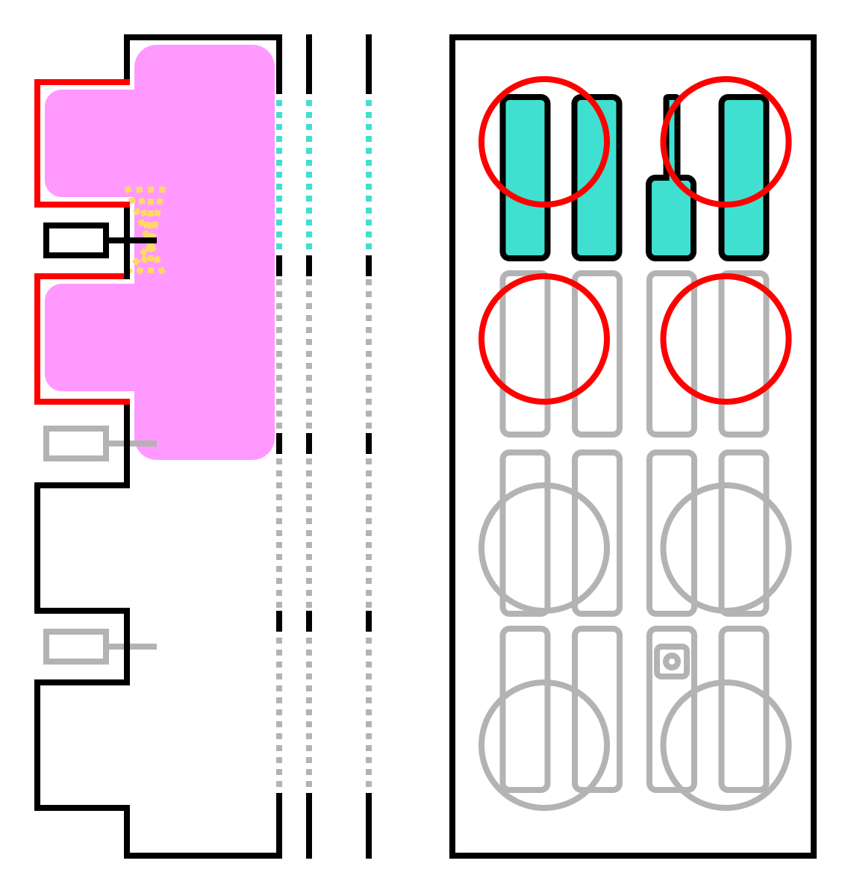
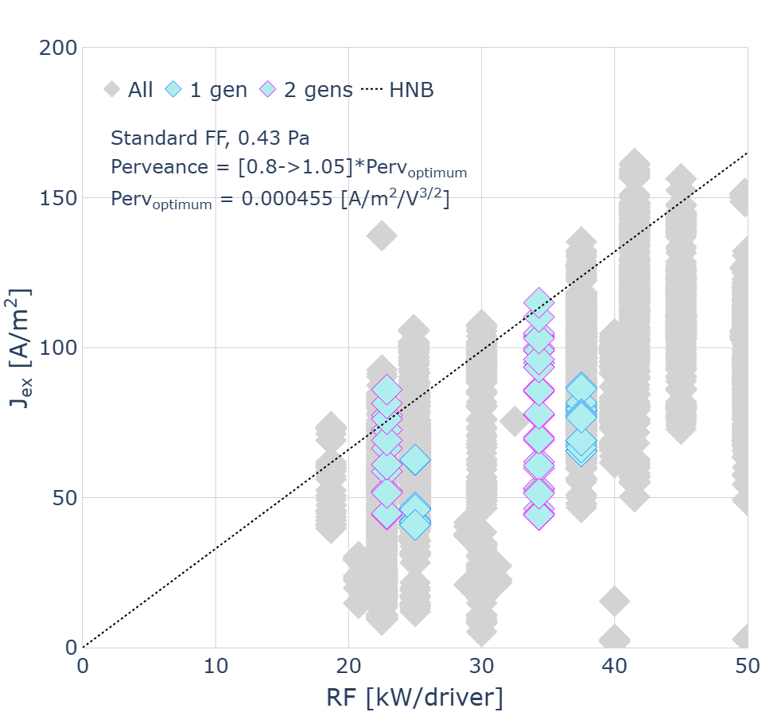
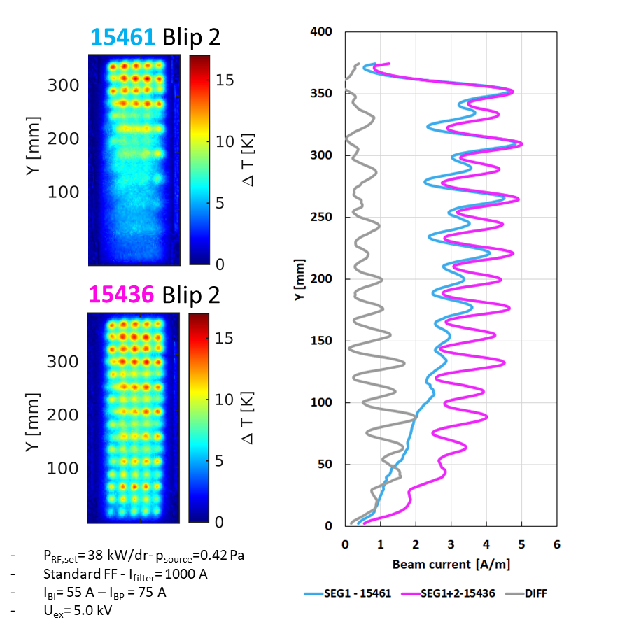
Two generators
Illuminating top segment with two drivers:
Increases the average current density by 20%
Improvement in uniformity across the segment → compensation for upwards drift and offset drivers

Slide 25
OUTLINE
ITER NBTF and SPIDER
SPIDER campaign overview 2024/25
Extracted current estimation
Beam current performance
Conclusions and future perspectives

Slide 26
Conclusions and future perspectives
High power beam acceleration (>10 A) achieved for the first time on ¼ SPIDER
→ Challenges in operation of single edge segments
Unexpected large factor (up to 2) increasing the acceleration drain current (AGPS)
→ downstream of the GG, shields and mesh at GG found to reduce the issue
→ Solution to be developed for ITER HNB
Decoupling the driver and expansion region showed reasonable perspectives
→ Relevant for ITER HNB
Beam uniformity depends on drifts and number of generators
→ Positive implications for future full source operation
For divergence results see presentation by Giulia Emma
SPIDER operation in 2026:
Solid state RF generators and enhanced pumping system (non-evaporable getters)
Full source operation aiming at ≥270 A/m² and >80 kW/driver

Slide 27
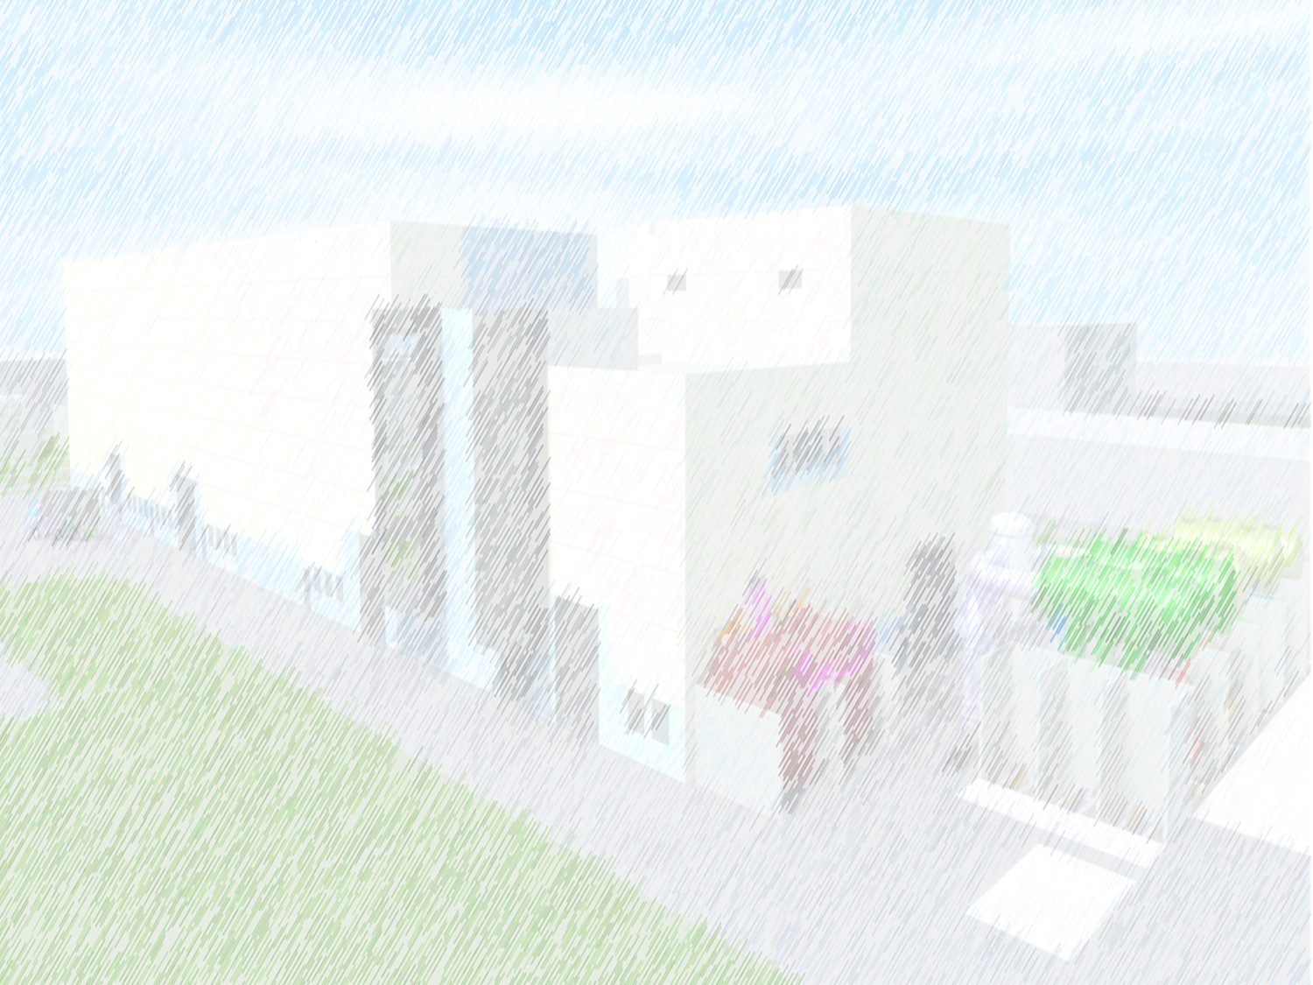
Thank you for listening
Any questions?

Slide 28
References
[1] R. S. Hemsworth et al., New J. Phys., vol. 19, 025005 (2017), doi: 10.1088/1367-2630/19/2/025005
[2] A. Chakraborty et al., IEEE TPS, vol. 38 (3), pp. 248-253 (2010), doi: 10.1109/TPS.2009.2035809
[3] V. Toigo et al., New J. Phys., vol. 19, 085004 (2017), doi: 10.1088/1367-2630/aa78e8
[4] M. Pavei et al., Fusion Eng. Des., vol. 161, 112036 (2020), doi: 10.1016/j.fusengdes.2020.112036
[5] U. Fantz et al, Nucl. Fusion, vol. 64, 086063 (2024), doi: 10.1088/1741-4326/ad5dcd
[6] A. Shepherd et al., JINST, vol. 18, C07019 (2023), doi: 10.1088/1748-0221/18/07/C07019
[7] E. Sartori and P. Veltri, Vacuum, vol. 90, pp. 80-88 (2013), doi: 10.1016/j.vacuum.2012.09.022
[8] E. Sartori et al., Nuclear Fusion, vol. 62 (8), 086022 (2022), doi: 10.1088/1741-4326/ac715e

Slide 29
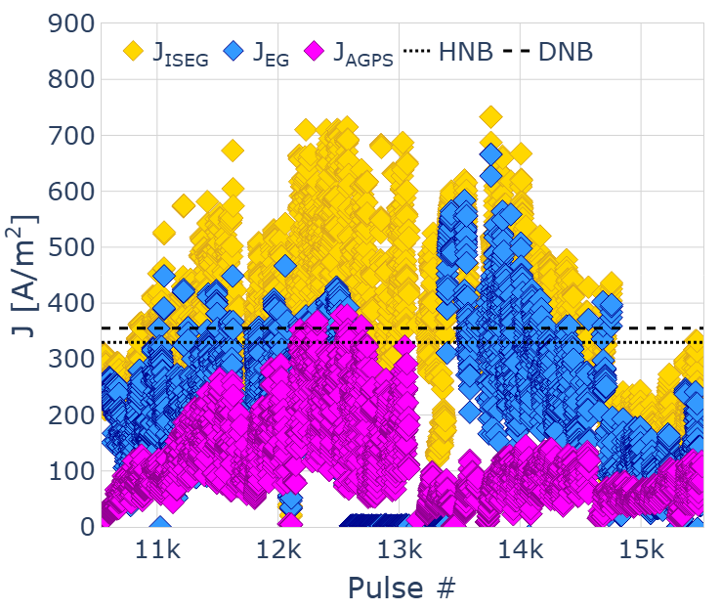
AGPS current
AGPS current reached over 355 A/m²
Overestimation of accelerated current as exceeds CL
Extrapolating to 100 kW/driver and 1280 beamlets ISEG and AGPS currents exceed PS limits
Issue needs to be removed, not just corrected for

Slide 30
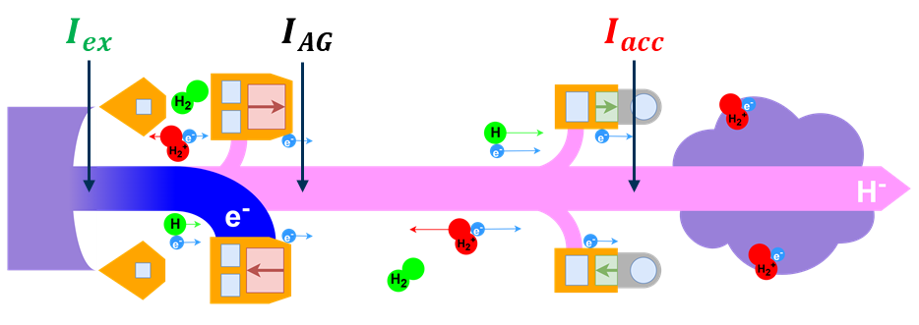
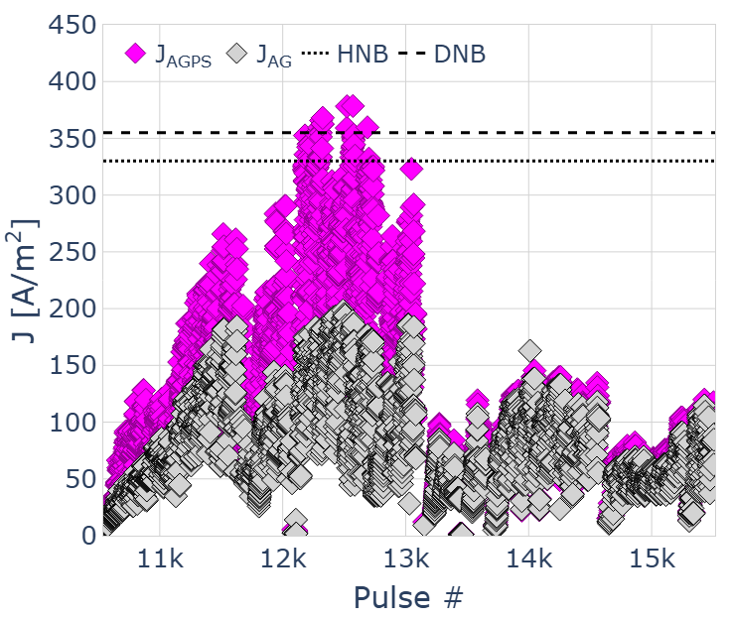

Current scaling

Slide 31





Effect of drifts on beam uniformity
DRIFT UP
DRIFT DOWN
Example of vertical profiles at top segment
std
rev
B_{FF}
B_{FF}
#14216 – blip1 (Top)
P_{RF,set}= 50 kW/dr- p_{source}=0.45 Pa
Standard FF - I_{filter}= 1400 A
I_{BI}= 89 A – I_{BP} = 102 A
V_{BI}= 37.4 V – V_{BP} = 32.0 V ➔ 5.4 V
U_{ex}= 5.5 kV
#14046 – blip2 (Top)
P_{RF,set}= 60 kW/dr- p_{source}=0.45 Pa
Reversed FF - I_{filter}= 1400 A
I_{BI}= 108 A – I_{BP} = 111 A
V_{BI}= 37.4 V – V_{BP} = 33.4 V ➔ 4.0 V
U_{ex}= 5.75 kV

Slide 32
Two generators
15461
15436
Illuminating top segment with two drivers:
Similar profiles seen from ion saturation currents (Langmuir probes) and H_{β} (OES)
2nd generator enhances the plasma density in the top segment

Slide 33

ITER filter field
Long range FF in the accelerator to deflect stripped electrons

