Slide 1



Space Charge Compensation in Hydrogen Ion Beams:
A Particle-In-Cell Study
Kiran Jonathan, Benzi John, and David Emerson
Computational Engineering Theme
Scientific Computing, STFC Daresbury Laboratory
Olli Tarvainen, Erin Flannigan, Dean Morris,
Alejandro Garcia Sosa, and Daniel Faircloth
Low Energy Beam Group
ISIS Neutron and Muon Source, STFC Rutherford Appleton Laboratory
Notes:
The abstract pattern can be removed or repositioned if required. Be careful to ‘Send to Back’ so that it does not obscure any important information.

Slide 2
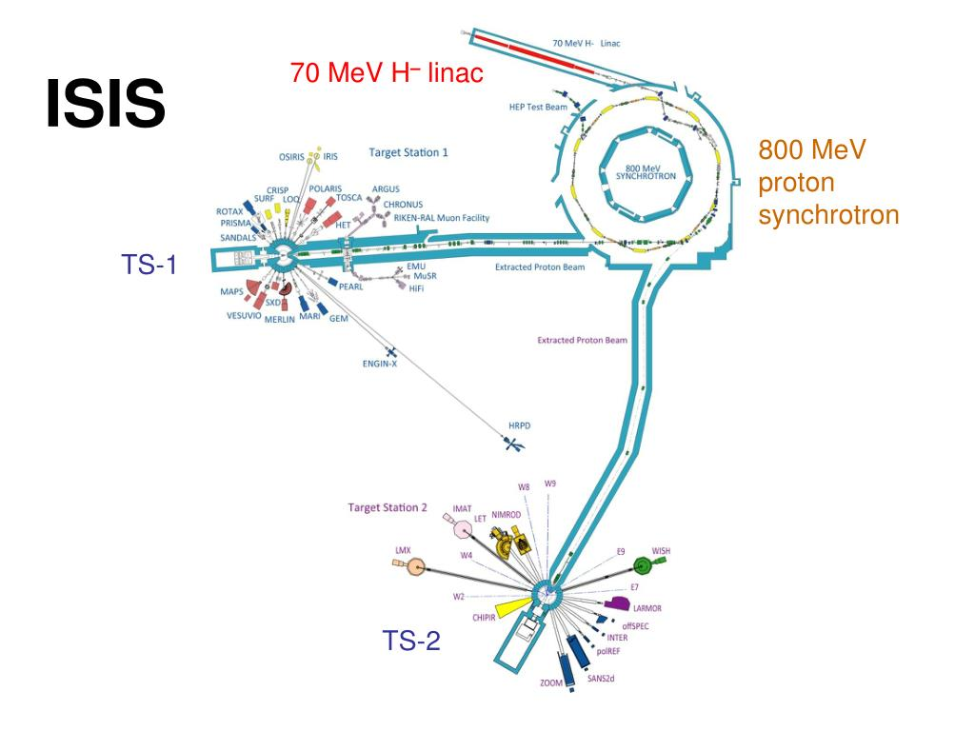


Project Overview
Studying space charge compensation in hydrogen ion beams
Joint simulation and experimental diagnostic campaign
H⁻ beams of interest:
ISIS Neutron and Muon Source
Front End Test Stand (FETS)
Future H⁺ experiments will be performed in collaboration with India DAE
Image © STFC John Dawson
Notes:
To replace photo with one of your own. 1) Send the geometric shape overlay to the back – Right-Click > Send to Back > Send to Back. 2) Replace image – use the guides provided to correctly position it. 3) Send your image to the back so that the geometric overlay re-appears over the image. Remember to delete the image credit if using your own image.

Slide 3
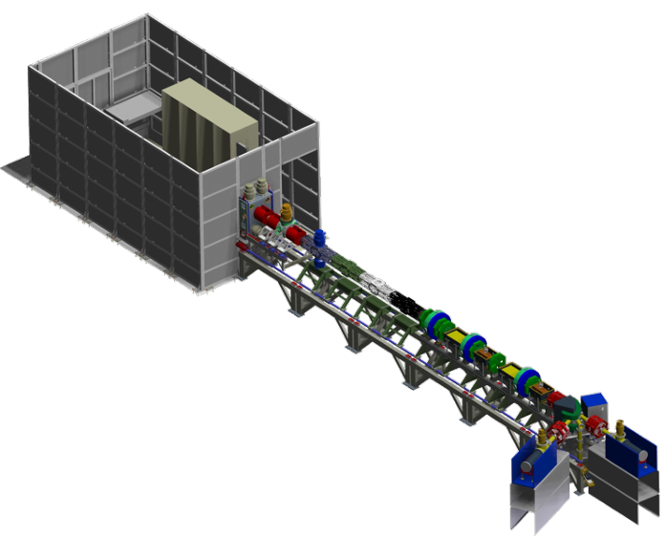
The Front End Test Stand (FETS)
H⁻ ion source and beam hosted at ISIS Facility
Separate from main ISIS beamline
Ideal for testing and diagnostics
Up to 60mA pulsed beam at 50Hz
Magnetostatic 65keV low energy beam transport (LEBT) region
Main reference point for simulations
H⁻ Ion Source
65 keV LEBT
3 MeV RFQ
Notes:
To replace photo with one of your own. 1) Send the geometric shape overlay to the back – Right-Click > Send to Back > Send to Back. 2) Replace image – use the guides provided to correctly position it. 3) Send your image to the back so that the geometric overlay re-appears over the image. Remember to delete the image credit if using your own image.

Slide 4
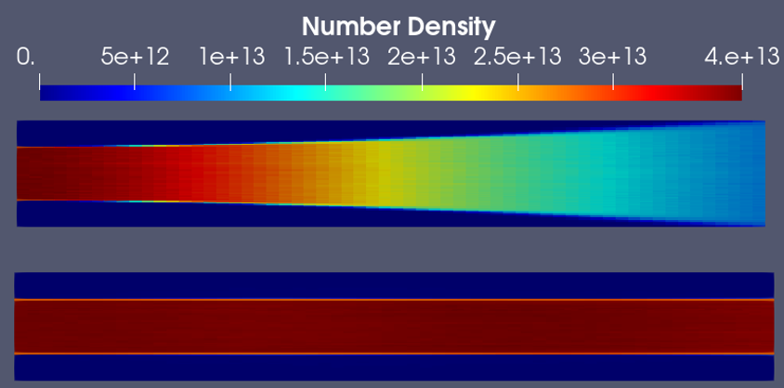
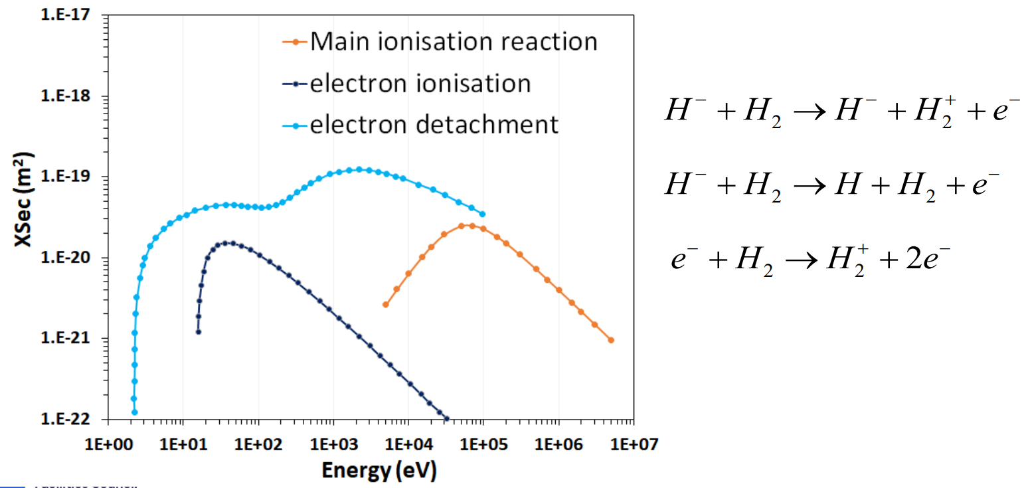
Space Charge Compensation (SCC) in FETS
SCC is used to reduce beam divergence from space charge repulsion
Magnetic lensing:
3 solenoids in LEBT region
Directly influences ion paths
Oppositely charged compensating particles:
Produced via ionisation of residual background gas (H₂)
Reduces net charge density, minimising space charge repulsion
Notes:
To replace photo with one of your own. 1) Send the geometric shape overlay to the back – Right-Click > Send to Back > Send to Back. 2) Replace image – use the guides provided to correctly position it. 3) Send your image to the back so that the geometric overlay re-appears over the image. Remember to delete the image credit if using your own image.

Slide 5
Why Study SCC?
SCC transience limits beam output
ISIS/FETS use a pulsed beam
Beam optics are focussed for steady state
Transmission is poor during build up of these particles
Reducing compensation time would maximise output of pulse and improve efficiency
How to minimise SCC time for future ISIS LEBT designs?
Current measurements taken at the end of the LEBT and RFQ during a typical FETS pulse
Notes:
To replace photo with one of your own. 1) Send the geometric shape overlay to the back – Right-Click > Send to Back > Send to Back. 2) Replace image – use the guides provided to correctly position it. 3) Send your image to the back so that the geometric overlay re-appears over the image. Remember to delete the image credit if using your own image.

Slide 6
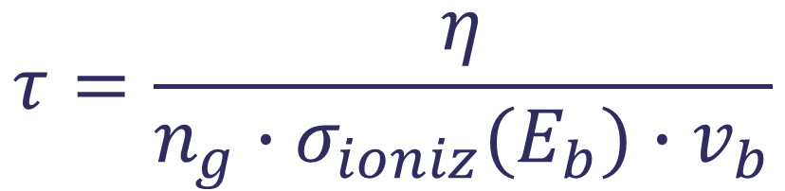
SCC Degree and Time
Mathematical definitions and analytic expectation
SCC Time [1]:
What other factors may influence SCC degree/time?
External fields
Properties of the compensating particles
LEBT design/boundary conditions
Beam velocity fixed by system design
Implies BGG species and density is only way to influence SCC time
$$τ=\frac{η}{n_{g}∙σ_{ioniz}(E_{b}){∙v}_{b}}$$
[1] C.A. Valerio-Lizarraga, I. Leon-Monzon and R. Scrivens, “Negative ion beam space charge compensation by residual gas”, Phys. Rev. ST Accel. Beams 18 (2015) 080101
Notes:
To replace photo with one of your own. 1) Send the geometric shape overlay to the back – Right-Click > Send to Back > Send to Back. 2) Replace image – use the guides provided to correctly position it. 3) Send your image to the back so that the geometric overlay re-appears over the image. Remember to delete the image credit if using your own image.

Slide 7

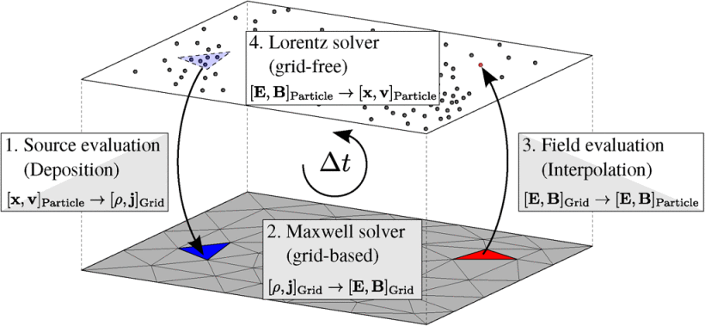
Particle-In-Cell (PIC) Simulations
Bridging the gap between experiment and theory
Using the open-source plasma kinetic code PICLas
PIC codes combine particle-based (Lagrangian) and field-based (Eulerian) methods
Direct-Simulation Monte Carlo (DSMC) for chemical reactions
Monte Carlo Collision (MCC) for background gas interactions
Gas density >> beam density
[2] PIC diagram taken from J. Neudorfer et al., “Efficient Parallelization of a Three-Dimensional High-Order Particle-in-Cell Method for the Simulation of a 170 GHz Gyrotron Resonator”, IEEE Transactions on Plasma Science, Vol. 41, No. 1 (2013)
Notes:
To replace photo with one of your own. 1) Send the geometric shape overlay to the back – Right-Click > Send to Back > Send to Back. 2) Replace image – use the guides provided to correctly position it. 3) Send your image to the back so that the geometric overlay re-appears over the image. Remember to delete the image credit if using your own image.

Slide 8
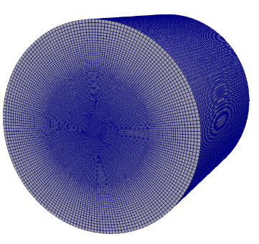
Problem Definition – General Parameters
PIC Simulation Parameters
“Typical” FETS parameters:
65keV, 30mA, 2.5cm radius beam
1×10⁻⁵mbar neutral H₂ background gas
Simplified LEBT:
0.2m long, 5cm radius cylindrical domain
Dirichlet (0 ϕ) on radial boundaries
Neumann (0 E_{z}) on longitudinal boundaries
0 ϕ
0 E_{z}
0 E_{z}
10cm
0 ϕ
0.2m
Notes:
To replace photo with one of your own. 1) Send the geometric shape overlay to the back – Right-Click > Send to Back > Send to Back. 2) Replace image – use the guides provided to correctly position it. 3) Send your image to the back so that the geometric overlay re-appears over the image. Remember to delete the image credit if using your own image.

Slide 9
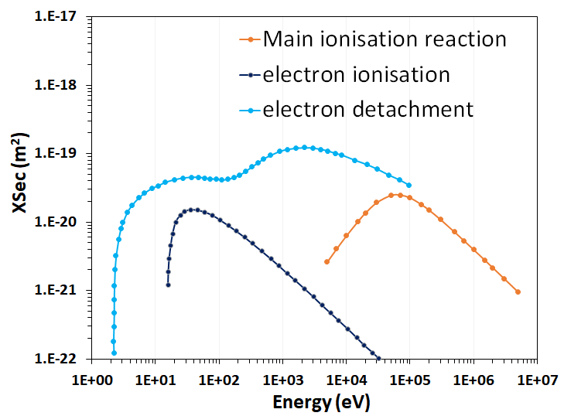
Impact of B-Field on H⁻ Beam
PIC Simulation Parameters
3 chemical reactions considered for H⁻ [3]:
Cross-sections for H⁺ used due to data availability
With and without an axial magnetic field (B_{z} = 0.35T)
Compensating Particles
How do external B-fields influence SCC?
[3] M.E. Rudd et al., “Cross sections for ionization of gases by 5–4000-keV protons and for electron capture by 5–150-keV protons”, Phys. Rev. A 28 (1983) 3244
Notes:
To replace photo with one of your own. 1) Send the geometric shape overlay to the back – Right-Click > Send to Back > Send to Back. 2) Replace image – use the guides provided to correctly position it. 3) Send your image to the back so that the geometric overlay re-appears over the image. Remember to delete the image credit if using your own image.

Slide 10
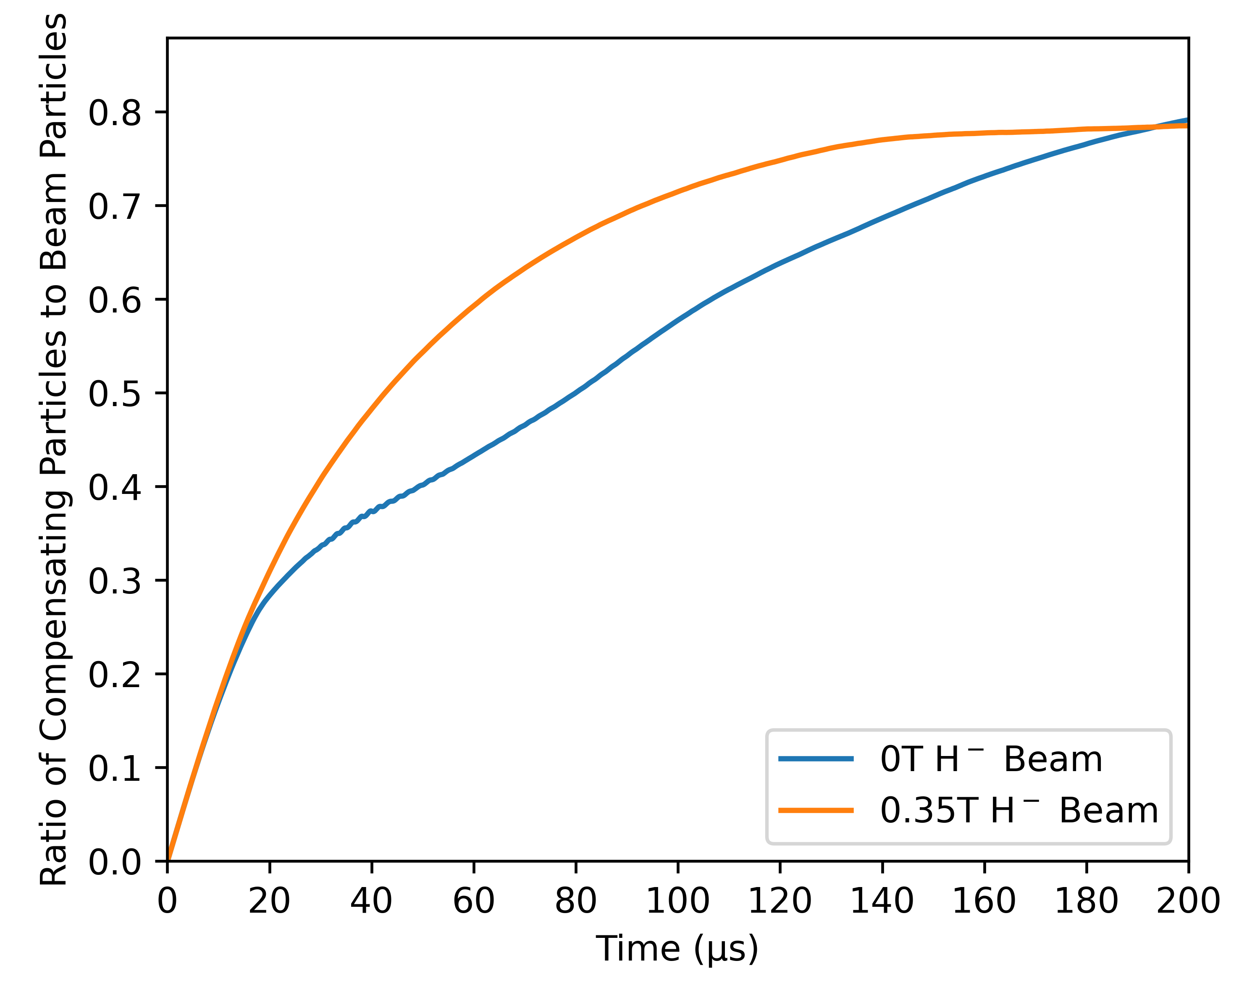
Results – Impact of B-Field on H⁻ Beam
Negative H⁻ Beam with 0T and 0.35T Axial Magnetic Field
SCC build up initially linear, then loss dominated
B-Field influences beam dynamics and changes loss mechanisms
Notes:
To replace photo with one of your own. 1) Send the geometric shape overlay to the back – Right-Click > Send to Back > Send to Back. 2) Replace image – use the guides provided to correctly position it. 3) Send your image to the back so that the geometric overlay re-appears over the image. Remember to delete the image credit if using your own image.

Slide 11
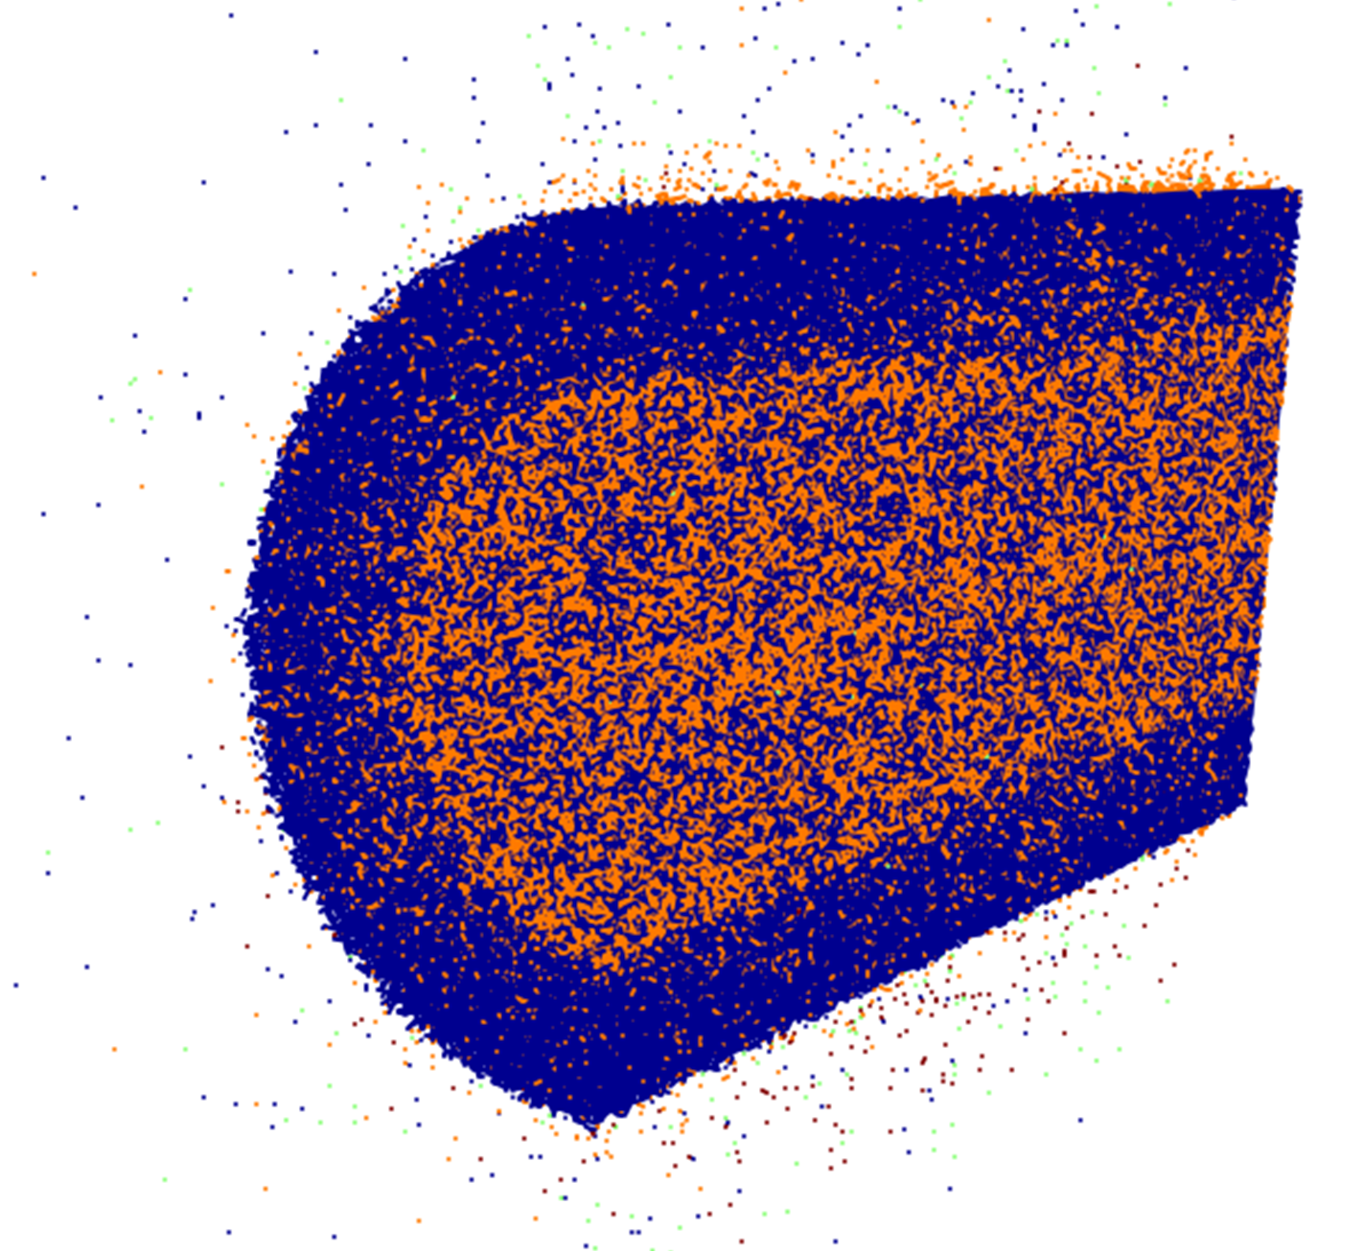
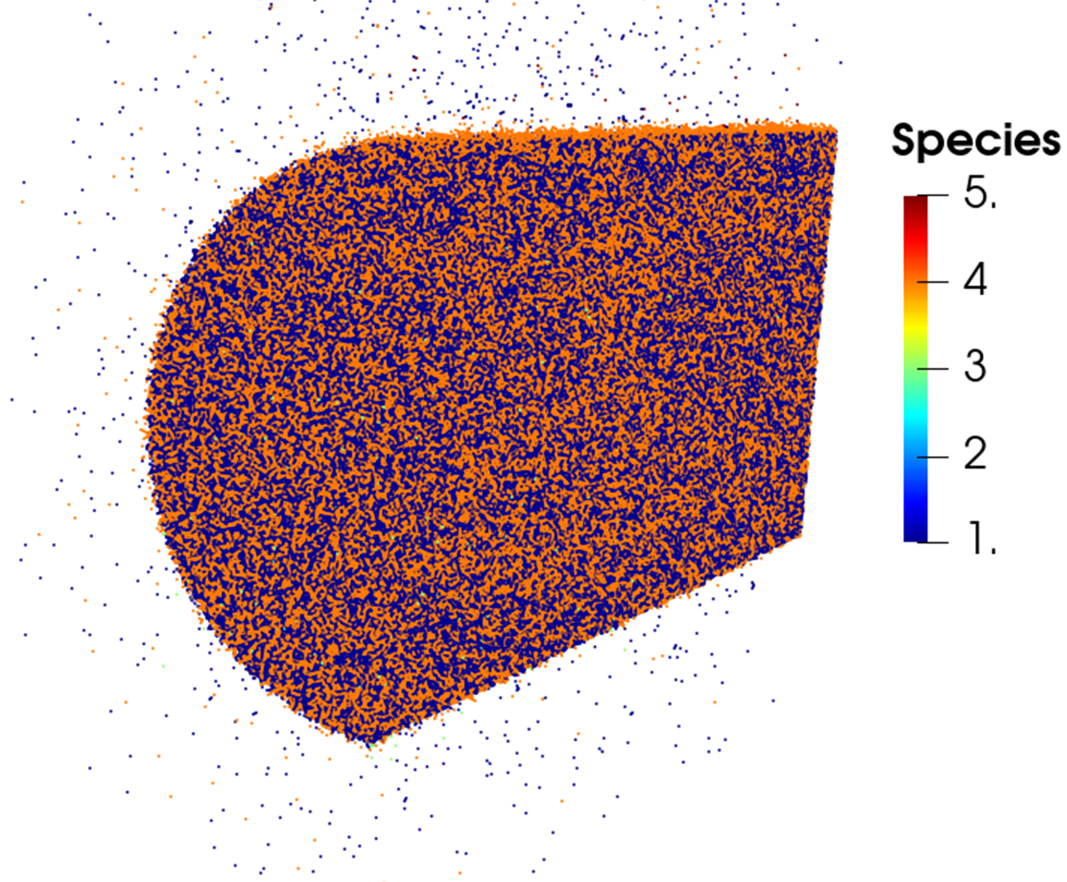
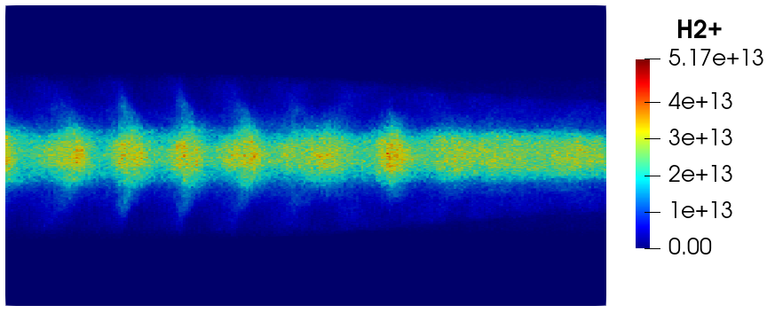
Results – Impact of B-Field on H⁻ Beam
Particle distributions for 0T and 0.35T H⁻ Beam
0T 0.35T
H₂⁺ distribution along LEBT for
0T H⁻ Beam during SCC transience
(Species colour: 1=H⁻, 3=electron, 4=H₂⁺, 5=H)
For 0T case, pooling can cause compression waves to form in the beam centre
B-Field restricts radial motion and E×B drifts prevent pooling in centre of beam
Figures from recent work “Effect of Magnetic Field on Space Charge Compensation in Negative Hydrogen Ion Beams: A Computational Study”, B. John et al. [4]
[4] B. John et al., “Effect of Magnetic Field on Space Charge Compensation in Negative Hydrogen Ion Beams: A Computational Study”, Journal of Instrumentation, 20 C05024, 2025.
Notes:
To replace photo with one of your own. 1) Send the geometric shape overlay to the back – Right-Click > Send to Back > Send to Back. 2) Replace image – use the guides provided to correctly position it. 3) Send your image to the back so that the geometric overlay re-appears over the image. Remember to delete the image credit if using your own image.

Slide 12
Impact of B-Field on H⁺ Beam
PIC Simulation Parameters
Same as H⁻, with one reaction excluded:
Same (H⁺) cross-sections used
e⁻ are
the new
compensating
species
How does a change of compensating species influence SCC?
Notes:
To replace photo with one of your own. 1) Send the geometric shape overlay to the back – Right-Click > Send to Back > Send to Back. 2) Replace image – use the guides provided to correctly position it. 3) Send your image to the back so that the geometric overlay re-appears over the image. Remember to delete the image credit if using your own image.

Slide 13
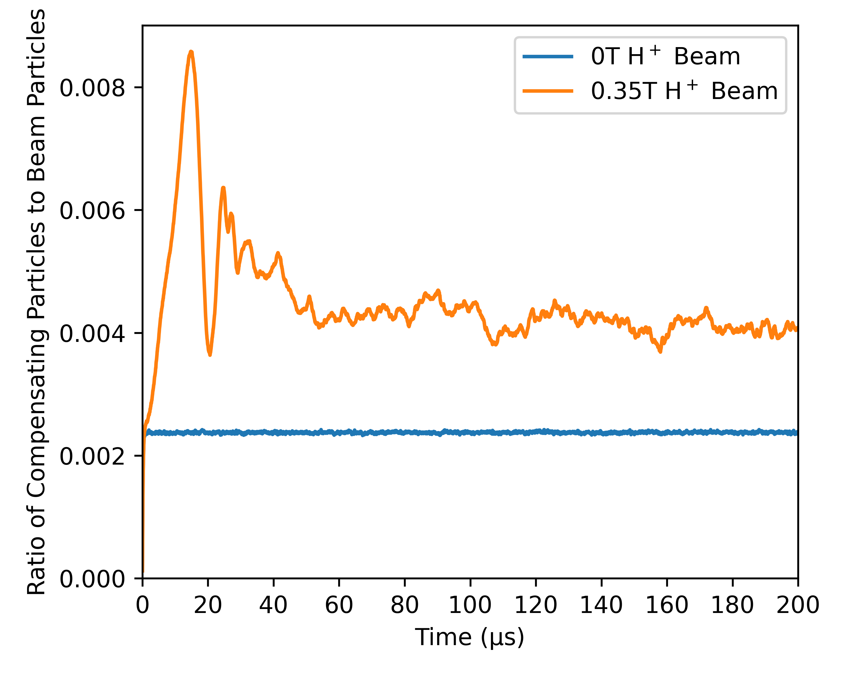
Results – Impact of B-Field on H⁺ Beam
Positive H⁺ Beam with 0T and 0.35T Axial Magnetic Field
SCC process is once again affected by B-Field
Overall SCC degree is negligible and transience is short
Notes:
To replace photo with one of your own. 1) Send the geometric shape overlay to the back – Right-Click > Send to Back > Send to Back. 2) Replace image – use the guides provided to correctly position it. 3) Send your image to the back so that the geometric overlay re-appears over the image. Remember to delete the image credit if using your own image.

Slide 14
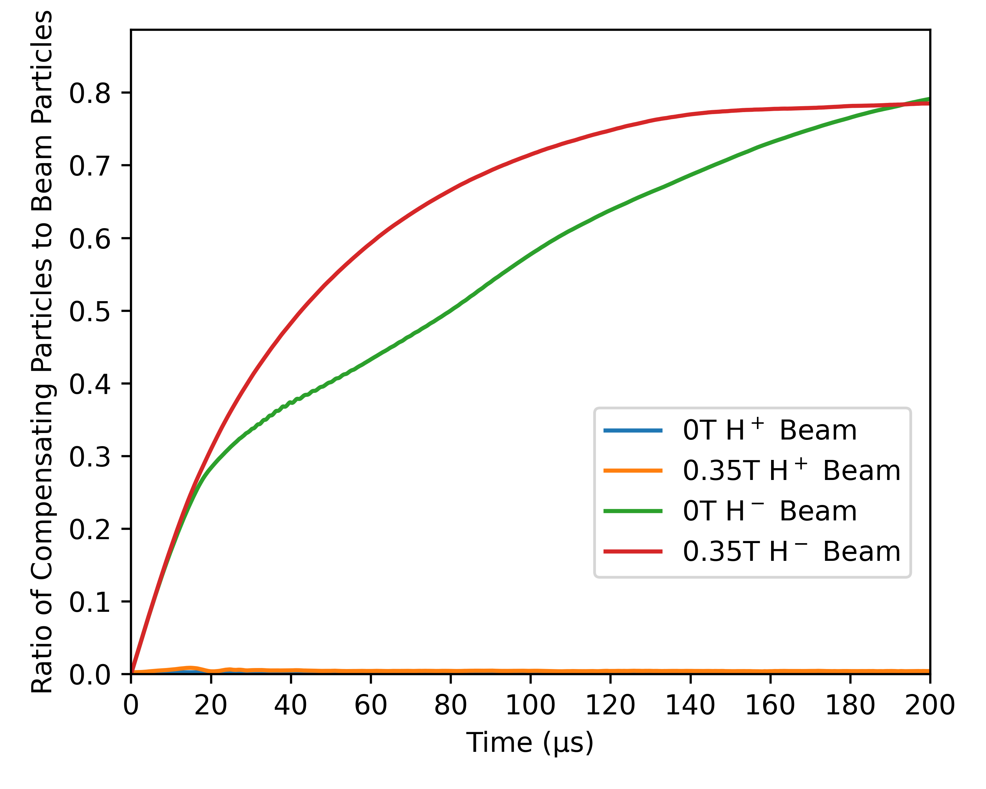
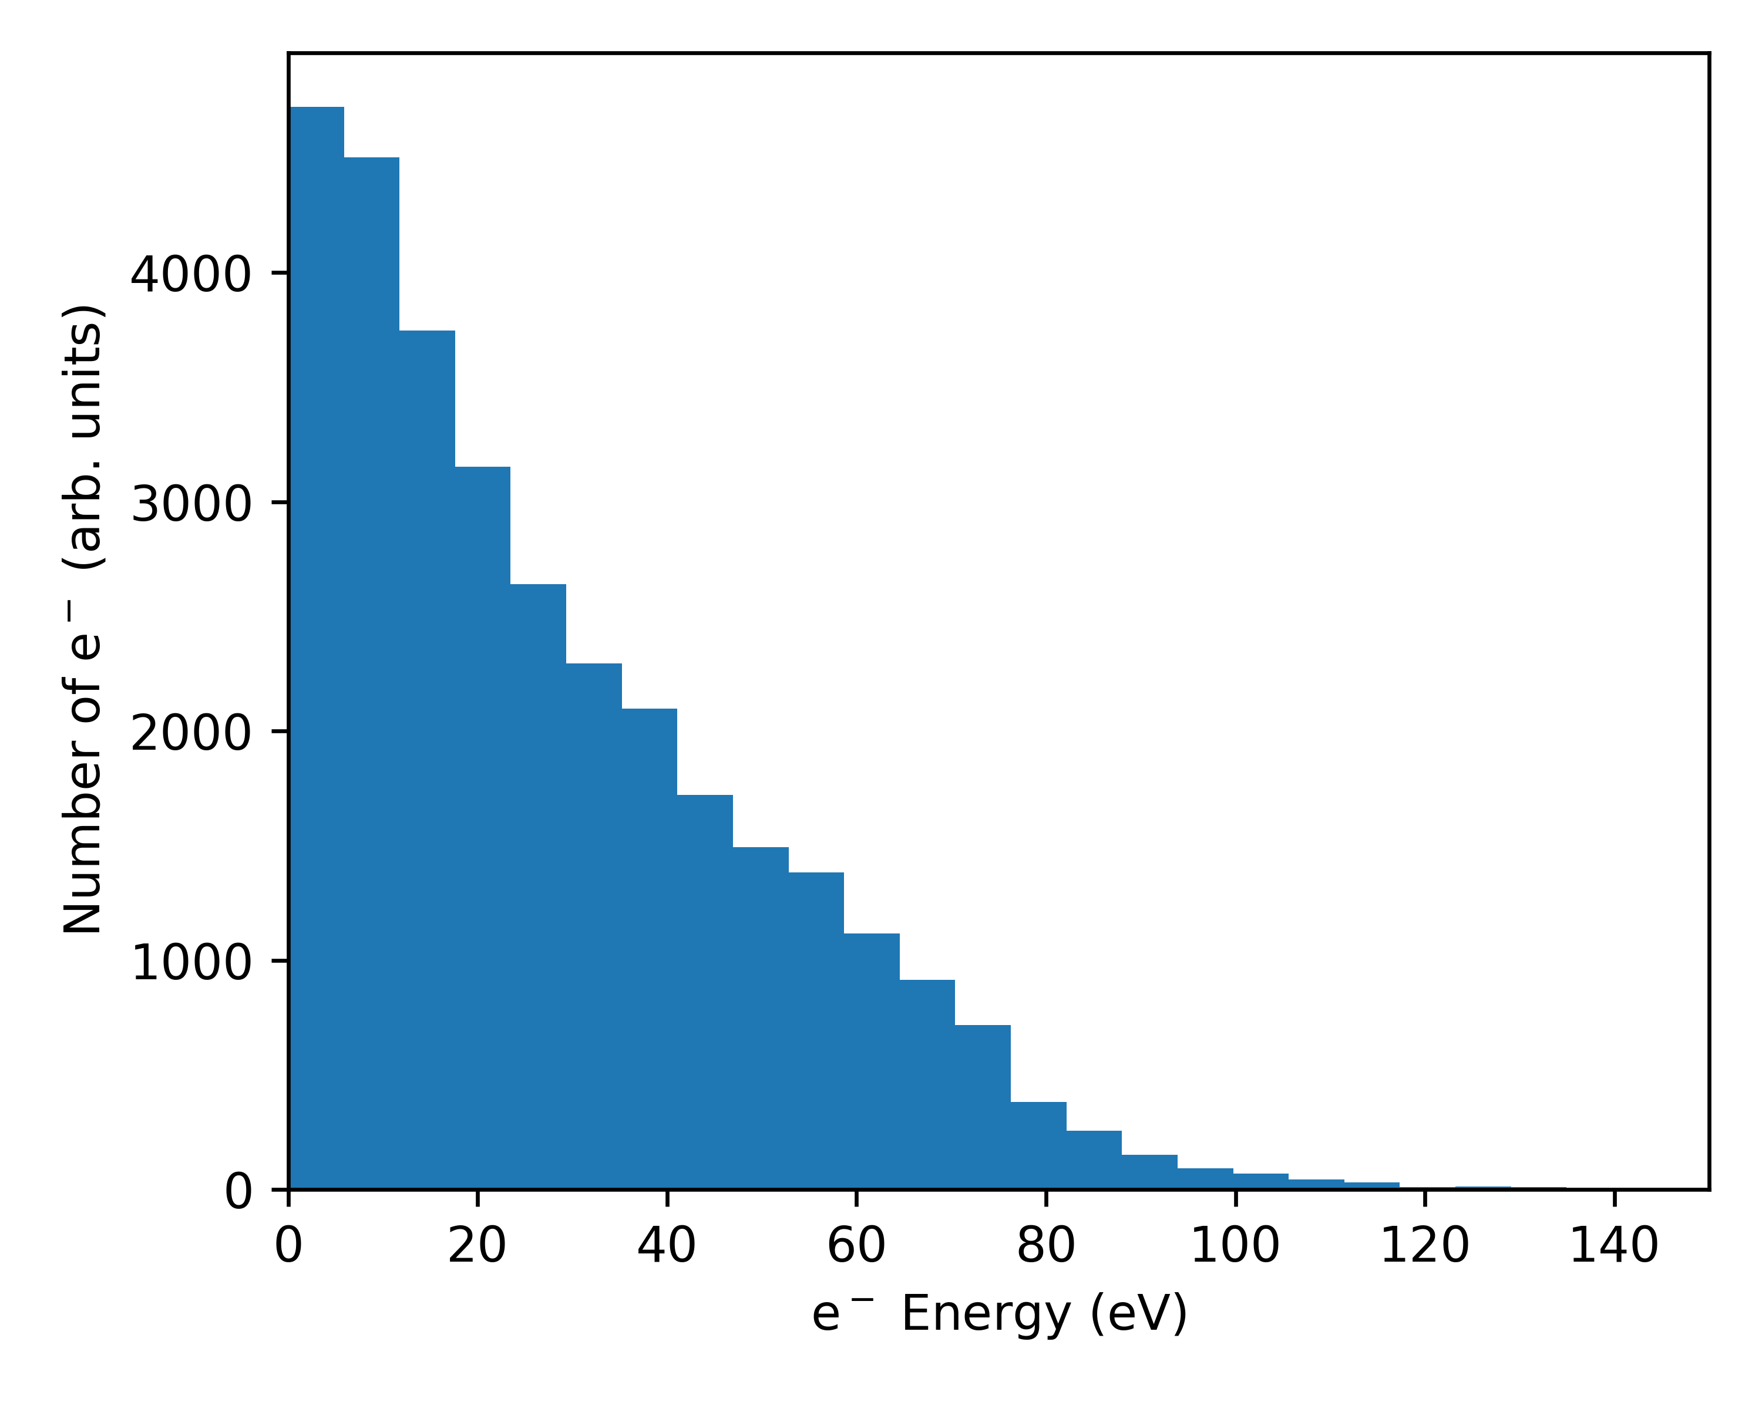
Results – Impact of Compensating Species
Comparing Positive H⁺ Beam and Negative H⁻ Beam
Electron energies for 0T H⁺ Beam at t=200µs
H₂⁺ maintain thermal energies (~0.025eV) of H₂ during ionisation
e⁻ take on more energy from incident ion (10s of eVs) – leave domain easily
e⁻ are lighter – even low energy e⁻ have higher velocities to leave the domain
Notes:
To replace photo with one of your own. 1) Send the geometric shape overlay to the back – Right-Click > Send to Back > Send to Back. 2) Replace image – use the guides provided to correctly position it. 3) Send your image to the back so that the geometric overlay re-appears over the image. Remember to delete the image credit if using your own image.

Slide 15
Impact of Invasive Diagnostics
PIC Simulation Parameters
Invasive diagnostic (e.g. emittance scanner or Faraday cup) at end of domain
Simplified model:
Dirichlet (0 ϕ) on positive z boundary
Secondary electrons emitted
Constant yield of 2 e⁻ per H⁻
5eV energy for secondary electrons
0 ϕ
0 E_{z}
0 ϕ
SEE
10cm
0 ϕ
0.2m
How do invasive diagnostics influence SCC?
[5] A.K. Fazlul Haque et al., “Proton-induced secondary electron emission from elemental solids over the energy domain 1 keV–1000 MeV”, Results in Physics, Volume 15 (2019) 102519
Notes:
To replace photo with one of your own. 1) Send the geometric shape overlay to the back – Right-Click > Send to Back > Send to Back. 2) Replace image – use the guides provided to correctly position it. 3) Send your image to the back so that the geometric overlay re-appears over the image. Remember to delete the image credit if using your own image.

Slide 16
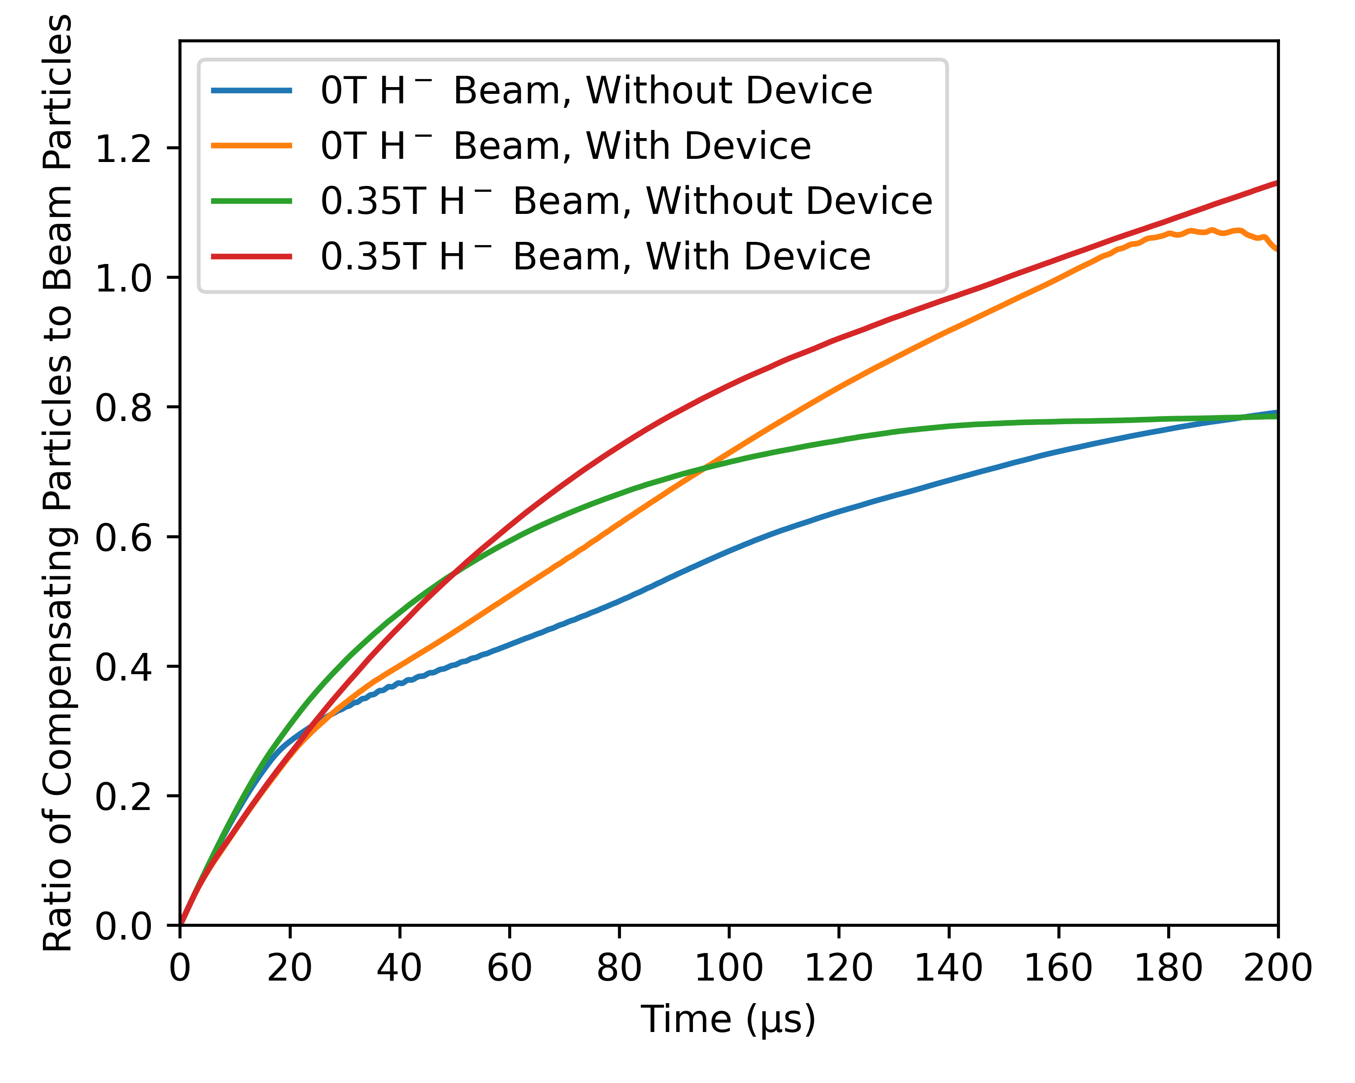
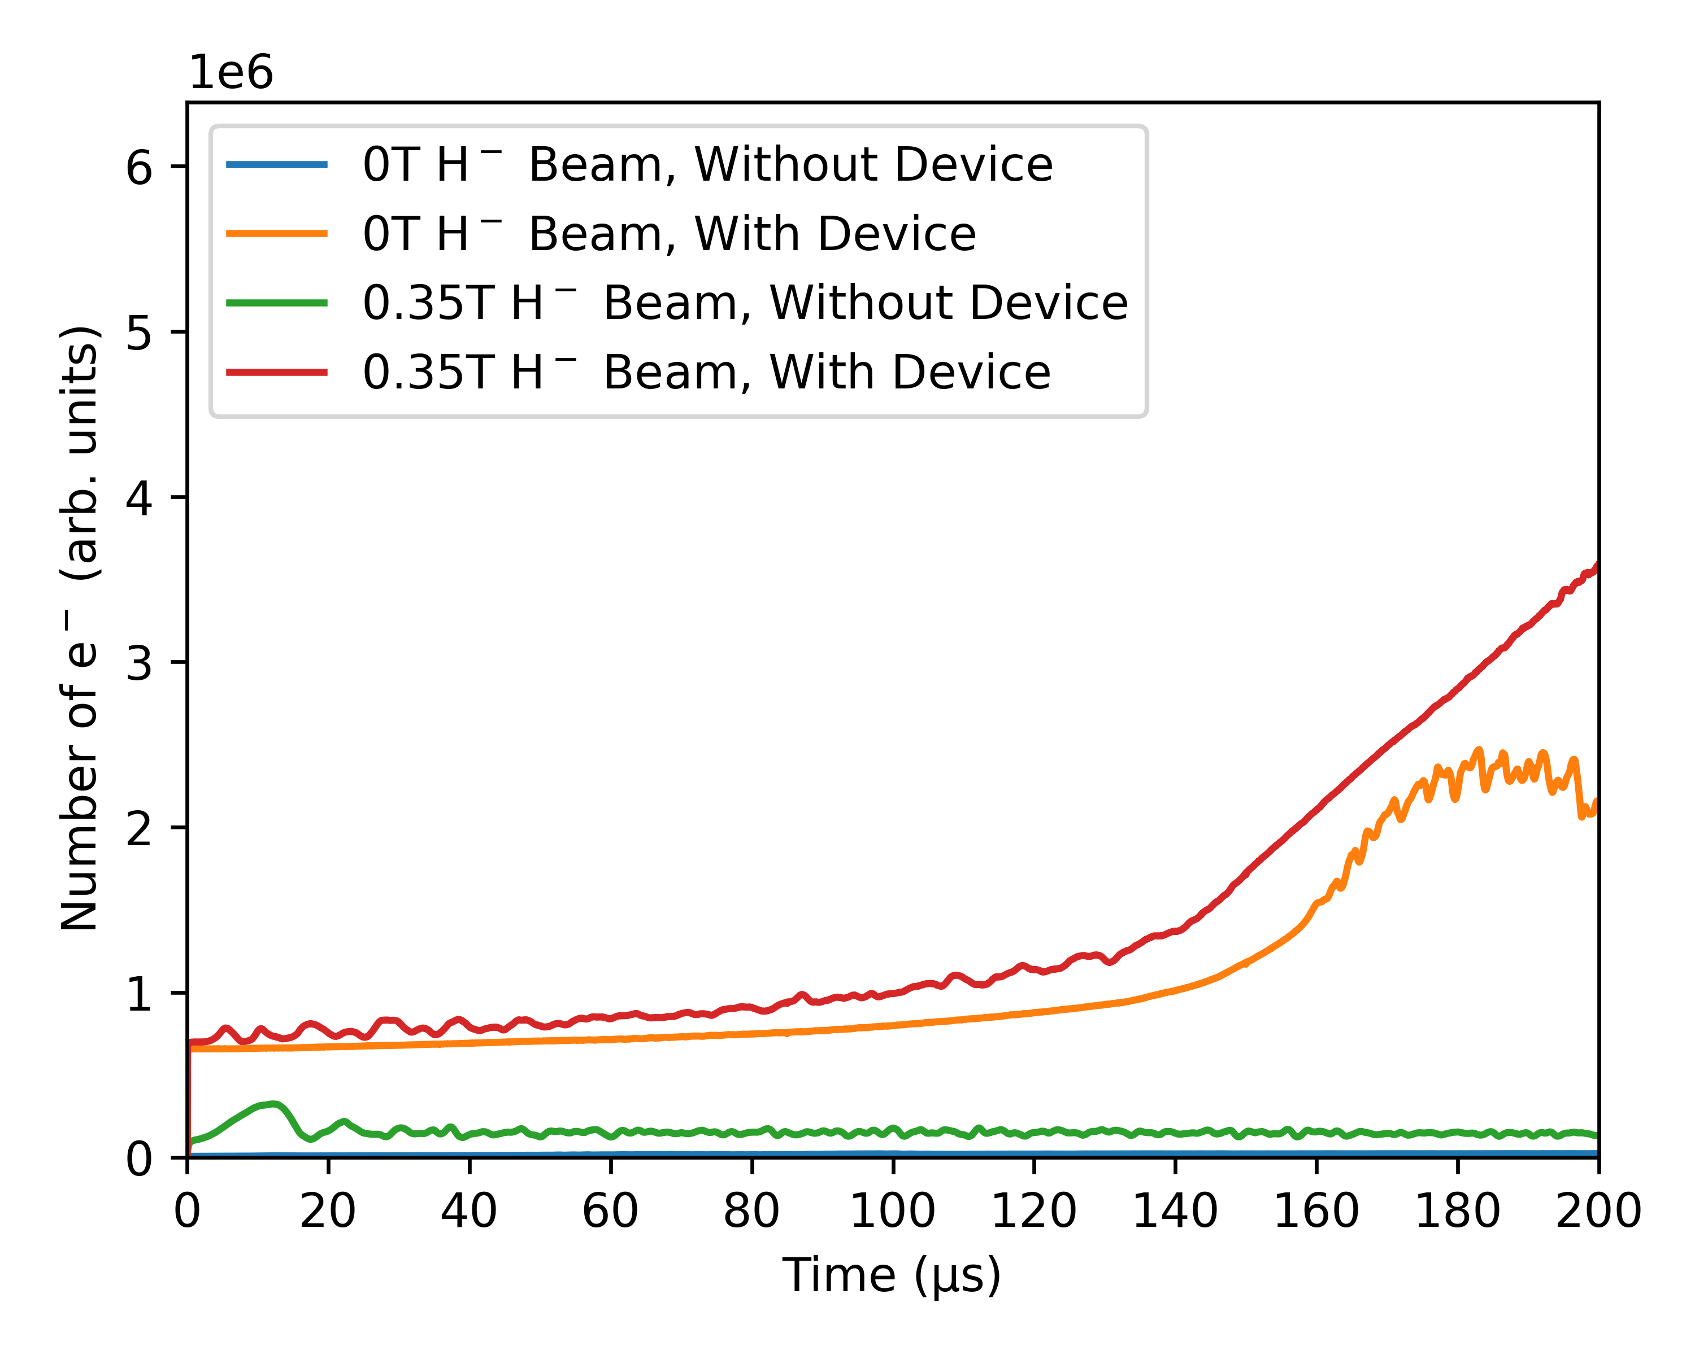
Results – Impact of Invasive Diagnostics (H⁻)
Diagnostic Inserted Into Negative H⁻ Beams
Number of e⁻ in domain
H⁻ beam quickly ejects e⁻ until compensated, impact comes from Dirichlet BC
Apparent “overcompensation” at large time - secondary e⁻ enhance capacity for H₂⁺
Notes:
To replace photo with one of your own. 1) Send the geometric shape overlay to the back – Right-Click > Send to Back > Send to Back. 2) Replace image – use the guides provided to correctly position it. 3) Send your image to the back so that the geometric overlay re-appears over the image. Remember to delete the image credit if using your own image.

Slide 17
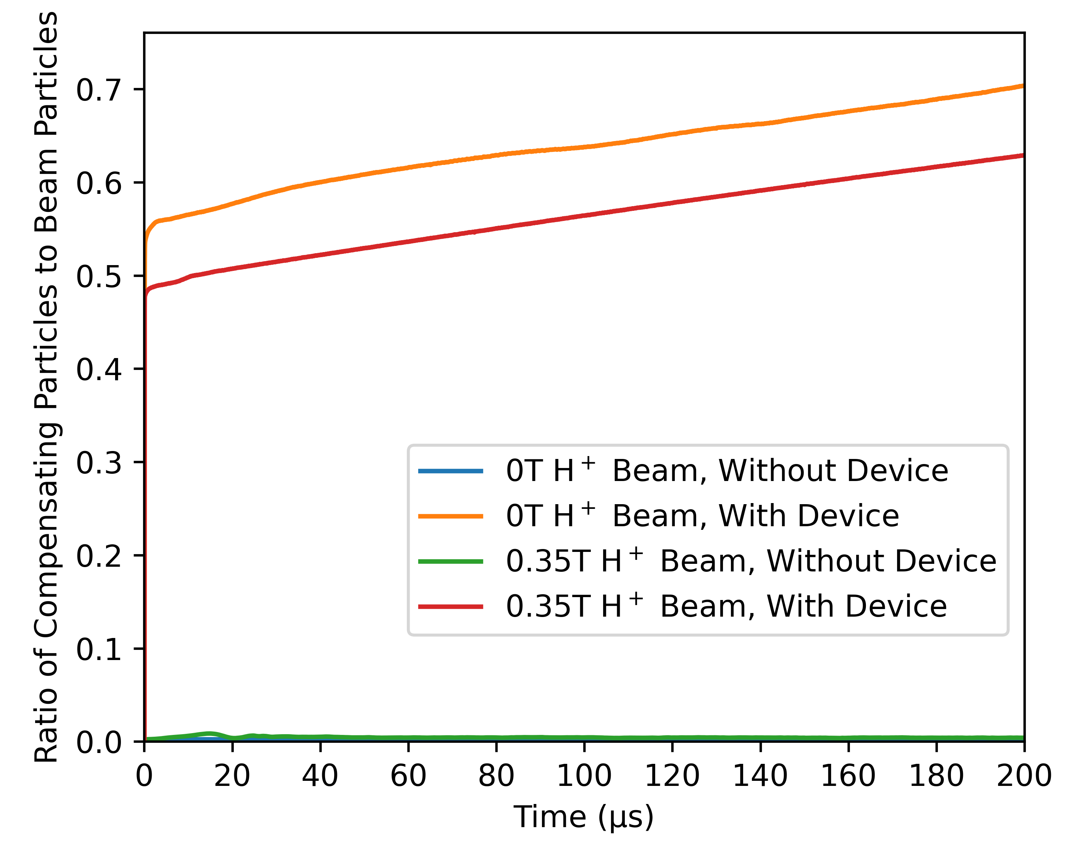
Results – Impact of Invasive Diagnostics (H⁺)
Diagnostic Inserted Into Positive H⁺ Beam
SEE adds new source of compensating particles
Slow (5eV) secondary electrons can be trapped by the beam potential
Notes:
To replace photo with one of your own. 1) Send the geometric shape overlay to the back – Right-Click > Send to Back > Send to Back. 2) Replace image – use the guides provided to correctly position it. 3) Send your image to the back so that the geometric overlay re-appears over the image. Remember to delete the image credit if using your own image.

Slide 18
Conclusions
SCC is a spatially and temporally complex process
SCC time is determined by trade off between compensating particle production and loss mechanisms
Loss mechanisms (and production rates) depend on many factors other than the BGG, including:
External fields
Properties of compensating particles (e.g. mass, initial velocity, etc…)
Boundary conditions and secondary electron emission (e.g. electrodes, invasive diagnostics)
PIC simulations are ideal for studying these non-linear effects, due to fine parameter control and diagnostic availability
Important to consider these sensitivities when designing and running PIC simulations
Notes:
PLEASE DELETE/REPLACE PHOTO CREDIT IF CHANGING THE IMAGE.

Slide 19
Future Work
Increased scale of simulations
Full model of FETS LEBT and upcoming H+ system with India DAE
Longer domain, more accurate field BCs (including RFQ backflow), full treatment of solenoid fields
Direct comparisons with diagnostics
Parametric study for optimal SCC time
More realistic simulation models for diagnostics
E.g. repelling electrodes on devices, device geometries, etc…
Experimental collaborators working on non-invasive light-based diagnostics for SCC
Notes:
PLEASE DELETE/REPLACE PHOTO CREDIT IF CHANGING THE IMAGE.

Slide 20



Acknowledgements
Funding and support:
Ada Lovelace Centre
Computational time:
SCARF (internal STFC tier-2 cluster)
ARCHER2
Isambard3
Notes:
To replace photo with one of your own. 1) Send the geometric shape overlay to the back – Right-Click > Send to Back > Send to Back. 2) Replace image – use the guides provided to correctly position it. 3) Send your image to the back so that the geometric overlay re-appears over the image. Remember to delete the image credit if using your own image.

Slide 21



✉ kiran.jonathan@stfc.ac.uk
Notes:
The abstract pattern can be removed or repositioned if required. Be careful to ‘Send to Back’ so that it does not obscure any important information.

