Slide 1
Overview and performance of the MAST Upgrade Neutral Beam Injectors
M. Nicassio
21st International Conference on Ion Sources, Oxford, 08-12 September 2025

Slide 2
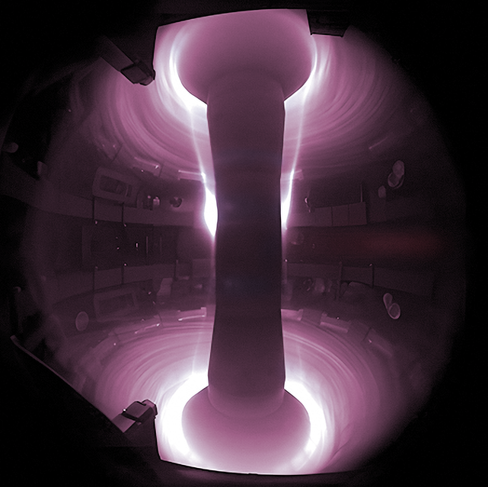
Contents
Overview of the Mega Amp Spherical Tokamak Upgrade
(MAST Upgrade) Neutral Beam Injectors (NBI)
MAST Upgrade NBI ion source and accelerator
MAST Upgrade NBI operational experience
NBI ion source maintenance, conditioning
and characterisation
Performance up to 1 s and 3 MW average power
Future improvements and upgrades
Summary and outlook

Slide 3
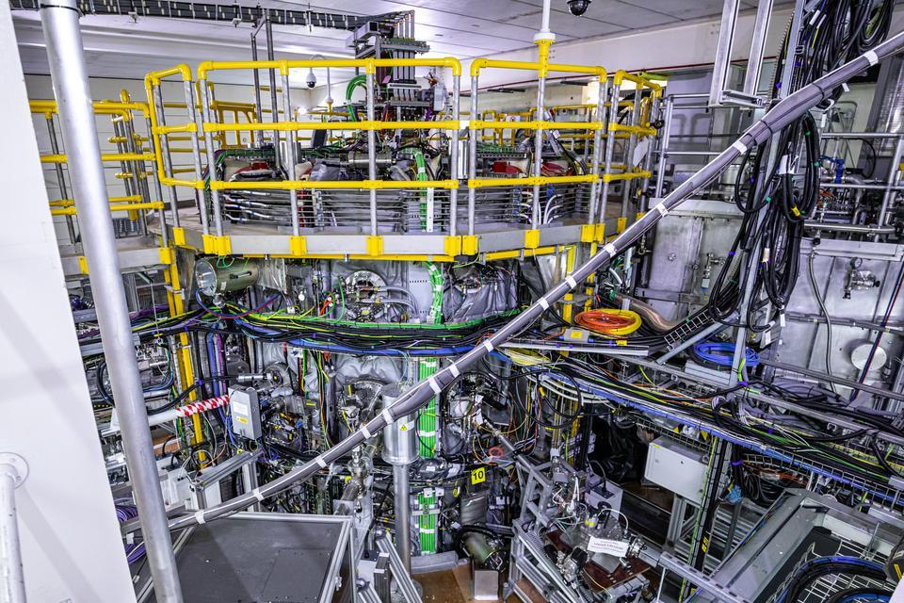
MAST Upgrade Neutral Beam Injectors
MAST Upgrade
largest operational spherical tokamak
main goals: explore novel plasma exhaust concepts, de-risk spherical tokamaks as future fusion power plants
NBI is the MAST Upgrade auxiliary plasma heating system with 5 s pulse capability
two beamlines with one injector each known as South (SS) and Southwest (SW)
main upgrades for long pulses
- cooling system
- beamline elements (residual ion dumps
and bending magnet)
ion source and accelerator
- JET Positive Ion Neutral Injector (PINI) design
- tetrode accelerator
- max design energy and current 75 kV / 65 A
- operating gas D₂
- beam horizontal and vertical focal lengths
14 and 6 m respectively

Slide 4
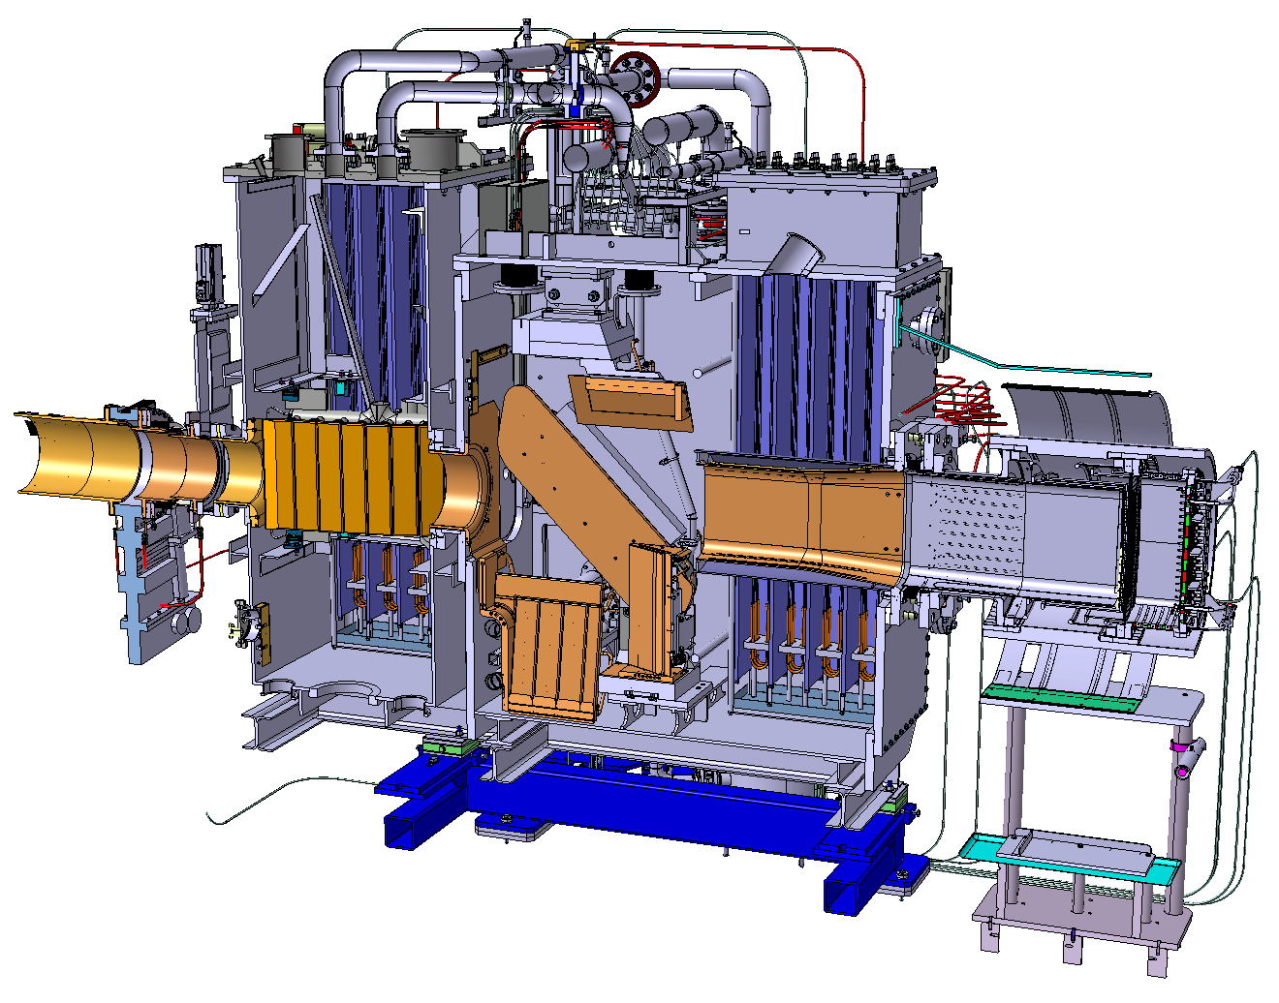
MAST Upgrade Neutral Beam Injectors
MAST Upgrade
largest operational spherical tokamak
main goals: explore novel plasma exhaust concepts, de-risk spherical tokamaks as future fusion power plants
NBI is the MAST Upgrade auxiliary plasma heating system with 5 s pulse capability
Turbomolecular pump
Getter pumps
Calorimeter
Neutraliser
Duct
MAST-U
tokamak
PINI
Bending magnet
Residual ion dumps

Slide 5
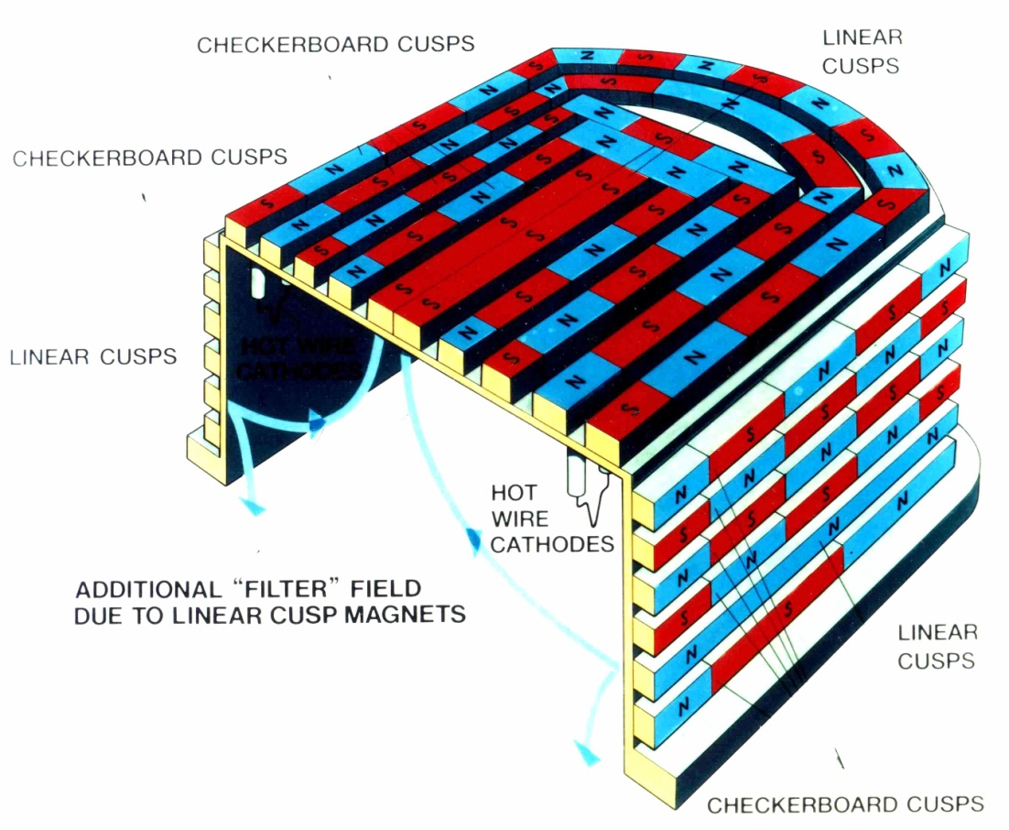
Filament driven arc discharge ion source
Thermionic emission electrons from
heated filaments accelerated to source
walls ionise gas and create plasma
Species formed in primary and
subsequent interactions
D⁺, D₂⁺, D₃⁺
Magnetic confinement achieved by
using permanent magnets
chequerboard pattern
linear cusps to enhance D⁺ fraction
production (Supercusp configuration)
Cons: auxiliary supplies at high voltage,
filament lifetime causing downtime
Schematic of the MAST Upgrade ion
source in Supercusp configuration

Slide 6
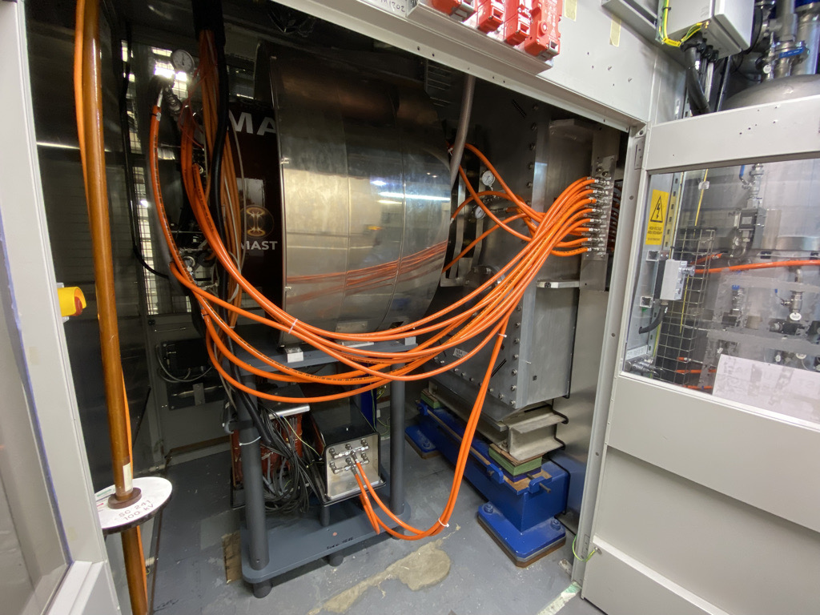
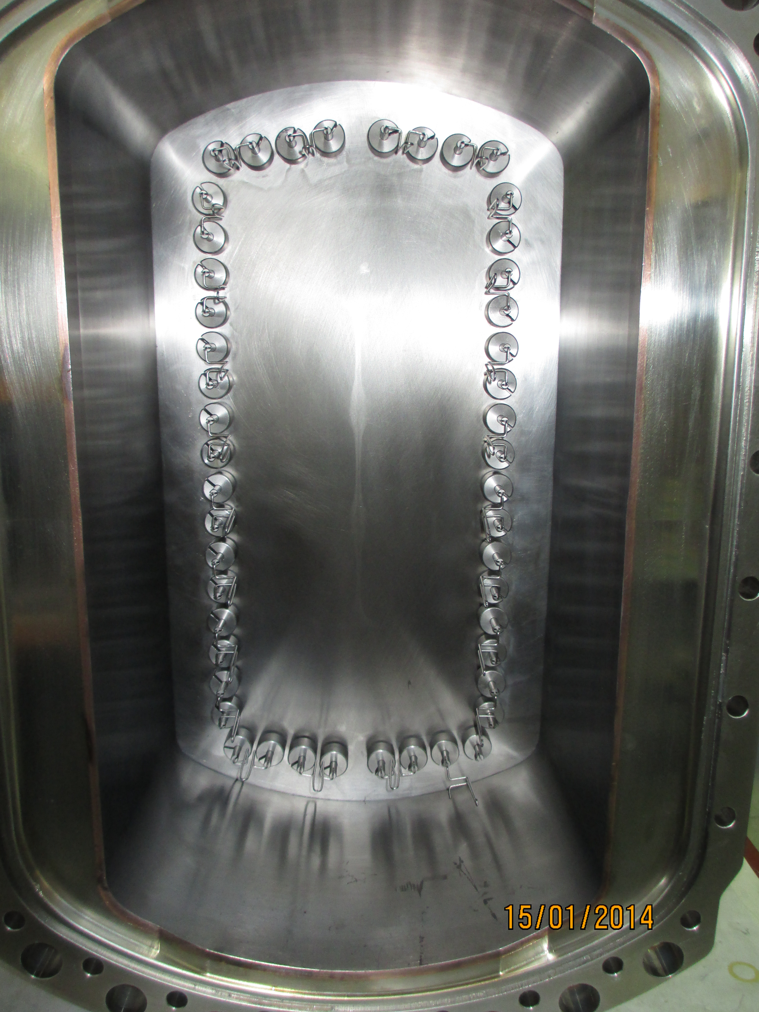
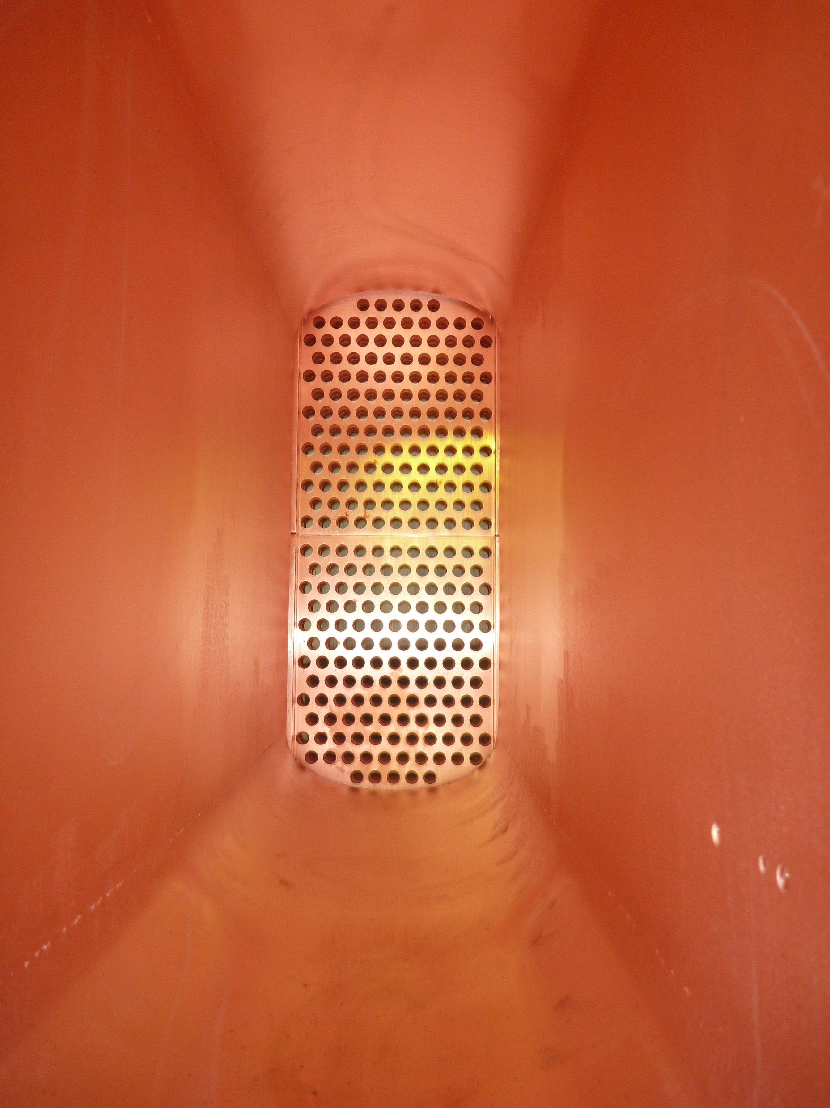
MAST Upgrade PINIs
Arc load resistor and
filament transformer
PINI on the SS beamline
Tungsten filaments in the ion source
Fourth accelerator grid as
seen from the neutraliser

Slide 7
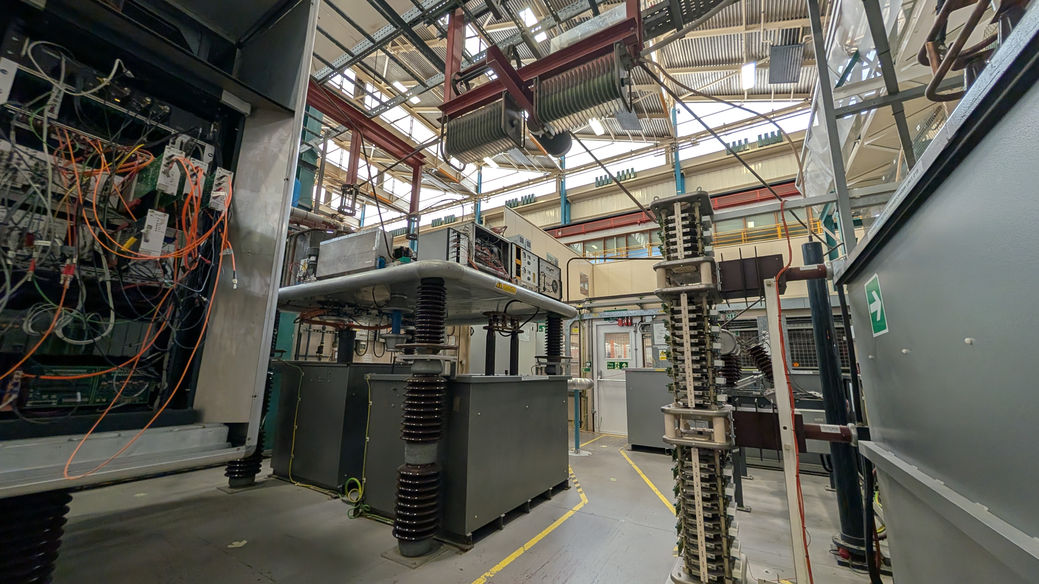

MAST Upgrade PINI Power Supplies
High Voltage areas including:
- ion source PS
- modulation deck housing 2
parallel connected tetrodes,
associated supply and control
- part of the accelerator PS
HV DC switchyard to configure
the output of 4 independent HVPSs

Slide 8
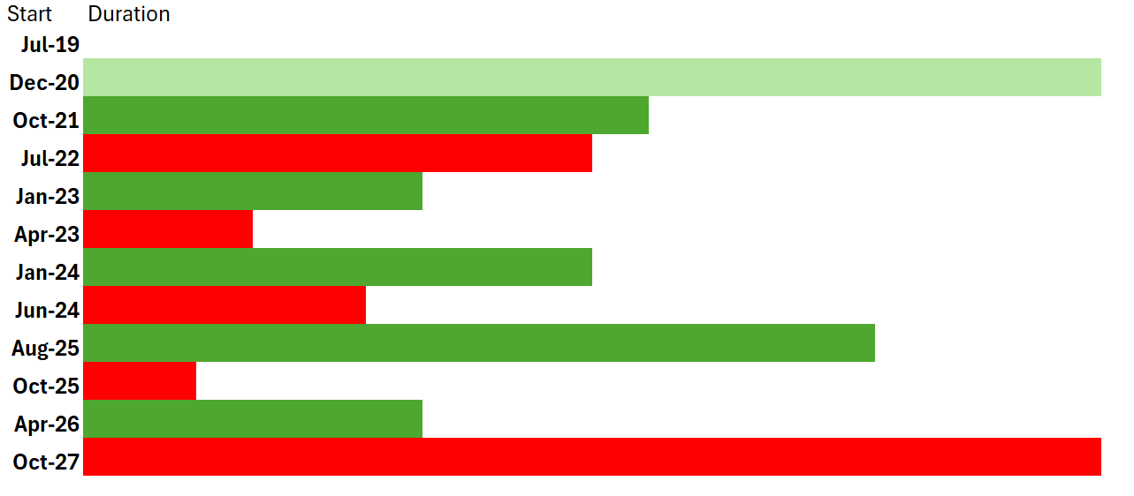
MAST Upgrade operational timeline
First beam
into MAST Upgrade
Commissioning
MU01
Brand new PINI on SS
* SW 2
* SS 1
MU02
* SS 3
MU03
MU04
MU05
Engineering break with installation of additional NBI and EBW
* = PINI maintenance, beamline, PINI number
= operational period
= engineering break

Slide 9
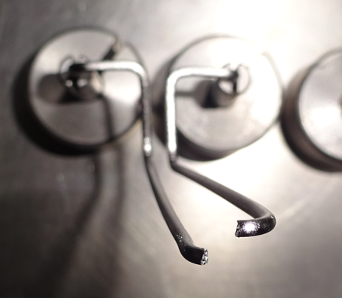
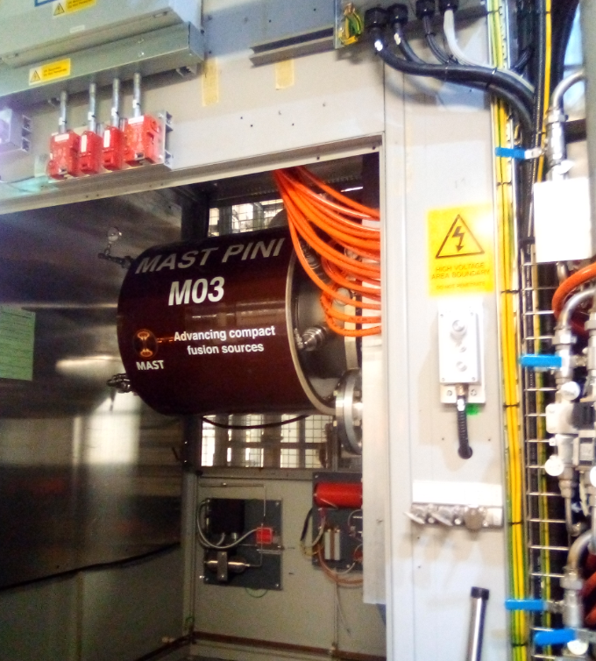
PINI maintenance
Three PINIs available, 2 used on MAST since 2006, 1 spare brand new used
first in 2021
PINI maintenance and inspections:
when performance compromised
- loss of filaments
- when no other issues can be identified in the beamline or power supplies
downtime about 2 weeks
rate of filament loss in the first operational periods was abnormal
- all replaced eventually with a new batch
broken filaments were always randomly placed not in batches
performed only once per PINI since the start of MAST Upgrade
operations

Slide 10
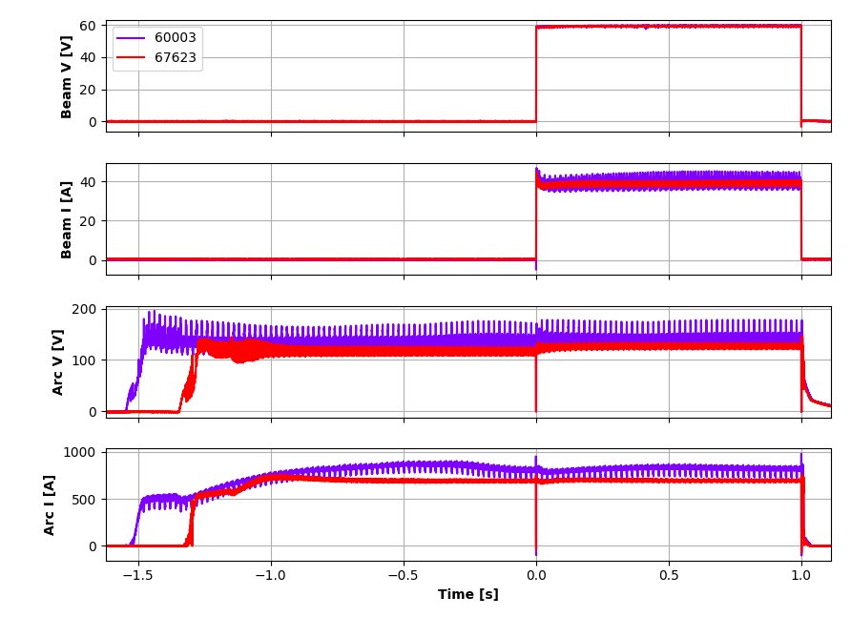
PINI operational experience - highlights
PINI conditioning:
beam extracted at gradually increasing voltage, current and gas flows,
aimed at maximising voltage, power and reliability of beams
to remove high spots, oxide coatings, micro-particles from grids and
implant the operating gas into the accelerator grids
necessary in the following cases
- use of brand new PINI
- after a vacuum breach
- after replacing parts of the source/accelerator
- changing operating gas
conditioning time varies
- for the brand new PINI ~10k pulses up to 70 kV
Other issues and improvements:
arcing outside of the PINI, required rerouting
cables
high failure rate of arc load resistors resolved
replacing failed resistors and thermal interface
paste
Examples of SS pulses before and after
PINI filament and arc load resistor work

Slide 11
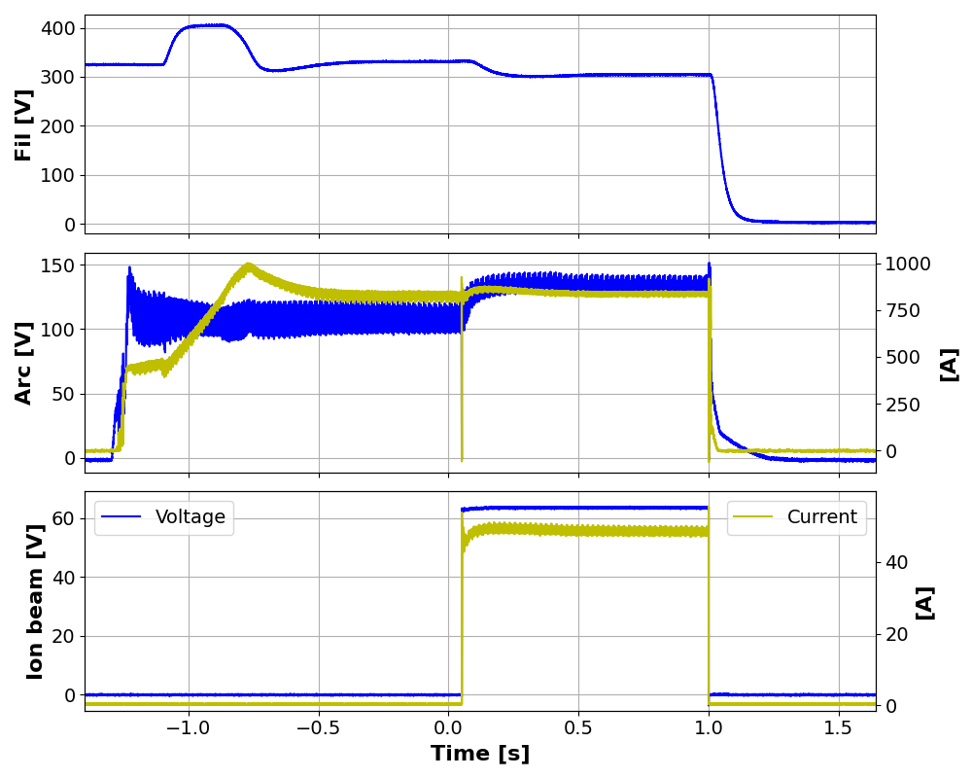
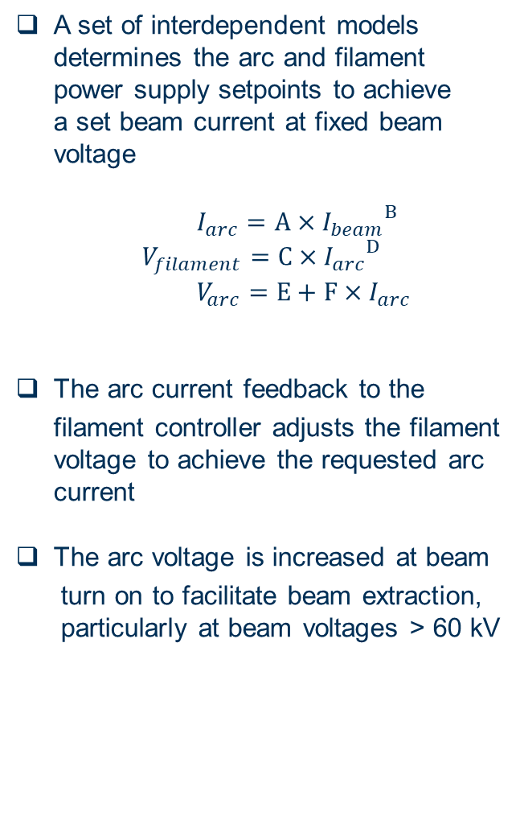
PINI operational experience - highlights
A set of interdependent models
determines the arc and filament
power supply setpoints to achieve
a set beam current at fixed beam
voltage
$I_{arc}=A×{I_{beam}}^{B}$
$$V_{filament}=C×{I_{arc}}^{D}$$
$V_{arc}=E+F×I_{arc}$
The arc current feedback to the
filament controller adjusts the filament
voltage to achieve the requested arc
current
The arc voltage is increased at beam
turn on to facilitate beam extraction,
particularly at beam voltages > 60 kV
Example of electrical waveforms SW pulse n. 52470

Slide 12
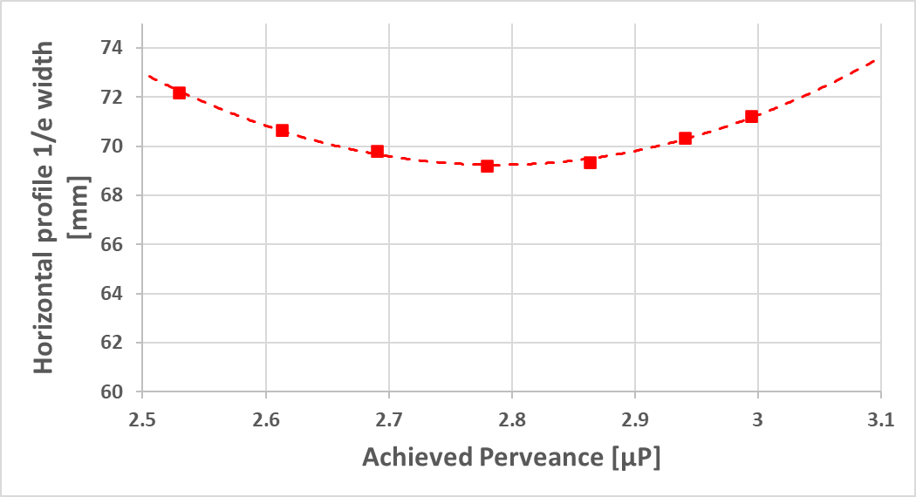
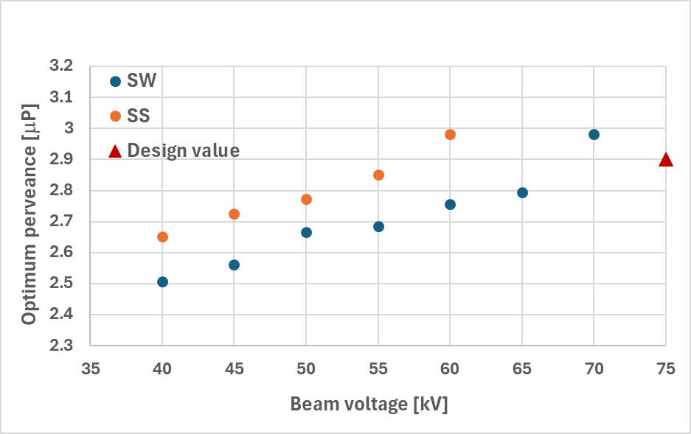
PINI operational experience - highlights
PINI characterisation: perveance
the beam current is set through perveance,
which determines the beam width
at optimum perveance the beam is the
narrowest therefore scraping losses
minimised and less likelihood of breakdowns
determined via scans at fixed beam
voltage, measuring width of horizontal and
vertical 2D beam profiles at the calorimeter
via thermocouples
MAST-U PINIs feature a shallow
perveance curve → potential to run well above
optimum perveance to increase power without
significantly increasing scraping losses
Perveance = I_{beam}/V_{beam}^{3/2}
Perveance scan on SW PINI at 65 kV

Slide 13
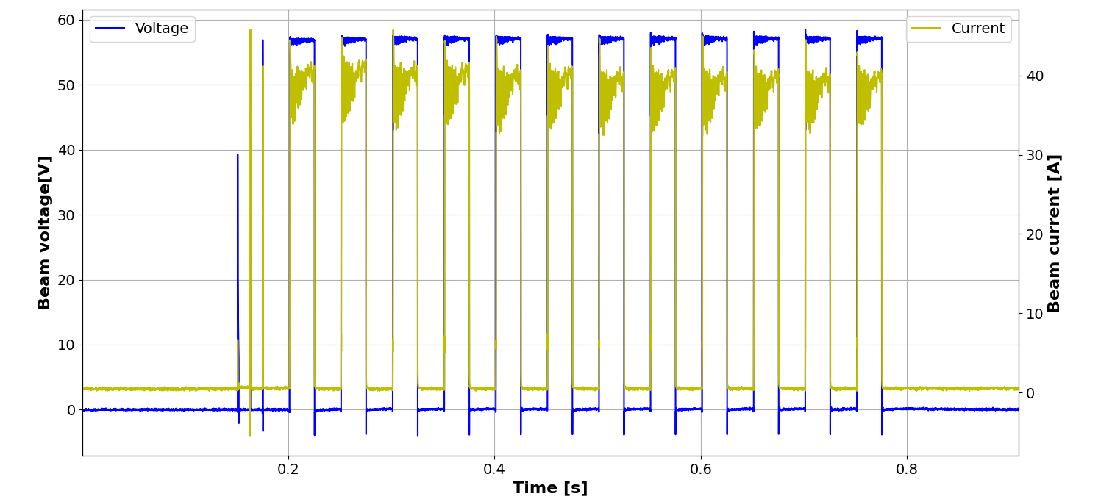
PINI operational experience - highlights
New functionality of beam blips during a pulse:
off time down to 11 ms
up to 40 blips per pulse
fixed duty cycle
Benefits:
higher resolution measurements for diagnostics measuring emissions from fast ions
no significant plasma perturbation with short blips
increased fidelity and duration of measurement
SS pulse n. 50968

Slide 14
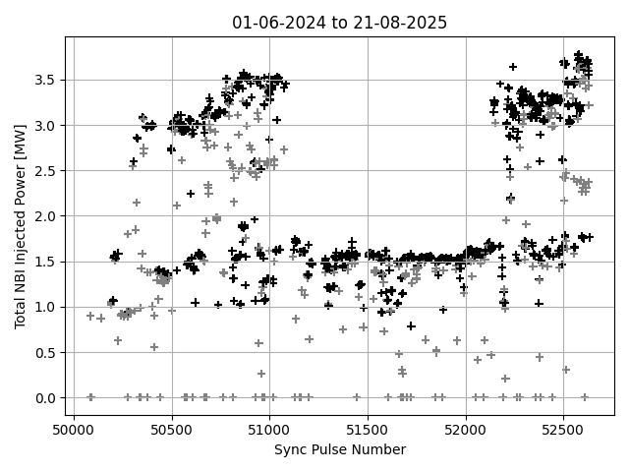
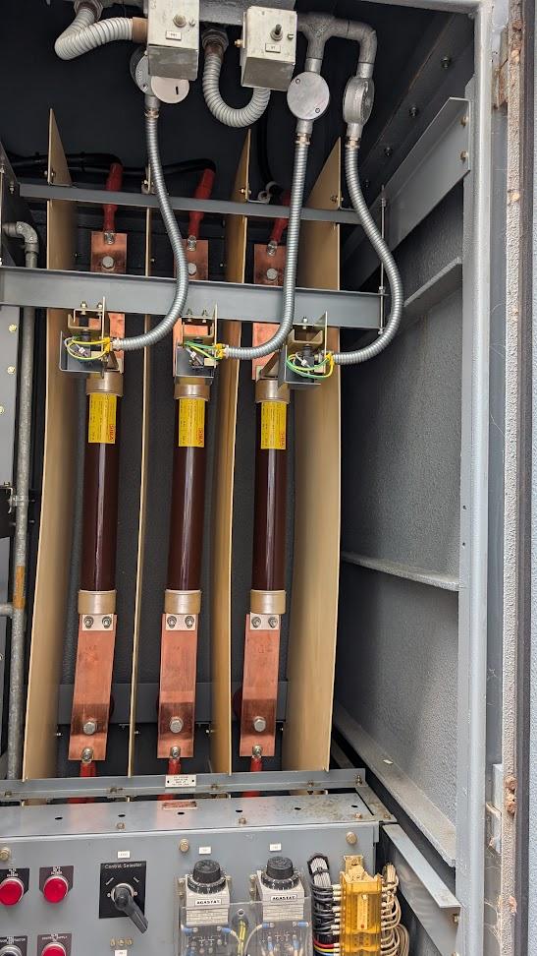
Performance - highlights
Campaign 4, about 1500 NBI pulses into plasma
gradually increasing power available
as PINIs are conditioned
SW 5 months downtime due to
HVPS 11 kV fuses failure
highest power from both beamlines
as a result of the optimisation of timing
and HV breakdown handling

Slide 15
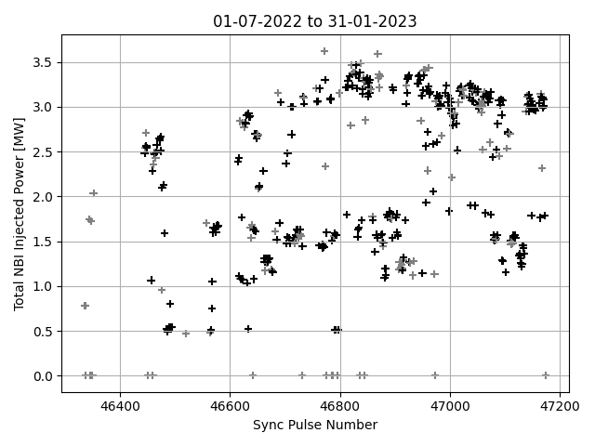
Performance - highlights
Campaign 2 vs campaign 4: average injected power per pulse

Slide 16
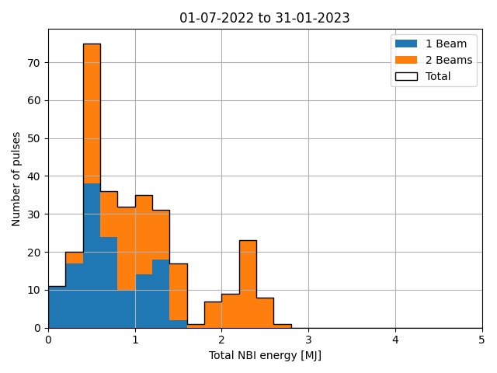
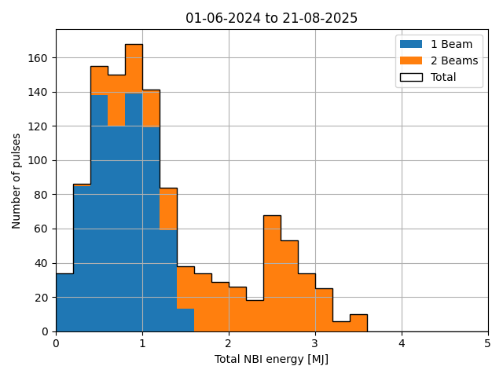
Performance - highlights
Campaign 2 vs campaign 4: average injected energy per pulse
longer pulses run in the last operational period

Slide 17
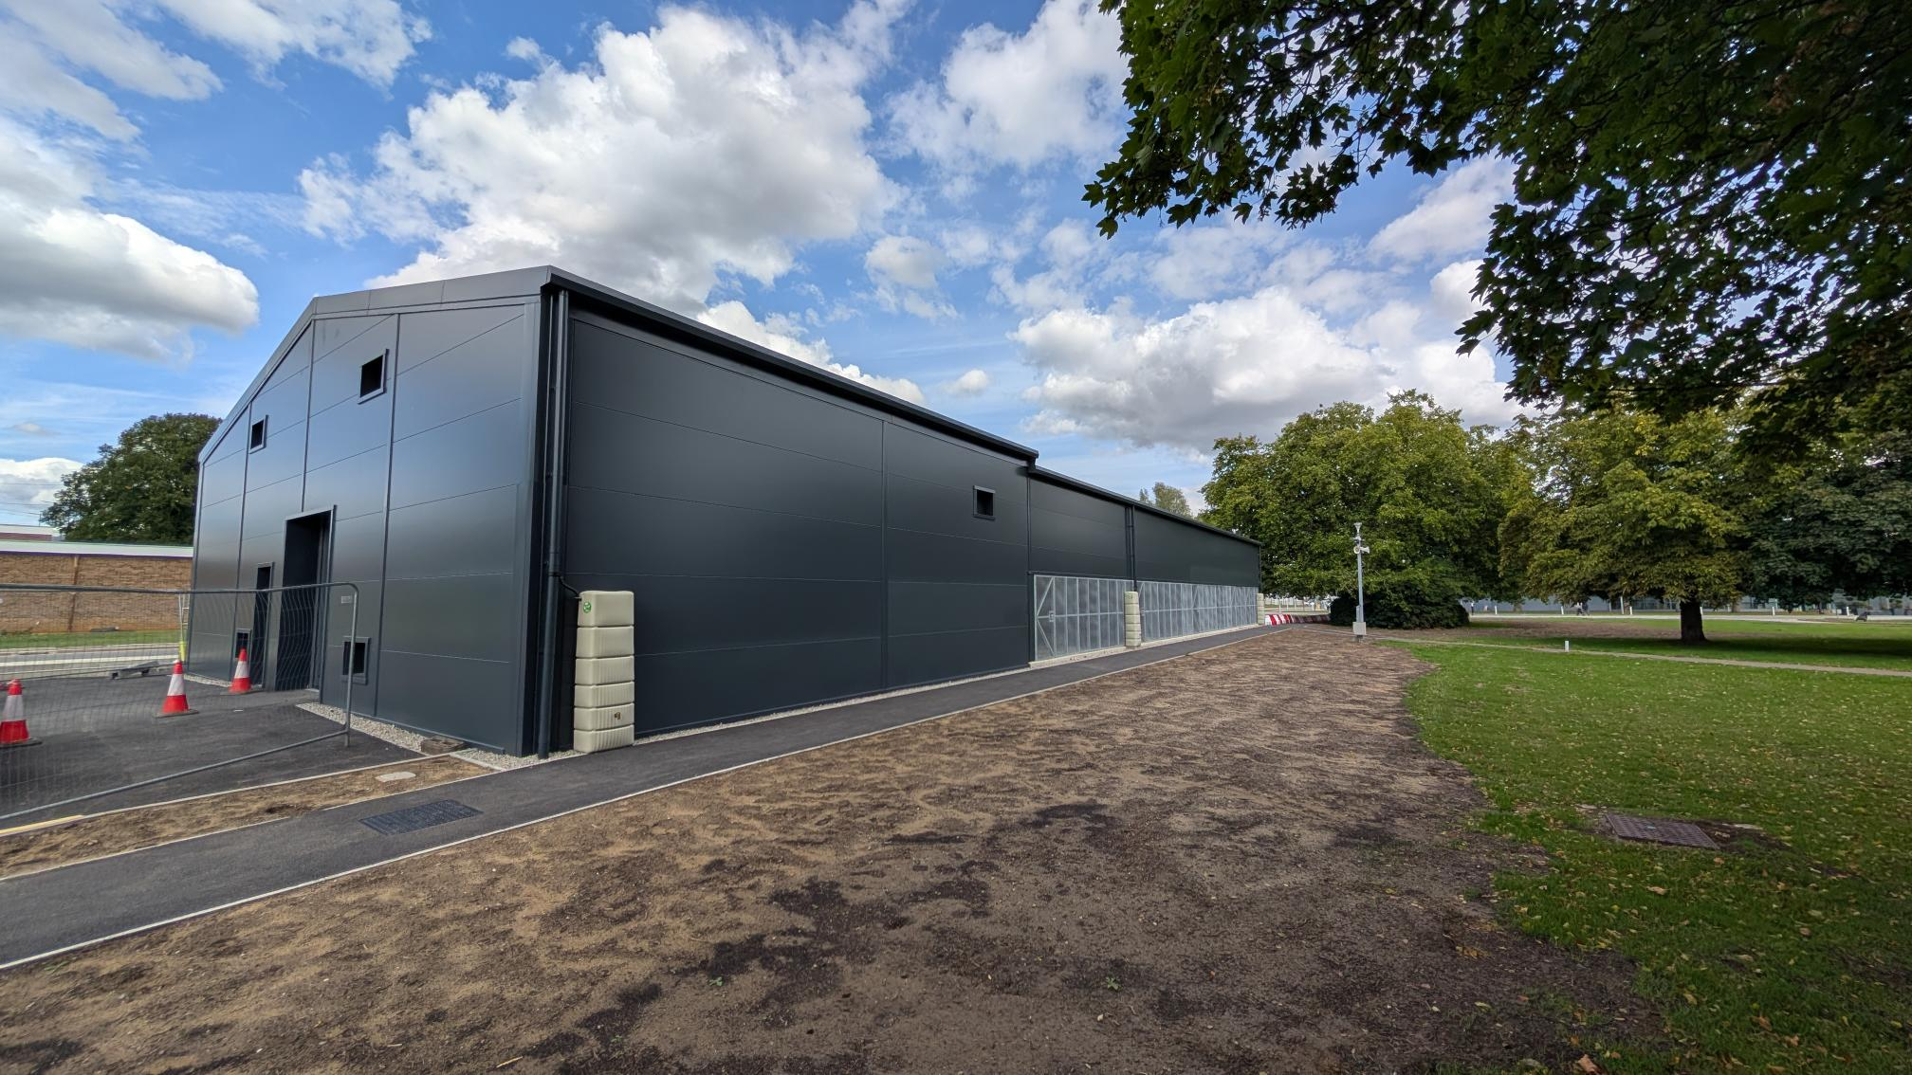
Future improvements
Main areas being improved
timing and HV breakdown handling to reduce spurious reapplications
arc power supply ripple and turn on with changes to the arc power supply topology
hardware that limits pulse length capability
higher bandwidth and resolution data acquisition system for PS analogue and digital signals to improve fault identification and diagnosis capability
ageing components, e.g. HVPS replacement with JET supplies

Slide 18
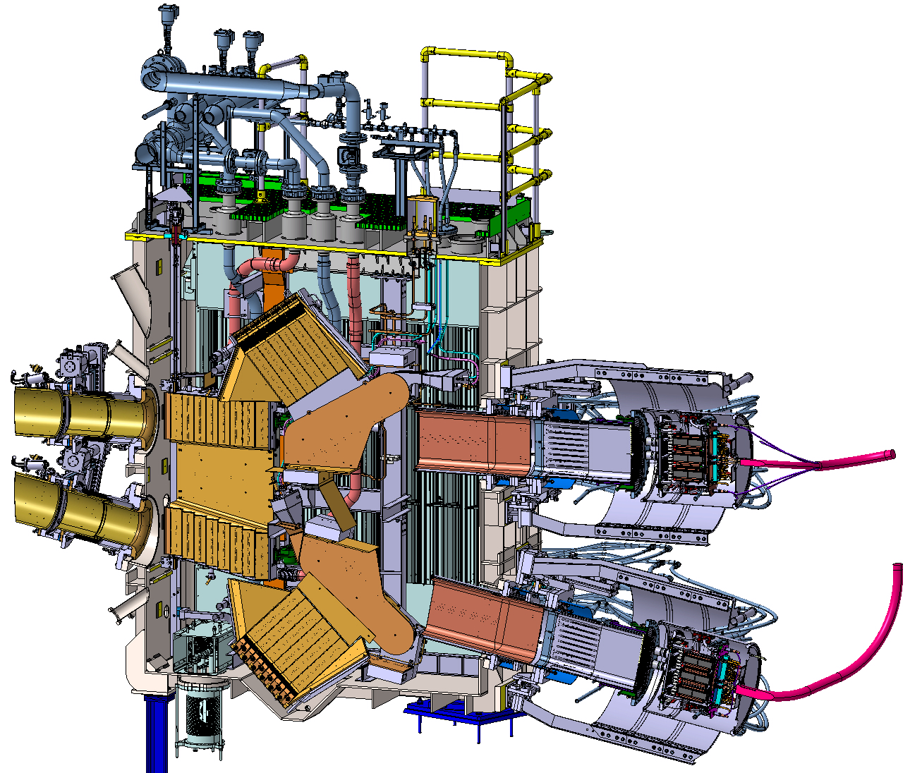
MAST-U NBI enhancement
Addition of two injectors (Double Beam Box)
installation commencing in 2026
5 MW of injected power
on and off axis injection
up to 5 s pulses
ion source PS topology based
on newer technologies
cryopumps
DBB
Upper beamline
Lower beamline
PINIs

Slide 19
Summary and outlook
MAST Upgrade NBI uses filament driven arc discharge ion sources
positive ions from D₂
design similar to JET NBI ion sources
operated on MAST since 2006, on MAST Upgrade since 2020
experienced and solved during the first operational period
- conditioning of a brand new PINI
- high rate of PINI filament loss
- high rate of arc load resistor loss
- arcing outside of the PINI
continued and extensive effort on power supplies
functionality of beam blips implemented
reliably delivering > 3 MW for up to 1 s
NBI are complex systems, crucial for scientific output
Experience gained and progress also influenced by staff turnover, knowledge sharing
Outlook
several projects underway to continue increasing reliability, average injected power and pulse length
new injector with 2 beamlines doubling power beyond 2026
See D. King talk
on JET NBI
08/09/25

Slide 20
Backup slides

Slide 21
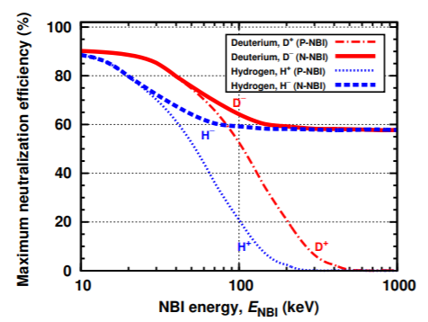
NBI for magnetic confinement fusion devices
Heat the plasma, drive current and plasma rotation, measure plasma parameters
neutral to penetrate the tokamak magnetic field, ionised by ion or electron impact
ionisation or charge exchange, transfer energy to plasma by Coulomb collisions
generated from positive or negative ions
Pros: well established technology for positive ion NBI, powerful heating method, flexible
injection geometry, efficient coupling to plasma up to high densities
Cons: low wall-plug efficiency (neutralisation), expensive, big nuclear island
Types of ion sources
Filament driven arc discharge
- mainly for positive ion beams and energy ≤ 100 keV,
e.g. JET and MAST-U NBI
Radio Frequency driven discharge
- mainly for negative ion beams and energy > 100 keV,
e.g. ITER NBI
choice of positive or negative ions dictated by
energy needed to penetrate the plasma core
Kazakov_HC-1.pdf

Slide 22
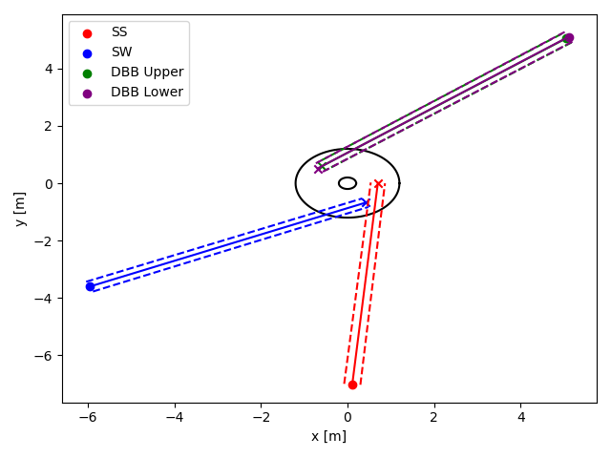
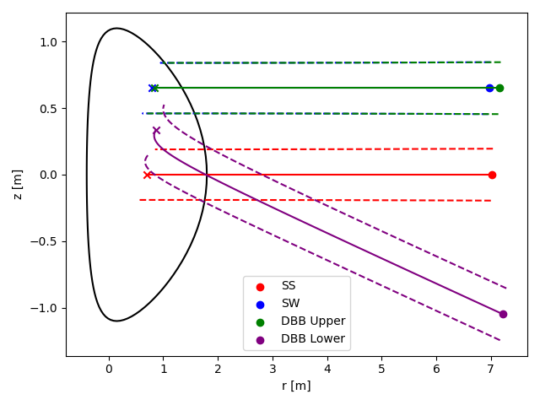
MAST-U NBI trajectories
Toroidal plane Poloidal plane

Slide 23
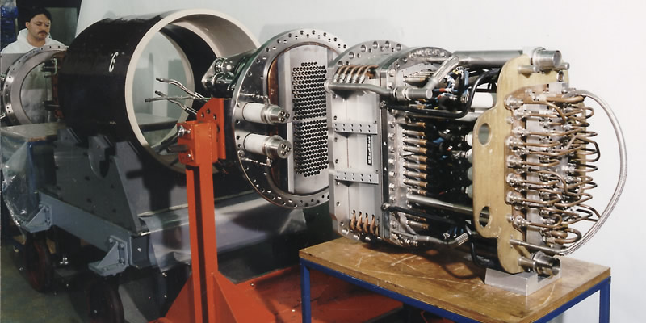
MAST-U PINIs
Ion source
Multi-aperture (262) and
multi-grid accelerator (4)
with variable offset
Backplate with 24
filaments feedthroughs
Water and electrical
connections
Ceramic insulator
Filament transformer and arc load resistors
(JET design)

Slide 24
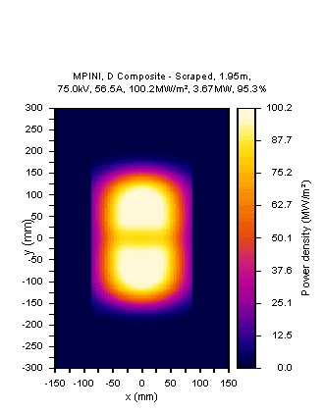
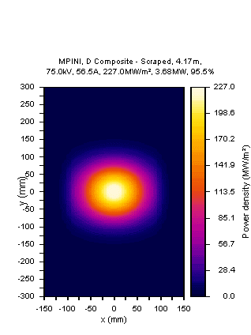
MAST-U PINI simulated profiles (ideal)
75 kV, 56 A
Neutraliser exit
Calorimeter

Slide 25
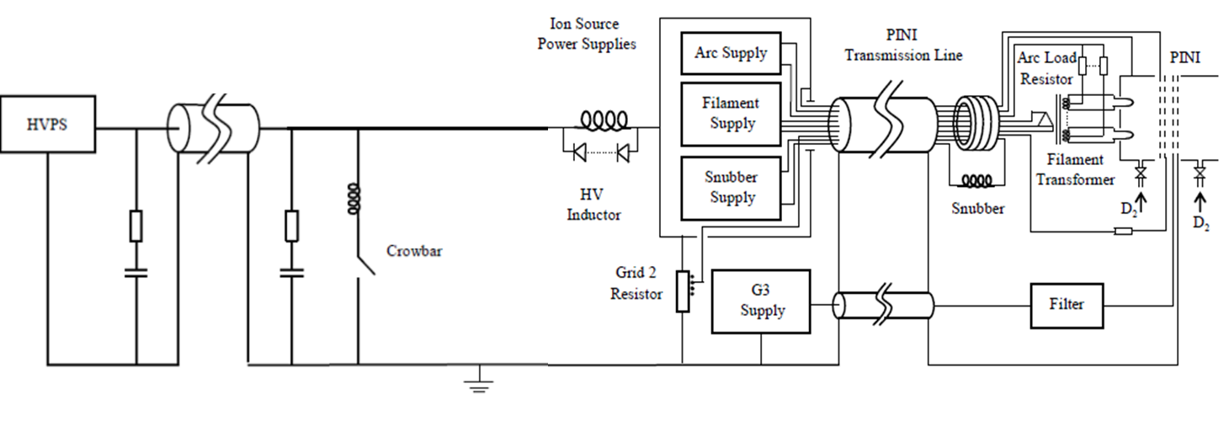
MAST Upgrade PINI Power Supplies
Arc DC supply:
voltage up to 200V, ripple <10%
current up to 1600 A for 20 s, ripple 4-5%
Filament 50 Hz 3-phase AC supply:
voltage up to 415V_{RMS}
current up to 100A_{RMS}
Accelerator PS
Ion source PS

