Slide 1

Ion Sources in Alternative Fusion
Shadrach Hepner¹, Samantha Valenteen¹, Scott Schipmann¹, Siamak Rahmanian¹, Robert Welton², Robin Langtry¹
¹Avalanche Energy
²Oak Ridge National Laboratory
International Conference on Ion Sources
September 8, 2025
Oxford, England
Shadrach Hepner
Ion beam lead
Avalanche Energy
Notes:
Shadrach Hepner, representing Avalanche Energy, where we are using ion beams to pursue our goals of compact nuclear fusion.
Interest in fusion has surged recently, likely in part due to…

Slide 2
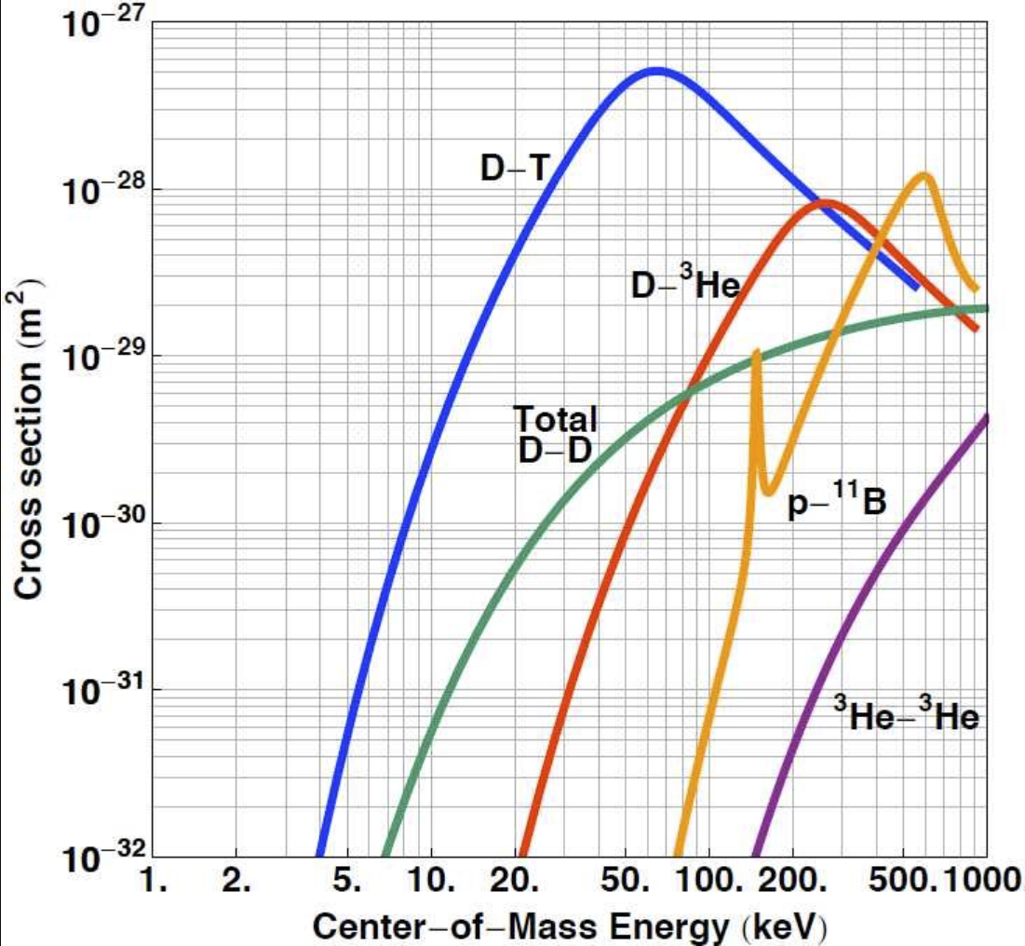
The fusion reaction
~64 keV
High energy particle
(hydrogen isotope)
H
Ion sources are a great way to provide initial energy
n
X
High energy product (neutrons)
Target
David Moiraf, “The use of Plasma Mirror for Relativistic Electron Generation Relevant to Fast Ignition in Inertial Confinement Fusion”
Notes:
Many ways to achieve these high energies – ion sources are certainly one of them. But this talk is about “alternative” sources- what does that mean?

Slide 3
The Fusion Scene
Tokamak
Energy production
Ion source
How does the private sector use ion sources for these goals?
Stellarator
Fusion
Laser-based inertial confinement
Neutron generation
No Ion Source
“Alternative”
Notes:
Shorten reactions- “Commonly hydrogen reactions for the purpose of high energy neutrons”
Maybe make the reactions their own slide
While publicity around private fusion focuses around energy production, the market for neutrons is significant and growing as well
First 3: ITER, Wendelstein-7X, NIF
(for reference): Public beam-related concepts:
Gamma10 tandem mirror (NBI)

Slide 4




Beam-target
(ECR)
Magnetic Bottle
(NBI)
Inertial electrostatic confinement
(Multiple)
Notes:
Mention that I have visited all but tae

Slide 5
Beam-target
(ECR)
Magnetic Bottle
(NBI)
Inertial electrostatic confinement
(Multiple)
Notes:
Mention that I have visited all but tae

Slide 6
ECR beam-target fusion
Electron cyclotron resonance
Gas target
Microwave power
Fusion Target
Solid target
High energy acceleration

Slide 7
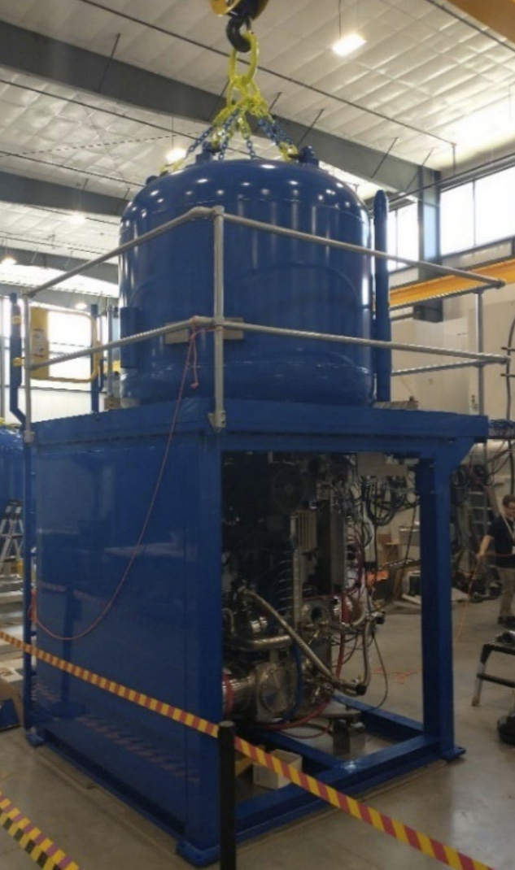
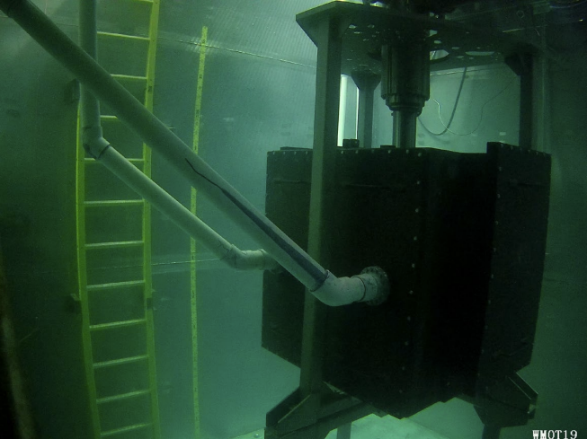
SHINE Technologies
2.45 GHz
ECR
Ion source
300 kV
Magnetic focusing
100 mA D+
Differential pumping
5e13 n/s
…
Neutron Target
Gaseous tritium target
Irradiation Cavity
R. Radel and L. Jacobson, “Characterization of SHINE’s High‑Flux DT Neutron Source,” presented at the Workshop for Applied Nuclear Data Activities (WANDA), Lawrence Berkeley National Laboratory, Feb. 2024.
Notes:
Mechanism:
(Permanent or electromagnets- could not find that information)
ECR ion source at 300 kV, produces ~100 mA
Magnetic focusing through multiple differential pumping stages
Focused through a gaseous tritium target to produce 5e13 n/s (continuous up to 132 hours)
Irradiation cavity houses target, surrounded by water for radiation suppression and water cooling’
Progression towards a potential plasma target to further increase neutron generation rate

Slide 8
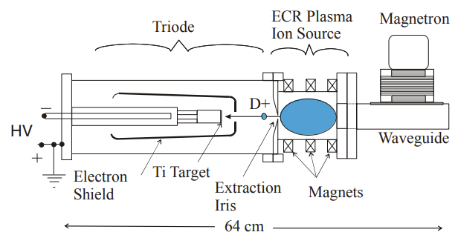
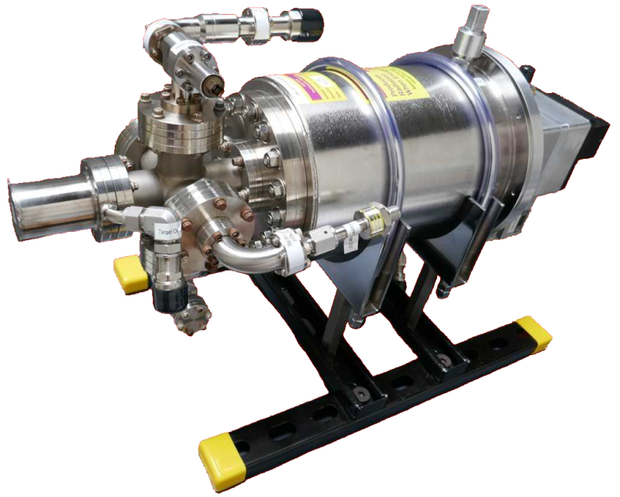
Adelphi Technology ECR neutron source
Actively pumped: ~20 mA
Deuterium only, 1e10 n/s
“Sealed”: ~2 mA
Tritium enabled, 2e10 n/s
J. H. Vainionpaa et. Al., “Technology and Applications of Neutron Generators Developed by Adelphi Technology, Inc,” Physics Procedia, vol. 60, pp. 203–211, 2014, doi: 10.1016/j.phpro.2014.11.029.
https://www.adelphitech.com
Notes:
Portable, often shipped out of house
Can be found on all continents except Antarctica
Make this slide quick
Add something for scale (labelled line?)
Ask about permanent vs electro magnets
Tweak words here
Electro vs permanent magnets
Picture with scale (also scale of ECR chamber if available)

Slide 9
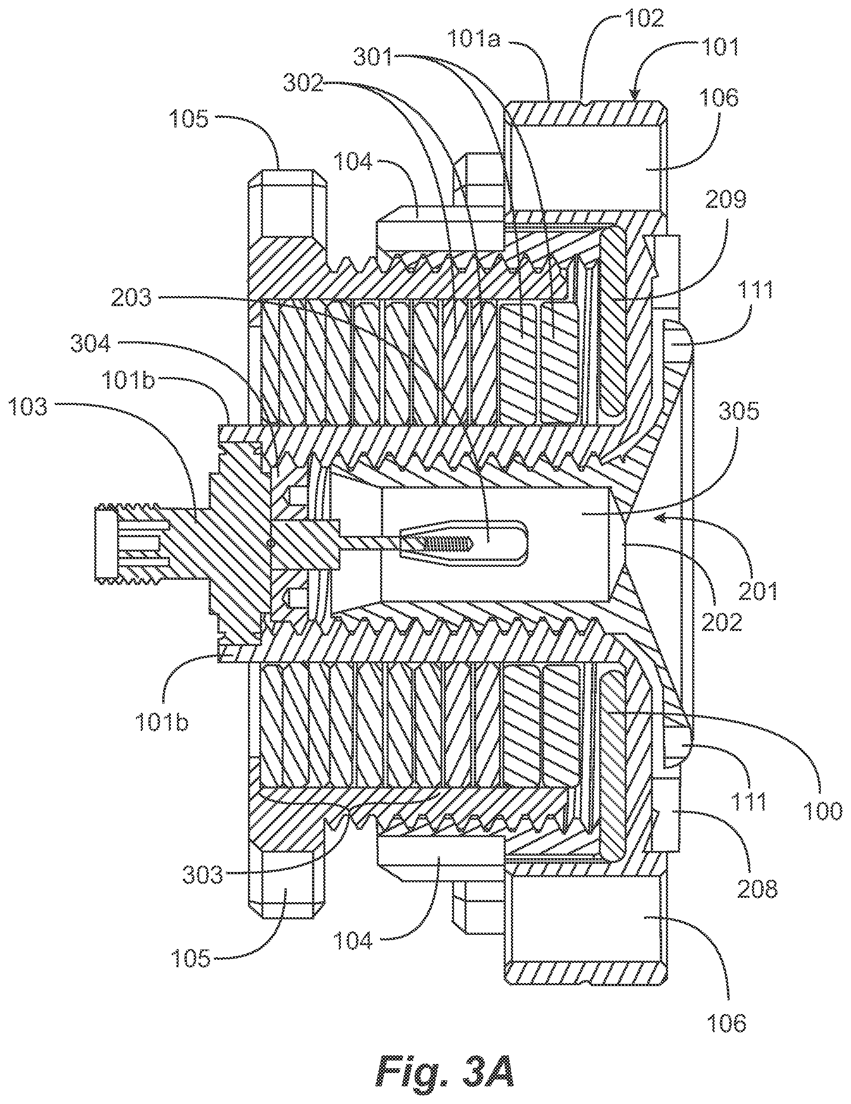
Miniaturization
Miniaturizing the ion source
~1 cm scale plasma
<1 W power
Ion source having a magnetic field translatable along an axis of the source, U.S. Patent No. 11,574,788 B1, filed October 8, 2021, issued February 7, 2023

Slide 10
Beam-target
(ECR)
Magnetic Bottle
(NBI)
Inertial electrostatic confinement
(Multiple)
300 kV, 100 mA
Gas target
5e13 n/s
100 kV, 2-20 mA
Solid target
2e10 n/s
Benchtop device
Notes:
Mention that I have visited all but tae

Slide 11
Beam-target
(ECR)
Magnetic Bottle
(NBI)
Inertial electrostatic confinement
(Multiple)
300 kV, 100 mA
Gas target
5e13 n/s
100 kV, 2-20 mA
Solid target
2e10 n/s
Benchtop device
Notes:
Mention that I have visited all but tae

Slide 12
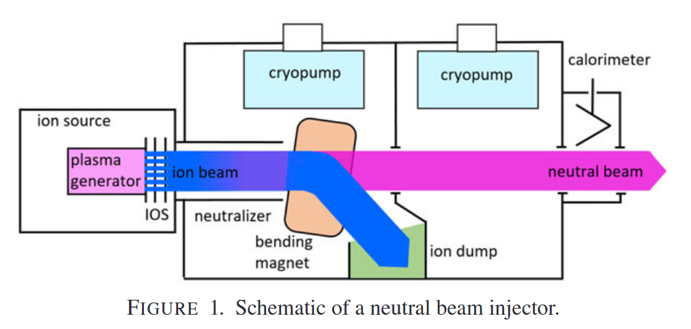

Neutral beam injection (NBI)
Target plasma
High energy ion deposition
Strong $B$ field
I. Shikhovtsev et al., “Overview of neutral beam injectors for plasma heating and diagnostics developed at Budker INP,” J. Plasma Phys., vol. 90, no. 1, p. 155900301, Feb. 2024, doi: 10.1017/S0022377824000278.
Notes:
Add bonus slide on negative sources for NBI (energy cutoff)
Generally kW-MW class neutral beam
Commonly used in traditional fusion to heat a plasma

Slide 13


Magnetic Bottles
Magnetic bottle baseline geometry
Seed plasma
Neutral beam injection
$$B$$

Slide 14


Magnetic Bottles
$$B$$
$$B$$
NBI directly heats and fuels the plasma
External systems maintain stability
Ions go into diamagnetic orbits

Slide 15

Magnetic Bottles
$$B$$
$$B$$
NBI directly heats and fuels the plasma
External systems maintain stability
Ions go into diamagnetic orbits
Plasma generates closed field geometry

Slide 16
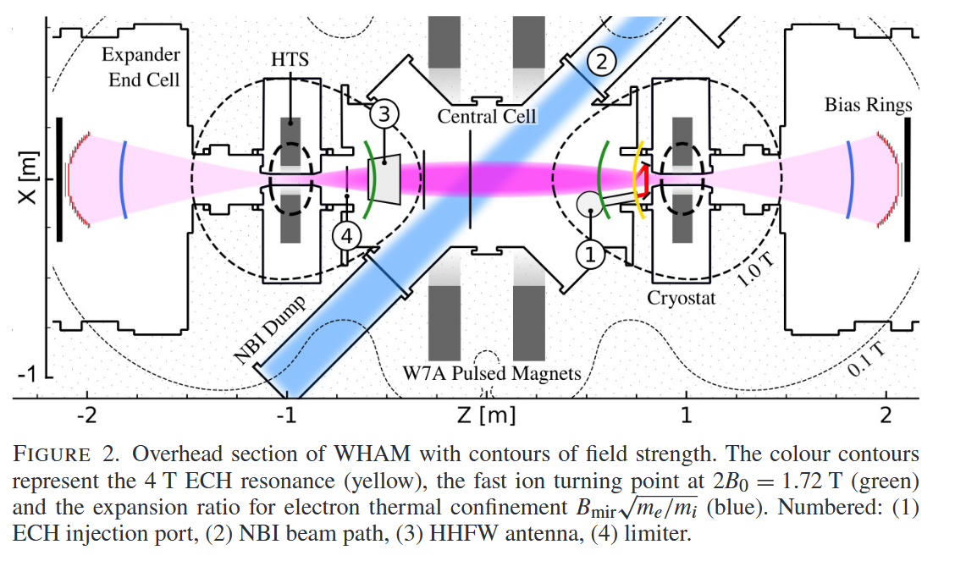
Realta
Wisconsin high-temperature superconductor axisymmetric mirror experiment (WHAM)
1 NBI system, space for a second
D. Endrizzi et al., “Physics basis for the Wisconsin HTS Axisymmetric Mirror (WHAM),” J. Plasma Phys., vol. 89, no. 5, p. 975890501, Oct. 2023, doi: 10.1017/S0022377823000806.
Notes:
NBI system from TAE- RF plasma version
https://arxiv.org/abs/2411.06644 - Hammir might use negative ion sources
WHAM vs Hammir vs Anvil?
Do a double check for published results since first plasma- if not mention that we have not seen any results publications

Slide 17
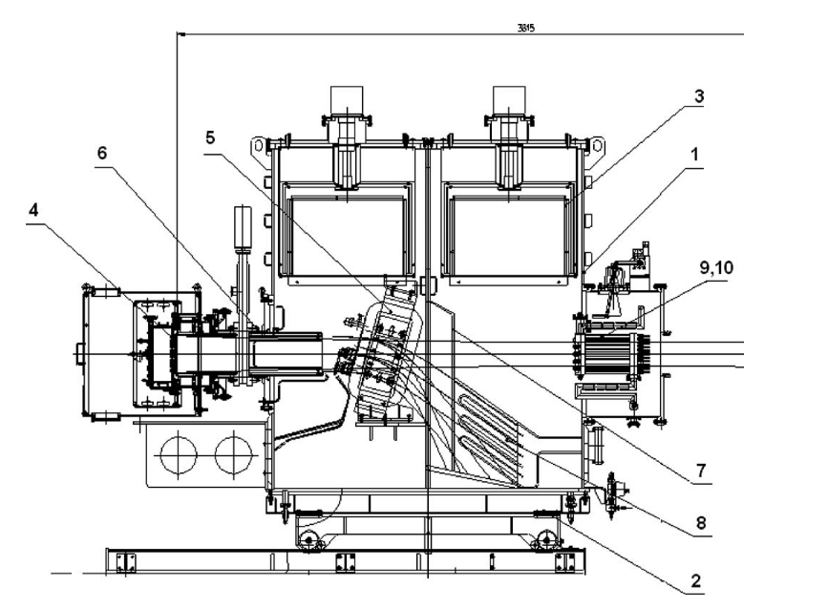

Realta NBI system
D. Endrizzi et al., “Physics basis for the Wisconsin HTS Axisymmetric Mirror (WHAM),” J. Plasma Phys., vol. 89, no. 5, p. 975890501, Oct. 2023, doi: 10.1017/S0022377823000806.
$2×7×{10}^{4}$L/s, cryogenic
25 keV, 40 A
Developed at Budker INP → TAE → WHAM
Heritage system from TAE architecture (C-2)
25 keV, 40 A
Neutralizer (80 cm)
A. Sorokin et al., “Characterization of 1 MW, 40 keV, 1 s neutral beam for plasma heating,” Review of Scientific Instruments, vol. 81, no. 2, p. 02B108, Feb. 2010, doi: 10.1063/1.3266141.
Notes:
Realta achieved their first plasma in 2024 and are already in the planning phase for their higher power systems, which will require 1 MeV neutral beams for energy production (Hammir- this will be a negative source)
4 MHz, 10 mTorr
https://arxiv.org/abs/2411.06644 - Hammir might use negative ion sources

Slide 18
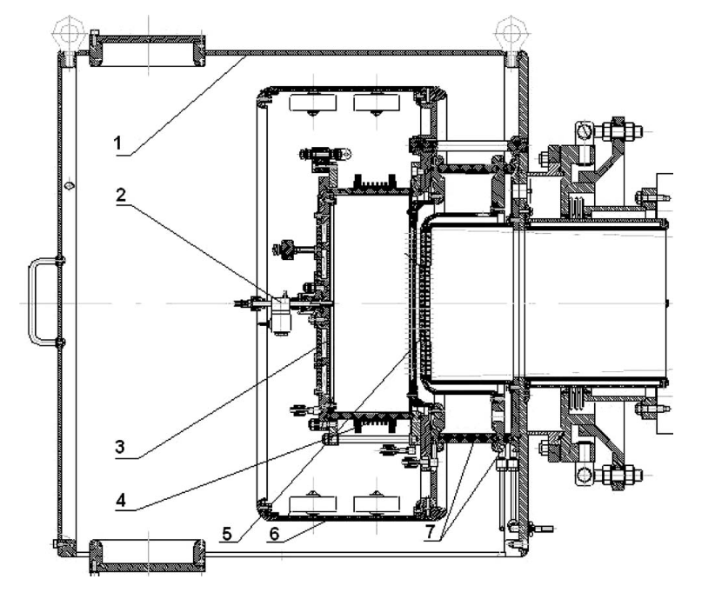
Realta NBI system
D. Endrizzi et al., “Physics basis for the Wisconsin HTS Axisymmetric Mirror (WHAM),” J. Plasma Phys., vol. 89, no. 5, p. 975890501, Oct. 2023, doi: 10.1017/S0022377823000806.
Triode optics
$2×7×{10}^{4}$L/s, cryogenic
RF coil
25 keV, 40 A
Developed at Budker INP → TAE → WHAM
Heritage system from TAE architecture (C-2)
Permanent magnets
Beam deflector
Gas puff
Future: 1 MeV NBI
S. Frank et al., “Confinement performance predictions for a high field axisymmetric tandem mirror,” J. Plasma Phys.
25 keV, 40 A
Neutralizer (80 cm)
A. Sorokin et al., “Characterization of 1 MW, 40 keV, 1 s neutral beam for plasma heating,” Review of Scientific Instruments, vol. 81, no. 2, p. 02B108, Feb. 2010, doi: 10.1063/1.3266141.
Notes:
Realta achieved their first plasma in 2024 and are already in the planning phase for their higher power systems, which will require 1 MeV neutral beams for energy production (Hammir- this will be a negative source)
4 MHz, 10 mTorr
https://arxiv.org/abs/2411.06644 - Hammir might use negative ion sources

Slide 19
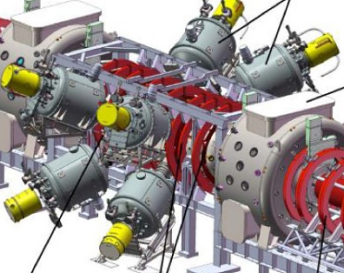
TAE NBI
Neutral beam injectors
8 NB Injectors, ~150 A each:
4x tunable (15-40 keV) beams
4x static (15 keV) beams
>20 MW of deposited power
H. Gota et al., “Formation of hot, stable, long-lived field-reversed configuration plasmas on the C-2W device,” Nucl. Fusion, vol. 59, no. 11, p. 112009, Nov. 2019

Slide 20
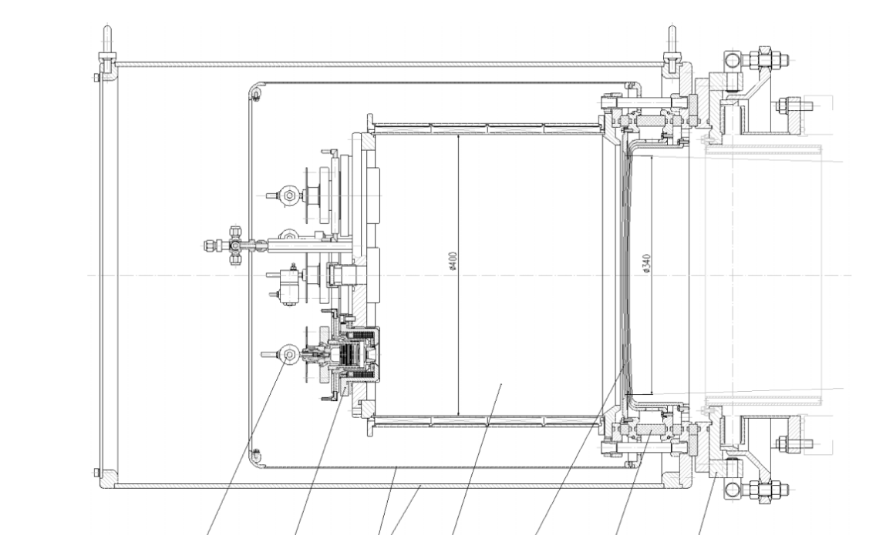
Budker Ion Source
Cusped magnetic field
40x35 cm expander chamber
4x 15 keV H+ beam
Multi-aperture triode optical system
Arc-discharge plasma source (x4)
Multiaperture Spherical optics
P. Deichuli et al., “Low energy, high power hydrogen neutral beam for plasma heating,” Review of Scientific Instruments, vol. 86, no. 11, p. 113509, Nov. 2015, doi: 10.1063/1.4936292.
Notes:
BLOW UP OF ARC DISCHARGE HERE
What benefit did they gain going from RF to arc?
What did they gain by going to ti getter instead of cryos?
Find some more info on the arc discharge- hollow anode? Something else?
- Ion sources with arc-discharge plasma box driven by directly heated LaB6 electron emitter or cold cathode „invited...
Limiting factor is grid overheating
Add image of optics if it can be found- or just some details (number of slits? Etc.)
Diameter of expander=40 cm, length=35 cm
[Expander is surrounded by] 48 rows of small ceramic Nd–Fe–B magnets (9 mm × 12 mm × 240 mm each) with the alternating magnetization directions, which form a longitudinal line-cusp plasma trap

Slide 21
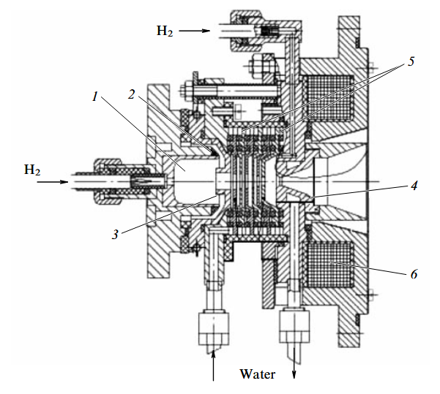
Budker Ion Source
Cusped magnetic field
Magnetic coils
40x35 cm expander chamber
4x 15 keV H+ beam
175 A pulsed
Multi-aperture triode optical system
Arc plasma
Arc-discharge plasma source (x4)
Multiaperture Spherical optics
P. Deichuli et al., “Low energy, high power hydrogen neutral beam for plasma heating,” Review of Scientific Instruments, vol. 86, no. 11, p. 113509, Nov. 2015, doi: 10.1063/1.4936292.
Notes:
BLOW UP OF ARC DISCHARGE HERE
What benefit did they gain going from RF to arc?
What did they gain by going to ti getter instead of cryos?
Find some more info on the arc discharge- hollow anode? Something else?
- Ion sources with arc-discharge plasma box driven by directly heated LaB6 electron emitter or cold cathode „invited...
Limiting factor is grid overheating
Add image of optics if it can be found- or just some details (number of slits? Etc.)
Diameter of expander=40 cm, length=35 cm
[Expander is surrounded by] 48 rows of small ceramic Nd–Fe–B magnets (9 mm × 12 mm × 240 mm each) with the alternating magnetization directions, which form a longitudinal line-cusp plasma trap

Slide 22
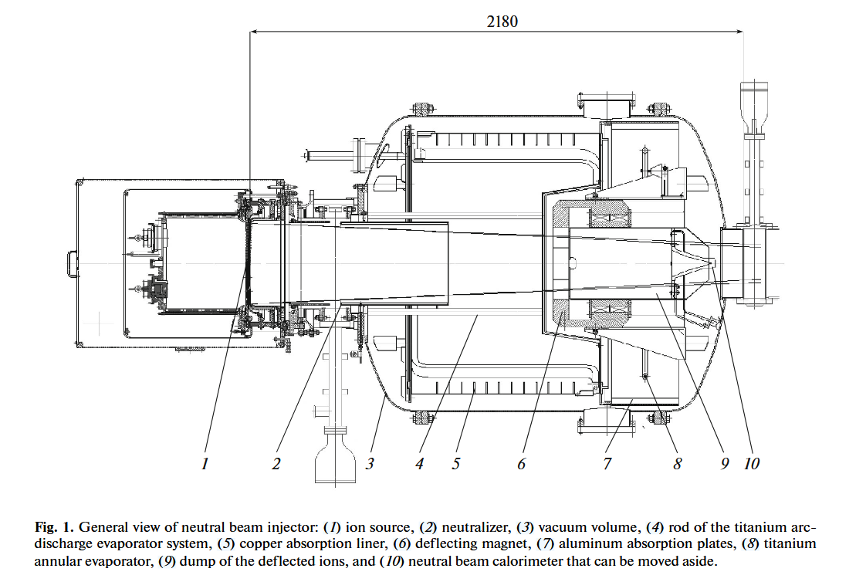
Injector
Converging neutral beam
Multislit optics
Plasma chamber
Titanium getter pumping
1e5 L/s
A. V. Brul et al., “High-Power Neutral Beam Injector with Tunable Beam Energy for Plasma Heating and Stabilization,” Plasma Phys. Rep., vol. 47, no. 6, pp. 518–525, June 2021
Notes:
Additional gas puff into the neutralizer- total between plasma source and neutralizer is 50 torr l/s = 4000 sccm

Slide 23
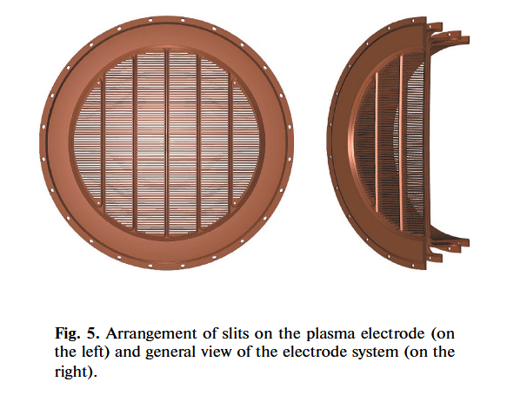
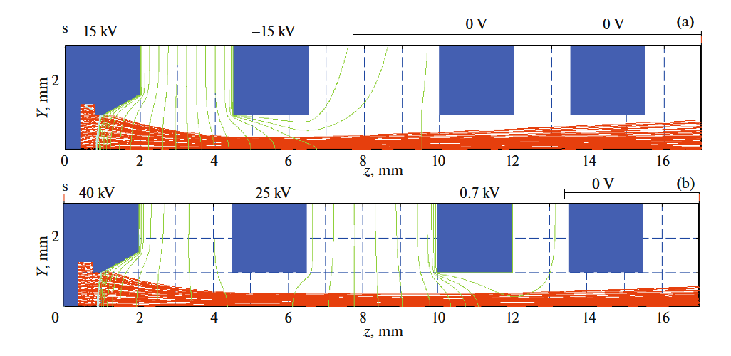
Tunable Beam Optics
Variable energy required for higher temperatures → higher B field
Tetrode allows constant current at varying beam energy
A. V. Brul et al., “High-Power Neutral Beam Injector with Tunable Beam Energy for Plasma Heating and Stabilization,” Plasma Phys. Rep., vol. 47, no. 6, pp. 518–525, June 2021, doi: 10.1134/S1063780X21060040.

Slide 24
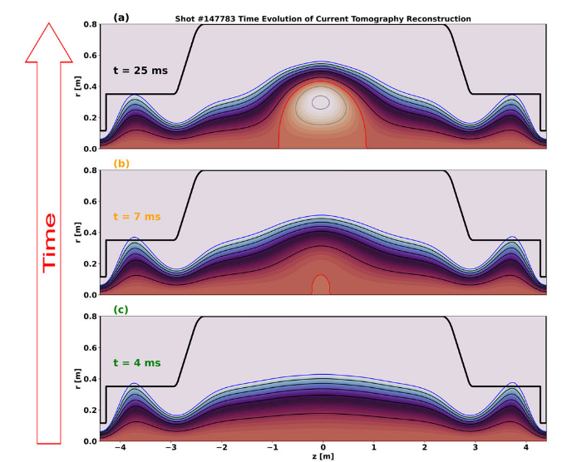
2025: FRC formation by NBI alone
FRC
Variable NBI system enabled full FRC
T. Roche et al., “Generation of field-reversed configurations via neutral beam injection,” Nat Commun, vol. 16, no. 1, p. 3487, Apr. 2025, doi: 10.1038/s41467-025-58849-5.

Slide 25
Beam-target
(ECR)
Magnetic Bottle
(NBI)
Inertial electrostatic confinement
(Multiple)
300 kV, 100 mA
Gas target
5e13 n/s
20 MW NBI
8 injectors
15-40 keV (variable)
100 kV, 2-20 mA
Solid target
2e10 n/s
Benchtop device
1 MW
1 injector, space for 2
25 keV
Notes:
Mention that I have visited all but tae

Slide 26
Beam-target
(ECR)
Magnetic Bottle
(NBI)
Inertial electrostatic confinement
(Multiple)
300 kV, 100 mA
Gas target
5e13 n/s
20 MW NBI
8 injectors
15-40 keV (variable)
100 kV, 2-20 mA
Solid target
2e10 n/s
Benchtop device
1 MW
1 injector, space for 2
25 keV
Notes:
Mention that I have visited all but tae

Slide 27
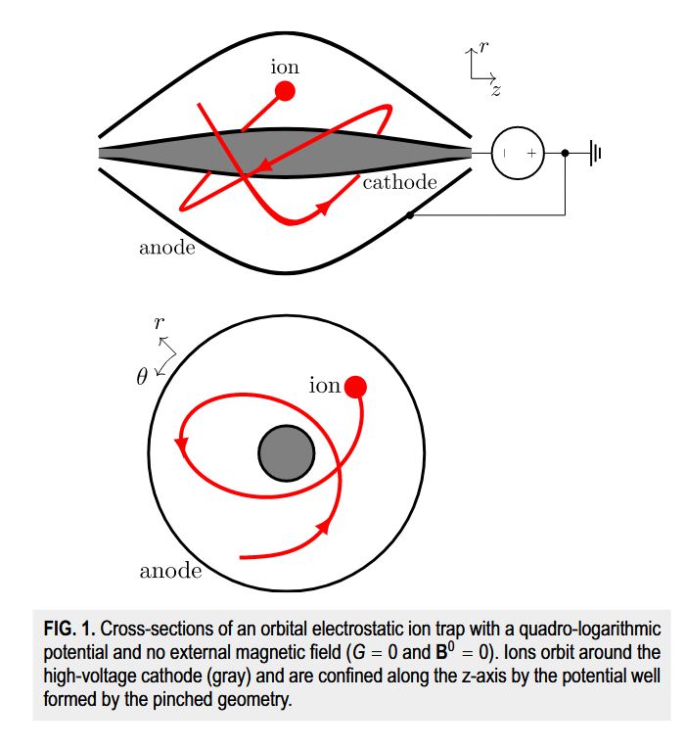
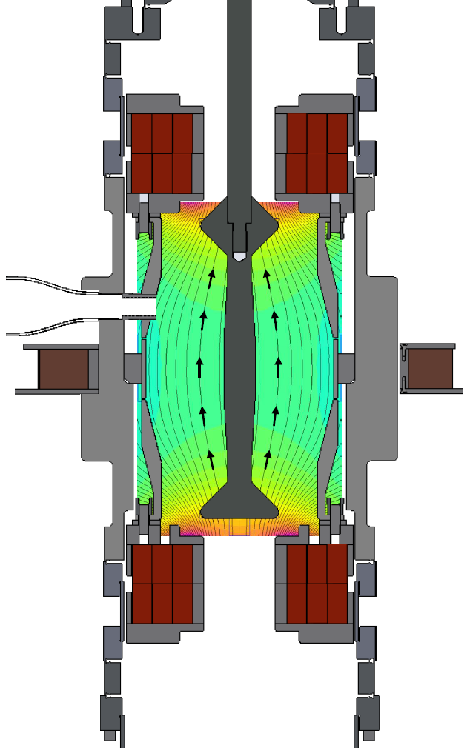
Orbitron: 10’s kW hybrid
Cathode
(-100-300 kV)
D+ beam injection
Anode (ground)
Magnets
~12 cm
M. Affolter et al., “The Orbitron: A Crossed-Field Device for Co-Confinement of High Energy Ions and Electrons,” AIP Advances, vol. 14, no. 8, p. 085025, Aug. 2024.
Notes:
The orbitron is a 10’s of kW class fusion reactor based on a hybrid electric-magnetic densification approach. We have a strong electric field in (r, z) generated by a negative cathode that, when ions are injected, can maintain ions in a long duration orbit. This is similar to an orbitrap.
The magnets that you see enable simultaneous electron confinement, which allows us to push past the space charge limits imposed by an ion-only trap.

Slide 28
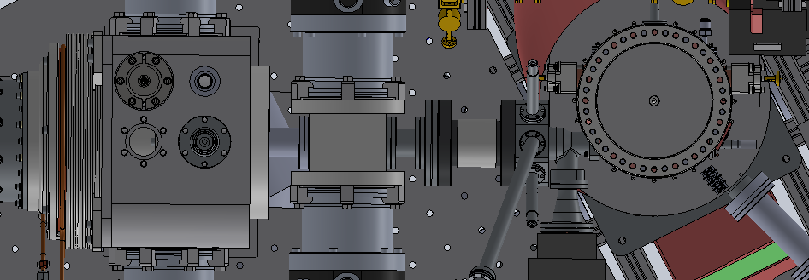
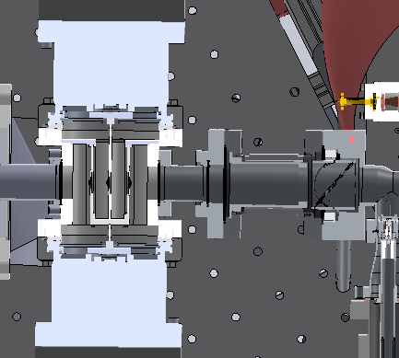
Avalanche Beamline
Orbitron entrance
Ion source
Differential Pumping
Deceleration, focusing, steering

Slide 29
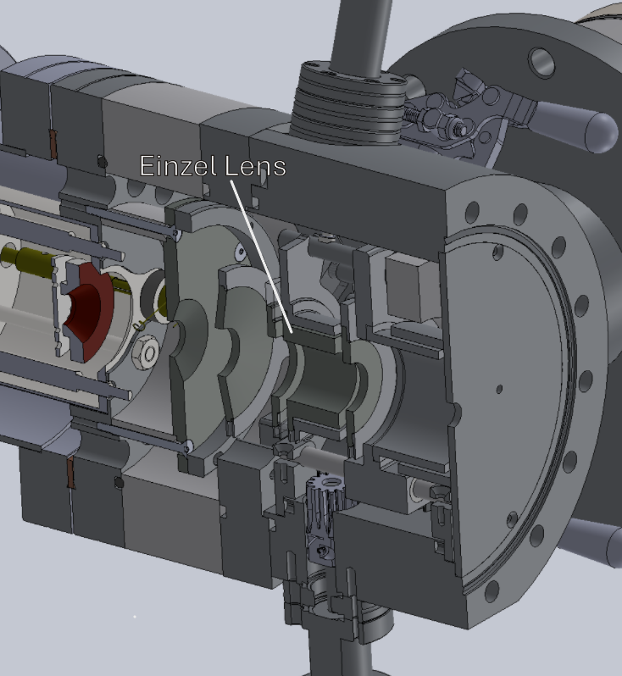
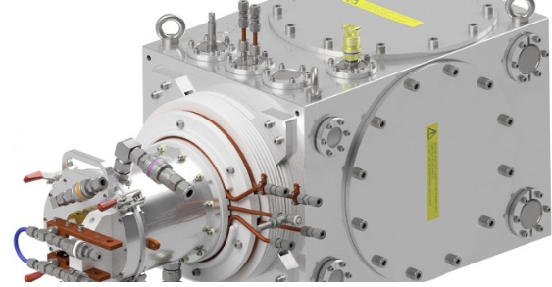
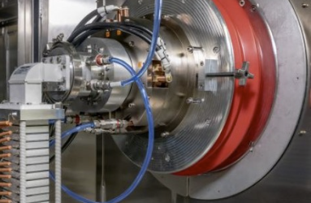
Ion sources
Veeco Mark 1 (1 mA)
D-Pace ISVF (2 mA)
D-Pace ECR (10 mA goal)
Repurposed broad beam source
Positive/negative source
30 mA generated at 50 kV
Development ongoing
Notes:
Progressive densification requires an increase in beam current to match
As the company has grown rapidly over the last few years, we have had multiple different goals and projects to achieve them
1 mA vs 6 mA? What’s going on here
Justify beam current levels

Slide 30
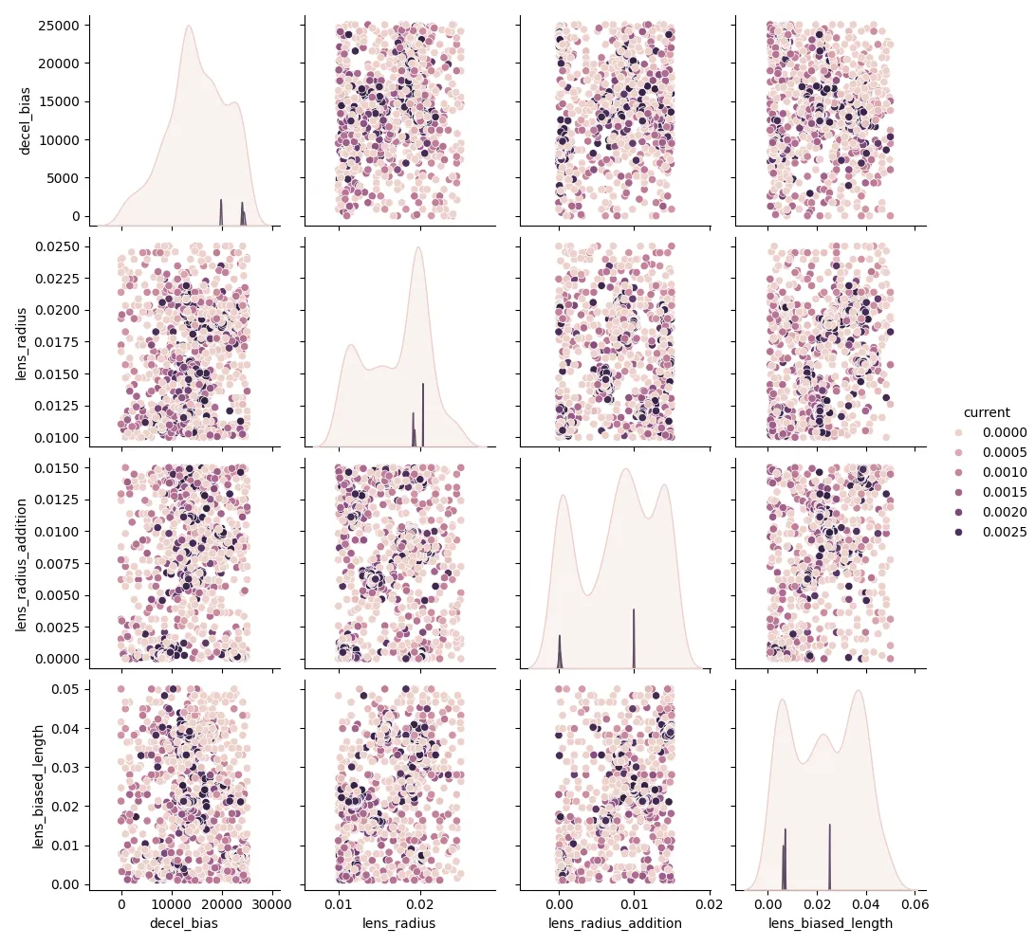
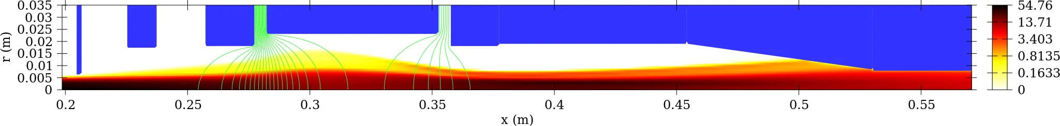

Ion beam simulations
Python-wrapped IBSimu (“pybsimu”)
Publicly available!
Wrapped in surrogate optimization techniques (pySOT)
Amazon Web Services used to host computations
$$V_{bias}$$

Slide 31
Beam-target
(ECR)
Magnetic Bottle
(NBI)
Inertial electrostatic confinement
(Multiple)
300 kV, 100 mA
Gas target
5e13 n/s
20 MW NBI
8 injectors
15-40 keV (variable)
10 mA
DC, ECR positive beams
100 kV, 2-20 mA
Solid target
2e10 n/s
Benchtop device
1 MW
1 injector, space for 2
25 keV
Notes:
Mention that I have visited all but tae

Slide 32
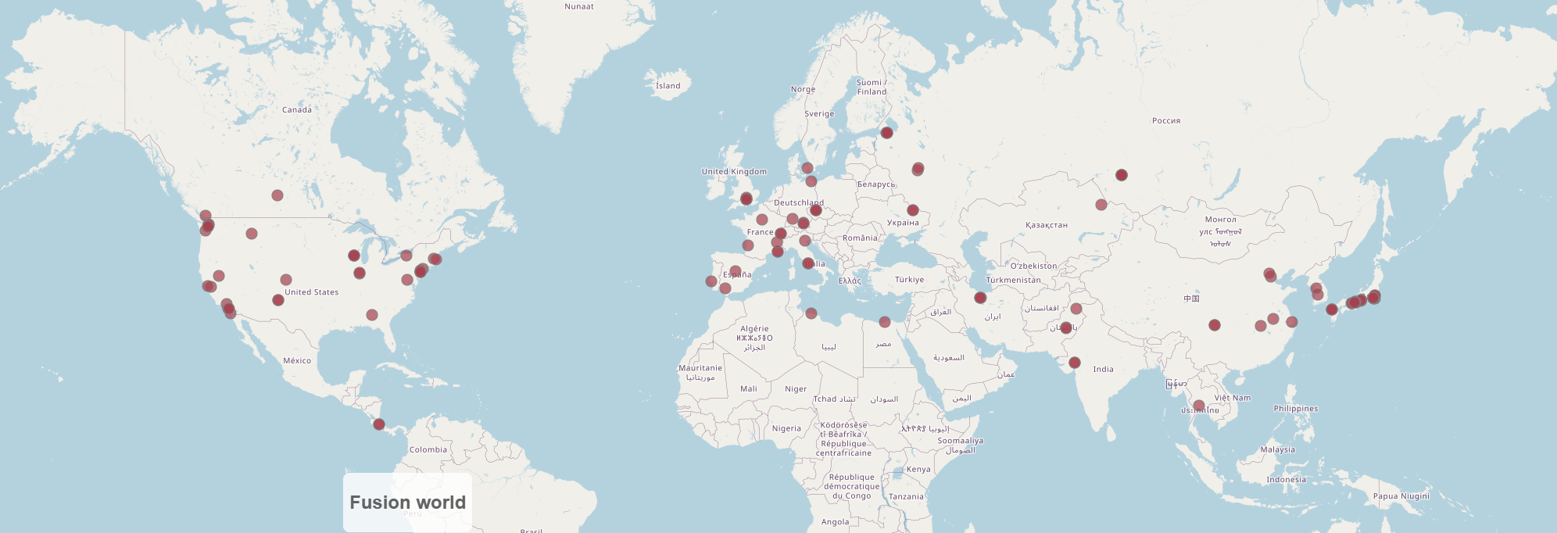
Fusion is everywhere, and growing fast!
Source: https://remdelaportemathurin.github.io/fusion-world/
Notes:
Fusion is everywhere!
I hopefully have convinced you that traditional fusion schemes, while vital, are not the only contribution to the field that the ion source community has to offer.

Slide 33
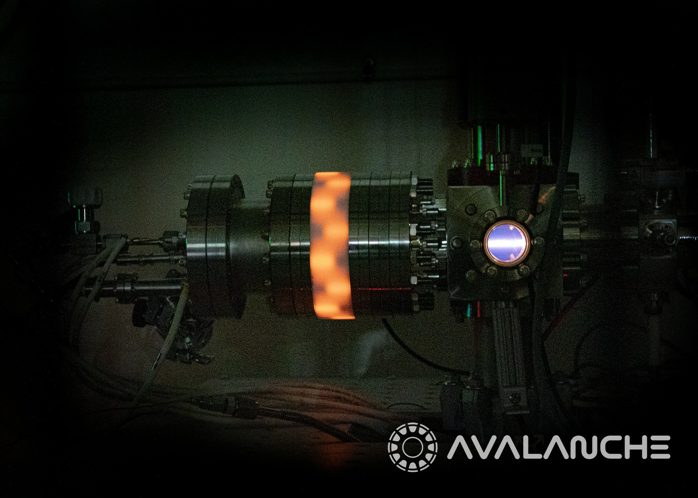

Thank you!
Pybsimu

Slide 34
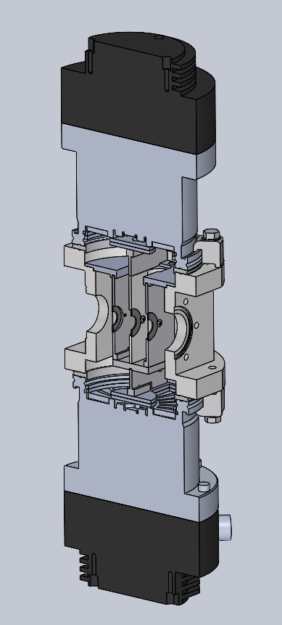
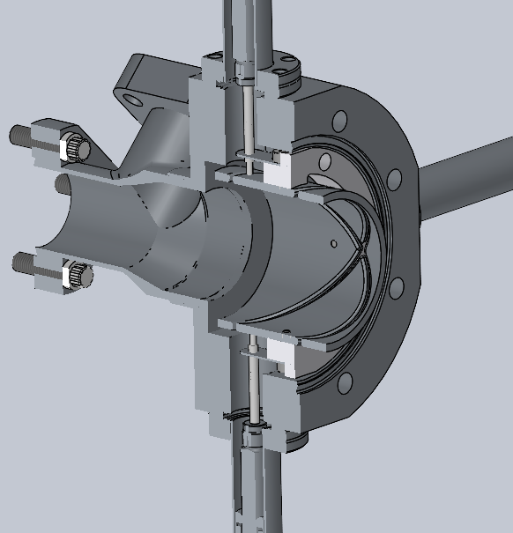
Beamline
Differential Pumping
Deceleration and Steering
4 Stage differential pumping on total of 500 L/s
Sikler geometry used to decelerate, focus, and steer into the orbitron
250 L/s turbopumps
>2 OOM pressure drop
Notes:
These may not be needed- could probably be removed

Slide 35
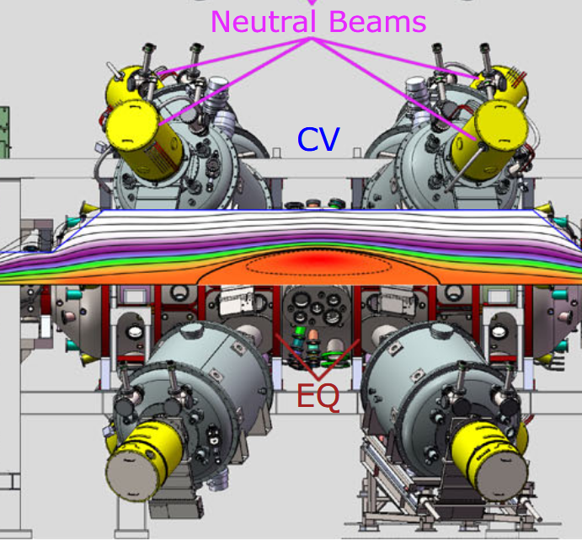
TAE
Field-reversed configuration (FRC) concept
Neutral beams are ionized by a seed plasma
Beam produces azimuthal current
Closed field geometry confines plasma
Notes:
https://tae.com/enhanced-plasma-performance-in-c-2w-advanced-beam-driven-field-reversed-configuration-experiments
Draw out cartoon explaining this concept (like Wikipedia image)
What developments would these companies value? Higher pulse lengths? Can put this on last TAE slide

Slide 36
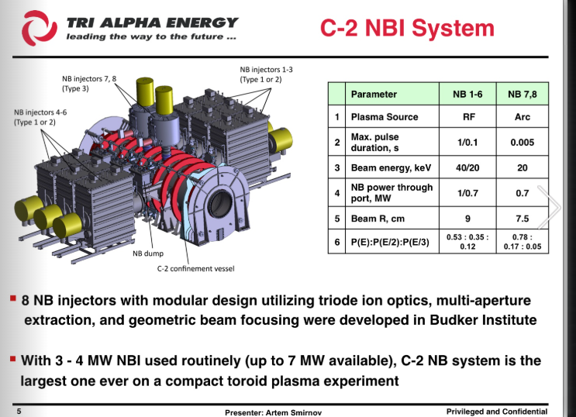
https://tae.com/neutral-beam-injection-in-the-c-2-facility/?utm_source=chatgpt.com
2012 status of C2

Slide 37
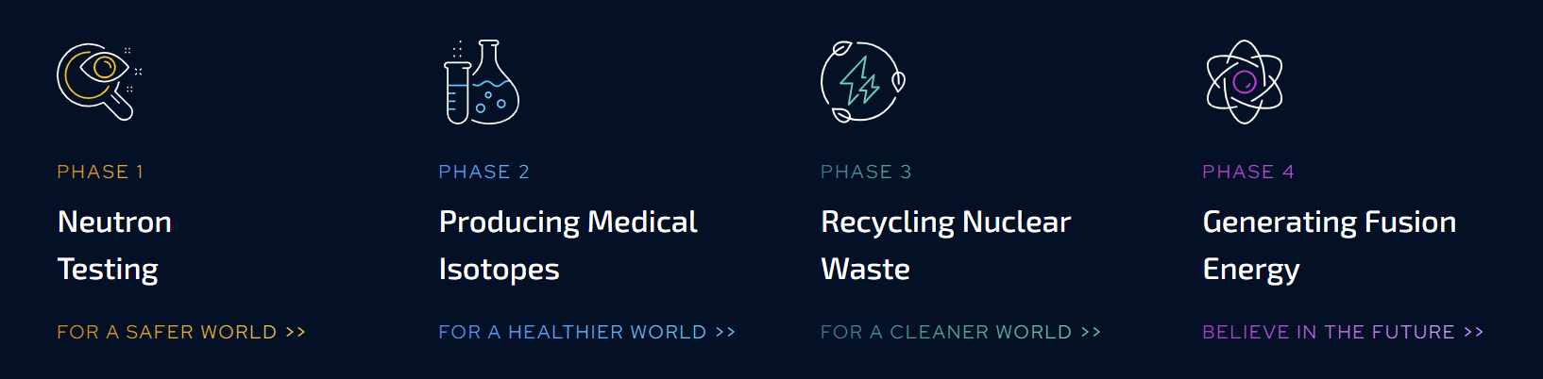
SHINE Technologies
Source: www.shinefusion.com
Notes:
Mention Janesville WI
Highlight that 1-3 are all neutrons
‘SHINE implements a staged approach where, while the ultimate goal is energy, there are staged applications for neutrons along the way
1: Neutron imaging (identifying defects, many aerospace and defense applications)
2: Medical isotopes (Weekly Lu-177 for cancer treatment)
3: Nuclear waste recycling: Waste still has nuclear potential
4: Energy (duh)

Slide 38

Magnetic mirror concept
17 T peak
Radial $E$ field
$$B$$
ECRH
ECRH
NBI for heating and fueling
Notes:
ECRH generates a plasma, adds energy to the electrons to reduce their drag effect on the ions
10 end rings

Slide 39
TAE: Field Reversed Configuration
1. Magnetic mirror baseline geometry
$$B$$
Seed plasma guns
2. Axial plasma guns produce seed plasma
3. Neutral beam injects high energy ions
Notes:
Cut this down- can talk about mirrors at first, then specialize with TAE and Realta?
Foothill Ranch, CA

Slide 40
TAE: Field Reversed Configuration
1. Magnetic mirror baseline geometry
4. Field reversal
$$B$$
Seed plasma guns
What are the NBI Systems?
2. Axial plasma guns produce seed plasma
3. Neutral beam injects high energy ions

Slide 41
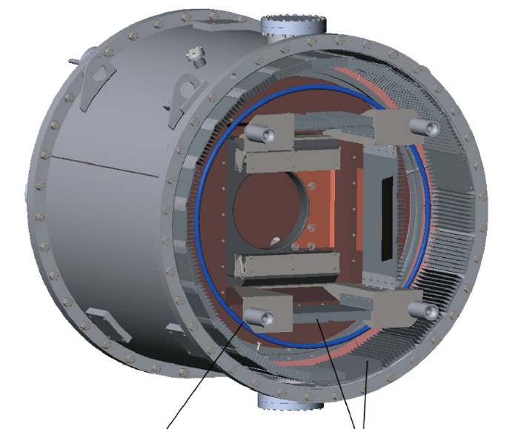
Tunable beam
Ti getter surfaces
A. V. Brul et al., “High-Power Neutral Beam Injector with Tunable Beam Energy for Plasma Heating and Stabilization,” Plasma Phys. Rep., vol. 47, no. 6, pp. 518–525, June 2021, doi: 10.1134/S1063780X21060040.

Slide 42
Realta NBI system
2x cryogenic pumps
(7e4 L/s each)
Triode optics
25 keV, 40 A
Developed at Budker INP → TAE → WHAM
Heritage system from older TAE architecture
Plans for 1 MeV neutral beams¹
RF plasma source
Expander chamber
80 cm Neutralizer
D. Endrizzi et al., “Physics basis for the Wisconsin HTS Axisymmetric Mirror (WHAM),” J. Plasma Phys., vol. 89, no. 5, p. 975890501, Oct. 2023, doi: 10.1017/S0022377823000806.
¹S. Frank et al., “Confinement performance predictions for a high field axisymmetric tandem mirror,” J. Plasma Phys.
Notes:
FIND THIS SOURCE- What is the pulse duration
Realta achieved their first plasma in 2024 and are already in the planning phase for their higher power systems.
Verify that it is actually multiple RF sources feeding the larger chamber
1 MeV beam for Hammir = power plant version
https://arxiv.org/abs/2411.06644 - Hammir might use negative ion sources

Slide 43
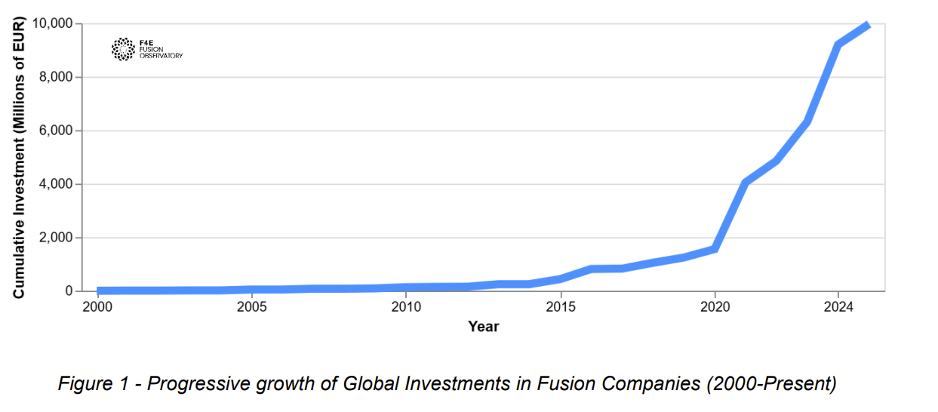
Fusion Excitement
2022: Scientific Breakeven
Growing investment in the private sphere
2.05 MJ input
3.15 MJ output
€9.9 B
€1.5 B
Fusion plasma
H. Abu-Shawareb et al., “Achievement of Target Gain Larger than Unity in an Inertial Fusion Experiment,” Phys. Rev. Lett., vol. 132, no. 6, p. 065102, Feb. 2024
“Global Investment in the Private Fusion Sector.” Fusion for Energy. (2025, June 10).
Notes:
“Dramatic” increase
Mix between private funds (~6.7 B) and public funding (~1.8 B) (rest is hybrid state-private funding)

