Slide 1
A gasdynamic ECR ion source developed at IMP
and its preliminary results
Huanyu Zhao, Yuting Lu
Institute of Modern Physics, Chinese Academy of Sciences

Slide 2
Outline
Motivation
Introduction to the gasdynamic ECR ion source
Preliminary results of the source
The first ion beams
Electron diagnostics of the plasma
Summary and outlook

Slide 3
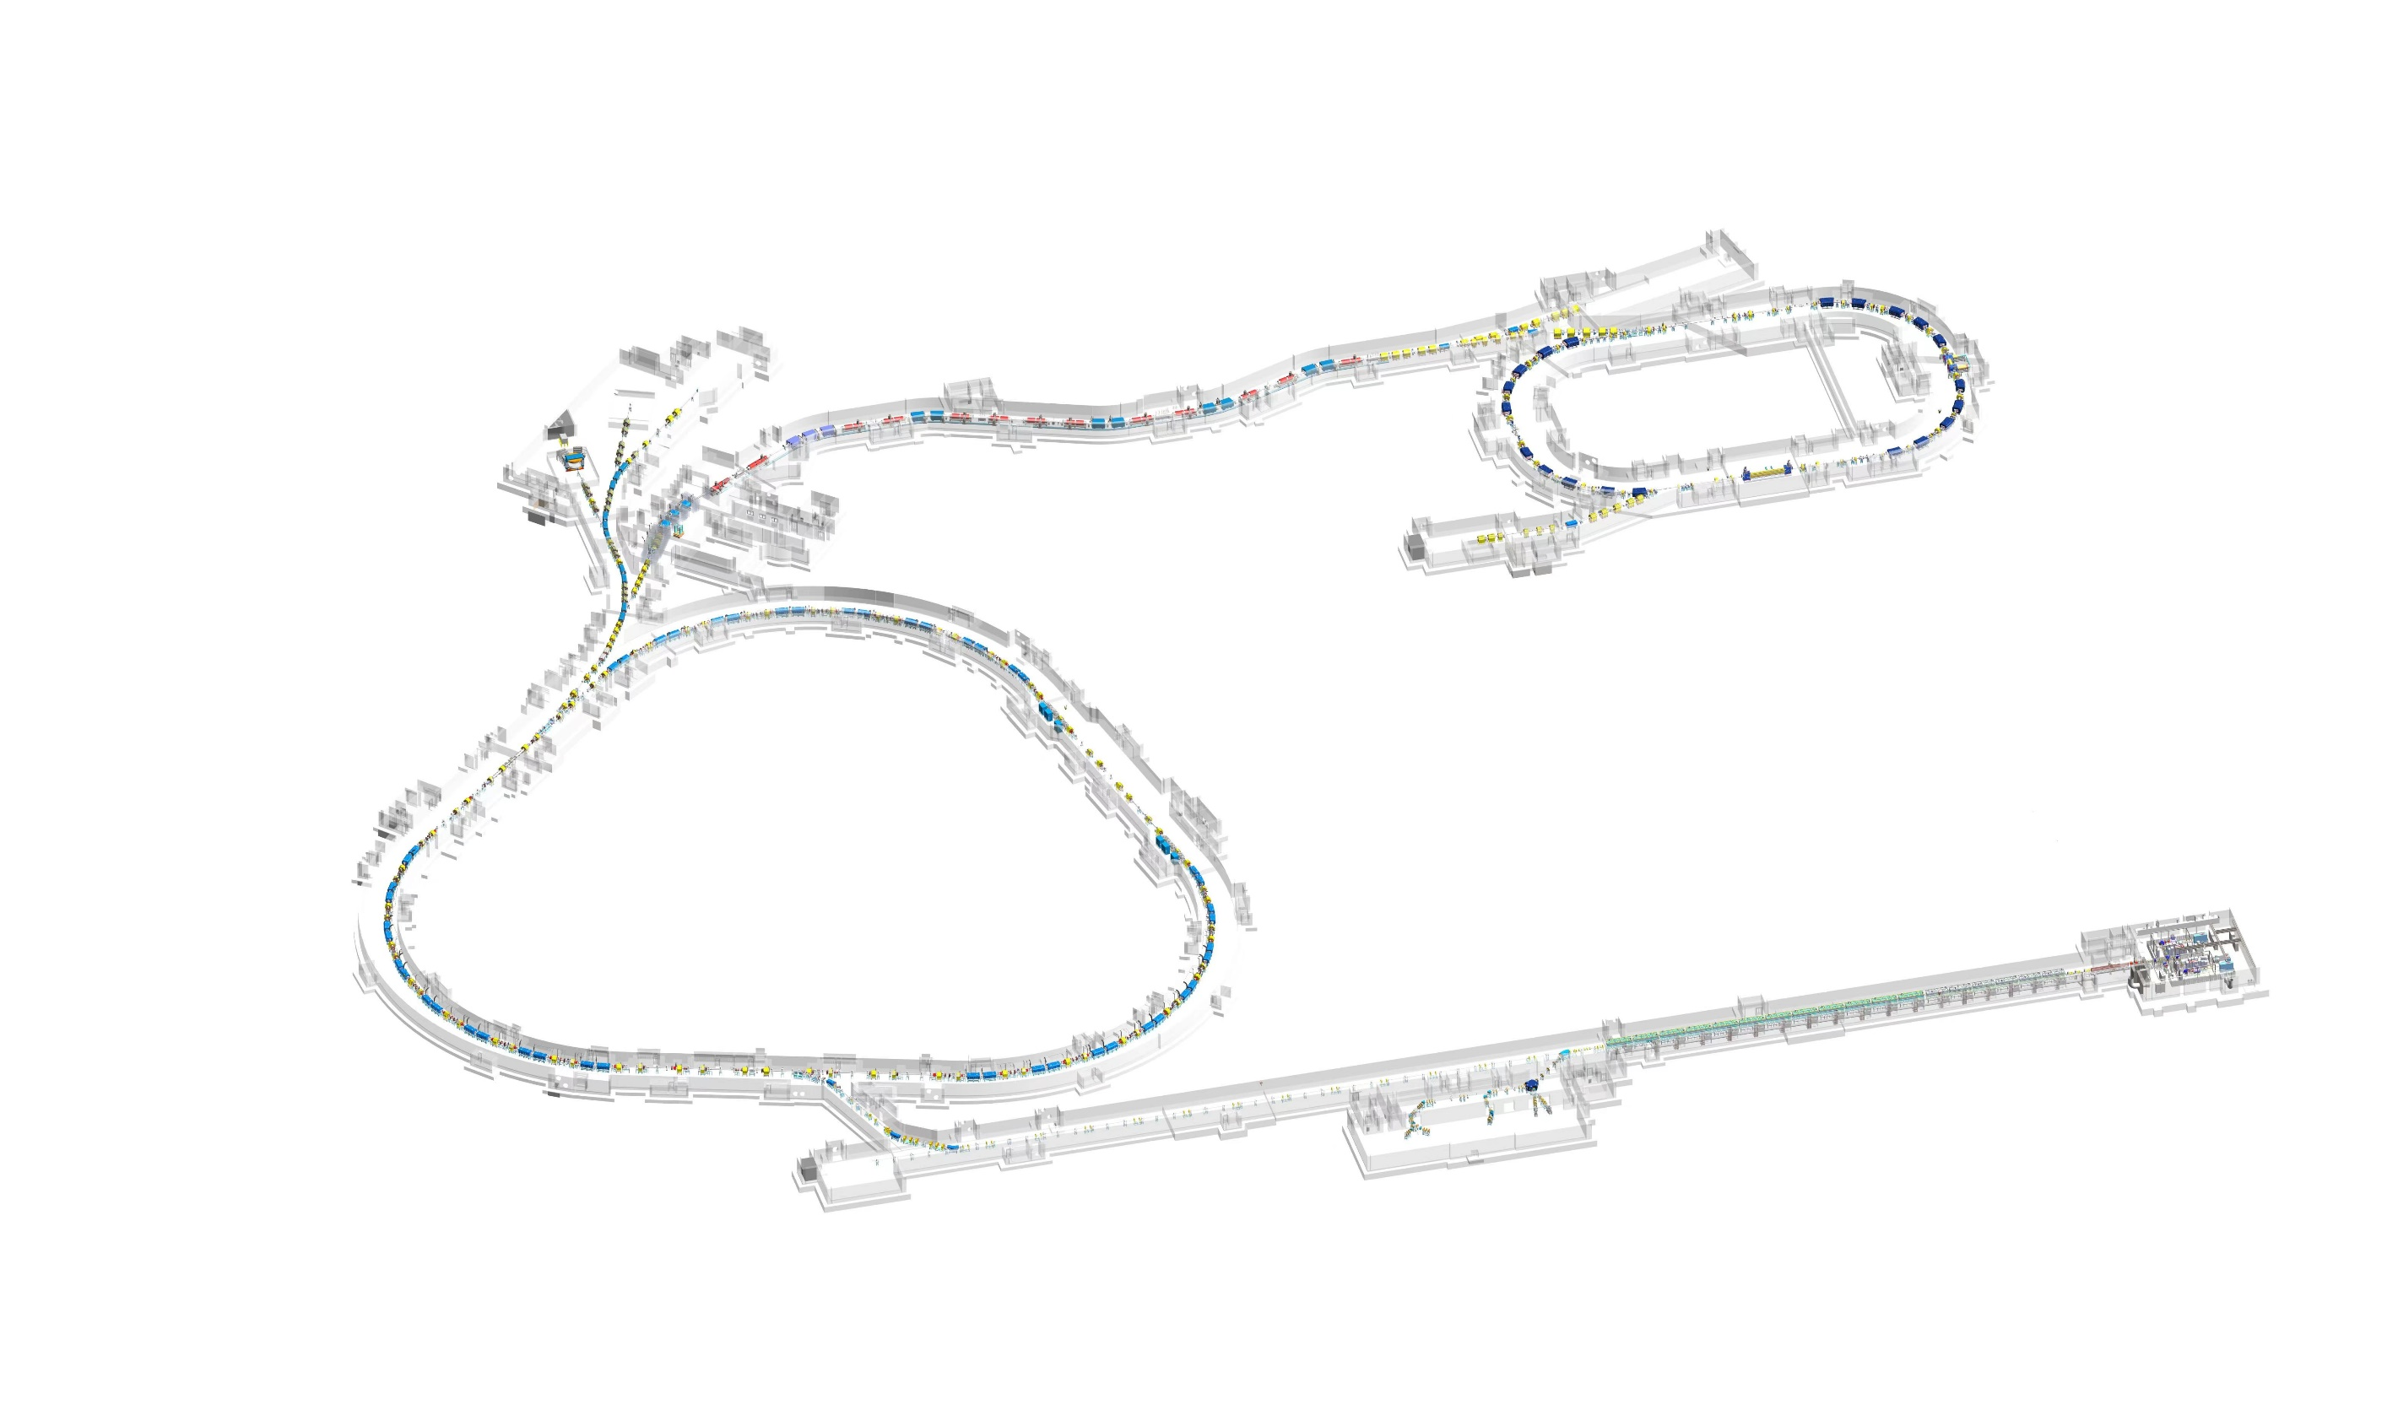
HIAF
High Intensity heavy-ion Accelerator Facility- HIAF
Requirements for injector
Phase I (2018-2025)
~1 emA U³⁵⁺ (1-5 Hz, 0.2-2 ms) from SECR
Phase II
2-10 emA U^{4n+} from pre-injector
HFRS
SRing
SRing: Spectrometer ring
C: 278m
Bρ: 15Tm
BRing: Booster Ring
C: 569 m
Bρ: 34 Tm
iLinac: Superconducting linac
E: 17 MeV/u( ²³⁸U³⁵⁺)
I : 1 emA
SECR
iLinac
iLinac-2 (reserved)
E: 100 MeV/u U⁴⁶⁺
T1

Slide 4
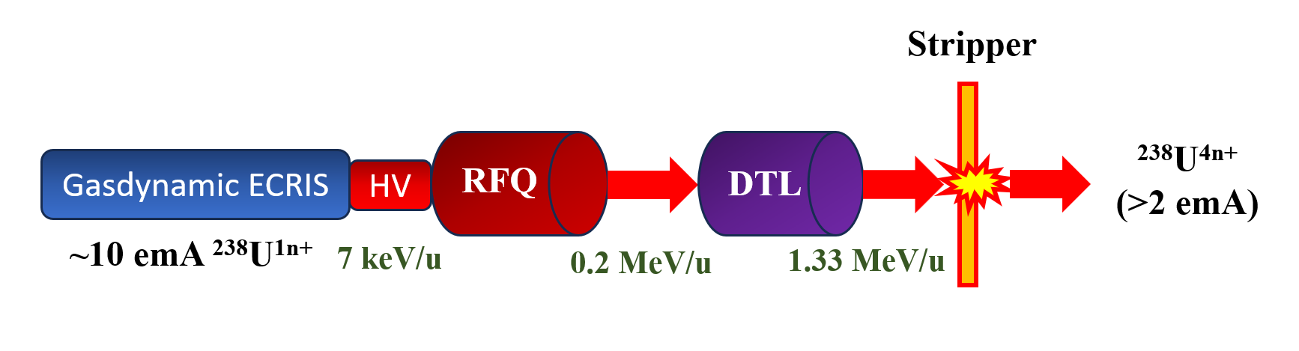
An alternative for front-end of HIAF

Slide 5
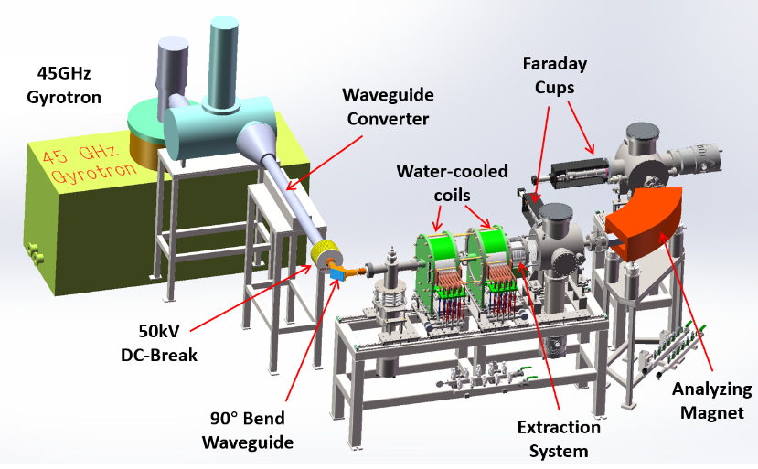
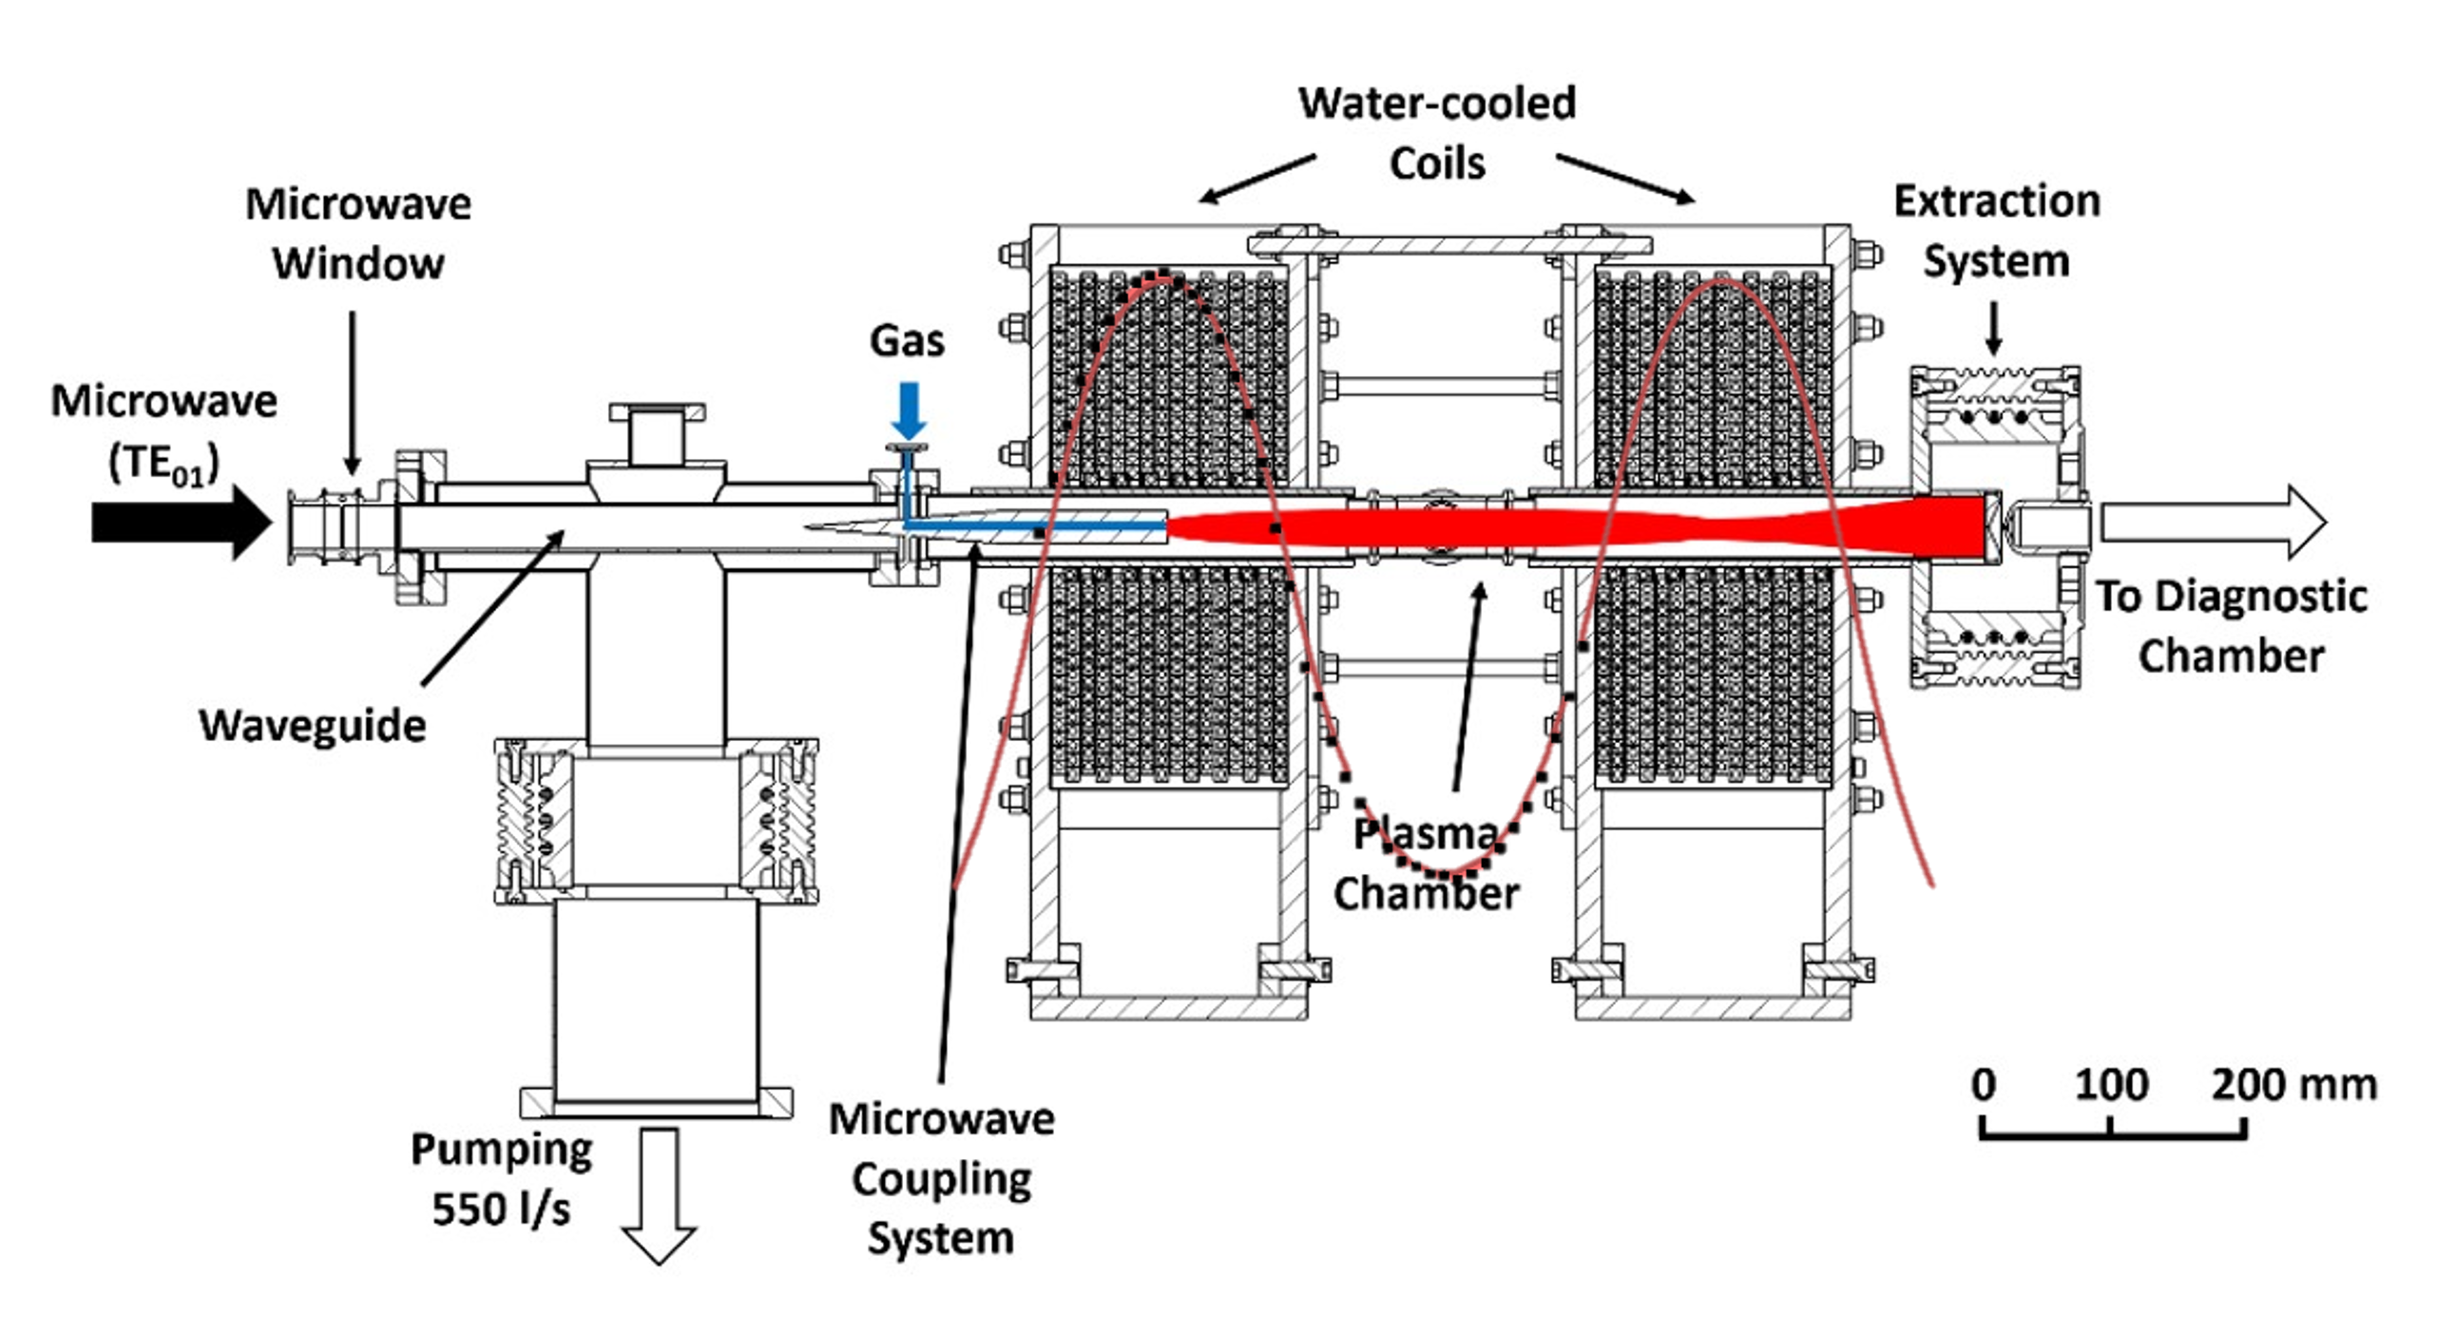
Gasdynamic ECR ion source @ IMP
Operation mode | Pulsed (1 Hz, 5-10 ms width)
Microwave power | up to 20 kW
Microwave transmission | TE₀₁ mode, circular waveguide (φ32.54 mm)
Magnetic field | Pulsed simple mirror trap (L=40 cm, R=3.3, B_{max} up to 3.0 T)
Plasma chamber diameter | 45 mm
Extraction | 2-electrode system, φ1 mm aperture

Slide 6
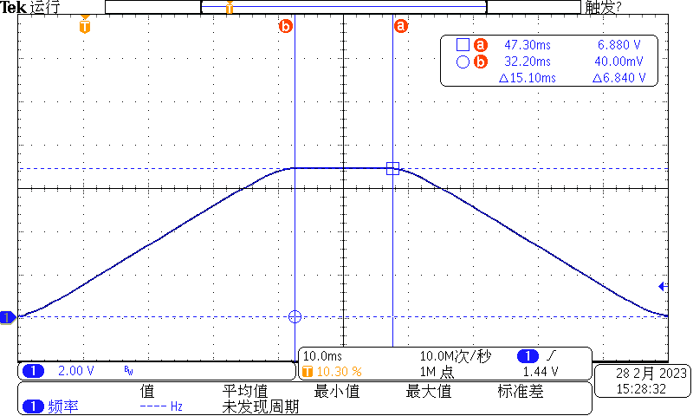
Magnetic confinement field- simple mirror
10 ms
Axial B field distribution with different coil current
Typical waveform of exciting current

Slide 7
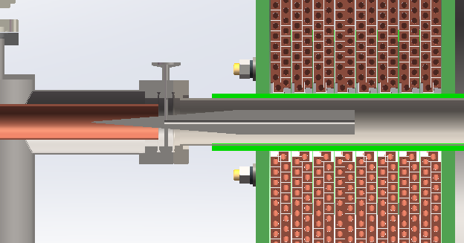
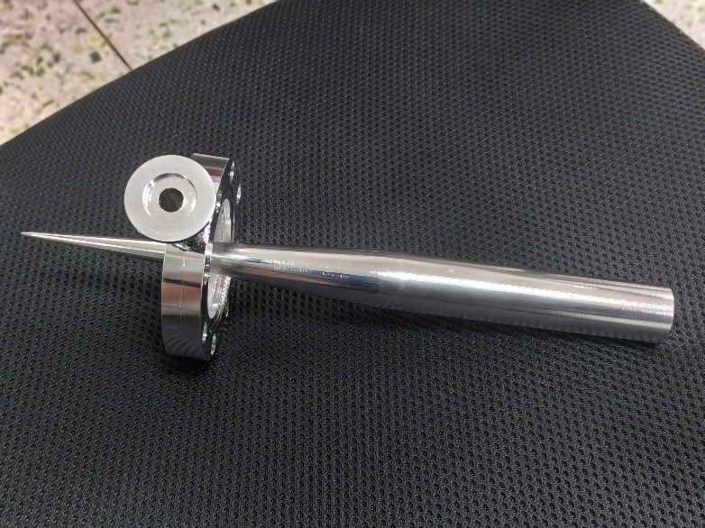
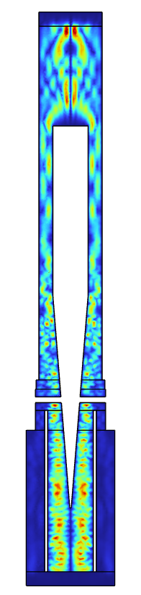
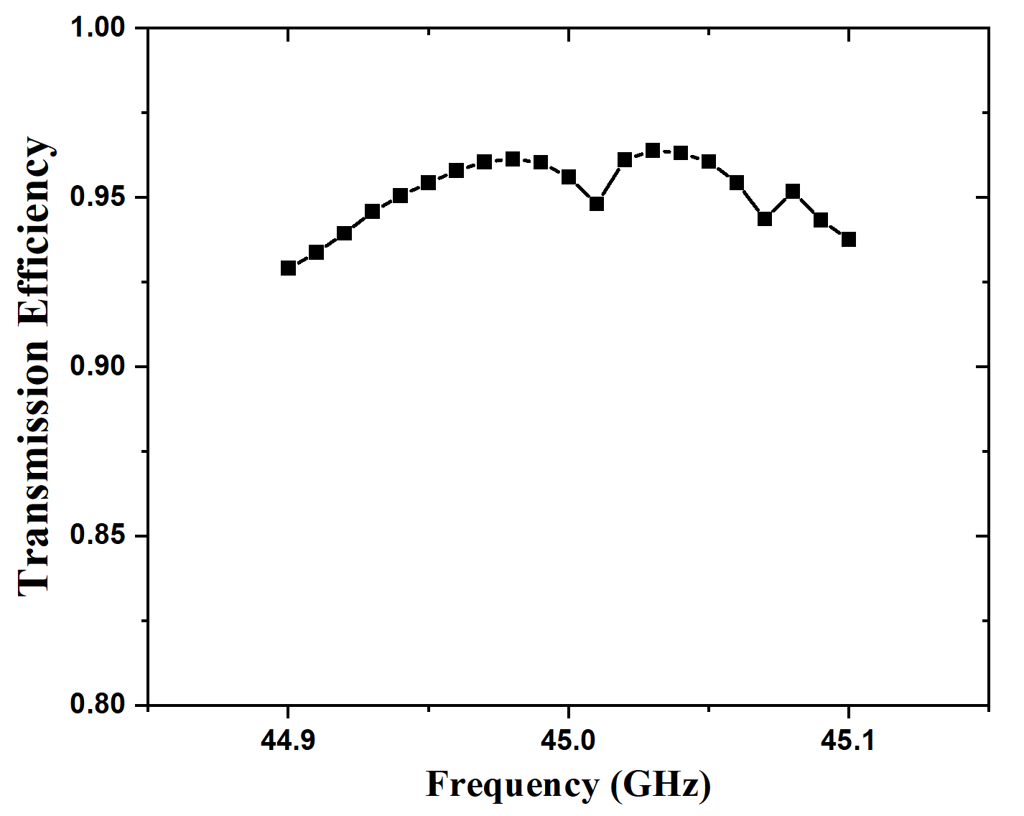
Microwave coupling module
Gas feeding
Waveguide
ECR zone outside the trap
Location of B_{max}
Electric field distribution (10 kW) :
Transmission efficiency for TE₀₁ mode
Electric field norm (V/m)
To avoid discharge outside the chamber
To protect the microwave window from the plasma

Slide 8
The first beams- Nitrogen
Current density reaches 128.0 mA/cm² at 19 kV and 1.2×10⁻⁴ mbar in space-charge-limited mode.
Higher current can be obtained by moving the extraction system closer to the mirror plug.
RF power: 20 kW
Φ-plasma=1 mm

Slide 9
The first beams- Hydrogen
Typical waveforms with different pressure
Peak current density reaches 305.6 mA/cm² at 19 kV and 4.1×10⁻⁴ mbar.
Compared with nitrogen, the working pressure is much higher for hydrogen.

Slide 10
Electron diagnostics of the plasma
Leaking electron current measurement
Electron energy distribution
EUV spectroscopy of the plasma
Electron temperature
Relative electron density
Electron density

Slide 11
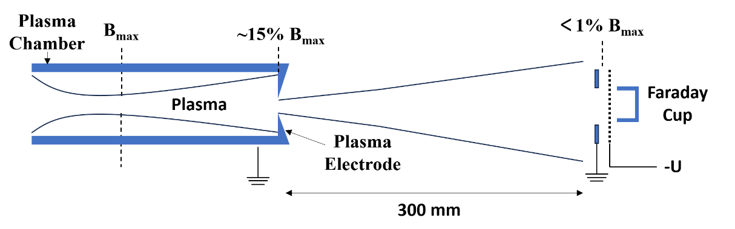
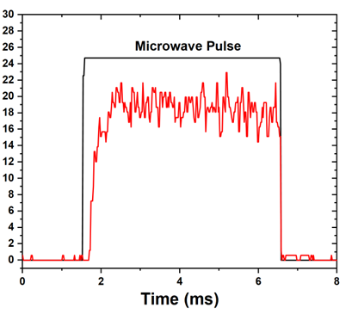
Measurement of leaking electron current
Amplitude of current @ FC (mA)
Waveform of negative current @ FC
Current @ FC vs negatively biased voltage

Slide 12
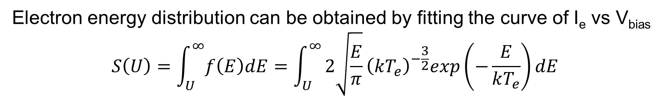
Fitting of electron energy distribution
Electron energy distribution can be obtained by fitting the curve of I_{e} vs V_{bias}
$$S\left(U\right)=\int_{U}^{∞}{f\left(E\right)dE}=\int_{U}^{∞}{2\sqrt{\frac{E}{π}}{\left(kT_{e}\right)}^{−\frac{3}{2}}exp\left(−\frac{E}{kT_{e}}\right)dE}$$

Slide 13
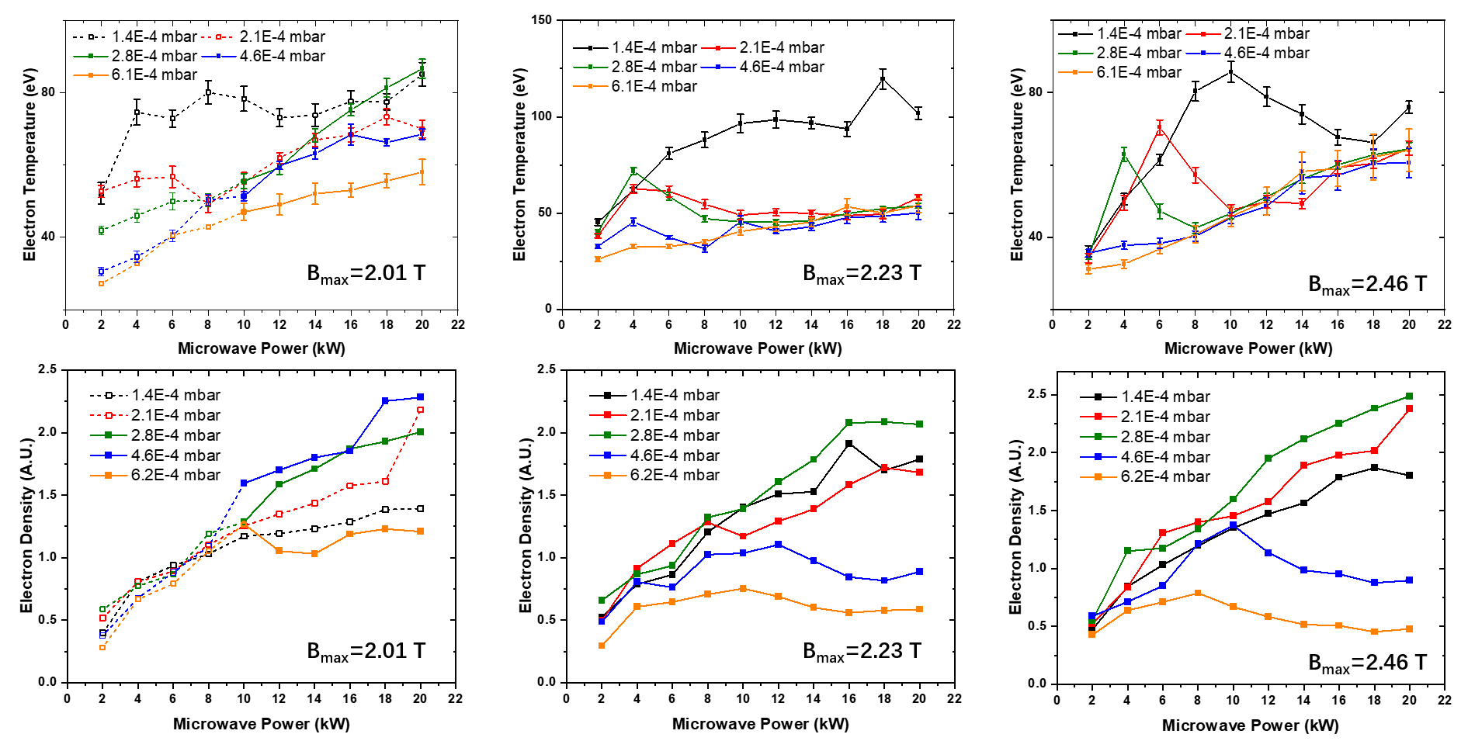
Influence of microwave power on T_{e} & n_{e}
Both T_{e} and n_{e} tend to saturate with the increasing P_{MW}, even decline for further increasing power.
Relatively low pressure is favorable for electron heating.
The T_{e} of 100 eV can be obtained.

Slide 14
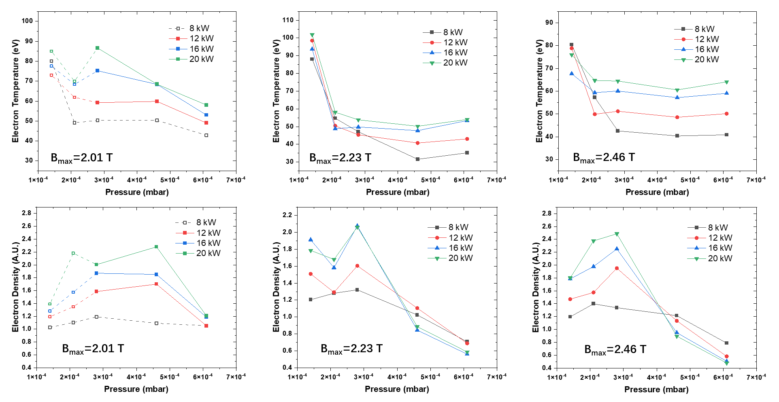
Influence of gas pressure on T_{e} & n_{e}
Electron temperature decreases with gas pressure.
Electron density increases with pressure at first, then decreases with pressure.

Slide 15
Influence of B_{z} on n_{e}
P_{chamber}=2.8×10⁻⁴ mbar
Electron density increases with magnetic field.
No obvious pattern for electron temperature.

Slide 16
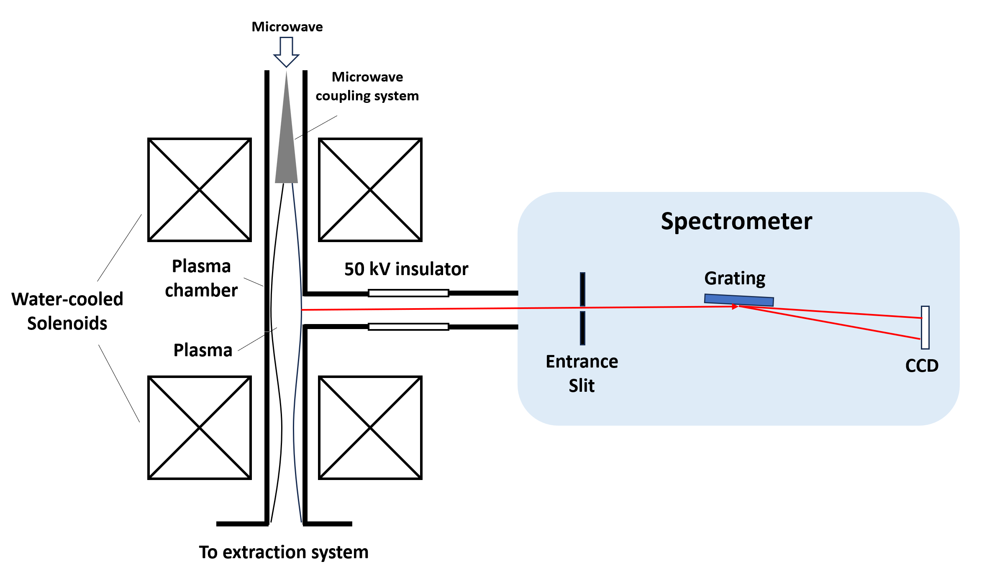
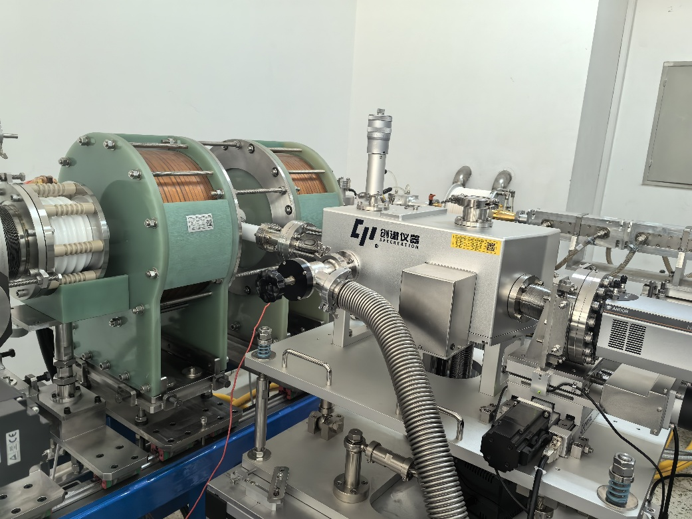

Spectroscopy @ EUV
EUV Spectrometer
Range: 1-5 nm and 5-20 nm
Groove density: 2400 grooves/mm and 1200 grooves/mm
Resolution: 0.042 nm @ 15.15 nm

Slide 17
Electron temperature diagnostics
The 5p-2s transition (12.46 nm) cannot be observed at low power or high gas pressure.
Cross-section data from: Itikawa Y, Hara S, Kato T, et al. Atomic Data and Nuclear Data Tables, 1985, 33: 149-193.

Slide 18
Influence of microwave power and pressure on T_{e}
The results are consistent with those from the leaking current measurements in terms of the value and trend of T_{e}

Slide 19
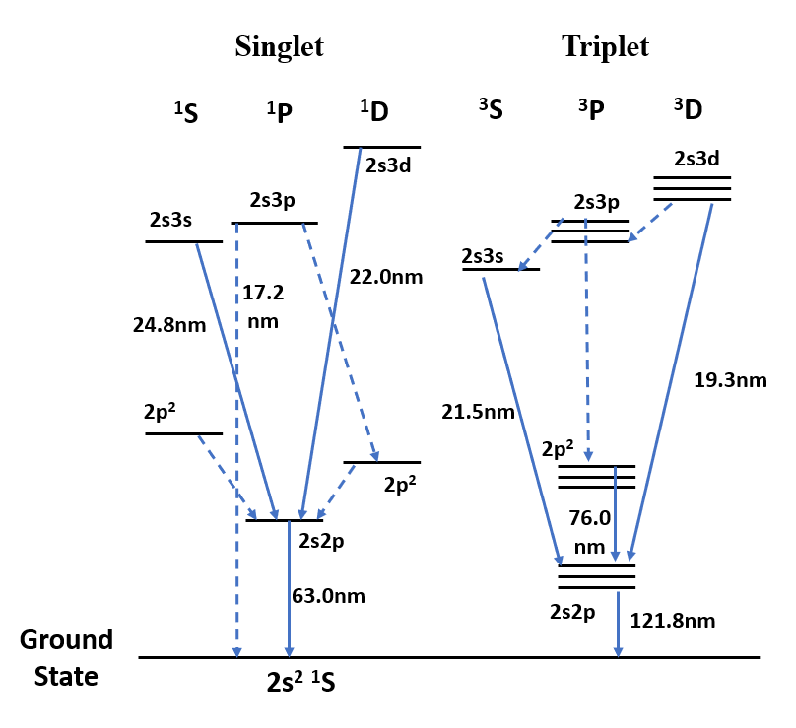
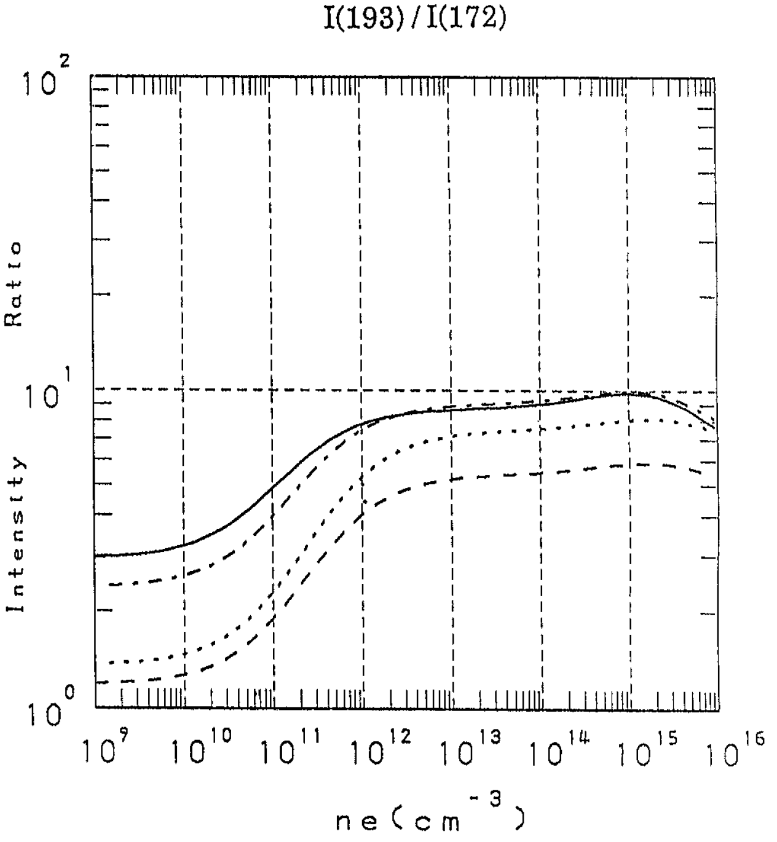
Electron density diagnostics
O⁴⁺
100 eV
20 eV
100 eV
40 eV
Dependence of n_{e} on gas pressure is similar to the result of the leaking current measurement.
The electron density approaches to 10¹³ cm⁻³ at medium pressure.
Kato T, Lang J, Berrington K E. Atomic Data and Nuclear Data Tables, 1990, 44(1): 133–187.

Slide 20
T_{e}, n_{e} dependence on P_{MW}, pressure and B
T_{e}
n_{e}

Slide 21
Summary and outlook
To meet the future requirements of HIAF on intense heavy ion beams, a gasdynamic ECR ion source has been being developed at IMP.
The beam intensity of hundreds of mA/cm² was obtained.
The electron temperature and density of the plasma were diagnosed with the measurements of the leaking current and EUV spectra.
The microwave transmission and feeding system and the extraction system need further optimizing to explore the capability of the ion source.
To get higher charge states, the electron temperature need increasing.

Slide 22
Thanks for your attention!

