Slide 1

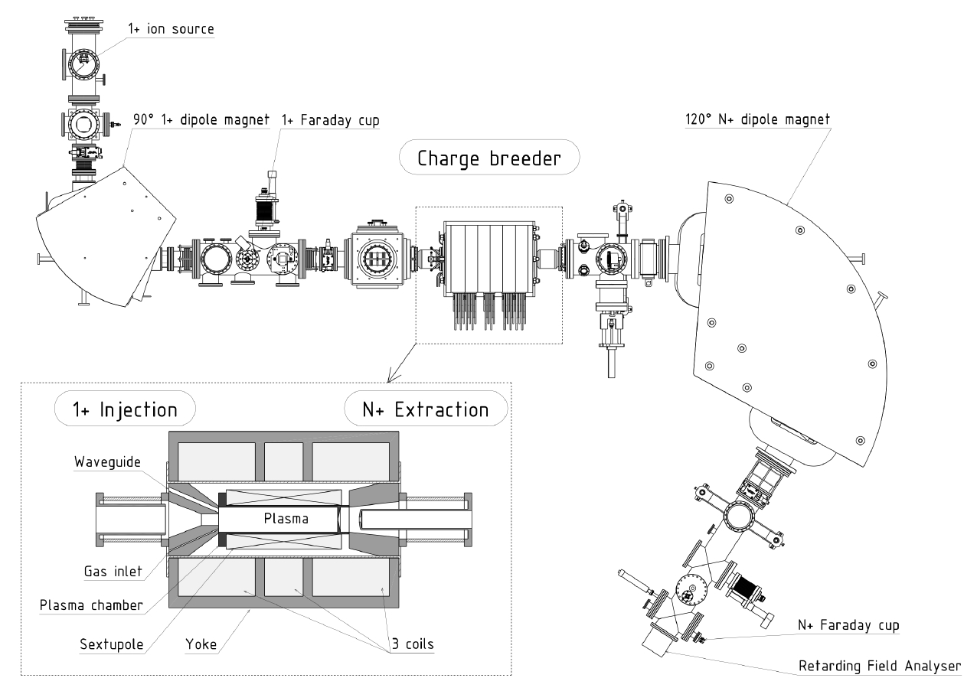
Numerical Analysis of the Influence of Plasma Parameters on The 1+ Beam capture in the ECR-Based Charge Breeder
A. Galatà¹, O.Tarvainen², J. Angot³, A. Pidatella⁴, B. Mishra⁴, C. S. Gallo¹, G. Torrisi⁴, D. Mascali⁴
¹INFN - Laboratori Nazionali di Legnaro, Legnaro (Padova), Italy
³ISIS Neutron and Muon Source, UK Science and Technology Facilities Council, Harwell Campus, United Kingdom
³Univ. Grenoble Alpes, CNRS, Grenoble INP, LPSC-IN2P3, Grenoble, France
⁴INFN - Laboratori Nazionali del Sud, Catania, Italy
LPSC TEST BENCH
NUMERICAL APPROACH
CHARACTERISTICS
Boris method to integrate the equation of motion
Langevin formalism for i-i collisions
Lotz formula for ionizations
Injection dynamics simulated with SIMION
N=10000 injected particles
T_{step}=10⁻¹⁰ s
T_{spam}= 500 µs
Oxygen plasma with <z>=3
Plasma Potential with Potential DIP
Potential profile following the magnetic field
COMPARISON EXPERIMENTS Vs SIMULATIONS
Rb EFFICIENCY FOR DIFFERENT PLASMA AND BEAM PARAMETERS
ANY PLASMA PARAMETER INCREASING THE IONS’ COLLISIONALITY LEAD TO AN INCREASE OF THE OPTIMUM INJECTION ENERGY
BY FIXING THE ION TEMPERATURE THE «EXTRA ENERGY» DOES NOT DEPEND ON THE VALUE OF THE PLASMA POTENTIAL
ION BEAM PARAMETERS AFFECT THE CAPTURE EFFICENCY. A HIGH ENERGY SPREAD LEADS TO A BROADER AND LOWER CAPTURE. THE SAME FOR A SMALLER INJECTED MASS, INFLUENCING ALSO THE OPTIMUM ENERGY.

