Slide 1
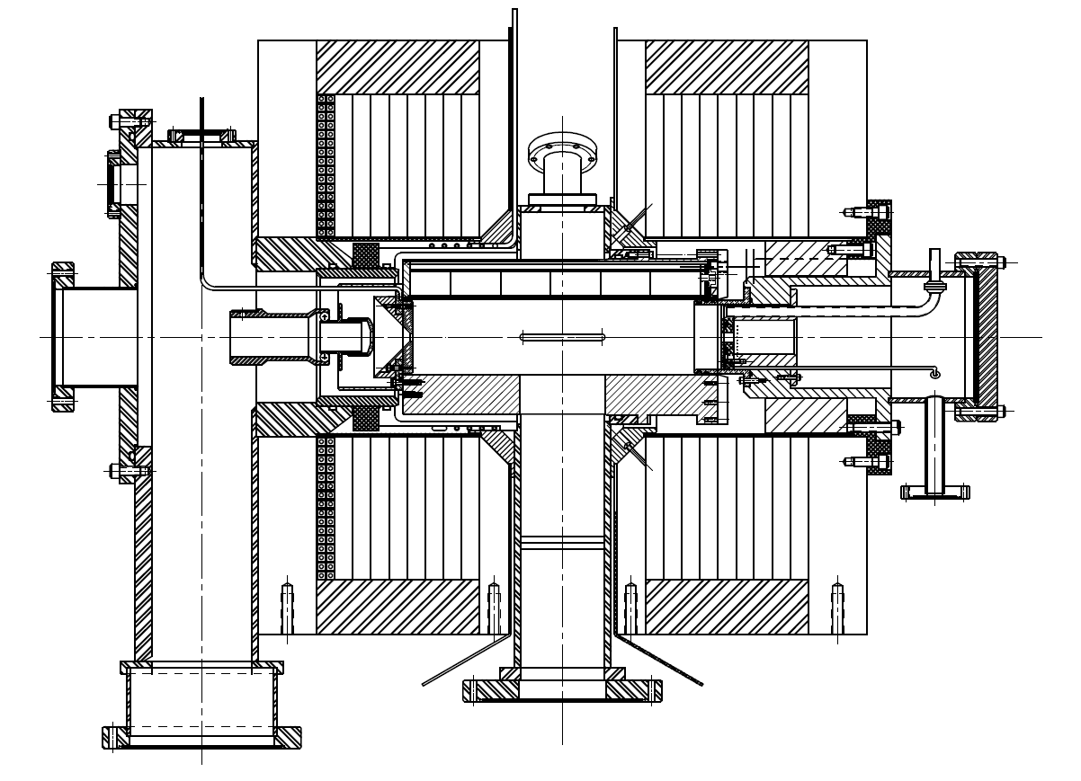

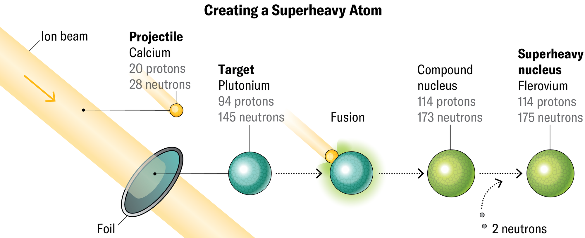


The role of ECR ion sources in superheavy element synthesis
Janilee Benitez
Lawrence Berkeley National Lab
ECR
Adapted from Source: https://www.scientificamerican.com/article/superheavy-elements-are-breaking-the-periodic-table/

Slide 2

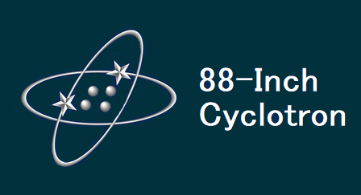
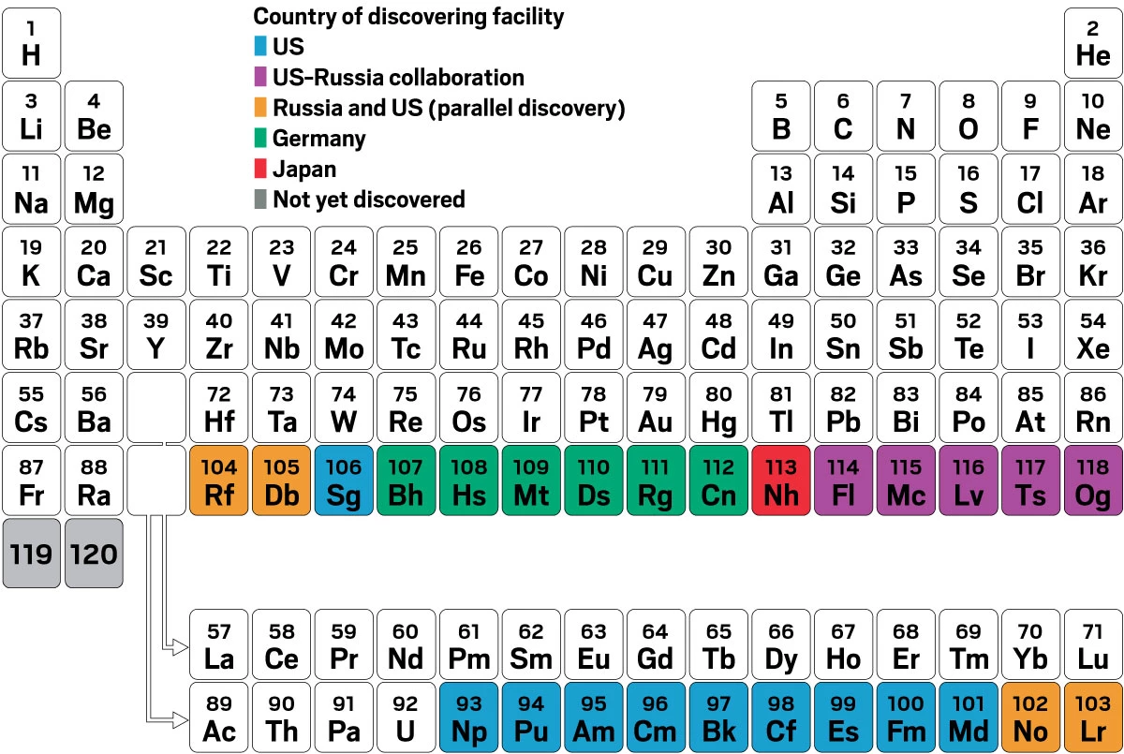
Why look for Superheavy Elements?
https://cen.acs.org/physical-chemistry/periodic-table/Japan-took-lead-race-discover/103/i2
Superheavy element (SHE) → Z ≥ 104
Not found in nature
National pride
Extend our understanding of nuclei and atoms with highest number of protons, neutrons, and electrons.
Synthesize new elements not previously observed and study their chemical properties
Stability and structure of nuclei at the limits of the periodic table
Generally, the half-lives of transactinides get progressively shorter as the z increases
mainly due to the increasing repulsion between the high number of protons
ICIS 2025 - Oxford, UK Janilee Benitez

Slide 3
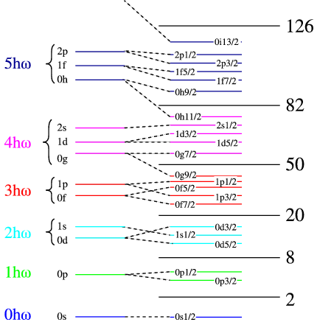
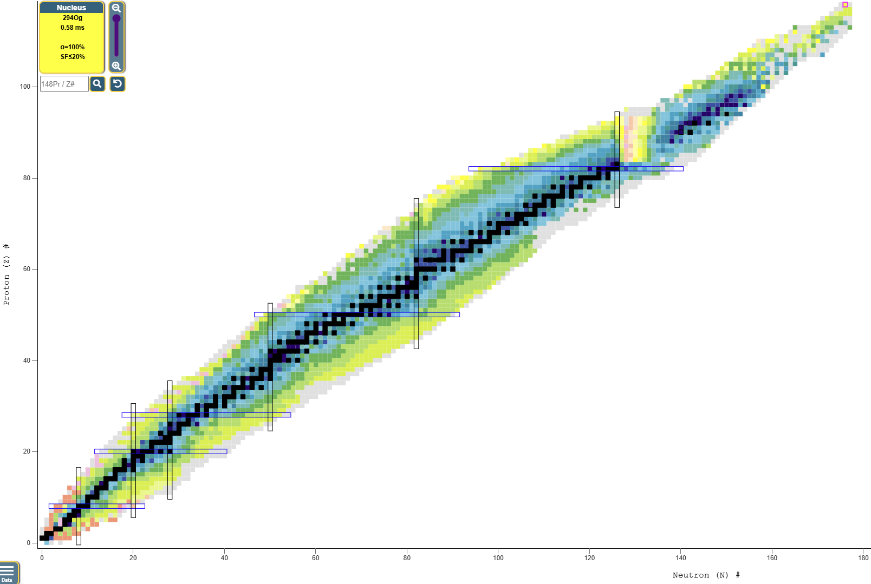
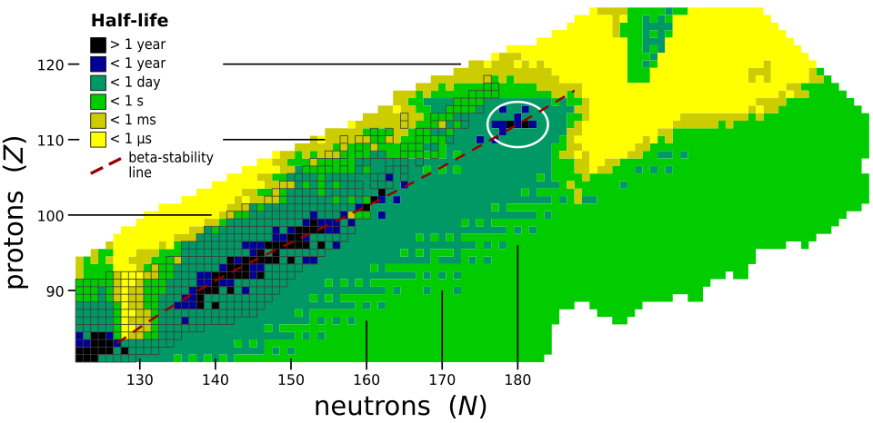
Why look for Superheavy Elements?
Island of Stability
Heavy isotopes with near magic number (closed shell) will reverse the decrease in stability
Theory that as you increase the mass towards these magic numbers, they will become more stable
Chart of the Nuclides
Og (118)
Island of Stability?
Proton #
Source: https://en.wikipedia.org/wiki/Island_of_stability
Source: https://www.nndc.bnl.gov/nudat3/
Neutron #
ICIS 2025 - Oxford, UK Janilee Benitez

Slide 4
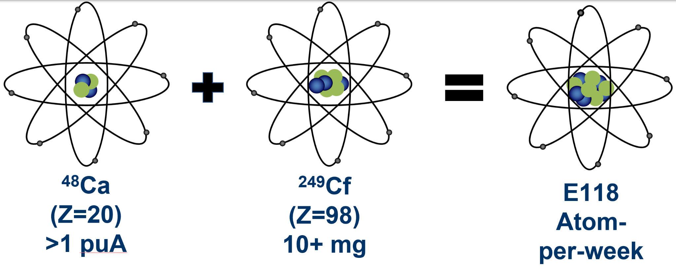

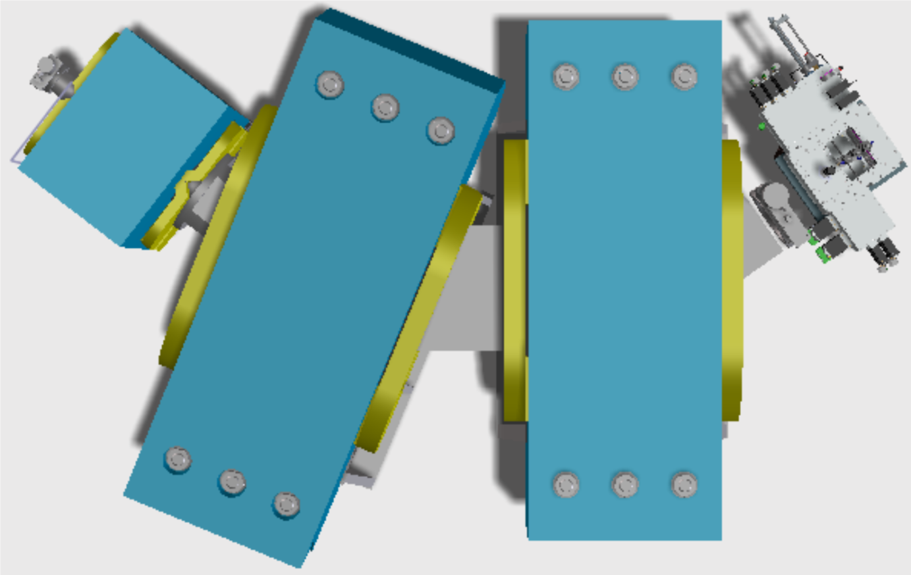
Making Superheavy Elements
Production
Detection (ex: Berkeley Gas-Filled Separator)
Everything recoils into the BGS
Beam and unwanted reaction products bend more and then crash into walls
Superheavy elements directed to a detector
target
Challenges
They are radioactive with short half-lives
To produce one nucleus of a SHE the target foil typically must be bombarded with a billion billion projectiles
ICIS 2025 - Oxford, UK Janilee Benitez

Slide 5









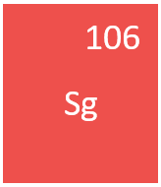

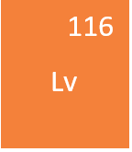

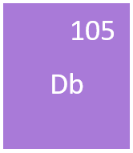
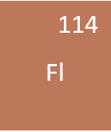
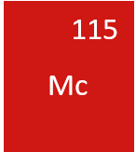
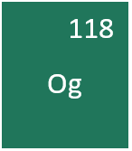
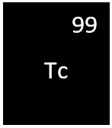

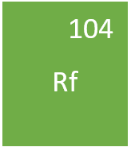

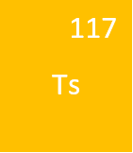

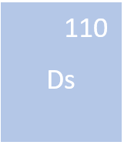
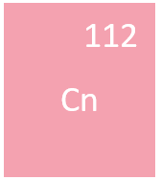
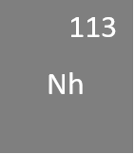
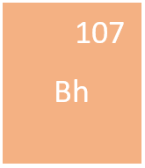
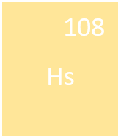
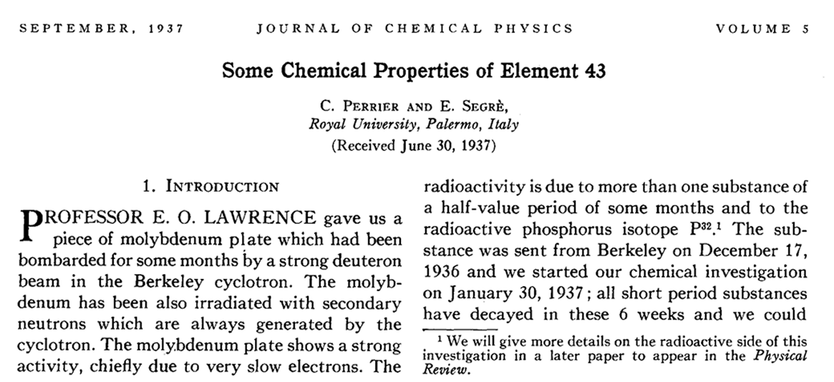
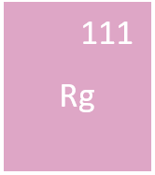


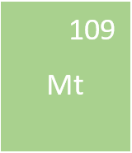

Some History: SHE Discovery
⁴⁸Ca:
doubly magic with 20 protons and 28 neutrons
Neutron rich makes elements more stable
First artificially created element
Livermorium
LBL created 116 using ⁵⁰Ti, precursor to 120; estimate creating an atom in 220 days
Flerovium
Moscovium
1974
1999
2006
2010
1964
1968
1982
1996
2001
1937
1981
1984
1994
2004
Nihonium
ICIS 2025 - Oxford, UK Janilee Benitez

Slide 6



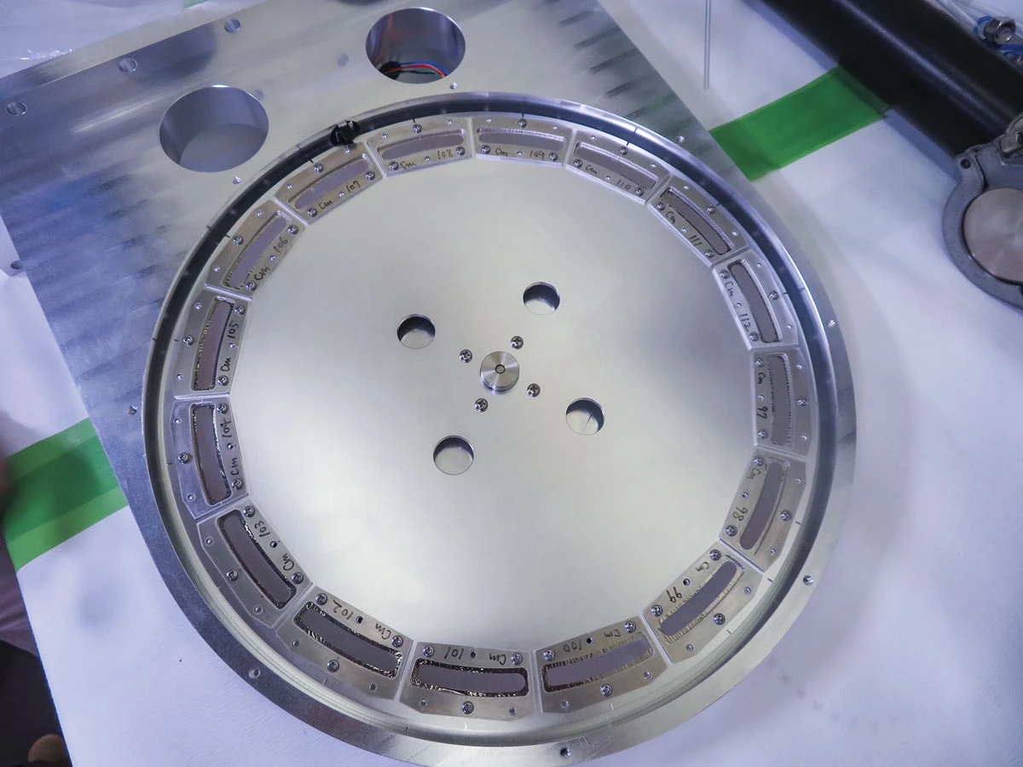



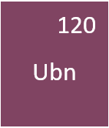



Looking for 119 and 120
Es production very slow → cannot use ⁴⁸Ca
Riken using ⁵¹V
IMP and JINR will use several combinations
Riken’s aluminum target wheel with 16 curium oxide target samples
cannot make Fm target → cannot use Ca
LBL and JINR will use ⁵⁰Ti
Rotates ~ 2,000 times per minute
Reaches temperatures 500-1000°C
Source: https://cen.acs.org/physical-chemistry/periodic-table/Japan-took-lead-race-discover/103/i2
ICIS 2025 - Oxford, UK Janilee Benitez
Notes:
SRILAC: superconducting RIken linear accelerator

Slide 7
Summary of SHE Production
Element |  | Facility | Source | Beam | Target | Year
104 | Rutherfordium (Rf) | JINR, LBNL | PIG | ²²Ne, ¹²C | ²⁴²Pu, ²⁴⁹Cf | 1964
105 | Dubnium (Db) | JINR, LBNL | PIG | ²²Ne, ¹⁵N | ²⁴³Am, ²⁴⁹Cf | 1968
106 | Seaborgium (Sg) | LBNL ,JINR | PIG | ¹⁸O (⁵⁴Cr) | ²⁴⁹Cf (Pb) | 1974
107 | Bohrium (Bh) | GSI | PIG | ⁵⁴Cr | ²⁰⁹Bi | 1981
108 | Hassium (Hs) | GSI | PIG | ⁵⁸Fe | ²⁰⁸Pb | 1984
109 | Meitnerium (Mt) | GSI | PIG | ⁵⁸Fe | ²⁰⁹Bi | 1982
110 | Darmstadtium (Ds) | GSI | CAPRICE ECR | ⁶²Ni | ²⁰⁸Pb | 1994
111 | Roentgenium (Rg) | GSI | CAPRICE ECR | ⁶⁴Ni | ²⁰⁹Bi | 1994
112 | Copernicium (Cn) | GSI | CAPRICE ECR | ⁷⁰Zn | ²⁰⁸Pb | 1996
113 | Nihonium (Nh) | Riken | 18 GHz ECRIS | ⁷⁰Zn | ²⁰⁹Bi | 2004
114 | Flerovium (Fl) | JINR | ECR4M | ⁴⁸Ca | ²⁴⁴Pu | 1999
115 | Moscovium (Mc) | JINR | ECR4M | ⁴⁸Ca | ²⁴³Am | 2004
116 | Livermorium (Lv) | JINR (LBNL*) | ECR4M | ⁴⁸Ca (⁵⁰Ti) | ²⁴⁸Cm (²⁴⁴Pu) | 2001
117 | Tennessine (117) | JINR | ECR4M | ⁴⁸Ca | ²⁴⁹Bk | 2010
118 | Oganesson (118) | JINR | ECR4M | ⁴⁸Ca | ²⁴⁹Cf | 2006
119 |  |  | AN ECR
120 |  |  | AN ECR
Electron Cyclotron Resonance Ion Sources
(ECRs)
*later production date
ICIS 2025 - Oxford, UK Janilee Benitez
Notes:
106 HILAC
105 88inch Giorso
Add one liner

Slide 8
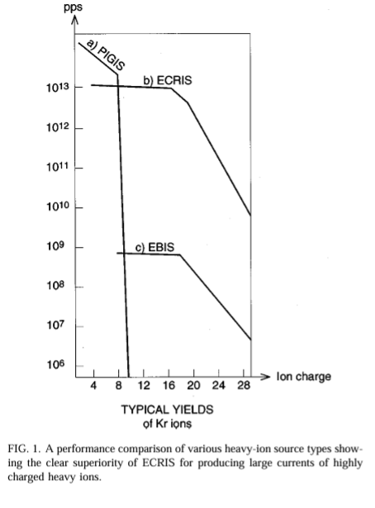
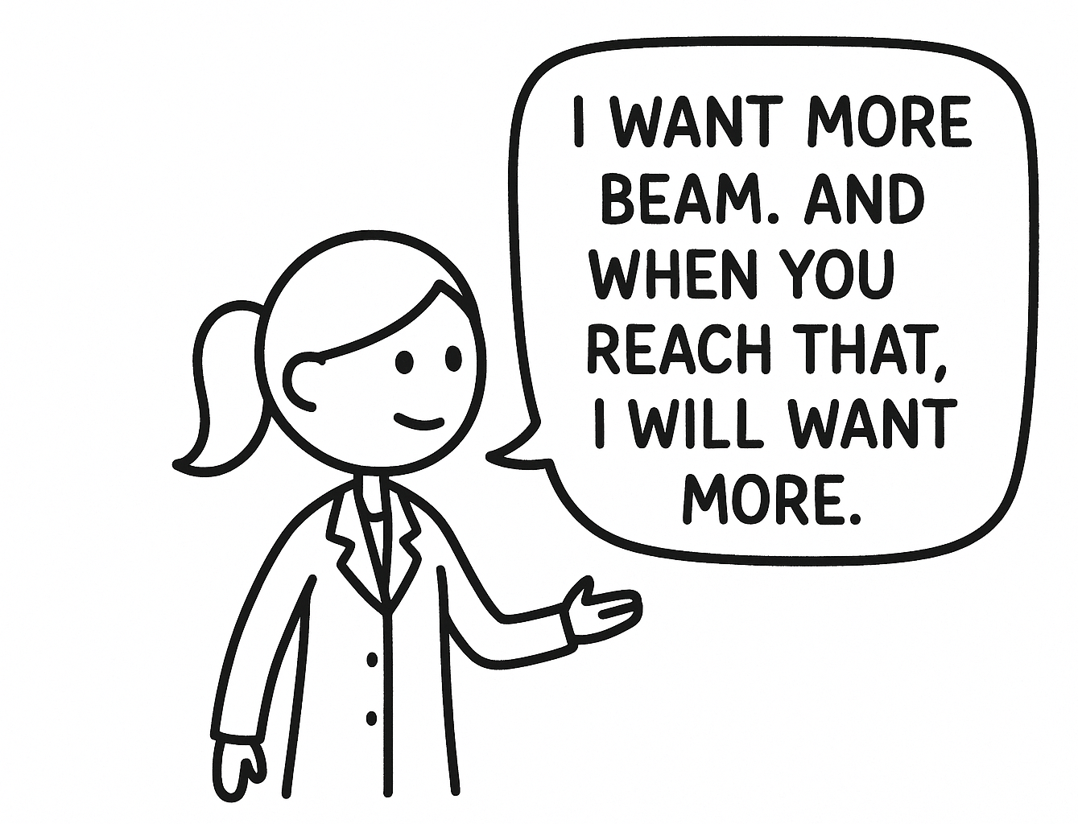
ECR Advantages & Challenges
Advantages
Production from gas or solid material
Long term performance
High charge states (E_{cyc}∝ Q²)
Low consumption rates as isotopes are expensive, need neutron rich isotopes (1g of 48Ca is $250k $450k)
Challenges
Production from gas or solid material
Long term stable performance
Appropriate, working production method
Limited accelerator and development time
Source: Rev. Sci. Instrum. 70 4737–4738 (1999)
ICIS 2025 - Oxford, UK Janilee Benitez

Slide 9
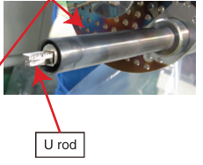
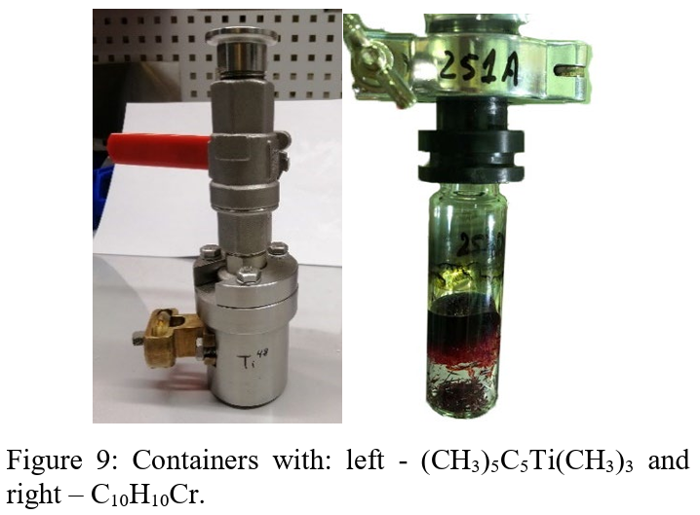
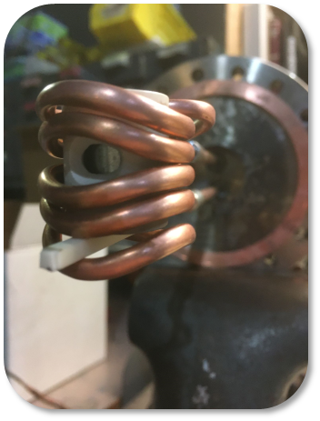
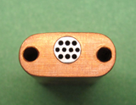
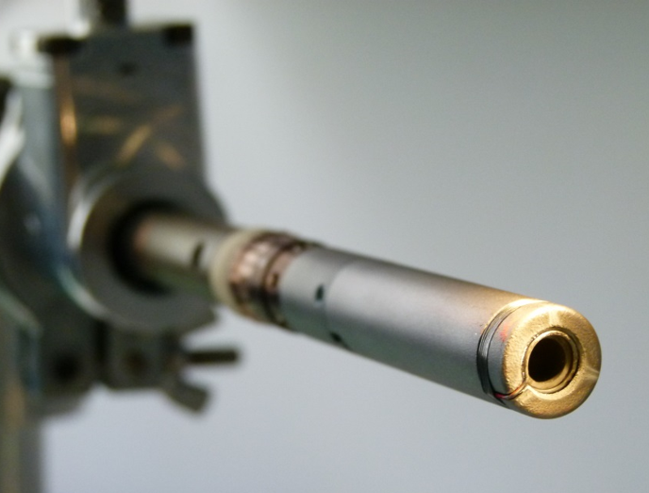
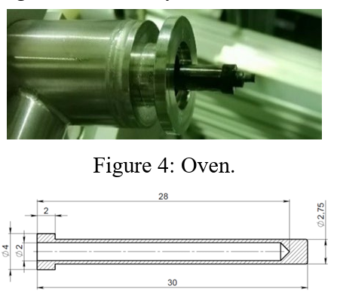
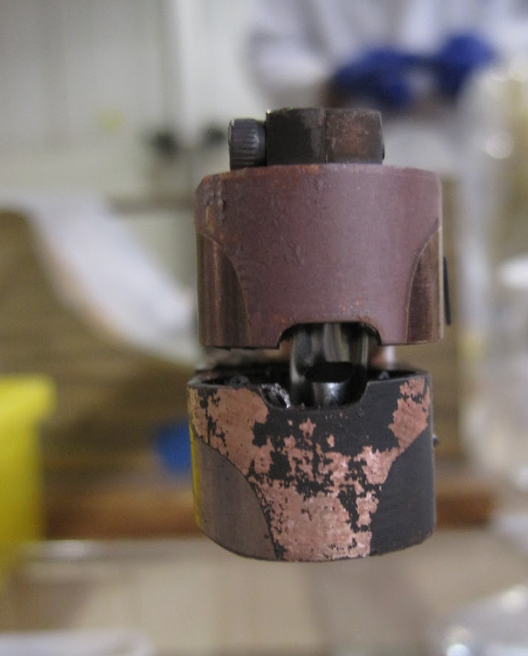
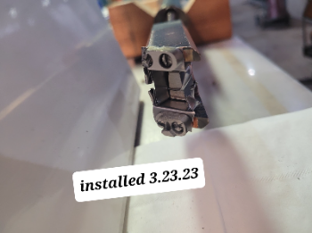
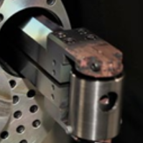
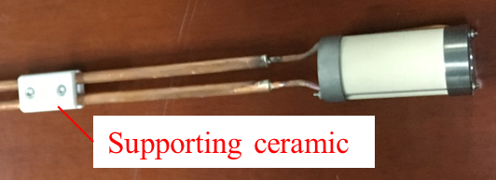
Metal Beam Production by an ECR
ECR
Sputter Probe or Insertion Rod
MIVOC
Low Temp Oven
High Temp Oven
Inductive Oven
Stemmed Oven
Boat
ICIS 2025 - Oxford, UK Janilee Benitez

Slide 10
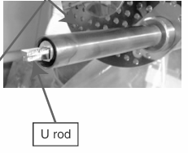
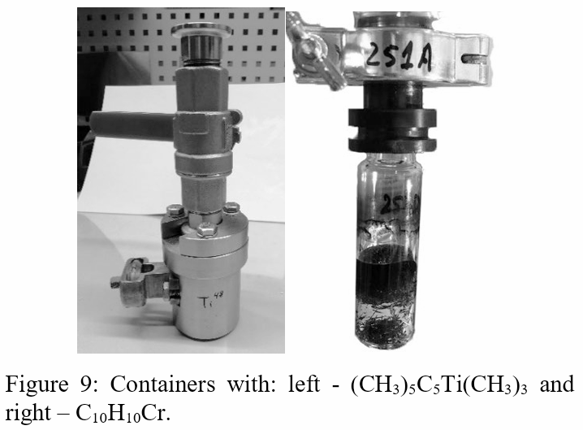
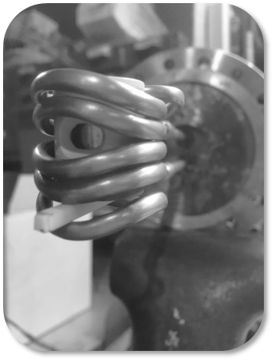
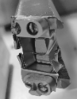
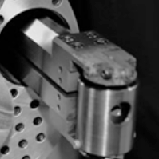
Metal Beam Production by an ECR
⁴⁸Ca:
Elemental Calcium (500°C)
Calcium Oxide (1100°C)
Calcium Oxide + Al or Zr (1300°C)
ECR
Sputter Probe or Insertion Rod
MIVOC
Low Temp Oven
High Temp Oven
Inductive Oven
Stemmed Oven
Boat
ICIS 2025 - Oxford, UK Janilee Benitez
Notes:
Didnt include laser ablation and arc sputtering
Three different methods to produce calcium: heating of elemental calcium (500C), heating calcium oxide (1100C), heating a mixture of calcium and aluminum or zirconium (reaction temperature ~1300C)

Slide 11
Beams for SHE
ECR
Sputter Probe or Insertion Rod
MIVOC
Low Temp Oven
High Temp Oven
Inductive Oven
ICIS 2025 - Oxford, UK Janilee Benitez

Slide 12
Current Efforts Towards Beam Production for SHE Searches
Ca, Cr, Mn, Ti
ICIS 2025 - Oxford, UK Janilee Benitez
Notes:
106 HILAC
105 88inch Giorso
Add one liner

Slide 13


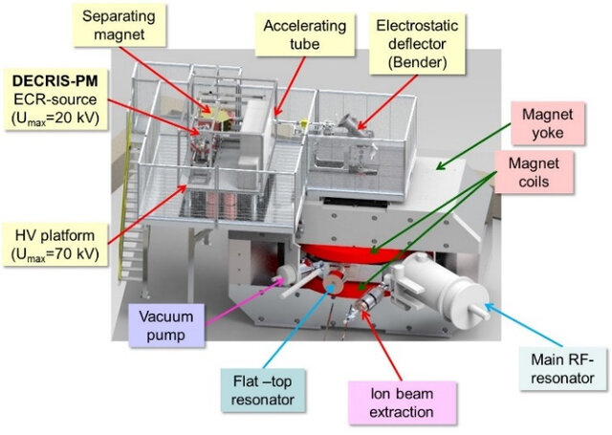
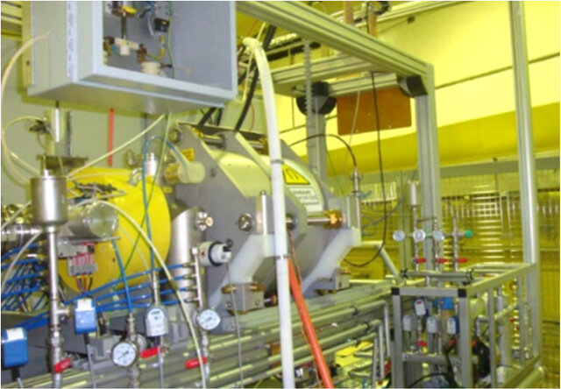
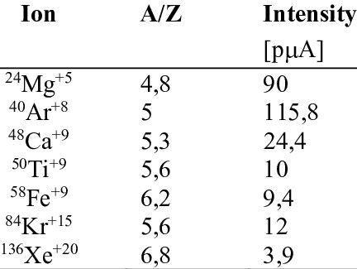
JINR Dubna, Russia
Joint Institute for Nuclear Research
Superheavy element factory (14 GHz DECRIS-PM + DC280 cyclotron)
1st experiment 2020, have produced SHE 115
Work towards synthesis of SHE > 118 using ⁵⁰Ti and ⁵⁴Cr with ²⁴⁸Cm, ²⁴⁹Bk, and ²⁴⁹⁻²⁵¹Cf isotopes
Superheavy Element Factory
14 GHz DECRIS-PM
14 GHz DECRIS-PM Performance
920
ICIS 2025 - Oxford, UK Janilee Benitez
Notes:
All permanent magnet to reduce power consumption
24 segment hexapole with halbach structure

Slide 14
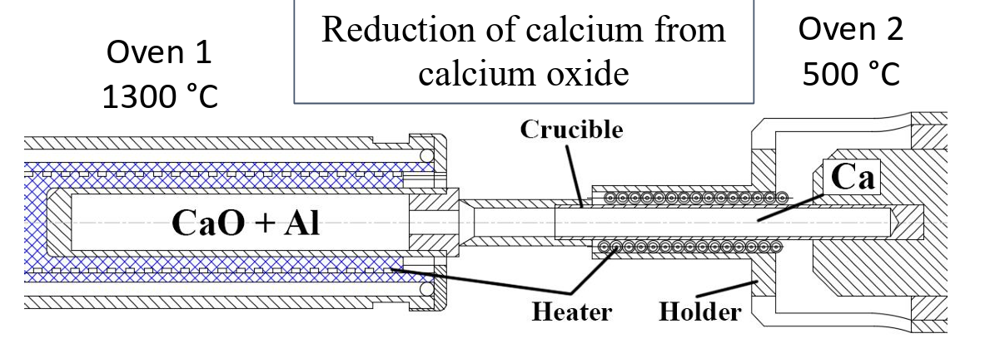
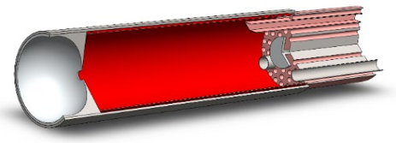

JINR Dubna, Russia
⁴⁸Ca Production
⁴⁸Ti, ⁵²⁻⁵⁴Cr Production
100 mg capacity
Source is run with a SS liner to facilitate C contamination cleaning
As of 2021, operational value not reached for Ti
C₁₀H₁₀Cr
(CH₃)₅C₅Ti(CH₃)₃
⁴⁸Ca¹⁰⁺ in Micro-oven + Ta screen
Production of ⁴⁸Ca¹⁰⁺ | 80 euA
Total Efficiency | 16%
Efficiency into ⁴⁸Ca¹⁰⁺ | 5%
Consumption | 0.67 mg/h
⁴⁸Ti^{10+/7+} in MIVOC
Production of ⁴⁸Ti¹⁰⁺/Ti⁷⁺ | ~30 euA/~115 euA
Total Efficiency | 15%/20%
Efficiency into ⁴⁸Ti¹⁰⁺ | 1.5%
Consumption | 0.55-0.67 mg/h
⁵²Cr¹⁰⁺ in MIVOC
Production of ⁵²Cr¹⁰⁺ | ~80 euA
Total Efficiency | 10%
Efficiency into ⁵²Cr¹⁰⁺ | 2%
Consumption | 0.55-0.67 mg/h
Sources: https://jacow.org/rupac2021/papers/tupsb36.pdf
doi:10.18429/JACoW-ECRIS2020-MOZZO01
ICIS 2025 - Oxford, UK Janilee Benitez

Slide 15





GSI Darmstadt, Germany
Long history of element production
Facility for Antiproton and Ion Research (FAIR) accelerator facility under construction
SHE group requested development of Ti, Cr, Ca, Mn
Current GSI Accelerator Facility
14.5 GHz CAPRICE
14.5 GHz CAPRICE
Performance
ICIS 2025 - Oxford, UK Janilee Benitez
Notes:
Fair is under construction. Shown is the current facility

Slide 16



GSI Darmstadt, Germany
Standard or High Temperature Oven
⁵⁰Ti⁸⁺ in High Temperature Oven
Production of ⁵⁰Ti⁸⁺ | 70*/90**euA
Consumption | 3.6 mg/h
CAPRICE
8.1mg/hr
⁵⁵Mn⁹⁺ in STO + Liner
Production of ⁵⁵Mn⁹⁺ | 70*/80**euA
Consumption | 8.1 mg/h
CAPRICE
⁴⁸Ca¹⁰⁺ in STO + Liner
Production of ⁴⁸Ca¹⁰⁺ | 80*/140** euA
Total Efficiency | 43% (3+ to 11+)
Efficiency into ⁴⁸Ca¹⁰⁺ | 12.6%
Consumption | 0.2-0.5 mg/h
CAPRICE
Key Takeaways:
Parasitic heating through oven orifice causes instabilities; solved with a mesh cover
⁵⁴Cr¹⁰⁺ in STO + Liner
Production of ⁵⁴Cr¹⁰⁺ | 40*/50** euA
Consumption | 8.0 mg/h
CAPRICE
See Poster:
“Hot Liner for the Production of Metallic Ion Beams at GSI” by F. Maimone, et al.
ICIS 2025 - Oxford, UK Janilee Benitez
*average
**peak

Slide 17




IMP Lanzhou, China
China Accelerator Facility for Superheavy Elements (CAFE2) (18 GHz LECR5 , 28 GHz SECRAL-III + RFQ LINAC)
Work towards synthesis of SHE 119 using ⁵⁵Mn and ⁵⁴Cr
18 GHz LECR5
28 GHz SECRAL-III
ICIS 2025 - Oxford, UK Janilee Benitez

Slide 18



IMP Lanzhou, China
Work towards synthesis of SHE 119 using ⁵⁵Mn and ⁵⁴Cr
18 GHz LECR5
850°C
⁴⁰Ca¹³⁺ in Inductive Oven
Production of ⁴⁰Ca¹³⁺ | 30-40 euA/235 euA
Total Efficiency | 2.82%
Consumption | 0.86mg/hr
1100°C
⁵⁴Cr¹⁷⁺ in Inductive Oven
Production of ⁵⁴Cr¹⁷⁺ | 40 euA
Key Takeaways:
Mixing gas very important
Used N₂ for Cr and Mn
650°C
⁵⁵Mn¹⁵⁺ in Inductive Oven
Production of ⁵⁵Mn¹⁷⁺ | 40 euA
Sources: personal communication,
W. Lu, et. al, Nuclear Instruments and Methods in Physics Research A 1062 (2024)
ICIS 2025 - Oxford, UK Janilee Benitez
High Intensity Heavy-ion Accelerator Facility (HIAF) will need 50+puA of U>40+

Slide 19




RIKEN, Japan
RIKEN Nishina Center for Accelerator-based Science
(28 GHz R28G-K + SRILAC)
Work towards synthesis of SHE 119 using ⁵¹V
ICIS 2025 - Oxford, UK Janilee Benitez
Notes:
RIKEN 28-GHz
R28G-S: for RILAC II (RIBF)
R28G-K for RILAC (SHE)
GARIS3: gas-filled recoil separator used to detect residuals of the hot-fusion reaction

Slide 20





RIKEN, Japan
Stemmed Resistive HT Oven
Key Takeaways:
Extensive development of HT oven
Flakes caused instabilities and beam reduction of 10%
Anti-deposition shield around oven helps with consumption and stability
⁵¹V¹³⁺ in High Temperature Oven
Production of ⁵¹V¹³⁺ | 150*/~1000** euA
Efficiency into ⁵¹V¹³⁺ | 1%
Consumption | mg/h
Source: PIBHI, April 2025
“Beam reliability, reproducibility and stability issues”
T. Nagatomo
*average
**peak
ICIS 2025 - Oxford, UK Janilee Benitez
Notes:
PIBHI25

Slide 21


LBNL Berkeley, USA
Berkeley Gas Filled Separator (28 GHz VENUS + 88-Inch Cyclotron)
Made 116 using ⁵⁰Ti
Work towards synthesis of SHE 120 using ⁵⁰Ti
28 GHz VENUS
ICIS 2025 - Oxford, UK Janilee Benitez
Notes:
By removing the requirement of doubly magic nuclei, the work opens up new paths to producing elements beyond element 118.

Slide 22


LBNL Berkeley, USA
Subject to Lorentz forces at high magnetic fields! Similar to stemmed oven.
⁵⁰Ti¹²⁺ in Inductive oven
Production of ⁵⁰Ti¹²⁺ | 100-150 euA
Efficiency into ⁵⁰Ti¹²⁺ | 0.58 %
Consumption | 2.5-5 mg/h
⁴⁸Ca¹¹⁺ in Low Temp oven
Production of ⁴⁸Ca¹¹⁺ | 75-100 euA
Total Efficiency | 16%
Efficiency into ⁴⁸Ca¹¹⁺ | 5%
Consumption | 0.27 mg/h
⁵¹V¹³⁺ in Boat Oven
Production of ⁵¹V¹³⁺ | ~230 euA
Efficiency into ⁵¹V¹³⁺ | 1 %
Consumption | 1.7 mg/h
Key Takeaways:
Vertical, aiming oven inductive oven
Liner in VENUS did not help; why?
ICIS 2025 - Oxford, UK Janilee Benitez

Slide 23
Summary of Current ECR Effort for SHE
There are several ways to produce same beam.
We can learn from our ECR colleagues.
Facility | Current Needed at Target | ECR | Method | Production at source To-Date | Beam on target
Dubna, Russia | ⁴⁸Ca | DECRIS-PM (14 GHz) | Micro-oven | ⁴⁸Ca¹⁰⁺ ~230euA** @ | source to target ~50%
 | ⁵⁰Ti | DECRIS-PM (14 GHz) | MIVOC | ⁴⁸Ti¹⁰⁺/⁴⁸Ti⁷⁺ ~30 euA/115 euA
 | ⁵²Cr | DECRIS-PM (14 GHz) | MIVOC | ⁵²Cr¹⁰⁺ ~80 euA
GSI, Germany | ⁵⁴Cr¹⁰⁺ | CAPRICE (14.5 GHz) | Standard Temperature Oven | ⁵⁴Cr¹⁰⁺ 40 euA , 50*euA @
 | ⁵⁵Mn⁹⁺ | CAPRICE (14.5 GHz) | Standard Temperature Oven | ⁵⁵Mn⁹⁺ 70 euA, 80*euA @
 | ⁵⁰Ti⁸⁺ | CAPRICE (14.5 GHz) | High Temperature Oven | ⁵⁰Ti⁸⁺ 70 euA, 90*euA
 | ⁴⁸Ca¹⁰⁺ | CAPRICE (14.5 GHz) | Standard Temperature Oven | ⁴⁸Ca¹⁰⁺ 80 euA, 140*euA @
IMP CAFE2 (RFQ/linac), China | 1-5 puA ⁵⁴Cr17+ | LECR5 (18 GHz) | Inductive Oven | ⁵⁴Cr¹⁷⁺ 40 euA
 | 1-5puA 48Ca¹⁴⁺ | LECR5 (18 GHz) | Inductive Oven | ⁴⁰Ca¹¹⁺ 235 euA**
 | 1-5puA ⁵⁵Mn¹⁷⁺ | LECR5 (18 GHz) | Inductive Oven | ⁵⁵Mn¹⁵⁺ 105 euA
LBL 88” Cyclotron, USA | 2 puA V | VENUS (28 GHz) | Boat Oven | ⁵¹V¹³⁺ 231 euA | ⁵¹V¹²⁺ 20 euA out of 119 euA
 | 2 puA Ca | VENUS (28 GHz) | Low Temperature Oven | ⁴⁰Ca¹¹⁺ 854 euA | ⁴⁸Ca¹¹⁺ 23 euA out of 132 euA
 | 2 puA Ti | VENUS (28 GHz) | Inductive Oven | ⁵¹Ti¹²⁺ 200euA | ⁵⁰Ti¹²⁺ 23.5 euA out of 178 euA
RIKEN, Japan | 11 puA ⁵¹V¹³⁺ | R28G-K (28 GHz) | Resistive Stemmed HTO | ⁵¹V¹³⁺ 150 euA-->1 mA
*max | @hot liner | **3CaO + 2Al →3Ca + Al₂O₃
ICIS 2025 - Oxford, UK Janilee Benitez
23

Slide 24

Summary
Thank you!
ECRs are reliable and provide advantages
Many facilities are working on production techniques and we can learn from each other!
Older facilities place a lot of weight on improvements at the ECR source
ECR development has and will continue to play an important role in SHE discovery
Acknowledgements for Material Included in Talk:
Rustam Berezov, Ralph Hollinger, Fabio Maimone, Takashi Nagatomo, Lianting Sun, Dmitriy Pugachev, Damon Todd
ICIS 2025 - Oxford, UK Janilee Benitez

Slide 25
References
A. Efremov, S. Bogomolov, V. Mironov, “The role of ion sources in synthesis of the super-heavy elements.” Rev. Sci. Instrum., 91 (1), 013314 (2020). DOI: 10.1063/1.5128172
V. B. Kutner et al. Review of Scientific Instruments, Vol. 71, No. 2, February 2000, pp. 860–862
“High Intensity Calcium, Chromium and Titanium Ion Beams from the Permanent Magnet ECR Ion Source DECRIS-PM.” RuPAC2021 Proceedings, November 2021. DOI: 10.18429/JACoW-RuPAC2021-TUPSB36
PRODUCTION OF 48Ca AND 48Ti ION BEAMS AT THE DC-280 CYCLOTRON. S. L. Bogomolov, D. K. Pugachev† , V. E. Mironov, A. A. Efremov, V. N. Loginov, A. N. Lebedev, A. E. Bondarchenko, K. I. Kuzmenkov
https://cen.acs.org/physical-chemistry/periodic-table/Japan-took-lead-race-discover/103/i2
https://www.nndc.bnl.gov/nudat3/
Rev. Sci. Instrum. 85, 02A961 (2014)
W. Lu, et. al, Nuclear Instruments and Methods in Physics Research A 1062 (2024) 169207
https://doi.org/10.1016/j.nima.2024.169207
Rev. Sci. Instrum. 70, 4737–4738 (1999) https://doi.org/10.1063/1.1150140
T. Nagatomo “28 GHz ECRIS results and development at RIKEN”PIBHI, Acitrezza, Italy April 2025
H. Koivisto, J. Arje, M. Nurmia “Metal ion beams from an ECR ion compounds“ Nuclear Instruments and Methods in Physics Research B 94 (1994) 291-296
Tinschert, K., Stöckli, M., Spädtke, P., & Lang, R. (2012). The CAPRICE ECR ion source at GSI: Status and development. Review of Scientific Instruments, 83(2), 02A333. https://doi.org/10.1063/1.3671737
ECRIS 2008 proceedings (https://proceedings.jacow.org/ecris08/papers/proceedings.pdf)
Tinschert, K., et al. (1998). Status report on ECR ion source operation at the GSI accelerator facilities. Review of Scientific Instruments, 69(2), 709. https://doi.org/10.1063/1.1148558
J.M. Gates et al., Towards the Discovery of New Elements: Production of Livermorium 9Z=116) with 50Ti. Phys. Rev. Lett. 133, 172502 (2024) DOI: https://doi.org/10.1103/PhysRevLett.133.172502
RIKEN Nishina Center for Accelerator-Based Science. (n.d.). The 113th element: Nihonium. RIKEN. Retrieved [Month Day, Year], https://www.nishina.riken.jp/research/113_e.html
T. Nakagawa, Development of ECR ion sources at Riken. RIKEN Accel. Prog. Rep. 50 (2017)
Heinz, S. (2024, October 21). A route toward the island of stability. Physics, 17, Article 150. https://doi.org/10.1103/Physics.17.150
ICIS 2025 - Oxford, UK Janilee Benitez

Slide 26
Abstract: The role of ECR ion sources in superheavy element synthesis
Superheavy element (SHE) research focuses on understanding the structure of the heaviest nuclei at the edges of the Island of Stability as well as the synthesis of new elements. Electron Cyclotron Resonance (ECR) ion sources are pivotal in this endeavor since superheavy elements (z>104) are produced by bombarding a target with an ion beam that is often produced by an ECR. The synthesis of these elements, their low lifetimes, and the low reaction cross-sections require intense ion beams of ⁴⁸Ca, ⁵⁰Ti, ⁵¹V, ⁵⁴Cr, and ⁵⁵Mn, for example. The need for high intensities, coupled with the low isotopic abundance of some of these metals, and thus low availability, requires efficient production methods and careful tuning. These beams are produced by an ECR using various methods that include low temperature ovens, resistively heated high temperature ovens, inductive ovens, sputter probes, and MIVOC. I will summarize the production methods and the results achieved by ECR ion sources around the world.
ICIS 2025 - Oxford, UK Janilee Benitez

