Slide 1
Developments for Target-Ion Sources at TRIUMF towards the ARIEL era
Friedhelm Ames, Carla Babcock, Luca Egoriti, Alexander Gottberg, Oliver Kester, Jens Lassen, Fernando Maldonado Millan, Navid Moori
ICIS 2025
Oxford
September 8-12, 2025

Slide 2
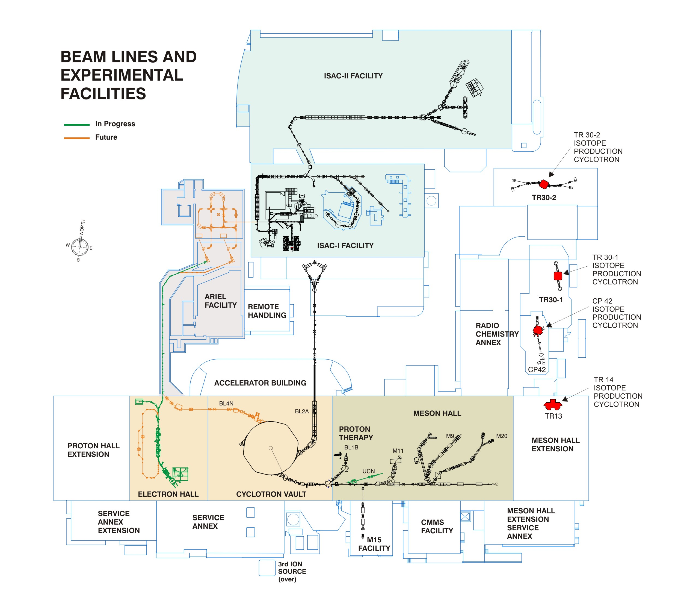
ISAC I and II
Isotope Separator and Acceleartor)
rare isotope beams up to 15 MeV/u
2 target stations for
up to 100 µA p beam @ 480 MeV
ECRIS charge state breeding
CANREB
high resolution
mass separation
EBIS charge state breeding
5 cyclotrons 13-30 MeV
for medical isotope production
For BWTX and IAMI
(Institute foe Advanced Medical
Isotopes)
ARIEL
(Advansed Rare IsotopE
Laboratory)
e-linac 30 MeV 10 mA
e⁻ and p⁺ target station
for rare isotope
beam production
500 MeV H⁻ cyclotron
up to 4 simultaneously
extracted p⁺ beams
individually variable energy
up to 120 μ A per beam line
Beam line 1
µSR experiments
isotope production
ultra cold neutron source
p and n irradiation
(p therapy)

Slide 3
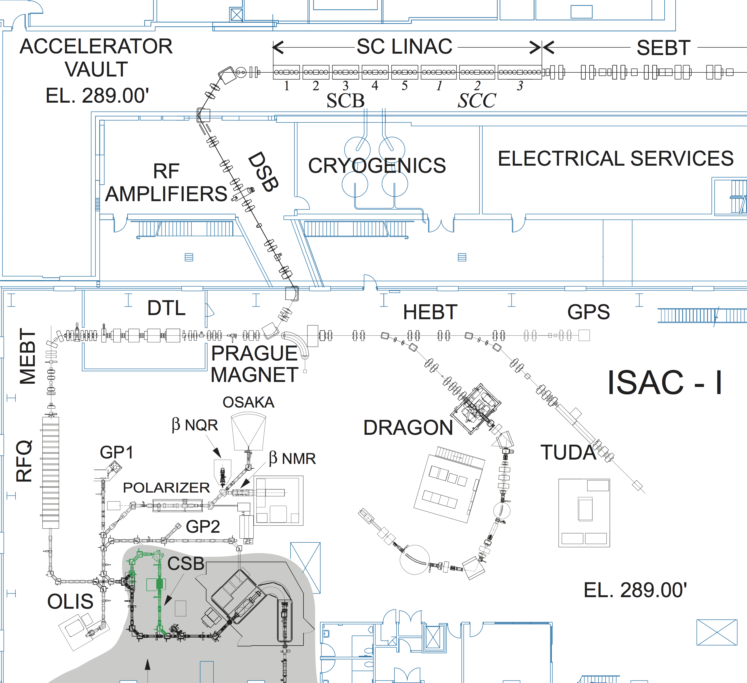
post acceleration
ISAC accelerator chain
RFQ: (radiofrequency quadrupole accelerator)
acceptance : A/q < 30 @ 2.04 keV/u
final energy: 150 keV/u
DTL: (drift tube linear accelerator)
acceptance A/q <7
final energy 1.5 MeV/u
superconducting LINAC:
acceptance A/q <7
final energy 15 MeV/u for A/q=3
A/q < 30 injection of 1+ ions < 60keV,
stripping after RFQ
A/q > 30 charge state breeding with ECRIS to A/q <7
stripping after DTL for higher energy or purification
Off-line ion source (OLIS) for setup and experiments
From ARIEL

Slide 4

Rare Isotope production (ISOL)
Dipole
magnet
Mass-separated
RIB
Cyclotron
To
potacceleration or experiments
RIB cocktail
Ion Source
480 MeV p⁺
Target

Slide 5
rare isotope beam (RIB) rate at experiment
R = N ∙ x ∙ σ ∙ I_{p} ∙ ε_{R} ∙ ε_{I} ∙ ε_{T} ∙ ε_{A}
N: target density
x: target length
σ: production cross section
I_{p}: primary beam current
ε_{R}: release efficiency ε_{R} = ε_{D} ε_{E} ( half life dependent)
ε_{D}: diffusion efficiency
ε_{E}: effusion efficiency
ε_{I}: ionization efficiency
ε_{T}: beam transport efficiency
ε_{A}: acceleration efficiency and charge state breeding

Slide 6
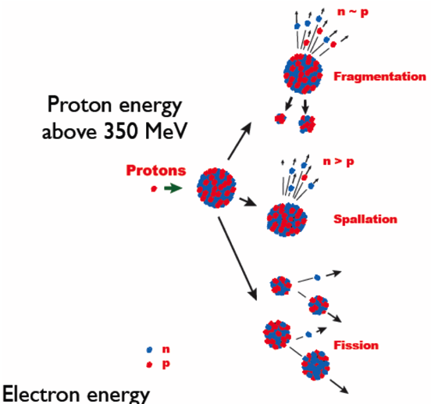
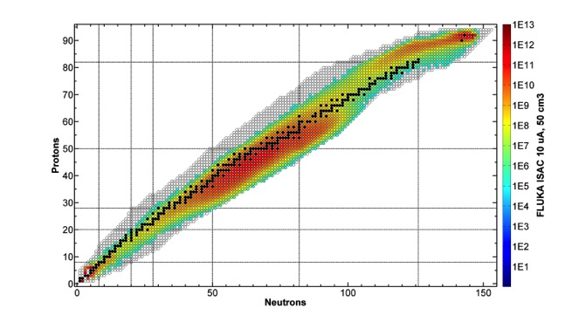
Production of radioactive isotopes with a proton beam driver
500 MeV Protons on UC_{x}

Slide 7
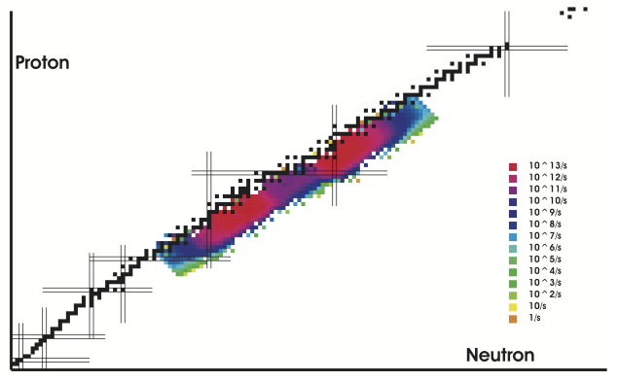
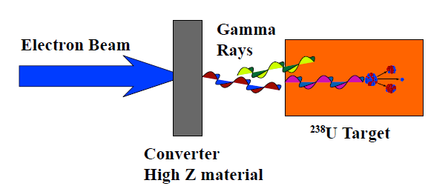
Production of radioactive isotopes with an electron beam driver
Photo fission of U
Maximum in cross section at γ energy ~10-15 Mev (giant dipole resonance)
γ photons produced from Bremsstrahlung of e beam impact on high Z material
Higher production for neutron rich isotopes, less for neutron deficient
  → higher purity
50MeV electrons

Slide 8
Target materials
Requirements for target materials
  High cross section to produce the desired isotope
  Chemically compatible with fast release of desired products
  Can be operated at high temperature
  High heat conductance to manage high power deposition
Target materials used at ISAC
  Refractory elements, metals (C, Nb, Ta, …)
      easy to handle, susceptible to radiation damage
  Carbides / Oxides (SiC, ZrC, TaC, UC, NiO, UO…)
      Stable during operation, chemically unstable in air, not compatible with all products or target container material (Ta)
  New developments
      (nanofiber materials)
        Potentially fast release due to reduced diffusion length
      p to n converter ( W rod )
        n induced fission in U

Slide 9
Requirements for ion sources for rare isotopes at ISAC
High ionization efficiency
  Only small amounts of desired isotopes are available
Fast ionization process
  For short lived isotopes
High reliability
  No or only limited maintenance is possible in high radiation areas
  Source cannot be repaired due to high contamination
Radiation hard
  Very high radiation fields
Operation at high temperature and on high voltage (up to 60 kV)
Element selectivity and purity of beams
  Production process is often not selective
  → isobar (chemical) selective processes are needed

Slide 10
Ion sources for rare isotopes at ISAC
Surface ion source
  Mainly used for elements with E_{i} < ~ 6 eV
Resonant Laser Ion Source (RILIS)
  Element selective ionization 5 eV <E_{i} < 10 eV
  Ion Guide Laser Ion Source (IGLIS) suppression of surface ions
Forced Electron Beam Induced Discharge ion source (FEBIAD)
  Mainly used for Gaseous elements, molecules

Slide 11
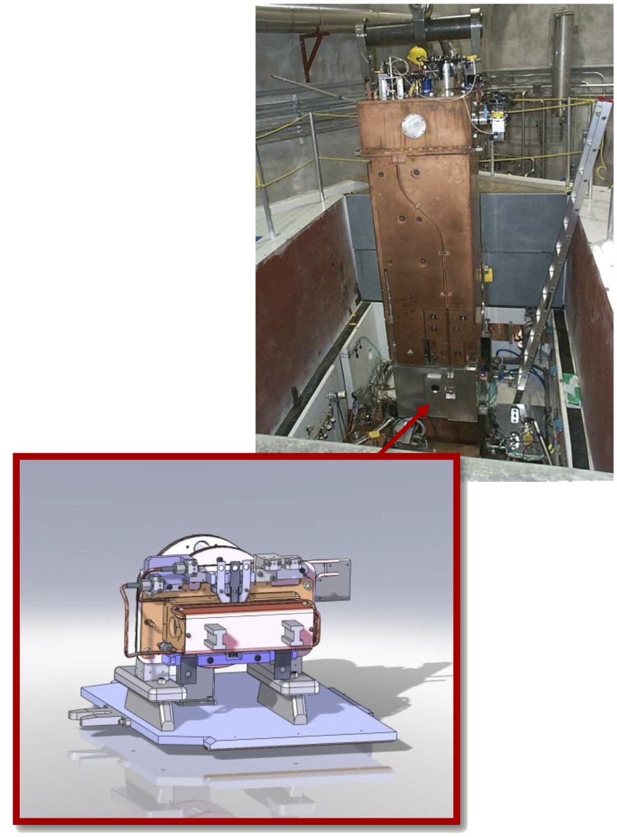
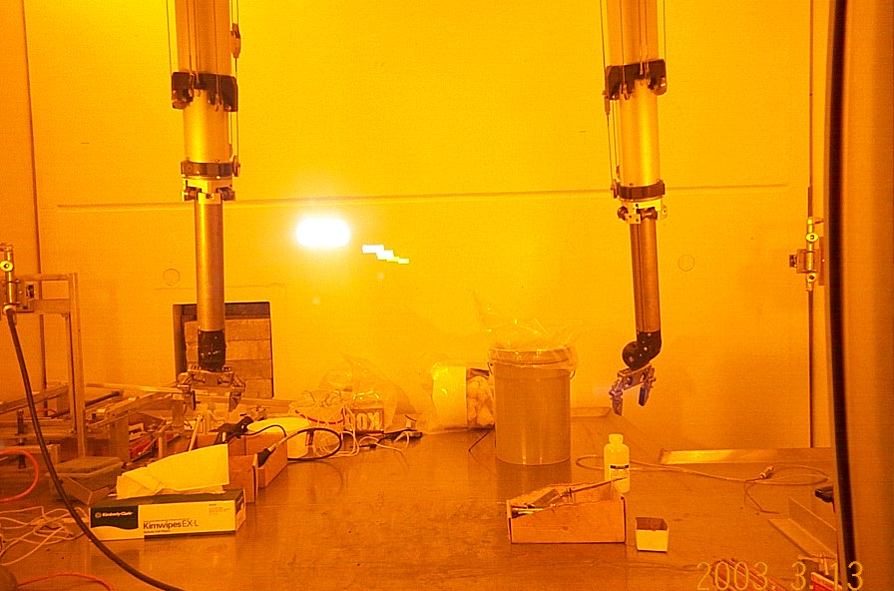
ISAC target station at TRIUMF
target at bottom of shield plug
no rad. sensitive components near to target
remote manipulations with crane and in hot-cell
2 target stations
  one operating while target exchange on other one
maximum proton current
  100 µA @ 480 MeV

Slide 12
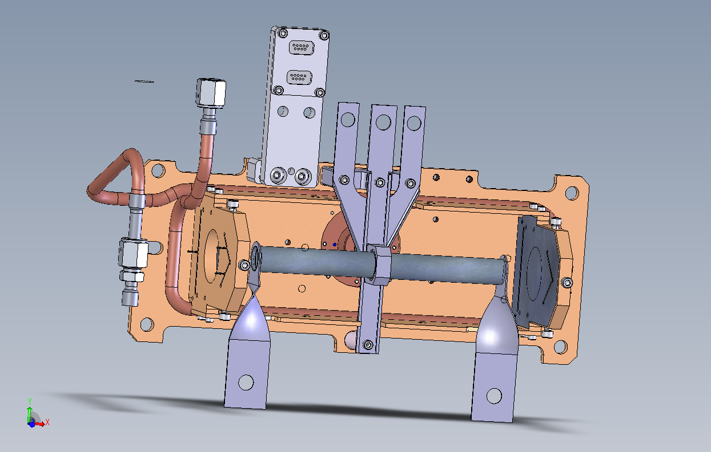
ISAC target assembly
low power
0-50 µ A

Slide 13
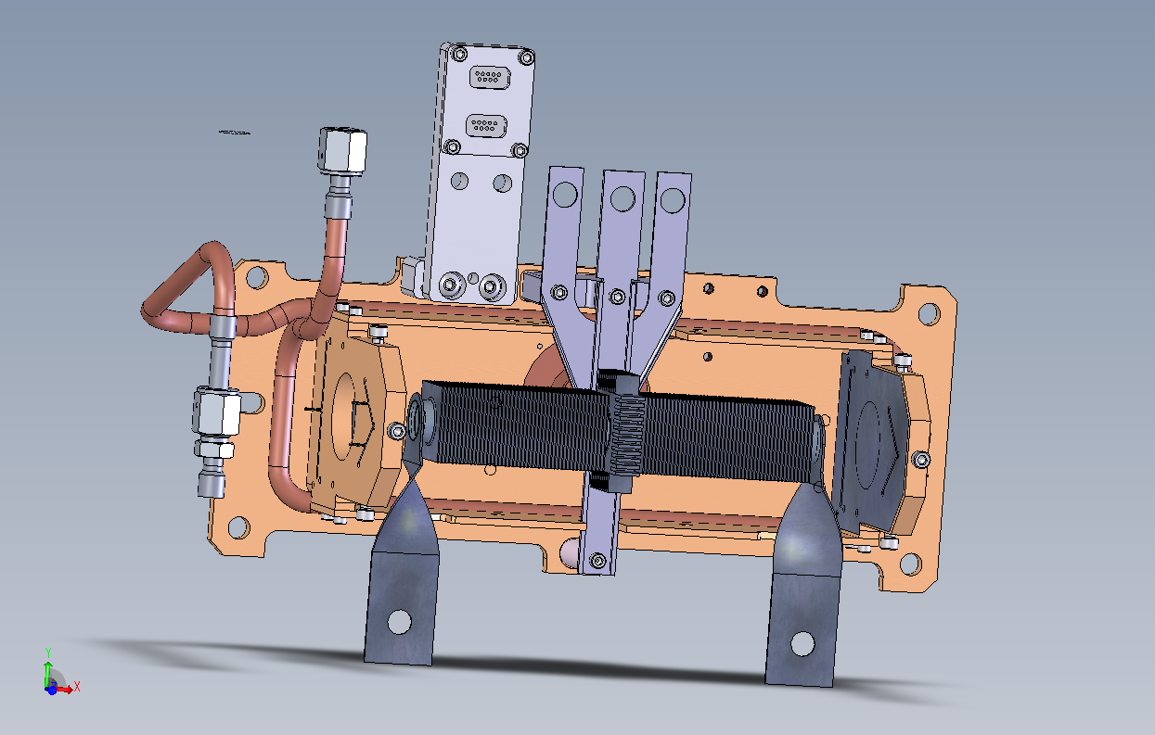
ISAC target assembly
high power
0-100 µ A

Slide 14
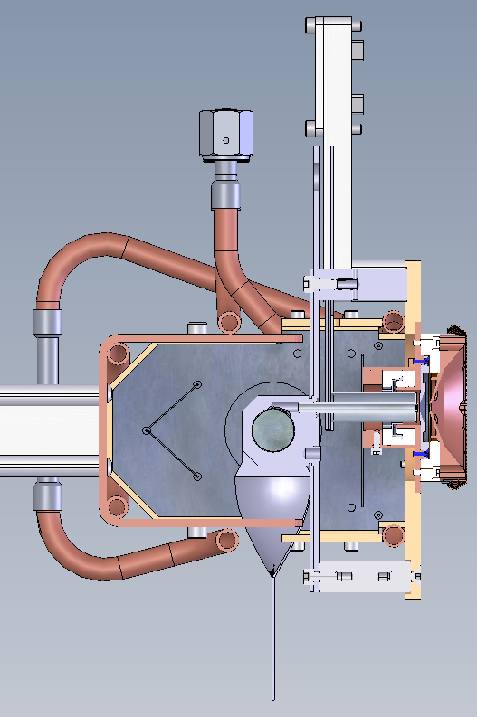
Surface ion source
For ionization of elements with ionization energy ε_{i} ~< 6 eV
ionizer:
  Ta tube with Re insert
  Operated at 2300 K
extraction electrode
Re ionizer
+
0
ground
target
ionizer
Transfer tube
extraction
target

Slide 15
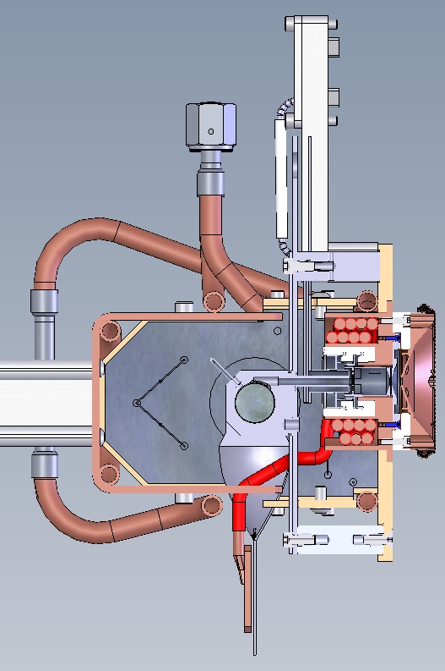
FEBIAD
(forced electron beam induced arc discharge) ion source
-
+
coil
B
target
plasma chamber
cathode
extraction
grid, anode
coil
Voltage difference between cathode and anode : 100-200 V
Electron current 0.1-0.5 A
Mainly used for gaseous elements
Based on a design by R. Kirchner, GSI (1976)
More details in presentation by Fernando Maldonado Millan later in this session
cathode

Slide 16
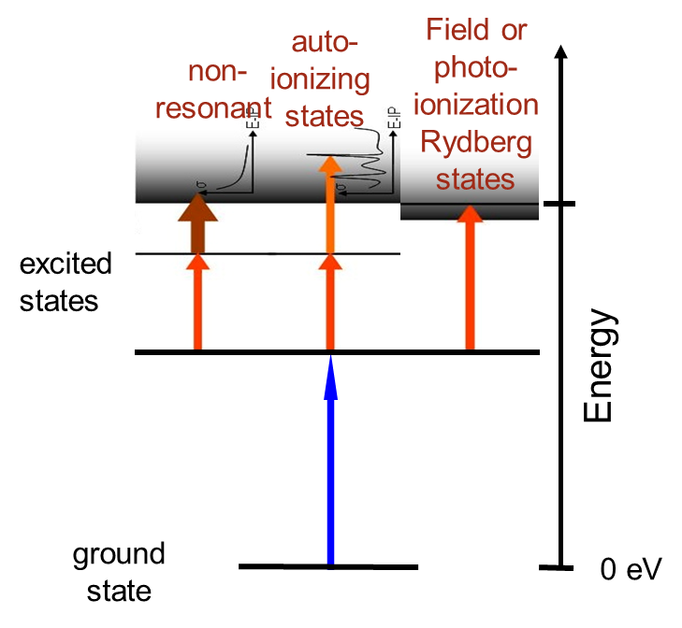
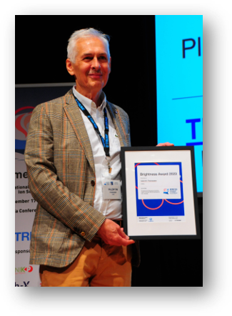
Resonant laser ion source
ions
Laser(s)
V
0
Resonant laser ionization in a hot cavity
2 or 3 steps → ε_{i} ~< 7-8 eV
Pulsed lasers needed to saturate transitions
Element selective, Isotope/isomer selectivity possible
Efficiency depends on
pulse repetition frequency and geometry
Laser power
thermal ground state population in the atom
Beam purity is limited by
Ions from surface ionization in the hot cavity
Non resonant laser ionization (molecules)
ICIS 2023, Brightness award
for Valentin Fedosseev

Slide 17
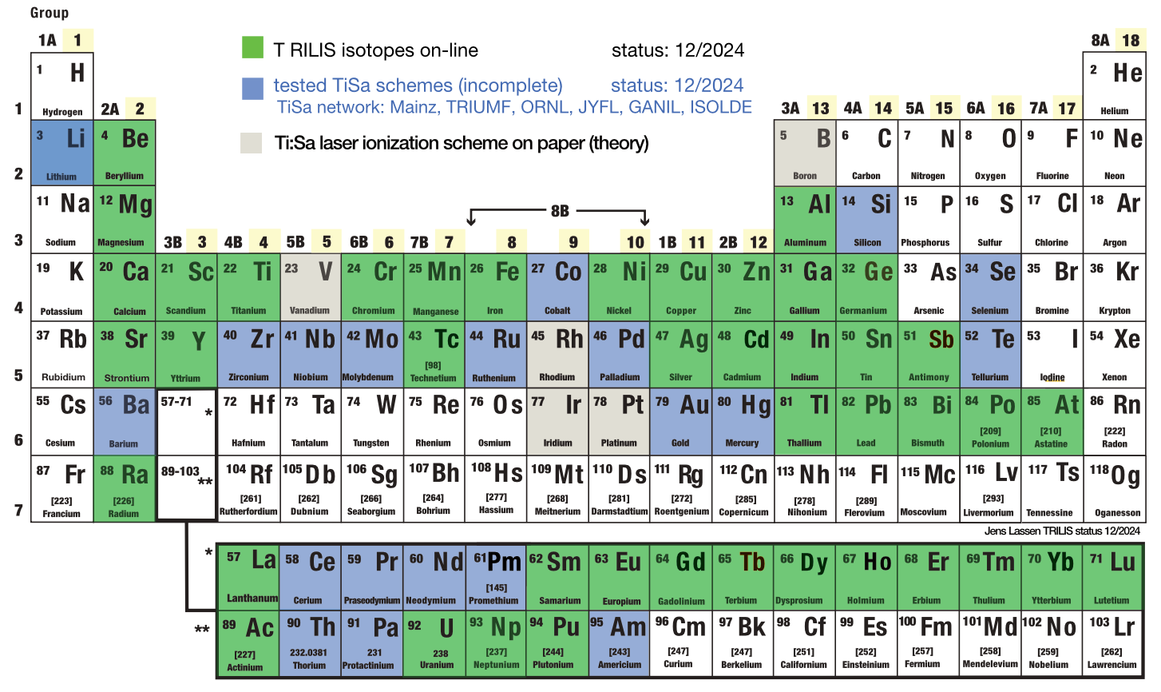
Resonant laser ion source
extraction electrode
laser
ionizer
J. Lassen
Titanium Sapphire based laser system
frequency doubling and tripling up to 3 steps
For some elements two lasers for ground state transition to cover fine/hyperfine structure
Ionizing 2 elements simultaneously (ex: Ac Ra
  or Ho Tb for ¹⁵⁵Tb collection )

Slide 18
IGLIS (Ion Guide Laser Ion Source)
Blocking of surface ions from the hot target and transfer line by a “repeller” electrode
Only neutrals (atoms can reach the ionization zone
Containment and guiding of the ions by a radiofrequency quadrupole
→High purity beams
Recent examples from UC target
  ⁷Be versus ⁷Li and ¹³⁷Sb versus Cs,Ba
-
+
-
RF quadrupole
target
laser(s)
transfer
tube
extraction
M. Mostamand, et al., Hyperfine Interactions (2020) 241: 36
repeller

Slide 19
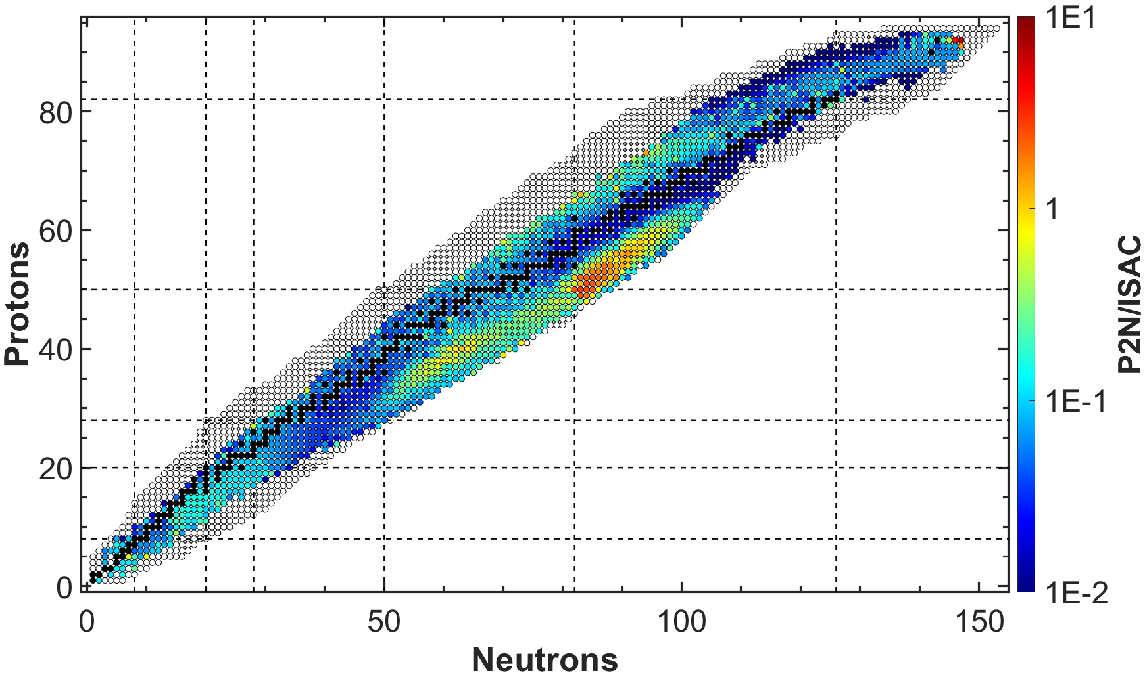
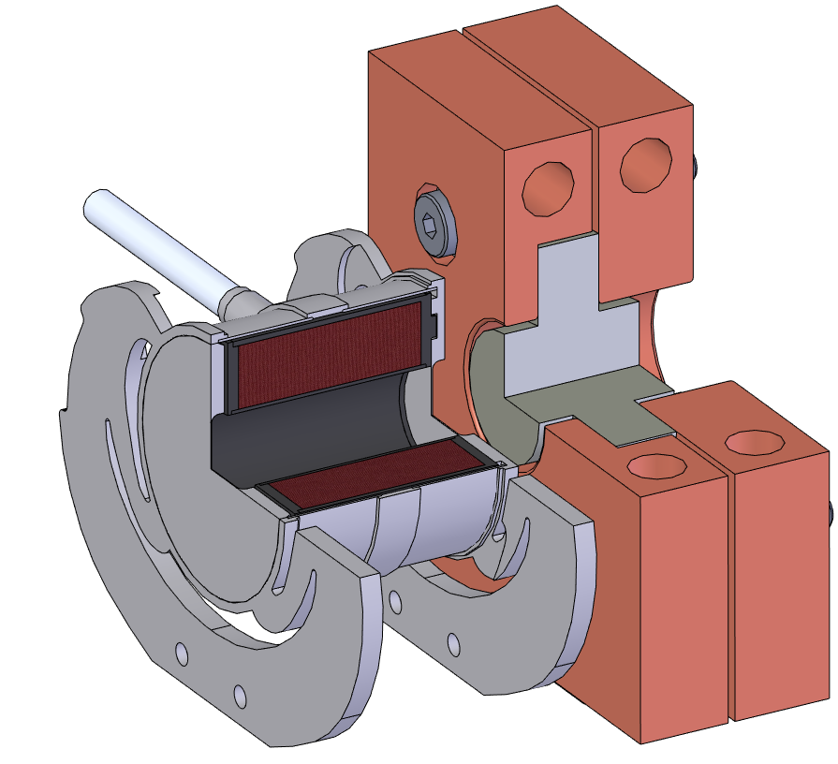
Proton to neutron converter target
Neutron induced fission in Uranium
→High purity beams of neutron rich isotopes
Spallation neutrons
Target
Converter / conventional
P⁺ beam
UC_{x}
Tungsten
Converter
P⁺ beam

Slide 20
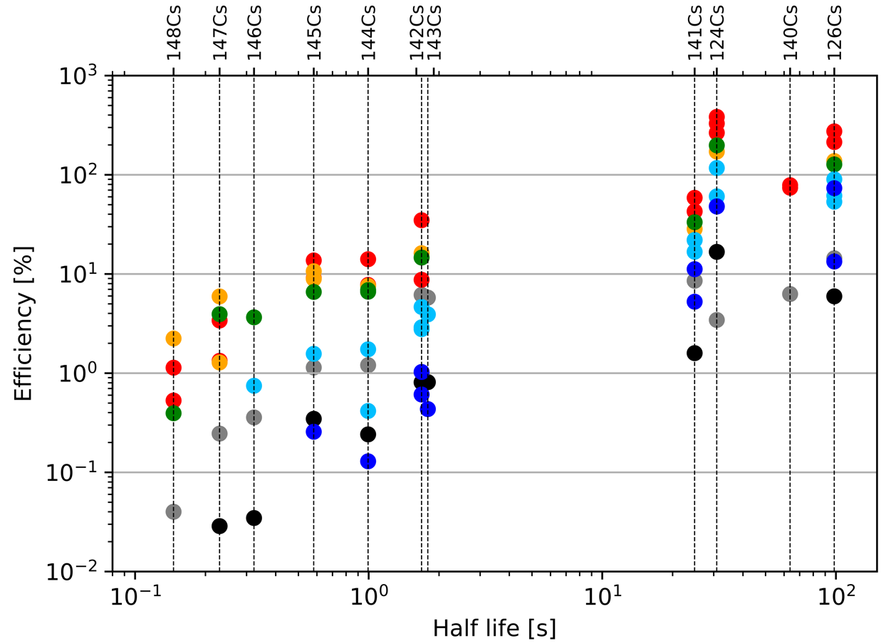

Proton to neutron converter target results
Measured release efficiency of Cs isotopes as function of half lives compared to FLUKA simulation
Trend comparable with ISAC-UC_{x}
P2N release efficiency higher
  Temperature homogeneity
N-deficient efficiency > 100%
  P-beam mis-steered or scattered
Cs yields at lower temperature
  Temperature-controlled mode
  Enables cleaner Cs, Rb beams by suppressing n-deficient lanthanides
PHD thesis Luca Ergoriti

Slide 21
Target materials and Ion Sources
ISAC targets for
experiments
1998-2024
Total 197
Since 2004 with
both target stations
in operation
~10 targets/year
Additional target tests
ThO
SiC fiber

Slide 22
RIB operation at TRIUMF
Up to 2017 (9 month /year)
Scheduled operation of ISAC 5000 hours/ year
Overhead and downtime 2000 hours/ year
Beam to experiments and development 3000 hours/ year
Typical duration of an experiment 2 days to 3 weeks (average ~1 week)
Ratio accelerated to non accelerated beams 30-40%
In 2025: 10 targets
29 scheduled experiments, 16 experiments use laser ionization
Since 2018
7-8 months per year reduced schedule for ARIEL installation
2020-22 further reduction due to COVID
2026 planned complete shutdown to finish ARIEL installation

Slide 23
RIB downtime
RIB operation
One target complete failure ~ 10% downtime/year
Recent improvements:
Redesign of high voltage chase through shield plug
IGLIS and FEBIAD connections

Slide 24
Recent improvements and developments:
Redesign of high voltage chase through shield plug to increase high voltage stability
  Tested off-line up to 75 KV, on-line operated at 53 kV for the acceleration of ²⁶Al
  IGLIS and FEBIAD connections redesigned for better stability.
  Thin foil Ta target (10 µm) for better release of short-lived isotopes (¹¹Li (8.8 ms) and ¹²Be (21.5 ms)

Slide 25
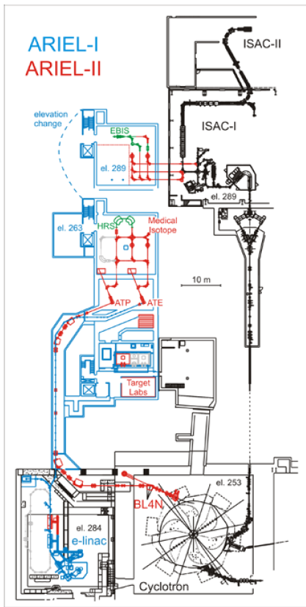
ARIEL
Two target stations
ATP: up to 100 µA p⁺ @ 480 MeV from main cyclotron
ATE: up to 100 kW e⁻ @ 30 MeV from e- linac (50 Mev upgrade possible)
New design for target stations with hermetically sealed targets
  Allows use of more chemically reactive target materials (ThC)
  Faster turn around (reduced pump down time and conditioning)

Slide 26
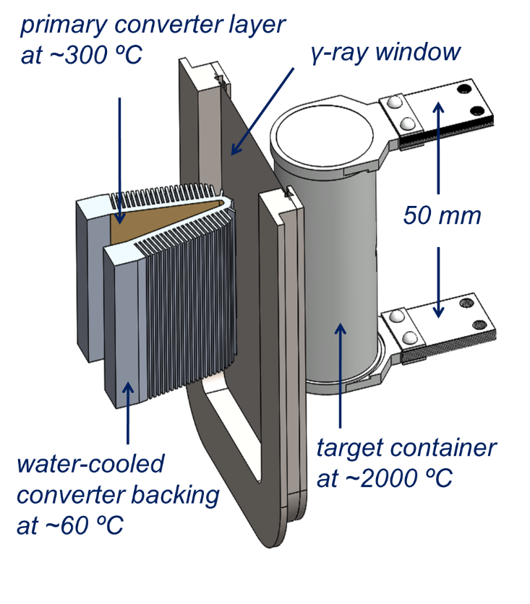
Electron beam target
Converter made of high Z material, Au, W, Ta. Thickness ~ 3.5 mm.
Electrons MUST be stopped in a low Z material like Al.
The TRIUMF e-linac delivers 100 kW electron beam with FWHM ≈ 1 mm → 1 MW/cm³ power density inside of the converter
The electron beam will be scanned over a larger area to dissipate the beam power.
Penetration depth of 30 MeV gamma photons in U ~20 mm
Target geometry has to be changed compared to p target
electron-
beam

Slide 27
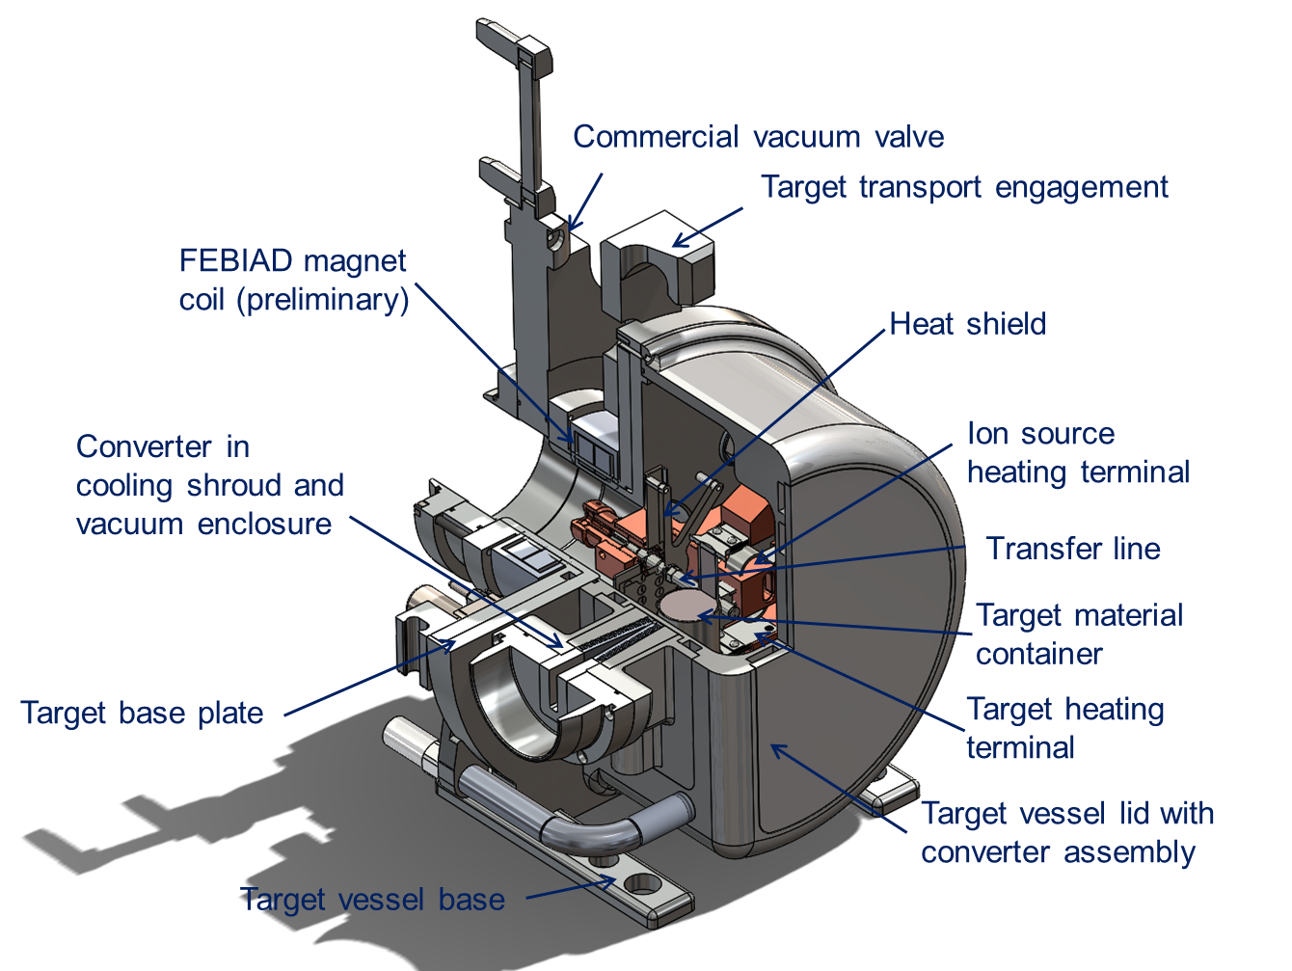
Electron beam target hermetic vessel assemly
Increased development space for new ion source and transfer line concepts (cold transfer line, variable temperature transfer line, quartz transfer line, improved FEBIAD or IGLIS, low work function cavity for laser ionization)
Service connections with provisions for future ion source and target concepts
Allows for routing additional cooling for high power target operation
Vessel volume increased for new target concepts (liquid targets, new converters, etc.)

Slide 28
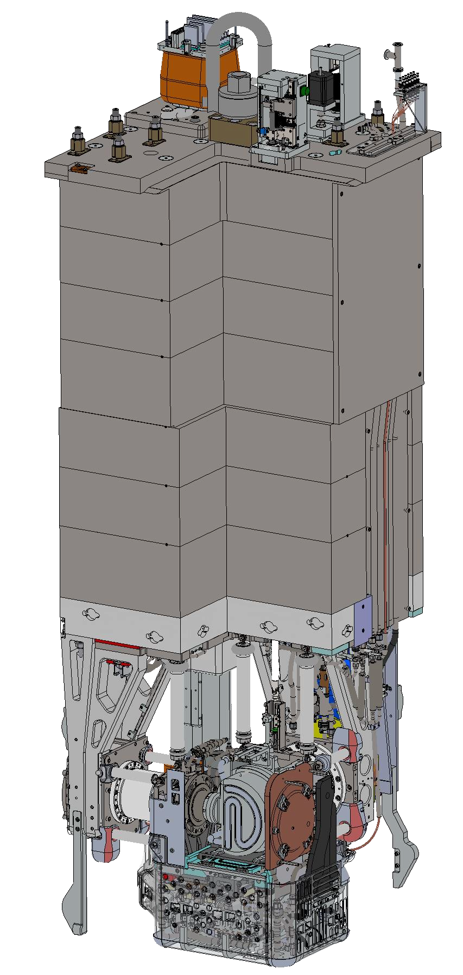
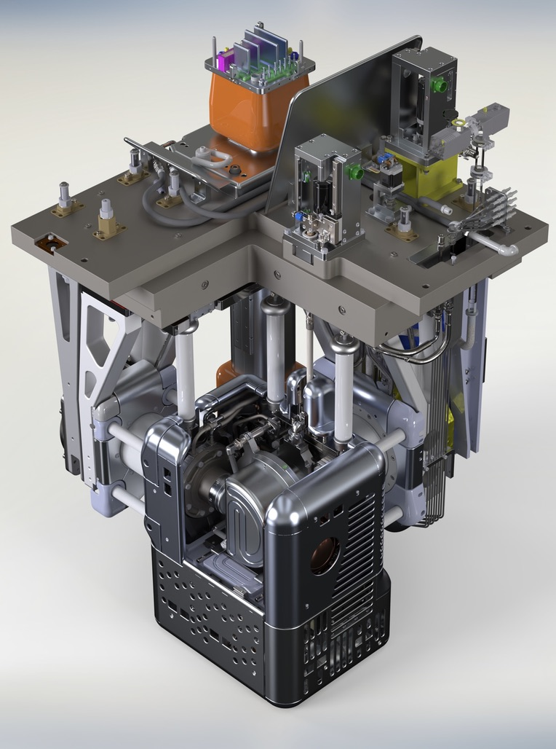
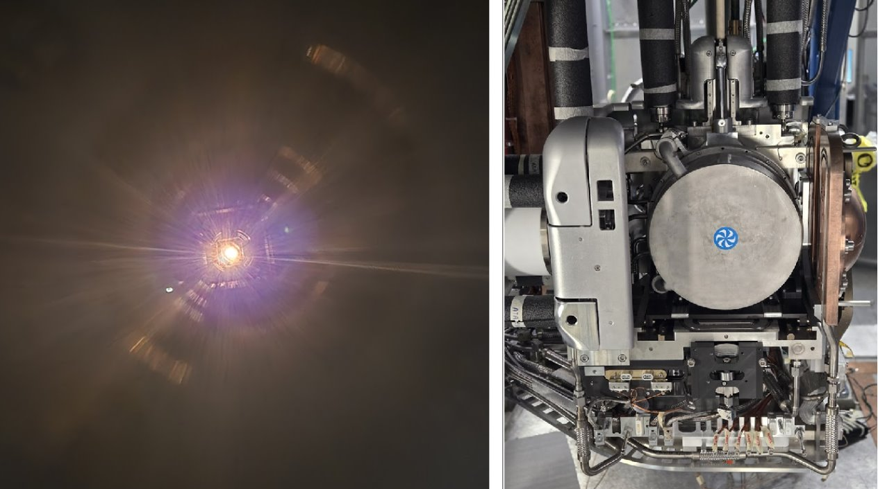
ARIEL target station.
Shield plug
Target ion source front end assembly at test facility
High voltage tested up to 75 kV
Heaters tested o.k
First beam extracted beginning of August 2025

Slide 29
Summary
ISAC has been operated for more than 2 decades using several combinations of targets and ion sources to deliver radioactive ion beams to experiments.
Constant improvements have been implemented for
  Delivering new ion beams
  Improving the efficiency and purity of the ion beams
  Improving the reliability
Additionally, to a new proton tatget ARIEL will use photo fission for the production of radioactive isotopes
A newly designed target ion source system will be installed
the same type of ion sources as in ISAC will be used

Slide 30




Thank you
Merci
www.triumf.ca
Follow us @TRIUMFLab

