Slide 1
Superconducting magnet structures and developments for 4th Generation ECR ion sources
P. Ferracin
Lawrence Berkeley National Laboratory
21st International Conference on Ion Sources (ICIS)
September 11th, 2025

Slide 2
Acknowledgements
88-inch Cyclotron, NS Division, LBNL
  Brian Bell, Janilee Benitez, Patrick Coleman, Jaime Cruz Duran, Jeff Hansen, Rae de Leon, Jacob Melendrez, Roman Nieto, Larry Phair, Chris Reardon, Nathan Seidman, Damon Todd, Daniel Xie, Lianrong Xu, and Sean Zhong
Superconducting Magnet Program, ATAP Division, LBNL
  Philip Mallon, Simone Johnson, Mariusz Juchno, Soren Prestemon, Matt Reynolds, Jose Luis Rudeiros Fernandez, James Swanson, Chet Spencer, Tengming Shen, Ye Yang

Slide 3
Outline
Superconducting magnets for particle accelerator: why?
Superconducting materials for high field: two families
From third to fourth generation ECR ion sources
  MARS (Nb-Ti)
  The Nb₃Sn and HTS option
Conclusions

Slide 4
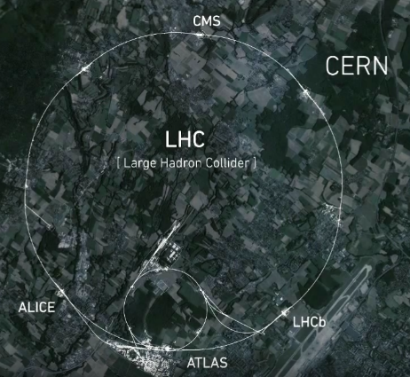
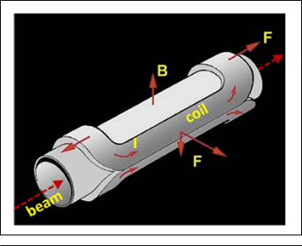

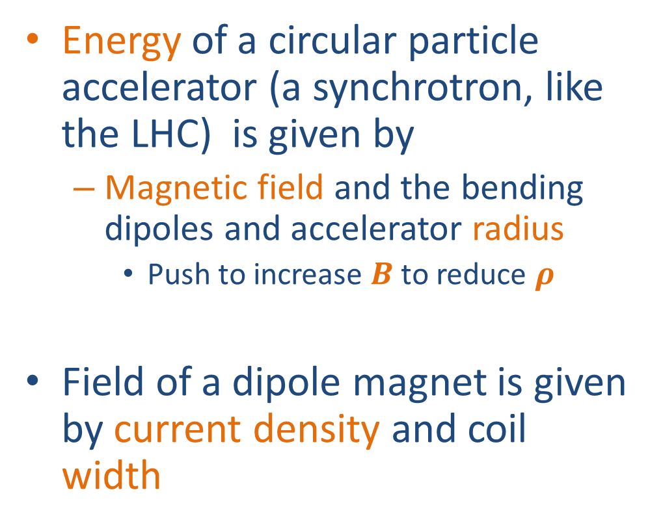
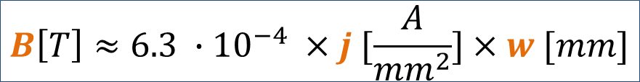

Superconducting magnets for particle accelerator: why?
Energy of a circular particle accelerator (a synchrotron, like the LHC) is given by
  Magnetic field and the bending dipoles and accelerator radius
    Push to increase $B$ to reduce $ρ$
Field of a dipole magnet is given by current density and coil width
$$E \left[GeV\right]≈0.3 ×B \left[T\right]× ρ [m]$$
w
$$B\left[T\right]≈6.3 ∙{10}^{−4} ×j [\frac{A}{{mm}^{2}}]×w [mm]$$

Slide 5
Superconducting magnets for particle accelerator: why?
Resistive magnets
  → j of ~5 A/mm²
Superconducting magnets
  → j of ~500 A/ mm²
    Two order of magnitude increase
SC magnets are extremely effective for colliders
  Zero electrical resistance → no consumption
    Except for cryogenics (1.9-4.5 K operations)
  Very compact colliders
  Therefore → sustainability
$$E \left[GeV\right]≈0.3 ×B \left[T\right]× ρ [m]$$
w
$$B\left[T\right]≈6.3 ∙{10}^{−4} ×j [\frac{A}{{mm}^{2}}]×w [mm]$$

Slide 6
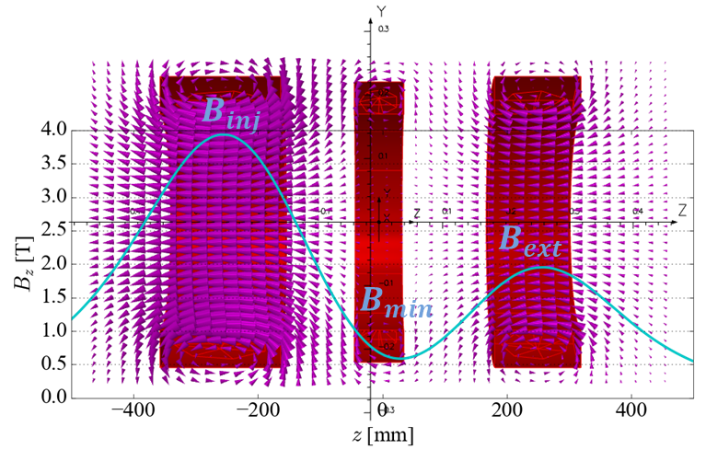
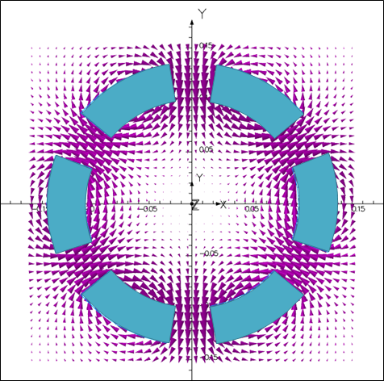
Superconducting magnets for particle accelerator: why?
To achieve high charge state and high intensity we need high frequency Electron Cyclotron Resonance Ion Source (ECRIS)
This translate in high magnetic field
  𝐵_𝑒𝑐𝑟=𝑓/28[GHz]
Similar request, as for HEP, to maximize the magnetic field
  → ECRIS with superconducting magnets

Slide 7
Outline
Superconducting magnets for particle accelerator: why?
Superconducting materials for high field: two families
From third to fourth generation ECR ion sources
  MARS (Nb-Ti)
  The Nb₃Sn and HTS option
Conclusions

Slide 8
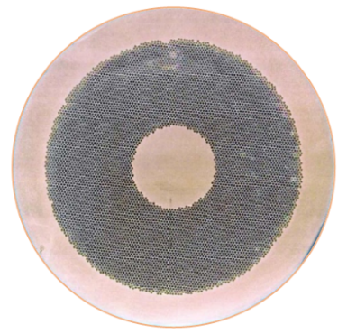
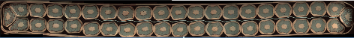
Superconducting materials: two families
1) Low temperature superconductors
Nb-Ti (the workhorse)
  5-9 T field level
  Multi-filamentary round wires in multi-wire cables
  Tevatron, HERA, RHIC, LHC

Slide 9
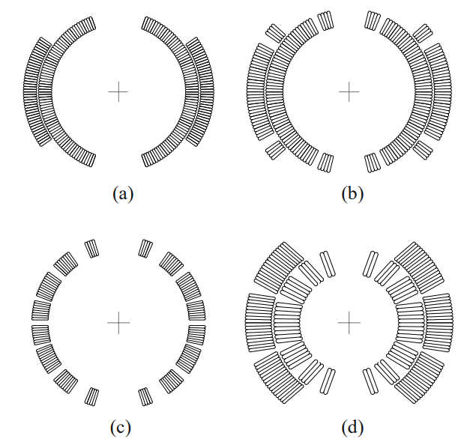
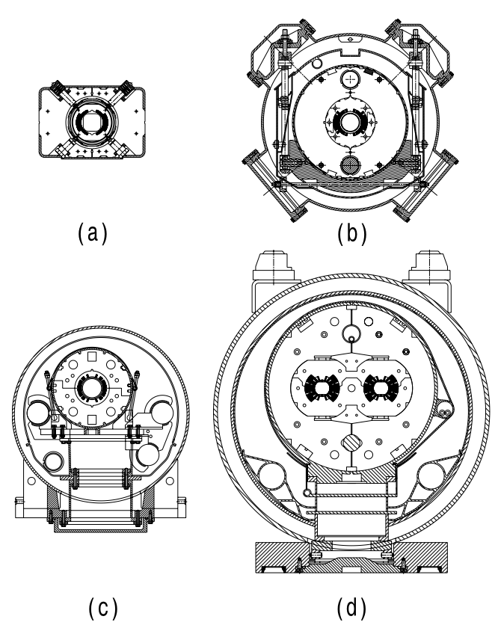
Nb-Ti accelerator dipole magnets
Tevatron, 4.3 T, 6.1 m
HERA, 5.3 T, 8.8 m
Tevatron, 76 mm ∅
HERA, 75 mm ∅
RHIC, 80 mm ∅
LHC, 56 mm
RHIC, 3.5 T, 9.5 m
LHC, 8.3 T, 14.3 m

Slide 10

Superconducting materials: two families
1) Low temperature superconductors
Nb-Ti (the workhorse)
  5-9 T field level
  Multi-filamentary round wires in multi-wire cables
  Tevatron, HERA, RHIC, LHC
Nb₃Sn (the next step)
  11-15 T field level
  Multi-filamentary round wires in multi-wire cables
  Accelerator quality magnets fabricated: field ~12 T
    HL-LHC Project: to be installed in 2026-2028
      First time for Nb₃Sn !

Slide 11
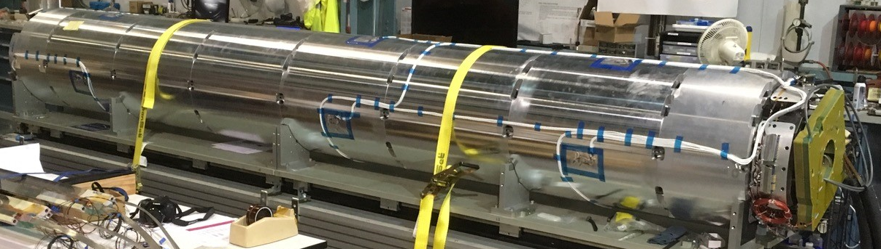
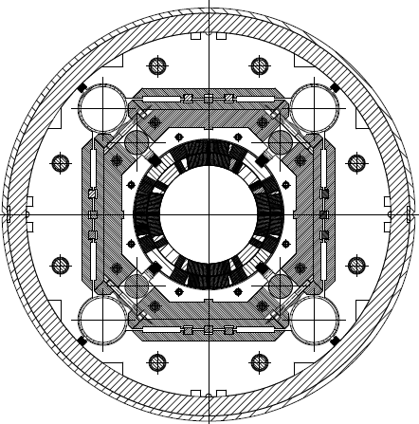
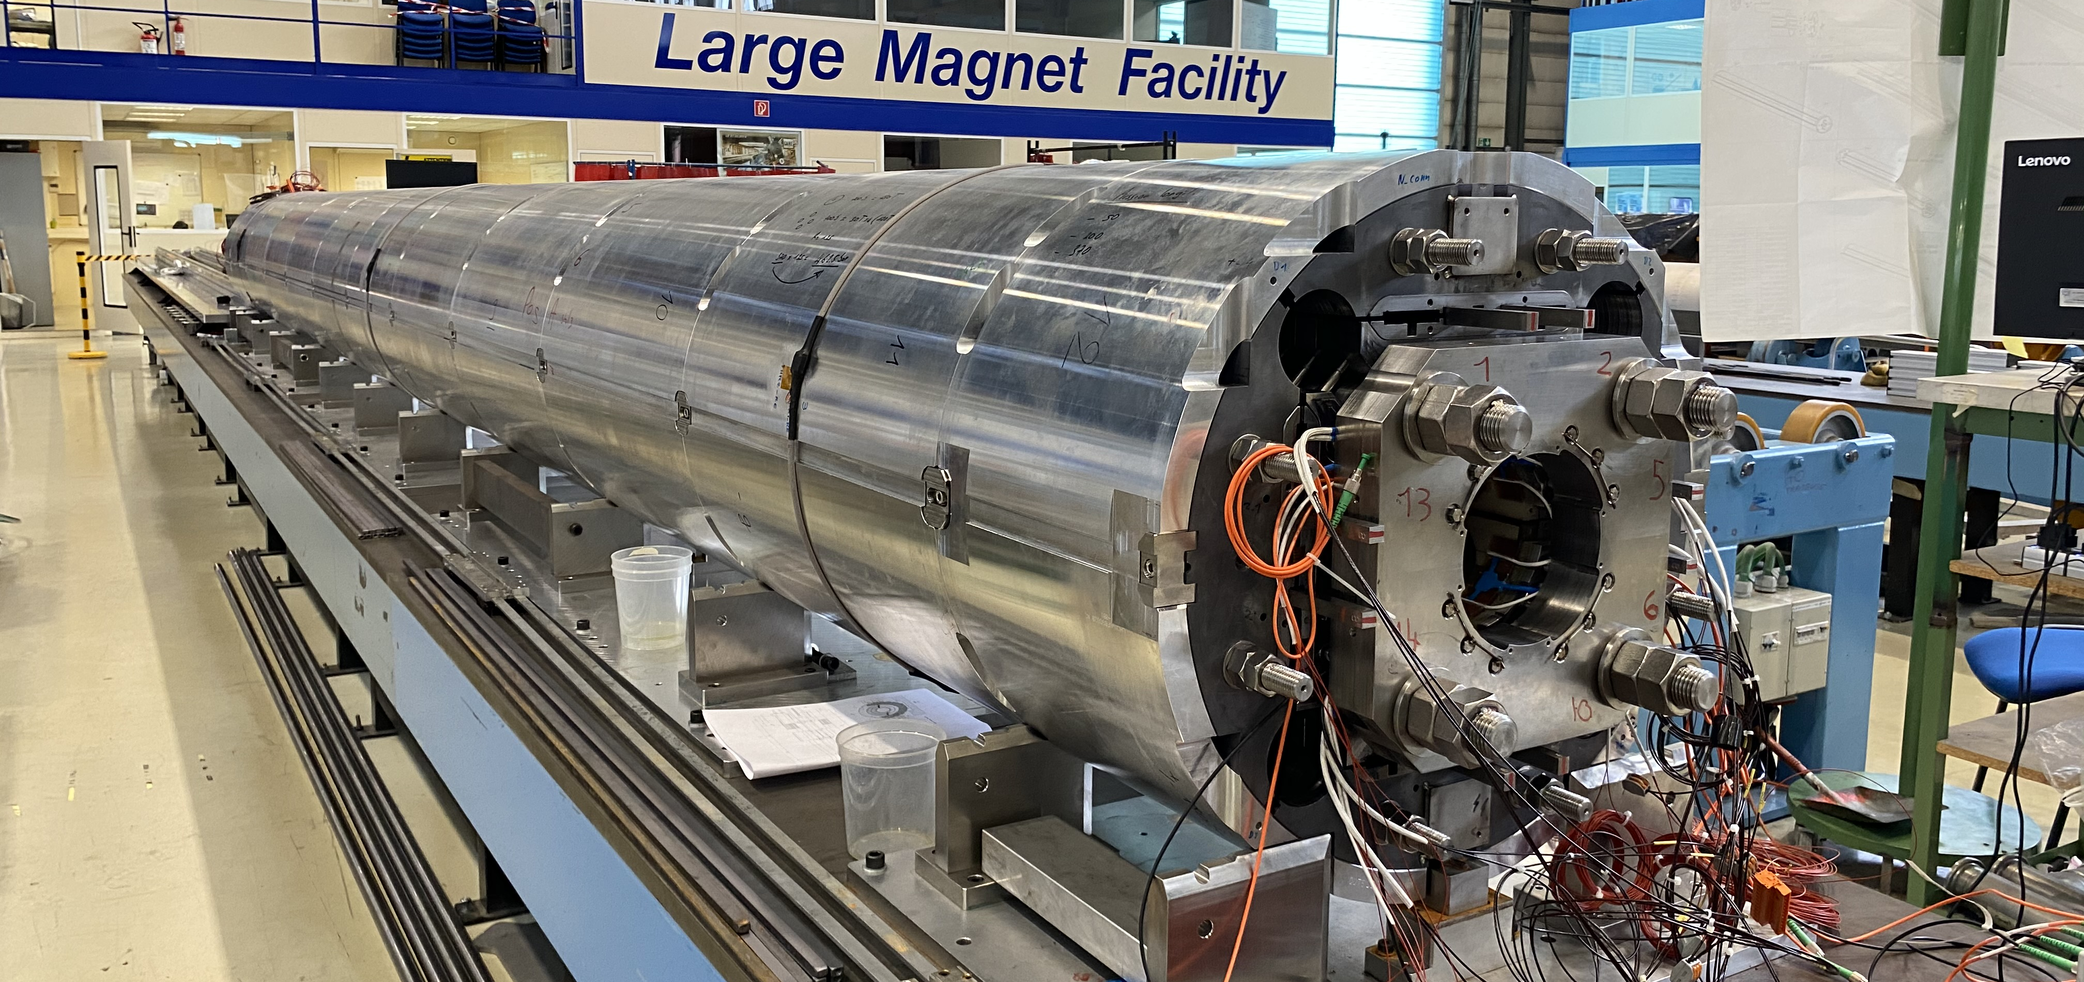
Nb₃Sn accelerator quadrupole magnet
Quadrupole magnets (focusing the beam) for the LHC Interaction Region (HL-LHC)
US AUP MQXFA, 150 mm ∅, 11.3 T, 4.2 m
CERN MQXFA, 150 mm ∅, 11.3 T, 7.2 m

Slide 12
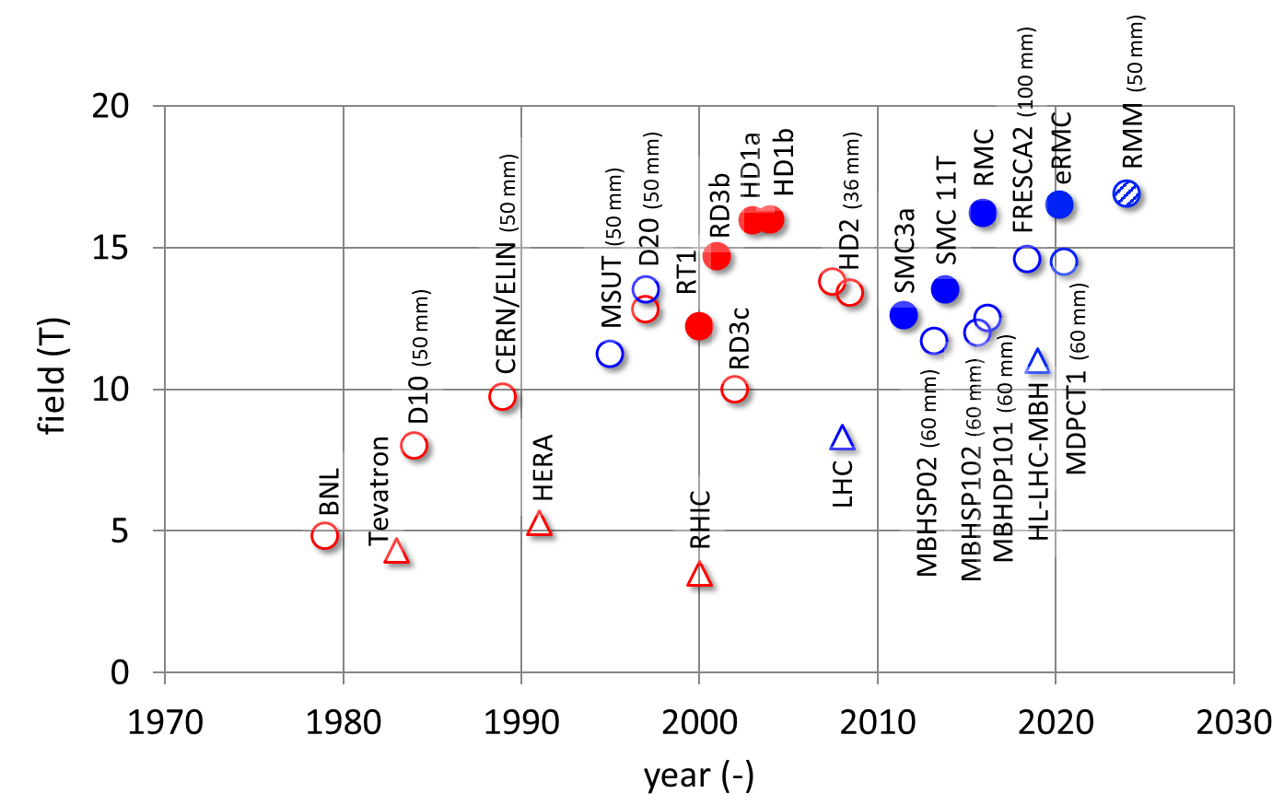
Status of magnets with low temperature superconductors
By Luca Bottura
1.9 K
4.2 K
Long accelerator magnets
Short or R&D magnets
(with/without aperture)
Nb₃Sn accelerator magnets up to 11-12 T
14-16 T reached on short R&D magnets

Slide 13
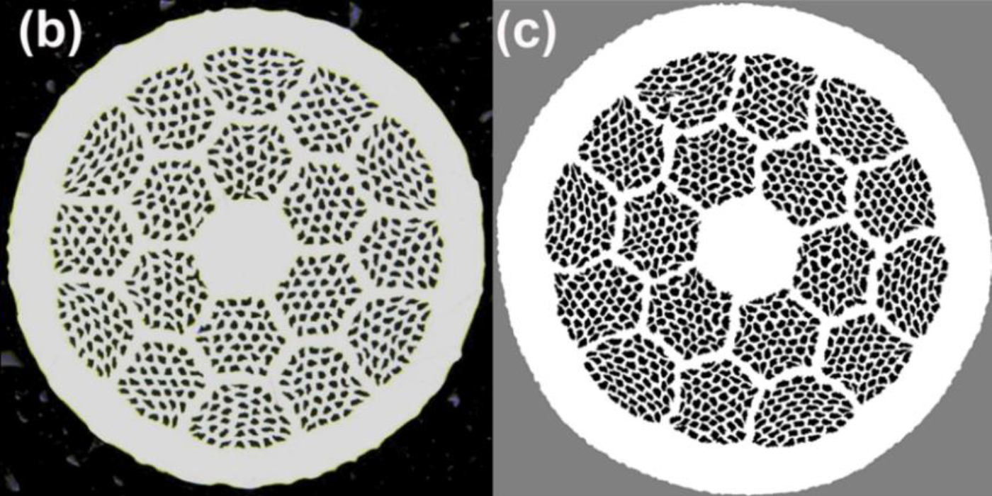
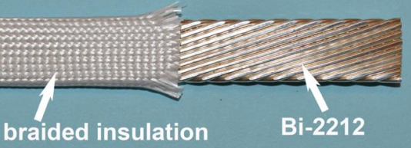
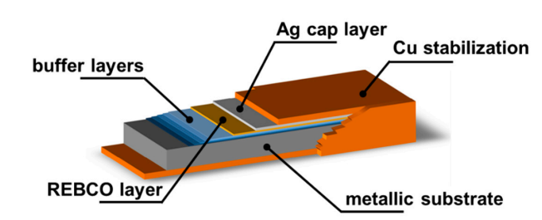
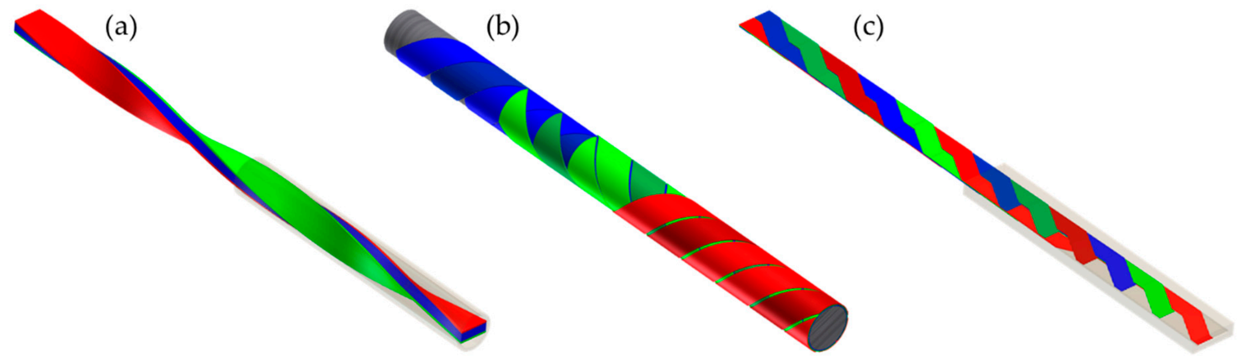
Superconducting materials: two families
2) High temperature superconductors
Bi2212
  Beyond field limits of Nb₃Sn → 16-20 T range (and above)
  Multi-filamentary round wires in multi-wire cables
  50 bar overpressure heat treatment (OPHT) in Ar-O₂ or O₂ at 885-900 °C
REBCO
  Beyond field limits of Nb₃Sn → 16-20 T range (and above)
    And 20 K operation
  Available only in tapes
  Several cable geometries considered
    Twisted stack, CORC/STAR, Roeble
L. Rossi and C. Senatore, Instruments 2021, 5, 8.

Slide 14
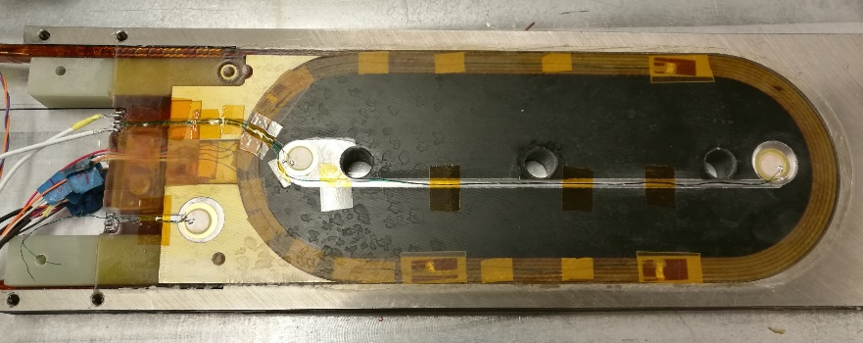
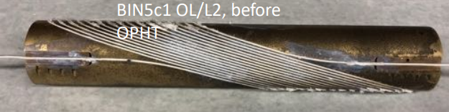
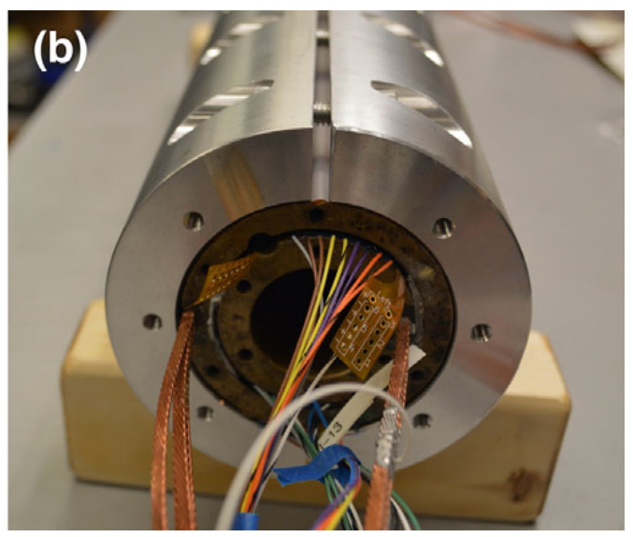
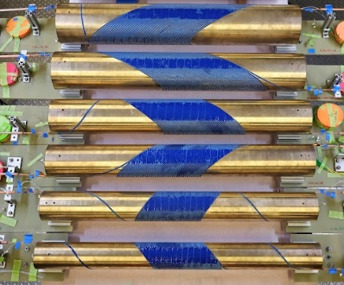
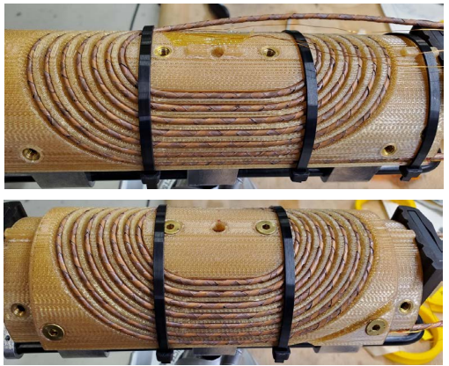
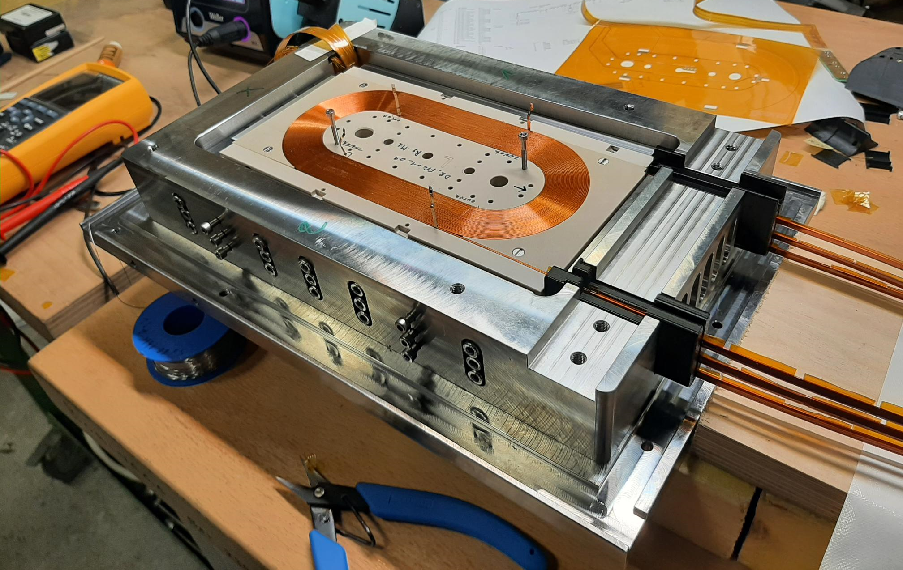
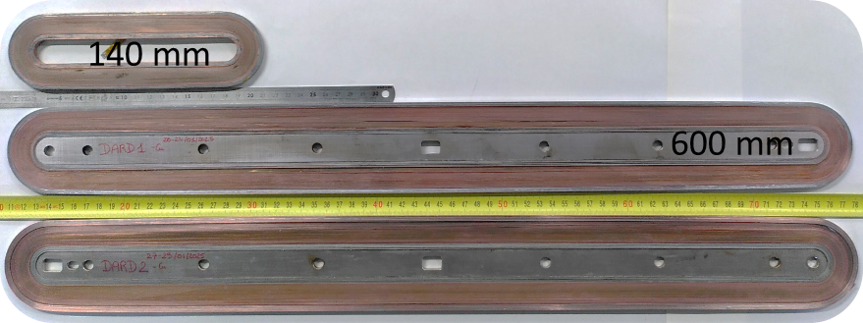
Superconducting materials: two families
2) High temperature superconductors
Bi2212
REBCO
US MDP
US MDP
HFM, CEA
HFM, CERN

Slide 15
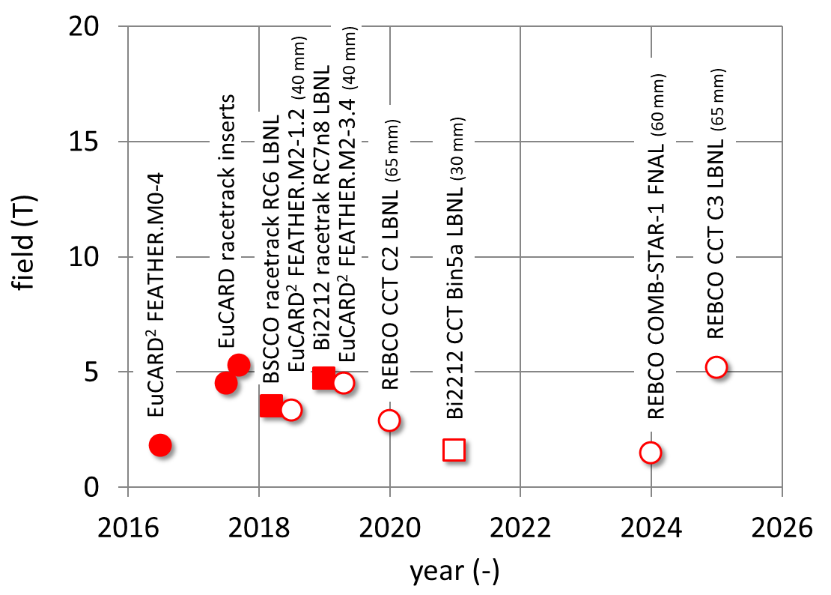
Status of magnets with high temperature superconductors
By Luca Bottura
4.2 K
Bi2212 (with/without aperture)
REBCO (with/without aperture)
5 T with aperture reached in stand-alone test
Relatively low, however possibility to push beyond the Nb₃Sn limits

Slide 16
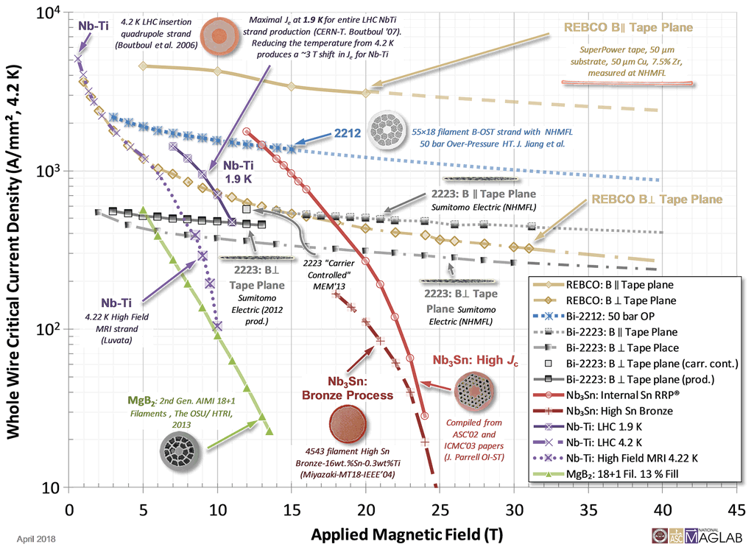
Superconducting materials: summary
REBCO parallel
Bi2212
Nb-Ti
REBCO perp.
Nb₃Sn
In addition, R&D on going in EU and China on Iron-based HTS conductor

Slide 17
Outline
Superconducting magnets for particle accelerator: why?
Superconducting materials for high field: two families
From third to fourth generation ECR ion sources
  MARS (Nb-Ti)
  The Nb₃Sn and HTS option
Conclusions

Slide 18
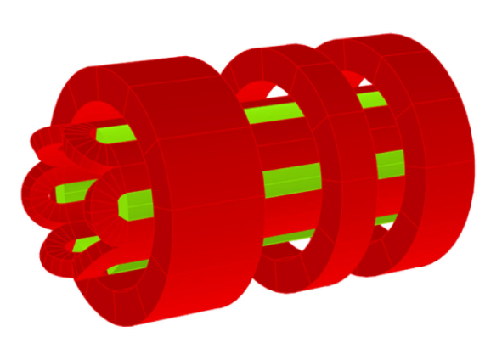
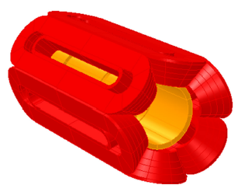
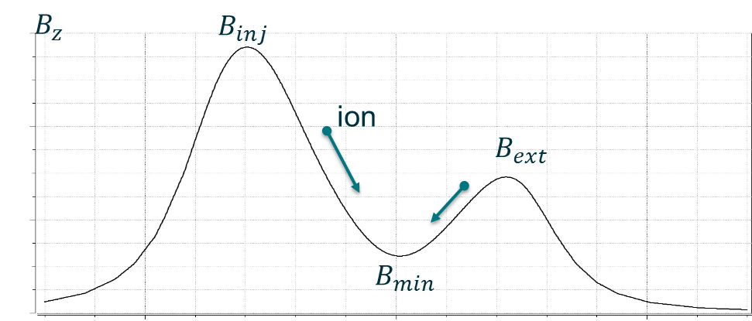
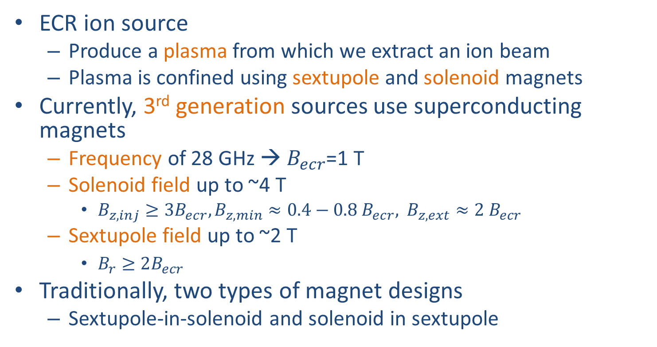
Superconducting magnets for ECRIS
Sextupole-in-solenoid
ECR ion source
  Produce a plasma from which we extract an ion beam
  Plasma is confined using sextupole and solenoid magnets
Currently, 3rd generation sources use superconducting magnets
  Frequency of 28 GHz → $B_{ecr}$=1 T
  Solenoid field up to ~4 T
    $B_{z,inj}≥3B_{ecr}, B_{z,min}≈0.4−0.8 B_{ecr},$ $B_{z,ext}≈2 B_{ecr}$
  Sextupole field up to ~2 T
    $B_{r}≥2B_{ecr}$
Traditionally, two types of magnet designs
  Sextupole-in-solenoid and solenoid in sextupole
Solenoid-in-sextupole

Slide 19
Superconducting magnets for ECRIS
Facility | Conductor | Frequency | Status | Bmax on winding | Design concept
LBNL / VENUS | NbTi | 28GHz | Under operation | 6.5T | Sextupole-in-solenoid
RIKEN | NbTi | 28GHz | Under operation | 7.4T | Sextupole-in-solenoid
IMP / SECRAL | NbTi | 28GHz | Under operation | 7.9T | Solenoid-in-sextupole
FRIB | NbTi | 28GHz | Under operation | 6.5T | Sextupole-in-solenoid
RAON | NbTi | 28GHz | Under operation | 6.8T | Sextupole-in-solenoid
GANIL / ASTERICS | NbTi | 28GHz | Under development | 6.5T | Sextupole-in-solenoid
LBNL / MARS-D | NbTi | 45GHz | Under development | 8.2T | Closed-loop-in-solenoid
MARS (Mixed Axial and Radial field System)
  New coil configuration with the goal of achieving a frequency of ~45 GHz, still with Nb-Ti superconductor

Slide 20
Outline
Superconducting magnets for particle accelerator: why?
Superconducting materials for high field: two families
From third to fourth generation ECR ion sources
  MARS (Nb-Ti)
  The Nb₃Sn and HTS option
Conclusions

Slide 21
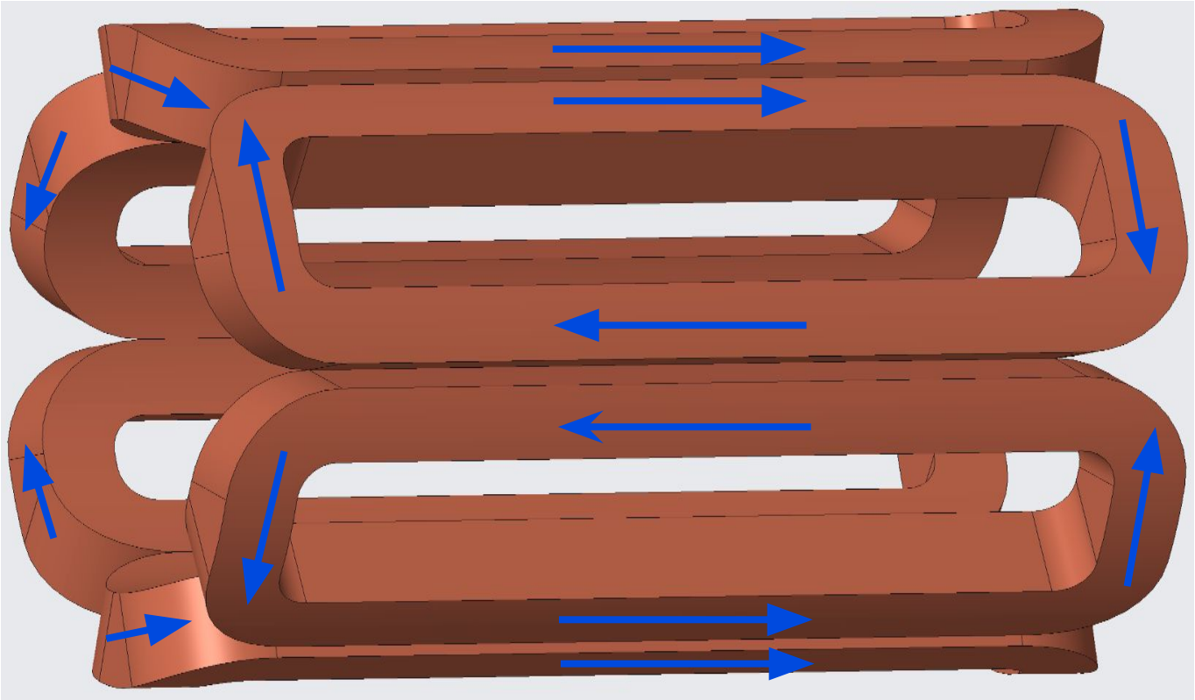
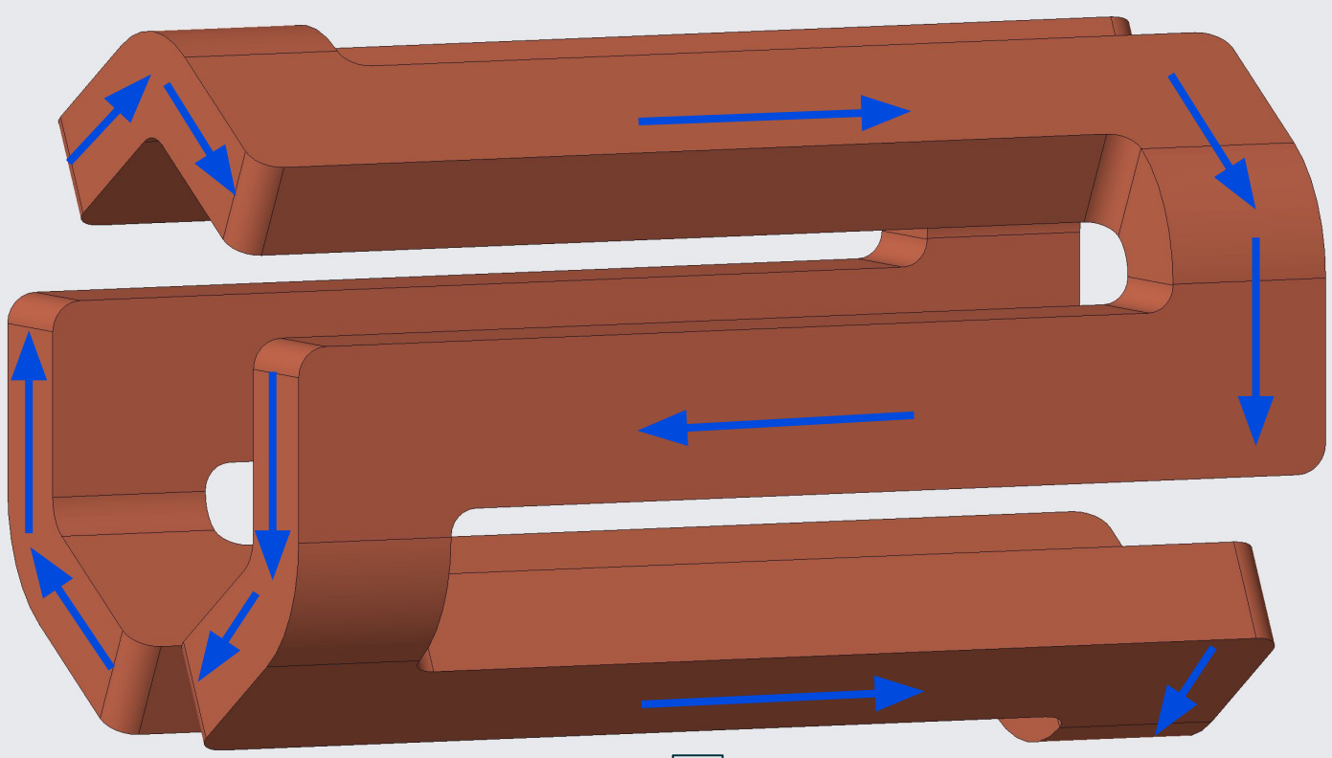
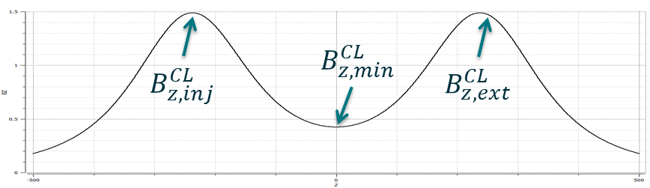
MARS magnet design
“Traditional” sextupole coils
28 GHz ECRISs use six-sextupole coils configuration
MARS uses close-loop or serpentine coil design
  Conductor goes back and forth on a mandrel generating at the same time a sextupole field in the straight section and a solenoidal field in the ends
  The end configuration naturally produces two peaks of B_{z}
    With traditional sextupole coils, no axial field is generated
  Additional solenoids are then added only for “fine tuning”
  As a result, a significant increased efficiency is achieved
    Less conductor for the same frequency
MARS closed-loop coil

Slide 22
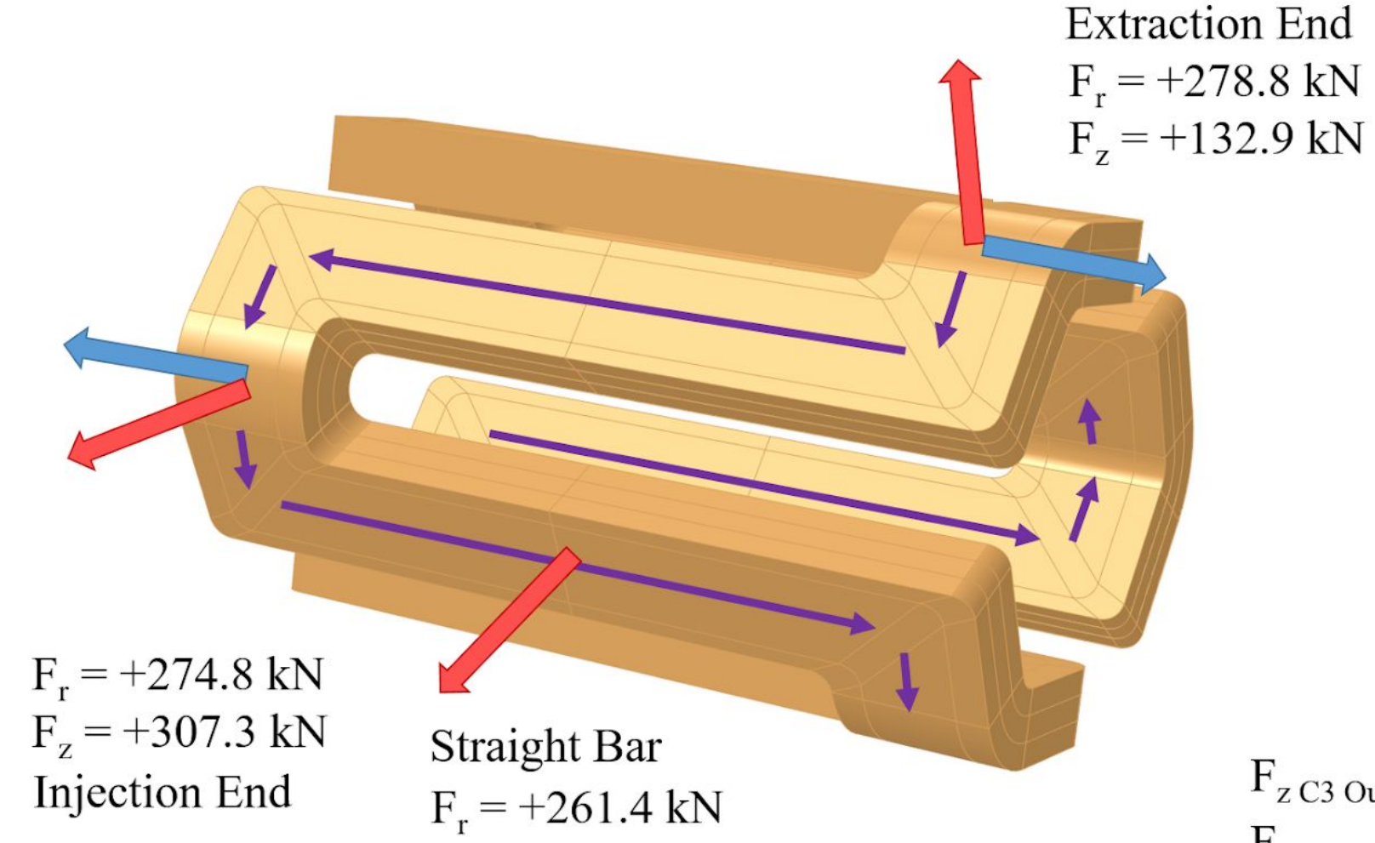
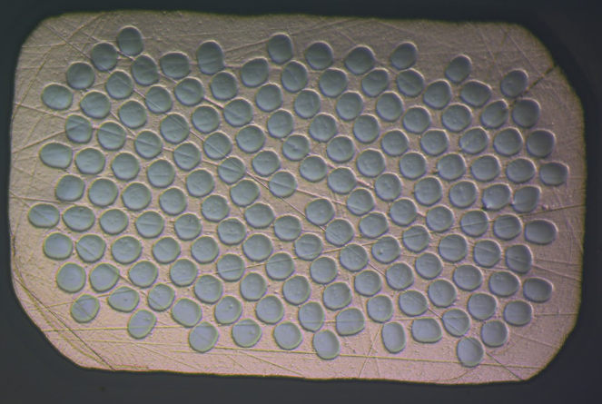
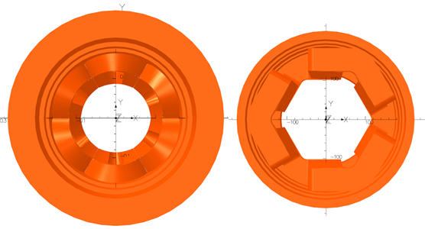
MARS magnet design
Electro-magnetic forces on the sextupole coil ends face outwards, both axially and radially
    In VENUS/FRIB alternating end forces between coils
Higher frequency / field is then achieved by
  More superconductor in the strand
    1.3-1.4 Cu/SC instead of 3-4 for VENUS
  Hexagonal plasma chamber and coil mandrel
    Chamber IR from from 72 mm to 94 mm → higher B_{r}
Important: ~ same frequency achievable also with VENUS-type design, but with larger coils and more conductor

Slide 23
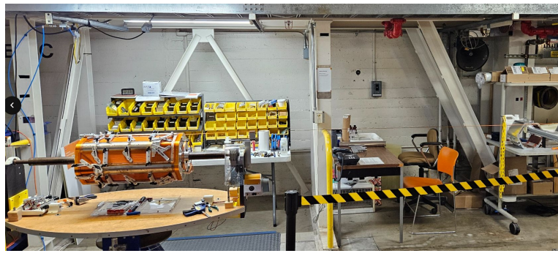
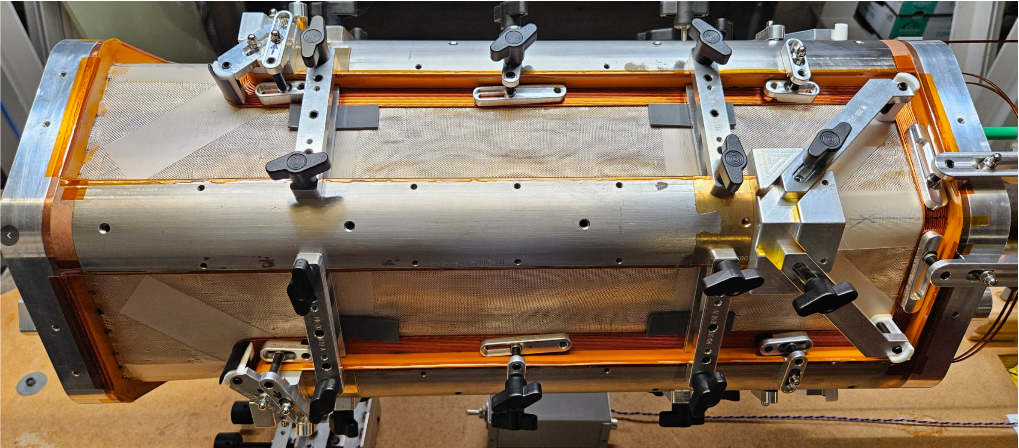
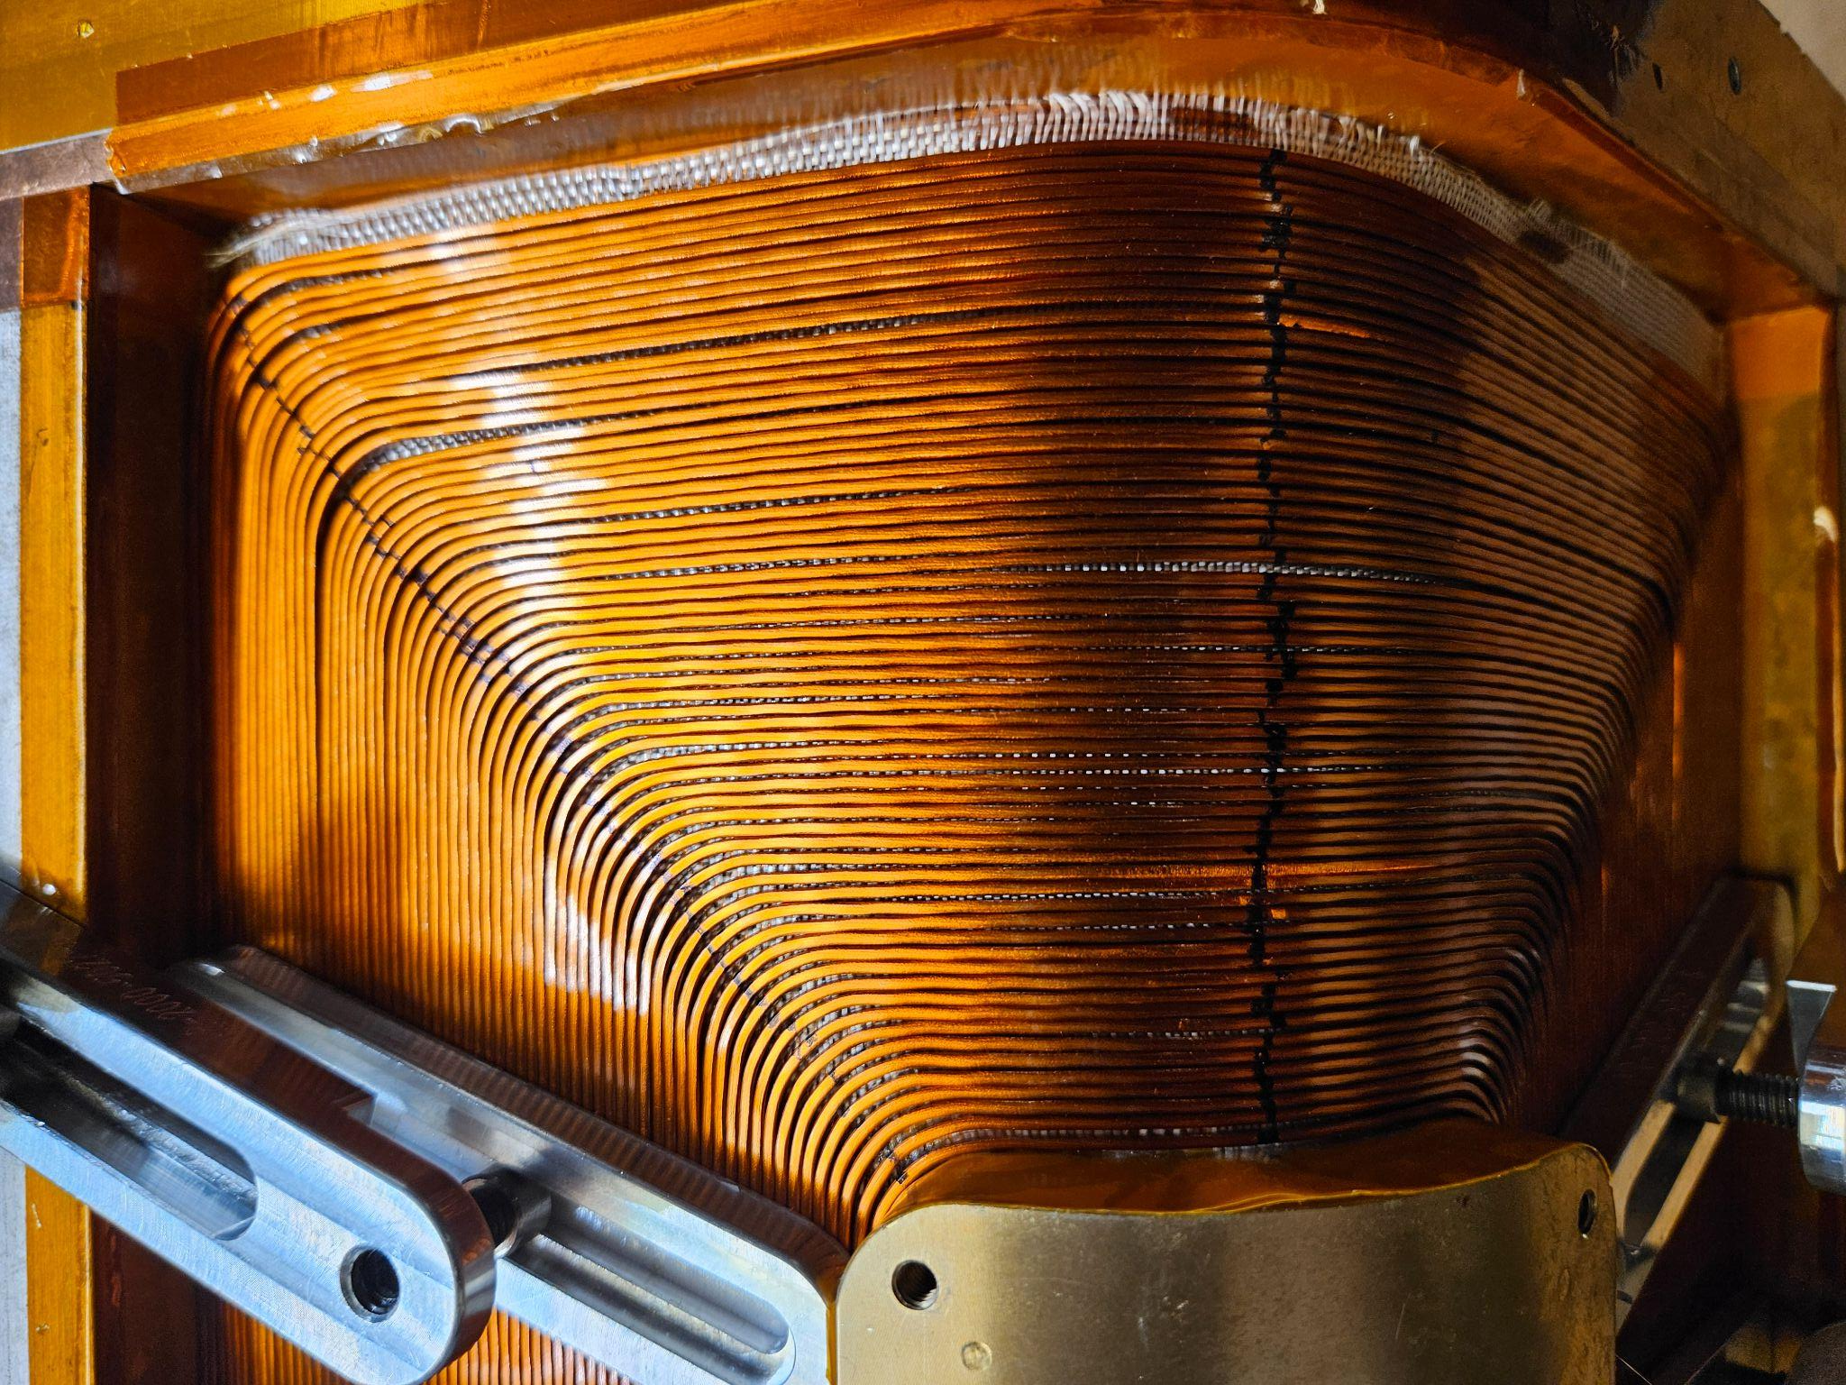
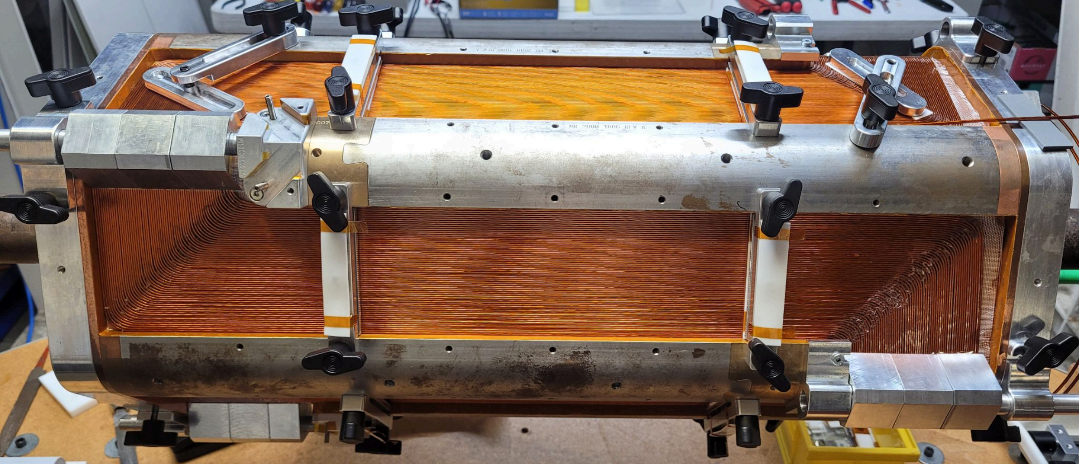
MARS design
Challenge: continuous coil winding (back-and-forth) with pre-overbending operation
Each turn about 1 h, each layer 2.5 weeks, 24 layers in total
  22 layers done, two more to go (end by October 2025)
Layer 1 of 24
Layer 4 of 24

Slide 24
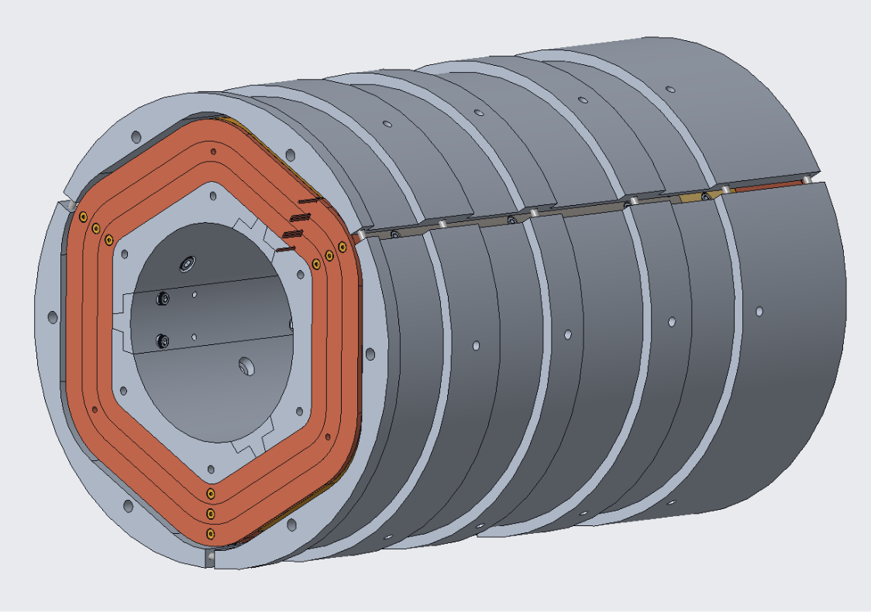
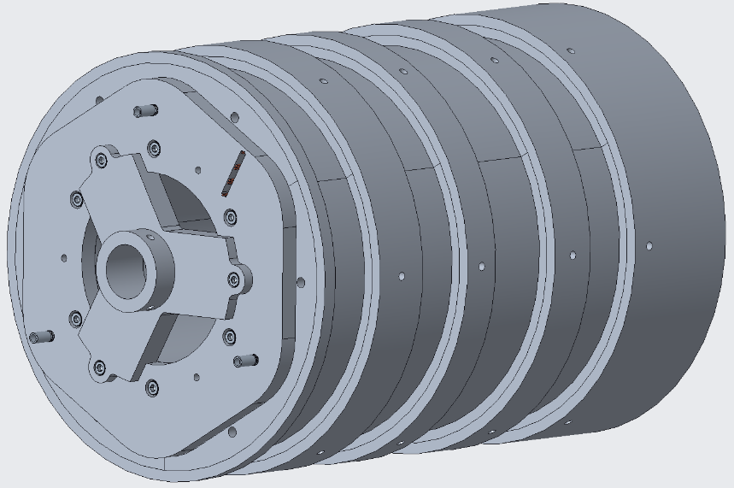
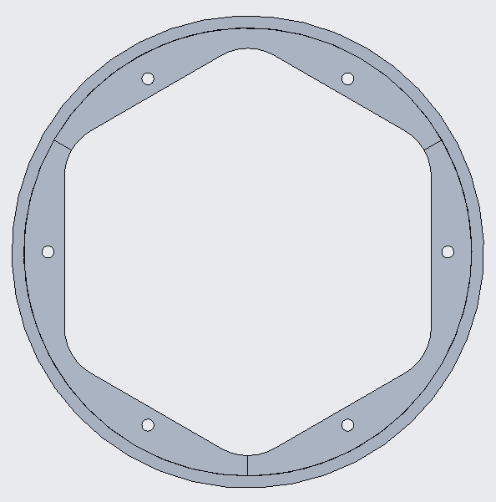
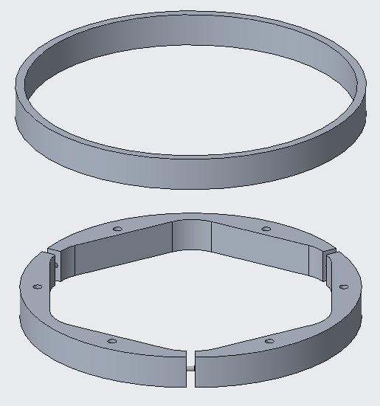
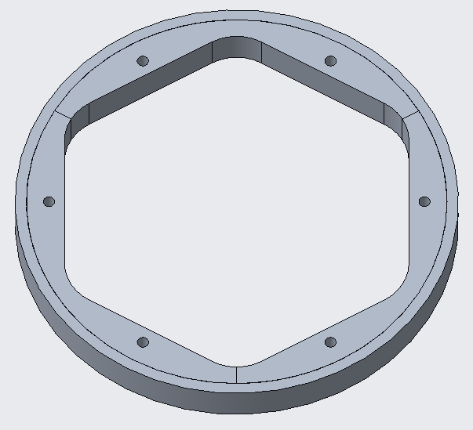
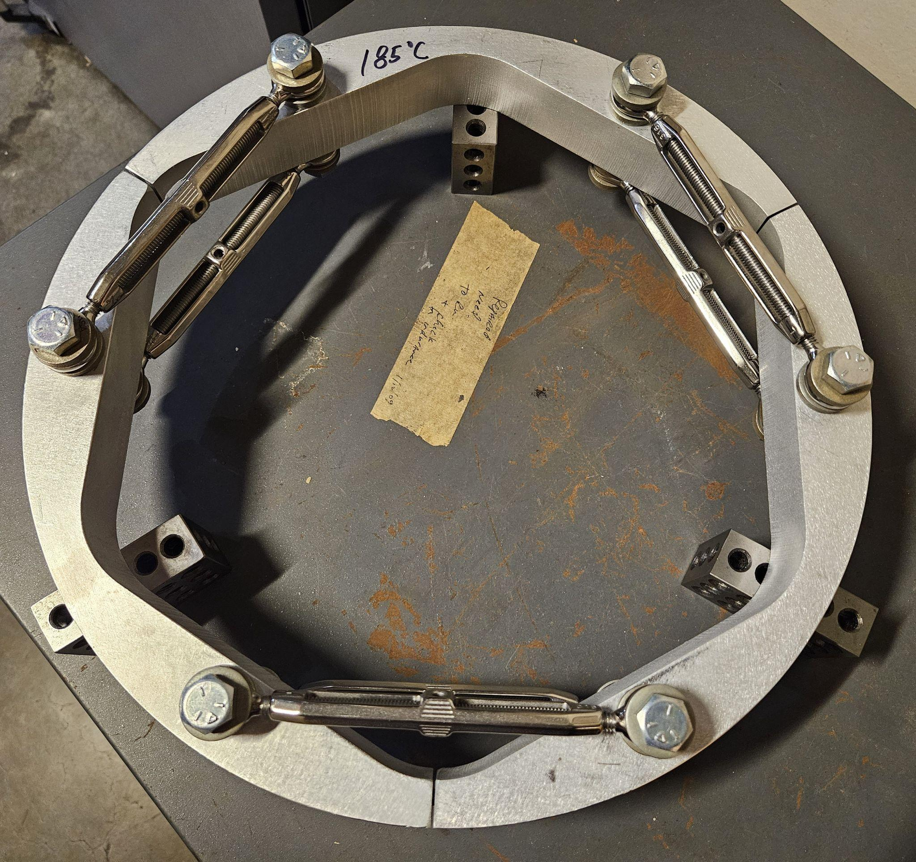
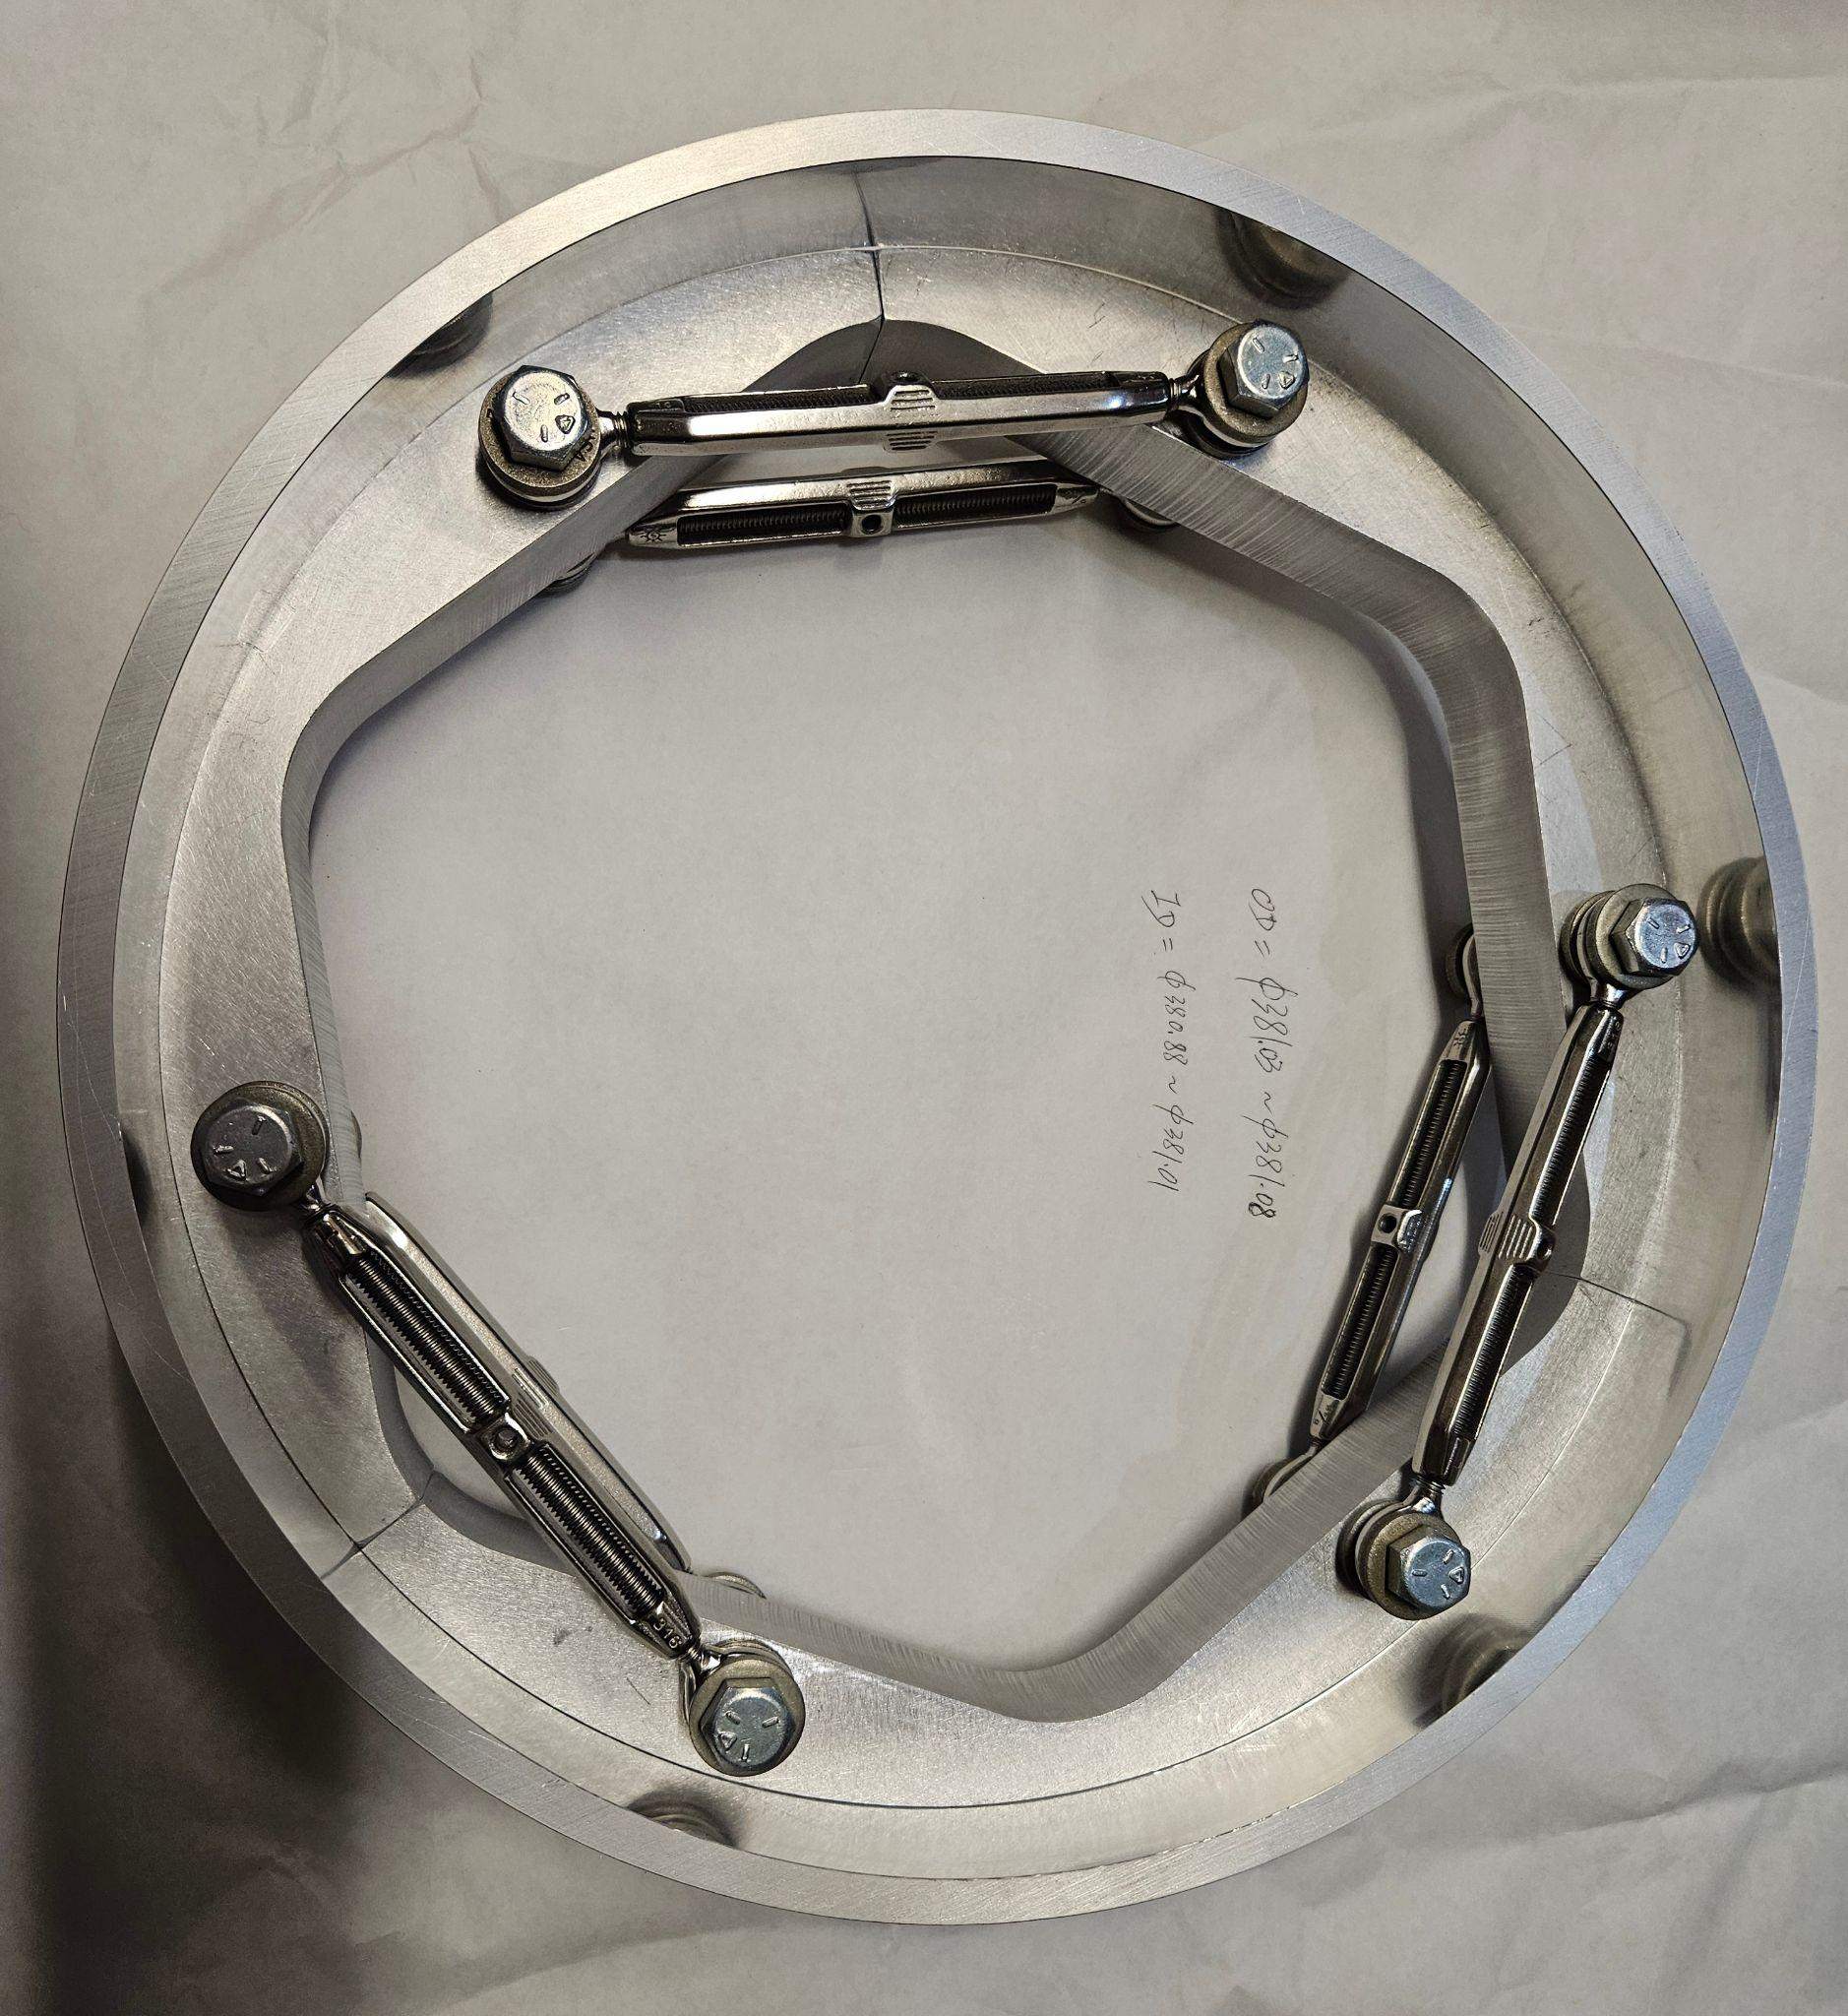
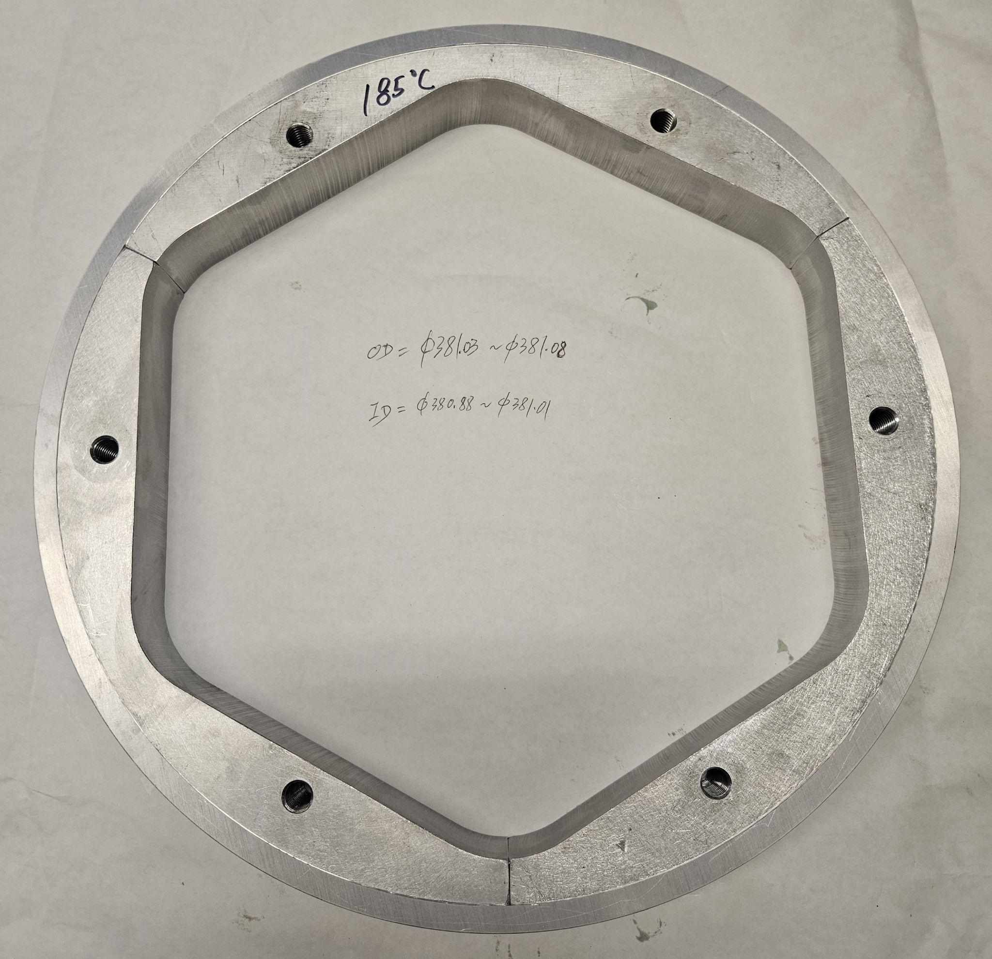
MARS magnet design
In order to ensure good contact between solenoid mandrel and closed-loop coil
  New solenoid mandrel design and new assembly procedure defined
    Mandrel split in 3 parts, assembled around sextupole coils
    Shrink-fit with external rings successfully tested

Slide 25
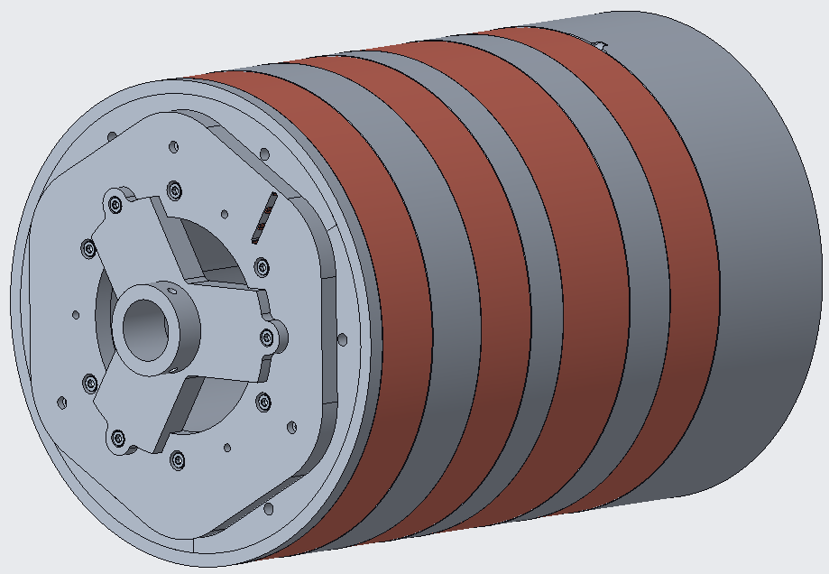



MARS magnet design
Coming up
  Solenoid winding
  Full impregnation
  Assembly and pre-load
    Shell-based structure with keys and bladders
    Pre-load provided with water-pressurized bladders + during cool-down
Test expected in 2026

Slide 26
Outline
Superconducting magnets for particle accelerator: why?
Superconducting materials for high field: two families
From third to fourth generation ECR ion sources
  MARS (Nb-Ti)
  The Nb₃Sn and HTS option
Conclusions

Slide 27




Preliminary study (2010)
Experience from particle accelerator Nb₃Sn magnets applied to ECR ion sources
Comments from that analysis
  The use of Nb₃Sn superconductor makes possible the design of a fourth generation ECR ion source.
  Nevertheless, because of its brittleness and strain dependence, extreme care must be paid in order to minimize coil stresses.
  The magnetic system operates at high field and stored energy, with a low copper to superconductor ratio. This requires the design of a sophisticated quench protection system capable of protecting the coil from high temperatures.
  Unlike current third generation sources, the magnet will most likely implement Rutherford cables operating at high current (>10 kA). The operational current will strongly affect cryogenic system, current leads, and test set-up.

Slide 28




FECR (IMP, China)
First 4th generation ECR ion source
  Target 45 GHz with Nb₃Sn → 11.8 T maximum peak field
Support structure based on aluminum shell pre-loaded with bladders
Sextupole coils successfully tested in hybrid configuration
  See talk from L. Sun

Slide 29






FRIB_II (LBNL)
Second FRIB, identical to the first one, but with Nb₃Sn sextupole coils and Nb-Ti solenoid coils
  It will operate at 28 GHz, so with significant margin, but it will qualify most of the steps toward a “beyond 45 GHz”
Coil for mirror test fabricated and ready for test
Winding
Reaction
Impregnation
Post-impregnation
Mirror magnet

Slide 30







A possible additional Nb₃Sn option: uni-layer
Cable-in-groove design
  Mechanical support provided to every turn
  Tested in canted cos-theta dipole design, Impregnation with filled wax
    Reached 10 T bore field with minimum quenches
Possibility to apply the same concept to a closed-loop type design (uni-layer) , with Nb₃Sn cable
  Preliminary conceptual design in progress
  3D printed plastic parts fabricated

Slide 31

The HTS option
REBCO seems to be the most practical option
  “Magnetic fields for frequencies up to 80 GHz are in principle within the reach of this technology”
    T. Shen, et al. ECRIS2018, Catania, Italy
Issues to be addressed
  Cost of the conductor, quench protection, coil fabrication with tape
10 GHz ECRIS fabricated and tested (RCNP, Osaka University)
Preliminary conceptual design with uni-layer option with stack of 20 tape per groove → ~60 GHz

Slide 32
Outline
Superconducting magnets for particle accelerator: why?
Superconducting materials for high field: two families
From third to fourth generation ECR ion sources
  MARS (Nb-Ti)
  The Nb₃Sn and HTS option
Conclusions

Slide 33
Conclusions
Clear synergy between HEP and NS towards very high field magnets for the next generation of particle colliders and ECR ion sources
Several options under investigation to move beyond the 28 GHz level
In general, all adopt a shell-based structure pre-loaded with bladders to cope with the high electromagnetic forces
MARS is a very efficient design which attempts to push Nb-Ti technology towards ~45 GHz
  Close loop coil fabrication almost completed
Nb₃Sn is the natural next step, pursued with “traditional” coil fabrication techniques (FRIB-II, FECR)
Alternatively, a cable-in-groove close-loop coil seems extremely promising
Times are mature to expand R&D towards an HTS option (synergy with HEP and Fusion applications)

Slide 34
Thank you for your attention

Slide 35
Appendix

Slide 36



Venus/FRIB vs MARS
In summary with MARS we can explore the 45 GHz level still using Nb-Ti
  Optimization of the conductor architecture, coil design, and plasma chamber shape design
FRIB, VENUS – 28GHz
Sextupole-in-solenoid
Circular plasma chamber
  Inner wall radius, 71.85mm
Coil outer diameter, 0.47m
Coil length, 0.85m
$B_{inj}/B_{mid}/B_{extr}$, 3.9 / 0.6 / 2.0 T; $B_{r}$, 2.0 T
MARS-D – 45GHz
Closed-loop coil-in-solenoid
Hexagonal plasma chamber
  Inner wall height, 82mm
  Inner wall corner, 94mm
Coil outer diameter, 0.40m
Coil length, 0.64m
$B_{inj}/B_{mid}/B_{extr}$, 5.7 / 1.2 / 2.9 T; $B_{r}$, 3.0 T (corner)

Slide 37

Venus/FRIB vs MARS
With MARS we can explore the 45 GHz level still using Nb-Ti
  Optimization of the conductor architecture, coil design, and plasma chamber shape design
FRIB, VENUS – 28GHz
Sextupole-in-solenoid
Circular plasma chamber
  Inner wall radius, 71.85mm
Coil outer diameter, 0.47m
Coil length, 0.85m
MARS-D – 45GHz
Closed-loop coil-in-solenoid
Hexagonal plasma chamber
  Inner wall height, 82mm
  Inner wall corner, 94mm
Coil outer diameter, 0.40m
Coil length, 0.64m

Slide 38

The Nb₃Sn option
Nb₃Sn could bring us beyond 45 GHz
  Still, we are just looking at magnetics…..
  Mechanics (brittle material) and coil fabrication (heat treatment and impregnation) are challenging
Past and current work towards a Nb₃Sn ECR Ion source
  Design study of a Nb₃Sn magnet (2010)
  FECR (see previous talk)
  FRIB_II
  Uni-layer (MARS-like design)
The HTS option

Slide 39



Superconducting magnet for ECR ion source based on the Uni-layer concept - Nb3Sn
Parameter | Unit | Value
------------------+------+-------------
Conductor Type | - | Nb₃Sn RRP 132/169
Strand Diameter | mm | 0.60
Cu:non-Cu ratio | - | 1.17
Cable Width | mm | 4.0
Cable Thickness | mm | 1.1
Number of Strands | - | 11

Slide 40



Next generation of superconducting magnet for ECR ion source based on the Uni-layer concept

Slide 41
Item | Unit | MARS-D 45GHz |  |  | MARS design w. FRIB cond. |  |  | FRIB 28GHz |  |  | FRIB design w. MARS cond. |  |  | circular MARS (72mm)
Coil | - | Sextupole | Solenoid | Total | Sextupole | Solenoid | Total | Sextupole | Solenoid | Total | Sextupole | Solenoid | Total | Solenoid | Sextupole | Total
Wire specification | - | MARS NbTi wire |  |  | FRIB NbTi wire |  |  | FRIB NbTi wire |  |  | MARS NbTi wire |  |  | MARS NbTi wire
Wire cross section (ins) | mm² | 1.45x0.71 | 1.91x1.23 | - | 1.65x0.96 | 1.90x1.00 | - | 1.65x0.96 | 1.90x1.00 | - | 1.45x0.71 | 1.91x1.23 | - | 1.45x0.71 | 1.91x1.23 | -
Copper ratio | - | 1.4 | 1.3 | - | 4 | 3 | - | 4 | 3 | - | 1.4 | 1.3 | - | 1.4 | 1.3 | -
RRR | - | 70 | 99 | - |  |  | - |  |  | - | 70 | 99 | - | 70 | 99 | -
Coil volume | m³ | 1.48E-02 | 1.25E-02 | 2.73E-02 | 1.48E-02 | 1.25E-02 | 2.73E-02 | 1.51E-02 | 2.87E-02 | 4.38E-02 | 1.51E-02 | 2.87E-02 | 4.38E-02 | 1.19E-02 | 1.25E-02 | 2.44E-02
Superconductor volume | m³ | 7.98E-03 | 6.74E-03 | 1.47E-02 | 5.30E-03 | 3.26E-03 | 8.56E-03 | 5.33E-03 | 7.46E-03 | 1.28E-02 | 8.27E-03 | 1.59E-02 | 2.42E-02 | 4.18E-03 | 6.74E-03 | 1.09E-02
Total turns | - | 1536 | 9962 | 11498 | 1752 | 6324 | 8076 | 3876 | 12960 | 16836 | 3300 | 19808 | 23108 | 1632 | 9962 | 11594
Wire length | km | 5.6 | 10.9 | 16.5 | 6.4 | 6.9 | 13.3 | 6.6 | 16.0 | 22.6 | 5.6 | 24.5 | 30.1 | 4.5 | 10.9 | 15.4
Max. field | T | 8.26 | 7.93 |  | 7.18 | 7.39 |  | 6.54 | 6.12 |  | 7.33 | 6.95 |  | 5.87 | 7.74
Max. current density | A/mm² | 193.2 | 218.1 |  | 170.0 | 193.1 |  | 129.9 | 196.0 |  | 224.4 | 147.5 |  | 157.0 | 219.8
Load line margin | % | 88.6 | 83.8 |  | 87.1 | 86.0 |  | 87.2 | 77.6 |  | 85.3 | 78.0 |  | 62.0 | 88.9
Tcs | K | 5.07 | 5.41 |  | 5.05 | 5.09 |  | 5.07 | 5.64 |  | 5.20 | 5.65 |  | 6.04 | 4.75
MQE | μJ | 10.44 | 5.04 |  | 6.24 | 4.75 |  | 6.08 | 9.41 |  | 11.06 | 6.78 |  | 2.53 | 8.92
Integral heat capacity | J/kg | 0.43 | 0.65 |  | 0.29 | 0.26 |  | 0.29 | 0.49 |  | 0.51 | 0.81 |  | 0.47 | 0.39
Stored energy | kJ | 707.3 |  |  | 568.7 |  |  | 658.1 |  |  | 892.4 |  |  | 454.2
Binj / Bmid / Bext | T | 5.70 / 1.22 / 2.92 |  |  | 5.15 / 1.08 / 2.60 |  |  | 3.93 / 0.59 / 1.95 |  |  | 4.40 / 0.72 / 2.21 |  |  | 4.47 / 0.86 / 2.50
Br | T | 3.01 (at 94 mm) |  |  | 2.72 (at 94 mm) |  |  | 1.96 (at 72 mm) |  |  | 2.23 (at 72 mm) |  |  | 2.42 (at 72 mm)
Frequency | GHz | 45 |  |  | 41 |  |  | 28 |  |  | 32 |  |  | 34

