Slide 1
UKAEA overview (shameless plug!)
ICIS25, 8th Sept 2025

Slide 2
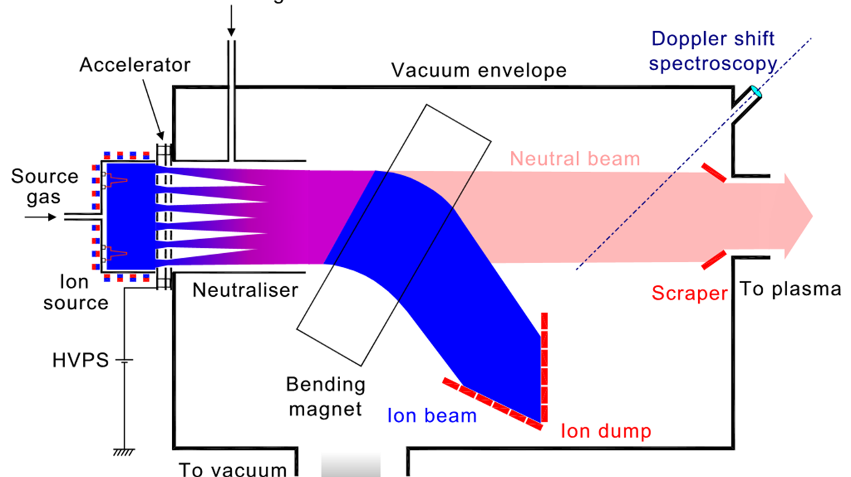
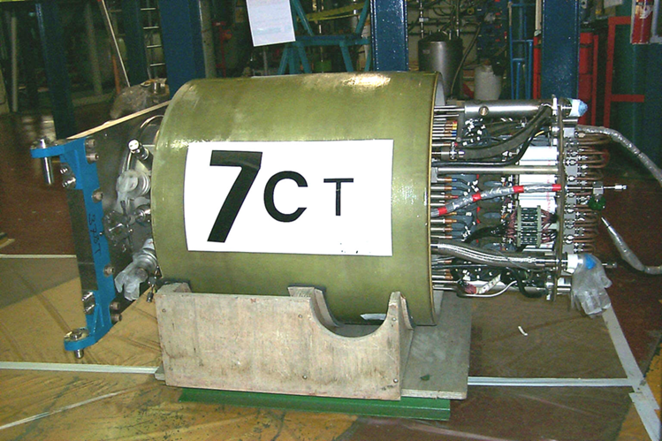
My first experience of ion sources…

Slide 3
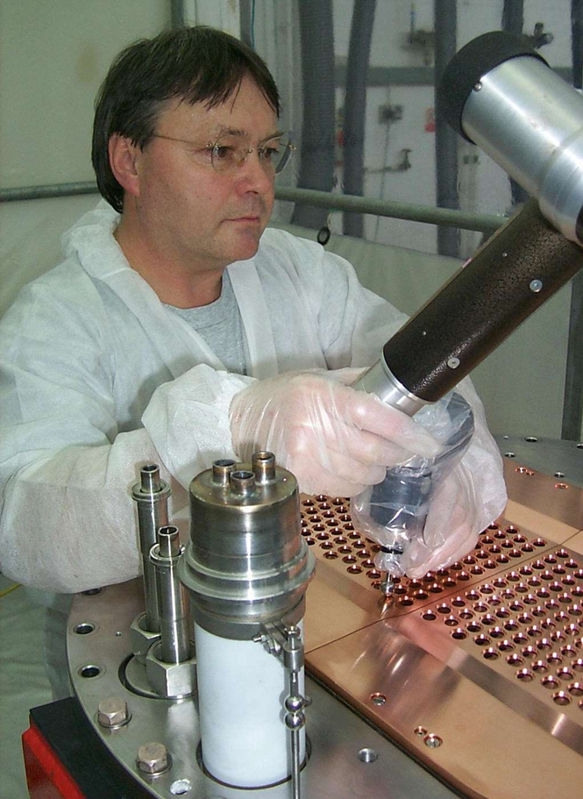
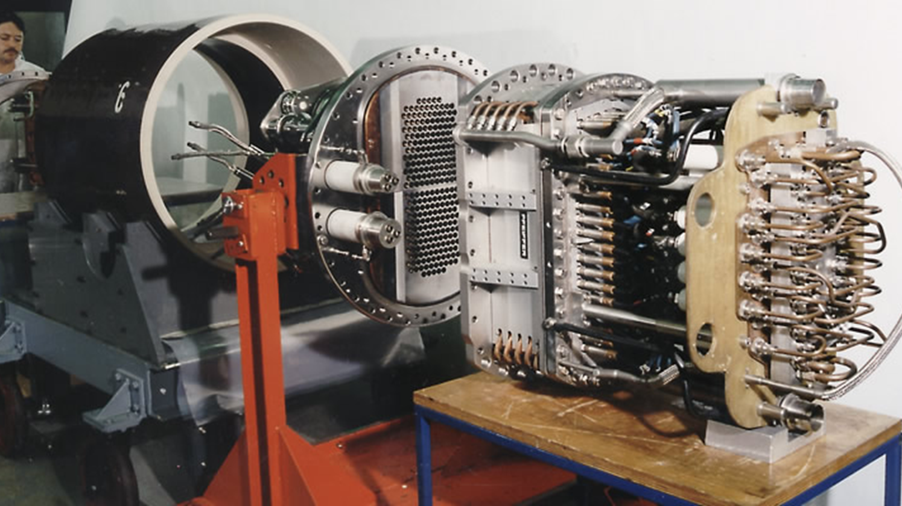
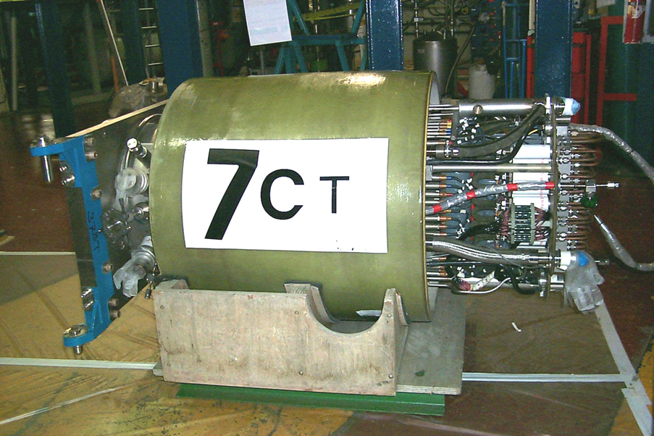
My first experience of ion sources…

Slide 4
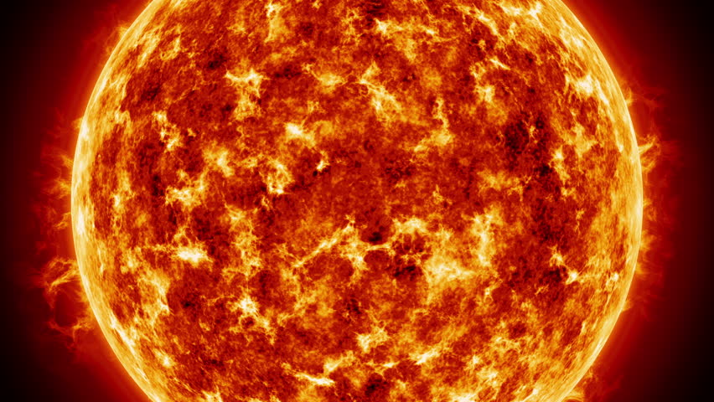

Slide 5
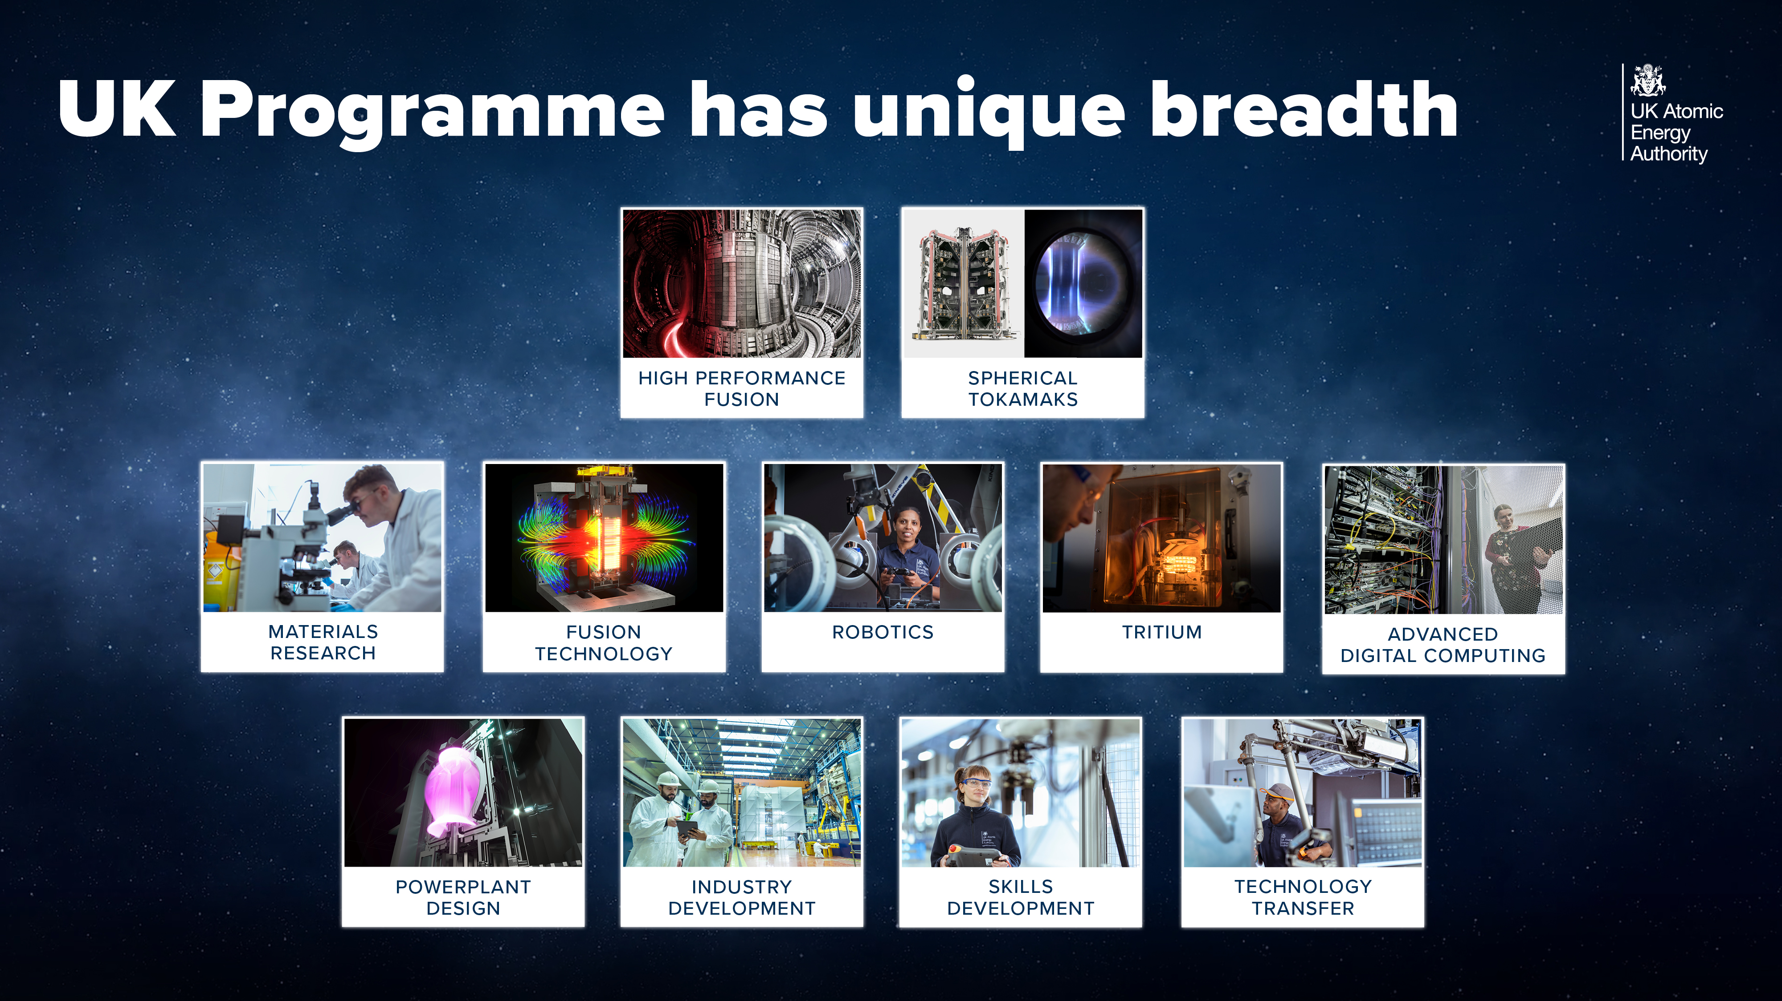

Slide 6
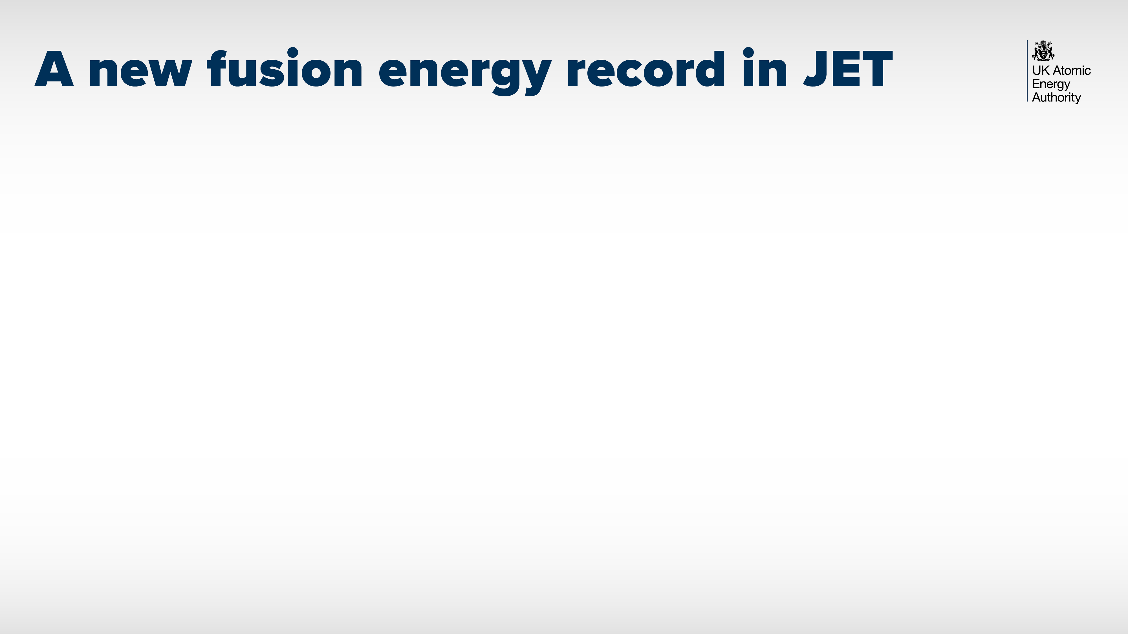
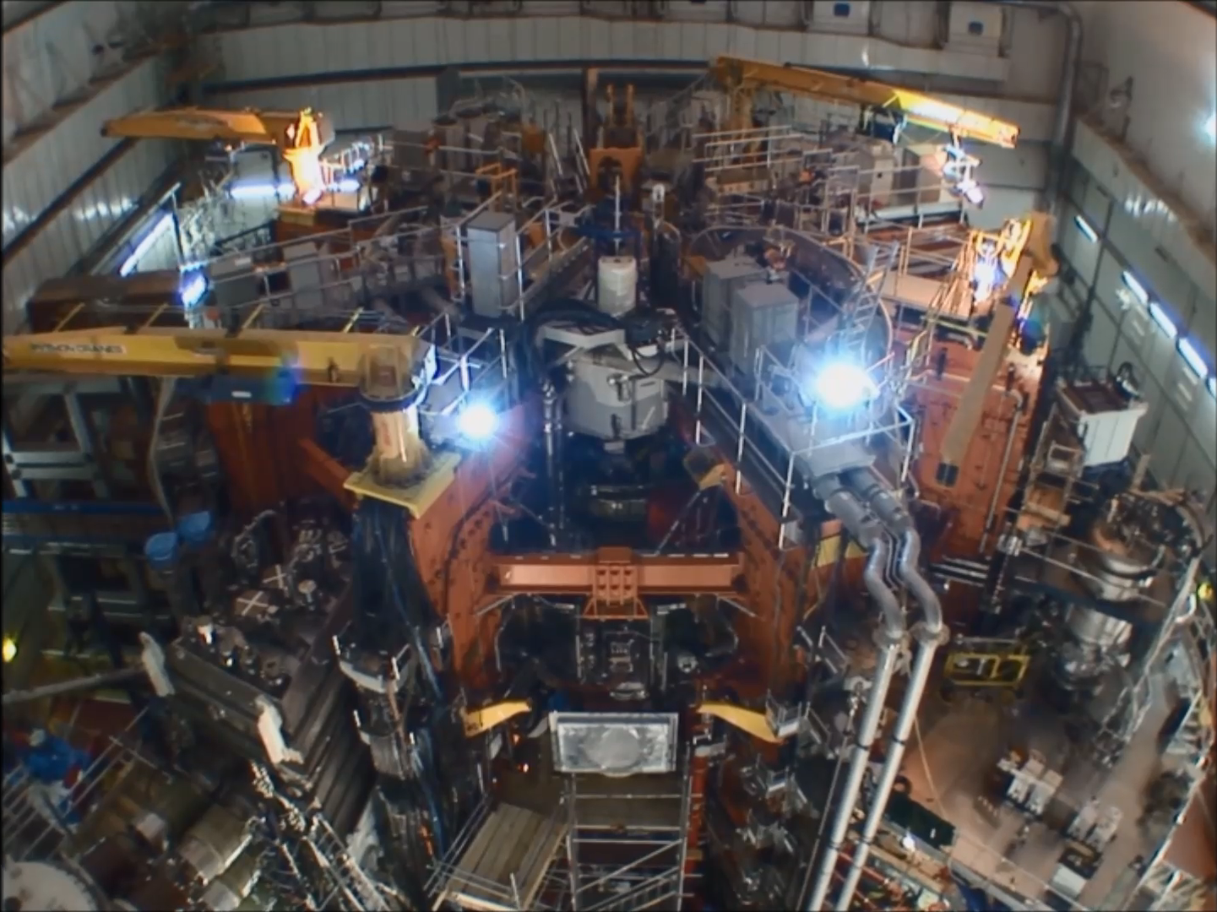
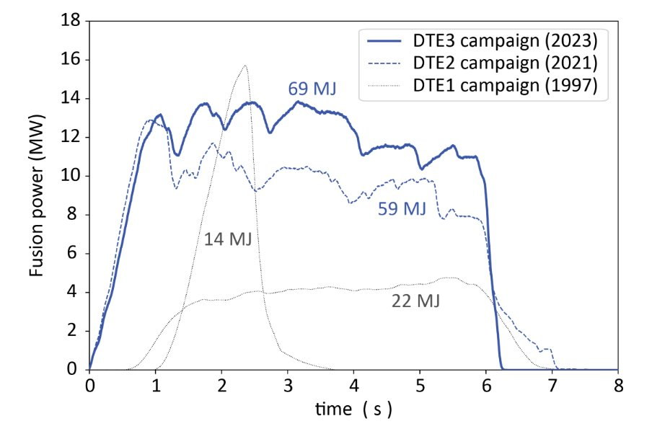

Notes:
Operating JET on behalf of the whole EUROfusion community
Teams from all over EU set a new world record for fusion energy released in 2022

Slide 7

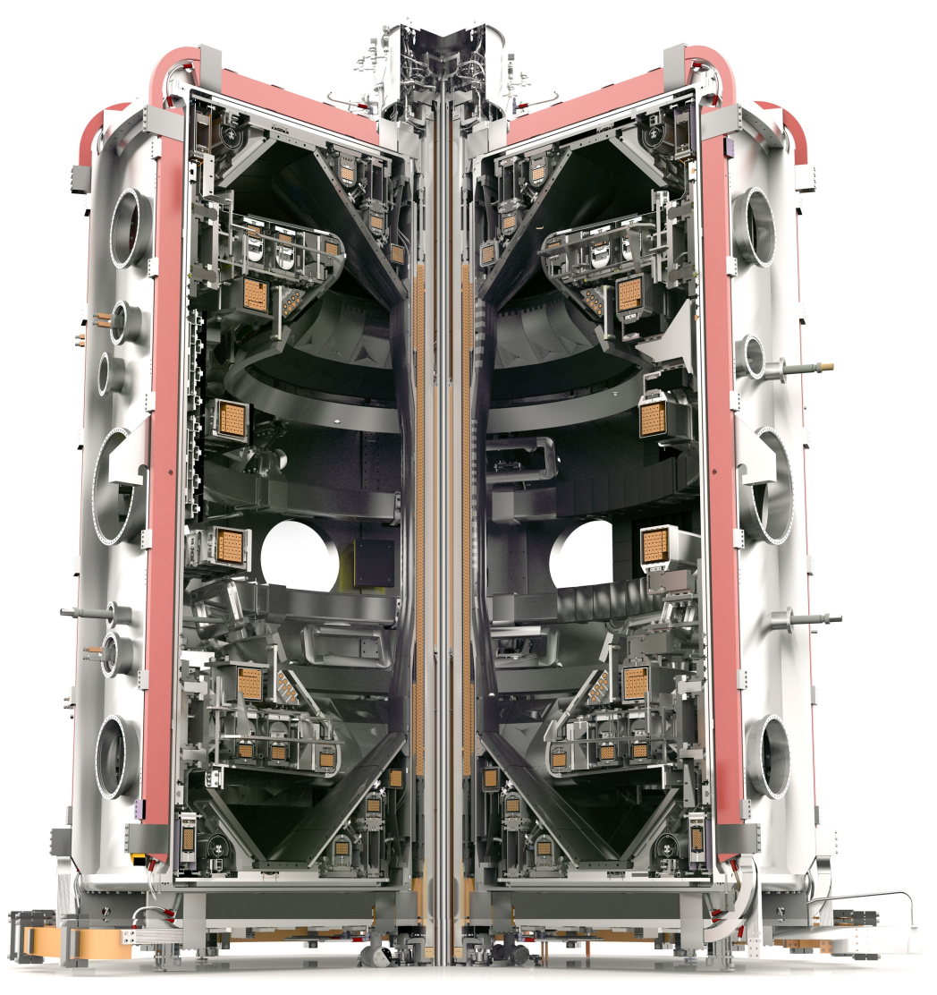
MAST Upgrade – A Spherical Tokamak

Slide 8
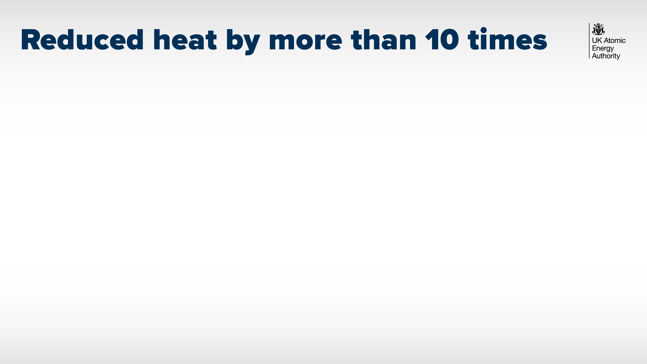
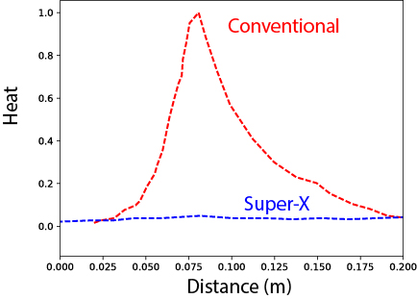
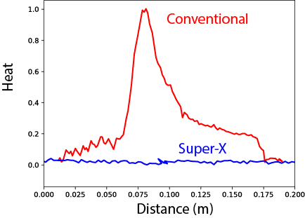
Modelling
Experiment

Slide 9
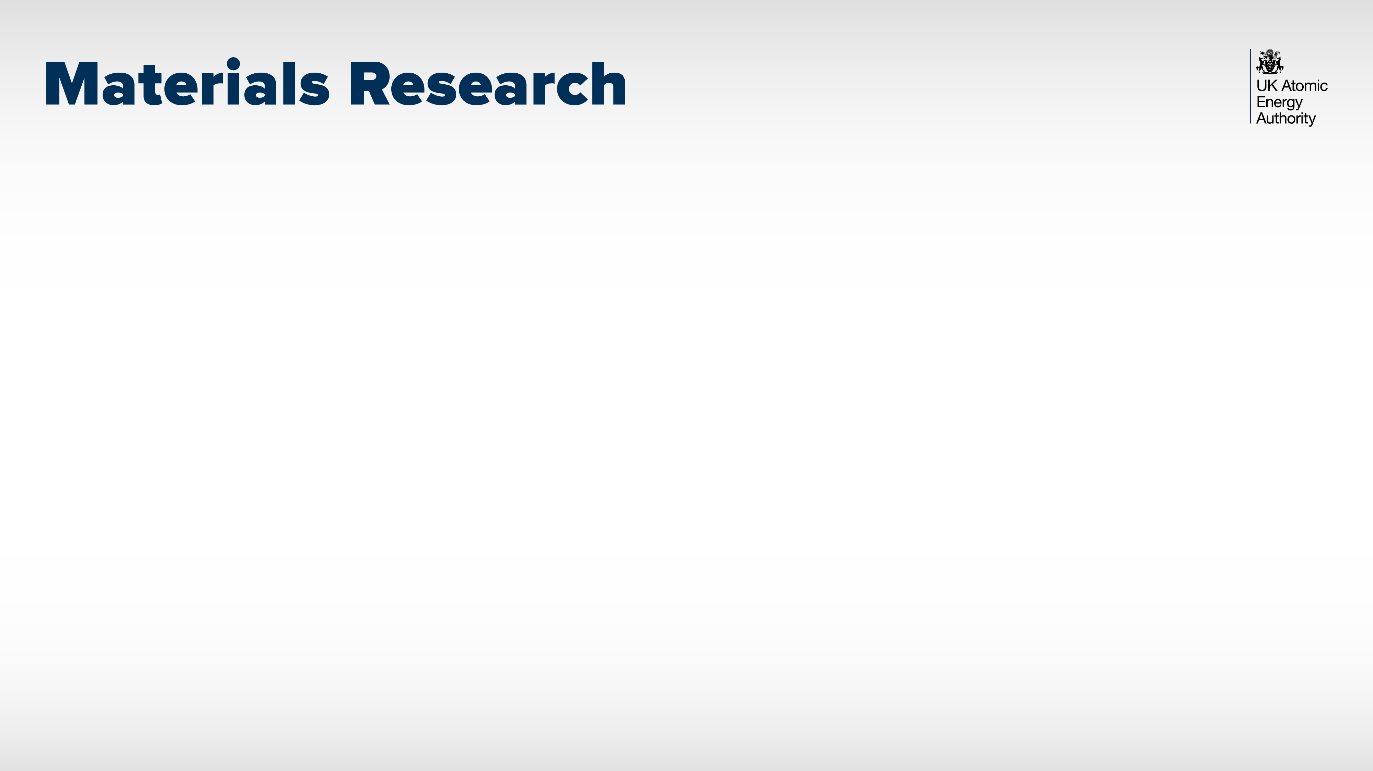
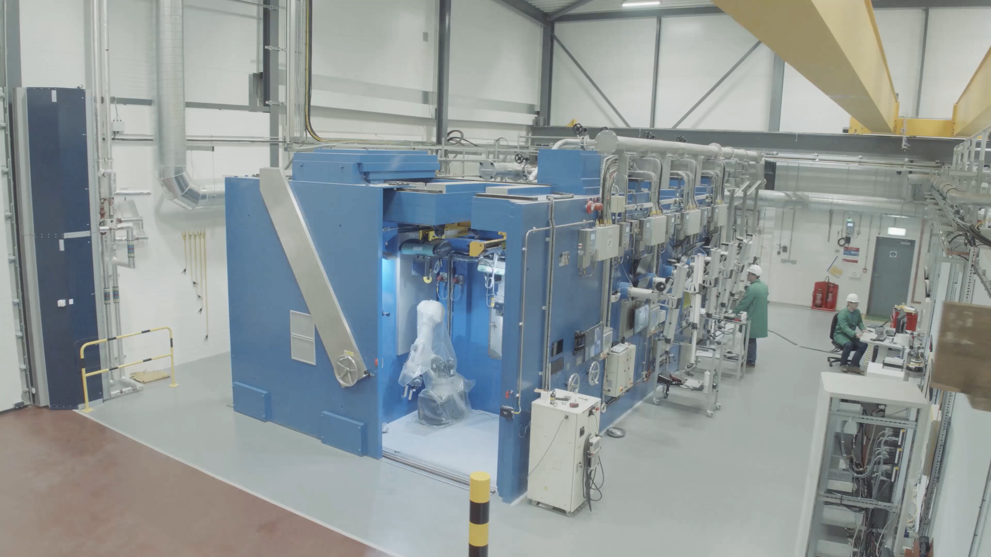
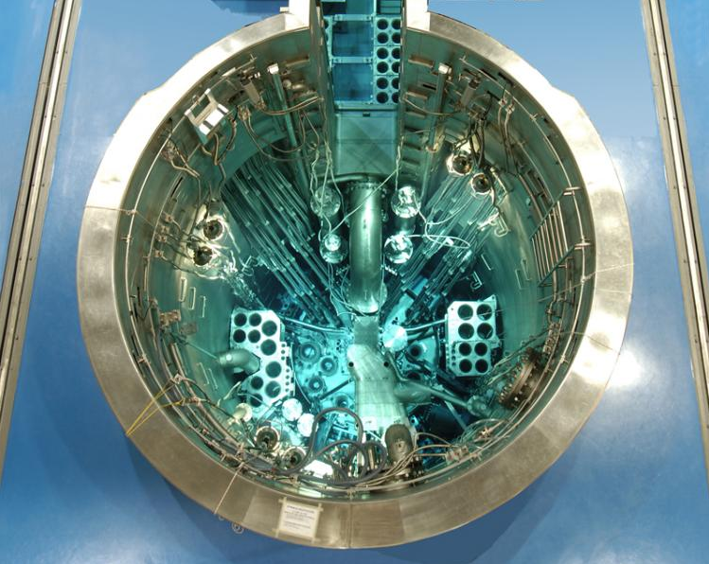
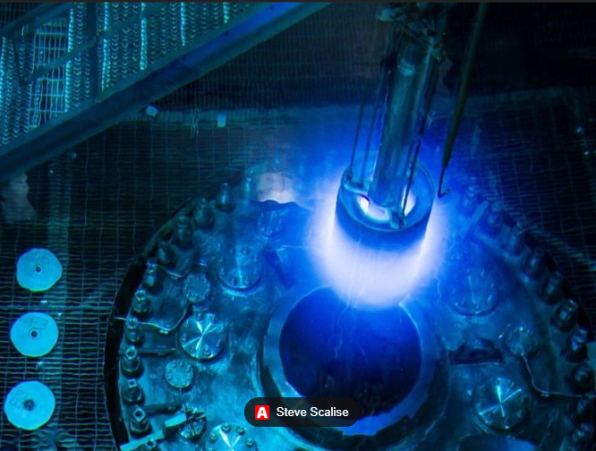
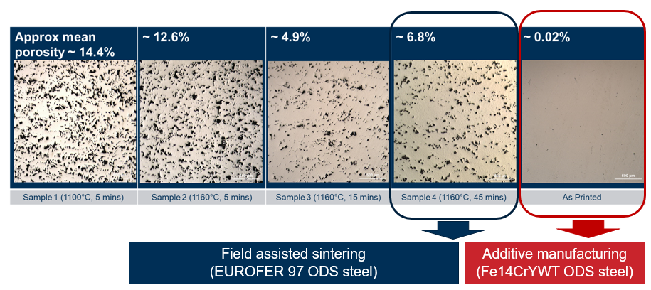
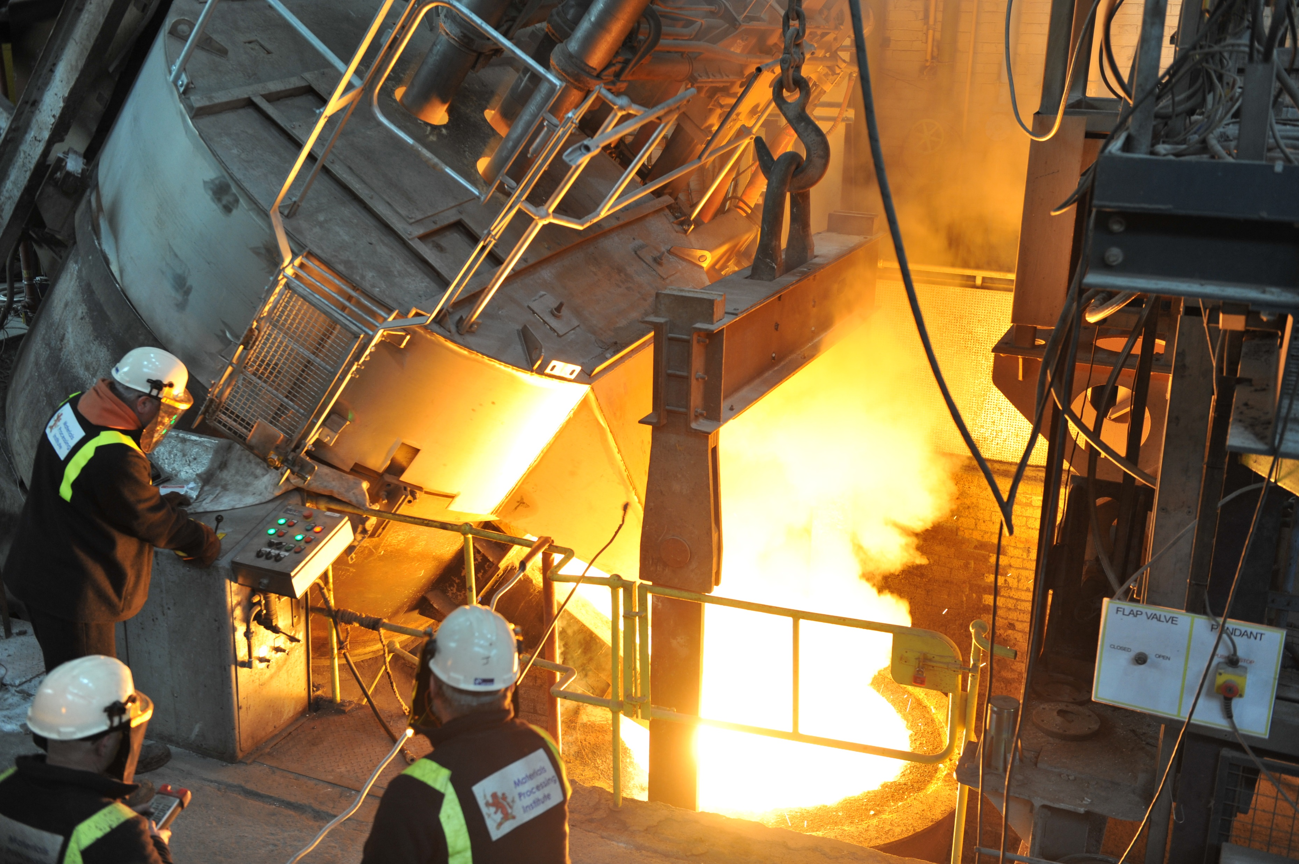
Neutron irradiations
Novel fabrication at scale
Better structural design
Damage determination
OPAL at ANSTO
HFIR at ORNL
Metals, ceramics, composites and coatings
Image: Materials Processing Institute
Notes:
We’re irradiating new fusion materials across the globe (Oak Ridge in USA, Ansto in Australia)
Our expanding MRF is used to analyse the damage from those irradiations
Damage teaches us how to model material performance in service
Damage also teaches us how to design better materials
…through better fabrication processes.

Slide 10
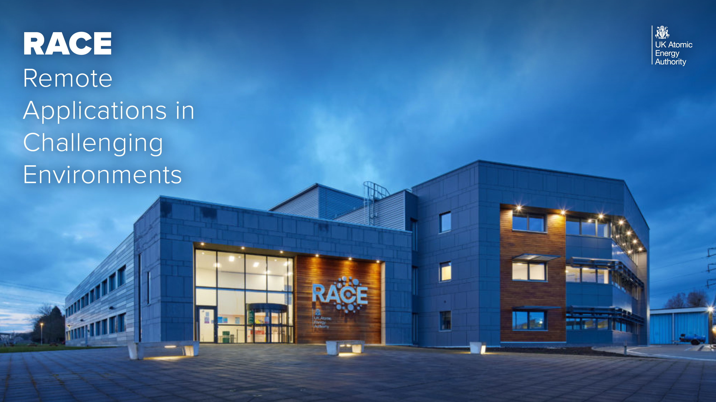

Slide 11
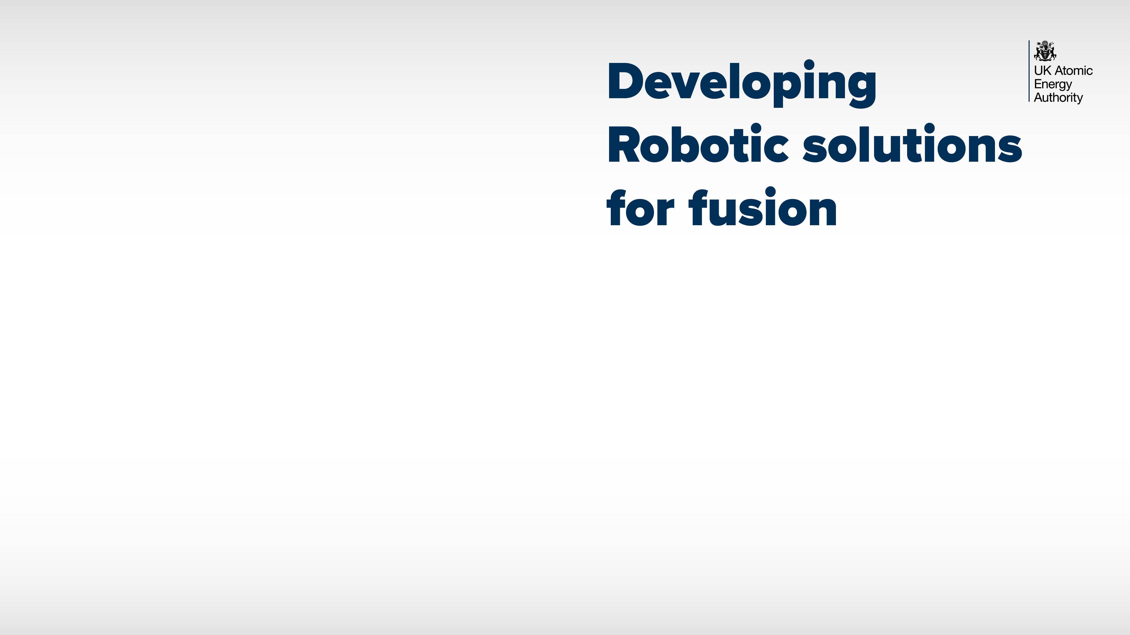
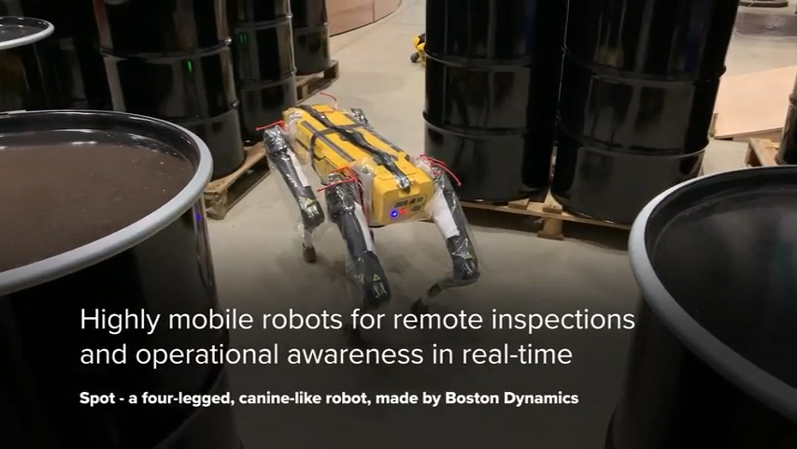

Slide 12
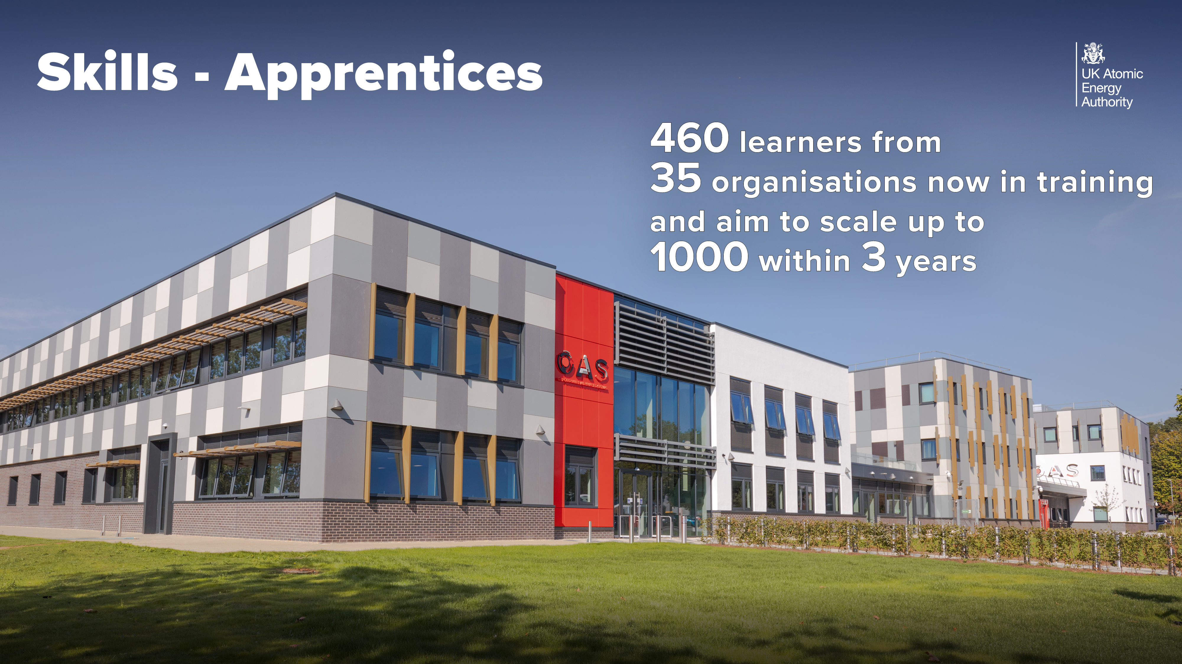

Slide 13
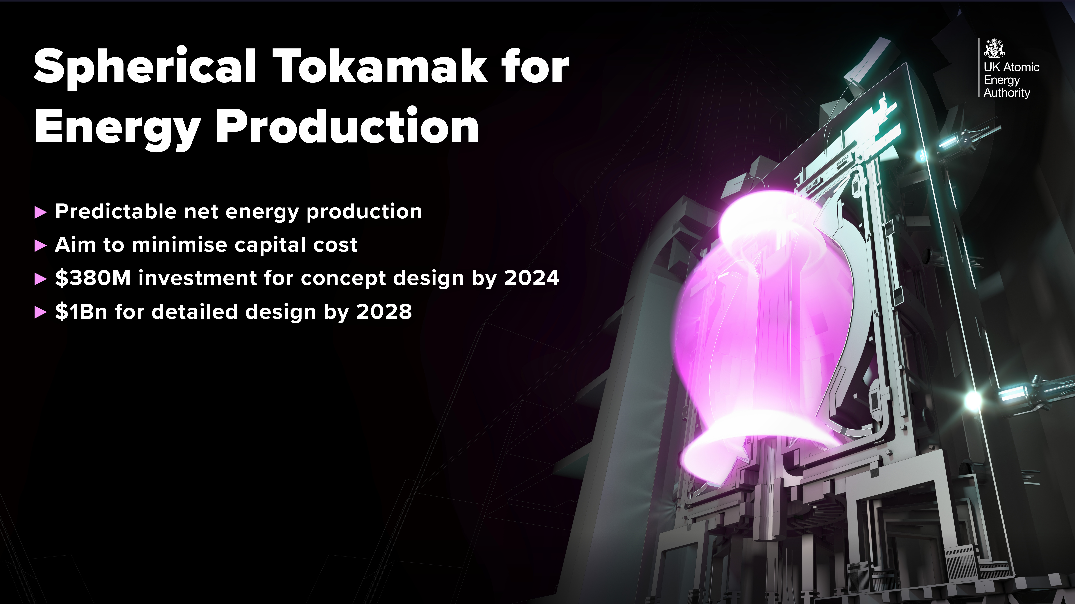
Predictable net energy production
Aim to minimise capital cost
£290M investment for concept design by 2024
£800M for detailed design by 2028

