Slide 2
Overview of the Heavy Ion Physics Programme at CERN Current and Future Ion Source Requirements and Challenges
D. Küchler, R. Alemany Fernández, G. Bellodi, B.S. Bhaskar, E. Mahner, R. Scrivens, M. Slupecki (CERN)

Slide 3
Contents
Ion injector complex at CERN
Accelerators and users
GTS-LHC ion source
Operation
New Ion types
Requests from the users
Challenges and upgrade proposals
Summary and Outlook

Slide 4
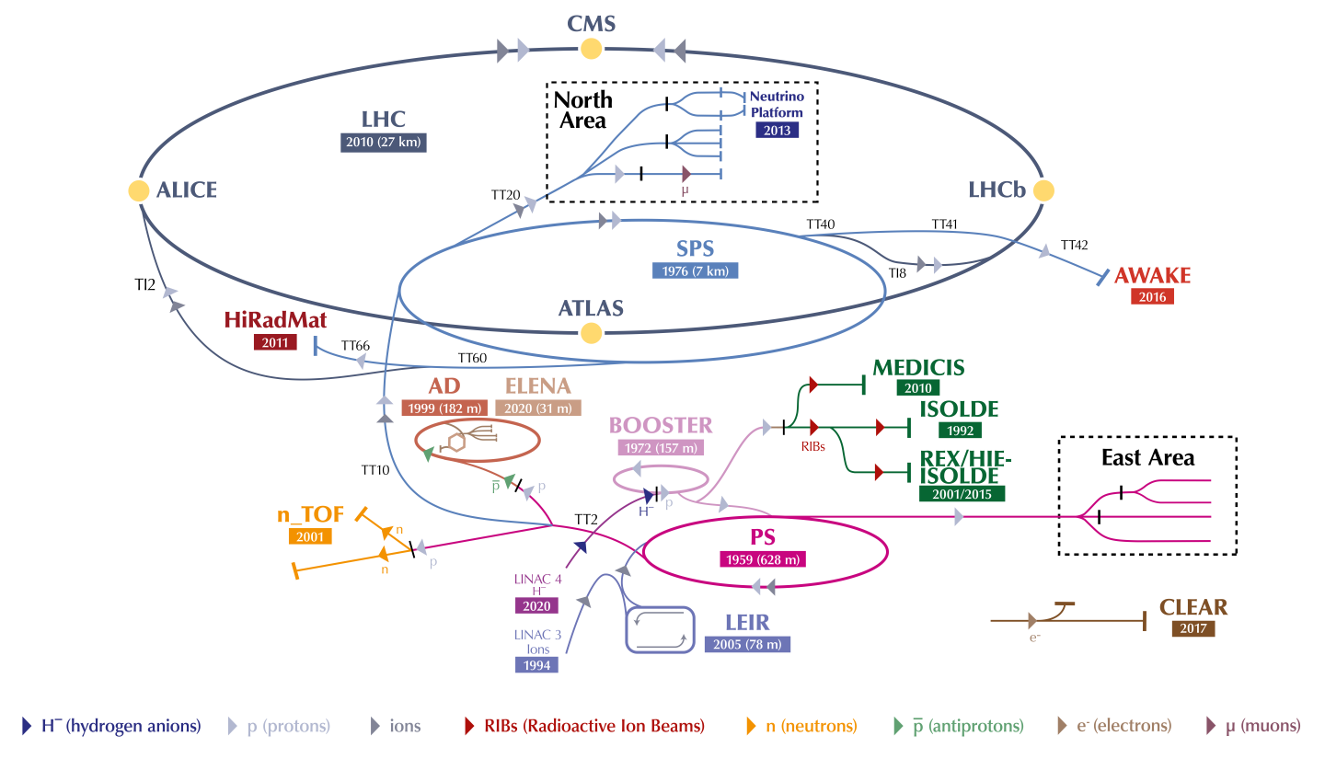
Accelerator complex at CERN

Slide 5
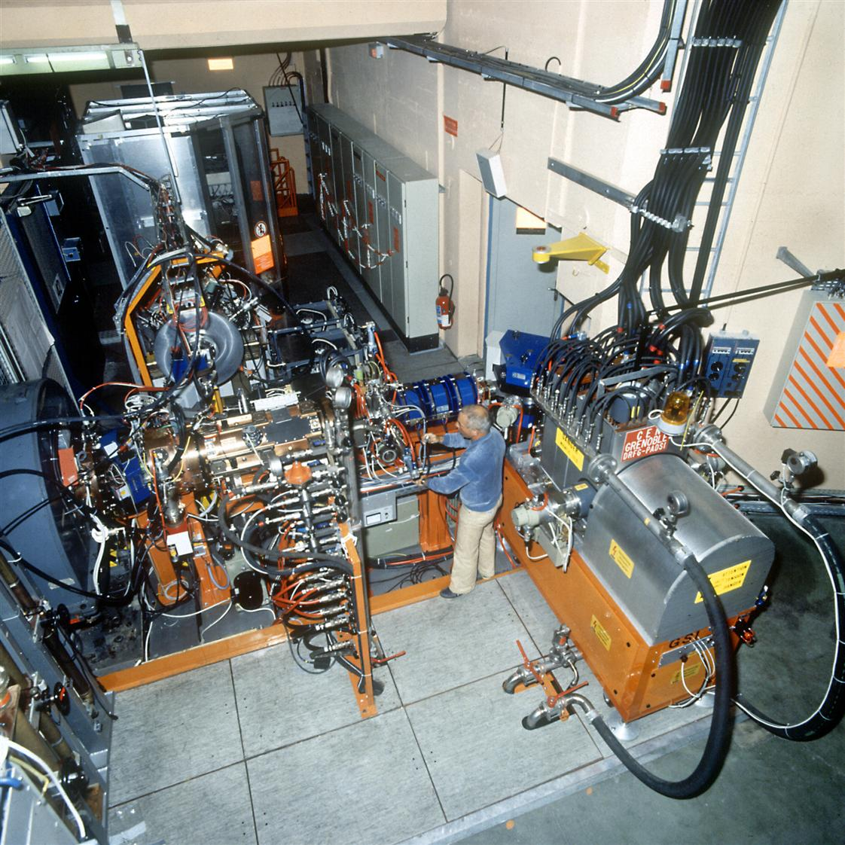
A long history with ions
Ion front end with a duoplasmatron and an ECR type ion source on the Linac1 linear accelerator in the 80s
Study of ion beam transport through the CERN accelerator chain and first ion experiments using oxygen and sulphur ion beams
Design and construction of Linac3 (dedicated linear accelerator for ions with an ECR4 type ion source) at the beginning of the 90s
A new ion source (GTS-LHC) and the Low Energy Ion Ring (LEIR) designed and constructed at the beginning of the 2000s as part of the LHC ion injector complex upgrade to overcome brightness limitations
Linac1 front end with two sources

Slide 6
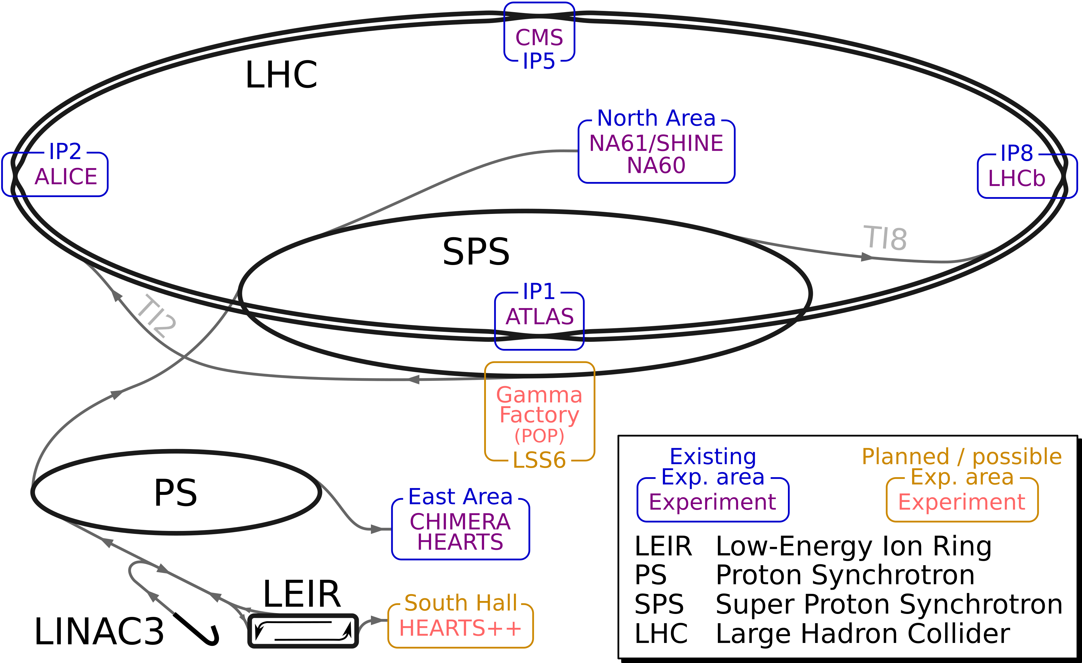
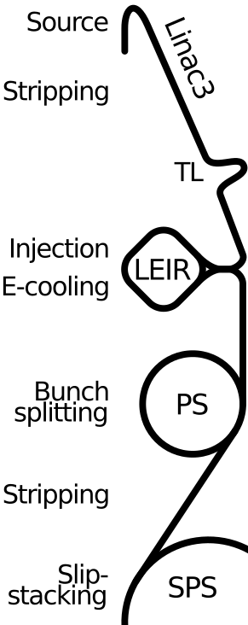
Ion injector complex at CERN
2.5 keV/u
4.2 MeV/u
5.36 TeV/u
72.2 MeV/u
5.9 GeV/u
177 GeV/u

Slide 7
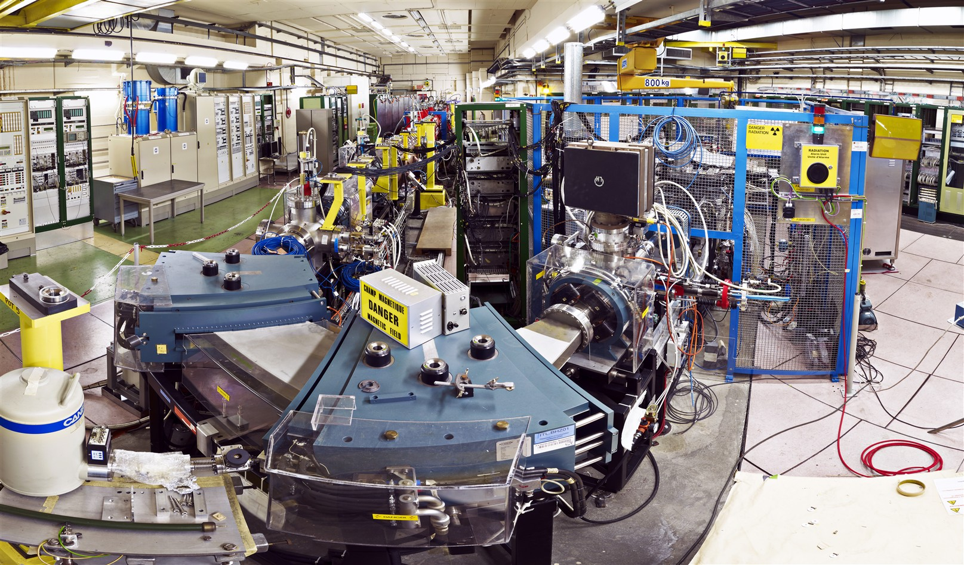
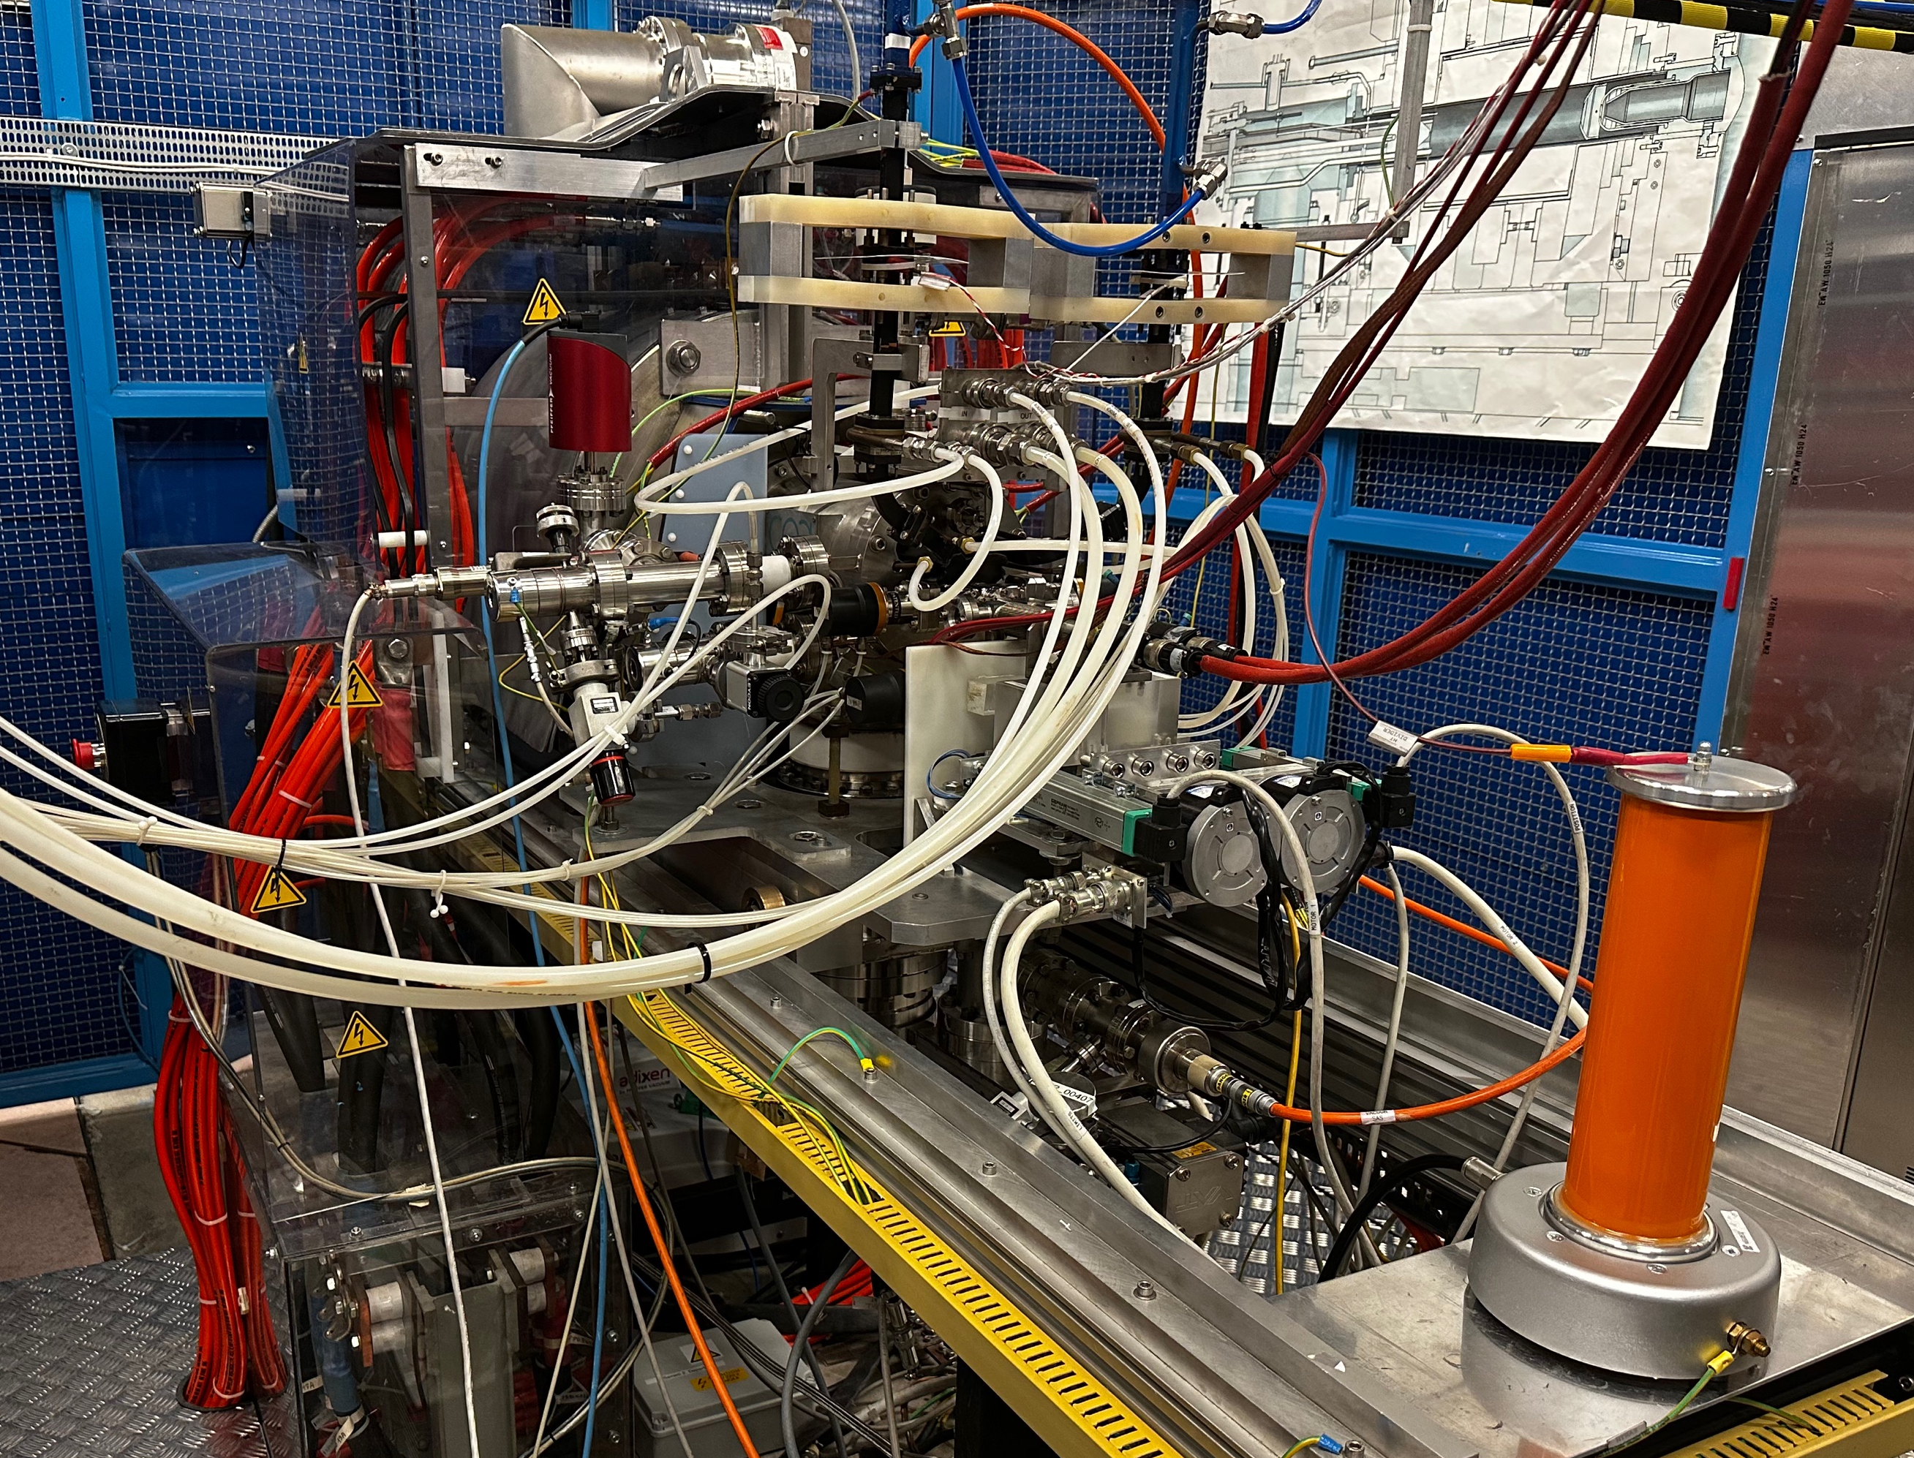
Linac3 linear accelerator and GTS-LHC ion source

Slide 8
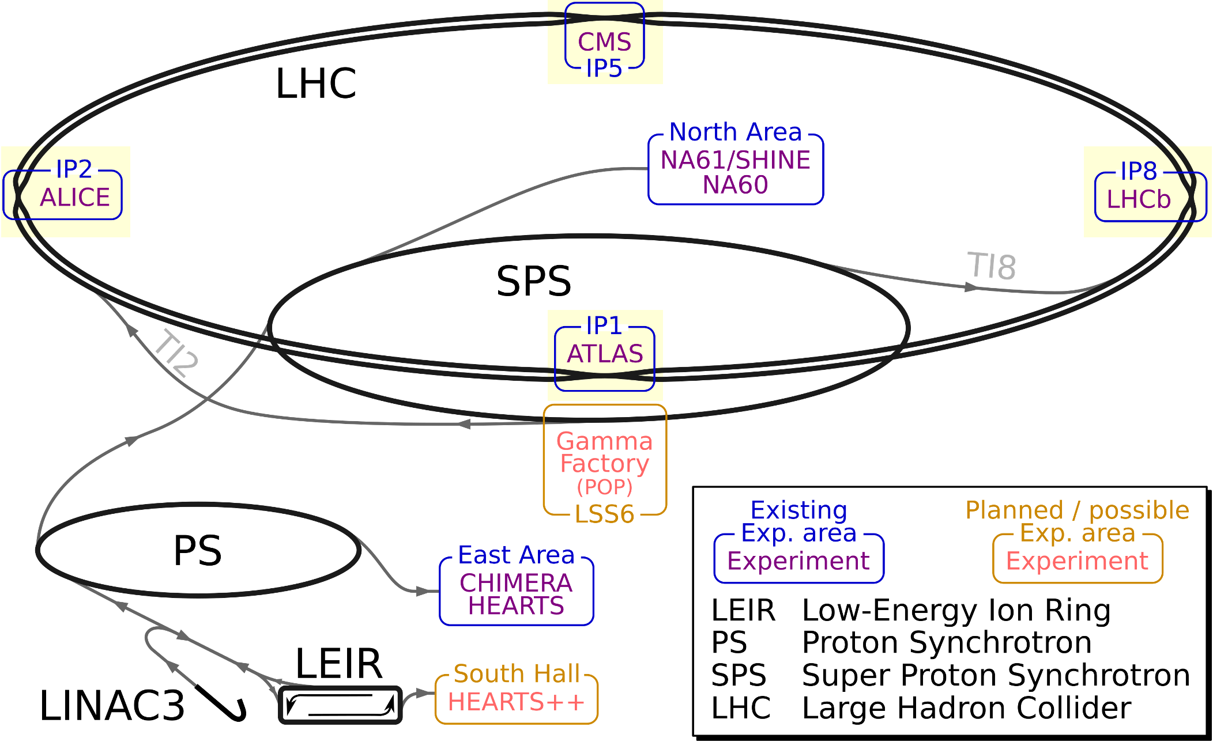
Collider experiments

Slide 9
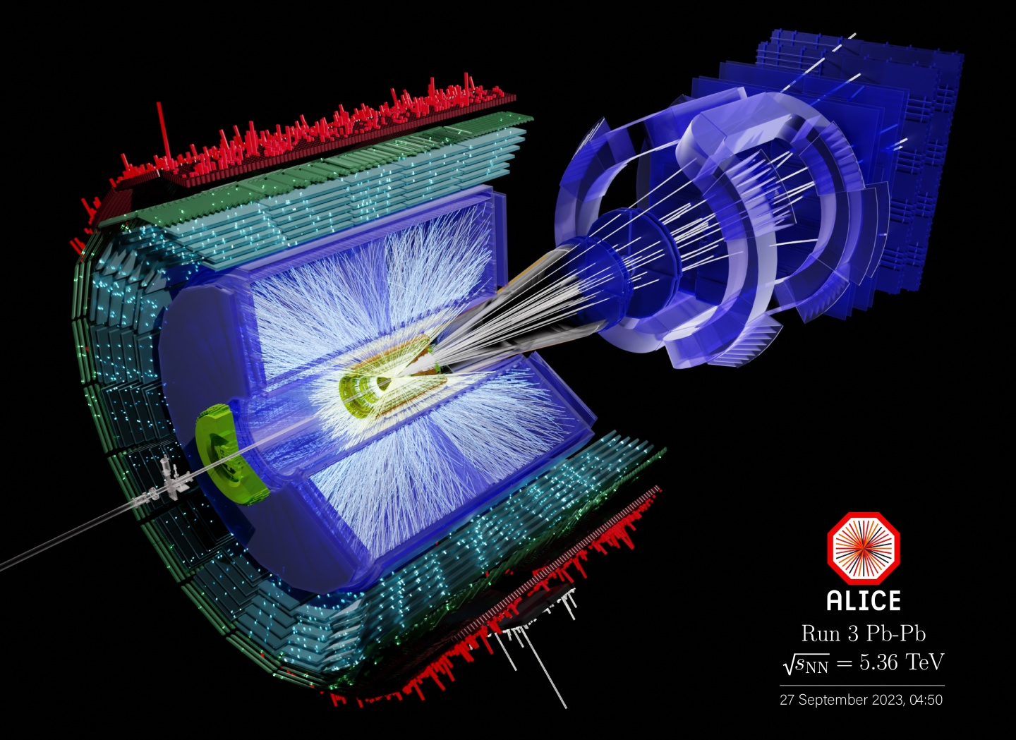
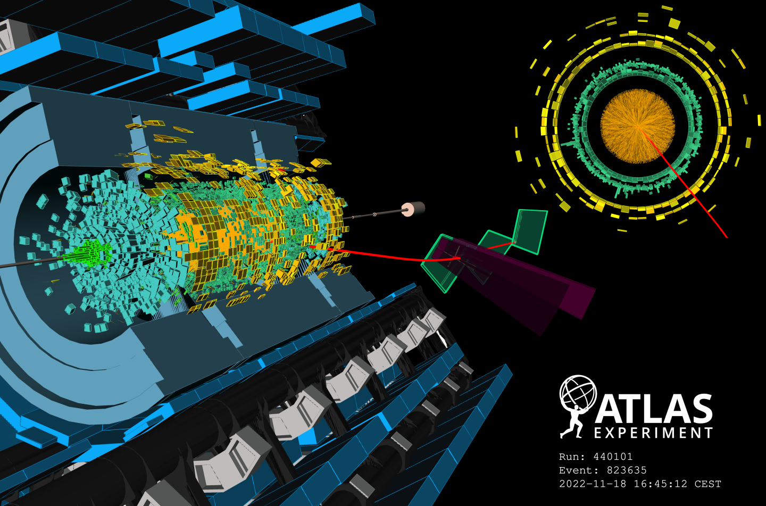
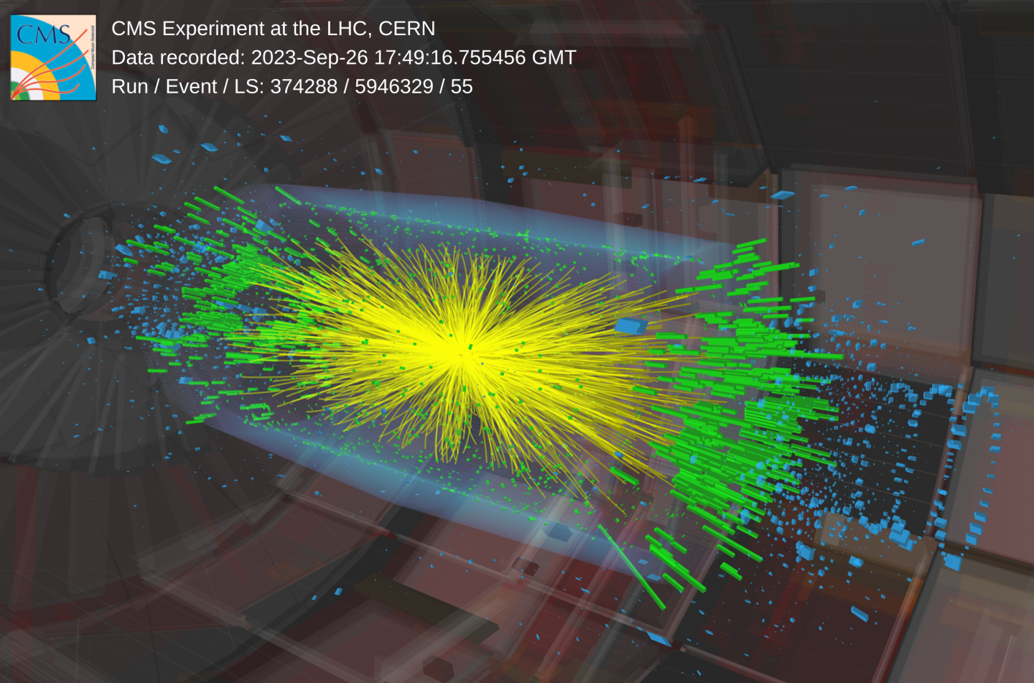
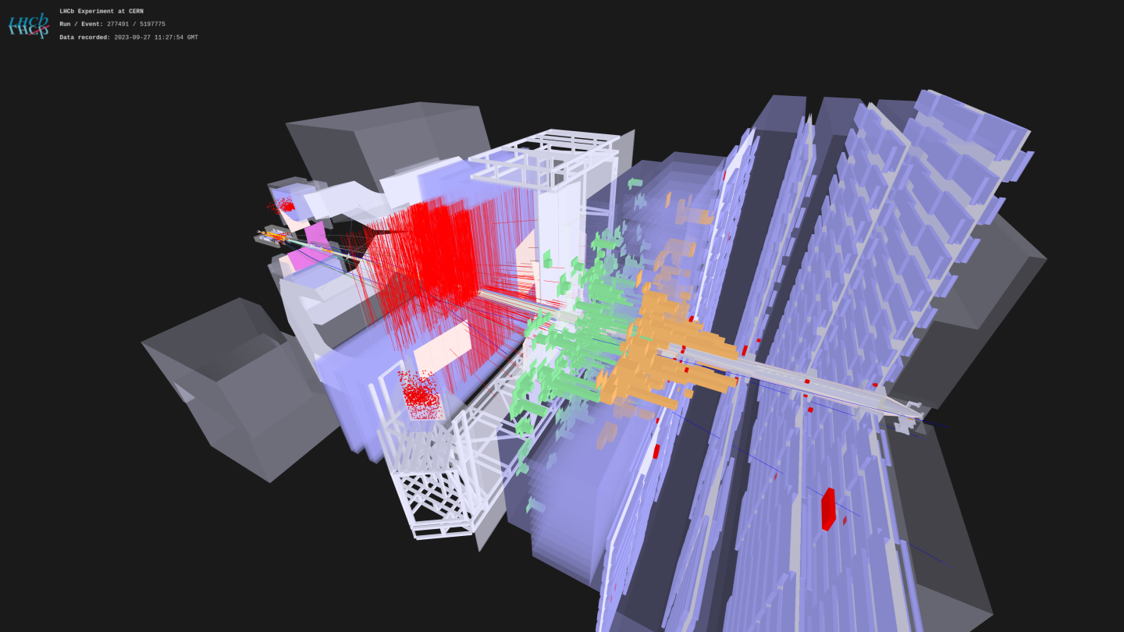
Event displays of the collider experiments during lead-lead collisions

Slide 10
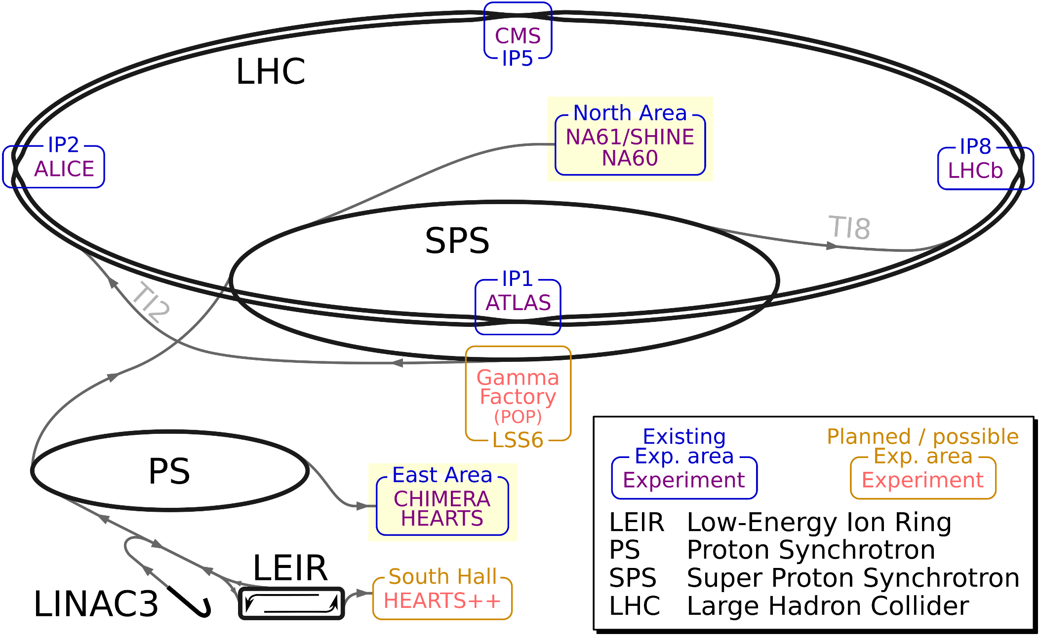
Fixed target experiments

Slide 11
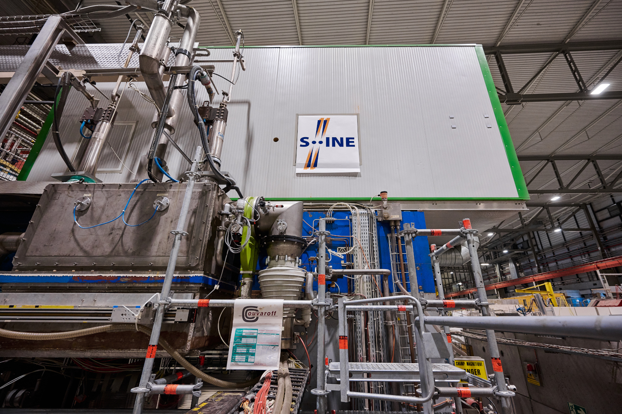
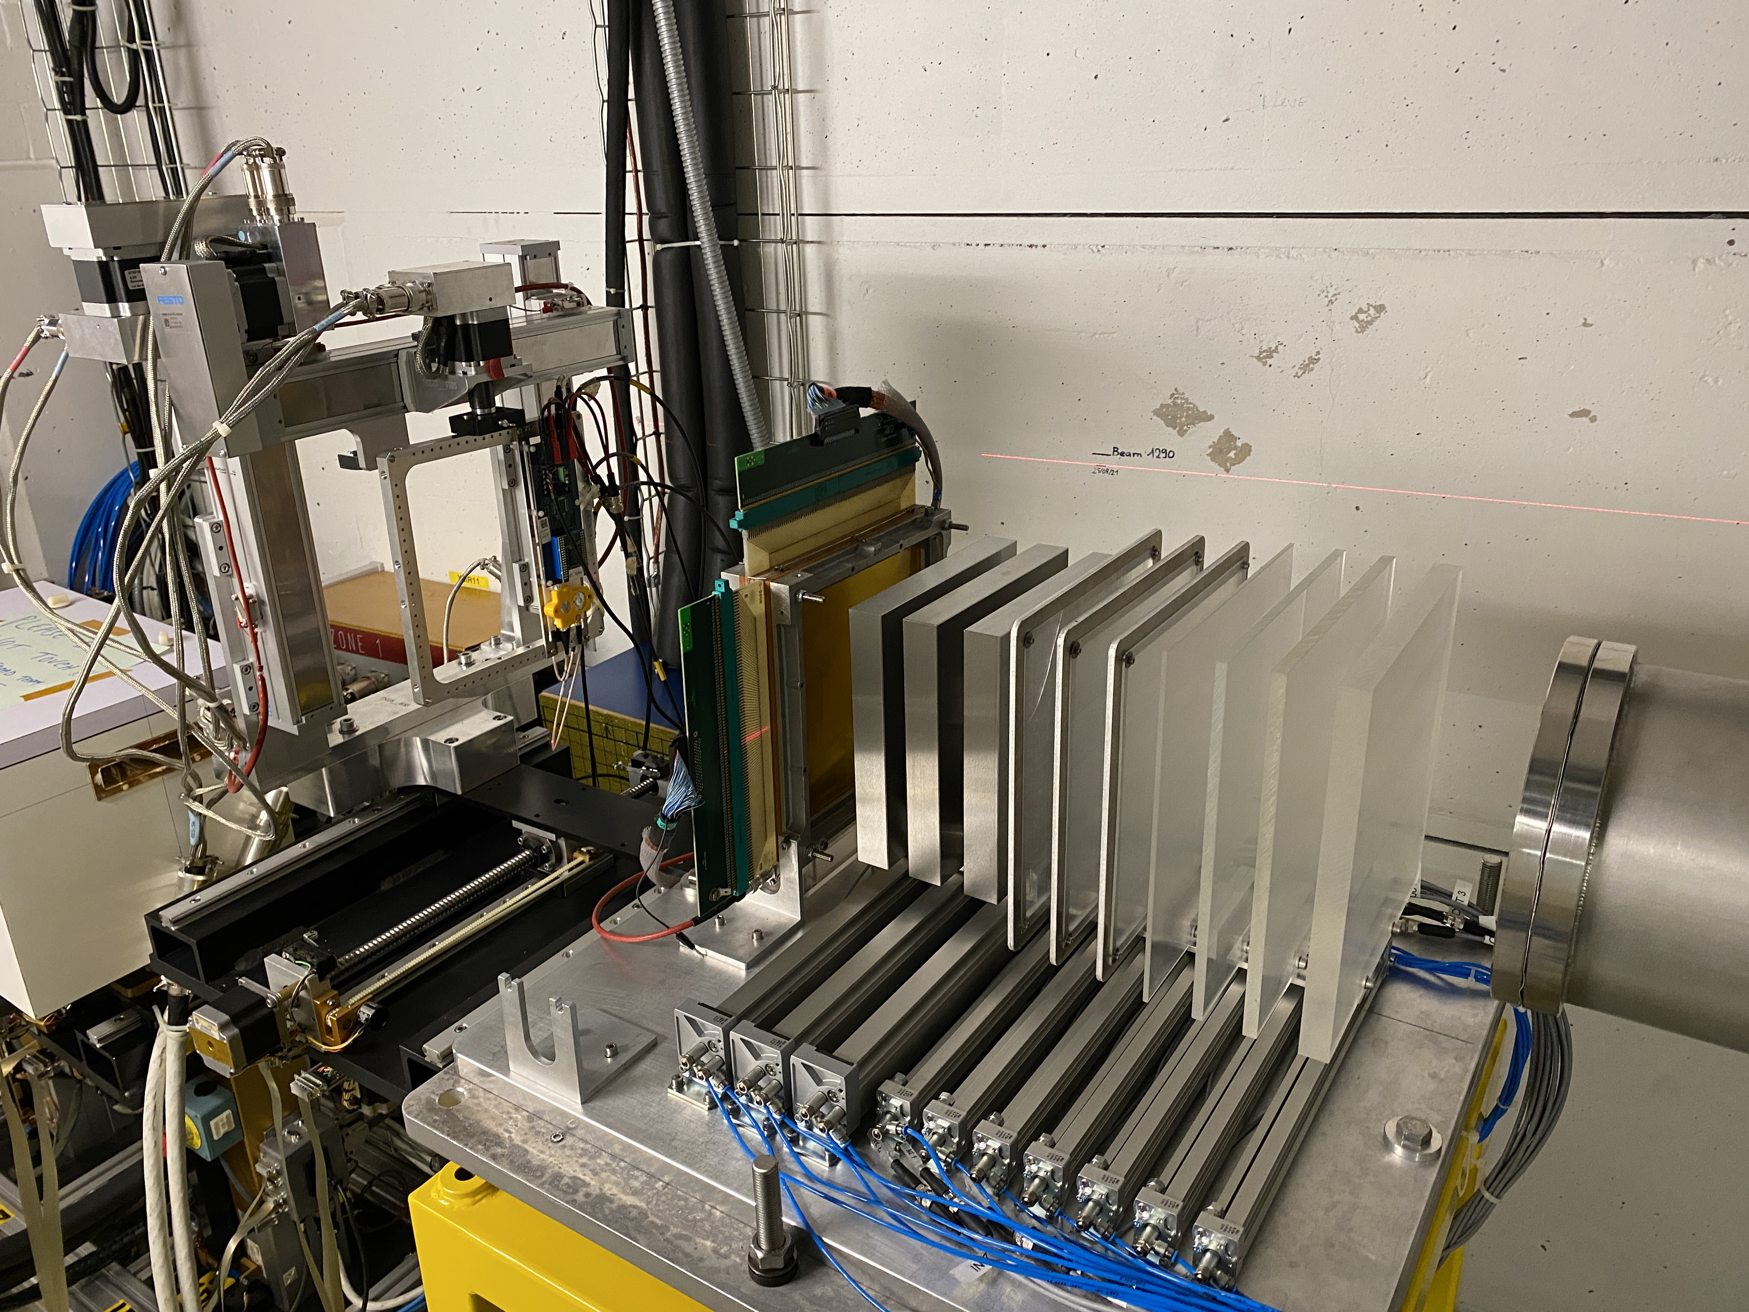
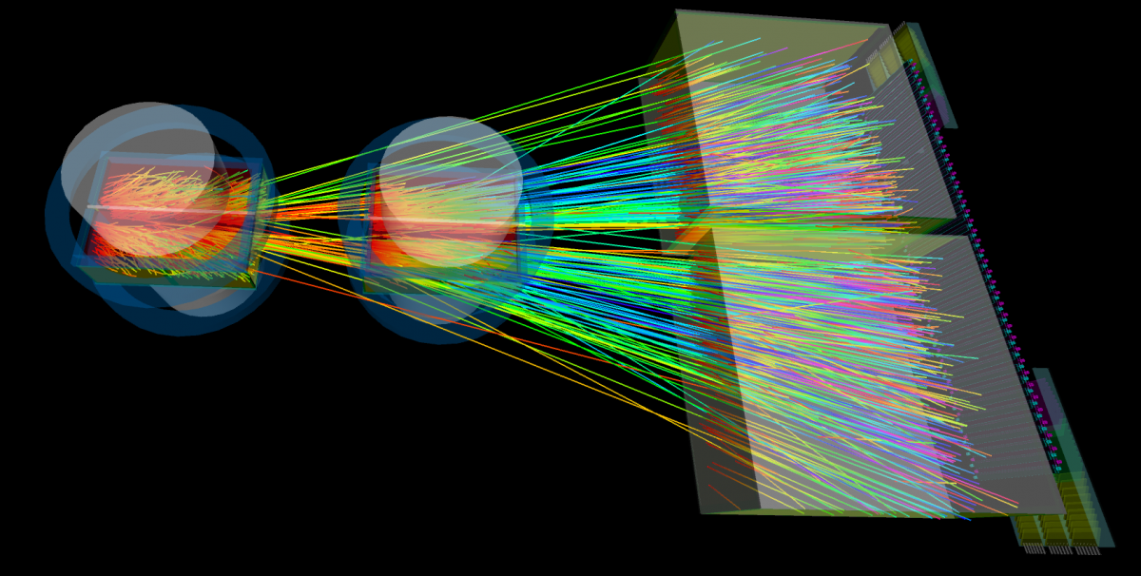
Fixed target experiments
NA61/Shine in the North Area of SPS
HEARTS in the East Area of PS

Slide 12
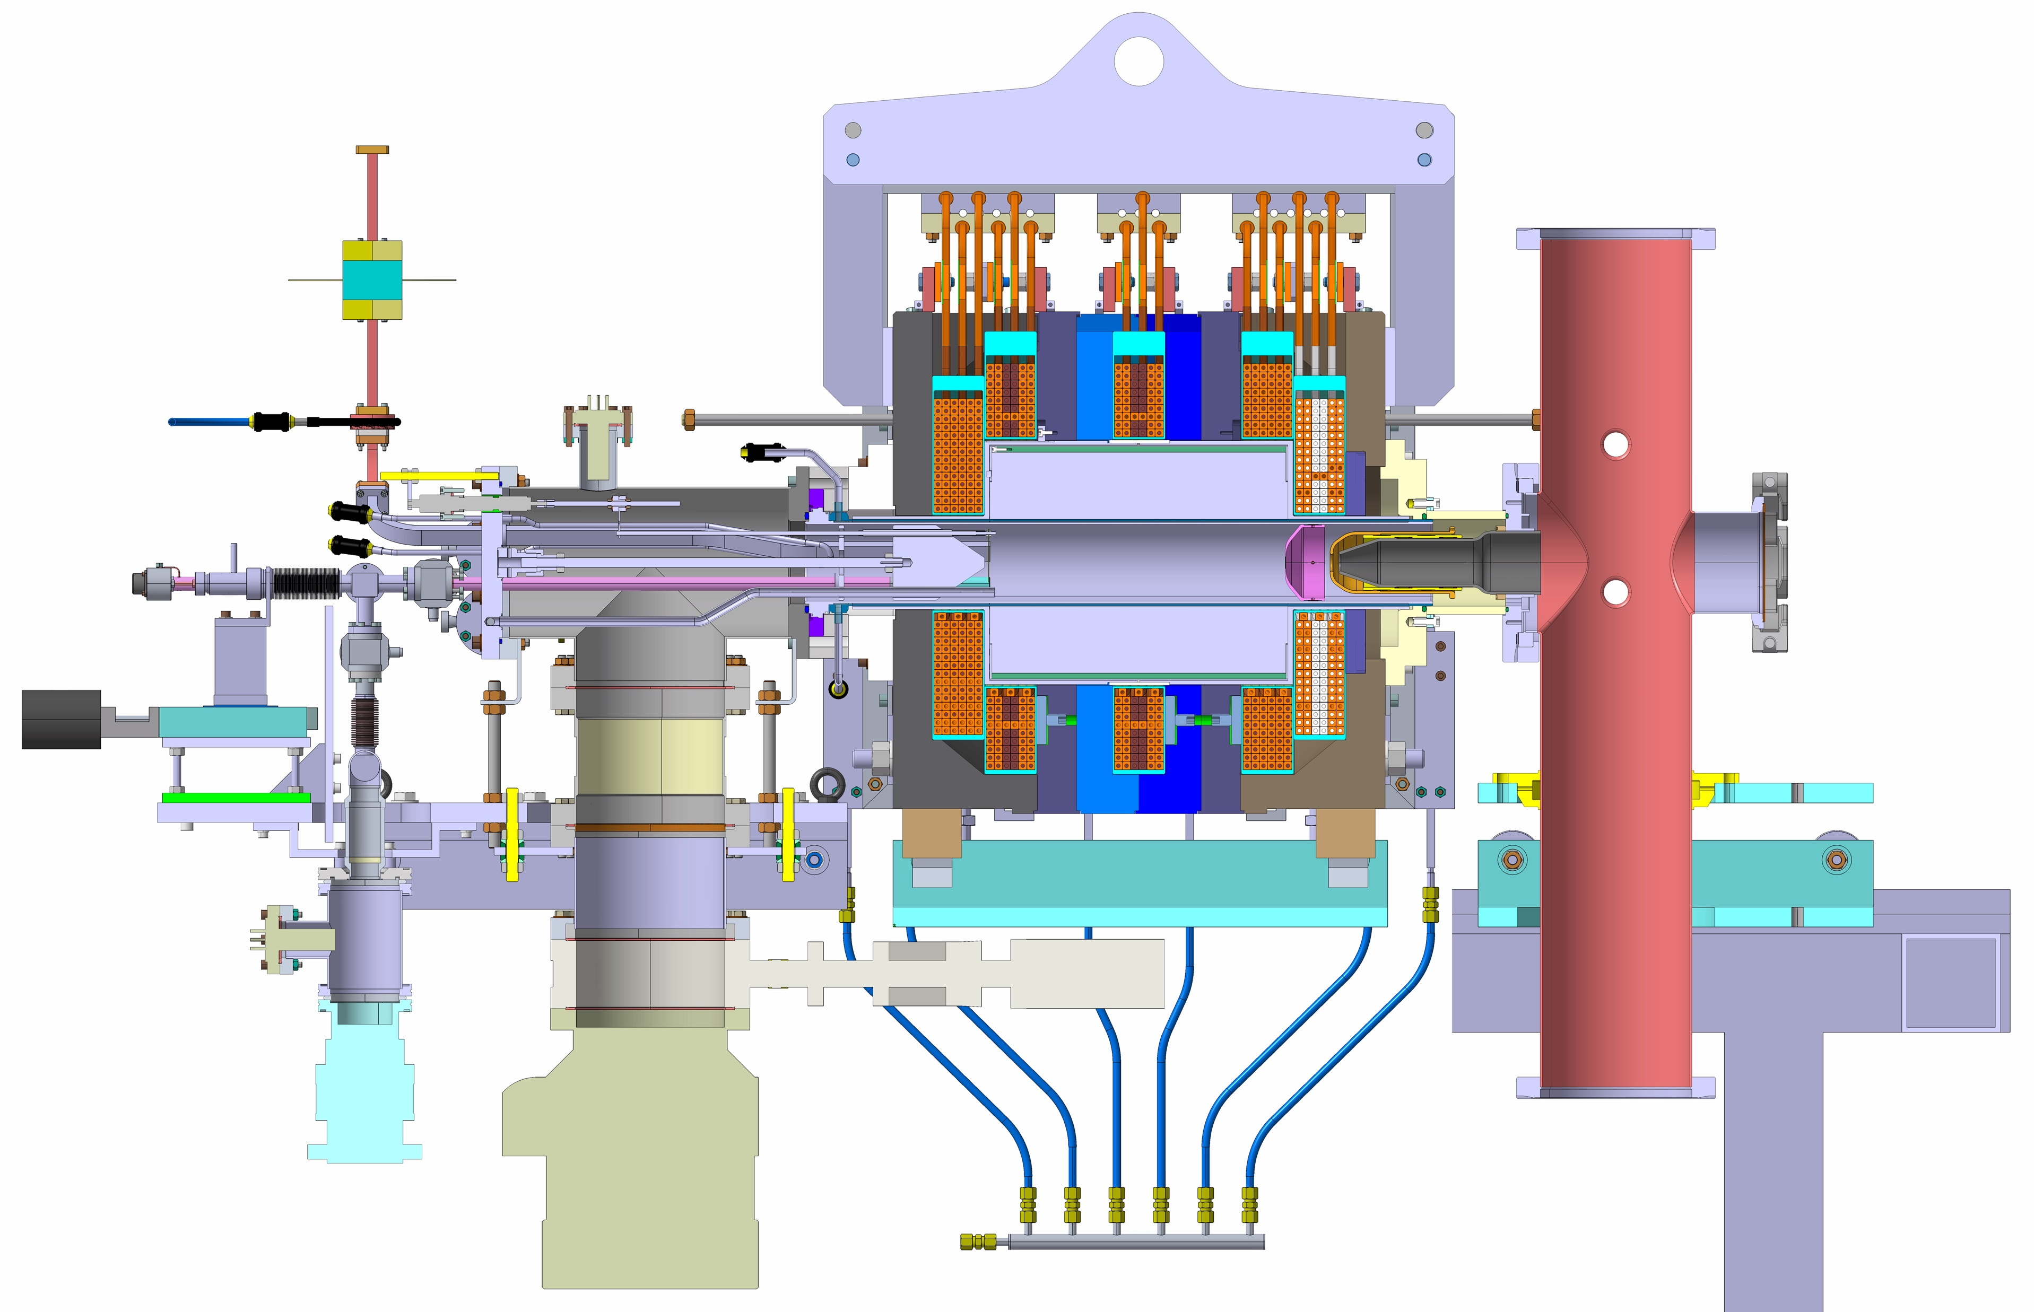
The GTS-LHC ion source
GTS-LHC ion source is an ECR type ion source based on the Grenoble Test Source, installed at Linac3 in 2005
14.5 GHz up to 2.2 kW, 10 Hz repetition rate, 50 ms microwave pulse
Operation in afterglow mode
Two operational micro-ovens
Pulsed bias disk up to 800 V
Three electrode extraction system with voltage up to 25 kV
PLC based controls integrated in the CERN controls network
Main ion type: ²⁰⁸Pb²⁹⁺

Slide 13
Source operation and beam performance
Past short ion runs or tests
2015: Argon run up to SPS → for NA61
2017: Xenon run → for NA61 & LHC
2023: Krypton test → input for injector model & LHC Run 5
2023: Oxygen test → validation of LHC oxygen run in 2025
2024: Magnesium test → validation for NA61++ (Run 4, 2030+)
2025: Oxygen run → for LHC & NA61
2025: one day Neon run → for LHC (Nuclear imaging)
Ion @ Src | I / eµA | Ion @ Linac3 | I / eµA
⁴⁰Ar¹¹⁺ | 140 | ⁴⁰Ar¹¹⁺ | 60
¹²⁹Xe²²⁺ | 175 | ¹²⁹Xe³⁹⁺ | 34
⁸⁶Kr²²⁺ | 130 | - | -
²⁴Mg⁷⁺ | 50 | ²⁴Mg⁷⁺ | 19
¹⁶O⁴⁺ | 239 | ¹⁶O⁴⁺ | 93
²⁰Ne⁵⁺ | 181 | ²⁰Ne⁵⁺ | 59
²⁰⁸Pb²⁹⁺ | 182 | ²⁰⁸Pb⁵⁴⁺ | 31
Source extraction matched to 2.5 keV/u for RFQ injection
Stable part of the source pulse ~ 300 µs for LEIR injection
Some for the beams are stripped at the end of the linac
Transmission in the linac and stripper efficiency vary for the different ion types

Slide 14
Ion beam operation in the complex
2025
300 µs of flat beam pulse from the linac with up to 5 Hz repetition rate
High pulse and pulse-to-pulse stability required (~ 5%)
Beam delivery during working hours from the source for the setup of all the machines in the ion accelerator chain followed by beam delivery 24/7 during the physics period of the different users
Operation periods of several weeks up to several months
Due to the long setup periods only two ion types per year possible
O
O
Pb

Slide 15
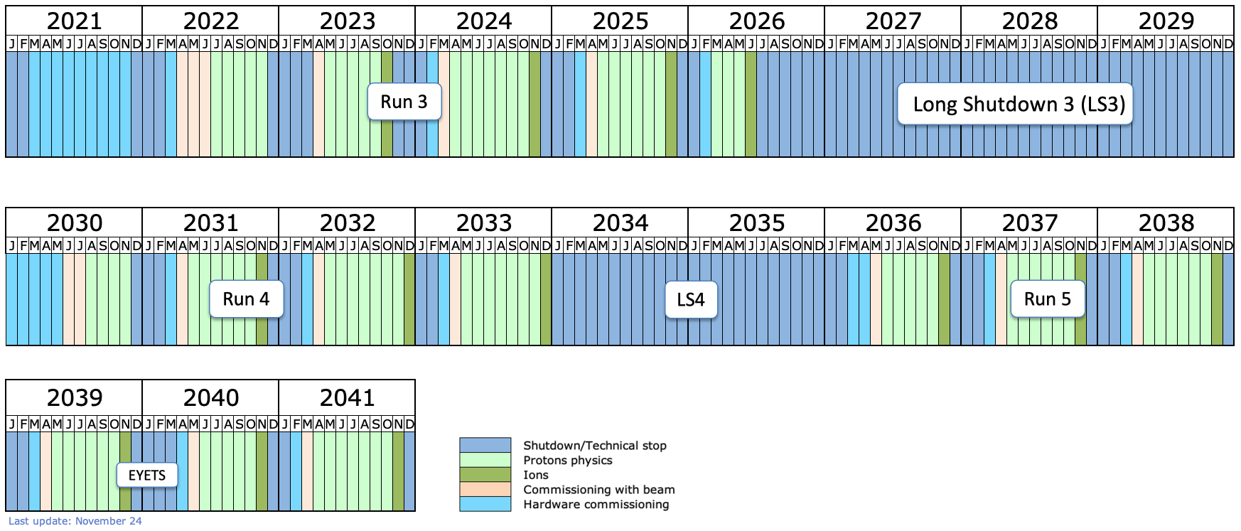
LHC Long-term schedule

Slide 16
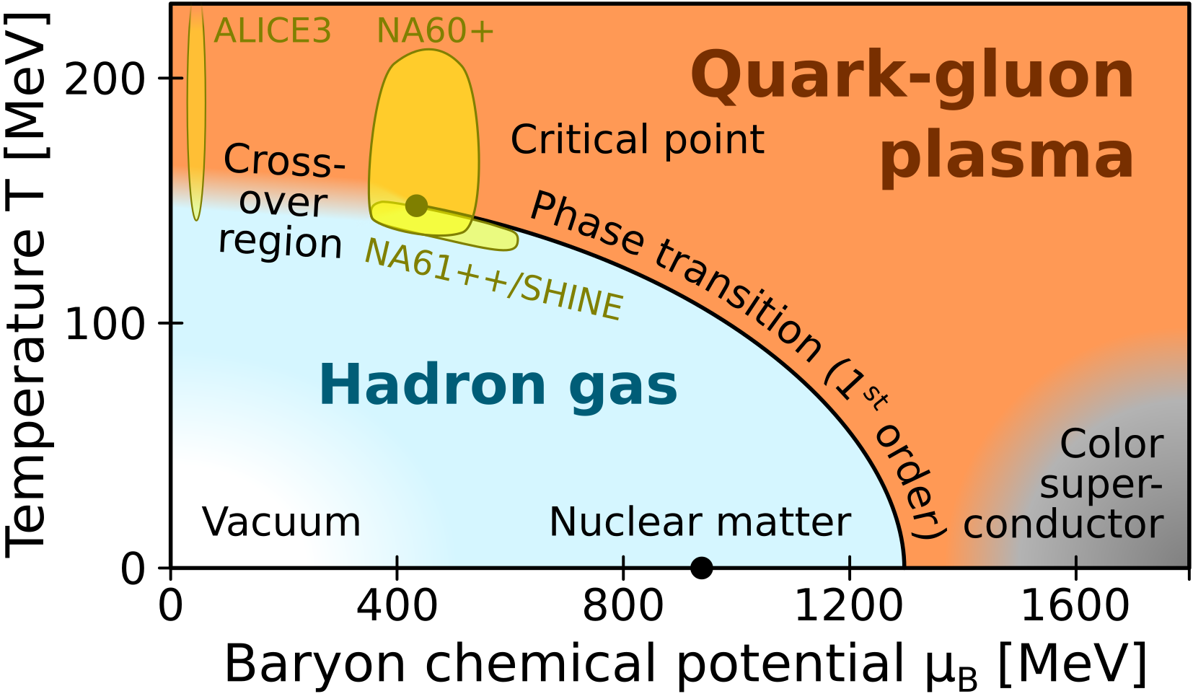
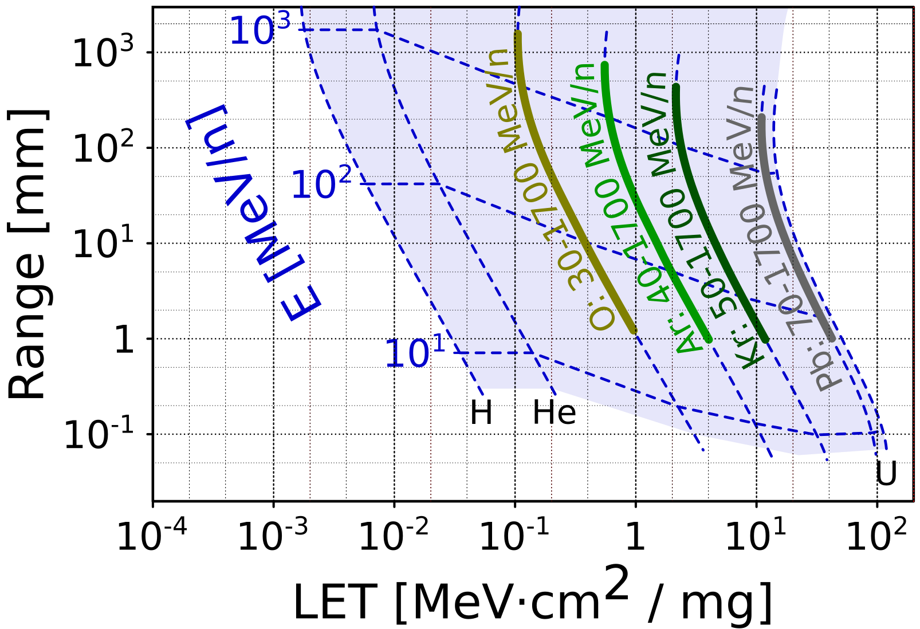
Motivation for new ion types
Physics
Explore different regions of the phase diagram of quark-gluon plasma → ALICE, NA61/SHINE, NA60+
Measure high-energy cross-sections for astroparticle physics models
Enrich nuclear shape models (traditionally based on low-energy measurements)
Facilities
Irradiation using wide range of linear energy transfer (LET) beams → HEARTS – facility for irradiation of space and accelerator electronic components and boards
Gamma factory
Using principle of resonant absorption and gamma boosted emission of photons
Better intensity and higher energy of photons than traditionally used methods (inverse Compton scattering)
Spin-off: possibly enable high-brilliance Ca beams and high-rate collisions (Use the same principle to cool the beam by emitting gammas)

Slide 17
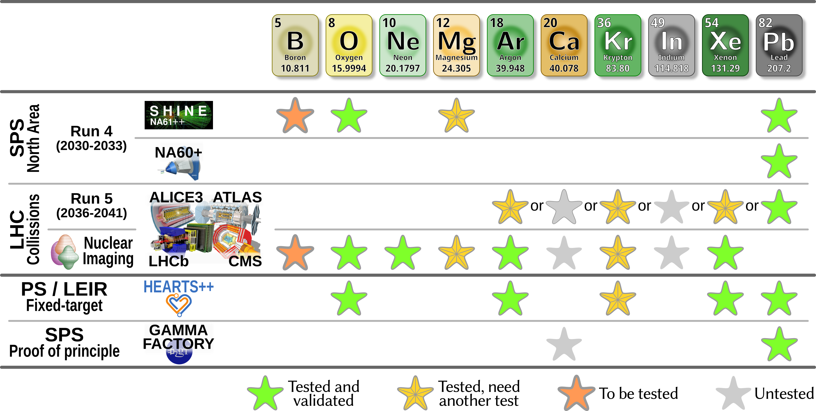
Future ion beam requests
These projects are not approved yet

Slide 18
Status and Challenges Fixed target SPS North Area
NA61++ / SHINE (Run 4, 2030+)
Beam test with magnesium done in 2024
Sufficient intensity for LEIR injection
Bottleneck found, to be retested
2nd magnesium test planned for 2026
Validation of mitigation against short oven lifetime Reduction of magnesium consumption by adding a tantalum hot screen in the plasma chamber
Beam test with boron planned for 2027
At the source and Linac3
Validation of decaborane (B₁₀H₁₄) delivered with the MIVOC setup
Goal: Stability and beam intensity reach
NA60+
Ongoing beam tests with lead

Slide 19
Status and Challenges Fixed target PS East Area
HEARTS – most demanding request for Run 4 (2031+)
Provide: O, Ar, Kr, Xe, Pb
No specific ions required, but rather a menu consisting of ions covering a wide mass range
Every operational day, with switching times between species of maximum 15 minutes
The experiment decides the order in which the species are delivered
Switch between ions at will
Impossible with present injectors: switching between ions takes days to weeks
Cocktail beams to be tested at the source (not scheduled yet)

Slide 20
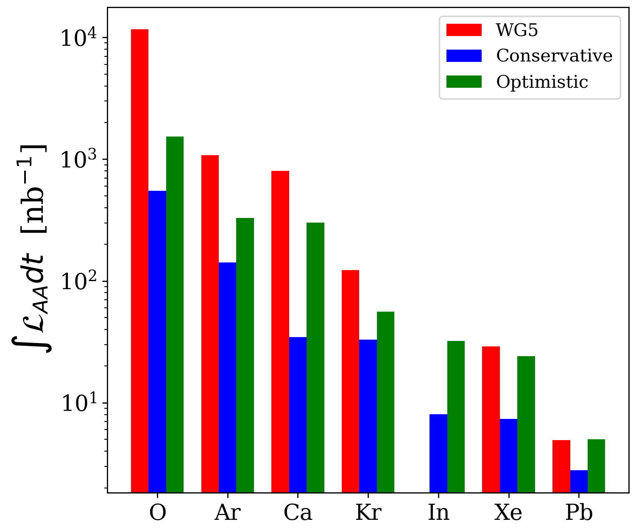
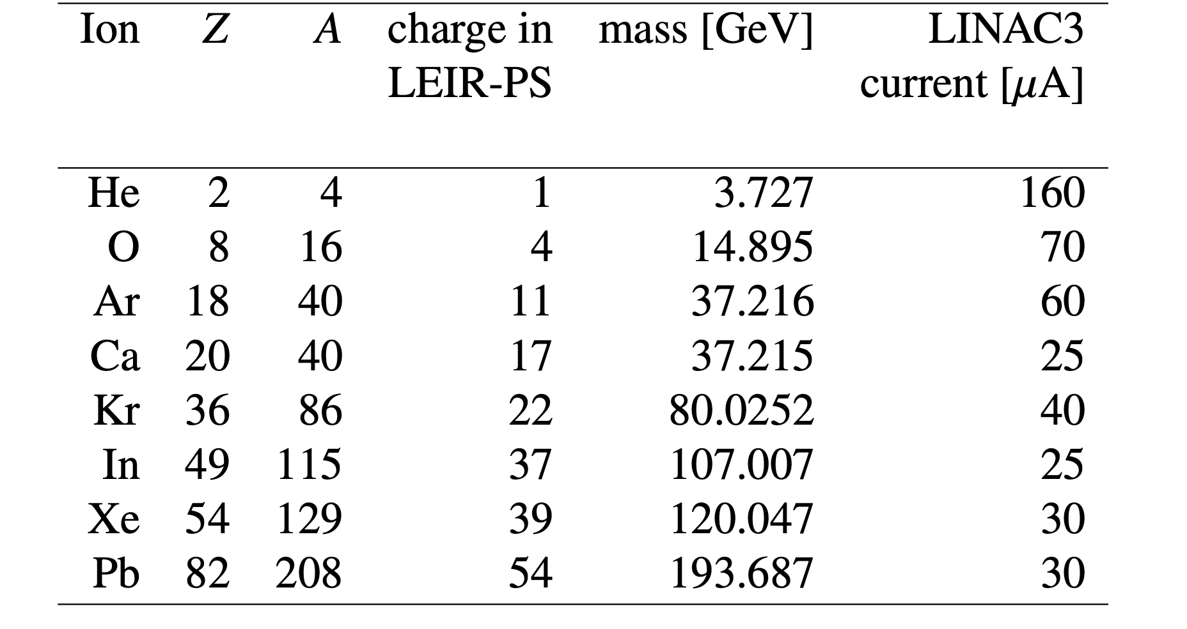
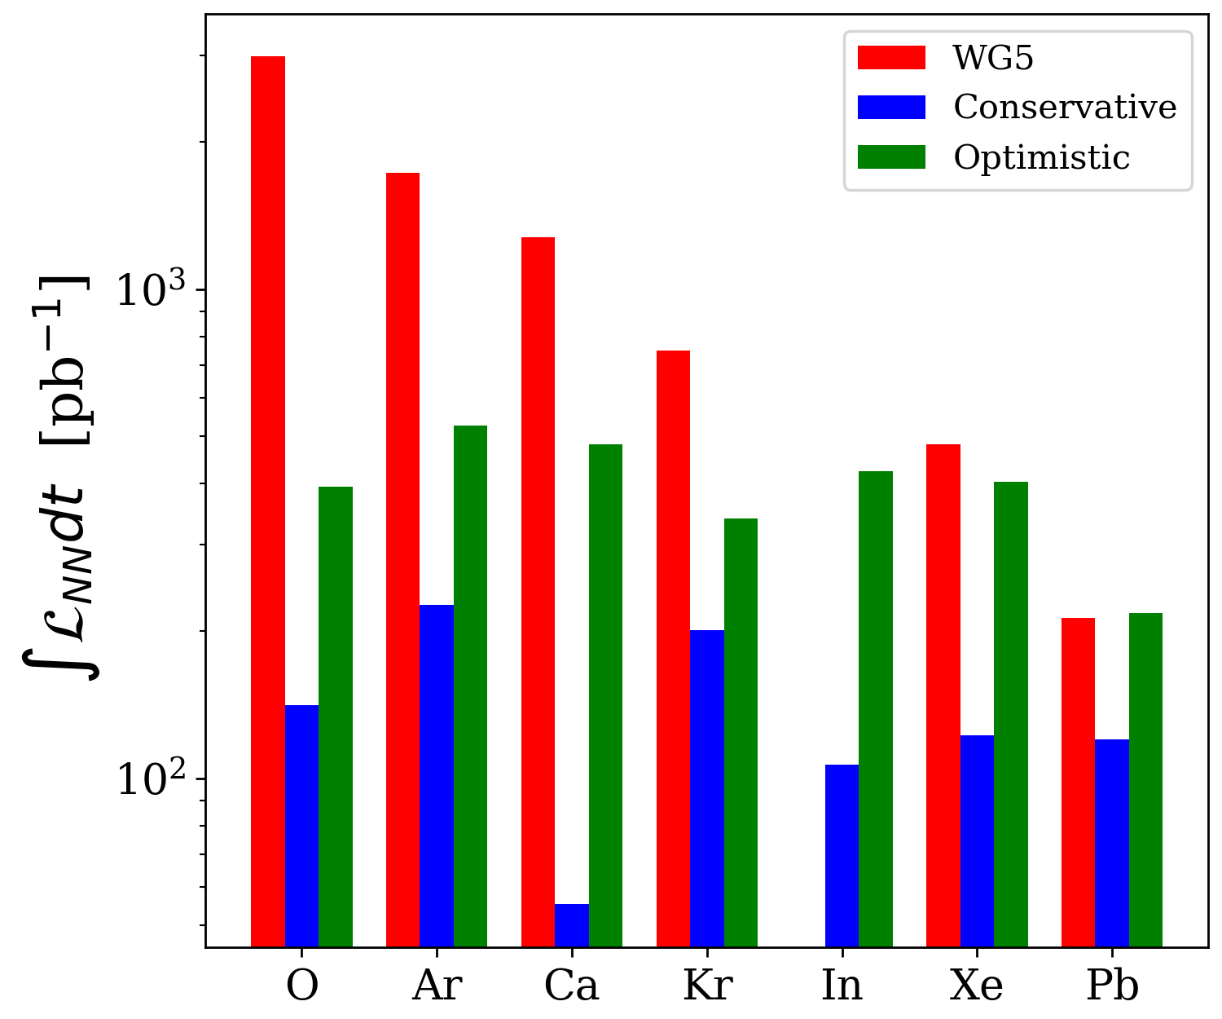
Status and Challenges LHC
One month integrated ion-ion luminosity
LHC experiments in Run 5
One ion species to be selected to maximize nucleon-nucleon luminosity
Need inputs from source operational tests with new ions for beam transport simulations along the accelerator chain
Beam tests with krypton up to Linac3 done in 2023
2nd krypton test possibly in Run 4
Nuclear physics at the LHC
Many ideas, e.g. this years short LHC neon run
Gamma factory
Proof of principle in the SPS is being prepared
Possible ions for LHC Run 5 and 6
One month integrated nucleon-nucleon luminosity
All Linac3 currents are experimental values as known
in 2024, except for Ca, which has never been tested

Slide 21
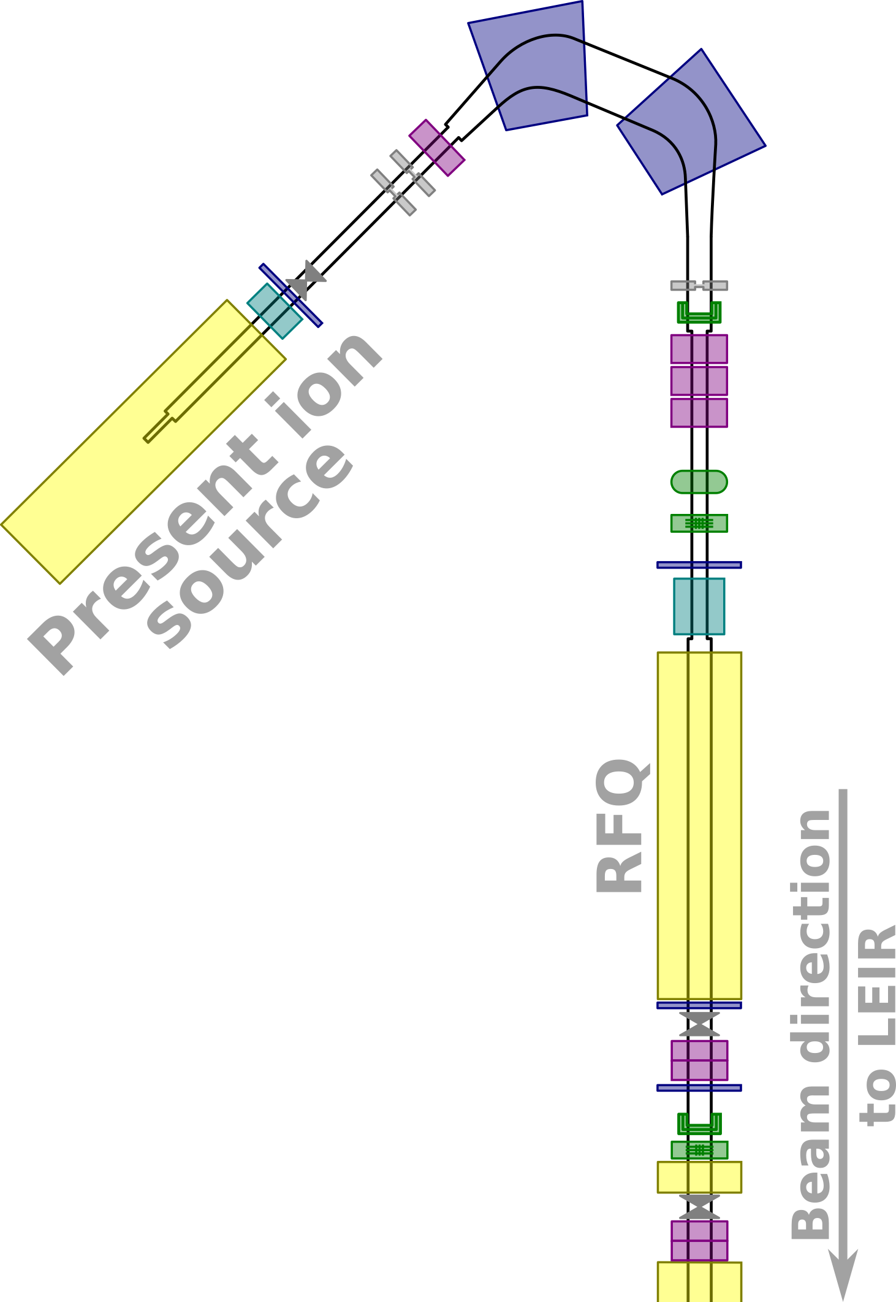
Ion Complex Upgrade study (ICU) Low-energy region of Linac3 – present limitations
One ion source, fully committed to operation from Run 4
Limited time for any tests (new ions, automation)
Only up to two ion species (mixtures) can be operated per year
Beam-destructive instrumentation located far away from the source extraction
Minimal feedback while tuning parameters, especially when the source is unstable
Source tuning based more on experience than measurements
Time-consuming new beam development with trial-and-error
Limited feedback for automation
Beam dynamics model improvements limited
CSD scans time consuming

Slide 22
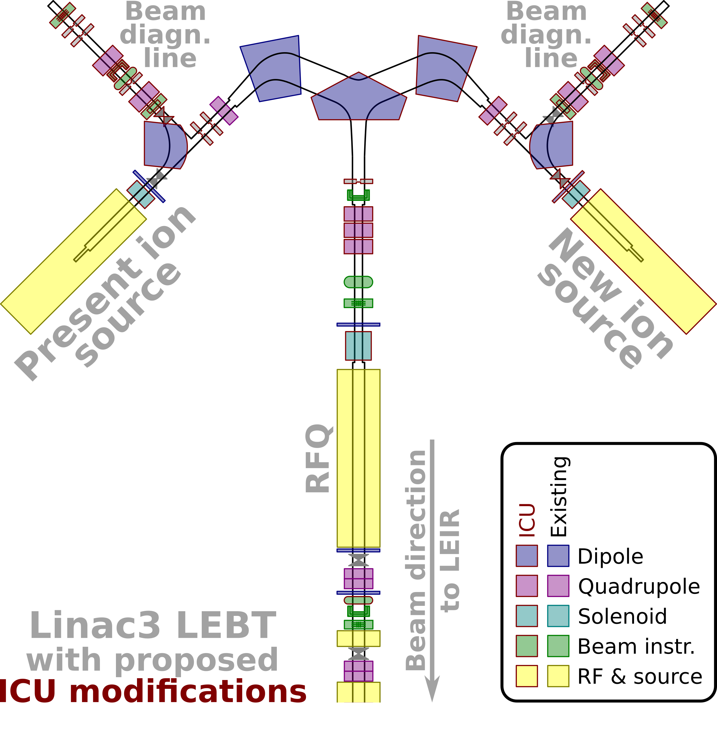
Ion Complex Upgrade study (ICU) 2nd source & new low-energy beam diagnostics
Specifications and caveats
Position and connection of the new source is under discussion
Need thorough study to select an optimal source type to fulfil the requests
Need extensive beam dynamics study to select an optimal LEBT
Most LEBT components need to be pulsed to monitor and optimize the performance of both sources when coupled with the RFQ concurrently
Every beam pulse unused by downstream accelerators could be redirected to the beam diagnostic line
Continuously measure charge-state distribution (2 min per full scan)
On demand 2D beam profile measurement, emittance and energy distribution

Slide 23
Summary and outlook
CERN has a long and rich history of ion beam acceleration and ion physics
Until the end of Run4 (2033) mainly lead will be operated for the collider physics at the LHC
Ongoing studies to identify the optimal ion species for maximizing nucleon-nucleon luminosity in Run 5 Krypton is one candidate and a first test at the source was done
There is growing interest in short LHC runs with lighter ions
Several new ion species have recently been tested (Kr, Mg) and operated (O, Ne)
More tests have to be performed for validation and tests of the accelerator chain with these ions
2nd magnesium test, boron, cocktail beams for HEARTS
A second source and an upgrade of the Linac3 front-end will be needed if some of the proposed projects would be approved and funded
A schedule cannot be given as it depends on the approval of the related projects and the availability of resources

Slide 25
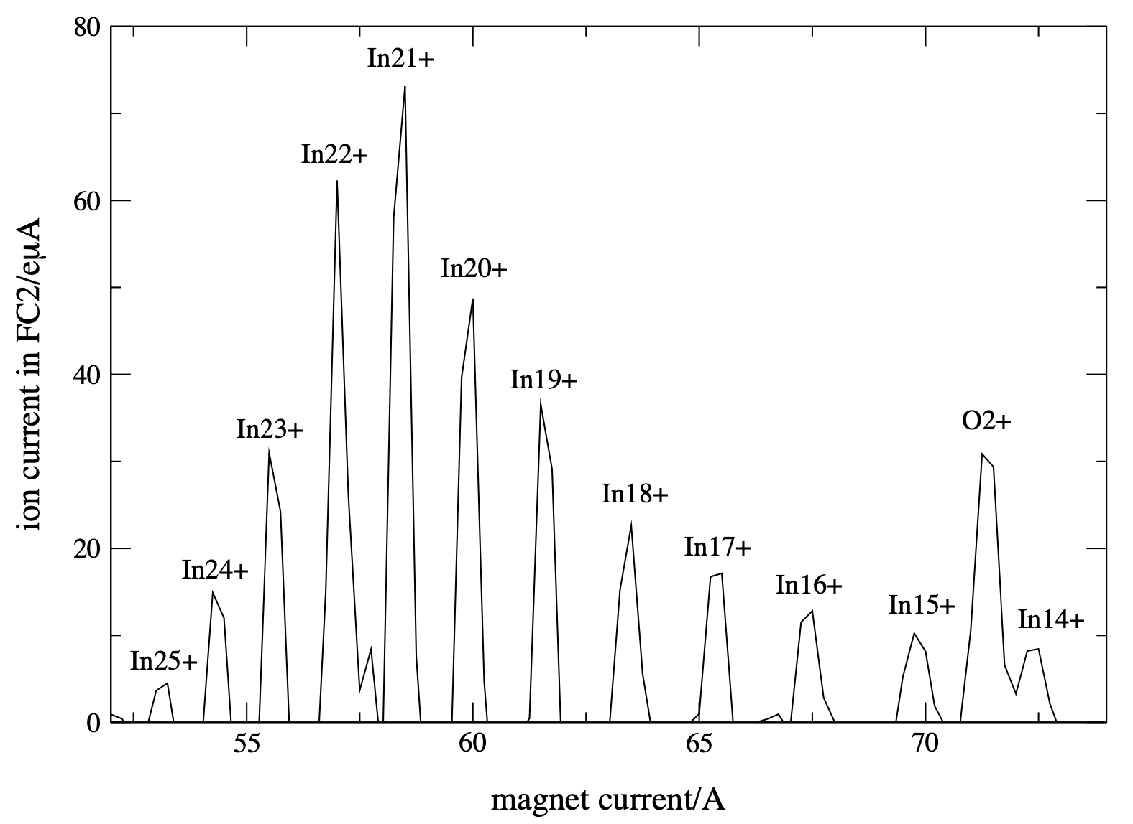
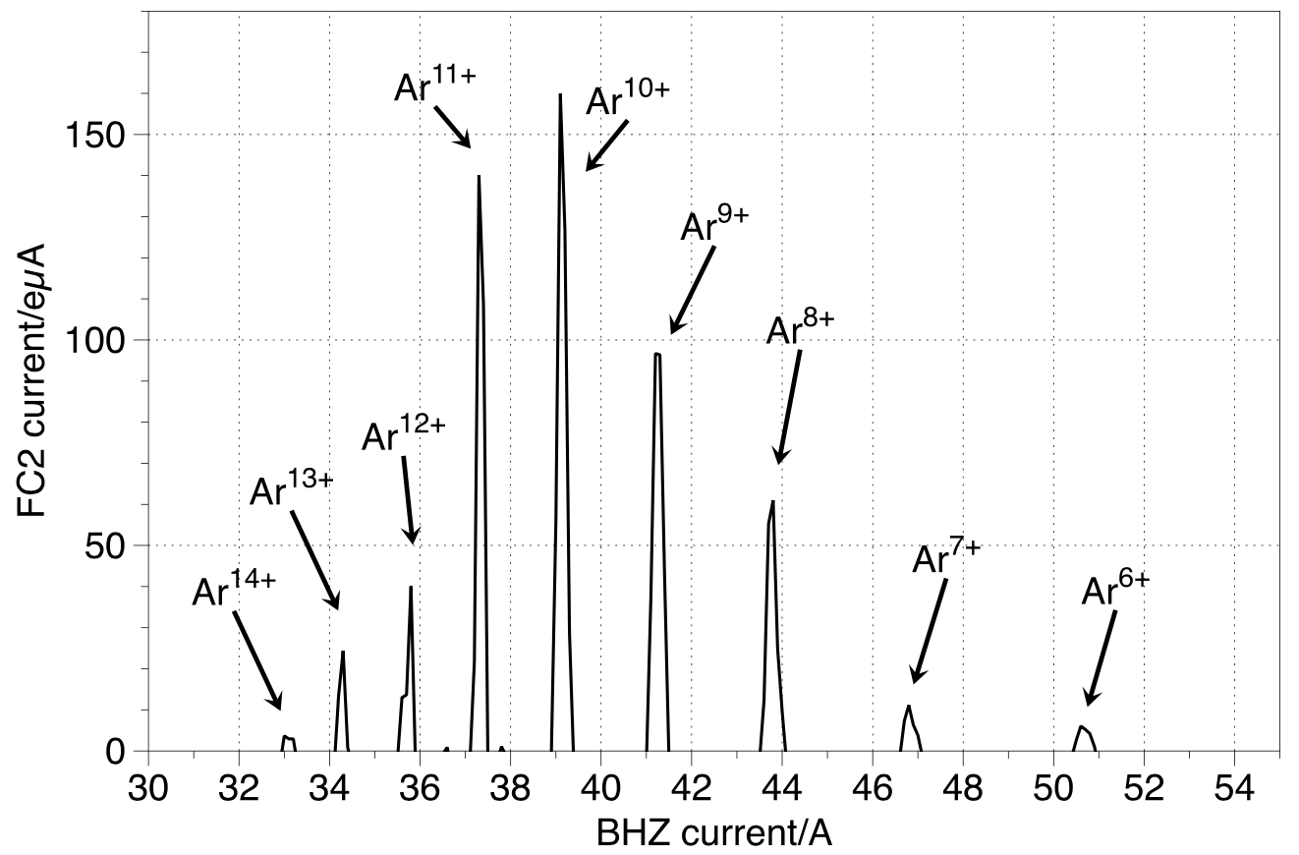
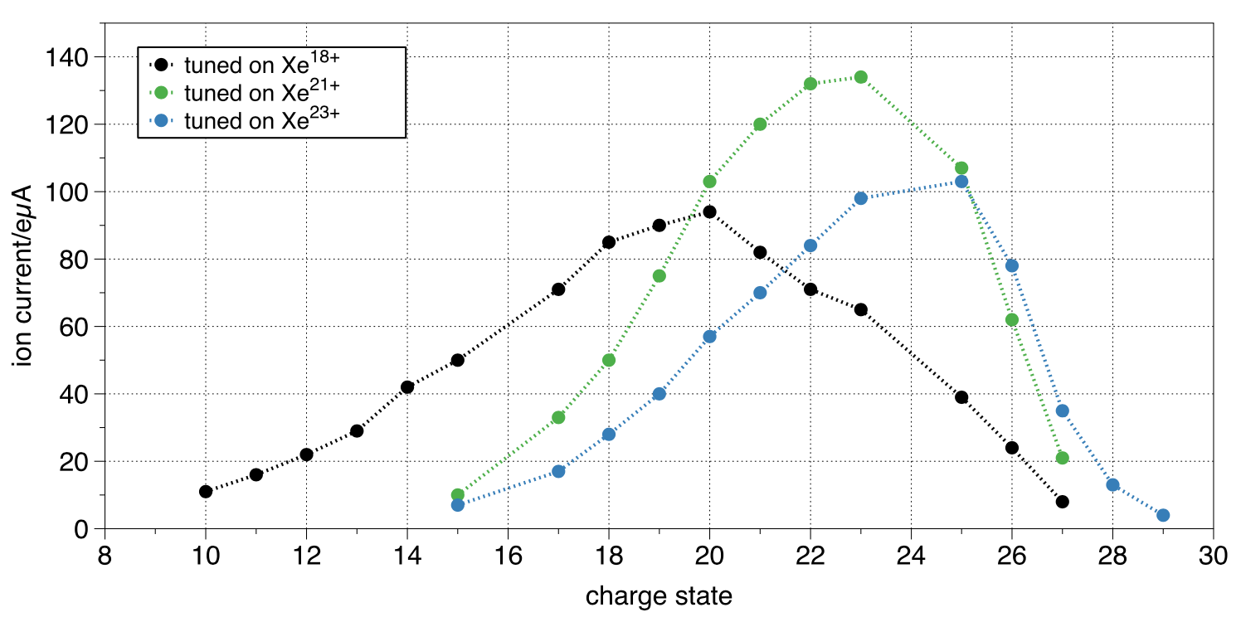
Operation with ions at CERN Past experience
⁴⁰Ar 2015 (fixed target)
¹²⁹Xe 2017 (fixed target & LHC pilot run)
Xe²²⁺ from source ~160 𝛍A
¹¹⁵In 2003 (fixed target)
In²¹⁺ from source >70 𝛍A
Not stripped; at the end of Linac3: ~60 µA
Stripped to Ar¹⁸⁺ before SPS
No attempt at LEIR NOMINAL beam
Stripped to Xe³⁹⁺ at the end of Linac3, ~ 30 A
Stripped to Xe⁵⁴⁺ before SPS
Attempted LEIR NOMINAL beam
Stripped at the end of Linac3 to In³⁷⁺, ~ 25 𝛍A
Stripped to In⁴⁹⁺ before SPS
No attempt at LEIR NOMINAL beam
Ref: CERN-PS-2002-058-PP

Slide 26
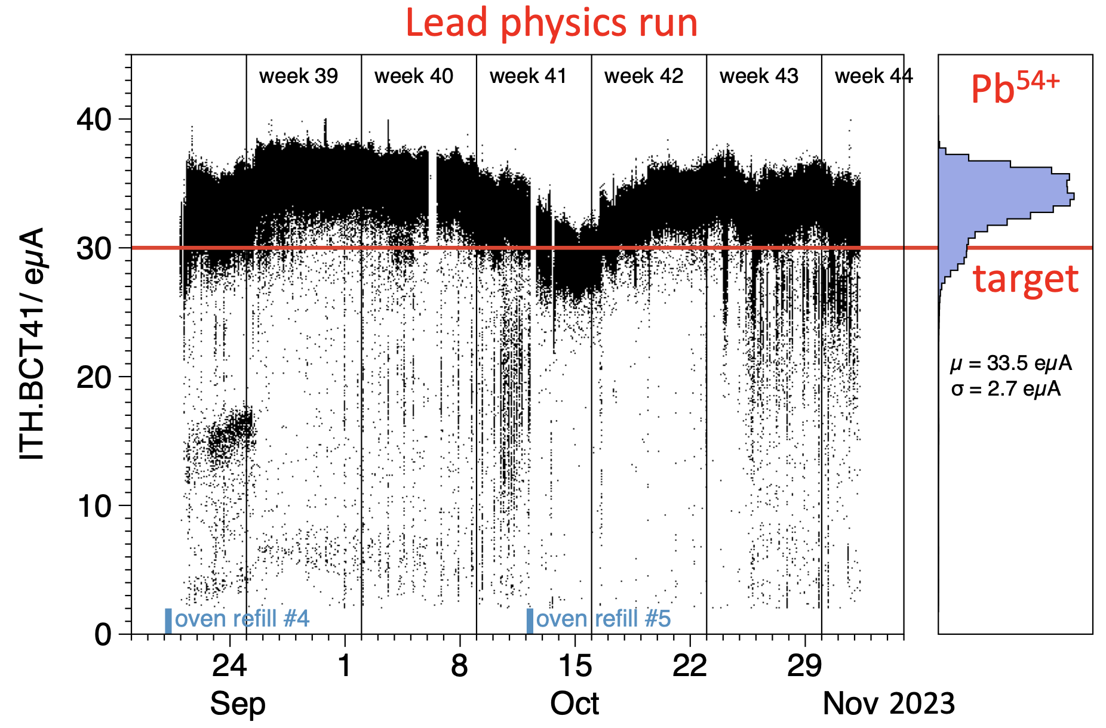
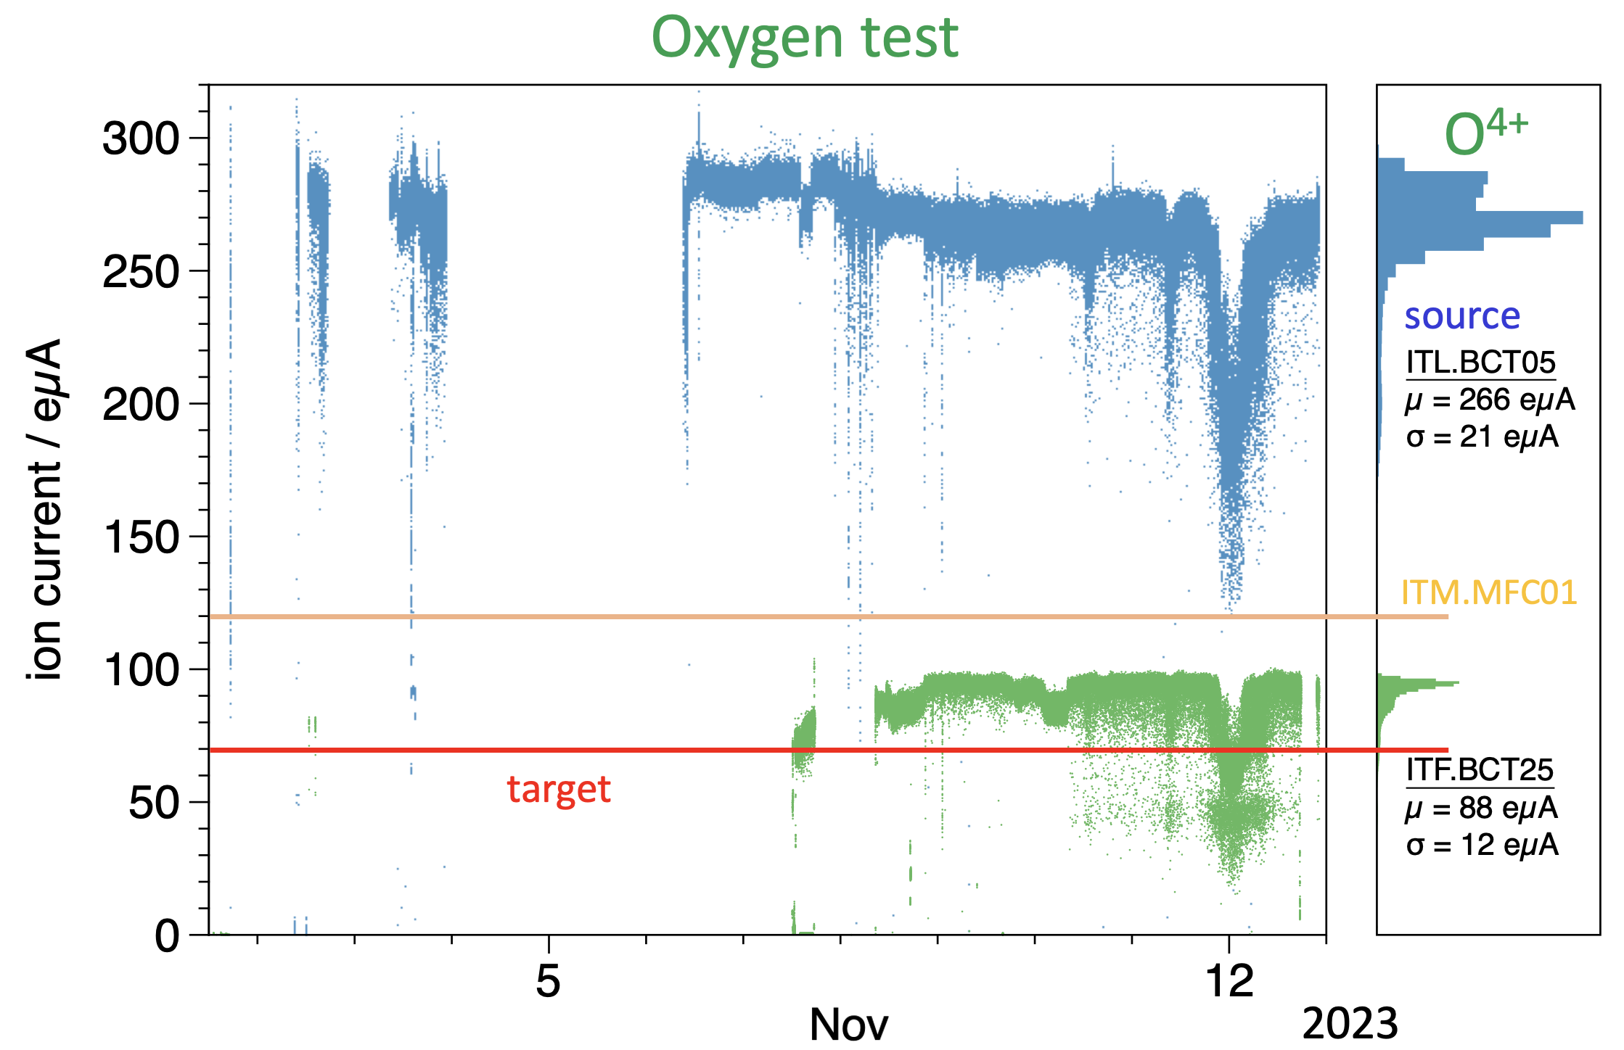
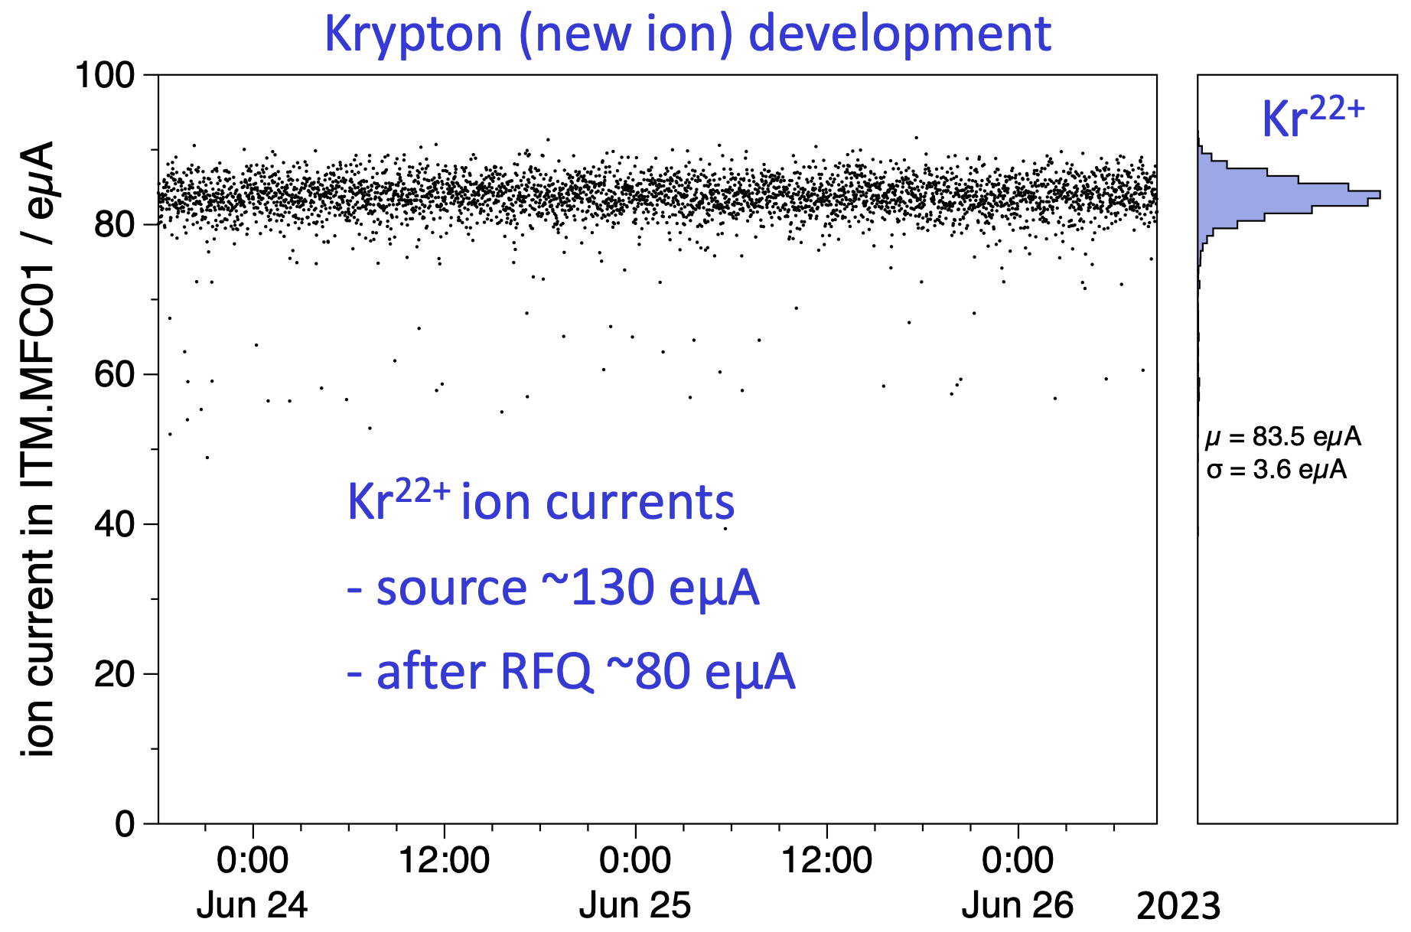
Operation with ions at CERN 2023: Pb, O, Kr

