Slide 1
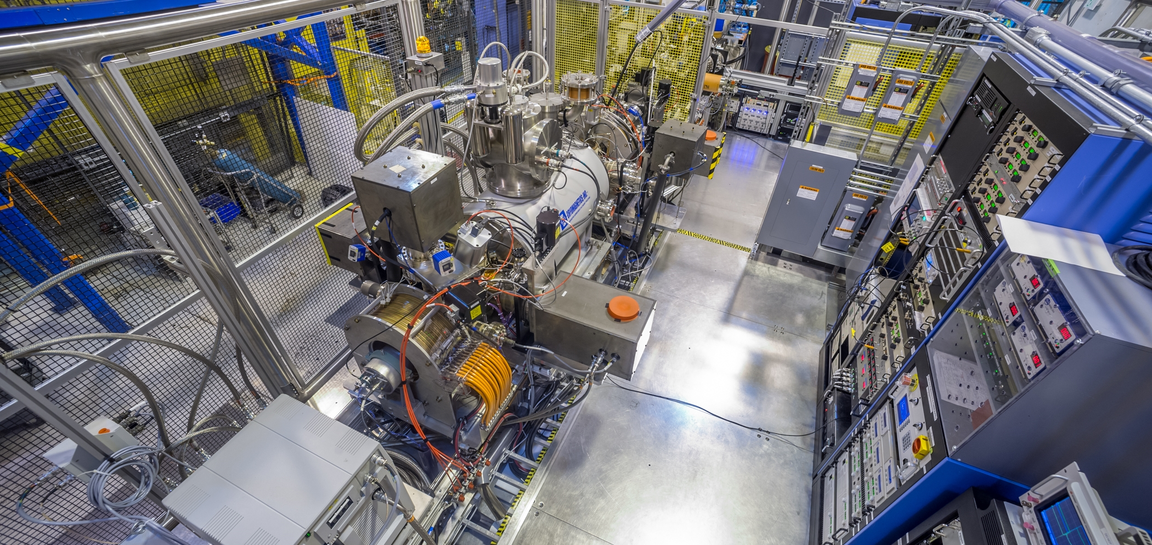
Closed Shell Charge Breeding of Radioactive Fission Products with an Electron Beam Ion Source
September 10, 2025
Richard vondrasek
ICIS 2025
Science and Technology Facilities Council (STFC)
Oxford, England

Slide 2
Acknowledgements
The work of many people made these results possible
nuCARIBU
G. Savard, R. Pardo, J. McLain, R. Scott, D. Santiago-Gonzalez, J. Nolen, J. Song, J. Clark
EBIS development
P.N. Ostroumov, C. Dickerson, S.A. Kondrashev, G. Zinkann, A. Barcikowski, G. Cherry, S. Sharamentov, J. Alessi, E. Beebe, A. Pikin
Helpful conversations
E. Beebe, A. Lapierre, B. Schultz, F. Wenander
This work was supported by the U.S. Department of Energy, Office of Nuclear Physics, under Contract No. DE-AC02-06CH11357. This research used resources of ANL’s ATLAS facility, which is a DOE Office of Science User Facility.

Slide 3
Outline
The ATLAS facility
nuCARIBU
Source of radioactive ion beams (1+ and 2+)
An upgrade of the Californium Rare Ion Breeder Upgrade
EBIS charge breeder
Raises 1+ and 2+ ions to n+ for post-acceleration
Past performance
Closed shell breeding
Current status

Slide 4
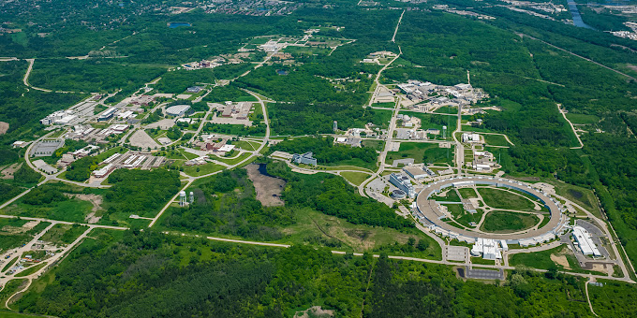
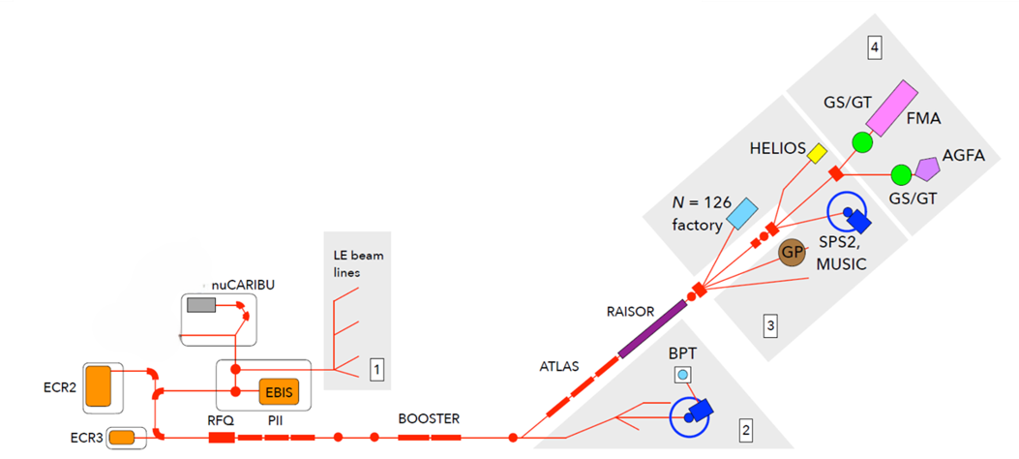
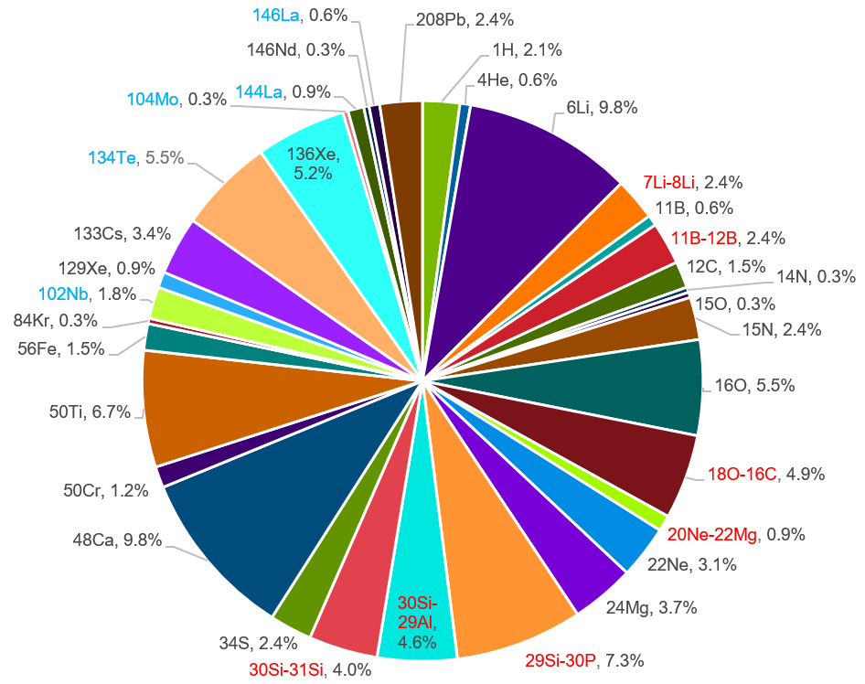
atlas
Argonne Tandem Linac Accelerator System
ATLAS is primarily a stable beam facility for nuclear physics
Beam current typically <500 pnA, energy <20 MeV/u
20-25% of beams are radioactive
nuCARIBU - Heavy neutron-rich beams
RAISOR - Light in-flight beams close to stability
Deliver ~6000 hours of accelerated beam each year
Plus 2000 hrs/yr of CARIBU stopped beam
24 hours a day / 7 days a week / 93% availability
300-400 users per year

Slide 5
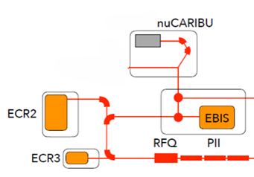
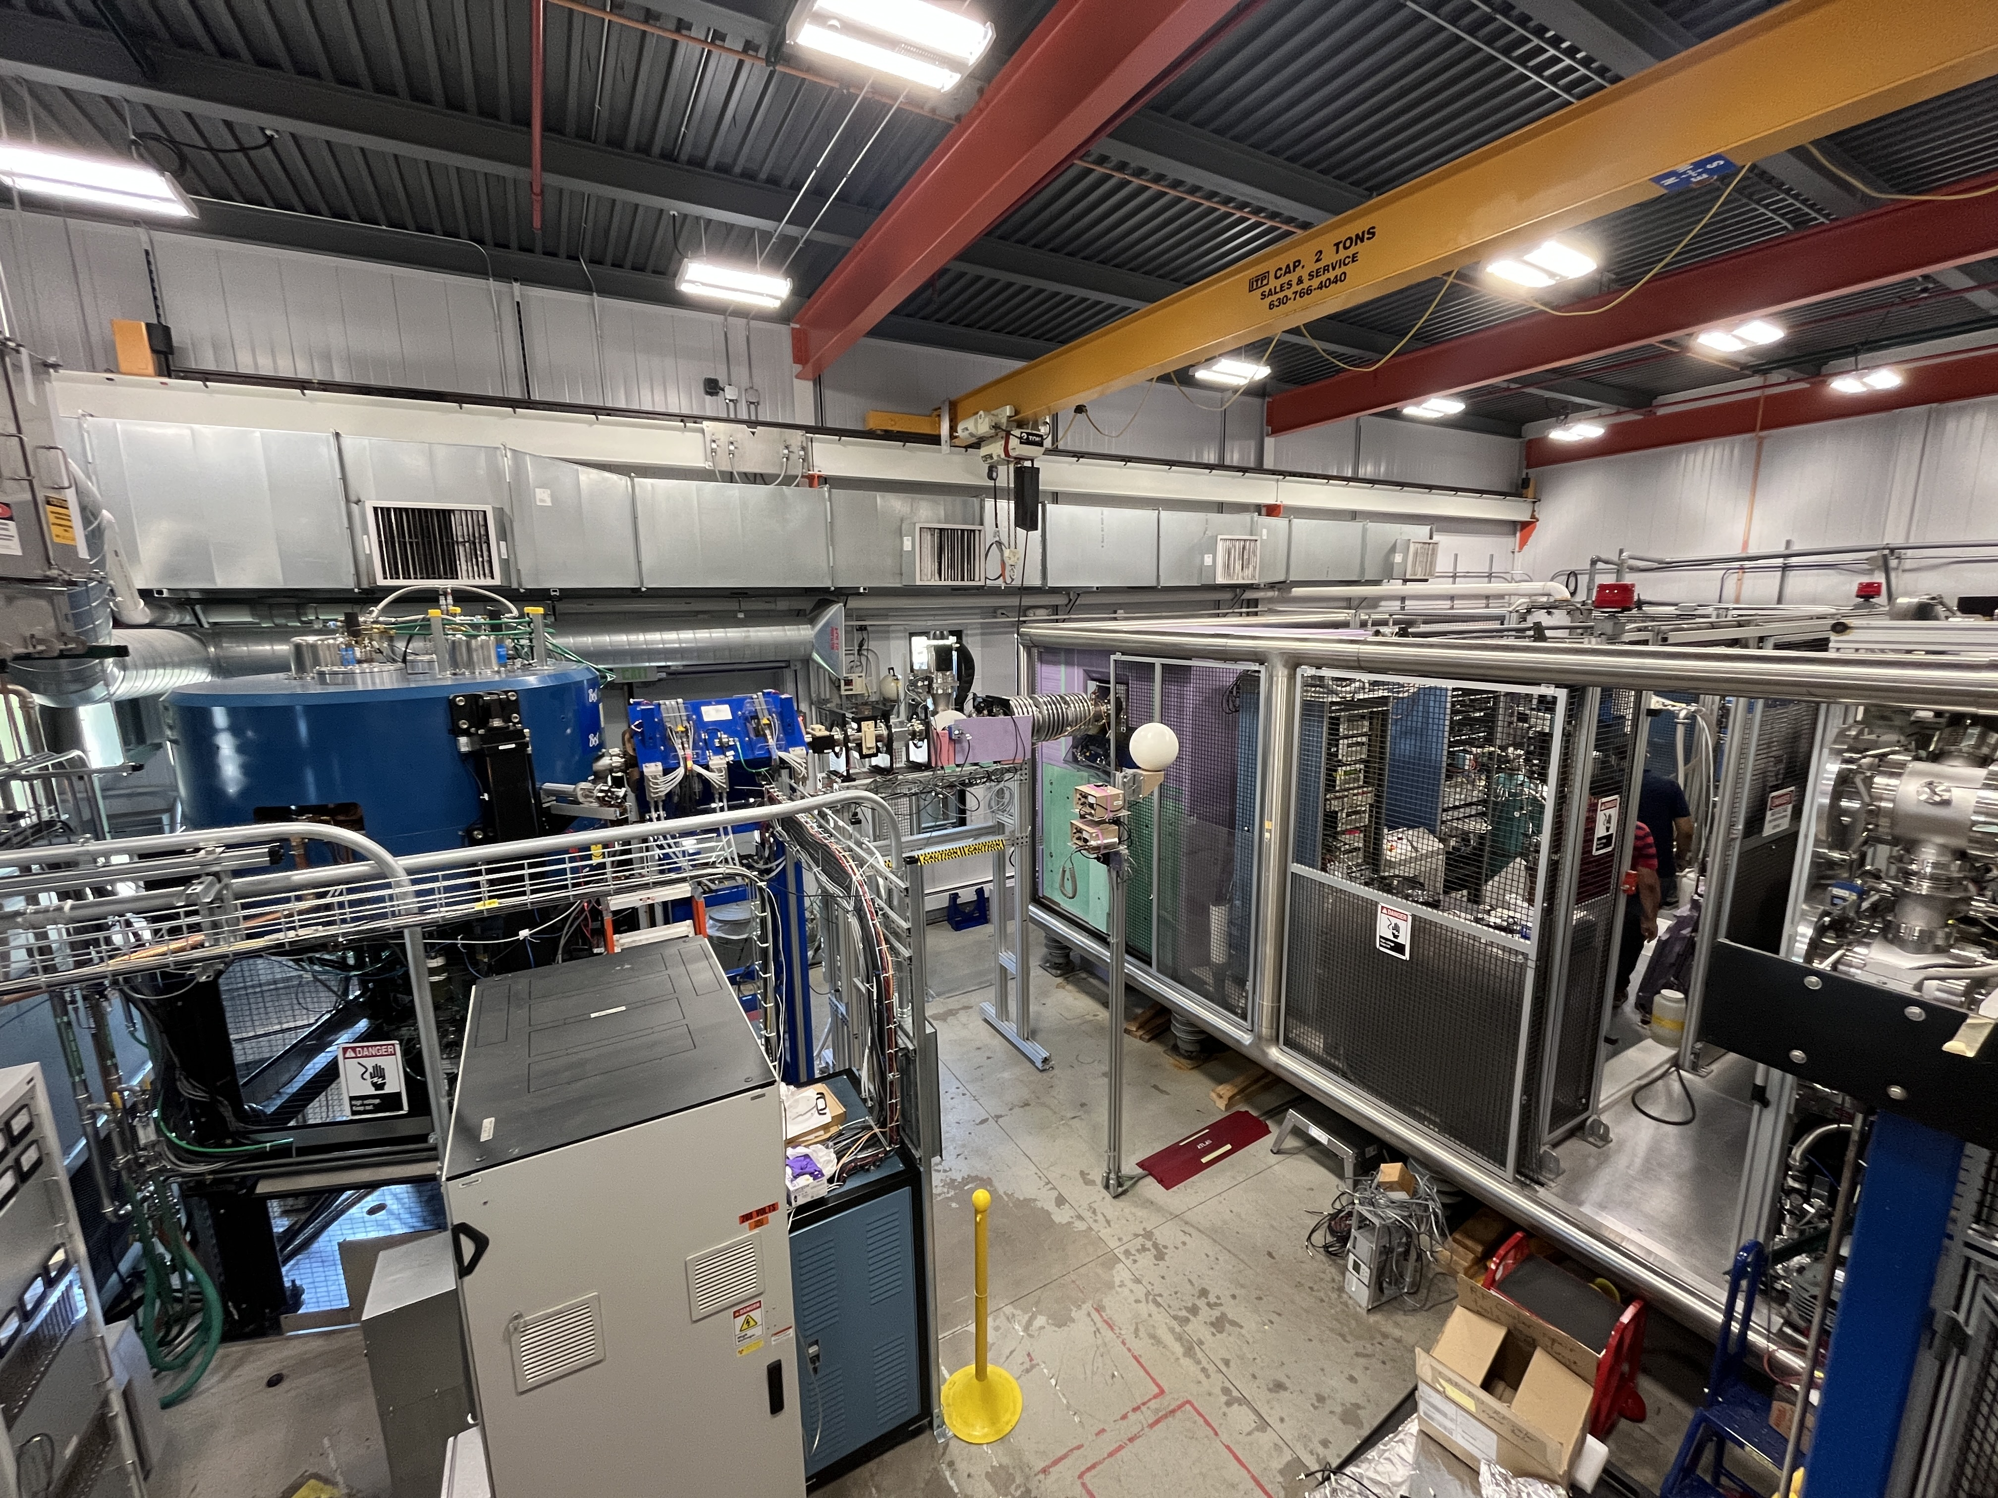
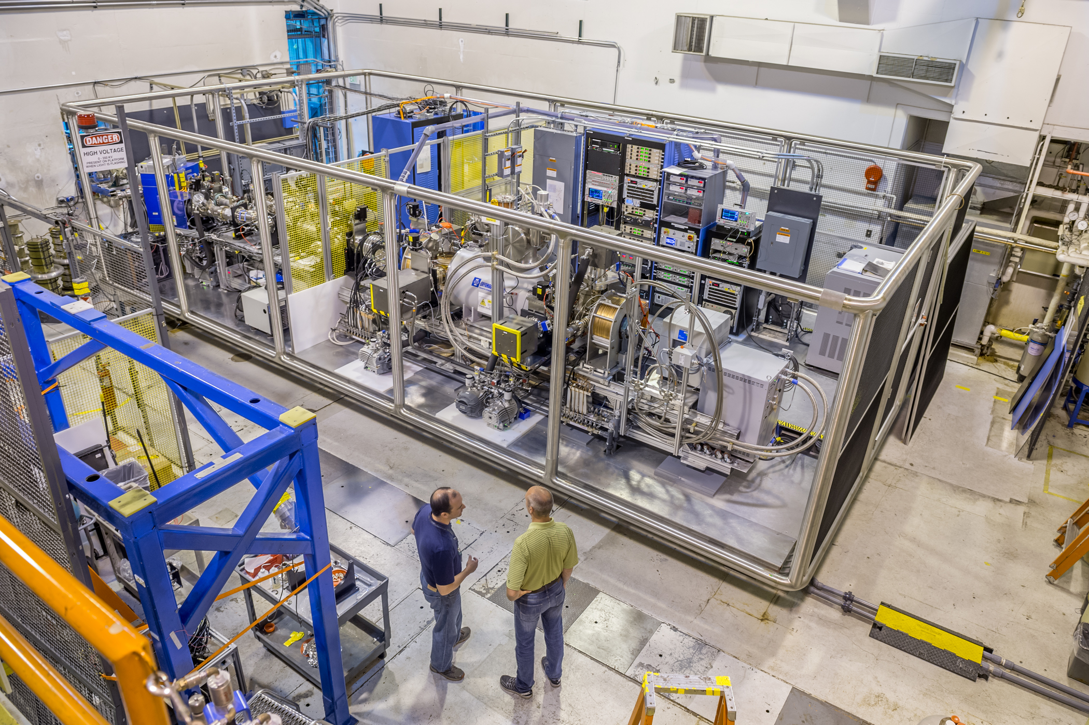
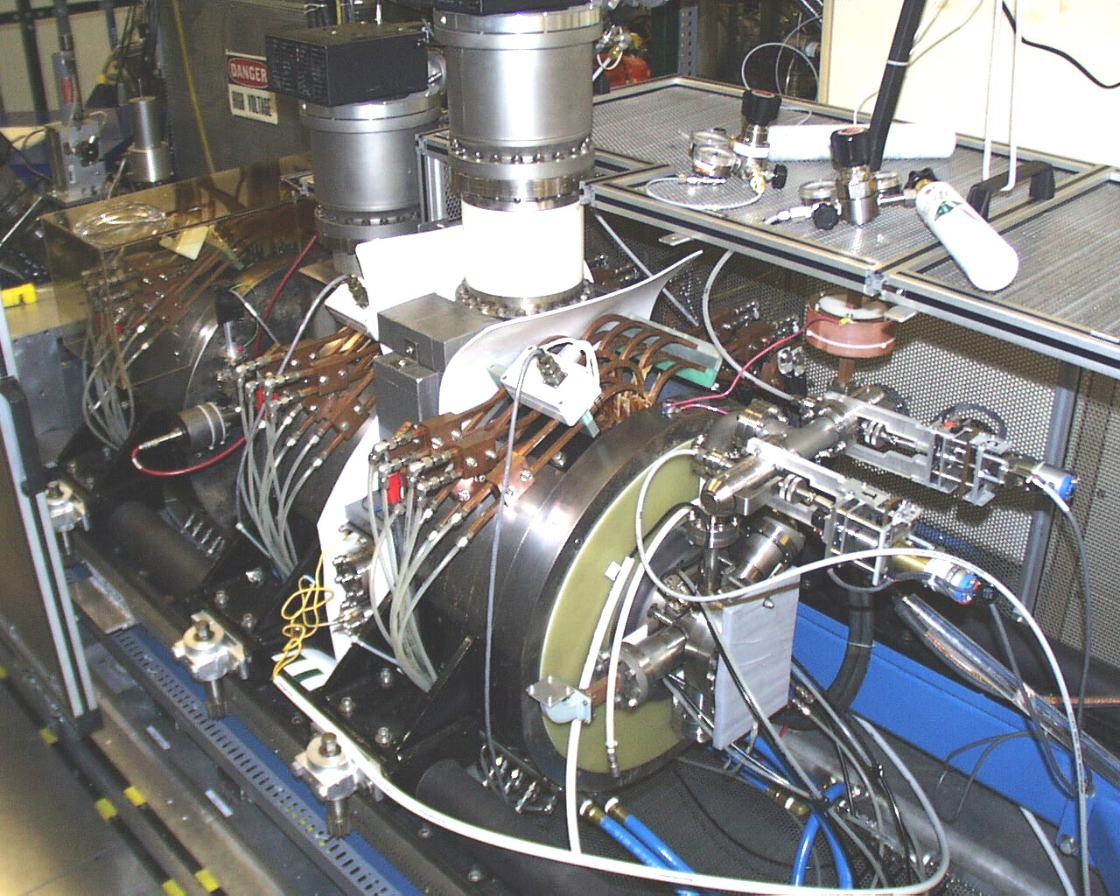
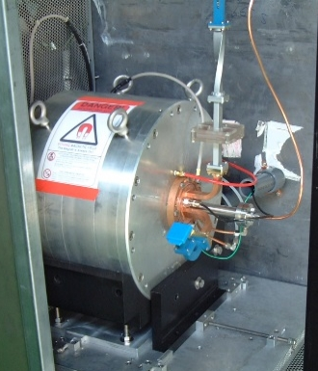
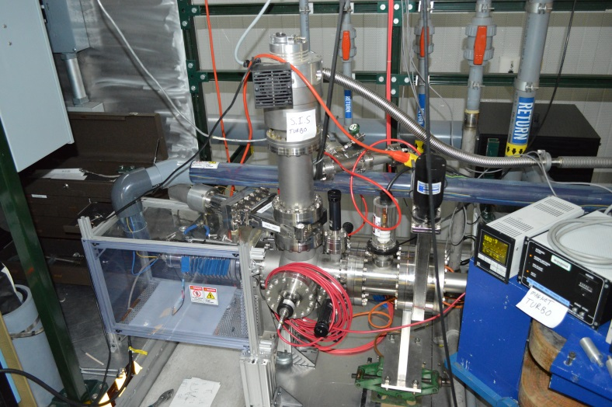
Atlas
Ion sources
nuCARIBU – n-rich beams
EBIS – charge breeder
ECR2 – stable beams
ECR3 – C-14, stable
Surface Ionization Source - lithium

Slide 6
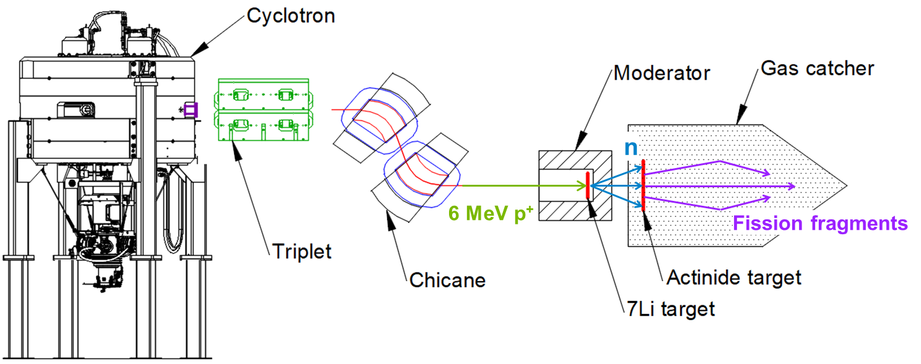
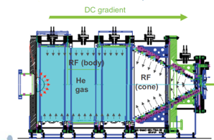
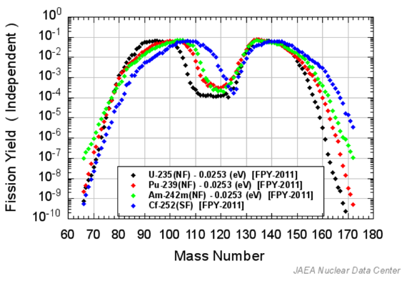
nuCARIBU
Upgrade of CARIBU (2025)
Radioactive beams produced via neutron-induced fission
6 MeV, 0.5 mA protons
p-⁷Li reaction for neutron production
10¹⁰ n/cm²
Moderator
Actinide target – ²³⁵U
10⁹ fissions/s
Fission fragments are thermalized in large volume helium gas catcher
Extracted as 1+ or 2+ ions
Energy spread - 1 eV
Emittance – 3 π·mm·mrad
Isobar separator - 1:20,000 resolution

Slide 7
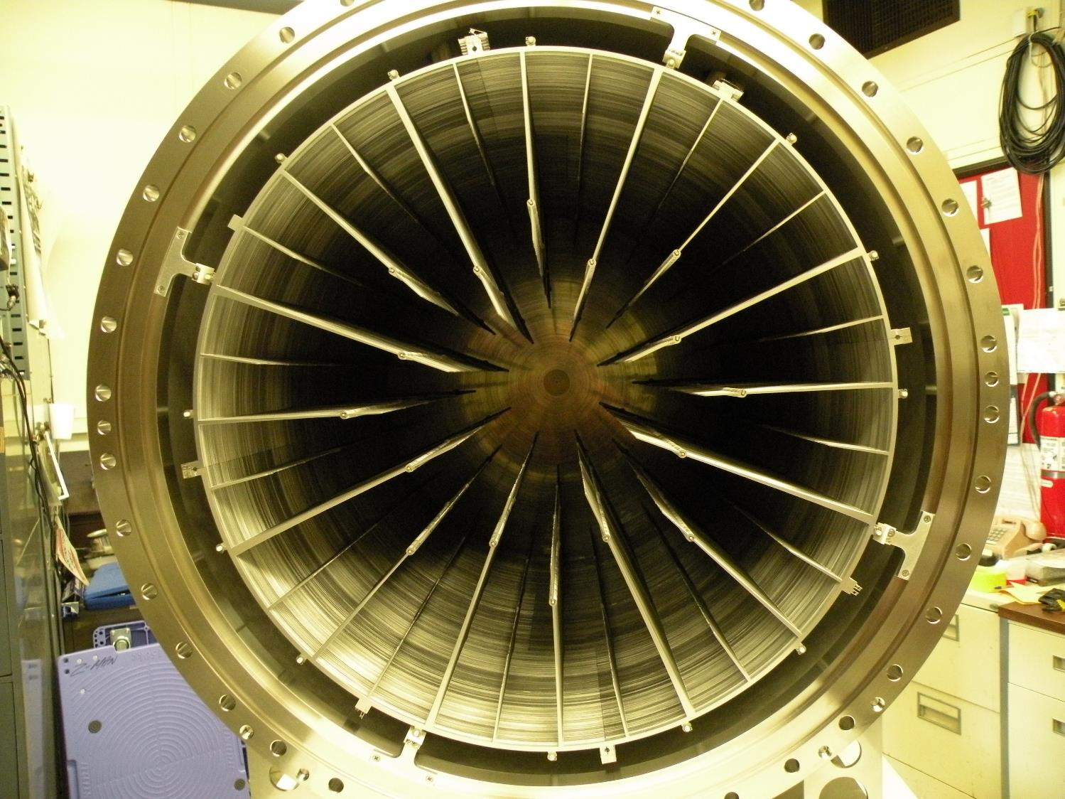
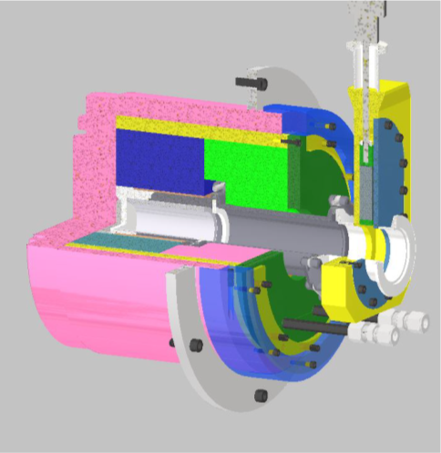
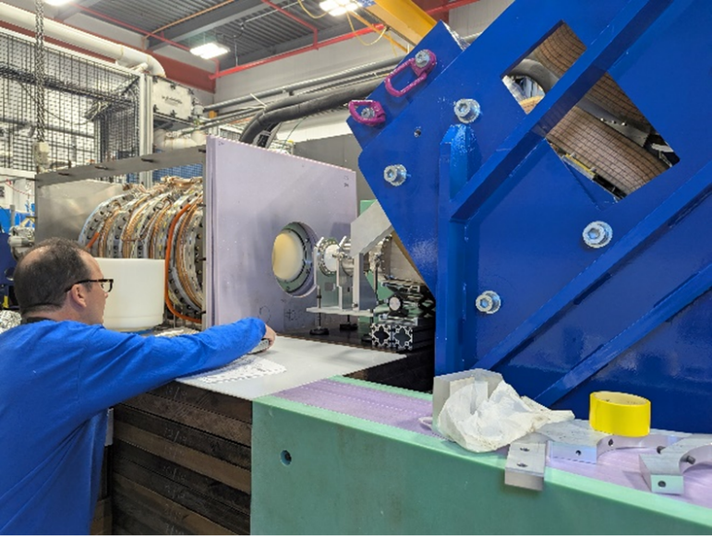
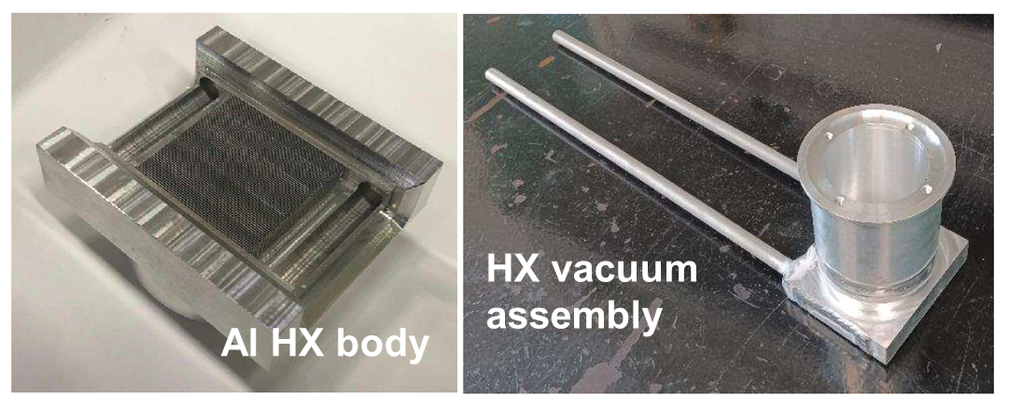
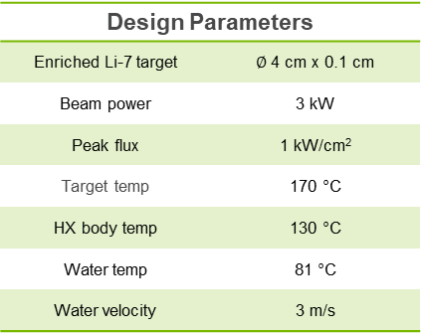
nuCARIBU
Lithium target
Design Parameters
Enriched Li-7 target | $∅$ 4 cm x 0.1 cm
Beam power | 3 kW
Peak flux | 1 kW/cm²
Target temp | 170 °C
HX body temp | 130 °C
Water temp | 81 °C
Water velocity | 3 m/s
Al6063 HX
25 µm Mo
p+
1 mm Li

Slide 8
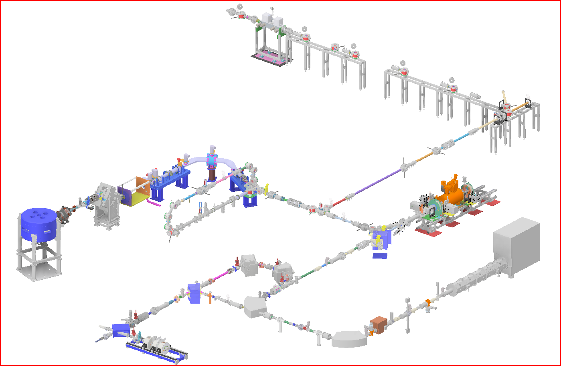
nuCARIBU
Stopped beam experimental area
Charge breeding cycle
Isobar Separator
Resolution: 1:14,000
Transmission: 100%
Resolution: 1:20,000
Transmission: 60%
Gas catcher
1+ and 2+ ions
RFQ cooler/buncher
Capacity: 10⁵ ions/bunch Accumulation: 30-100 ms
Transmission: 70% (2+), 50% (1+)
Pulse width: 100 ns
EBIS
Frequency: 10 Hz
Breeding time: 30-90 ms
Efficiency: 10-70%
Cyclotron
6 MeV, 0.5 mA
Protons
PII Linac
Superconducting
Elevator
Beam energy
2 keV → 25 keV
RFQ
Room temperature
60.625 MHz
A/q < 7
MR-TOF
Capacity: 10⁴ ions/bunch
Resolution: 1:100,000 Transmission: <50%
Hold-up time: 15 ms
ECR2
AECR-U type
14 GHz
HIGH VOLTAGE PLATFORMS AND ECR3 ARE NOT SHOWN IN THIS VIEW

Slide 9
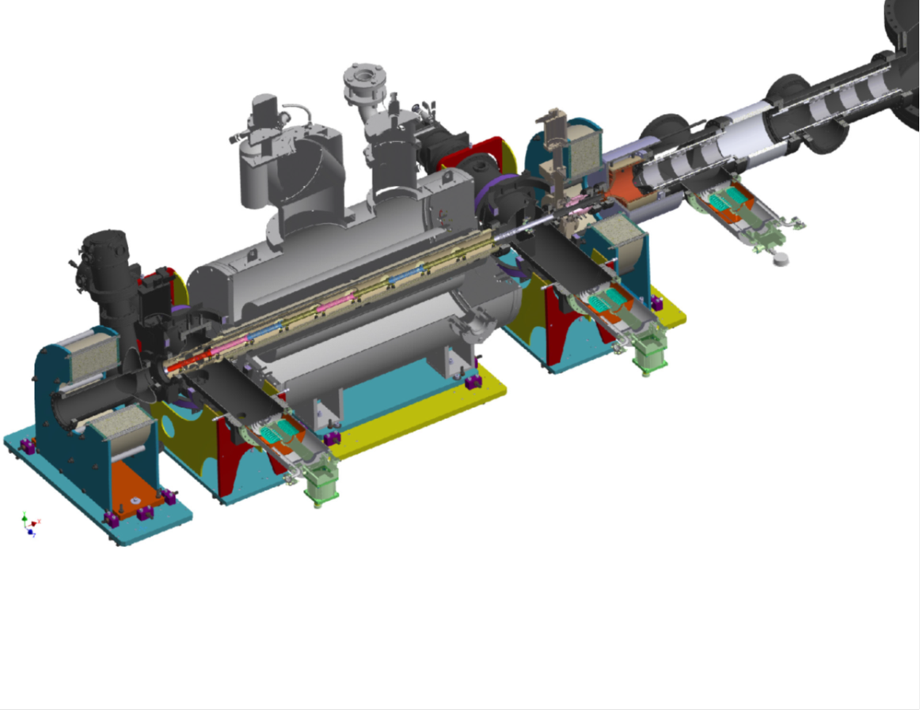
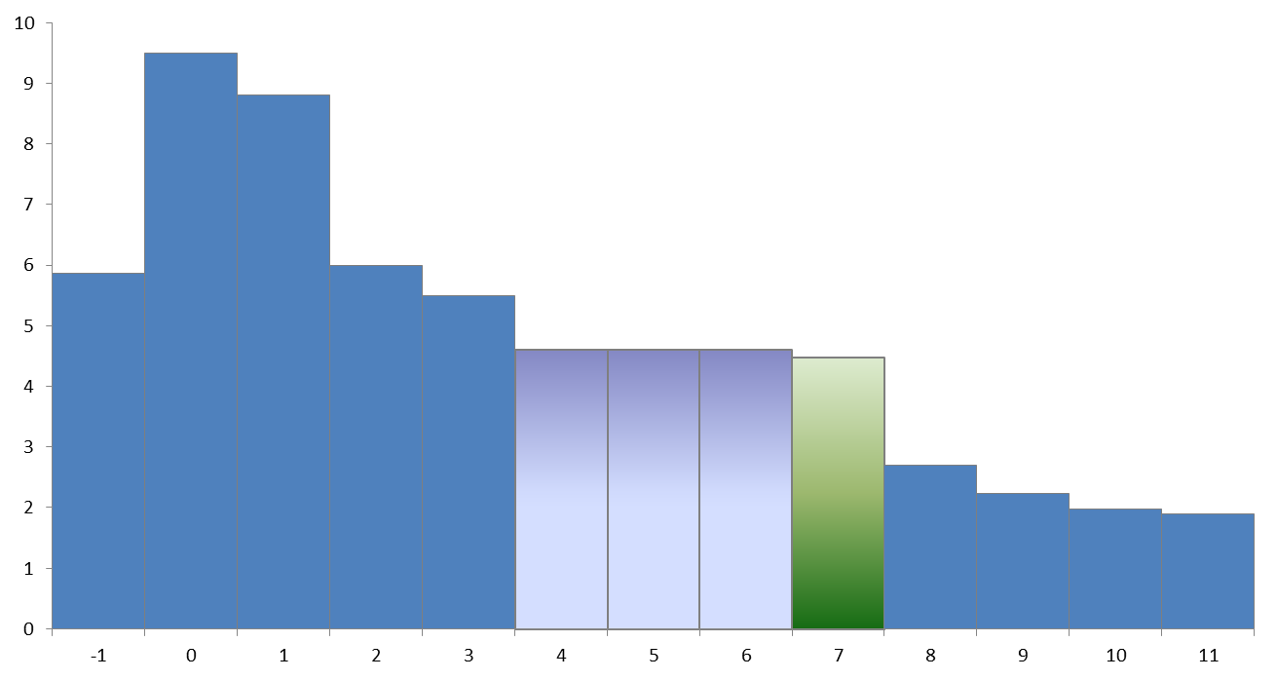
EBIS Charge breeder
20 kW Collector
7.3E-10 torr
1⁺
High-energy electron beam
EBIS Operating Parameters
Solenoid field | 5.5 T
Magnetic field on cathode | 0.15 T
Cathode diameter | 4.2 mm
Drift tube diameter | 20 mm
Electron energy in trap | 6300 eV
Electron current | 0.32 A
Effective electron current density in trap | 190 A/cm²
Trap length | 50 cm
Charge capacity | 2.2x10¹⁰
Injection time | 50 µs
Repetition rate | 10 Hz
Duty cycle | 50 %
EBIS bias | 20 kV
Pressure | 1x10⁻¹⁰ torr
n⁺
Electrostatic transport line
Injection/extraction cycle
Warm bore
11 drift tubes
3 for trap
Trap drift tubes
Electron gun
3.9E-10 torr
Voltage (kV)
Barrier drift tube
Drift tube number

Slide 10
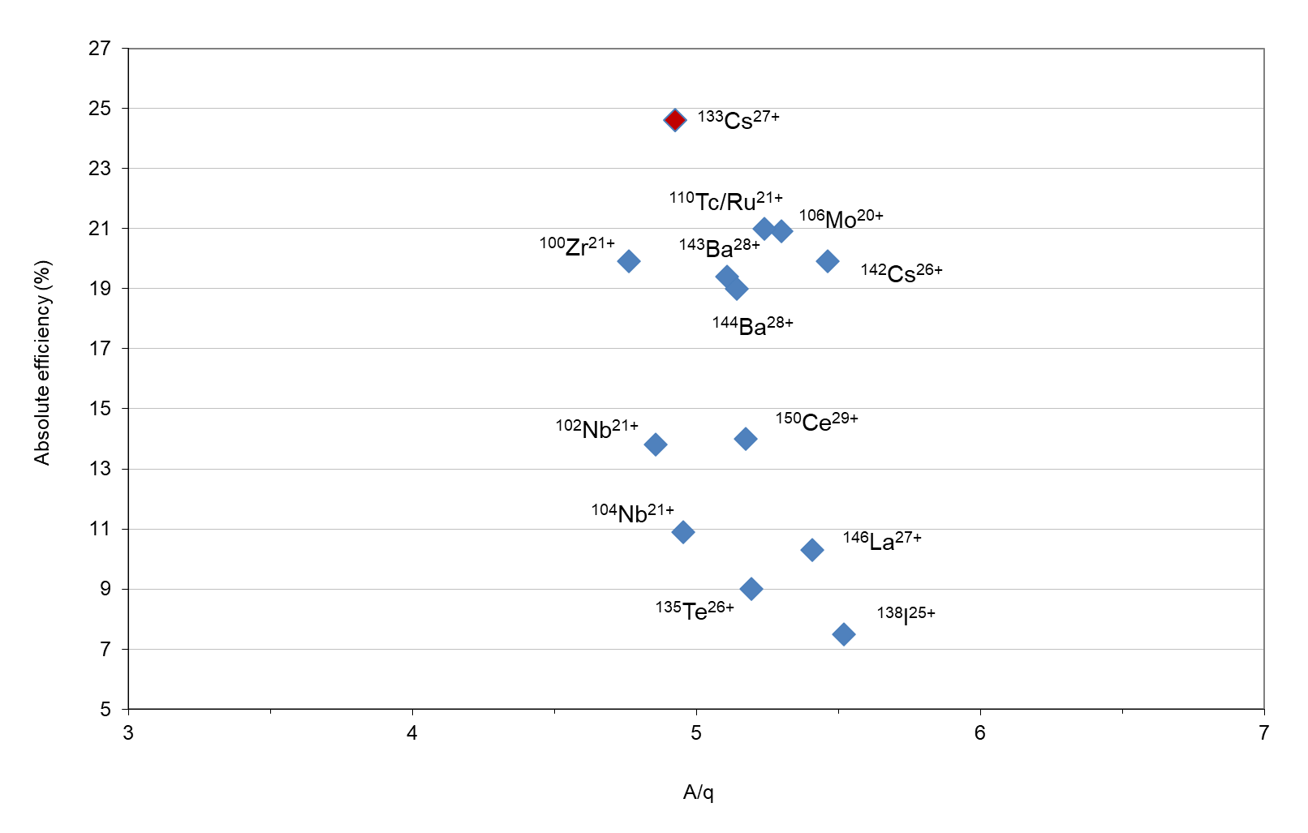
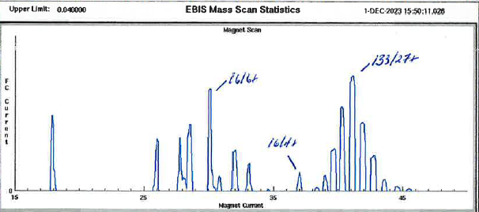
Ebis charge breeder
Breeding efficiency, EBIS only
Absolute efficiency
Ratio of n+ particles out in a single charge state (SCS) to 1+ particles in
Stable Cs-133 from surface ionization source
Pulsed deflector
50 µs, ~10 epA
Radioactive beams from CARIBU
All beams from Cf-252 (2017-2020)
High electron beam energies (>3 keV)
Moderate breeding times (<100 ms)
Broad charge state distributions (CSD) for the mid-mass species
Limits how many particles can populate a single charge state
Gun+trap: 6265 V
E-beam: 317 mA
Time: 49 ms
Cs+: 13.5 pA
86 epA
23%

Slide 11
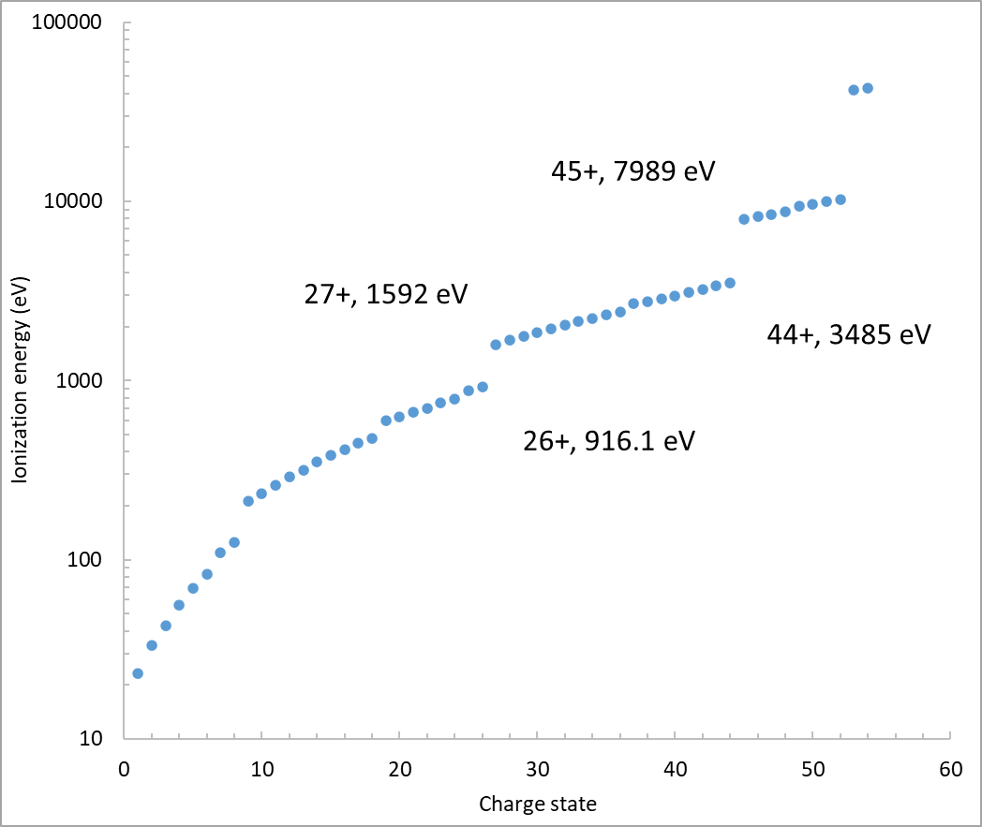
Closed shell breeding
Improve single charge state efficiency
Target large gaps in ionization energy at shell closures
Narrow charge state distribution
Enhance single charge state abundance
Set electron beam energy slightly below ionization energy of last electron in a shell
Ionization of this charge state is inhibited
Its relative abundance is enhanced
R. E. Marrs, M. A. Levine, D. A. Knapp, J. R. Henderson, Phys. Rev. Lett. 60, 17, 1715-1718 (1988)
R. Becker, "EBIS/EBIT: Electron Beam Ion Source/Trap," Handbook of Ion Sources, B. Wolf, Ed., Boca Raton, NY, London, Tokyo, CRC-Press, 157-182 (1995)
Ba⁴⁶⁺, 5.69-8.20 keV, continuous mode (EBIT)
R. E. Marrs et al.
Na⁹⁺, K^{9+,17+}, Cu¹⁹⁺, 35-40% SCS efficiency
F. Wenander, JINST 5, C10004 (2010)
Ar¹⁶⁺, 4.95 keV and 1000 ms (EBIT)
S. Geyer, A. Sokolov, A. Thorn, G. Vorobyev, h. Stohlker, O. Kester, JINST, vol. 5, no. C10003, (2010)
[Ar]3d¹⁰
[Ar]3d¹⁰4s
Cesium ionization energies. A. Kramida, Y. Ralchenko, J. Reader and NIST ASD Team (2023), NIST Atomic Spectra Database (ver. 5.11)

Slide 12
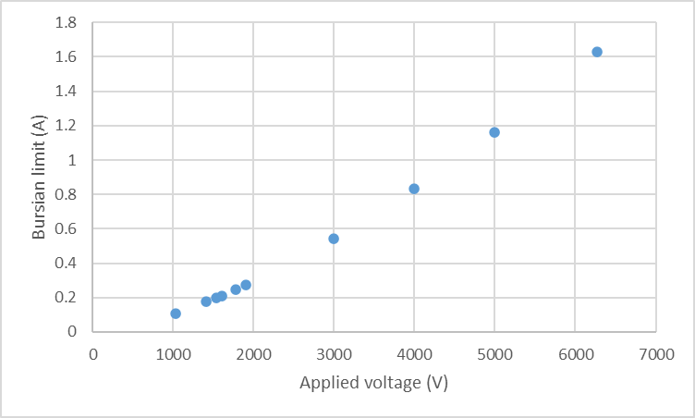
Closed shell breeding
Shell Ionization Energy
+25 [Ar]3d104s2 875 eV
+26 [Ar]3d104s 916.1
+27 [Ar]3d10 1592
+28 [Ar]3d9 1672
NIST Atomic Spectra Database (ver. 5.11)
Constraints
Desired charge state dictates electron beam energy
Linac acceptance A/q < 7
Ionization/radiative recombination > 1
Beam energy affects electron beam intensity
Lower energy → less electron beam propagated
Lower current density → longer breeding time
Cesium
Breeding window
RFQ-C/B 10 Hz rep rate → 100 ms window
R. Becker; O. Brinzanescu; Th. Stöhlker, AIP Conf. Proc. 572, 119–125 (2001)

Slide 13
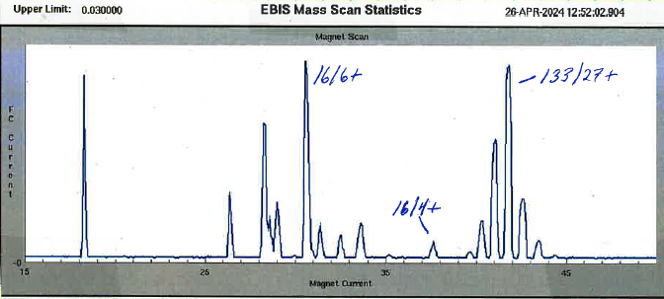
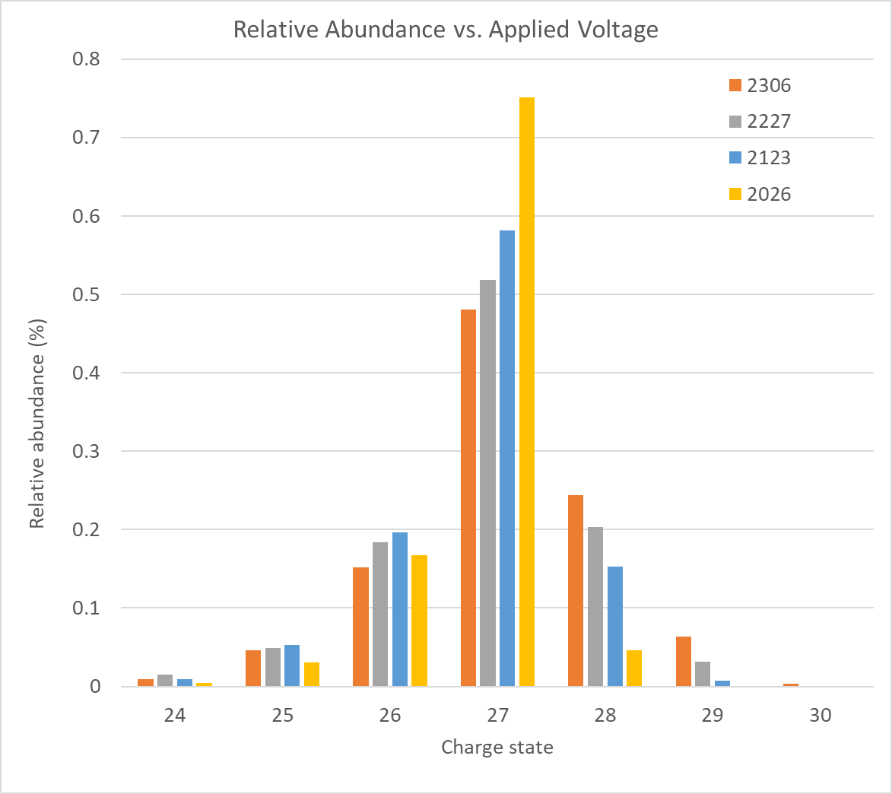
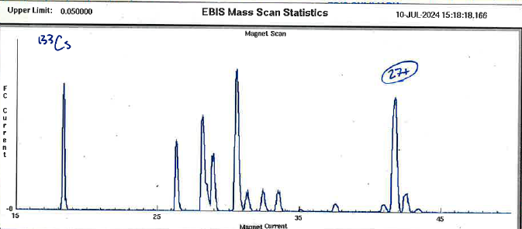
Closed shell breeding
Gun+trap: 6265 V
E-beam: 317 mA
Time: 49 ms
Cs+: 13.5 pA
86 epA
23%
10 charge states
Implementation
Selected ¹³³Cs²⁷⁺
Electron beam energy in trap < 1592 eV
Electron current limited to < 200 mA
Electron current density ~ 50 A/cm²
Slowly lowered electron gun and trap voltages
Lowered electron current to avoid virtual cathode
Increased breeding time to stay on 27+ peak
Gun+trap: 2736 V
E-beam: 174 mA
Time: 79 ms
Cs+: 10 pA
7 charge states
Gun+trap: 2033 V
E-beam: 171 mA
Time: 89 ms
Cs+: 5.2 pA
87 epA
62%
4 charge states

Slide 14
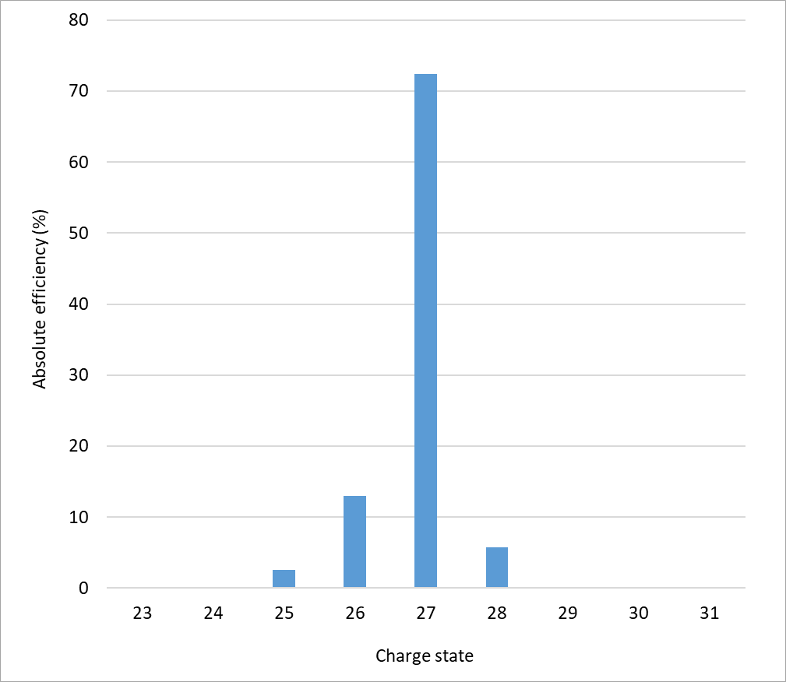
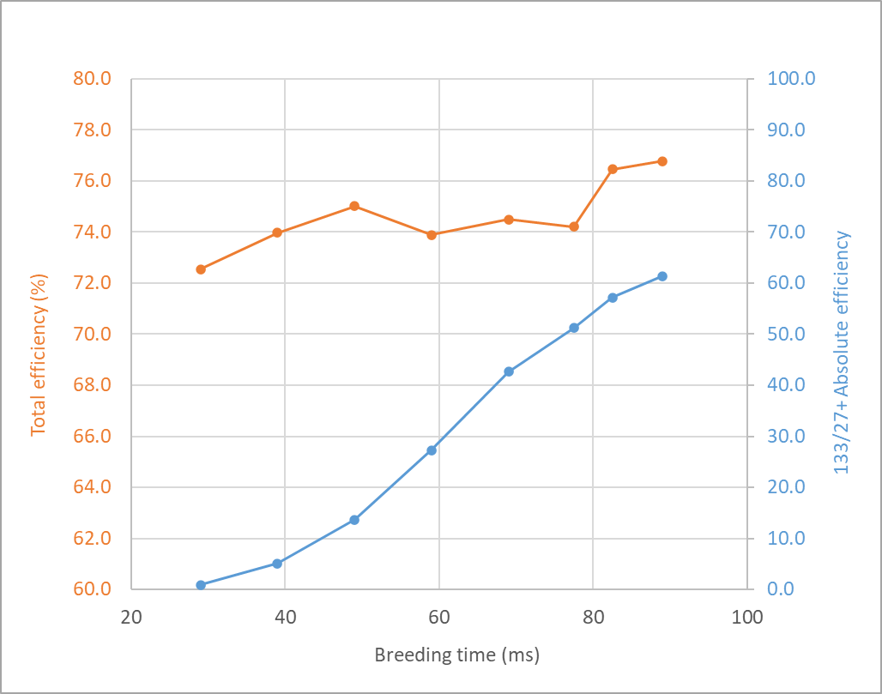
Closed shell breeding
Low-energy electron beam
EBIS Operating Parameters
Solenoid field | 5.5 T
Magnetic field on cathode | 0.15 T
Cathode diameter | 4.2 mm
Drift tube diameter | 20 mm
Electron energy (est.) | 1610 eV
Electron current | 0.172 A
Effective electron current density in trap (est.) | 280 A/cm²
Trap length | 50 cm
Charge capacity | 2.4x10¹⁰
Injection time | 50 µs
Repetition rate | 10 Hz
Duty cycle | 90 %
EBIS bias | 20 kV
Pressure | <1x10⁻¹⁰ torr
Cesium - measured absolute efficiencies (EBIS only).
Measured absolute efficiency and EBIS total efficiency versus breeding time. No tuning between data points.
V_{gun}: -890 V, V_{trap}: 1141 V (applied voltage: 2031 V)
Effective electron current density estimated with EBISIM

Slide 15
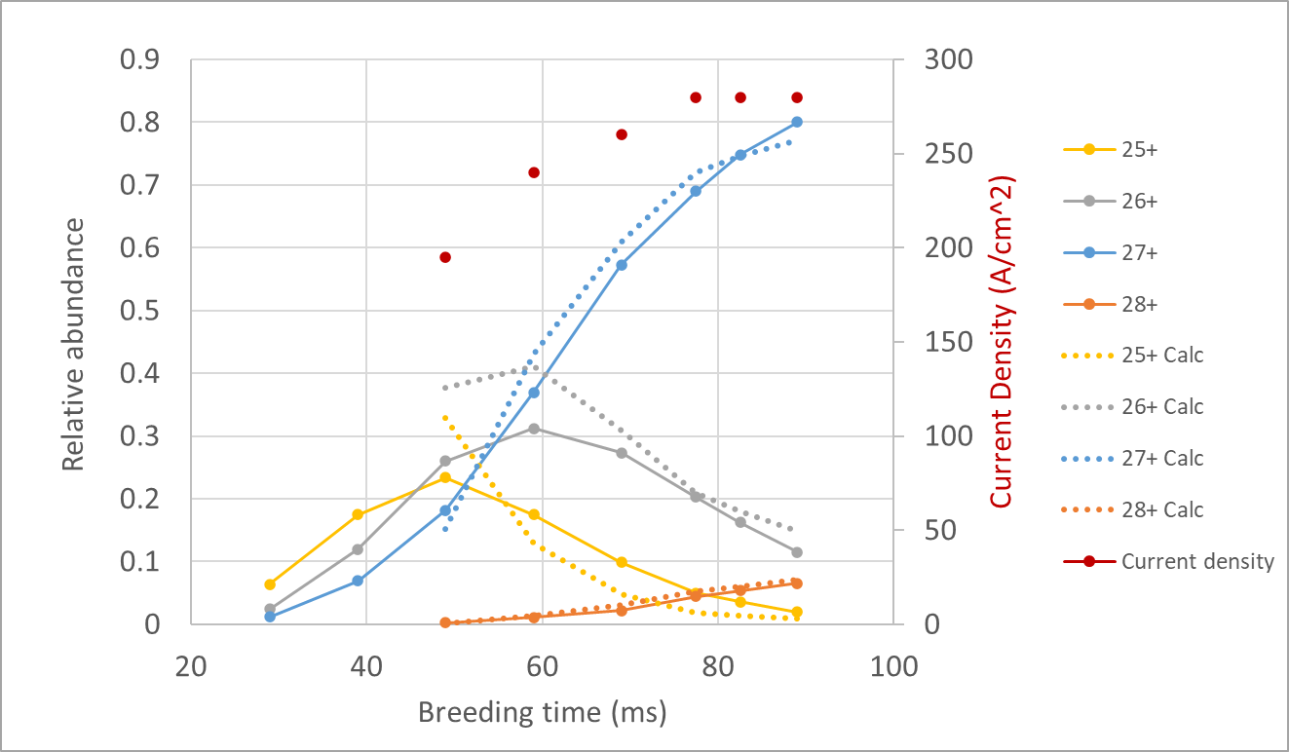
Closed shell breeding
Current density discrepancy
Mode | Beam energy (eV) | Expected current density (A/cm²) | Effective current density (A/cm²) | Breeding time (ms) | SCS eff. (%)
High energy | 6000 | 83 | 190 | 49 | 23
Medium energy | 2000 | 46 | 185 | 78 | 28
Low energy | 1610 | 43 | 280 | 89 | 72
Gas (xenon) | 6000 | 71 | 125 | 130 | ---
EBISIM best CSD fit for 89 ms breeding time
Beam energy: 1610 eV
Effective current density: 280 A/cm²
Observed by MSU and REXEBIS groups as well
A. Gunnarsson et al., 2025, JINST 20 C03053

Slide 16
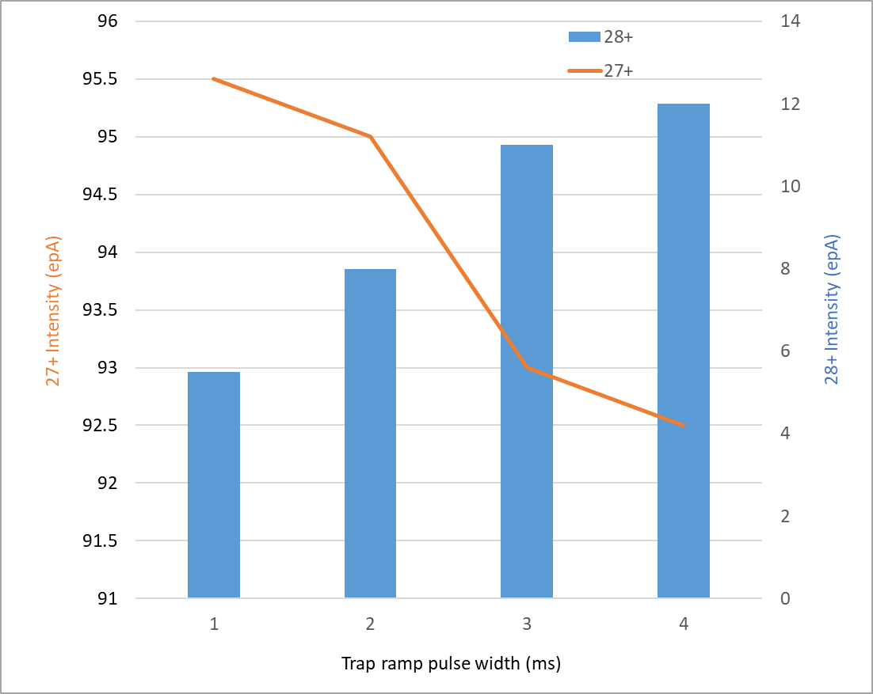
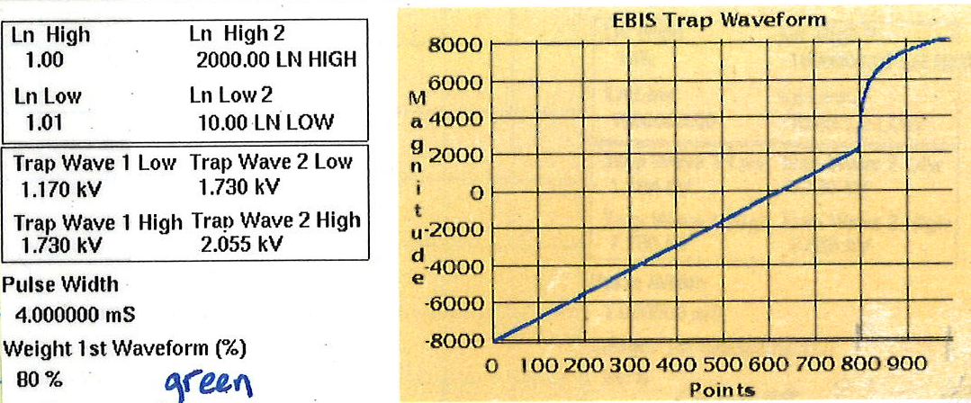
Closed shell breeding
28+ presence
Suspect portion of 28+ is created during trap emptying cycle
Breeding voltage: 1953 V
Emptying voltage: 2913 V
IE(27+): 1592 eV, IE(28+): 1672 eV
Trap cycle consists of two waveforms
“Close to emptying” ramp
“Emptying” ramp
Extended duration of ramp cycle 1 → 4 ms
Held “emptying” ramp at 0.8 ms

Slide 17
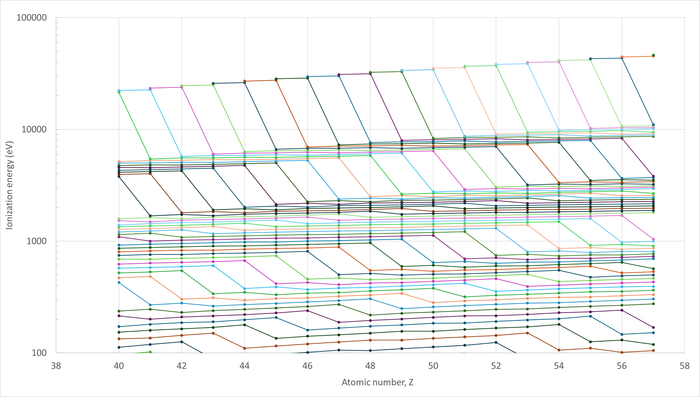



Closed shell breeding
Operational space assuming 100 ms breeding window
2p/3s transition
Large energy differential
Unrealistic current density?
3p/3d transition
Realistic current density
Moderate energy differential
Limits effectiveness
3d/4s transition
Large energy differential
Realistic current density
Need to explore lower Z region
Zirconium, Z=40
1000 A/cm²
$$\frac{2p}{3s}$$
30+
$$\frac{3p}{3d}$$
22+
27+
$$\frac{3d}{4s}$$
15+
60 A/cm²
Zr
Cs
Compiled from NIST ionization energies. A. Kramida, Y. Ralchenko, J. Reader and NIST ASD Team (2023), NIST Atomic Spectra Database (ver. 5.11)

Slide 18
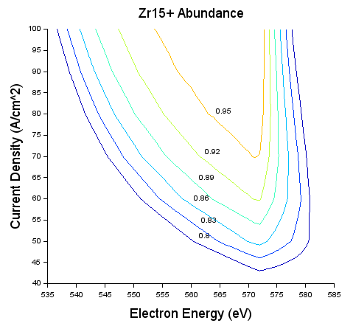
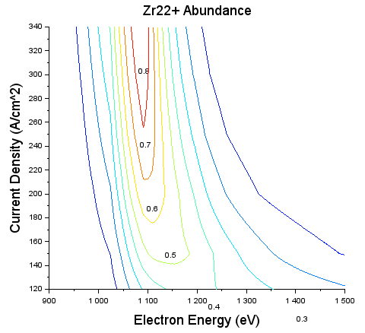
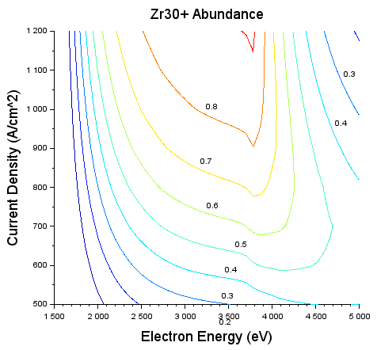
Closed shell breeding
Zirconium
Charge state | A/q | Beam energy (eV) | Effective current density (A/cm²) | Breeding time (ms) | Absolute SCS efficiency (%)
15+ | 6.67 | 573 | 59 | 89 | 72
22+ | 4.54 | 1160 | 171 | 89 | 43
30+ | 3.33 | 3788 | 1010 | 89 | 68
EBISIM
Determine optimum beam energy
Corresponding effective current density
Constrained by Bursian limit
Assume 80% device efficiency

Slide 19
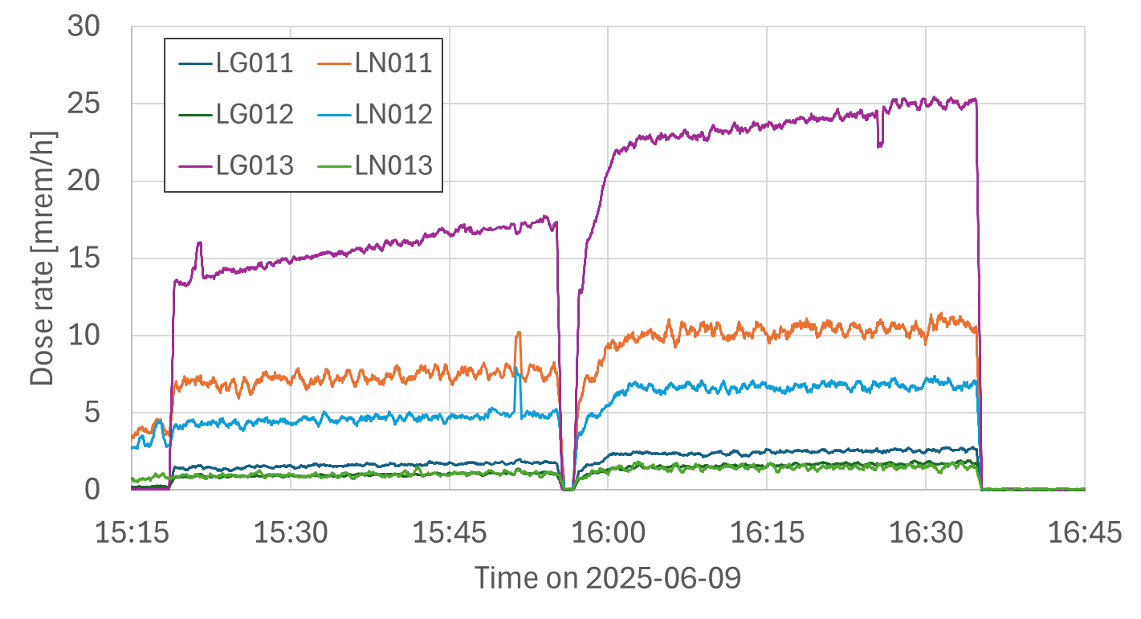
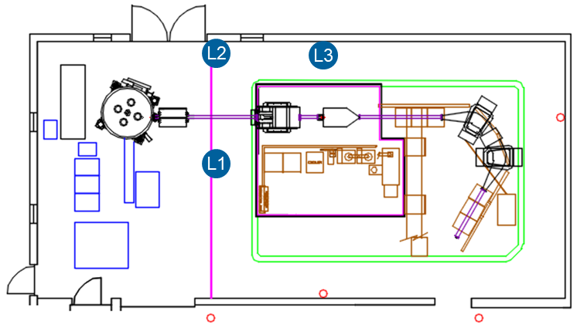
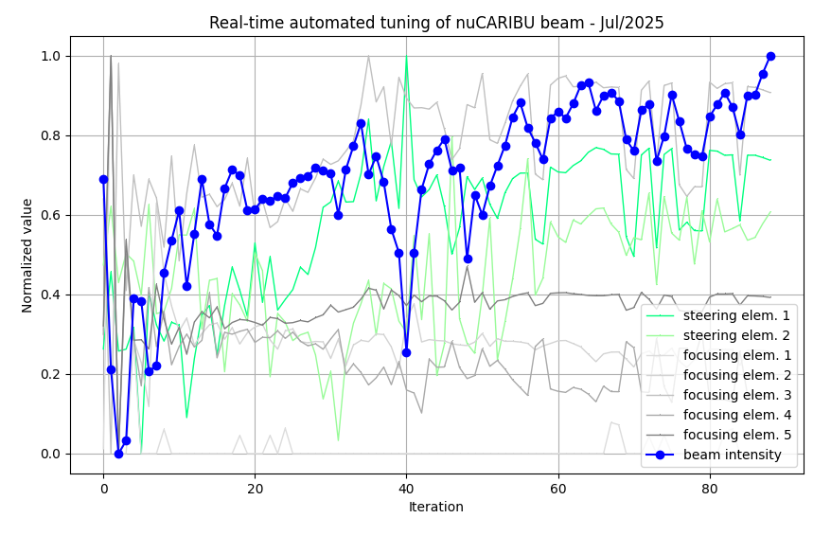
nuCARIBU
Current status
First RIB out of gas catcher– June 18, 2025
Proton current: 15 μA
Limited by radiation levels
¹⁴²Cs¹⁺, T_{1/2} = 1.687 s
First charge bred RIB – July 9
Normal mode
Proton current: 50 μA
More shielding but still limited by radiation
Worked on closed shell mode with RIB – July 14
Exceedingly difficult
Shifted to ¹⁰⁰Zr²⁺ high energy mode – July 16
Tested machine-learning-based tuning of injection line
Started tuning beam through linac to target
~15 μA
~10 μA

Slide 20
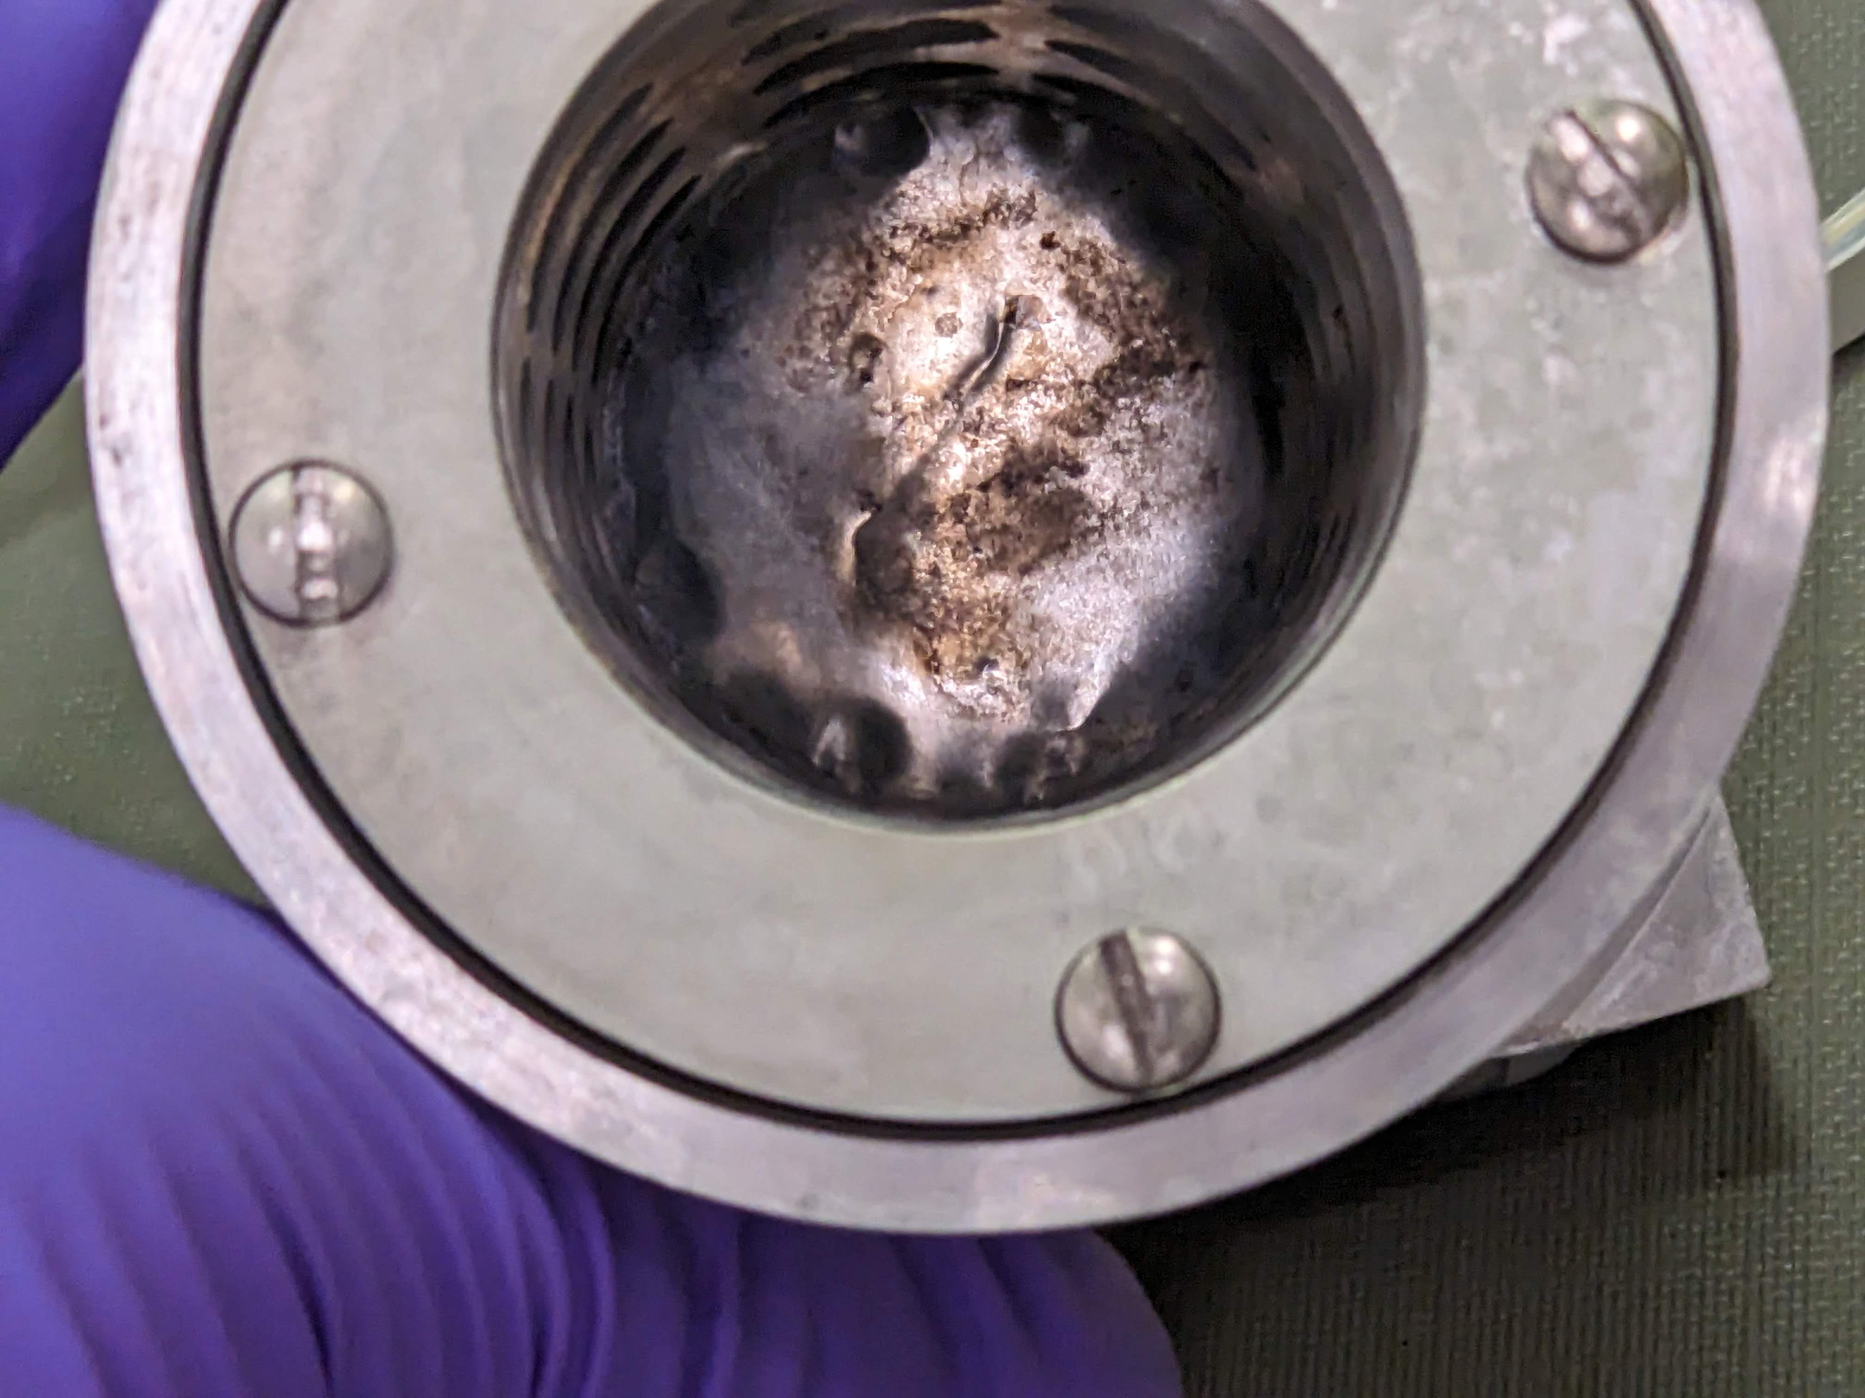
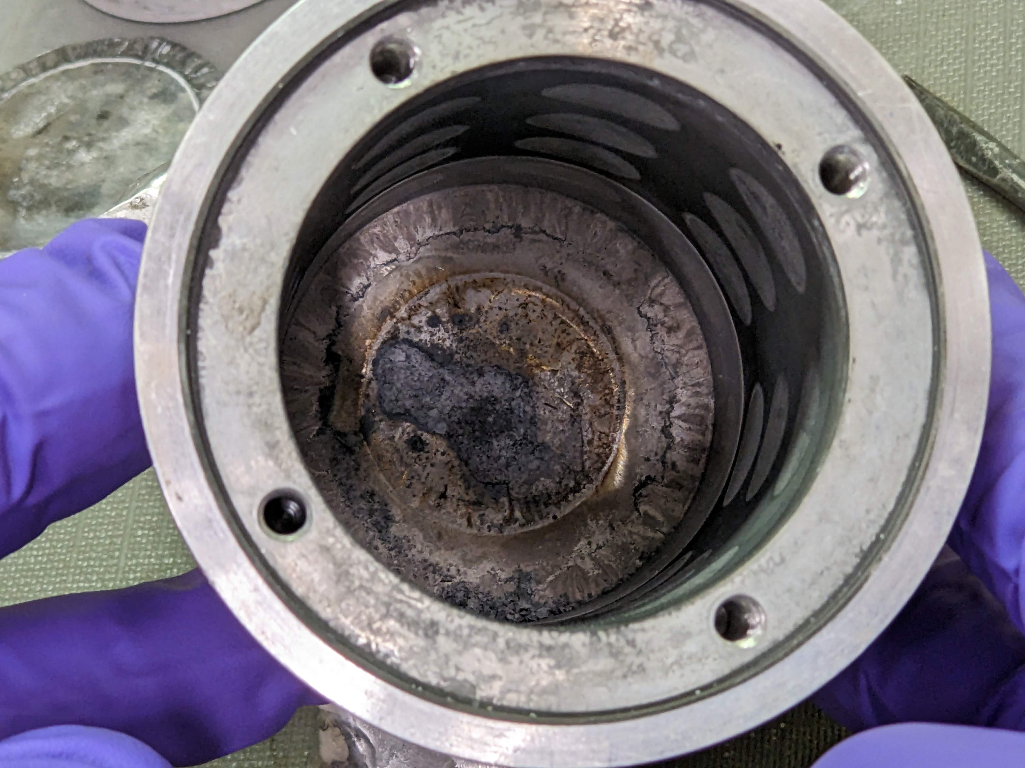
nuCARIBU
Current status
Lithium target failure – July 18, 00:45
Breach between cooling circuit and vacuum
Only 135 hours of beam on target
Investigating failure mode

Slide 21
summary
nuCARIBU
First fission products (Cs-142, Ba-144, Zr-100) extracted from gas catcher
Failure analysis of lithium target underway
Closed shell breeding with Cs-133 has been very effective
72% single charge state efficiency
Need to establish closed shell breeding of RIBs
Matching stable beam into EBIS is challenging in closed shell mode
Doing this with RIBs is especially difficult
Investigating electron current density discrepancy

