Slide 1

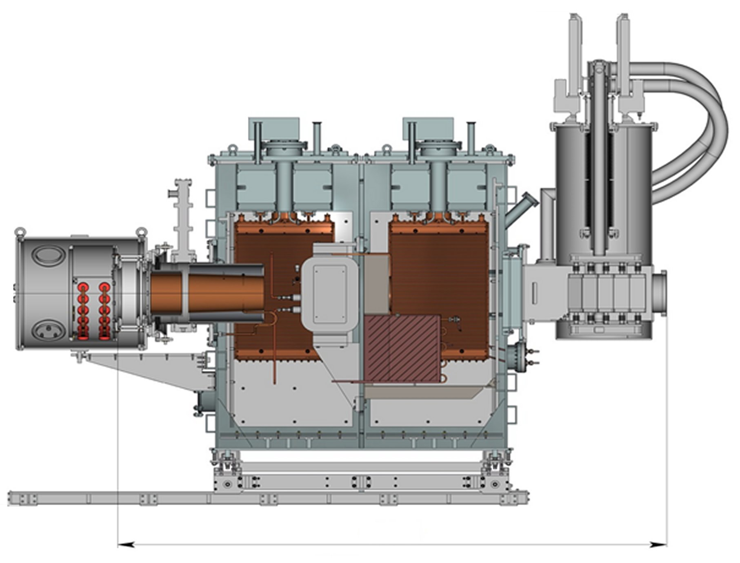
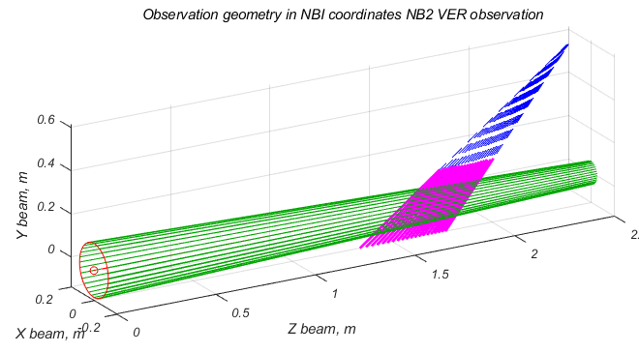
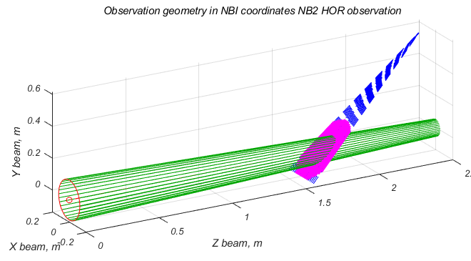
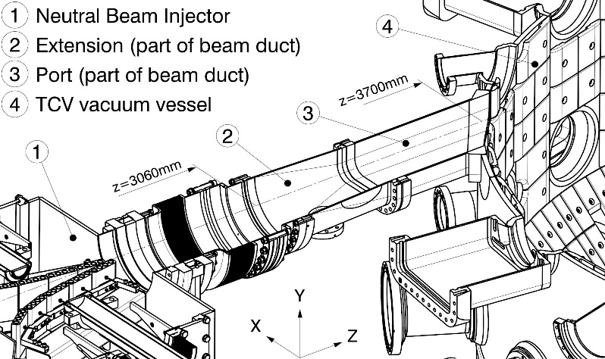
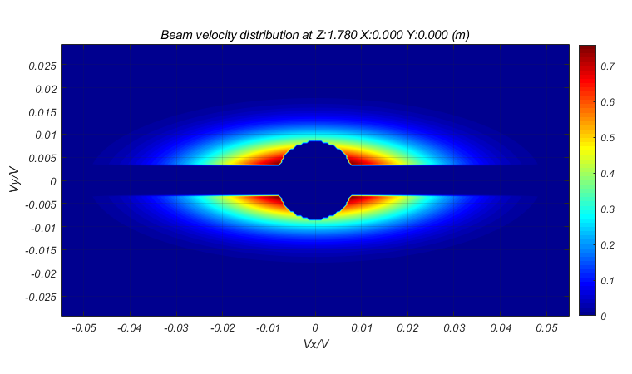
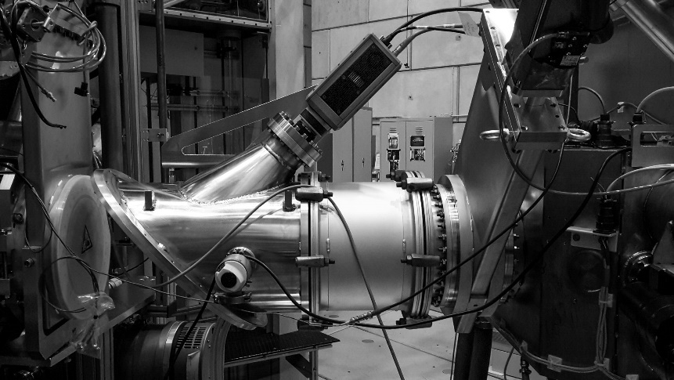
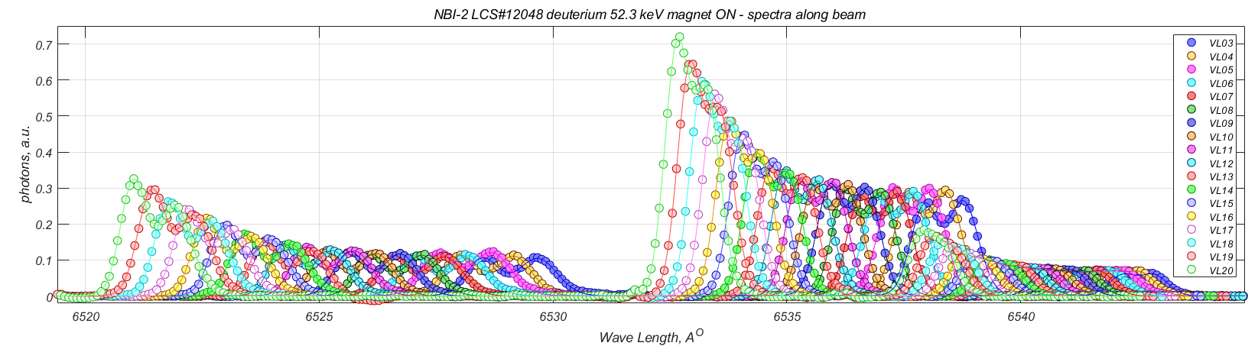
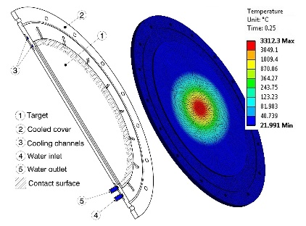
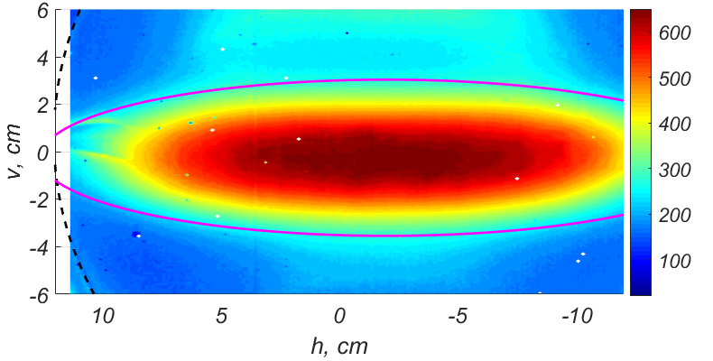
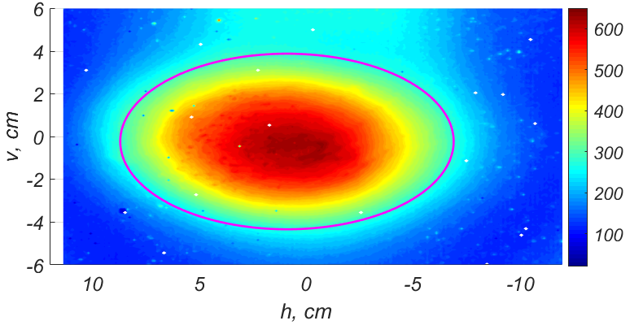
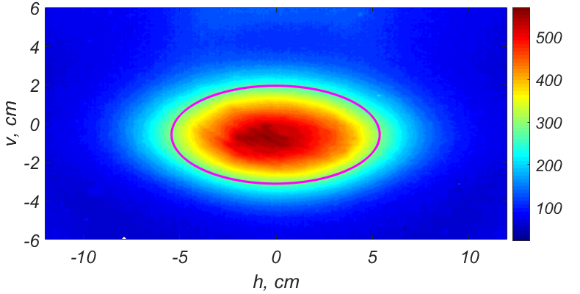
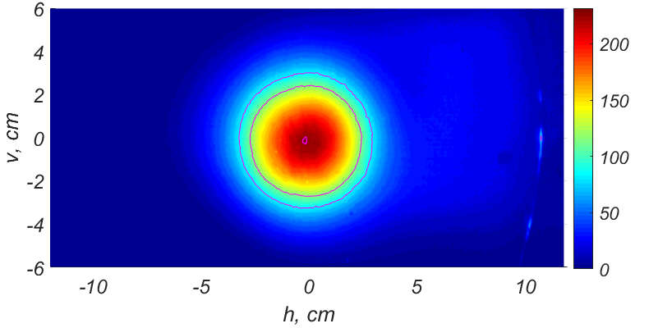

21st International Conference on Ion Sources, Oxford, UK, 8th–12th of September 2025 ID:#10
Diagnostics for characterization of neutral beams parameters at TCV
A.N. Karpushov, Y. Andrebe, B.P. Duval, R. Jacquier, A. Listopad, D. Mykytchuk, H. Reimerdes, M. Toussaint, and TCV teamª
Ecole Polytechnique Federale de Lausanne (EPFL), Swiss Plasma Center (SPC), CH-1015 Lausanne, Switzerland
ªSee author list of B.P. Duval et al 2024 Nucl. Fusion 64 112023, DOI:10.1088/1741-4326/ad8361
NBIs on TCV
cryo-panels
Multi-channel spectroscopy
TCV^{[1]}: R_{O}/a 0.88/0.25m B_{T}≤1.54T
NBI-1 ≤1.3MW, ≤28keV (D/H) &
NBI-2 ≤1.1MW, ≤52keV (D/H)
RF plasma source, triode IOS with slit beamlets, geometrical focusing
“standard” set of diagnostics: grids U&I, RF power, magnet I, TCs on calorimeter and ion dump, vacuum, …
DNBI 80kW, 50keV (H)
cold cathode arc-plasma source, tetrode IOS with circular beamlets
magnet
optical port
Collection optics: ×3 N-BK7 ∅ 1 inch lenses, f:30mm on NBI-1/2 optical ports
View lines along (35-52 deg. to beam axis) or across (-12…+12 cm) beam
Bundle of 20 fused silica fibers, NA:0.22, core ∅365μn arranged on 8mm in line
Czerny-Turner spectrometer – Acton Research SpectraPro-750, focal length 750 mm, aperture ratio f/9.7
AndorTM iXon^{EM+} Ultra DU 897 BV BI CCD Camera, 512×512 pixels, 16×16μm pixels
RF plasma
source
neutralizer
ion optics
(grids)
ion dump
calorimeter
aiming CEMs
3.2 m
Layout on NBI-2 (& NBI-1)
NBI-2 layout (similar NBI-1) ^{[2]}
Measurement of Doppler-shifted (Balmer-α, 656 nm) lines:
WL range 6519…6564 A^{O}, 0.087 A^{O}/pixel, instrumental function ~0.25A^{O}
Beam duct protection: NBI-2/1 max.280/150MW/m² − 17×22cm² ports
Tokamak protection: shine-through on central column and beam dump
NBI profiles (F(r³,v³)) essential for:
Optimization of beam duct – min. losses, overheat, beam blocking
Modelling of NBI deposition in plasma (fast ion birth rate)
Interpretation of CXRS measurement – DNBI profiles in plasma
NBI & spectroscopy model
Ballistic motion of beam particles form emitter (grids, G) ∅250mm = 2R_{G} to point O
“Beamlet” axes to focal points (F_{X} & F _{Y} ~4m)
Velocity distribution from each point on emitter
f’(v) = j_{G} × exp(– (θ’_{X}/Δθ _{X})² – (θ’_{Y}/Δθ _{Y})²)
Velocity distribution at point (O) on view-line (OC)^{[5]} : F’_{O}(v) = ∫_{G} f’ dG
Projection of velocity distribution on view-line
F’’(v_{Z’’}) = ∫_{Z’’} (n_{BG}(z’’) × F’_{O}(v) dz’’,
n_{BG}(z’’) – background density along view-line
θ’_{X}
NBI-1/2 ducts
∅250 →
156×206mm²
Design optimization:
Minimal power density on walls
Minimal surface temperature
Surface material – heat remove & low sputtering, release of gas/impurities
θ’_{Y}
CuCrZr beam duct insert^{[3]}
Spectral distribution of Doppler shifted line on observation chord (OC)
F’’(λ) = const × F’’(v_{Z’’}), λ = λ_{O} (1 -(v_{Z’’}/c)
Power density distribution P_{O}(r) ≈ ∫_{v} E(v) F’_{O} (v) dv
Measurements: 19 thermocouples & optical (350-1100 nm) detector
measurement NBI-2 49keV 900kW deuterium, along beam
Background density (n_{BG} ) along beam axis – gas from neutralizer and calorimeter
Tungsten target
model: Δθ _{X}&Δθ _{Y} 0.8&0.3 deg.
Measurement of 3-D NB power density distribution
4mm actively cooled tungsten tile at 45° to beam axis
“EQUUS 81k M“ IR camera 3.0‐5.0μm wave length
DN320 25cm length aluminium extensions – shift alonng beam
j_{G} =0 on IOS axis r≤15mm and cooling bar |z|≤5mm.
Spectroscopy measurement
Vertical divergence (Δθ _{Y} ) form measurement along beam
Larger line broadening for more perpendicular (to beam axis) view lines
measurement NBI-2 52keV 1.1MW deuterium, along beam
half energy
full energy
Eo/3
magnet ON – only neutrals
Δθ _{Y} 0.28 deg.
magnet OFF – neutrals & ions
Δθ _{Y} 0.32 deg.
Vertical divergence from spectroscopy ~0.3 deg. is in good agreement with measurement on W-Target and calorimeter
On-axis temperature vs time
Horizontal (-) and vertical (--) profiles after 200ms of NBI
COMSOL thermo-mechanical simulation
Line broadening vs observation angle (full energy fraction)
Limitation: sputtering at high power density high surface temperature → “cloud” between target and camera
Optimization of NBI divergency with spectroscopy measurement across beam
Minimal beam size at the same perveance for 3 beam energy fractions and for measurement on the calorimeter
perveance scan
I_{OPT}
NBI-1 (old IOS, 2017) 471kW 21keV (D) 200ms 3.30×14.63cm
NBI-1 (new IOS, 2019) 544kW 20keV (D) 100ms 4.12×7.80cm
NBI-2 (2021) 674kW
41keV (D) 95ms 2.34×5.40cm
calorimeter
Eo Eo/2 Eo/3
profiles vs I_{B}
profile
redistribution
Thermography measurement on W-Target
NBI-1 “old” grids unacceptable divergency across slits (horizontal)
Lower horizontal beam size and divergency with new grids
Lower divergency and beam size for high energy NBI-2
Circular beam profile for axisymmetric IOS of DNBI
I_{B} < I_{OPT}
I_{B} = I_{OPT}
I_{B} > I_{OPT}
DNBI (2024) 67kW 49keV 330ms
I_{B} < I_{OPT}: profile broadening; I_{B} > I_{OPT}: redistribution form axis to 4-8cm
Beam halo, especially at low beam current
Summary
This work was supported in part by the Swiss National Science Foundation
E-mail: alexander.karpushov@epfl.ch WWW: spc.epfl.ch
Measurement of NBI profiles with 3 systems implemented for NBIs on TCV:
Calorimeter: power profile 10 points 1-D horizontal, max.500kJ (0.5s@1MW), fixed z, NBI shots on calorimeter
W-target thermography: 2-D power distribution, different z, max. 100-200kJ, NBI disconnected from tokamak
Beam spectroscopy: density of beam fractions, non-perturbative, > 2s@1.3MW, shots on calorimeter and in TCV

