Slide 1













21ST INTERNATIONAL CONFERENCE ON ION SOURCES
SEPT
8-12
ORGANISERS
OUR SPONSORS

Slide 2
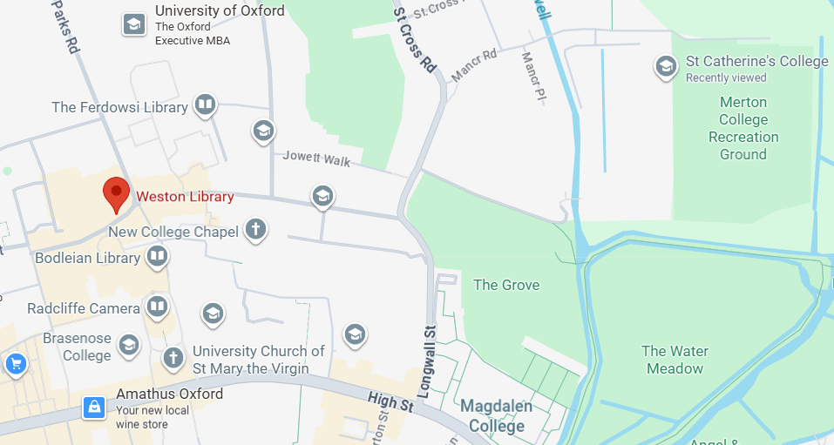

Drinks reception at 19:00-20:00 at Weston Library – Bodleian Libraries
I
I
You are here
10-minute walk
SEPT
8-12
21ST INTERNATIONAL CONFERENCE ON ION SOURCES

Slide 3
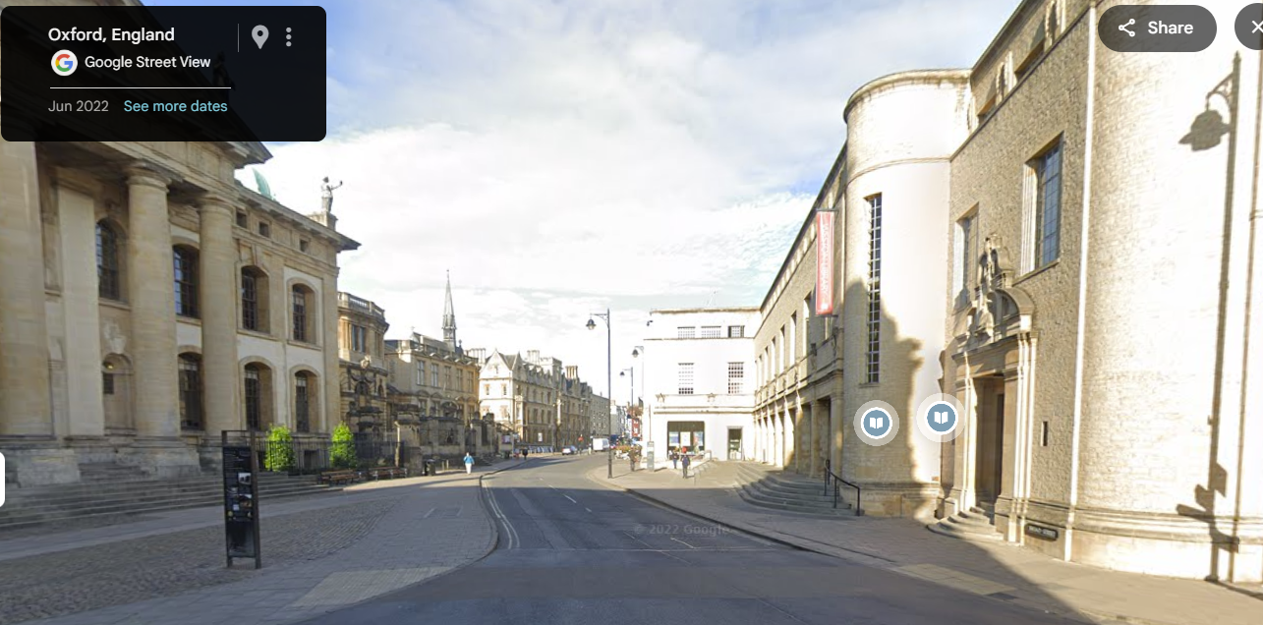
Drinks reception at 19:00-20:00 at Weston Library – Bodleian Libraries
I
I
SEPT
8-12
21ST INTERNATIONAL CONFERENCE ON ION SOURCES

Slide 4
I
I
Conference photo to be taken just before the afternoon coffee break.
Those who wish to appear in the photo, please remain seated in the lecture hall.
SEPT
8-12
21ST INTERNATIONAL CONFERENCE ON ION SOURCES

