Slide 1
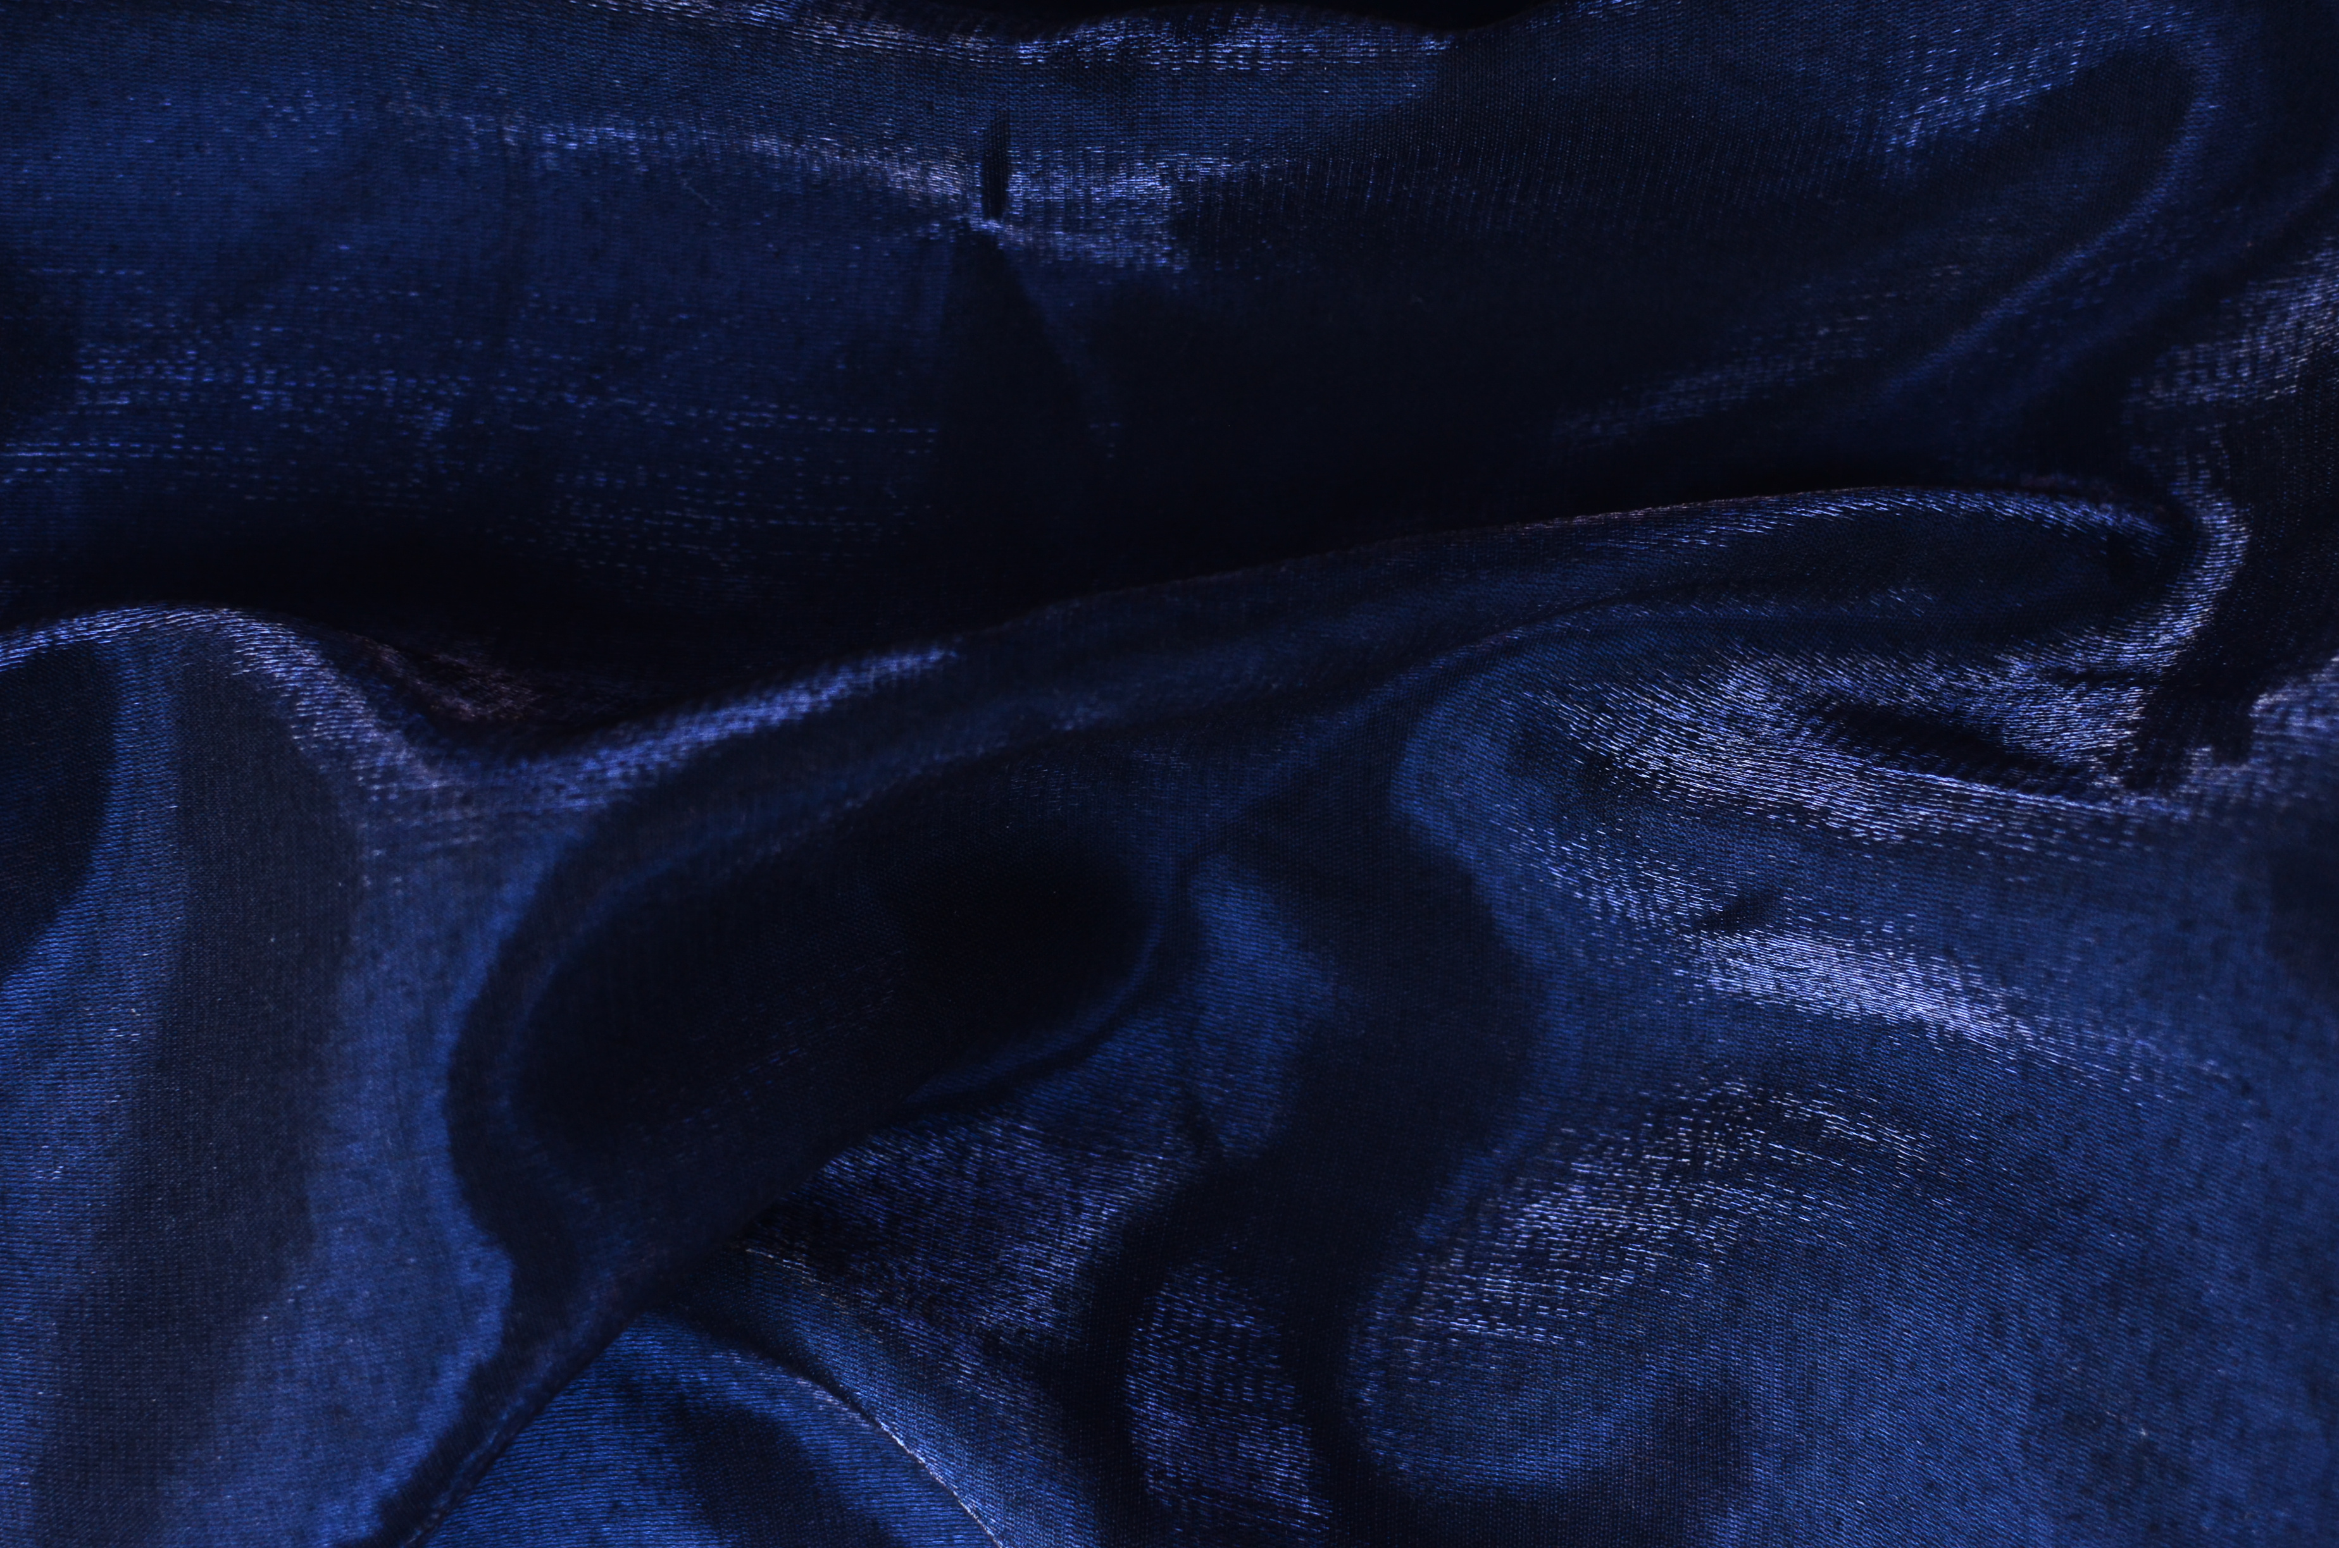












21ST INTERNATIONAL CONFERENCE ON ION SOURCES
SEPT
8-12
ORGANISERS
OUR SPONSORS

Slide 2


Lab tour – ISIS at Rutherford Appleton Laboratory
Buses will depart from Manor Road at 14:00.
Please be there in time!
Water bottles handed out in the bus.
Please bring your conference badge and carry a photo ID.
We have asked those going to RAL to fill in
Safety Information for Visitors to ISIS form.
Please talk to the organisers if you have not done that.
If you have any questions, concerns or would like to cancel, please talk to the organisers.
Check the weather forecast and
dress up for walking outdoors
I
I
SEPT
8-12
21ST INTERNATIONAL CONFERENCE ON ION SOURCES

Slide 3
Lab tour – UKAEA at Culham
Bus to Culham will depart from Manor Road at 14:00.
Please be there in time!
Water bottles handed out in the bus.
Please bring your conference badge and carry a photo ID.
If you have any questions, concerns or would like to cancel, please talk to the organisers.
Check the weather forecast and
dress up for walking outdoors
I
I
SEPT
8-12
21ST INTERNATIONAL CONFERENCE ON ION SOURCES

