Slide 1
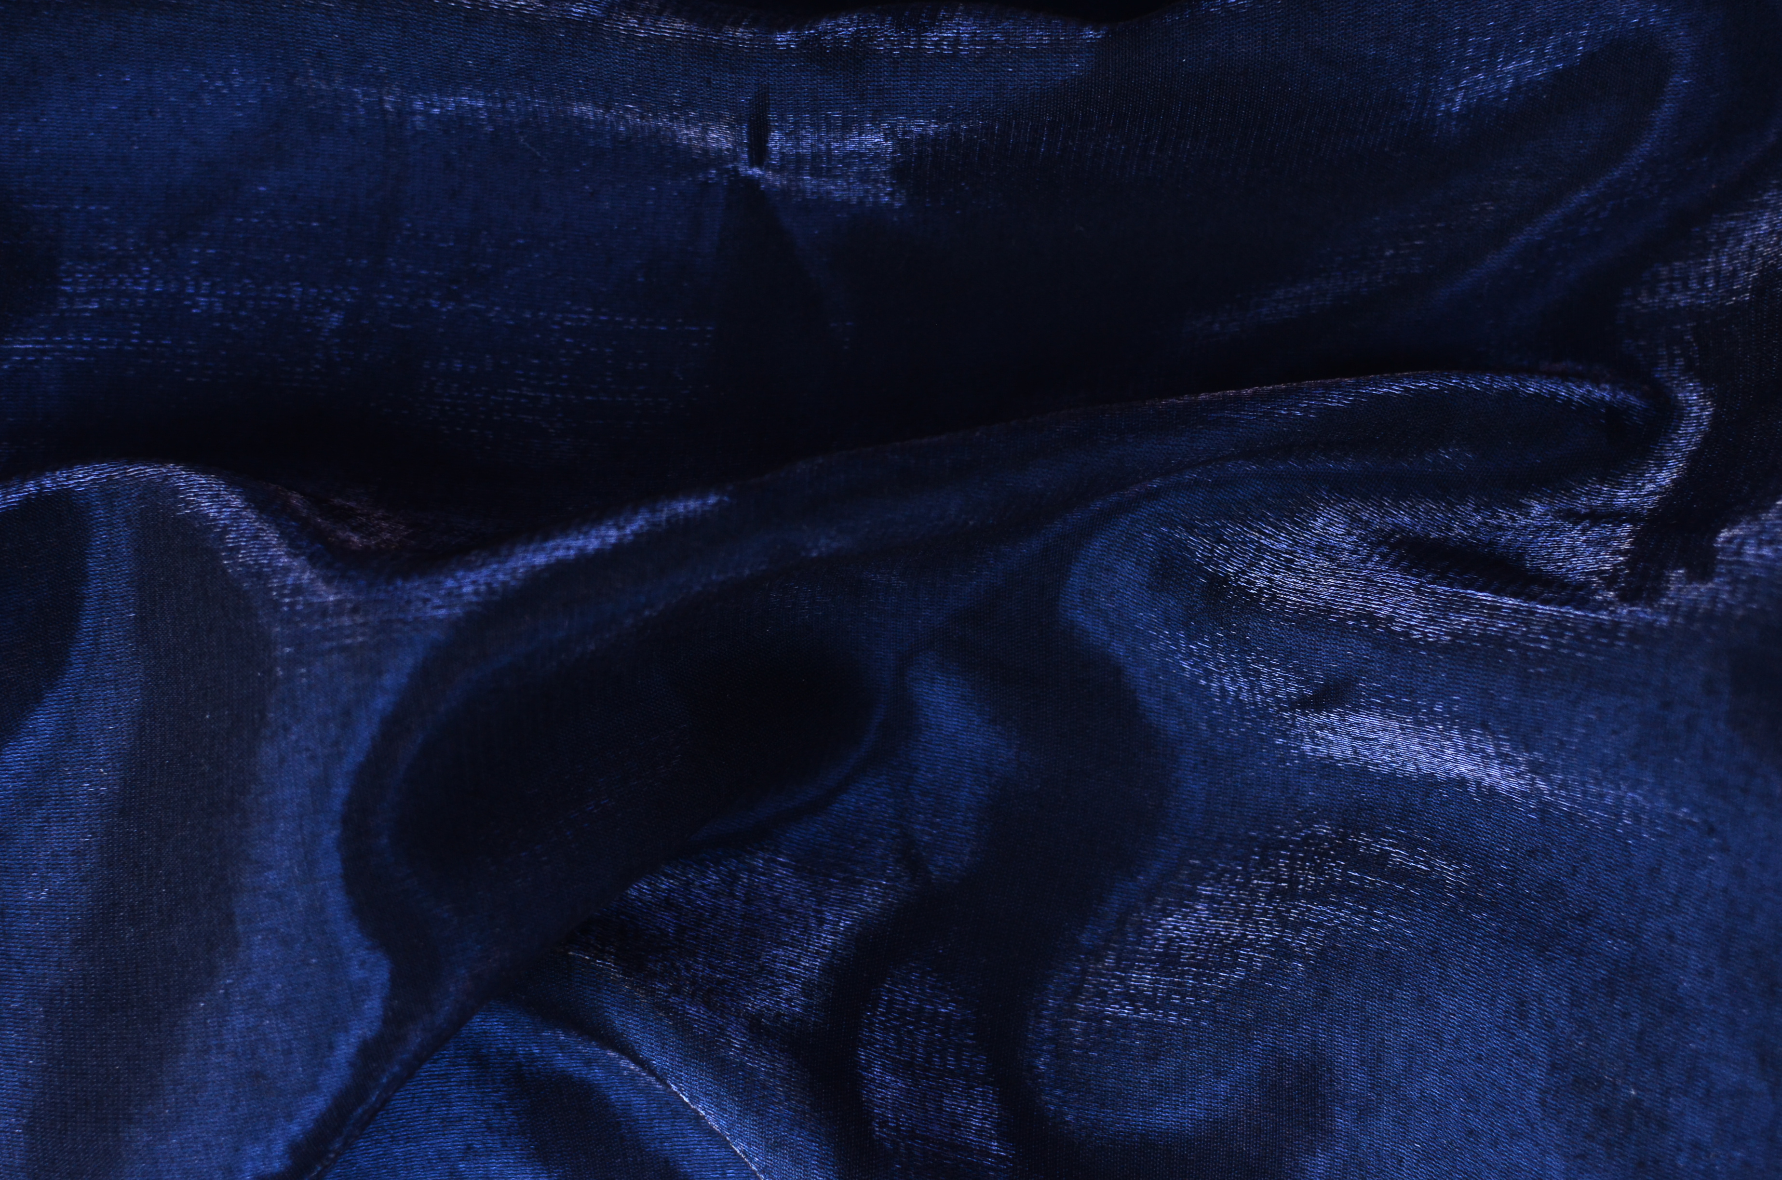












21ST INTERNATIONAL CONFERENCE ON ION SOURCES
SEPT
8-12
ORGANISERS
OUR SPONSORS

Slide 2
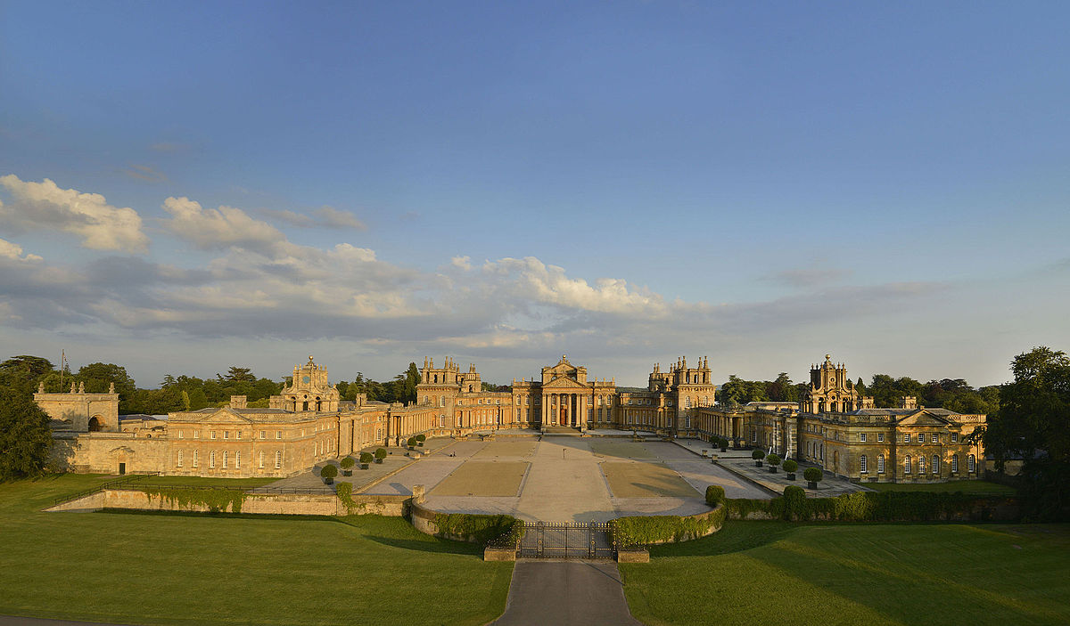

Conference excursion – Blenheim palace
Bus to Blenheim will depart from
Manor Road at 14:05.
Please be there in time!
Water bottles handed out in the bus.
The excursion to Blenheim palace is led by Dan Faircloth
If you have any questions, concerns or would like to cancel, please talk to the organisers.
I
I
SEPT
8-12
21ST INTERNATIONAL CONFERENCE ON ION SOURCES

Slide 3
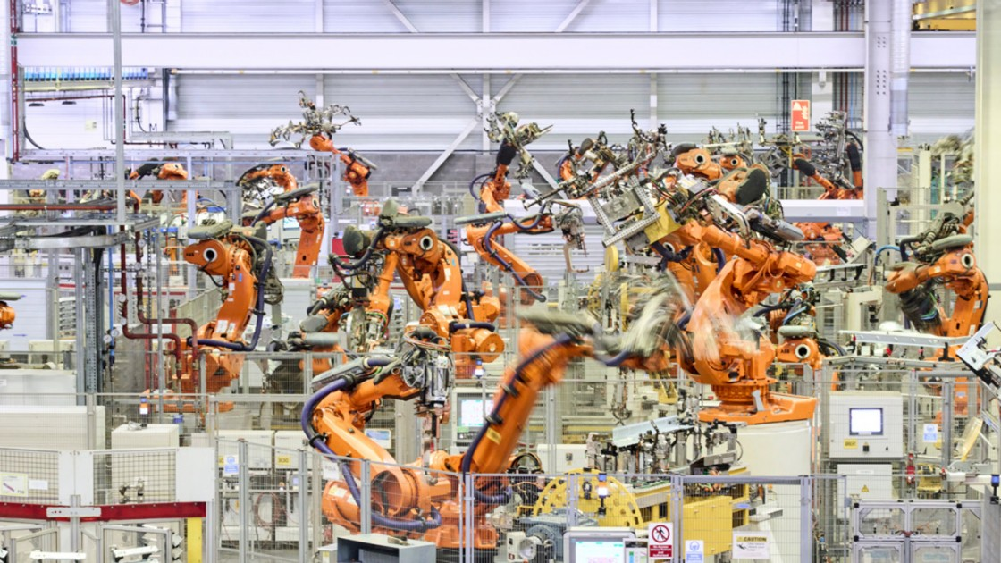
Conference excursion – BMW Mini Factory Tour
Bus to the Mini Plant will depart from
Manor Road at 14:00.
Please be there in time!
Water bottles handed out in the bus.
No mobile phones or recording devices allowed – lockers provided.
The Mini Plant tour is led by Amanda Hoyland
(+ expert guides in three groups of 15 visitors).
If you have any questions, concerns or would like to cancel, please talk to the organisers.
I
I
SEPT
8-12
21ST INTERNATIONAL CONFERENCE ON ION SOURCES

Slide 4
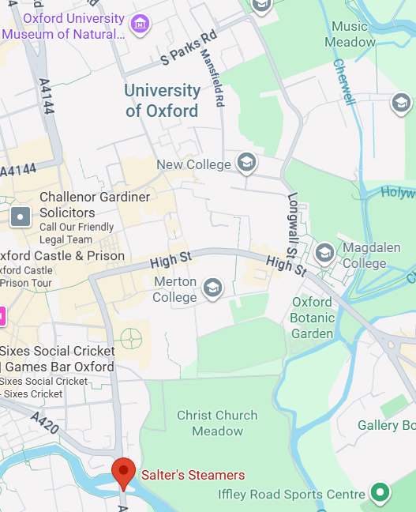
Conference excursion – river cruise
We will meet by the Porter’s lodge at
14:00 and walk to the departure point
Salter’s Steamers
Folly Bridge
Oxford, OX1 4LA
The cruise will depart at 14:30
Drink and some food offered, the bar accepts card payments.
The river cruise excursion is led by Olli Tarvainen
If you have any questions, concerns or would like to cancel, please talk to the organisers.
I
25-minute walk
I
SEPT
8-12
21ST INTERNATIONAL CONFERENCE ON ION SOURCES

