Slide 1
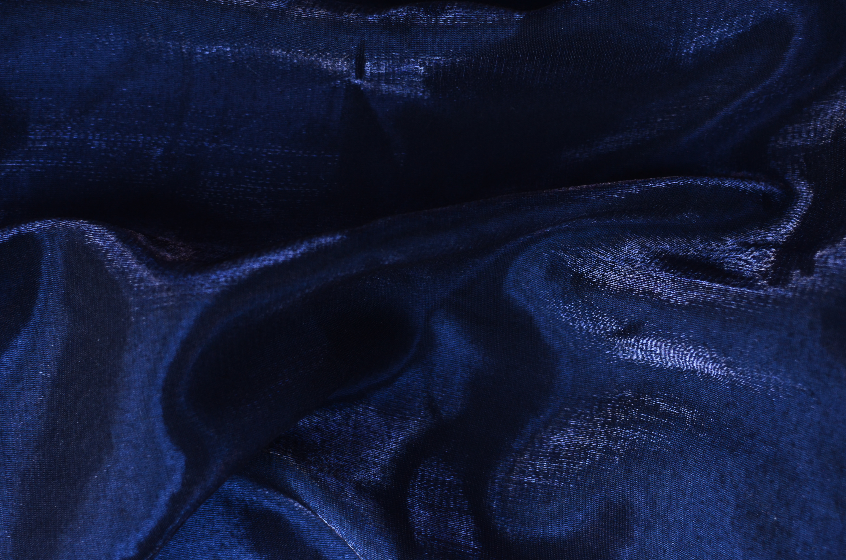












21ST INTERNATIONAL CONFERENCE ON ION SOURCES
SEPT
8-12
ORGANISERS
OUR SPONSORS

Slide 2
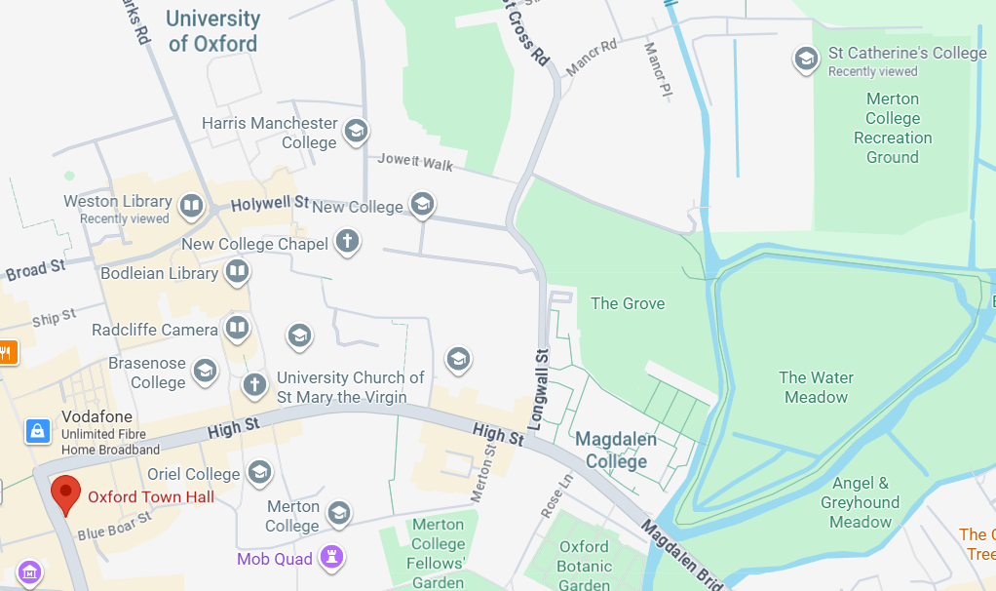

Conference banquet at 19:00 – 23:00 at Oxford Town Hall
I
I
You are here
20-minute walk
SEPT
8-12
21ST INTERNATIONAL CONFERENCE ON ION SOURCES

Slide 3
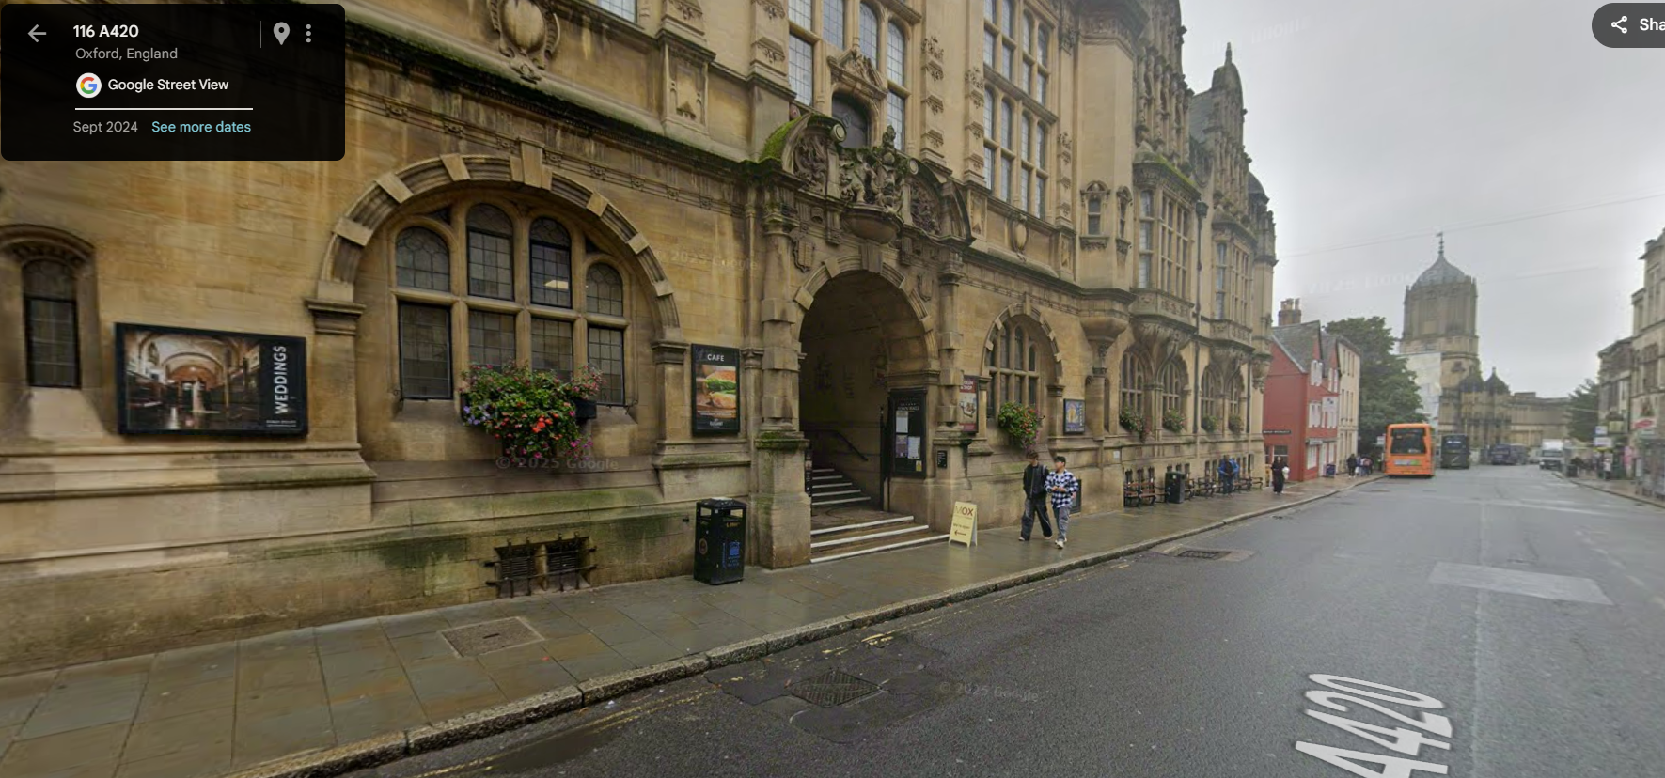
Conference banquet at 19:00 – 23:00 at Oxford Town Hall
I
I
SEPT
8-12
21ST INTERNATIONAL CONFERENCE ON ION SOURCES

Slide 4
I
I
Conference photo to be taken just before the afternoon coffee break.
Those who wish to appear in the photo, please remain seated in the lecture hall.
SEPT
8-12
21ST INTERNATIONAL CONFERENCE ON ION SOURCES

