Slide 1
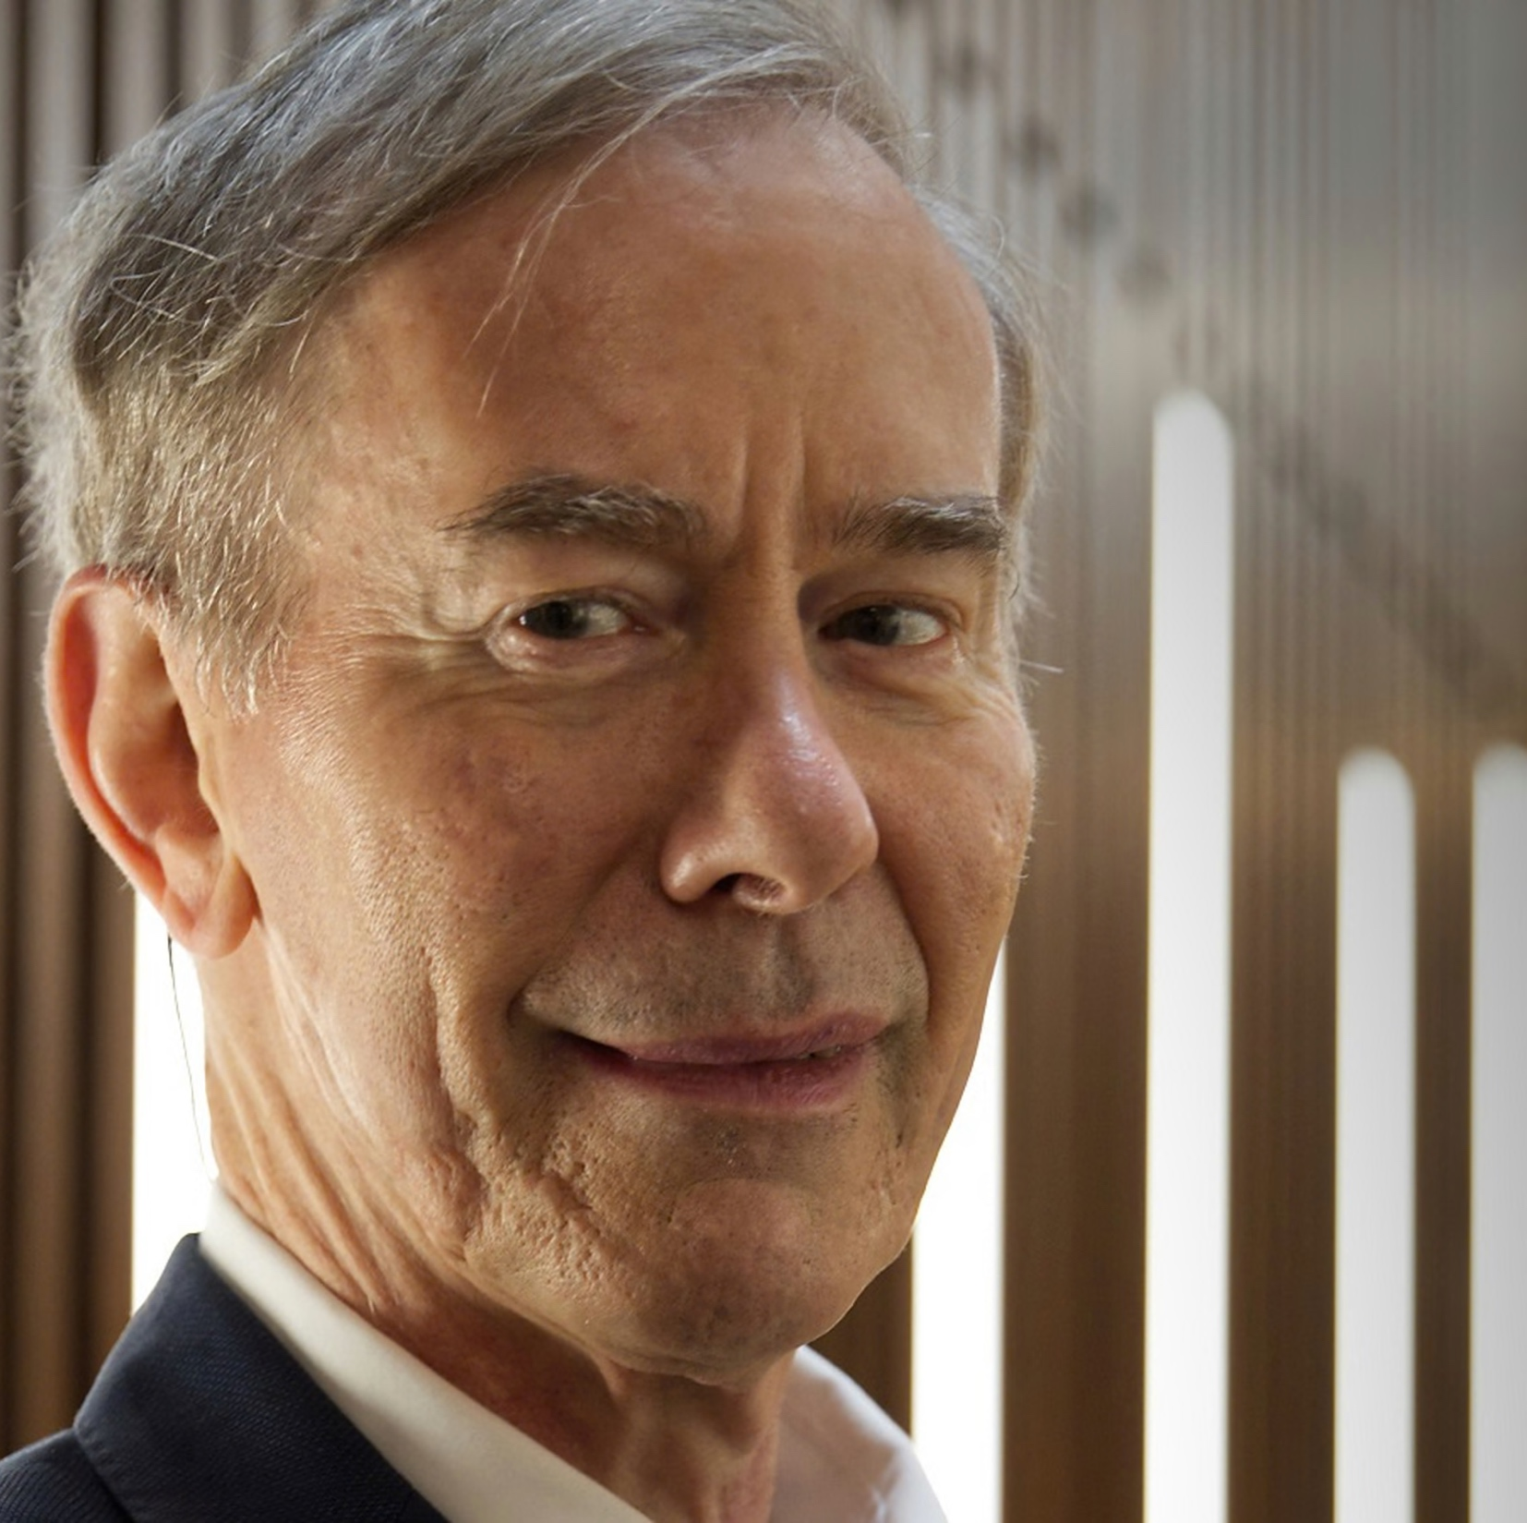
Ian Shipsey
25 July 1959 – 7 October 2024
A true friend, a wonderful colleague, an outstanding physicist and an amazing person, who will remain in our hearts forever.

Slide 2
Brief Resumé
Ian was educated at Queen Mary University of London
He earned his PhD in 1986 from the University of Edinburgh, for his work on the NA31 experiment at CERN (where he met Daniela)
He joined Syracuse as a post-doc (that’s where Daniela was!) working on the CLEO experiment at the Cornell Electron Storage Ring (CESR).
In 1990 he became faculty member at Purdue, and in 2007 was elected Julian Schwinger Distinguished Professor of Physics.

Slide 3
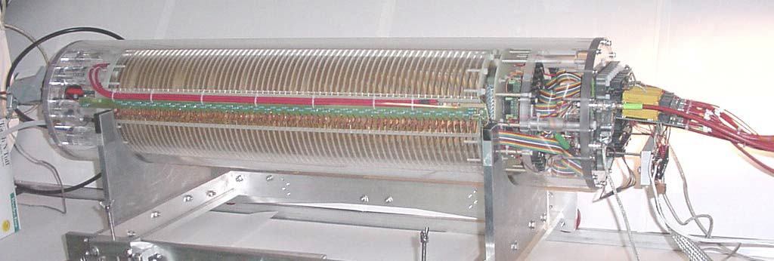
Purdue
At Purdue he constructed key CLEO instrumentation including the muon detector and worked on the development of MPGDs (1992 NSF National Young Investigator Award)
In 1995 he co-founded with Daniela, a 300 m², class 100,000 Purdue Particle Physics Microstructure Detector Laboratories (P3MD)

Slide 4
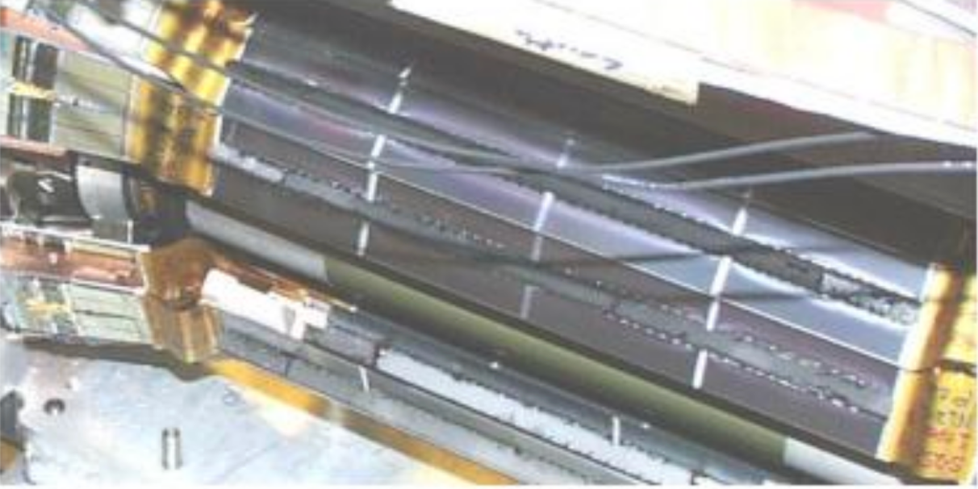
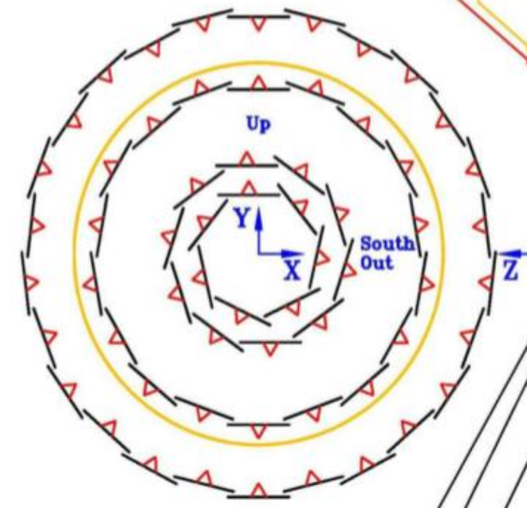
Purdue
From 1994-2000 Ian was designer and fabrication manager to lead the assembly team for the CLEO III silicon vertex detector
Served as co-spokesperson of CLEO from 2001 – 2004.
CLEO-III silicon detector:
4-layer, double-sided silicon;
447 identical 1”×2” wafers;
50 μm strip pitch on the r-φ side;
100 μm pitch on the z side.

Slide 5
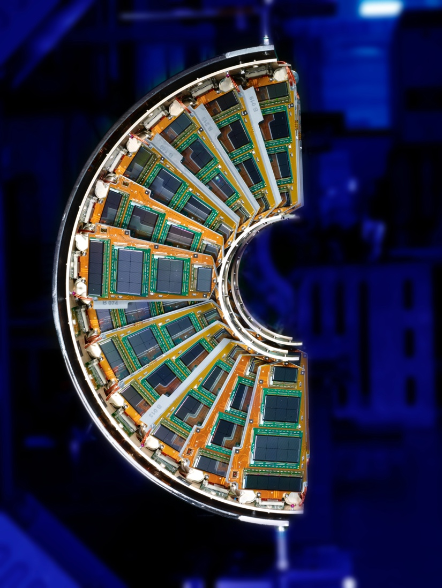
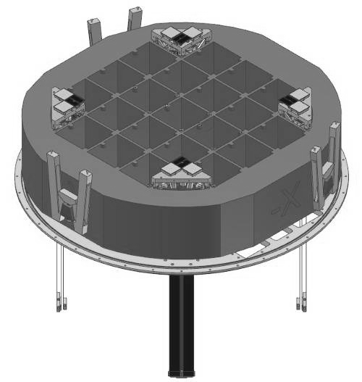
Purdue
CMS FPIX
Ian joined CMS in 2001; as the CMS Forward Pixel manager he coordinated the development of the assembly and verification techniques and then the production and testing of all of the forward silicon sensor pixel detector modules (plaquettes) for CMS
He joined LSST in 2007 (Vera Rubin Observatory)
Corner guide rafts for LSST

Slide 6
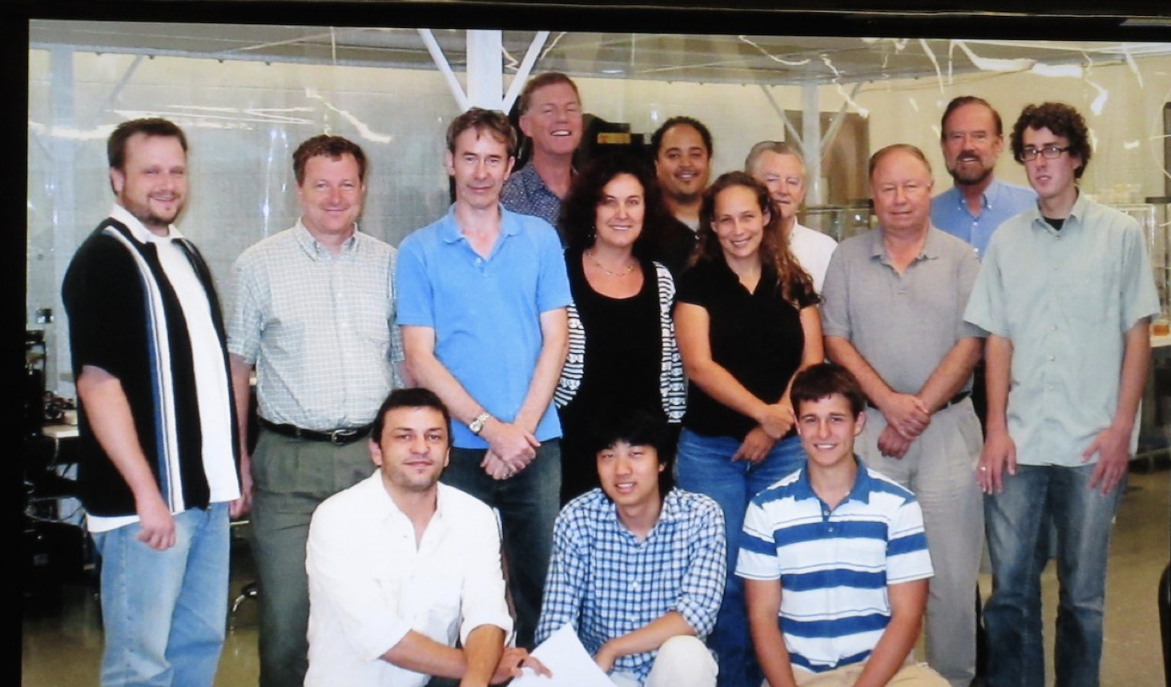
Ian’s Purdue Team around 2008

Slide 7
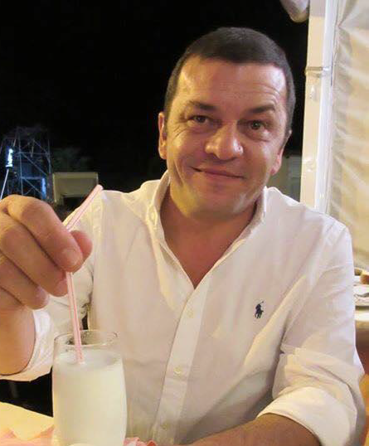
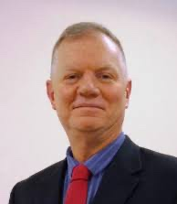
Gino Bolla:
Sept. 25, 1968 – Sept. 4, 2016
Kirk Arndt:
June 22, 1959 – June 12, 2019

Slide 8
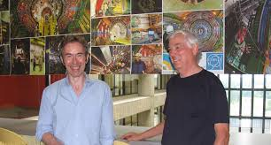
Purdue
He joined CMS in 2001
He was co-Leader, the LHC Physics Center (LPC) from 2009-12 and made it what it is today!
He co-developed hands-on CMS data analysis schools and the CMS Fellows program.
Elected CMS Collaboration Board Chair (2013)

Slide 9
Instrumentation in the US Anno 2009
During the summer of 2009, A review of the detector R&D programs at the ﬁve national labs urged the development of a coherent national instrumentation program and self-organization of the community.
In October 2010 a workshop dedicated to an overview of detector R&D in the country was organized. This was a first!
There was an acute awareness that for the sustained viability of the field renewed investment in instrumentation was needed.
A DPF Taskforce was created to address the organization of HEP instrumentation.

Slide 10
DPF Taskforce

Slide 11
DPF Taskforce

Slide 12
Recommendations of Taskforce
The primary recommendation of the Taskforce report is that a standing Detector R&D Coordinating Panel (DRDCP) be formed, under the auspices of the DPF Executive Committee.
Recommendations:
A standing body – Detector R&D Coordinating Panel – should should be formed to promote and stimulate the national instrumentation detector R&D program.
The DRDCP should be largely self-organized and consist of representatives from the national HEP labs and the university community to form a representative panel of outstanding capability in detector and instrumentation R&D.
The primary role of the Detector R&D Coordinating Panel should be to promote and assist in generic detector R&D
Presented and endorsed at HEPAP meeting October 27 and 28, 2011

Slide 13
CPAD Was Born (February 2012)
CPAD was formed by DPF early in February 2012 in response to the recommendations of the DPF Instrumentation Task Force (ITF).
Ian and I were appointed chairs of CPAD and the first thing we did was get rid of that awful acronym DRDCP and call it CPAD (prize challenge).
This was just weeks before the Snowmass process was set in motion. The DPF Chairline made the strategic decision to recognize the fundamental importance of instrumentation to particle physics by creating a Snowmass frontier devoted to instrumentation on the same footing as the energy, intensity and cosmic frontiers (Ian was member of the DPF chairline 2011 – 2014) .

Slide 14
Initial CPAD Working Groups
Development and a solicitation of instrumentation grand challenges (based on Snowmass)
Coordination of instrumentation resources at National Labs for the HEP community
Creation of a National Instrumentation Fellowship program for post docs & grad. students
A program to further develop instrumentation schools and education
The creation of an APS DPF Award for Excellence in Instrumentation and Development
Continuation of frequent national instrumentation workshop for the HEP community
The enhancement of interdisciplinary aspects of instrumentation including a closer relationship with Nuclear Physics, Basic Energy Sciences, the medical community, NASA, ....
CPAD should request to have input in the yearly SBIR/STTR proposal calls.
CPAD should establish and maintain a repository of examples of migration of technologies into and out of high-energy physics.
CPAD should establish an improved model of an equipment pool that could be used for instrumentation development at U.S. universities and labs.

Slide 15
But … Snowmass first
Instrumentation Frontier
Conveners:
Ian Shipsey
Marcel Demarteau
Ron Lipton
Howard Nicholson
https://indico.fnal.gov/event/6890/
Notes:
The “Situation Room” in preparation for Snowmass.

Slide 16
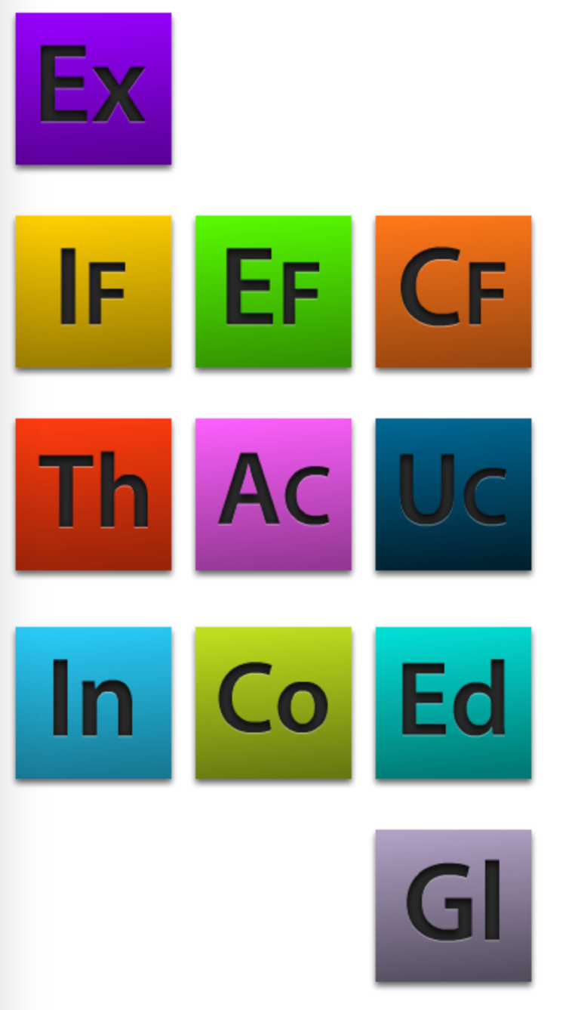
First time instrumentation
was highlighted as a separate
Chapter in the Snowmass
Proceedings
https://www.slac.stanford.edu/econf/C1307292/

Slide 17
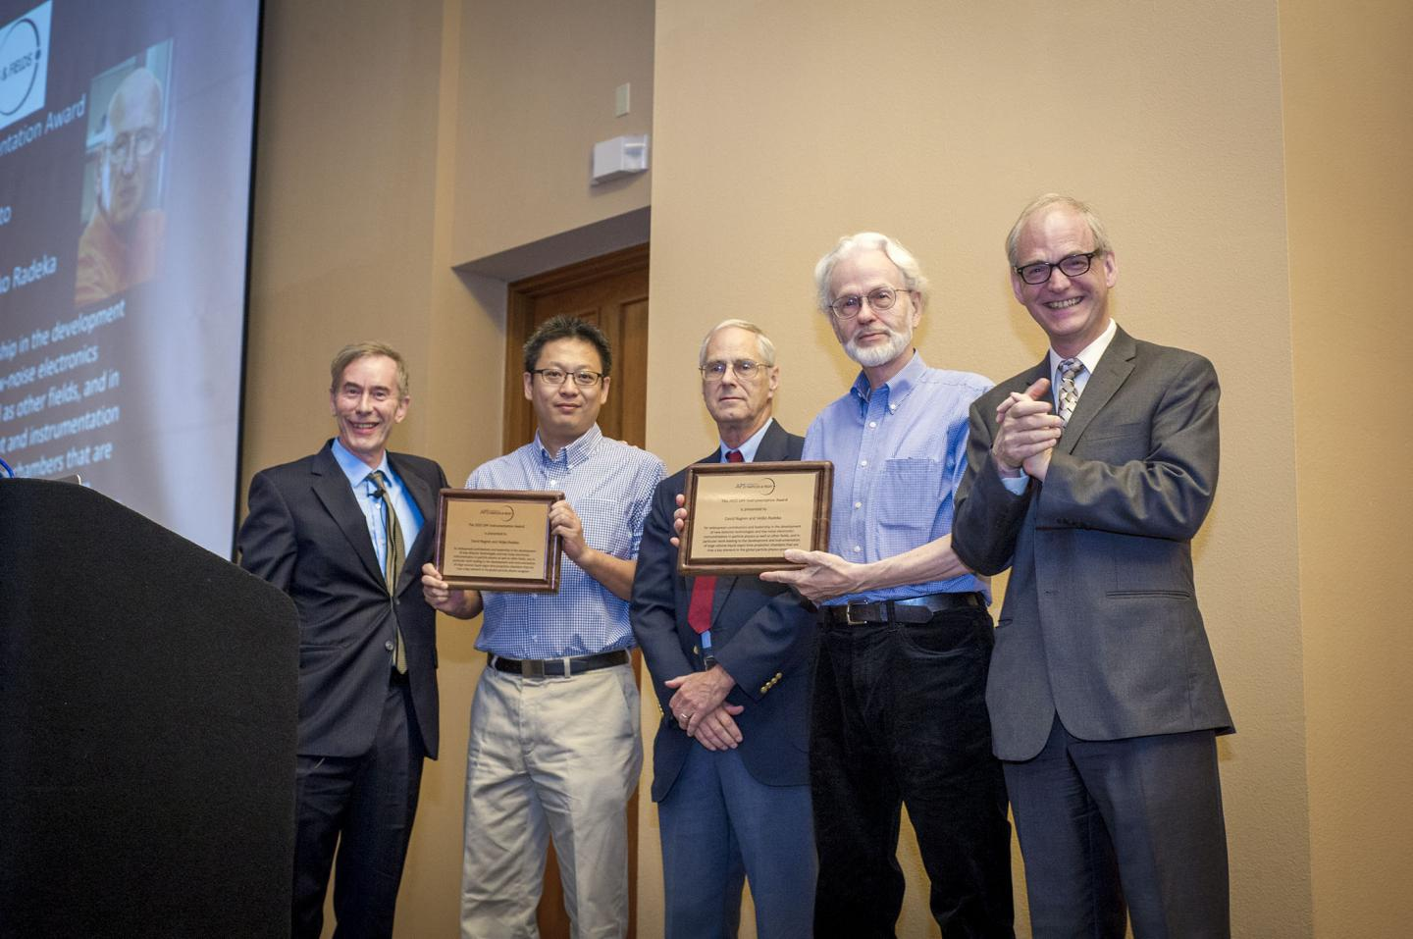
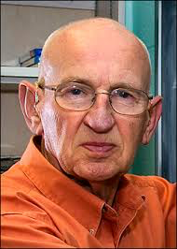
The DPF Instrumentation Awards
First award in 2015 to
David Nygren and
Veljko Radeka

Slide 18
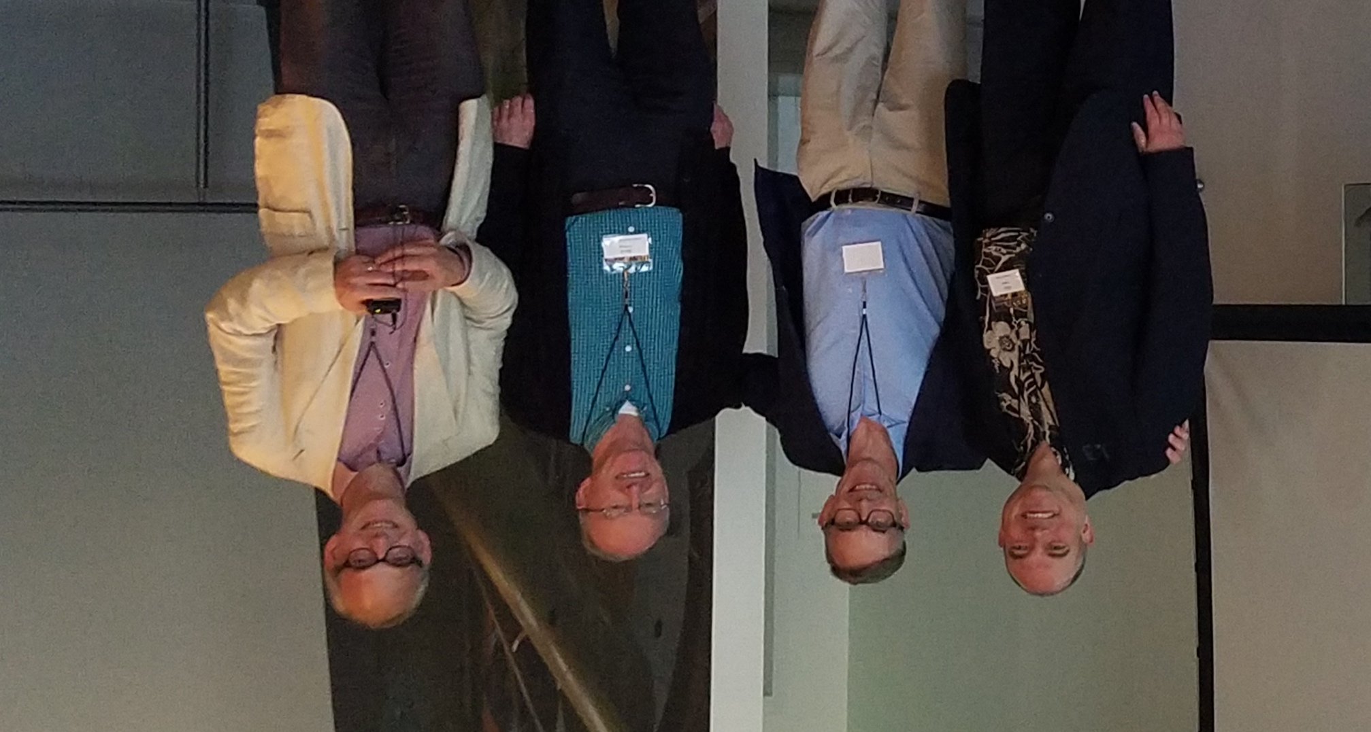
The DPF Instrumentation Awards
2016 CPAD meeting at Caltech with prize winners Gary Varner and Steve Holland
https://cpad-dpf.org/?page_id=750

Slide 19
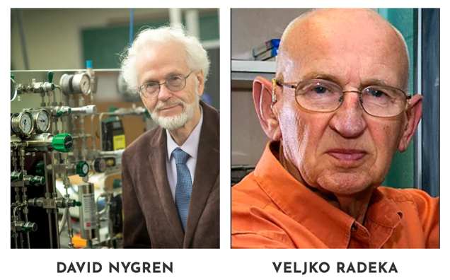
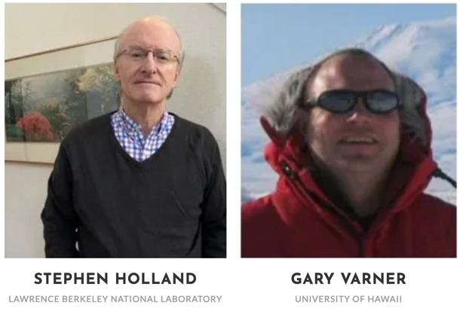
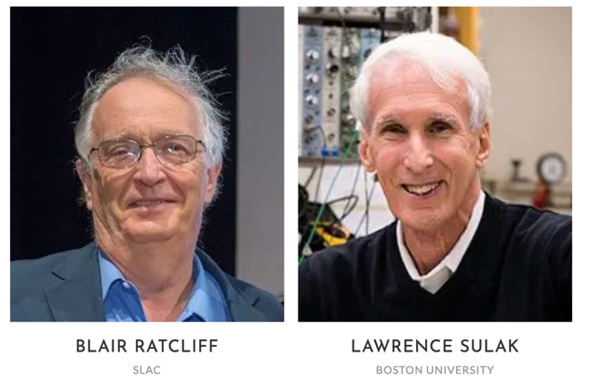
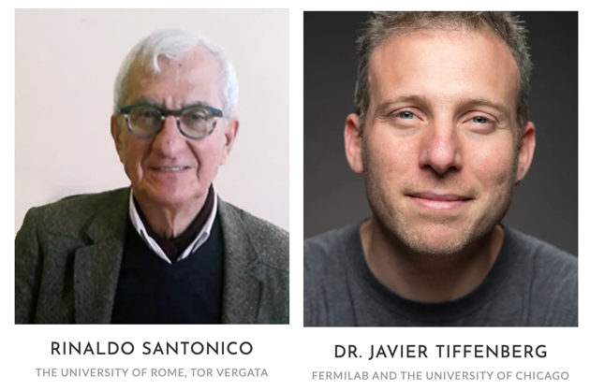
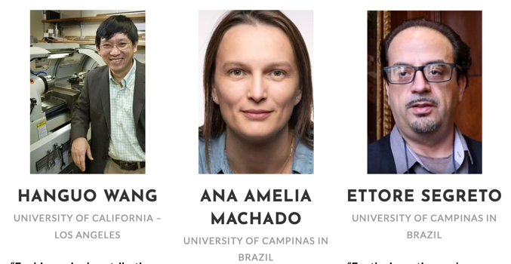
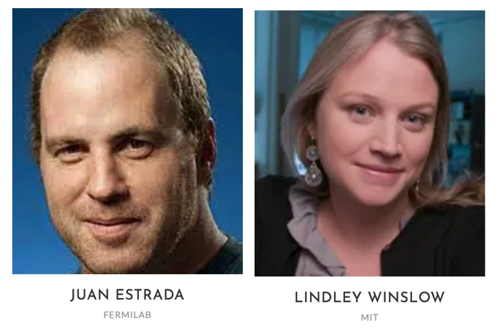
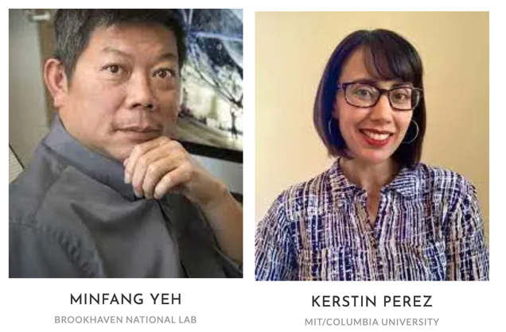
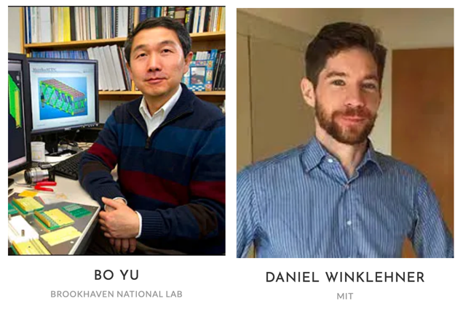
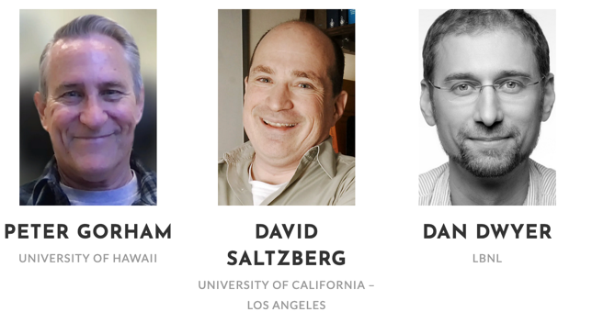
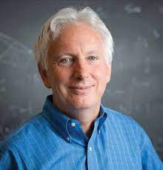
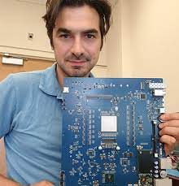
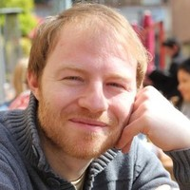
The DPF Instrumentation Awards
2015
2016
2017
2018
2019
2020
2021
2022
2023
2024
Bob Svoboda
Michalis Bachtis
Roel Aaij

Slide 20
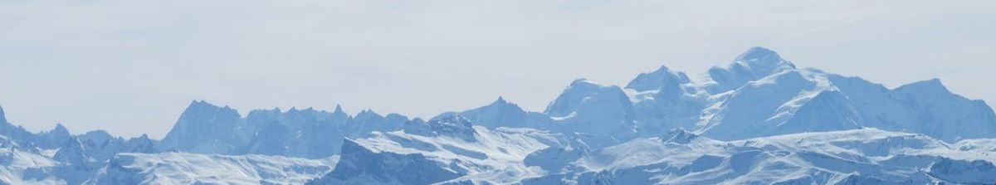
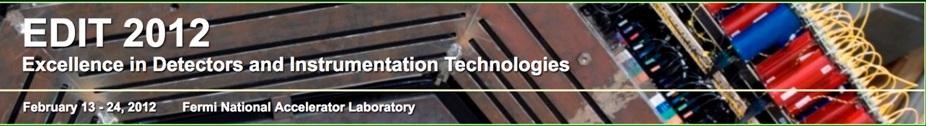

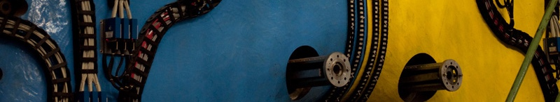
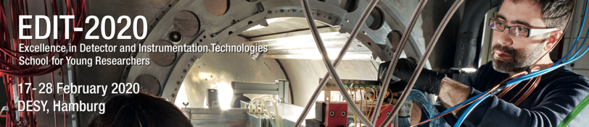
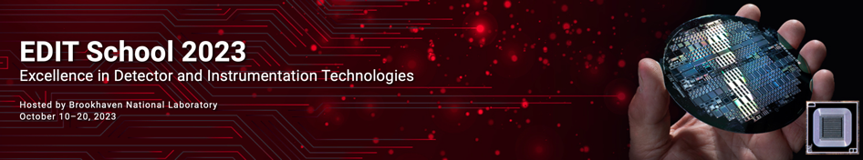
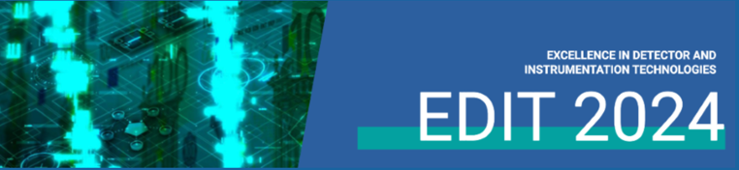
Schools !
2011 @ CERN
2012 @ FNAL with Test Beam !
2013 @ KEK
2015 @ Frascati
2018 @ FNAL
2020 @ DESY
2023 @ BNL
2024 @ FNAL
EDIT 2015
INFN - Laboratori Nazionali di Frascati, Italy October 20-29, 2015

Slide 21
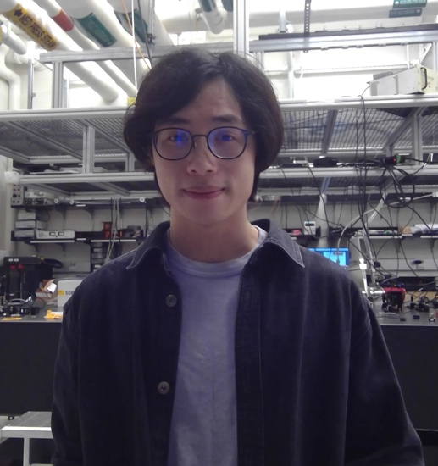
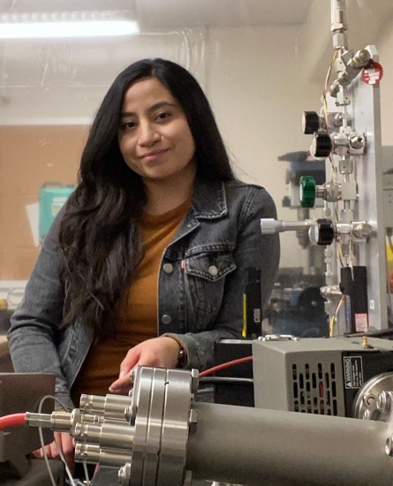
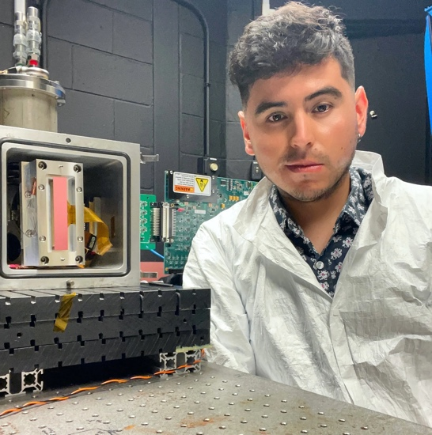
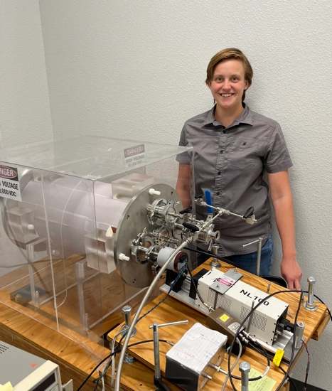
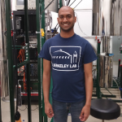
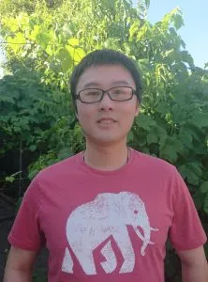
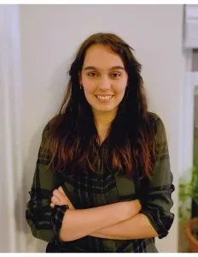
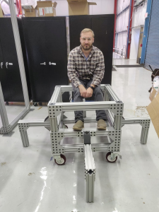
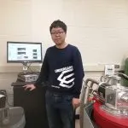
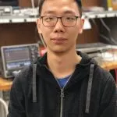
Graduate Instrumentation Research Awards
Initiated the program in 2018 supported by DOE, to encourage and facilitate greater involvement of physics graduate students in significant instrumentation development.
https://cpad-dpf.org/?page_id=750

Slide 22

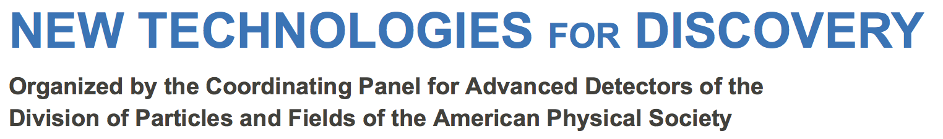
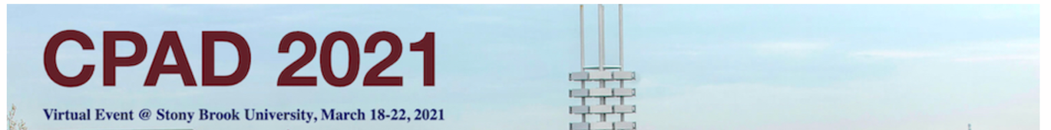

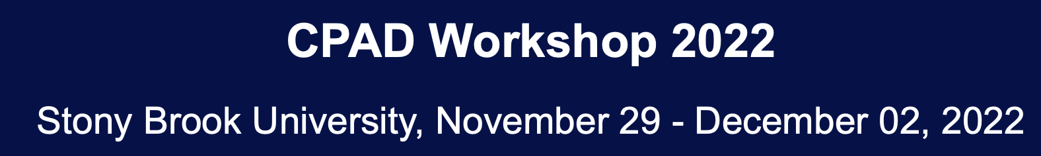


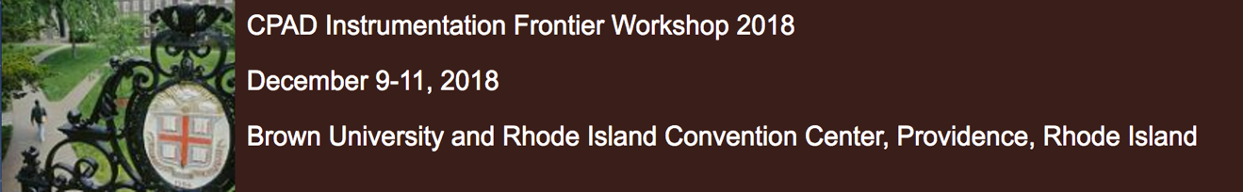
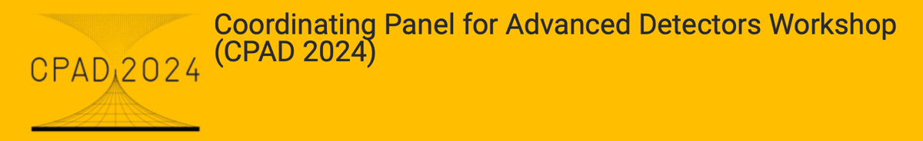
Annual Workshop!
2019, Madison
2015, Arlington, Texas
2021, Stony Brook
2016, Caltech
2022, Stony Brook
2017, Albuquerque
2023, Stanford
2018, Providence
2024, Knoxville

Slide 23
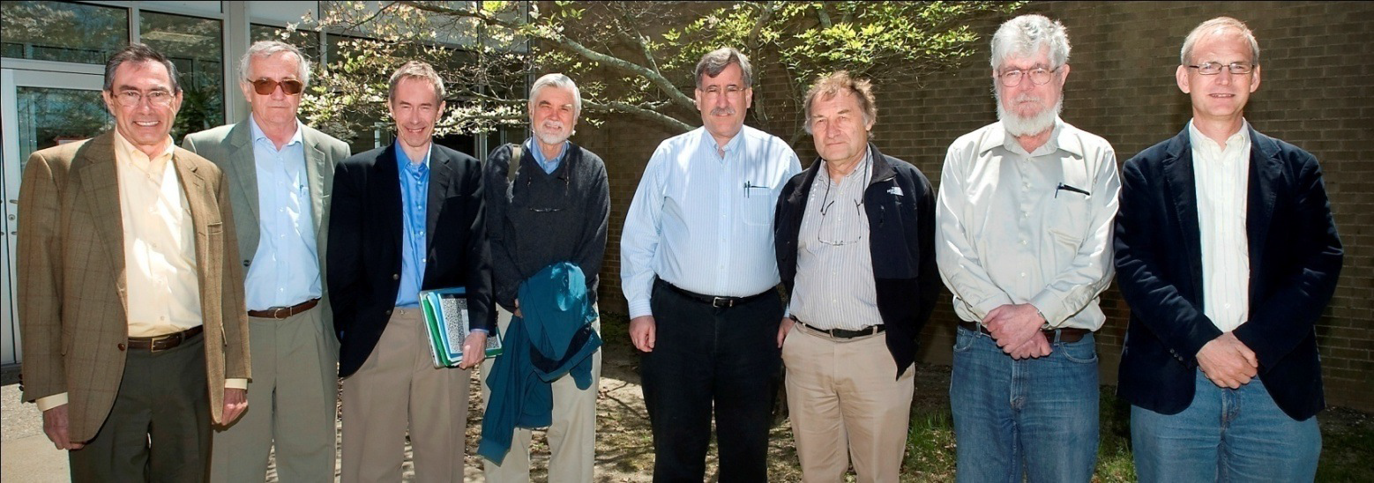
Electron Ion Collider Detector R&D
We served together on the Panel for Detector R&D for the Electron Ion Collider (2011 – 2019)
(Carl Haber and Peter Krizan replaced Robert Klanner and Howard Wieman)

Slide 24
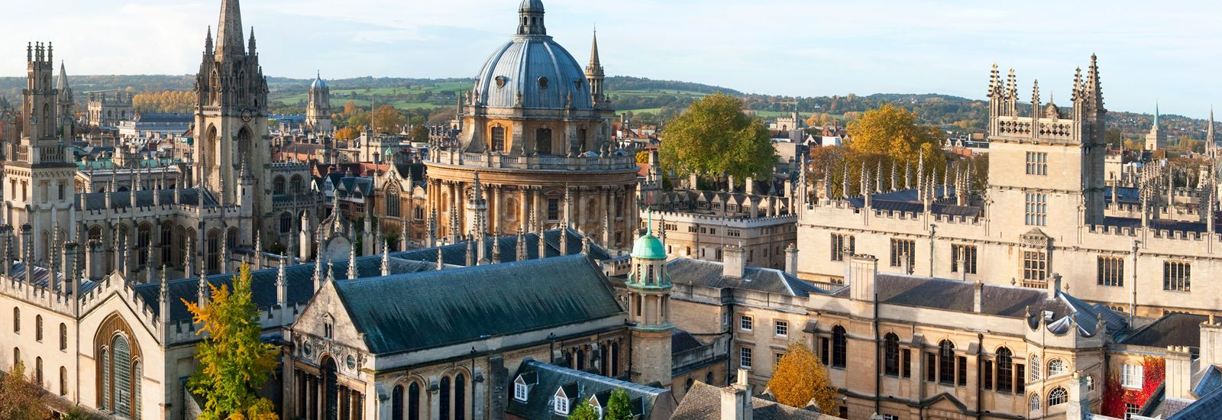
Moving to Oxford (2013)
Move back to the Old World or not?
British people speak funny!

Slide 25
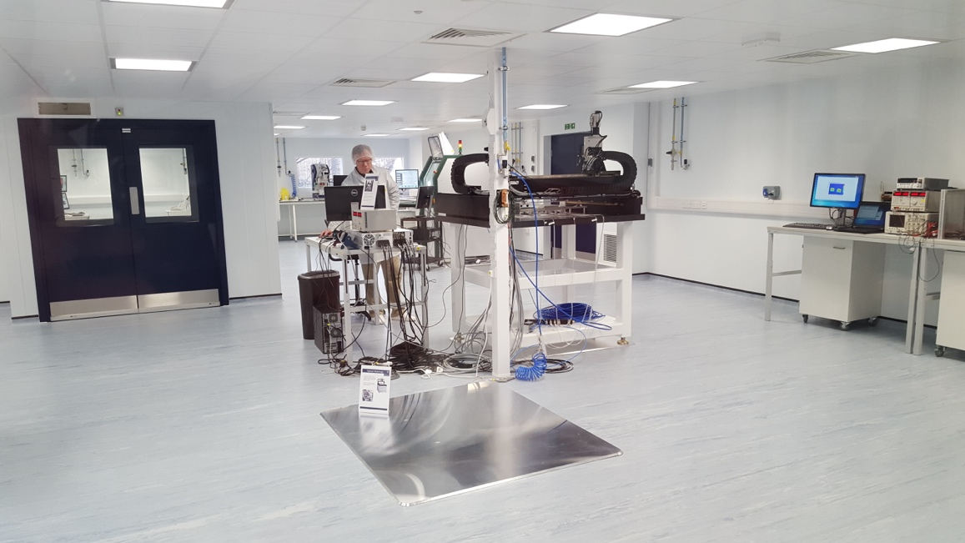


Silicon Lab at Oxford

Slide 26
The “Dawn of Quantum”
Around 2016-2017 discussions were held between various offices within the DOE Office of Science on the topic of
“Grand Challenges at the Interface of Quantum Information Science, Particle Physics, and Computing”
https://www.osti.gov/servlets/purl/1358078

Slide 27
Accelerating Development of and Research Impacts from QIS
A ‘Dear Colleague’ letter from the Director of the Office of Science, issued November 29, 2017
https://science.osti.gov/-/media/sc-2/pdf/presentations/2017/DOE-Office_of_Science_Dear_Colleague_Letter_on_QIS.pdf

Slide 28


A Transformative Event:
First Quantum Sensing Workshop
https://indico.fnal.gov/event/ANLHEP1246/
https://arxiv.org/pdf/1803.11306

Slide 29
First Quantum Sensing Workshop
American Institute of Physics

Slide 30

UK Workshop
Similar workshop in the UK on Quantum Sensors for Fundamental Physics, Oct 16 – 18, 2018
https://indico.global/event/1665/

Slide 31
The Birth of QTFP

Slide 32

Atom Interferometry
Ian was fascinated by atom interferometry.
He was one of the original five team members who conceived AION.
With the Beecroft building at Oxford, a demonstrator experiment (AION-10) is planned there.
Ian’s passion and leadership has made AION as it exists today.

Slide 33


AION Collaboration Days in Oxford: Fall 2021
Today, AION
~60 people
(52 came to Oxford)
Start of AION in 2018
~5 people
https://aion-project.web.cern.ch
Ratio of Cold Atom : Particle/Fundamental Physics people is 1:1

Slide 34

Basic Research Needs Workshop
Right after the CPAD meeting in 2019 in Madison, the Basic Research Needs workshop started with Ian as co-chair
This Report developed the roadmap for detector R&D for particle physics for the US.
The ECFA Detector Roadmap closely followed this template.

Slide 35

Photo credit: DOE

Slide 36
Illness
Shortly after their marriage, Ian was diagnosed with acute mylegoneous leukemia at age 30.
At the time, almost nobody survived leukemia, but being an eternal optimist and with the support from his doctors, who told him that they would make him well again, he believed in them and believed in science.
Ian was able to beat the leukemia, but the treatments, a harsh round of chemotherapy and antibiotics, took his hearing. He actually was in coma for an extended period. He had accepted the position at Purdue just before the diagnosis. Purdue kept him on staff despite everything and he did not have to teach for three years after the treatment.
In the meantime, Daniela gave birth to a daughter, Francesca, but Ian was unable to hear his daughter’s voice.
He started teaching at Purdue in 1993. The first thing he did when he stepped into the classroom full of students was to them them that he was completely deaf. The students voted him Professor of the Year that semester.

Slide 37

Cochlear Implant
Part of his hearing was restored after twelve years with a cochlear implant.
Ever being the physicist, he fully described the
physics behind a cochlear implant and gave many talks on it, some in front of audiences of more than 800 people
https://www.youtube.com/watch?v=aecxK2gFBRY
But, without the implant he was profoundly deaf.

Slide 38

Bionic Hearing
“Bionic Hearing: The Science and the Experience”
Santa Fe Radio Café, organized by the Santa Fe Alliance for Science

Slide 39

December 12, 2019: BRN meeting in Washington DC
Notes:
Ian turned off his implant during a discussion at the BRN and utterly confused Bonnie.

Slide 40

Oxford Physics Advisory Committee
Notes:
Promoting the work of his students and the Department.

Slide 41

A Family Man
Notes:
His Christmas cards; almost missed the Christmas carols … Liliana and Daniela had left already, still on a zoom call with me.

Slide 42

Oxford and Quantum
Ian played a leading role in realizing the Beecroft building in Oxford, dedicated among others to quantum information science
https://www.hawkinsbrown.com/projects/beecroft-building-university-of-oxford/

Slide 43

Oxford
Ian helped launch in November 2022 a brand new world-class research facility, the National Thin-Film Cluster Facility (NTCF) for Advanced Functional Materials, hosted by the University of Oxford’s Department of Physics
Professors Henry Snaith, Moritz Riede,
Dame Louise Richardson (Vice-Chancellor of the University of Oxford),
Ian Shipsey. Image credit: Stuart Bebb.

Slide 44




ICFA
When Ian took over from Ariella Cattai as chair of the ICFA Instrumentation Innovation and Development Panel he immediately reinvigorated it and pushed the further development of the ICFA Instrumentation Schools and the ICFA Instrumentation Prize.

Slide 45

Schools !
ICFA
ICFA school, 12-25 Feb, 2023, TIFR, Mumbai

Slide 46


ICFA Presentation
Passions surpassed succinctness
The slide deck for the 10-minute talk had 67 slides!!
Notes:
Asked me to present IID talk, given the time difference. 67 slides for 10 minutes!

Slide 47

ECFA
Ian was a major driver of the development of the ECFA detector R&D Roadmap and was fierce supporter of including Quantum Sensors in the roadmap.
He himself has been the lead in pushing the Quantum Sensing program in the UK

Slide 48

Ian Shipsey
One of the most precious gifts a person can give is to be an inspiration for all. Ian was that person.
He was indefatigable, passionate, curious, full of life and empathy, enthusiastic, an excellent physicist and a great friend.
Now he left a vacuum and we have to find a way to live with that.

Slide 49

December 9, 2019, CPAD workshop in Madison Wisconsin; our last CPAD workshop as co-chairs.
Goodbye to a true friend!

