Slide 1
Probing the universe with ultracold atoms
QTFP Community Meeting
22/01/2025
Dr Tiffany Harte, University of Cambridge: on behalf of the AION collaboration

Slide 2
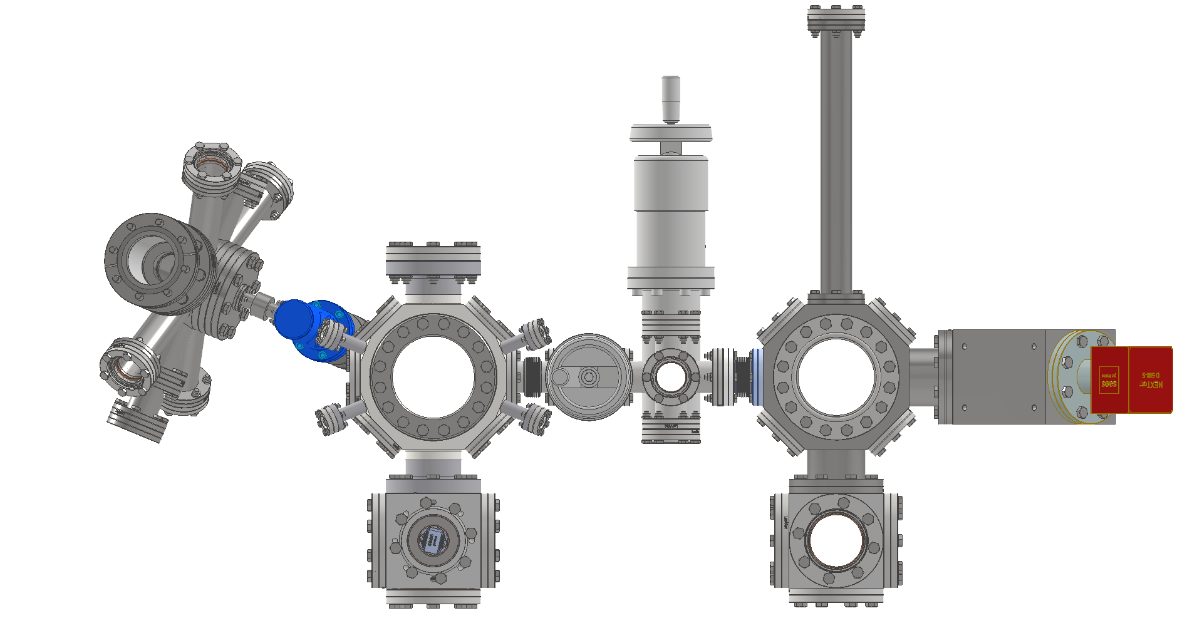

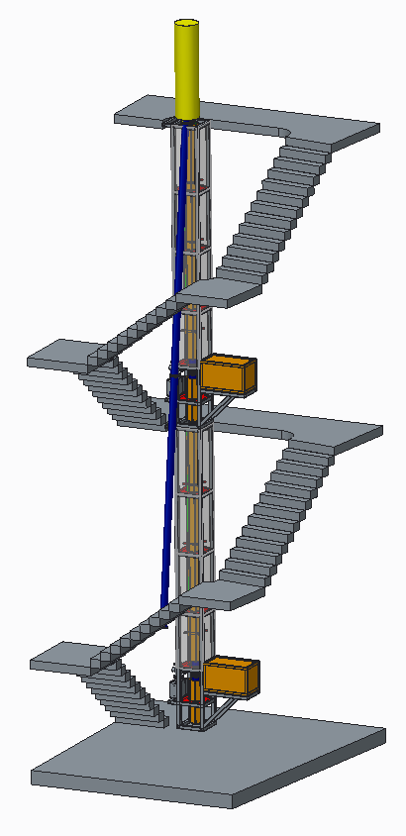
The AION consortium
14.7m
7 UK institutions
5 ultracold strontium labs following HEP-style collaboration principles [1]
  Parallel production
  Interlinked R&D
  Common control systems and codebase
Phenomenology and noise modelling
Design and deploy increasing-baseline atom interferometers 10m -> 100m -> 1km
Ground level
AI-10
10.0m
7.7m
Atom source
Oven, laser cooling, optical dipole trap and transport
Interferometry chamber
Tabletop technology demonstrator
5.0m
Project executed in national partnership with UK National Quantum Technology Hub in Sensors and Timing, Birmingham, UK,
and international partnership with The MAGIS Collaboration and The Fermi National Laboratory, US
Planned AION-10 detector (University of Oxford)
[1] AVS Quantum Sci. 6, 014409 (2024)

Slide 3
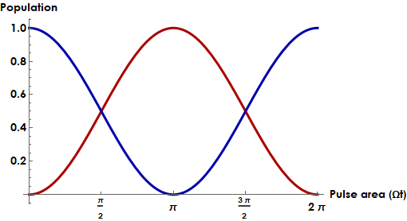

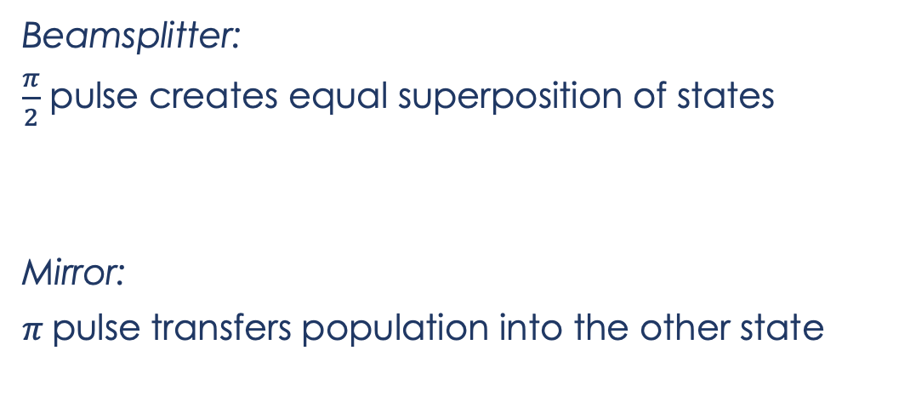
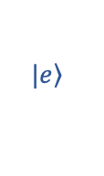
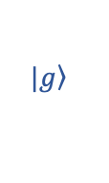


Atom-light interactions
$$|\left.e\right\rangle$$
$$ω_{0}$$
$$|\left.g\right\rangle$$
Beamsplitter:
$\frac{π}{2}$ pulse creates equal superposition of states
Mirror:
$π$pulse transfers population into the other state
$$\left.|g\right\rangle → \frac{1}{\sqrt{2}}\left(\left.|g\right\rangle −ie^{iφ}\left.|e\right\rangle \right)$$
$$\left.|g\right\rangle →−ie^{iφ}\left.|e\right\rangle$$
Recent atom-optics implementation using time-varying potentials: Phys. Rev. Lett. 129, 183202 (2022)

Slide 4

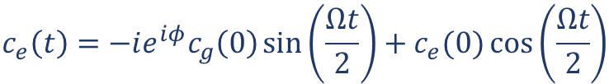

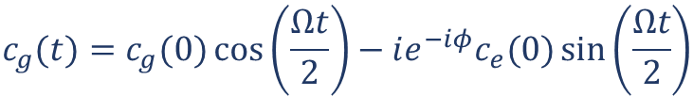


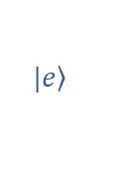
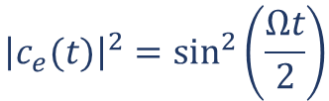


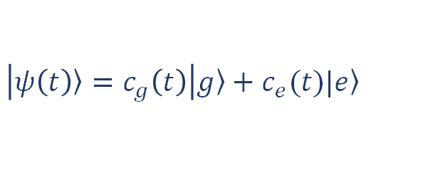
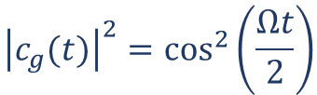
Atom-light interactions
Substitute into Schrödinger equation and ignore rapidly-oscillating terms.
$$|\left.e\right\rangle$$
$$\frac{dc_{g}(t)}{dt}=−i\frac{Ω}{2}e^{−iφ}c_{e}(t)$$
$$\frac{dc_{e}(t)}{dt}=−i\frac{Ω}{2}e^{iφ}c_{g}(t)$$
$$ω_{0}$$
$$|\left.g\right\rangle$$
$$c_{g}(t)=c_{g}(0)\cos\left(\frac{Ωt}{2}\right)−ie^{−iφ}c_{e}(0)\sin\left(\frac{Ωt}{2}\right)$$
$$c_{e}\left(t\right)={−ie^{iφ}c}_{g}\left(0\right)\sin\left(\frac{Ωt}{2}\right)+c_{e}(0)\cos\left(\frac{Ωt}{2}\right)$$
$$H_{int}=er∙E_{0}\cos{(φ−ω_{0}t)}$$
$$Ω=\frac{\left\langle g | er∙E_{0} | e\right\rangle }{ℏ}$$
$${\left|c_{g}(t)\right|}^{2}=\cos^{2}\left(\frac{Ωt}{2}\right)$$
$${\left|c_{e}(t)\right|}^{2}=\sin^{2}\left(\frac{Ωt}{2}\right)$$
$$\left|\left.ψ\left(t\right)\right\rangle =c_{g}\left(t\right)\right|\left.g\right\rangle +c_{e}(t)|\left.e\right\rangle$$
Following C.J. Foot, Atomic Physics
Notes:
`

Slide 5

Optical interferometry
Mach-Zehnder interferometer:
$$∆φ$$

Slide 6
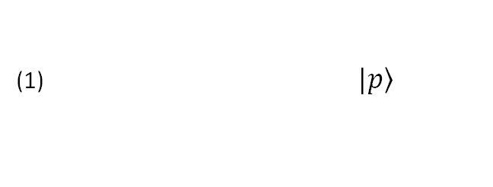

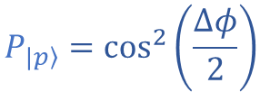
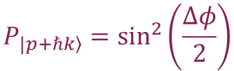
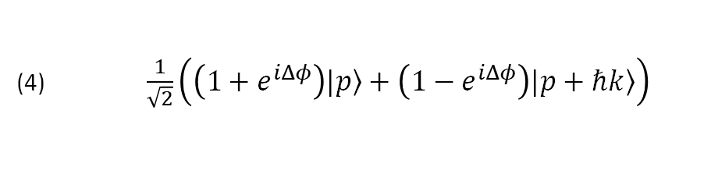

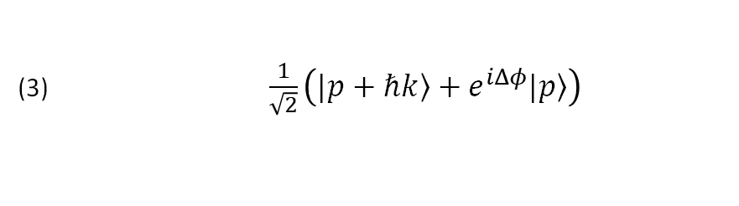

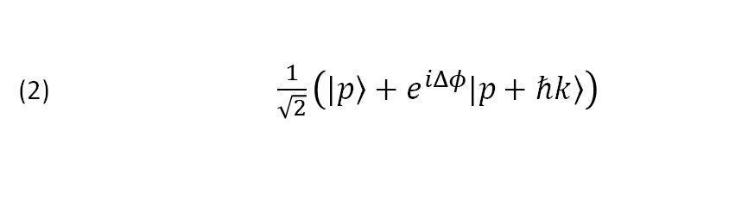
Atom interferometry
(1) $|\left.p\right\rangle$
(2) $\frac{1}{\sqrt{2}}\left(|\left.p\right\rangle +e^{iΔφ}|\left.p+ℏk\right\rangle \right)$
Mach-Zehnder interferometer:
(3) $\frac{1}{\sqrt{2}}\left(|\left.p+ℏk\right\rangle +e^{iΔφ}|\left.p\right\rangle \right)$
(1)
(2)
(3)
(4)
(4) $\frac{1}{\sqrt{2}}\left(\left(1+e^{iΔφ}\right)|\left.p\right\rangle +\left(1−e^{iΔφ}\right)|\left.p+ℏk\right\rangle \right)$
$$P_{|\left.p\right\rangle }=\cos^{2}\left(\frac{∆φ}{2}\right)$$
$$P_{\left.|p+ℏk\right\rangle }=\sin^{2}\left(\frac{∆φ}{2}\right)$$
$$\frac{π}{2}$$
$$π$$
$$\frac{π}{2}$$
${∆φ}_{total} ={∆φ}_{propagation}$ + ${∆φ}_{separation}$+ ${∆φ}_{laser}$
Time
Useful references:
arXiv:0806.3261 (2008)
Quantum Sci. Technol. 6, 044003 (2021)

Slide 7
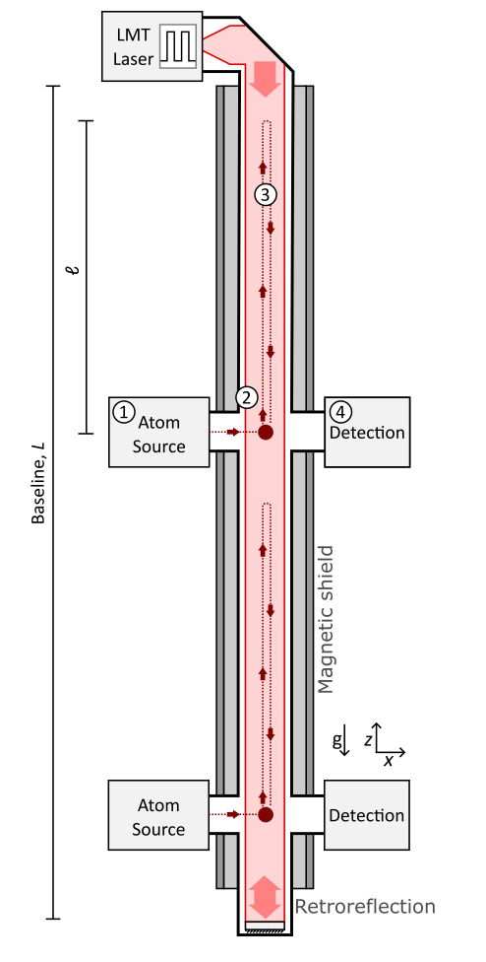

The Atom Interferometer Observatory and Network
Journal of Cosmology and Astroparticle Physics 5, 011 (2020)
Strontium-87 (fermionic)
  Clock transition
  Single-photon interferometry* [1,2]
Differential measurement: fluctuations in relative phase between AIs
Sensitivity scales with baseline length
Detector network for fundamental physics
5s6s ³S₁
5s6s ³S₁
707 nm
5s5p ¹P₁
679 nm
461 nm
2π x 30 MHz
J=2
689 nm
2π x 7.5 kHz
J=1
5s5p ³P_{J}
J=0
698 nm
mHz
5s² ¹S₀
[1] P. Graham et al. PRL 110 171102 (2013)
[2] L. Hu et al. PRL 119, 263601 (2017)
* Recent 3-photon excitation of ⁸⁸Sr clock transition: arXiv:2406.07902 (S. Carman et al, Stanford)

Slide 8
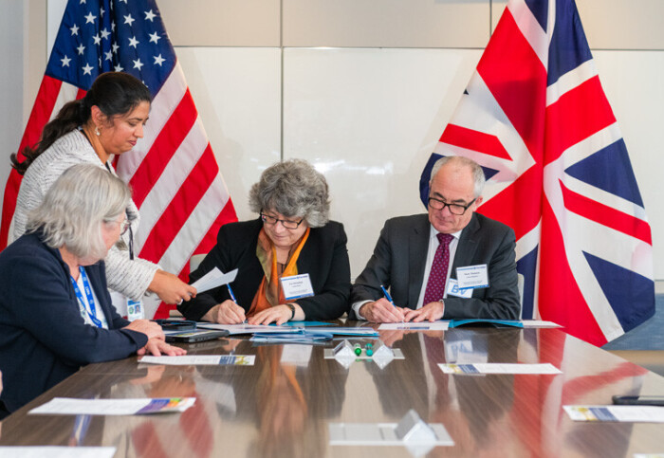
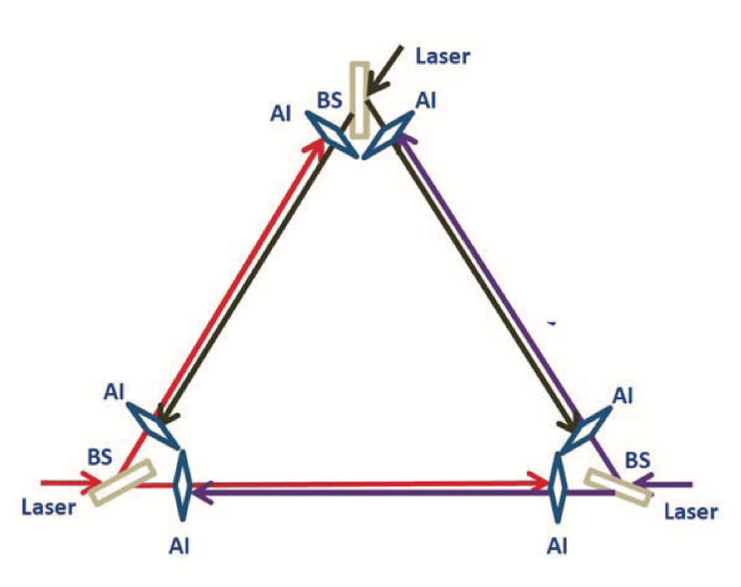
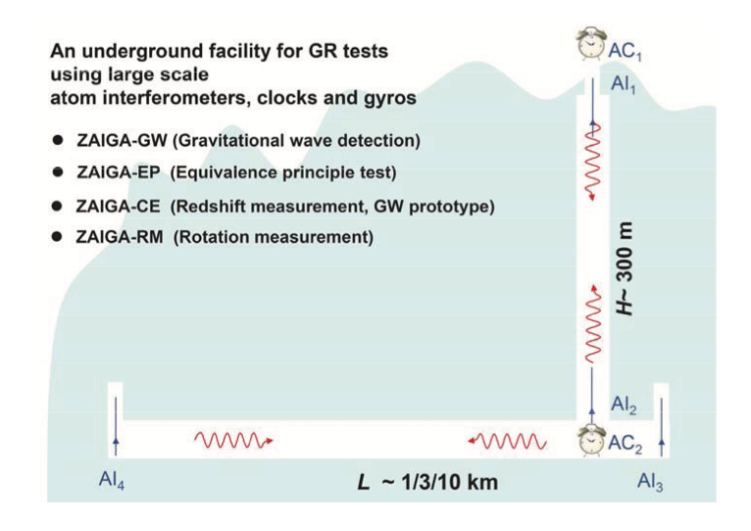
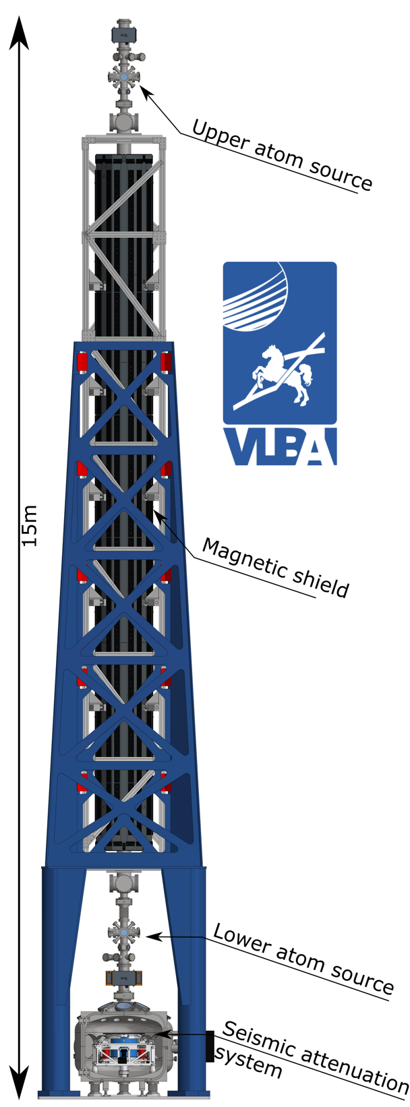
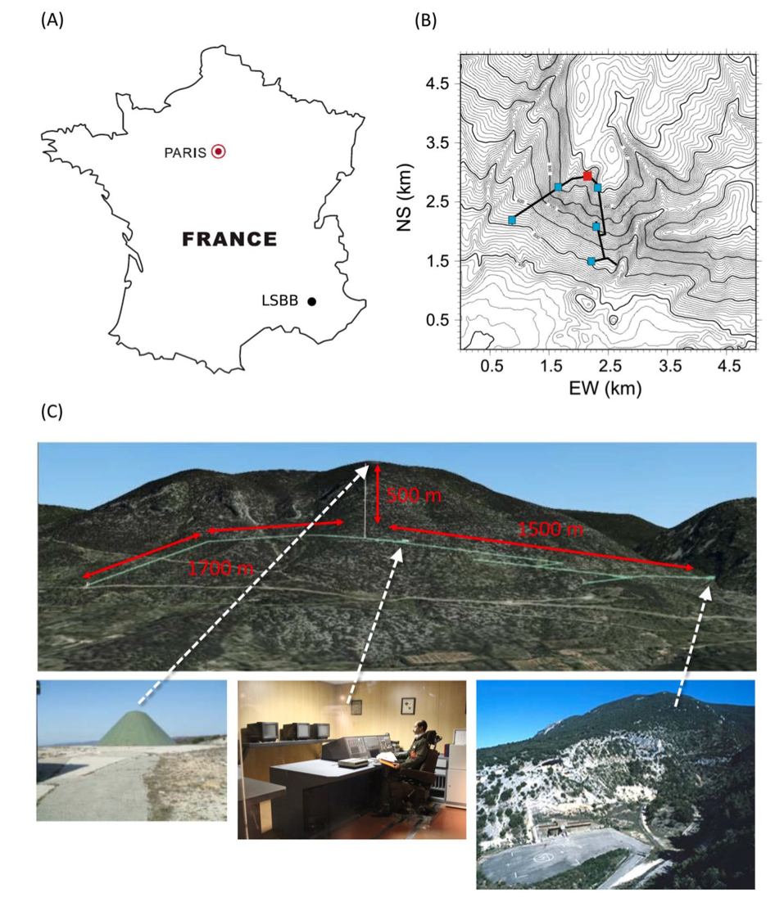
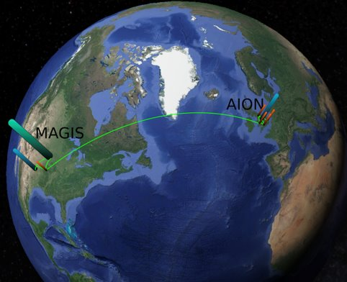
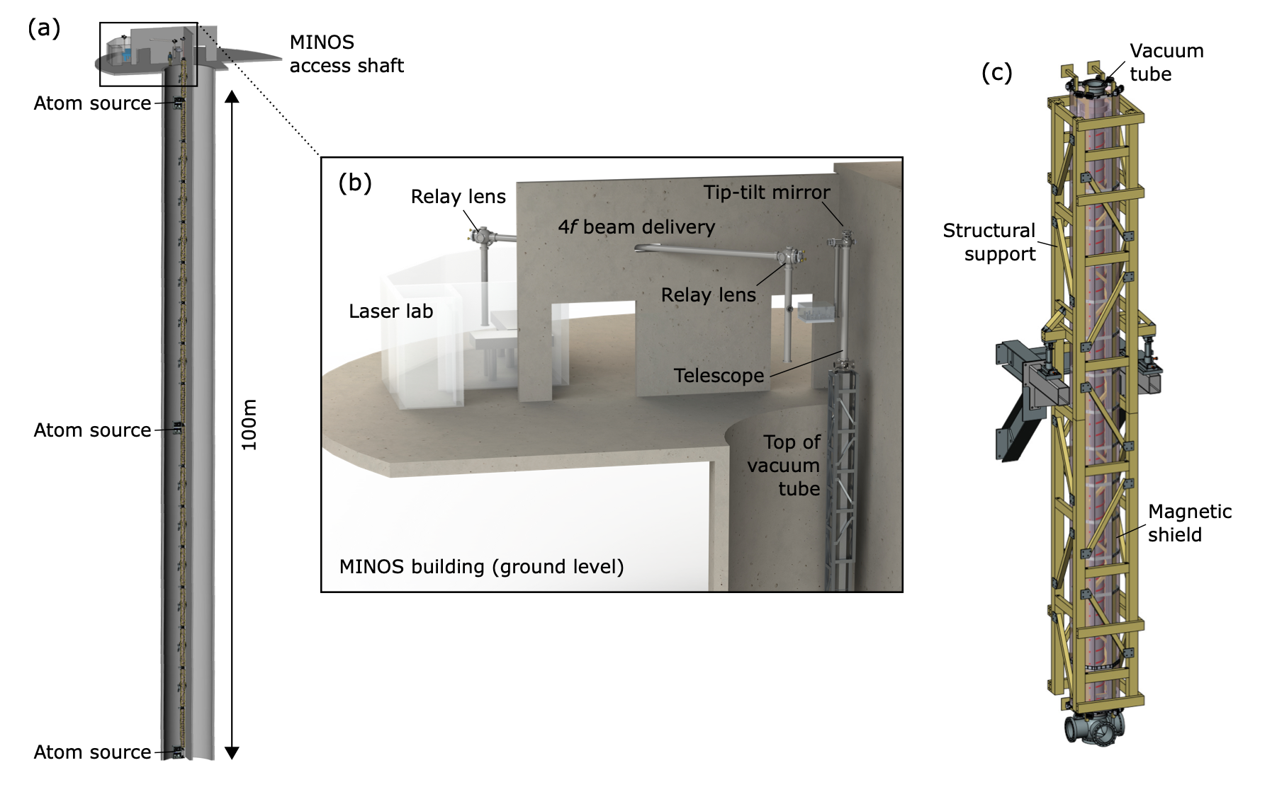
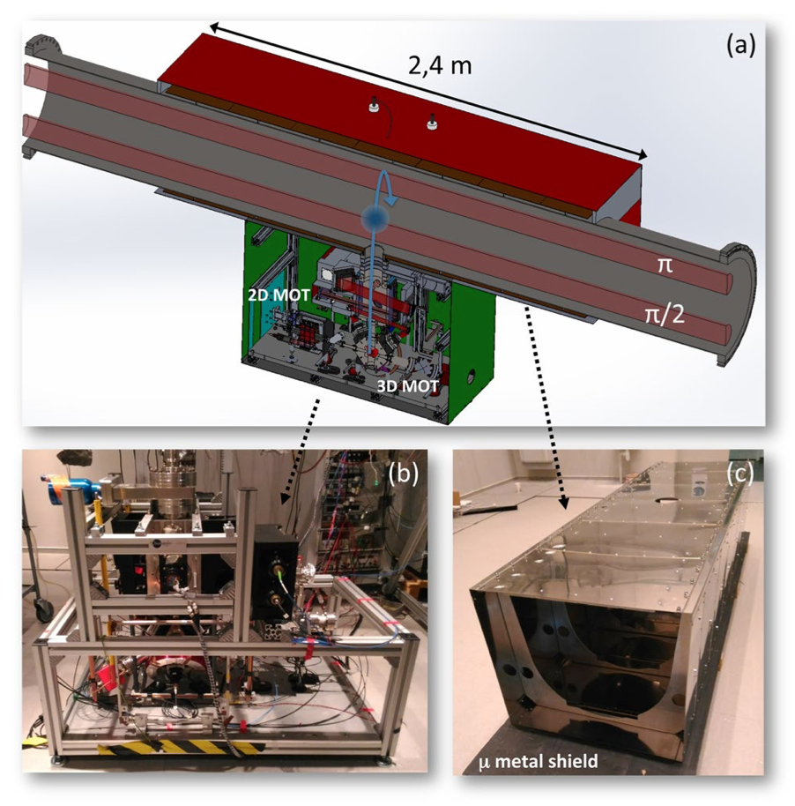
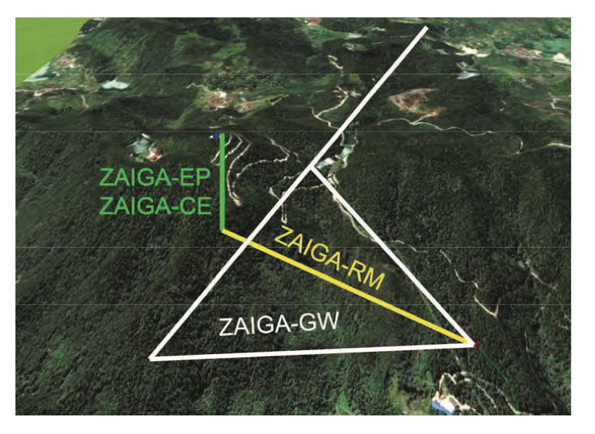
Terrestrial long-baseline atom interferometers
MIGA and ELGAR
ICRADA ceremony Fermilab, November 2023
ZAIGA (China)
M.-S. Zhan et al. Int. J. Mod. Phys. D 29 1940005 (2020).
VLBAI
AION (UK)
L. Badurina et al. J. Cosmol. Astropart. Physics 5, 011 (2020)
J. Hartwig et al. New J. Phys. 17 035011 (2015)
MAGIS-100 (US)
M. Abe et al, Quantum Sci. Technol. 6 044003 (2021)
B. Canuel et al. Sci. Rep. 8 14064 (2018)

Slide 9
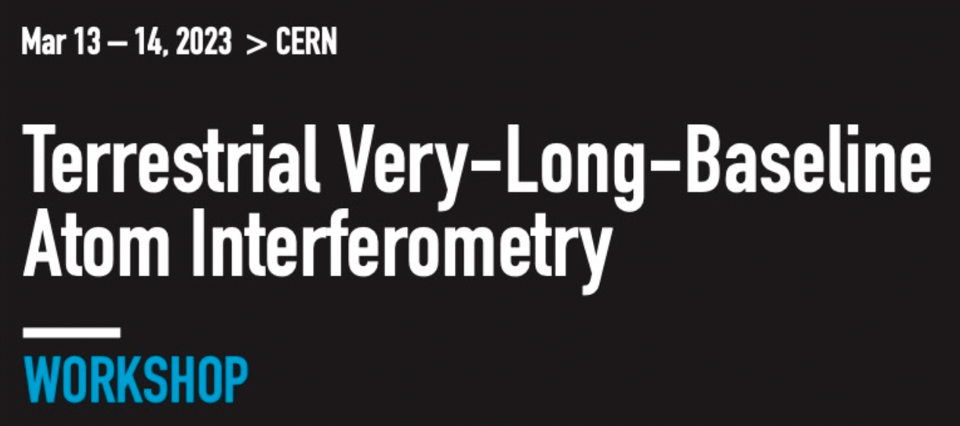
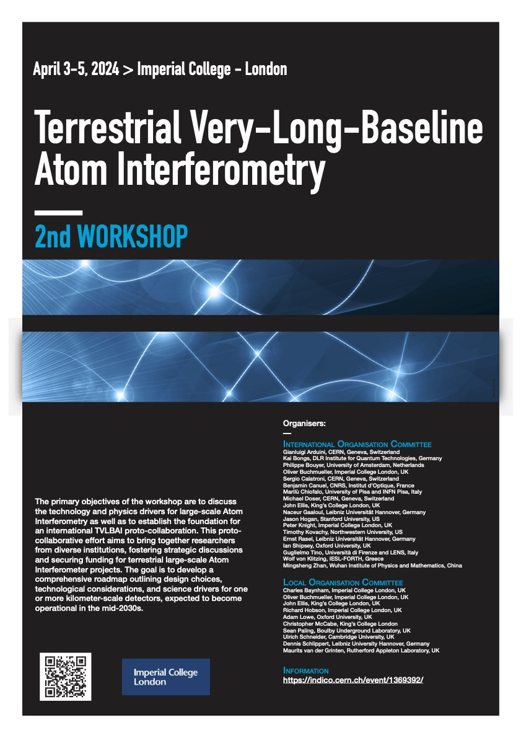
Terrestrial long-baseline atom interferometers
International community: interferometer networking and technology development
AVS Quantum Science 6, 024701 (2024)
https://doi.org/10.1116/5.0185291
arXiv:2412.14960 [hep-ex] (2024)
3rd workshop upcoming summer 2025 (dates tbc)

Slide 10
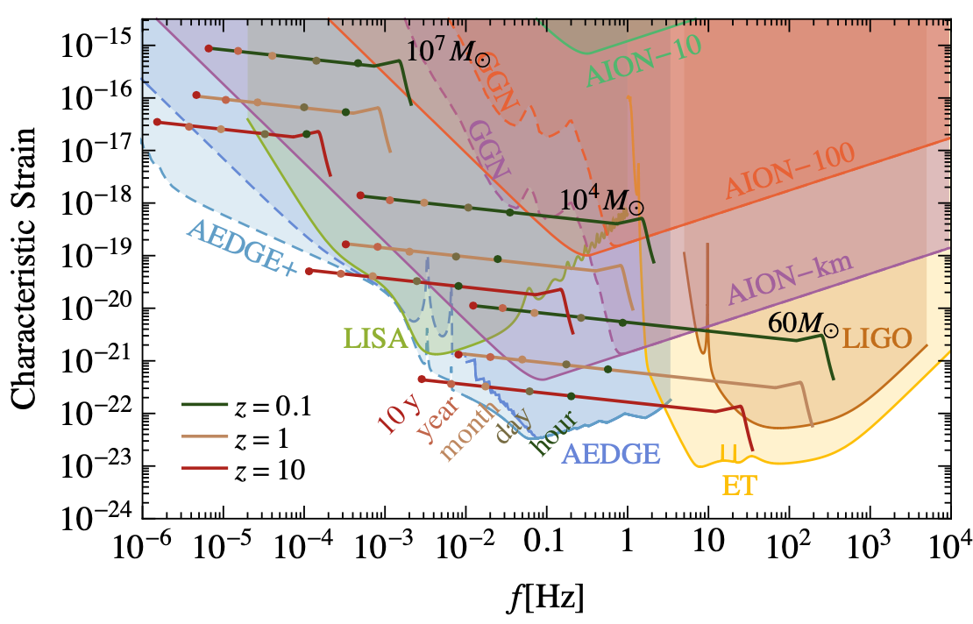


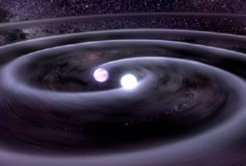
AION detection goals
decihertz range
Decihertz gravitational waves [1]
Fine-structure constant measurements [2]
Probing dark energy models [3]
L. Badurina et al, Phil. Trans. A. Math. Phys. Eng. Sci. 380 20210060 (2021).
[1] P.W. Graham et al. Phys. Rev. Lett. 110, 171102 (2013).
[2] J. Schelfhout et al. Phys. Rev. A 110, 053309 (2024).
[3] B. Elder et al., Phys. Rev. D 94, 044051 (2016).
[4] Y. V. Stadnik and V. V. Flambaum, PRL 114 161301 (2015).
[5] A. Arvanitaki et al. Phys. Rev. D 91 015015 (2015).
[6] L. Badurina, et al. Phys. Rev. D 107, 055002 (2023).
[7] G. Rosi et al. Nat. Commun. 8, 15529 (2017).
[8] P. Asenbaum et al. PRL 125, 191101 (2020).
[9] J. Mitchell et al., J. Inst., 17, 01 (2022).

Slide 11
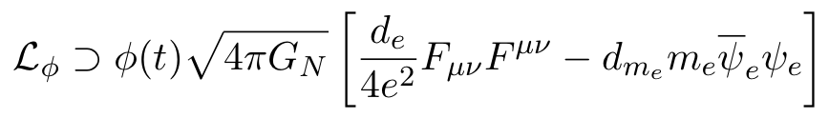
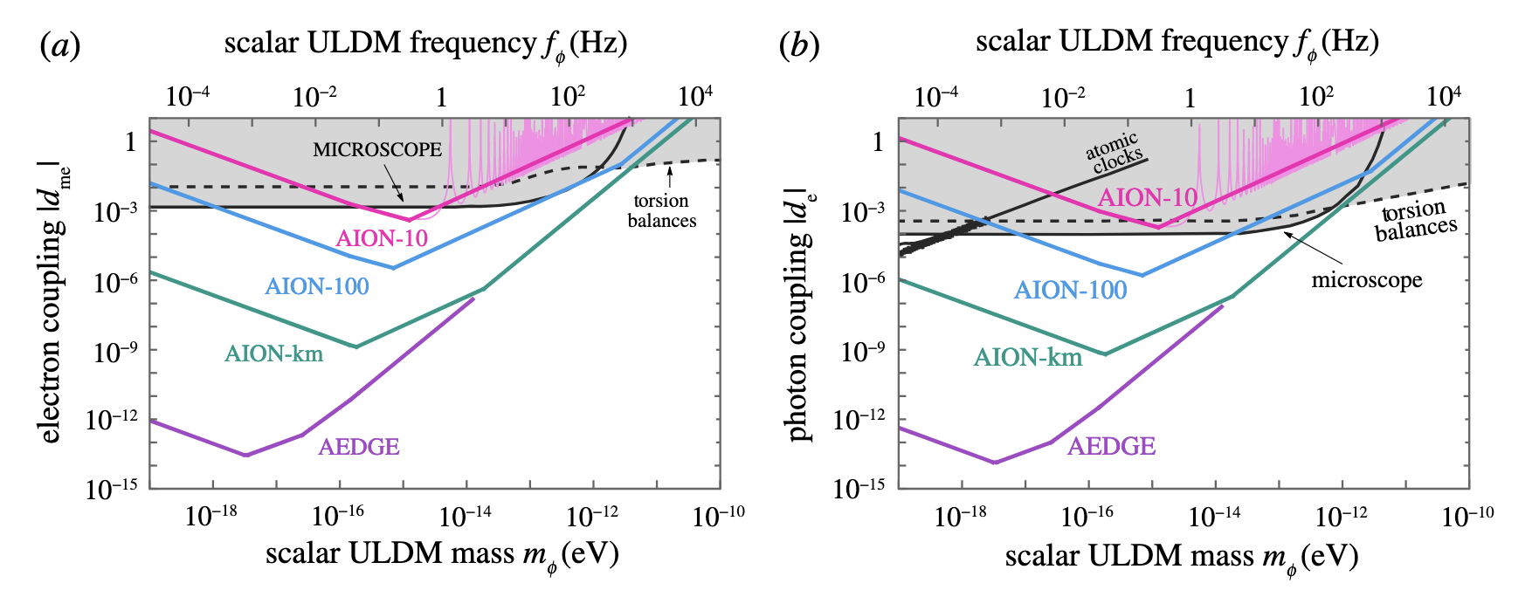
AION detection goals
Ultralight (wavelike) dark matter [4-6]
Decihertz gravitational waves [1]
Photon coupling
Electron mass coupling
Equivalence principle tests
Gradiometer comparison between different states or species [7,8]
Fine-structure constant measurements [2]
Earth science and seismology
Turning noise into signal: gravity fluctuations and gradients [9]
Probing dark energy models [3]
L. Badurina et al, Phil. Trans. A. Math. Phys. Eng. Sci. 380 20210060 (2021).
[1] P.W. Graham et al. Phys. Rev. Lett. 110, 171102 (2013).
[2] J. Schelfhout et al. Phys. Rev. A 110, 053309 (2024).
[3] B. Elder et al., Phys. Rev. D 94, 044051 (2016).
[4] Y. V. Stadnik and V. V. Flambaum, PRL 114 161301 (2015).
[5] A. Arvanitaki et al. Phys. Rev. D 91 015015 (2015).
[6] L. Badurina, et al. Phys. Rev. D 107, 055002 (2023).
[7] G. Rosi et al. Nat. Commun. 8, 15529 (2017).
[8] P. Asenbaum et al. PRL 125, 191101 (2020).
[9] J. Mitchell et al., J. Inst., 17, 01 (2022).

Slide 12
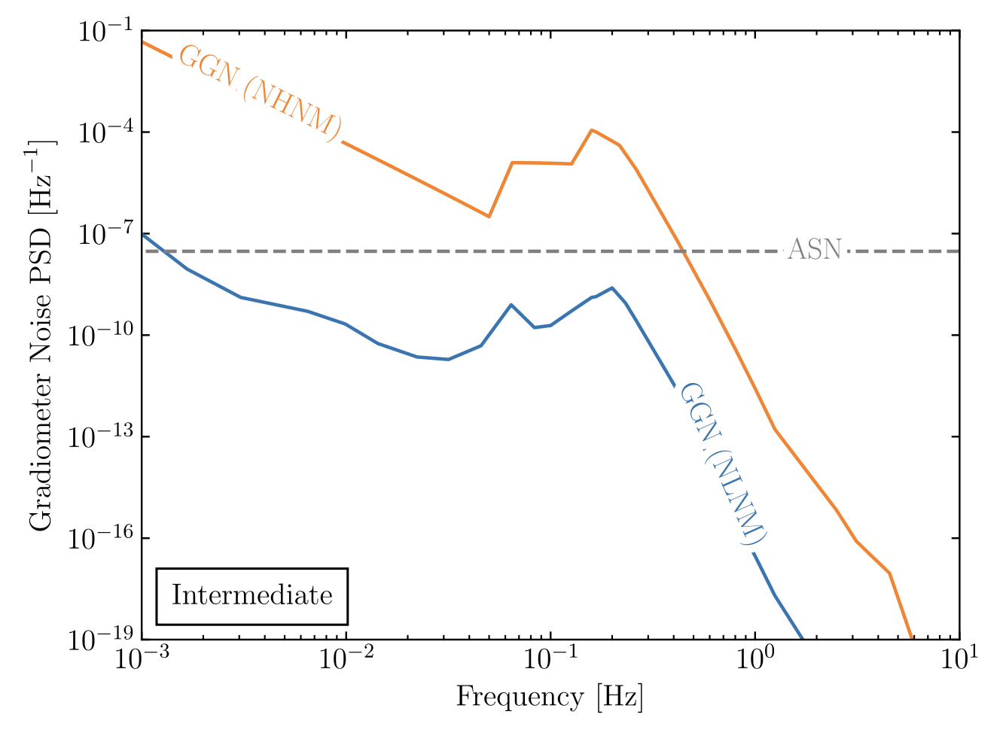
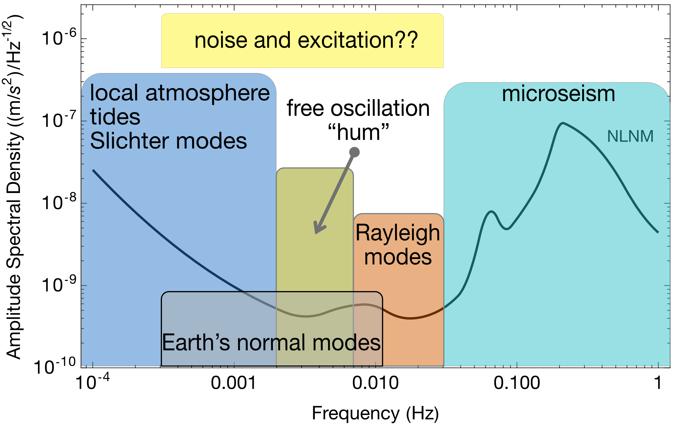
Earth Science and gravitational fluctuations
Terrestrial backgrounds cause gravity gradient noise limiting fundamental physics searches
AION can use gravitational signal channel to answer open questions in Earth science
  Earth’s free oscillation and normal modes
  Low-frequency Earth dynamics
Rayleigh seismic waves source gravitational fluctuations
Mitchell et al., J. Inst., 17, 01 (2022)
Seismic Frequency Spectrum
Badurina et al. Phys. Rev. D 107, 055002 (2023)
Atmospheric infrasound and temperature gradient noise
Carlton et al., arXiv:2412.05379 (2024).

Slide 13
The AION programme
Stage 1:
  Build and commission 10 m detector
  Develop existing technology and the infrastructure for 100 m detector.
Stage 2
  Build, commission and exploit the 100 m detector
  Design study for the km-scale detector.
  AION selected in 2018 by STFC as a high-priority medium-scale project.
  AION will work in equal partnership with MAGIS in the US to form a “LIGO/Virgo-style” network & collaboration: pathway for UK leadership.
Stage 1 is partially funded with about £10M by the QTFP Programme and other sources
Stage 2 could be placed at national facility in Boulby or Daresbury (UK), possibly also at CERN (France/Switzerland).
Stage 3
  Build a kilometre-scale terrestrial detector.
Stage 4:
  Pair of satellite detectors (thousands of kilometres scale) [AEDGE proposal to ESA Voyage2050 call]
  AION has established science leadership in AEDGE, bringing together collaborators from European and Chinese groups (e.g. MIGA, MAGIA, ELGAR, ZAIGA).
International funding and collaboration (technology development and networking) required for stage 3 and 4 and science goal exploitation: AION key player in building foundations for international long-baseline interferometry community

Slide 14
Stage 1 science and technology goals
  Differential measurement (long baseline)
  Single photon transition atom interferometry
  Cold clouds with large atom number
  Fast repetition rate
  Large momentum transfer
  Spin squeezing
  Launch
  Detection/imaging
  Long-baseline detector engineering
  Simulation pipeline
  Noise modelling, systematics analysis and signal verification
  Phenomenology
  Detector networking
Check out the AION posters tomorrow!

Slide 15
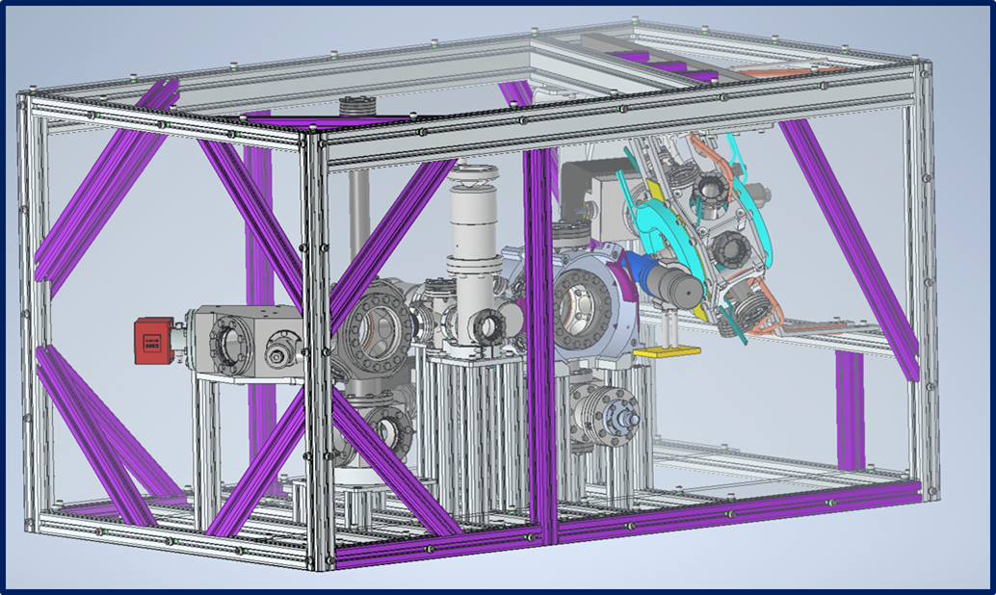
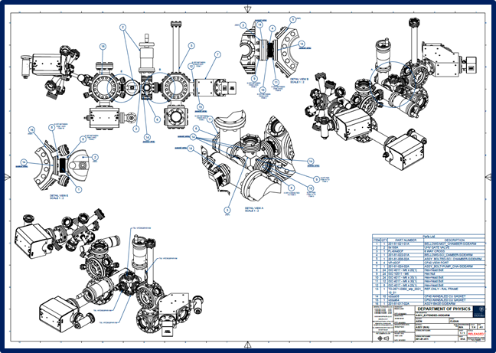
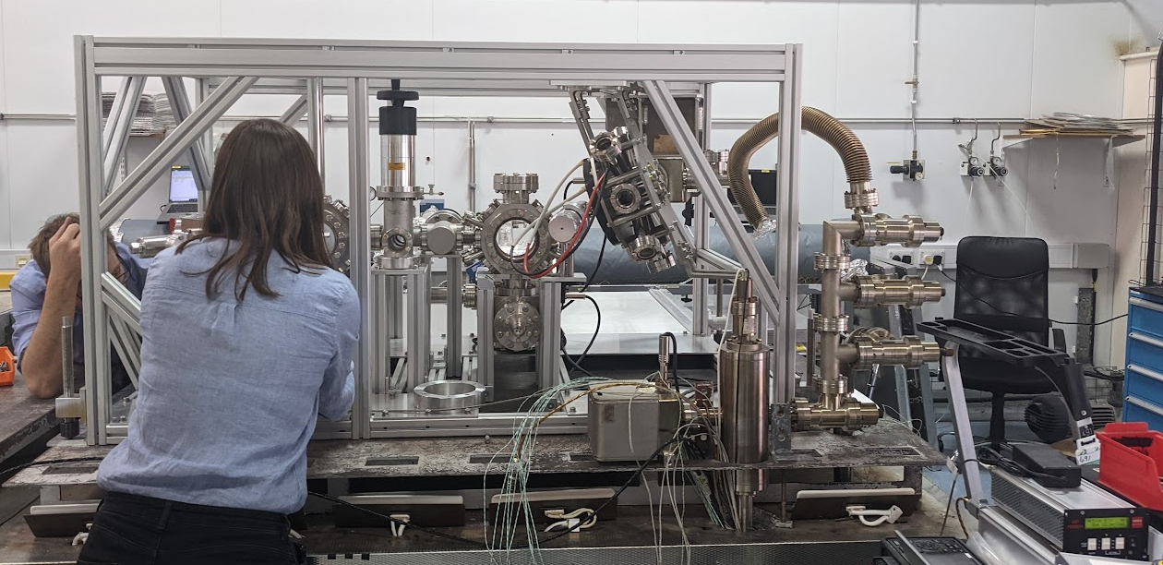
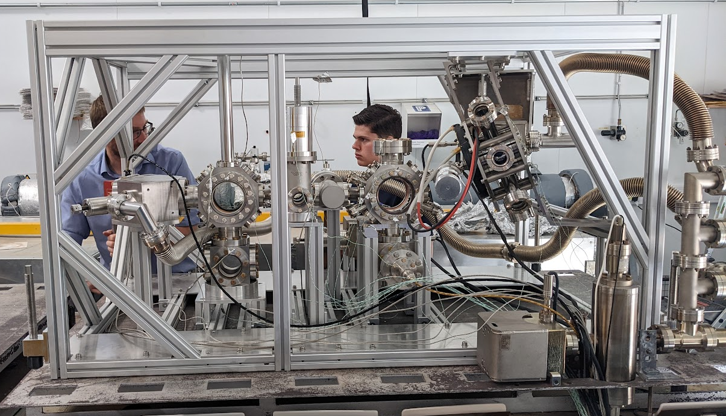
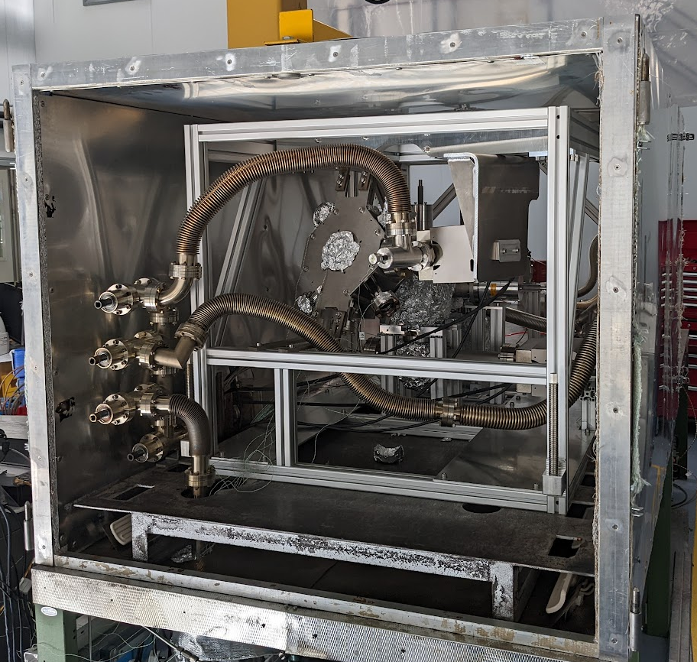
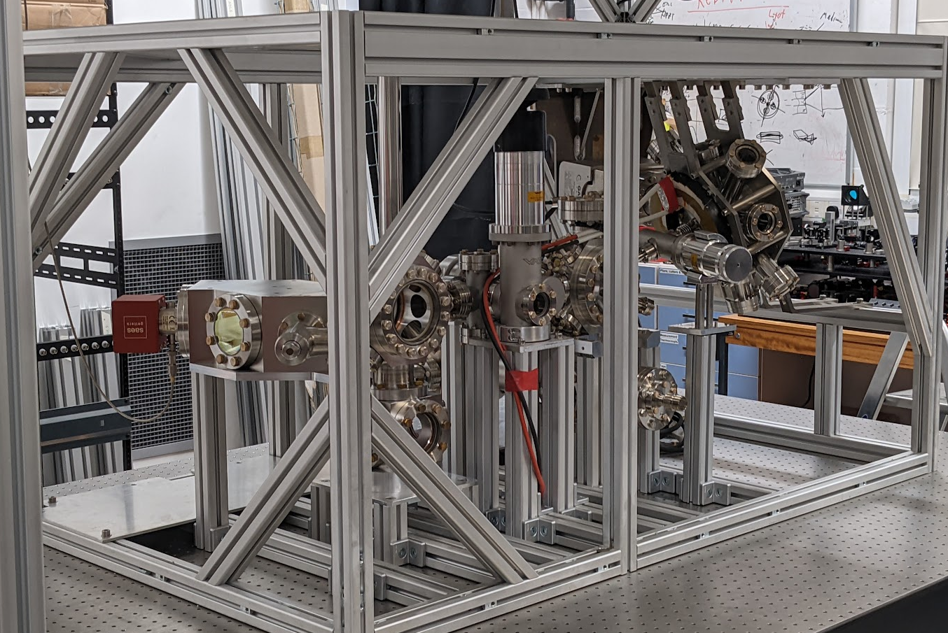
Some experimental highlights
5 ultracold strontium laboratories built in 24 months using centralised design and production methods and expertise from cold atom scientists and Rutherford Appleton and Daresbury Laboratories [1]
[1] AVS Quantum Sci. 6, 014409 (2024)

Slide 16
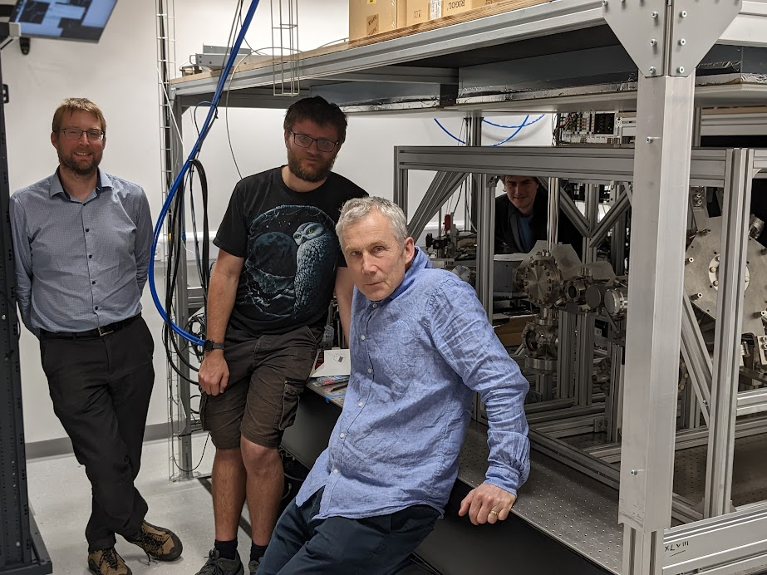
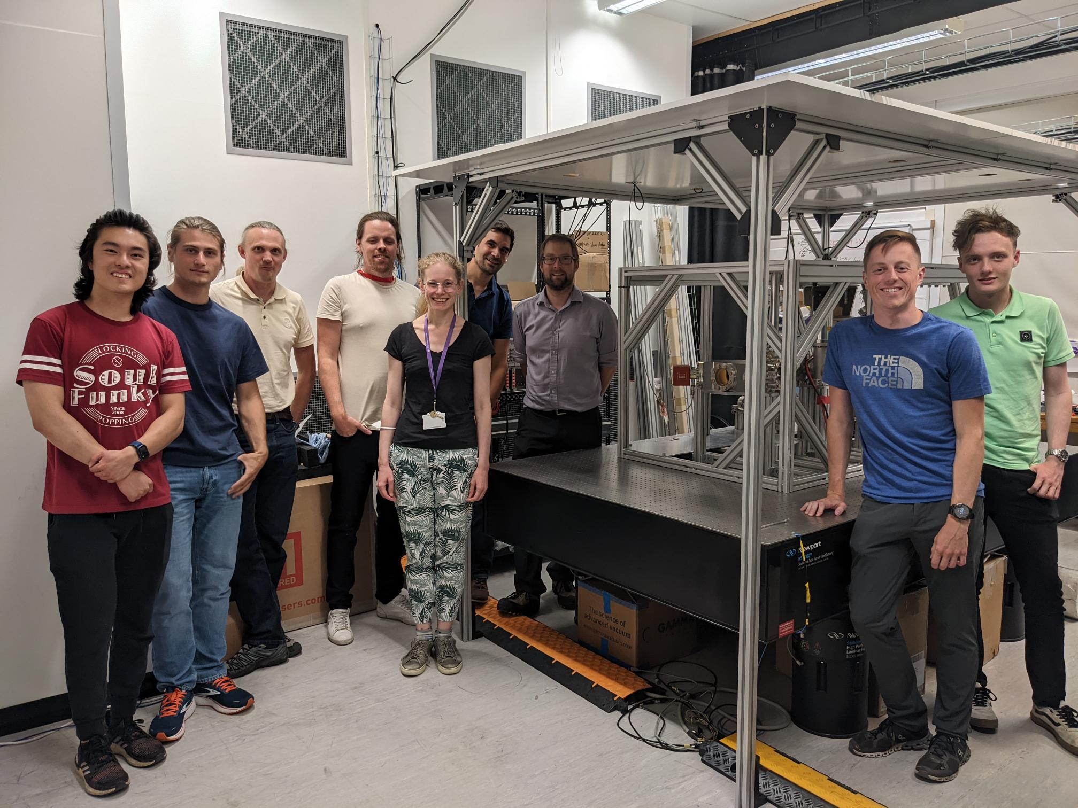

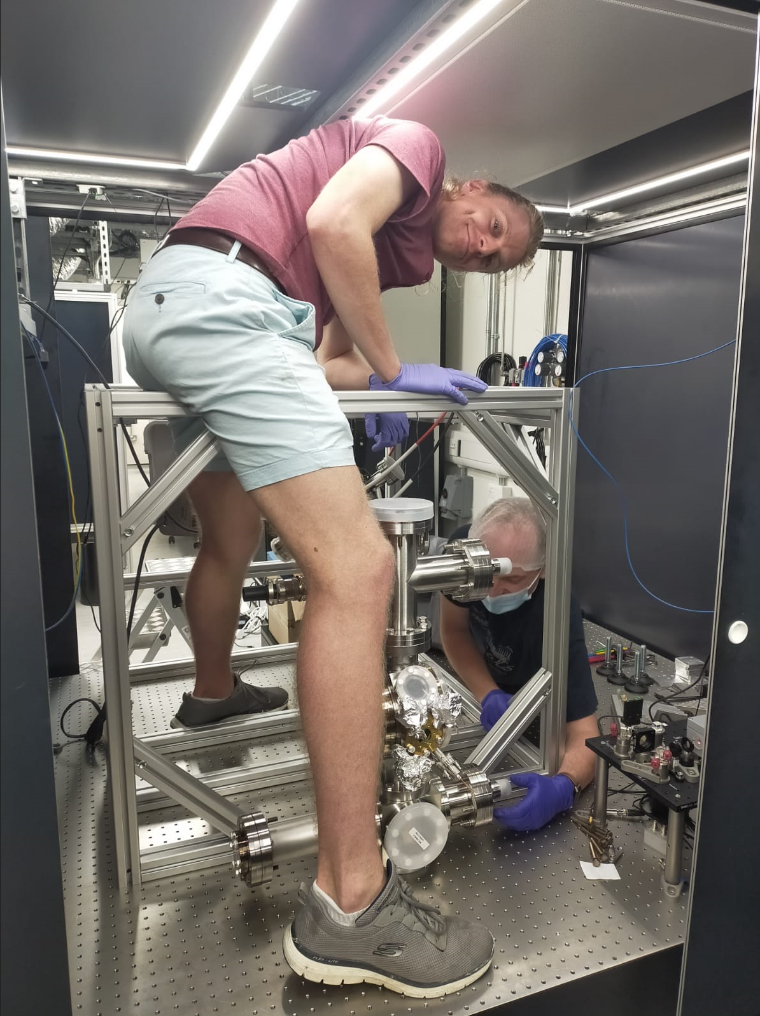
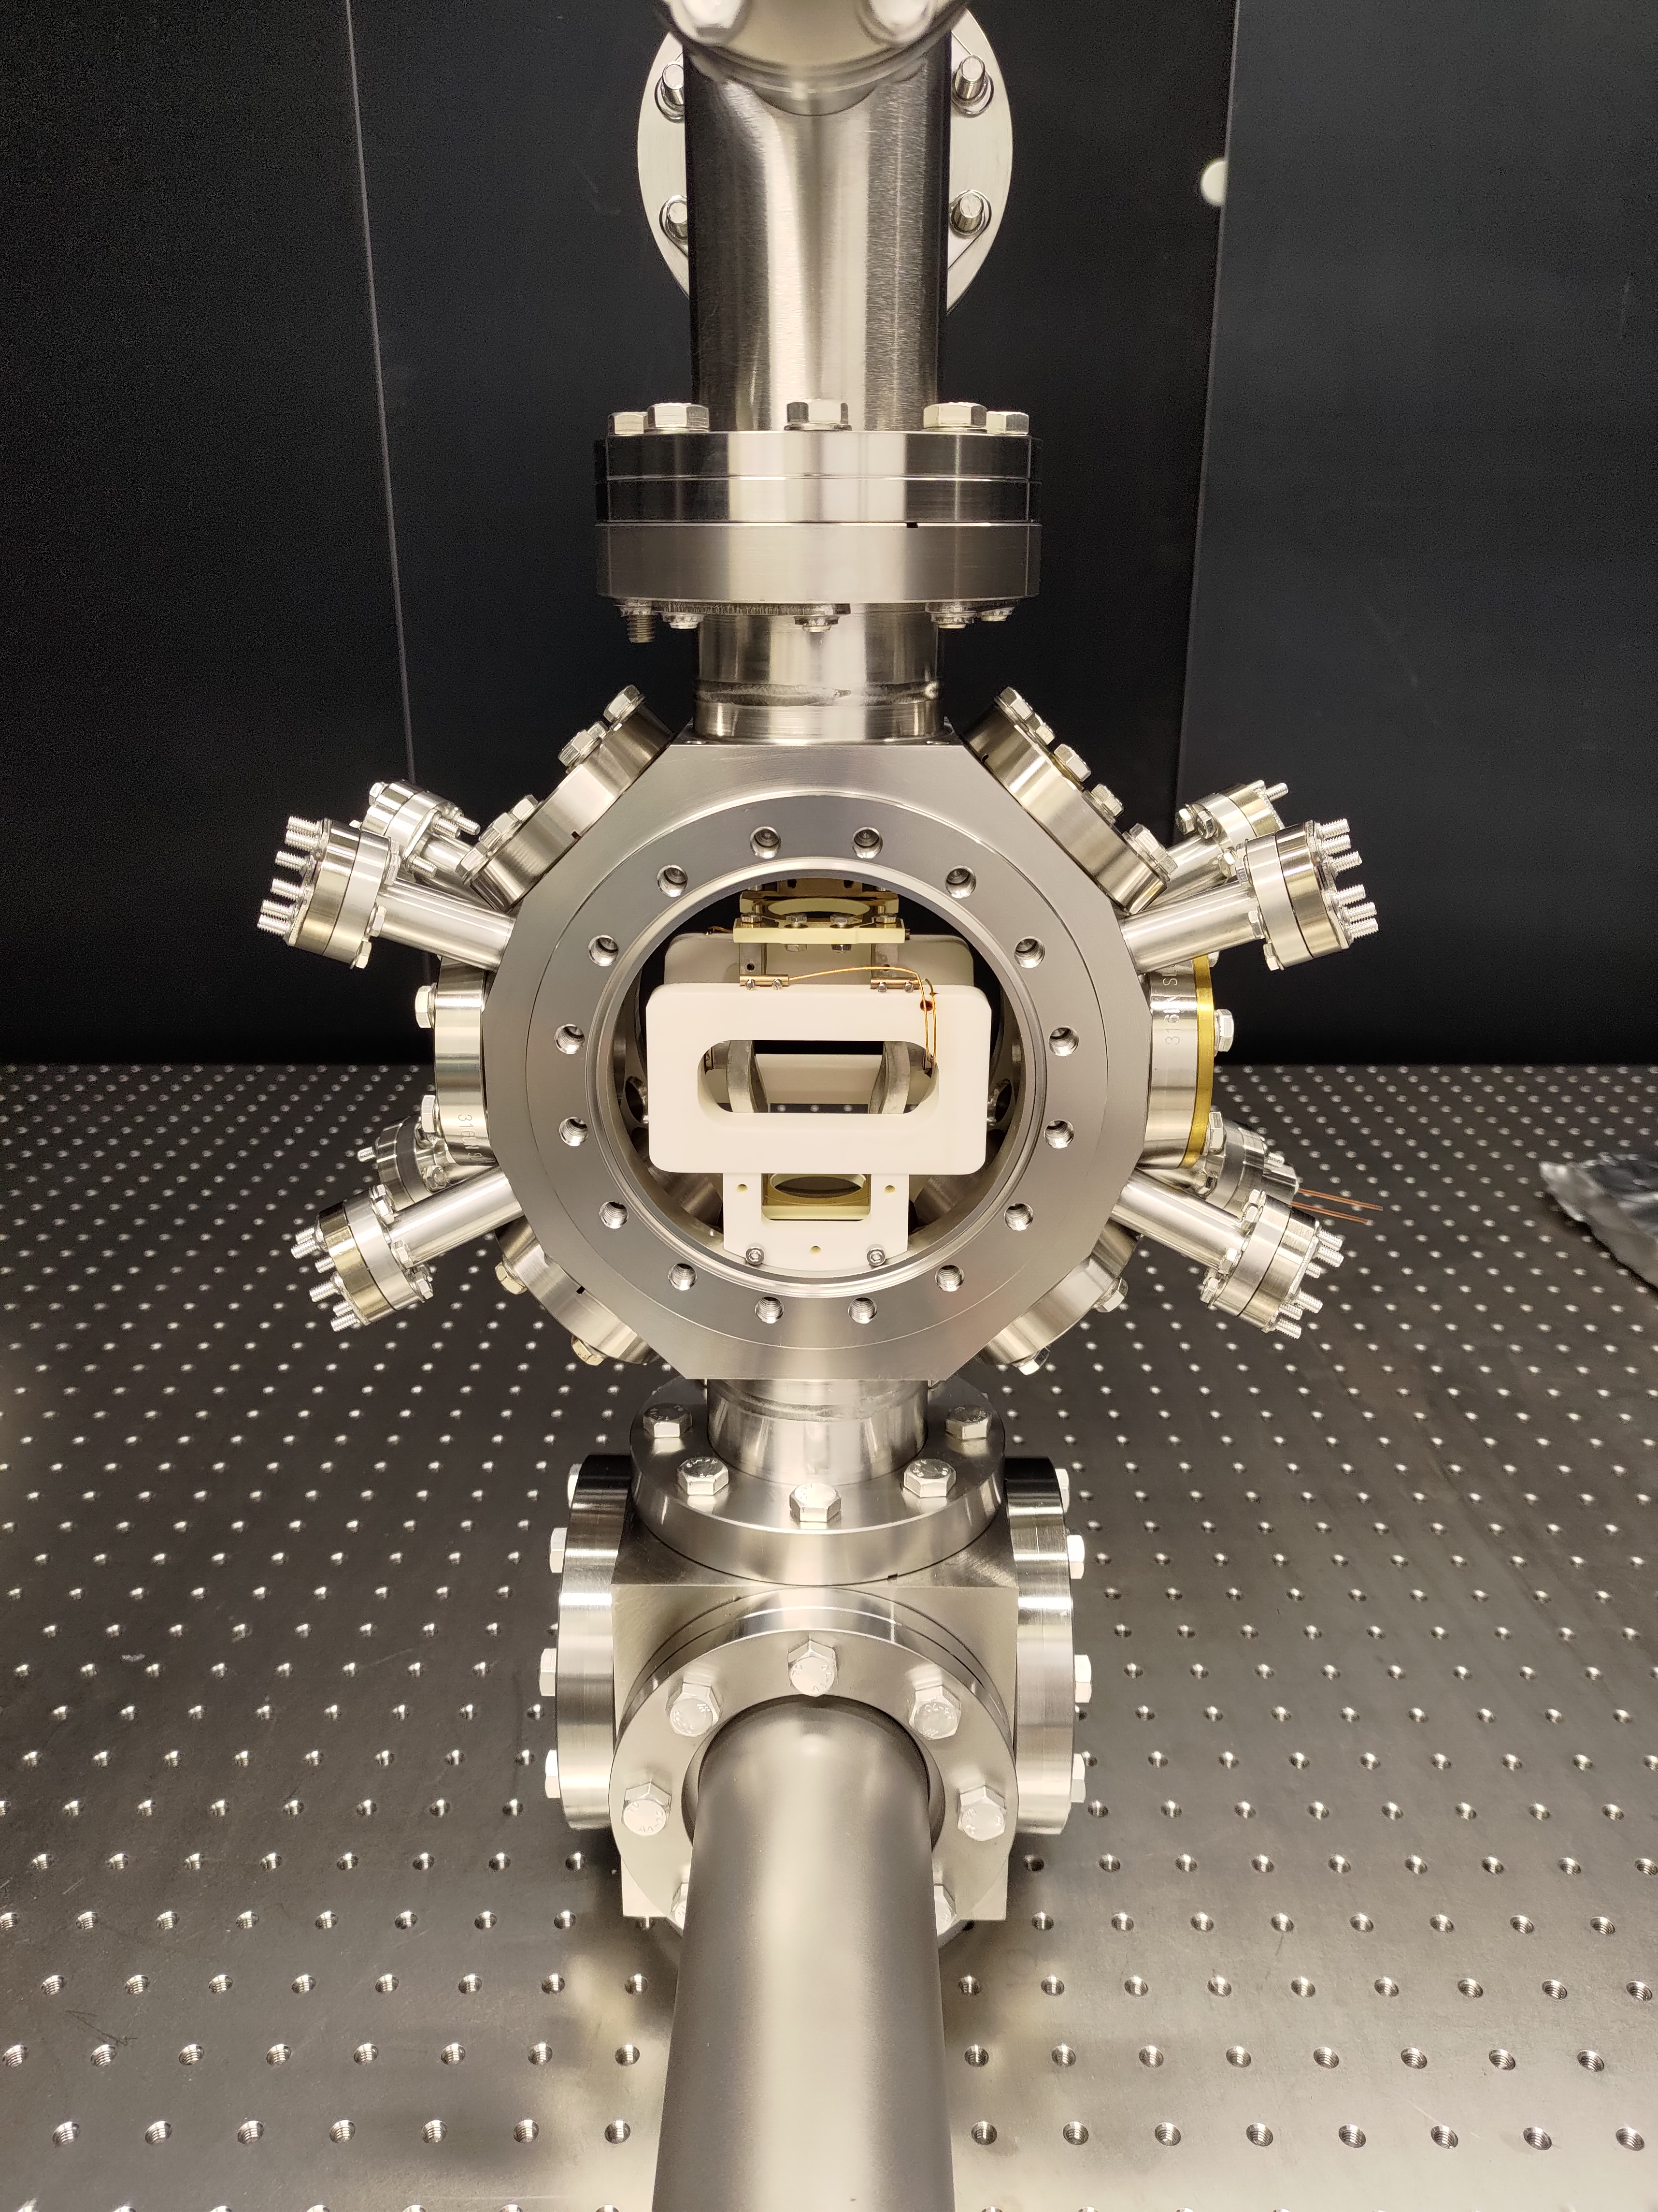
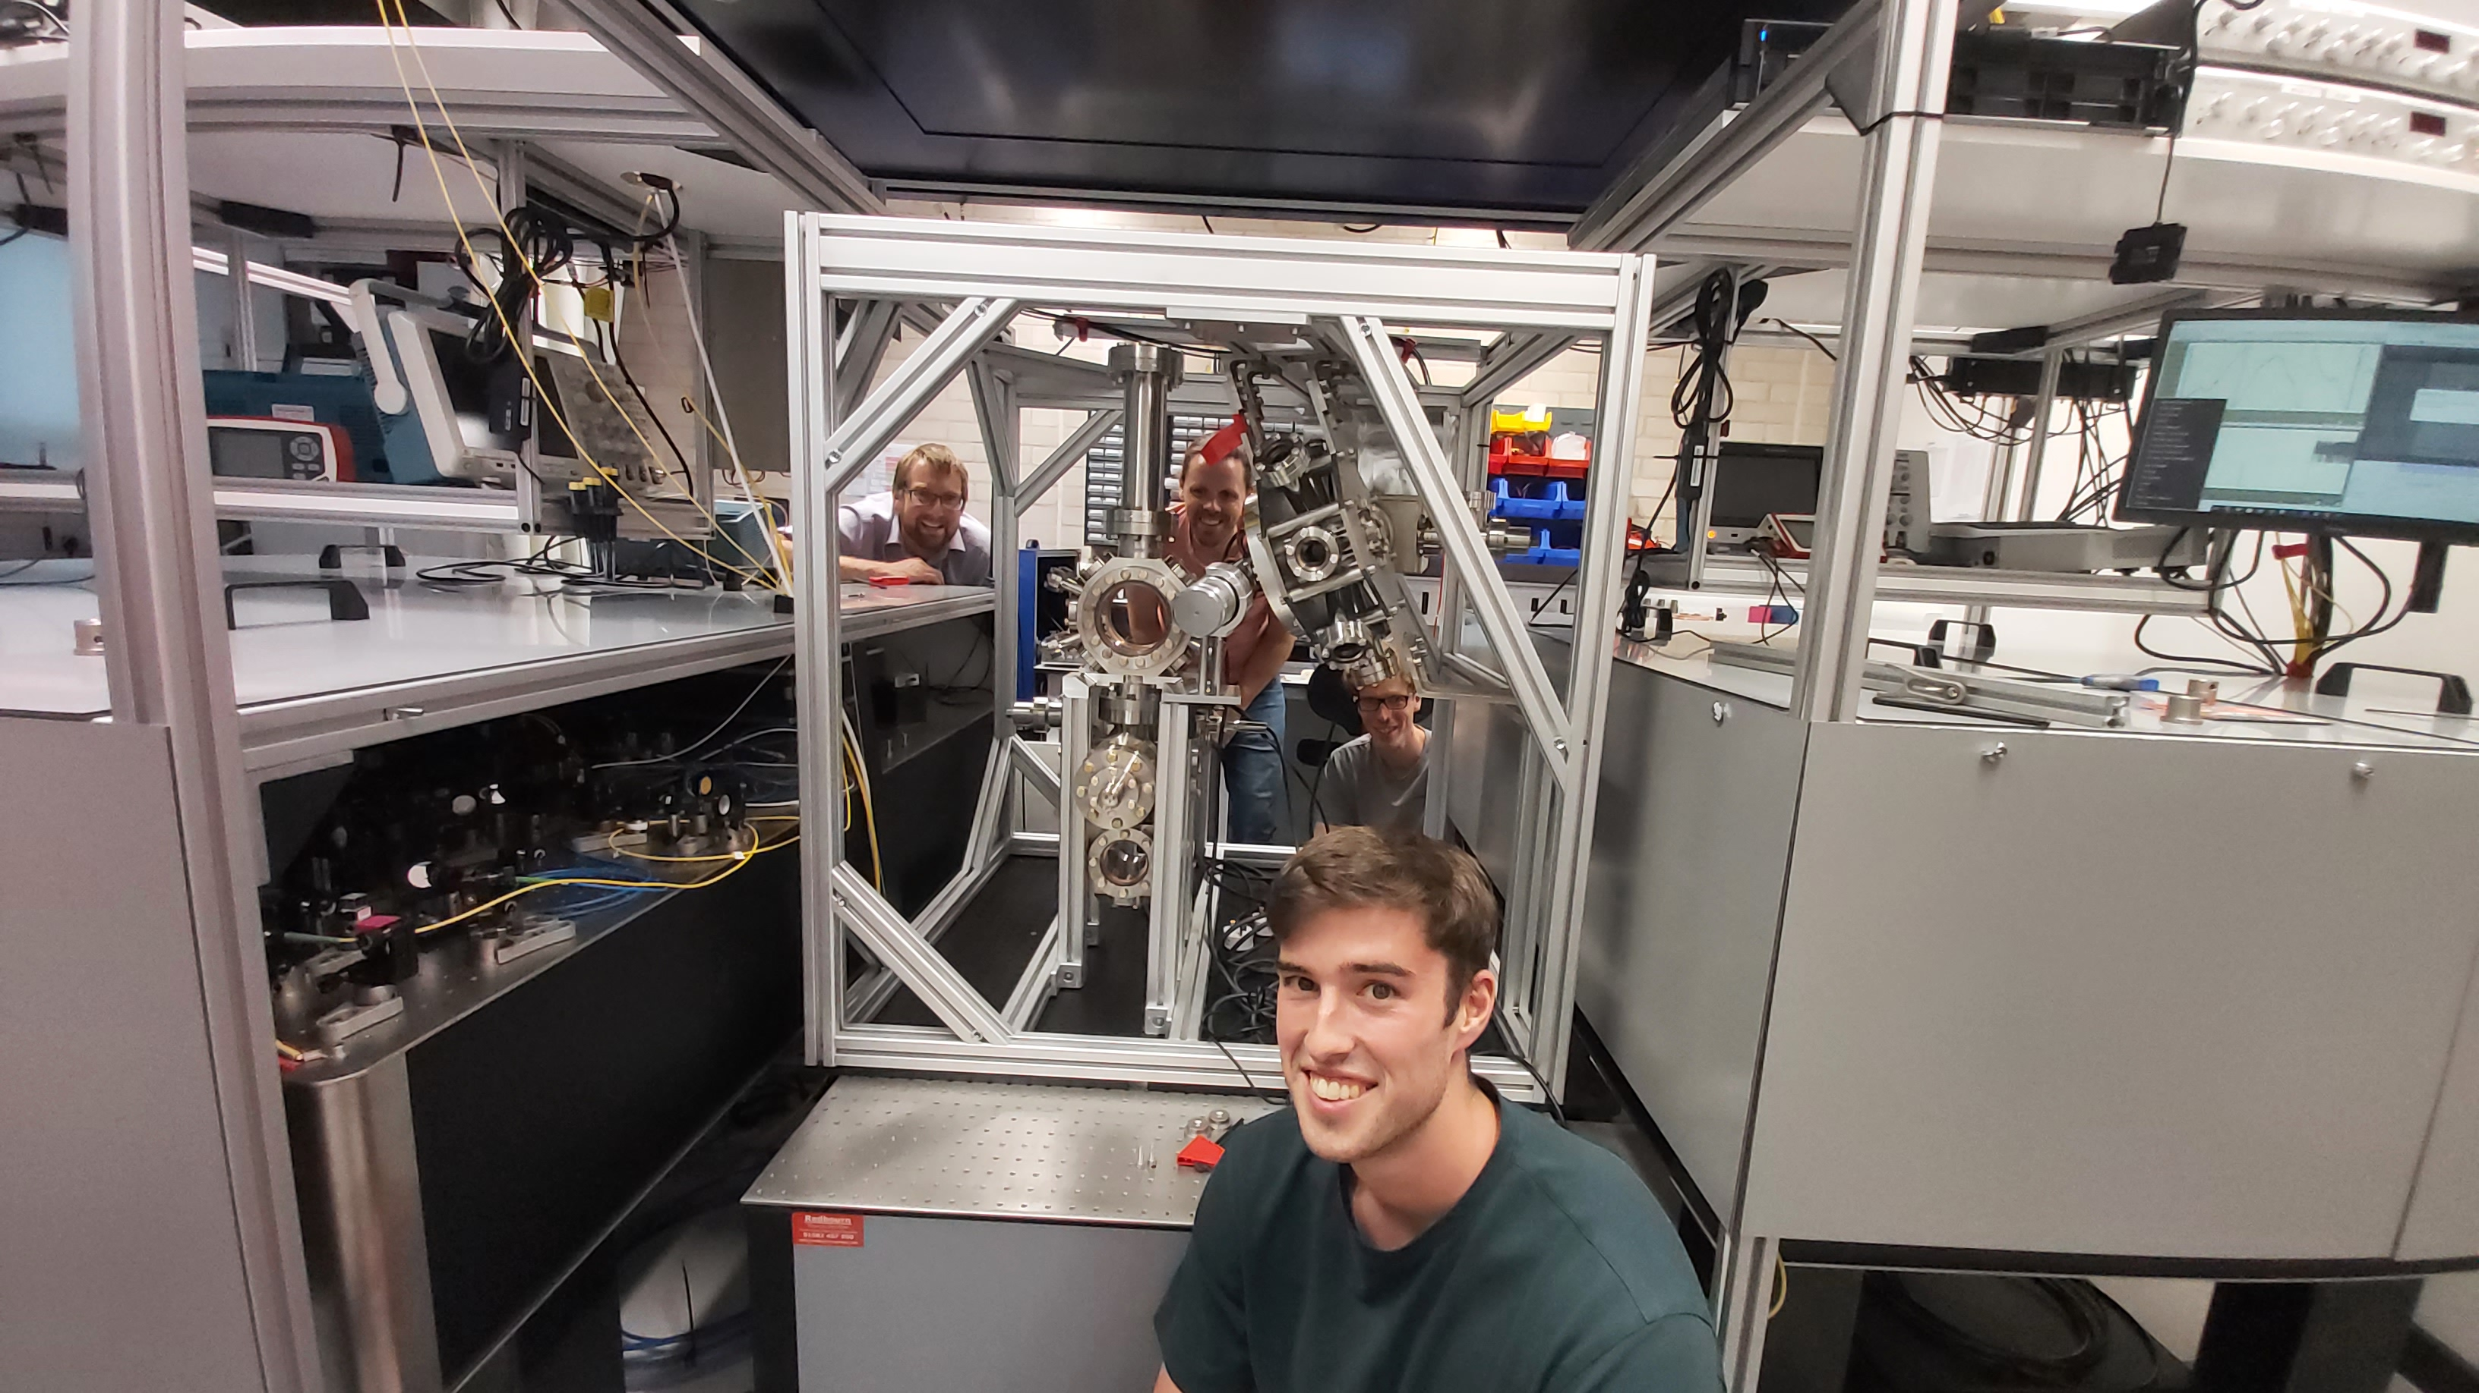
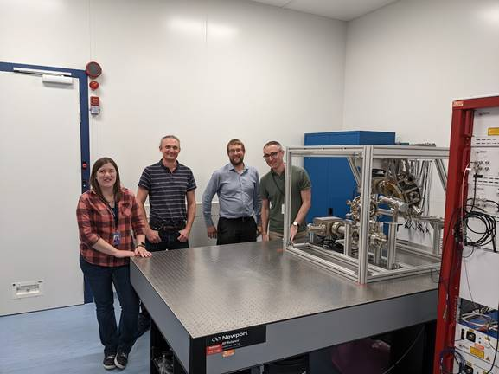

Some experimental highlights
5 ultracold strontium laboratories built in 24 months using centralised design and production methods and expertise from cold atom scientists and Rutherford Appleton and Daresbury Laboratories [1]
Oxford October 2022
Cambridge July 2022
Imperial August 2022
Birmingham July 2022
RAL October 2022
[1] AVS Quantum Sci. 6, 014409 (2024)

Slide 17








Some experimental highlights
Atom cooling
Optical dipole trapping
Large momentum transfer
Atom interferometry on the clock transition
Differential atom interferometry (preliminary)
2D blue MOT
3D blue MOT
3D red MOT
1 mm
L. Badurina et al, Phys. Rev. D 107, 055002 (2023)

Slide 18

Differential measurement
‘Simulation beam’ introduces artificial noise:

Slide 19


AION-10 engineering
Pathfinder detector with 10 m baseline: demonstration of combined technology and physics exploitation
AION-10 detector will be located at the University of Oxford.
Successful preliminary design review in 2023; final review imminent.
Optical design: beam cleaning and delivery optics
Magnetic field requirements: coil and shield design
Mechanical, thermal, vibrational stability
Assembly plans

Slide 20
Ongoing research avenues
Technical challenges require extreme precision for quantum control
  Atom flux and interferometer repetition rate
  Atom kinematics, temperature, collimation
  Laser frequency, phase, and pointing stability
  Quantum enhancements to measurement: squeezed states
  Interferometer readout
  Temperature, vacuum, stray magnetic fields, and vibrations
  Gravitational static gradients and moving masses
  Subsampling instrument, aliasing L. Badurina et al., Phys. Rev. D 108, 083016 (2023)
Exquisite sensitivity to gravity results in environmental noise sources which are harder to mitigate
  Seismic and atmospheric gravity gradient noise L. Badurina et al. Phys. Rev. D 107, 055002 (2023); J. Mitchell et al., J. Inst., 17, 01 (2022)
  Random anthropogenic and synanthropic noise J. Carlton and C. McCabe, Phys. Rev. D 108, 123004 (2023)
Scaling baseline
  High power laser sources
  Optics stability and ruggedisation
  Shaft and environment engineering
Coordinated community effort and opportunities for collaboration

Slide 21
Summary
Long-baseline atom interferometry network: detection platform for tests of fundamental physics
AION combines expertise and techniques from atomic and particle physics, engineers and national laboratories
Significant gains in experiment, theory and cross-community collaboration
Future: exciting research avenues

Slide 22


The AION Consortium
First AION consortium meeting post-funding: Oxford, November 2021

