Slide 1
Towards a nitrogen molecular ion clock for fundamental physics tests
Laura Blackburn, Amber Shepherd, Matthias Keller

Slide 2
The nitrogen clock
Our clock, based on a N₂⁺ ion, will be sensitive to potential changes in the proton-to-electron mass ratio, μ
Nitrogen clock (I=0, (0,0) → (2, 0):
Transition frequency (THz)
129.4
Natural linewidth (Hz)
<0.1
Zeeman shift (2nd order)
~0
Stark shift (cm/V)
~10⁻²⁰
Quadrupole shift
0
QSNET network
Blackbody shift (300 K)
~10⁻¹⁸
M. Kajita et al., Phys. Rev. A 89, 032509

Slide 3
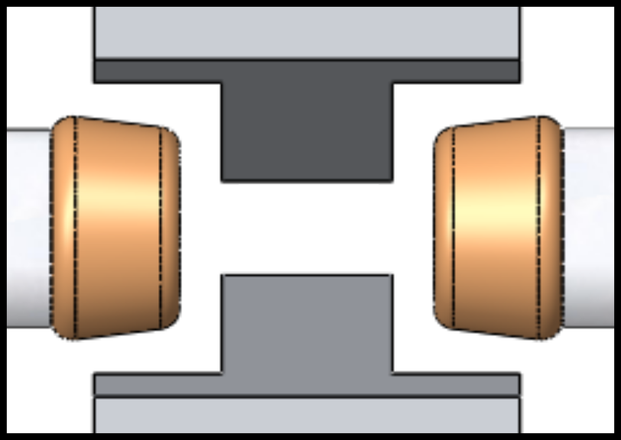
Experiment overview
Spectroscopy of the clock transition in nitrogen has three main stages:
State-selective loading of nitrogen ions
Raman spectroscopy of clock transition
Quantum logic detection scheme
Notes:
Three parts of experiment
Nitrogen requires an auxiliary ion – we use calcium
Step 1 – load nitrogen into trap in right state and cool using the calcium
Step 2 – the clock transition
Step 3 – read out the state of the nitrogen ion using the calcium

Slide 4
Nitrogen ionisation and loading

Slide 5
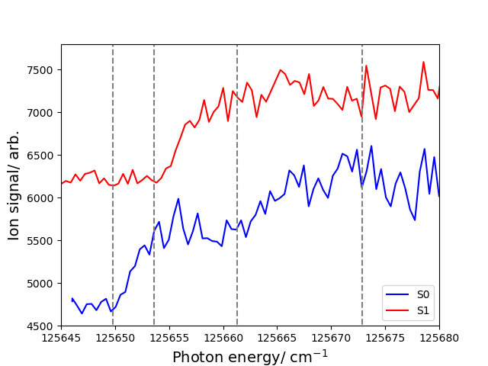
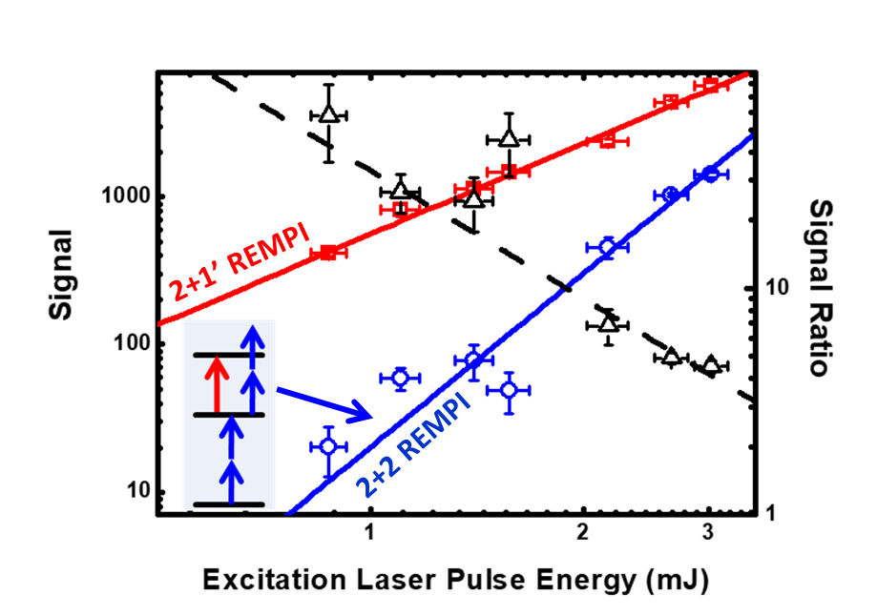
Ionisation scheme
Nitrogen ions will be loaded into the trap using a 2+1’ REMPI scheme:
Scans of the ionisation threshold (offset for clarity)
X²Σ_{g}⁺
v=0
N=0
1
2
3
212 nm
a¹Π_{g}⁺
v=6
2x 255 nm
X¹Σ_{g}⁺
v=0
The 2+1’ ionisation is state selective

Slide 6
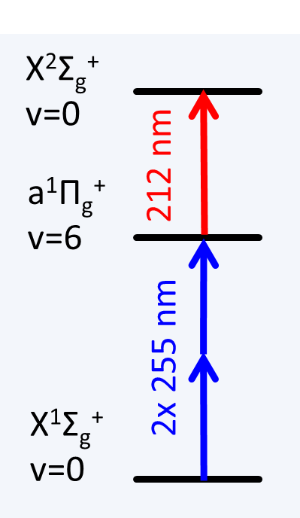
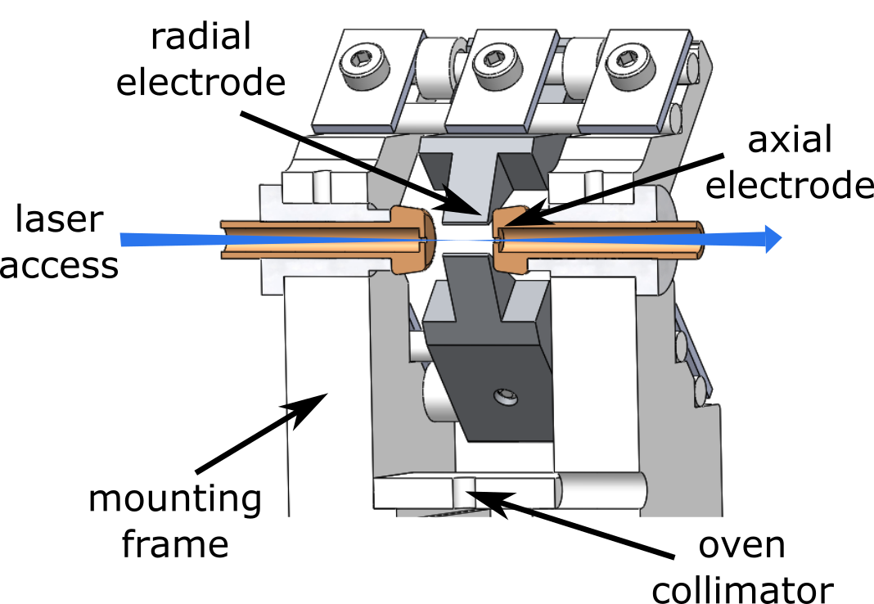
Ionisation in an rf ion trap
Electric fields in the ion trap are high amplitude, vary in space and oscillate in time.
So the ionisation threshold for a molecule depends on where and when it is ionised – this leads to a broad distribution of thresholds!
State selectivity severely reduced even for low trap confinement
Notes:
So far we’ve talked about ionisation outside of the ion trap
Inside the ion trap, we have to consider the effect of the electric fields – which have large gradients in space and fast oscillations in time
And the ionisation threshold of a molecule depends on the electric field it experiences – the larger the field, the lower the threshold
If the molecules and lasers have finite distributions, which they always will in reality, then there will be a distribution of ionisation thresholds
And if that distribution is wider than the spacing between consecutive rotational states, then it’s no longer possible to ionise into the desired state deterministically
We know from simulations we did previously that this becomes a big problem for modest trap parameters

Slide 7
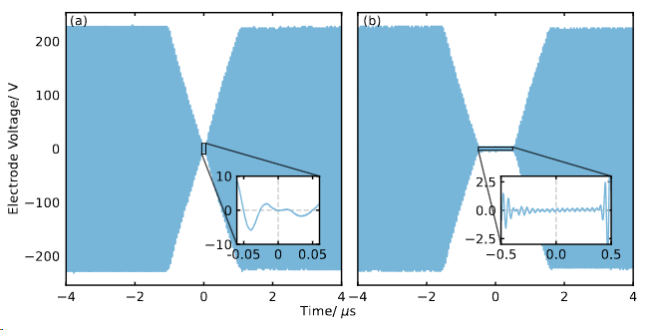
Fast switching of the trap drive
High amplitude drives achieve faster-than-natural decay of the field, with >50 dB extinction:
We use one high-power rf pulse to interfere with the resonator field, and another for fast resonator build-up:
An additional pulse for which the resonator is grounded can be used to extend the zero-field time.
Notes:
Our solution to this is to switch the trap off whilst the ionisation lasers are fired in
If we were to do this by simply switching off the rf signal that drives the trap, the decay of the field amplitude would be a slow exponential decay because of the stored energy in the high Q factor resonator
The alternative is to use high amplitude drives to switch it off faster – first a high amplitude out-of-phase drive to interfere destructively with the intra-resonator field and second a high amplitude in-phase drive to recover the field quickly
This results in a minimum where the lasers could be fired in
However, if there are longer-lived Rydberg states then it may be necessary to hold the trap off for longer – it is possible to do this by using a third switch (ground signal)

Slide 8
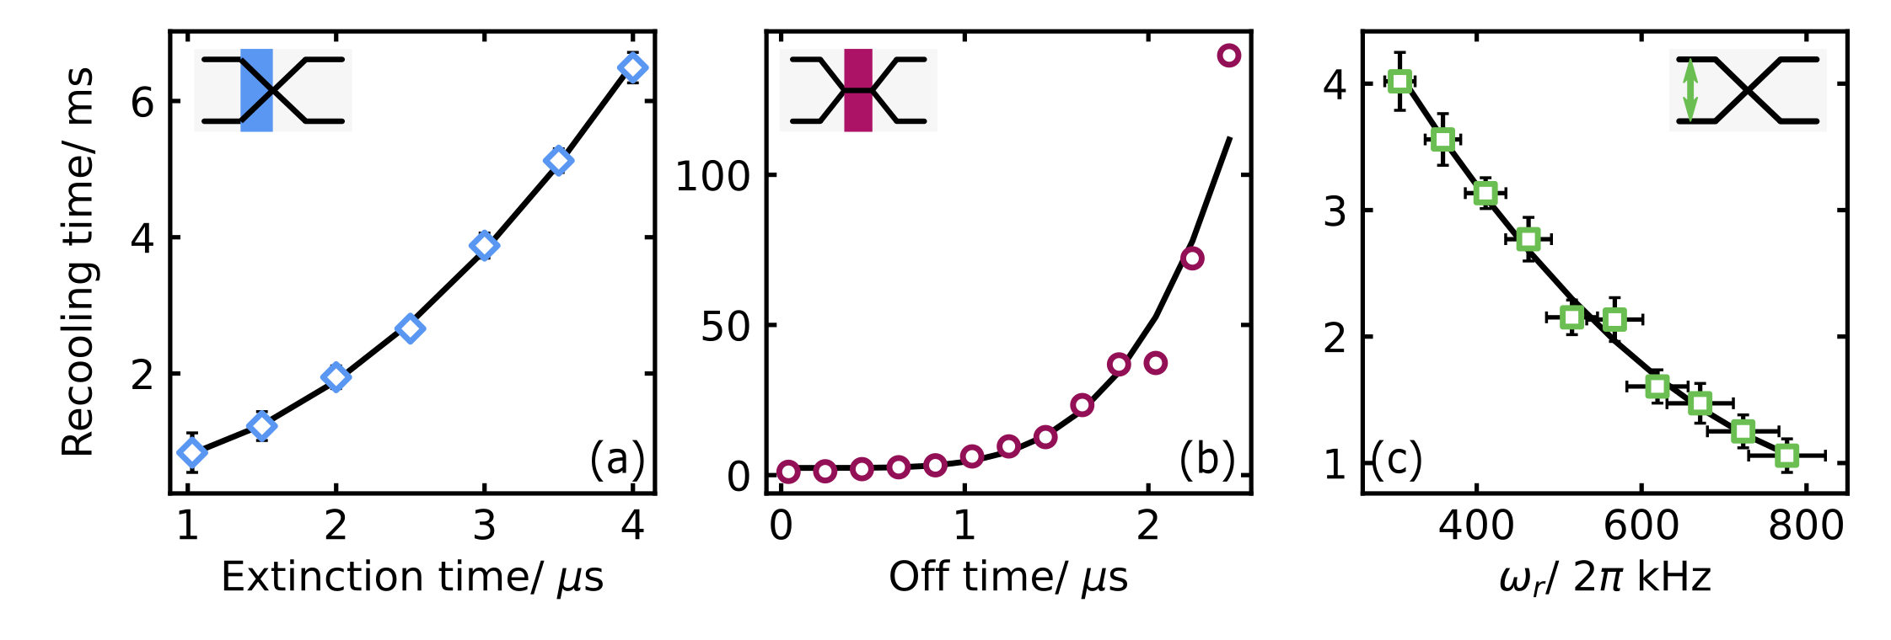
Retention and heating of existing ions
Recooling time increases with switching time and number of ions:
The fluorescence was recorded while the trap was switched off at a rate of 1 Hz with different switching and ion parameters
Recooling time was defined as the time taken for the fluorescence to recover to 95 % of its original value
Retaining ions is feasible even for large crystals of many tens of ions
Recooling time
Notes:
In addition to testing with single ions, we have also tested the effect of switching on crystals with multiple ions
Here, we find the scaling is linear for small 1D and 3D crystals and that it is possible to retain even very large crystals over many cycles of switching
This additional heating can be explained by the repulsion of the ions and rf heating?

Slide 9
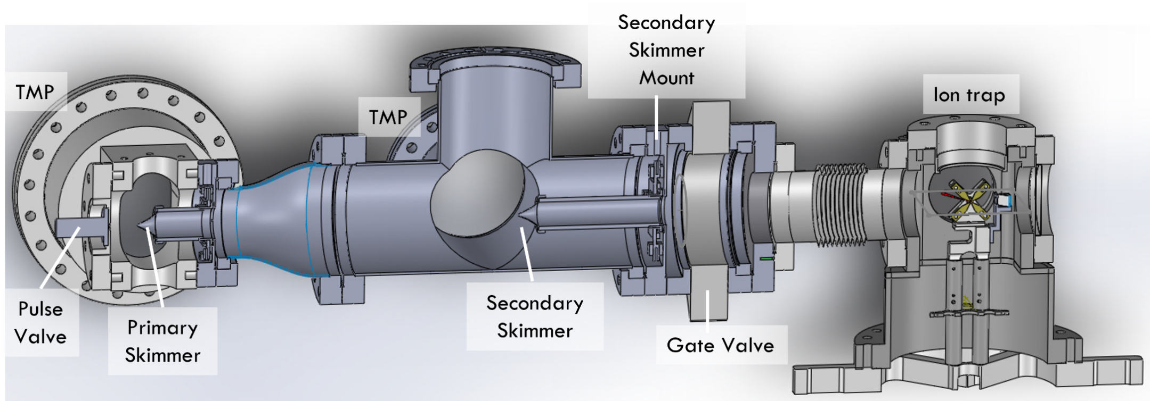
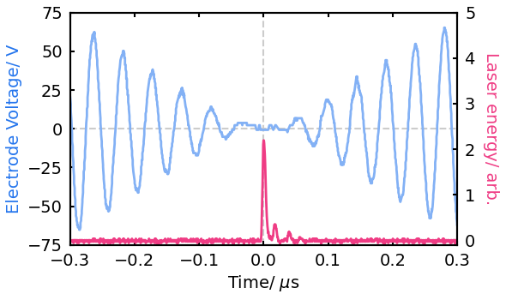
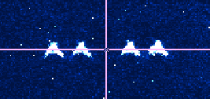
Loading nitrogen whilst switching the trap
We load nitrogen from a beamline attached to the trap chamber:
Nitrogen ions have been loaded by REMPI using the switching technique:
Trap rf
Dark N₂⁺ ion
Laser pulse
Nitrogen ions appear dark on the camera, but can be identified via the change in secular frequency
Notes:
Since installing the new beam line, we now have a reliable signal of nitrogen ions produced using this switching method
We had done this before, but these are new ions, produced in this case using the 2+2 method we mentioned earlier

Slide 10
Raman lasers for nitrogen spectroscopy

Slide 11
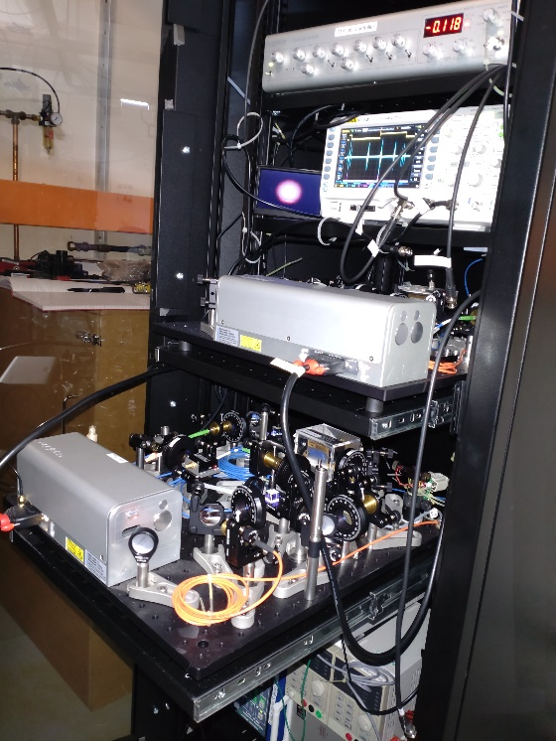
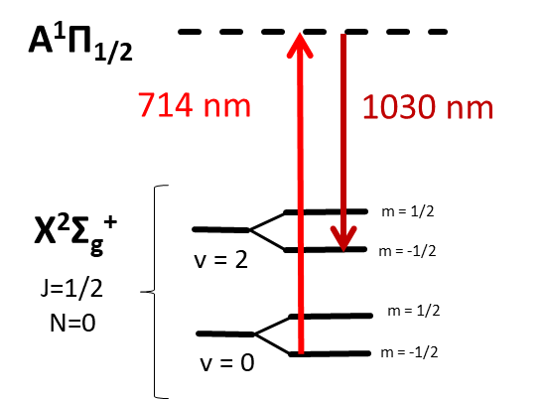
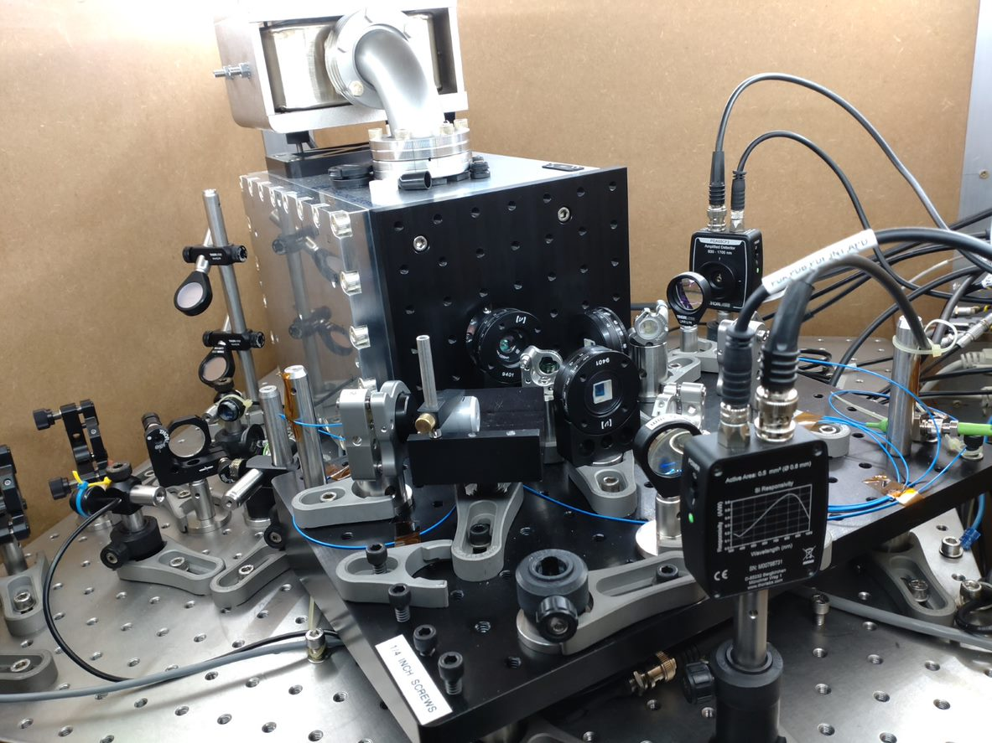
Raman laser systems built and locked
Two diode lasers locked to a single ULE glass cavity via Pound-Drever-Hall lock
Optical frequency comb to be used for laser frequency measurement
EOMs temperature stabilised to reduce residual amplitude modulation
Rack-mounted Raman lasers
Optical cavity setup
Notes:
Moving on to the next stage in our experiment, we have also set up the lasers which will be used for the clock transition
These lasers are locked to a dual-coated ULE cavity via a PDH lock which you can see in the picture and the EOMs used for the lock are temperature stabilised to reduce amplitude modulation
The lasers and their electronics are mounted in a standard rack, next to the new frequency comb which will be used for frequency measurement

Slide 12
Towards quantum logic spectroscopy

Slide 13
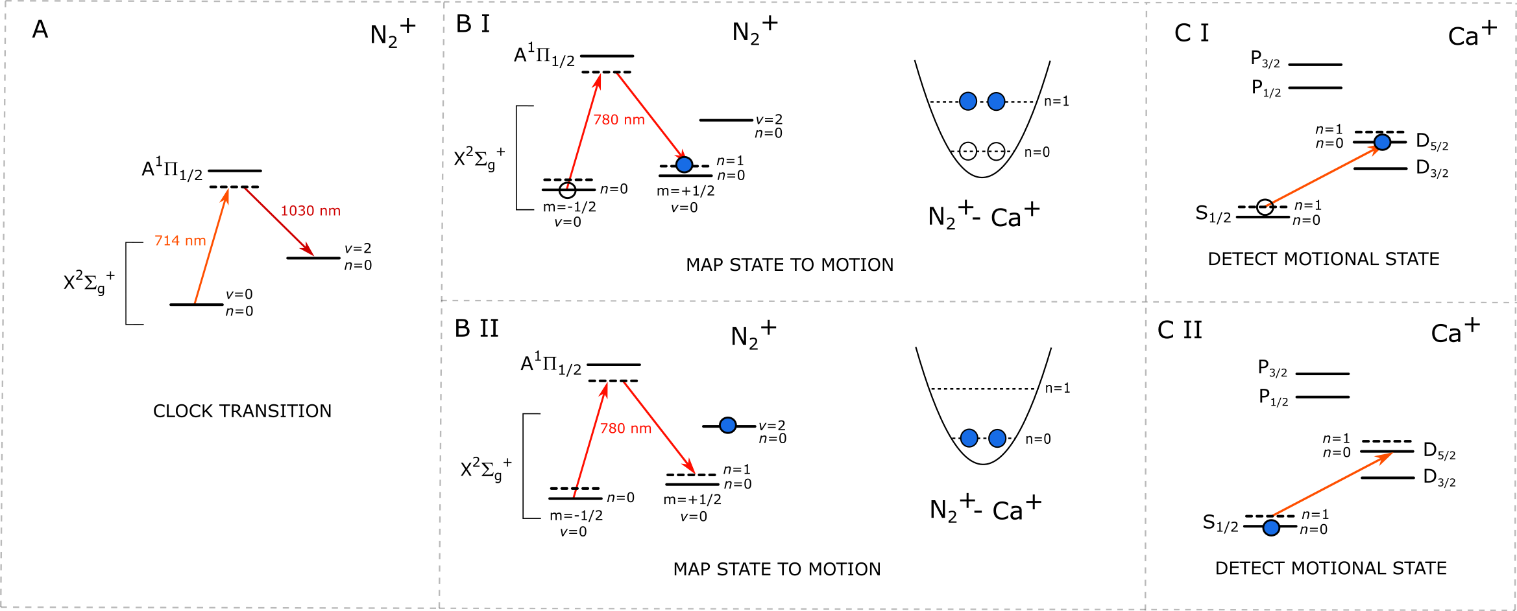
Proposed quantum logic scheme
The proposed quantum logic scheme for nitrogen state detection:
Notes:
The final stage of the process will be to read out the state of the nitrogen
To do that we will use quantum logic spectroscopy. The proposed scheme is here
First we cool the two ion crystal to the ground state, then we attempt the Raman transition from the v=0 to v=2 states
Then, we plan to use another Raman transition between Zeeman sublevels of the initial state to map the state of the nitrogen onto the shared motion of the crystal by using a frequency difference between the two 780 beams of the Zeeman splitting plus the motional frequency
Finally, we will drive a transition in the calcium from the S to D state on a red sideband which is only possible if there is motional excitation so we can distinguish between the dark and light ion

Slide 14
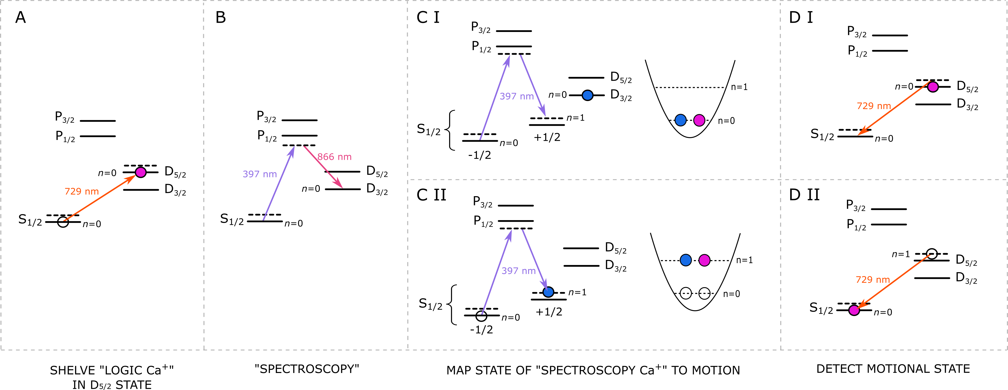
Quantum logic spectroscopy test
We are testing quantum logic with two calcium ions:
= one light ion
= two light ions
Notes:
We are now moving on to testing out the principle of the quantum logic spectroscopy – using two calcium ions, one to play the role of the spectroscopy ion (which would be nitrogen in real scheme) and one to play the role of the logic ion (which is calcium in the real scheme)
We are currently setting up to test this out

Slide 15
See Amber’s poster about the Ti:sapph lasers we have built for ionisation!
PI:
Matthias Keller
Research Fellows:
Xavier Fernandez Gonzalvo
Sam Snowden
Natasha Bierrum
Graham Stutter
Laura Blackburn
Amy Gardner
Scott Thomas
Markus Vogt
PhD Students:
Amber Shepherd
Ian Ford
Maoling Chu
Adrien Amour

Slide 16
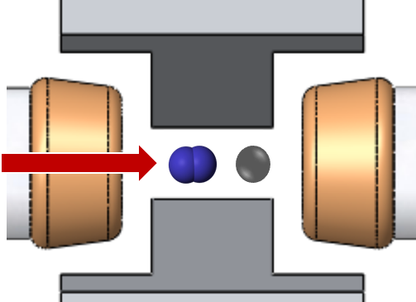
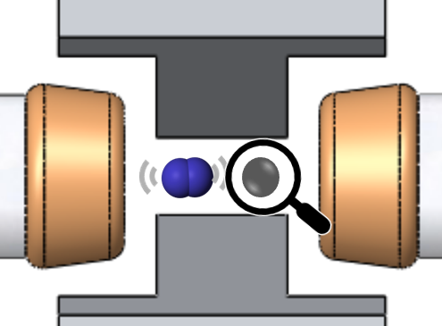
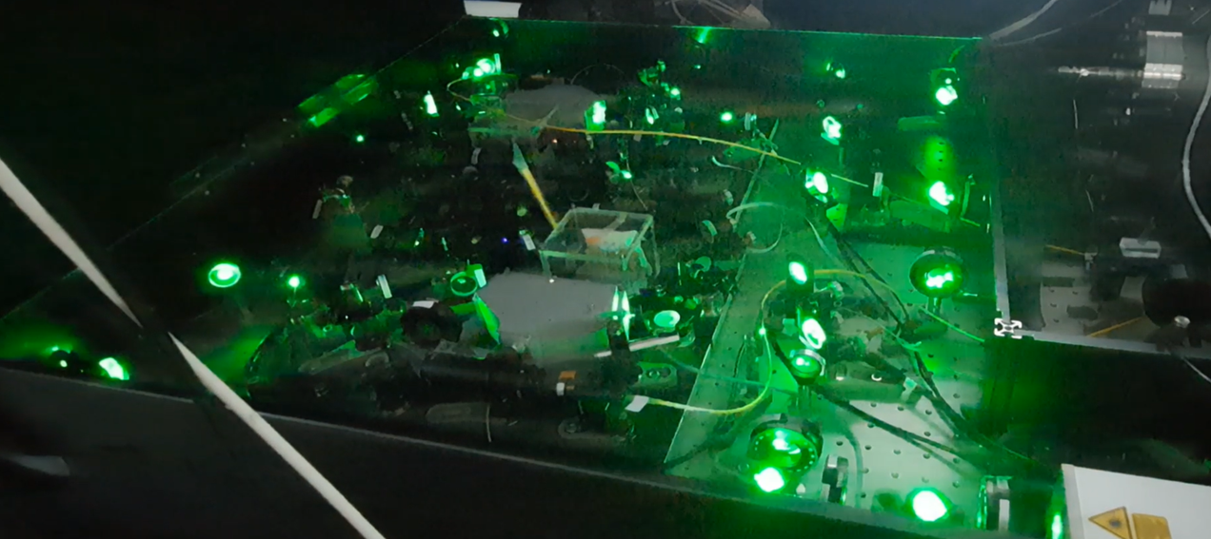
Summary
State-selective loading of nitrogen ions
Raman spectroscopy of clock transition
Quantum logic detection scheme
Set-up spectroscopy lasers (locked to ULE cavity)
Sideband cooled calcium and are preparing to test quantum logic spectroscopy
Built lasers and developed techniques for N₂ ionisation

