Slide 1

Hydrogen Lattice Clock and Bounds on Physics Beyond the Standard Model
D. Carty, M. P. A. Jones, A. Nicolson, R. M. Potvliege, J. P. Scott, M. Spannowsky
Notes:
I’m here to talk to you about some theory work that’s been going on in the last few years in Durham on the use of precision spectroscopy of hydrogen atoms to look for new physics.
This work is a collaboration between Matt Jones, Robert Potvliege, Michael Spannowsky and myself and we have been working with a couple of very able students Joseph Scott and Adair Nicolson.

Slide 2
Talk Outline
Search for new physics – a fifth force – using hydrogen and deuterium atom spectroscopy.
New physics bounds based on current world H and D atom spectroscopic data.
Make a case for the need for new experiments with improved uncertainties.
Potential hydrogen optical lattice clock – some pros and cons.
Outlook.
Notes:
I’ll give a brief introduction to the use of precision spectroscopy in hydrogen to search for a so-called fifth force.
I’ll then talk about the results of global fit analysis that we did on the world hydrogen and deuterium spectroscopic data to put bounds on the possibility of new physics.
Then I’ll make a case for the need for new and improved hydrogen precision spectroscopy experiments and introduce the properties a potential hydrogen optical lattice clock might have.

Slide 3
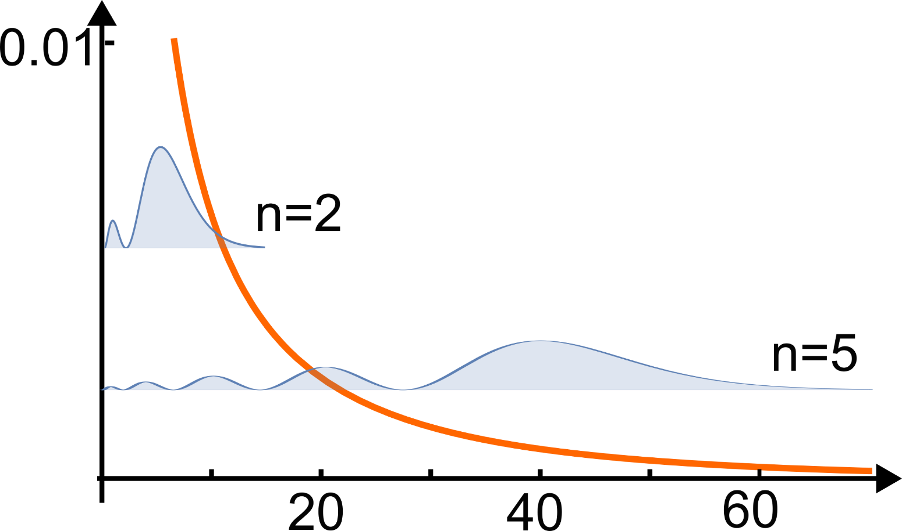
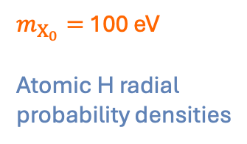
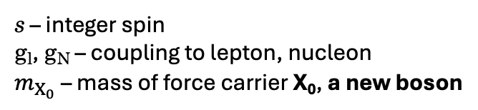
[1] Safranova et al., Rev. Mod. Phys., 90, 025008 (2018).
Searching for New Physics
Deviations between spectroscopic measurements and standard model (SM) predictions may imply existence of a “fifth force” – new physics (NP) [1].
Yukawa potential gives an n, l – dependent shift of atomic energy levels.
$m_{X_{0}}=$ 100 eV
Atomic H radial probability densities
s – integer spin
g_{l}, g_{N} – coupling to lepton, nucleon
$m_{X_{0}}$– mass of force carrier X₀, a new boson
Notes:
Looking for deviations between precise spectroscopic measurements and their standard model predictions is a powerful way to set constraints on new physics.
Some extensions to the Standard Model require the existence of a fifth force. This scenario can be described by a Yukawa potential that depends on the resulting force acting on leptons, such as the electron and the muon, and on protons and neutrons.
The Yukawa potential depends on the mass of the carrier of the new force, which would be a new boson, in a way that sets the length scale of the force.
In the example shown here, the Yukawa potential for a boson mass of 100 eV is plotted, and you can see that the ranges of the potential and the radial probability densities of nS states of hydrogen are comparable.
The result is an n-dependent shift of atomic energy levels. There is actually an l-dependence as well.

Slide 4
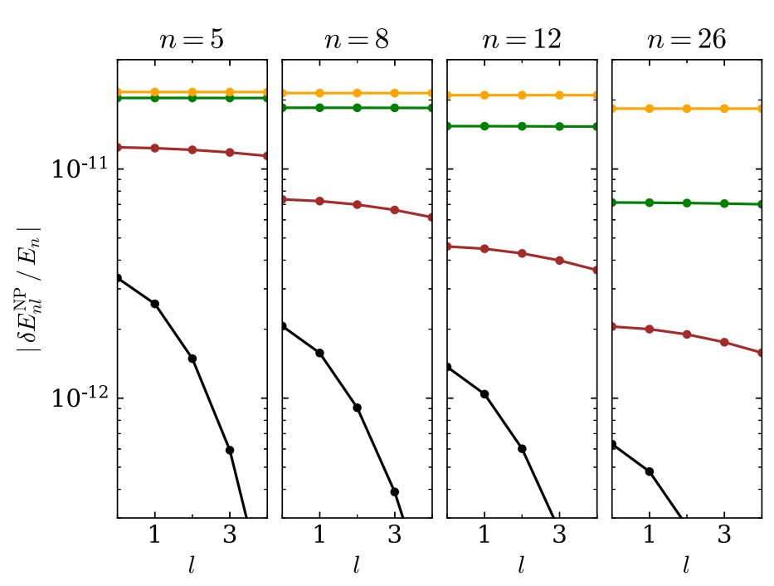



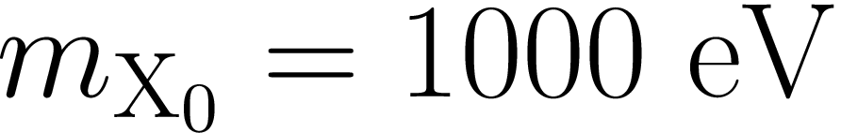
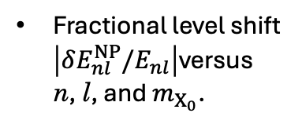
[2] Jones et al., Phys. Rev. Res., 2, 013244 (2020)
Searching for New Physics
Fractional level shift $\left|δE_{nl}^{NP}/E_{nl}\right|$versus n, l, and $m_{X_{0}}$.
Using transitions involving different n and l states probes “range” of force as well as size.
More reliable bounds.
Notes:
This figure shows the general trends.
The fractional shift is largest for light bosons, where the range of the Yukawa potential is comparable to or larger than the range of the atomic wave function.
As the new boson mass increases, the fractional shift decreases, but in a way that depends on the shape of the atomic wave function through both n and l.
The effect of the Yukawa potential is largest at the origin.
As n and l increase, the probability density of the atomic wave function in the region close to the nucleus is reduced, leading to a smaller NP shift.
Combining measurements for different values of n and l could provide additional information on the properties of the fifth-force carrier, i.e., its mass and its couplings to the electron and nuclei.

Slide 5
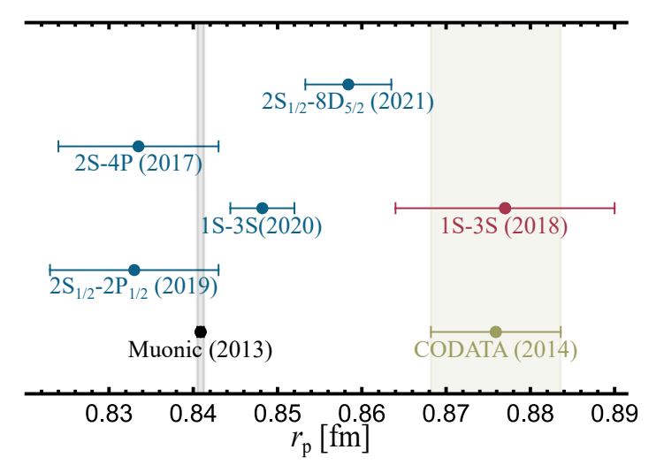
Global NP Bounds in Hydrogen and Deuterium
Direct comparison to SM theory.
Global fit comparing all experimental transition frequencies in H and D to SM theoretical (th) values.
[3] Solaro et al., Phys. Rev. Lett., 125, 123003 (2020)
Rydberg constant
proton charge radius
deuteron charge radius
coupling constants
deuteron/proton coupling ratio
mass of force carrier
Free parameters
Notes:
Now, over the years there have been very many precision measurements on measuring the frequency of hydrogen and deuterium transitions, including to Rydberg states.
Typically, but not always, the 2S state is the spectroscopic ground state, which means that the frequency of the 1S to 2S transition frequency must be known to the same uncertainty or better in advance.
My colleagues, Jones, Potvliege, and Spannowsky, have made a global fit of all existing experimental transition frequencies in H alone, D alone, and H and D together, to standard-model theoretical frequencies with an added theoretical new physics frequency.
The free parameters in the global fit are listed here.

Slide 6
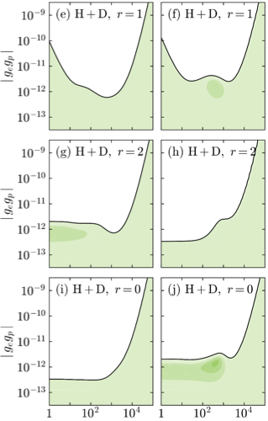
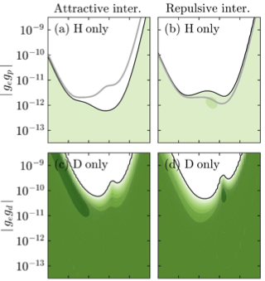
Global NP Bounds in Hydrogen and Deuterium
NP bounds based on current world data for H and D.
White areas – NP interaction excluded with 95% confidence.
Green areas – extent world data compatible with an NP interaction.
[4] Potvliege et al., Phys. Rev. A, 108, 052825 (2023)
Notes:
This enables the calculation of coupling constants over a range of new boson masses under the assumption that the new physics interaction is attractive or repulsive.
This allows the setting of upper bounds above which the strength of the interaction can be excluded with good confidence.
Notice how the combination of hydrogen and deuterium data results in a large reduction in the upper bounds, not so much when the deuteron-to-proton coupling ratio is one and the coupling constants are equal, but certainly when they are not equal, especially for masses in the range 1 eV to 1 keV.

Slide 7
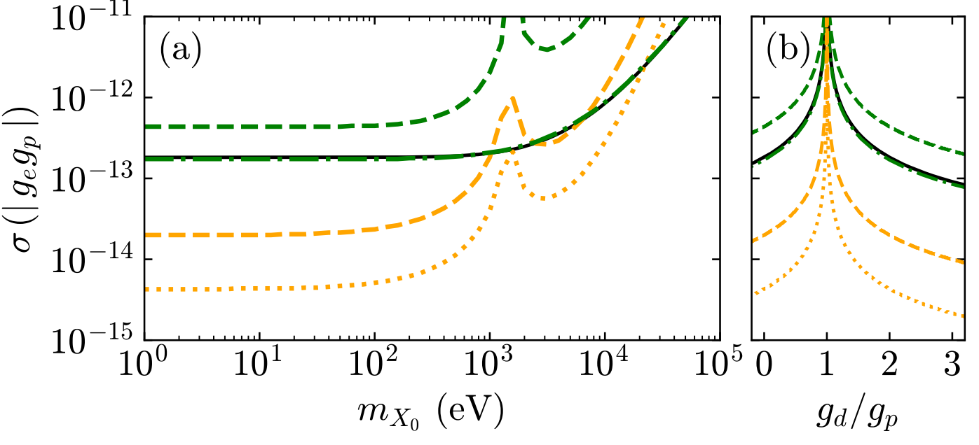
[5] Parthey et al., Phys. Rev. Lett., 107, 203001 (2011)
Need for Better Data
“Proton radius puzzle” due to inconsistencies in H dataset.
Single 1S – 2S datapoint [5] plays a key role.
Precise measurements of transitions to Rydberg states are also important [4].
1S-3S @ 1 kHz
Uncertainty in beam experiments [5] dominated by second-order Doppler (SOD) shift ➞ velocity-dependent, asymmetric lineshape.
1S-2S current (+3S)
1S-2S + 2S-20S @1 kHz
1S-2S + 2S-20S @100 Hz
Notes:
The level at which the bounds appear is limited by inconsistencies in the world dataset for hydrogen and for deuterium.
Here are the results of some relatively recent measurements conducted in H-atom-beam experiments.
Measured frequencies have been expressed in terms of the proton charge radius by fixing the value of the Rydberg constant.
As you can see, there is very little consistency, even between measurements of the same transition – as exemplified by the two 1S to 3S measurements.
A very precise measurement (at 10^–15 relative uncertainty) of the 1S to 2S transition frequency in an H-atom beam experiment by the group of Thomas Udem plays a central role.
It is used to fix the value of the Rydberg constant, and it is used in all measurements where the 2S state is the spectroscopic ground state.
Precise measurements of transitions to Ryberg states are also important.
This figure shows how the sensitivity of the method of combining H and D data varies with new boson mass.
The method is orders of magnitude more sensitive for a given coupling constant when transition frequencies to Rydberg states such as 20S are included and when those measurements are more precise.
H and D-atom measurements have overwhelmingly been done in beam experiments.
However, these experiments have reached, or are approaching, a limit in precision.
With this in mind, we wanted to explore the same pathway taken in the development of atomic clocks, which was to move from beams to atoms trapped in magic wavelength optical lattices to increase precision.

Slide 8
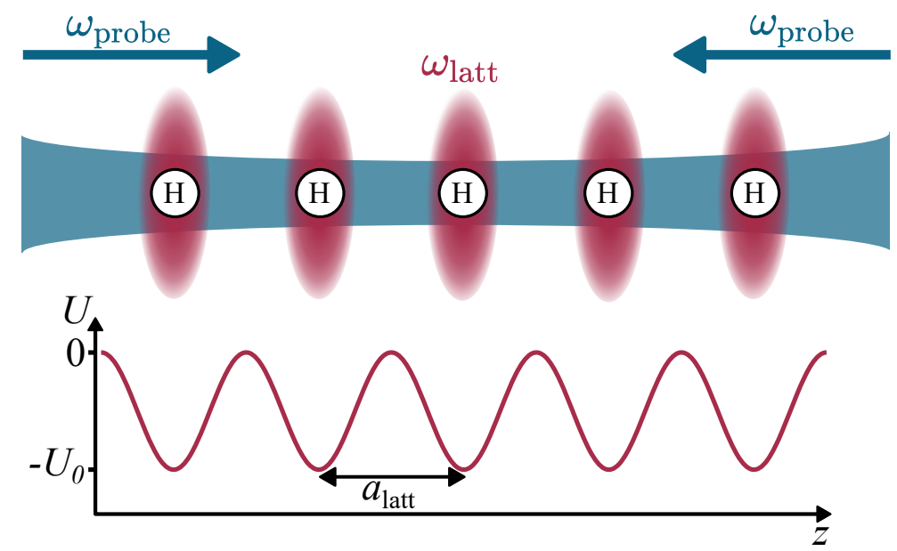
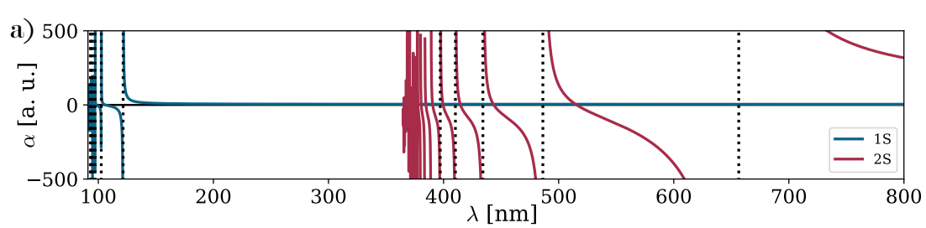
[6] Scott et al., Metrologia, 61, 025001 (2024)
A Hydrogen Optical Lattice Clock (OLC)?
State-of-the-art ➞ cold atoms in magic-wavelength optical lattices, e.g., Sr OLC.
Two-photon 1S – 2S and 2S – nS transitions.
Calculated polarisabilities of 1S and 2S states using implicit summation method that included continuum (ca. 10%) [4]. Magic wavelengths for 1S – 2S transition where curves cross.
1S – 2P etc.
2S – 5P etc.
2S – 3P
2S – 4P
Low 1S polarizability means high lattice laser power is required.
Notes:
Here is the basic hydrogen optical lattice clock concept.
Hydrogen or deuterium atoms would be cooled to ultracold temperatures by some unspecified method, and loaded, by another unspecified method, into a one-dimensional, magic-wavelength optical lattice.
The 1S to 2S transition would then be probed with 243 nm laser light in an optical cavity.
The first thing is to determine the magic wavelengths, which we did by calculating the polarisabilities of the 1S and 2S states as a function of lattice wavelength using an implicit summation method that included the continuum and enough bound states to make the calculations converge.
Magic wavelengths occur where the 1S and 2S polarisabilities are equal.
As expected, the polarizability of the 1S state is about 4 atomic units.
This is 70 times smaller than polarizability of the ground state of strontium at its magic wavelength.
Such low 1S state polarizability means that high lattice laser power is required.

Slide 9
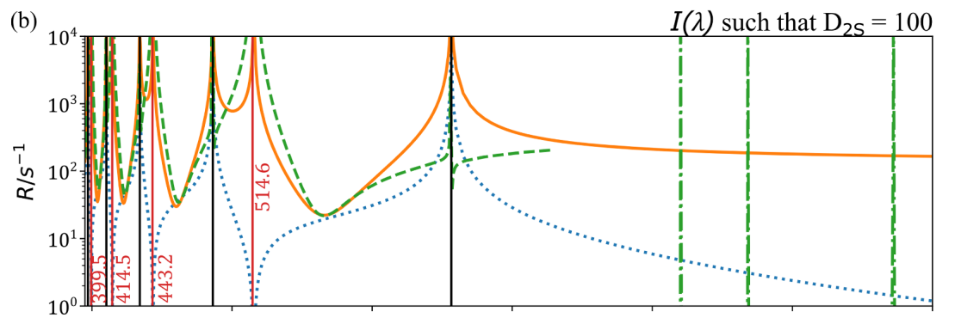
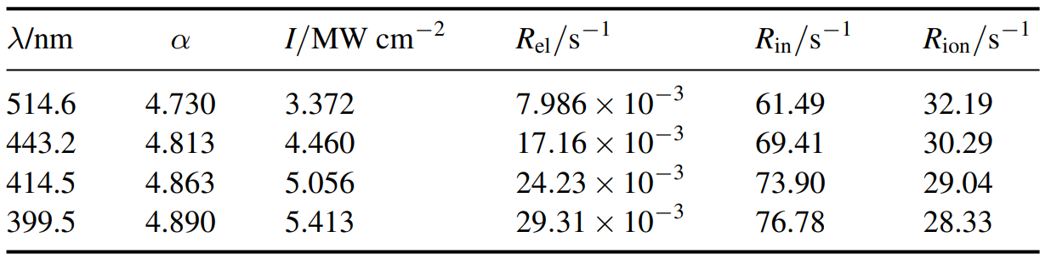
[6] Scott et al., Metrologia, 61, 025001 (2024)
Effect of Scattering and Ionisation from Lattice
Calculated scattering and ionisation rates [4].
Elastic
2ph ion.
Inelastic
3ph ion.
2S state lifetime severely reduced by ionisation.
1S – 2S line broadened from 1.3 Hz to 50 kHz at 100E_{rec}.
Cryogenic H beam ➞ 2 kHz [5].
Magic wavelengths
Intensity for a depth (D) of one recoil (E_{rec}).
[5] Parthey et al., Phys. Rev. Lett., 107, 203001 (2011)
Notes:
The need for such high laser intensity means that one must consider the consequences of scattering and ionisation for the measurement of the 1S to 2S transition frequency.
Here you can see the elastic, inelastic, and two and three-photon ionisation rates that we have calculated.
Now there is quite a lot in this figure, but hopefully it is clear that inelastic scattering rates out of the 2S state and two-photon ionisation rates are large.
This has the effect of severely reducing the 2S state lifetime from 125 ms down to 100 us, typically, and broadening the linewidth from about a Hertz to 50 kHz at lattice depths of 100 recoil energies.
Two-photon ionisation becomes the majority loss source at lattice depths of only 2 recoil energies because it scales quadratically with intensity whereas inelastic scattering scales linearly.
Now, a 100-recoil lattice depth would be unnecessarily deep, it’s just an illustrative example, but the point is that the line is broadened to widths comparable to the state-of-the-art cryogenic hydrogen beam experiments of Thomas Udem’s group.

Slide 10
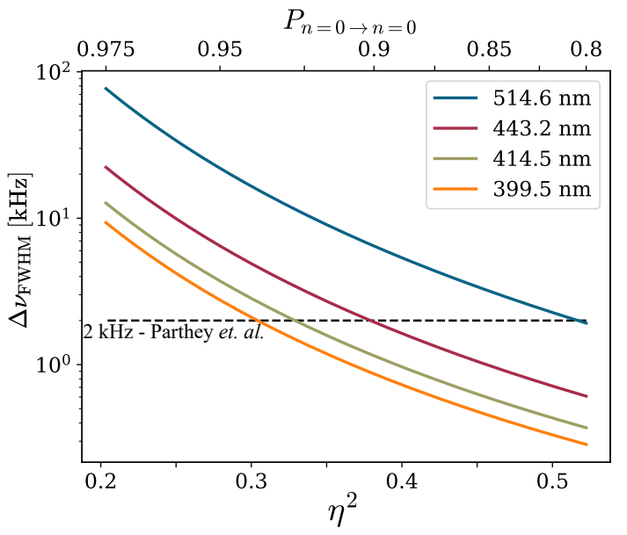
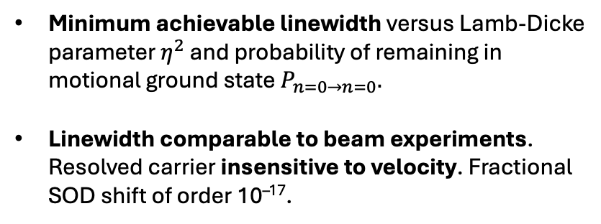
“Eliminating” Motional Systematics
Systematic uncertainties in state-of-the-art beam experiments [5] dominated by second-order Doppler (SOD) shift ➞ velocity-dependent, asymmetric lineshape.
Must operate H OLC in limit of resolved motional sidebands, i.e., Lamb-Dicke regime.
Minimum achievable linewidth versus Lamb-Dicke parameter $η^{2}$ and probability of remaining in motional ground state $P_{n=0→n=0}.$
Linewidth comparable to beam experiments. Resolved carrier insensitive to velocity. Fractional SOD shift of order 10^{–17}.
Notes:
What limits the line widths to of order kHz in the beam experiments is the second-order Doppler shift, which results in a velocity-dependent, asymmetric lineshape.
Trapping hydrogen atoms in an optical lattice clock would effectively eliminate a measurement’s sensitivity to atom velocity and thus the second-order Doppler shift.
To achieve this, one must operate in the so-called Lamb-Dicke regime.
This is where one sets the lattice depth such that the quantized motional states that the atoms can occupy in a trap are separated by an energy that is much larger the recoil energy from absorbing 243 nm photons.
This figure shows the calculated FWHM linewidth of the 1S to 2S transition as a function of probability of remaining in the motional ground state of the trap for lattices at each of the four possible magic wavelengths.
At 90% probability, the linewidths are comparable to beam experiments at lattice depths in the range of 10 to 30 recoils energies.

Slide 11
Conclusions
Global AMO bounds on NP are robust but currently limited by systematic uncertainty.
New precision experiments should aim for both H and D and measure Rydberg states.
Optical lattice offers similar linewidth to beams, but with greatly improved systematic uncertainty.
Tweezer array could be useful for shorter-lived nP and nS Rydberg states.

Slide 12
Outlook
Incorporate latest measurements on H Rydberg states [6,7].
Incorporate electric field and interaction effect for Rydberg state atoms in tweezer array – what is the effect on precision?
Approach extended to He³ and He⁴ [8].
Towards and experiment: cryogenic and evaporative cooling [9], or CaH molecular dissociation in lattice or tweezer array [10,11].
[6] Scheidegger et al., Phys. Rev. Lett., 132, 113001 (2024)
[7] Bullis et al., Phys. Rev. A, 110, 052807 (2024)
[8] Potvliege, arXiv:2412.16315v1 [physics.atom-ph] (2024)
[9] Fried et al., Phys. Rev. Lett., 81, 3811 (1998)
[10] Lane, Phys. Rev. A, 92, 022511 (2015)
[11] Vazquez-Carson et al., New. J. Phys., 24, 083005 (2022)

Slide 13



Acknowledgements
Funding
EPSRC responsive mode Grant No. EP/R035482/1.
EU Horizon 2020 research and innovation programme under the EMPIR Grant Agreement No. 17FUN03-USOQS.
Rodney and Frances Stubbs for providing a Stubbs Scholarship to J. P. Scott.
Other contributions
Martin Bauer, Cédric Delaunay, Stephen Hogan, Joerg Jaeckel, Savely Karshenboim, Natalie McAndrew-D’Souza, Suniyah Minhas, Krzysztof Pachucki, Yotam Soreq, Andrew Spiers, Thomas Udem and Dylan Yost.

