Slide 1







Quantum Enhanced Superfluid Technologies for Dark Matter and Cosmology, QUEST –DMC
Phase transitions in extreme matter – Cosmological phase transitions
Detection methodologies for sub-GeV dark matter
Linked experimentally through combining quantum sensors with ³He at ultralow temperatures and theoretically through beyond-standard model physics.
SQMS Quantum for Science (London 2024), https://indico.cern.ch/event/1379776/
Andrew Casey, QTFP Glasgow, 21-22/01/25

Slide 2
Quantum Enhanced Superfluid Technologies for Dark Matter and Cosmology, QUEST –DMC
A-B transition in superfluid ³He and cosmological phase transitions,
Mark Hindmarsh, J.A. Sauls, Kuang Zhang, S.Autti, Richard P. Haley, Petri J. Heikkinen, Stephan J. Huber, Lev V. Levitin, Asier Lopez-Eiguren, Adam J. Mayer, Kari Rummukainen, John Saunders, Dmitry Zmeev,
J Low Temp Phys 215, 495–524 (2024). https://doi.org/10.1007/s10909-024-03151-9
Nanofluidic platform for studying the first-order phase transitions in superfluid helium-3,
Petri J Heikkinen, Nathan Eng, Lev V Levitin, Xavier Rojas, Angadjit Singh, Samuli Autti, Richard P Haley, Mark Hindmarsh, Dmitry E Zmeev, Jeevak M Parpia, Andrew Casey, John Saunders,
J Low Temp Phys 215, 477–494 (2024). https://doi.org/10.1007/s10909-024-03146-6
QUEST-DMC superfluid ³He detector for sub-GeV dark matter,
S. Autti, A. Casey, N. Eng, N. Darvishi , P. Franchini, R. P. Haley, P. J. Heikkinen, A. Jennings, A. Kemp, E. Leason, L. V. Levitin, J. Monroe, J. March-Russel, M. T. Noble, J. R. Prance, X. Rojas, T. Salmon, J. Saunders, R. Smith, M. D. Thompson, V. Tsepelin, S. M. West, L. Whitehead, V. V. Zavjalov, D. E. Zmeev,
Eur. Phys. J. C 84, 248 (2024). https://doi.org/10.1140/epjc/s10052-024-12410-8
Andrew Casey, QTFP Glasgow, 21-22/01/25

Slide 3
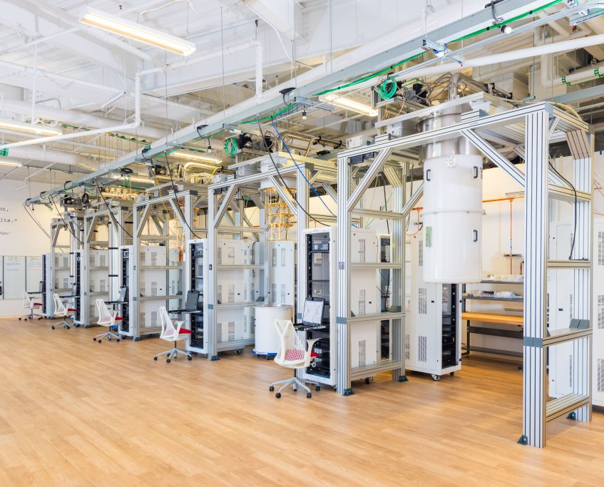
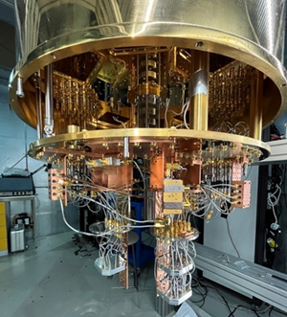
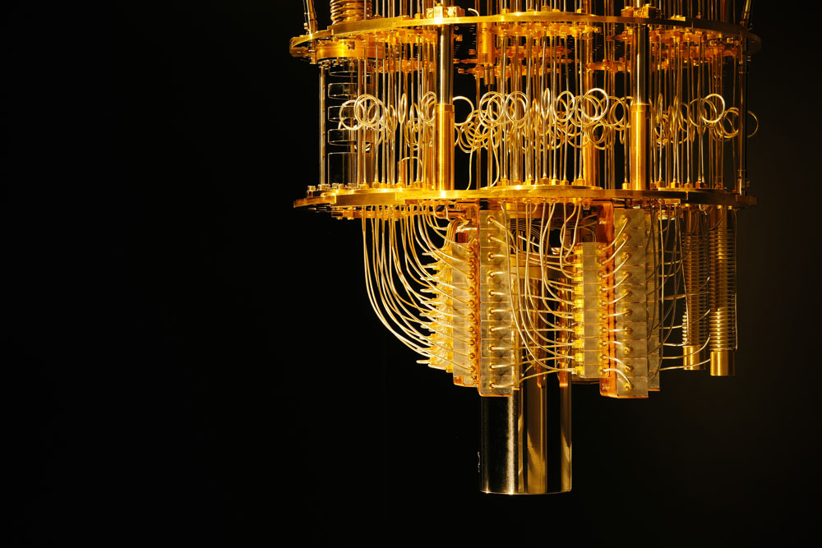

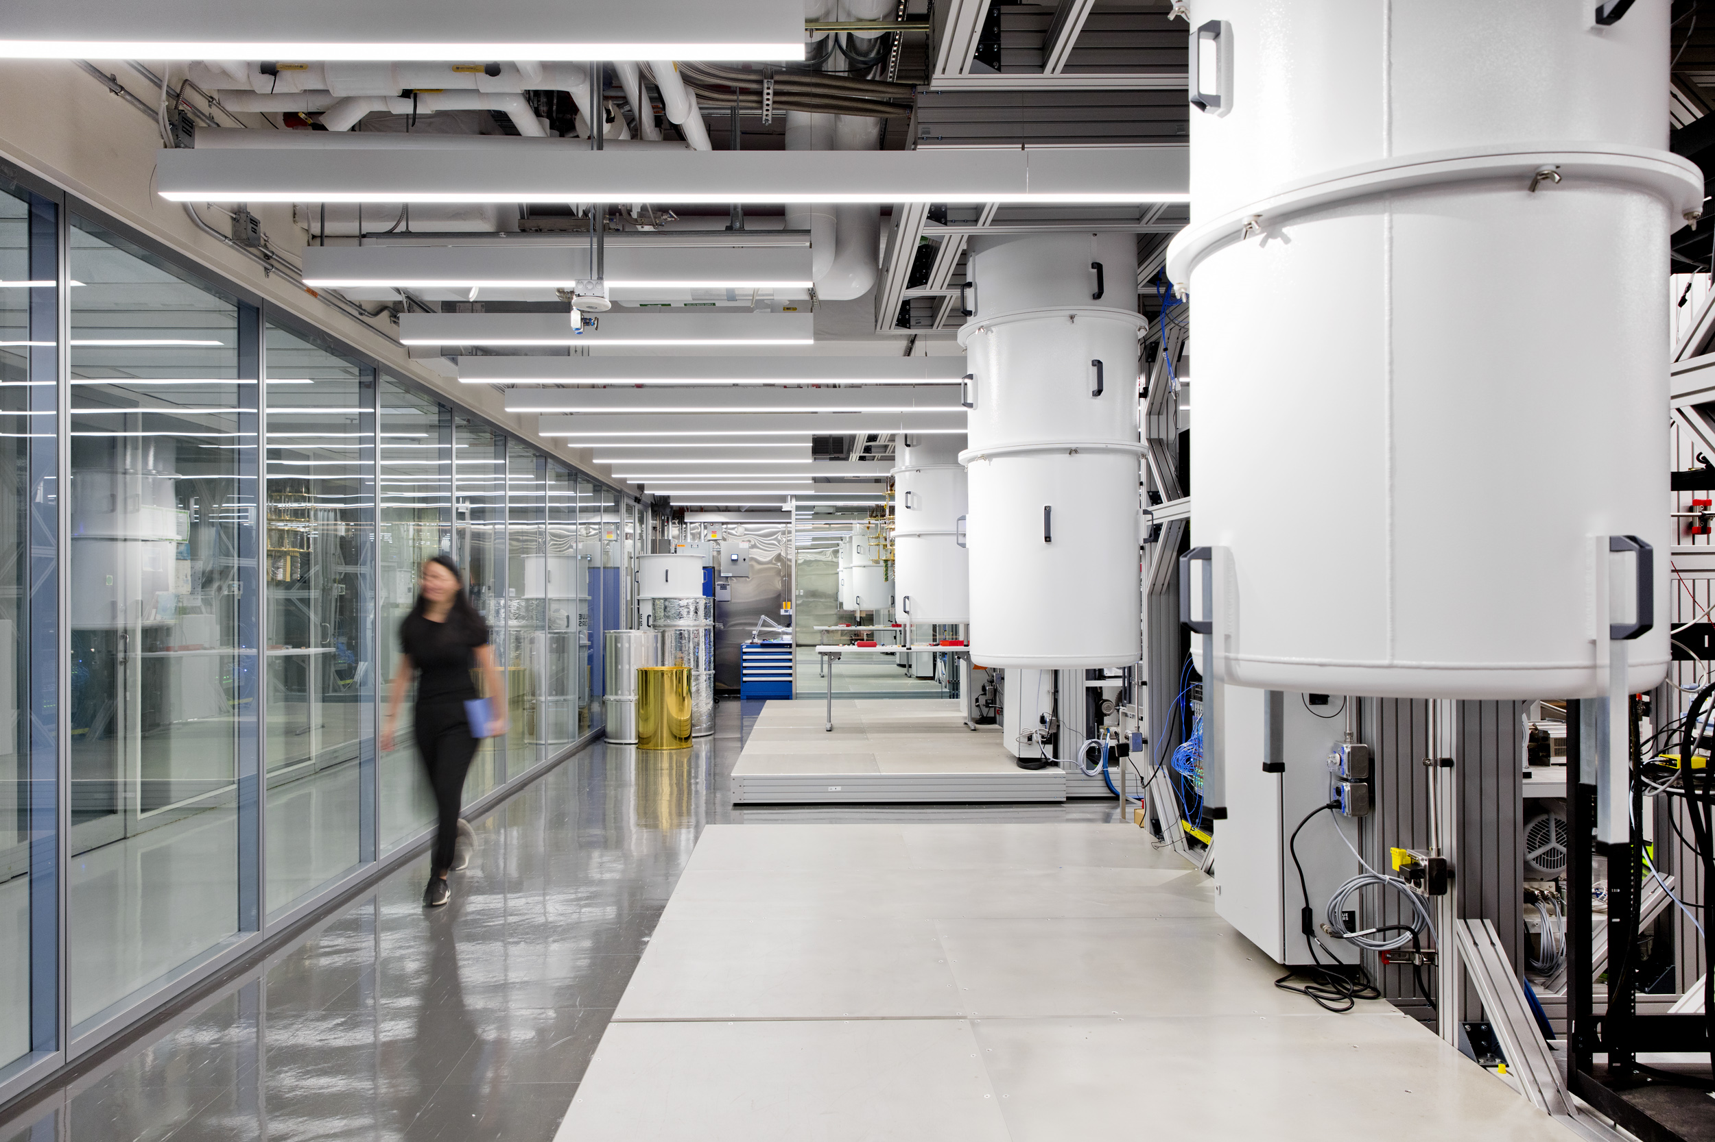

Dilution Refrigerator – 5 mK,
Workhorse of Quantum Technologies based on Superconductors
The Quantum Garage at the SQMS Center
https://sqmscenter.fnal.gov/facilities/enabling-labs-and-tools/
Andrew Casey, QTFP Glasgow, 21-22/01/25
Notes:
These challenges have come at a time when there is an explosion of new quantum enhanced technologies. We are ideally positioned to implement the current generation of quantum sensors, in a new ultralow temperature regime using existing ULT platforms at RHUL and Lanc,.
And through our nanofabrication facilities ( Superfab in the UK Centre for Superconducting and Hybrid Quantum Systems at RHUL and the Quantum Technology Centre in Lancaster) and QT partners we are able to co-design hybrid quantum sensors explicitly to tackle these fundamental physics questions.

Slide 4
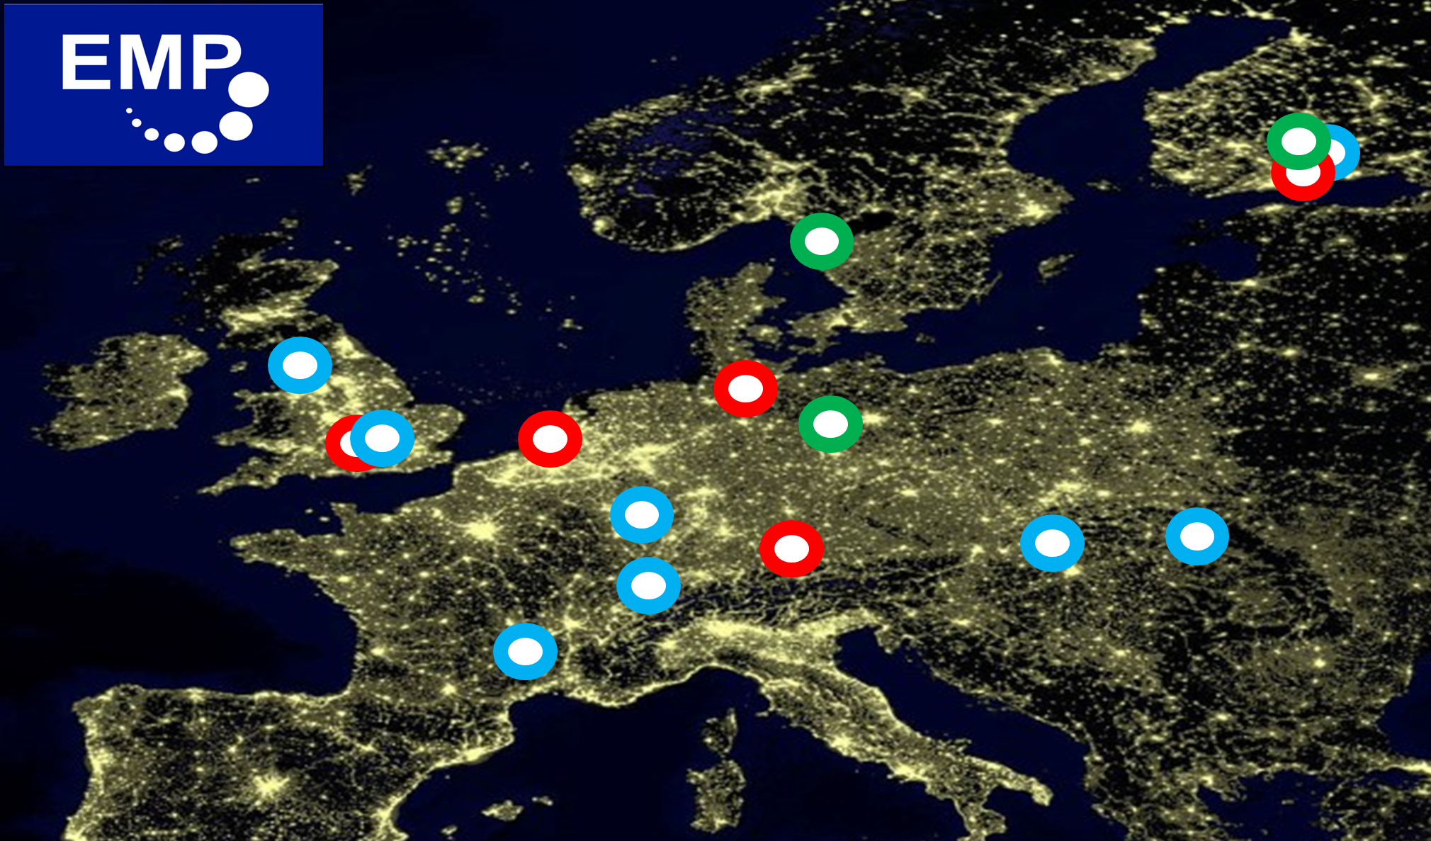





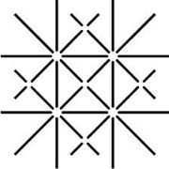


European Microkelvin Platform, network of ULT laboratories
http://emplatform.eu/
Andrew Casey, QTFP Glasgow, 21-22/01/25
Notes:
These challenges have come at a time when there is an explosion of new quantum enhanced technologies. We are ideally positioned to implement the current generation of quantum sensors, in a new ultralow temperature regime using existing ULT platforms at RHUL and Lanc,.
And through our nanofabrication facilities ( Superfab in the UK Centre for Superconducting and Hybrid Quantum Systems at RHUL and the Quantum Technology Centre in Lancaster) and QT partners we are able to co-design hybrid quantum sensors explicitly to tackle these fundamental physics questions.

Slide 5
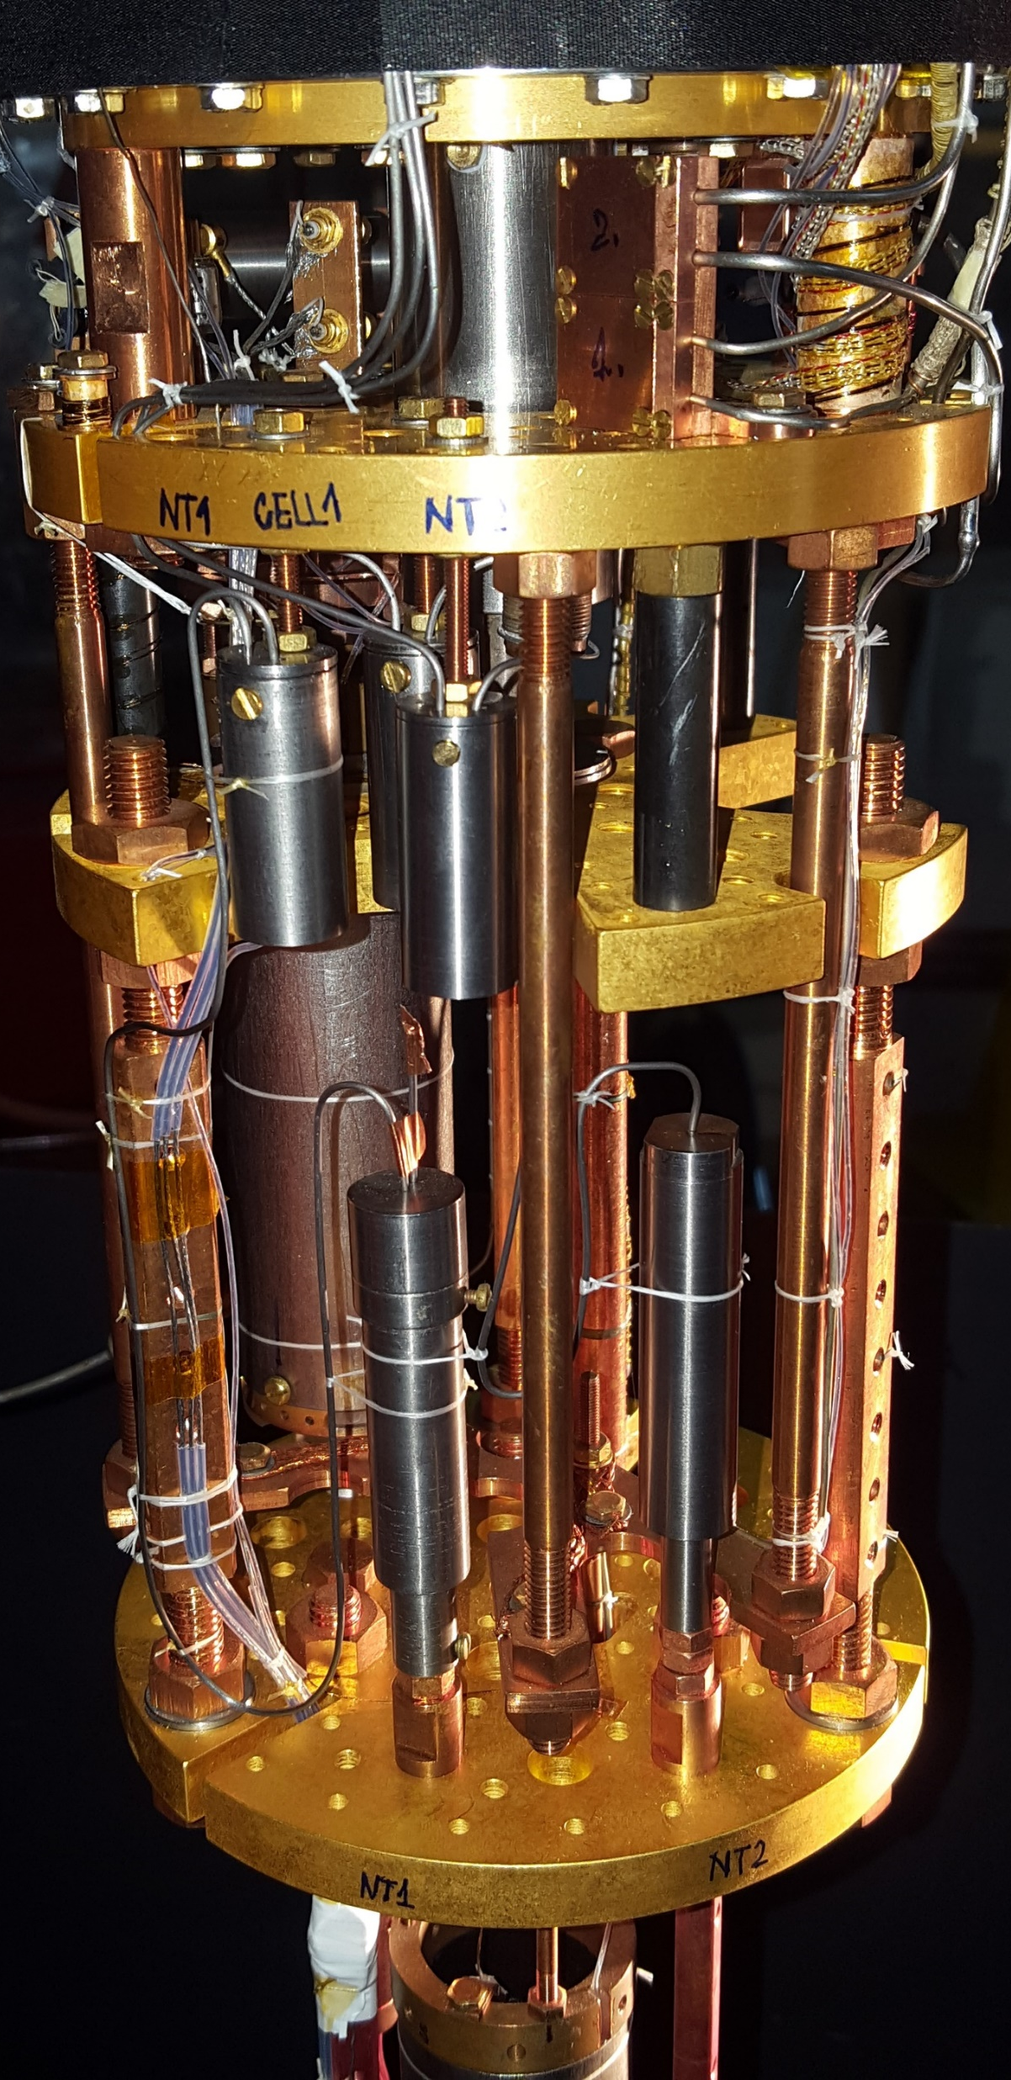
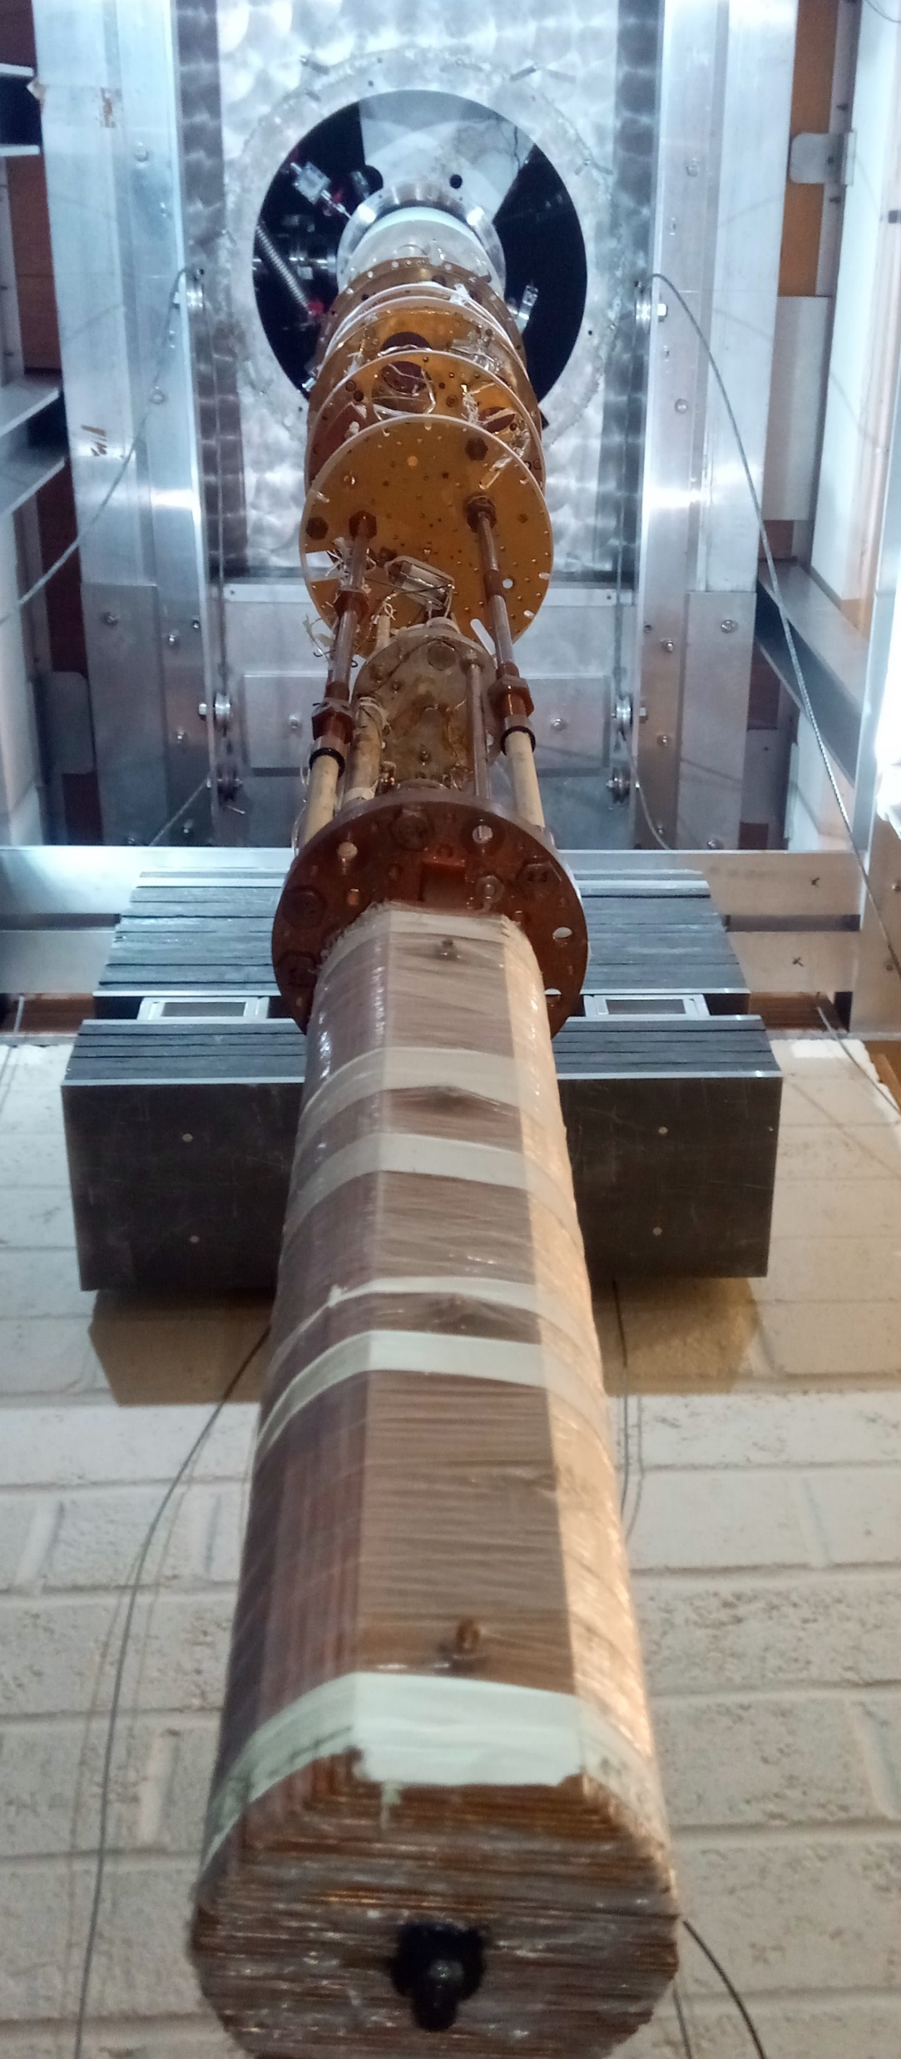
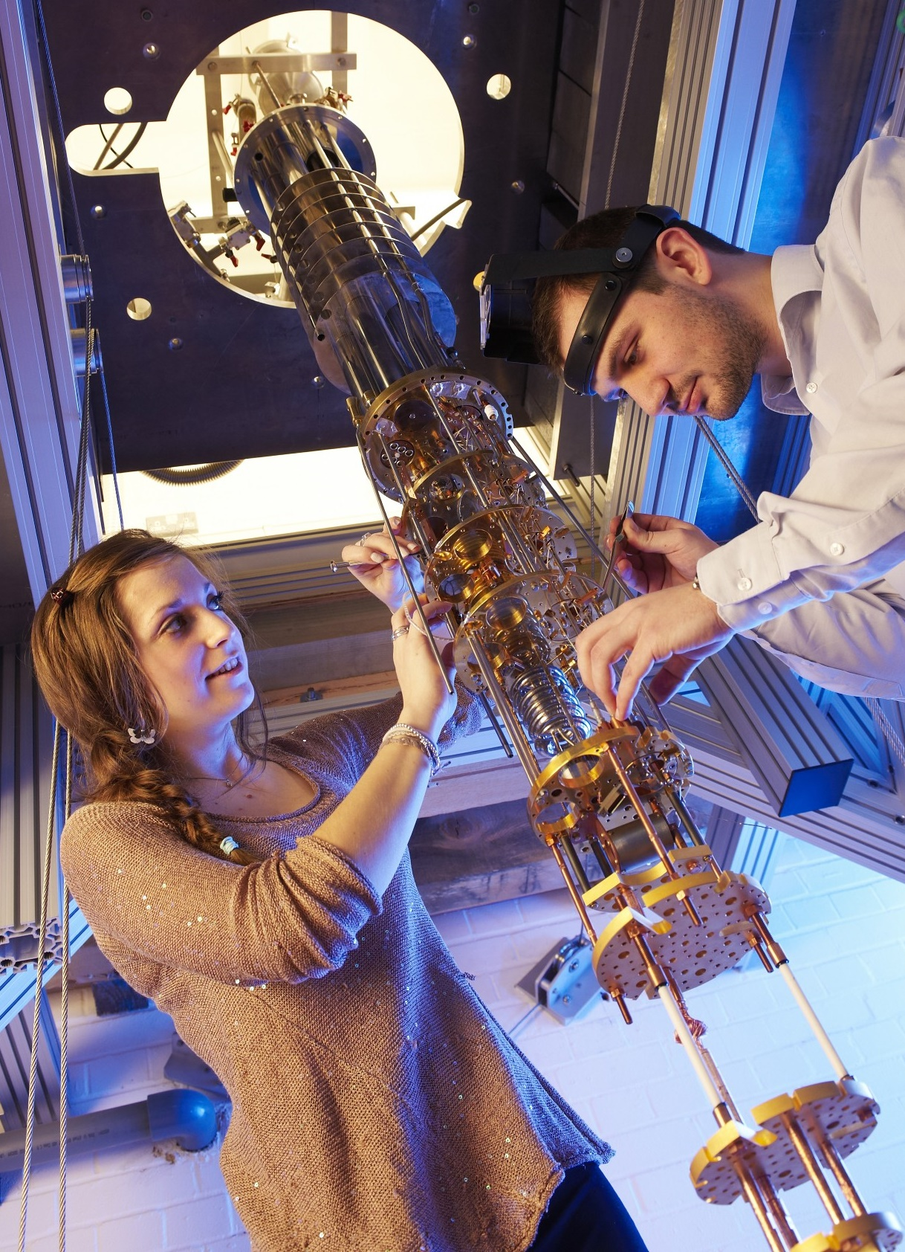
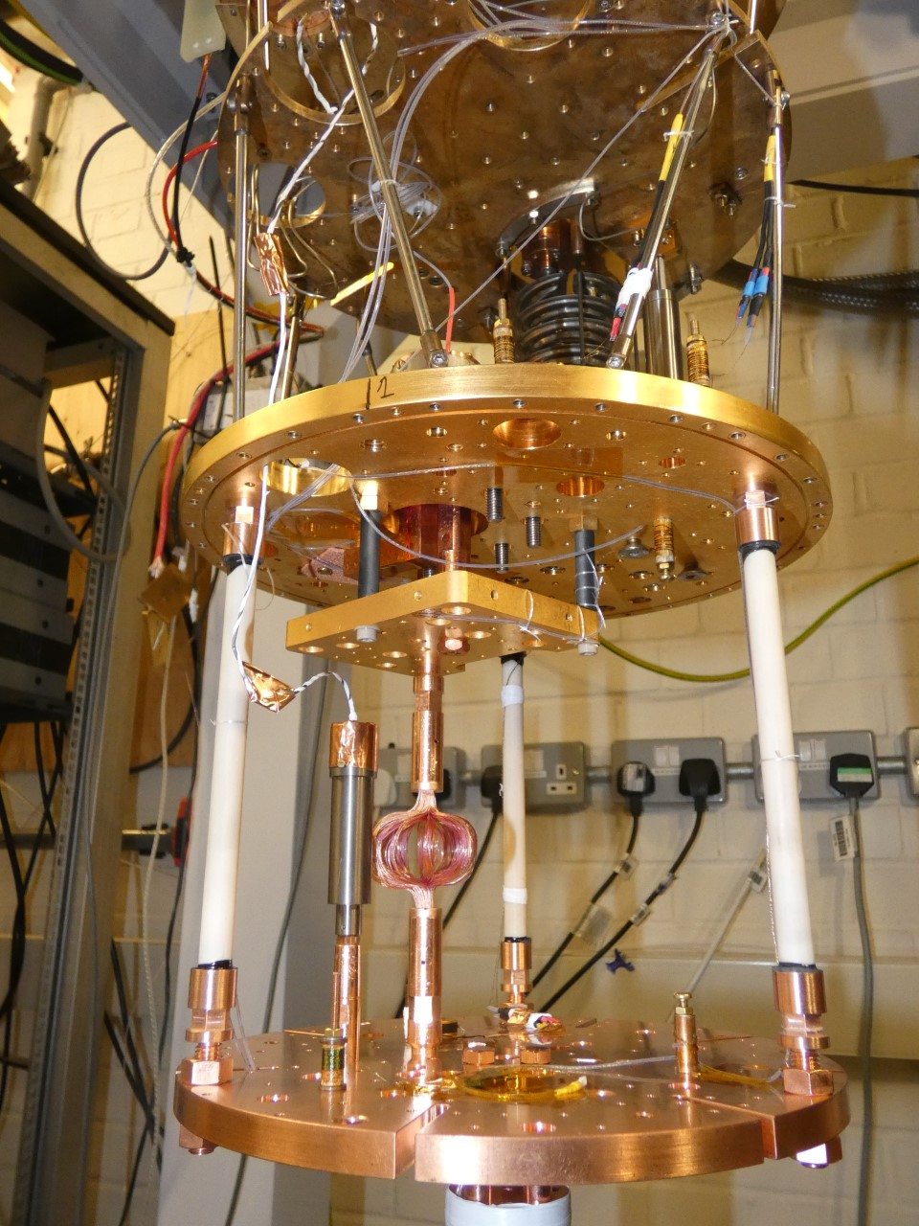

Royal Holloway, London Low Temperature Laboratory LLTL
ND1
ND2
ND3
ND4: Cryo-free
High performance cryogen-free microkelvin platform, J. Nyéki, M. Lucas, P. Knappová, L.V. Levitin, A. Casey, J. Saunders, H. van der Vliet, and A.J. Matthews, Phys. Rev. Applied 18, L041002 (2022)
Quantum bath suppression in a superconducting circuit by immersion cooling. Lucas, M., Danilov, A.V., Levitin, L.V. et al. Nat Commun 14, 3522 (2023)
Andrew Casey, QTFP Glasgow, 21-22/01/25
Notes:
These challenges have come at a time when there is an explosion of new quantum enhanced technologies. We are ideally positioned to implement the current generation of quantum sensors, in a new ultralow temperature regime using existing ULT platforms at RHUL and Lanc,.
And through our nanofabrication facilities ( Superfab in the UK Centre for Superconducting and Hybrid Quantum Systems at RHUL and the Quantum Technology Centre in Lancaster) and QT partners we are able to co-design hybrid quantum sensors explicitly to tackle these fundamental physics questions.

Slide 6

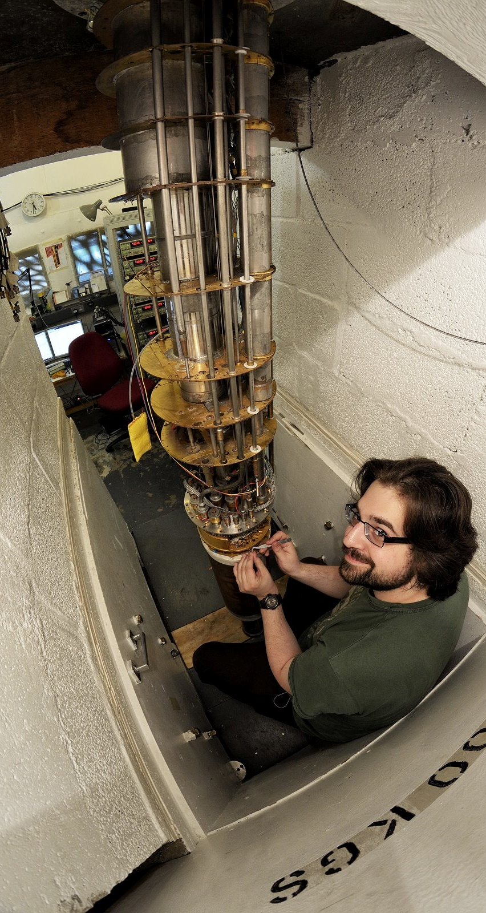
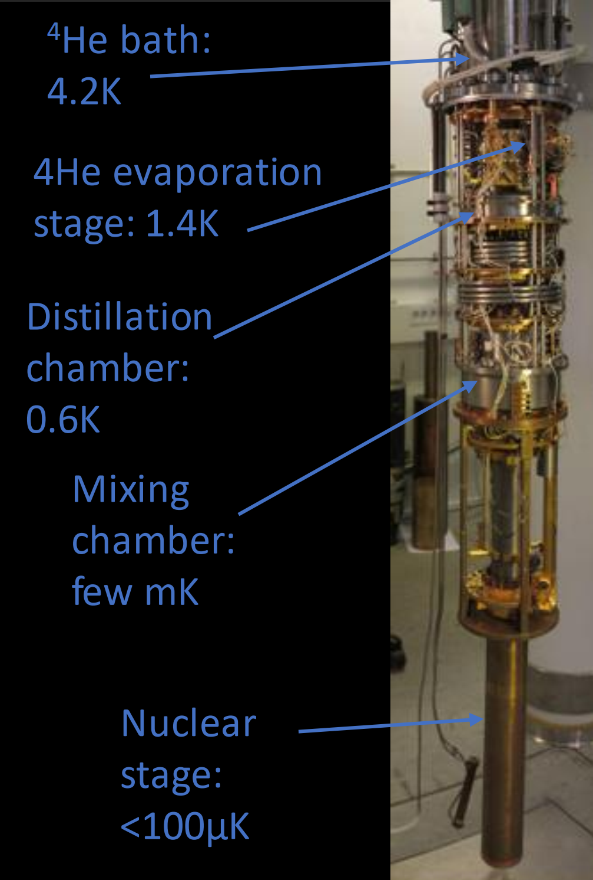
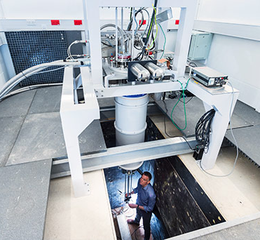
Lancaster Low Temperature Physics, Isolab
Andrew Casey, QTFP Glasgow, 21-22/01/25

Slide 7
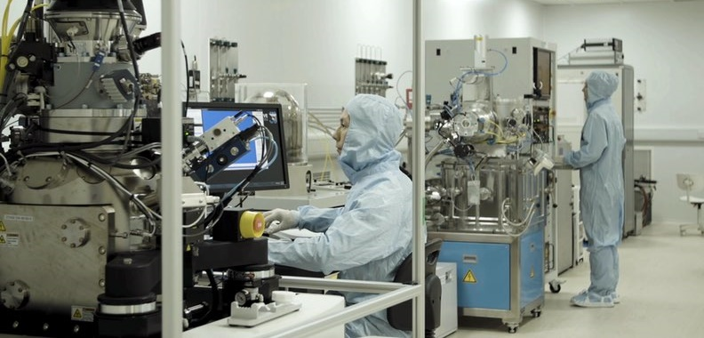
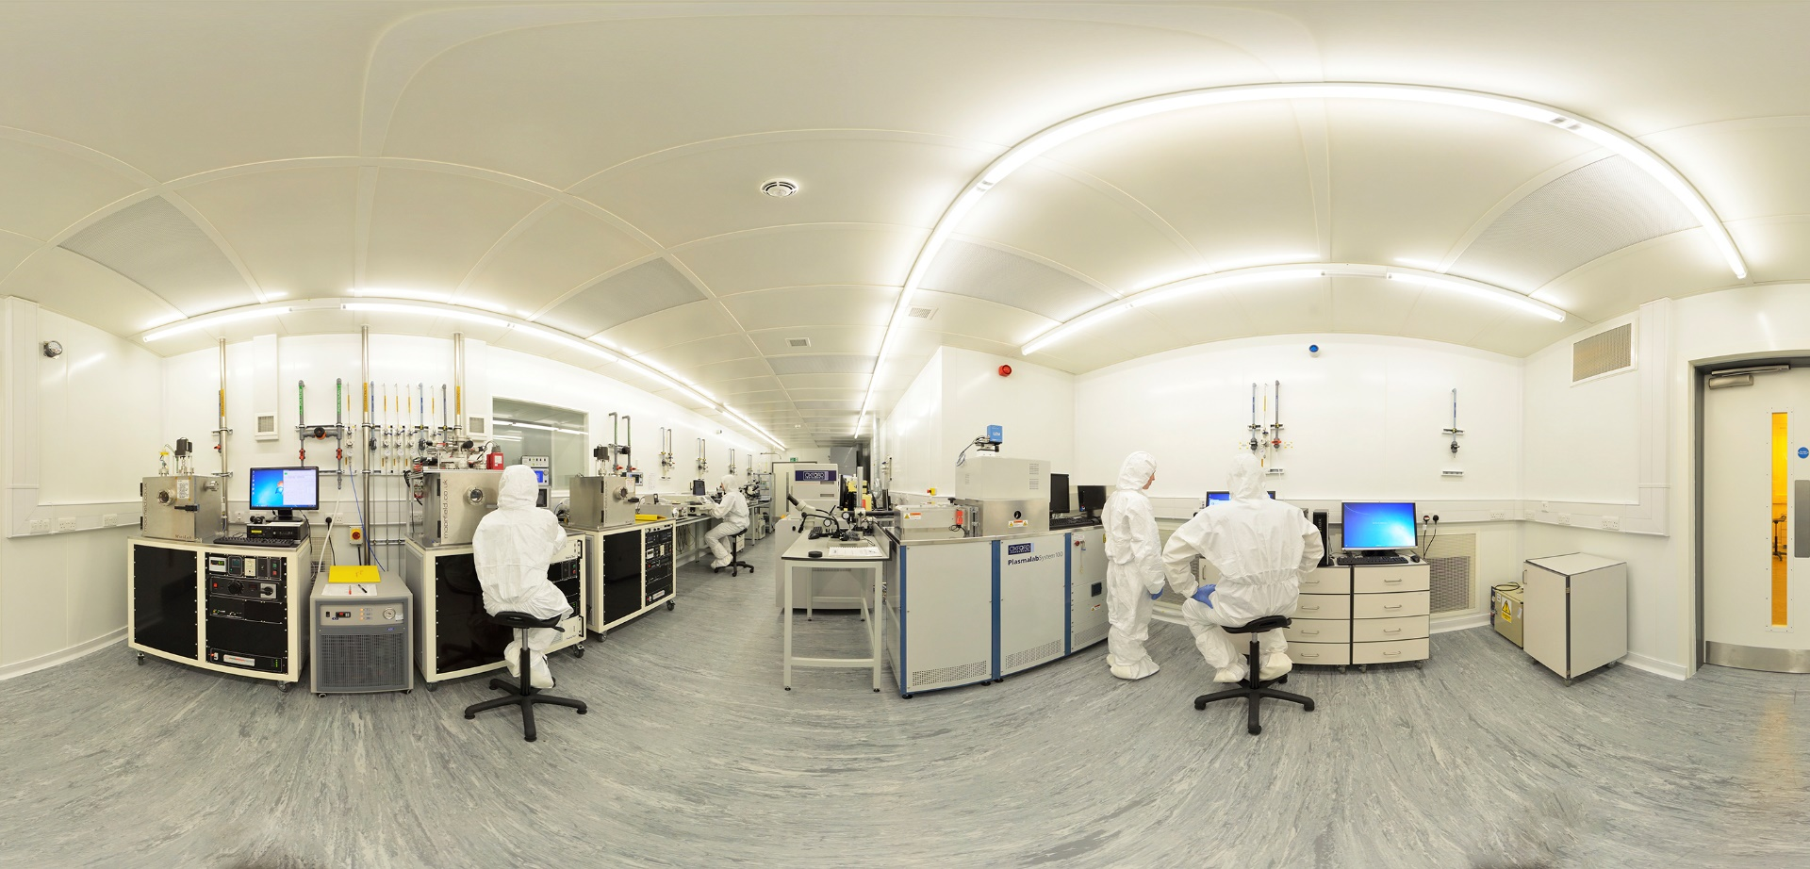
Nanofabrication Facilities
Quantum Technology Centre, ULANC
UK CSQS-Centre for Superconducting and Hybrid Quantum Systems, RHUL
Andrew Casey, QTFP Glasgow, 21-22/01/25

Slide 8



Nanofabrication Facilities
Nanofluidic cells, NEMs and SQUIDs.
Andrew Casey, QTFP Glasgow, 21-22/01/25

Slide 9
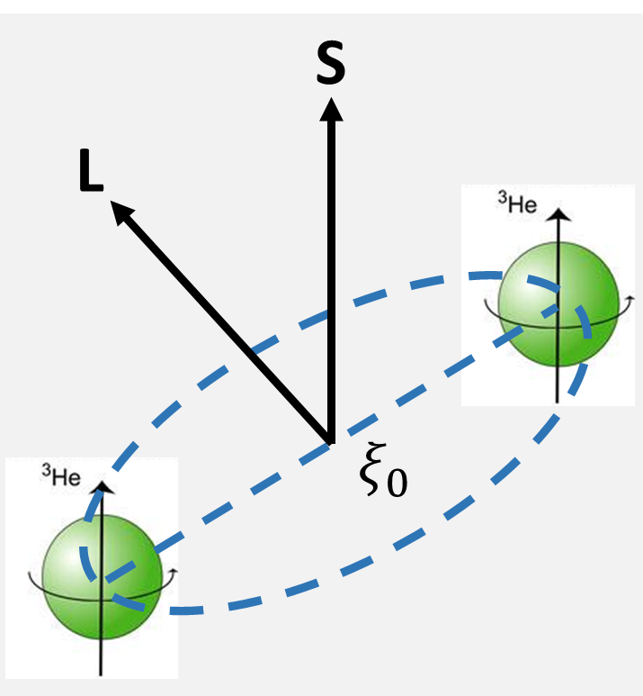
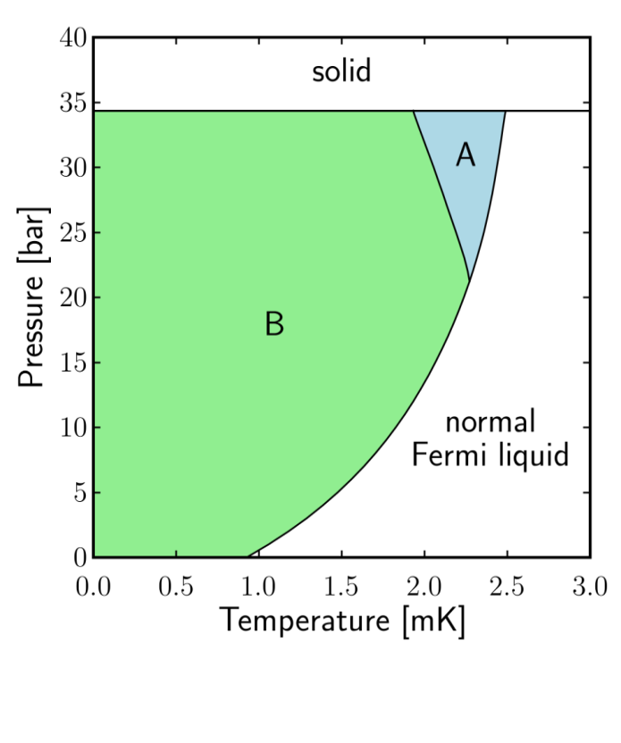
Superfluid Helium, ³He
Extremely pure quantum fluid
Cooper pairs with L = S = 1
Spin dependent dark matter
Multiple superfluid phases
  A-phase: Anderson-Brinkman-Morel
  B-phase: Balian-Werthamer
Broken Cooper pairs = thermal excitations with energy Δ ~ 10⁻⁷ eV
Andrew Casey, QTFP Glasgow, 21-22/01/25

Slide 10
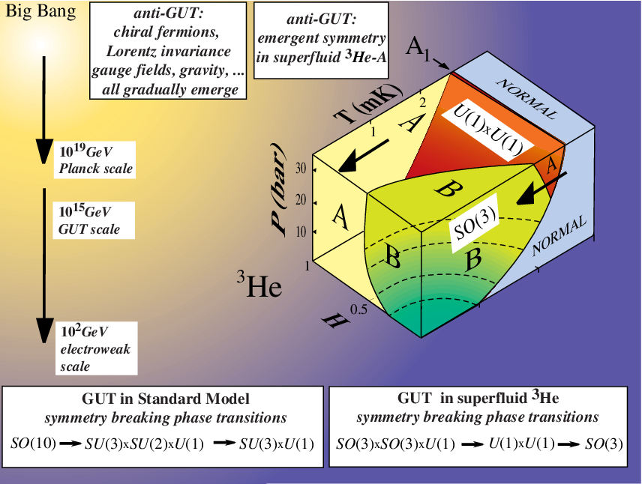
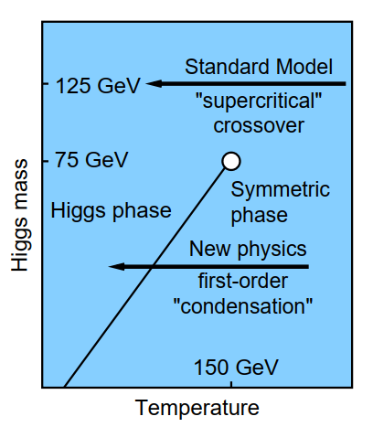
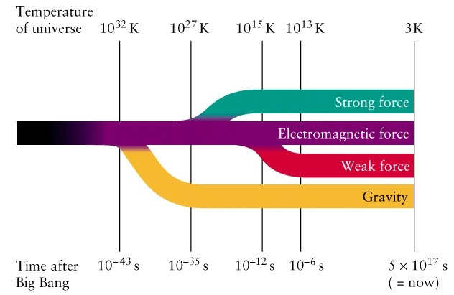
How did the early universe evolve?
First-order electroweak phase transition (Tc ∼ 100 GeV, 10 ps after the Big Bang) predicted in various extensions to the Standard Model to account for, e.g., the dark matter and the baryon asymmetry.
Andrew Casey, QTFP Glasgow, 21-22/01/25

Slide 11
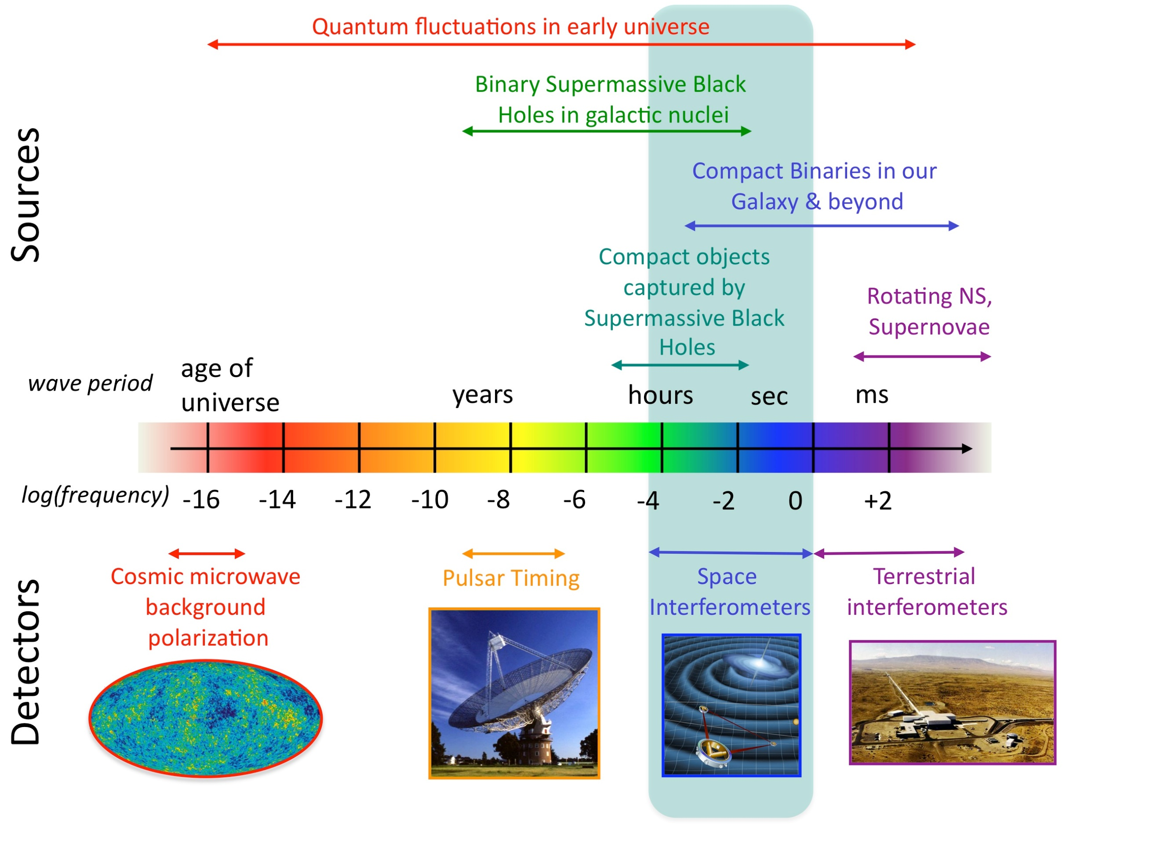

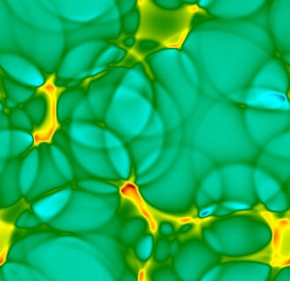
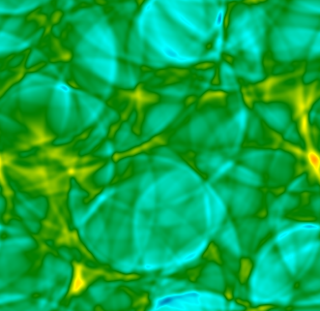
How did the early universe evolve?
Gravitational wave (GW) background in the frequency range to be probed by Laser Interferometer Space Antenna (LISA) from 2037 onwards. M. Hindmarsh et al., SciPost Phys. Lect. Notes 24 (2021)
Model for the cosmological phase transition, homogeneous nucleation theory.
Quantum fluctuations, topological defects
Andrew Casey, QTFP Glasgow, 21-22/01/25

Slide 12
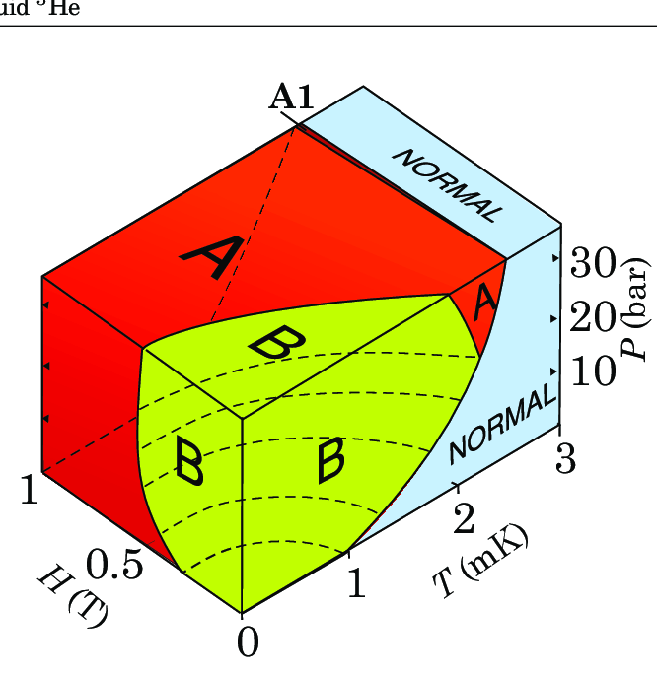
Phase transitions in extreme matter
Superfluid ³He provides an example of a first order phase transition in a pure system.
Nanofabrication techniques and magnetic fields allow precise control of this Quantum analogue system.
Phase-transition rate (lifetime of the metastable phase) and the phase-boundary speed are key parameters in defining the GW spectrum
Opens a gravitational wave window to physics beyond the Standard Model in the early universe
Andrew Casey, QTFP Glasgow, 21-22/01/25

Slide 13
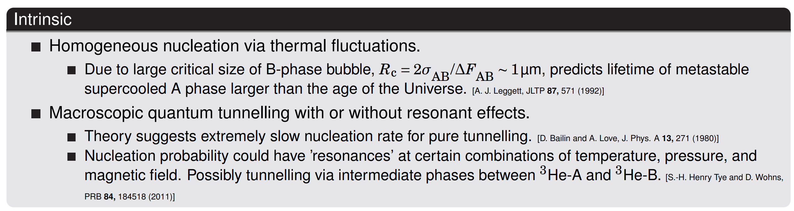
Models for the AB phase transition
Intrinsic and extrinsic factors controlling nucleation
Andrew Casey, QTFP Glasgow, 21-22/01/25

Slide 14
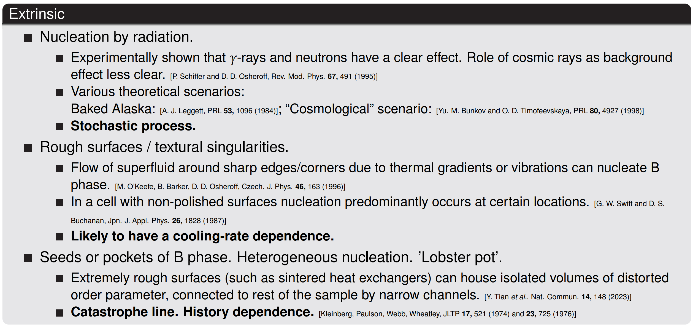
Models for the AB phase transition
Andrew Casey, QTFP Glasgow, 21-22/01/25

Slide 15
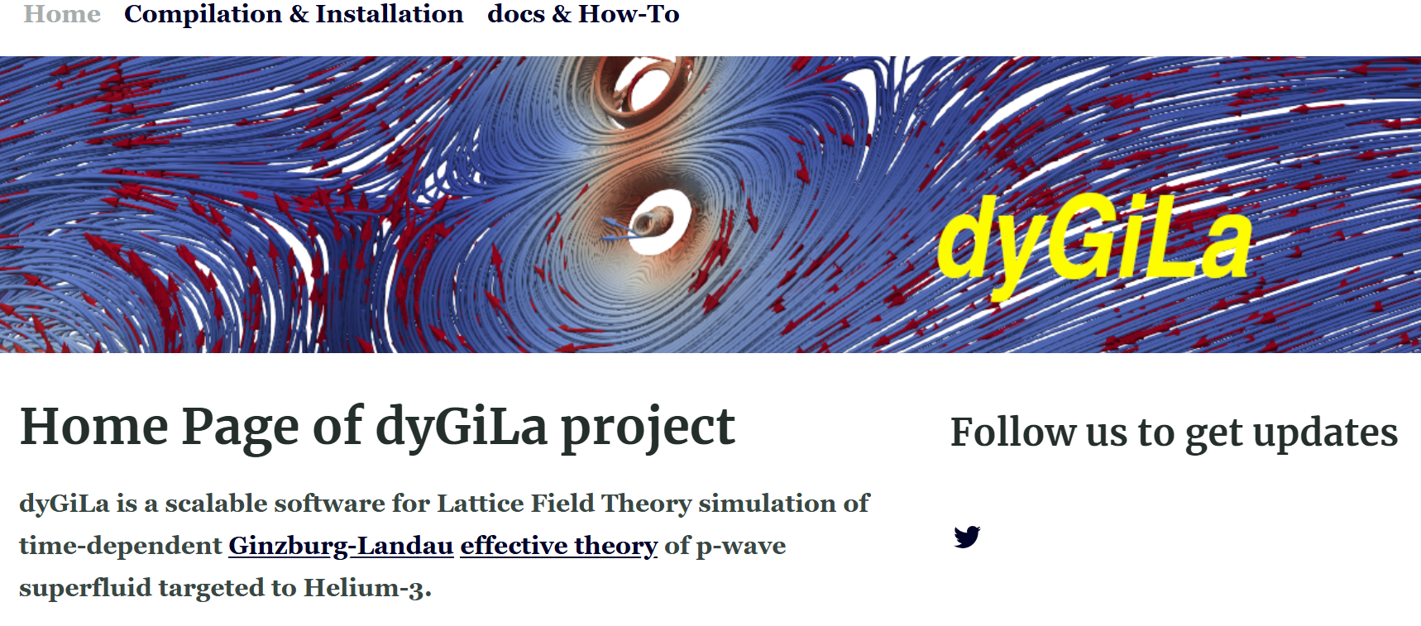
Simulations for the AB phase transition
https://dygila.github.io/
Andrew Casey, QTFP Glasgow, 21-22/01/25

Slide 16
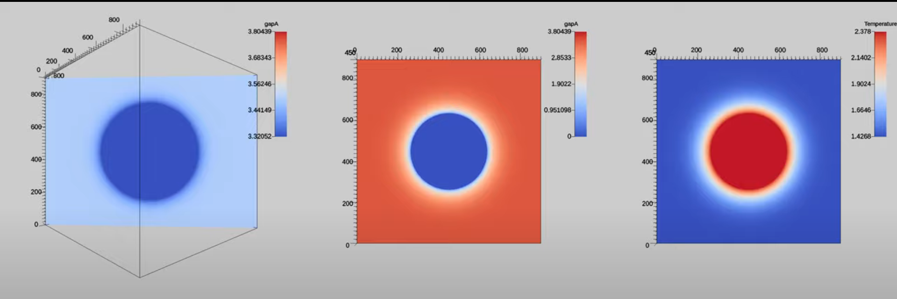
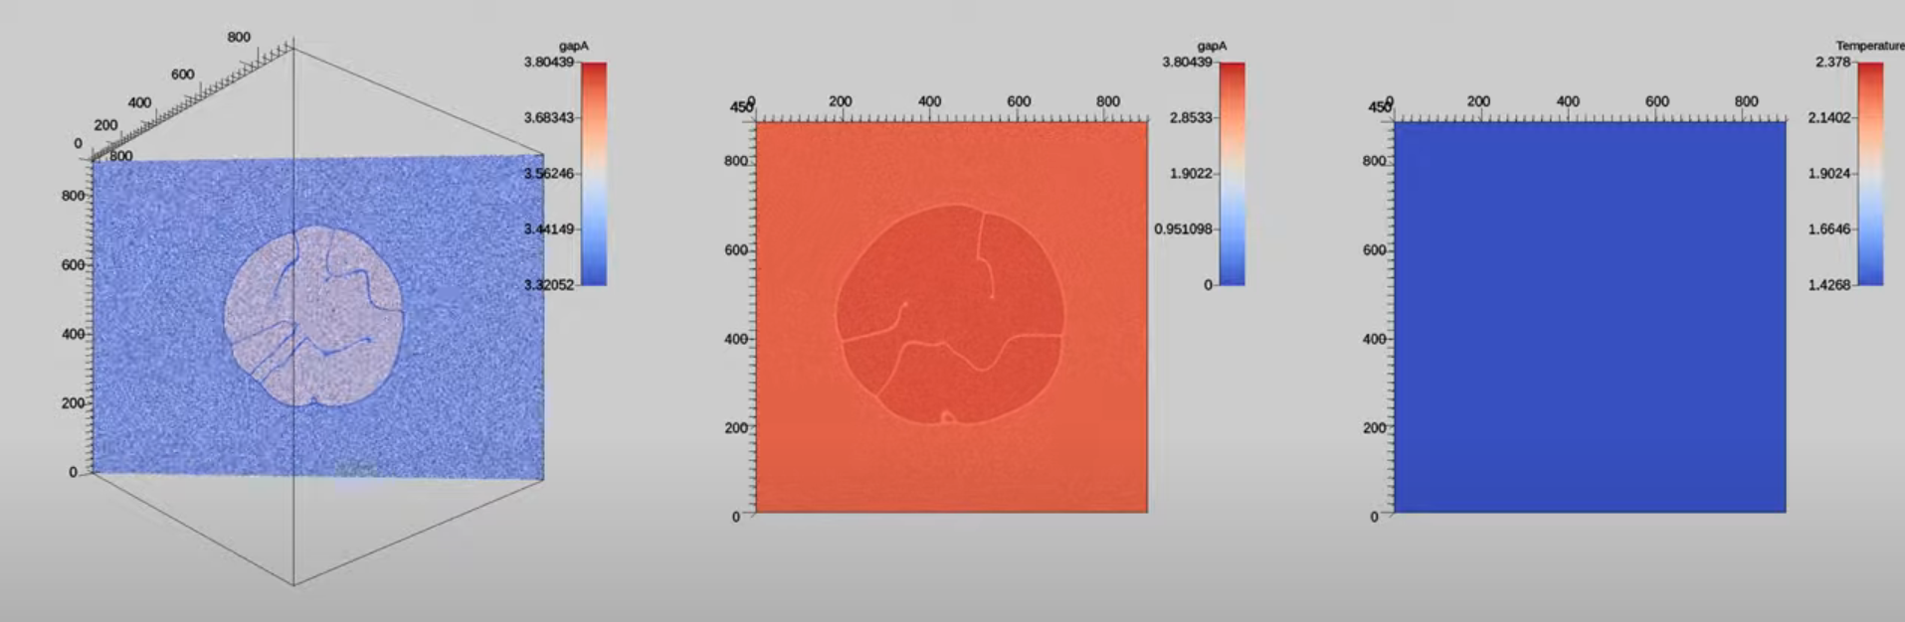
Simulations for the AB phase transition
https://www.youtube.com/@Superfluid-Field-Sim
Andrew Casey, QTFP Glasgow, 21-22/01/25

Slide 17
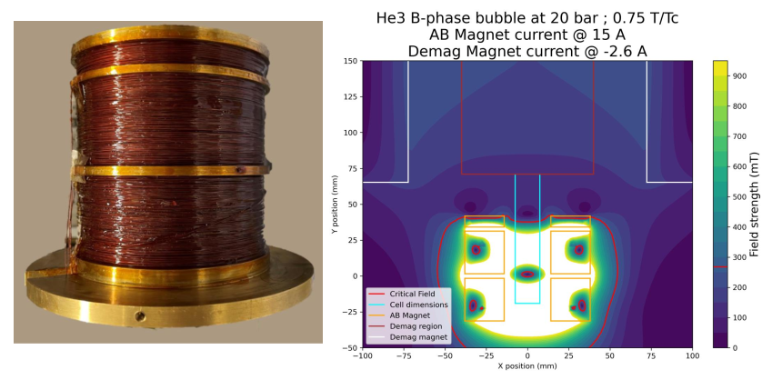
Engineering the phase through magnetic field
Using magnetic field to define the AB boundary allows us to create an isolated region, reducing the effects of the walls of the container, poster by Luke Whitehead
Andrew Casey, QTFP Glasgow, 21-22/01/25

Slide 18
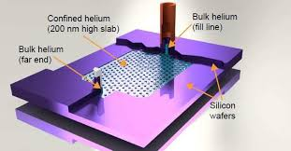
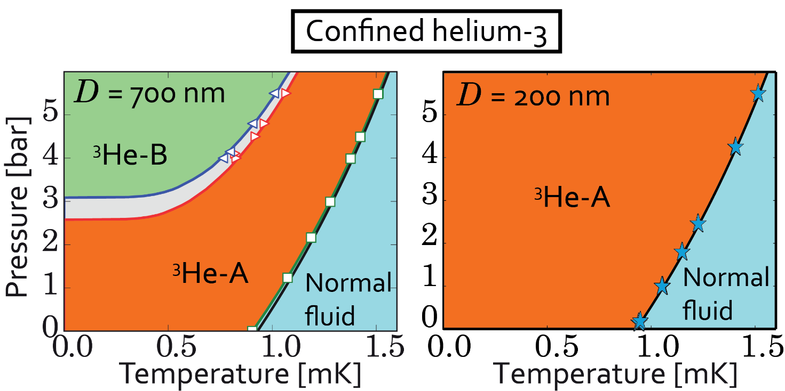
Engineer phase landscape through confinement
Engineer phase transitions between superfluid ³He phases of distinct symmetry.
Control the free energy landscape with tuning parameters. (Temperature, pressure, surface specularity, magnetic field)
Levitin LV, Bennett RG, Casey A, Cowan B, Saunders J, Drung D, Schurig T, Parpia JM.
Phase diagram of the topological superfluid ³He confined in a nanoscale slab geometry.
Science. 340, 6134,841-444 (2013). doi:10.1126/science.1233621
Andrew Casey, QTFP Glasgow, 21-22/01/25

Slide 19
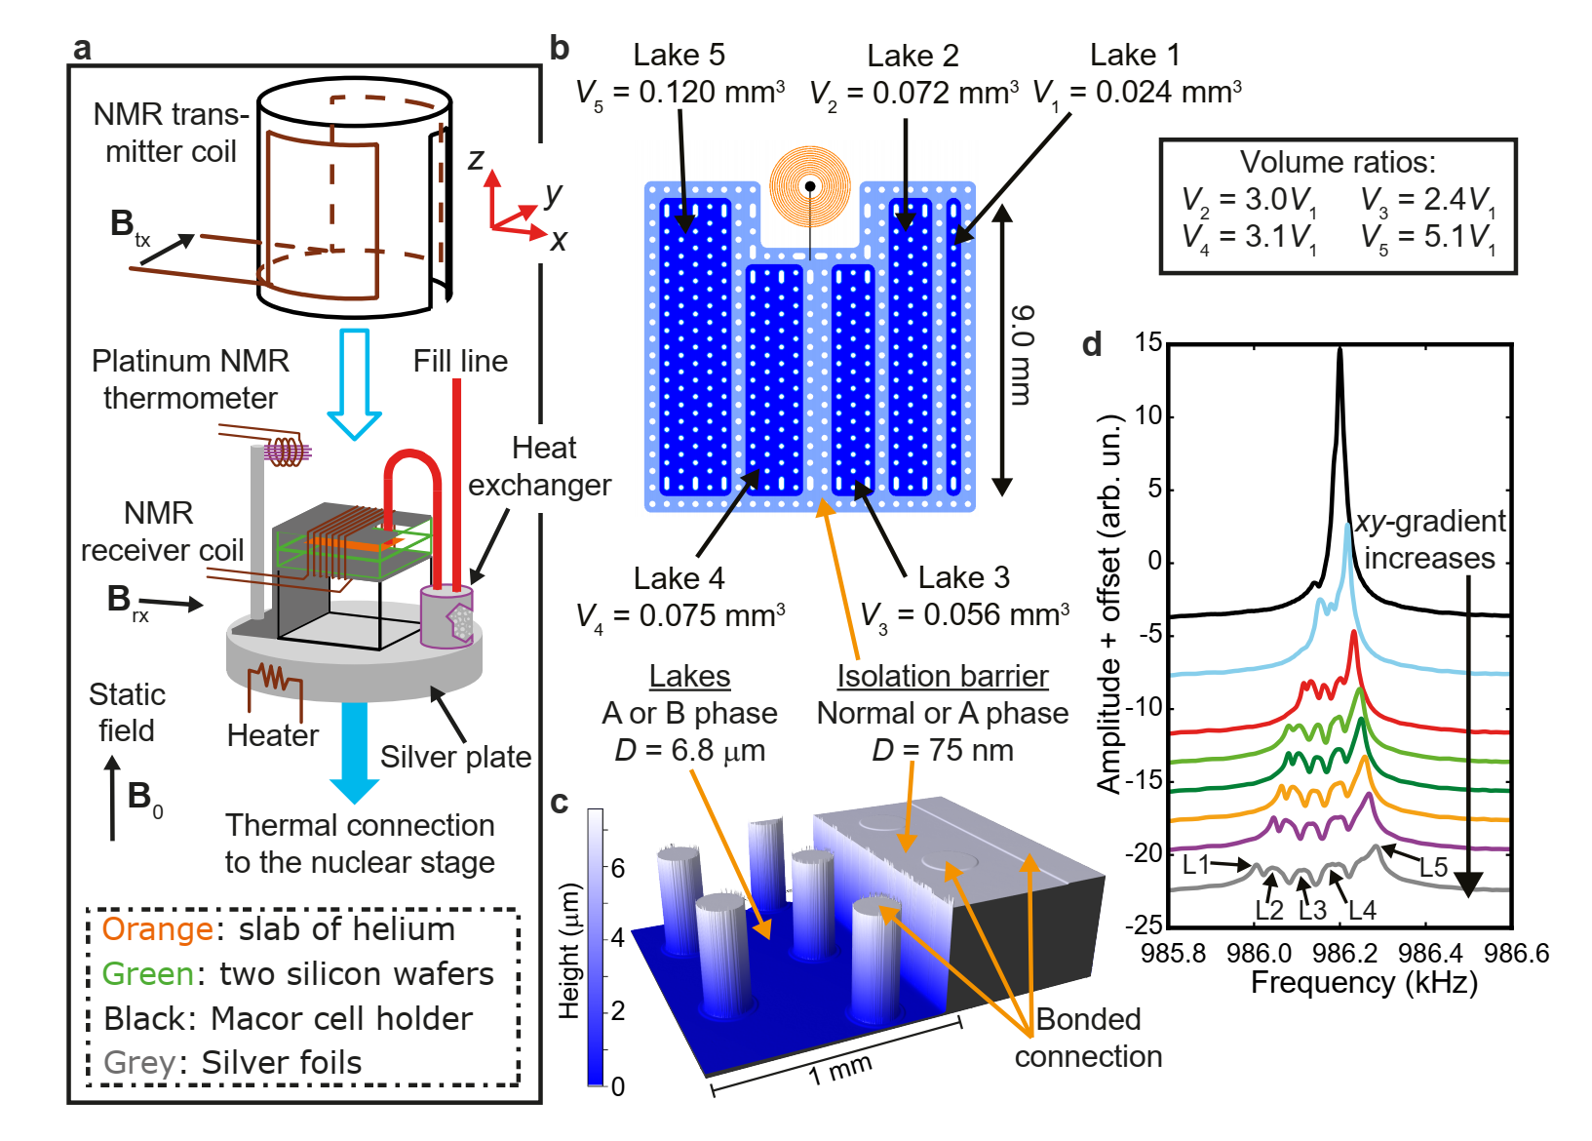
Engineer phase landscape through confinement
Andrew Casey, QTFP Glasgow, 21-22/01/25

Slide 20
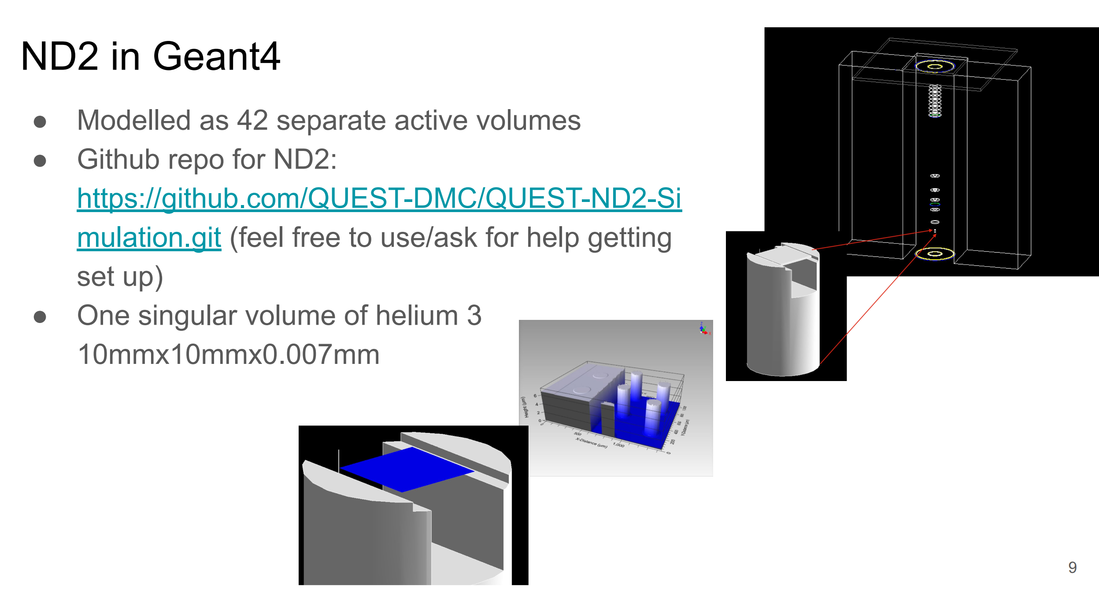
Geant4 modelling of ND2
Andrew Casey, QTFP Glasgow, 21-22/01/25

Slide 21
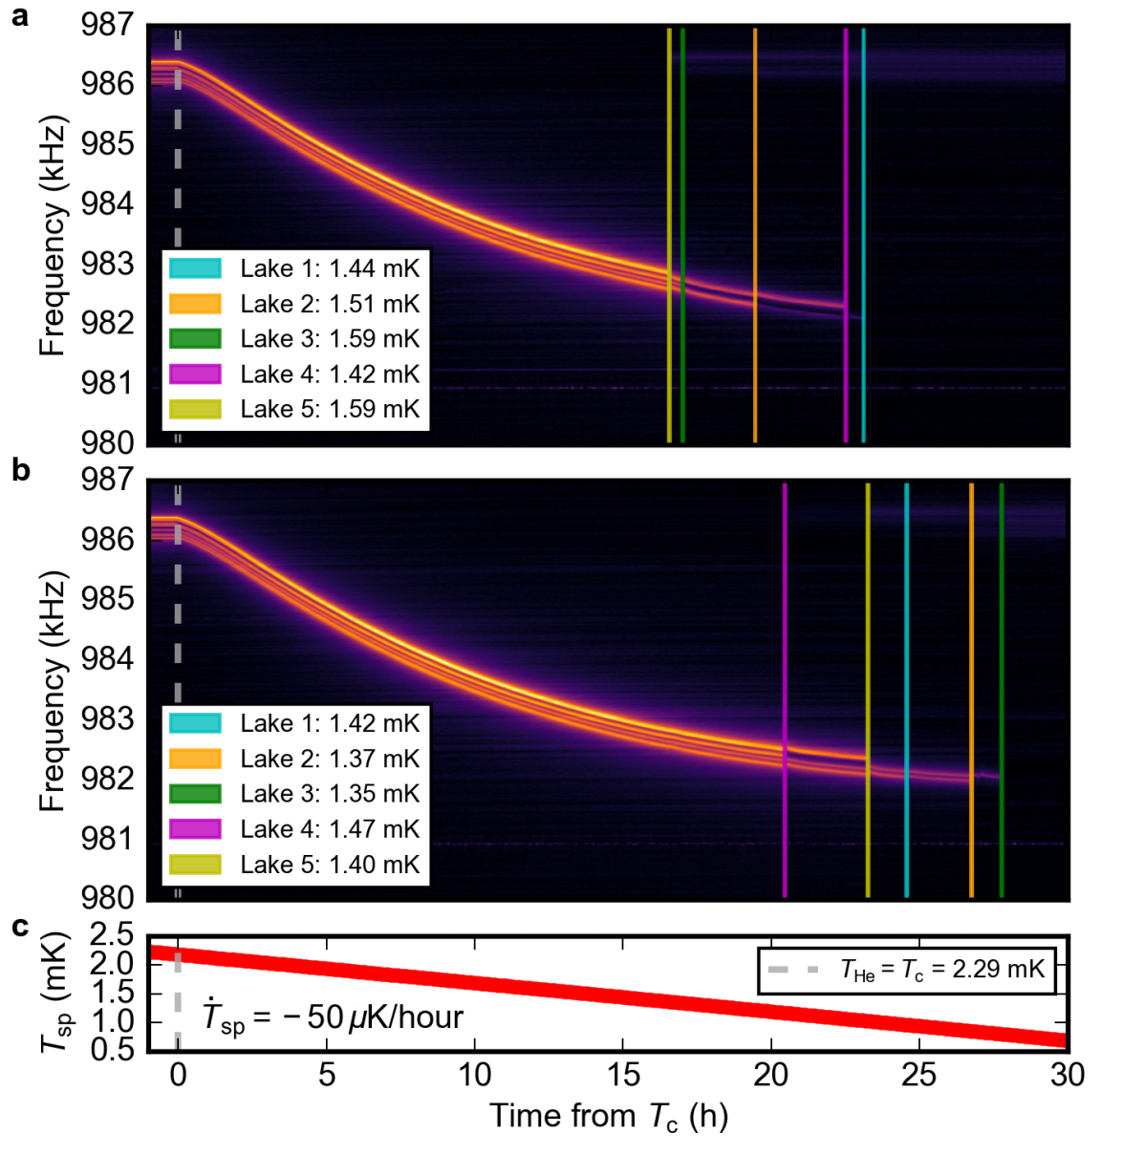
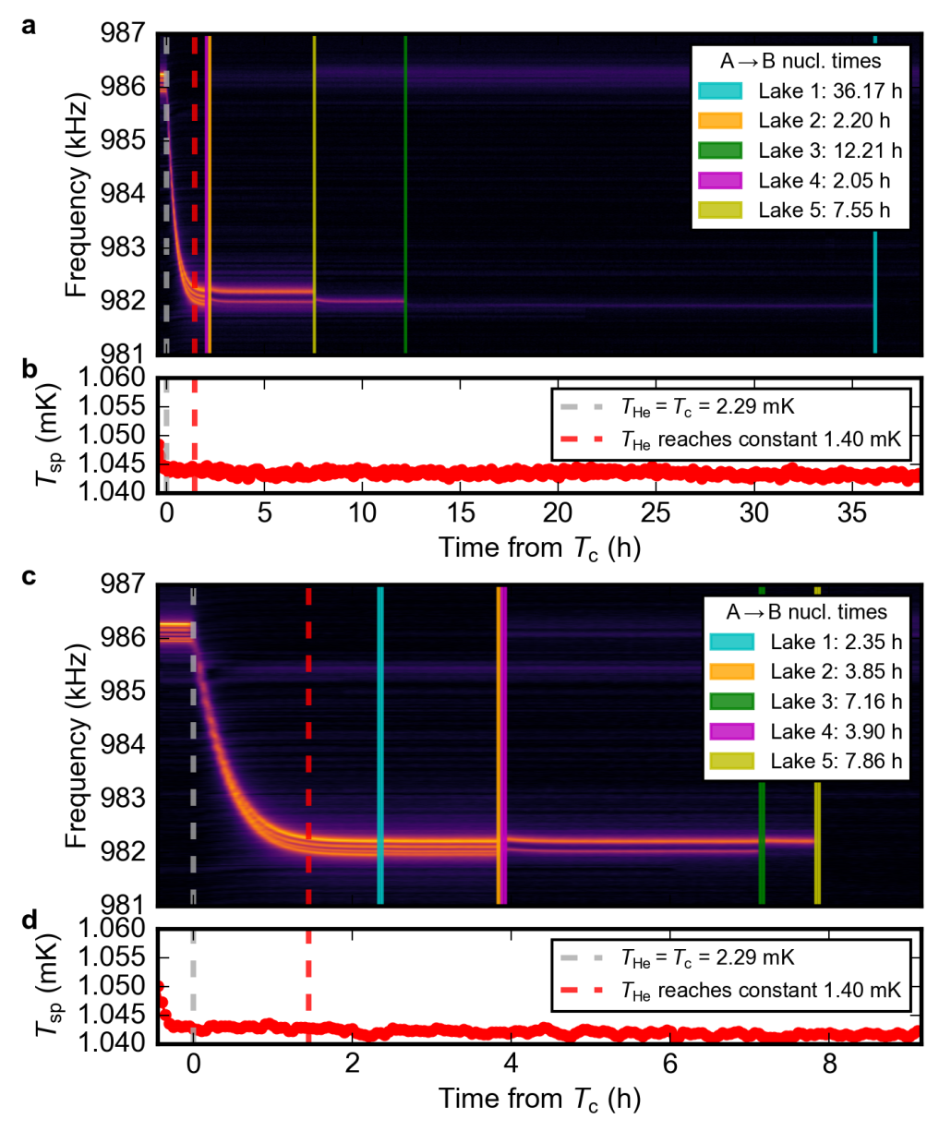
Observations of AB transition from supercooled A phase
Andrew Casey, QTFP Glasgow, 21-22/01/25

Slide 22
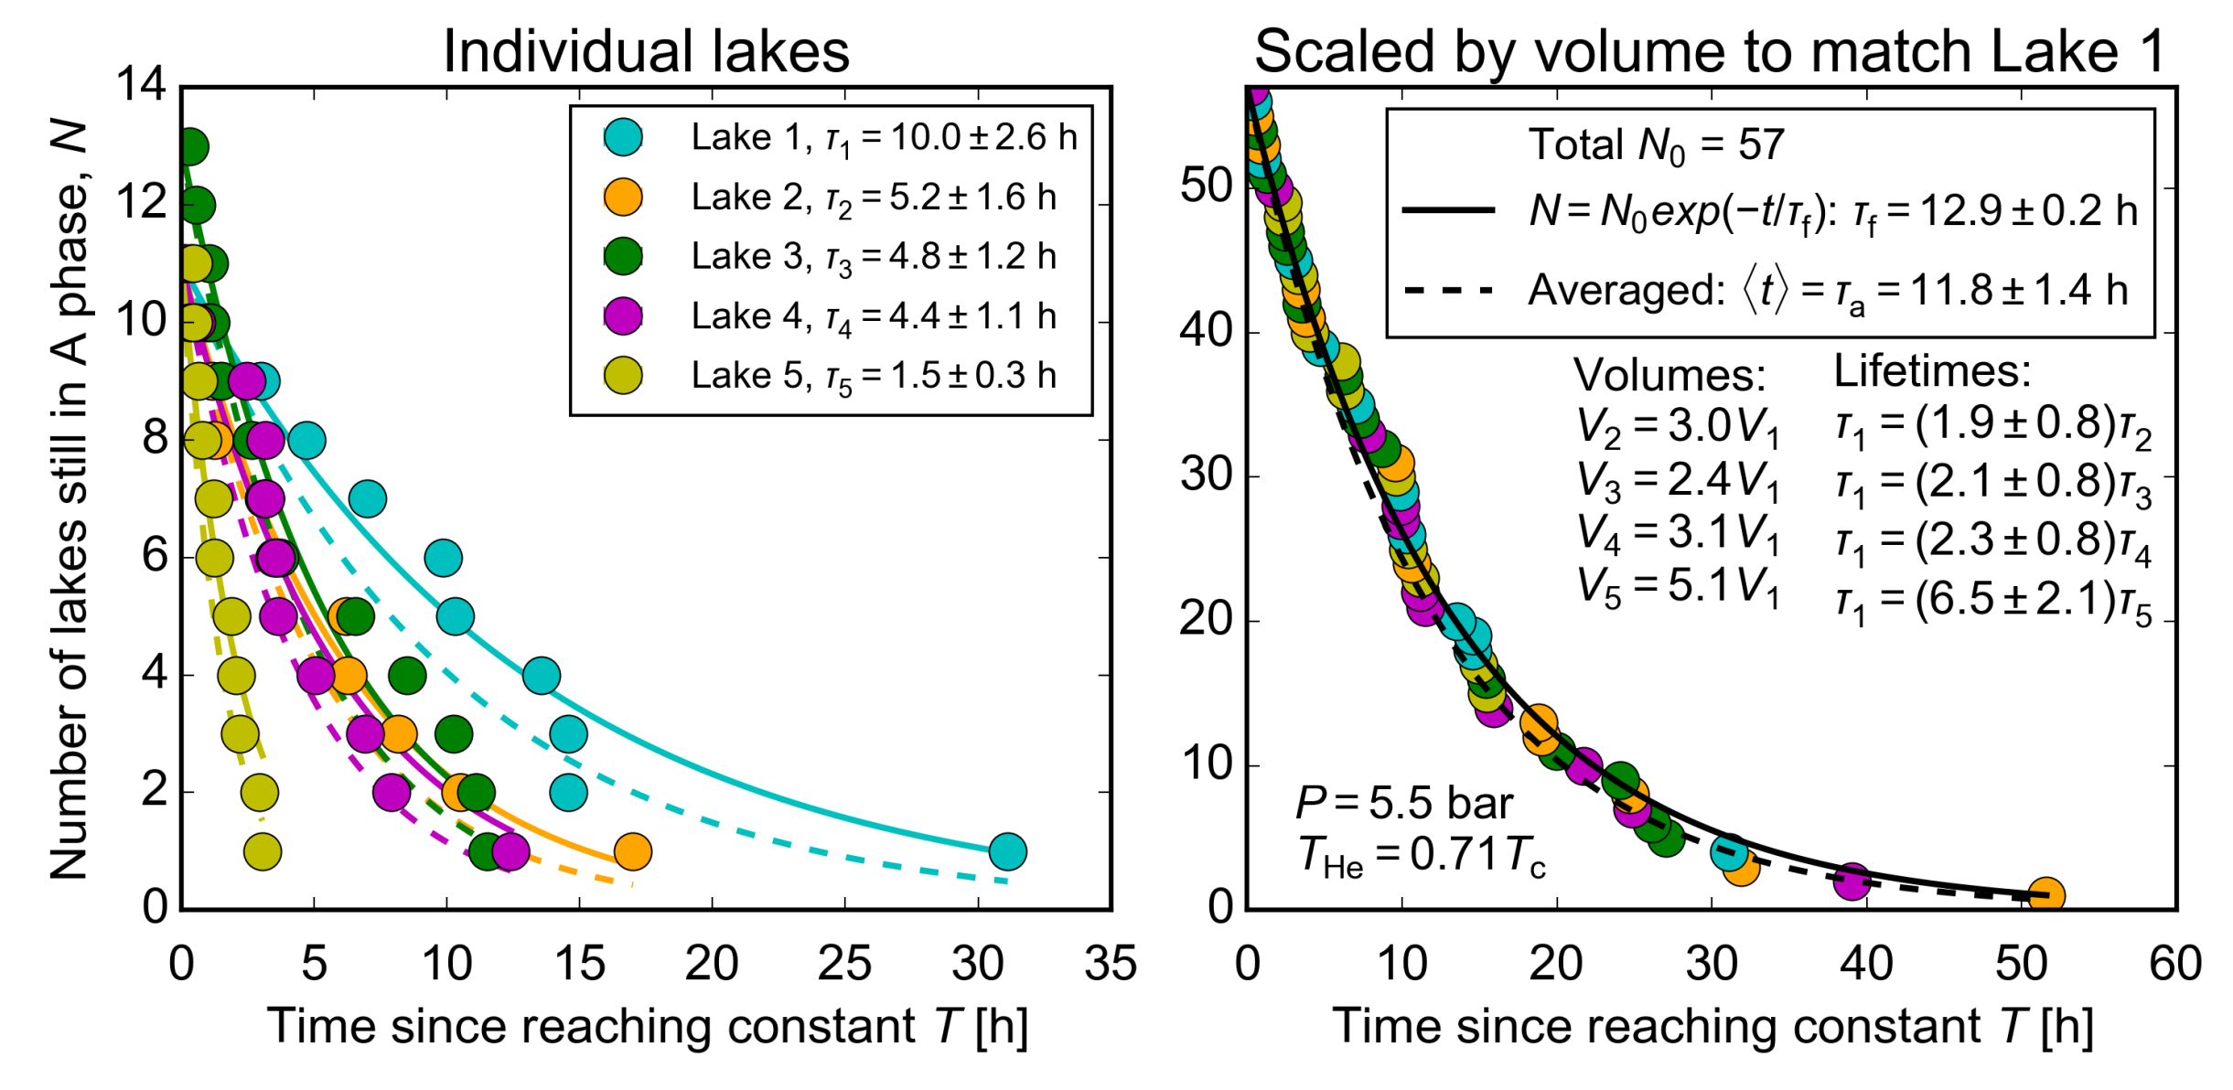
Collection of statistics: lifetime scales with volume
Andrew Casey, QTFP Glasgow, 21-22/01/25

Slide 23
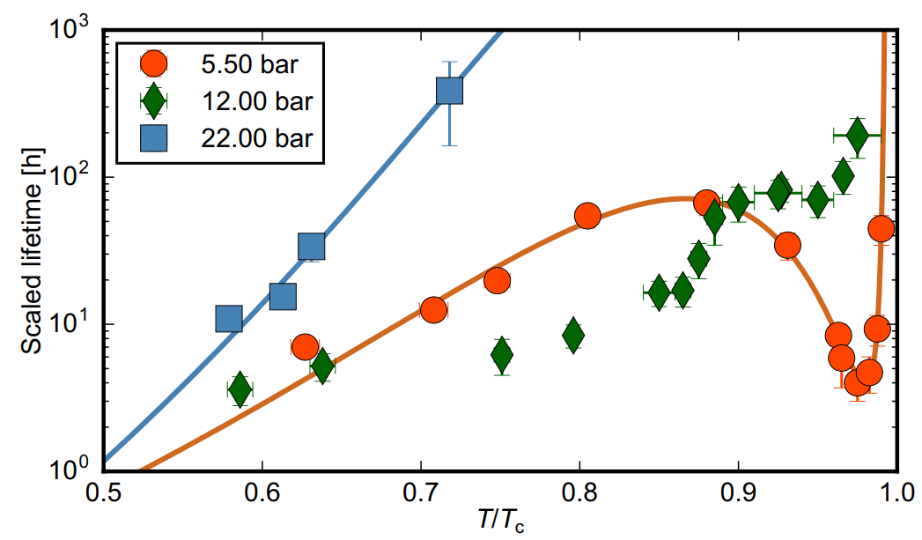
Temperature / Pressure dependence of the lifetime scaled to the smallest volume
Andrew Casey, QTFP Glasgow, 21-22/01/25

Slide 24
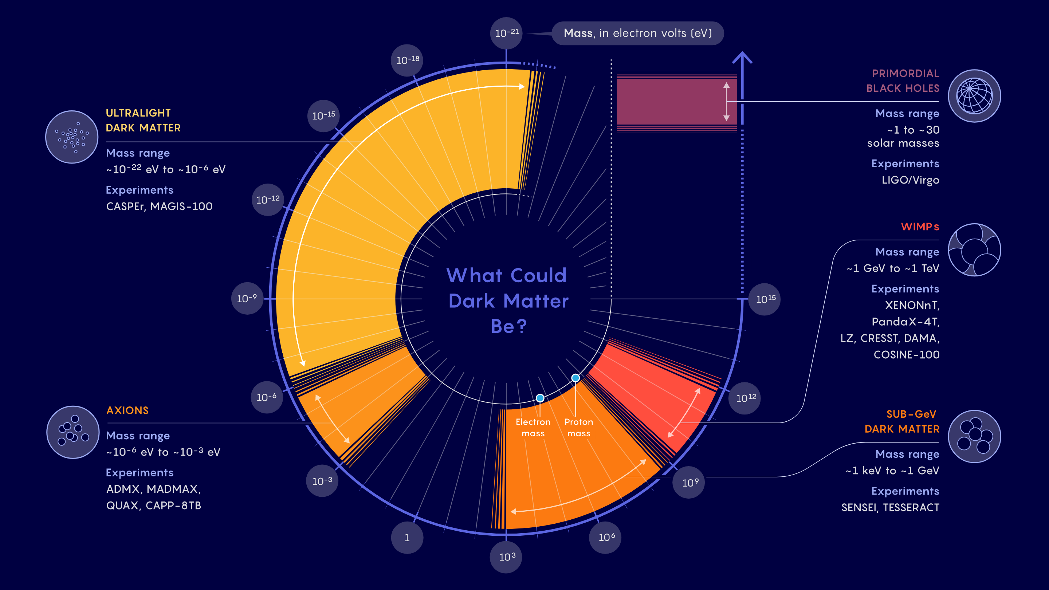
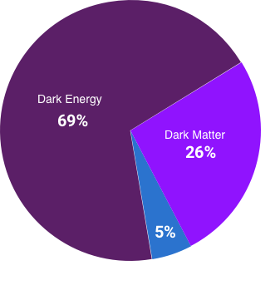
What mass range are we searching for Dark Matter in?
Mass range of the order GeV theoretically motivated by Asymmetric dark matter models
Samuel Velasco/Quanta Magazine
Andrew Casey, QTFP Glasgow, 21-22/01/25

Slide 25
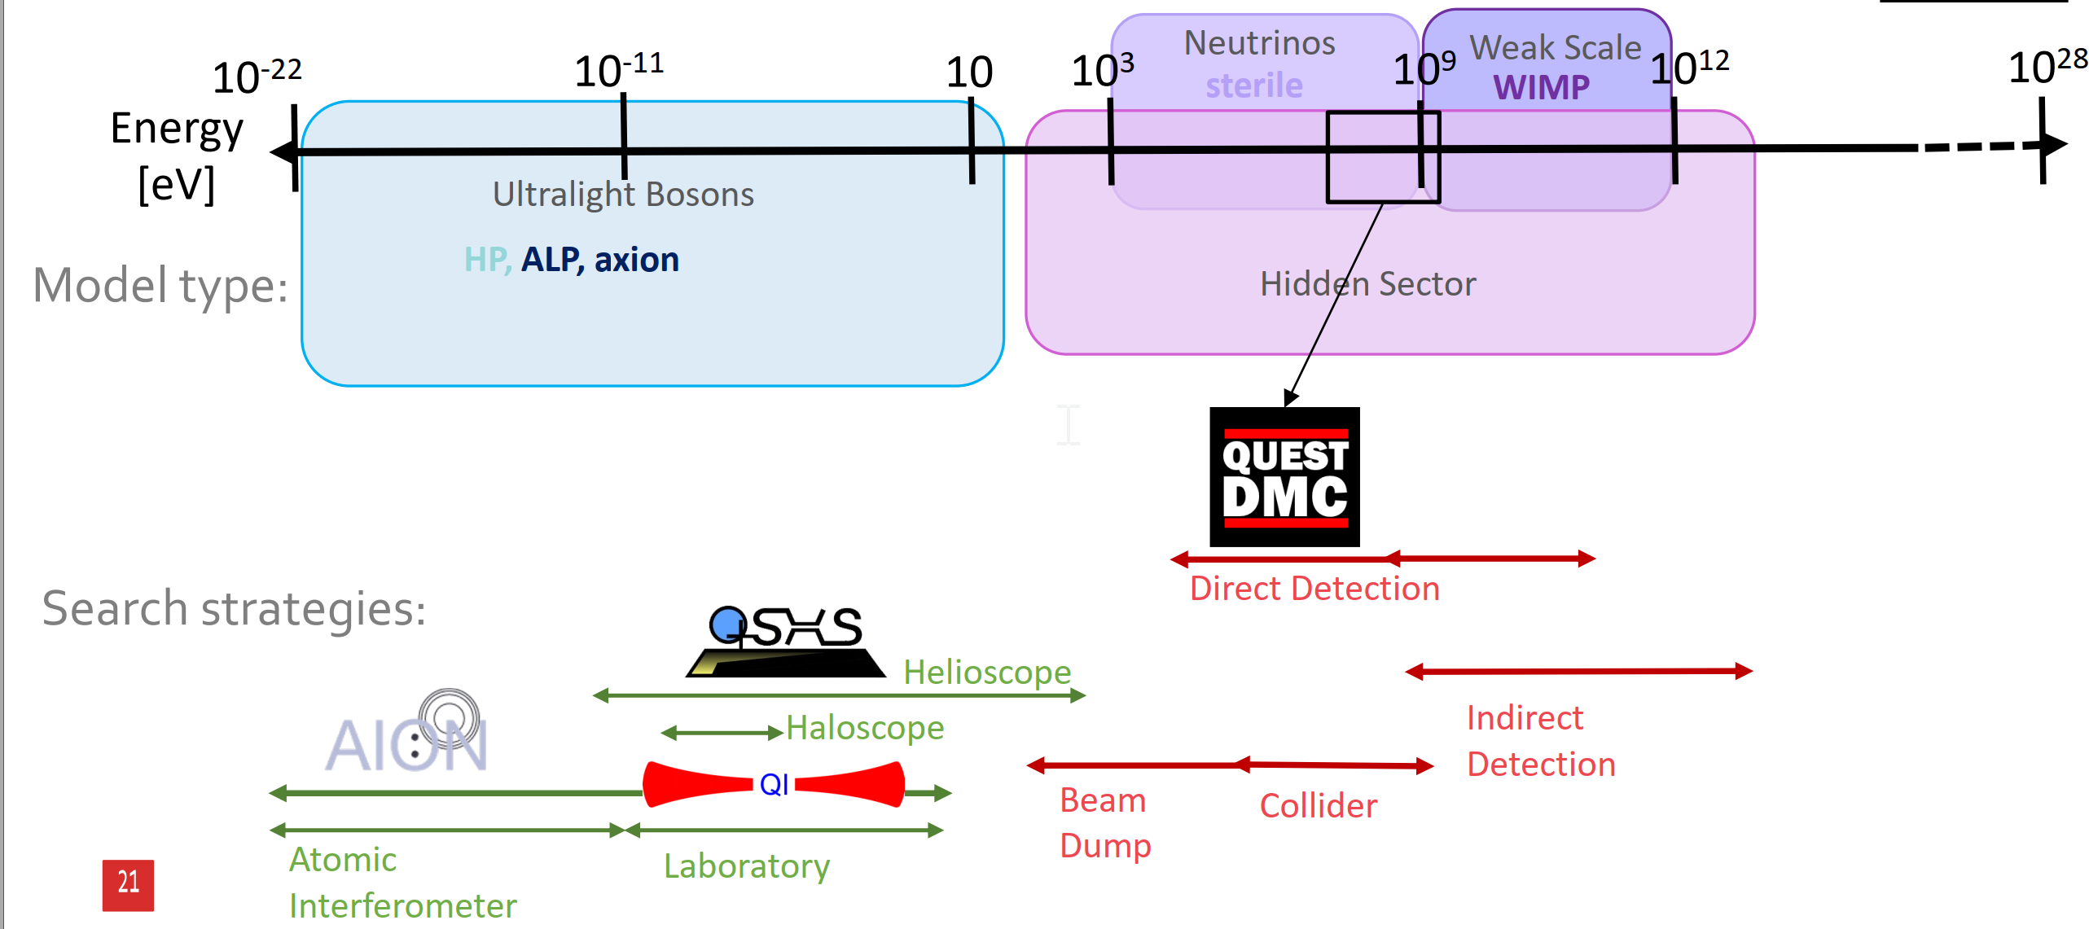
What mass range are we searching for Dark Matter in?
Mass range of the order GeV theoretically motivated by Asymmetric dark matter models
Andrew Casey, QTFP Glasgow, 21-22/01/25

Slide 26
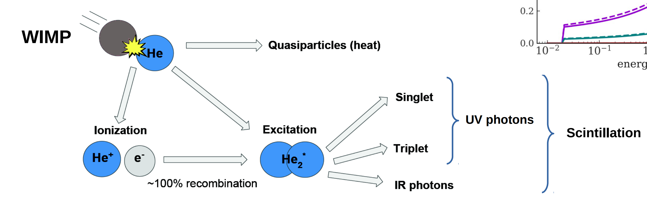
Superfluid ³He as a Dark Matter target
Collision WIMP - ³He atom (mass 3 versus argon - 39.948, xenon -131.293)
– Heat as quasiparticle excitations
– Light from de-excitation, threshold for ionization is ~ 20 eV
DM particle
ULTIMA: D.I. Bradley, et al., Nucl. Instrum. Methods A 370, 141 (1996); C.B. Winkelmann, et al., Nucl. Instrum. Methods A 559, 384 (2006); C.B. Winkelmann, et al., Nucl. Instrum. Methods A 574, 264 (2007).
Andrew Casey, QTFP Glasgow, 21-22/01/25

Slide 27
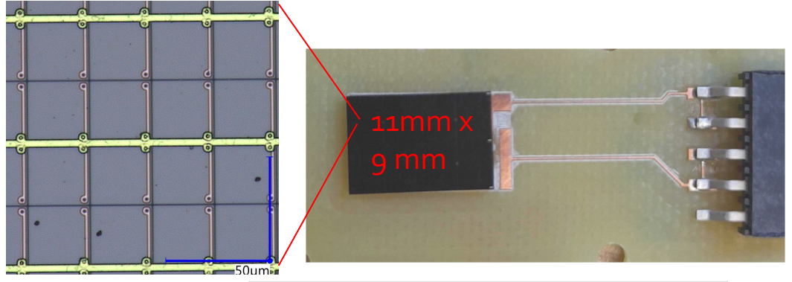
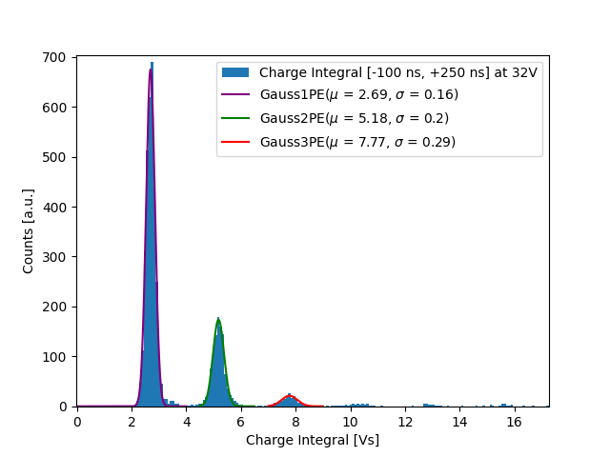
Ionisation energy channel
Superconducting devices:
  TES, Nanowires, mKIDs
SiPMs (developed for Darkside) normally operated at LN₂ consists of matrix of single photon avalanche diodes. High gain and single photo-electron resolution.
Operational at 10 mK.
Use as Veto rather than measure energy partition fraction.
Coupled with a scintillator can detect muons.
Andrew Casey, QTFP Glasgow, 21-22/01/25
Notes:
In the case of Dark Matter , as you can see from this figure of potential DM candidates and their masses there is there is a very well theoretically motivated sub GeV mass regime, this has been largely inaccessible to traditional dark matter searches, with the application of quantum sensors we aim to investigate the region in dark green.
Baryon Asymmetry
Masses in the region of a Nucleon

Slide 28
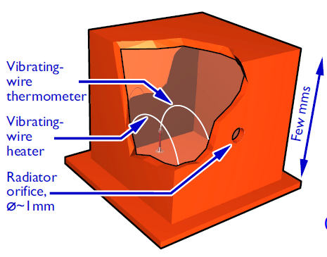
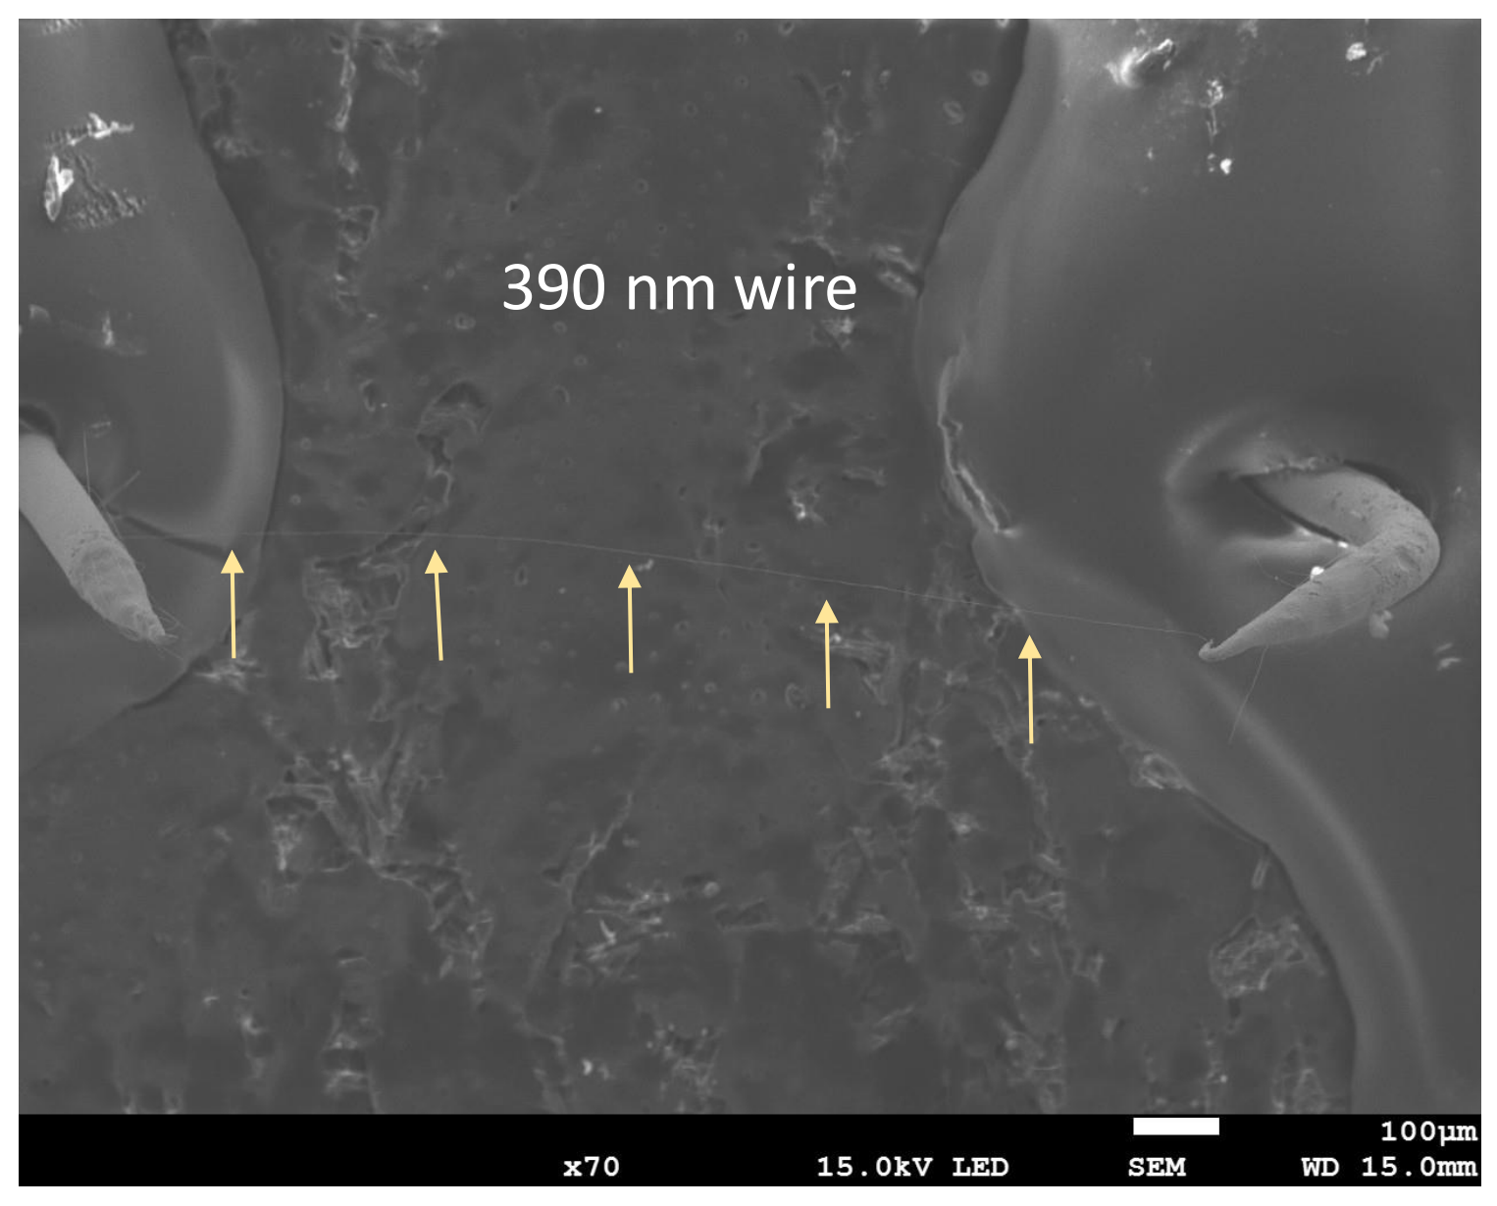
Optimising beam/wire geometry for and both He and SQUID response
Long nanomechanical resonators with circular cross-section, D. Zmeev et al. arXiv:2311.02452 (2023)
Andrew Casey, QTFP Glasgow, 21-22/01/25

Slide 29
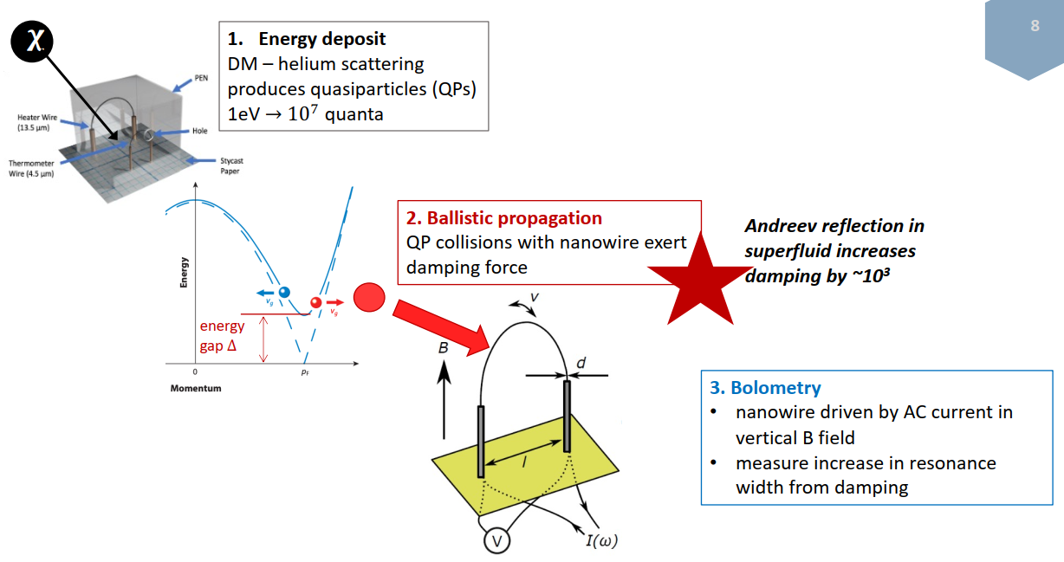
Superfluid ³He as a Dark Matter target
Andrew Casey, QTFP Glasgow, 21-22/01/25

Slide 30
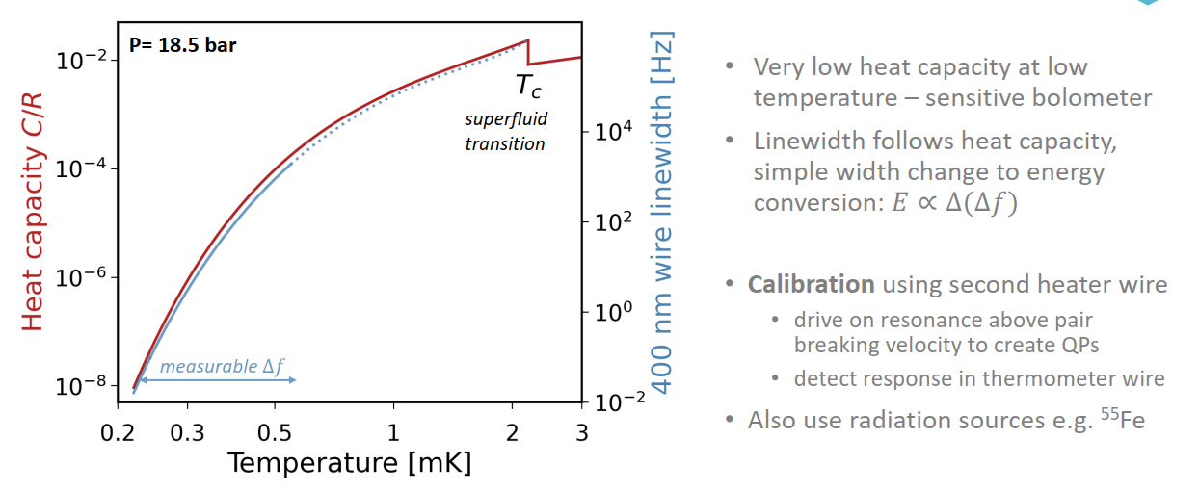
Superfluid ³He as a Dark Matter target
Andrew Casey, QTFP Glasgow, 21-22/01/25

Slide 31
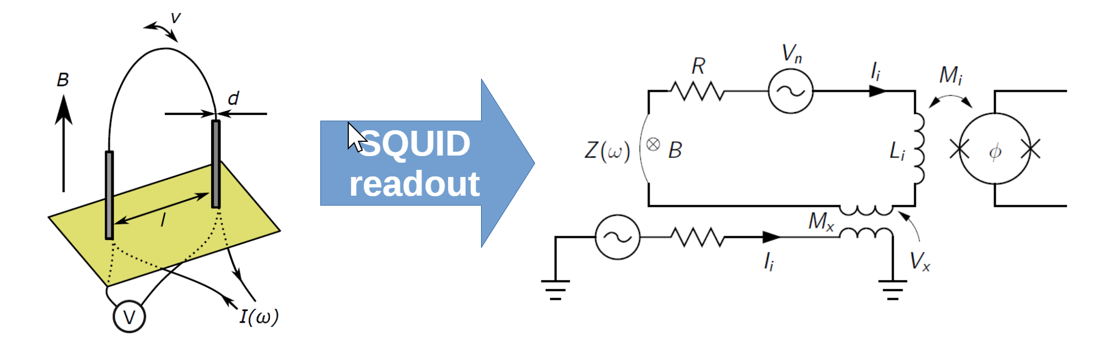
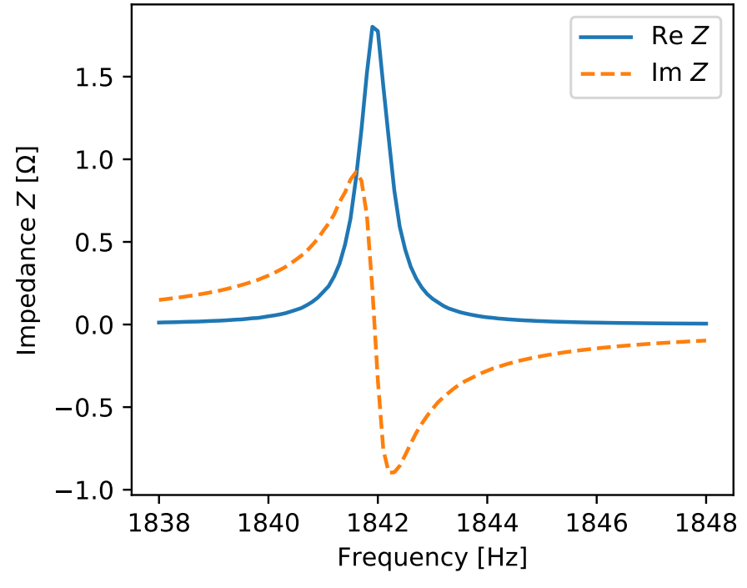


SQUID readout of nanowire
2-stage SQUID amplifier (PTB)
IEEE Trans. Appl. Supercond. 17 (2007)
Vacuum characterisation of SQUID nanowire readout. 315 nm wire, 8.5 mT, 4.2 K
Andrew Casey, QTFP Glasgow, 21-22/01/25

Slide 32


Dark Matter search ULANC cryostat modelling
Andrew Casey, QTFP Glasgow, 21-22/01/25

Slide 33



Bolometer for quasiparticle detection
0.3 g ³He
7 tonne Xe e.g.LZ,PRL,131,041002(2023)
Andrew Casey, QTFP Glasgow, 21-22/01/25

Slide 34

Future Prospects: ULT Underground
UltraDark: Sub mK Cryo-free, low radiogenic background, shielded low vibration underground laboratory for high coherence quantum phenomena and rare event searches
Andrew Casey, QTFP Glasgow, 21-22/01/25

Slide 35

The Team
Nathan Eng
Andrew Casey, QTFP Glasgow, 21-22/01/25

Slide 36
Andreev Scattering
P wave superfluid, Retroreflection, reverses velocity but not momentum (Fermi Momentum)
When the superfluid is in motion (around beam), canting of the dispersion curve results in a strong damping term.
Quantum Enhanced Superfluid Technologies for Dark Matter and Cosmology, QUEST –DMC

