Slide 1


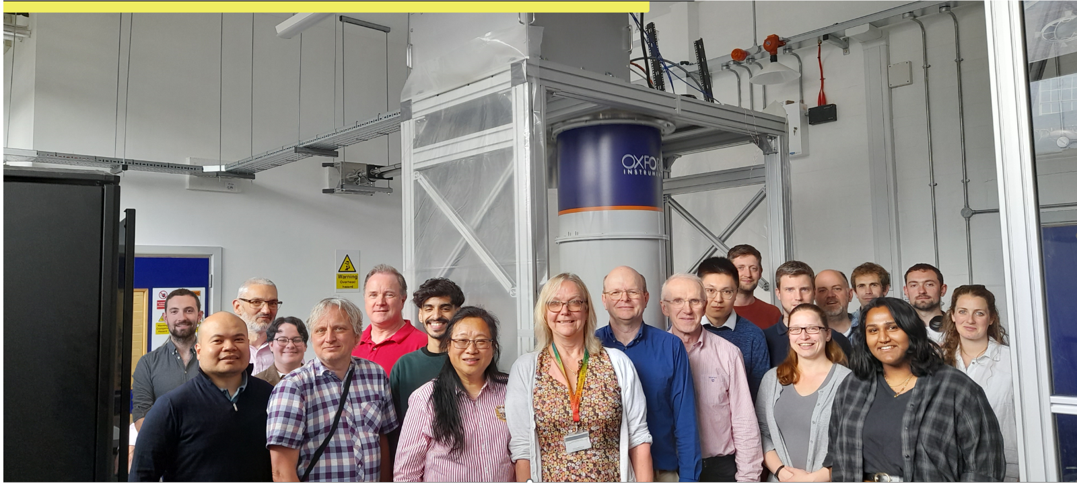







Quantum Sensing for the Hidden Sector
+
Ed Daw, on behalf of the Quantum Sensors for the Hidden Sector collaboration

Slide 2
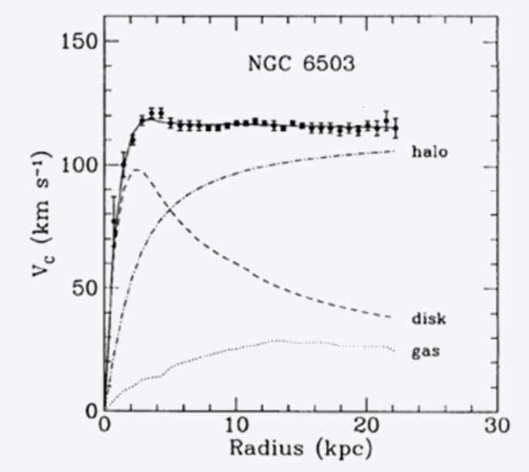
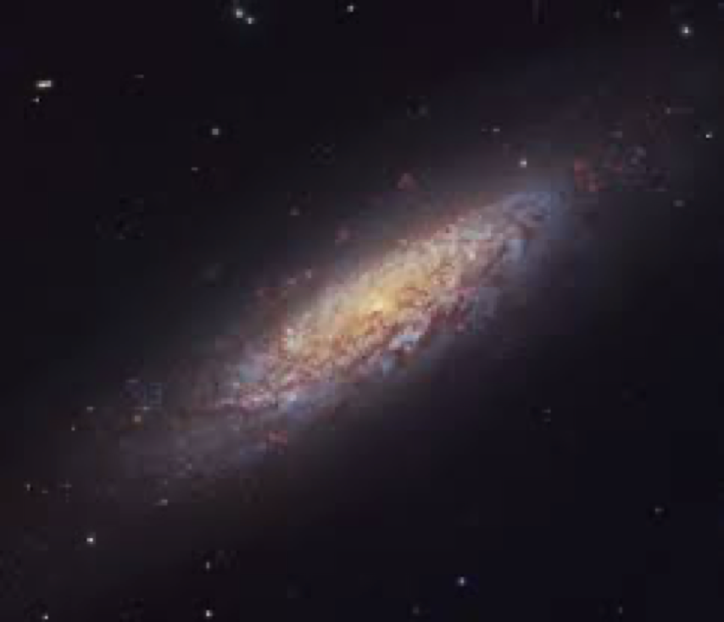

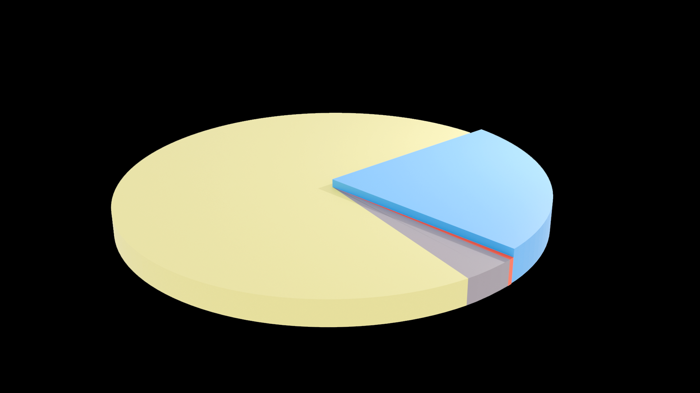









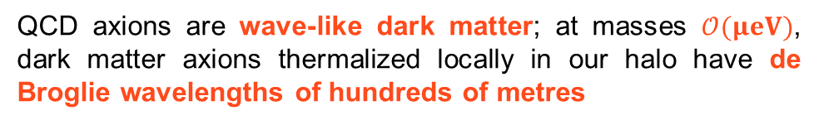







QCD Axions
Strong CP problem
Dark matter problem
Standard model symmetry group is:
QCD
Electroweak
EM
$$SU(3)$$
$$×$$
$$SU(2)$$
$$×$$
$$U(1)$$
$v_{rot}$ [DATA]
Non-Abelian
Non-Abelian
Abelian
CP Conserving?
CP
Violating
CP Conserving
Peccei Quinn mechanism:
CP conserved in QCD below a symmetry breaking energy scale
$$v_{rot}∝\frac{1}{\sqrt{r}}$$
Neutron electric
dipole moment
$${<10}^{−26} e −cm$$
Breaking of the Peccei Quinn symmetry yields axions
Other Nonluminous Matter:
Supermassive BHs 0.04%
Intergalactic Gas 3.6%
Neutrinos 0.1%
Dark Matter 23%
$$f$$
$$γ$$
$$a$$
$$f$$
$$g_{aγγ}∝m_{a}$$
Dark Energy 73 %
Luminous Matter:
Radiation 0.005%
Stars/Luminous Gas 0.4%
$$\overline{f}$$
$$γ$$
QCD axions are wave-like dark matter; at masses $𝒪(μeV)$, dark matter axions thermalized locally in our halo have de Broglie wavelengths of hundreds of metres

Slide 3
Theoretical Progress - HEP
Ed Hardy, John March Russell, Stephen West, Subir Sarkar, N. Song, G. Gregori, Ph.D students
[1] K.A. Beyer and S. Sarkar, Ruling out light axions: The writing is on the wall. SciPost Phys. 15 (2023) 003. (DOI:10.1088/1475-7516/2022/10/019, cited in the 2023 update of the Review of Particle Properties) https://inspirehep.net/literature/2105425
[2] M. Gorghetto & E. Hardy. Post-inflationary axions: a minimal target for axion horoscopes. JHEP 05 (2023) 030. (DOI:10.1007/JHEP05(2023) 030) https://inspirehep.net/literature/2618652
[3] M. Gorghetto, E. Hardy, H. Nicolaescu, A. Notari, M. Redi. Early vs late string networks from a minimal QCD Axion. JCAP accepted (DOI:10.48550/arXiv.2311.09315) https://inspirehep.net/literature/2723225
[4] E. Hardy & N. Song. Listening for dark photon radio signals from the Galactic Center. Phys. Rev. D. 107 (2023) 115035. (DOI:10.1103/PhysRevD.107.115035) https://inspirehep.net/literature/2616309
[5] J. March-Russell & J. G. Rosa. Micro-Bose/Proca dark matter stars from black hole superradiance (DOI:10.48550arXiv.2205.15277) https://inspirehep.net/literature/2089045
[6] M. Gorghetto, E. Hardy, J. March-Russell, N. Song, S. M. West. Dark photon stars: formation and role as dark matter substructure. JCAP 08 (2022) 018. (DOI:10.1088/1475-7516/2022/08/018) https://inspirehep.net/literature/2055691
[7] S. Hassan, J. March-Russell, G. Obied. Chern-Simons bubbles: Lopsided false vacuum decay in axion electrodynamics. e-Print: 2402.00119 (DOI:10.48550/arXiv.2402.00119)
https://inspirehep.net/literature/2753908
[8] G. Domenech, R. Mohayaee, S. P. Patil, S. Sarkar. Galaxy number-count dipole and superhorizon fluctuations. JCAP 10 (2022) 019. (DOI: 10.1088/1475-7516/2022/10/019) https://inspirehep.net/literature/2105425
[9] K. A. Beyer, G. Morocco, R. Bingham, G. Gregori. Light-shining-through-wall axion detection experiments with a stimulating laser. Phys.Rev.D 105 (2022) 035031. (DOI: 10.1103/PhysRevD.105.035031) https://inspirehep.net/literature/1935832
[10] K. A. Beyer, G. Morocco, C. Danson, R. Bingham, G. Gregori. Parametric co-linear axion photon instability. Phys.Lett. B 839 (2023) 137759. (DOI: 10.1016/j.physletb.2023.137759) https://inspirehep.net/literature/1898348
Theoretical progress - Devices
Stafford Withington– new schemes for wideband axion detection, Boon Kok Tan – theory of TWPAs
[11] S. Whithington. Quantum Electronics for Fundamental Physics. Contemporary Physics, 63 (2023) 116. (DOI:10.1080/00107514.2023.2180179) https://inspirehep.net/literature/2630609]
[12] C.N.Thomas, S. Withington and D.J. Goldie, Superconducting Microwave Detector Technology for Ultra-Light Dark Matter Haloscopes and other Fundamental Physics Experiments: Background Theory (Part I) – arXiv:2403.135541v1
[13] C.N.Thomas, S. Withington and D.J. Goldie, Superconducting Microwave Detector Technology for Ultra-Light Dark Matter Haloscopes and other Fundamental Physics Experiments: Device Physics (Part II) – arXiv:2403.13555v1

Slide 4
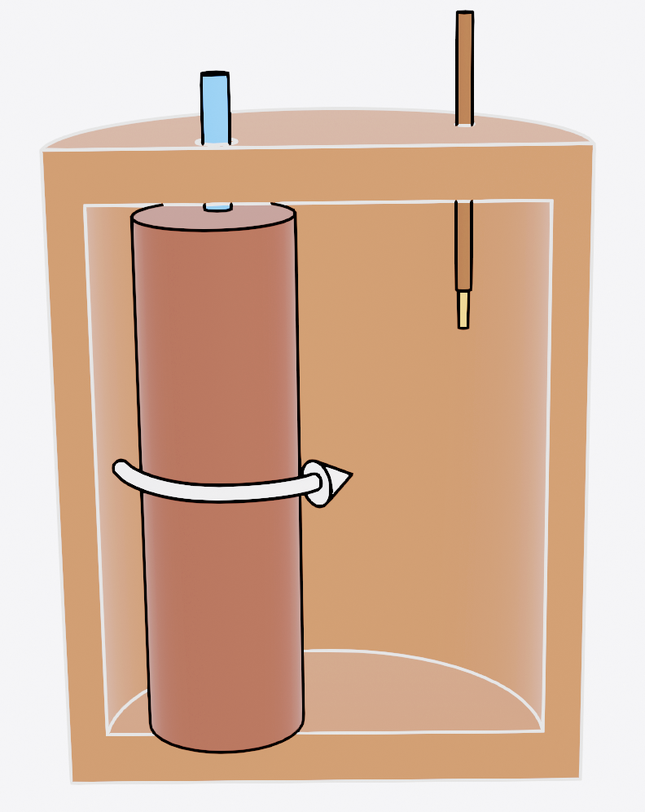
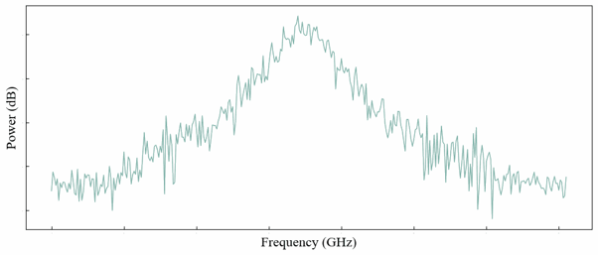
Haloscope and Receiver Chain
Network
Analyser
Bandpass
Filter
LO
RF
IF
Piezo
motors
HEMT
amplifiers
Cryogenic
Attenuators
Superconducting
low noise amplifier
in magnetic field shield
Cryogenic
RF switch
weak
port
variable
port
Tuneable
resonant cavity
in magnetic field
18.5cm magnet
bore.
Static magnetic field

Slide 5
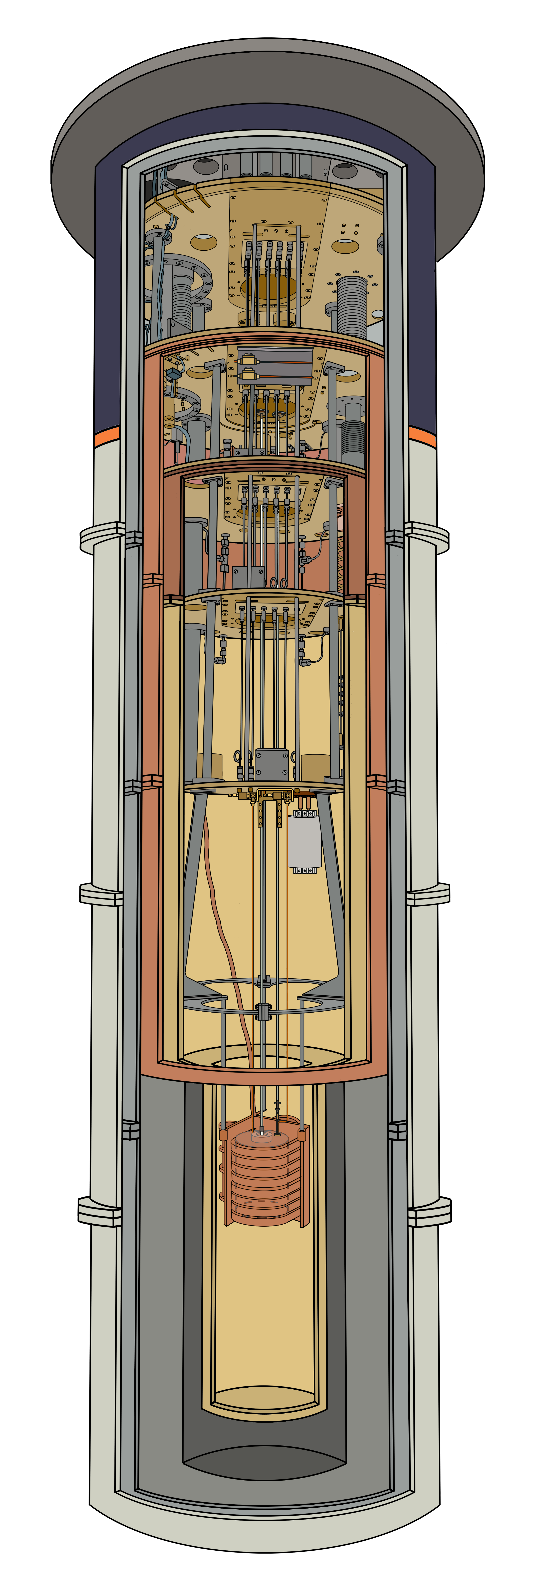
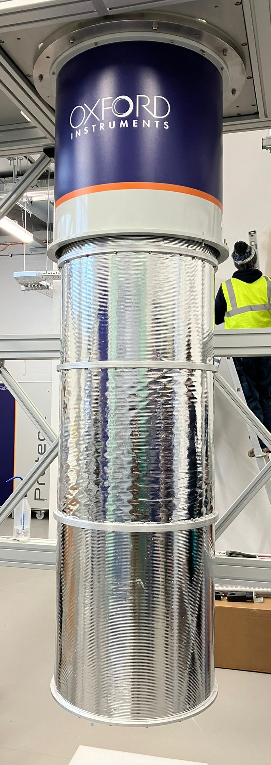
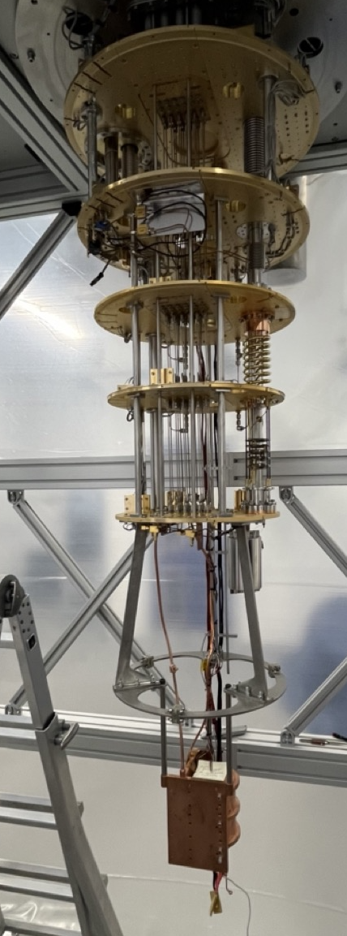
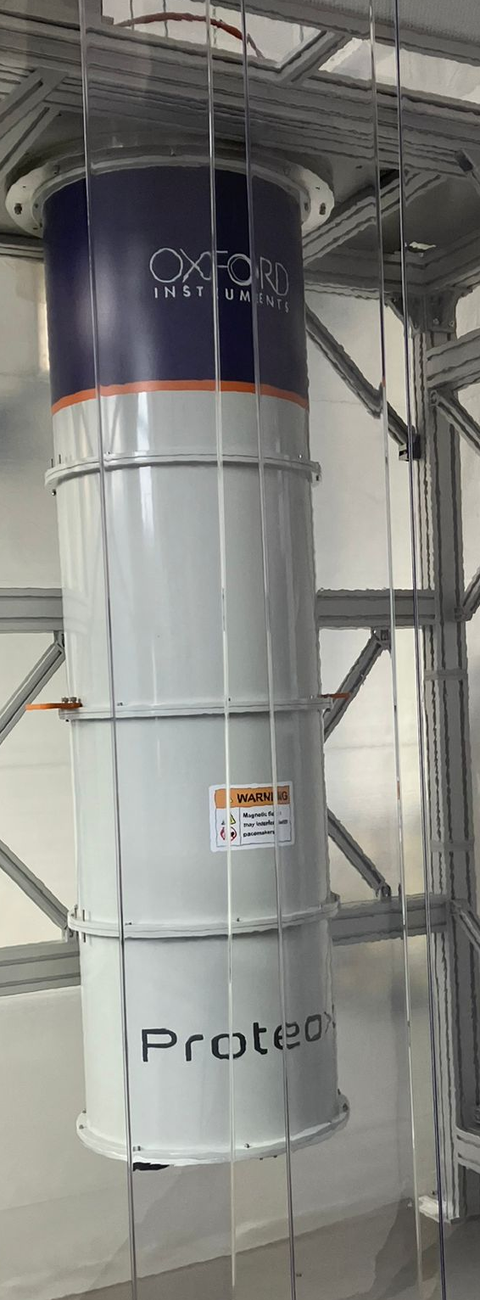
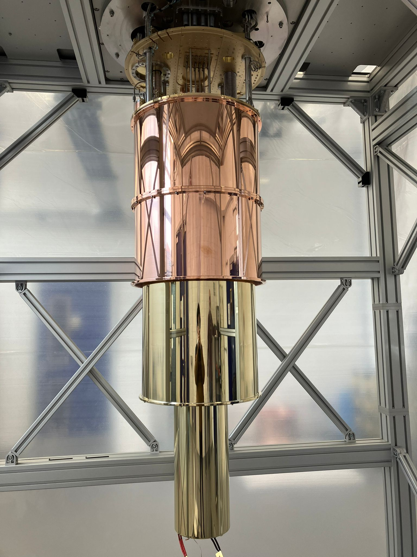
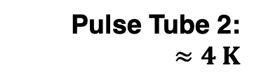
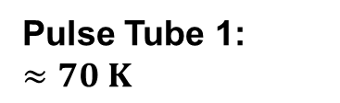
The Fridge
Data Acquisition: Room Temperature
Pulse Tube 1:
$$≈70 K$$
Pulse Tube 2:
$$≈4 K$$
Still Plate:
700 mK
Cold Plate:
100 mK
Mixing Chamber Plate:
8.5 mK
Tuneable 5 GHz Cavity
Cavity Temperature:
12 mK
Magnet Internal Bore:
18.5 cm

Slide 6
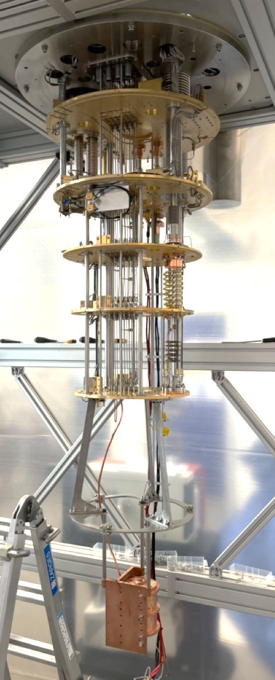
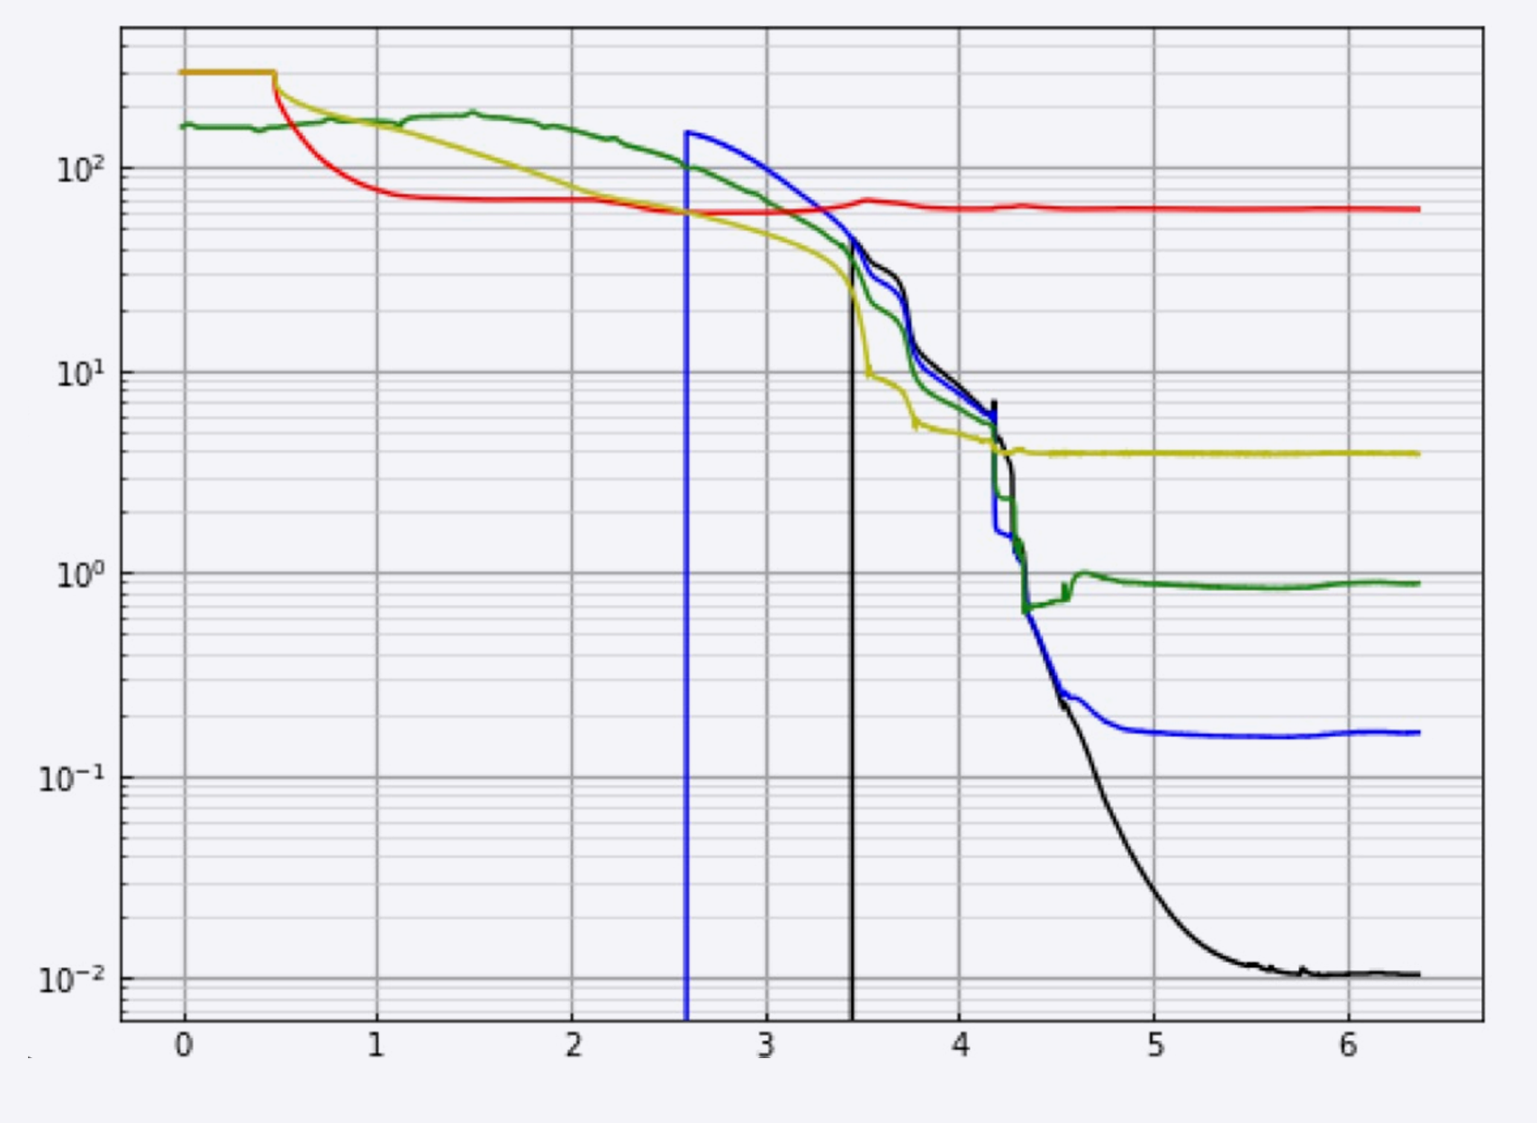
First Cavity Cooldown
Temperature (K)
Time offset (days)
Cavity temperature
sensor at 18mK

Slide 7
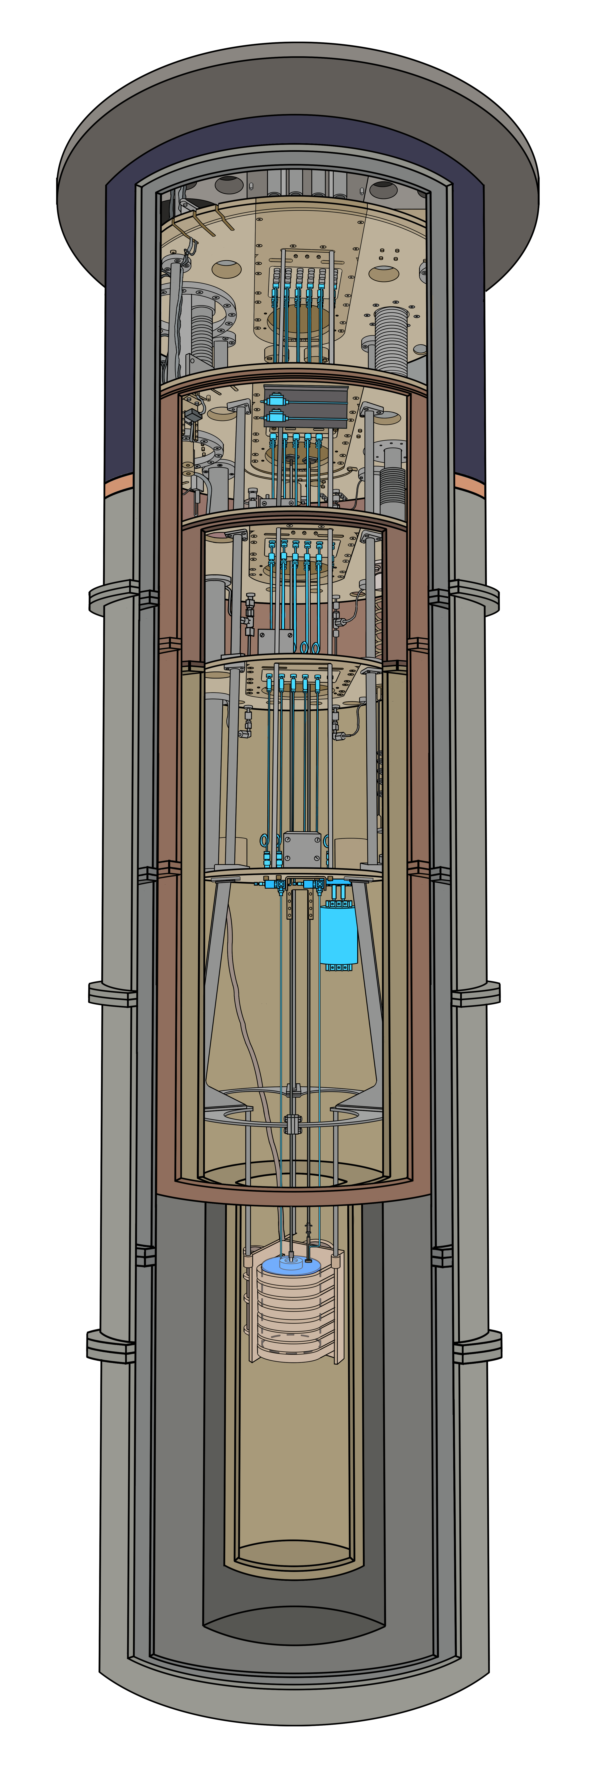
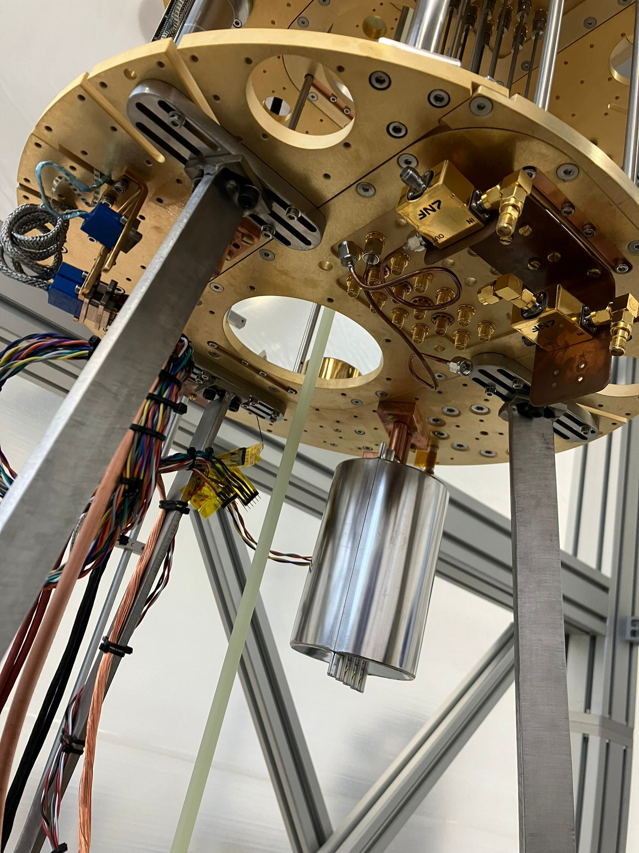
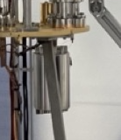
The Magnetic Field Shield
Field Shield
design,
Ed Laird
(Lancaster)
simulations
by
Paul Smith
(Sheffield)

Slide 8

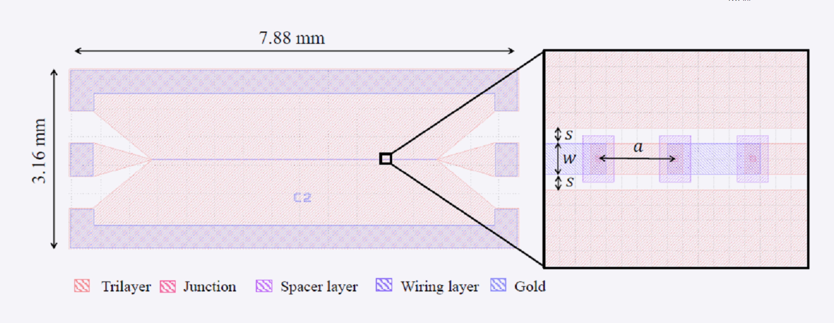


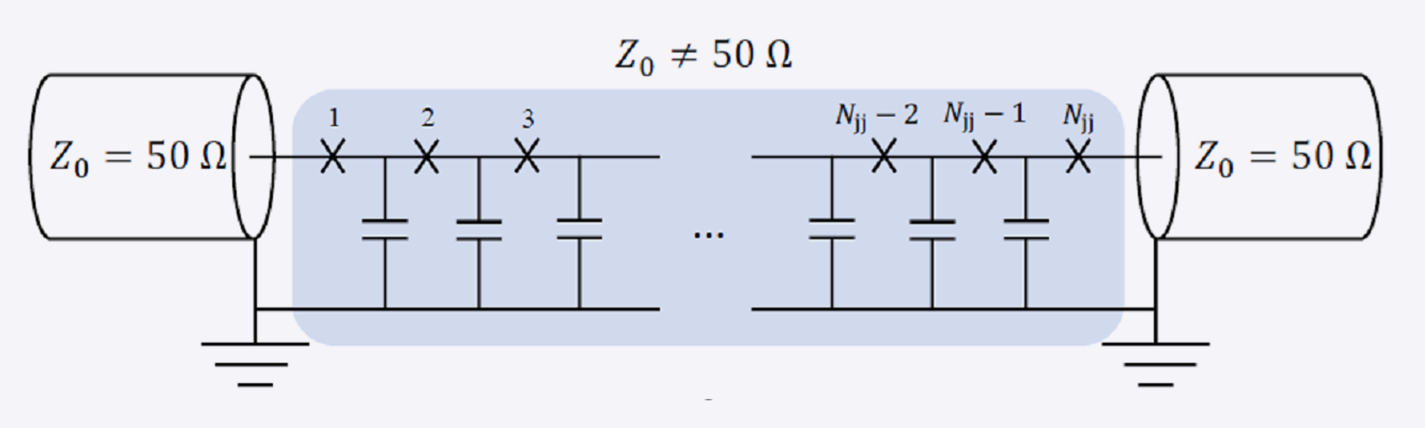
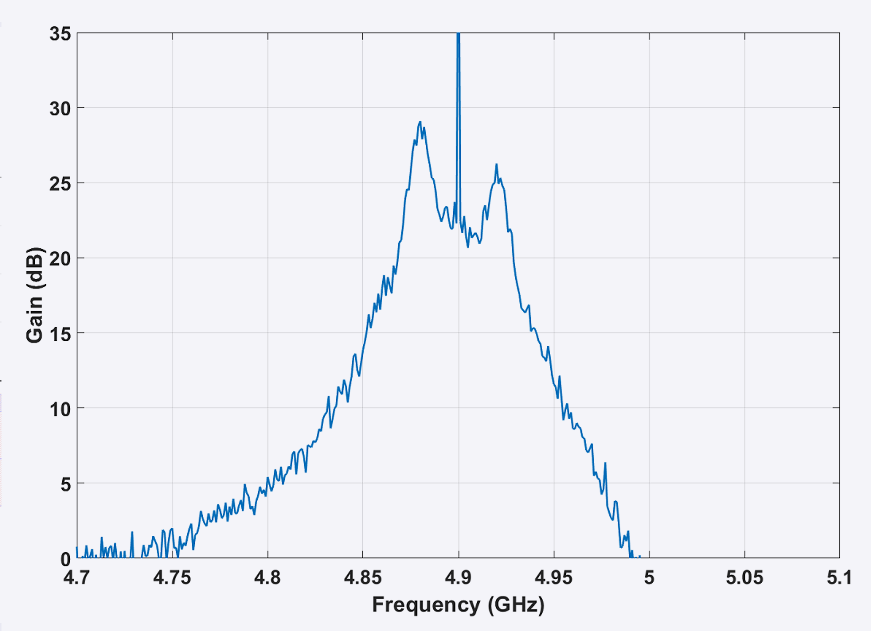
Standing Wave Parametric Amplifier (SWPA)
Boon Kok Tan, Javier Navarro Montilla
Over 20 dB gain over ~ 60 MHz optimal region

Slide 9
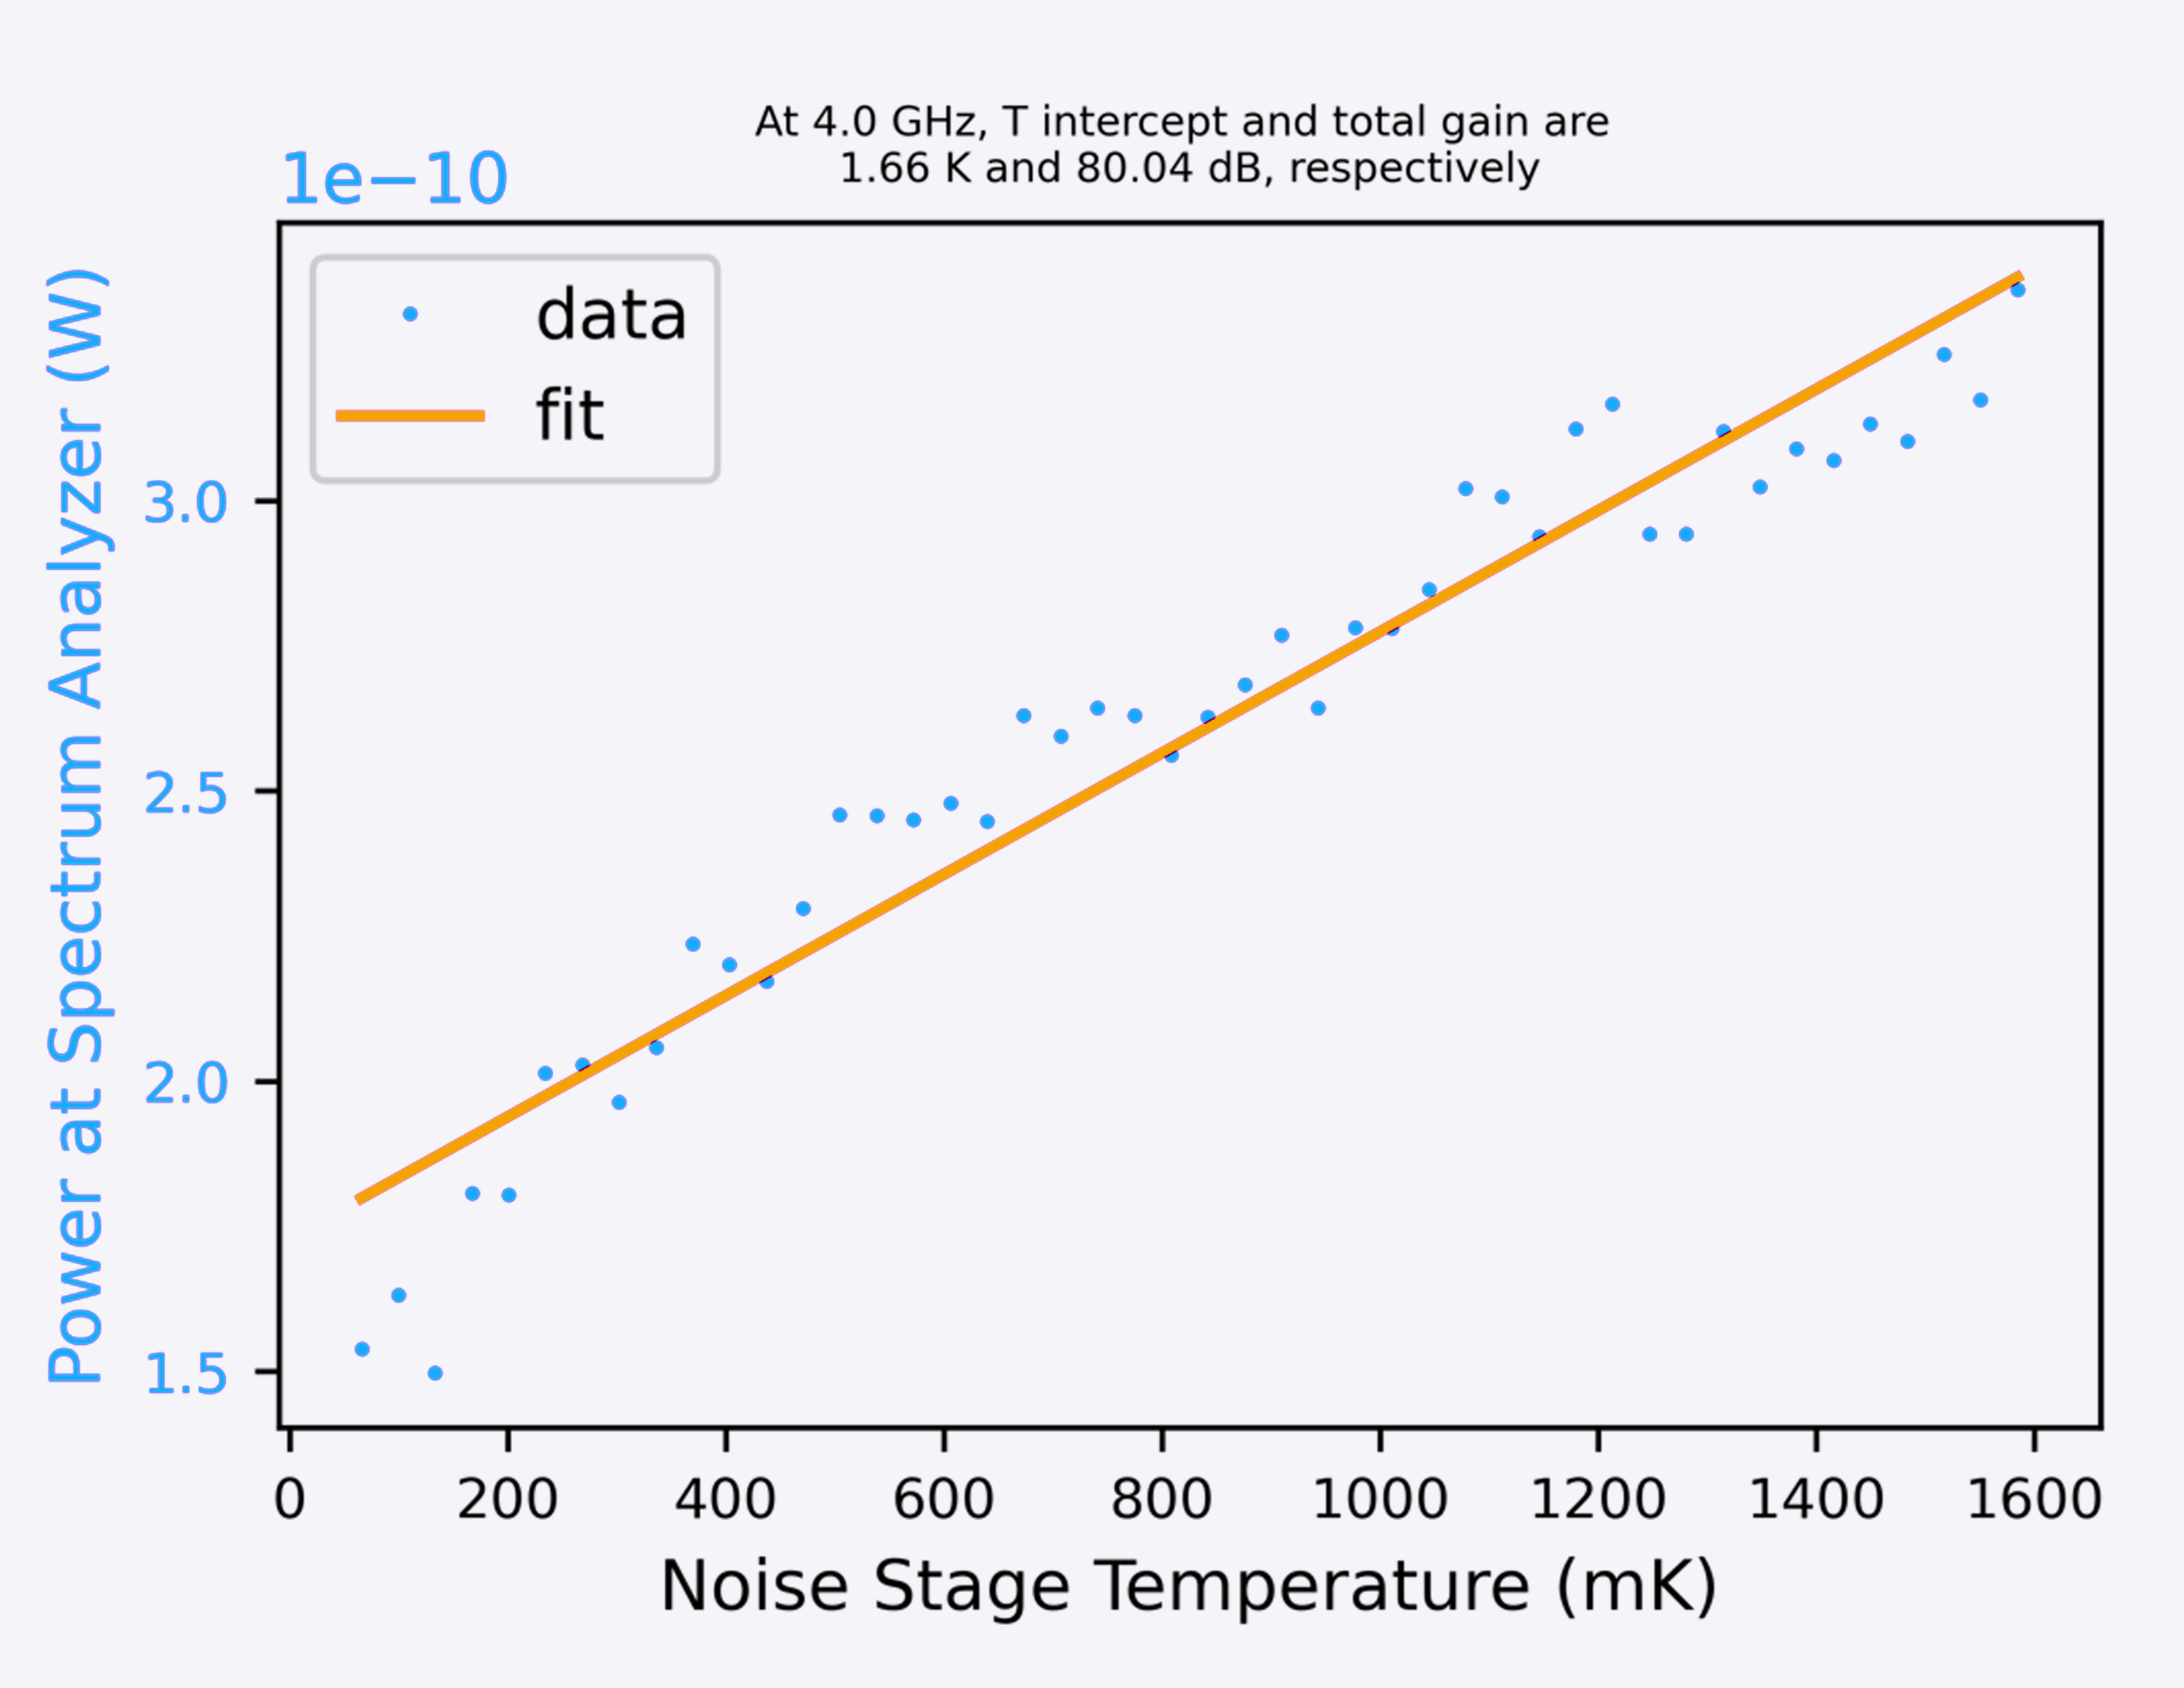
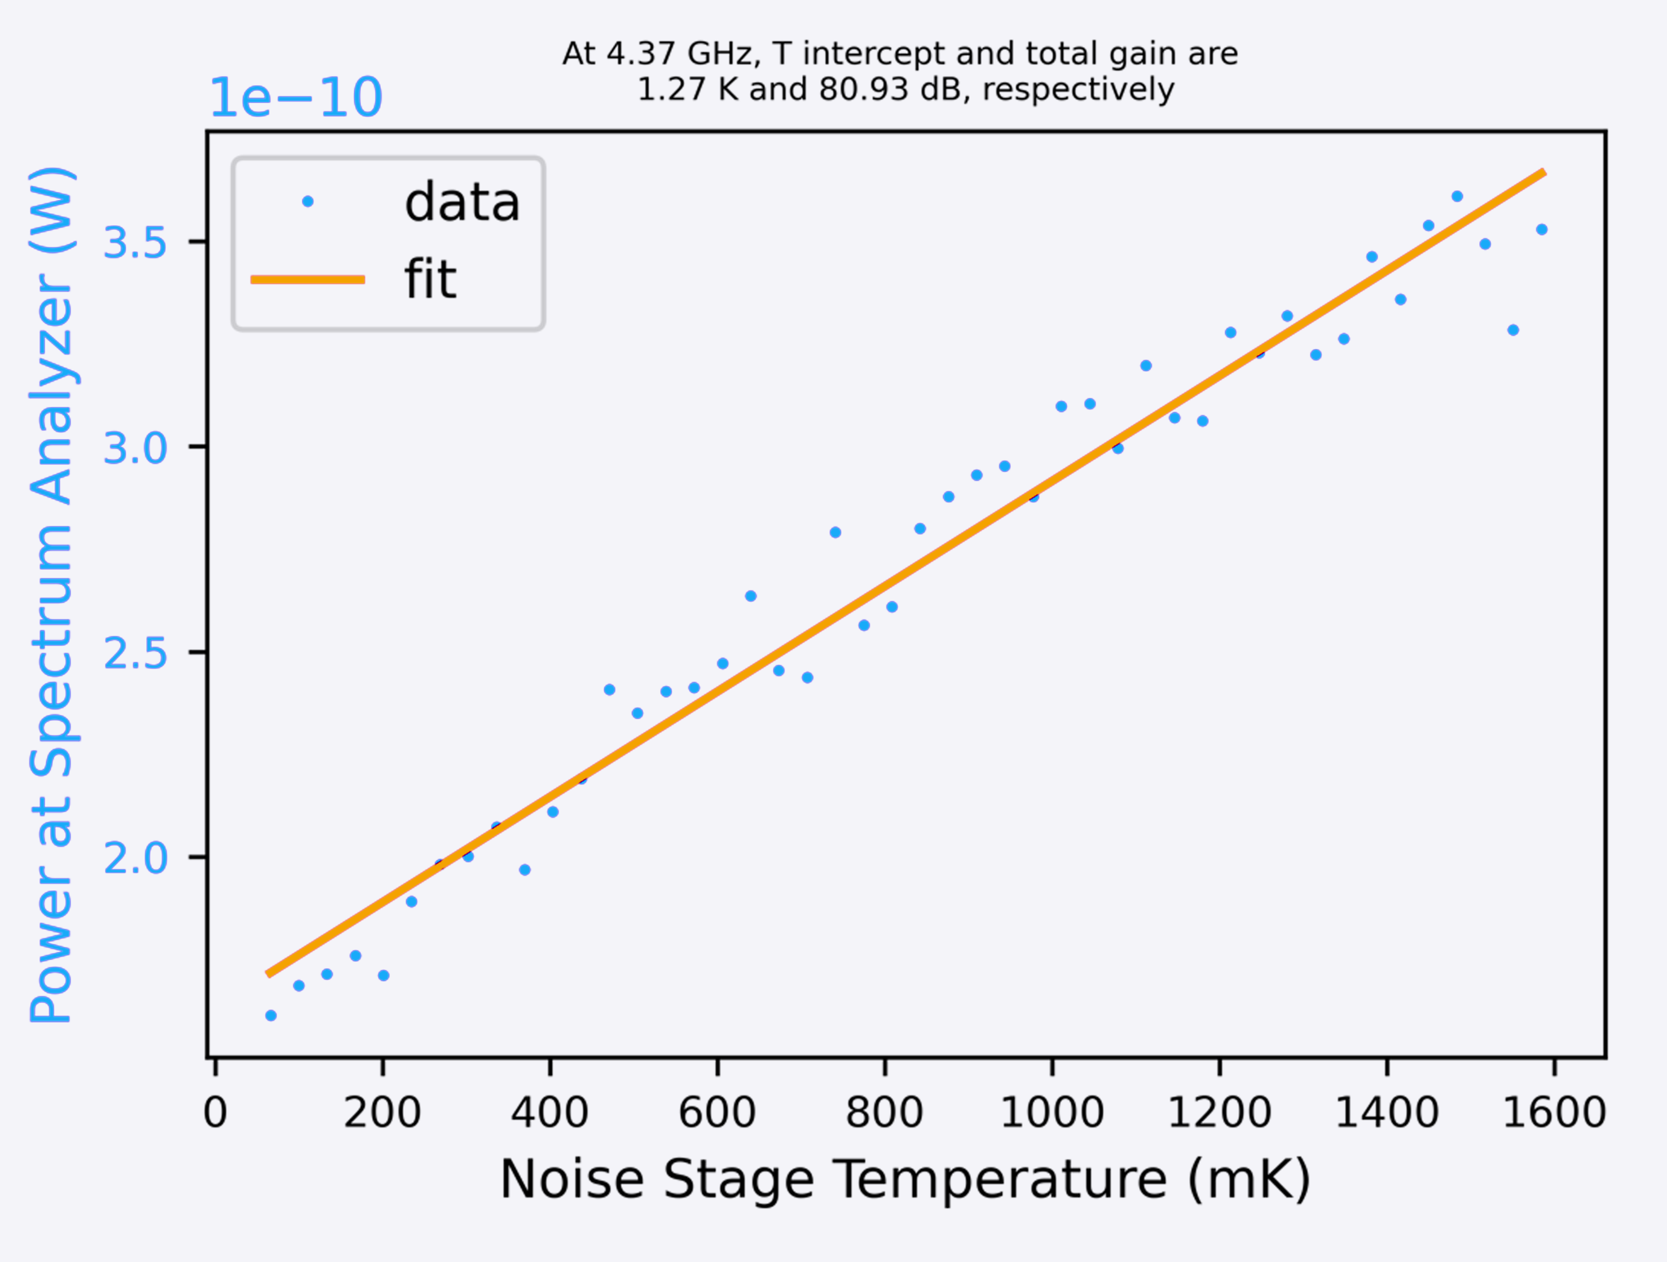
Joshoua
SNAIL JTWPA – Lancaster, VTT (Finland)
Joshoua Esmenda, Yuri Pashkin & Collaborators
4.0 GHz:
1.66 K Gain
80.04 dB T Intercept
4.37 GHz:
1.27 K Gain
80.93 dB T Intercept
Noise temperatures as low as 574 mK
4.0 GHz
4.37 GHz
Signal Frequency (GHz) | Bypass |  | Parameters 0 Pump=13 GHz, -61 dBm, BC = 670 uA
 | T_{bypass} (K) | G (dB) | T_{total} (K) | G (dB) | T_{TWPA} (K) | G_{TWPA} (dB)
4.00 | 9.3 | 69.34 | 1.91 | 79.05 | 0.915779 | 9.71
4.37 | 9.94 | 69.38 | 2.4 | 79.3 | 1.38752 | 9.92
5.00 | 8.75 | 68.62 | 1.85 | 80.18 | 1.239047 | 11.56
6.00 | 7.55 | 66.93 | 1.72 | 77.79 | 1.100635 | 10.86
6.20 | 7.94 | 66.79 | 1.95 | 76.85 | 1.166894 | 10.06
8.00 | 7.85 | 67.76 | 1.88 | 81.05 | 1.511981 | 13.29
 | Parameters 1 Pump=12.4 GHz, -61 dBm, BC = 695 uA |  |  |  | Parameters 2 Pump=12.4 GHz, -61 dBm, BC = 705 uA
 | T (K) | G (dB) | T_{TWPA} (K) | G_{TWPA} (dB) | T (K) | G (dB) | T_{TWPA} (K) | G_{TWPA} (dB)
 | 1.7 | 81.08 | 1.077007 | 11.74 | 1.66 | 80.04 | 0.868442 | 10.7
 | 1.27 | 80.93 | 0.574357 | 11.55 | 1.75 | 81.2 | 1.096288 | 11.82
 | 2.64 | 79.17 | 1.869082 | 10.55 | 2.13 | 80.51 | 1.56375 | 11.89
 | 1.85 | 75.81 | 0.872882 | 8.88 | 4.93 | 77.36 | 4.246172 | 10.43
 | NA | NA | NA | NA | NA | NA | NA | NA
 | 3.61 | 81.64 | 3.28873 | 13.88 | 4.58 | 79.71 | 4.078963 | 11.95
Signal Frequency (GHz)

Slide 10
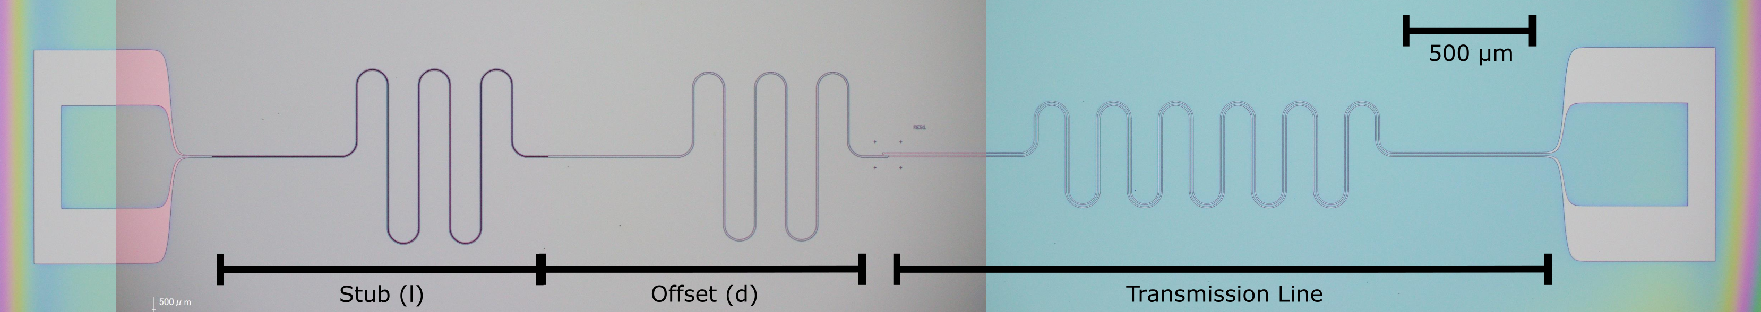
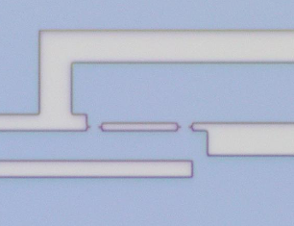
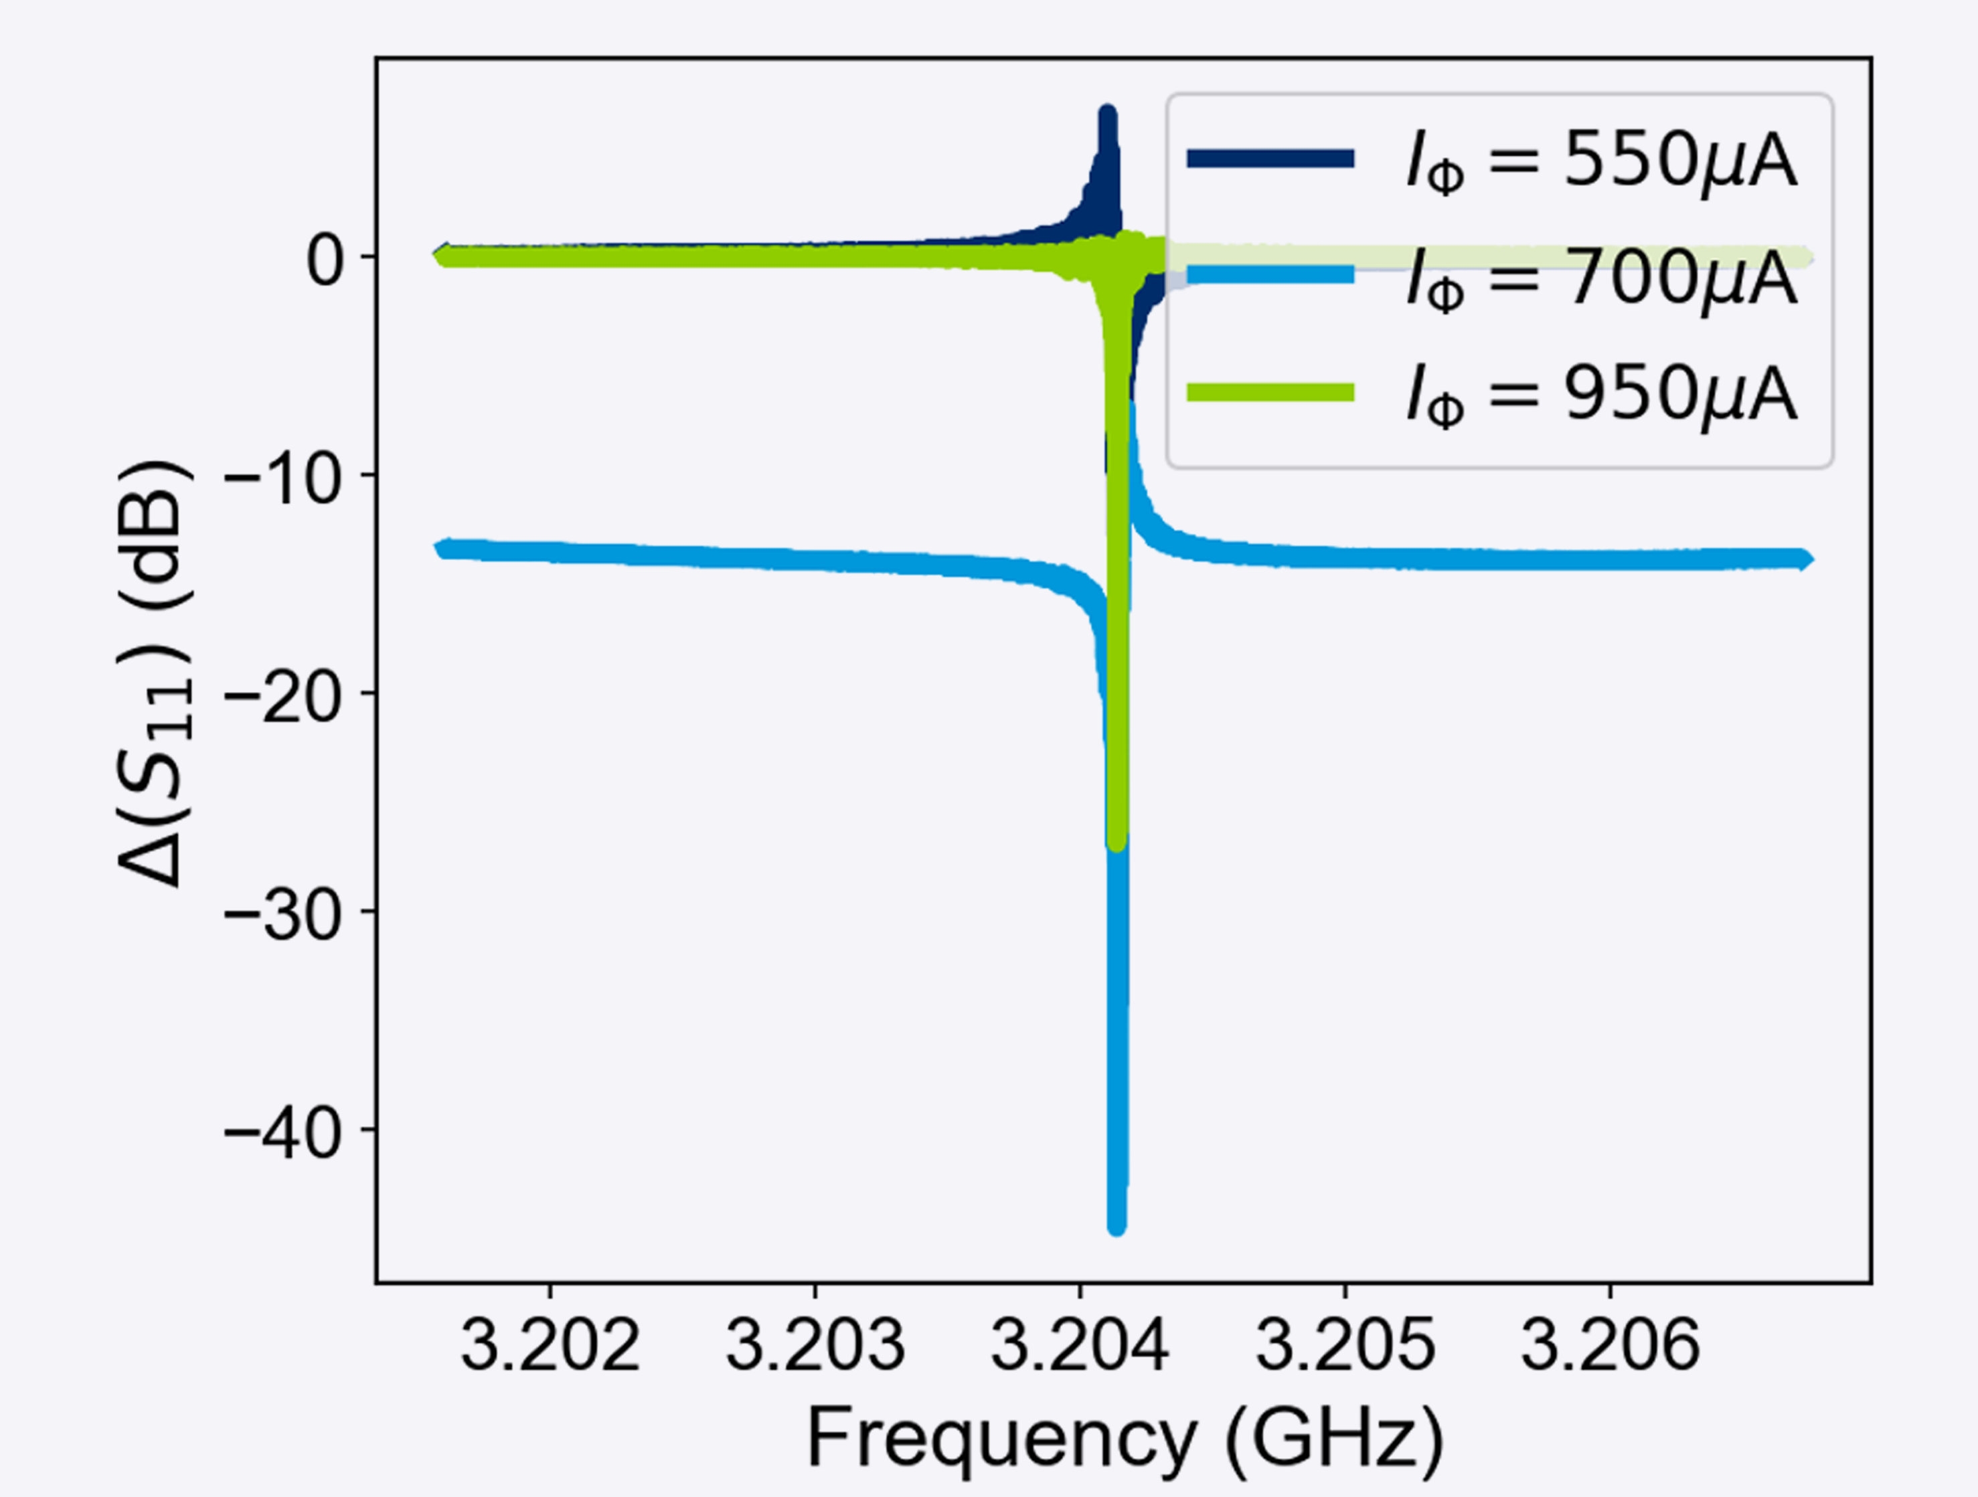
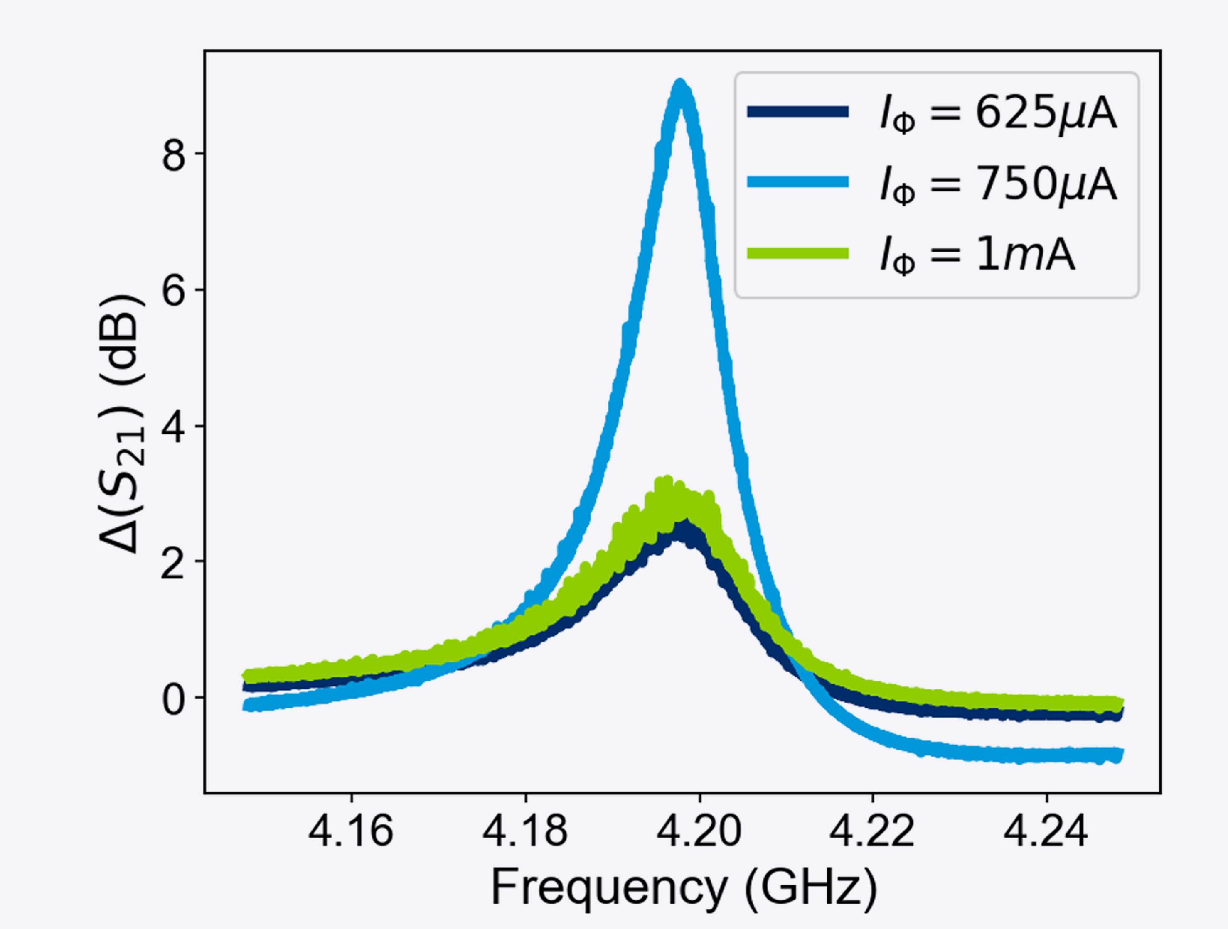
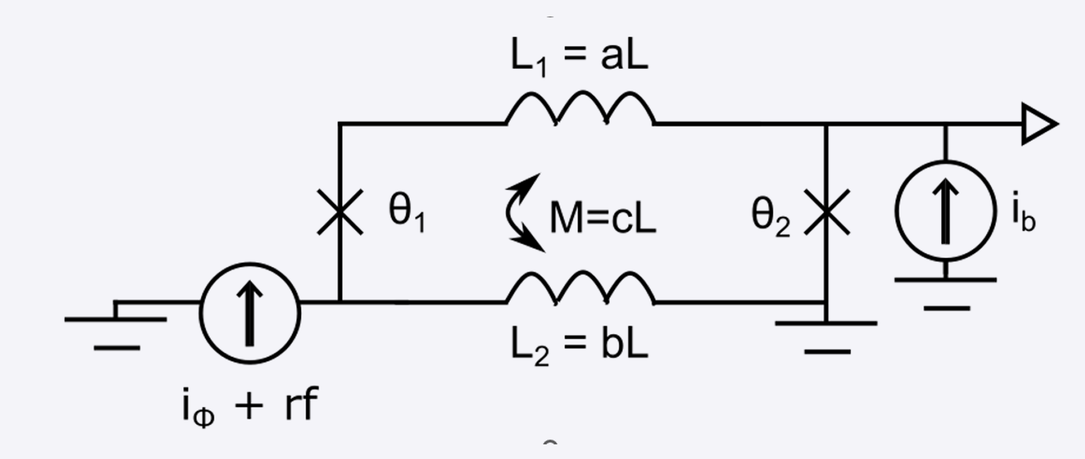
SLUG Loaded SQUID Amplifier
2 µm
1 µm
L = 3.1 pH
R = 5.8 Ω V_{Φ} = 0.14 mV/Φ₀
Ling Hao (NPL)
Gemma Chapman (NPL)
Ed Romans (UCL)
Thomas Godfrey (UCL)
T = 6.4 K
P_{in} = -40 dBm

Slide 11
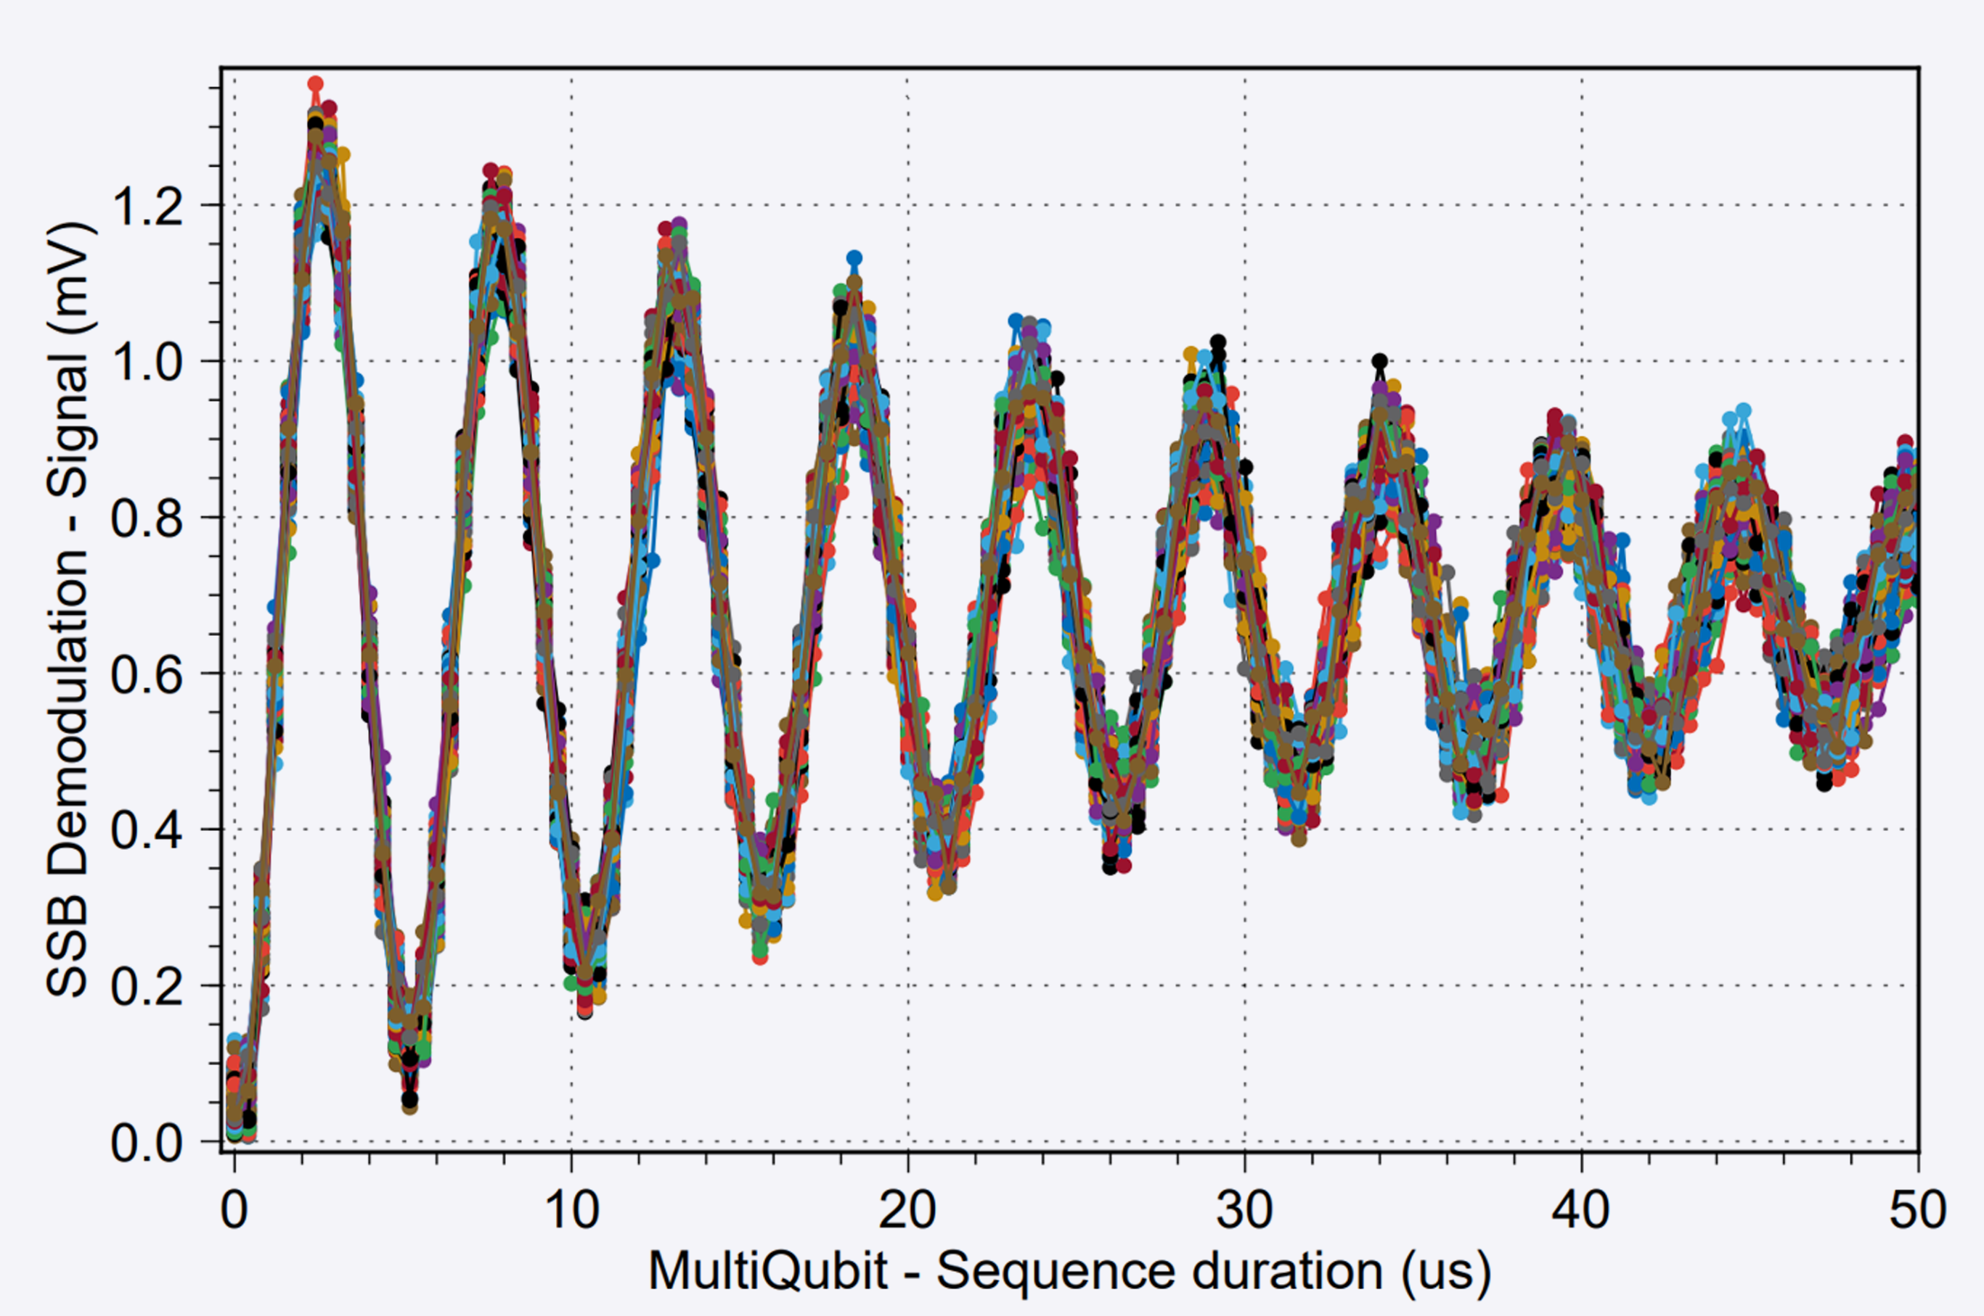
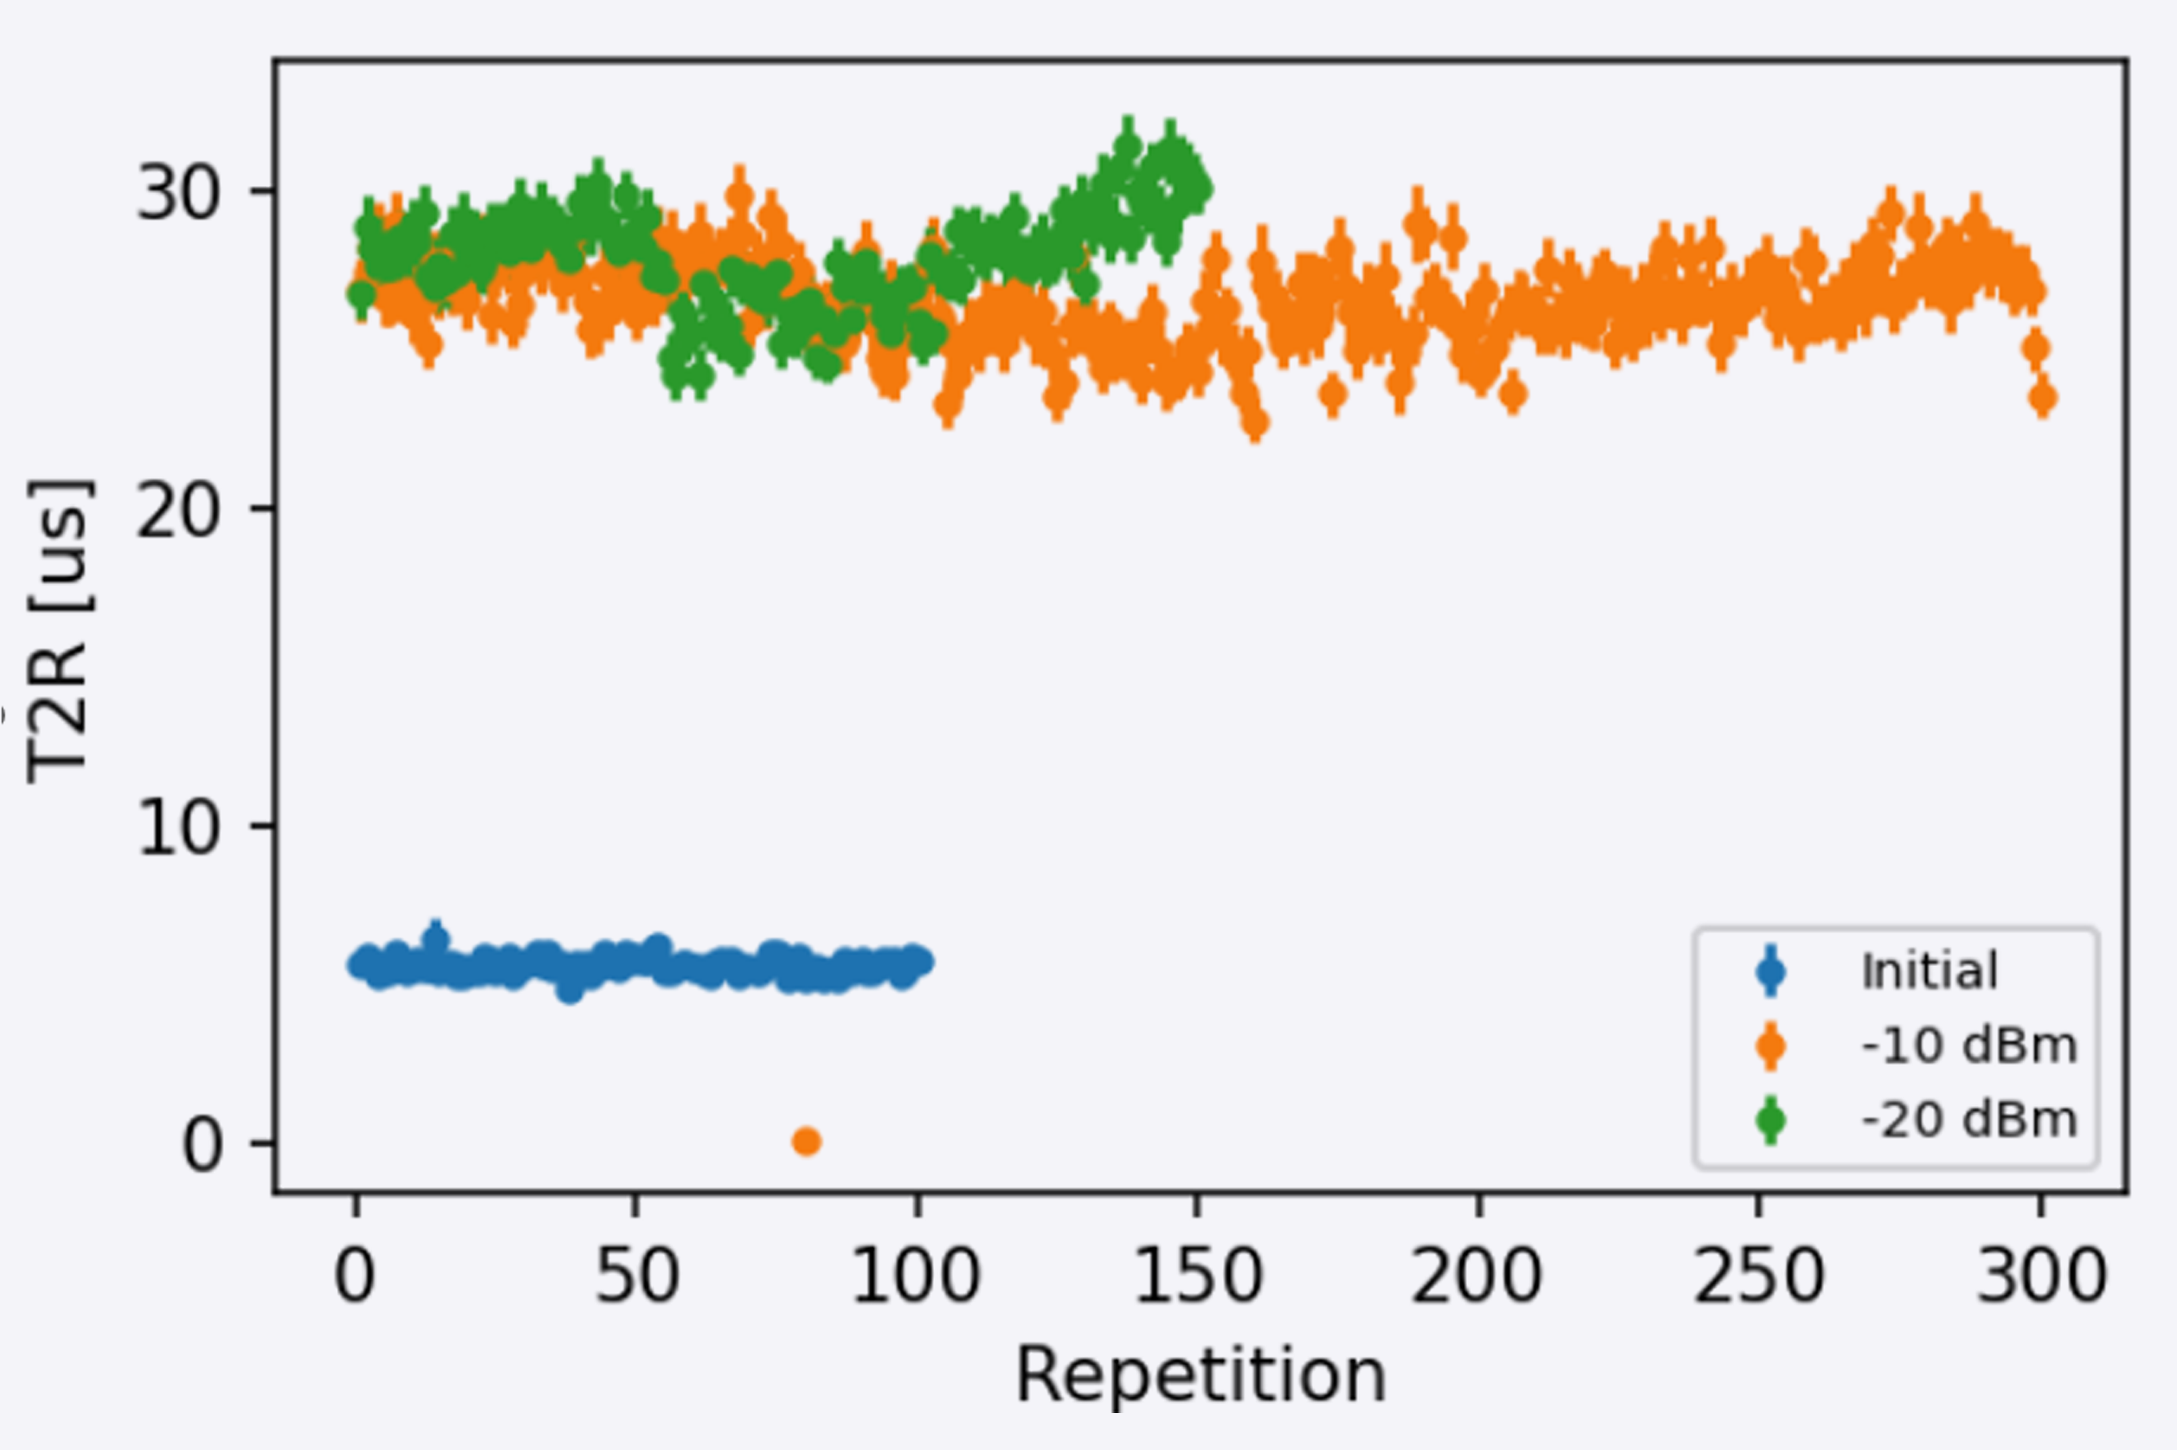
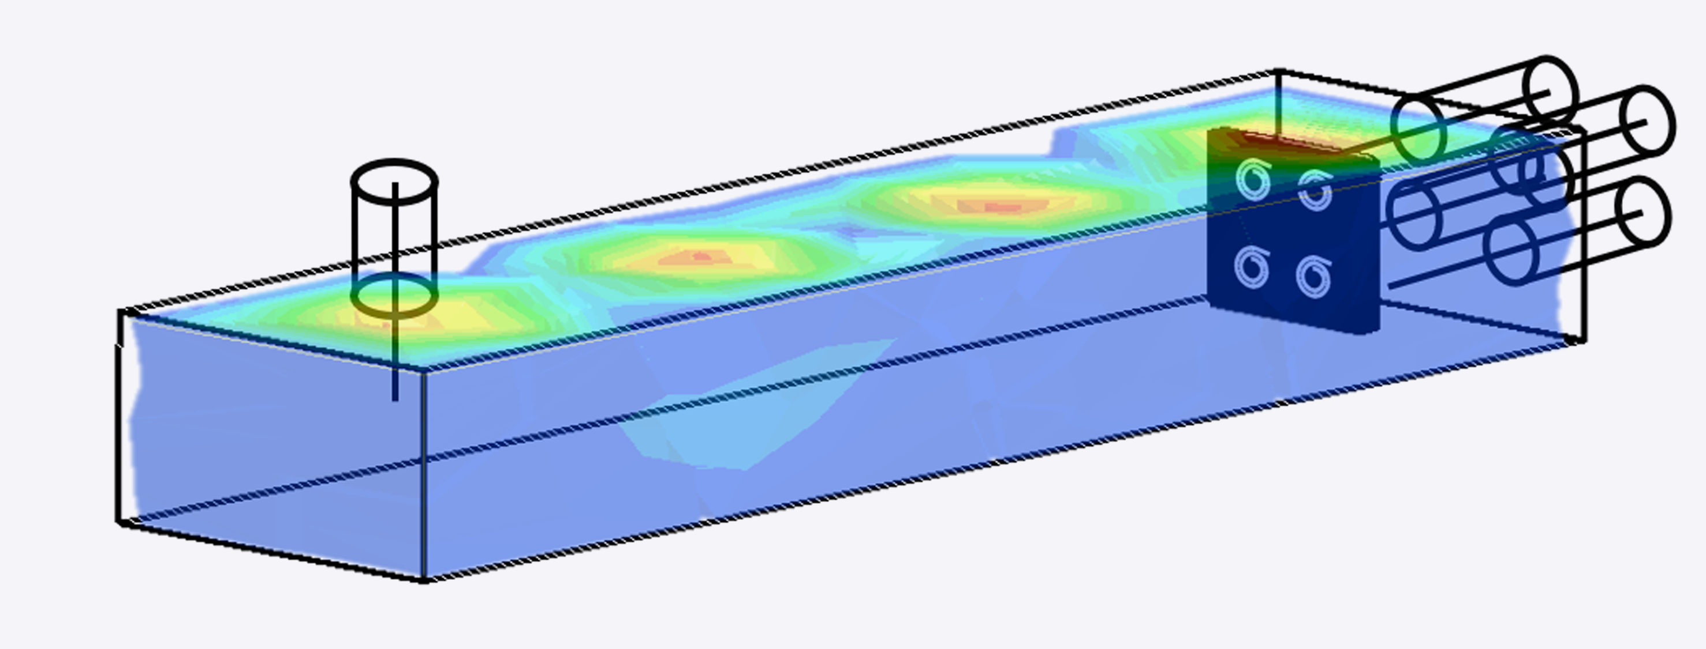
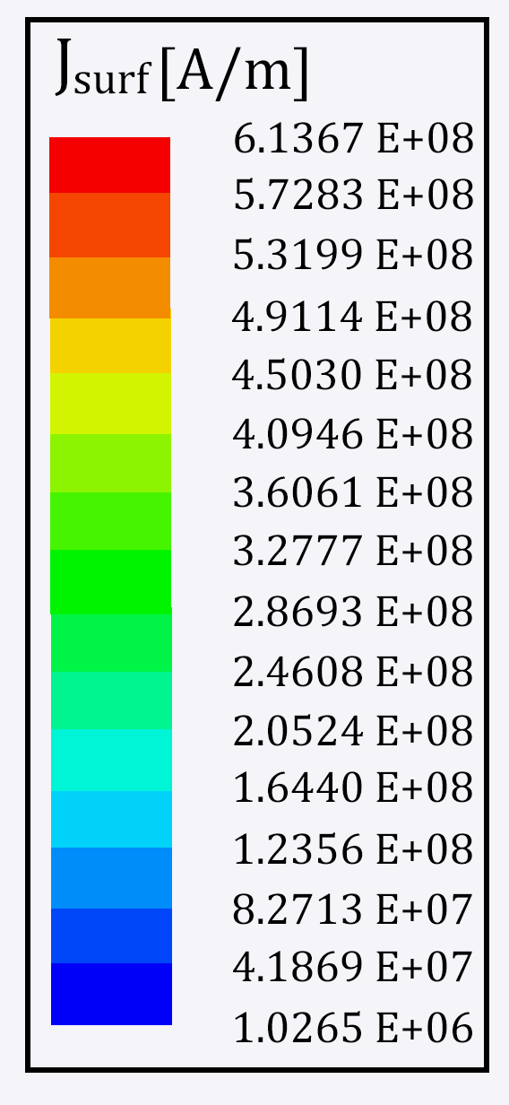
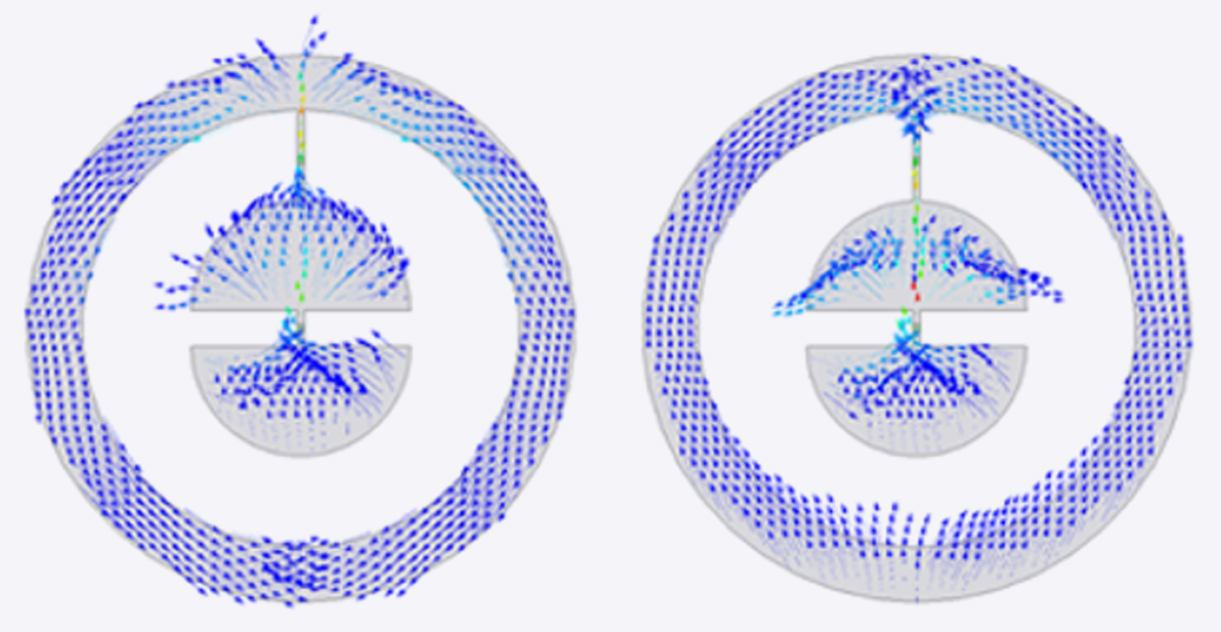
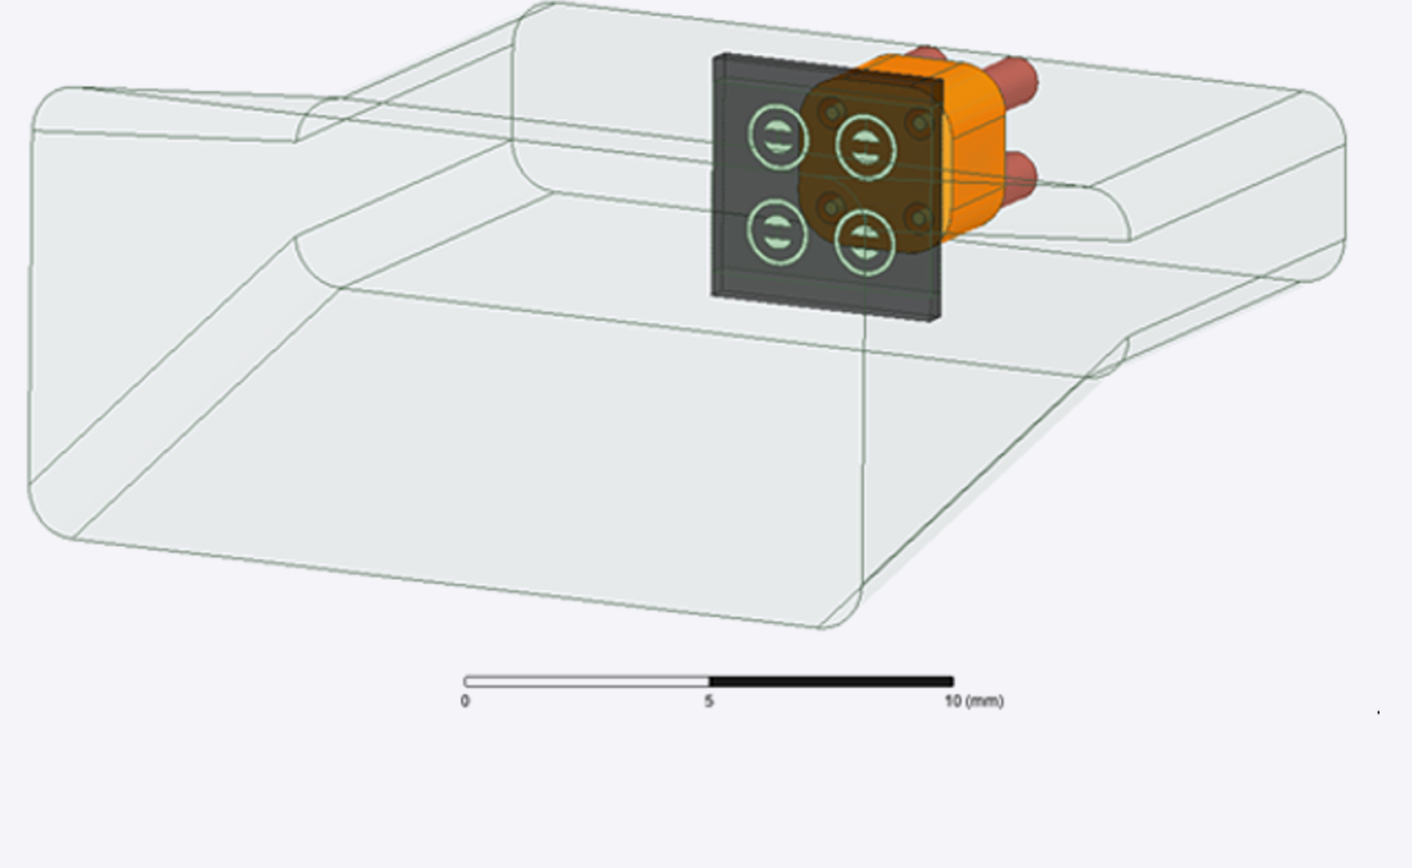
Qubit Sensor Development
Michele Piscatelli
Peter Leek
-20 dBm: Ramsey_x150
Coaxial Control Ports
Waveguide Input Port
Device
Low Frequency Port (4 GHz)
High Frequency Port (10 GHz)

Slide 12
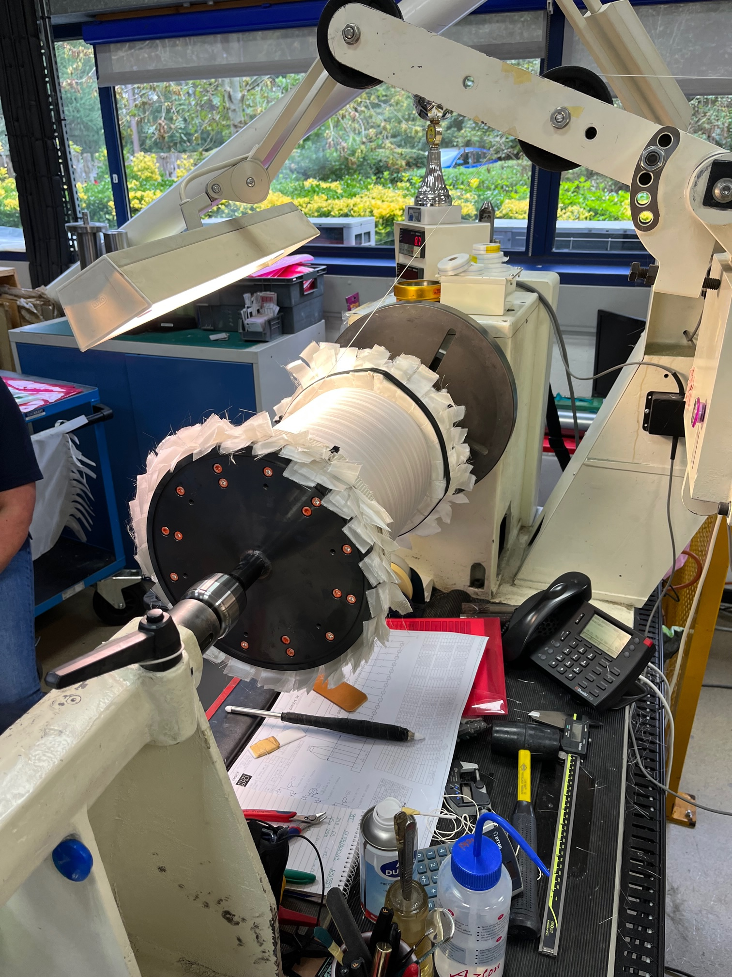
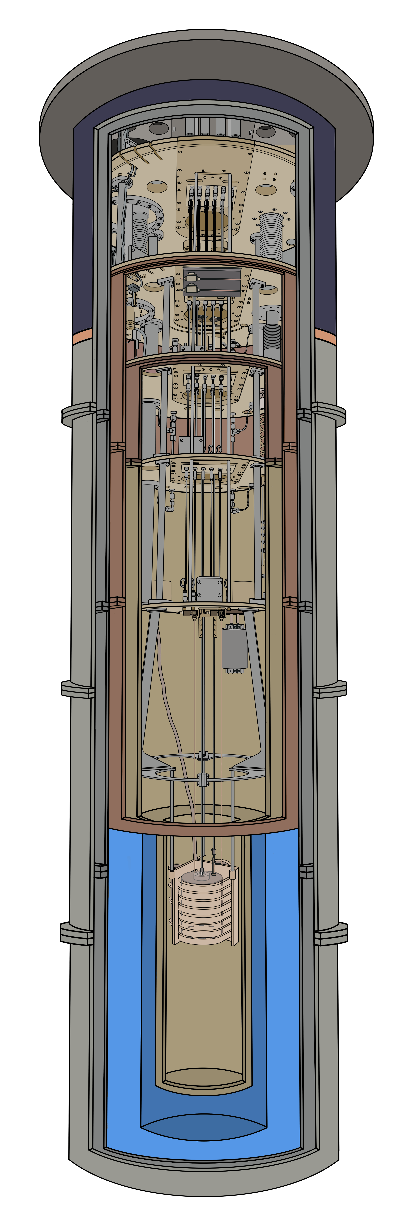
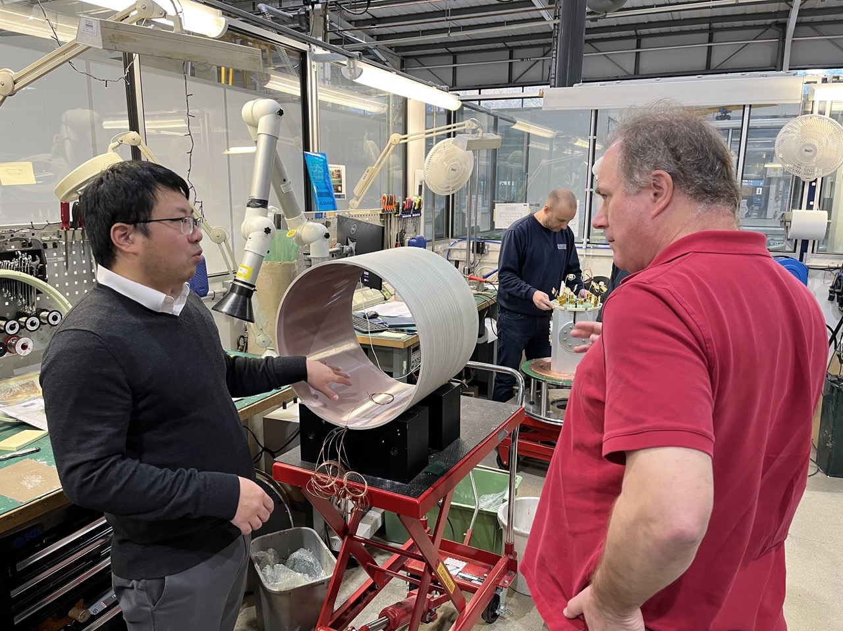
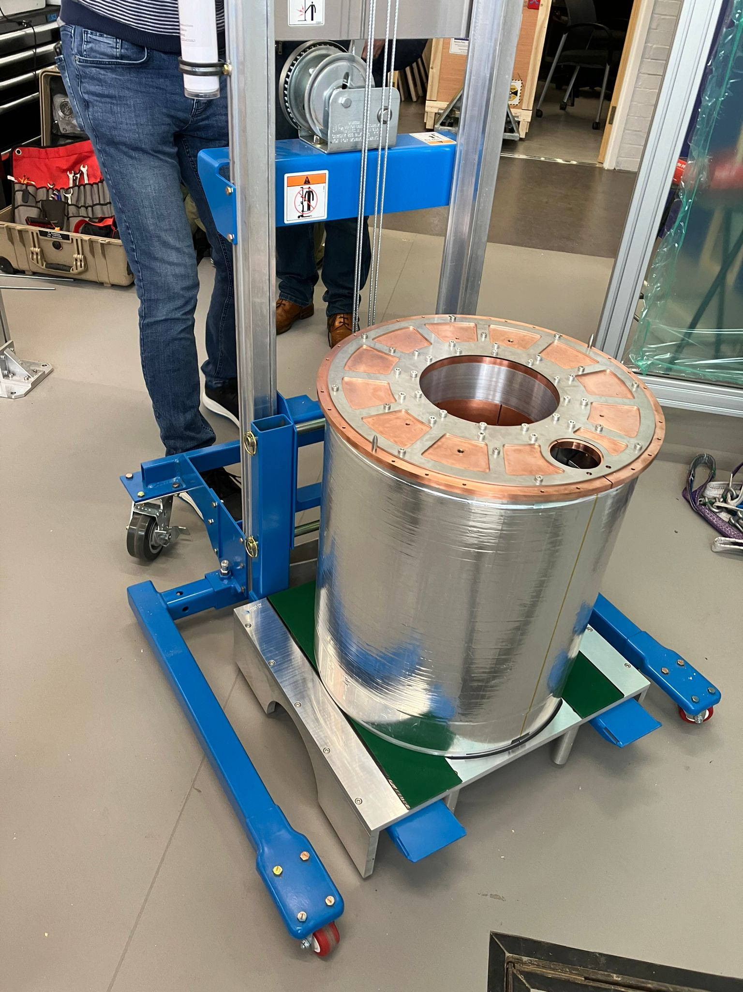
Current Magnet Status
Magnet Coil Being Wound at Oxford Instruments
Gu Yuwei (Magnet Engineer, Oxford Instruments) and Phil Meeson (RHUL). New Outer Coil.
6T max field with initially delivered magnet, design was for 8T
Quench at higher fields suspected to be caused by deformation of outer shield coil relative to former.
New formerless coil now fabricated and assembled at Oxford Instruments. Cold tests imminent.
Initial Magnet at Sheffield

Slide 13
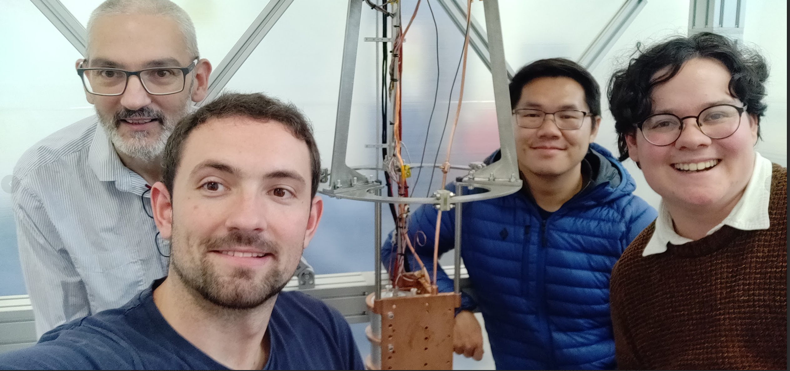
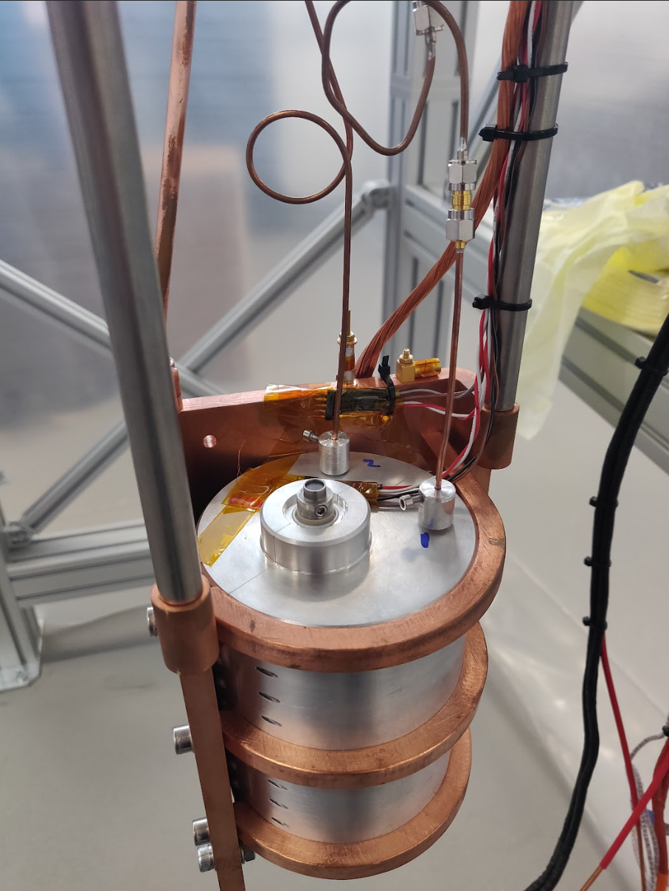
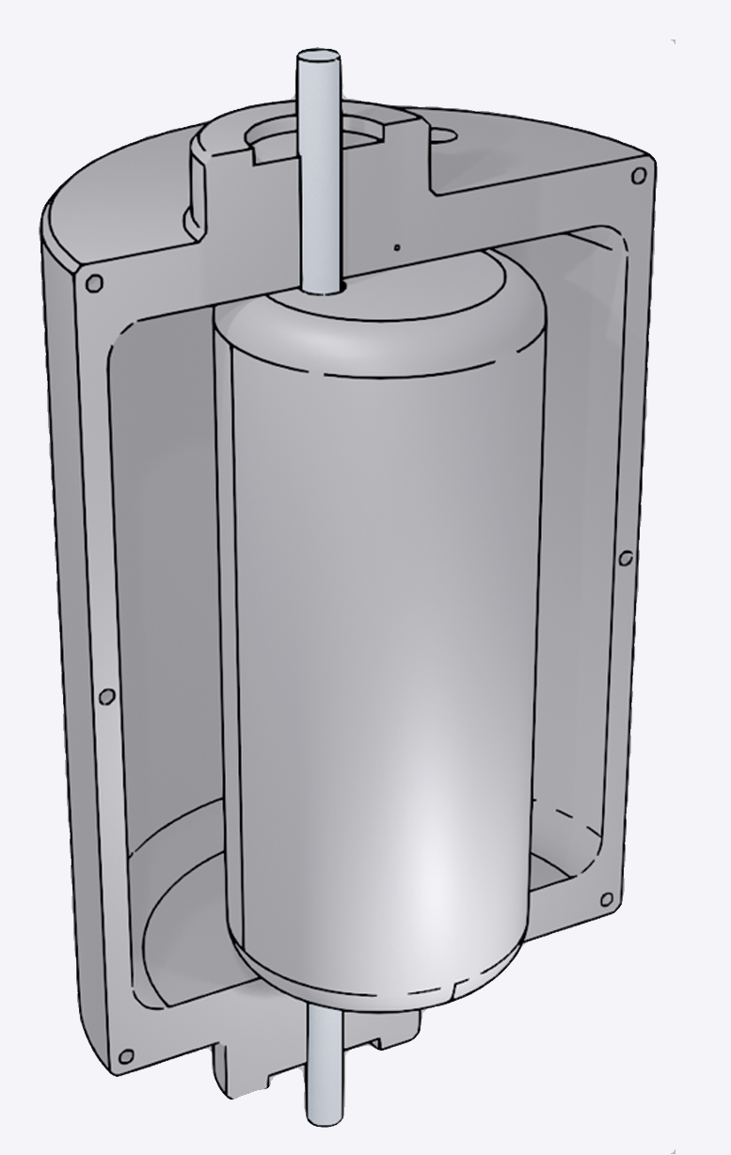
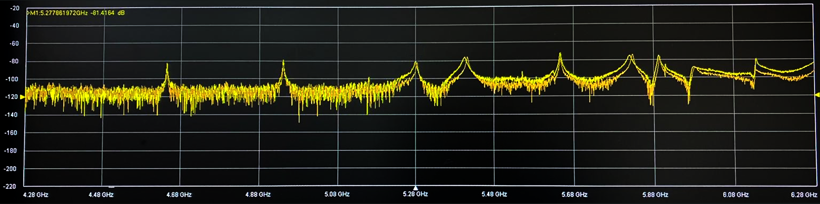





ADMX: Superconducting Magnet Test
Niobium Tin Tuning Rod Coating:
11 K Superconducting
Transition
Nick Du (Post Doc, LLNL ADMX), Paul Smith (Post Doc, Sheffield), Mitch Perry and Claude Mostyn (PhD Students, Sheffield)
$$f_{r4}≈5.820 GHz$$
$$f_{r5}≈5.897 GHz$$
Niobium Tuning Rod:
9 K SC Transition
Aluminium Cavity:
1 K SC Transition
VNA Spectrum, Before Cool
$$f_{r3}≈5.691 GHz$$
$$f_{r2}≈5.398 GHz$$
$$f_{r1}≈5.269 GHz$$

Slide 14

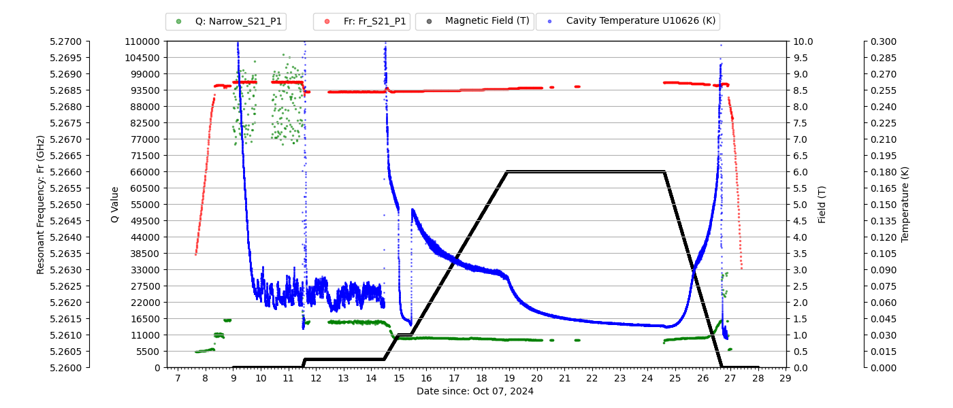
Characterisation of superconducting resonators in magnetic fields
PRELIMINARY
Paul Smith – Postdoctoral Associate, Nick Du (Livermore Lab research fellow, ADMX collaborator)

Slide 15
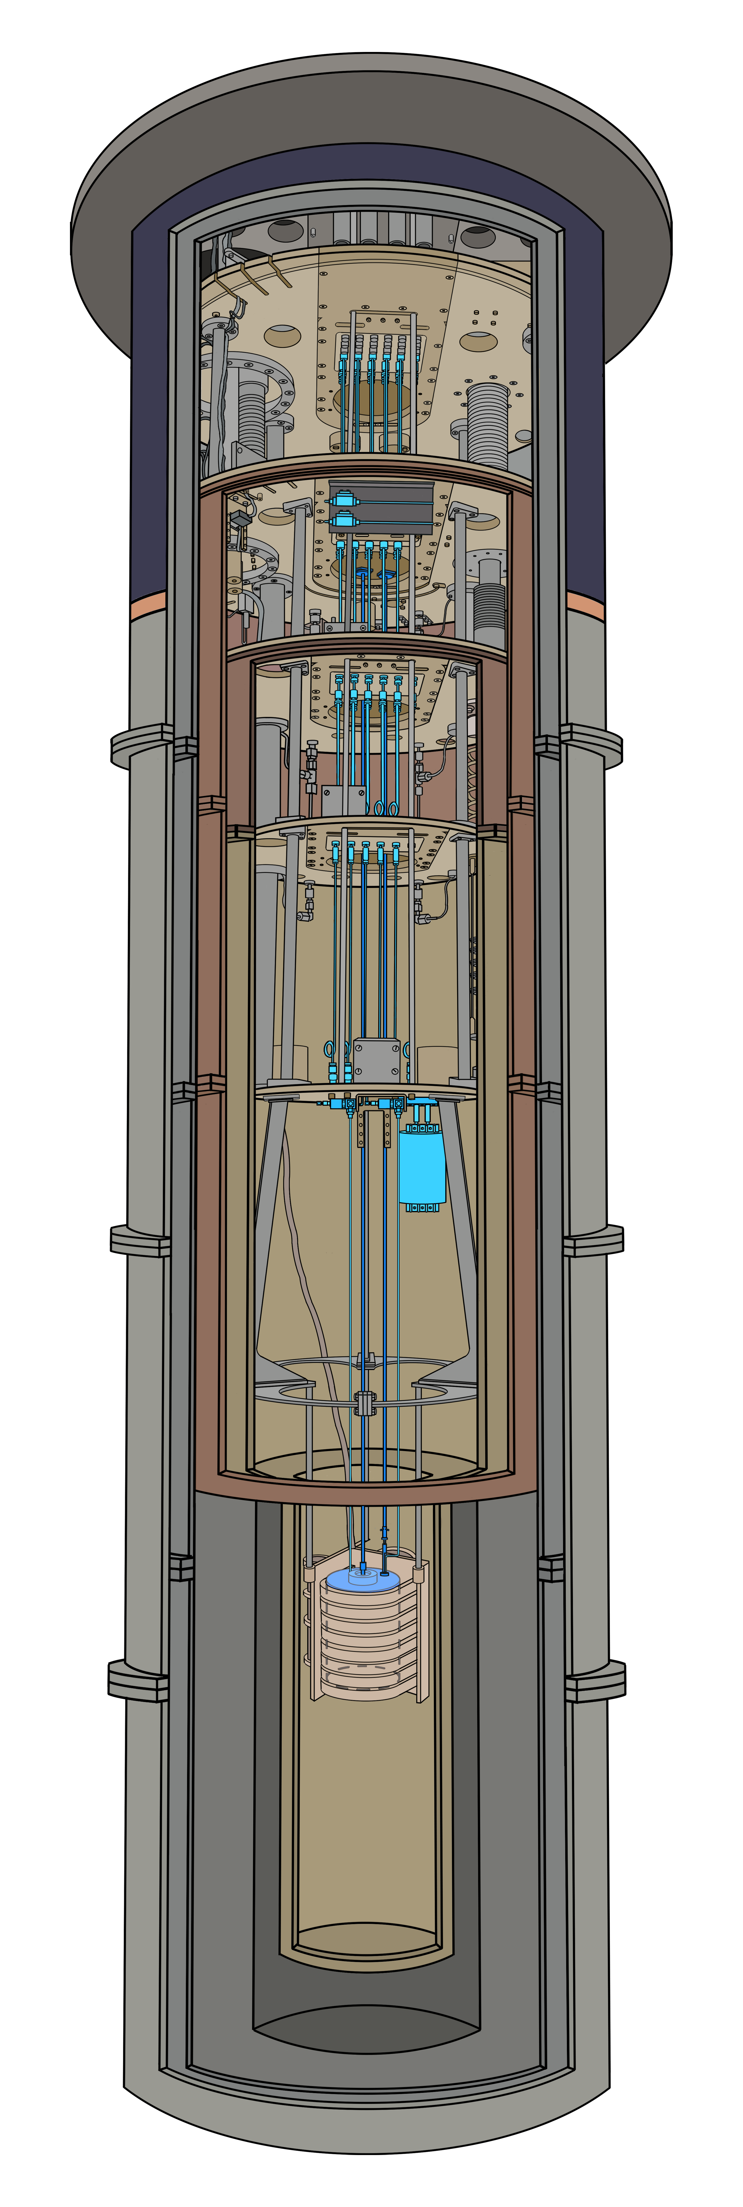
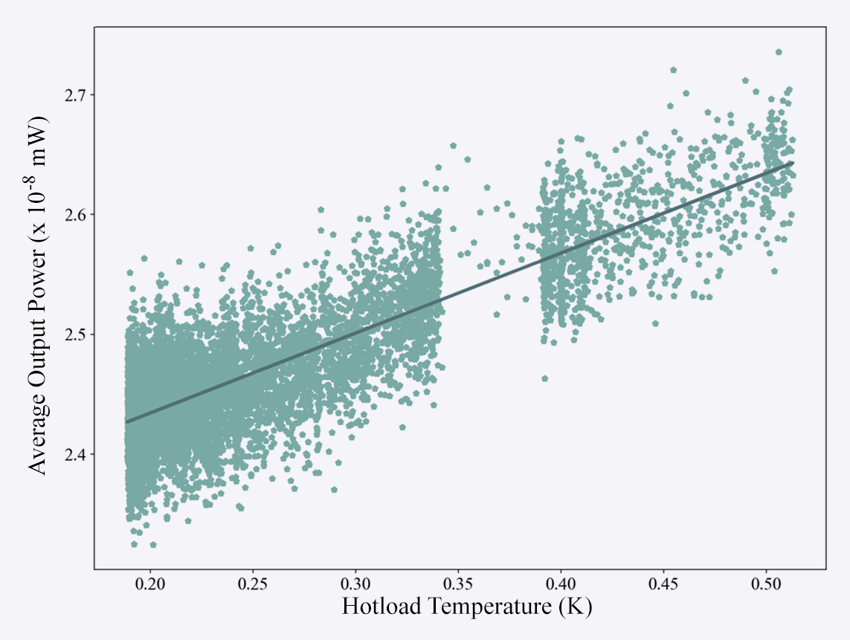
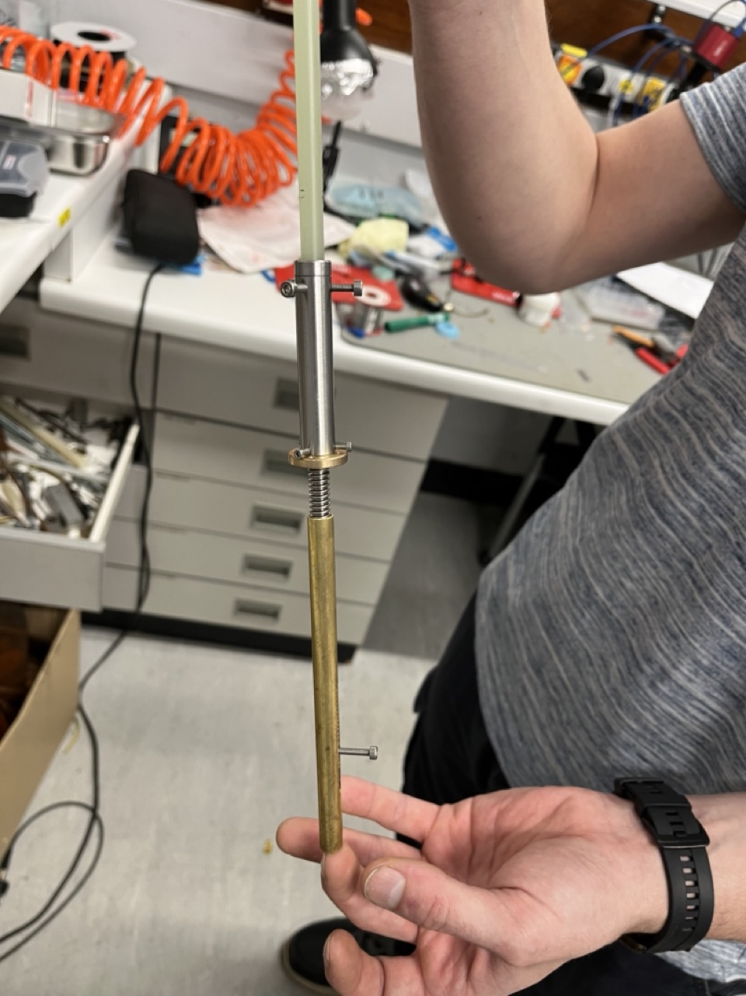
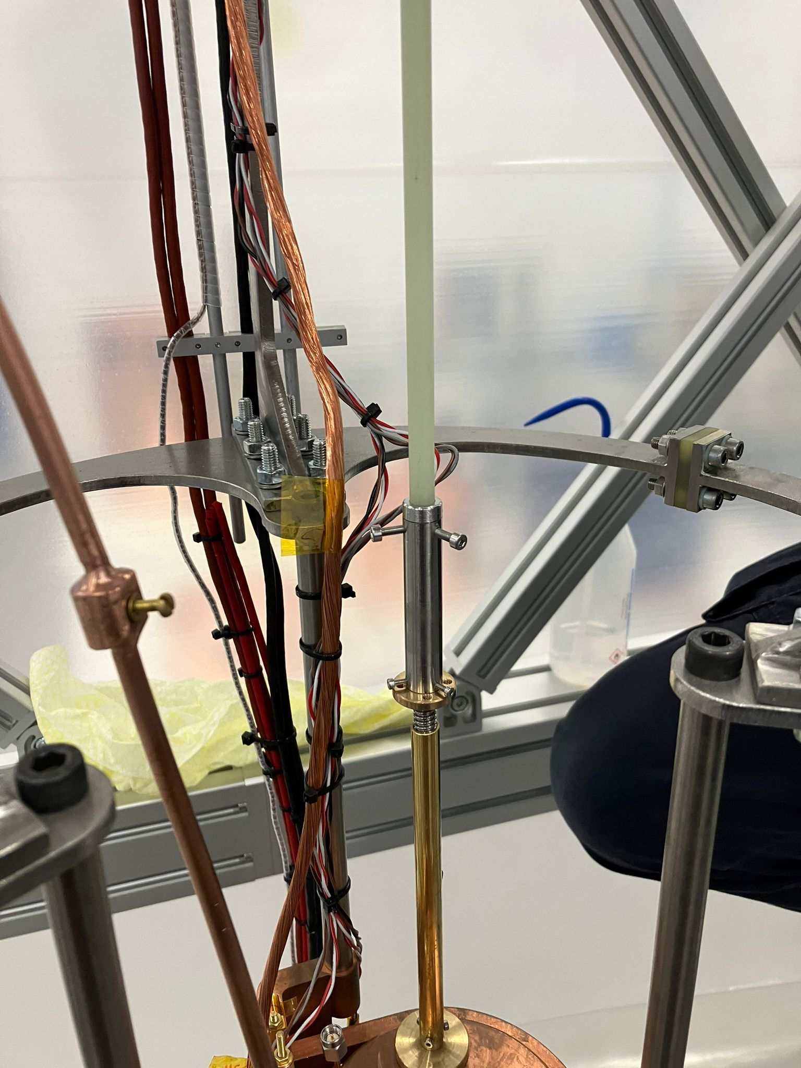
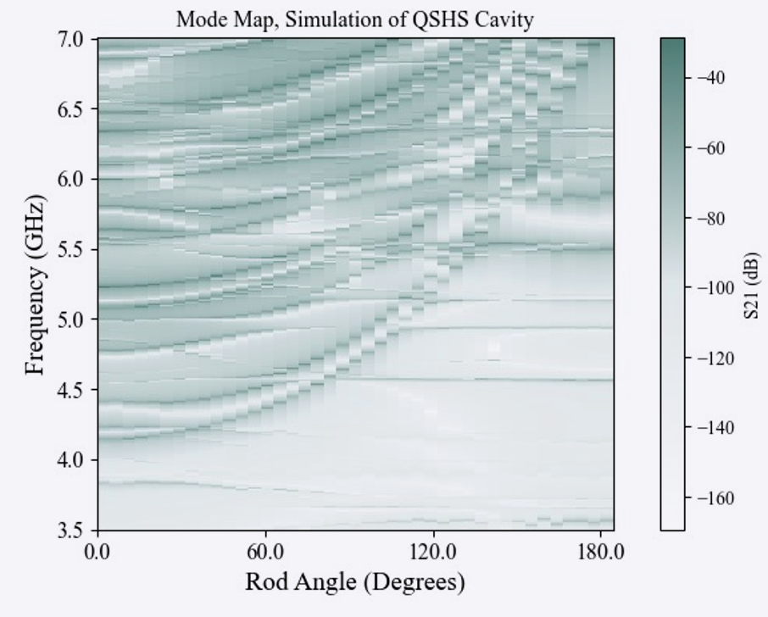
Current Work
AttoCube piezo actuators to control antenna and tuner installed, hardware connection in progress
Limited torque; about 2 N-cm.
Low friction rotation to
linear motion actuator for
antenna just fabricated.
Mitch Perry (Ph.D.student)
PRELIMINARY
C. Mostyn (Ph.D. student)
First hot-cold load measurement of stage-2 HEMT amplifier noise temperature was 3.5K
Attenuation of cable between noise source and amplifier at -4.6dB was too high
Planned to be modified with a single length of NbTi coax.

Slide 16
Summary
S
Motor drives for cavity tuning and antenna coupling installed and tuning test run planned for February
First noise temperature measurements on HFET amplifiers performed in-situ.
Tests with ADMX of NbSn coated tuning rod indicate that the coating is superconducting in 6T field.
Several low noise amplifiers are far advanced in development at Oxford, Lancaster, UCL, NPL.
6T magnet installed. Can raise field and keep cool.
Fridge and cavity installed. Cavity temperature 20mK.
First axion search using QSHS will happen in 2025!
Upgraded shield coil fabricated, under test, for 8T field.
Thanks to Claude Mostyn,
slide artwork for this talk.

Slide 17
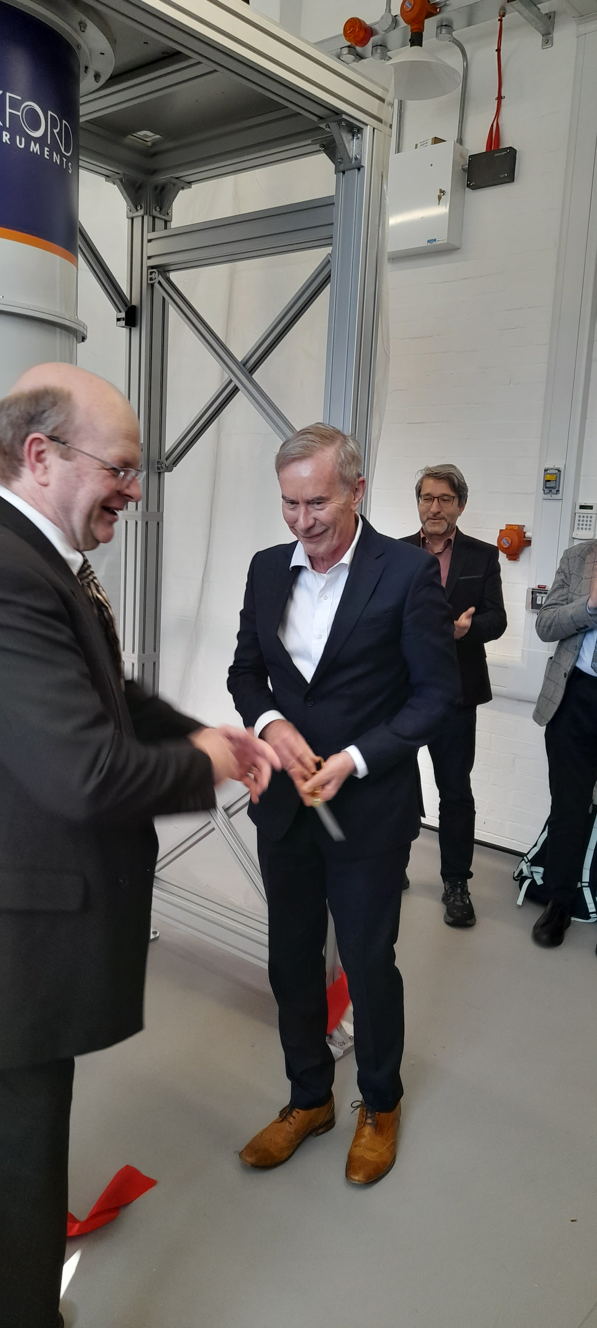
Ian Shipsey – Thanks for Everything

