Slide 1
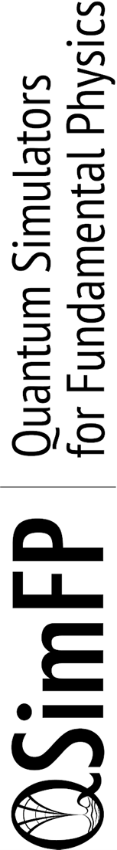
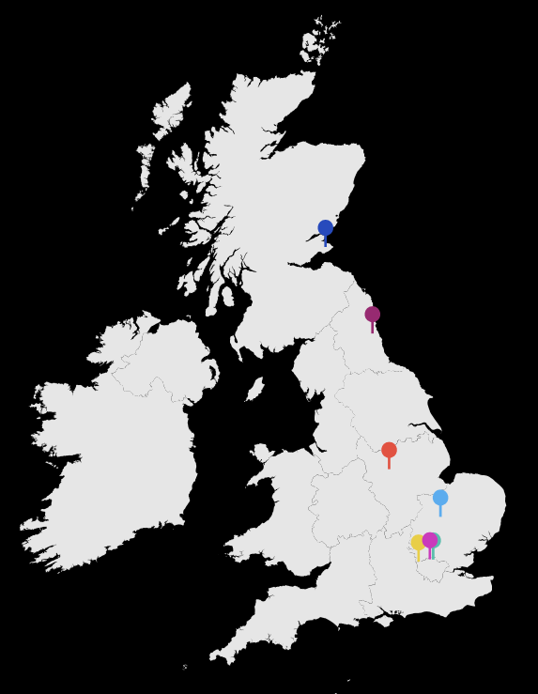
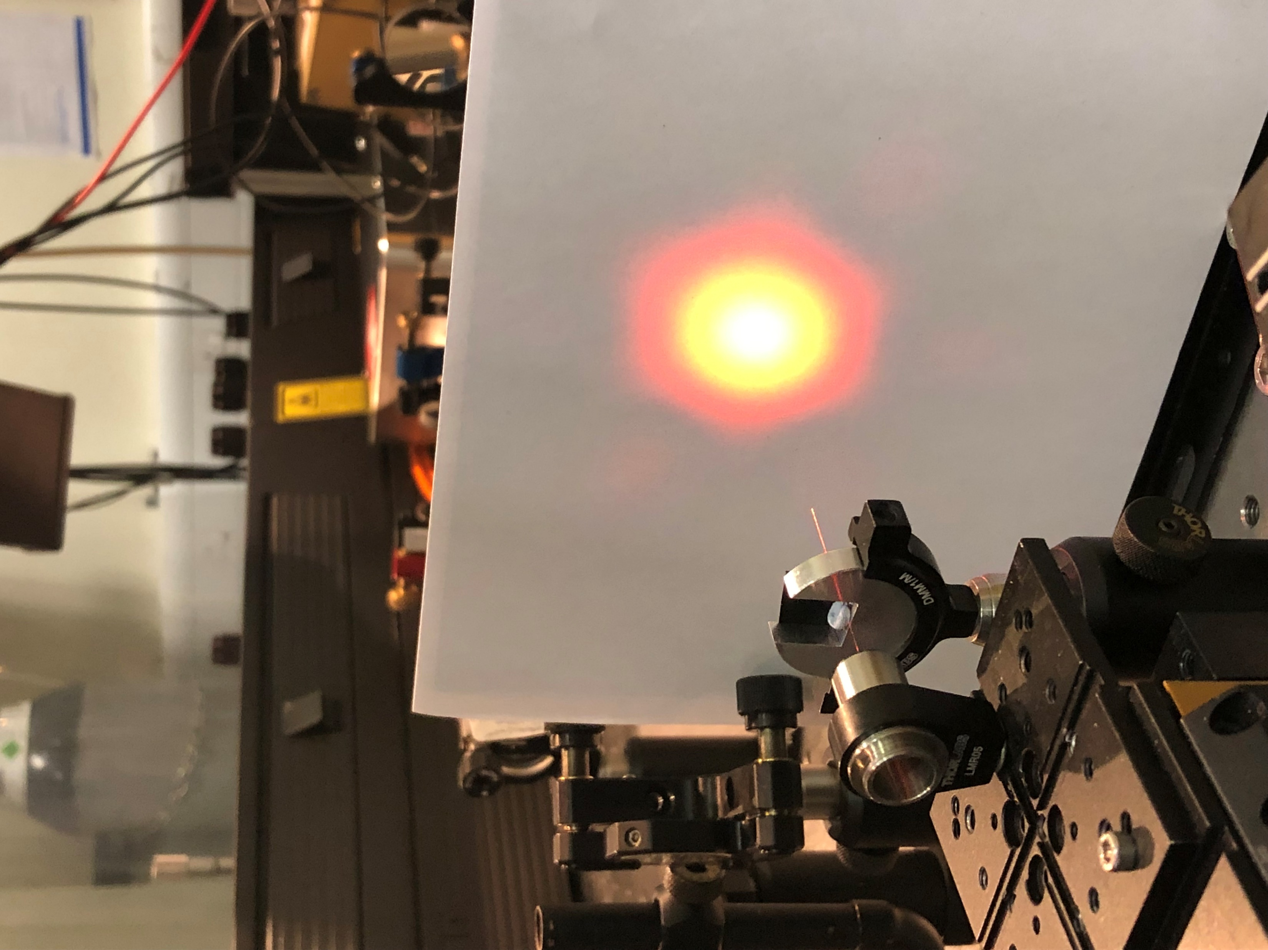
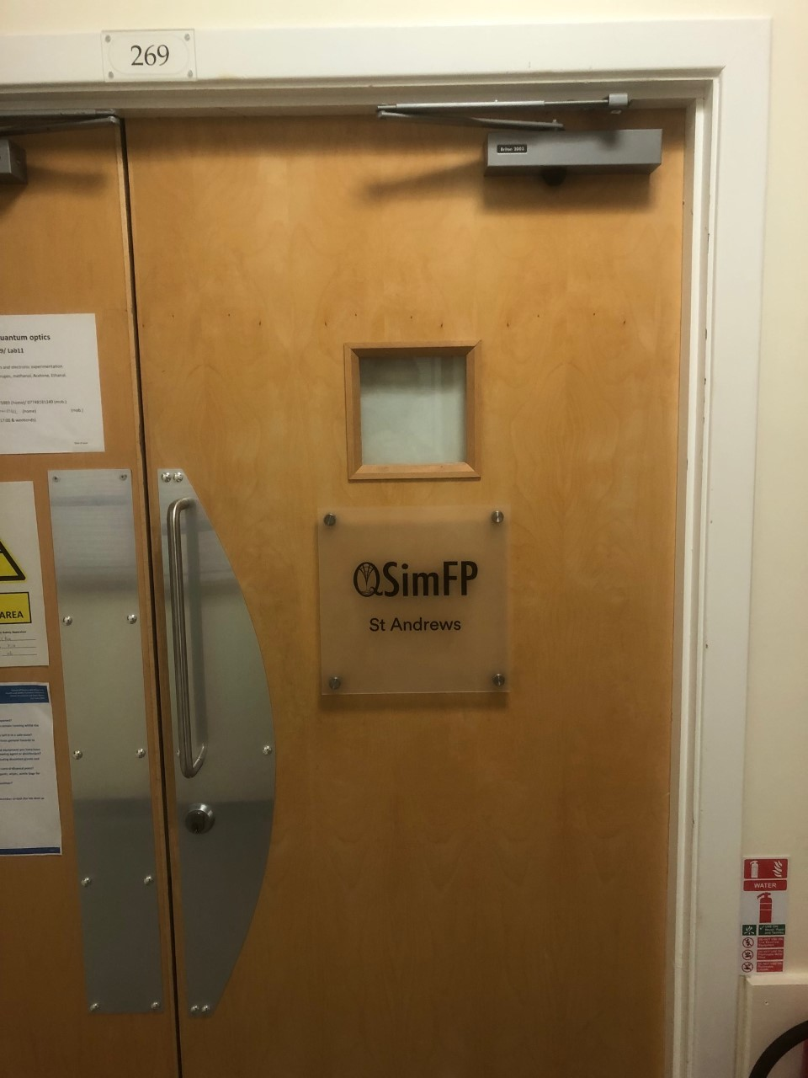
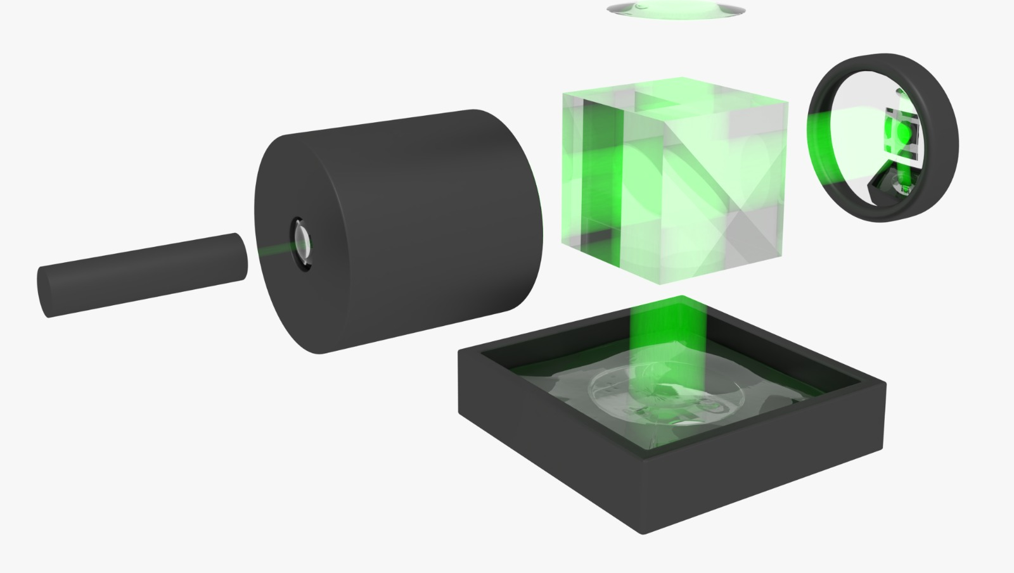
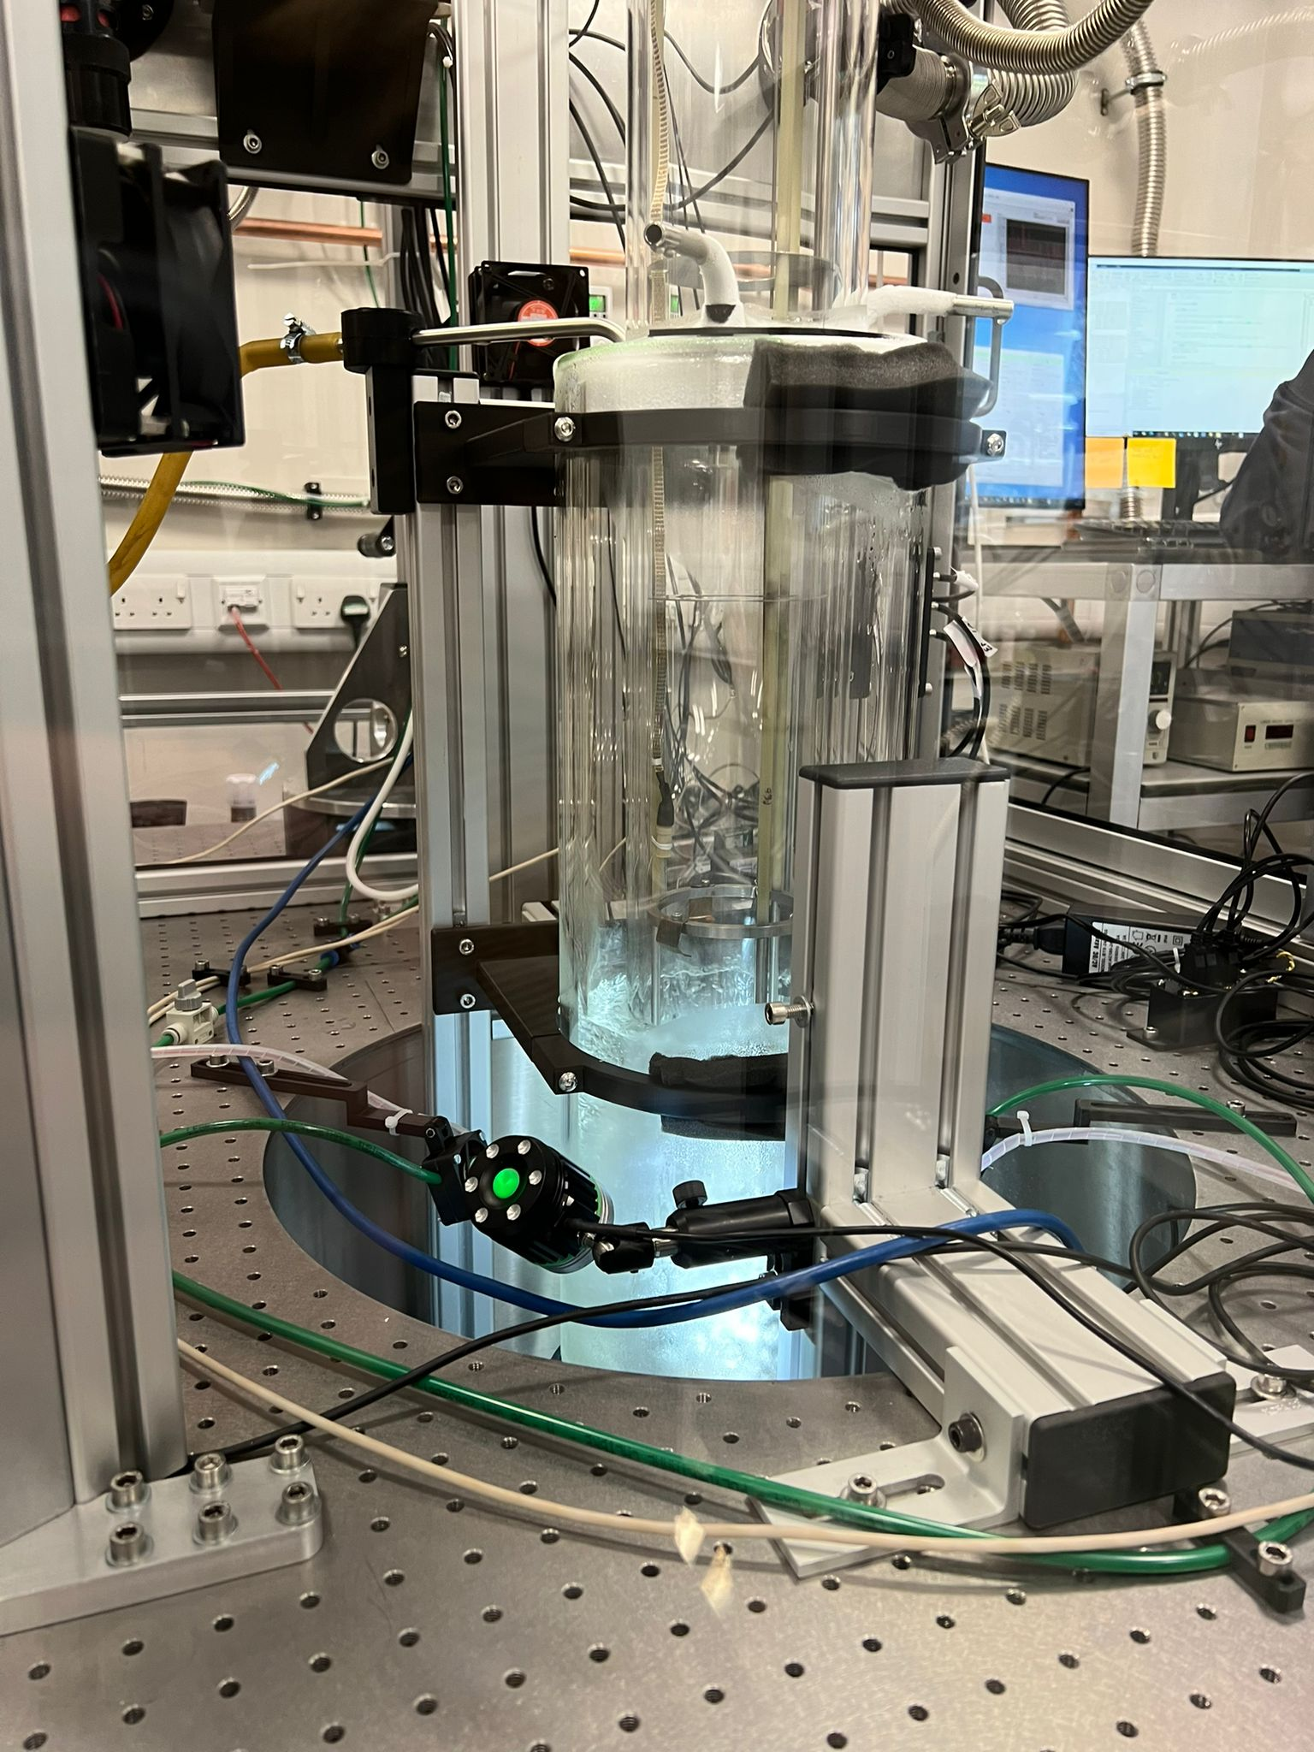
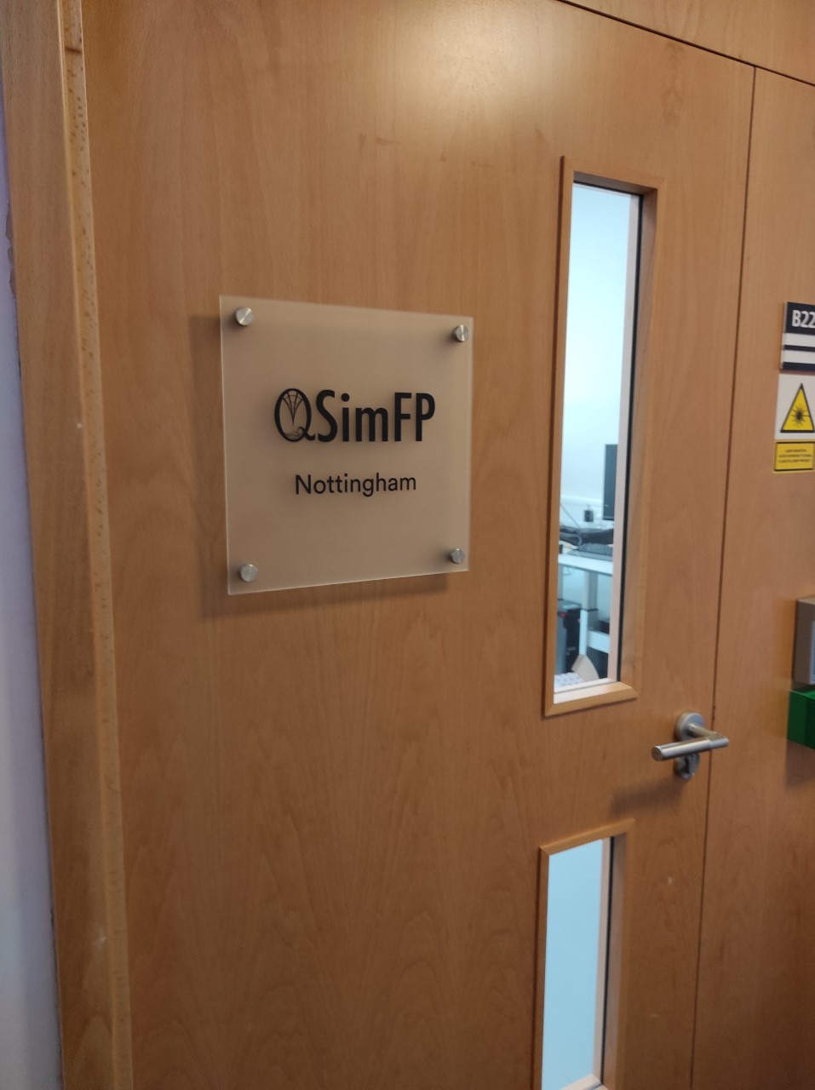
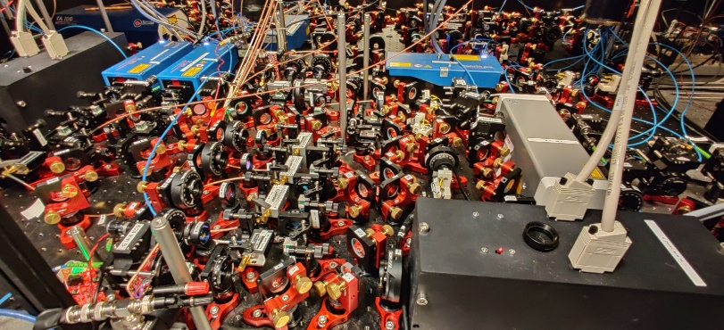
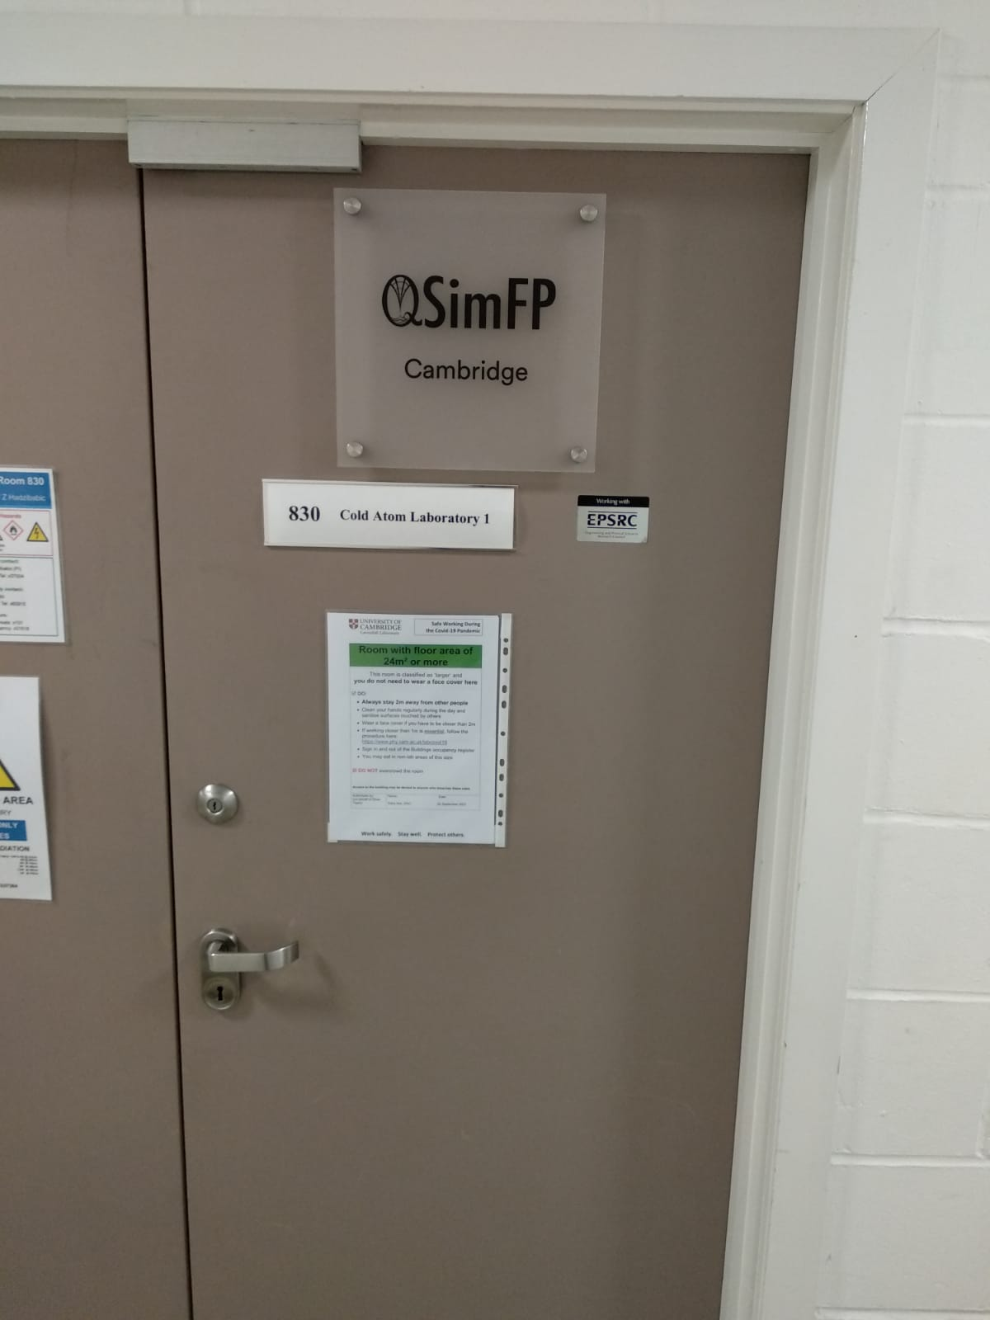
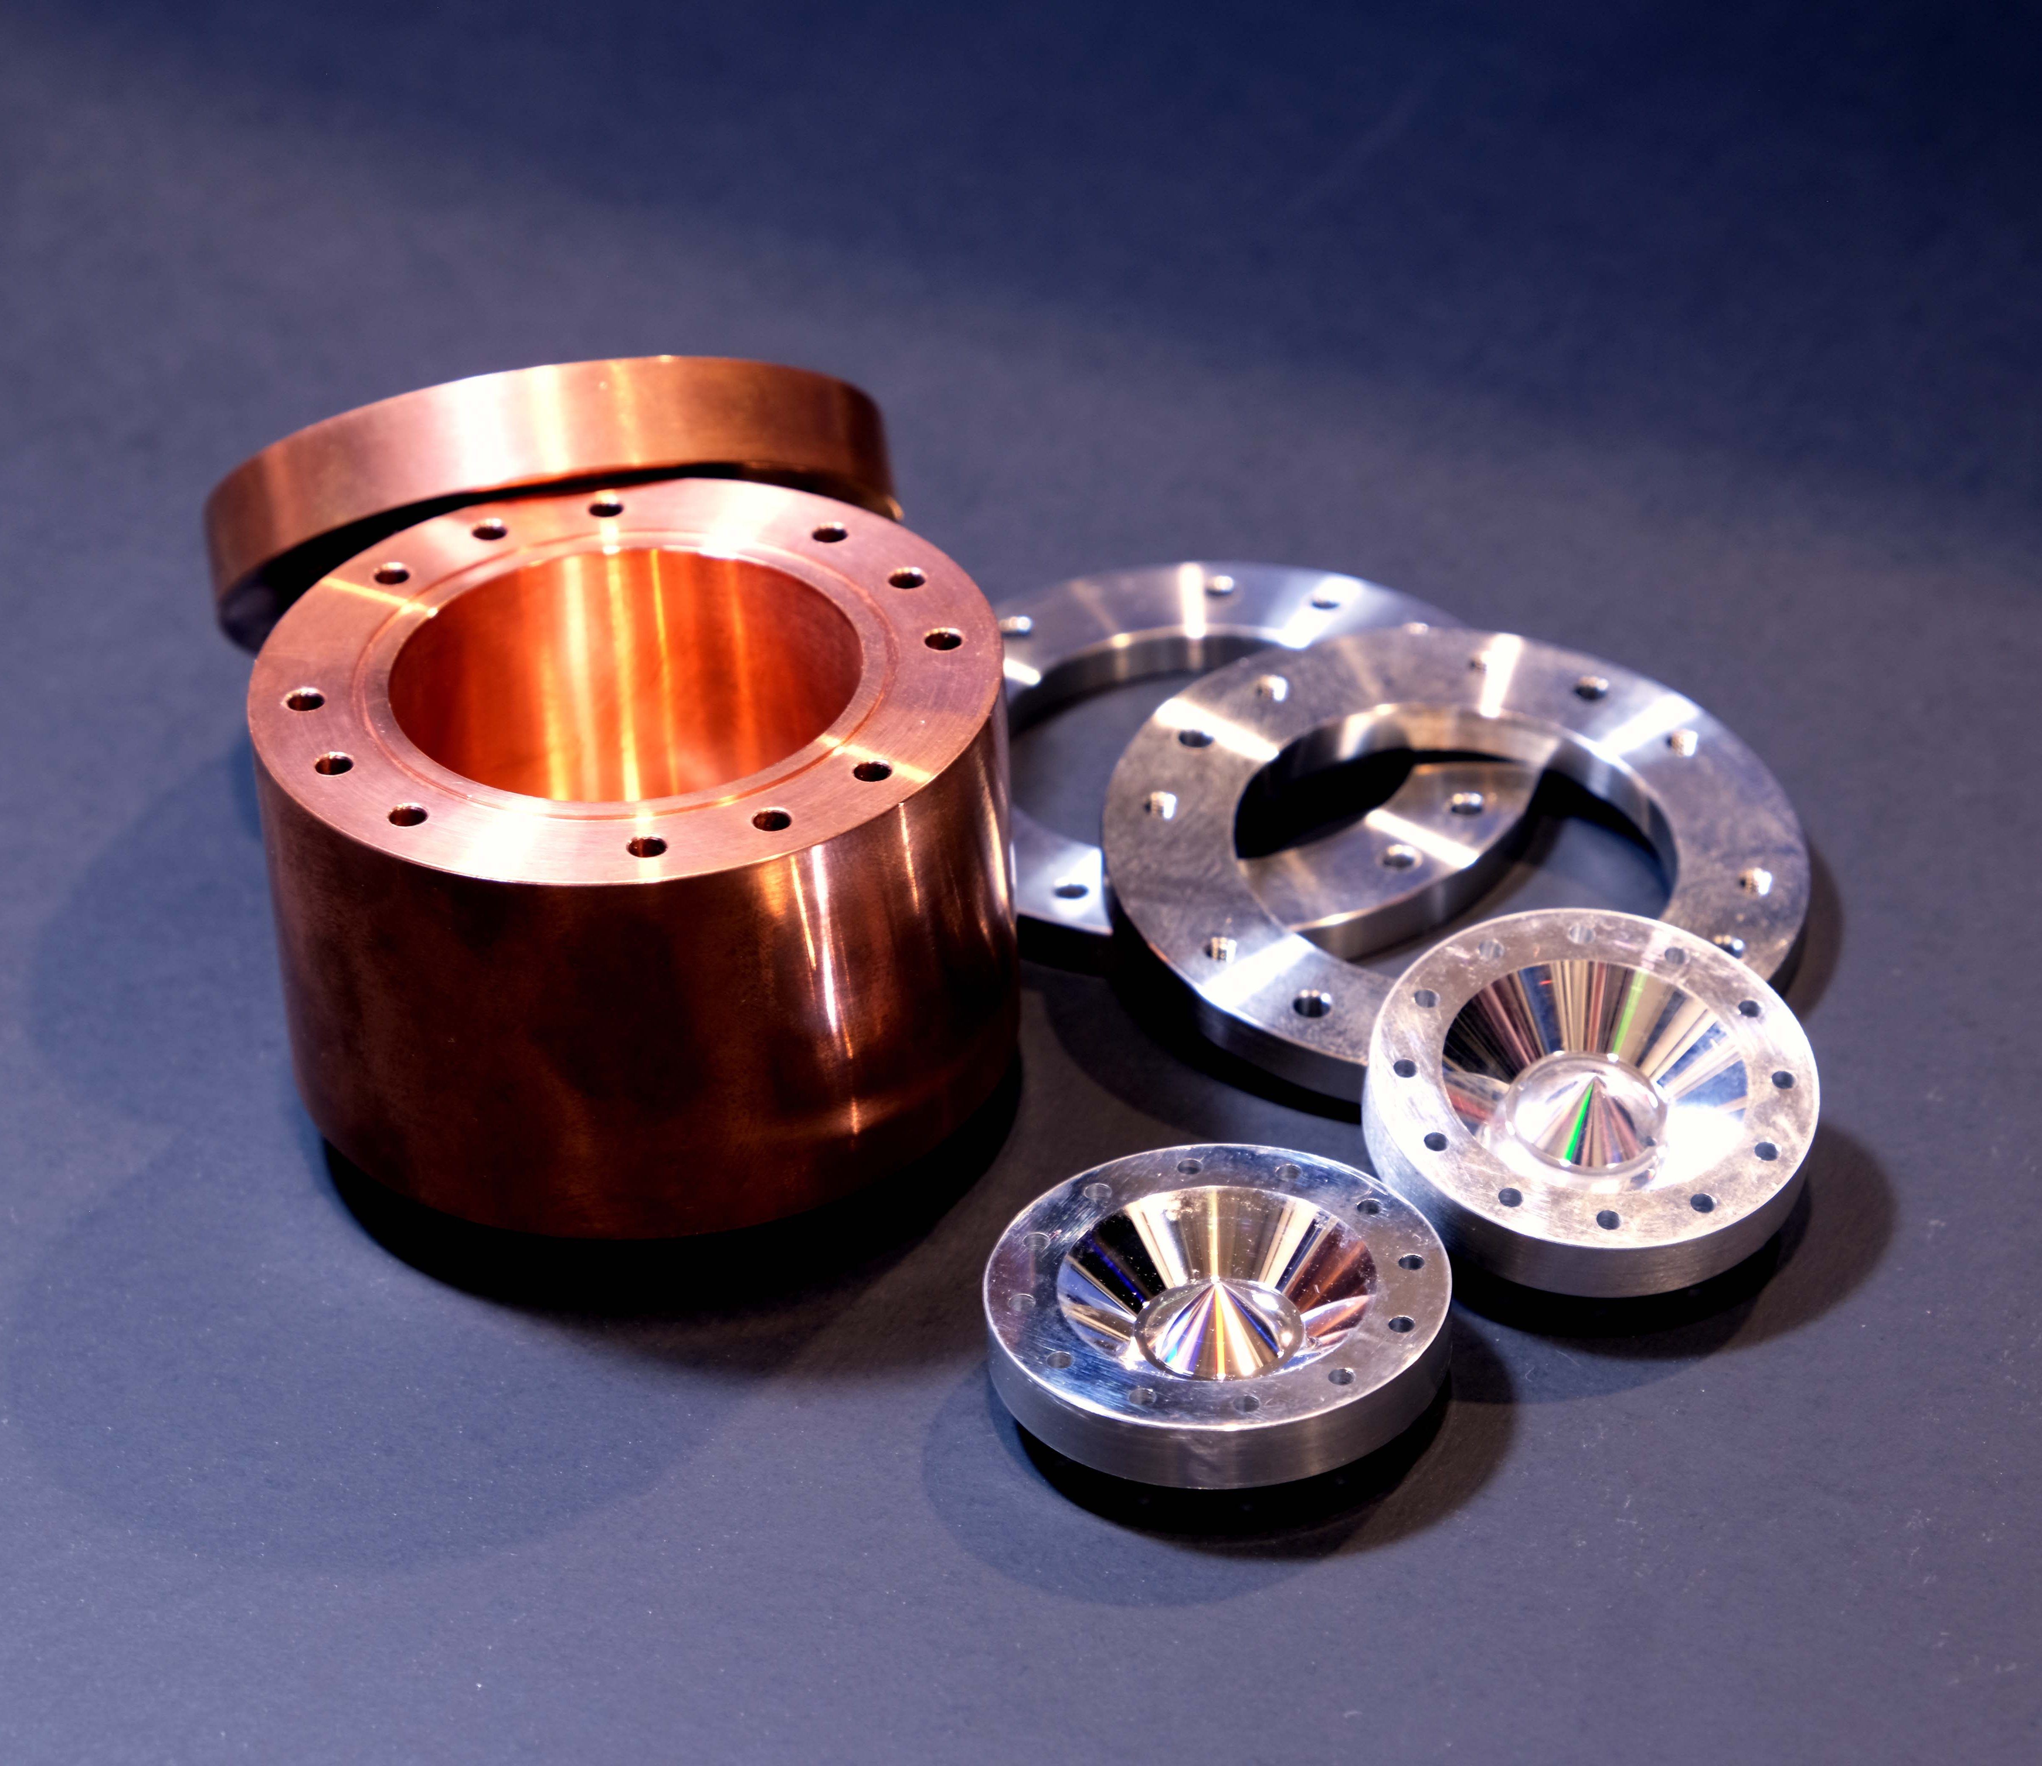
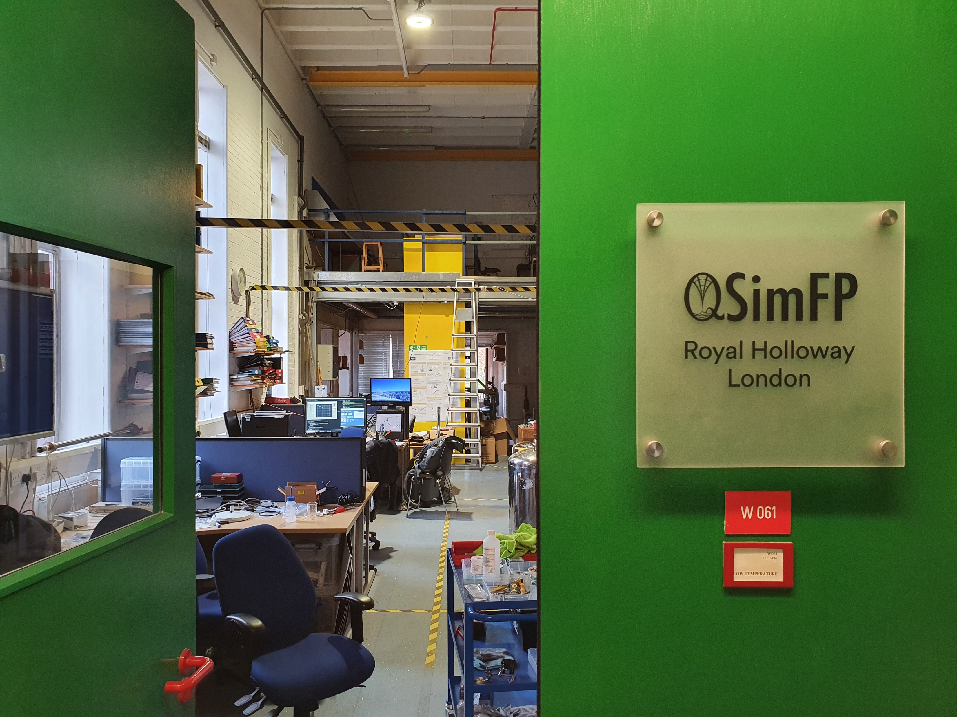
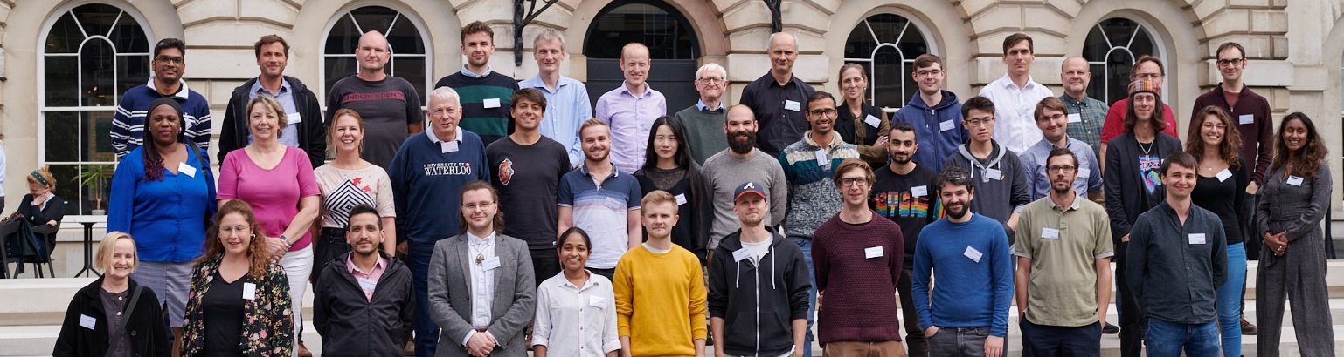
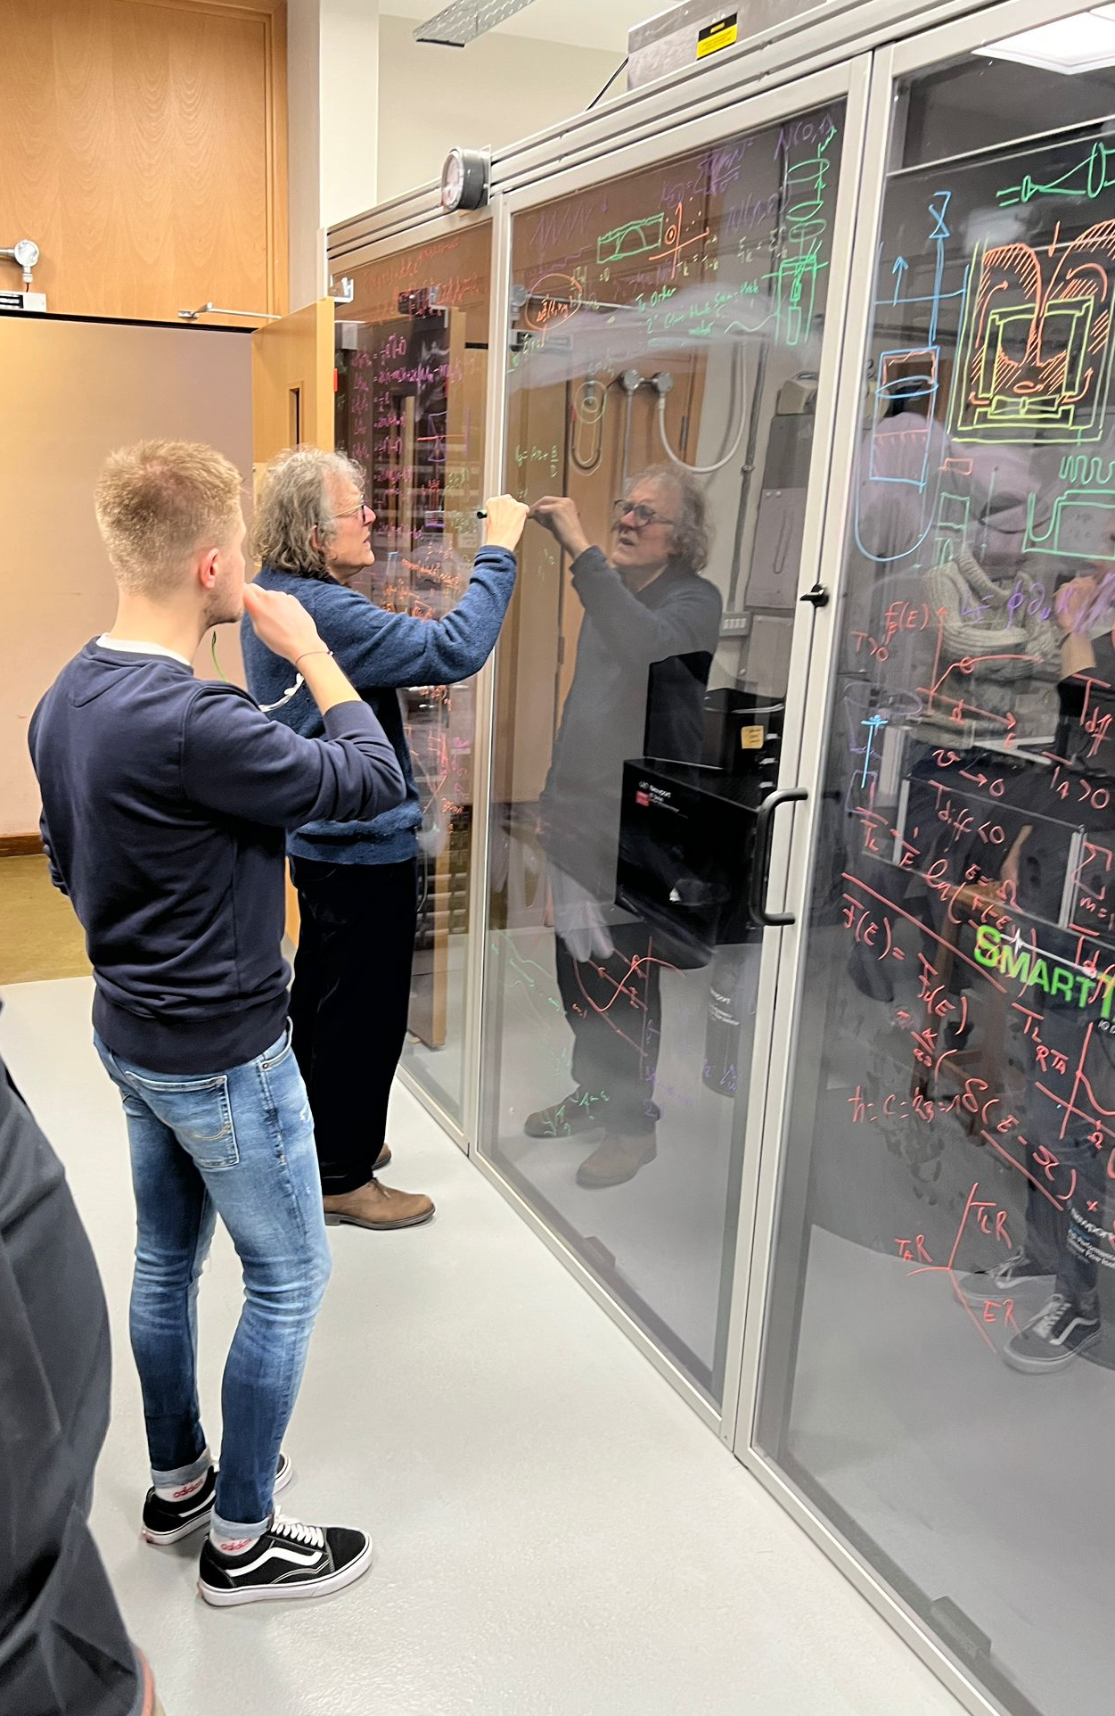
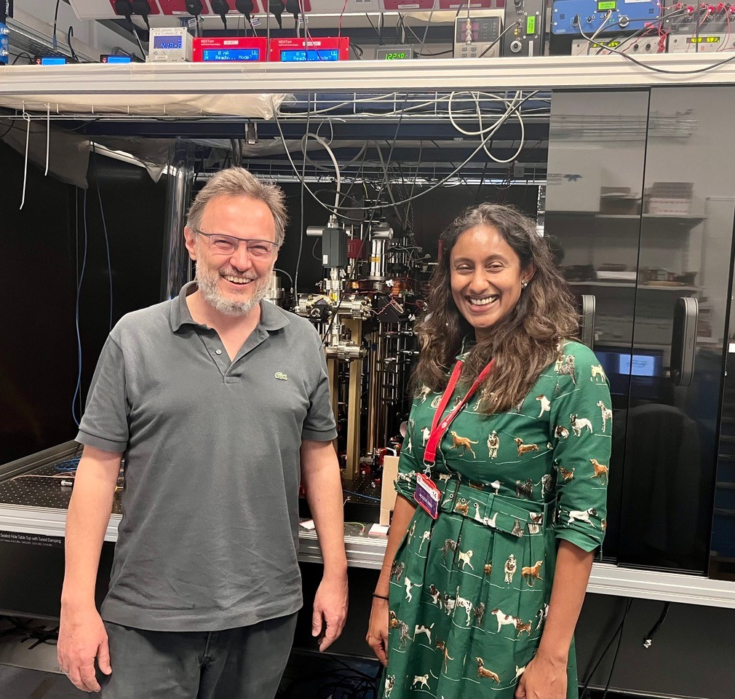
Outputs (start 2021)
1 Patent Application
25 Publications
6 Preprints
4 Feature News Articles
BBC ‘Sky At Night’
4 Quantum Simulators
Experimental
Facilities
Scientific Goals
Quantum Simulations of Black Hole
and Early Universe Processes
Community
50-50 QT-FP researchers
27 QTFP funded (79 Partners)
St Andrews
Newcastle
Governance
Silke Weinfurtner (PI, Nottingham)
Zoran Hadzibabic (Cambridge)
Ruth Gregory (KCL)
Nottingham
Cambridge
KCL
UCL
RHUL
Modelling Support
Notes:
Feature articles: 2 cover stories in the New Scientist, Quanta Magazine and The Guardian

Slide 2

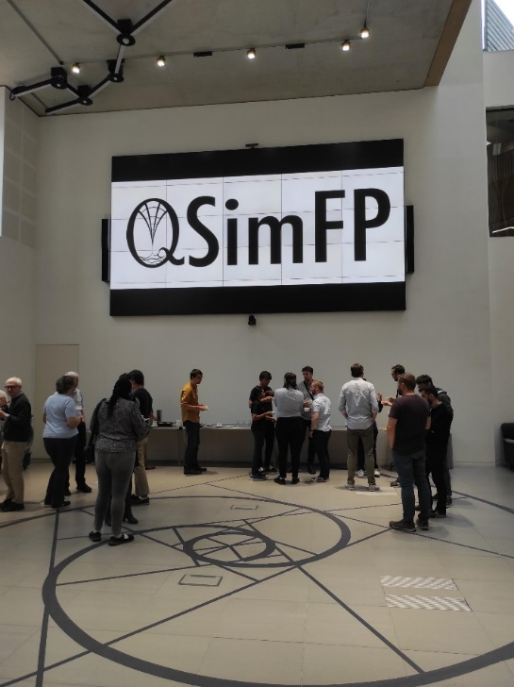



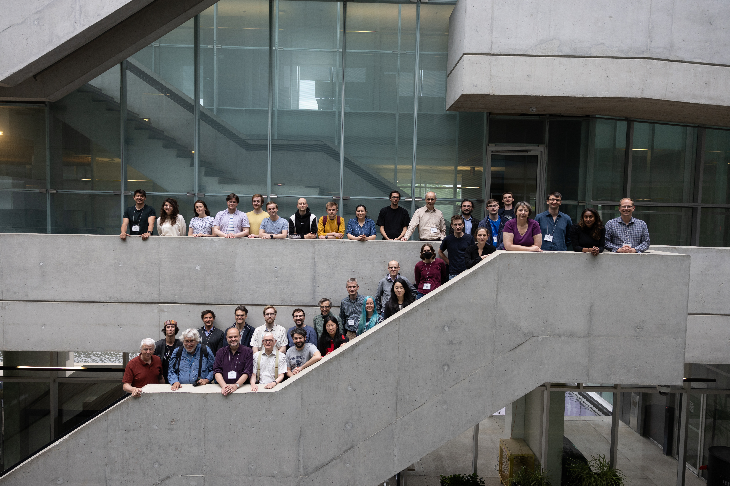

IOP, London, UK, QSimFP 2022
Location | STFC Funding | External Funding
University of St. Andrews | 2 | 4
Newcastle University | 4 | 5
Nottingham University | 7 | 22
Cambridge University | 6 | 13
Royal Halloway University London | 3 | 4
Durham | 1 | 0
King's College London | 2 | 5
Sheffield University | 3 | 3
UK (Southampton, Glasgow, York) | 0 | 5
Canada/USA | 0 | 8
Europe (Austria, Germany, Italy) | 0 | 10
Total | 27 | 79
Community
Upcoming workshop:
Nottingham, 16-21 Mar 2025
Community
Community
Perimeter Institute, Waterloo, Canada, QSimFP 2022
Notes:
Expanding Community Highlights:
- Consortia Growth: Our community is rapidly expanding.
- Support Letters:
- Provided support letters for four 6 QTFP small applications, resulting in 2 successful outcomes.
- Supported one successful EPSRC application.
- External Partnerships: Established partnerships with institutions in Austria, Germany, Canada, and the USA.
- Annual Community Workshops:
- 1st workshop held in London in 2022.
- 2nd workshop hosted at the prestigious Perimeter Institute in 2023.
- Next workshop scheduled for January 2024 in Nottingham.

Slide 3
Immediate and long-term Fundamental Physics
Black Hole Ringdown:
  Spectral Stability
  Black Hole Bound States (Axion Fields)
  Non-linearities in Black Hole Bombs
Holographic Superfluid:
  Exploration of Strongly Dissipative FTs
Mutual Information / Area Law:
  Expansion beyond 1+1 Dim Systems
1st and 2nd Relativistic Phase Transitions:
  False Vacuum Decay (1st Order)
  Tachyonic Field Decay (2nd Order)
Non-equilibrium (Open) Field Theory Simulator:
  Investigation into Multi-mode Scattering Processes
  Extraction of Scattering Amplitudes
Primary objective: Establish groundbreaking quantum field theory simulators using
quantum gases, liquids, and optical systems.
Enhanced Quantum Capabilities: Leveraging techniques and facilities honed through the NQTP program to precisely control and
discern quantum systems, pertinent to
fundamental physics applications.
Synthetic Quantum Systems
Opportunity:
Validate advanced mathematical
frameworks for fundamental physics.
Explore genuine relativistic quantum process.
Translate abstract concepts into reality.
Simulate the uncalculatable.
Notes:
- Primary objective: Establish groundbreaking quantum field theory simulators using quantum gases, liquids, and optical systems.
- Enhanced Quantum Capabilities: Leveraging techniques and facilities honed through the NQTP program to precisely control and discern quantum systems, pertinent to fundamental physics applications.
- Opportunity:
- Validate advanced mathematical frameworks for fundamental physics.
- Explore genuine relativistic quantum processes.
- Translate abstract concepts into reality.
- Simulate the uncalculatable.
- Immediate and Long-term Fundamental Physics Examples:
- Black Hole Ringdown Spectral Stability
- Black hole instabilities
- Strongly Dissipative Field Theories and relevance for strongly dissipative quantum field theories
- 1st Relativistic Phase Transitions to explore the False Vacuum Decay (1st Order)

Slide 4
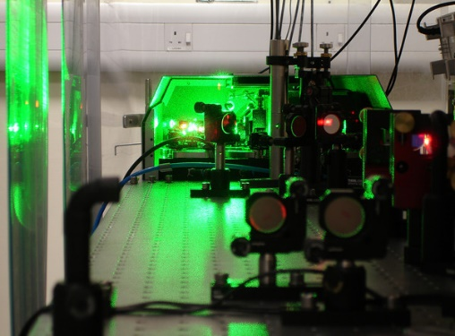
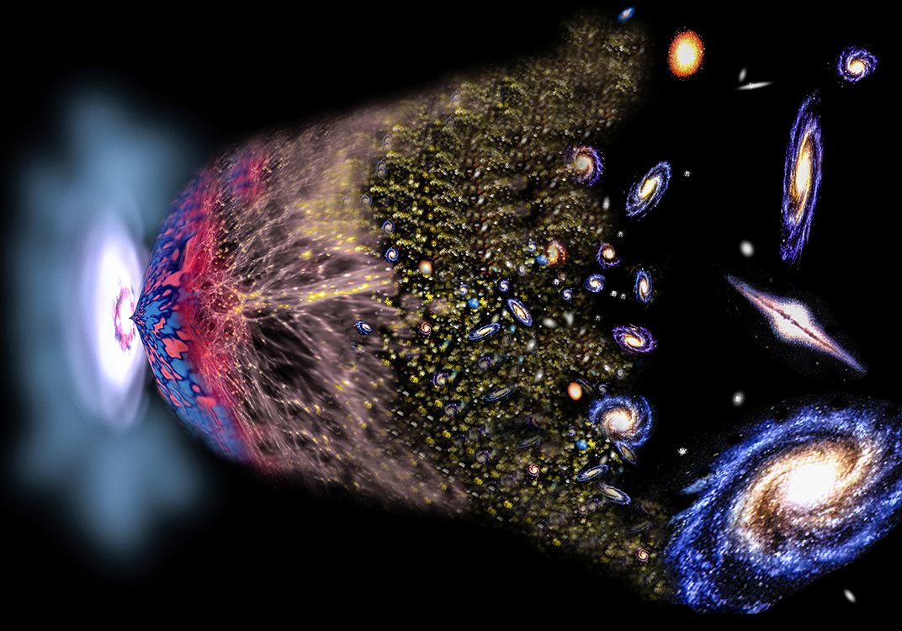

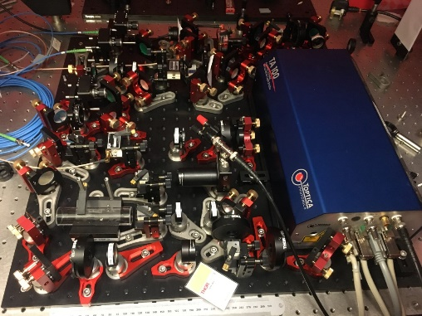
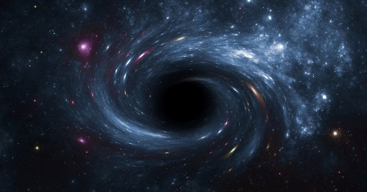
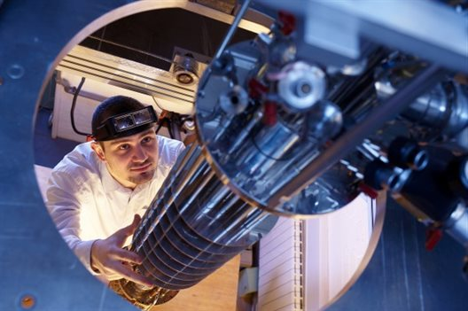

Vision
St Andrews
Quantum Vacuum:
False Vacuum Decay
Quantum Black Hole:
Black hole ring-down
Cambridge, Newcastle and Durham
Cambridge
KCL and Newcastle
Nottingham and RHUL
Notes:
- Advancements in Experimental Facilities across the UK:
- Locations: St. Andrews, Cambridge, Nottingham, and RHUL.
- Symbiotic Relationship: Integration of theoretical modeling and design.
- Synthetic Quantum Systems:
- Demand: Advanced control and detection methods.
- Purpose: Simulating early universe and black hole effects.
- Quantum Simulator Setup:
- Cambridge: One FVD quantum simulator.
- Exploration: Three QBH simulators, each focusing on different aspects of black hole ringing.
- Modeling Expertise:
- Institutions: Newcastle, Nottingham, Cambridge, KCL, and UCL.
-Contribution: Enhancing experimental efforts with high-level modeling support.

Slide 5
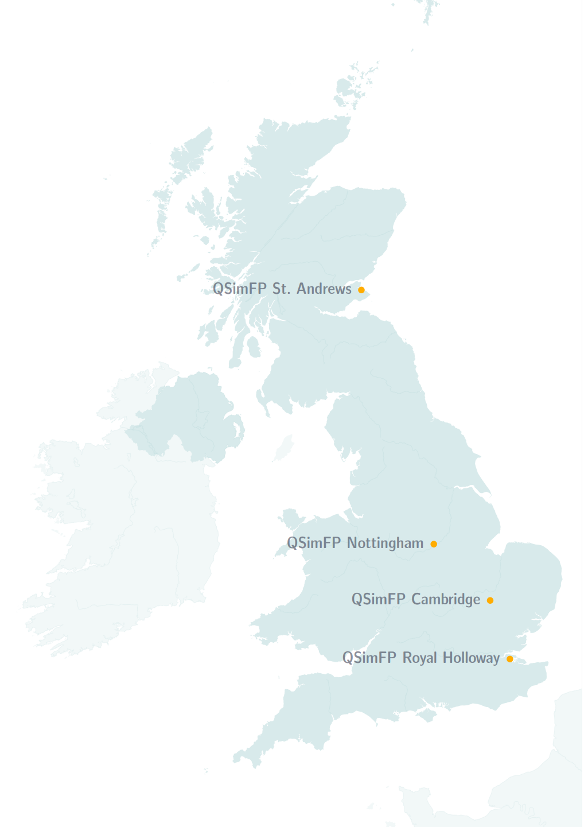
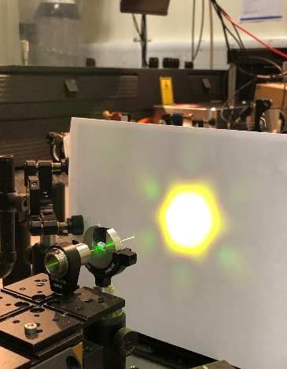
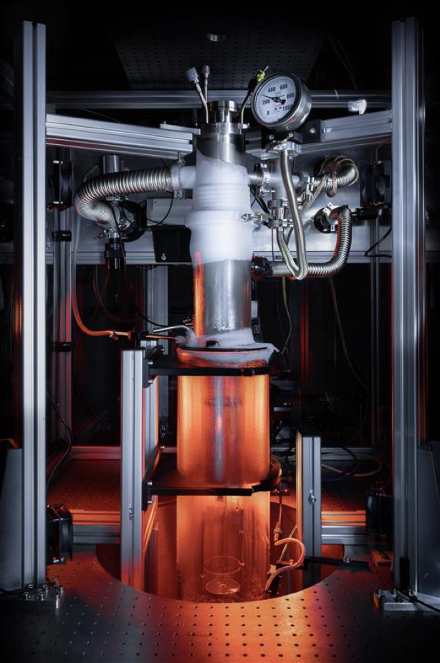
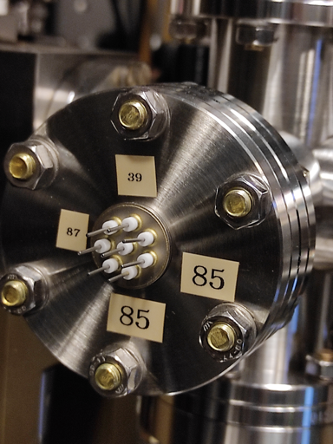

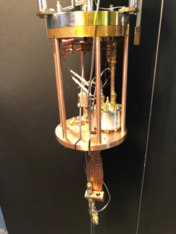
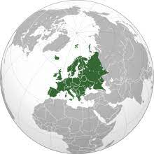
1+1-Dimensional Black Hole Simulator
Fibre-optical solitons
Quantum Light Detectors
Black Hole Spectral Stability
2+1-Dimensional Black Hole Simulator
Biggest Quantum Vortex Flows
Off-axis Holography Detectors
Black Hole Ringing and Instabilities
Facilities
2+1-Dim. False Vacuum Decay Simulator
Ultracold-atoms in optical box traps
Biggest Potassium Condensate
First-order Relativistic Phase-Transitions
2+1-Dimensional Black Hole Simulator
State-of-the-art nanotechnology facilities
Superconducting microwave micro-structures
Quantum Fields Dynamics & Quantised Rotation
Notes:
- Advancements in experimental facilities: St. Andrews, Cambridge, Nottingham, and RHUL.
- Tight integration of theoretical modeling and practical design.
- Synthetic quantum systems demanding advanced control and detection methods.
- Focus on simulating early universe dynamics and black hole effects.
- Establishment of one FVD quantum simulator in Cambridge and three QBH simulators: St. Andrews, Nottingham and RHUL.
- Collaborative efforts with modeling expertise at Newcastle, Nottingham, Cambridge, KCL, and UCL.
- Experimental Facility in St. Andrews:
- 1+1-Dimensional Black Hole Simulator
- Fibre-optical solitons
- Quantum Light Detectors
- Fundamental Physics Investigation: Black Hole Spectral Stability
- Experimental Facility in Nottingham:
- 2+1-Dimensional Black Hole Simulator
- Giant Quantum Vortex Flows with record breaking circulation
- Development Off-axis Holography Detectors for quantum liquid interfaces
- Investigation in Black Hole Bound states and Instabilities
Experimental Facilities in Cambridge:
- 2+1-Dimensional False Vacuum Decay Simulator
- Ultracold Atom multi-component system in Optical Box Traps
- Largest Potassium Condensate
- First-order Relativistic Phase Transitions
Experimental Facilities in RHUL:
- 2+1-Dimensional Black Hole Simulator
- State-of-the-art Nanotechnology Facilities
- Superconducting Microwave Micro-Structures
- Quantum Fields Dynamics & Quantised Rotation
- Strong Quantum Collaboration with Nottingham, Emphasizing Nanoscale and Cryogenic Research
- All setups completed:
- Nottingham: First results published in Nature this week.
- St. Andrews and Cambridge: Crucial aspects finalized, currently undergoing benchmarking.
- RHUL: Testing first microwave cavity design in experimental setup.

Slide 6
Cambridge
Hiranya Peiris
Alex Jenkins
Emily Hertig
Durham
Andrew Pontzen
Newcastle
Ian Moss
Kate Brown
PI/CITA
Matt Johnson
Jonathan Braden
Dalila Pirvu
Zoran Hadzibabic
Christoph Eigen
Konstantinos Konstantinou
Nishant Dogra
False Vacuum Decay

Slide 7
False Vacuum Decay
Particle physics-inspired cosmological theories exhibit
false vacuum decay via bubble nucleation
Relativistic first-order phase transition: non-perturbative, non-linear,
non-equilibrium process
Understanding dynamics could shed light on origin of Universe
False Vacuum Decay
Synthetic Quantum System:
2-component coupled Bose-Einstein Condensates/BECs
ultra-cold dilute gas of N bosons, in two-single particle states
e.g. atoms in two different hyperfine states or double-well potential

Slide 8
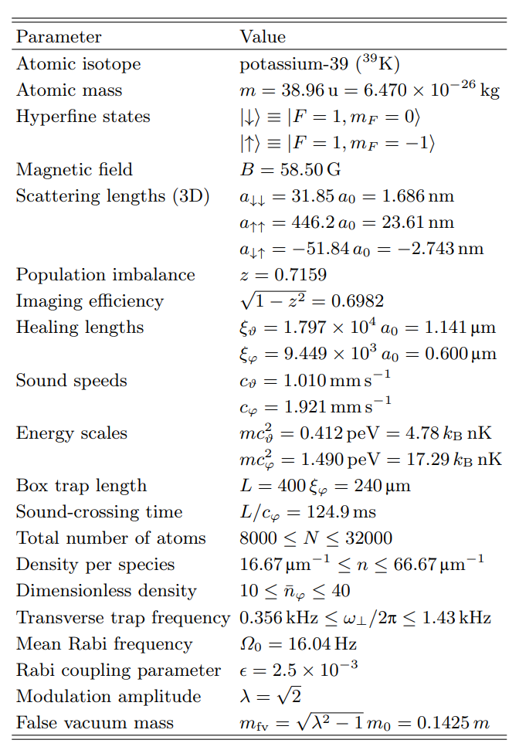
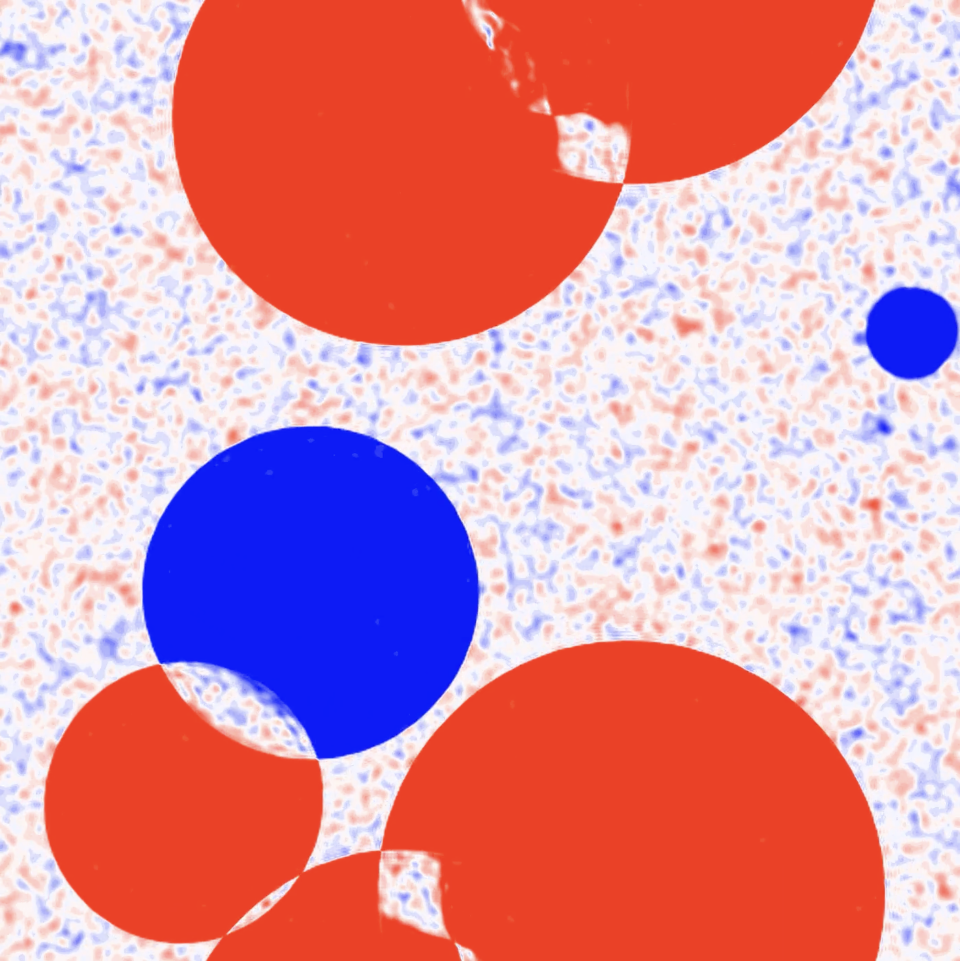
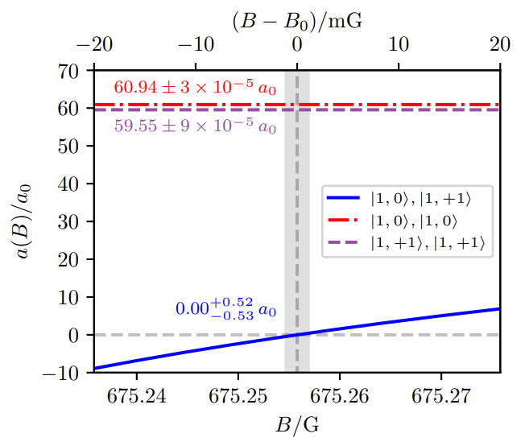
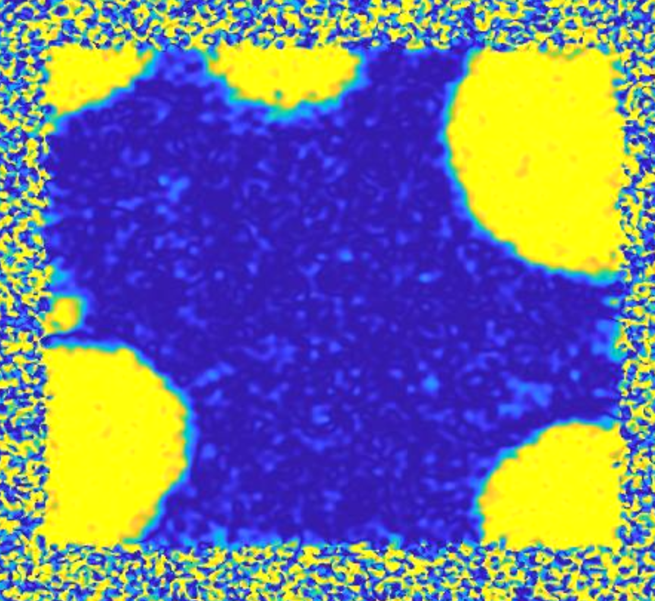
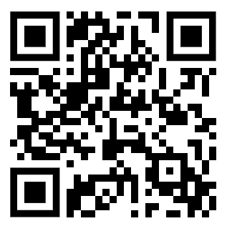
Identification of viable parameter space
FVD - Theory
Identification of Viable parameter space
→ Experimental feasibility
Modelling of thermal False Vacuum Decay
→ Non-zero initial temperature
Realistic boundary conditions
→ Optimal trapping

Slide 9
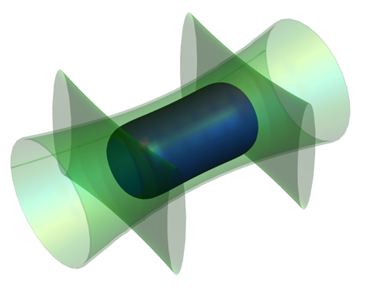
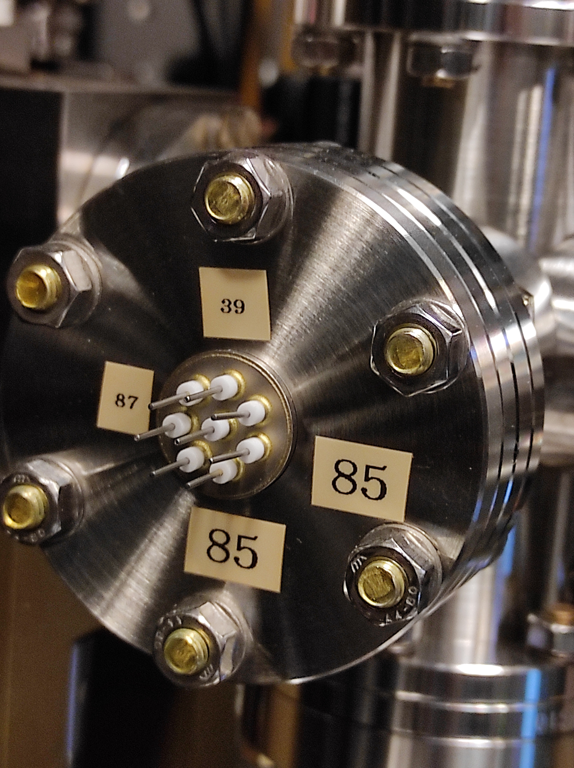
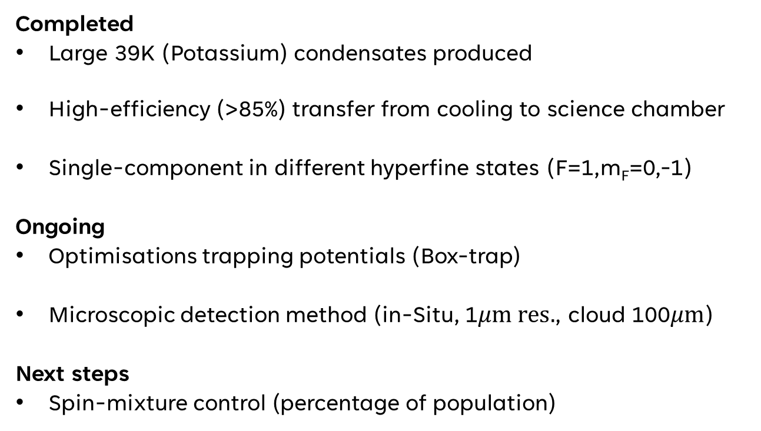
Zoran Hadzibabic & team (Cambridge)
Completed
Large 39K (Potassium) condensates produced
High-efficiency (>85%) transfer from cooling to science chamber
Single-component in different hyperfine states (F=1,m_{F}=0,-1)
Ongoing
Optimisations trapping potentials (Box-trap)
Microscopic detection method (in-Situ, 1$μm res.$, cloud 100$μm$)
Next steps
Spin-mixture control (percentage of population)
0.1mm
Optical box
FVD - Experiment
Notes:
What exactly will be done as part of the benchmarking?
Potential is uniform
Spatial resolution needed, order of healing length
Required precision (down to one percent in spin-population), informed by theorists
Leading postdoc left with one-note notice: due to Brexit, parents couldn’t visit newborn baby
Remaining team works well, delay but better product
One student developing the 2d trapping,
Microscopic-detection method – inSitu method
Single component – in different states, the ones in the theory paper are implemented
Micro-wave to create the mixture (you have done this previously)
Half a year more for benchmarking
With extension we should still do more than promised, delay smaller than extension
Both need to be developed in parallel, to detect small things you need the trap.

Slide 10
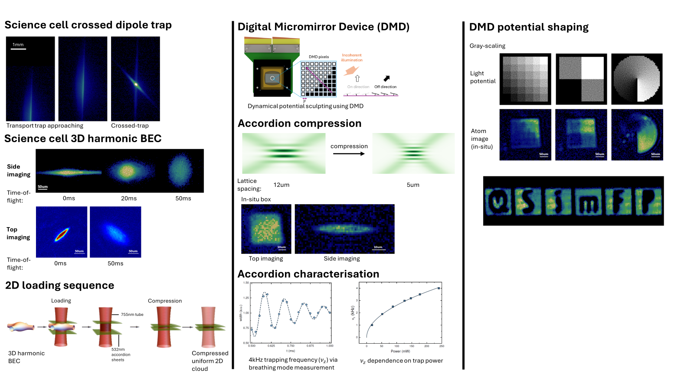
Experiment in Cambridge
Notes:
We now have the BEC in the science chamber (transporting the atoms from the MOT chamber and condensing in the science one), we have set up the optics for 2D trapping and also have first condensates in a 2D Box trap. The next big thing, which is less predictable, is to iron out imperfections in the trapping potential. The slide shows images of 2D condensates of different shapes, with some technical details. This is still all done with low-resolution optics. The special objectives for high-resolution imaging (and potential shaping) is in place, but there was nothing to exactly align the objective to until we produced the 2D condensates.

Slide 11
Nottingham
Silke Weinfurtner
Anthony Kent
Patrik Švančara
Vitor S. Barroso
Chris Goodwin
Pietro Smaniotto
Leonardo Solidoro
Maciej Jarema
Sreelekshmi Ajithkumar
RHUL
Xavier Rojas
Sumit Kumar
St. Andrews
Friedrich Koenig
Pavlos Manousiadis
Christopher Burgess
KCL
Ruth Gregory
Sam Patrick
Newcastle
Carlo Barenghi
Nottingham
Jorma Louko
Cisco Gooding
Cameron Bunny
RHUL
Gregoire Ithier
Quantum Black Holes

Slide 12
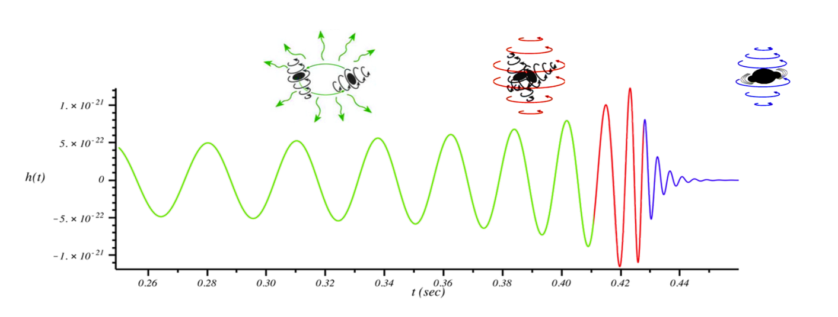


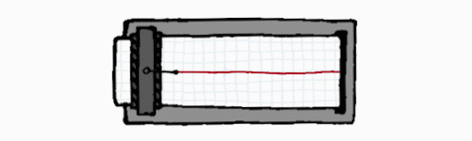
Quantum Black Holes
PERTURBED BLACK HOLE
LIGO DETECTOR
Quantum Black Holes
Perturbed black-holes emit characteristic waves
Recent validation of universality of black hole
ring-down in gravity simulators
Contribution of quantum effects to black hole
ringdown dynamics
LIGO SIGNAL
Notes:
BLACK HOLES RING DOWN
Even the simplest BH spacetime supports black hole oscillations.
Schwarzschild spacetime is static and in no way oscillatory.
But we see oscillations if it is perturbed.
e.g. a field evolving on the gravitational background or the gravitational field itself, via perturbations to the metric.
The most experimentally relevant are gravitational (metric) perturbations.
These have been seen by LIGO collaboration.

Slide 13
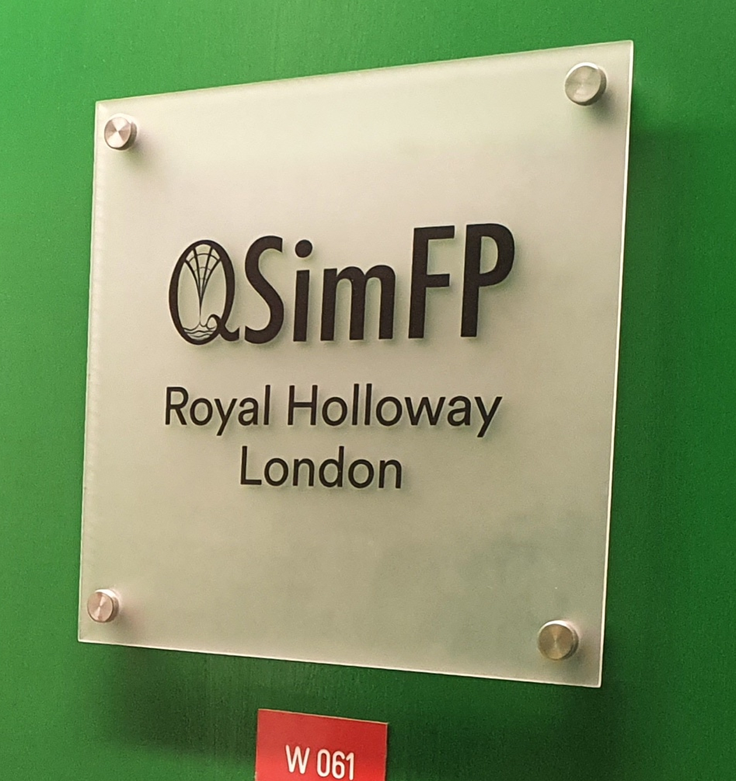
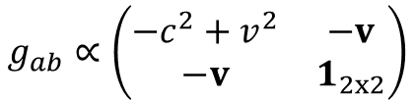

Experimental QBH Facilities
Fibre-optical system:
(1+1)-dim. non-rotating geometry
Quantum correlations from ringdown modes
Klein-Gordon equation for a massless scalar field
$$∂_{a}\left(\sqrt{−g}g^{ab}∂_{b}ψ\right)=0$$
Effective metric
Quantum Black Holes
$$g_{ab}∝\left(\begin{matrix}−c^{2}+v^{2} & −v \\ −v & 1_{2x2}\end{matrix}\right)$$
Superfluid ⁴He (Xavier Rojas and SW):
(2+1)-dim. rotating geometry
BH with quantised circulation
Synthetic Quantum Systems:
2D Quantum Vortex Flows
Notes:
two types of quantum simulators
To cover the entire range of accessible analogue quantum black hole (QBH) ringdown processes
deploying two distinct sets of experiments:
fibre-optical (1+1)-dimensional black hole ringdown respectively: quantum correlations between the ringdown modes and the analogue black hole
superfluid ⁴He (2+1)-dimensional black hole ringdown respectively: possibility of investigating analogue black holes with quantised angular momentum
Two types of quantum simulators covering
accessible range of quantum black hole ringdown:

Slide 14


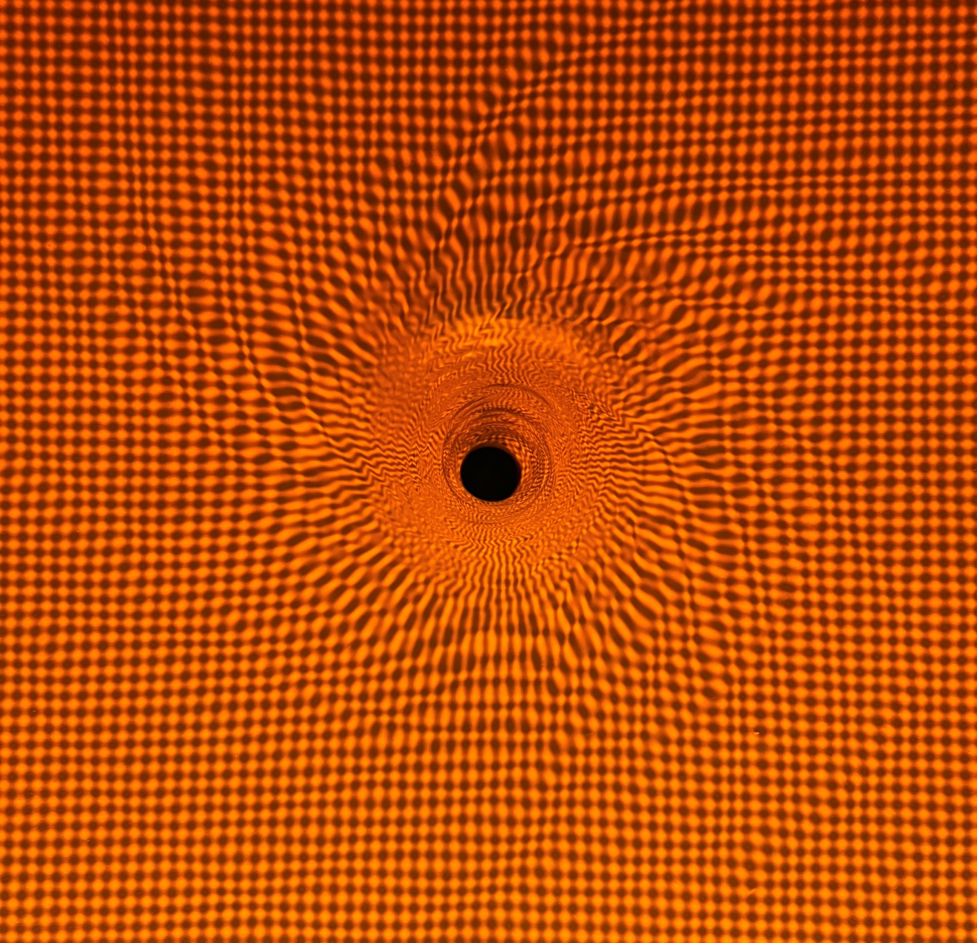
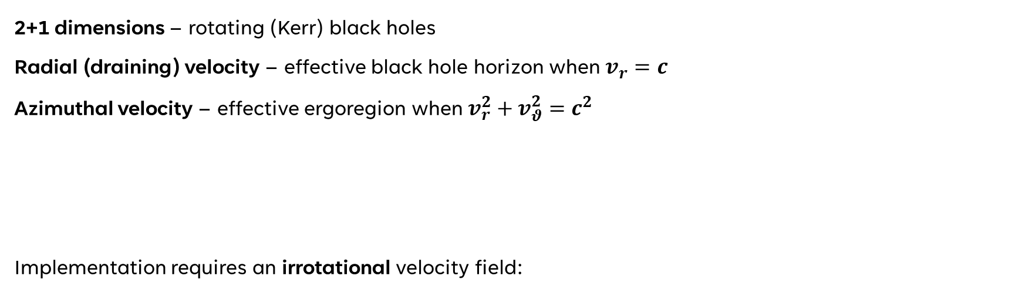

Superfluid helium systems: (2+1)-dimensional rotating geometries
are simulated by a draining (bathtub) vortex
2+1 dimensions – rotating (Kerr) black holes
Radial (draining) velocity – effective black hole horizon when $v_{r}=c$
Azimuthal velocity – effective ergoregion when $v_{r}^{2}+v_{θ}^{2}=c^{2}$
Implementation requires an irrotational velocity field:
Quantum Black Holes
$$v\left(r\right)=−\frac{D}{r}e_{r}+\frac{C}{r}e_{θ}$$
Notes:
two types of quantum simulators
To cover the entire range of accessible analogue quantum black hole (QBH) ringdown processes
deploying two distinct sets of experiments:
fibre-optical (1+1)-dimensional black hole ringdown respectively: quantum correlations between the ringdown modes and the analogue black hole
superfluid ⁴He (2+1)-dimensional black hole ringdown respectively: possibility of investigating analogue black holes with quantised angular momentum

Slide 15
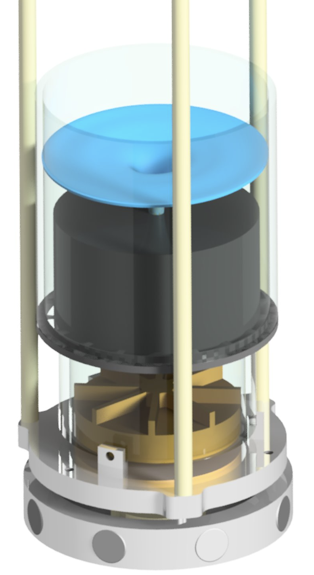
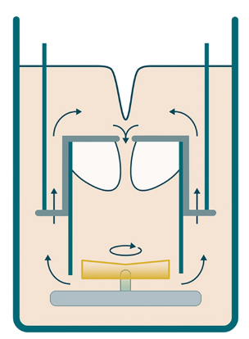
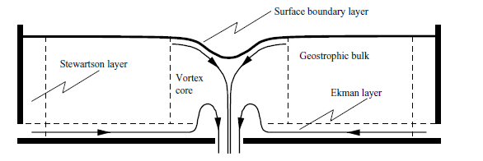
Experimental setup Nottingham
flow conditioner & sink
magnetic coupling

Slide 16
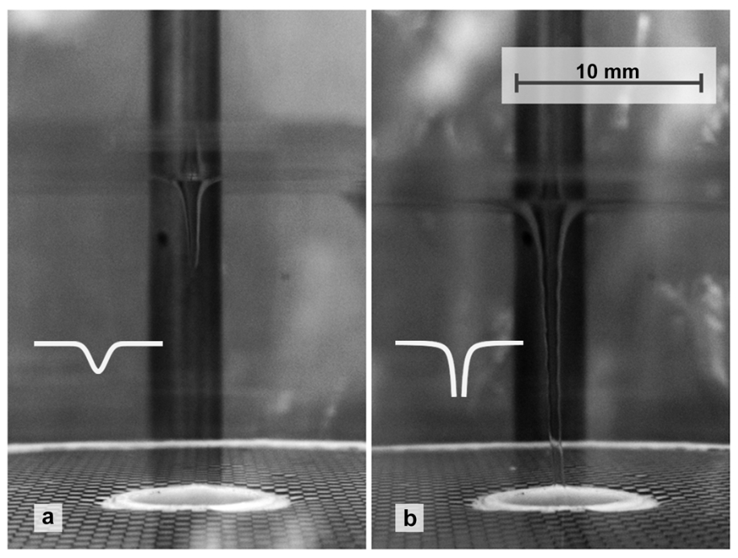
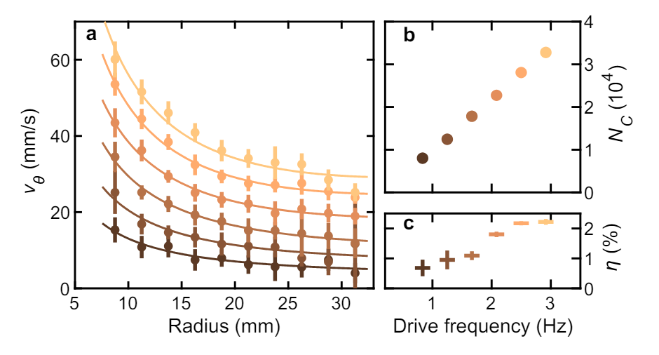
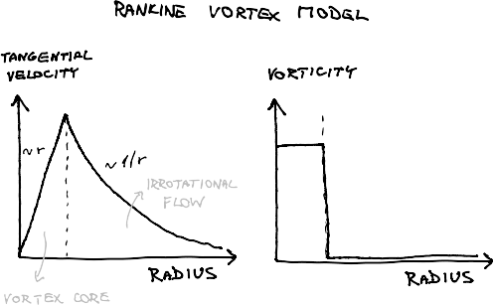
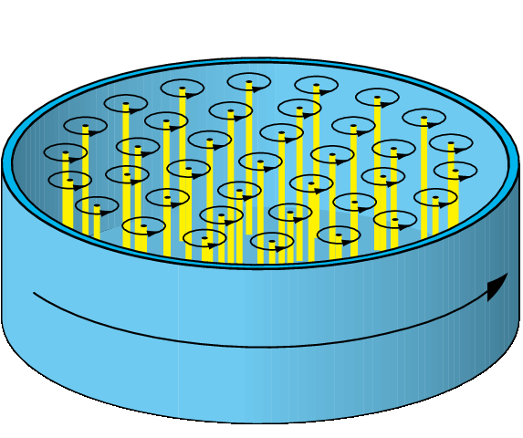


Giant quantum vortex flows
Rotating curved spacetime signatures from a giant quantum vortex
P. Švančara, P. Smaniotto, L. Solidoro, J. MacDonald, S. Patrick, R. Gregory, C. Barenghi & S. Weinfurtner, 2024 Nature 628
Macroscopic Fluid Flow
Circulation Quanta
$$v_{θ}\left(r\right)=Ω r+\frac{C}{r}$$
$${10}^{−7}\frac{m^{2}}{s}$$
Possibility of controlling stable quantum vortices with high quantisation number.
Notes:
Patrik Švančara, Pietro Smaniotto, Leonardo Solidoro, James F. MacDonald, Sam Patrick, Ruth Gregory, Carlo F. Barenghi & Silke Weinfurtner

Slide 17




Superfluid helium interface detection methods
Švančara at al, 2024
Nature 628
Effective potential (measured velocity)
Effective potential (simplified, $C/r)$
Spectral amplitude
Bound state amplitude
Reconstructing Velocity Fields via Wave-Vortex Interaction

Slide 18



Quantum Black hole physics simulator
KCL Modelling support for semi-open systems
Partially reflective wall on one side
Waves partially reflected (ε parameter)
Wall introduces a resonance condition
Quasi-normal ringing
Overtone investigation (spectral stability)
$$ω_{QNM}\left(m\right)=ω_{⋆}−iΛ(m)\left(n+\frac{1}{2}\right)$$
Detection of quasinormal modes and migration of overtones

Slide 19



Design of sub-100mK platform for ground state superfluid system
Cryostat
Microwave Optomechanics with Thin-Films
Surface wave resonator
disk’s diameter ~ 500 µm
RHUL - Experiment
⁴He films thickness: up to 10 µm
cavity fabrication
cavity polishing
hermetic microwave feedthroughs installation
characterization at room temperature
characterization at cryogenic temperature
Notes:
Sumit came back in September this year
Recruited a PhD student to work on QSimFP project, RS and RHUL (starting this fall delayed due to VISA issues, delay)
Simulation and characterisation at room temperature

Slide 20










Royal Holloway, University of London
Thin film superfluid optomechanics
$$ω_{c}=6.365 GHz$$
Electric field
Superfluid He film
surface wave mode
Superconducting
microwave cavity
Superfluid helium thin-film
Quantum Black Holes
$$ω_{c}−Ω_{m}$$
$$ω_{c}$$
$$ω_{c}+Ω_{m}$$
Aims
Detection of surface wave modes
Control of film thickness
Future:
Quantized vortex generation & control
Enhanced detection sensitivity
Impact:
KTPs discussions with industry
(e.g. Drumgrange)
Surface wave mode
($Ω_{m}$= 1.17 kHz , thickness = 23 nm)

Slide 21









Scientific Impact:
1 publication / month
Phys Rev Editor’s Suggestions
Physical Review Letters
2 Nature Publications
Widening Communities:
School Kids Event
Artist Residency
APEX Grant: Philosophy-QSimFP
Artlab Nottingham
Impact
Patent Application 2214343.2 &
Applied Optics, Vol. 62, pp. 7175-7184
Optical Path Length Characterisation
Compact and modular
Applicable for fluids and gases
EPSRC IAA Impact Exploration Grant
Engagement Highlights
Arte ‘42’ TV Show: 1M+ views
The Guardian Feature
Quanta Magazine Feature
New Scientist Cover Story (x2)
The Skye at Night BBC
Cheltenham Science Festival
Notes:
What about the showcase
- Scientific Impact:
- Consistently publishing one article per month.
- Editor's suggestions in Phys Rev.
- Notable contributions to Physical Review Letters.
- Two publications in Nature.
- Widening Communities:
- Engaging school children through events.
- Fostering artist collaborations.
- Supporting innovative projects like APEX Grant: Philosophy-QSimFP.
- Establishing art-science co-creation facility Artlab Nottingham.
- Engagement Highlights:
- Over 1 million views on Arte's '42' TV show.
- Featured in The Guardian and Quanta Magazine.
- Two cover stories in New Scientist.
- Nottingham Labs filmed for BBC The Skye at Night.
- Representation at Cheltenham Science Festival.
Industry Engagement:
- Patent application initiated in 2022, stemming from this initiative.
- Further exploration facilitated by EPSRC IAA Impact Exploration Grant.
- Collaboration with QI network to develop bespoke noise-isolation systems.

Slide 22








Cosmic Titans (QTFP + NQTP)
Photon Bricks: QI + QSimFP
Future Engagement
  Join us for the art-science exhibition:
  Nottingham, Jan-Mar 2025
Notes:
What about the showcase
- Scientific Impact:
- Consistently publishing one article per month.
- Editor's suggestions in Phys Rev.
- Notable contributions to Physical Review Letters.
- Two publications in Nature.
- Widening Communities:
- Engaging school children through events.
- Fostering artist collaborations.
- Supporting innovative projects like APEX Grant: Philosophy-QSimFP.
- Establishing art-science co-creation facility Artlab Nottingham.
- Engagement Highlights:
- Over 1 million views on Arte's '42' TV show.
- Featured in The Guardian and Quanta Magazine.
- Two cover stories in New Scientist.
- Nottingham Labs filmed for BBC The Skye at Night.
- Representation at Cheltenham Science Festival.
Industry Engagement:
- Patent application initiated in 2022, stemming from this initiative.
- Further exploration facilitated by EPSRC IAA Impact Exploration Grant.
- Collaboration with QI network to develop bespoke noise-isolation systems.

