Slide 1


A network of clocks for measuring
the stability of fundamental constants
qsnet.org.uk
Birmingham NPL Sussex Imperial

Slide 2
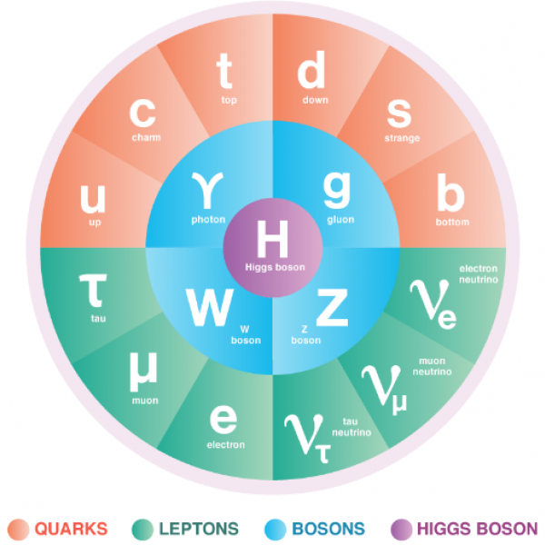
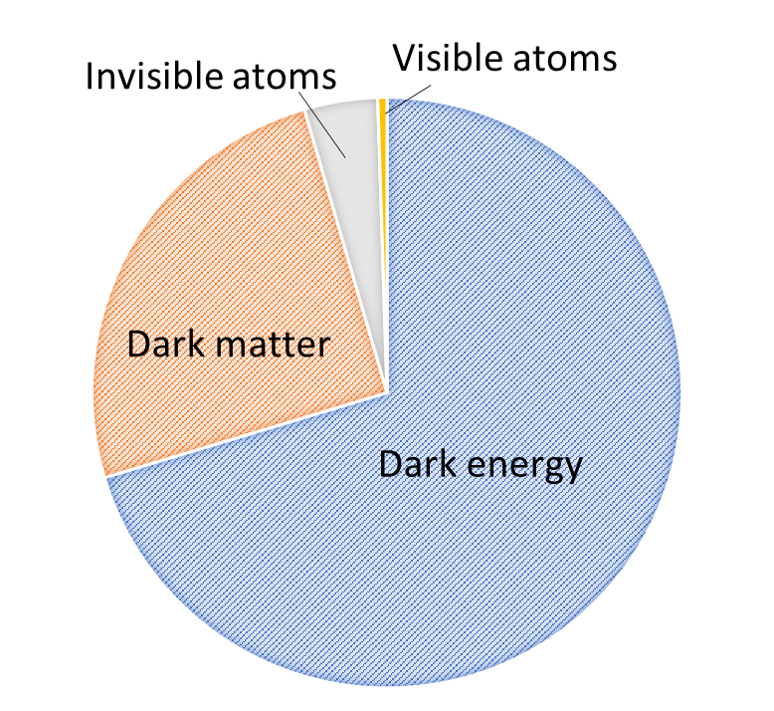
Background
The Standard Model and ΛCDM are very successful theories but…
The ΛCDM model postulates that 95% of the energy content of the universe is dark matter and dark energy. Their exact nature is unknown. Only the remaining 5% is described by the SM.

Slide 3
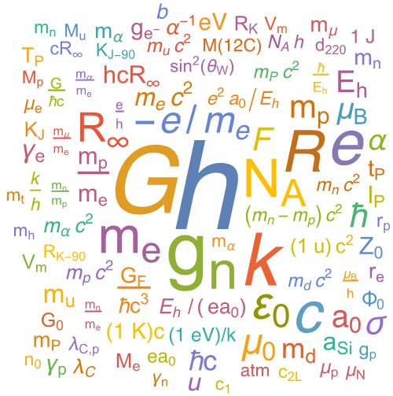
Background
The Standard Model and ΛCDM are very successful theories but…
The ΛCDM model postulates that 95% of the energy content of the universe is dark matter and dark energy. Their exact nature is unknown. Only the remaining 5% is described by the SM.
Both models have several parameters, supposed to be immutable, called fundamental constants.
Challenging this assumption could be the key to solving the dark matter and dark energy enigmas

Slide 4


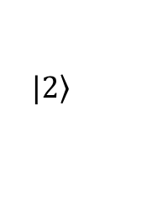
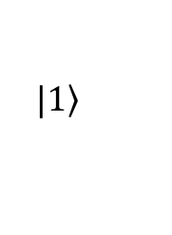
Why clocks?
All atomic and molecular energy spectra depend on the fundamental constants of the Standard Model
Spectroscopy lends itself to measure variations of:
Atomic and molecular spectra can be measured with extreme precision using atomic clocks
Grand unification physics fixes relations between fundamental constants (if one changes with time, others will as well)
$$|\left.1\right\rangle$$
$$α=\frac{1}{4πε_{0}}\frac{e^{2}}{ℏc}$$
α
μ
$$μ=\frac{m_{p}}{m_{e}}$$
$$|\left.2\right\rangle$$
α

Slide 5
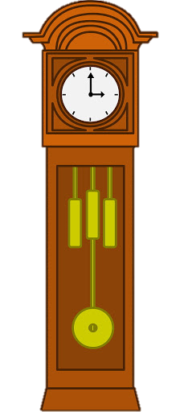
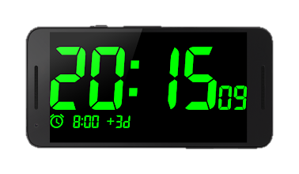
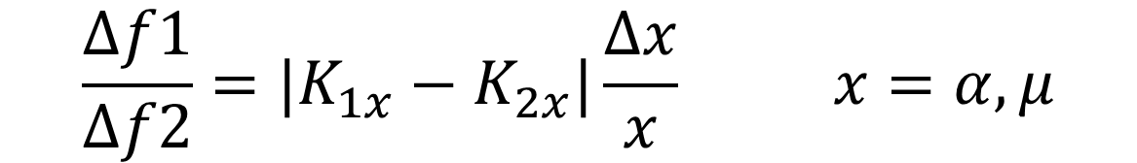
How to measure variations of fundamental constants
Comparing clocks with different sensitivities to fundamental constants
Measure ratio f₁/ f₂
Look for changes over time
$$\frac{Δf1}{Δf2}={|K}_{1x}−K_{2x}|\frac{Δx}{x} x=α,μ$$

Slide 6

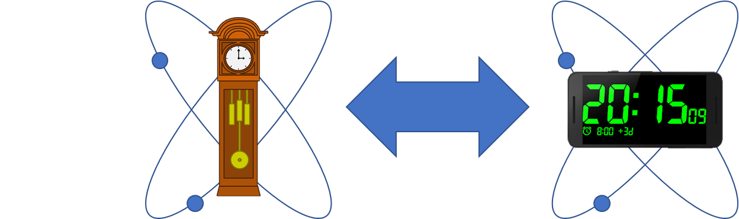
How to measure variations of fundamental constants
“in house” comparison

Slide 7


How to measure variations of fundamental constants
satellite
“Dark fibre”

Slide 8
The QSNET project
Search for variations of fundamental constants of the Standard Model
using a network of clocks
A unique network of clocks chosen for their different sensitivities to variations of α and μ
The clocks will be linked, essential to do clock-clock comparisons

Slide 9
The QSNET project
Search for variations of fundamental constants of the Standard Model
using a network of clocks
A unique network of clocks chosen for their different sensitivities to variations of α and μ
The clocks will be linked, essential to do clock-clock comparisons
TRL

Slide 10

The QSNET project
Search for variations of fundamental constants of the Standard Model
using a network of clocks
A unique network of clocks chosen for their different sensitivities to variations of α and μ
The clocks will be linked, essential to do clock-clock comparisons

Slide 11
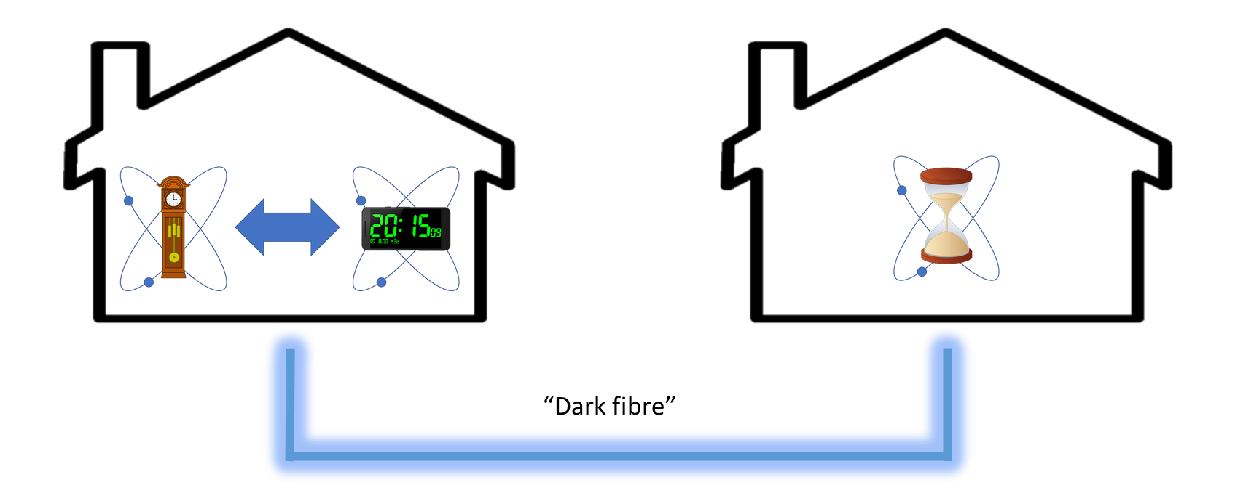
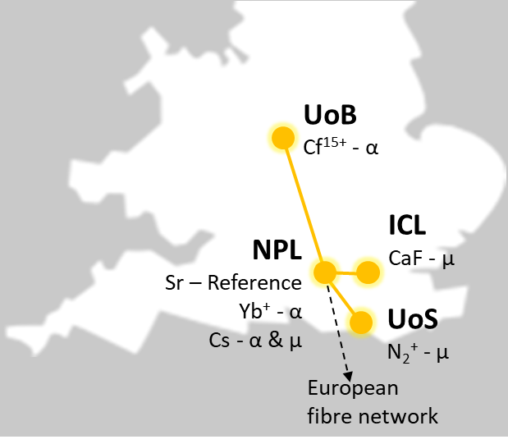
The network approach
Optimally exploit existing expertise. No single institution has the range of expertise required to run a sufficiently large and diverse set of clocks
Sensors with similar sensitivities and different systematics are necessary to confirm any measurements and reject false positives
Networks enable probing of space-time correlations
The possibility of detecting transient events such as topological defects in dark matter fields or oscillations of dark matter
A new versatile and expandable national infrastructure with possible further applications in and beyond fundamental physics.

Slide 12




Look for variation on different timescales
Slow drifts
Oscillations
Fast transients
$$\frac{Δα}{α}$$
Time
Year 1
Year 2
Year 3
$$\frac{Δα}{α}$$
Time
minutes / hours / days
$$\frac{Δα}{α}$$
Time
And any combination…
minutes / hours / days

Slide 13
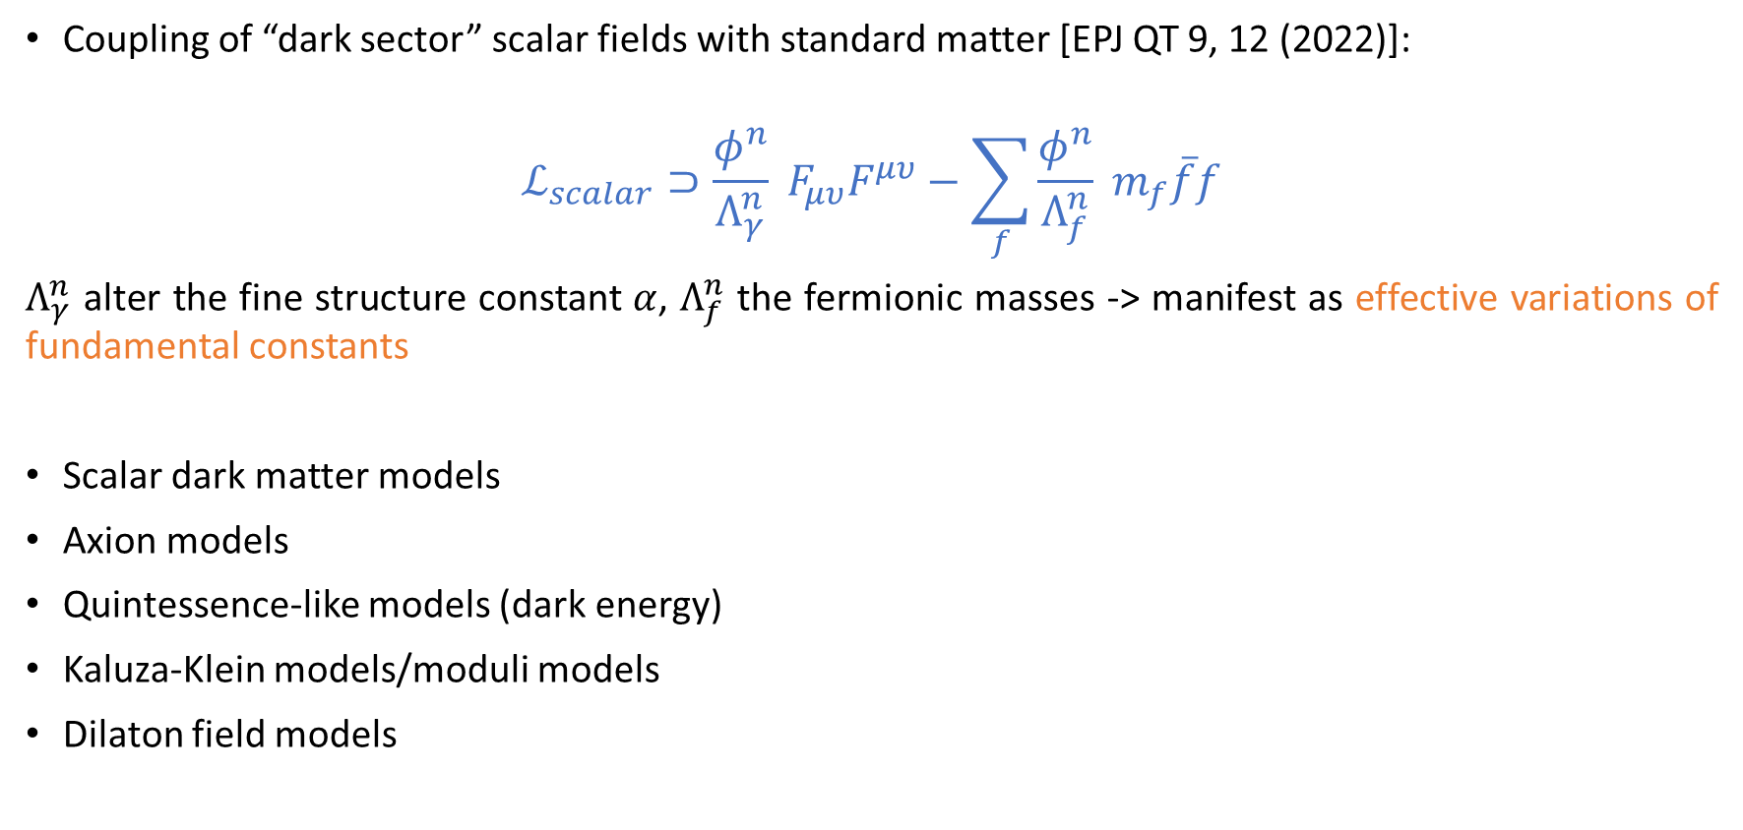
Phenomenology
Coupling of “dark sector” scalar fields with standard matter [EPJ QT 9, 12 (2022)]:
$$ℒ_{scalar}⊃\frac{φ^{n}}{Λ_{γ}^{n}} F_{μυ}F^{μυ}−\sum_{f}{\frac{φ^{n}}{Λ_{f}^{n}}} m_{f}\overline{f}f$$
$Λ_{γ}^{n}$ alter the fine structure constant $α$, $Λ_{f}^{n}$ the fermionic masses -> manifest as effective variations of fundamental constants
Scalar dark matter models
Axion models
Quintessence-like models (dark energy)
Kaluza-Klein models/moduli models
Dilaton field models

Slide 14
Example: scalar dark matter
Linear Quadratic

Slide 15
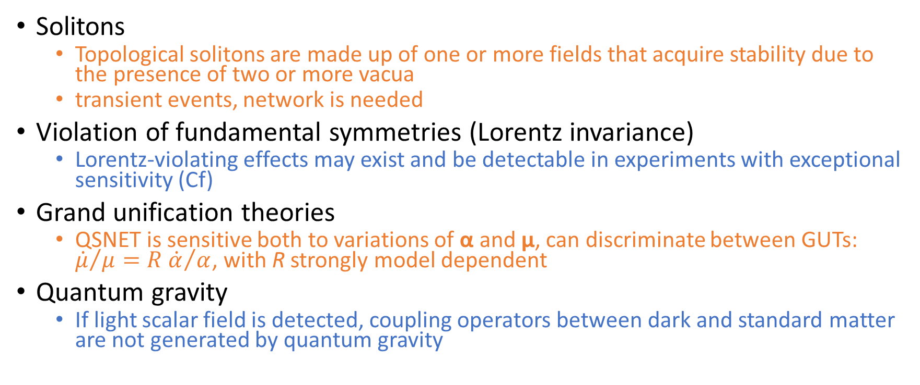
Other tests [EPJ QT 9, 12 (2022) ]
Solitons
  Topological solitons are made up of one or more fields that acquire stability due to the presence of two or more vacua
  transient events, network is needed
Violation of fundamental symmetries (Lorentz invariance)
  Lorentz-violating effects may exist and be detectable in experiments with exceptional sensitivity (Cf)
Grand unification theories
  QSNET is sensitive both to variations of α and μ, can discriminate between GUTs: ${\dot{μ}}/{μ={R \dot{α}}/α}$, with R strongly model dependent
Quantum gravity
  If light scalar field is detected, coupling operators between dark and standard matter are not generated by quantum gravity

Slide 16
Our results

Slide 17


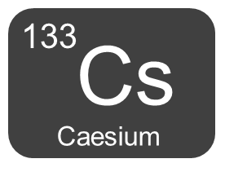
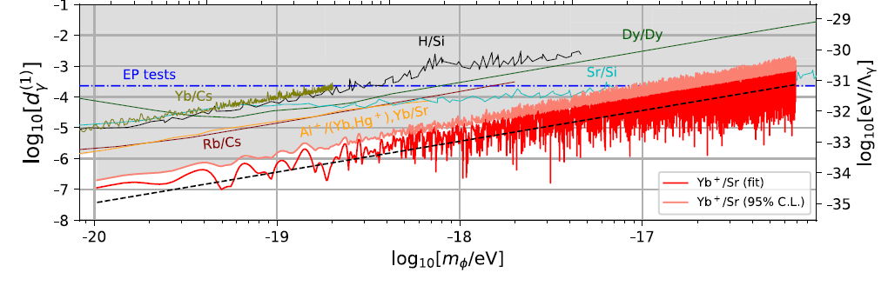
NPL optical clock measurements
Frequency ratios between NPL’s optical clocks and Cs fountain have allowed limits to be placed on variations in the fine structure constant, α and the proton-to-electron mass ratio, µ.
During QSNET, we have:
Improved the stability, accuracy and automation of the optical clocks -> now the most accurate clock in Europe!
Carried out several month-long measurement campaigns to search for variations in fundamental constants
Worked with the theory team at Sussex to interpret the results for fundamental physics, e.g:
New data from NPL (red and pink lines) improved the constraint on the coupling strength between dark matter and photons by an order of magnitude compared to any previous measurements
N. Sherrill et al., New J. Phys. 25 093012 (2023)
mass of dark matter bosons

Slide 18
Theory at Sussex
More than 20 published papers [qsnet.org.uk/publications]:
  We have proposed a new framework to discuss new physics effects in clocks using effective field theory methods.
  We have emphasized that one can obtain model independent bounds.
  We have obtained limits for the case of dark matter and reconsidered the framework of grand unified theory.
  Cross-fertilization of ideas, besides exciting results direct relevant to clocks
    we made progress on dark matter deriving some theoretical bounds on their masses and in quantum gravity with some applications to the information paradox of black holes and their thermodynamics (in particular showing that they have not only a temperature but also a pressure).
    The world, including our universe and black holes, is really quantum. The notation of macroscopic superposition is absolutely crucial in our resolution of the Hawking paradox.

Slide 19
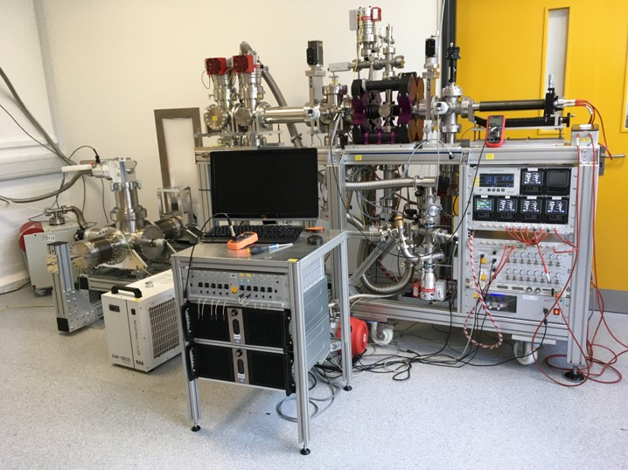
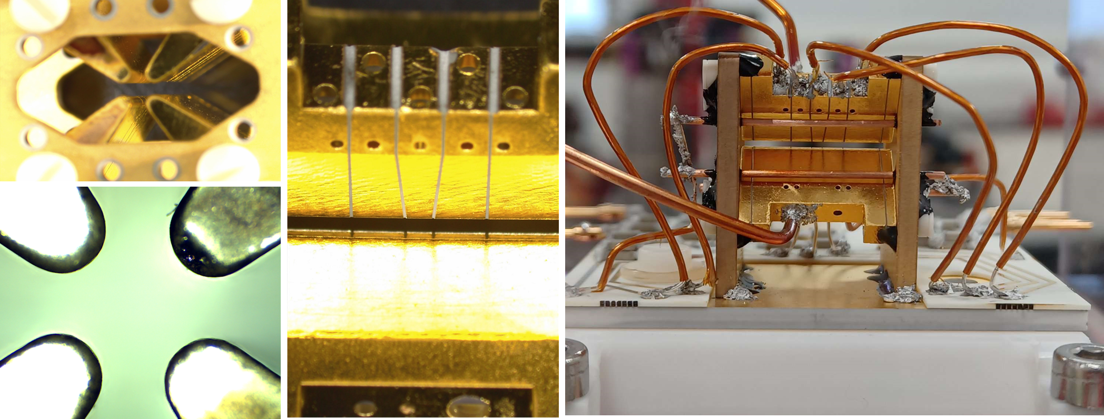

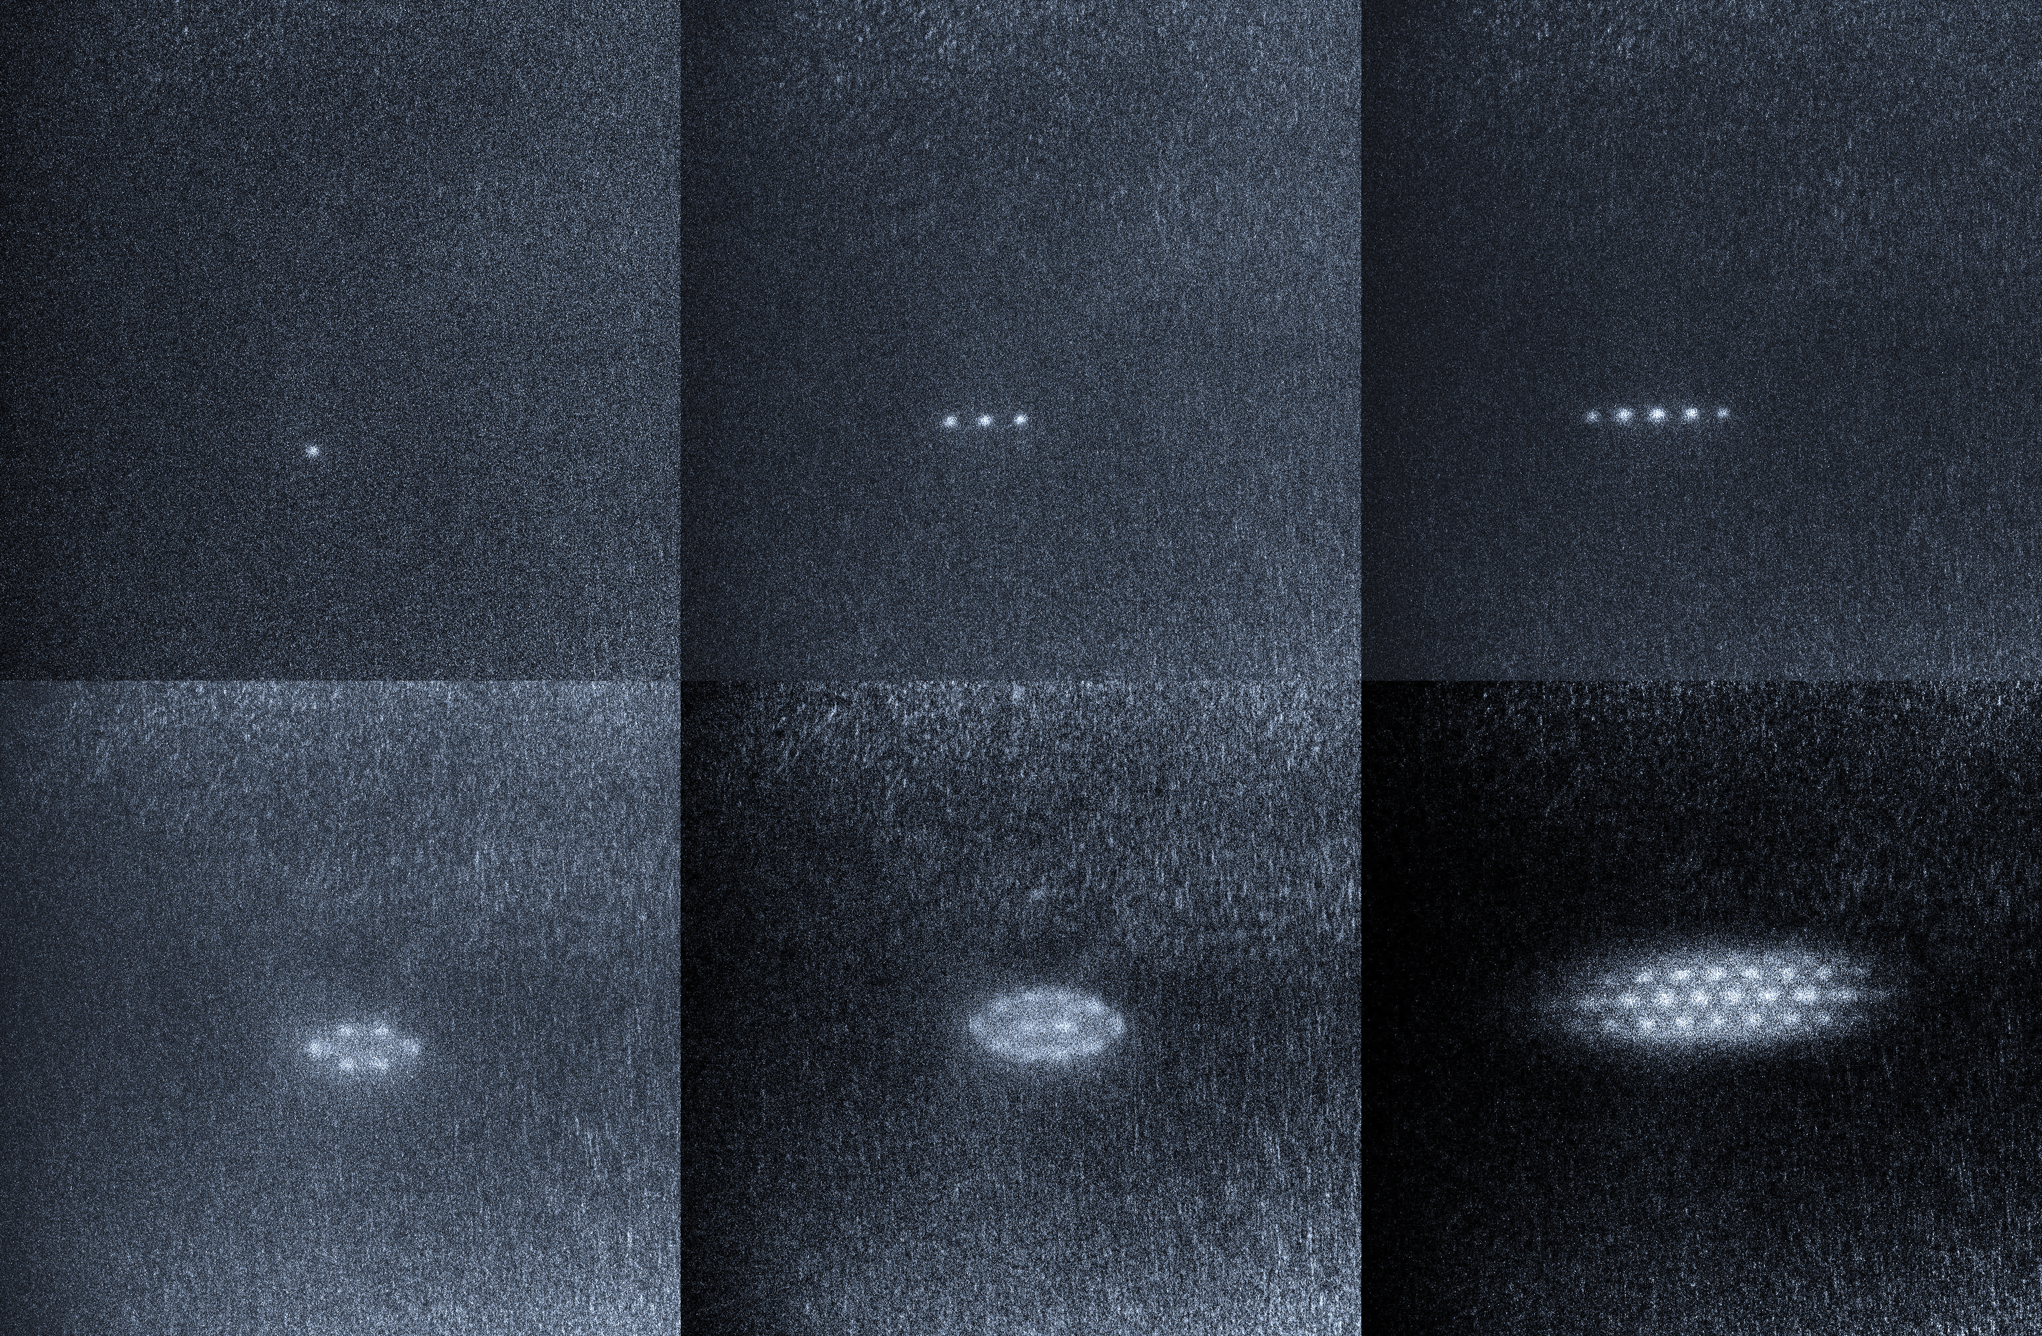
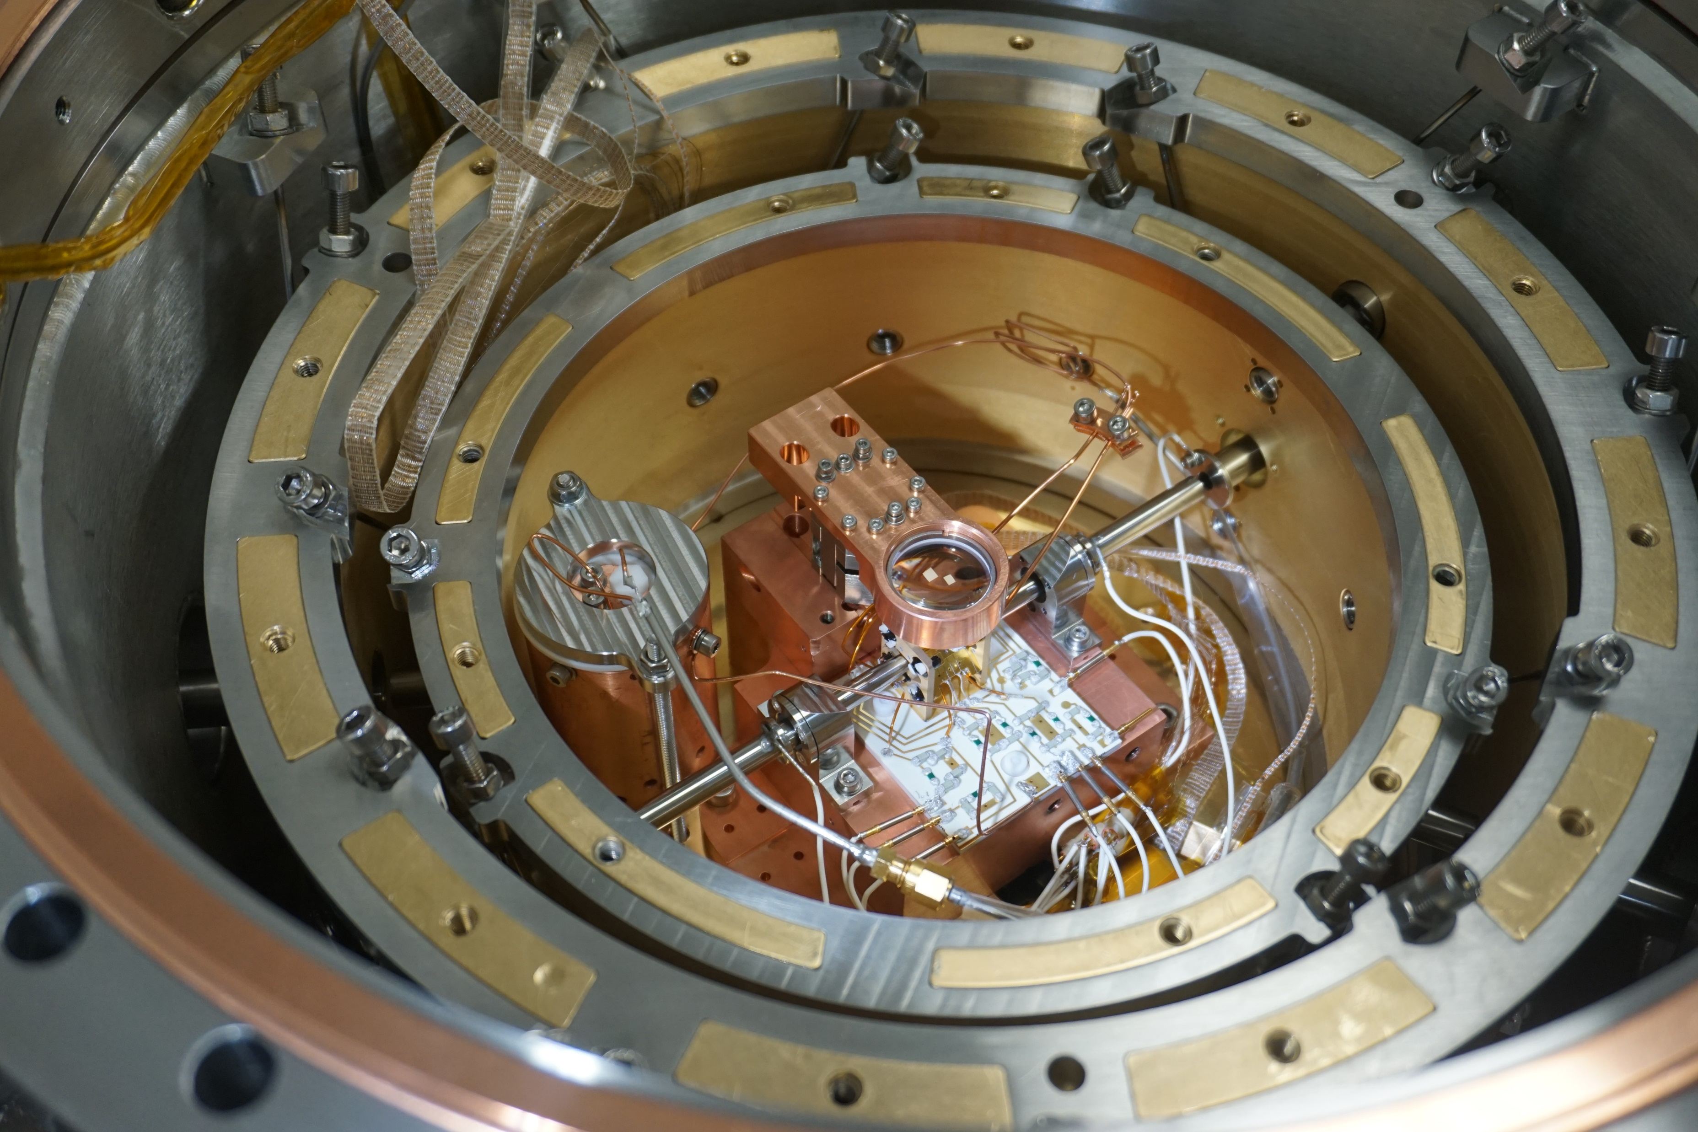


Towards Cf HCI clocks at Bham
Compact Electron Beam Ion trap (1st in UK) [ ]
Ion optics
Ultra-low vibration cryogenic vacuum
Cryogenic Paul trap [ ]
Laser system
Cf samples
Laser cooled Ca+ Coulomb crystals

Slide 20
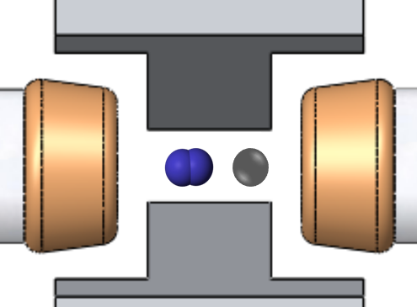
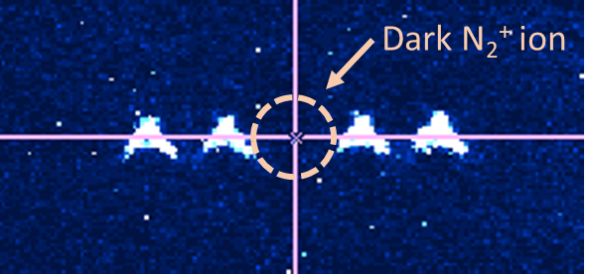
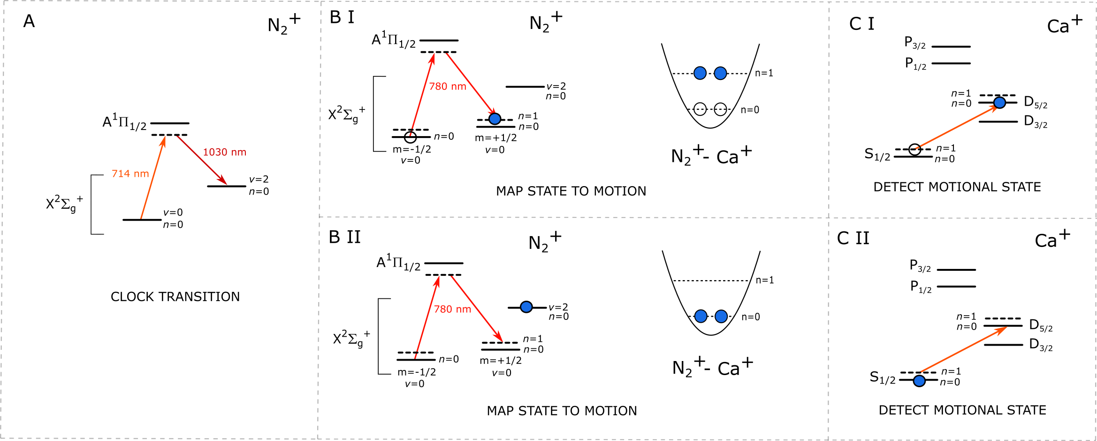
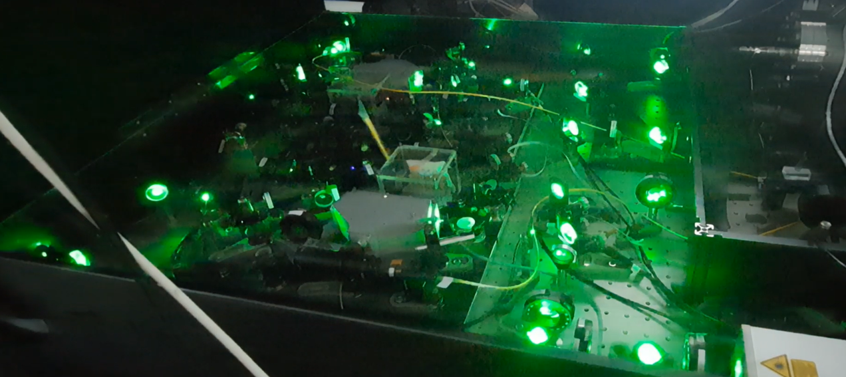
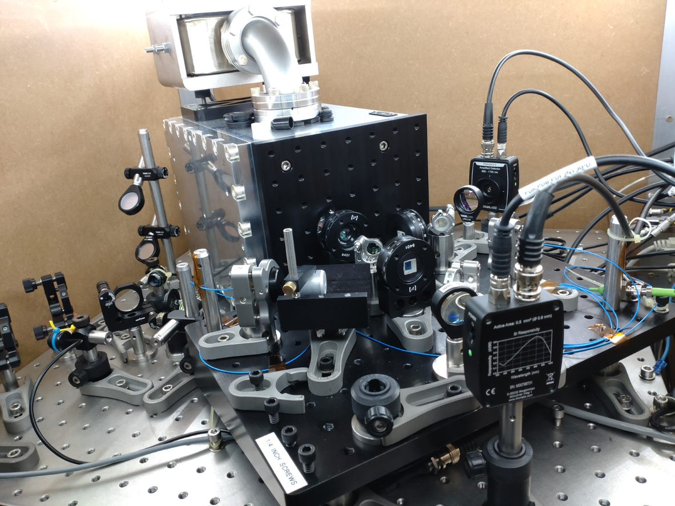
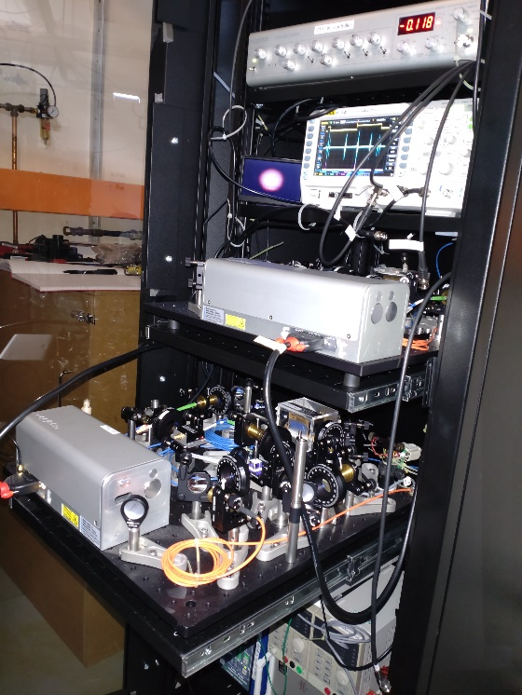
N₂⁺ clock at Sussex
At Sussex we are building a clock system based on a vibrational transition in a trapped molecular nitrogen ion, using a calcium ion for cooling and read out.
As part of QSNET, we have:
Sideband cooled calcium and are preparing to test quantum logic spectroscopy
Set-up spectroscopy lasers (locked to ULE cavity)
Built lasers and developed techniques for N₂ ionisation

Slide 21

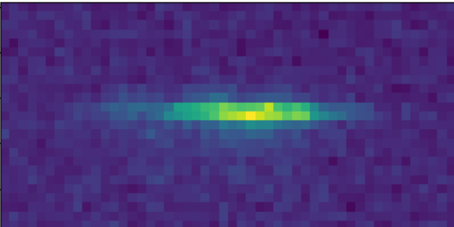
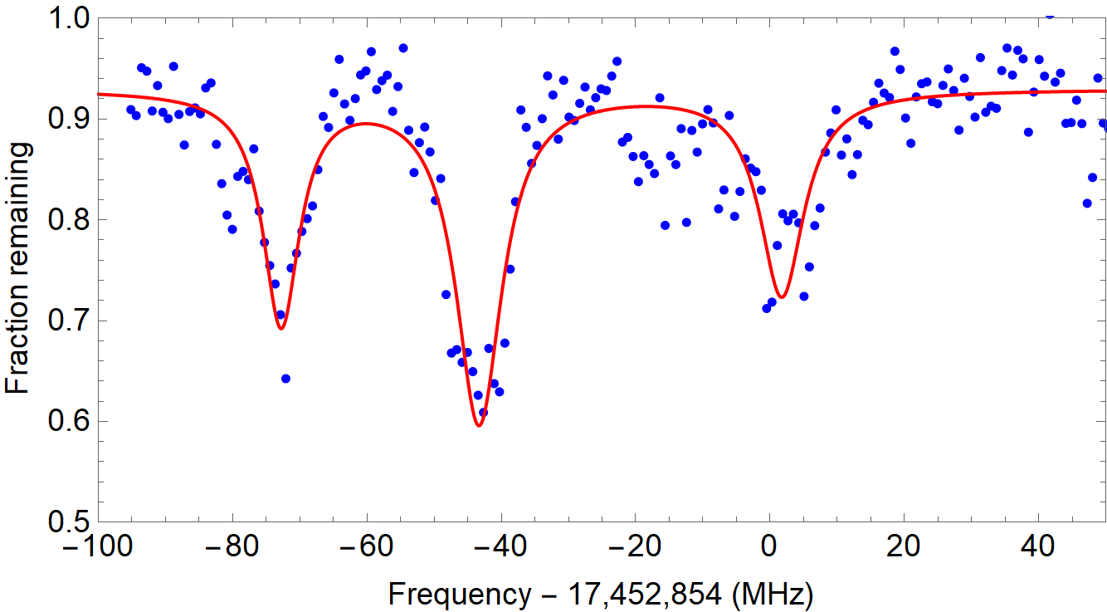
Towards a molecular lattice clock at Imperial
Spectroscopy for frequency calibration in the mid-infrared
Raman laser system with a 1 Hz linewidth
1064nm laser
SERVO
~
EOM
PDH Lock
See arXiv:2410.22328
Ultra stable cavity
Finesse ~ 300,000
Driving mid-ir vibrational transitions in ultracold CaF
PDH Lock
1mm
SERVO
~
EOM
Ultracold CaF molecules trapped in an optical lattice
1134nm laser

Slide 22
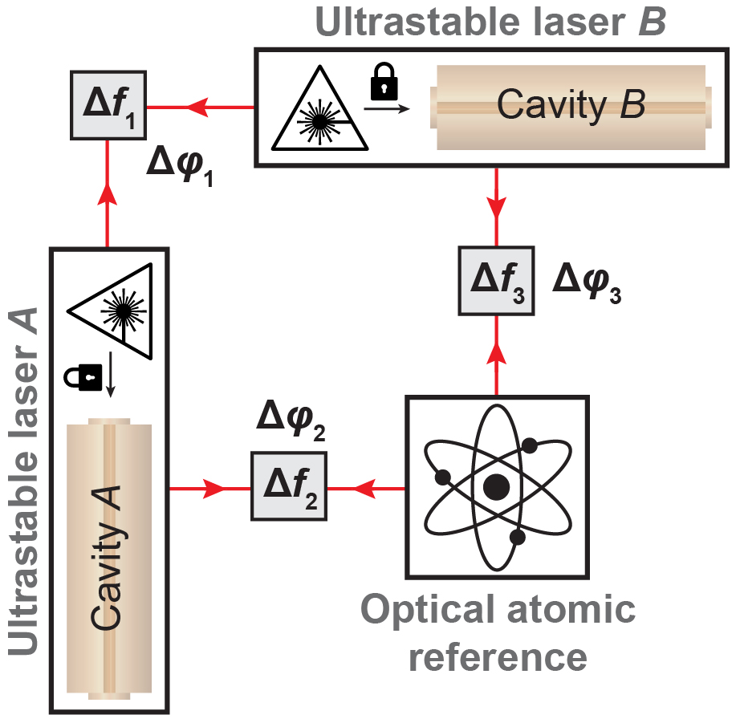
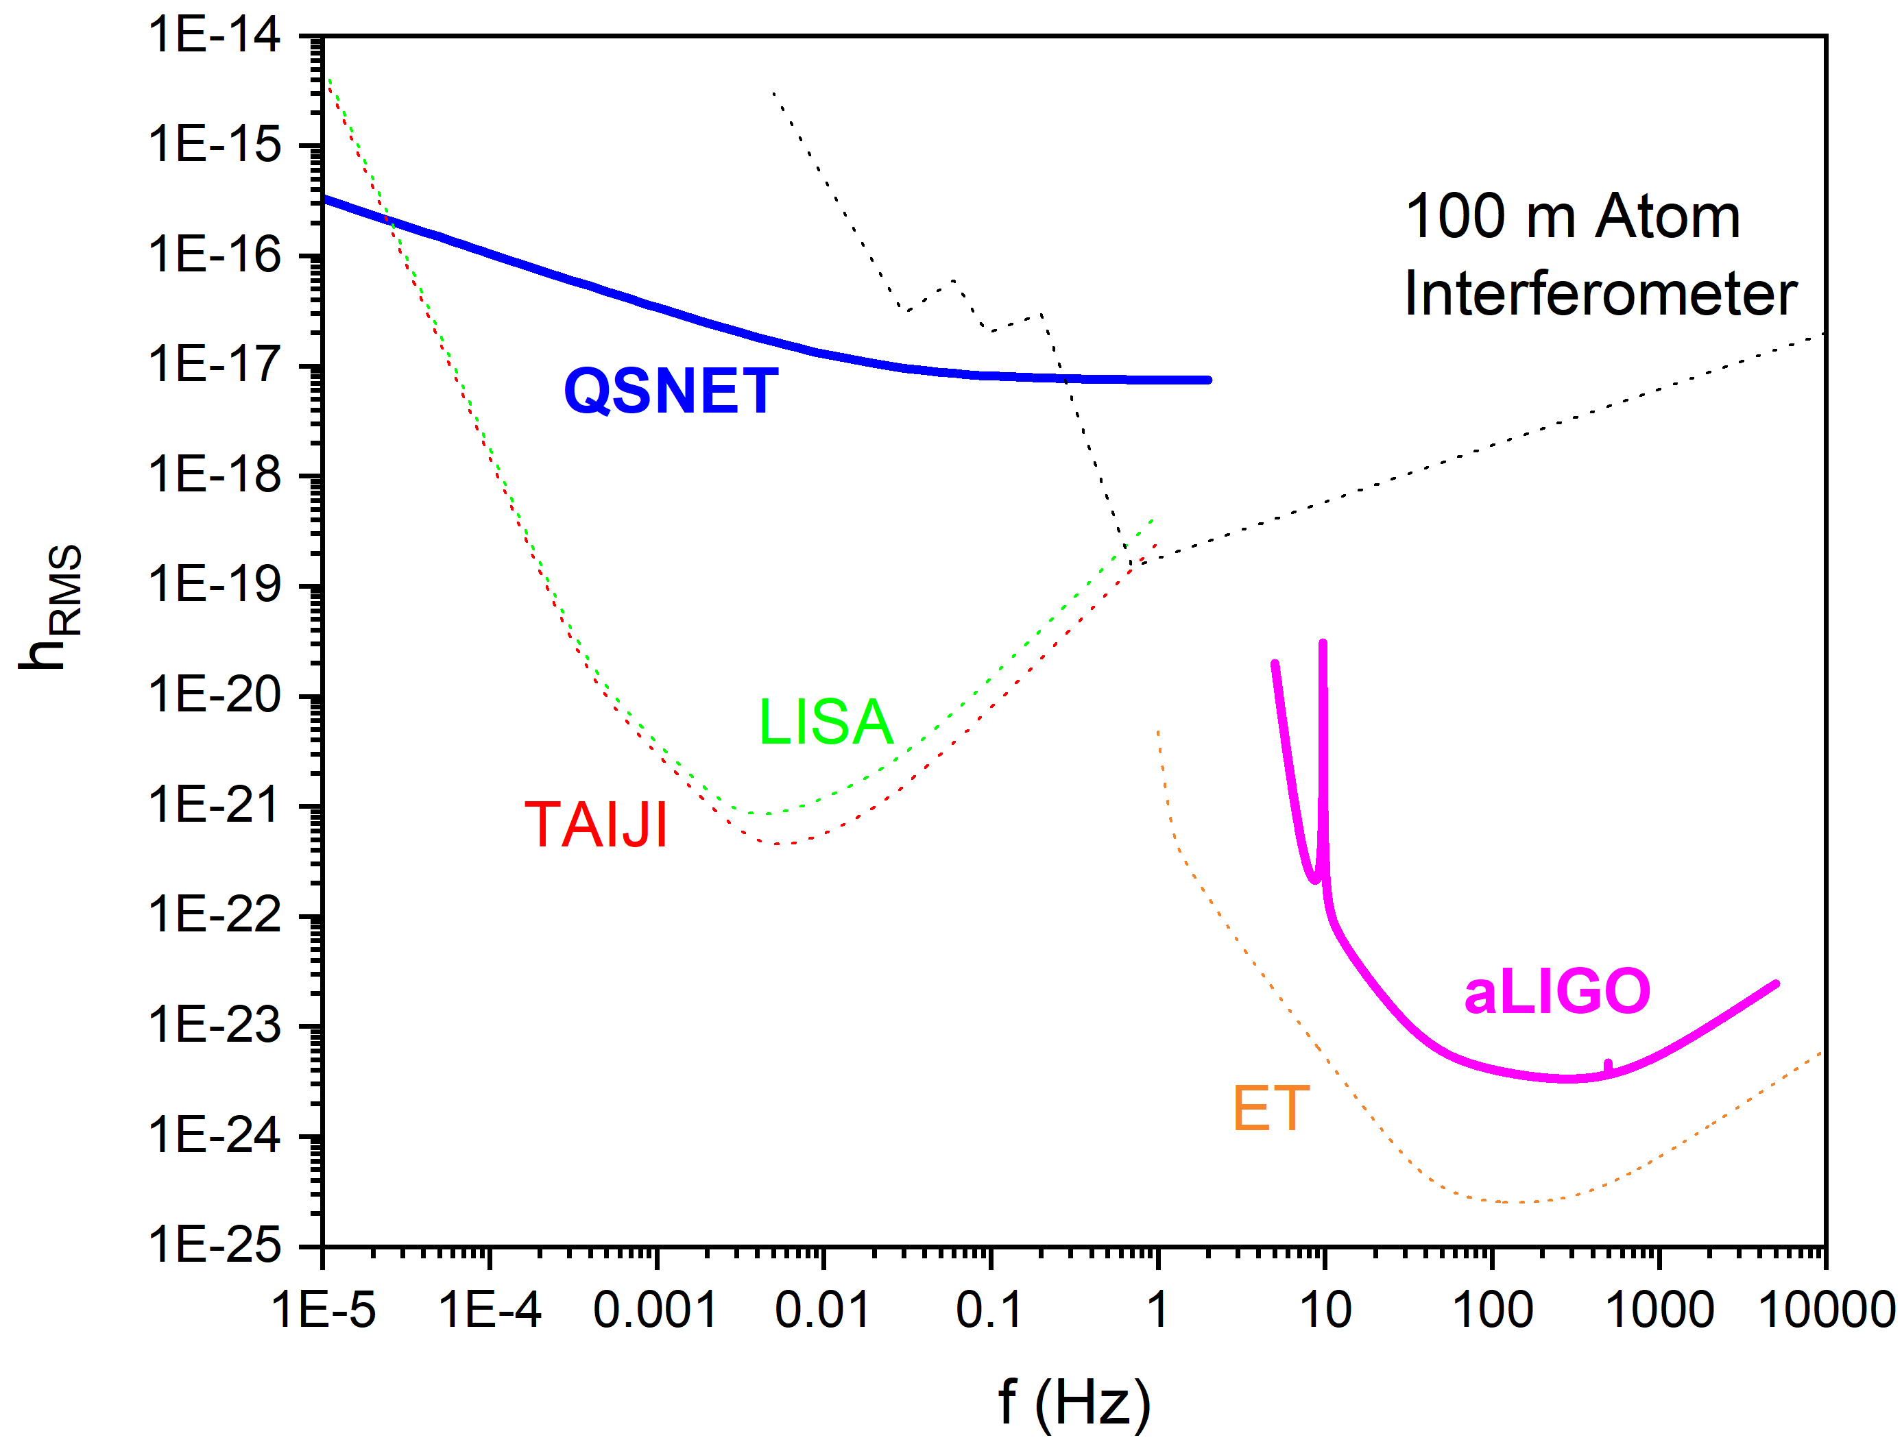
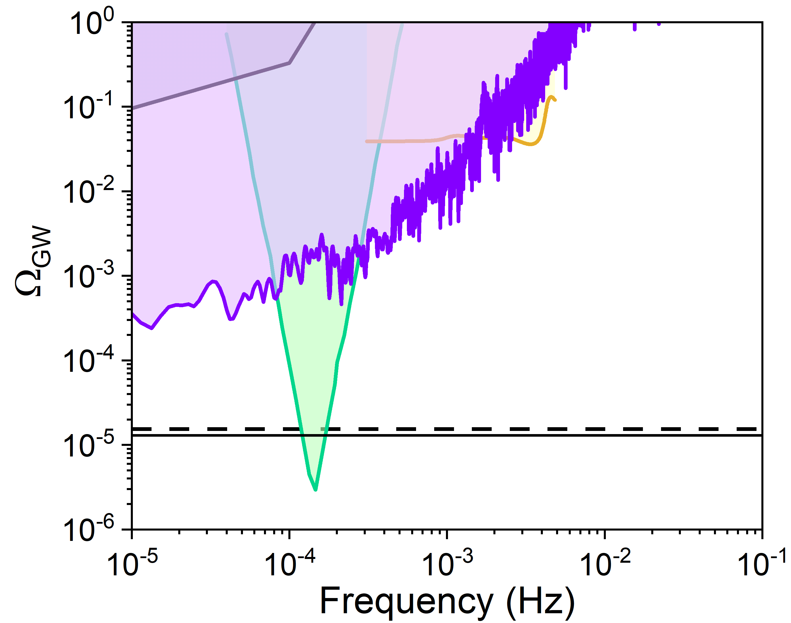
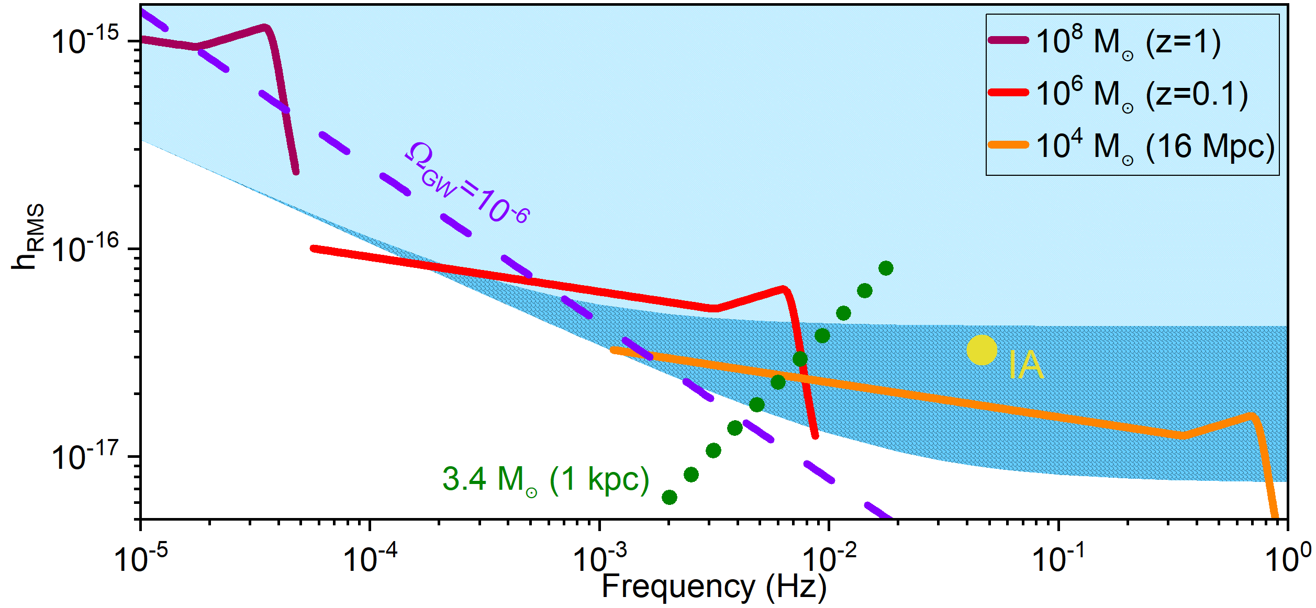
Detector of GW in the milli-Hz band
Only other GW detector besides LIGO
For the next ~15-20 years

Slide 23
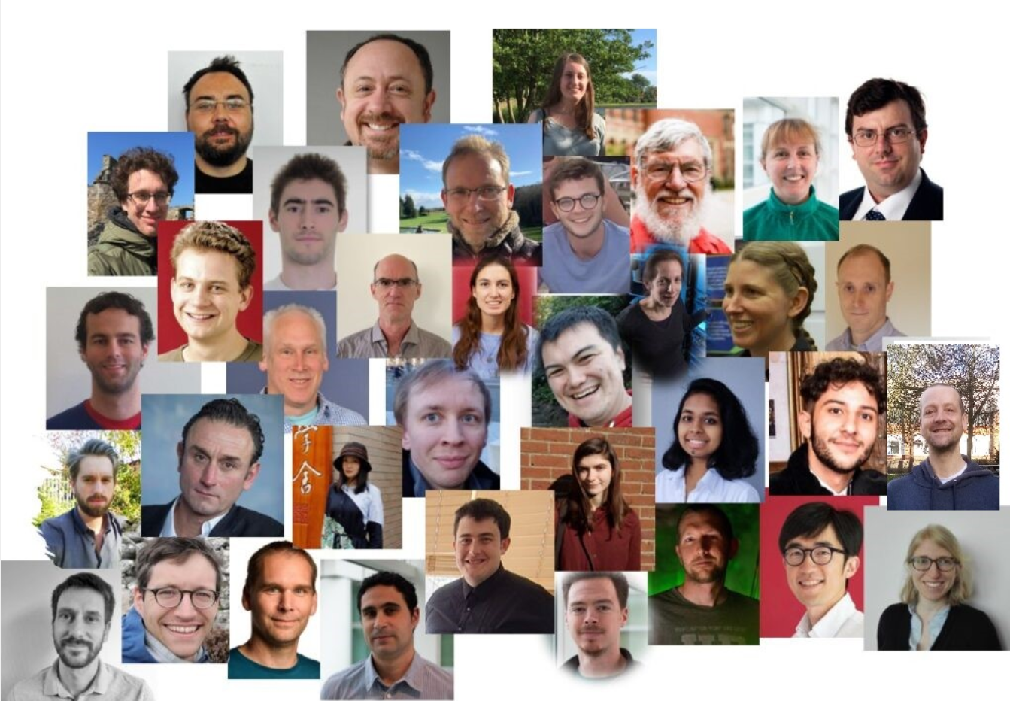
Summary
Achieved all the objectives for Phase 1:
Crucial milestones towards world-unique network of
next-generation clocks
World leading constraints on variations of fundamental constants
Substantial theoretical advances
New detectors of GWs in an unexplored range
An inter-disciplinary community gathered around a new (expandable) national infrastructure
Over 30 publications/preprints, over 100 invitations to give plenary talks, colloquia and seminars. Seminar series with more than 45 speakers -> qsnet.org.uk/seminar-series

