Slide 1
How can the STFC National Laboratories Research Office help me?
Katharine Hollinshead, Julius Ursu and Victoria Wright
Notes:
The abstract pattern can be removed or repositioned if required. Be careful to ‘Send to Back’ so that it does not obscure any important information.

Slide 2
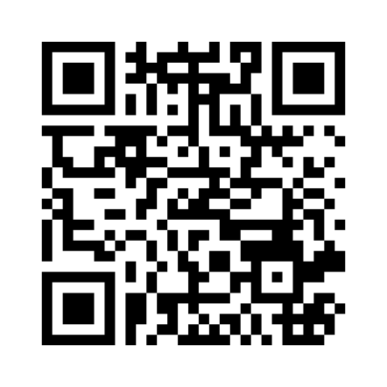
To the Mentimeter!
www.menti.com 5621 0630
https://www.menti.com/al7fkxrv2z1p

Slide 3
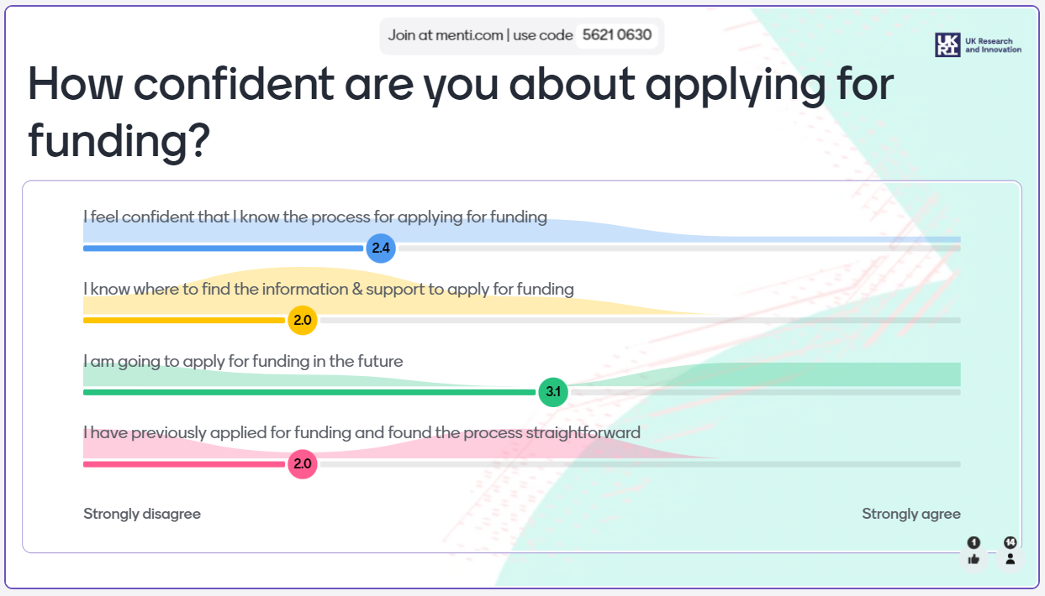

Slide 4
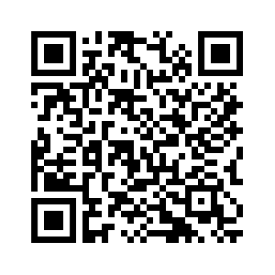
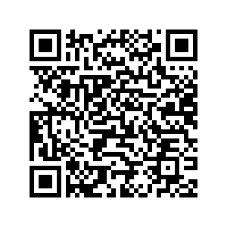
National Labs Research Office
Here to help you:
Find funding opportunities – our site has links to relevant upcoming calls as well as research funders
Apply for grants – we currently have guidance notes on UKRI and European funding
Produce better proposals – advice, training, mentoring
SharePoint Hub
https://stfc365.sharepoint.com/sites/NLResearchOffice
Research Bulletin sign up
https://stfc365.sharepoint.com/sites/NLResearchOffice/SitePages/National-Lab-Research-Bulletin.aspx
Victoria Wright
Acting Head
General enquiries
Julius Ursu
European Funding Lead
Our European Funding Expert
Katherine Hollinshead
Research Facilitator (secondment)
Our UKRI Funding Expert
ResearchOffice@stfc.ac.uk

Slide 5
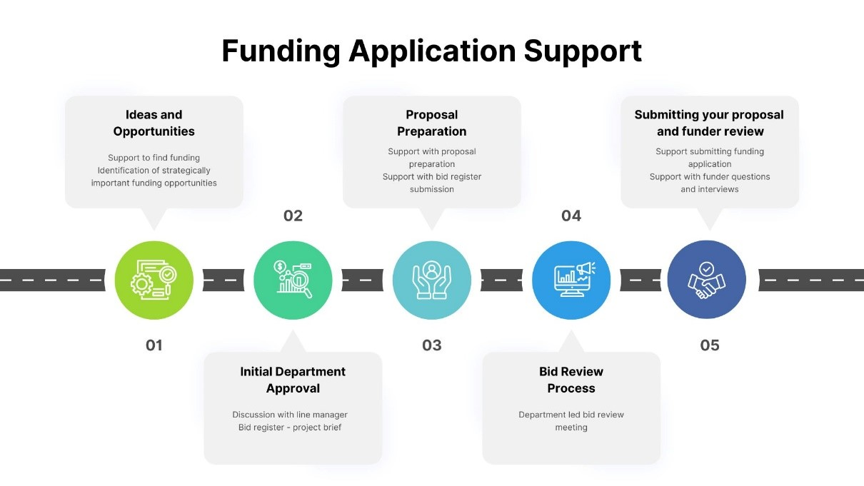

Slide 6
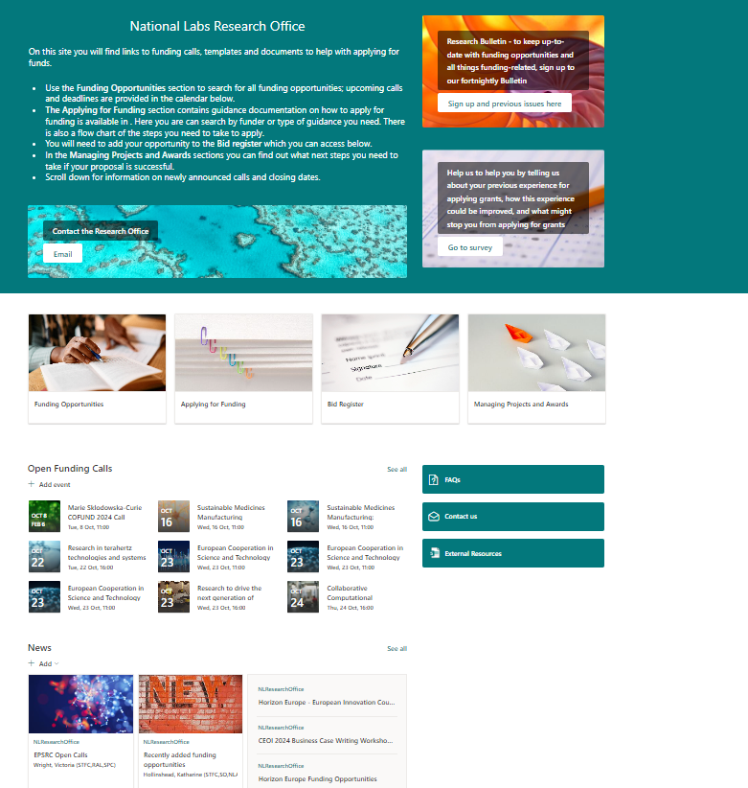
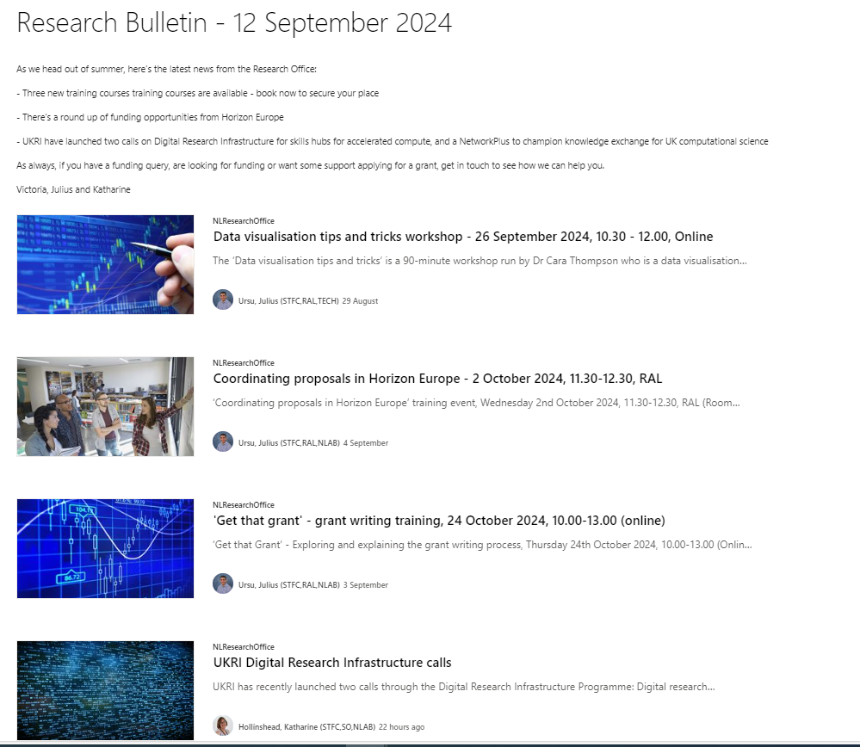
Support, Guidance, and Opportunities
Notes:
Replace this guidance text with your own bullet pointed content.
For further guidance please see https://www.bdadyslexia.org.uk/advice/employers/creating-a-dyslexia-friendly-workplace/dyslexia-friendly-style-guide

Slide 7
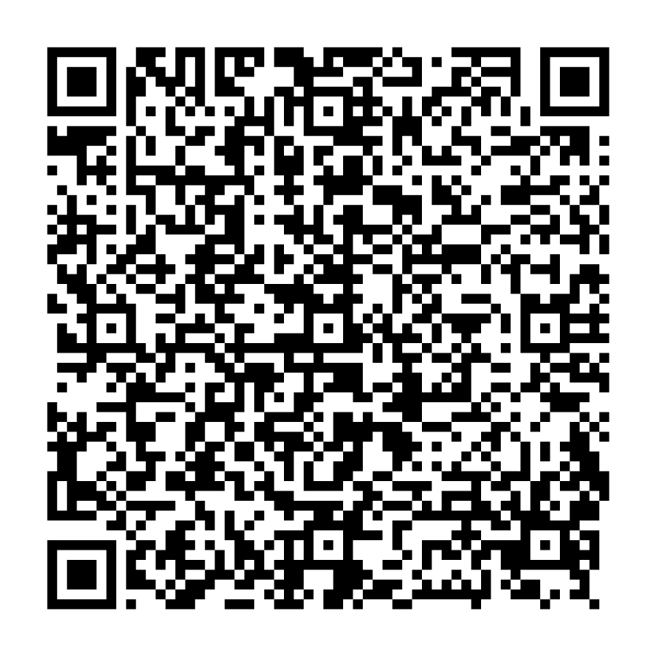
Learn more through the NLs Research Office
Get that Grant
Explore and understand the grant writing process in a practical way
Thursday 24th October 2024
10:00-13:00
Online
Newcomers to Horizon Europe
Day 1: How to get started with HEu research activities
Monday 2nd December 2024
10:00-12:00
Online
Newcomers to Horizon Europe Pillar II
Day 2: How to select partners for consortia
Tuesday 3rd December 2024
10:00-12:00
Online
SharePoint Hub
Research Bulletin
sign up
Contact us: ResearchOffice@stfc.ac.uk
https://stfc365.sharepoint.com/sites/NLResearchOffice
Grant Funding Experience Survey

Slide 8
Back to the Mentimeter!
www.menti.com 5621 0630
https://www.menti.com/al7fkxrv2z1p

Slide 11
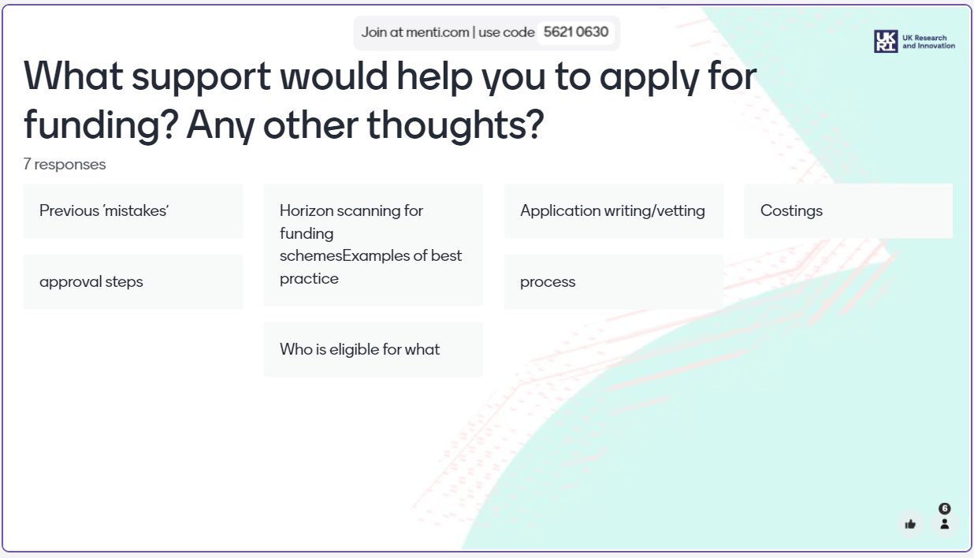

Slide 12
European funding opportunities: why, what and how?
Julius Ursu
European Funding Lead
National Laboratories Research Office

Slide 13
Why apply for EU research funding?
STFC Participation in Horizon Europe
Access to significant funding,
Aligns to UKRI’s Strategy and STFC’s Strategic
Delivery Plan and its 6 strategic objectives:
World-class people and careers - Develop your
career; mobility – international, intersectoral and
interdisciplinary,
World-class ideas – Share expert knowledge and
lead on innovative practices,
World-class places - Experience different cultures and work environments,
World-class innovation – Develop cutting edge technology and create business opportunities,
World-class impacts - Collaborate internationally to address global challenges,
World-class organisation - Access state of the art facilities and research,
DRAFT | 2
REJECTED | 53
RESERVE LIST | 5
AWARDED | 31
IN FLIGHT | 5
TOTAL | 96
SUCCESS RATE | 35%

Slide 14
EU-UK Relationship vis-a-vis EU Programmes
1 January 2024 – UK associates to Horizon Europe and Copernicus, but not to Euratom;
UK organisations can participate in Horizon Europe calls on the same terms as institutions from other Associated Countries,
Can lead consortia and receive EU funding, from the 2024 Work Programme and onwards - including any 2024 calls that opened/closed in 2023; exception UK is not eligible for EIC Fund,
UK applicants to calls in 2021, 2022, and 2023 Work Programmes remain fully eligible for evaluation by the EU and, if successful, for funding through the UK Horizon Guarantee;
UK is considered a non-associated third country in the following EU programmes: Erasmus+, Euratom, Digital Europe, LIFE, EU4Health, European Defence Fund
13 May 2024 – UK joins the European High Performance Computing Joint Undertaking (EuroHPC JU), 35th participating state;​
UK average annual contribution to Horizon Europe is €2.34bn (£2bn) and €154m (£133m) to Copernicus;

Slide 15
What funding is available?
Horizon Europe is the EU’s current Framework Research and Innovation funding programme.
It is the largest R&I funding programme in the world, with a budget of over £81bn for 2021-27.
The programme is divided into three main parts:
Pillar 1 supports excellence in science
Pillar 2 focuses on solving global challenges through collaborative research & innovation
Pillar 3 supports business growth and competitiveness
Other parts of Horizon also include support for research infrastructure and widening participation.
Key priority areas include space, digital, energy, industry, climate change, food, bioeconomy, health, transport and mobility, civil security and humanities. The programme is open to all types of organisations.

Slide 16
What funding is available from Horizon Europe?
Horizon Europe budget: €95.5bn
€25bn
€53.5bn
€13.6bn
€16bn
€10bn
€6.6bn
€2.4bn
€3bn
Notes:
The second Horizon Europe strategic plan 2025-2027
The Horizon Europe strategic plan 2025-2027 addresses the key global challenges such as climate change, loss of biodiversity, the digital transition and an ageing population.
The strategic plan sets out 3 strategic orientations for research and innovation investment under Horizon Europe for the years 2025-2027:
Green transition
Digital transition
A more resilient, competitive, inclusive and democratic Europe
Pillar 2 largest budgets cluster 4 and cluster 5 with c €15bn each.
Research and innovation action (RIA) that establishes new knowledge or explores a new or improved technology, product, process, service or solution. The EU funding covers up to 100% of the project costs.
Innovation action (IA) that produces plans or designs for new or improved products, processes or services including prototyping, testing, demonstrating, piloting, large-scale product validation and market replication. The EU funding covers up to 70% of the project costs.
Coordination and support action (CSA) that improve cooperation among EU and associated countries to strengthen the European Research Area including, for example, standardisation, dissemination, awareness-raising, communication and networking activities, policy dialogues, mutual learning or studies. The EU funding covers up to 100% of the project costs.

Slide 17
Horizon Europe – need to know!
Types of projects | Eligibility | Typical proposals
RIA: Research and Innovation Actions 100% funding rate, TRL 2-6 IA: Innovation Actions 70%- 100%, TRL 6-9 CSA: Coordination and Support Actions 100% funding rate | Consortium: minimum 3 independent legal entities in a different EU Member State (MS) or Associated Country (AC), at least 1 in a MS. UK is an Associated Country, eligible for EU funding and to coordinate proposals and projects. | Size: ranges from €1–10M+ Duration: 2-3 years + Budget: Eligible costs + 25% Indirect costs Proposal application: 45-50 pages + forms

Slide 18
European Research Council Grants – key features ERC funds ambitious ‘frontier research’ proposals submitted by a Principal Investigator (PI), Any area of research and without predefined priorities, Scientific excellence is the sole evaluation criterion - the scientific excellence of the PI’s track record and of the proposed project,
Notes:
Synergy Grants (SyG)
ERC Synergy Grants support groups of two to four PIs, who bring together complementary skills, knowledge, and resources in new ways, to jointly address ambitious research problems. Synergy Grants award up to a maximum of €10 million for a period of six years. Applicants can request €4 million of additional funding to cover specific expense categories.
Proof of Concept Grants (PoC)
The Proof of Concept scheme funds ERC grant holders to explore the innovation potential of an idea developed during an ERC-funded project. The scheme aims to build upon ideas which draw substantially from research that has been funded by the ERC, exploring opportunities for commercial or societal applications of ideas that have arisen from research performed on Starting, Consolidator, Advanced or Synergy Grants.

Slide 19
Notes:
ERC Work Programme 2025 isn’t out yet, but a draft is expected next month. Call dates for 2024 WP in the table above.

Slide 20
Current and upcoming funding opportunities – Marie Sklodowska Curie Actions
Marie Sklodowska-Curie Actions – key features
Research projects with training aspects,
Bottom-up approach in any subject area,
Researcher mobility – interdisciplinary, intersectoral, international,
Enhances the skills and career of researchers,
Duration of the project between 12 – 36 months,
Budget determined by unit costs set by the EC,
Open and upcoming calls
MSCA Doctoral Networks 2024 (HORIZON-MSCA-2024-DN-01), deadline
27 November 2024
Doctoral Networks, Industrial Doctorates and Joint Doctorates
MSCA Staff Exchanges 2024 (HORIZON-MSCA-2024-SE-01), deadline
5 February 2025
MSCA COFUND 2024 (HORIZON-MSCA-2025-COFUND-01), deadline
Doctoral Programme and Postdoctoral Programme
Opening date: 23 January 2025, Deadline: 24 June 2025,
Marie Sklodowska-Curie Actions (MSCA) Postdoctoral Fellowships 2025
(HORIZON-MSCA-2025-PF-01),
European Fellowships and Global Fellowships
Opening date: 9 April 2025, Deadline: 10 September 2025,
Notes:
Postdoctoral Fellowships – Enhance the creative and innovative potential of researchers holding a PhD.
COFUND – Co-finances new or existing doctoral programmes and postdoctoral fellowship schemes.
Doctoral Networks – Support doctoral programmes developed by universities, research institutions, research infrastructures and business
Staff Exchanges – Promote innovative international, intersectoral and interdisciplinary collaboration in research and innovation.

Slide 21
Funding opportunities – Research Infrastructures
Research Infrastructures – key features
Objective – to empower Europe through world-class, accessible RIs as part of an integrated European research and technology infrastructures landscape,
RIs are facilities providing resources and services for research communities to conduct research and foster innovation (single site, distributed, virtual),
Examples of RIs - data infrastructures, telescopes, research vessels, computing systems, communication networks – ISIS, Vulcan, CLARA etc.,
Collaborative projects; EC sets topics; duration 3-4 years; budget €1mil-€8mil,
Work Programme 2025, 4 Destinations
INFRADEV - Consolidation and evolution of the European Research Infrastructure landscape (2025), 1 call, 5 topics (3/2024),
INFRAEOSC - Enabling an operational, open and FAIR EOSC ecosystem (2025), 1 call, 6 topics (5/2024),
INFRASERV - Research infrastructures services to support health research, accelerate the green transition and the digital transformation, and advance frontier knowledge (2025), 1 call, 3 topics,
INFRATECH - Next generation of scientific instrumentation, tools, methods, and advanced digital solutions of research infrastructures and foster innovation and co-creation with industry (2025), 1 call, 4 topics,
Budget per project: €1m-€15m, Total call budget: €399.5m
Opening: 06 May 2025, Deadline(s): 18 Sep 2025

Slide 22
Funding opportunities – Cluster 4 – Digital, Industry and Space
Cluster 4 – Digital, Industry and Space - key features
Collaborative projects of minimum three partners); EC sets the topics; duration 3-4 years; budget €1m-€17.5m per project; total call budget €139m
Destination 5: Open Strategic Autonomy in Developing, Deploying and Using Global Space-Based Infrastructure, Services, Applications and Data
Adoption of work programme expected in March/April 2025.
Calls opening: 03 Jun 2025,
Deadline(s): 13 Nov 2025

Slide 23
Funding opportunities – Cluster 5 – Climate, Energy and Mobility
Cluster 5 – Climate, Energy and Mobility – key features
Clusters 5 - Collaborative projects (at least three partners); EC sets the topics; duration 3-4 years; budget €5mil-€10mil per project.
Objective/s - to accelerate the twin green and digital transitions and associated transformation of the economy, industry and society with a view to achieving climate neutrality in Europe by 2050
Destination 1 – Climate sciences and responses for the transformation towards climate neutrality,
Total call budget: €154.50m, Opening: 06 May 2025, Deadline(s): 24 Sep 2025
Destination 2 – Cross-sectoral solutions for the climate transition,
Total call budget: €263.50, Opening: 06 May 2025, Deadline(s): 16 Sep 2025
Total call budget: €153m, Opening: 16 Sep 2025, Deadline(s): 13 Jan 2026
Destination 3 – Sustainable, secure and competitive energy supply
Destination 4 – Efficient, sustainable and inclusive energy use
Destination 5 – Clean and competitive solutions for all transport modes

Slide 24
Funding opportunities – Widening Participation
Widening Participation – key features
Objective/s - to improve the European research and innovation landscape, to better interconnect innovation ecosystems etc.
Destination 1 – Improved access to excellence
Building Research & Innovation capacity in Widening countries,
Beyond scientific scope; development of management and administrative competencies (Twinning, European Excellence Initiative)
HORIZON-WIDERA-2025-ACCESS-01-01-two-stage – opening 3 December 2024, two-stage 10 April 2025, 20 January 2026, €8-€15 mil per project (18 projects) – Coordinator from a widening country,
Future calls on Teaming and/or Twining,
Destination 2 – Reforming and enhancing the EU research and innovation system –
Professionalisation of research management
Capacity building on Intellectual Property management to support open science
Next generation AI and Human Behaviour: promoting an ethical approach
Collaborative projects (at least 2 partners); duration 3 years; budget €1mil-€5mil.

Slide 25
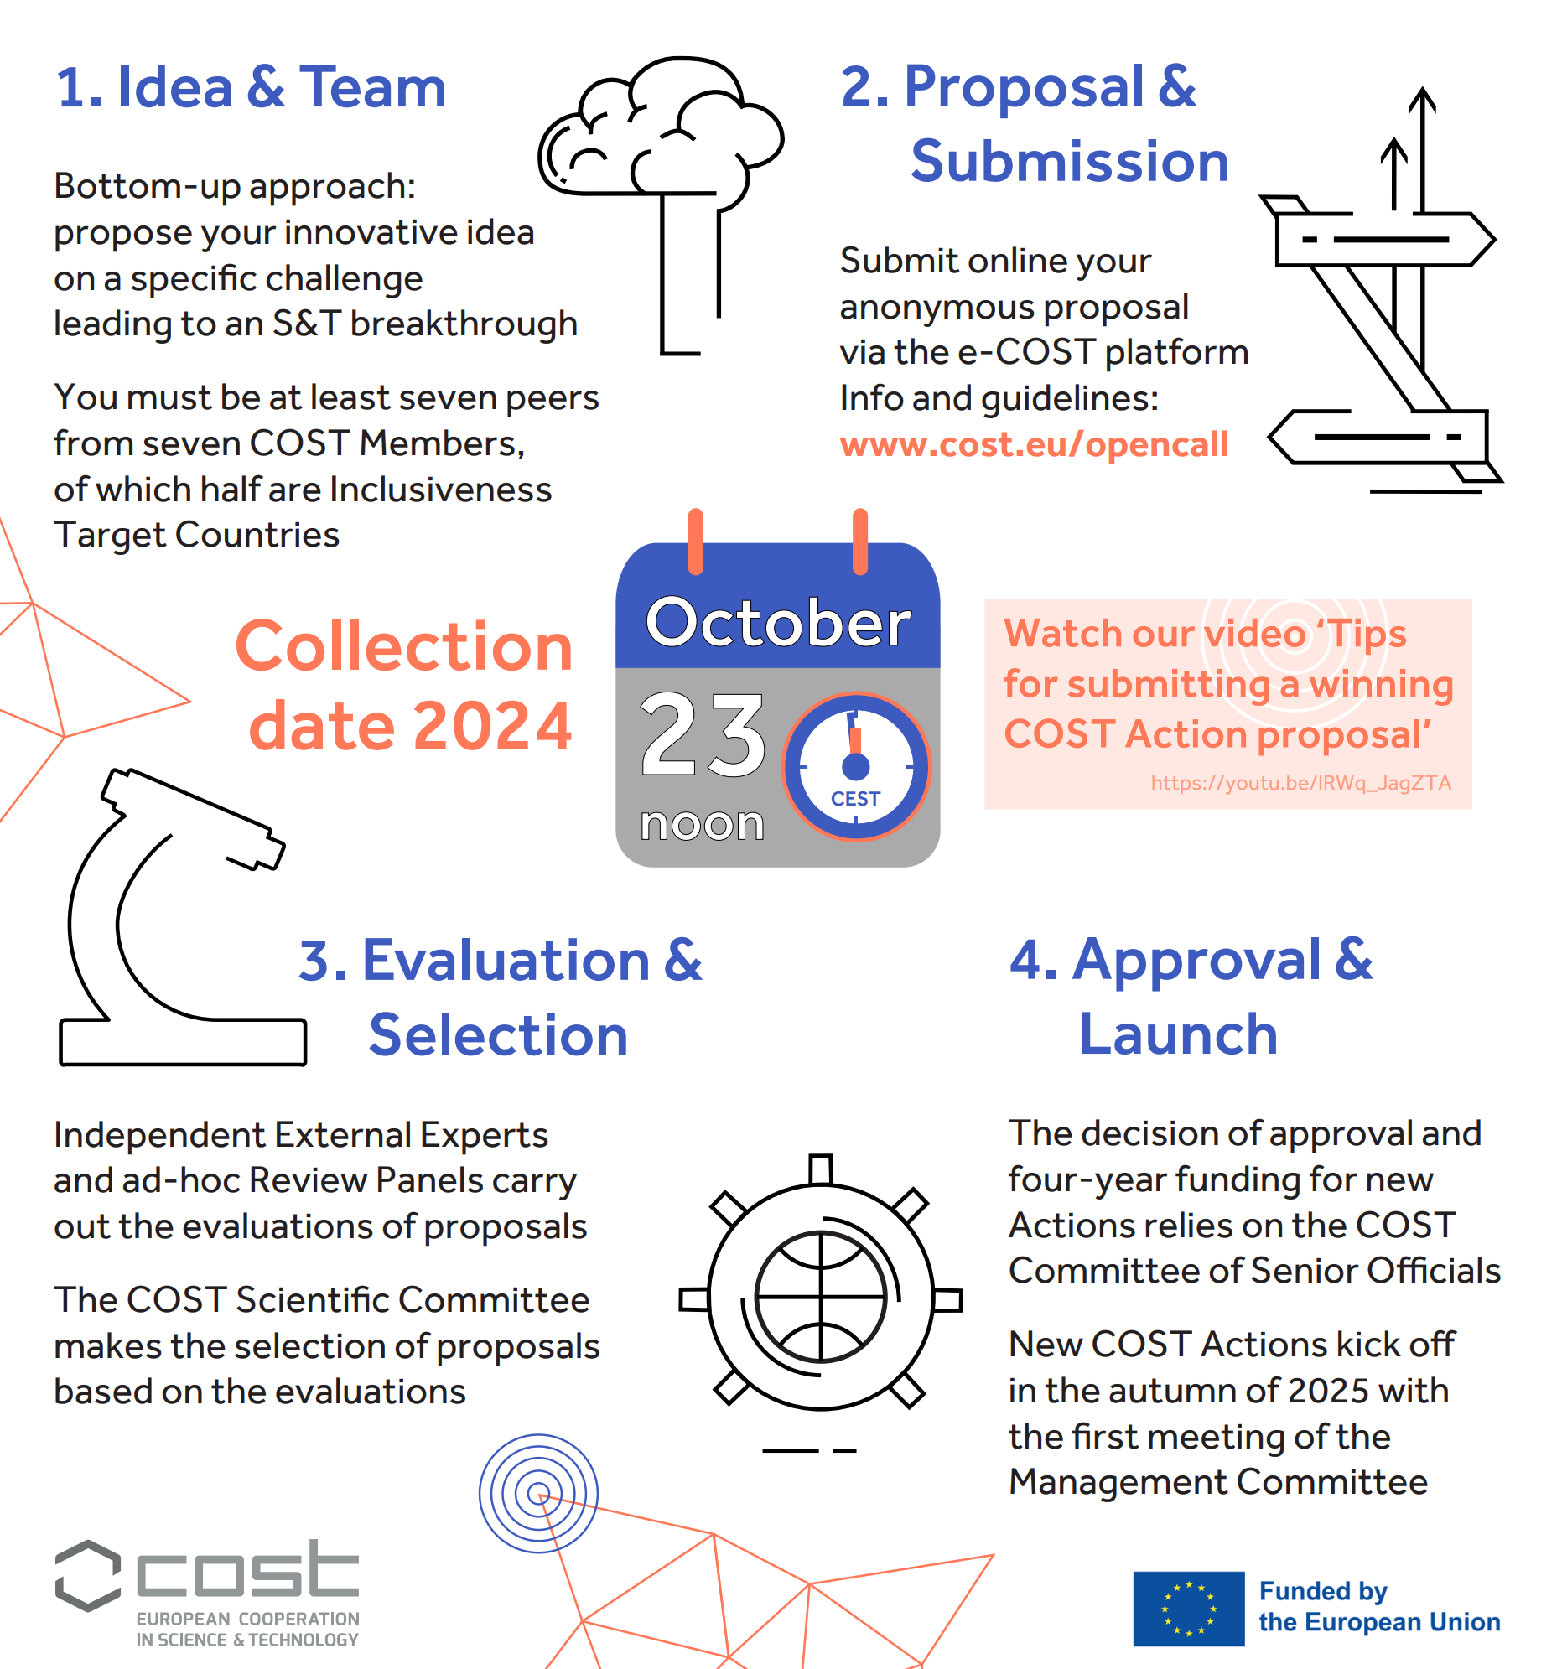
Funding opportunities – COST Actions
European Cooperation in Science and Technology (COST) Actions – key features
COST Actions act as a pre-portal to other funding instruments – e.g. Horizon Europe. Follow-up proposals from COST Actions have a 37% success rate.
A COST Action is an interdisciplinary research network that brings researchers and innovators together to investigate a topic of their choice for 4 years. COST Actions are typically made up of researchers from academia, SMEs and public institutions.
Open to all science and technology fields, including new and emerging fields; COST Actions offer an inclusive, pan-European environment for individuals of all levels of seniority to grow their professional research networks and boost their careers.

Slide 26
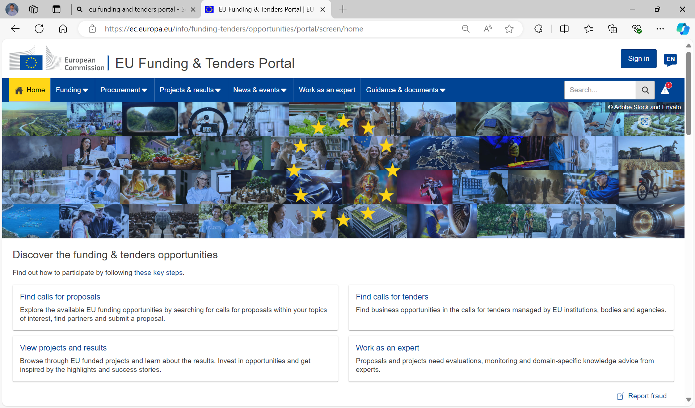
How to access EU funding?
National Laboratories Research Office will guide you through the funding maze
EU Funding & Tenders Portal | EU Funding & Tenders Portal (europa.eu)

Slide 27
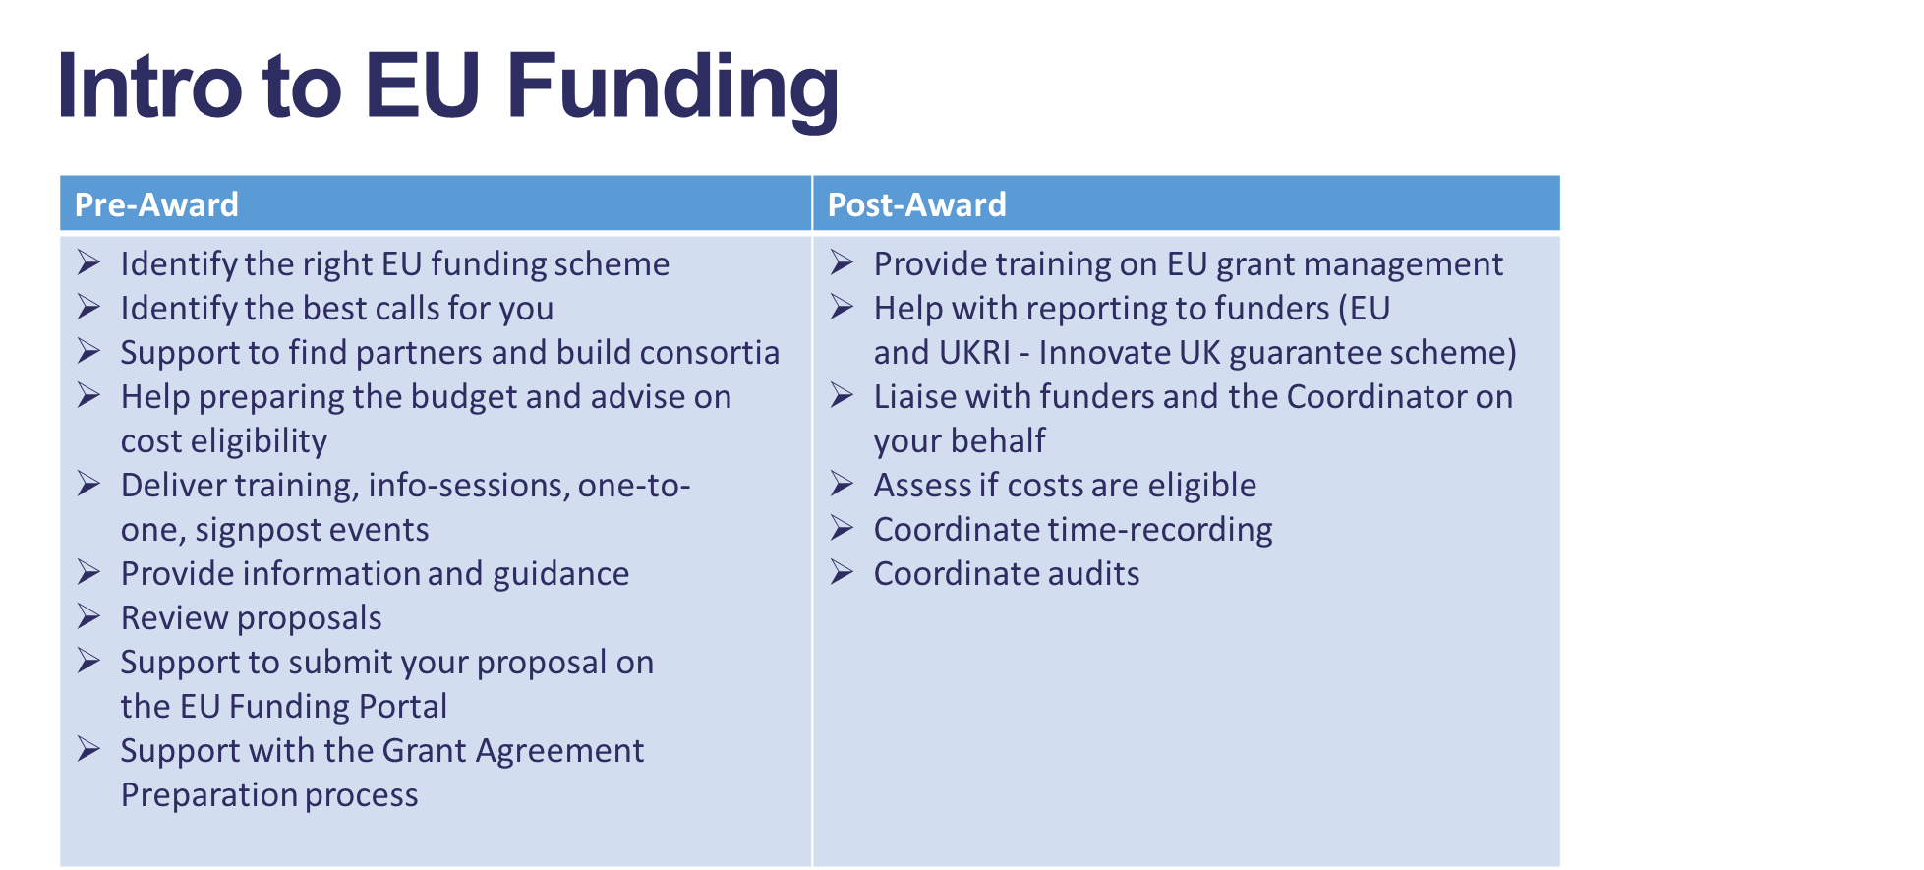
Research Office Support – Full EU grant management cycle

Slide 28
Resources and contacts
Research Office SharePoint Hub - https://stfc365.sharepoint.com/sites/NLResearchOffice
RESEARCHOFFICE@stfc.ac.uk
National Contact Points – Horizon Europe funding - GOV.UK (www.gov.uk)
CORDIS - Projects & results | CORDIS | European Commission (europa.eu)
UKRI, Horizon Europe - https://ukri.sharepoint.com/sites/thesource/SitePages/Horizon-Europe.aspx
EU Funding and Tenders Portal - https://ec.europa.eu/info/funding-tenders/opportunities/portal/screen/opportunities/calls-for-proposals

Slide 29
Thank you!

