Slide 1
Wrap Up
Cyber Security Awareness Event

Slide 2
Overview
We’ve seen the importance of cybersecurity for STFC
A history of cybersecurity from phone phreaking and the Morris Worm to the modern day
Improving our cybersecurity posture needs work at the organizational level as well as working in national and international scopes
Building long-term relationships with national and international colleagues

Slide 3
Approach
The threat we face is substantial, and the risk of cyber attack is one of the most impactful for our organization and community
But the tools we need to defend ourselves are ones we are familiar with
Collaboration
Problem solving
Risk management
We are ideally placed to embark on the work we need to do, as well as supporting the rest of our community and working closely with national and international colleagues

Slide 4
Myths and misconceptions
Myth #1: “Why would anybody be interested in me / my account / my organisation?”
Myth #2: “I’m not technical, so there’s nothing I can do is there? And isn’t security IT’s problem anyway?”
Myth #3: “You’ll get hacked whatever you do.”

Slide 5
STFC and DLS activity
Both Diamond and STFC have programmes of work towards improving their cybersecurity posture
A lot of work, but something we can embark on
Both long- and short- term work is important
Explored and gained insight into the work that DLS have undertaken to improve security

Slide 6
Pentesting
Scanning and analysis tools we use in the organization
Overview of why pentesting is useful and what is available from the UKRI team
Different kinds of pentest

Slide 7
Anatomy of an incident & GenAI
Explored the stages of an incident
Stages of incident response
Focus on GenAI and areas to be aware of and mindful about
How it can be applied in Cybersecurity

Slide 8
Summary
The challenge that we face in managing the risk of cyber attack is considerable
We collectively have a lot of work to do: our staff is our strongest defence, and we need to make sure that everyone has the right training and support
We have the opportunity to be an exemplar for our community

Slide 9
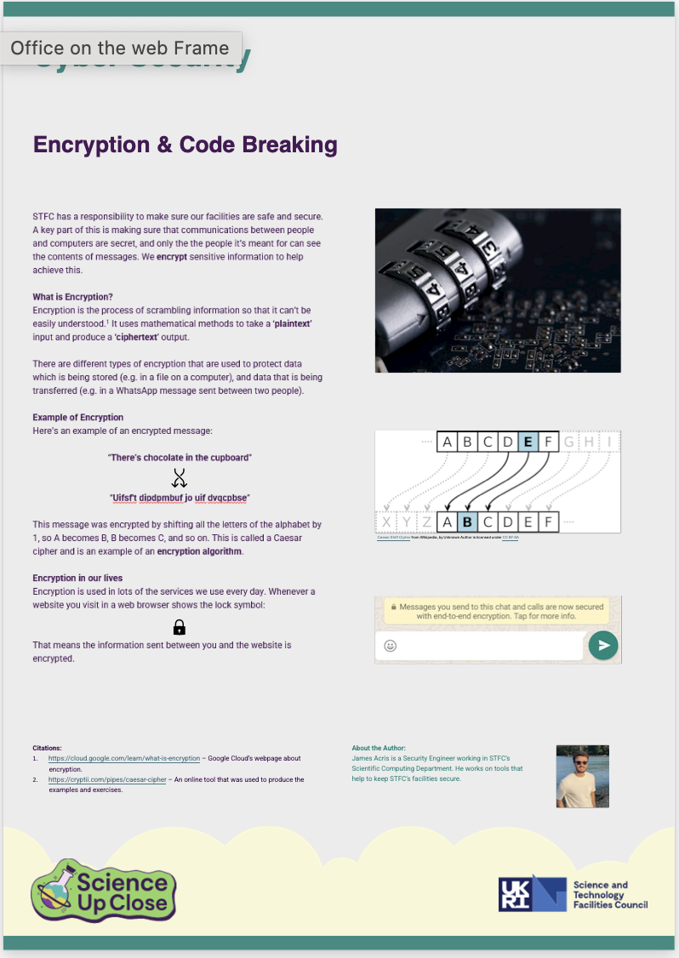
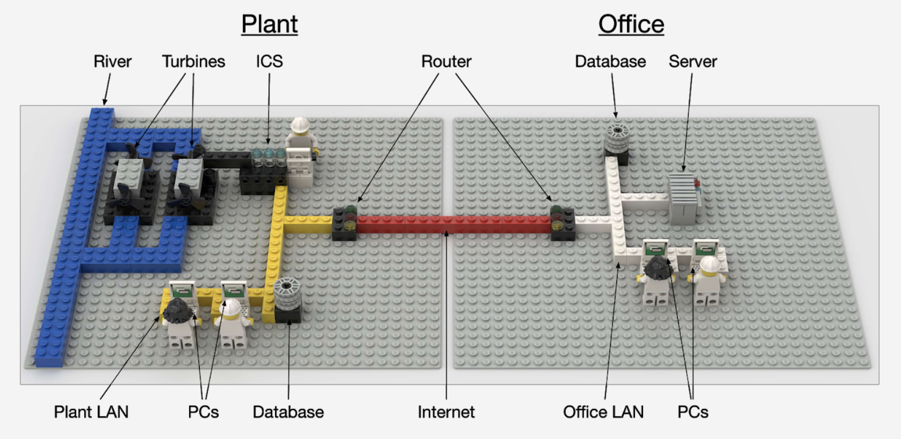
Trailer for Wednesday!

Slide 10
Thank you for coming!

