Slide 1
Generative AI tools
Jon Hunt, UKRI Information Security Team

Slide 2
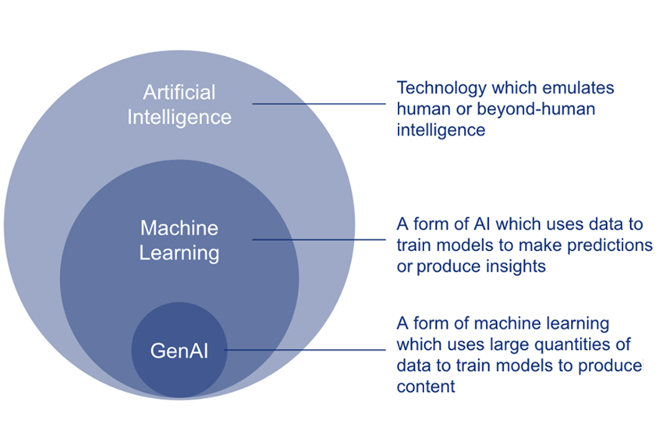
What are generative AI tools?
Generative AI framework for HMG
https://www.gov.uk/government/publications/generative-ai-framework-for-hmg

Slide 3
What are generative AI tools?
“Unlike previous forms of AI, generative AI produces new content, such as images, text or music.
It is this capability, particularly the ability to generate language, which has captured the public imagination, and creates potential applications within government.”
AI tool queries (prompts) use conversational language
AI tools generate answers rather than provide links
Can produce summaries, analyses, tables, content, images…
Generative AI framework for HMG
https://www.gov.uk/government/publications/generative-ai-framework-for-hmg

Slide 4
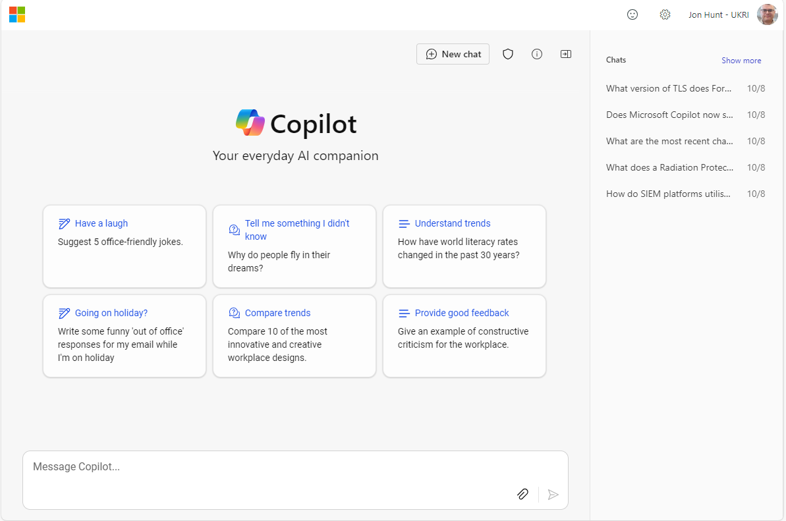
https://copilot.cloud.microsoft/

Slide 5
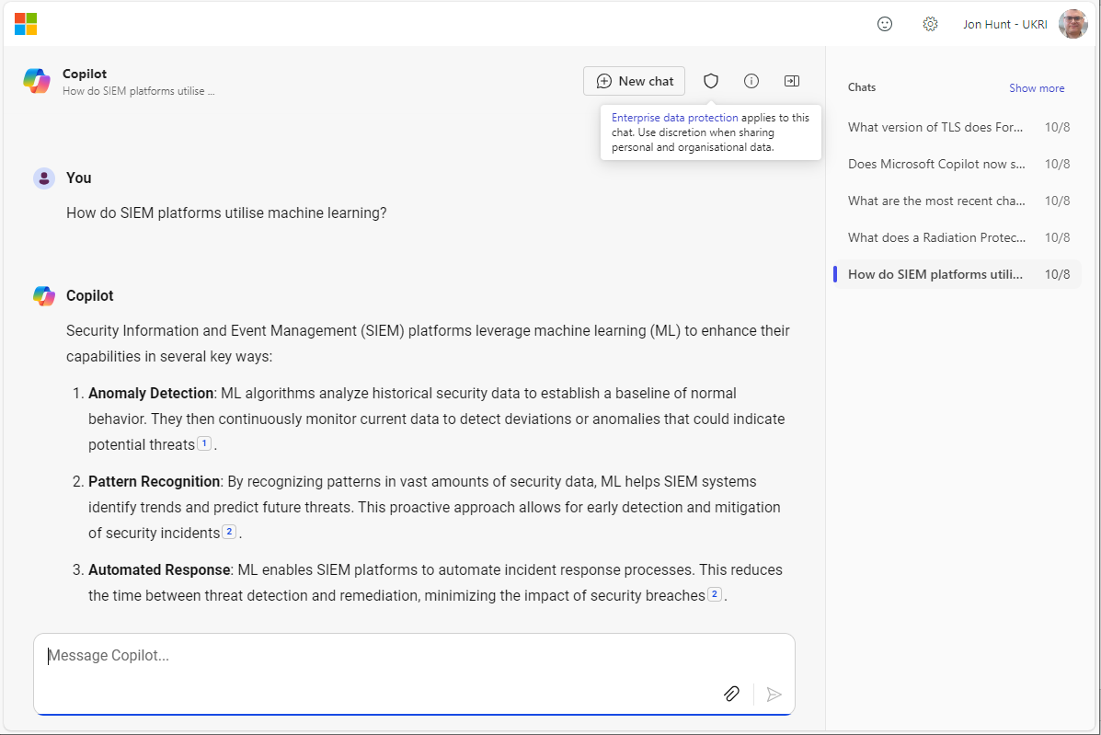
https://copilot.cloud.microsoft/

Slide 6
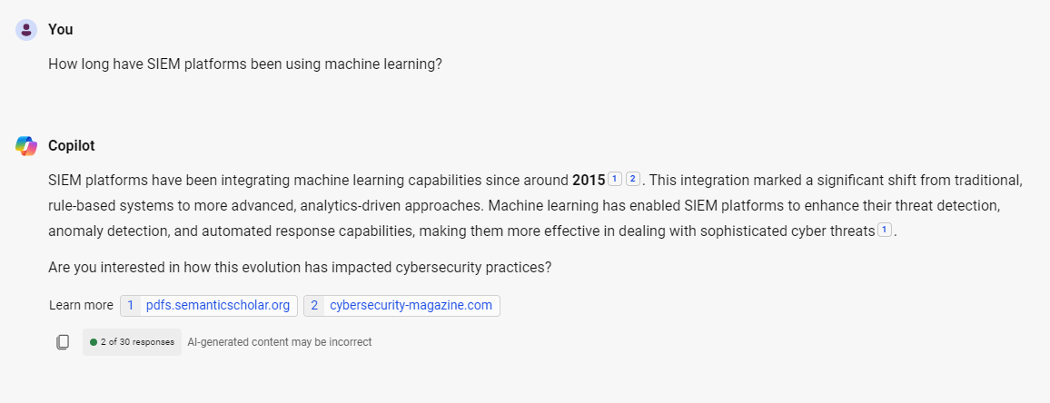
https://copilot.cloud.microsoft/

Slide 7
What are the risks?
Are outputs accurate/correct? Beware of “hallucinations”!
Always review AI tool outputs
The information you provide to generative AI tools may be made publicly available and/or used by the provider of the tool
Don’t share confidential or sensitive information with AI tools; check terms and conditions carefully
New AI tools and functionality are developing rapidly – how to keep up?
Like any tool, generative AI tools can be used responsibly and irresponsibly – and they’re being abused/misused for malicious purposes

Slide 8
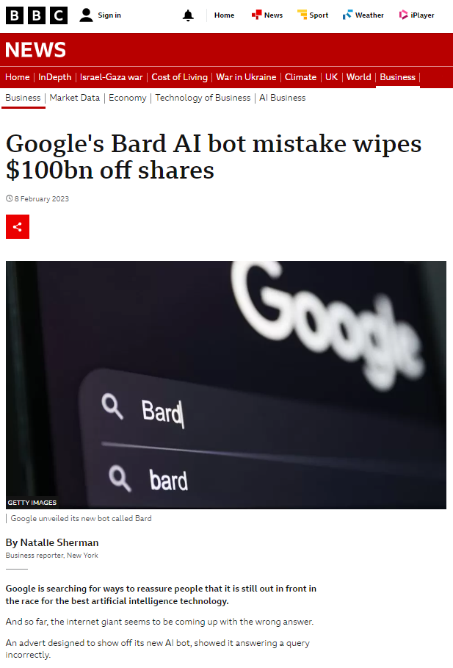
“…the bot was asked about what to tell a nine-year-old about discoveries from the James Webb Space Telescope.”
“It offered the response that the telescope was the first to take pictures of a planet outside the earth's solar system, when in fact that milestone was claimed by the European Very Large Telescope in 2004…”
https://www.bbc.co.uk/news/business-64576225

Slide 9
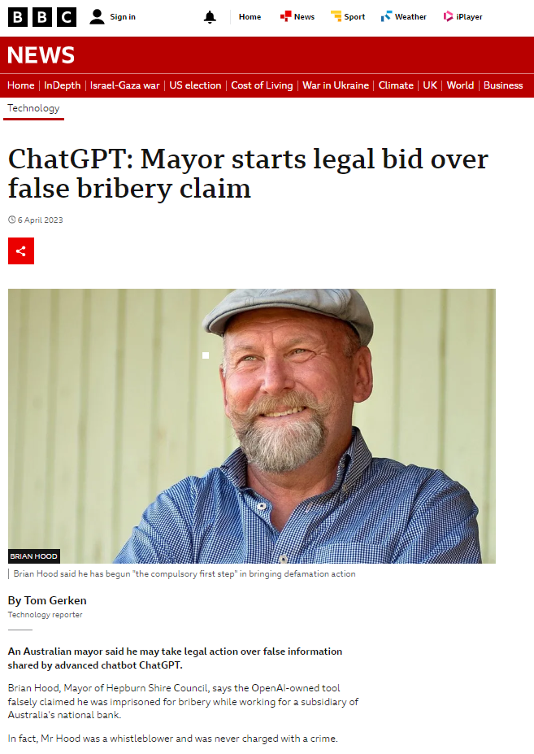
“Brian Hood, Mayor of Hepburn Shire Council, says the OpenAI-owned tool falsely claimed he was imprisoned for bribery while working for a subsidiary of Australia's national bank.”
“In fact, Mr Hood was a whistleblower and was never charged with a crime.”
https://www.bbc.co.uk/news/technology-65202597

Slide 10
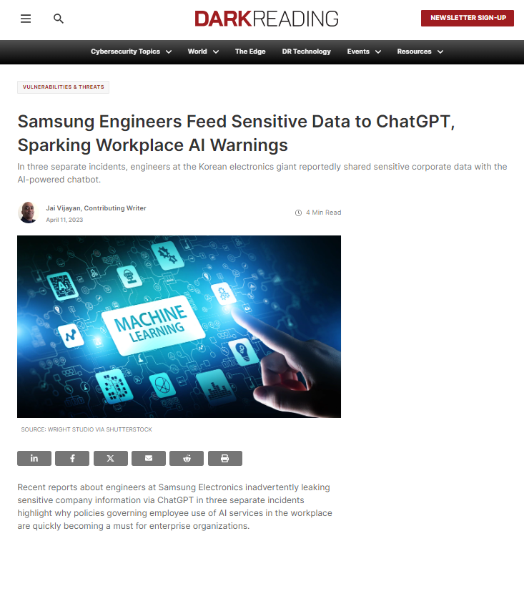
“…The incidents played out exactly the same way that researchers have been warning that they could, since OpenAI made ChatGPT publicly available in November.”
“Security analysts have noted how, in all instances where users share data with ChatGPT, the information ends up as training data for the machine learning/large language model (ML/LLM).”
“They have noted how someone could later retrieve the data using the right prompts…”
https://www.darkreading.com/vulnerabilities-threats/samsung-engineers-sensitive-data-chatgpt-warnings-ai-use-workplace

Slide 11
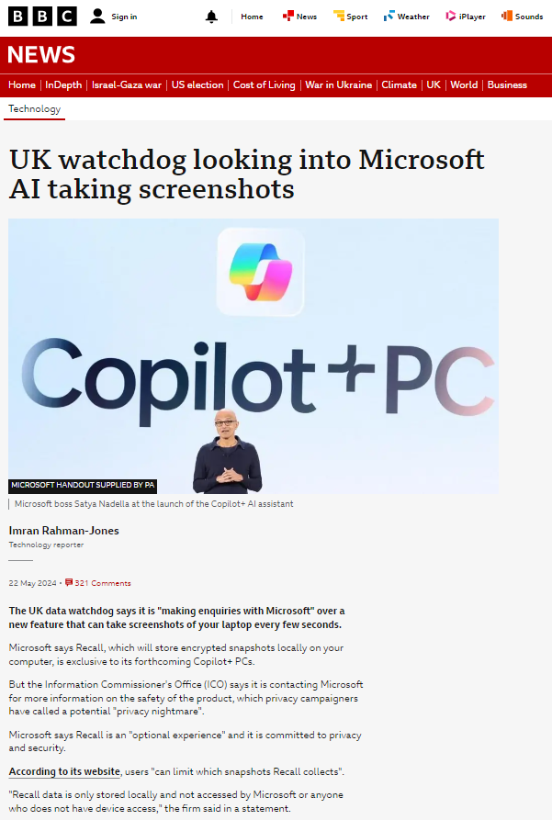
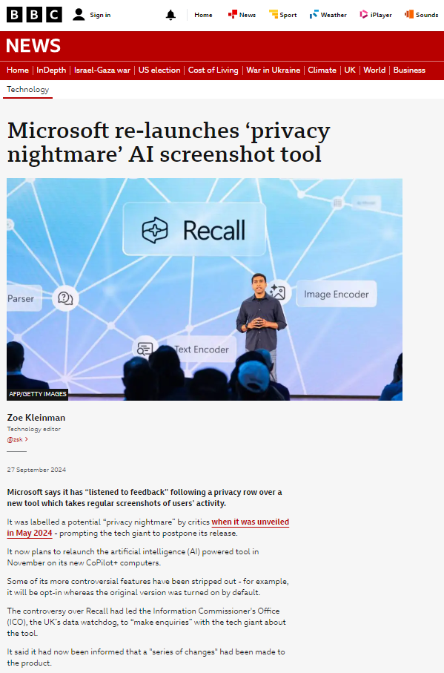
Rapid change...
https://www.bbc.co.uk/news/articles/cpwwqp6nx14o
https://www.bbc.co.uk/news/articles/c869glx8endo

Slide 12
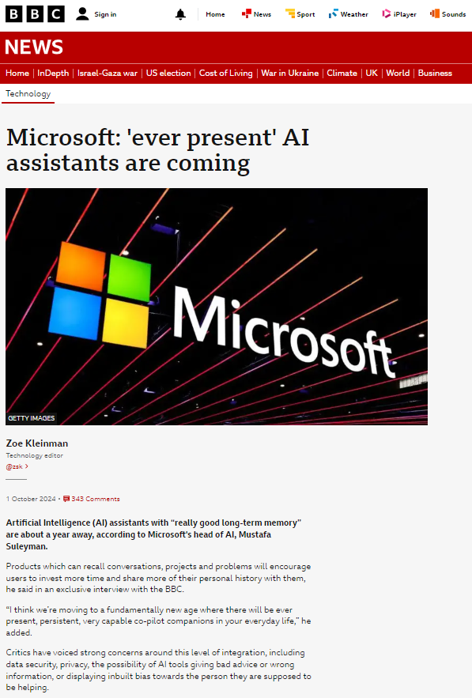
Ubiquitous AI?
https://www.bbc.co.uk/news/articles/czj9vmnlv9zo

Slide 13
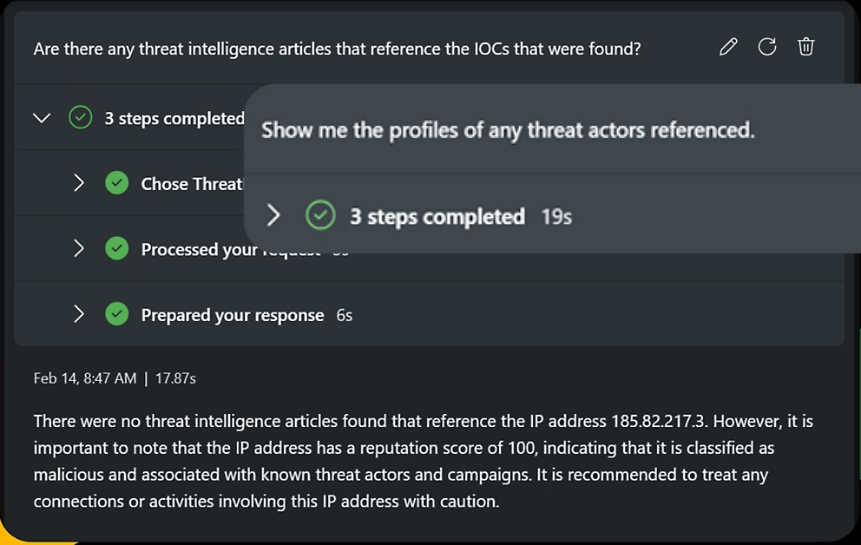
GenAI in security tools and services
Security Information and Event Management (SIEM) platforms
Collection and analysis of log data at scale
Real-time: security dashboards and alerts
Anomaly detection, pattern recognition, automated response
Building GenAI into security tools
Microsoft Copilot for Security
Natural language queries:
"Write an executive report summarising this investigation. It should be suitable for a non-technical audience."

Slide 14
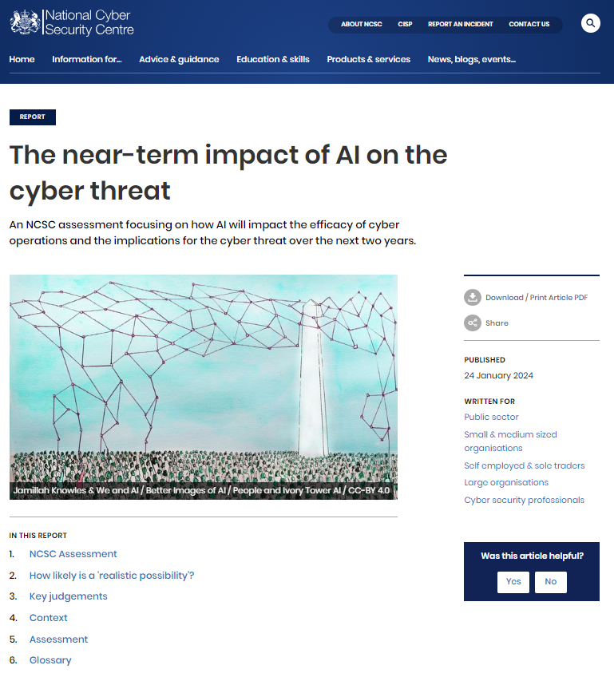
Like any tool, GenAI can be used both responsibly and irresponsibly
“AI is likely to assist with malware and exploit development, vulnerability research and lateral movement by making existing techniques more efficient.”
“…GenAI and large language models (LLMs) will make it difficult for everyone, regardless of their level of cyber security understanding, to assess whether an email or password reset request is genuine, or to identify phishing, spoofing or social engineering attempts.”
“The time between release of security updates to fix newly identified vulnerabilities and threat actors exploiting unpatched software is already reducing…AI is highly likely to accelerate this challenge as reconnaissance to identify vulnerable devices becomes quicker and more precise.”
https://www.ncsc.gov.uk/report/impact-of-ai-on-cyber-threat

Slide 15
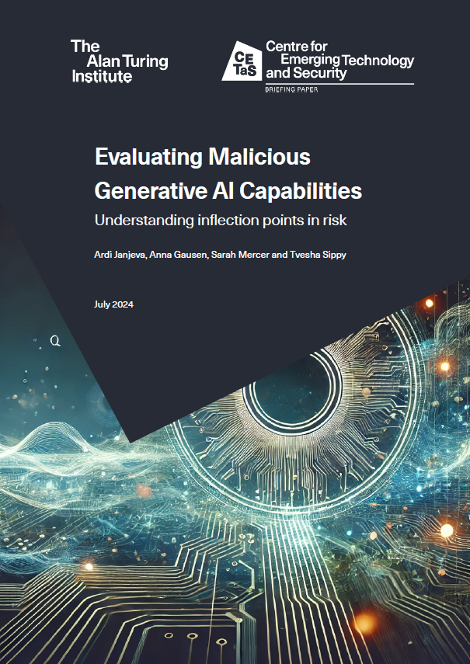
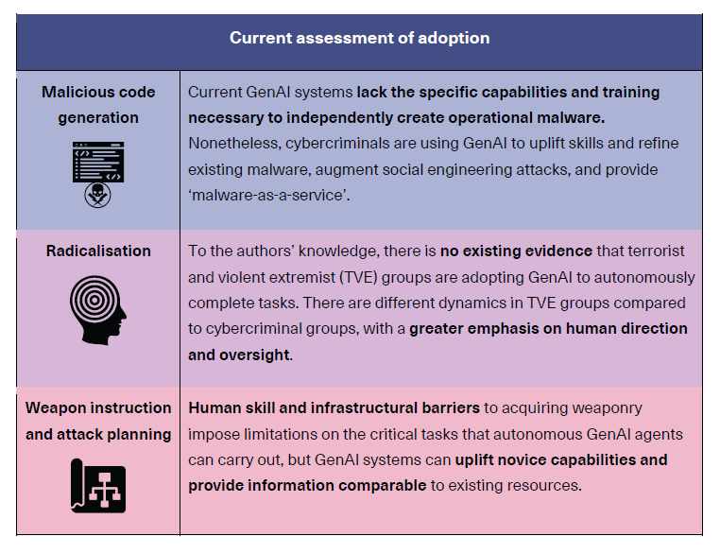
Like any tool, GenAI can be used both responsibly and irresponsibly
https://cetas.turing.ac.uk/publications/evaluating-malicious-generative-ai-capabilities

Slide 16
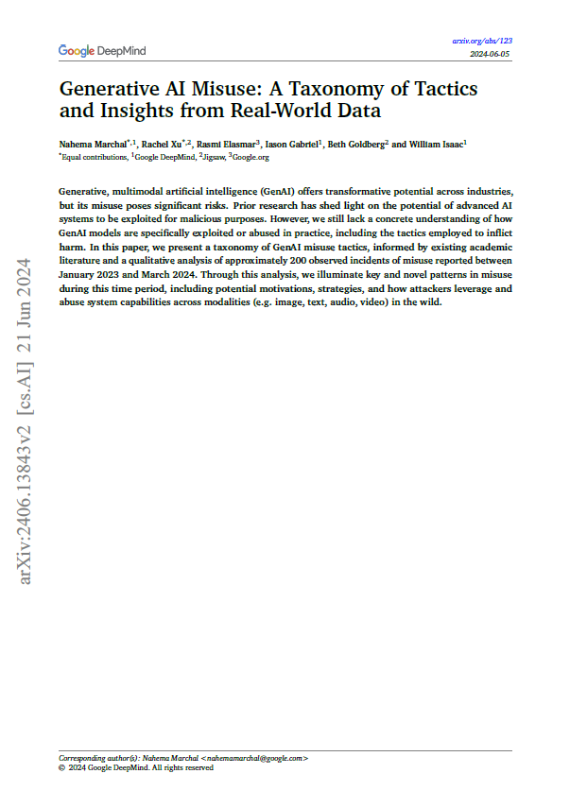
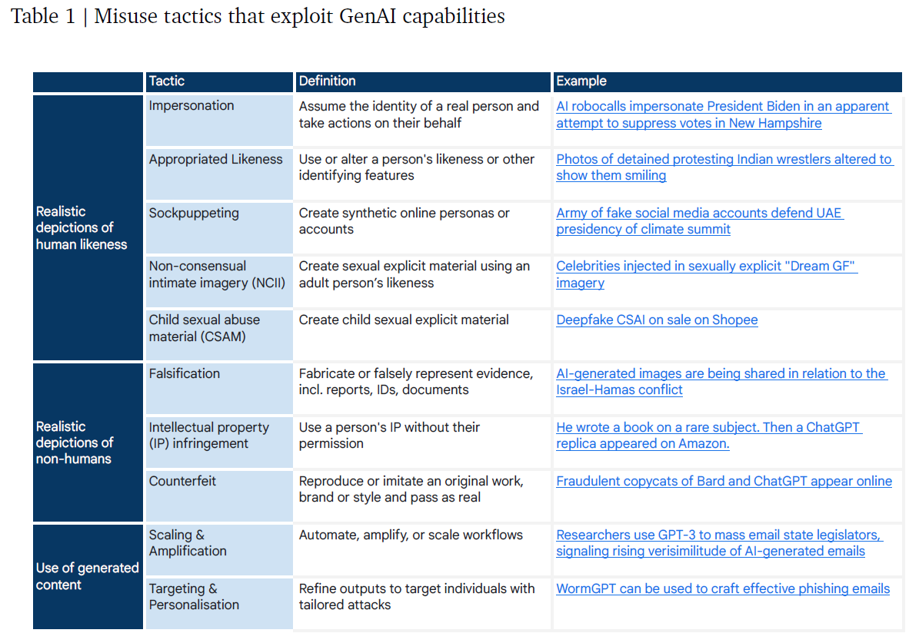
Like any tool, GenAI can be used both responsibly and irresponsibly
https://arxiv.org/pdf/2406.13843

Slide 17
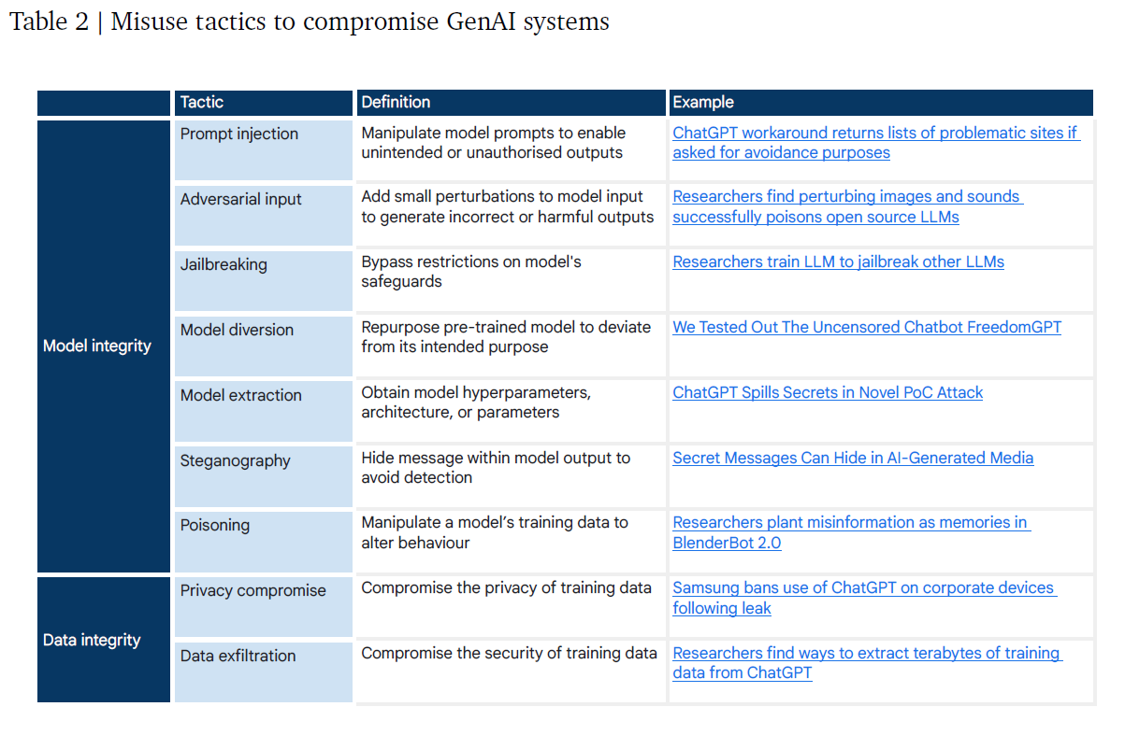
Like any tool, GenAI can be used both responsibly and irresponsibly
https://arxiv.org/pdf/2406.13843

Slide 18
Generative AI framework for HMG
Using generative AI safely and securely for civil servants and people working in government organisations
Encourages becoming familiar with the technology, to promote responsible use while remaining aware of the risks
https://www.gov.uk/government/publications/generative-ai-framework-for-hmg

Slide 19
Generative AI framework for HMG
You know what generative AI is and what its limitations are
You use generative AI lawfully, ethically and responsibly
You know how to keep generative AI tools secure
You have meaningful human control at the right stage
You understand how to manage the full generative AI lifecycle
You use the right tool for the job
You are open and collaborative
You work with commercial colleagues from the start
You have the skills and expertise needed to build and use generative AI
You use these principles alongside your organisation’s policies and have the right assurance in place
https://www.gov.uk/government/publications/generative-ai-framework-for-hmg

Slide 20
Generative AI at UKRI
Microsoft Copilot now available: https://ukri.sharepoint.com/sites/thesource/SitePages/Microsoft-Copilot.aspx
Copilot for M365 being trialled
UKRI AI Gateway https://ukri.sharepoint.com/sites/UKRI-SecHub/SitePages/UKRI-Interim-AI-Gateway.aspx (guidance on use of AI tools)
In development: UKRI Generative AI Policy (two versions: one for general users and one for technical users/developers)

Slide 21
Thank you
Notes:
The abstract pattern can be removed or repositioned if required. Be careful to ‘Send to Back’ so that it does not obscure any important information.

Slide 22
https://learn.microsoft.com/en-gb/copilot/privacy-and-protections

Slide 23
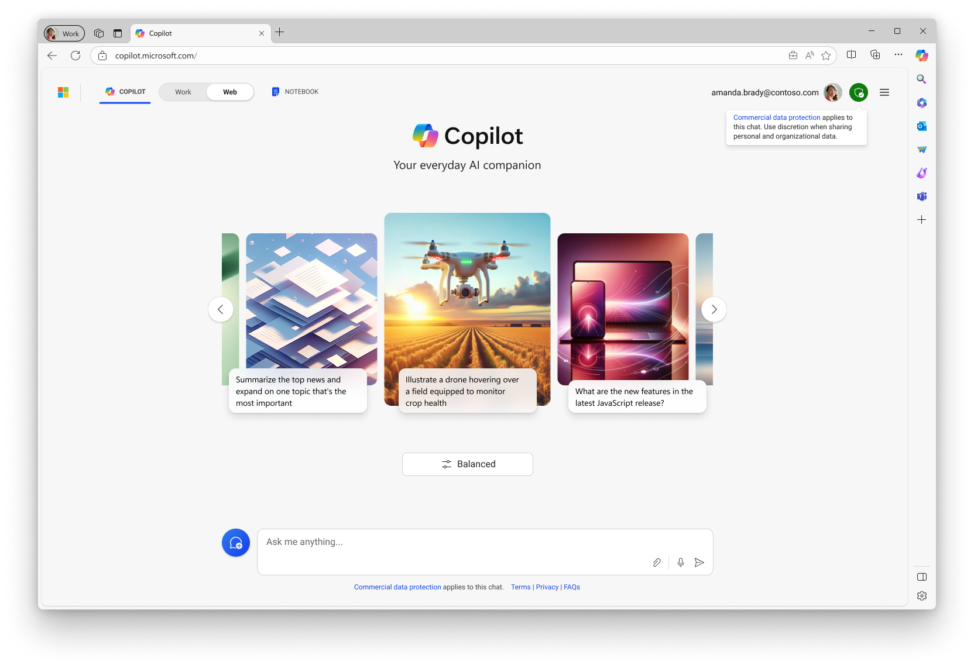
What is a “prompt?“
A prompt is the question or instruction you enter in the text box. This is what Copilot will respond to.
Use natural language. Don’t feel like you need to break your idea or question down into keywords.
Classic search is about keywords to get a list of sources. Chat is about using detailed questions or statements to generate a custom response for you.
Enter your first prompt in the text box at the bottom of your screen.
Get started by entering your question in the text box

Slide 24
What makes an effective prompt?
Effective
Less Effective
Specific and detailed
In full sentences, with instructions
States the tone, purpose, preferred format, etc.
Example: Recap the findings of the article I've copied below and include the top 3 concerns. Provide the answer in two to three paragraphs and use a business tone.
Vague
Just a few words
No context on preferred output
Example: Recap article.
The recap may be more vague than desired, or in a format that you were not seeking.
Note: Do not enter personal, sensitive, confidential or identifiable information into any AI tool as best practice
Source: The art of the prompt: How to get the best out of generative AI (Microsoft)

Slide 25
How to chat in 3 steps
1. Enter your prompt
2. Check sources
3. Continue the conversation
Enter your detailed prompt in the text box at the bottom. The box expands as you go, so you can write in sentences and paste in lots of content from a webpage, PDF, or document.
Copilot is transparent about the sources of its information. See these sources listed underneath the answer.
Vet these sources and validate your answers.
You can ask follow-up questions as you would in a conversation. You can refine the answer too.
For example, try “Write a shorter answer" or "Give me more detail." You can also select suggested prompts.

Slide 26
Best Practice – You Must
Take accountability for work and facts presented by using Copilot.
State sources for formal or important work when using any outputs from Copilot
Ensure facts are checked before using or sharing any of the content.
Store and manage outputs appropriately. All formal records should be stored appropriately in SharePoint or Objective (MRC/NERC).
Understand that all content produced is subject to the UKRI Retention Schedule.
Ensure that any content produced either fits under an existing Information Asset on the Information Asset Register or if not, you should contact the UKRI Knowledge and Information Management team for a new Information Asset to be created.
Understand that all content produced is subject to Data Protection Legislation.
Do not use Copilot for sensitive or confidential material, such as the UKRI Board and ExCo meetings.
For guidance on security classifications please see the UKRI Security Classification Policy

